Slide 1

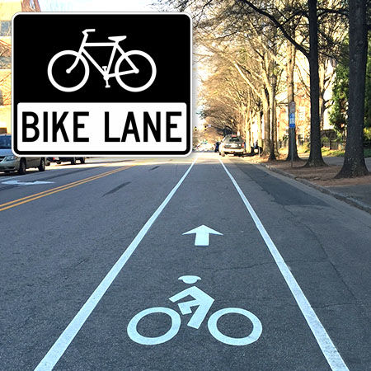
Environmentally friendly bike lane network in Nablus
An-Najah National University
Faculty of Engineering and Information Technology
Prepared by:
Diala Juma
Batool Al-Tanbour
Under supervision of:
Dr. Khaled Al-Sahili

Slide 2
Objectives
The General objectives
The particular objectives
Designing a network of bicycles or electric bikes lanes between the two campuses of An-Najah National University (old and new campuses) to the city center area.
To know the range of people who use bicycles or electric bicycles or their willingness to use them, specifically An-Najah National University students.
To assess the suitability of the existing road network to the use of bicycles or electric bicycles, and based on that, to set standards for designing an appropriate bicycle network.

Slide 3
Methodology
Specifying Study Area
Collection of Data
Data Analysis
Network Design

Slide 4
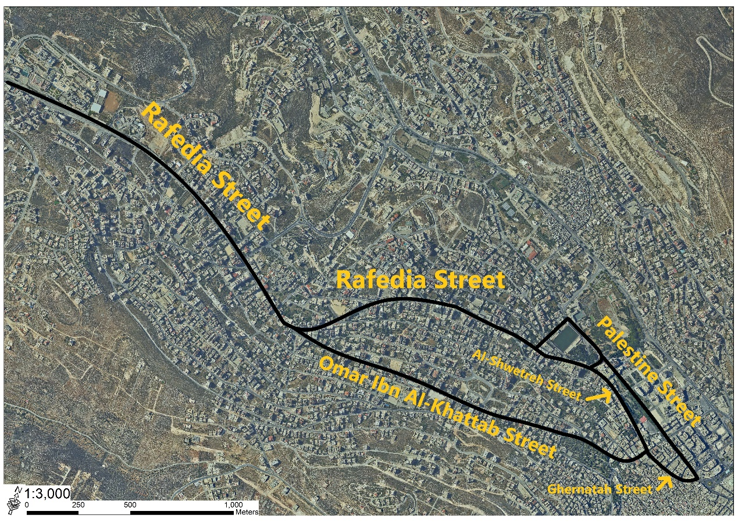
Specifying the Study Area

Slide 5
Data Collection
Traffic Volume Study
Obtain Maps
Inventory Study
Questionnaire

Slide 6
Vehicular Peak Hour Volume
Traffic Volume Study
Total (veh/hr) | Westbound (veh/hr) | Eastbound (veh/hr) | Peak hour | Street name
2056 | 895 | 1161 | 7:15-8:15 Am | Rafedia Street
426 | --- | 426 | 7:15-8:15 Am | Al-Shwetreh Street
1971 | 952 | 1019 | 7:15-8:15 Am | Omar Ibn Al-Khattab Street
1120 | --- | 1120 | 7:15-8:15 Am | Ghernatah Street
1031 | 1031 | --- | 7:15-8:15 Am | Palestine Street

Slide 7
Intersections' Level of Service
Rafedia Street
Intersection # | 1 | 2 | 3 |  | 4 | 5 | 6 | 7 | 8 |  | 9
LOS | A | A | F |  | C | F | F | F | B |  | D
Intersection # | 10 | 11 | 12 |  | 13 | 14 | 15 | 16 | 17 |  | 18
LOS | F | F | D |  | F | B | A | E | F |  | A
Omar Ibn Al-Khattab Street
Intersection # | 1 | 2 | 3 |  | 4 | 5 | 6 | 7 | 8 |  | 9
LOS | E | A | F |  | A | A | F | F | F |  | F
Ghernatah Street
Intersection # | 1 |  |  |  |  |  | 2
LOS | C |  |  |  |  |  | F
Palestine Street
Intersection # | 1 |  |  | 2 |  |  | 3 |  |  | 4
LOS | F |  |  | F |  |  | F |  |  | C
Al Shwetreh Street
Intersection # | 1 |  |  |  |  |  | 2
LOS | A |  |  |  |  |  | C

Slide 8
Inventory Study
Pavement condition
No. of lanes
Traffic Signals and Signs
Parking
Sidewalks

Slide 9
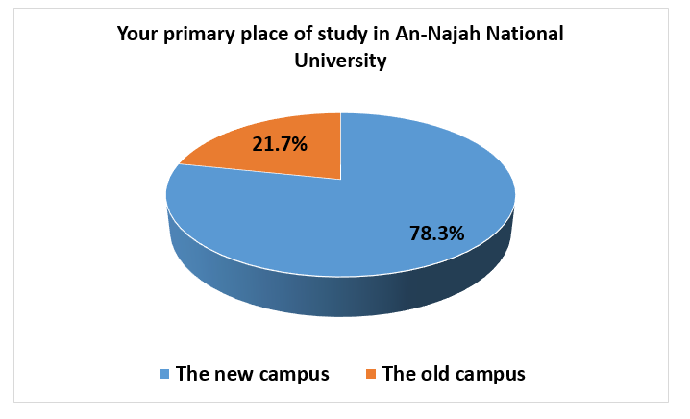
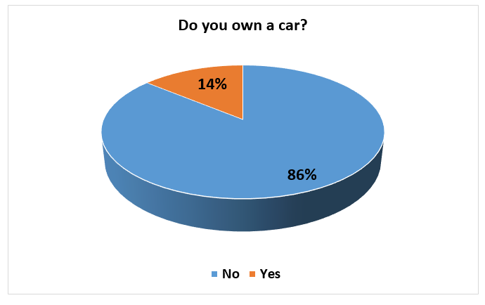
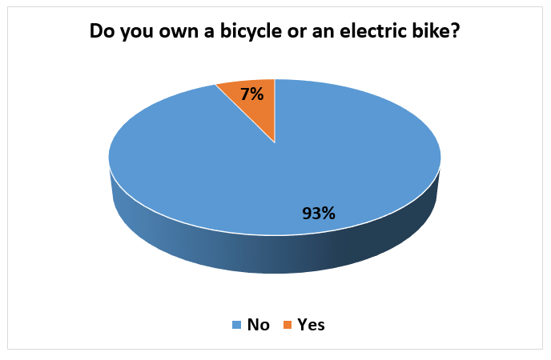
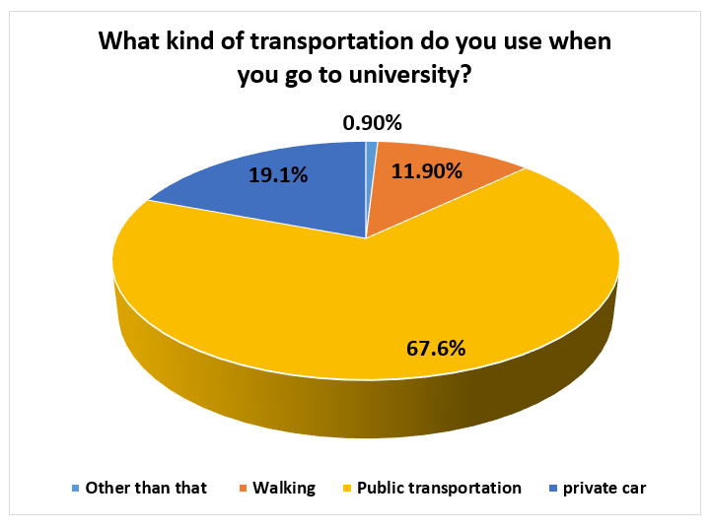
Questionnaire Analysis

Slide 10
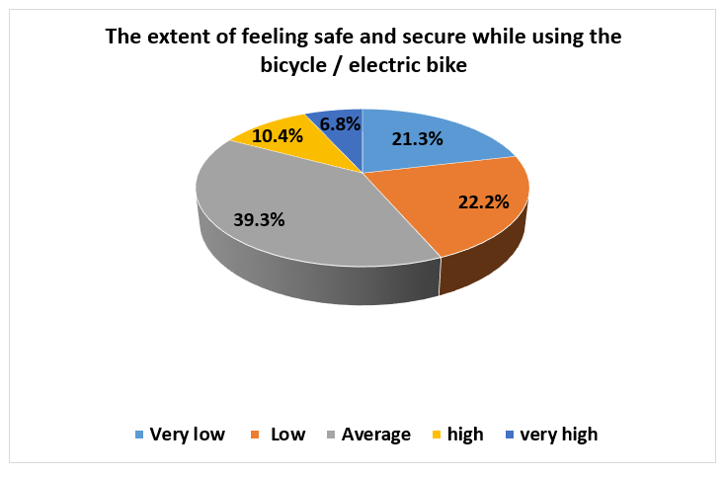
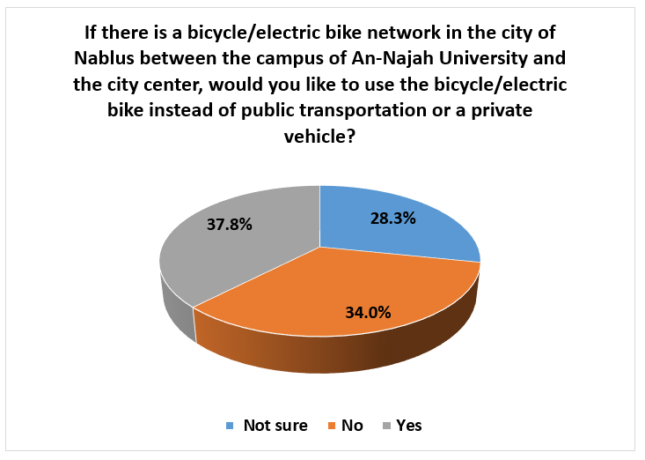
Questionnaire Analysis

Slide 11
Design Criteria
Functional Classification
Design Vehicle
Elements of Design
Bike Lanes
On-Street Parking
Signs and Marking
Grades
Drainage
Drainage

Slide 12
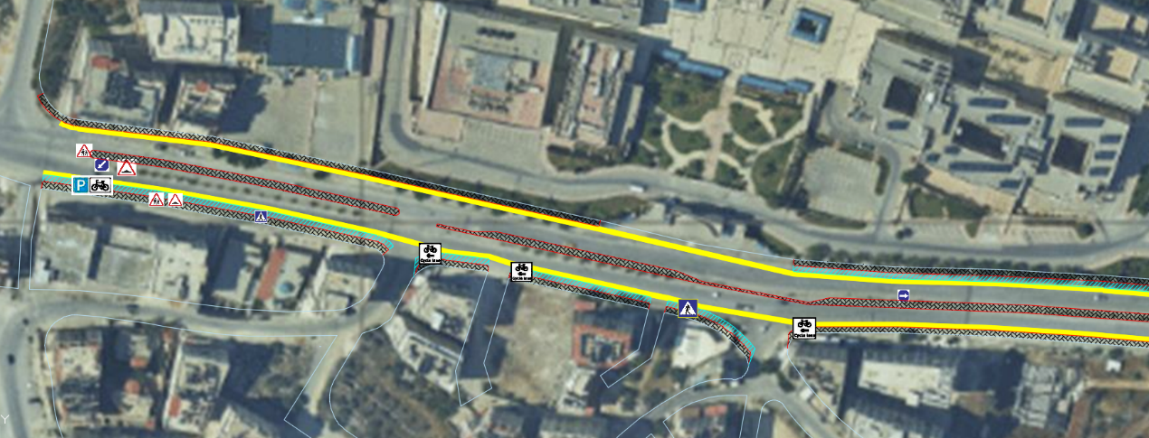
Rafedia Street (An-Najah National University Street (New Campus)) Design

Slide 13
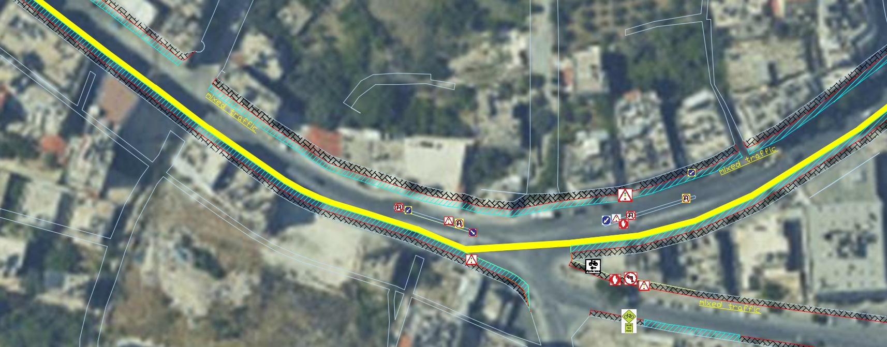
Rafedia Street(At Rafedia Old Mosque) Design

Slide 14
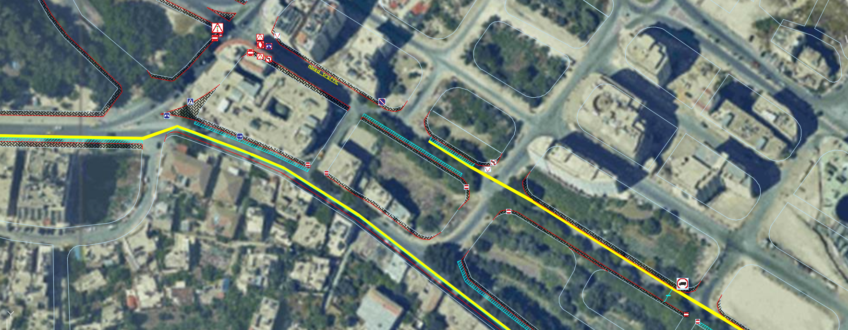
Al-Shwetreh Street Design

Slide 15
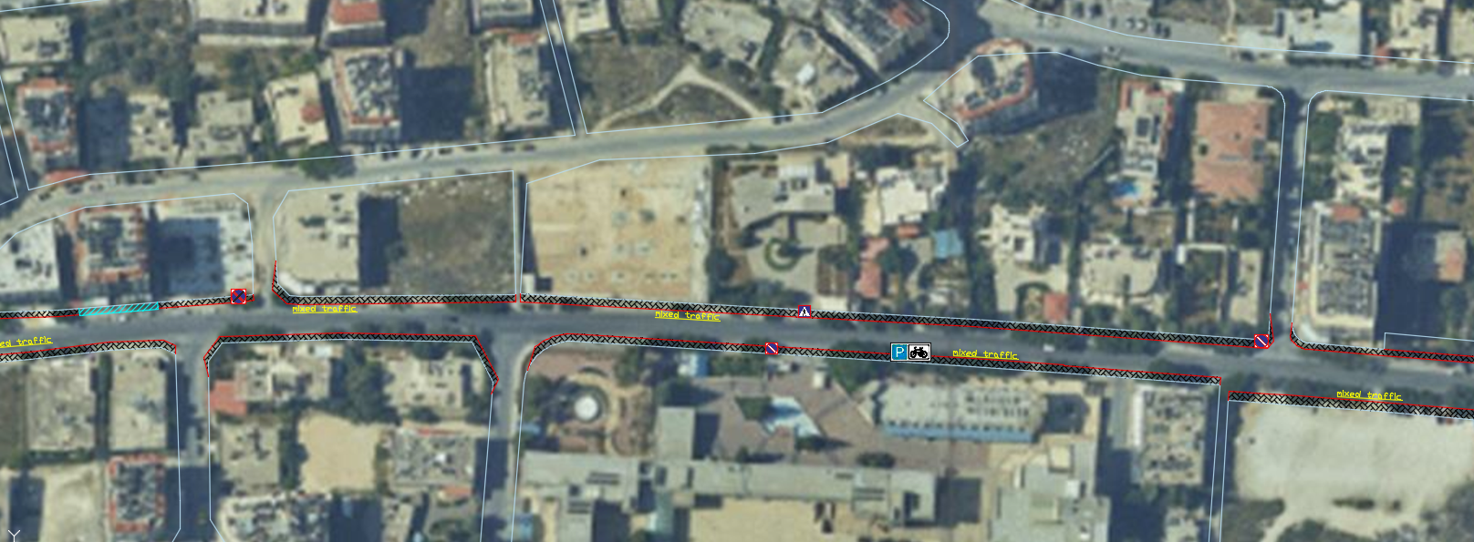
Omar Ibn Al-Khattab Street (Near An-Najah National University (Old Campus)) Design

Slide 16
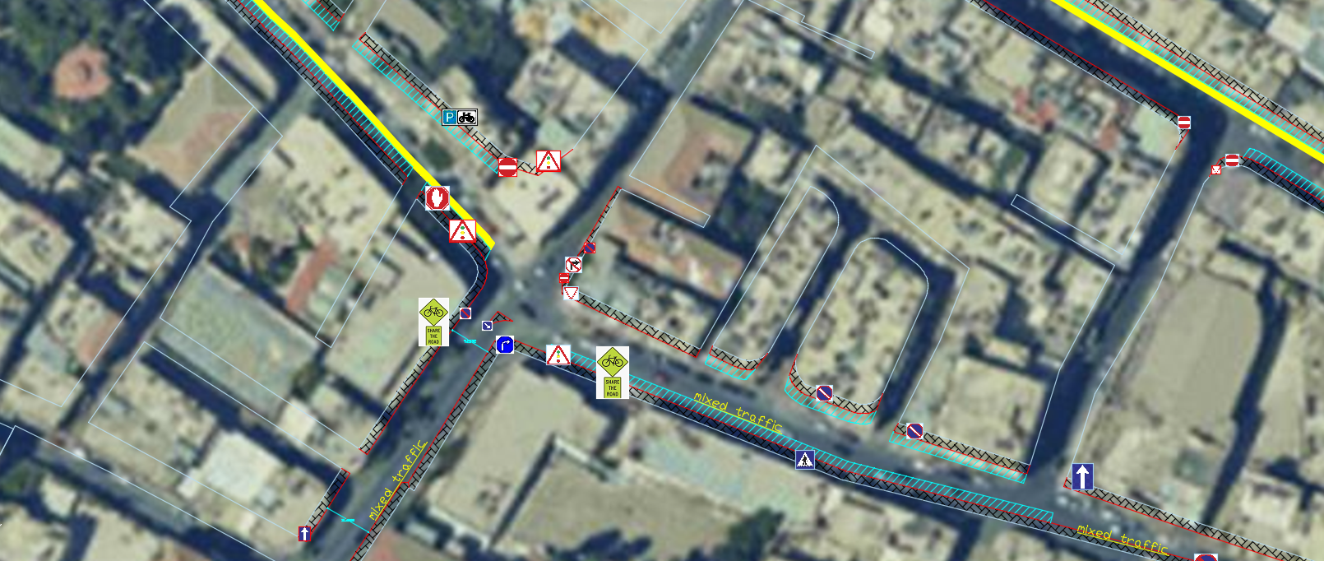
Ghernatah Street Design

Slide 17
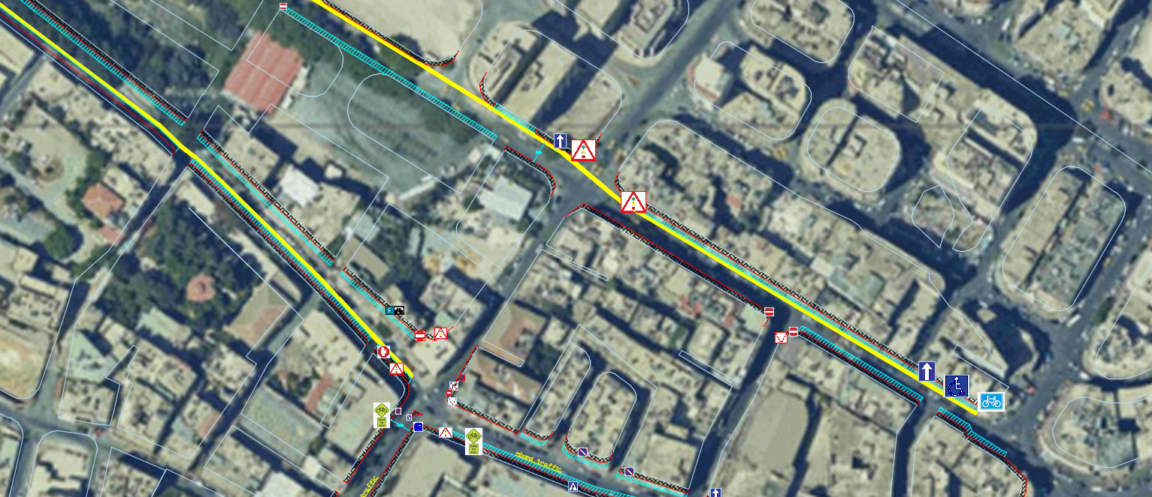
Palestine Street Design

Slide 18
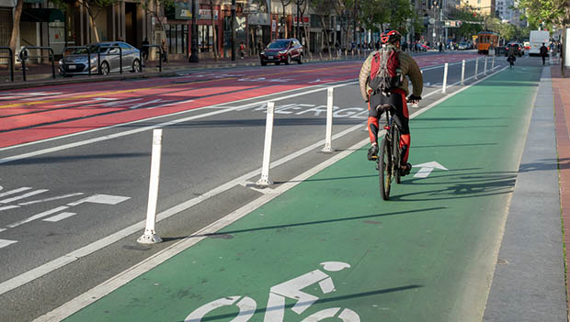
Conclusions
Difficulties
The Work Process
Vehicles Reduction

Slide 19
the end Thank you for listening

