Slide 1


Graduation Project 2
Prepared by
Mohannad Salameh
Ayyob Dwikat
Yazan Tamimi
Supervisor
Dr. Mahmoud Assad

Slide 2
Reuse of Electric Vehicles Batteries at their End-of-Life in Solar Energy Storage

Slide 3




Table of Contents
01
02
03
04
Introduction
Experimental Setup
Simulation Model
Second Life Estimation

Slide 4
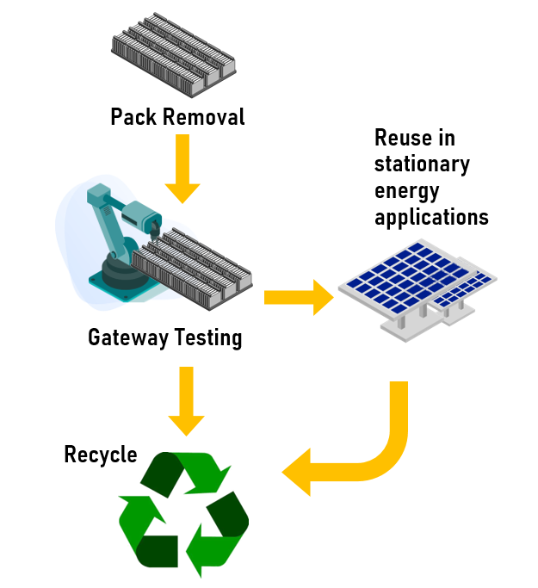
Introduction
The EV battery is removed when its capacity is reduced to be 70-80% of its original capacity
Some batteries can be reused in another applications (Solar Energy Storage)
The batteries are tested before deciding their next life.

Slide 5


Experimental Setup

Slide 6
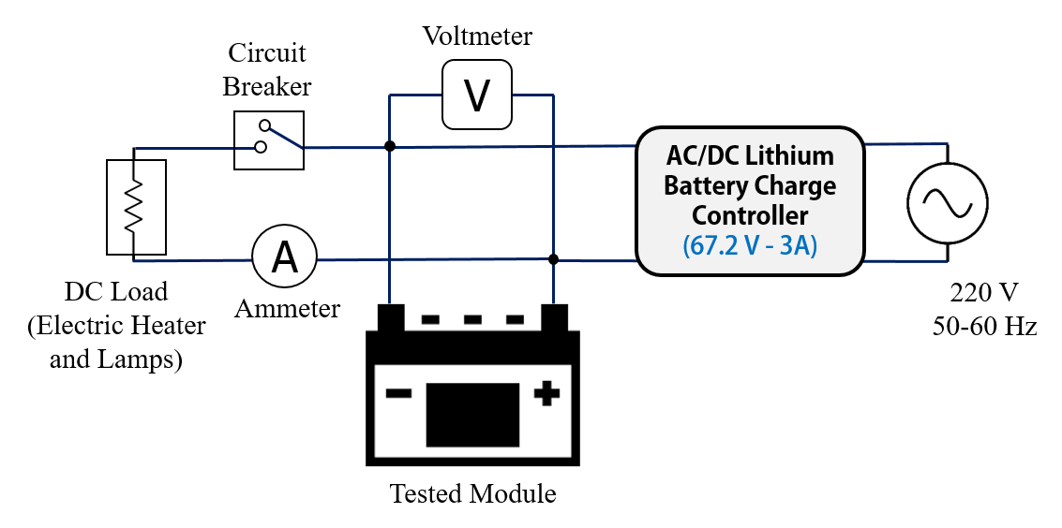
Battery State Test
A module capacity can be determined by charging and discharging
A sample of Five Battery modules of type Hybrid Hyundai Ioniq 5 were tested as follows

Slide 7
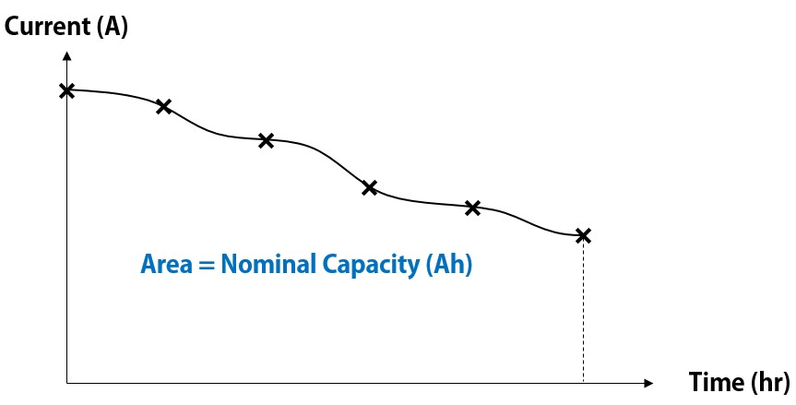
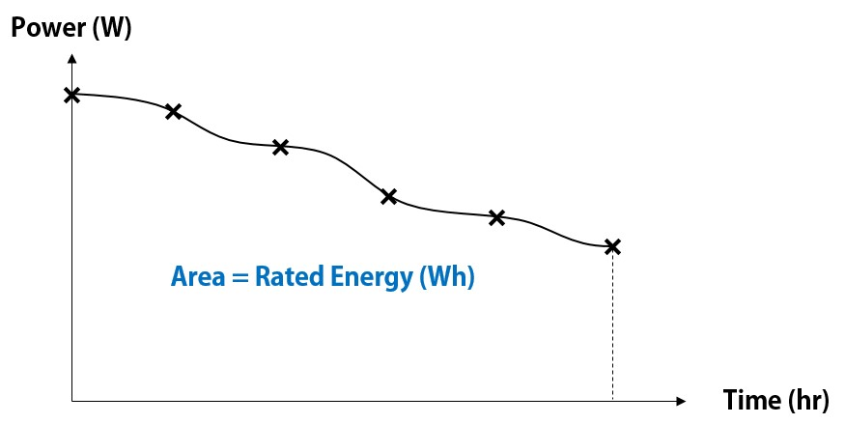
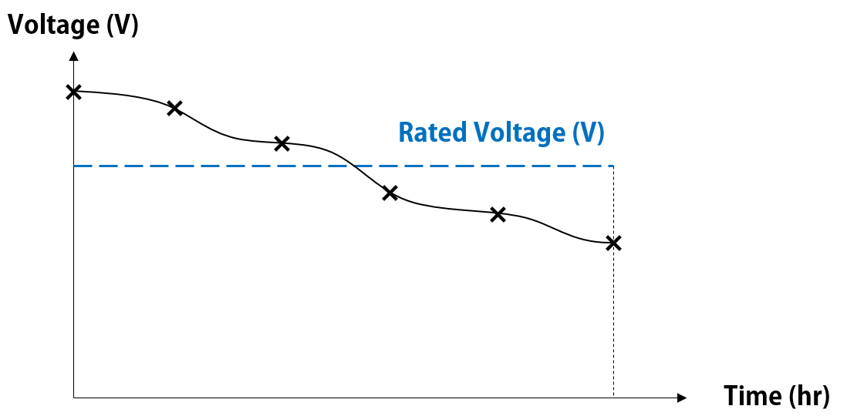
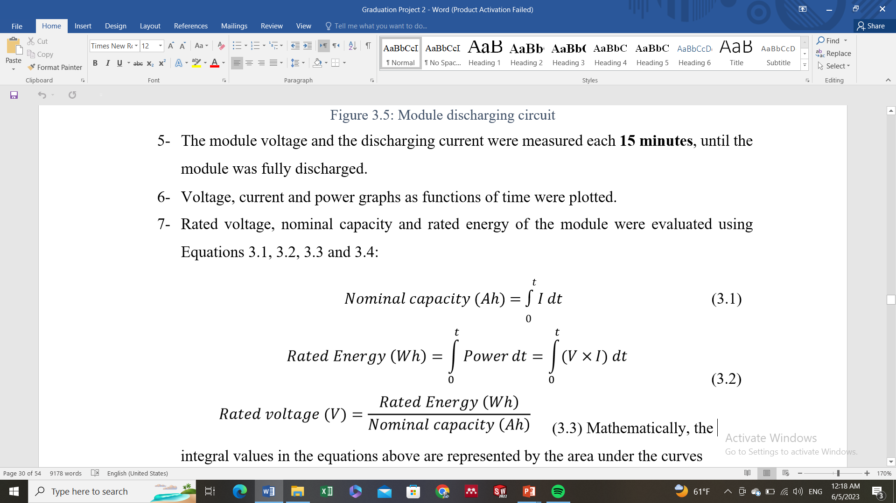
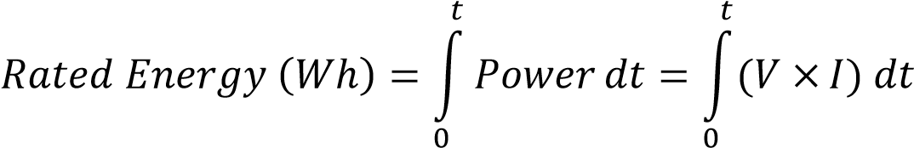
Results
The obtained graphs were used to evaluate the modules specifications

Slide 8
Results and Discussion
Voltage
Current

Slide 9
Results and Discussion
Voltage
Most of the tested modules shown a voltage drop under (40 V) after discharging
Module 4 only has shown the most effective performance.
The voltage drop could be due to internal cells and circuit damages.
The capacity of the modules is relatively small, so it can’t be reused in large scale PV systems.

Slide 10

Results and Discussion
Module’s SOH is calculated as follows:
 | Rated Energy (Wh) | SOH (%)
Module 1 | 302.9 | 77.70%
Module 2 | 257.7 | 66.10%
Module 3 | 238.4 | 61.10%
Module 4 | 328.2 | 84.20%
Module 5 | 280.2 | 71.80%
$$SOH(\%)=\frac{current rated energy}{initial rated energy} ×100\%$$
The initial rated energy of each module was obtained from the guide manual to be 390 Wh

Slide 11

Simulation Model

Slide 12
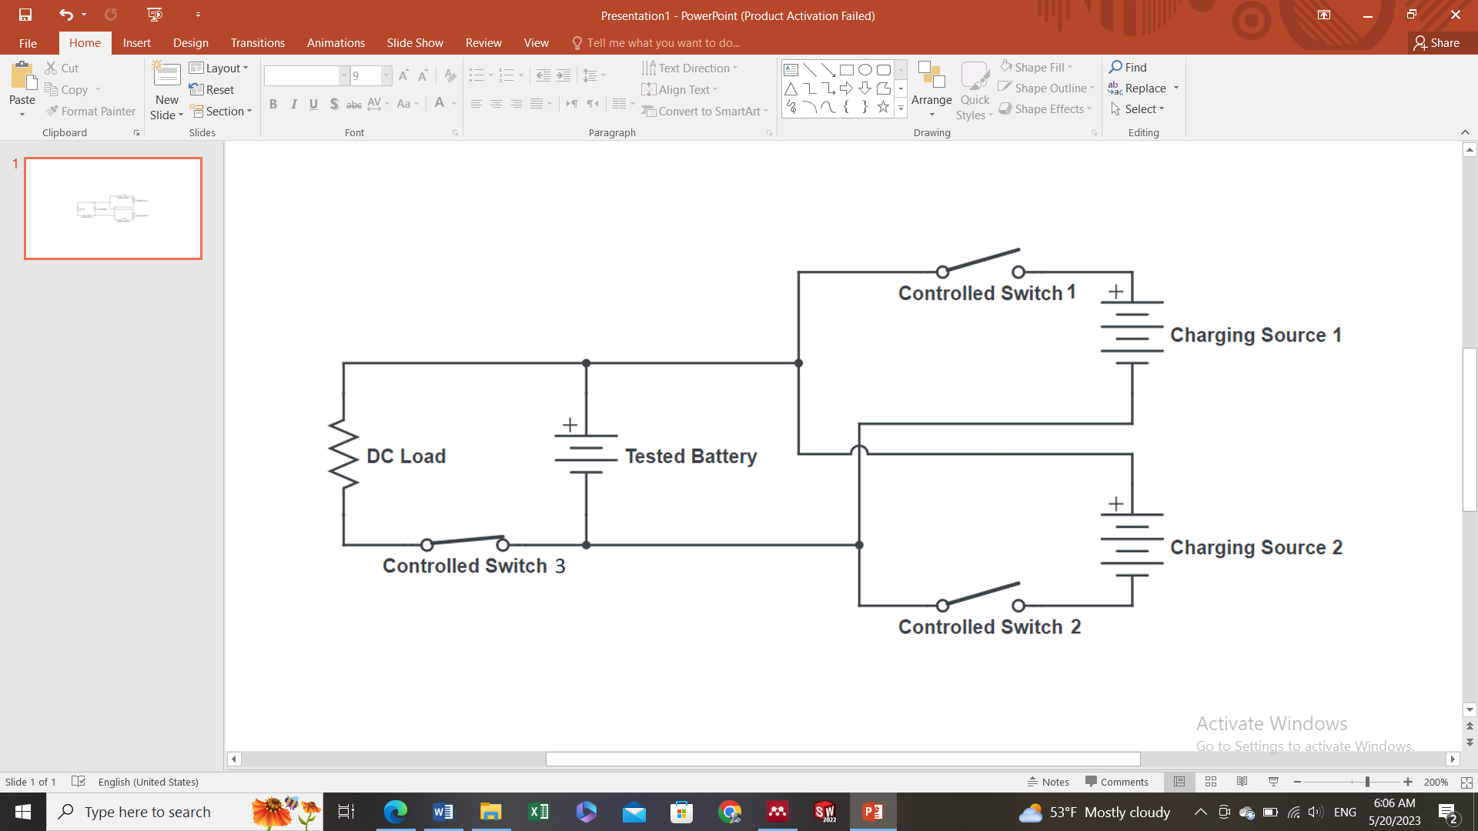
Model Structure
The tested battery is charged by another battery and discharged to feed a DC Load
The switches are controlled by a MATLAB programed controller
More cycles can be simulated by adding more charging sources

Slide 13
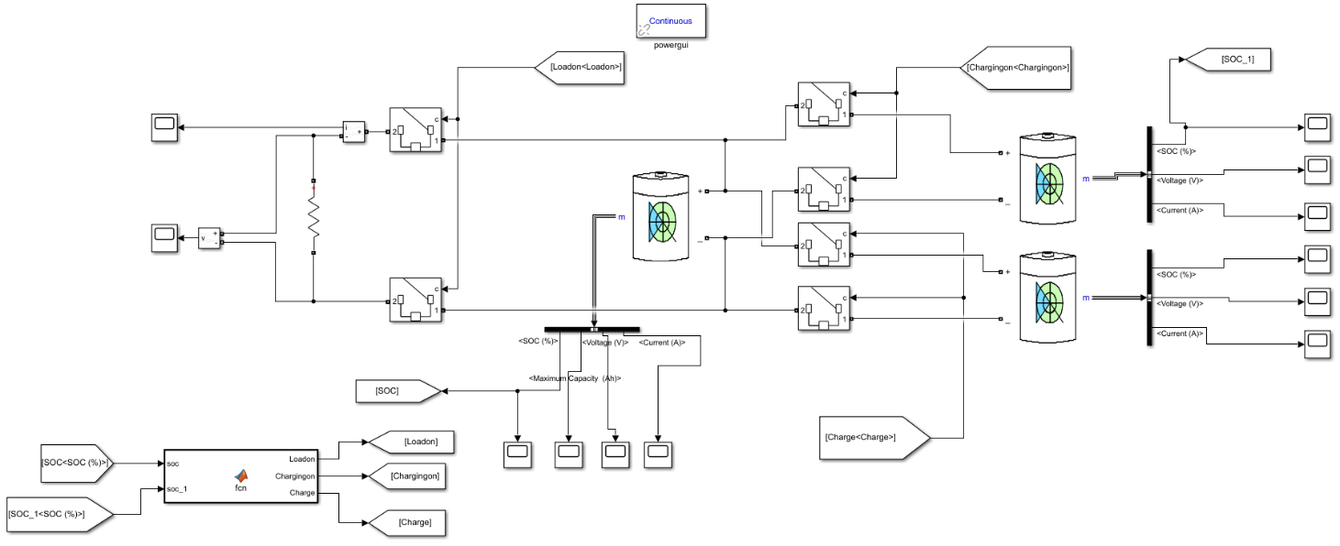
Model Structure

Slide 14
Input and Output Parameters
The model is parameterized and can be used to study the effect of each parameter on charging-discharging process
Simulation Model
Battery Specifications
Battery Voltage (V)
Initial Age (Cycles)
Battery Current (A)
DoD (%)
SOC (%)
Discharging Load (Ω)
Capacity Fade (Ah/Cycle)
Initial SOC (%)

Slide 15
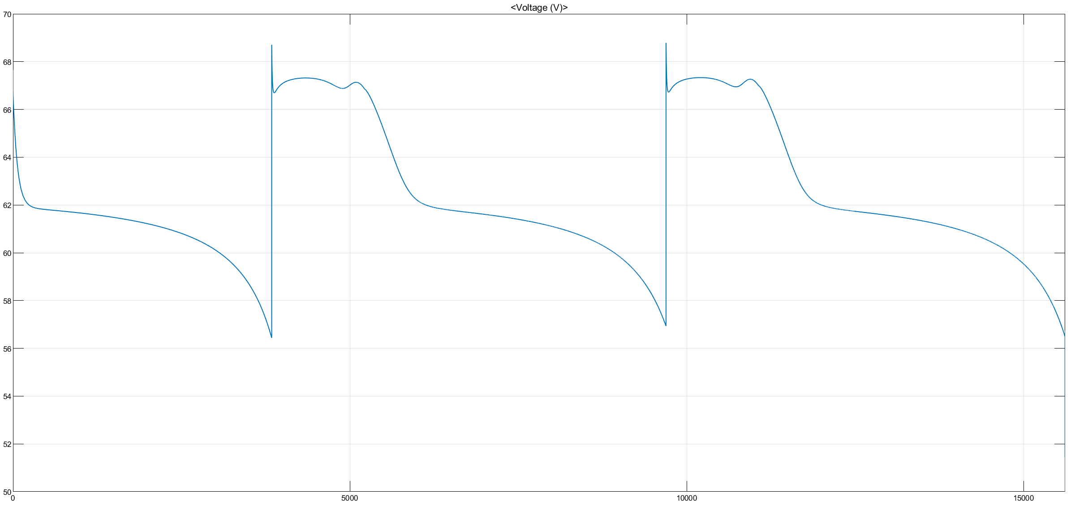
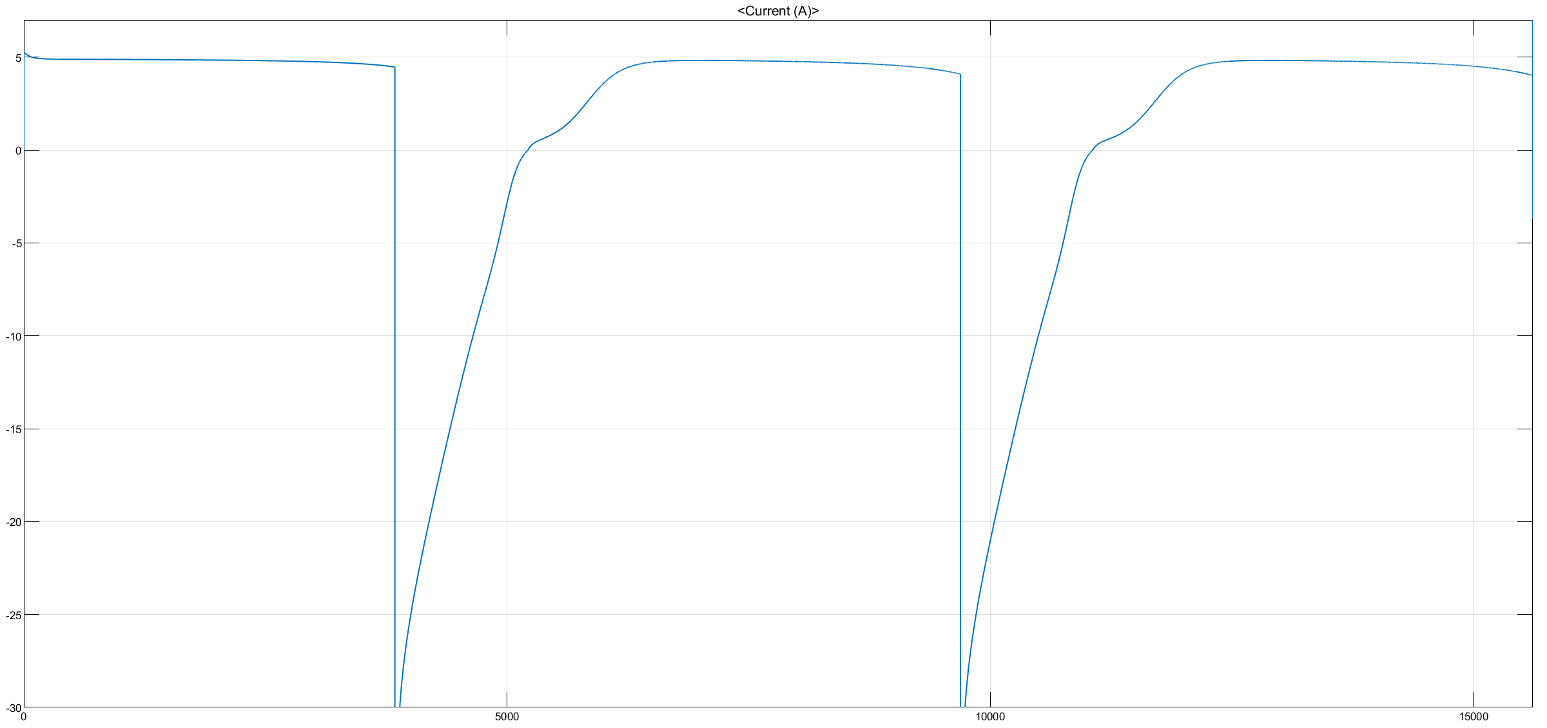
Model Validation
Voltage
Module 4 was simulated in the model, as it has shown the best performance
The charging process was not simulated properly due to the presence of a block that corresponds the used charger
The Root Mean Square Error (RMSE) was used to measure the deviation between the simulation and experiment for discharging
Current

Slide 16
Model Validation
Voltage
Current
RMSE = 4.1 V
RMSE = 0.52 A

Slide 17
Second Life Estimation

Slide 18
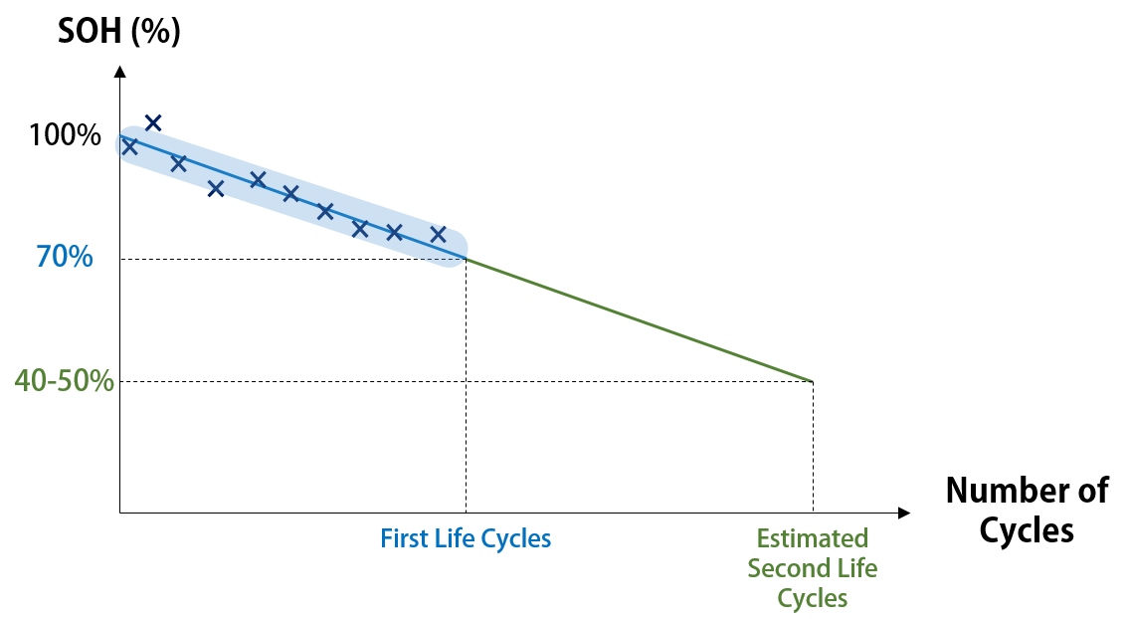
Second Life Estimation
Empirical Method: Depends on experiments and observations
Data-Driven Method: Based on historical data as shown in the figure
Model-Driven Method: Based on mathematical models and simulation

Slide 19
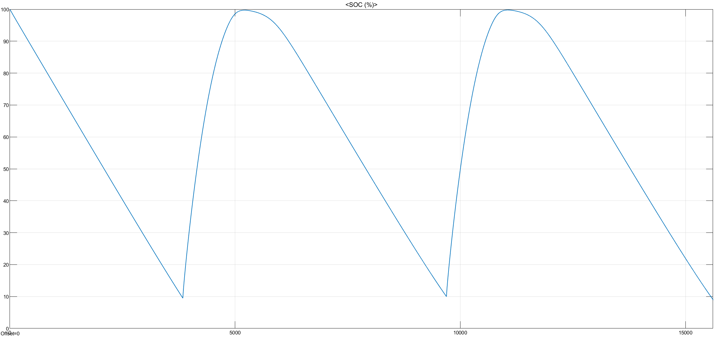
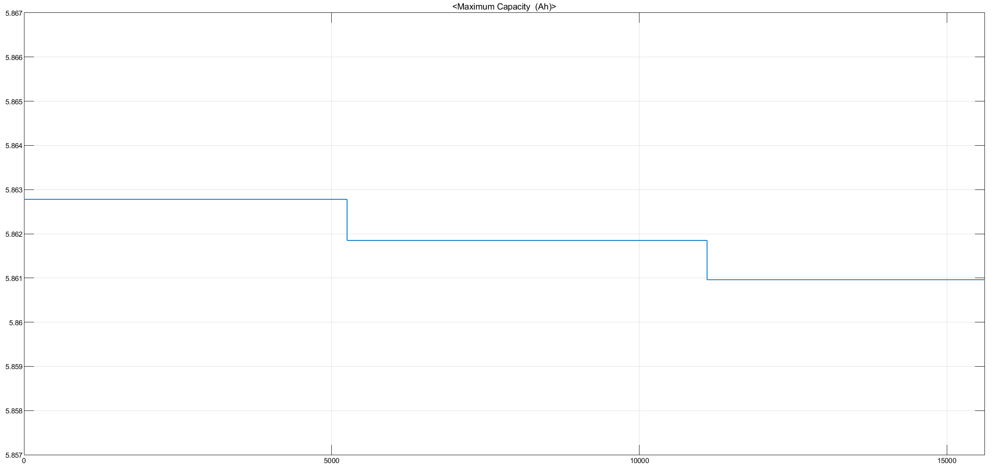
Second Life Estimation
SOC (%)
The model was used to predict the remaining lifespan of the module
The same conditions were simulated and the capacity fade was observed with each charging-discharging cycle
Capacity (Ah)

Slide 20
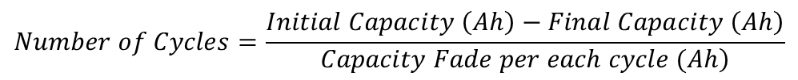
Second Life Estimation: Case Study
The remaining cycles were estimated with different DoD’s when it serves from 80% SOH to 40% SOH
$$Number of Cycles=\frac{Initial Capacity \left(Ah\right)−Final Capacity \left(Ah\right)}{\left.Capacity Fade per each cycle (Ah\right)}$$

Slide 21

Thank You!

