Slide 1
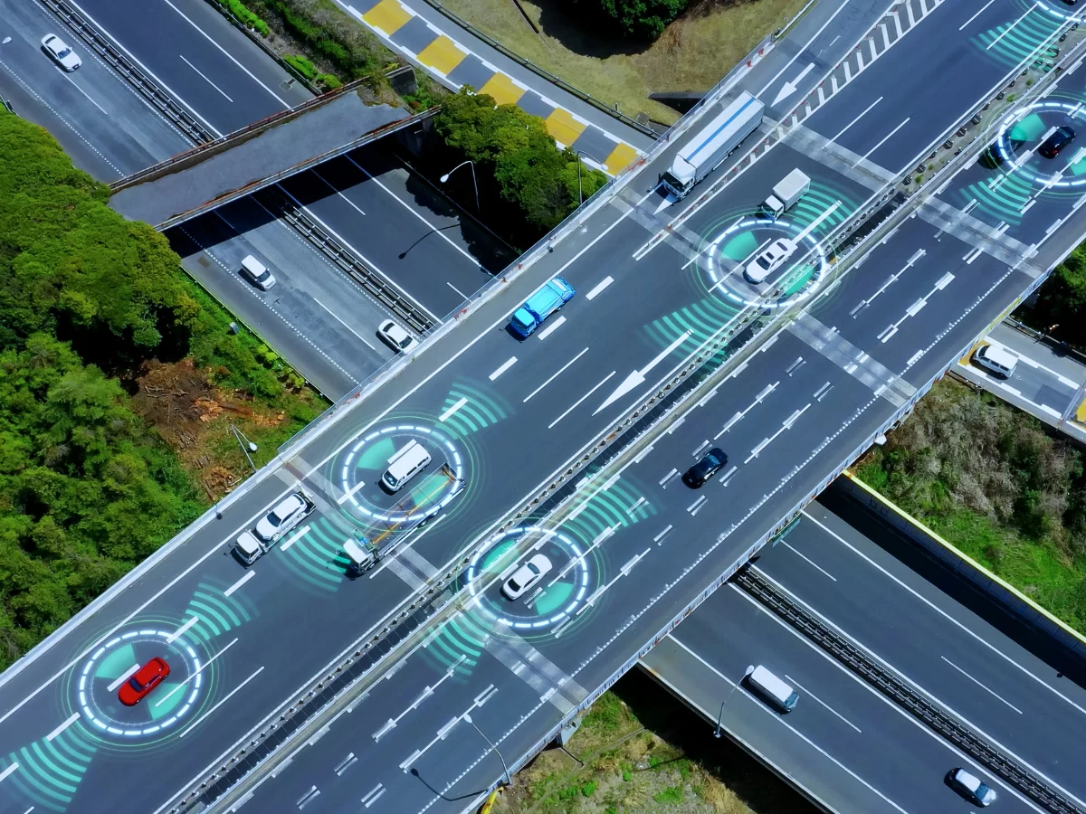
Supervised by: Dr-Raed Jaber
Vehicle Tracking Based on GSM&GPS
By: Eman Alawnah

Slide 2
STEP FOUR
STEP TWO
STEP THREE
the three functions that the system works on
STEP FIVE
Hardware circuit
STEP one
introduction
Hardware component
Conclusions and Recommendations

Slide 3
introduction
The GPS GSM system that has been developed using an Arduino Uno, an ignition sensor and a DC motor is an example of tackling the issue of vehicle theft. The system effectively addresses the problem by providing location information of the vehicle through SMS commands. Additionally, it allows for control by sending SMS instructions, such as "turn on vehicle" which activates the DC motor. Overall this practical and cost effective solution greatly enhances vehicle security. The inclusion of an ignition sensor adds another layer of protection, by triggering an SMS whenever there are attempts to steal the vehicle, thus serving as a powerful deterrent, against theft. This aligns with the primary objective of mitigating vehicle theft, as the system empowers users with a direct means of monitoring, controlling, and securing their vehicles.
In summary, the GPS-GSM system is a practical and efficient solution that successfully tackles the complex issue of vehicle theft. Its reliance on GSM technology, nominal cost, and straightforward design contribute to its effectiveness and accessibility for users seeking an uncomplicated yet powerful anti-theft solution.

Slide 4
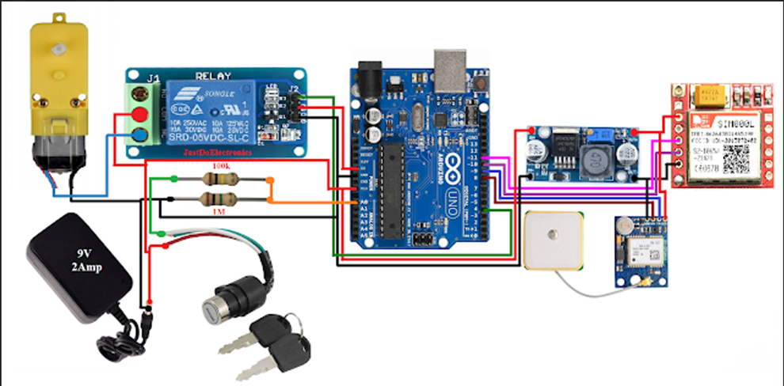
Hardware circuit

Slide 5
Components needed for the Hardware :
1-Arduino UNO Board
3- SIM800/900 GSM Module
4- Neo-6M GPS Module
5- Connecting Jumper Wires
6- Breadboard
7- DC motor
8- relay
9- 9v power supply
10- LM2596 DC-DC

Slide 6
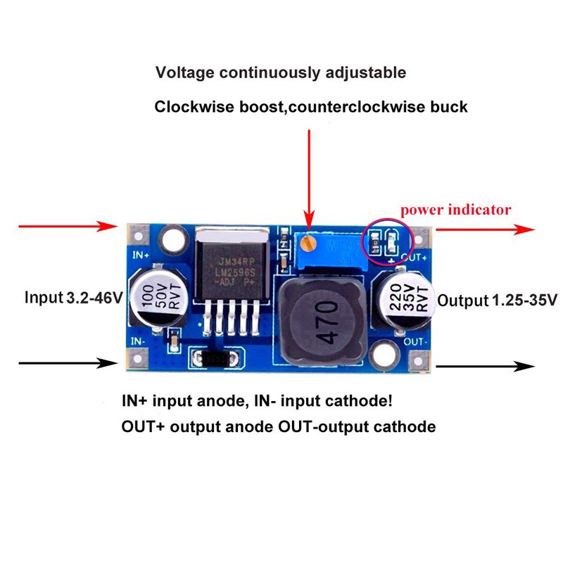
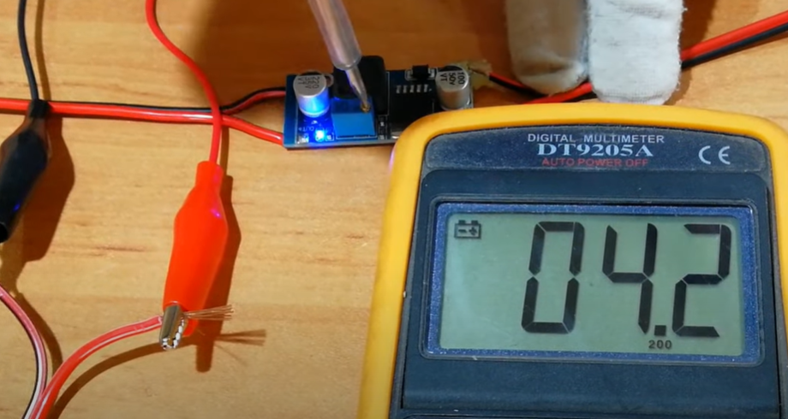
LM2596 DC DC

Slide 7
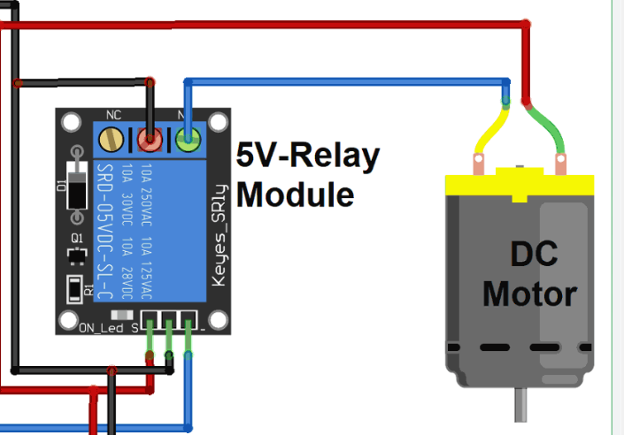
Ignition Switch
The ignition switch is a physical switch that controls the vehicle’s ignition system.
It can be turned on or off remotely through SMS commands, providing control over the vehicle’s engine.

Slide 8
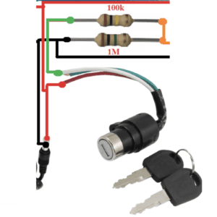
Ignition Sensor
The ignition sensor is an analog sensor connected to the Arduino board.
It measures the voltage or resistance associated with the vehicle’s ignition status.
The sensor helps detect whether the ignition is on or off, enabling the system to monitor the vehicle’s status.

Slide 9
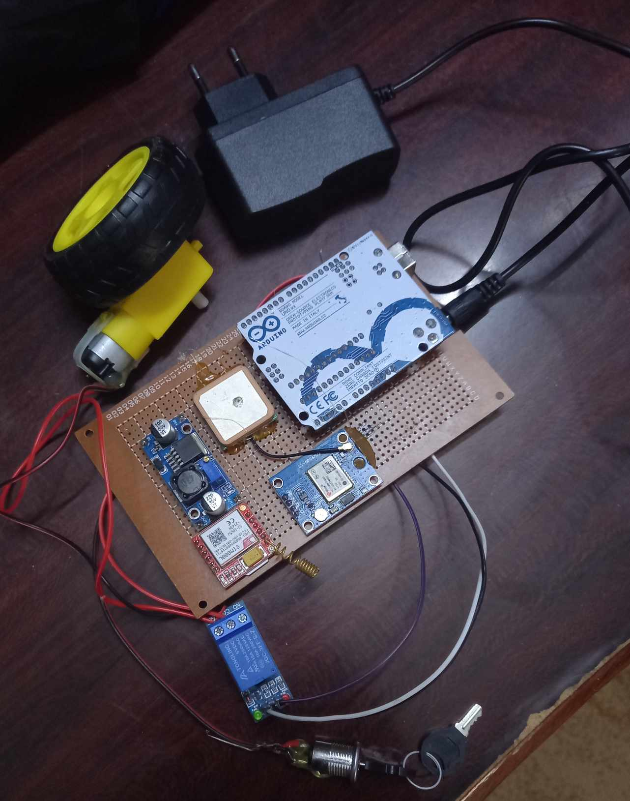
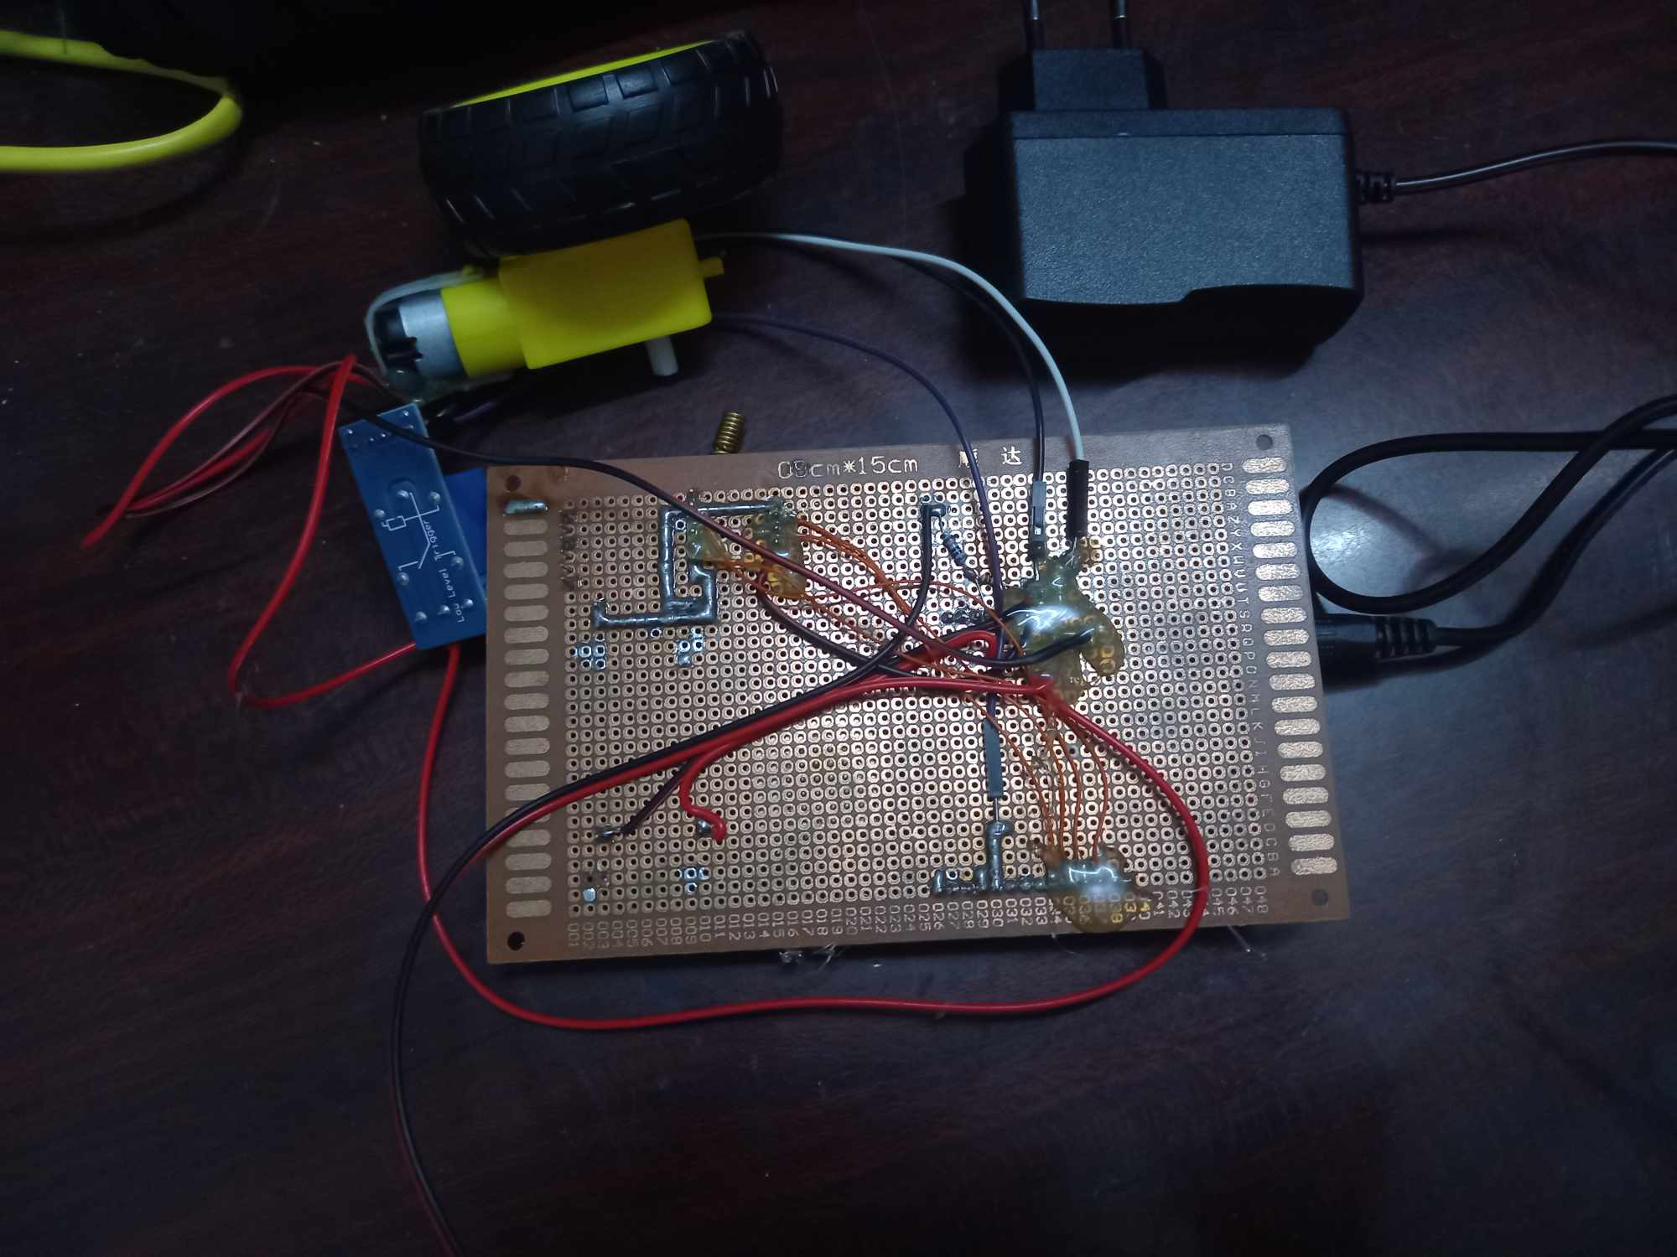
Hardware

Slide 10
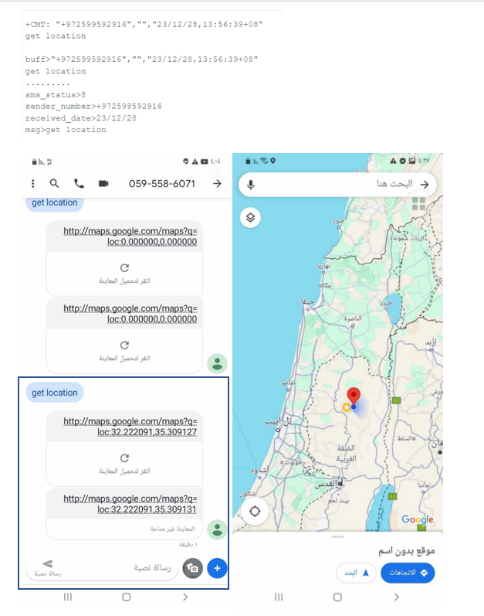
the three functions that the system works on:
  if you send an SMS ( get location) to the system from the vehicle owner number then you will get the location as SMS

Slide 11
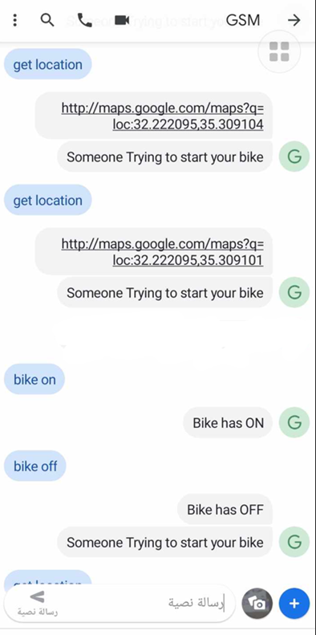
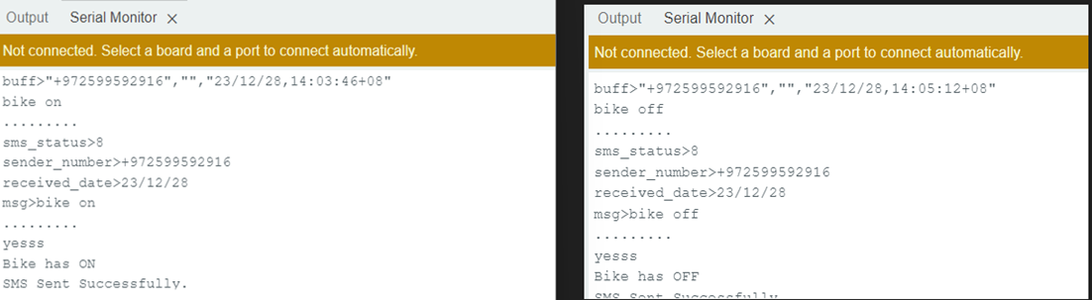
2-you can control the vehicle motors by sending a short message that says (bike on, bike off) and the system will understand if you will want to make your vehicle on or off, This system enables users to exercise precise control over the DC motor through the transmission of SMS commands. The simplicity and accessibility of this mechanism are exemplified by a straightforward command like "bicke on," triggering the activation of the DC motor. This capability not only offers users the convenience of remotely initiating or deactivating the motor but also serves as a pivotal feature in enhancing vehicle security

Slide 12
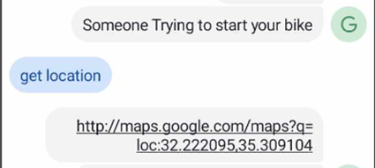
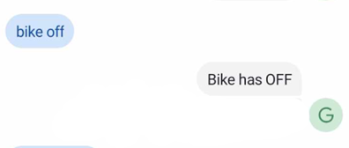
3-if someone is trying to open your vehicle the system will quickly send a sms to tell you that (someone Trying to start your bike)

Slide 13
Conclusions
the implementation of GPS and GSM-based vehicle tracking and security systems has yielded significant outcomes, substantiated by clear evidence of successful location tracking, remote control functionalities, and robust security features.
GPS technology ensures accurate and timely location updates Upon request from the vehicle owner
These simplistically designed user-friendly semi-offline systems provide easy installation with minimal technical expertise requirements, which makes them accessible by individuals and businesses alike for obtaining strategic asset management support service updates by simply utilizing uncomplicated commands or messages.
The semi-offline system has proven effective due to its capacity to offer precise and current location data. These systems ensure steadfast tracking by directly transmitting information and relying on satellite signals. In incidents of car theft or unauthorized use, the system is able to promptly establish the vehicle’s whereabouts, thus enabling immediate action towards recovery or necessary measures.

Slide 14
Recommendations
Improve SMS Communication: Look for ways to optimize SMS communication to reduce delay and make remote commands more responsive. This could involve collaborating with mobile network providers to ensure timely data transmission.
Refine User Interface: Develop a user web interface, alongside SMS-based commands providing users with a platform to monitor and control their vehicles. This improvement can contribute to a more interactive user experience.

Slide 15
Thank you

