Slide 1
An - NAJAH NATIONAL UNIVERSITY
FACULITY OF ENGINEERING
INDUSTRIAL ENGINEERING DEPARTMENT
Implementation of statistical process control “ SPC”
in AZIZA poultry slaughterhouse
Supervised by:
Dr. Yahya Saleh Eng. Tamer Haddad
Prepared by:
Aseel Khateeb Asmaa’ Nouri Odai Dweekat

Slide 2
Agenda
About Palestine Poultry Company AZIZA
Main types of products in AZIZA
Problem Statement
Literature Review
Objectives
Statistical Process Control “SPC”.
Major Process in slaughterhouse
Methodology and Analysis
Recommendation

Slide 3
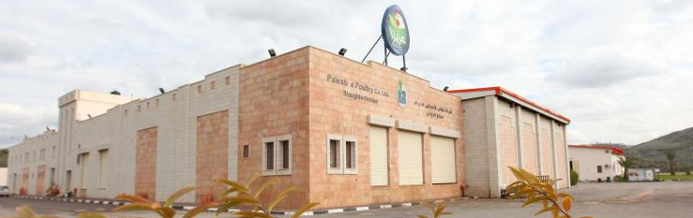
About Palestine Poultry Company AZIZA
Was established as public shareholding company in Nablus-Palestine in 1997 with paid in capital of JD10 million .
Provide the Palestinian market with health and high quality products using latest technology.
Different sites in Tulkarm, Jenin, Jericho, Nablus, Ramallah and Qalqiliah.
Has been certified with HACCP Codex and ISO 22000:2005

Slide 4
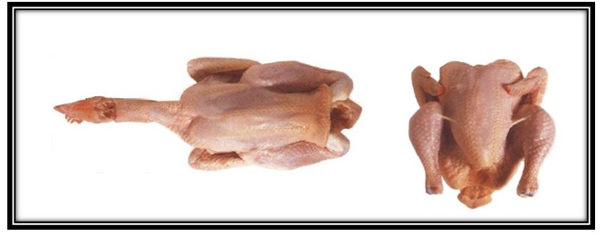
Main types of products in AZIZA
Whole chicken

Slide 5
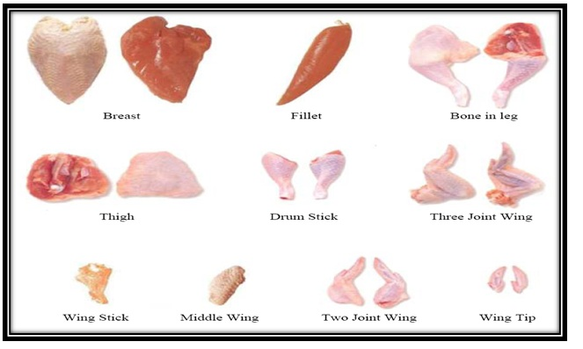
Cutting parts

Slide 6
Problem Statement
Aziza Poultry Company has not enough sufficient quality system.
Aziza Company implements HACCP so that they have a lot of data that haven’t been analyzed.
AZIZA don’t have any indicators about their progress in production and the causes for non-conforming products.

Slide 7
Literature review(Sample)
Study name :Integration Statistical Process Control to monitor and improve carcasses quality in a poultry slaughterhouse implementing a HACCP system
Researchers:Marios Mataragas, Eleftherios H. Drosinos, Evangelia Tsola, Pantelis E. Zoiopoulosmade
Main concept: by integrate tools of SPC such control charts and process capability Analysis in HACCP system that support :
Prevention strategy
Monitoring and optimizing microbiological quality of products
Implementation of corrective actions
Implementation prevention of failure

Slide 8
Study name : Impacting Poultry Meat Quality from Production to Pre-Slaughter.
Researchers: Baracho MSI; Camargo GAII; Lima AMCIII; Mentem JFIV; Moura DJI; Moreira JV; Nääs
Main concept : Understanding where critical points are in the poultry meat production chain and investing in solving critical problems may lead to better control and management, and consequent reduction of losses
Main problems :
Harvesting and transportation:
E.g: Brazil most damage in the carcass was found during catching in the breast (11%), thighs (33%), and wings (38%).
Pre-slaughter stress.

Slide 9
Study name :Applying statistical process control to monitor and evaluate the hazard analysis critical control point hygiene data.
Researchers: G. D. Hayes,A. J. Scallan and J. H. F. Wong
Main concept : make integration between HACCP (hazard analysis critical control point) and SPC (Statistical Process Control) tools to analyze the collected data and evaluate and monitor the CPs in order to obtain advance warning on the status of a CP and not just a Pass/Fail classification.

Slide 10
Objectives
Improve and implement an advanced quality system
Increase customer satisfaction
continuous improvement for the process.
Measure the progress of the process.
Measure the process capabilities
Implement the seven quality tools.
Monitoring and optimizing microbiological quality of products .

Slide 11
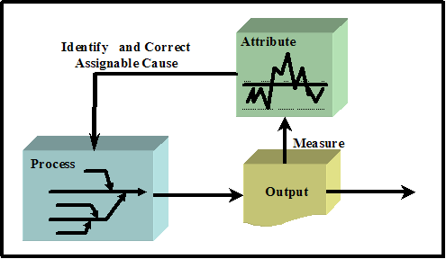
Statistical Process Control “SPC”
Statistical process control (SPC) is a method of monitoring, controlling, and improving a process through statistical analysis. An important SPC tool is the control chart, which can be used to detect changes in production processes .
Input-output of SPC process

Slide 12
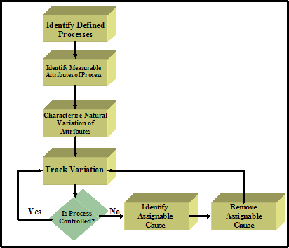
How to perform SPC

Slide 13
SPC tools
Pareto diagram
Check sheet
Histogram
Process flow diagram
Scatter diagram
Control charts
Cause and effect diagram “fishbone diagram”

Slide 14
Major Processes in slaughterhouse
Slaughter
- Unloading -Stunning -Killing
Feather removal
-Scalding -Picking
Evisceration
Chilling

Slide 15


Slide 16
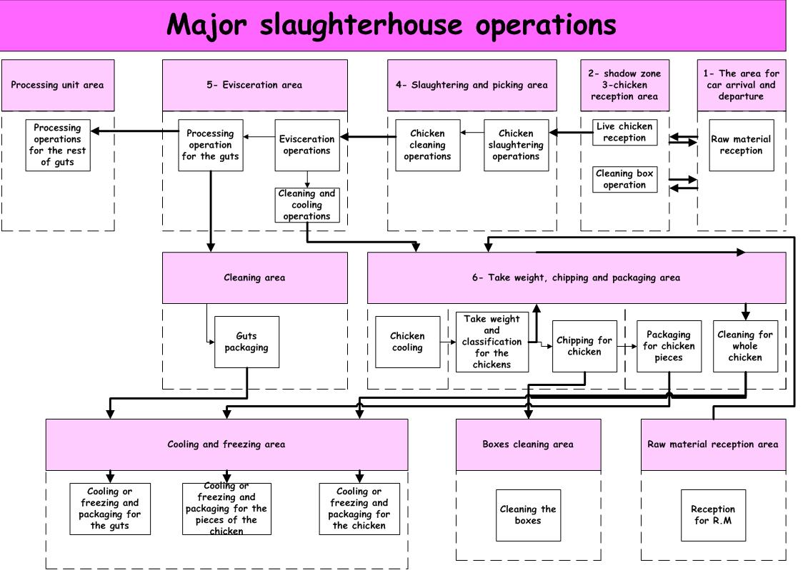
Process flow chart

Slide 17
Methodology and analysis
Tests
Collecting data
SPC tools
Cost reduction
Quality plan

Slide 18
Major Tests
Variable tests
Attribute tests
Microbiological tests

Slide 19
Attribute Tests
Monitor the slaughter process
Monitor the defeathering process
Monitor the color of the chicken
These three tests are done in slaughtering area visually ,with 75 bird per half an hour frequency , and at most two birds as an acceptance limit .

Slide 20
Check the chicken cavity and entrails
150 Bird per 0.5 hour
Visual
zero non-conforming
Evisceration area
Check the quality of the chickens
150 Bird per 0.5 hour
Visual
Zero non-conforming
Weighing department

Slide 21
Check packaging and printing processes
3 birds per 0.5 hour
Visual
Zero non-conforming
Packaging department
Check the chipping process for the chickens
150 Bird per 0.5 hour
Visual
According to order
Chipping department

Slide 22
Variable Tests
Check the temperature of the chicken after the drying room
Check the temperature of the cold tank “chiller”
Check the temperature of the chicken after the chiller
These three tests are done in evisceration area visually ,with twice per hour,2 birds per half an hour respectively frequencies , and the acceptance limit are max 12 c, at most 7 c for the bird, respectively .

Slide 23
Check the temperature of the chicken before packaging
3 birds per 0.5 hour
Visual
At most 7 C° for bird tem.
Packaging department
Monitor the temperature of the hot water
once per hour
Visual
57C°-59C°
Slaughtering department

Slide 24
Microbiological tests
1. E.coli
Definition:
is one of several types of bacteria that normally inhabit the intestine of humans and animals (commensal organism)
Sampling:
2 different samples from each batch
Acceptance limit:
It will be Accepted if NOT ABOVE 100 cfu/ml

Slide 25
2. Coliform Bacteria
Definition:
Is Group of gram-negative bacteria found in the intestinal tract of humans and other animals.
Sampling:
2 different samples from each batch
Acceptance limit:
It will be Accepted if NOT ABOVE 100 cfu/ml
Difference between E.coli
Warm Blooded animals
an indicator organism of contamination
indicate the existence of other pathogenic organisms
reflecting the potential health risks

Slide 26
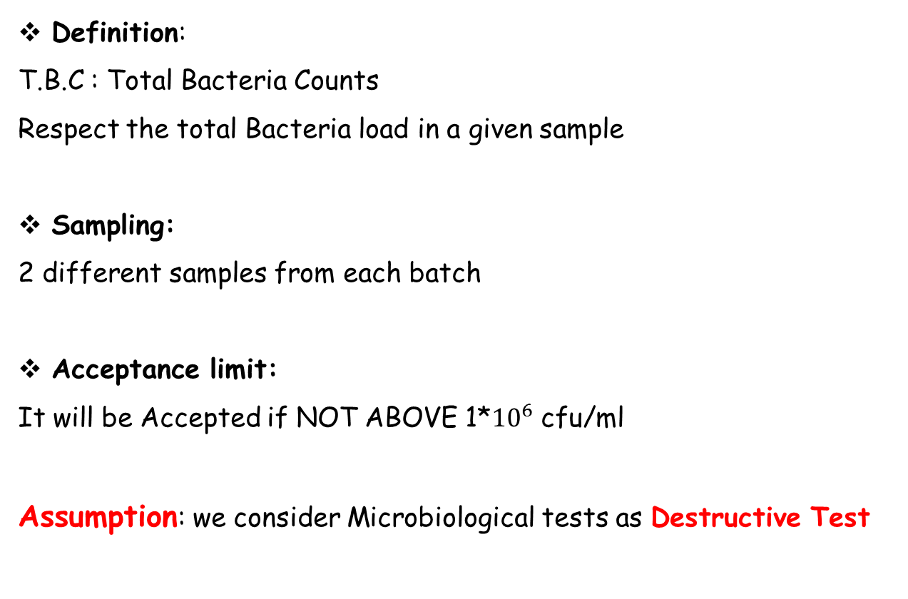
3. T.B.C
Definition:
T.B.C : Total Bacteria Counts
Respect the total Bacteria load in a given sample
Sampling:
2 different samples from each batch
Acceptance limit:
It will be Accepted if NOT ABOVE 1*${10}^{6}$ cfu/ml
Assumption: we consider Microbiological tests as Destructive Test

Slide 27
Collecting Data
There are a certain number of slaughters were distributed among January to September for variable and attribute tests ,with different batch size for each. The data were checked according to the type of inspection.
The following tables used to show how we collected the data for variable test, attribute test and microbiological test respectively.

Slide 28
Month | From Jan to Sep |  | Test Type |  | visual measuring temperature
Test Area | Evisceration area |  | Test Frequency |  | twice per hour
Test Name | Check the temperature of the cold tank “chiller |  | Acceptance Limit |  | max 12 C
Month | Batch number | Batch Date | Batch Size(m) | Temperature per 1/2 hour
 |  |  |  | 1.0 | 2.0 | 3.0 | 4.0
January | 272 | 02-01-12 | 3600 | 7.1 | 6.8 | 6.5
 | 273 | 03-01-12 | 3500 | 7.0 | 7.3 | 6.9
 | 274 | 04-01-12 | 3600 | 8.0 | 7.9 | 7.8
 | 275 | 05-01-12 | 10000 | 7.9 | 8.1 | 9.3 | 8.2
 | 276 | 07-01-12 | 7000 | 8.1 | 7.9 | 7.5 | 6.9
 | 277 | 08-01-12 | 4000 | 7.2 | 7.5 | 7.9
 | 278 | 09-01-12 | 6000 | 7.1 | 8.1 | 7.9 | 6.5
 | 279 | 10-01-12 | 3600 | 7.1 | 7.1 | 7.3
 | 280 | 11-01-12 | 6000 | 7.2 | 6.9 | 6.8 | 6.3

Slide 29
Month | from Jan- Sep |  | Test Type |  | visual
Test Area | Slaughtering Dept. |  | Test Frequency |  | 75 Bird / 0.5 hour
Test Name | Monitor the slaughter process |  | Acceptance Limit |  | At most Two Birds
Month | Batch number | Batch Date | Sample Size(n) | Number of non-conforming per 1/2 hour
 |  |  |  | 1 | 2 | 3 | 4
January | 272 | 02-01-12 | 75 | 0 | 0 | 0
 | 273 | 03-01-12 | 75 | 0 | 0 | 0
 | 274 | 04-01-12 | 75 | 0 | 0 | 0
 | 275 | 05-01-12 | 75 | 0 | 0 | 0
 | 276 | 07-01-12 | 75 | 0 | 0 | 0
 | 277 | 08-01-12 | 75 | 0 | 0 | 0
 | 278 | 09-01-12 | 75 | 0 | 0 | 0
 | 279 | 10-01-12 | 75 | 0 | 0 | 0
 | 280 | 11-01-12 | 75 | 0 | 0 | 0

Slide 30
Date | COLIFORM COUNT | COLIFORM COUNT | COLIFORM COUNT
01-02-13 | 17 | 6 | 11
02-02-13 | 13 | 12 | 14
03-02-13 | 15 | 7 | 20
04-02-13 | 14 | 8 | 17
05-02-13 | 18 | 9 | 19
06-02-13 | 19 | 11 | 22
07-02-13 | 12 | 10 | 21
08-02-13 | 11 | 11 | 50
09-02-13 | 25 | 37 | 48
10-02-13 | 24 | 7 | 22
11-02-13 | 19 | 9 | 19
12-02-13 | 28 | 18 | 12
13-02-13 | 14 | 22 | 11
14-02-13 | 25 | 11 | 25
15-02-13 | 7 | 14 | 24
16-02-13 | 11 | 22 | 19

Slide 31
Analysis by SPC tools
After collecting the data for nine months, we use Minitab program to analysis the data ,and the main tools that used control charts, histograms, fish-bone diagram and run charts.
In order to determine the distribution that the data will have we use process capability ,and we used the probability plot

Slide 32
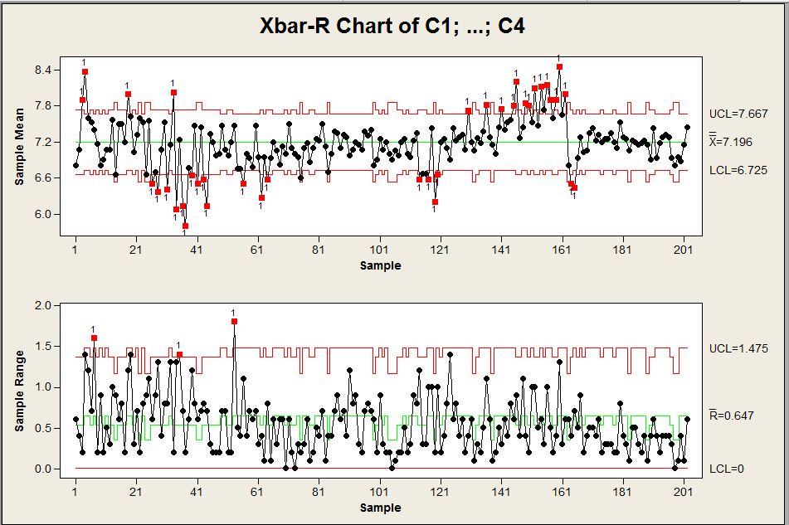
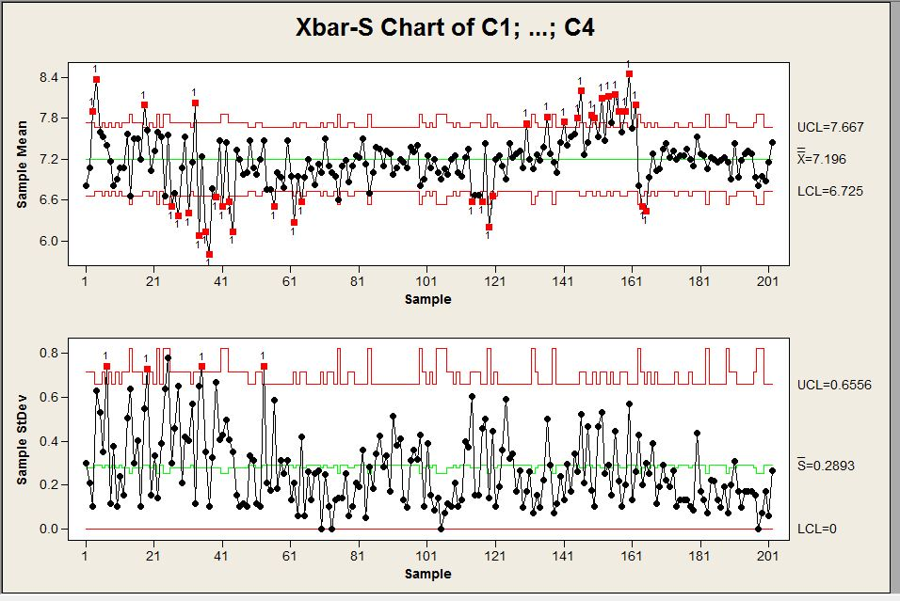
Check the temperature of the cold tank “chiller”
Control Charts:

Slide 33
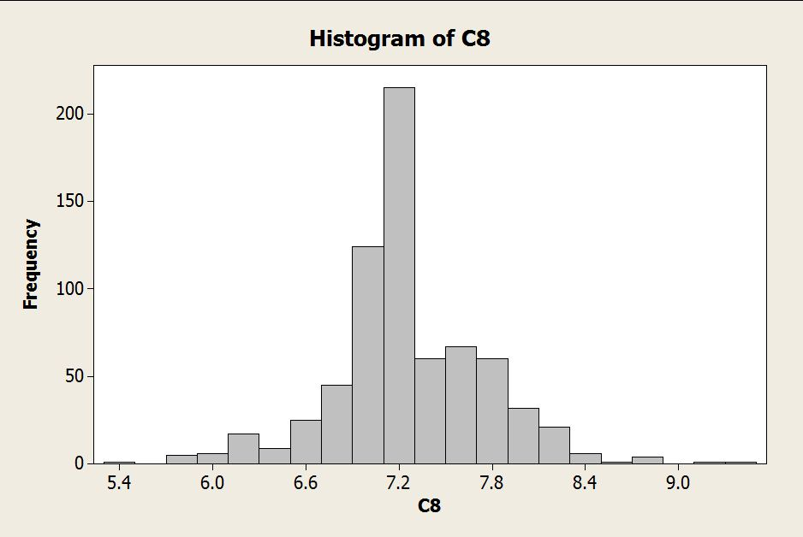
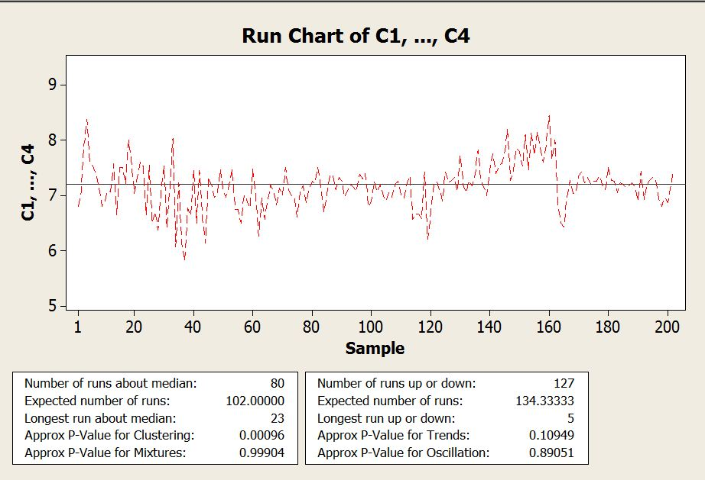
Histogram and run chart

Slide 34
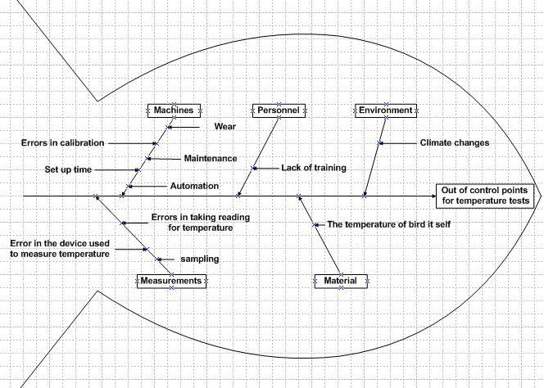
Fish-bone diagram

Slide 35
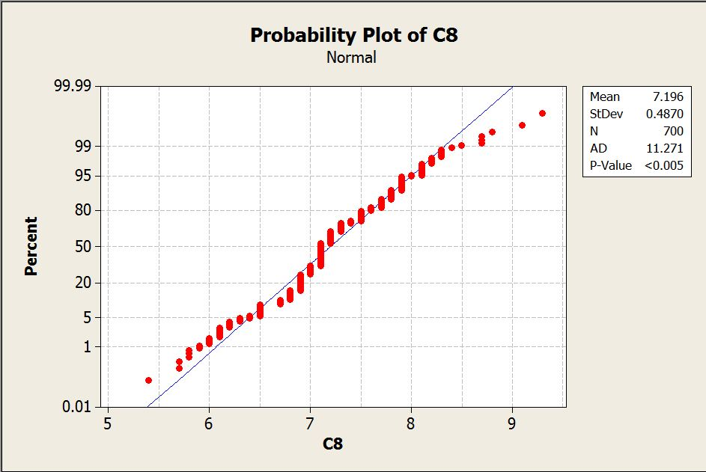
Probability plot
To check if the data of the test are normal or not.

Slide 36
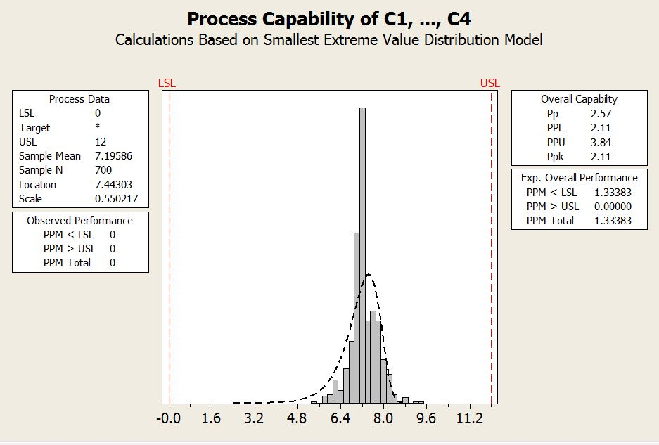
Process capability
measurable property of a process to the specification, expressed as a process capability index(e.g., Cpk or Cpm) or as a process performance index (e.g., Ppk or Ppm). And the analysis was taken on the worst case (the minimum Pp)

Slide 37
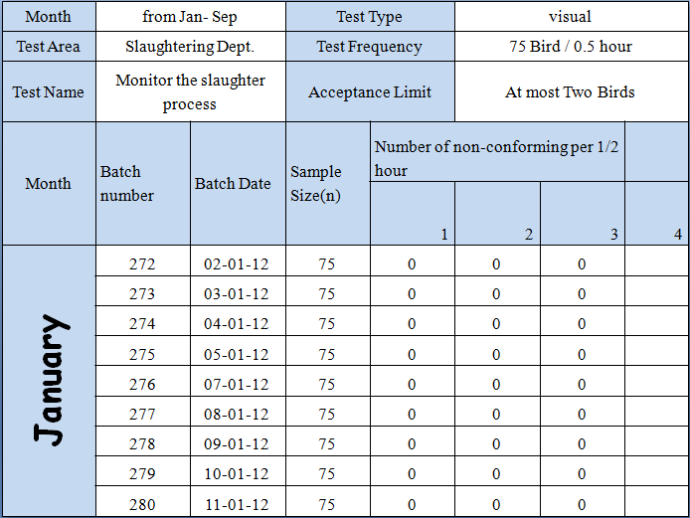

Monitor the slaughter process
As we can see, this type of monitor had a few out of control cases, that could be ignored according to the large in control cases. According to this we build the adjustment quality plan and cost reduction model.

Slide 38
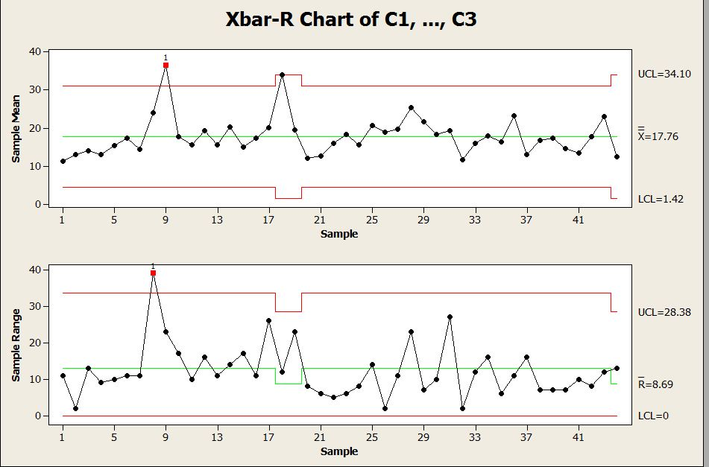
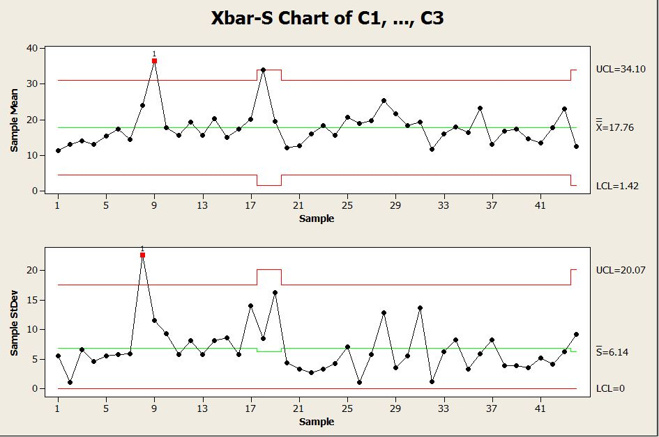
Coliform bacteria
Control Charts:

Slide 39
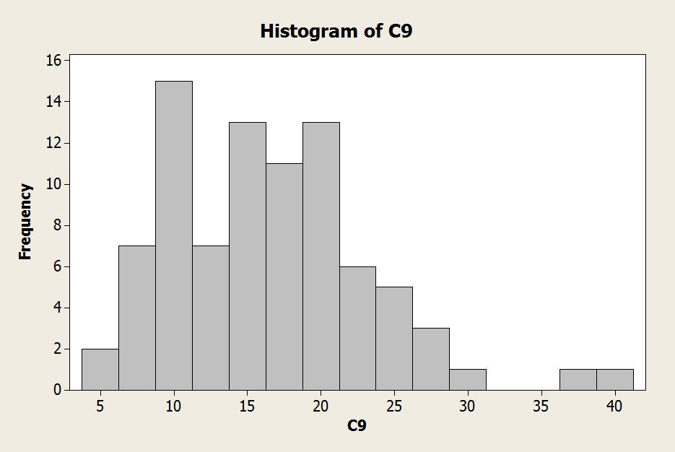
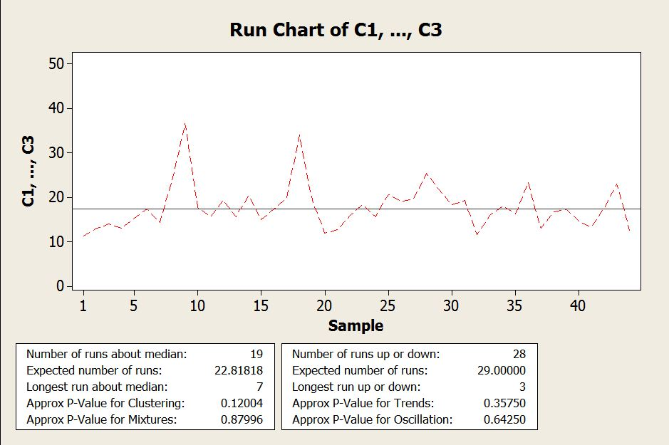
Histogram and run chart

Slide 40
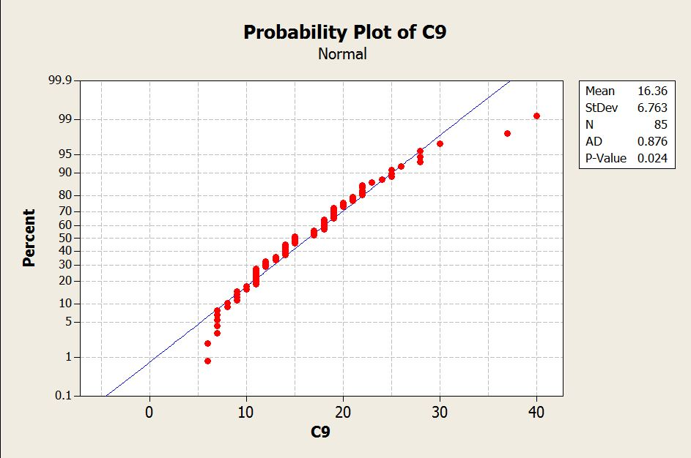
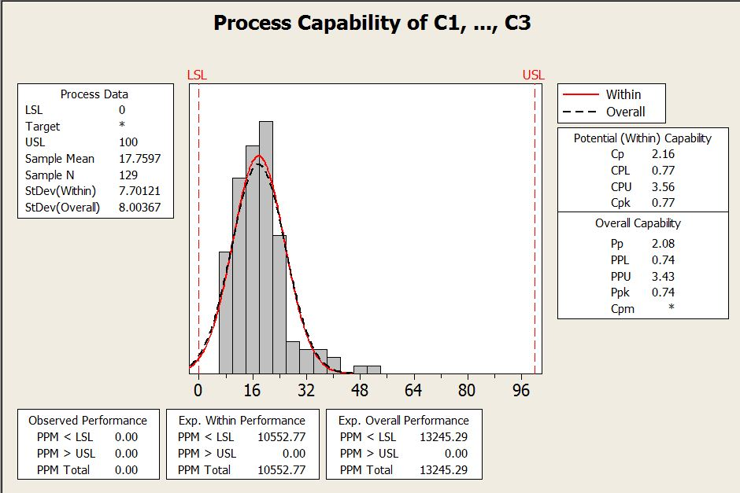
Probability plot and process capability:

Slide 41
Quality Plan
The following tables shows the main tests performed in the company and the reduced frequencies for the attribute test according to that there is no out of control points through nine months, and the old frequency was waste time and costs.

Slide 42
Process/Area | Test name | Test type | Test frequency | Tester | Acceptance limits | Non-conformities Procedures | Responsibility for the implementation of non- conformities procedures
Slaughtering Area | Monitor the slaughter process. | Visual by checking that the two artery and veins in the neck are cut. | 0.833% 2.5% | Veterinarian doctor. | Maximum 2 birds per 3000 birds. | -Destruction of non-conforming chicken. -Give instructions to person who slaughter chickens about the right way to slaughter. | -Veterinarian doctor. - Supervisor of production department. -employee at production department. - slaughter man
Chipping department | Check the chipping process for the chickens | Visual by examine how cutting meat or absence of bone | 0.833 % 2.5% | Quality Tester | -cutting according to the orders. - Bone-free meat. | Move the piece to the line to remove the bones | -Quality Tester. -Supervisor of production department. -Cutting staff

Slide 43

Cost reduction model

Slide 44
Recommendation
Finally, To obtain the benefits of the statistical process control tools, the company should take into consideration the following steps:
The company must use the seven tools to increase their awareness about the problems, try to solve any problem that may happen in the future, detect the main sources of variability, and measure the progress of the process.
The analysis shows that the implementation of SPC method will benefit the company in making savings in money and time consumptions.
The advanced quality plan must be implemented for new frequency of tests to make the savings.
Increase the number of samples taken for the microbiological tests, because the cost to test another sample is almost ignore.

Slide 45

Contribution
Variable tests
Process Flow diagram
Control charts
Tests
Collecting
Data
“Standard
Tables”
Attribute
tests
Fishbone Diagram
Tests
Microbiological
tests
Histogram
SPC tools
Run Chart
Quality plan
Time and motion study
Saving Time
Cost reduction

Slide 46


