Slide 1

Design for Directorate of Health in Nablus
An-Najah National University
Faculty of Engineering & Information Technology
Department of Building Engineering
Prepared By:
Ahmad Resha
Osama Khouerh
Qusai Abu Raad
Supervisor: Eng. Abdel Hakeem Al Jawhari

Slide 2
Contents:
Site analysis
Architectural Design
Environmental Design
Structural system Design
Electro-Mechanical system Design
Safety design
Quantity Survey and Cost

Slide 3
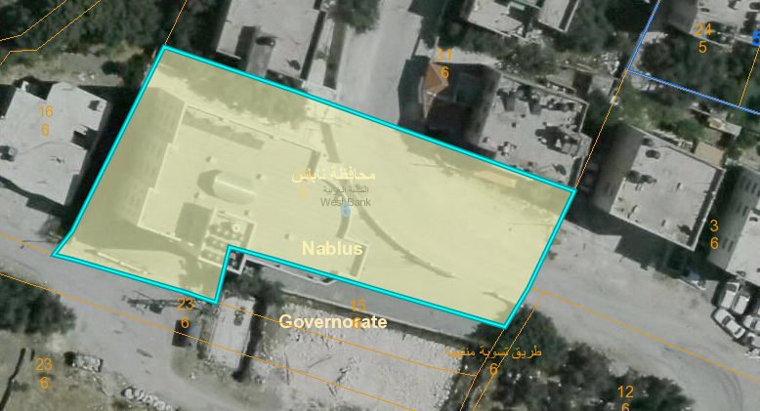
Architectural design
Site analysis
The site is located in (balata al balad), east of Nablus near to (Jacob’s well church), it’s to the East-north of Amman street, about 496 m above sea level and 2 kilometers away from city center. Site has a total area of 1483 m2.

Slide 4
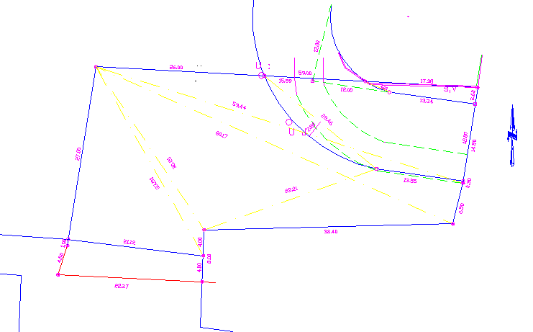
Site analysis

Slide 5
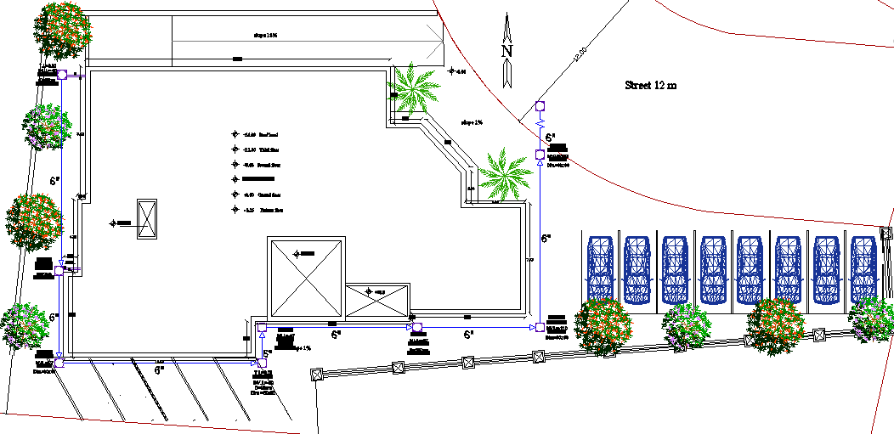
Site analysis
Building area = 447 m²

Slide 6
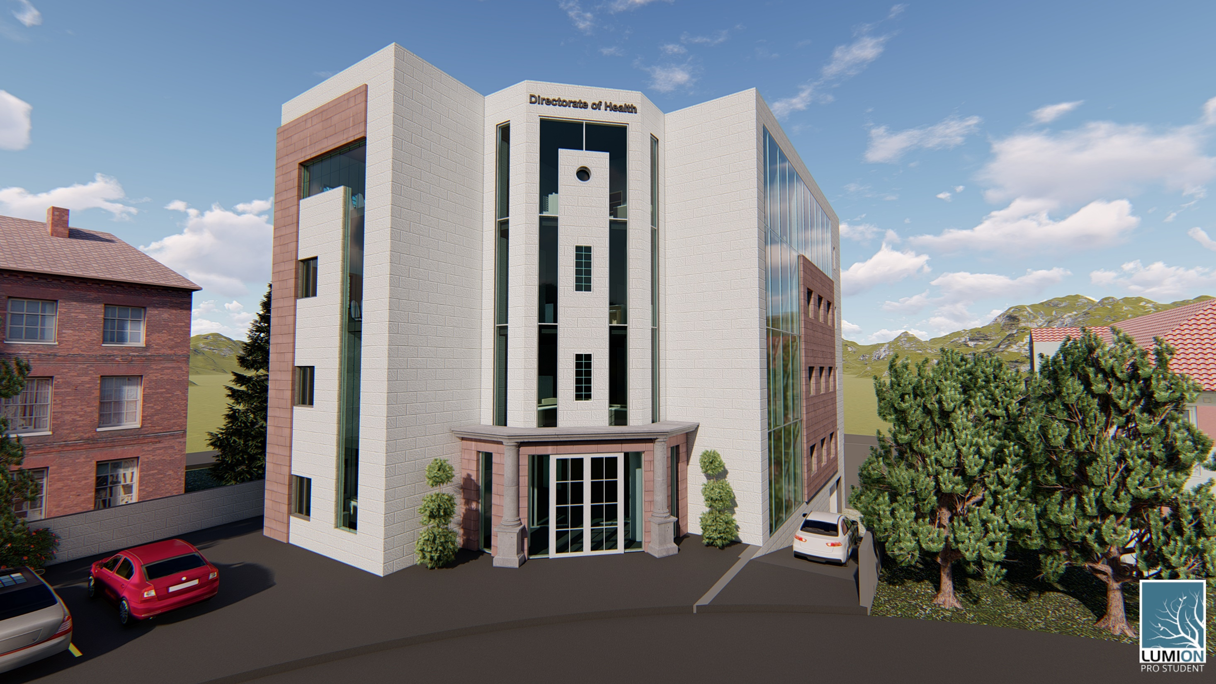
3D Model
3D model

Slide 7
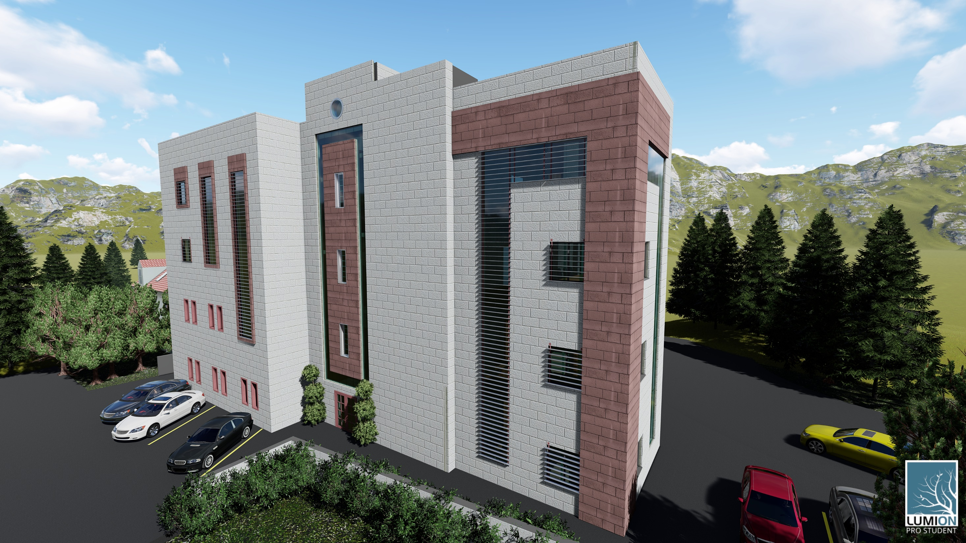
3D model

Slide 8
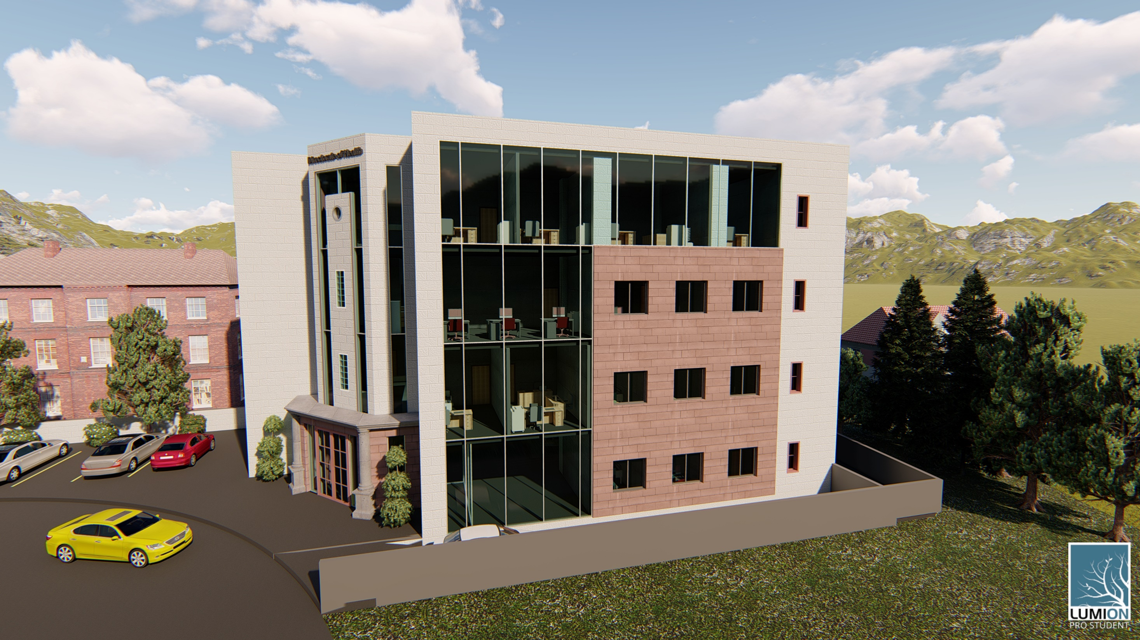
3D model

Slide 9
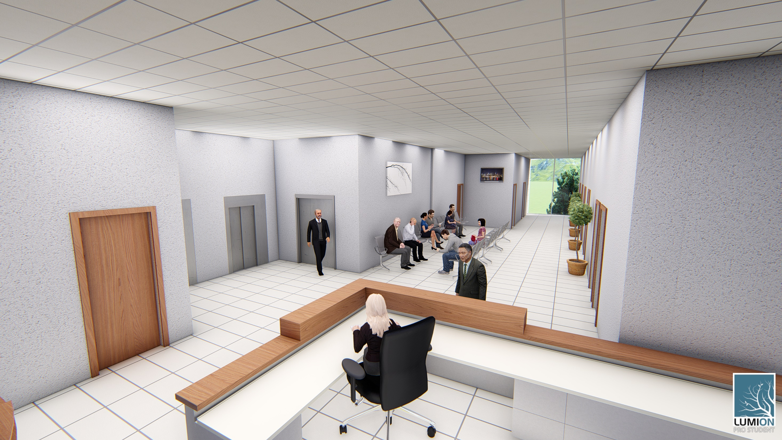

Slide 10
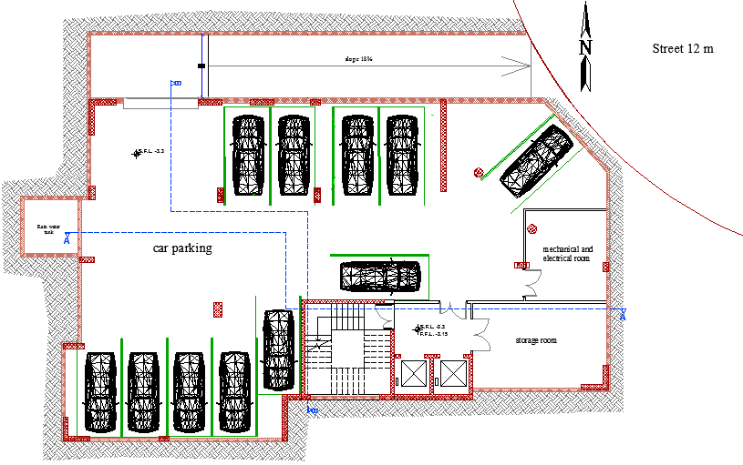
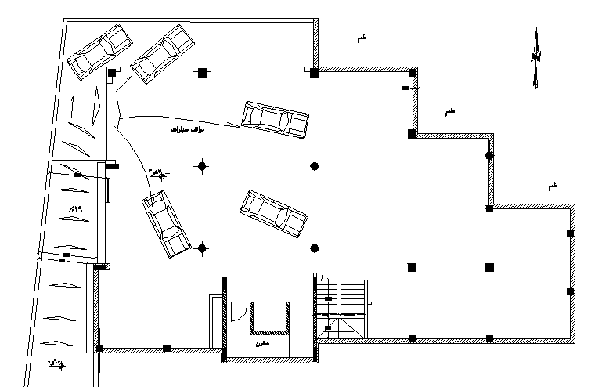
Parking Floor
Old Parking Floor area = 492 m²
Parking Floor area = 500 m²

Slide 11
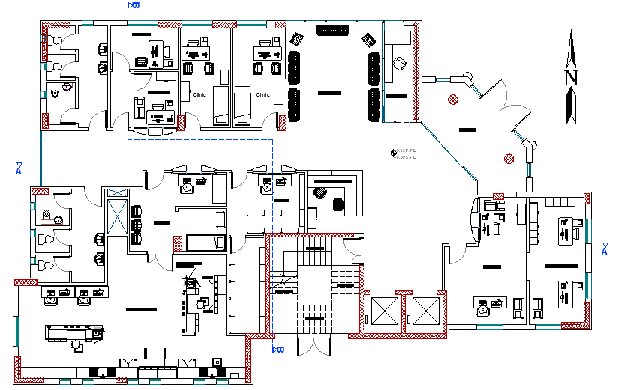
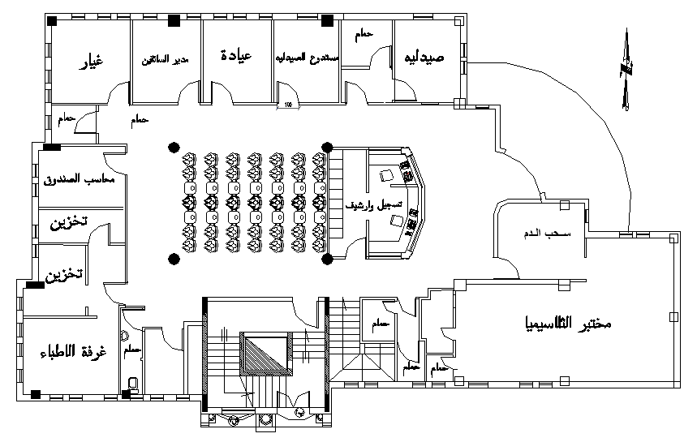
Ground Floor
Old Ground Floor area = 425 m²
Ground Floor area = 450 m²

Slide 12
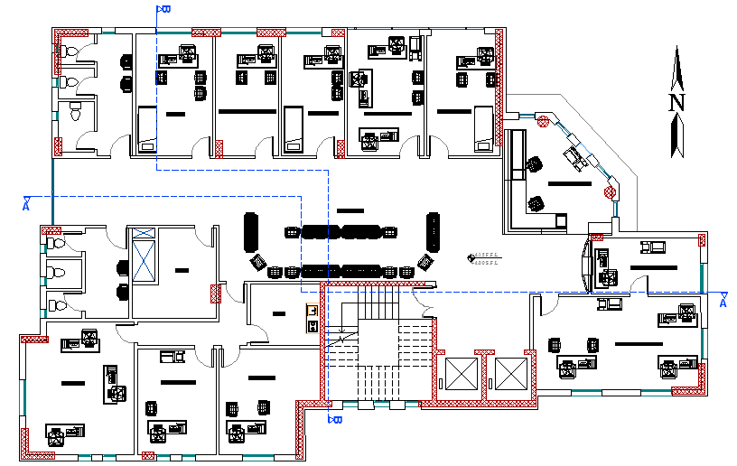
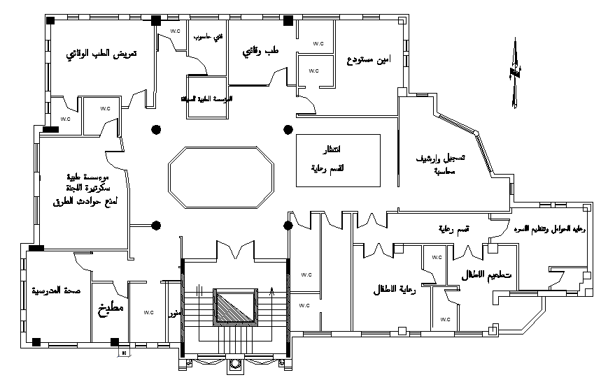
First Floor
Old First Floor area = 435 m²
First Floor area = 440 m²

Slide 13
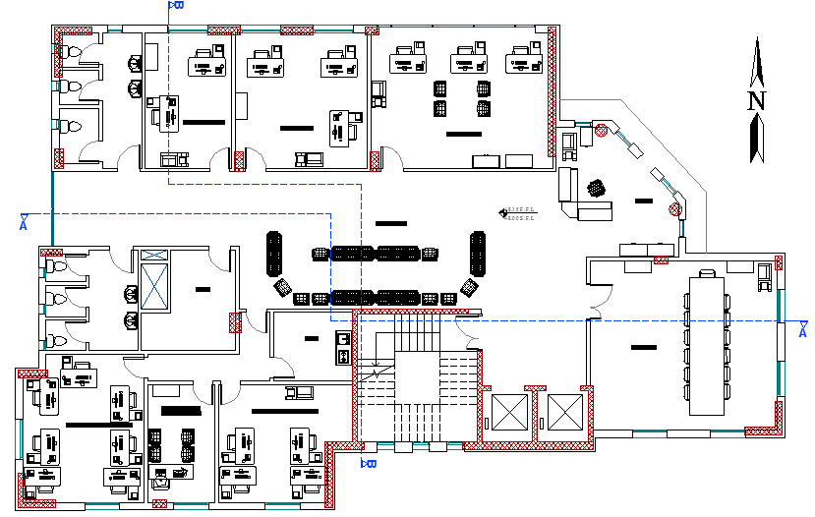
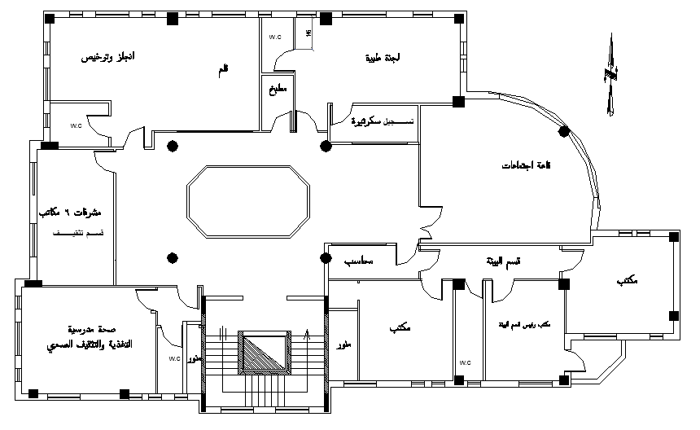
Second Floor
Old Second Floor area = 435 m²
Second Floor area = 440 m²

Slide 14
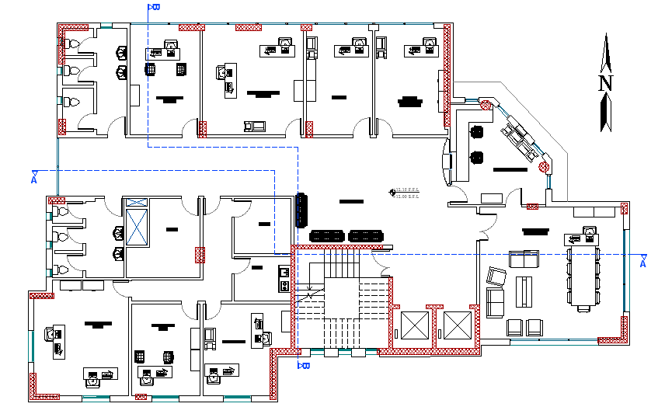
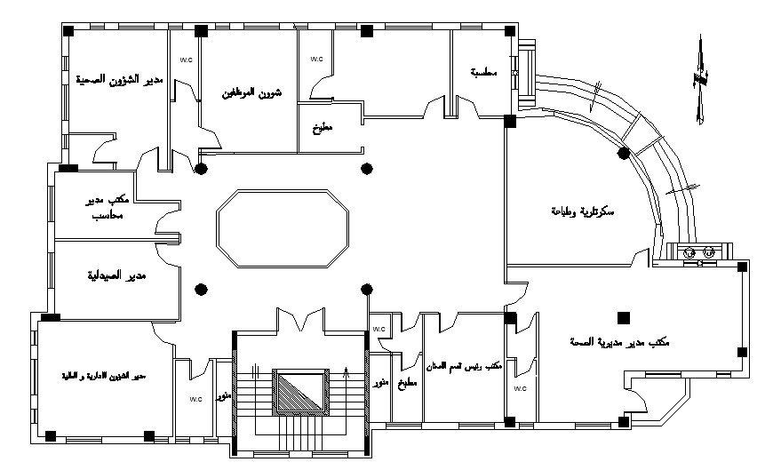
Third Floor
Old Third Floor area = 435 m²
Third Floor area = 440 m²

Slide 15
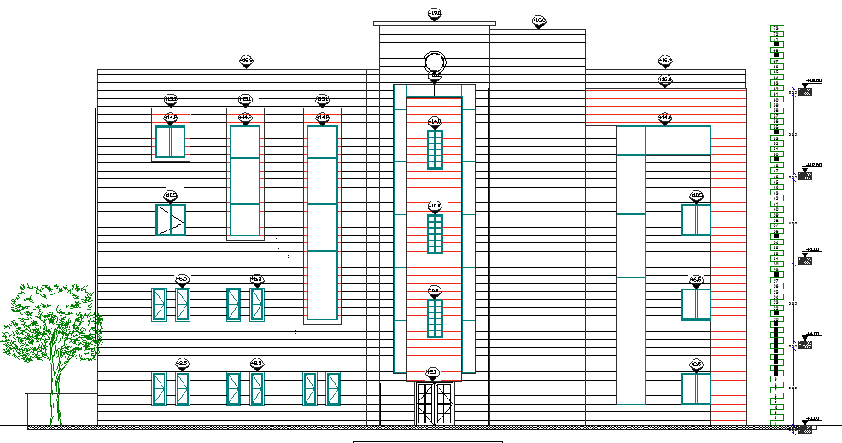
Southern Elevation

Slide 16
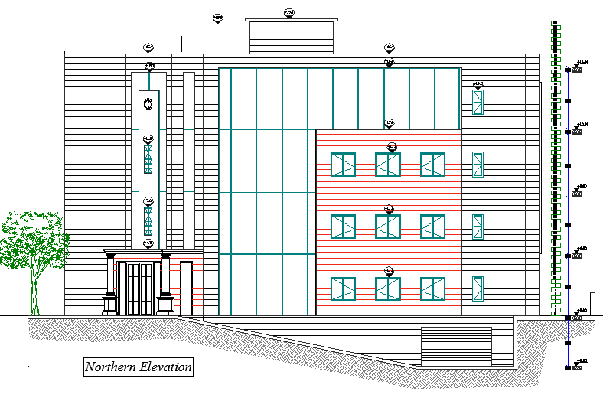
Northern Elevation

Slide 17
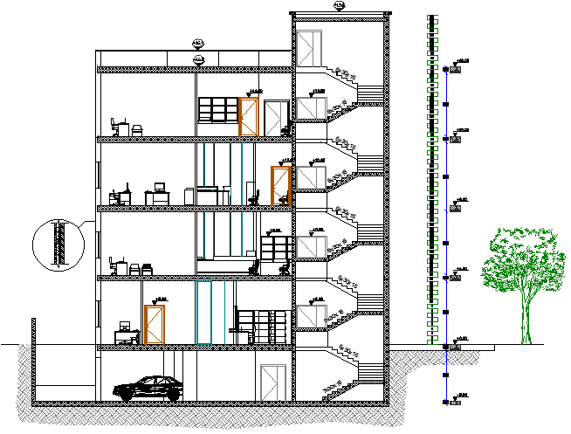
Section A-A

Slide 18
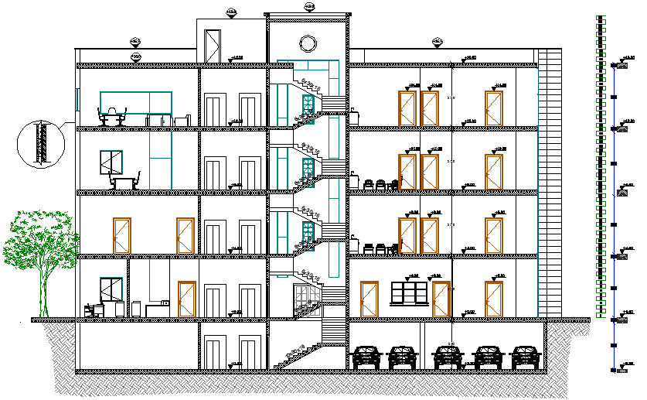
Section B-B

Slide 19
Environmental Design
Thermal Design
Old U value for building envelope
New U value for building envelope
Component | U-value (w/m²-k)
External Wall | 2.608
Partition Wall | 2.585
Floor | 2.106
Roof | 2.01
Windows (Clear glass 4 mm ) | 5.879
Component | U-value (w/m²-k)
External Wall | 0.492
Partition Wall | 2.585
Floor | 0.487
Roof | 0.498
Windows (Double glass, low e, 6 mm) | 1.493

Slide 20
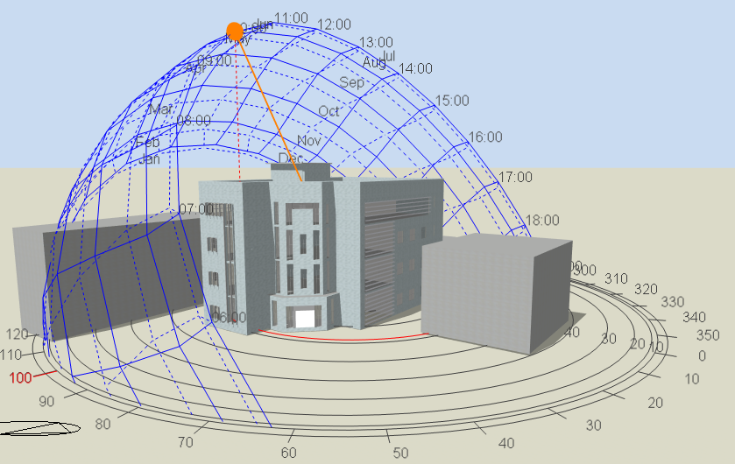
Shading
Design Builder program ( 3D Model )

Slide 21
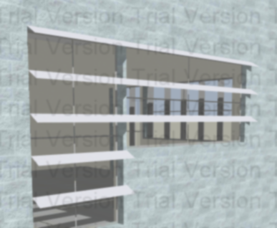
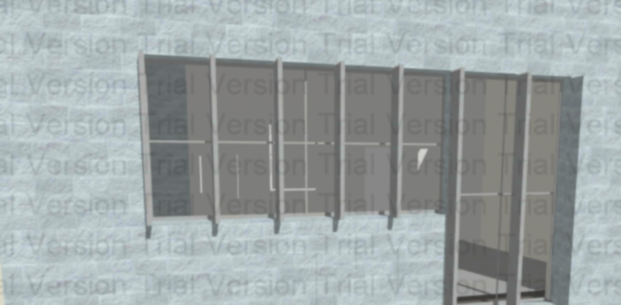
Shading
Southern windows (horizontal Louvers)
Eastern windows (vertical shutters)

Slide 22
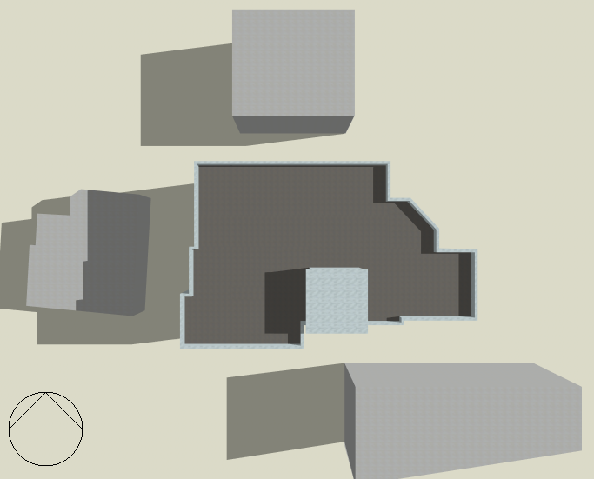
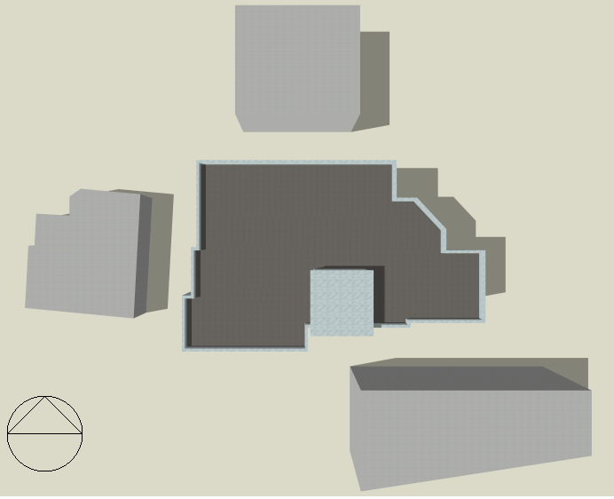
Shading
Summer day (sun path 21/1 at 8:00 am )
Summer day (sun path 21/1 at 2:00 pm )

Slide 23
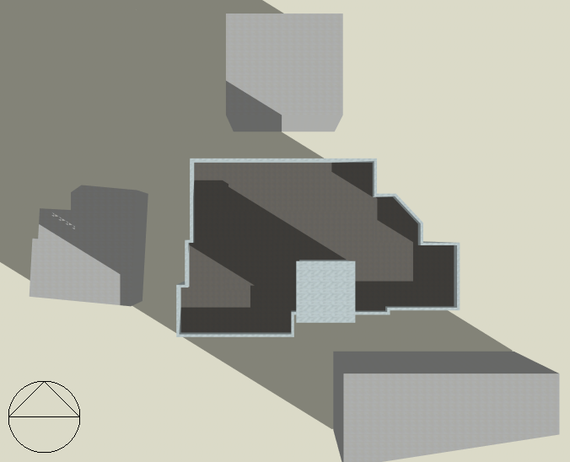
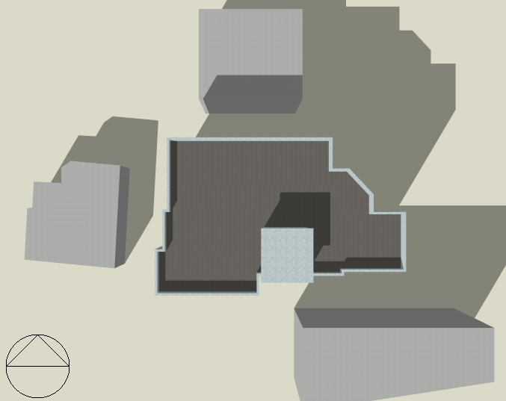
Shading
Winter day (sun path 21/1 at 8:00 am )
Winter day (sun path 21/1 at 2:00 pm )

Slide 24
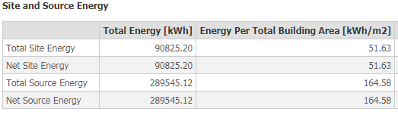
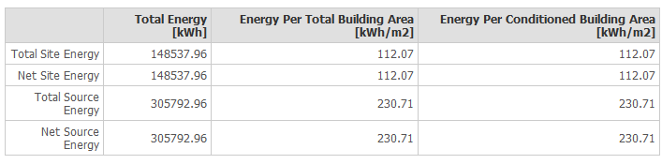
Thermal Design
Heating and cooling load
Cooling load 77.4 kw
Heating load 41.9 kw
Site and Source Energy
Old total site energy
New total site energy

Slide 25
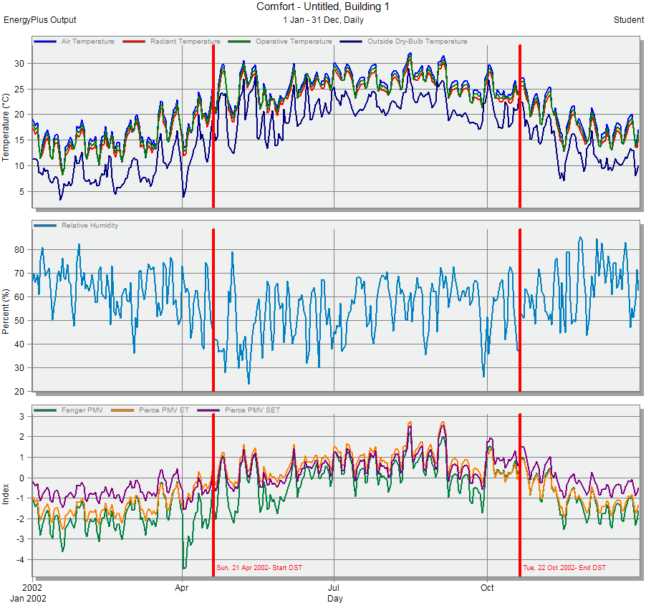
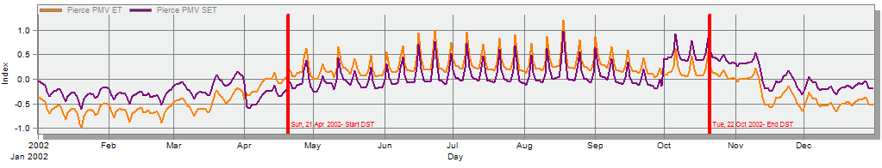
Comfort PMV-Set
Old PMV graph
New PMV graph

Slide 26
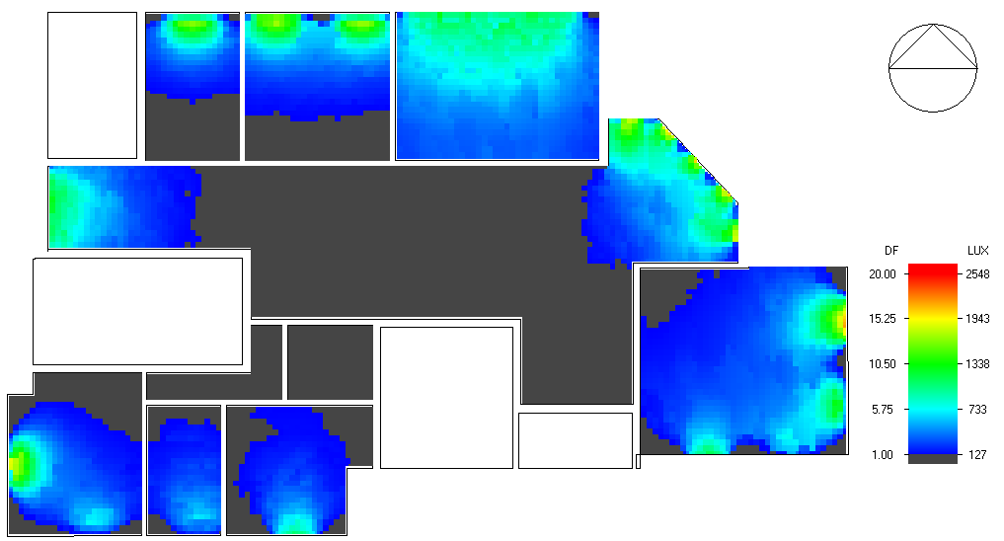
daylight analysis
D.F% | Space
3.64 | Meeting hall
5.23 | Reception
5.61 | Medical committee

Slide 27
Acoustics Design

Slide 28
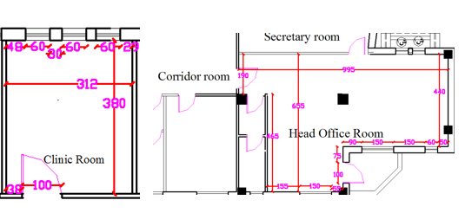
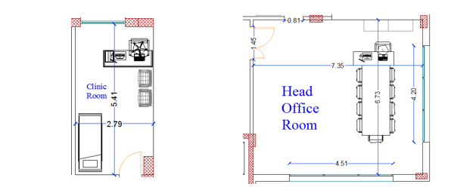
RT60 (Reverberation Time)
Old Spaces
New Spaces

Slide 29
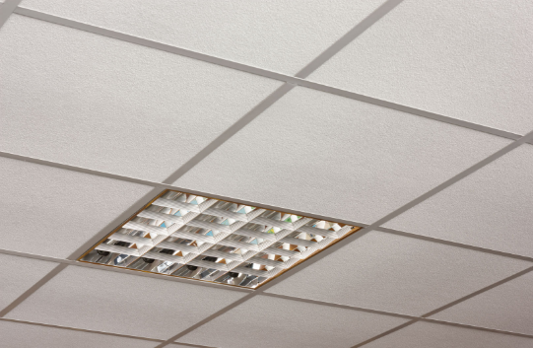
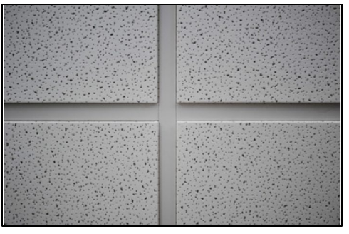
RT60 (Reverberation Time)
Element | Finish material | Absorption coefficient(α) at each frequency
 |  | 63_{HZ} | 125 _{HZ} | 250 _{HZ} | 500 _{HZ} | 1000 _{HZ} | 2000 _{HZ} | 4000 _{HZ} | 8000 _{HZ} | 16000_{HZ}
Ceiling | Acoustical Tile | 0.7 | 0.66 | 0.72 | 0.92 | 0.88 | 0.75 | 0.75 | 0.75 | 0.75

Slide 30
RT60 (Reverberation Time)
Old RT60 Values for Clinic Room
New RT60 Values for Clinic Room
At 50 % occupancy
FREQ. | RT₆₀
63Hz: | 1.1
125Hz: | 0.98
250Hz: | 0.91
500Hz: | 0.96
1kHz: | 0.57
2kHz: | 0.33
4kHz: | 0.17
8kHz: | 0.09
16kHz: | 0.1
At 50 % occupancy
FREQ. | RT (60)
63Hz: | 0.51
125Hz: | 0.52
250Hz: | 0.49
500Hz: | 0.45
1kHz: | 0.44
2kHz: | 0.44
4kHz: | 0.36
8kHz: | 0.23
16kHz: | 0.23
Recommended
Clinic room
(0.4-0.6)

Slide 31
RT60 (Reverberation Time)
Old RT60 Values for Manager Room
New RT60 Values for Manager Room
At 50 % occupancy
FREQ. | RT(60)
63Hz: | 0.98
125Hz: | 1.14
250Hz: | 1.16
500Hz: | 1.19
1kHz: | 1.16
2kHz: | 0.72
4kHz: | 0.43
8kHz: | 0.23
16kHz: | 0.26
At 50 % occupancy
FREQ. | RT (60)
63Hz: | 0.63
125Hz: | 0.66
250Hz: | 0.69
500Hz: | 0.72
1kHz: | 0.75
2kHz: | 0.81
4kHz: | 0.72
8kHz: | 0.5
16kHz: | 0.5
Manager office
room
(0.7-1.3)

Slide 32
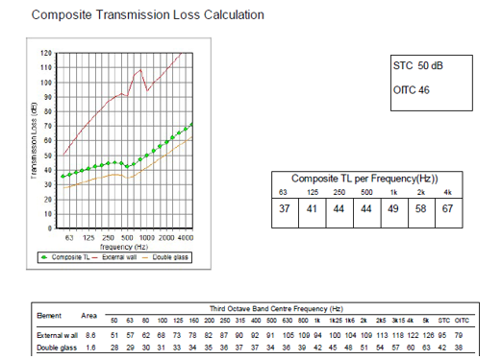
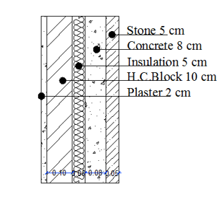
STC and IIC
TL = 50 dB
For External Wall of Clinic Room
External Wall

Slide 33
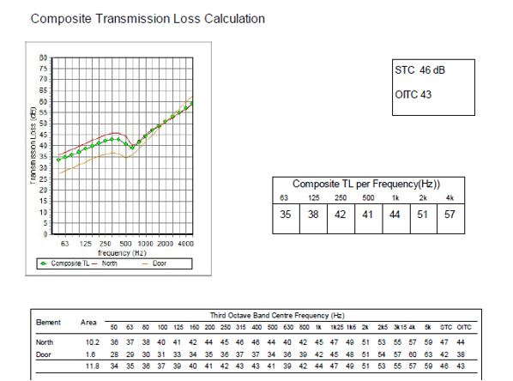
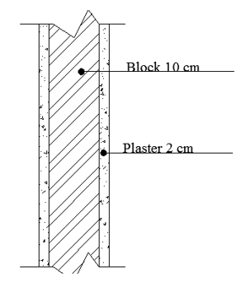
STC and IIC
Recommended Value 45 dB
TL = 46 dB
For Manger room adjacent to secretary office
Internal Wall

Slide 34
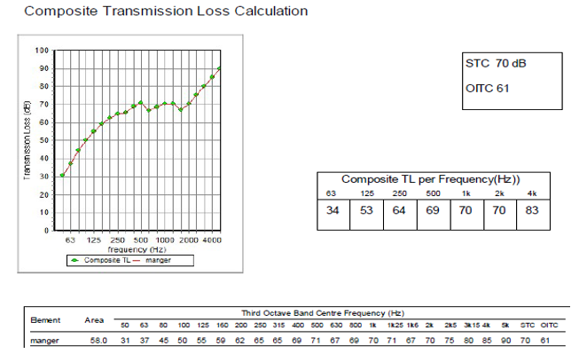
IIC For Ceiling
IIC = 70 dB

Slide 35
Structural Design

Slide 36
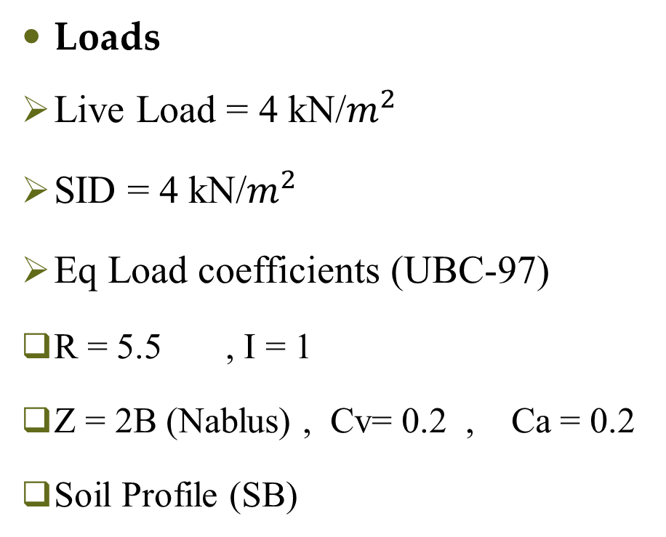
Codes and Loads
Structural design
Loads
Live Load = 4 kN/$m^{2}$
SID = 4 kN/$m^{2}$
Eq Load coefficients (UBC-97)
R = 5.5 , I = 1
Z = 2B (Nablus) , Cv= 0.2 , Ca = 0.2
Soil Profile (SB)
Codes
UBC-97 for Earthquake design
ACI 318-14 for RC structure design

Slide 37
Structural system
Structural design
Materials
Concrete B300 , B350
Steel fy = 420 Mpa
Final Design Sections
Slab thickness 35 cm
Columns dimensions ( 30*55 , 45*80 , 50 Circular ) cm
Beams dimensions ( 30 * 70 & 30 * 50 ) cm
Structural System
One Way Ribbed Slab
With Drop Beams
Walls Thickness 30 cm

Slide 38
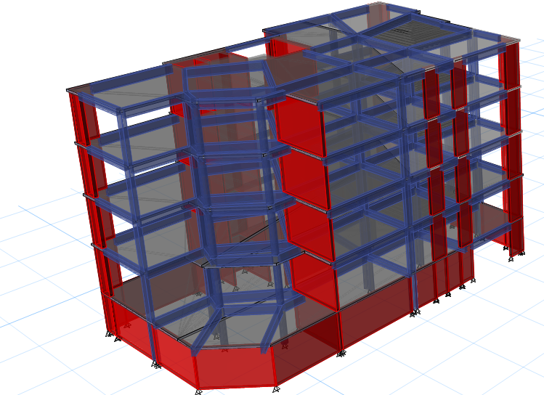
3D-Modeling
Structural design

Slide 39
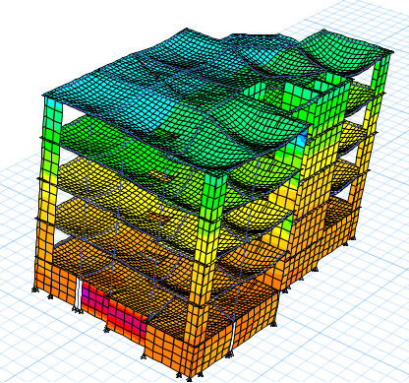
Model Checks
Structural design
Compatibility Check

Slide 40
Model Checks
Structural design
Equilibrium Check
Done for Dead, SID and Live load within difference less than 5 %.
Internal Forces Check
Done for 3 samples of slab strip, beams and columns within difference less than 10%

Slide 41
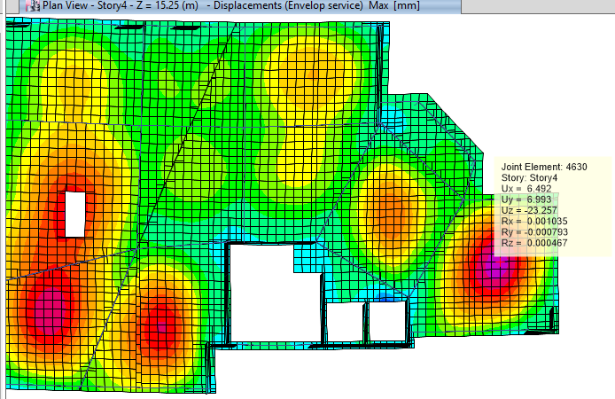
Model Checks
Structural design
Deflection Check
Limit = L/240
= 6.5/ 240 = 27 mm

Slide 42
Model Checks
Structural design
Period Check
Period from ETABS = 0.62 sec.
Period from hand calculation= 0.44
T from ETABS < 1.4 from hand calc.
0.62 sec.< 0.63 sec.

Slide 43
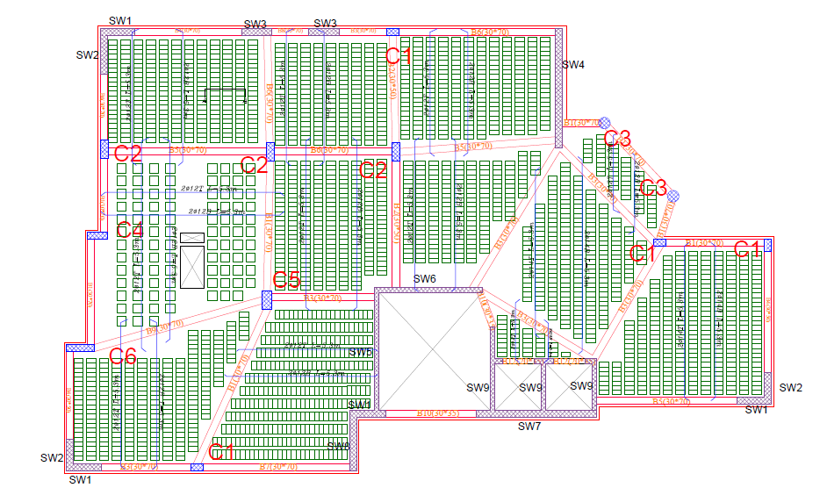
Slab Reinforcement
Structural design

Slide 44
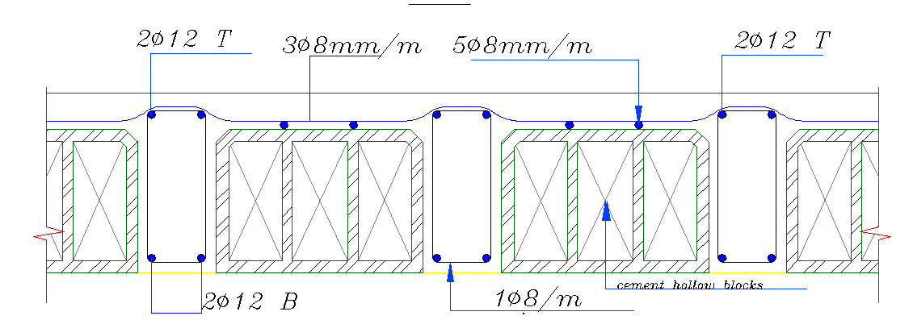
Slab Reinforcement
Structural design

Slide 45
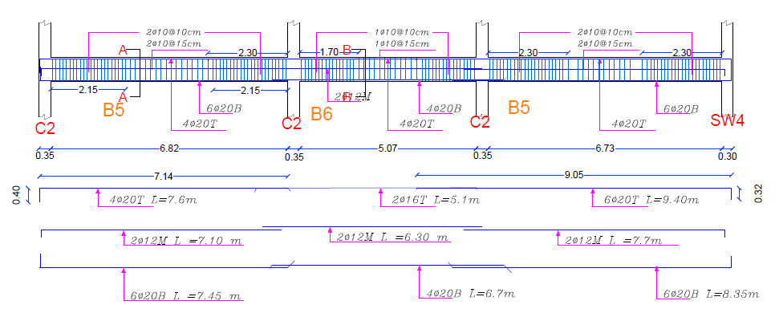
Structural design
Beams Reinforcement

Slide 46
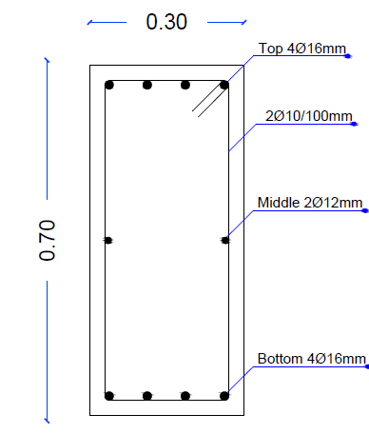





Structural design
Beams Reinforcement

Slide 47



Structural design
Columns Reinforcement

Slide 48



Structural design
Columns Reinforcement

Slide 49


Footing Reinforcement
Structural design

Slide 50


Structural design
Footing Reinforcement

Slide 51



Structural design
Shear Wall Reinforcement

Slide 52


Structural design
Basement Wall Reinforcement

Slide 53


Structural design
Stairs Reinforcement

Slide 54
Structural design
Past and New Design
Past
New Design
Not Designed For Seismic Load
High Eccentricity
Hidden Beams
Columns Prevent effective
using Parking
Earth quick Design Based
Minimum Eccentricity
Drop Beams
Structural Elements compatible with architectural purposes

Slide 55
Electrical Design

Slide 56

Ground Floor socket plan

Slide 57

Ground Floor Lighting Plan

Slide 58


Luminaires Layout
Old Main Luminaire
50 lm/w
100 lm/w
New Main Luminaire

Slide 59


3D Rendering model (Dialux)
Old Second Floor
New Second Floor

Slide 60


3D Rendering View for Selected Rooms
Health education office
Conference Room

Slide 61



Health Education Office
Required illuminance
500 lux
Required uniformity
(>0.60)
Average Illuminance
535 Lux
UGR = 17.7

Slide 62
Power Consumption Estimation
Old Electricity Consumption Estimation
New Electricity Consumption Estimation
Type | Consumption (KW/day) | Cost (Nis/day) | Cost (Nis/month)
Lighting | 117.67 | 84.72 | 1677
Power | 171 | 132.12 | 2462
Total | 288.67 | 216.84 | 4139
Type | Consumption (KW/day) | Cost (Nis/day) | Cost (Nis/month)
Lighting | 77.58 | 55.85 | 1117
Power | 222.96 | 160.53 | 3210
Total | 300.54 | 225.4 | 4327
Lighting
Decreased by 34 %
High efficacy luminaire
Increased by 30 %
Power
VRF system instead of Split Units for specific rooms

Slide 63
Mechanical Design

Slide 64



Water demand = 28 $m^{3}$/day
Water Supply System

Slide 65

Water Supply System
Old number of tanks = 13
New number of tanks = 16

Slide 66


Drainage system

Slide 67

Drainage system

Slide 68

Rain Water Drainage
Rain Water Tank size = 36 m3

Slide 69

(HVAC (System
VRF system used
From Design builder
Total Cooling load 77.4 kw
Total Heating load 41.9 kw

Slide 70

(HVAC (System
VRF system
Outdoor unit Selected From LG company with
Cooling capacity 80 kw
Heating capacity 87 kw
(MULTI V 5) MODEL NO: ARUM264BTE5

Slide 71


(HVAC (System
VRF system
Fan coil From LG company depending
on volumetric flow rate for each space.

Slide 72

Ground floor HVAC system layout

Slide 73


Reflective Ceiling Plan

Slide 74
Firefighting and Safety Design

Slide 75



Emergency Fire Protection System

Slide 76


Emergency Fire Protection System
Old Number of Firefighting Tanks = 2
New Number of Firefighting Tanks = 4

Slide 77


Emergency Egress System
Escaping Plan for Ground Floor
Escaping Plan for First Floor

Slide 78
Quantity Surveying and Cost Estimation

Slide 79
Cost Estimation
Directorate of Health | Total Direct Cost (Nis)
Structure work | 2,297,256
Mechanical Work | 240,500
Finishing Work | 1,158,506
Electrical Work | 294,801
Total direct project cost | 3,991,063
Unit Direct Cost = 3991063/2235 = 1786 Nis /m²
Unit Direct Cost = 352 JD /m²

Slide 80
Thank You

