Slide 1

Structural design of al-manarah center in ramallah city
An-Najah National University
Faculty of Engineering
Civil Engineering Department
Prepared by : Ghadeer G. Mukhemar
Nada A. Jaradat
Shireen A. Ktaifan
Under supervision of: Ibrahim Mohammad

Slide 2

1. Introduction.
2. Preliminary design.
3. Three dimensional analysis and design of structural elements using ETABS.

Slide 3
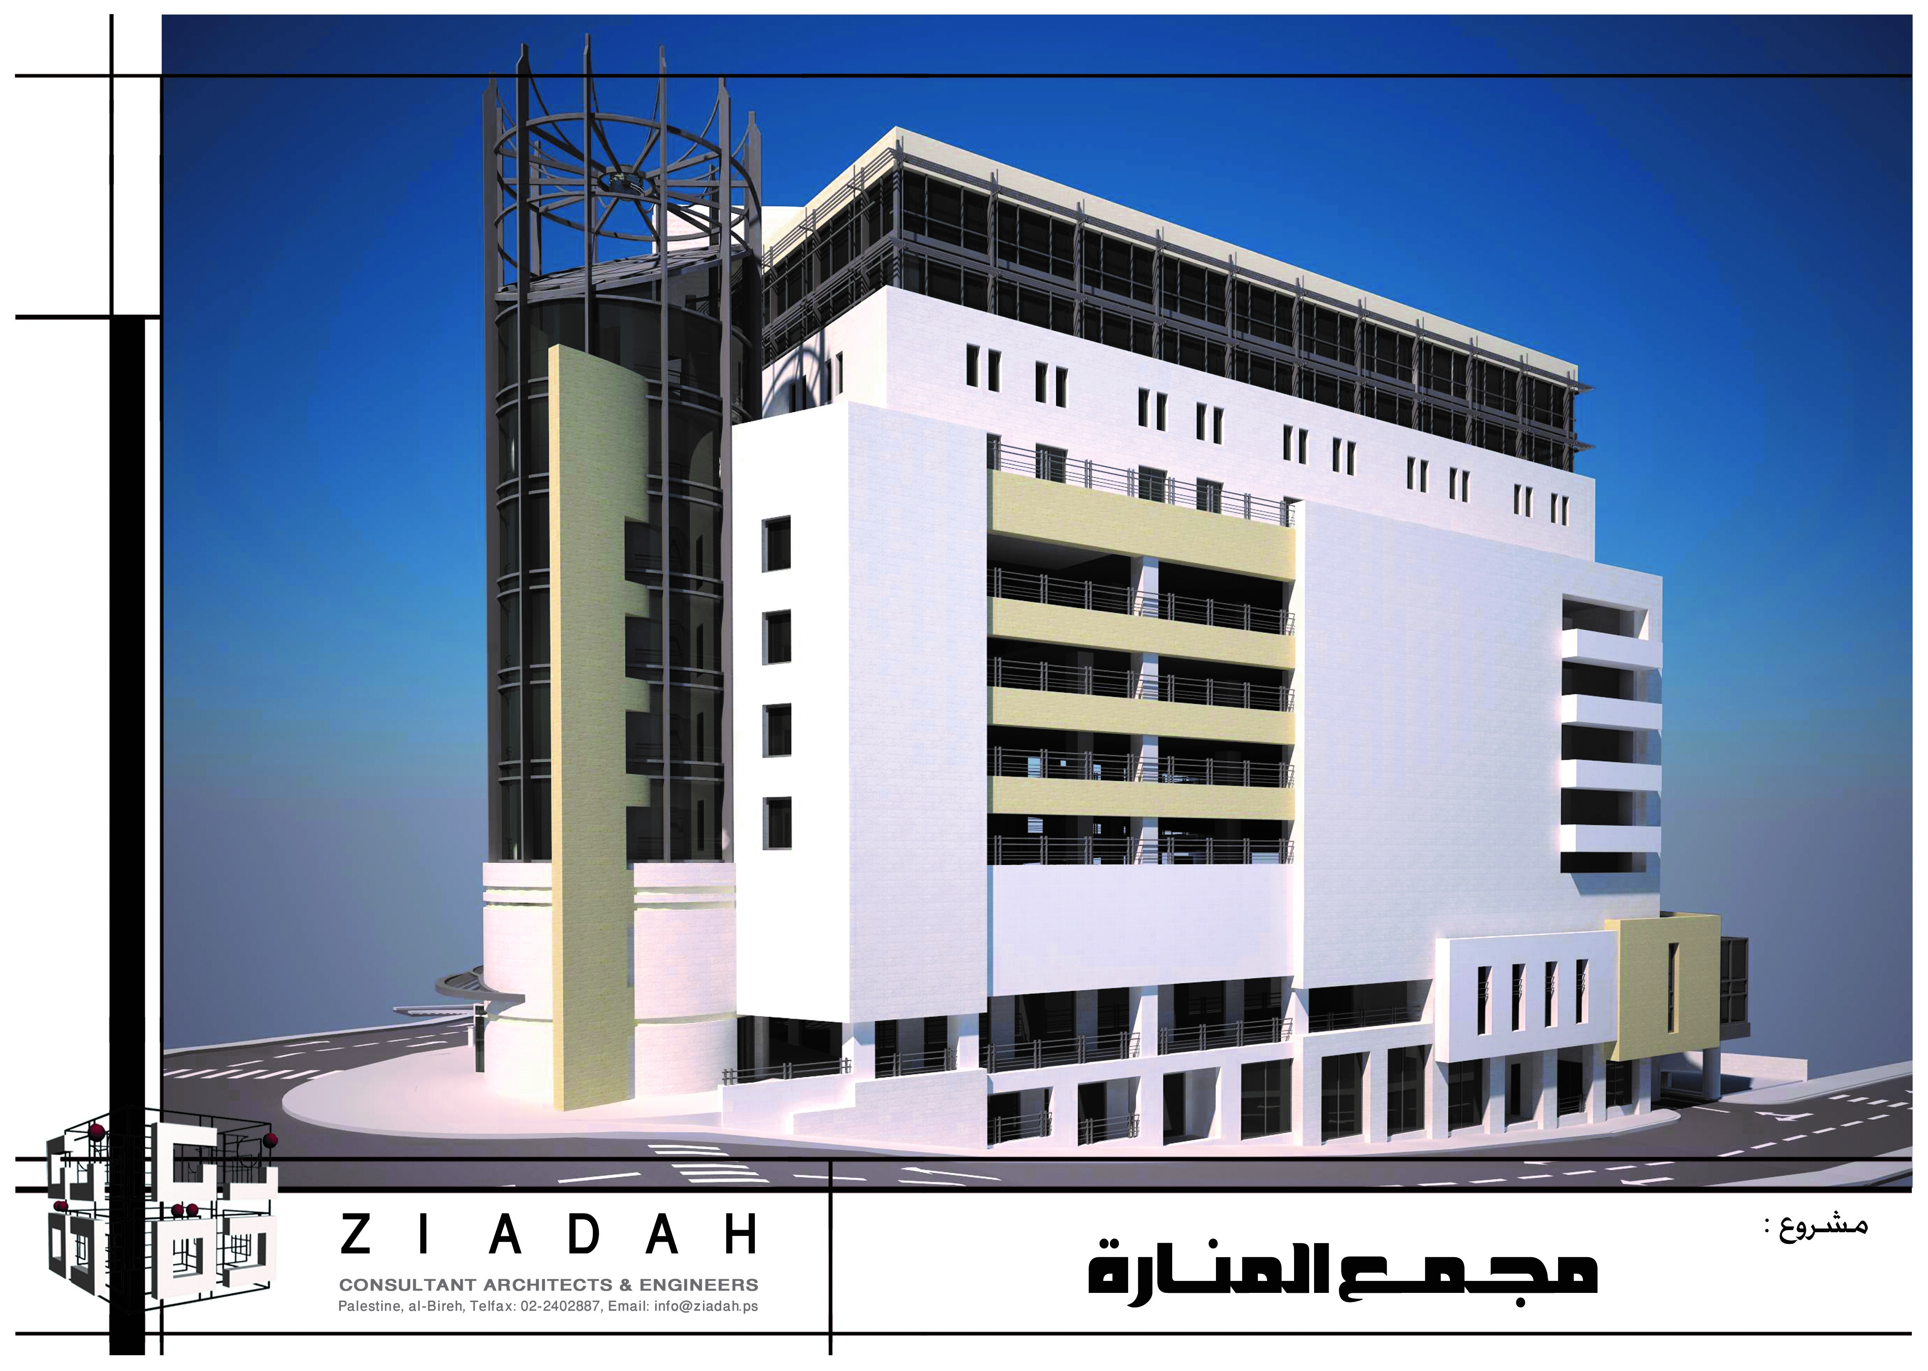
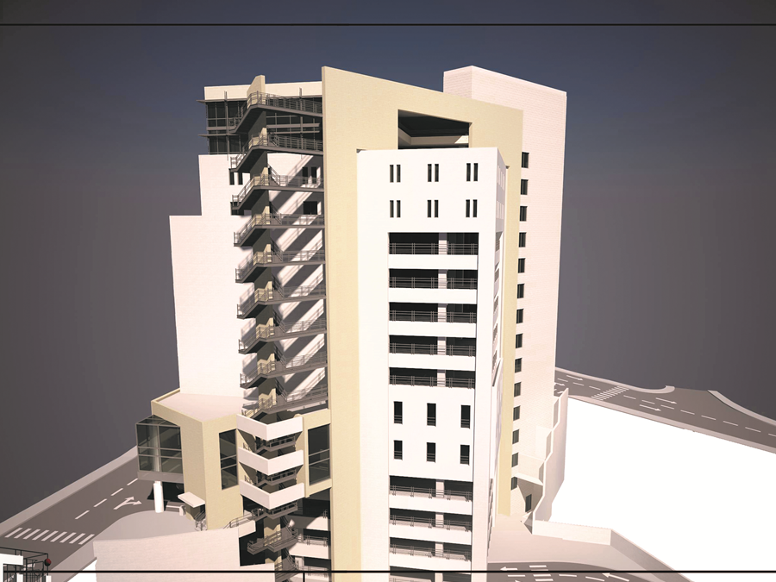
Introduction
3D Architectural Model
Figure 1.1 : 3D architectural model

Slide 4
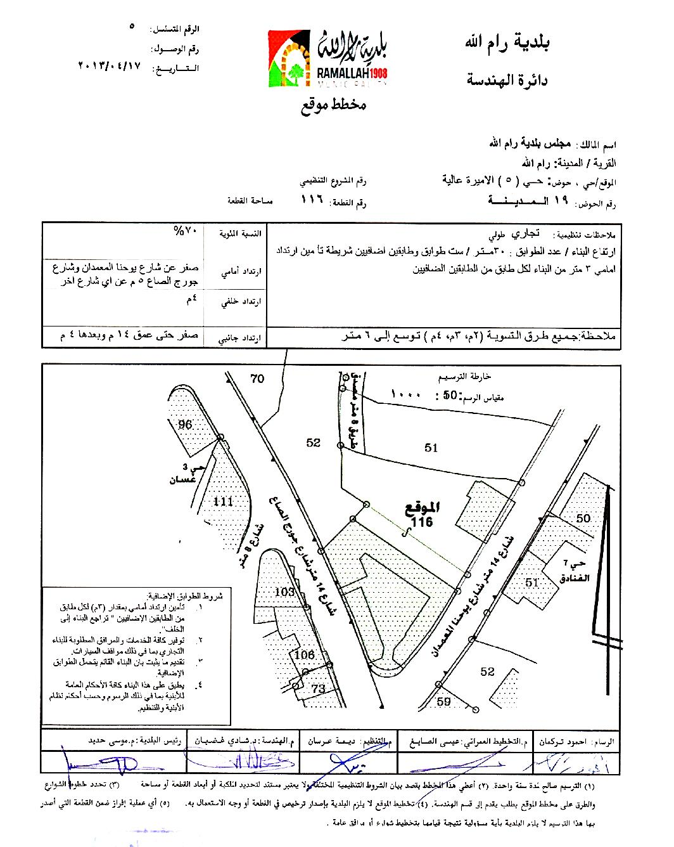
Introduction
Project Location
Figure 1.2: Project location

Slide 5

Introduction
General description
This project consists of fifteen floors of an approximate area of 25,578${ m}^{2}$, including five basements, a ground floor, eight top floors and a roof with a total height of 52.0m. The building has three main gates in the fifth basement, first basement and in the ground floor.

Slide 6
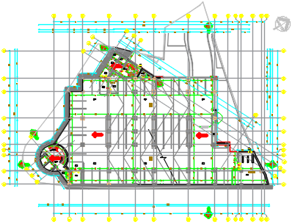
Introduction
AutoCAD architectural plans
Figure 1.3: Fourth Basement architectural plan

Slide 7
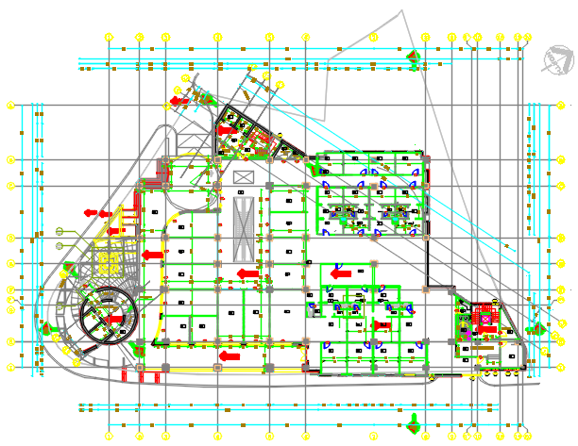
AutoCAD architectural plans
Introduction
Figure 1.4: Ground floor architectural plan

Slide 8
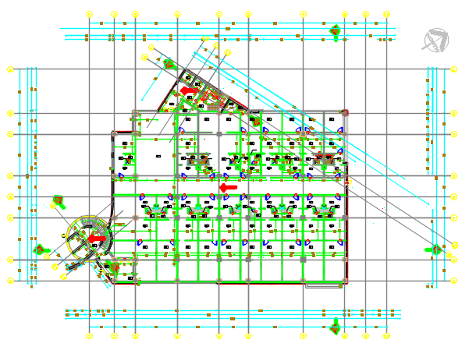
Introduction
AutoCAD architectural plans
Figure 1.5: Fifth floor architectural plan
The following table shows floors usage, areas and center to center heights.

Slide 9
Introduction
Table 1.1: Floors Description
Floor Name | Floor Usage | Floor Area(m²) | Floor Height C/C(m)
Fifth Basement | Parking and police office | 1886 | 3.12
Forth Basement | Parking and police office | 1875 | 3.12
Third Basement | Parking and police office | 1875 | 3.12
Second Basement | Parking and police office | 1882 | 3.12
First Basement | Parking and police office | 1986 | 3.9
Ground Floor | Shops, offices and police office | 1895 | 3.76
First Floor | Shops, offices and police office | 1939 | 3.52
Second Floor | Offices and police office | 1908 | 3.64
Third Floor | Offices | 1732 | 3.12
Fourth Floor | Offices | 1491 | 3.12
Fifth Floor | Offices | 1732 | 4.68
Sixth Floor | Offices | 1482 | 3.38
Seventh Floor | Offices | 1419 | 3.38
Eighth Floor | Offices | 1193 | 3.38
Roof | Offices | 1193 | 3.64
Staircase floor |  | 90 | -
Total |  | 25,578 | 48.62

Slide 10
Introduction
Codes and standards
American Concrete Institute (ACI318M-14): Building code requirements for structural concrete and commentary.
American Society of Civil Engineers (ASCE7-10).
American Society of Civil Engineers (ASCE41-13).
International Building Code (IBC2012).
Jordanian Code_2006.
Unified Facilities Criteria (UFC3-301-1).
Israeli Standard SI413.

Slide 11
Introduction
Materials
Structural materials
Concrete.
Concrete B400 for columns, shear walls and foundation.
concrete B350 for slabs and beams.
Reinforcing steel.
Other materials (non-structural materials).

Slide 12
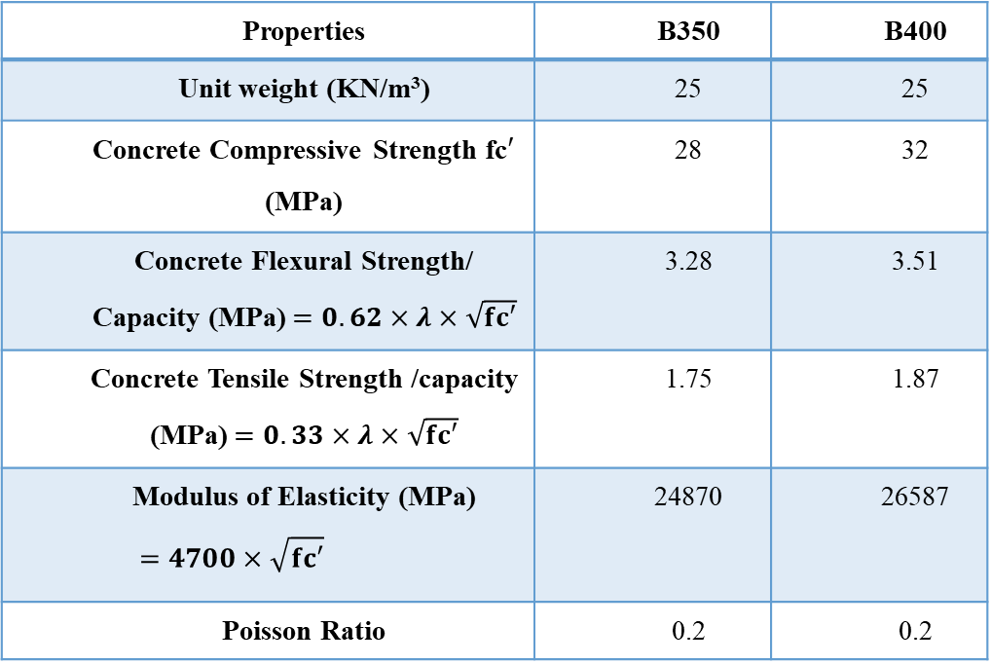
Introduction
Concrete
Table 1.2: Concrete proprieties
Properties | B350 | B400
Unit weight (KN/m³) | 25 | 25
Concrete Compressive Strength fc$′$ (MPa) | 28 | 32
Concrete Flexural Strength/ Capacity (MPa) $=0.62×λ×\sqrt{fc′}$ | 3.28 | 3.51
Concrete Tensile Strength /capacity (MPa) $=0.33×λ×\sqrt{fc′}$ | 1.75 | 1.87
Modulus of Elasticity (MPa) $$=4700×\sqrt{fc′}$$ | 24870 | 26587
Poisson Ratio | 0.2 | 0.2

Slide 13
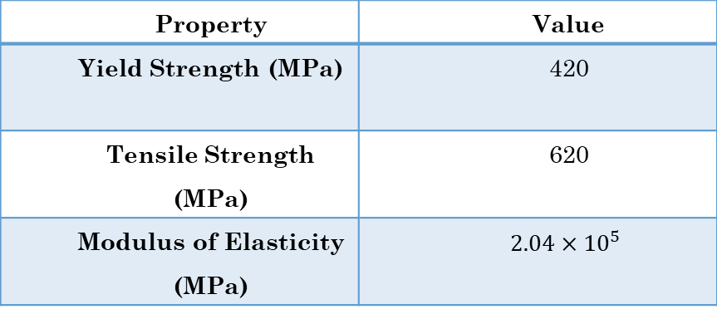
Introduction
Reinforcing steel
Table 1.3 steel properties:
Property | Value
Yield Strength (MPa) | 420
Tensile Strength (MPa) | 620
Modulus of Elasticity (MPa) | $$2.04×{10}^{5}$$

Slide 14
Introduction
Non-structural materials
Table 1.4: Unit weight for nonstructural material
Nonstructural material | Unit weight (KN/m³)
Tiles | 27
Mortar and Plastering | 23
Gravel | 18
Block | 12
Masonry Stone | 27
Polystyrene (insulation) | 0.3

Slide 15
Introduction
Loads
Gravity loads (dead, super imposed dead, live and snow loads).
Lateral loads (earthquake, wind and soil loads).

Slide 16
Introduction
Gravity loads
Dead load
The dead load includes the self-weight of the structural elements.
Superimposed dead load
1.Weight of tiles
2.Weight of mortar
3.Weight of gravel
4.Weight of plastering
5.Weight of false ceiling
6.Weight of partitions

Slide 17
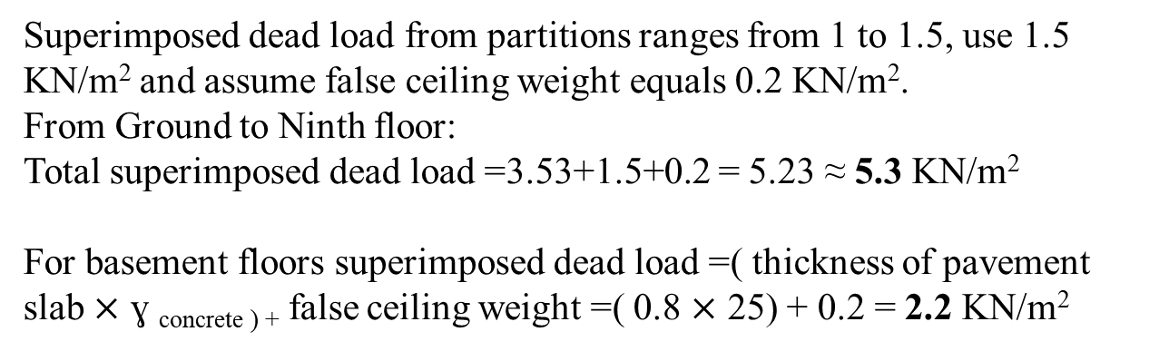
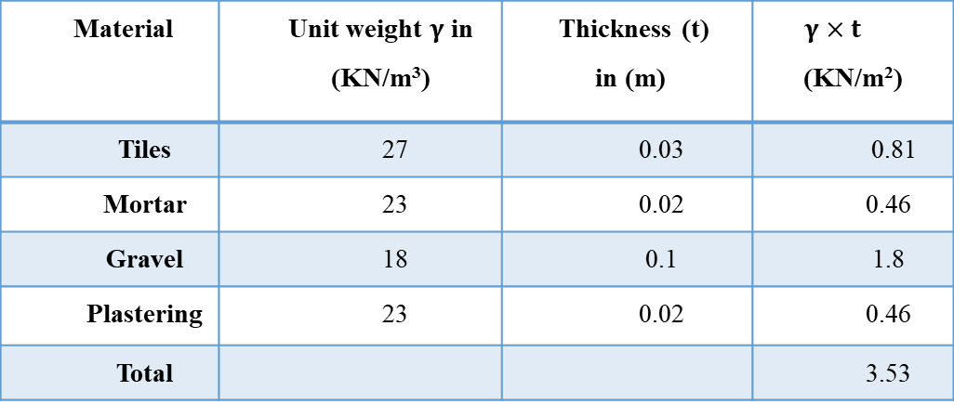
Introduction
Gravity loads
Table 1.5: Superimposed dead load calculations
Material | Unit weight $γ$in (KN/m³) | Thickness (t) in (m) | $$γ×t$$ (KN/m²)
Tiles | 27 | 0.03 | 0.81
Mortar | 23 | 0.02 | 0.46
Gravel | 18 | 0.1 | 1.8
Plastering | 23 | 0.02 | 0.46
Total |  |  | 3.53
Superimposed dead load from partitions ranges from 1 to 1.5, use 1.5 KN/m² and assume false ceiling weight equals 0.2 KN/m².
From Ground to Ninth floor:
Total superimposed dead load =3.53+1.5+0.2 = 5.23 ≈ 5.3 KN/m²
For basement floors superimposed dead load =( thickness of pavement slab $×$ ɣ _{concrete ) +} false ceiling weight =( 0.8 $×$ 25) + 0.2 = 2.2 KN/m²

Slide 18
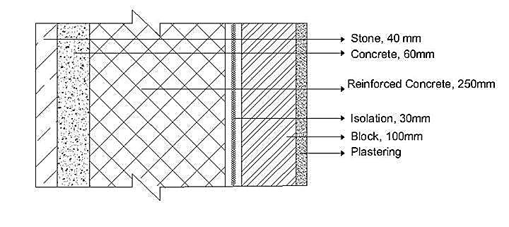

Introduction
Gravity loads
Superimposed dead load on perimeter walls
The weight of perimeter walls will differ for each floor based on the thickness, height and materials used and it will be presented as line load on the perimeter of the building.
Wall weight =(weight of stone +weight of mortar +weight of RC+ weight of insulation +weight of block + weight of plastering )$×$ floor height
Figure 1.6: Section in exterior wall

Slide 19
Introduction
Gravity loads
Table 1.6: Weight of perimeter walls
Name of Floors | Weight of Perimeter Walls (KN/m) | Weight of perimeter walls (KN/m²) | Weight of perimeter walls – weight of RC (KN/m²)
Fifth to Second Basements | 32.38 | 10.379 | 4.129
First Basement | 40.478 | 10.379 | 4.129
Ground Floor | 39.025 | 10.379 | 4.129
First Floor | 36.53 | 10.379 | 4.129
Second Floor | 37.78 | 10.379 | 4.129
Third and Fourth floors | 32.38 | 10.379 | 4.129
Fifth Floor | 48.57 | 10.379 | 4.129
Sixth and Seventh | 35.08 | 10.379 | 4.129

Slide 20
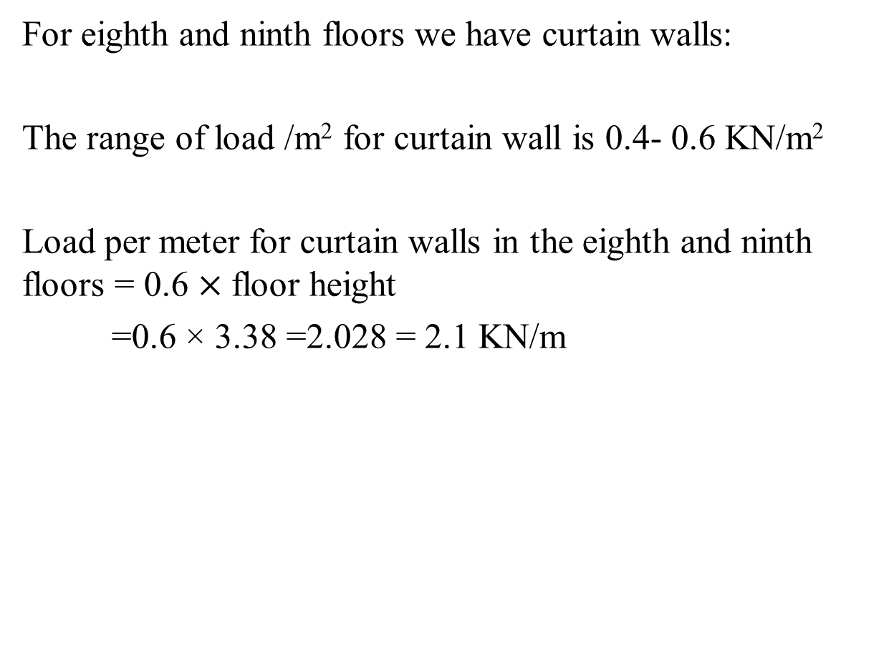
Introduction
Gravity loads
For eighth and ninth floors we have curtain walls:
The range of load /m² for curtain wall is 0.4- 0.6 KN/m²
Load per meter for curtain walls in the eighth and ninth floors = 0.6 $×$floor height
=0.6 × 3.38 =2.028 = 2.1 KN/m

Slide 21
Introduction
Gravity loads
Live load
In this project live load will differ according to the floor usage, the following live load values from ASCE7-10 are shown below
Table 1.7: Live Load values
Floor usage | Live load (KN/m²)
Parking | 3
Shops | 5
Offices | 2.4
Balconies | 4.8

Slide 22
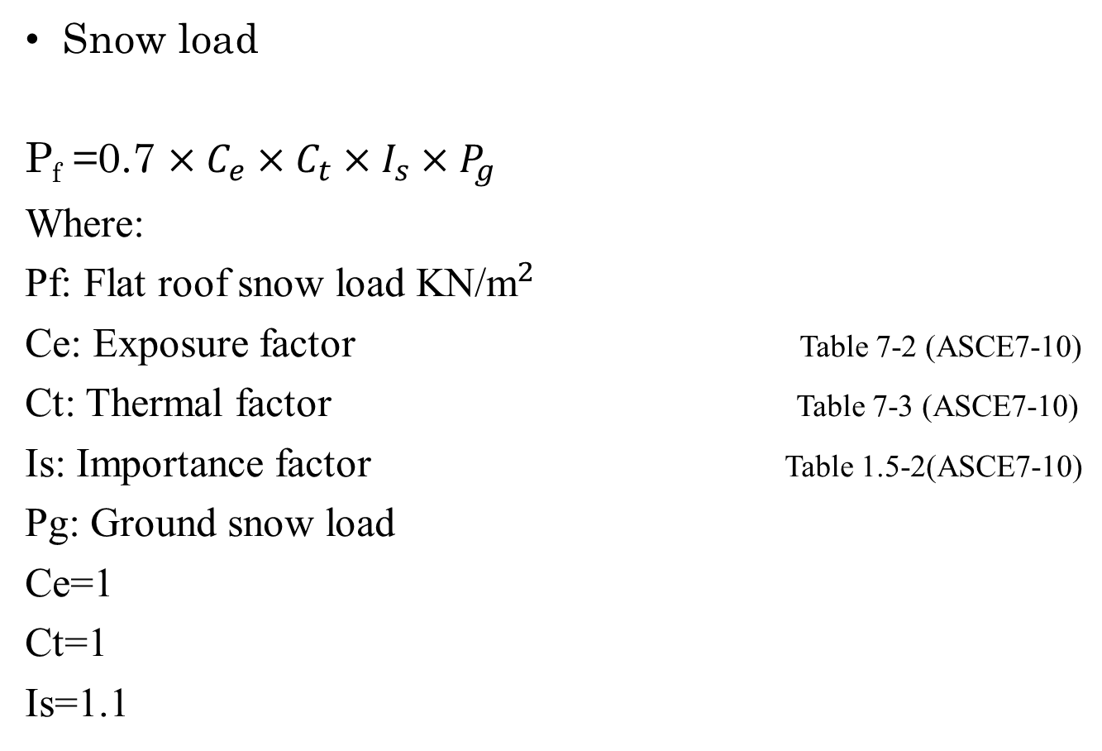
Introduction
Gravity loads
Snow load
P_{f} =0.7 $×C_{e}×C_{t}×I_{s}×P_{g}$
Where:
Pf: Flat roof snow load KN/${\text{m}}^{2}$
Ce: Exposure factor Table 7-2 (ASCE7-10)
Ct: Thermal factor Table 7-3 (ASCE7-10)
Is: Importance factor Table 1.5-2(ASCE7-10)
Pg: Ground snow load
Ce=1
Ct=1
Is=1.1

Slide 23
Introduction
Gravity loads
In snow load:
The value of Pg is taken from the Jordanian Code, it depends on the height of the building above mean sea level which equals 866.64 in our case.
Table 1.8: Pg value for snow load calculations (Jordanian Code Table5-3)
Structure height above mean sea level h in (m) | Snow load (KN/m²⁾
h<250 | 0
250<h<500 | (h-250)/800
500<h<1500 | (h-400)/320

Slide 24
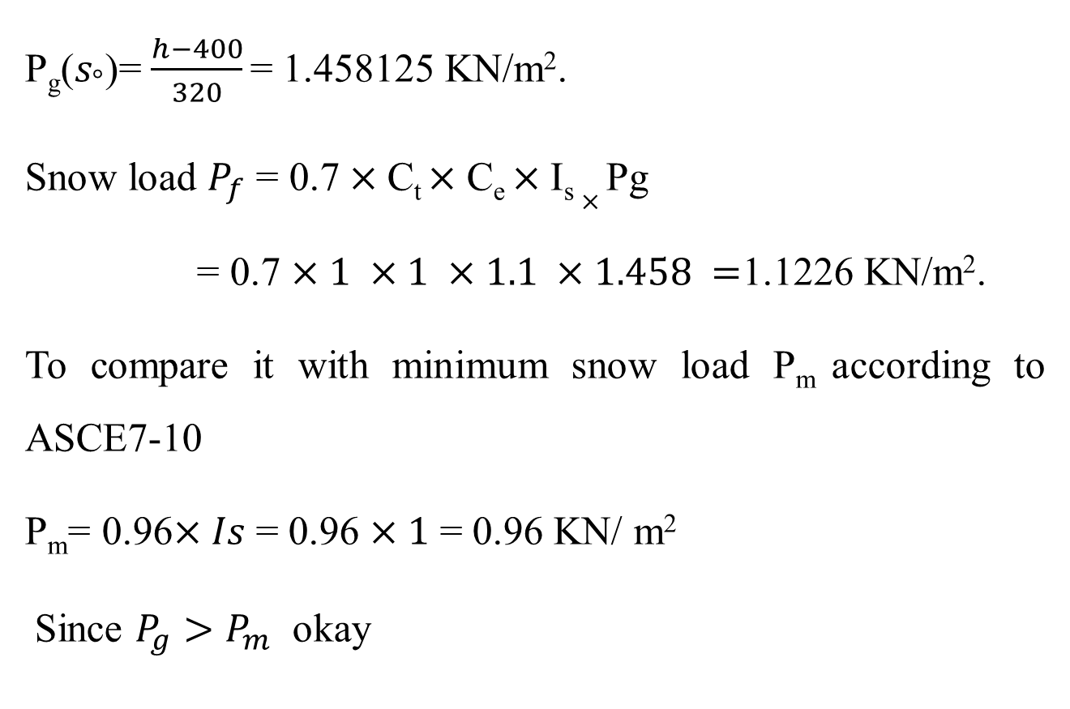
Introduction
Gravity loads
P_{g}($s_{°}$)= $\frac{h−400}{320}$ = 1.458125 KN/m².
Snow load $P_{f}$ = 0.7$×$C_{t}$×$ C_{e} $×$I_{s} $×$Pg
= 0.7 $×1 ×1 ×1.1 ×1.458 =$1.1226 KN/m².
To compare it with minimum snow load P_{m} according to ASCE7-10
P_{m}= 0.96$×Is$ = 0.96 $×1$ = 0.96 KN/ m²
Since $P_{g}>P_{m}$ okay

Slide 25
Introduction
Lateral loads
Earthquake load
Risk category (Ш)
“Buildings and other structures, the failure of which could pose a substantial risk to human life”.
Importance factor (I_{e}) = 1.25 (ASCE 7-10 Table 1.5-2)
Acceleration parameters S1 and Ss from Israel standard SI413.

Slide 26
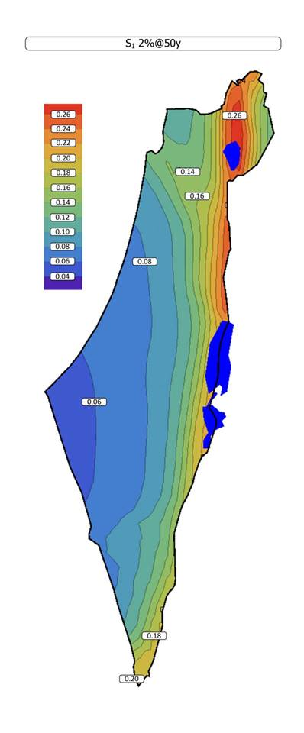
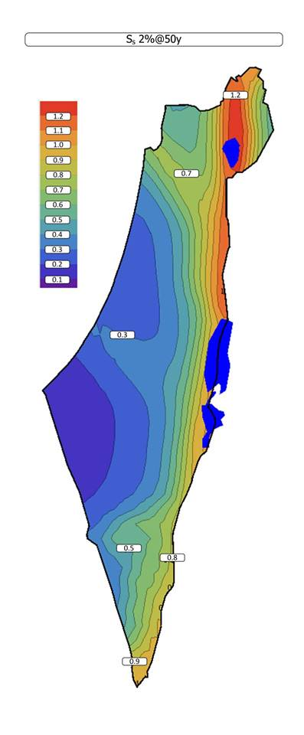
Introduction
Ss = 0.5
S1= 0.12
Figure 1.7: Mapped acceleration parameter S1 and Ss

Slide 27
Introduction
Lateral loads
Site classification “B” Rock (ASCE7-10 Table 1.3)
Site Coefficients Fa and Fv
Fa = short-period site coefficient.
Fv = long-period site coefficient.
Fa=1 (ASCE7-10 Table 11.4-1)
Fv =1 (ASCE7-10 Table 11.4-1)
Spectral response acceleration parameters SMS and SM1
SMS = Fa ×SS (ASCE7-10 equation11.4-1)
SMS= 1× 0.5=0.5
SM1 = Fv ×S1 (ASCE7-10 equation11.4-2)
SM1= 1×0.12 =0.12

Slide 28
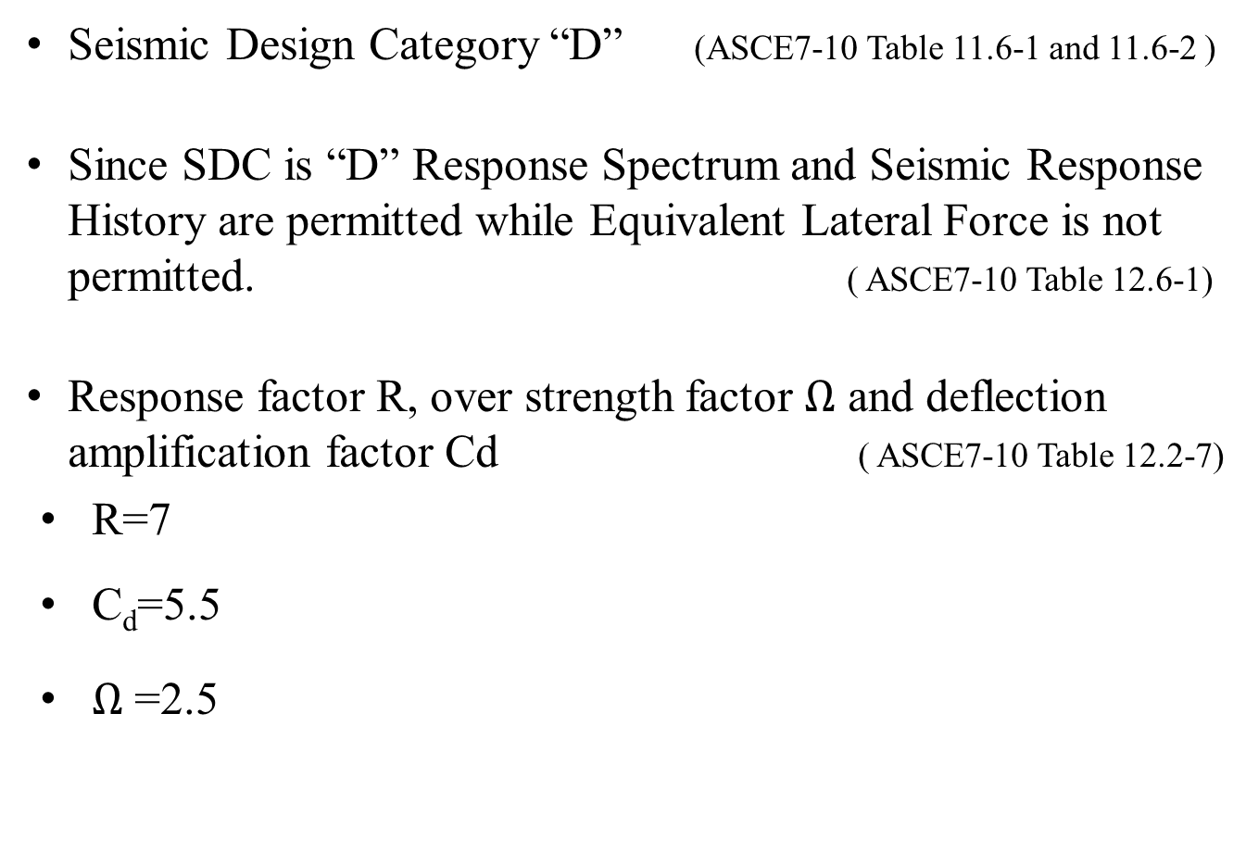
Introduction
Lateral loads
Seismic Design Category “D” (ASCE7-10 Table 11.6-1 and 11.6-2 )
Since SDC is “D” Response Spectrum and Seismic Response History are permitted while Equivalent Lateral Force is not permitted. ( ASCE7-10 Table 12.6-1)
Response factor R, over strength factor $Ω$ and deflection amplification factor Cd ( ASCE7-10 Table 12.2-7)
R=7
C_{d}=5.5
$Ω$ =2.5

Slide 29
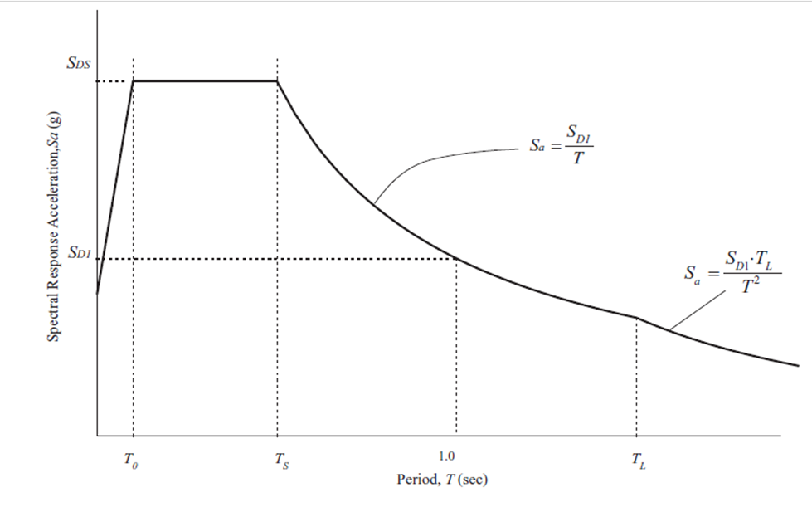
Introduction
Lateral loads
Response spectrum period versus acceleration curve
Figure 1.8: Response spectrum period vs. acceleration curve

Slide 30
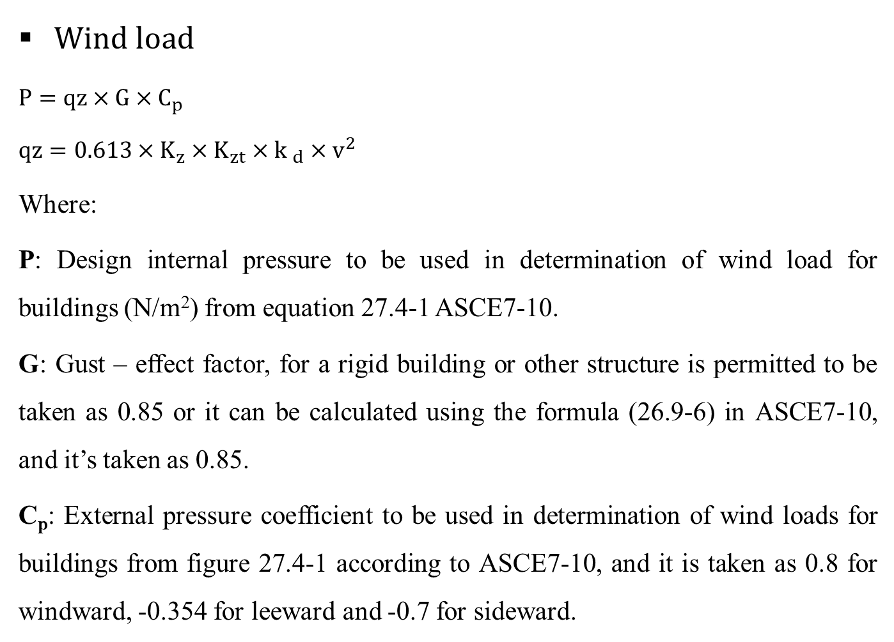
Introduction
Lateral loads
Wind load
$P=qz×G×C_{p}$
$qz=0.613×K_{z}×K_{zt}×{k }_{d}×v^{2}$
Where:
P: Design internal pressure to be used in determination of wind load for buildings (N/m²) from equation 27.4-1 ASCE7-10.
G: Gust – effect factor, for a rigid building or other structure is permitted to be taken as 0.85 or it can be calculated using the formula (26.9-6) in ASCE7-10, and it’s taken as 0.85.
C_{p}: External pressure coefficient to be used in determination of wind loads for buildings from figure 27.4-1 according to ASCE7-10, and it is taken as 0.8 for windward, -0.354 for leeward and -0.7 for sideward.

Slide 31
Introduction
Lateral loads
q_{z}: Velocity pressure evaluated at height Z above the ground (N/m) from equation 27.3-1in ASCE7-10.
K_{z}: Velocity pressure exposure coefficient evaluated at height Z Table 27.3-1 in ASCE7-10.
K_{zt}: Topographic factor from equation 26.8-1 in ASCE7-10, and it is taken as one.
K_{d}: wind directionality factor from Table 26.6-1 in ASCE7-10, and it is taken as 0.85.
V: Basic wind speed (m/s). Three-second gust speed at 33ft (10m) above the ground in Exposure C. It can be determined in two ways
1- From Jordanian Code and IBC2012, V= 39.44 m/s
2- From UFC3-301-1, V= 51.4 m/s
Z = height above ground level, in (m).

Slide 32
Introduction
Lateral loads
Wind Pressure in X and Y-direction (Windward)
Table 1.9:Wind Pressure in X and Y-direction (Windward)

Slide 33
Introduction
Lateral loads
Wind Pressure in X and Y-direction (Leeward)
Table 1.10:Wind Pressure in X and Y-direction (Leeward)

Slide 34
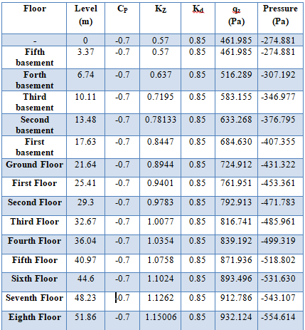
Introduction
Lateral loads
Wind Pressure in X and Y-direction (Sideward)
Table 1.11:Wind Pressure in X and Y-direction (Sideward)

Slide 35
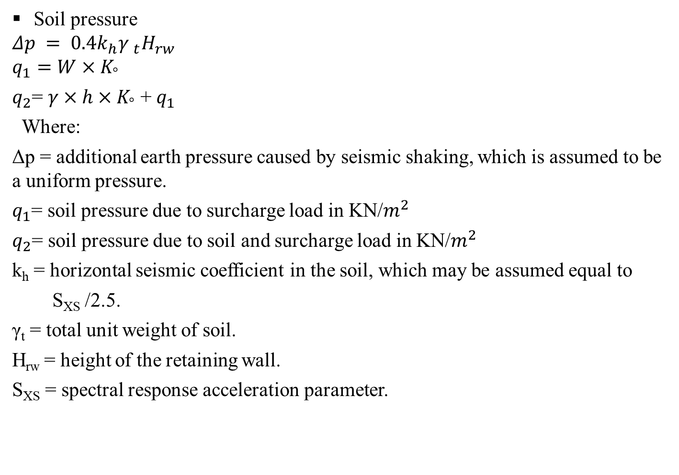
Introduction
Lateral loads
Soil pressure
$$Δp = 0.4k_{h}{γ }_{t}H_{rw}$$
$$q_{1}=W×K_{°}$$
$q_{2}$= $γ×h×K_{°}$ + $q_{1}$
Where:
Δp = additional earth pressure caused by seismic shaking, which is assumed to be a uniform pressure.
$q_{1}$= soil pressure due to surcharge load in KN/$m^{2}$
$q_{2}$= soil pressure due to soil and surcharge load in KN/$m^{2}$
k_{h} = horizontal seismic coefficient in the soil, which may be assumed equal to
S_{XS} /2.5.
γ_{t} = total unit weight of soil.
H_{rw} = height of the retaining wall.
S_{XS} = spectral response acceleration parameter.

Slide 36
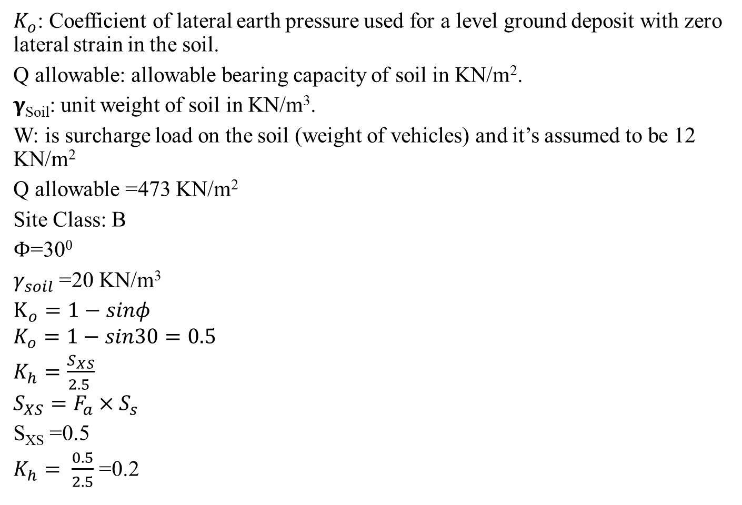
Introduction
Lateral loads
$K_{ο}$: Coefficient of lateral earth pressure used for a level ground deposit with zero lateral strain in the soil.
Q allowable: allowable bearing capacity of soil in KN/m².
$γ$_{Soil}: unit weight of soil in KN/m³.
W: is surcharge load on the soil (weight of vehicles) and it’s assumed to be 12 KN/m²
Q allowable =473 KN/m²
Site Class: B
$Φ$=30⁰
$γ_{soil}$ =20 KN/m³
$K_{ο}=1−sinφ$
$$K_{ο}=1−sin30=0.5$$
$K_{h}=\frac{S_{XS}}{2.5 }$
$$S_{XS}=F_{a}×S_{s}$$
S_{XS} =0.5
$K_{h}= \frac{0.5}{2.5}$ =0.2

Slide 37
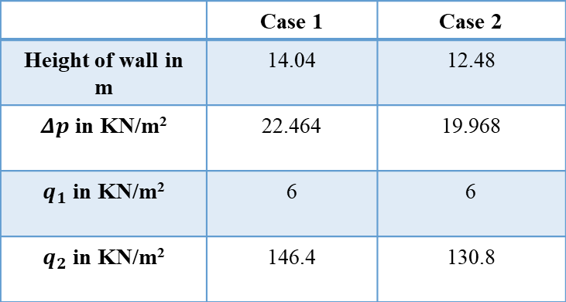
Introduction
Lateral loads
Since there are two levels of mat, two cases of soil pressure is obtained.
Table 1.12: Soil pressure cases
 | Case 1 | Case 2
Height of wall in m | 14.04 | 12.48
$Δp$ in KN/m² | 22.464 | 19.968
$q_{1}$ in KN/m² | 6 | 6
$q_{2}$ in KN/m² | 146.4 | 130.8

Slide 38
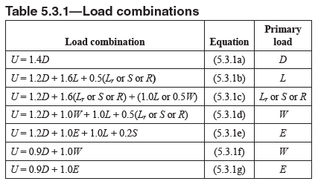
Introduction
Load combinations
Ultimate load combinations
Table 1.13: Ultimate load combinations

Slide 39
Introduction
Load combinations
Service load combinations (ASCE7-10)
1. D
2. D + L
3. D + (Lr or S or R)
4. D + 0.75L + 0.75(Lr or S or R)
5. D + (0.6W or 0.7E)
6a. D + 0.75L + 0.75(0.6W) + 0.75(Lr or S or R)
6b. D + 0.75L + 0.75(0.7E) + 0.75S
7. 0.6D + 0.6W
8. 0.6D + 0.7E

Slide 40
Introduction
Load combinations
Where:
D: Dead load.
L: Live load.
L_{r}: Roof live load.
S: snow load.
R: Rain load.
W: Wind load.
E: Earthquake load.
H: load due to lateral earth pressure, ground water pressure, or pressure of bulk materials.

Slide 41
Introduction
Analysis and design principles
Analysis and Design assumptions:
The foundation is mat.
Exterior walls will be modeled as shear walls, in order to have seismic resistance building.
Interior walls and partitions will not be modeled but there load has been taken in consideration as superimposed dead load of 1.5 KN/m².
There are no tie beams since mat foundation is used.
The ultimate strength design method will be used in the design process of this project. In the strength design method, actual loads or working loads are multiplied by load factor to obtain the ultimate design loads. The load factor represents a high percentage of factors for safety required in the design.
A three dimensional model will be used with all accurate dimensions.
Beams and columns are represented by line elements while slabs and walls are represented by area elements.
The masonry cladding will be applied external reinforced concrete walls as superimposed dead load.
Response spectrum method will be used for seismic forces computations.

Slide 42
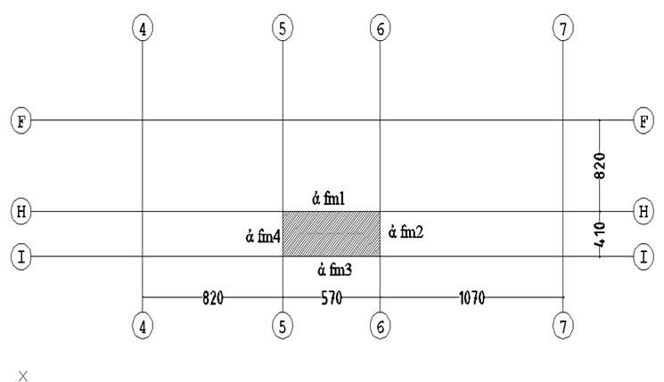
Preliminary Design
Preliminary design
Slab preliminary design:
Two panels were chosen, as follows:
Panel 1
Figure 2.1: Panel 1 in ground floor.

Slide 43
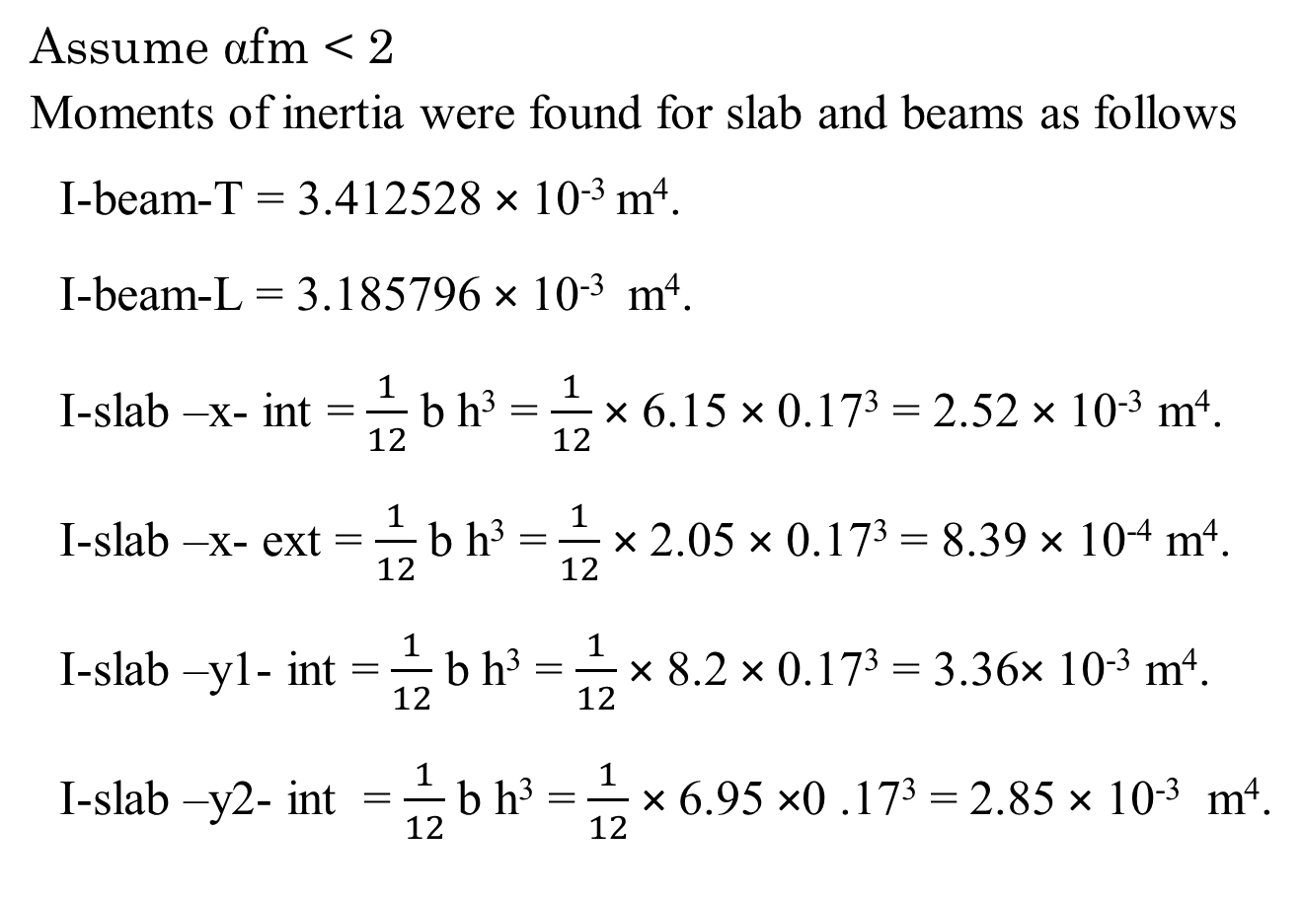
Preliminary Design
Preliminary design of slab
Assume fm < 2
Moments of inertia were found for slab and beams as follows
I-beam-T = 3.412528 × 10⁻³ m⁴.
I-beam-L = 3.185796 × 10⁻³ m⁴.
I-slab –x- int = $\frac{1}{12}$ b h³ = $\frac{1}{12}$ × 6.15 × 0.17³ = 2.52 × 10⁻³ m⁴.
I-slab –x- ext = $\frac{1}{12}$ b h³ = $\frac{1}{12}$ × 2.05 × 0.17³ = 8.39 × 10⁻⁴ m⁴.
I-slab –y1- int = $\frac{1}{12}$ b h³ = $\frac{1}{12}$ × 8.2 × 0.17³ = 3.36× 10⁻³ m⁴.
I-slab –y2- int = $\frac{1}{12}$ b h³ = $\frac{1}{12}$ × 6.95 ×0 .17³ = 2.85 × 10⁻³ m⁴.

Slide 44
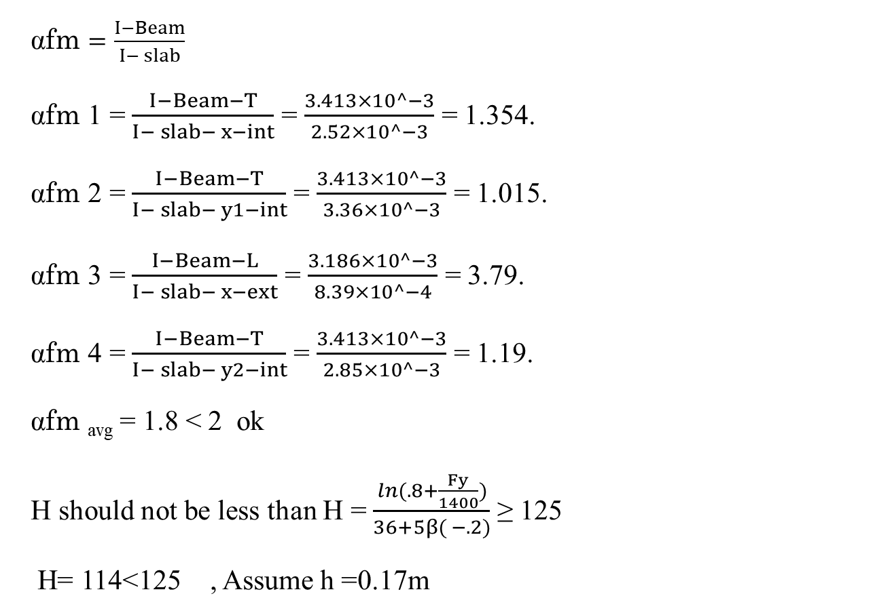
Preliminary Design
Preliminary design of slab
fm $=\frac{I−Beam}{I− slab}$
fm 1 = $\frac{I−Beam−T}{I− slab− x−int}$ = $\frac{3.413×10^−3}{2.52×10^−3}$ = 1.354.
fm 2 = $\frac{I−Beam−T}{I− slab− y1−int}$ = $\frac{3.413×10^−3}{3.36×10^−3}$ = 1.015.
fm 3 = $\frac{I−Beam−L}{I− slab− x−ext}$ = $\frac{3.186×10^−3}{8.39×10^−4}$ = 3.79.
fm 4 = $\frac{I−Beam−T}{I− slab− y2−int}$ = $\frac{3.413×10^−3}{2.85×10^−3}$ = 1.19.
fm _{avg} = 1.8 < 2 ok
H should not be less than H = $\frac{\ln{(.8+\frac{Fy}{1400})}}{36+5β( −.2)}$ ≥ 125
H= 114<125 , Assume h =0.17m

Slide 45
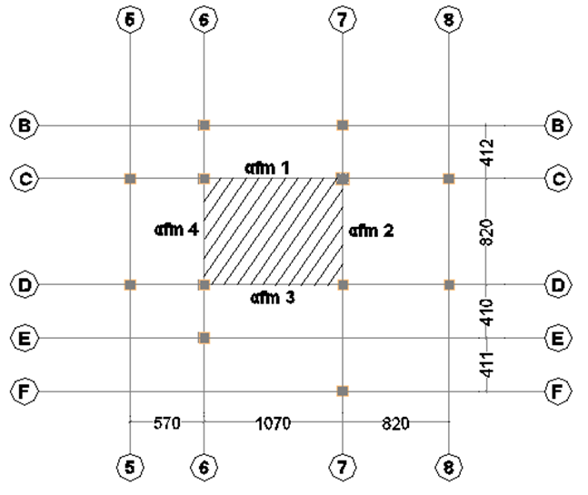
Preliminary Design
Preliminary design of slab
Panel 2
Figure 2.2: Panel 2 in ground floor.

Slide 46
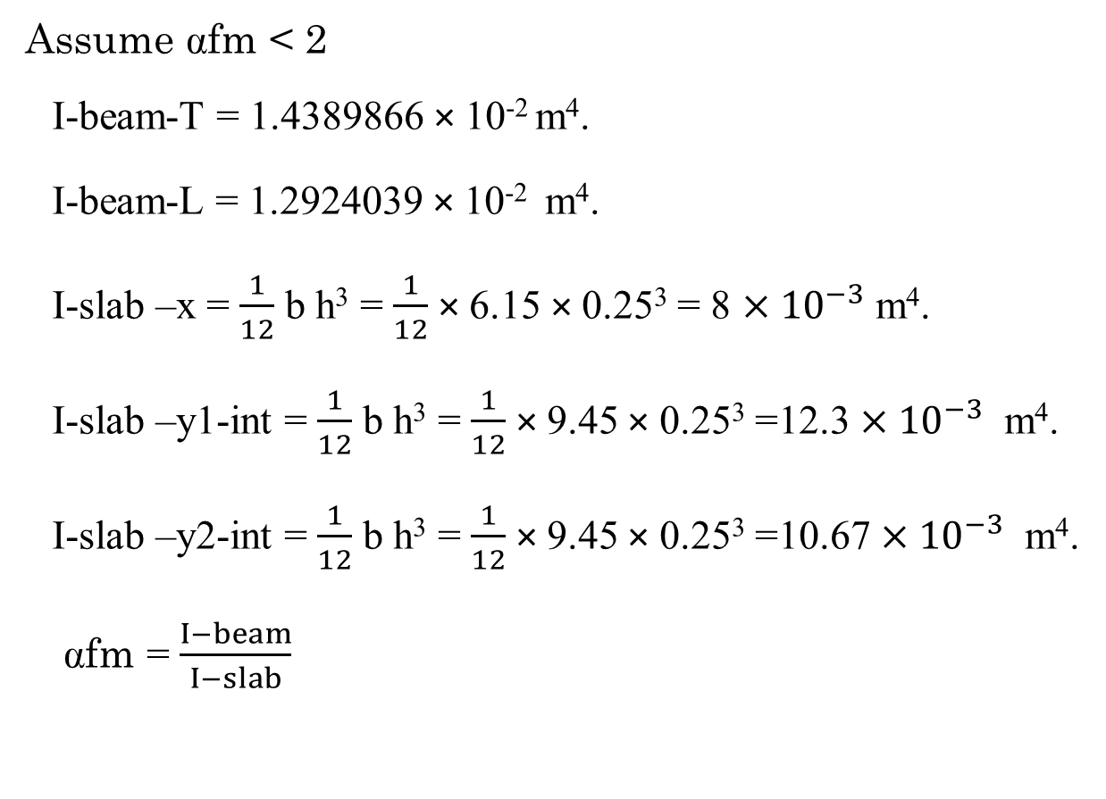
Preliminary Design
Preliminary design of slab
Assume fm < 2
I-beam-T = 1.4389866 × 10⁻² m⁴.
I-beam-L = 1.2924039 × 10⁻² m⁴.
I-slab –x = $\frac{1}{12}$ b h³ = $\frac{1}{12}$ × 6.15 × 0.25³ = 8 $×{10}^{−3}$ m⁴.
I-slab –y1-int = $\frac{1}{12}$ b h³ = $\frac{1}{12}$ × 9.45 × 0.25³ =12.3 $×{10}^{−3}$ m⁴.
I-slab –y2-int = $\frac{1}{12}$ b h³ = $\frac{1}{12}$ × 9.45 × 0.25³ =10.67 $×{10}^{−3}$ m⁴.
fm = $\frac{I−beam}{I−slab}$

Slide 47
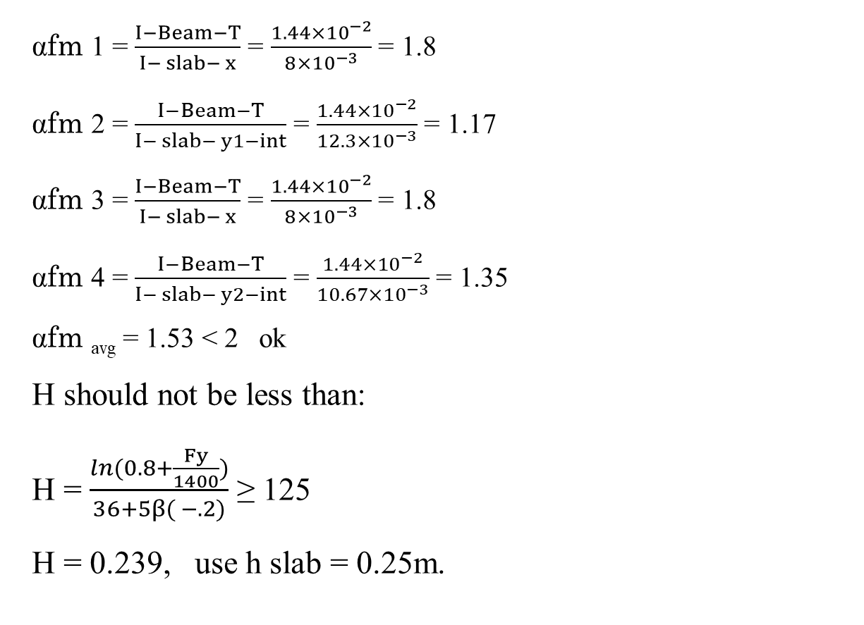
Preliminary Design
Preliminary design of slab
fm 1 = $\frac{I−Beam−T}{I− slab− x}$ = $\frac{1.44×{10}^{−2}}{8×{10}^{−3}}$ = 1.8
fm 2 = $\frac{I−Beam−T}{I− slab− y1−int}$ = $\frac{1.44×{10}^{−2}}{12.3×{10}^{−3}}$ = 1.17
fm 3 = $\frac{I−Beam−T}{I− slab− x}$ = $\frac{1.44×{10}^{−2}}{8×{10}^{−3}}$ = 1.8
fm 4 = $\frac{I−Beam−T}{I− slab− y2−int}$ = $\frac{1.44×{10}^{−2}}{10.67×{10}^{−3}}$ = 1.35
fm _{avg} = 1.53 < 2 ok
H should not be less than:
H = $\frac{\ln{(0.8+\frac{Fy}{1400})}}{36+5β( −.2)}$ ≥ 125
H = 0.239, use h slab = 0.25m.

Slide 48
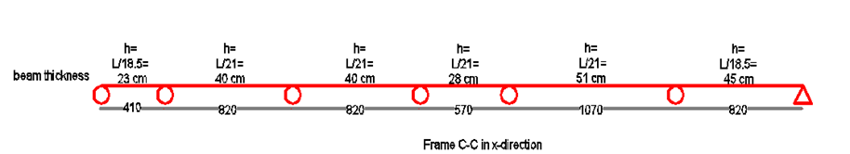

Preliminary Design
Preliminary design of beams
Minimum depth of non prestressed beam according to ACI318-14 Table 9.3.1.1 = $\frac{L}{21}$ = $\frac{1070}{21}$ = 51 cm , use 55 cm as preliminary beams depth
The width of beams can be assumed or L/20 can be used as an indication, $\frac{L}{20}$ = $\frac{1070}{20}$ = 53.5 cm, to be conservative width of 80 cm was used.
Figure 2.3: Frame C-C in x-direction in second floor.

Slide 49
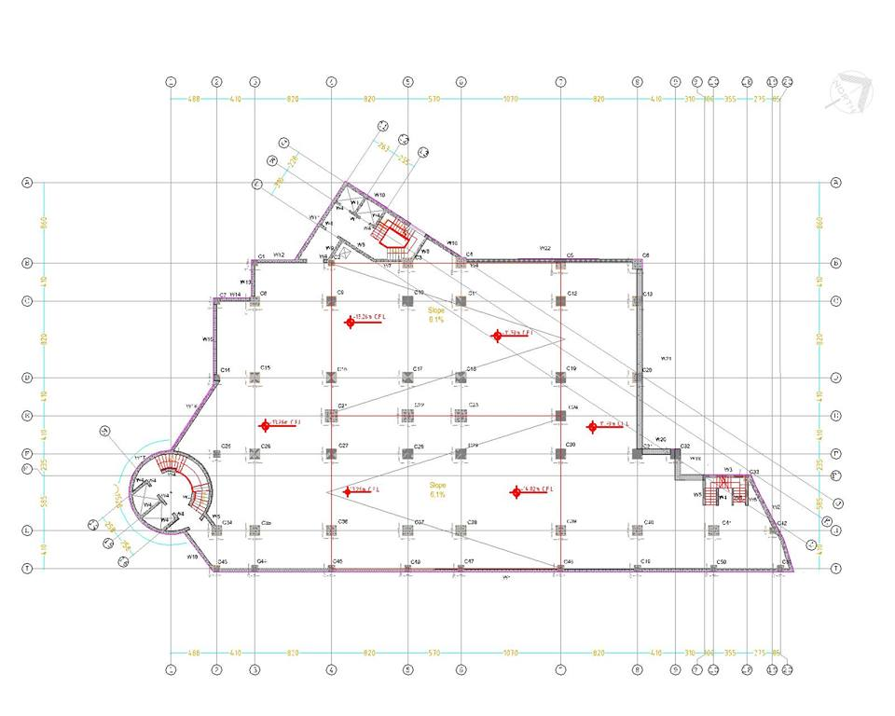
Preliminary Design
Preliminary design of columns
Figure 2.4: Columns plan in fourth basement.

Slide 50
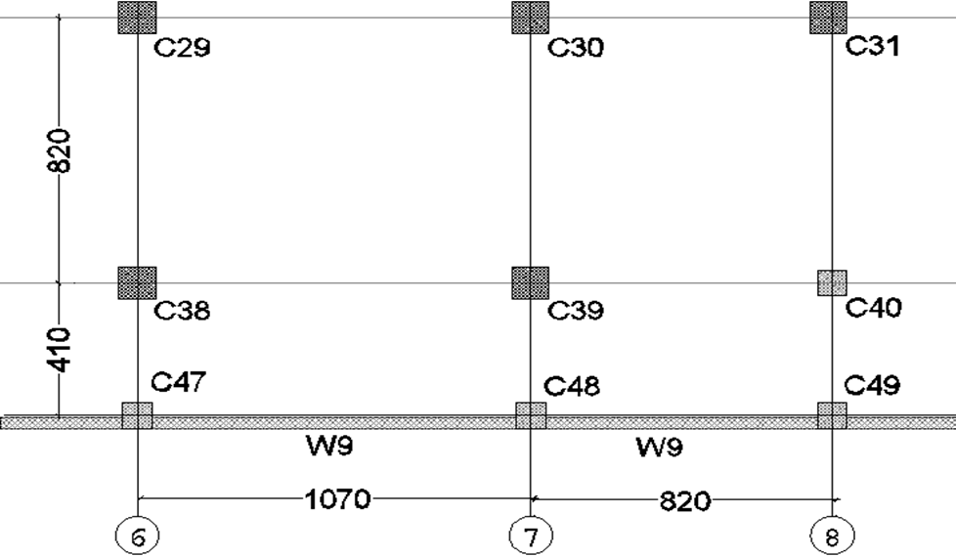
Preliminary Design
Preliminary design of columns
Column 39 was chosen as representative for interior columns preliminary dimensions.
Figure 2.5: Column 39 location and tributary area.

Slide 51
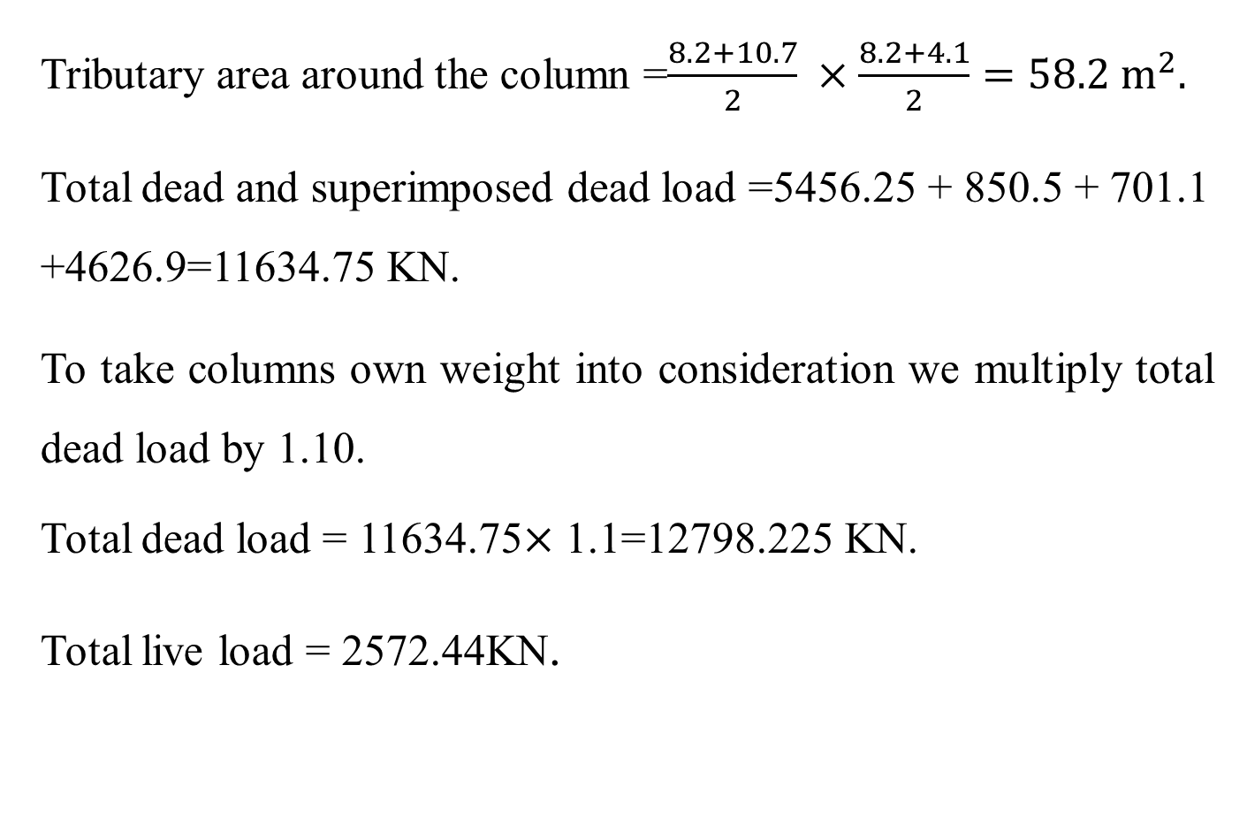
Preliminary Design
Preliminary design of columns
Tributary area around the column =$\frac{8.2+10.7}{2} ×\frac{8.2+4.1}{2}=58.2 m^{2}.$
Total dead and superimposed dead load =5456.25 + 850.5 + 701.1 +4626.9=11634.75 KN.
To take columns own weight into consideration we multiply total dead load by 1.10.
Total dead load = 11634.75$×$ 1.1=12798.225 KN.
Total live load = 2572.44KN.

Slide 52
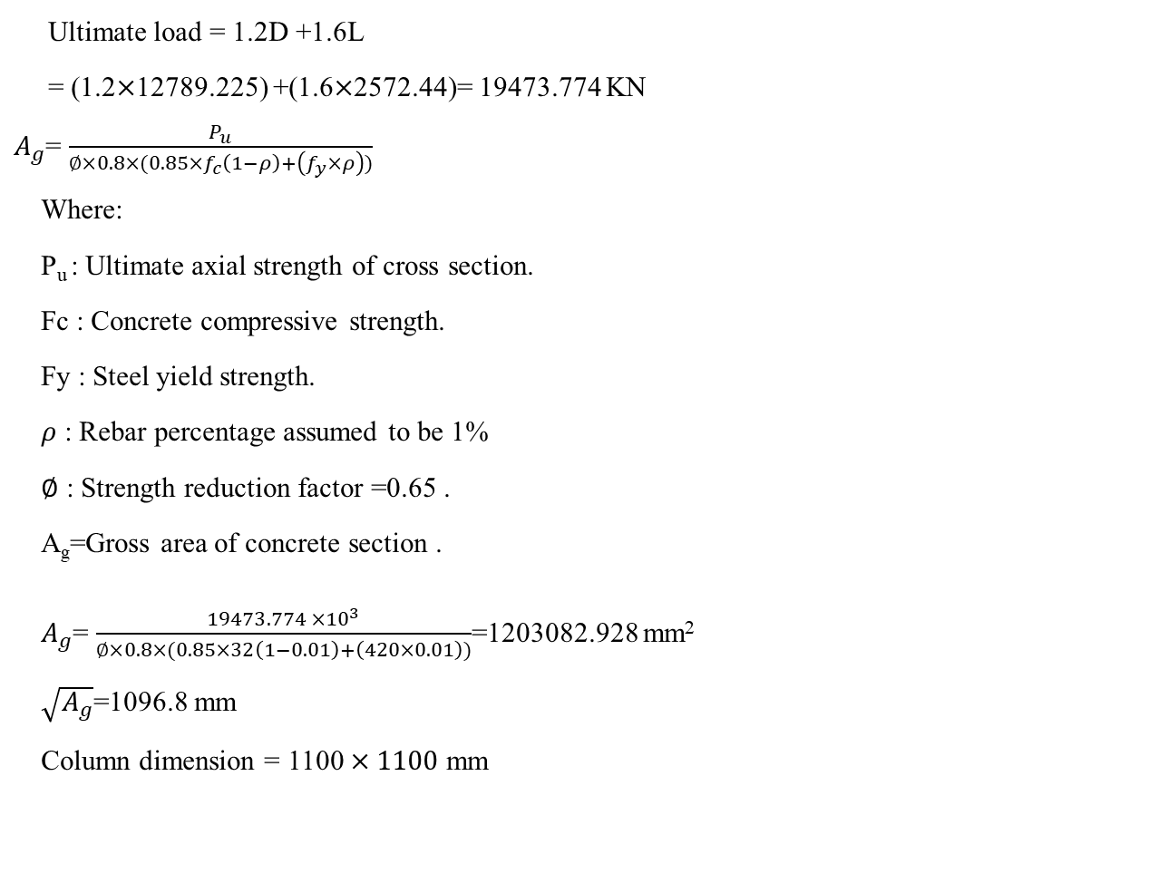
Preliminary Design
Preliminary design of columns
Ultimate load = 1.2D +1.6L
= (1.2$×$12789.225) +(1.6$×$2572.44)= 19473.774 KN
$A_{g}$= $\frac{P_{u}}{∅×0.8×(0.85×f_{c}\left(1−ρ\right)+\left(f_{y}×ρ\right))}$
Where:
P_{u} : Ultimate axial strength of cross section.
Fc : Concrete compressive strength.
Fy : Steel yield strength.
$ρ$ : Rebar percentage assumed to be 1%
$∅$ : Strength reduction factor =0.65 .
A_{g}=Gross area of concrete section .
$A_{g}$= $\frac{19473.774 ×{10}^{3}}{∅×0.8×(0.85×32\left(1−0.01\right)+\left(420×0.01\right))}$=1203082.928 mm²
$\sqrt{A_{g}}$=1096.8 mm
Column dimension = 1100 $×1100$ mm

Slide 53
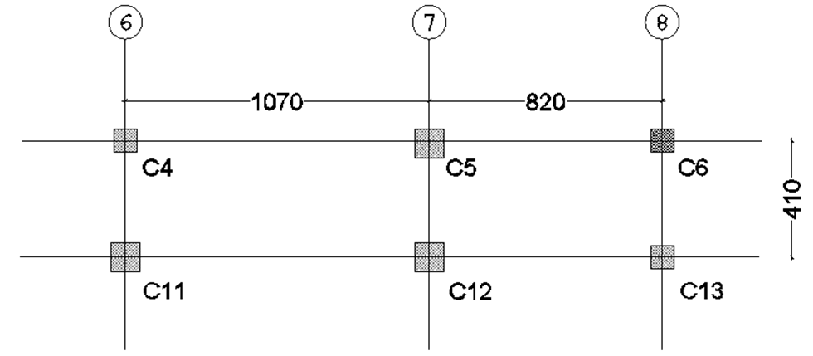
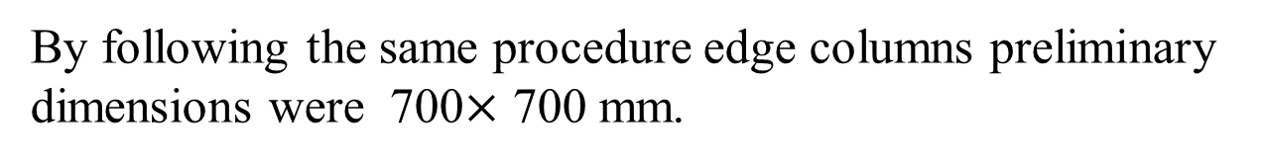
Preliminary Design
Preliminary design of columns
Column C5 was chosen as representative of edge columns.
Figure 2.6: Column 5 location and tributary area.
By following the same procedure edge columns preliminary dimensions were 700$×$ 700 mm.

Slide 54
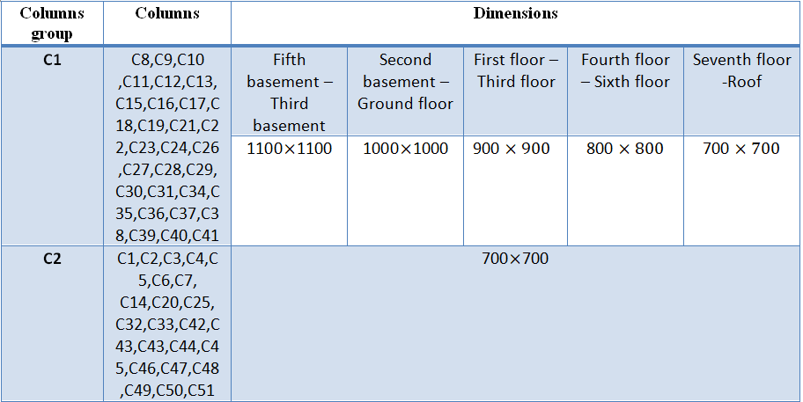
Preliminary Design
Preliminary design of columns
Columns preliminary dimensions are shown in the following table (referring to columns plan).
Table 2.1: Columns dimensions.

Slide 55
Preliminary Design
Preliminary design of walls
In this project there was three types of walls
Exterior walls: Made of reinforced concrete with masonry stone cladding with a preliminary thickness of 350 mm, (250 mm reinforced concrete + 60 mm plain concrete + 40 mm stone).
Interior walls: Surrounding elevators and staircases, these have a preliminary thickness of 300 mm.
Basement walls: In preliminary design, the thickness of walls are assumed to be 400 mm for fifth and fourth basements, 350 mm for third and second basements and 300 mm for first basement.

Slide 56
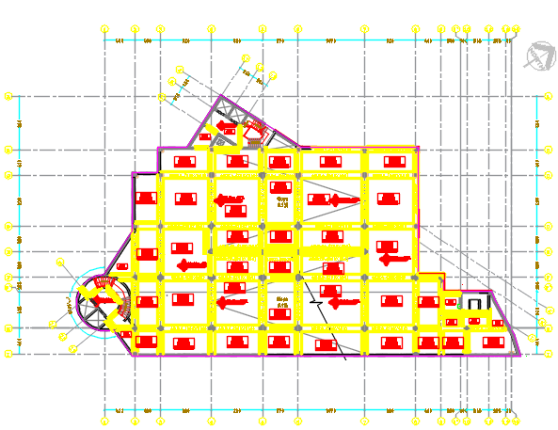
Preliminary Design
Preliminary design
Figure 2.7: Fourth basement floor framing plan.

Slide 57
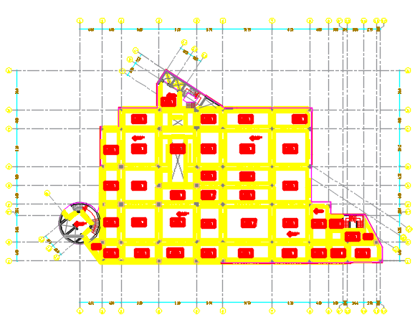
Preliminary Design
Preliminary design
Figure 2.8: Ground floor framing plan.

Slide 58
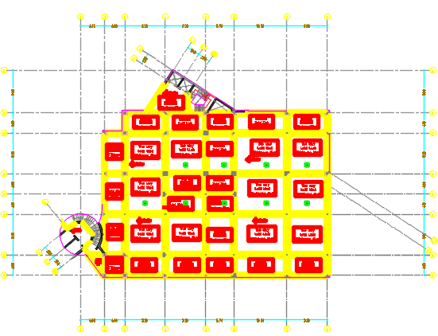
Preliminary Design
Preliminary design
Figure 2.9: Fifth floor framing plan.

Slide 59
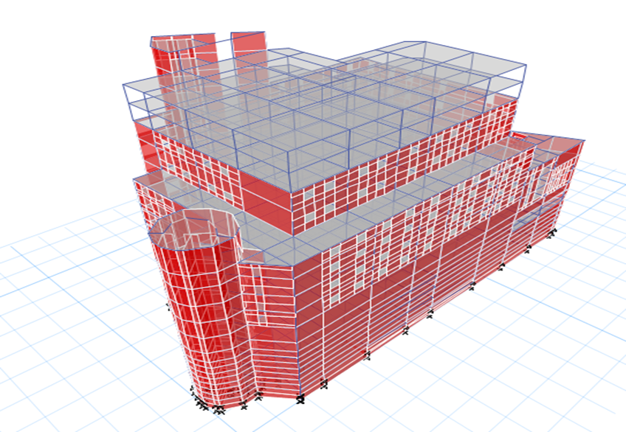
3D Analysis and Design
Three Dimensional Analysis and Design
Figure 3.1: Three dimensional model of the building.

Slide 60
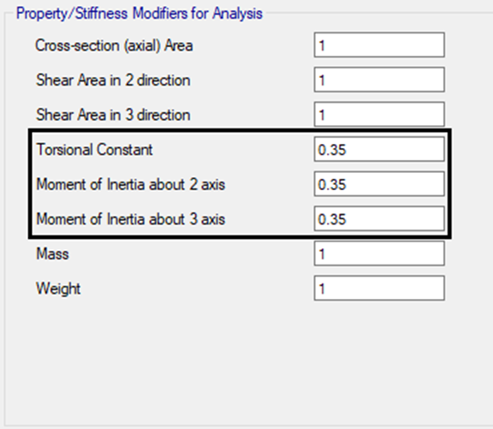
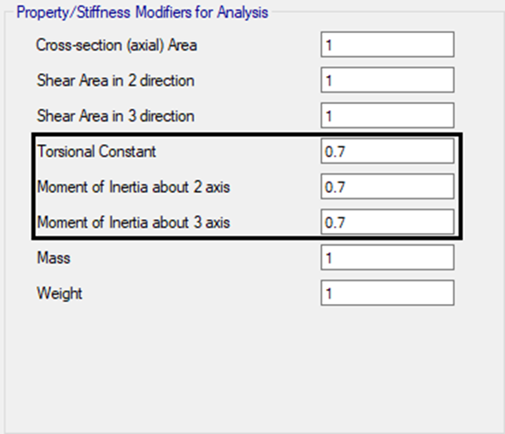
3D Analysis and Design
Three Dimensional Analysis and Design
Modifiers
Figure 3.2: Modifiers used in beam sections.
Figure 3.3: Modifiers used in column sections.

Slide 61
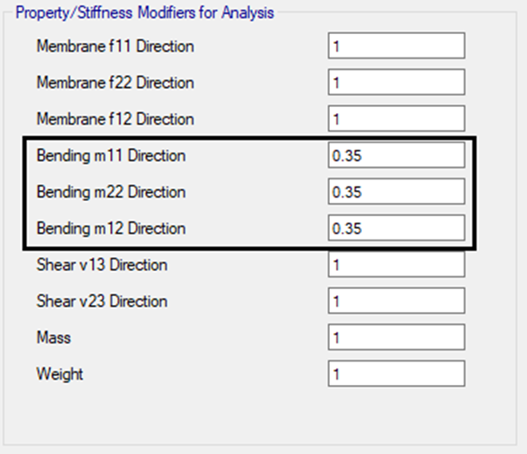
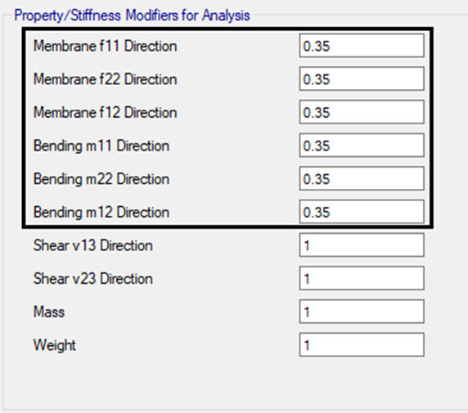
3D Analysis and Design
Three Dimensional Analysis and Design
Figure 3.4: Modifiers used in slab sections.
Figure 3.5: Modifiers used in wall sections.

Slide 62
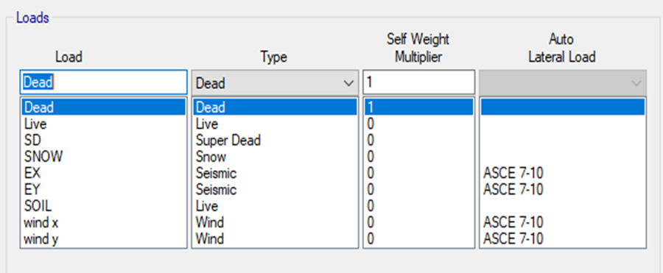

3D Analysis and Design
Three Dimensional Analysis and Design
Load patterns and cases
Figure 3.6: Load patterns.
Figure 3.7: Load cases.

Slide 63


3D Analysis and Design
Three Dimensional Analysis and Design
Springs and mass source
Figure 3.8: Spring assignment.
Figure 3.9: Mass Source.

Slide 64
3D Analysis and Design
Verification of Structural Analysis
Equilibrium checks
Table 3.1: Equilibrium Check.
Load pattern | Hand result (KN) | ETABS result (KN) | Difference %
Dead load | 311002.4324 | 304141.9225 | 2.2
Superimposed load | 125316.374 | 123796.7829 | 0.722
Live load | 57704.81 | 57671.927 | 0.057
Snow load | 1489.8 | 1489.7902 | 0
Soil Pressure | 17173.45 | 17177.94 | 0.026
Wind load X | 1065.77 | 1069.27 | 0.33
Wind load Y | 1603.19 | 1441.48 | 10
Seismic load X | 18481.66 | 18443.89 | 0.204
Seismic load Y | 15792.13 | 15766.73 | 0.16

Slide 65
3D Analysis and Design
Verification of Structural Analysis
Story forces from wind load
Table 3.2: Story forces from wind load.
Floor | Hand result (KN) | ETABS result (KN) | Difference %
Sixth floor X | 97.49 | 104.29 | 6.88
Sixth floor Y | 150.13 | 160.48 | 6.89
Seventh floor X | 100.15 | 118.59 | 18.4
Seventh floor Y | 105.82 | 103.25 | 2.42

Slide 66

3D Analysis and Design
Verification of Structural Analysis
Story forces from seismic load
The lateral seismic force (Fx) in KN induced at any level shall be determined from the following equations:
$F_{x}= C_{vx}×V$
And
$C_{vx}= \frac{W_{x}×h_{x}^{k}}{\sum_{i=1}^{n}{W_{i}×h_{i}^{k}}}$
Where
C_{vx} = vertical distribution factor
V = total design lateral force or shear at the base of the structure (KN)
w_{i} and w_{x} = the portion of the total effective seismic weight of the structure (W) located or assigned to level i or x and it was taken from the mass source in KN
h_{i} and h_{x} = the height (m) from the base to level i or x
k = an exponent related to the structure period, as follows:
For structures having a period of 0.5 s or less, k = 1.
For structures having a period of 2.5 s or more, k = 2.
Since the period in x direction =0.718 sec, interpolation was obtained to get the value of K_{x}
K_{x}= 1.109

Slide 67
3D Analysis and Design
Verification of Structural Analysis
Story forces from earthquake load
Table 3.3: Story forces from earthquake load.
Story | Story force from hand calculation (KN) | Story force from ETABS (KN) | %Difference
Stair Case 35.6 | 170.83 | 170.59 | 0.142
ROOF 31.98 | 1326.12 | 1325.11 | 0.076
8th Floor 28.6 | 1614.98 | 1613.6 | 0.085
7th Floor 25.22 | 1916.83 | 1915.3 | 0.079
6th Floor 21.84 | 2071.47 | 2069.8 | 0.080
5th Floor 17.16 | 1882.90 | 1881.3 | 0.084
4th Floor 14.61 | 1842.27 | 1840.3 | 0.107
3rd Floor 10.92 | 1775.77 | 1775 | 0.043
2nd Floor 7.28 | 1532.38 | 1531 | 0.089
1st Floor 3.76 | 1325.93 | 1325 | 0.070
Ground Floor 0.00 | 963.91 | 963 | 0.094
1st Basement -2.34 | 389.49 | 389 | 0.125
1st Basement -3.9 | 359.91 | 353 | 1.919
2nd Basement -5.46 | 330.72 | 331 | 0.084
2nd Basement -7.02 | 288.13 | 288 | 0.044
3rd Basement -8.58 | 234.50 | 234 | 0.211
3rd Basement -10.14 | 190.62 | 190 | 0.325
4th Basement -11.7 | 136.88 | 137 | 0.090
4th Basement -13.26 | 90.26 | 90 | 0.287

Slide 68

3D Analysis and Design
Verification of Structural Analysis
Equivalent static versus dynamic response spectrum
Before modification of scale factor $\frac{GI}{R}$
In the X direction = $\frac{response reaction }{equivalent reaction } = \frac{14850.62}{19687.51} ×100\%=75.4 \%<85\%$
In the Y direction = $\frac{response reaction }{equivalent reaction } = \frac{14102.99}{17172.47} ×100\%=82.13\%<85\%$
After modification
In the X direction = $\frac{response reaction }{equivalent reaction } = \frac{16516.1319}{18443.8984} ×100\%=98.5 \%>85\%$
In the Y direction = $\frac{response reaction }{equivalent reaction } = \frac{15372.1215}{15766.7316} ×100\%=97.5\%>85\%$

Slide 69

3D Analysis and Design
Verification of Structural Analysis
Period was calculated in three different ways
1- An approximate fundamental period, Ta, is determined according to equation (12.8-7) ASCE7-10
Ta = C_{t}$×h_{n}^{x}$
Where:
h_{n} is the structural height.
C_{t} and x are coefficients determined from Table 12.8-2 ASCE7-10 as shown below
C_{t} =0.0488
x= 0.75
h_{n}= 52 m
T_{a}=0.0488$× {52}^{0.75}$ =0.945 second.
2- From ETABS results in x and y directions
Period in x = 0.718 sec.
Period in y = 0.84 sec.

Slide 70

3D Analysis and Design
Verification of Structural Analysis
3- From Rayleigh
In X direction
T_{n}=2$× π×\sqrt{\frac{\sum{Wi ×∆^{2}} }{g \sum{Fi ×∆}}}$
Where
W: Weight of floor from mass source in KN.
$∆$ : Average displacement in each floor.
F: Force in each floor from ETABS in KN, after applying a force of 1 KN/m² in each floor.
T_{n}= 0.582 sec.

Slide 71

3D Analysis and Design
Verification of Structural Analysis
% Difference between Rayleigh and ETABS =$\frac{ Period from Rayleigh−Period from ETABS }{Period from Rayleigh }$ $×$ 100 %
= $\frac{0.582−0 .718}{0.582}$ $×$ 100% = 23.36 %
In Y direction
T_{n} = 2$× 3.14$ $×$ $\sqrt{\frac{20.18969555}{9.81 × 178.5275564}}$ = 0.674 sec.
% Difference between Rayleigh and ETABS =$\frac{ Period from Rayleigh−Period from ETABS }{Period from Rayleigh }$ $×$ 100 %
= $\frac{0.674 −0.84}{0.674}$ $×$ 100% = 24.29 %

Slide 72

3D Analysis and Design
Verification of Structural Analysis
Mass participation ratio for modal analysis
Figure 3.2: Periods in x and y directions from ETABS.

Slide 73

3D Analysis and Design
Verification of Structural Analysis
Figure 3.3: Sum Ux and Uy from ETABS.

Slide 74

3D Analysis and Design
Structural irregularities
1- Horizontal structural irregularities
Table 3.4: Horizontal structure irregularities.

Slide 75

3D Analysis and Design
Structural irregularities
2- Vertical structural irregularities
Table 3.5: Vertical structure irregularities.

Slide 76

3D Analysis and Design
    Verification of internal forces
Slabs and beams
Shear check for slab:
For 250 mm slab thickness
∅𝑉𝑐 = $\frac{1}{6 }$ × Ø× √𝑓′𝑐 ×𝑏𝑤×𝑑
Where
∅𝑉𝑐: shear capacity in KN.
∅: shear modification factor =0.75.
𝑓′𝑐: concrete compressive strength in MPa.
bw: width of slab section in mm.
d: effective depth in mm .
∅𝑉𝑐 = $\frac{1}{6 }$ × 0.75× √28 ×$\frac{1000}{1000 }$ ×210= 138.9 KN.
For 170 mm slab thickness
∅𝑉𝑐= $\frac{1}{6 }$ × Ø× √𝑓′𝑐 ×𝑏𝑤×𝑑
= $\frac{1}{6 }$ × 0.75× √28 ×$\frac{1000}{1000 }$ ×130= 86 KN.

Slide 77

3D Analysis and Design
    Verification of internal forces
V13 for 250 mm slab , <$∅Vc OK$
Figure 3.4: V13 for 250 mm slab (KN).

Slide 78

3D Analysis and Design
    Verification of internal forces
V13 for 170 mm slab , <$∅Vc OK$
Figure 3.5: V13 for 170 mm slab (KN).

Slide 79

3D Analysis and Design
    Verification of internal forces
Moment check:
Frames in x and y directions were chosen, moments by hand and from ETABS were obtained and compared.
Figure 3.6: Frames in x and y directions.

Slide 80

3D Analysis and Design
    Verification of internal forces
M _{live, hand} = $\frac{W×L2×{Ln}^{2} }{8}$ = $\frac{2.4×\frac{4.33+ 8.2 }{2} ×{7.51}^{2}}{8}$ = 106 KN.m
M _{live, ETABS} = $\frac{ΣMoment at joints }{2}$+ Moment at middle of span
=$\frac{59.1155+60.3965 }{2}$+ 47.3484 =107.1 KN.m
% Difference in moment 11 =$\frac{ load from hand−load from ETABS }{load from hand }$ $×$ 100 % =
= $\frac{106−107.1}{106}$ $×$ 100 % = 1.03 %

Slide 81

3D Analysis and Design
    Verification of internal forces
Columns
Column C38 was chosen to check axial loads from dead, superimposed, live and snow loads, the column and its tributary area
Figure 3.7: Column C38 used for internal force check.

Slide 82

3D Analysis and Design
    Verification of internal forces
P_{ultimate} = 1.2 Dead +1.2 SD + 1.6 Live +0.5 Snow
$=\left(1.2×\left(3602.5 +1300.7\right)\right)+\left(1.2×2702.64\right)+\left( 1.6×1689.66\right)+\left(0.5×40.32\right)=11850.6 KN$
From ETABS ultimate axial load = 11038.5888 KN
% Difference in axial load on column 38 =$\frac{ load from hand calculations −load from ETABS }{load from hand calculation }$ $×$ 100 %
=$\frac{11850.6−11038.5888}{11850.6} ×100 \%=6.8 \%$

Slide 83
3D Analysis and Design
    Deflection Check
Immediate and long term deflections
Here, immediate deflection due to live load and long term deflection will be checked according to ACI 318-14.
Long term deflection:
𝛥_{LT}= 𝛥_{L} + 𝜆∞ 𝛥_{D}+𝜆_{t} 𝛥_{LS}
Where
𝛥_{LT:} long term deflection.
𝛥_{L}: Immediate deflection due to live load.
𝛥_{D}: Immediate deflection due to dead load.
𝛥_{LS}: Immediate deflection due to sustained live load.
𝜆∞: Time dependent multiplier for infinite duration of sustained load.
𝜆_{t}: Time dependent multiplier for limited load duration.

Slide 84

3D Analysis and Design
    Deflection Check
𝜆 = $\frac{ξ}{1+50ρ^{′}}$
𝜆_{t}= 𝜆∞= $\frac{2}{1+(50x0)}$= 2
𝛥_{LT}= 𝛥_{L} + 2 𝛥_{D}+ (2$×0.25)$ 𝛥_{LS} = 2 𝛥_{D} + 1.5 𝛥_{L}
Deflection check for slab thickness 250 mm
$∆$_{D} at center = 21.698 mm.
Avg. $∆$_{D} at corners = $\frac{8.965+8.502+6.629+6.39}{4}$ = 7.6215 mm.
$∆$_{D} = $∆$_{D} at center - Avg. $∆$_{D} at corners = 14.0765 mm.

Slide 85

3D Analysis and Design
    Deflection Check
Figure 3.8: Deflection from dead load for slab thickness 250 mm (mm).

Slide 86

3D Analysis and Design
    Deflection Check
$∆$_{LT, max} = (2 $×14.0765)$ + (1.5 $×5.0655)$ = 35.75 mm.
$∆$_{LT, allowable} = $\frac{L}{240}$
Where
$∆$_{LT, allowable:} allowable long term deflection, L: longest span length.
$∆$_{LT, allowable} = $\frac{10.7 ×{10}^{3}}{240}$ = 44.58 mm $>$ $∆$_{LT, max} → Adequate
Immediate deflection:
$∆$_{L, max} = 5.0655 mm.
$∆$_{L, allowable} = $\frac{L}{360}$
Where
$∆$_{L, allowable:} allowable deflection due to live load ,L: longest span length.
$∆$_{L, allowable} = $\frac{10.7 ×{10}^{3}}{360}$ = 29.72 mm > $∆$_{L, max} → Adequate.

Slide 87

3D Analysis and Design
    Story drift, elastic and plastic deflection
There are two types of drifts.
1. Elastic drift.
2. Inelastic drift.
According ASCE 7-10
$δ$ Plastic = $\frac{Cd }{I}$ $× δ$ elastic
Plastic drift in each story should be smaller than the allowable story drift according to ASCE 7-10 which equals 0.015$h_{xx}$

Slide 88

3D Analysis and Design
Table 3.6: The values of plastic and elastic drifts.
For all stories $δ$ elastic max < $δ$ allowable → Adequate.

Slide 89
3D Analysis and Design
    Design of Slabs
14 Slabs.
Two slab thicknesses:
Slab 250 mm.
Slab 170 mm.
Column and middle strips were taken into consideration in directions x and y.
Second Floor was taken as a sample

Slide 90

3D Analysis and Design
    Design of Slabs
Figure 3.9: Strips Moment for second floor slab in x-direction (KN.m).

Slide 91

3D Analysis and Design
    Design of Slabs
Figure 3.10: Strips Moment for second floor slab in y-direction (KN.m).

Slide 92

3D Analysis and Design
    Design of Slabs
Figure 3.11: Area of steel for second floor from ETABS in direction x and y (${mm}^{2})$.

Slide 93

3D Analysis and Design
    Design of Slabs
Figure 3.12: Slab reinforcement for second floor in x direction.

Slide 94

3D Analysis and Design
    Design of Slabs
Figure 3.13: Slab reinforcement for second floor in y direction.

Slide 95
3D Analysis and Design
    Design of Beams
14 floors.
Different beam sections (width × depth) :
800 × 550 mm.
800 × 500 mm.
300 × 550 mm.
Beams are in x and y directions.
Beam B4 in fifth floor was taken as a sample.

Slide 96

3D Analysis and Design
    Design of Beams
Figure 3.14: Beam B4 in fifth floor

Slide 97

3D Analysis and Design
    Design of Beams
Figure 3.15: Longitudinal reinforcement in B4 (${mm}^{2}).$

Slide 98

3D Analysis and Design
    Design of Beams
Figure 3.16: Transverse reinforcement in B4.

Slide 99


3D Analysis and Design
    Design of Beams
Figure 3.17: Beam B4 reinforcement in fifth floor.

Slide 100
3D Analysis and Design
    Design of Columns
14 floors.
Columns dimensions ranges from (700 × 700) mm to (1300 × 1300) mm, as follows :
Column C23 in first floor was taken as a sample.
Table 3.7: Columns dimensions.

Slide 101

3D Analysis and Design
    Design of Columns
Figure 3.18: Columns layout in first floor.

Slide 102


3D Analysis and Design
    Design of Columns
Figure 3.19: Column C23 reinforcement in first floor from ETABS (${mm}^{2})$.

Slide 103

3D Analysis and Design
    Design of Columns
Figure 3.20: Column C23 reinforcement in first floor.

Slide 104

3D Analysis and Design
    Design of Walls
14 floors.
Different walls sections :
W400 mm.
W350 mm.
W300 mm.
W200 mm.
W3 was taken as a sample.
Figure 3.21: Walls in the structure.

Slide 105




3D Analysis and Design
    Design of Walls
Figure 3.22: Longitudinal reinforcement in W3 (${mm}^{2})$.
Figure 3.23: Shear reinforcement in W3 (${mm}^{2})$.

Slide 106

3D Analysis and Design
    Design of Walls
Figure 3.24: Wall W3 location.

Slide 107

3D Analysis and Design
    Design of Walls
Figure 3.25: Wall W3 reinforcement details.

Slide 108


3D Analysis and Design
    Design of Footings
Area of floor = 1886 $m^{2}$ .
$\frac{Area of footing }{Area of floor }×100\%$ = $\frac{1171}{1886}×100\%=62\%$
$\frac{Area of footing }{Area of floor }×100\%>60\% ,$ in addition there is the earthquake effect so
mat foundation is used.
The maximum ultimate compression force on columns equals 18453 for column C24.
Assume mat foundation thickness h= 1500 mm and d=1400 mm.
$$V_{u}<{{∅V}_{c}}_{punching}$$
The punching shear force V_{ult} = 18453 KN
The punching shear capacity Vc is given by:
$$V_{c}≤\left[\begin{aligned}0.17\left(1+\frac{2}{β}\right)\sqrt{f^{′}c}b_{°}d \\ 0.083\left(\frac{α_{s }d}{b_{ο}}+2\right)\sqrt{f^{′}c}b_{ο}d \\ 0.33\sqrt{f^{′}c}b_{°}d\end{aligned}\right]$$
Area of footing =$\frac{total service load from ETABS}{Q_{allowbale }}$ =$\frac{553944.05}{473}=1171m^{2}$

Slide 109

3D Analysis and Design
    Design of Footings
Vu should be less than or equals ${∅V}_{c}$.
$V_{c}=26134.6$,
$∅V_{c}=0.75×26134.6=19600.95 KN$.
$V_{u}=18453 KN<{{∅V}_{c}}_{punching}=19600.95KN$ Adequate
$A_{S, minimum}=0.0018×h×b=2700{mm}^{2}, 9∅20$
$∅M_{n}=∅A_{s}f_{y}\left(d−\frac{a}{2}\right)$ = 1408 KN.m
$a=\frac{A_{S}f_{y}}{0.85{f′}_{c}b}$ = 41.7 mm.

Slide 110

3D Analysis and Design
    Design of Footings
Where:
$f_{y}$: Yielding strength of steel in Mpa.
$f^{′}c$: Concrete compressive strength in MPa
Mu: Ultimate moment in KN.m.
b: Width of strip in footing in mm.
d: Effective depth of footing section in mm.
$A_{s}:$ Area of steel in mm².
$∅$: Strength factor =0.9.
$M_{ultimate 1 }=1408<∅M_{n},$minimum area of steel was used = $9∅20.$
$M_{ultimate 2}=1900>∅M_{n},$area of steel used = $8∅25$.

Slide 111


3D Analysis and Design
    Design of Footings
Figure 3.26: Mat foundation from ETABS

Slide 112


3D Analysis and Design
    Design of Footings
Figure 3.27: Ultimate moment M11 on Mat (KN.m).

Slide 113


3D Analysis and Design
    Design of Footings
Figure 3.28: Ultimate moment M22 on Mat (KN.m).

Slide 114

3D Analysis and Design
    Design of Footings
Figure 3.29: Reinforcement of mat in X direction.

Slide 115

3D Analysis and Design
    Design of Footings
Figure 3.30: Reinforcement of mat in Y direction.

Slide 116



3D Analysis and Design
    Design of Stairs
There are 3 different staircases.
Figure 3.31: Staircases 1, 2 and 3.

Slide 117

3D Analysis and Design
    Design of Stairs
W Dead =3.75 KN/m2.
W Live according to table 4.1 ASCE7-10 = 5 KN/m2.
W Superimposed dead = 5.3 KN/m2.
W ultimate =1.2(WD+WSD )+1.6(WL )
W ultimate =1.2(3.75+5.3)+1.6(5)=18.86 KN
M ultimate = $\frac{Wu × L^{2}}{8}$ = 32.3 KN.m
$ρ=\frac{0.85f^{′}c}{fy}(1−\sqrt{1−\frac{2.61×M_{u}×{10}^{6}}{f′c×b×d^{2}}}$ $=0.00748$
$As=ρbd=0.00748×1000×110=823{ mm}^{2}, 1∅16/20 cm$
$A_{s, minimum}=ρbt=0.0018×1000×150=270{ mm}^{2}, 1∅10/25 cm$

Slide 118

3D Analysis and Design
    Design of Stairs
Figure 3.32: Section A-A in staircases 1 detailing.

Slide 119

3D Analysis and Design
    Design Verification
Beams and slabs
1- Shear
Vu was taken from ETABS.
Vc = $\frac{1}{6}$ ʎ $\sqrt{fc` }$ bw d
Vs = $\frac{Vu }{Ø}$ – Vc
$\frac{Av}{s}$ = $\frac{Vs}{Fyt x d }$
$\frac{Av}{s}$ min = max of ( $\frac{0.35 bw }{Fyt }$, $\frac{0.062 \sqrt{Fc`}x bw }{Fyt }$)

Slide 120
3D Analysis and Design
    Design Verification
Where:
𝑉𝑐: shear capacity in KN.
Vu: ultimate shear force in KN.
Vs: nominal shear strength provided by shear reinforcement.
Av: area of vertical legs in stirrup.
S: spacing between stirrups.
Fyt: steel yield strength of stirrups.
∅: shear modification factor =0.75.
𝑓′𝑐: concrete compressive strength in MPa.
bw: width of slab section in mm.
d: effective depth of reinforced concrete section in mm

Slide 121

3D Analysis and Design
    Design Verification
2- Moment
Mu was taken from ETABS.
$$∅Mn=∅×f_{y}×A_{s}×\left(d−\frac{a}{2}\right)$$
$$a=\frac{A_{s}×F_{y}}{0.85×{f′}_{c}×b}$$
$ρ$ = $\frac{0.85 fc` }{Fy }$ (1- $\sqrt{1−\frac{2.61 Mu x {10}^{6}}{bd^{2}fc`}}$ )
$ρ_{min}$ = max of ( $\frac{1.4}{Fy} , \frac{0.25\sqrt{fc`}}{Fy}$ )
$ρ_{max, singly }$=$\frac{0.375 x B1 x 0.85 fc`}{Fy}$
As = $ρ$ x b x d

Slide 122

3D Analysis and Design
    Design Verification
Where:
Mu: Ultimate moment in KN.m
Fc`: Compressive strength of concrete in Mpa.
Fy: Yielding strength of steel in Mpa.
b: Width of slab in mm.
d: Effective depth of slab section in mm.
$A_{s}$: Area of steel in mm²
$∅Mn:$ Ultimate moment in KN
$∅$: Strength factor =1
$ρ$= steel ratio.

Slide 123

3D Analysis and Design
    Design Verification
3- Torsion
Tu was taken from ETABS.
Tth = Ø ʎ $\frac{\sqrt{fc`}}{12}$ $\frac{{Acp}^{2} }{Pcp}$
$\frac{At}{S}$ = $\frac{\frac{Tu}{Ø}}{2 A_{0} Fyt}$
Where:
Tth = Threshold torsion
Acp = Area enclosed by outermost perimeter of concrete cross section in mm²
Pcp = Outside perimeter of concrete cross section in mm
ʎ = Factor to account for light weight concrete, in this case we have normal weight concrete ,ʎ =1
A_{o} = Area enclosed by centerline of the outermost closed transverse torsional reinforcement in mm².

Slide 124

3D Analysis and Design
    Design Verification
Walls and Columns
Axial and moment
Pu and Mu1,2 were taken from ETABS.
Bresler reciprocal load method :
$\frac{1}{ᴓP_{n}}$ = $\frac{1}{ᴓP_{nx}}$ + $\frac{1}{ᴓP_{ny}}$ - $\frac{1}{ᴓP_{no}}$
Where:
$ᴓP_{n}$ : Axial capacity of column section in KN.
$ᴓP_{nx1}$ : Axial capacity of column section in direction x at first end of the column in KN corresponding to Mux1
$ᴓP_{nx2}$ : Axial capacity of column section in direction x at second end of the column in KN
corresponding to Mux2
$ᴓP_{ny1}$ : Axial capacity of column section in direction y at first end of the column in KN
corresponding to Muy1
$ᴓP_{ny2}$ : Axial capacity of column section in direction y at second end of the column in KN corresponding to Mu_{y2}

Slide 125

3D Analysis and Design
    Design Verification
Foundation
1- Punching shear
Vu was taken from ETABS.
$$V_{c}≤\left[\begin{aligned}0.17\left(1+\frac{2}{β}\right)\sqrt{f^{′}c}b_{°}d \\ 0.083\left(\frac{α_{s }d}{b_{ο}}+2\right)\sqrt{f^{′}c}b_{ο}d \\ 0.33\sqrt{f^{′}c}b_{°}d\end{aligned}\right]$$
Where:
$β:$ Short side of column dimensions / long side of column dimension.
$f^{′}c$: Concrete compressive strength in MPa
$b_{°}$: The perimeter of the critical section, for interior column:
$b_{°}$= $2\left(c_{1}+d\right)+2(c_{2}+d)$.
$α_{s }:$ 40 for interior column, 30 for edge column, 20 for corner column
$d$: Effective depth

Slide 126
3D Analysis and Design
    Design Verification
2- Moment : as in beams.
3- Soil pressure under the foundation
Soil pressure from ETABS < Q allowable , the values of soil pressure under the mat foundation is less than allowable bearing capacity of the soil so the area is adequate

Slide 127

3D Analysis and Design
    Seismic provisions for detailing
1- Beams
At both ends of the beam, hoops shall be provided over lengths not less than 2h measured from the face of the supporting member toward mid span. The first hoop shall be located not more than 50 mm from the face of the supporting member. Spacing of hoops shall not exceed the smallest of (a) and (b);
(a) d/4 (b) 150 mm.
Where
h : depth of beam section.
d : effective depth of beam section
Beams shall have at least two of the longitudinal bars continuous along both the top and bottom faces. These bars shall be developed at the face of support.
Clear spacing between longitudinal bars shall be at least the greatest of
(25 mm , d_{b} , $\frac{4}{3}$ d_{agg} )

Slide 128
3D Analysis and Design
    Seismic provisions for detailing
2- Columns
Length lo shall not be less than the largest of (a), (b), and (c):
(a) One-sixth of the clear span of the column.
(b) Maximum cross-sectional dimension of the column.
(c) 450 mm.
Beyond the length lo, the column shall contain hoop reinforcement not exceeding the smallest of (a) through (c):
(6 db , 48 ds , Least column dimension , 150 mm)
Where:
db: diameter of bar.
ds: diameter of stirrup.

Slide 129

3D Analysis and Design
    Seismic provisions for detailing
Spacing of transverse reinforcement shall not exceed the smallest of (a) to (c):
(a) One-fourth of the minimum column dimension
(b) Six times the diameter of the smallest longitudinal bar
(c) So as calculated by:
So = 100 + $\frac{350−h_{x}}{3}$
Where
h_{x}: largest distance between stirrups legs
The value of S_{o} shall not exceed 150mm and need not be taken less than 100mm.

Slide 130
Thank you for listening

