Slide 1







Al-Najah National University
Urban Planning Engineering Department
Housing Planning for the newly married couples
Done by :Ashraqat Nazzal
Presented to : Dr.Ali Abdelhamed Dr.Zahra Zawawi

Slide 2


The Idea of project :
Project Idea
WHY ?
Provide an affordable housing for the youth and new married couples, whose their ages (20-35) .
The increase in land prices.
and the cost of marriage.
Construction costs.
High costs of marriage and cost of living.
The increase in land prices.
The high cost of construction ,renting houses and apartments
All of these cause MARITAL DELAY!! ,and many social problems

Slide 3
Housing stages
Site Selection
01
Site Analysis
SWOT analysis
-.
02
03
The concept and design
.
04

Slide 4
Housing stages
Site Selection
01
Site Analysis
SWOT analysis
-.
02
03
The concept and design
.
04

Slide 5
Site Selection Stage

Slide 6
Site Selection
01
This stage is about the sites selection, the purpose is to select one or more community that fits the project,
- To facilitate this, the site was chosen in two main phases :
01
Selection of the suitable governorate
02
Selection of the suitable land parcel

Slide 7
01
Selection of the suitable governorate
Governorate Selection criteria
Demographic
criteria
Marriage contracts
Cultural criteria
How the project manages to attract youth
Geopolitical criteria
Political classification of land
Percentage of youth concentration
At this phase, specific criteria are set ,to choose the best governorate for the housing between the proposed communities .
Governorate Selection criteria
Demographic
Criteria
Marriage contracts
Cultural Criteria
How the project manages to attract youth
Geopolitical Criteria
Political classification of land
Percentage of youth concentration
3
2
1
3
2
1

Slide 8

01
Selection of the suitable governorate
At this phase, specific criteria are set ,to choose the best governorate for the housing between the proposed communities .
Governorate Selection criteria
Demographic
Criteria
Marriage contracts
Cultural Criteria
How the project manages to attract youth
Geopolitical Criteria
Political classification of land
Percentage of youth concentration
3
2
1

Slide 9
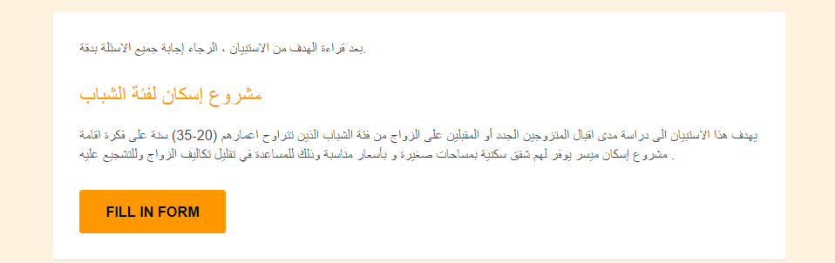
1
Cultural criteria
How the project manages to attract youth
A questionnaire was distributed to a sample of young people from the different governorates of the West Bank, aged between (20-35) and about 250 people.
Figure (1) : The questionnaire form

Slide 10
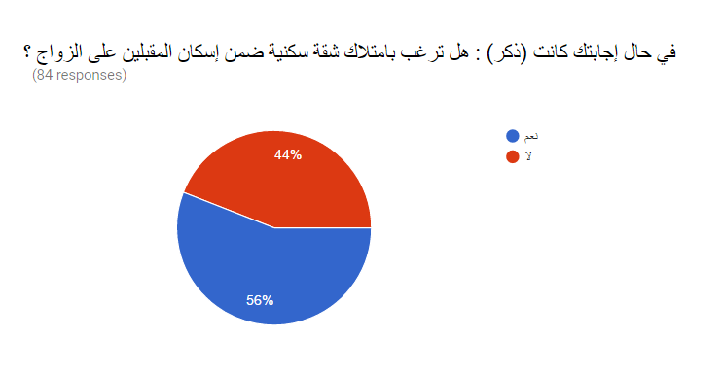
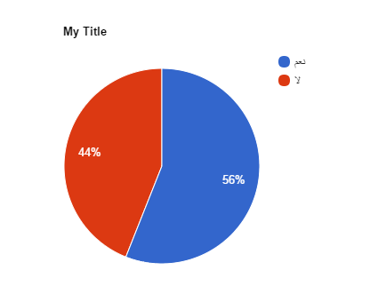
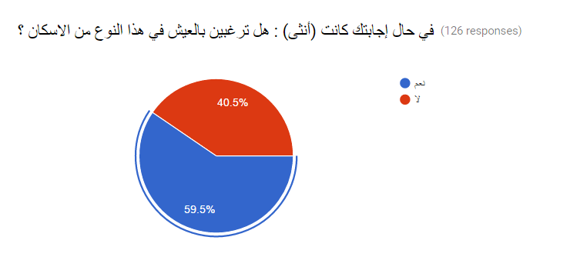
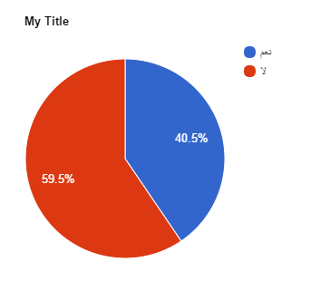
A sample of questions

Slide 11
56%
40.5%
Male
Female
.
Male acceptance of the idea of more than females may be due to cultural reasons…

Slide 12
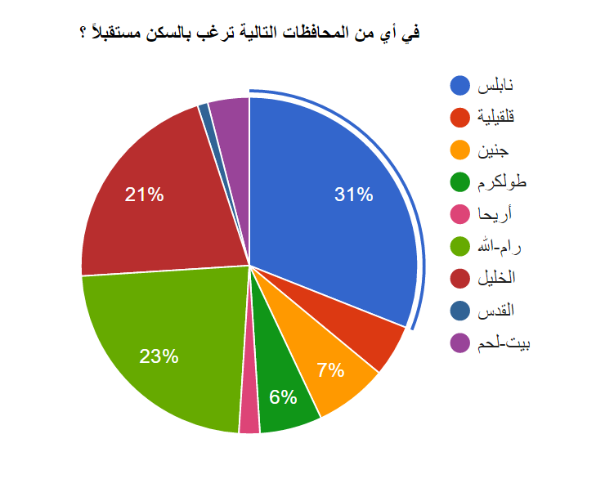
A sample of questions

Slide 13

35
30
25
20
15
10
5
0
Qalqilya
Nablus
Jericho
Ramallah
Hebron
Bethlehem
Jenin
Tubas
Jerusalem
Tulkarm
Salfit
As a result of the questionnaire: 31% of respondents chose Nablus as a future place to live in .

Slide 14
35
30
1
25
20
2
15
3
10
5
0
Qalqilya
Nablus
Jericho
Ramallah
Hebron
Bethlehem
Jenin
Tubas
Jerusalem
Tulkarm
Salfit
As a result of the questionnaire: 31% of respondents chose Nablus as a future place to live in .

Slide 15
01
Selection of the suitable governorate
At this phase, specific criteria are set ,to choose the best governorate for the housing between the proposed communities .
Governorate Selection criteria
Demographic
Criteria
Marriage contracts
Cultural Criteria
How the project manages to attract youth
Geopolitical Criteria
Political classification of land
Percentage of youth concentration
3
2
1

Slide 16
2
Geopolitical Criteria
Political classification of land
The selected governorate should has the highest percentage of B land area , and lowest percentage of C land area.
Content Here
Governorate | Total Area km2 | “A” land area | % of “A” land | “B” land area | % of “B” land | “C” land area | % of “C” land
Ramallah & Albiereh | 855 | 91 | %12 | 222 | 25% | 542 | %63
Nablus | 605 | 117 | 20% | 277 | 45% | 211 | %35
Hebron | 997 | 252 | 25% | 204 | 20% | 541 | %54
2
1
3
المصدر: الجهاز المركزي للإحصاء الفلسطيني، 2011

Slide 17
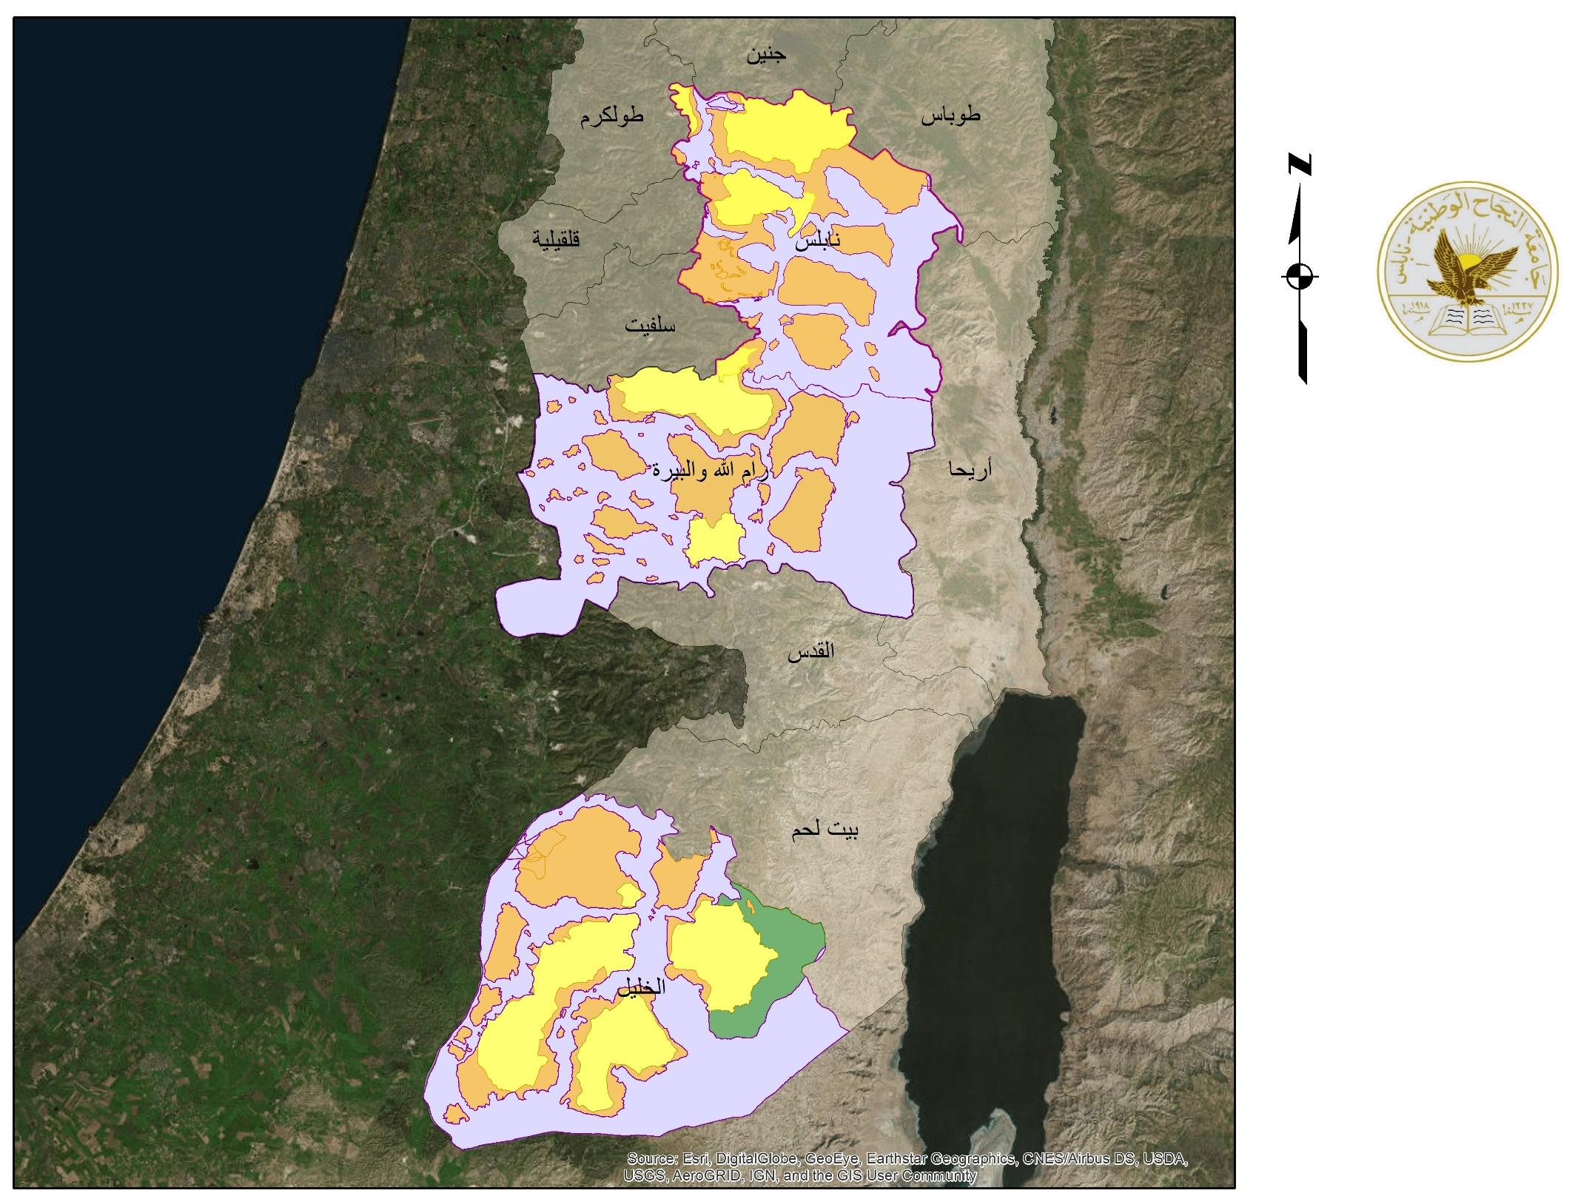

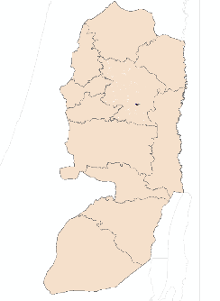
20%
خريطة التصنيف السياسي
45%
35%
12%
Content Here
25%
63%
20%
مفتاح الخريطة
التصنيف السياسي
A أراضي
B أراضي
%25
54%
C أراضي
محميات طبيعية
مقياس 1:600,000

Slide 18
01
Selection of the suitable governorate
At this phase, specific criteria are set ,to choose the best governorate for the housing between the proposed communities .
Governorate Selection criteria
Demographic
Criteria
Marriage contracts
Cultural Criteria
How the project manages to attract youth
Geopolitical Criteria
Political classification of land
Percentage of youth concentration
3
2
1

Slide 19

3
Demographic Criteria
Youth concentration
The selected governorate should has a high percentage of youth concentration .
Governorate | Percentage
Ramallah & Biereh | 23%
Nablus | 22%
Hebron | 22%

Slide 20
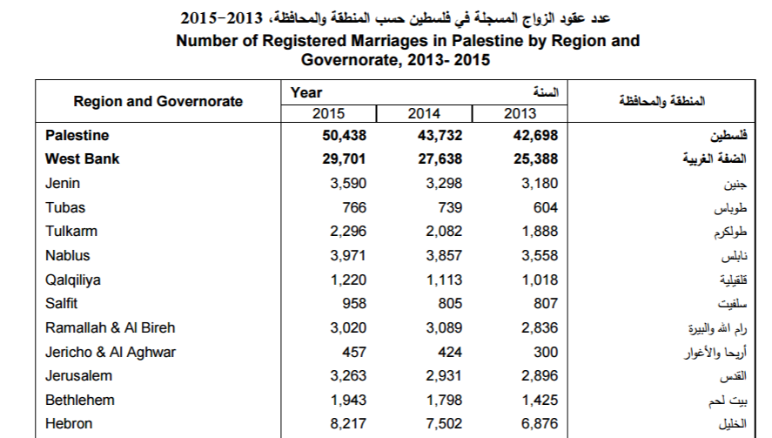
3
Demographic Criteria
II. Marriage contracts
2
3
1

Slide 21
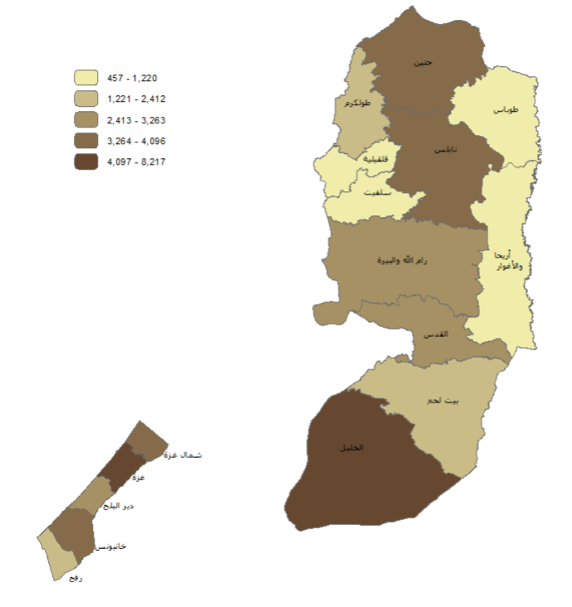
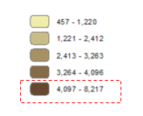



Slide 22
Selection and weight selection criteria
Criteria | Weight\10 | Site-rank
 |  | 1=Bad | 2=Good | 3=Excellent
How the project manages to attract youth | 9 | Attraction < 10% | Attraction= (10-20)% | Attraction > 20%
Political Classification | 8 | C Land > 50% | C Land = (20-30)% | C Land < (30-50)%
Percentage of the youth concentration | 6 | Concentration < 10% | Concentration = (20-30)% | Concentration > 30%
Marriage contracts | 7 | (450-1220) | (1221-2412) | (2413-3263)

Slide 23
Criteria | Weight\10 | Ramallah & Albiereh |  | Nablus |  | Hebron
 |  | Site-rank (1-3) | Total | Site-rank (1-3) | Total | Site-rank (1-3) | Total
How the project manages to attract youth | 9 | 2 | 18 | 3 | 27 | 2 | 18
Political Classification | 8 | 1 | 8 | 3 | 24 | 1 | 8
Percentage of the youth concentration | 6 | 2 | 12 | 2 | 12 | 2 | 12
Marriage contracts | 7 | 3 | 21 | 3 | 21 | 3 | 21
Total | - | 51 |  | 84 |  | 59

Slide 24
02
Selection of the suitable land parcel
several criteria have been taken into consideration that affect the selection of suitable land for housing.
1
Topography of the terrain
Location to master plans
2
Location near the street network
3
Away from Israeli settlement
4
5
Geopolitical classification
Biodiversity and land value
6
7
Land price

Slide 25
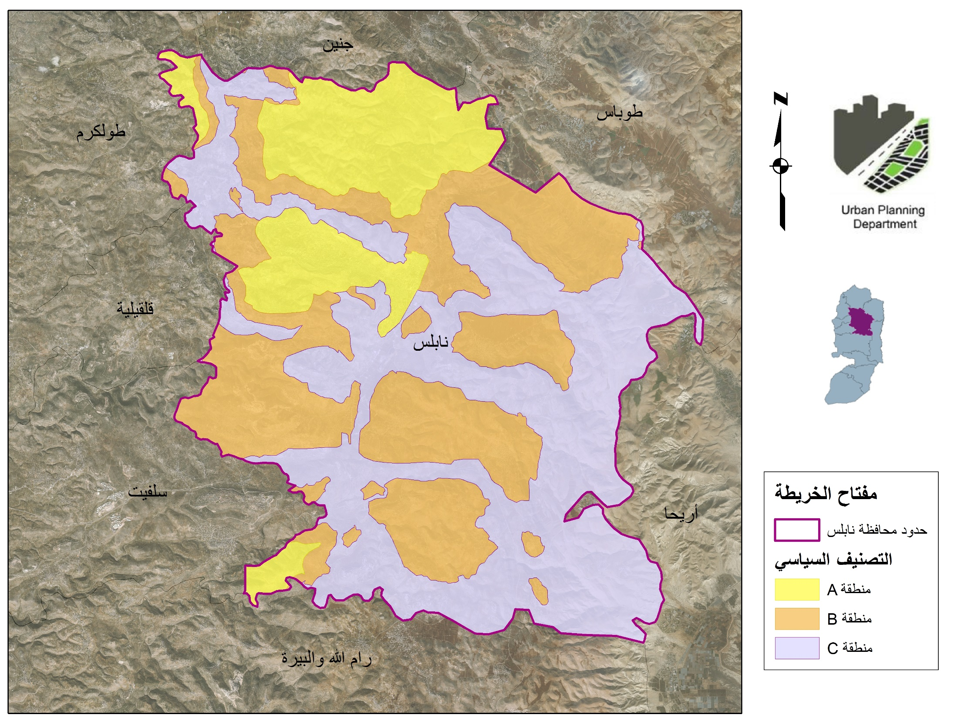
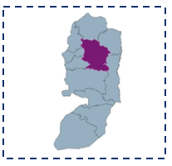
التصنيف السياسي للأراضي
مقياس 1:170,000

Slide 26
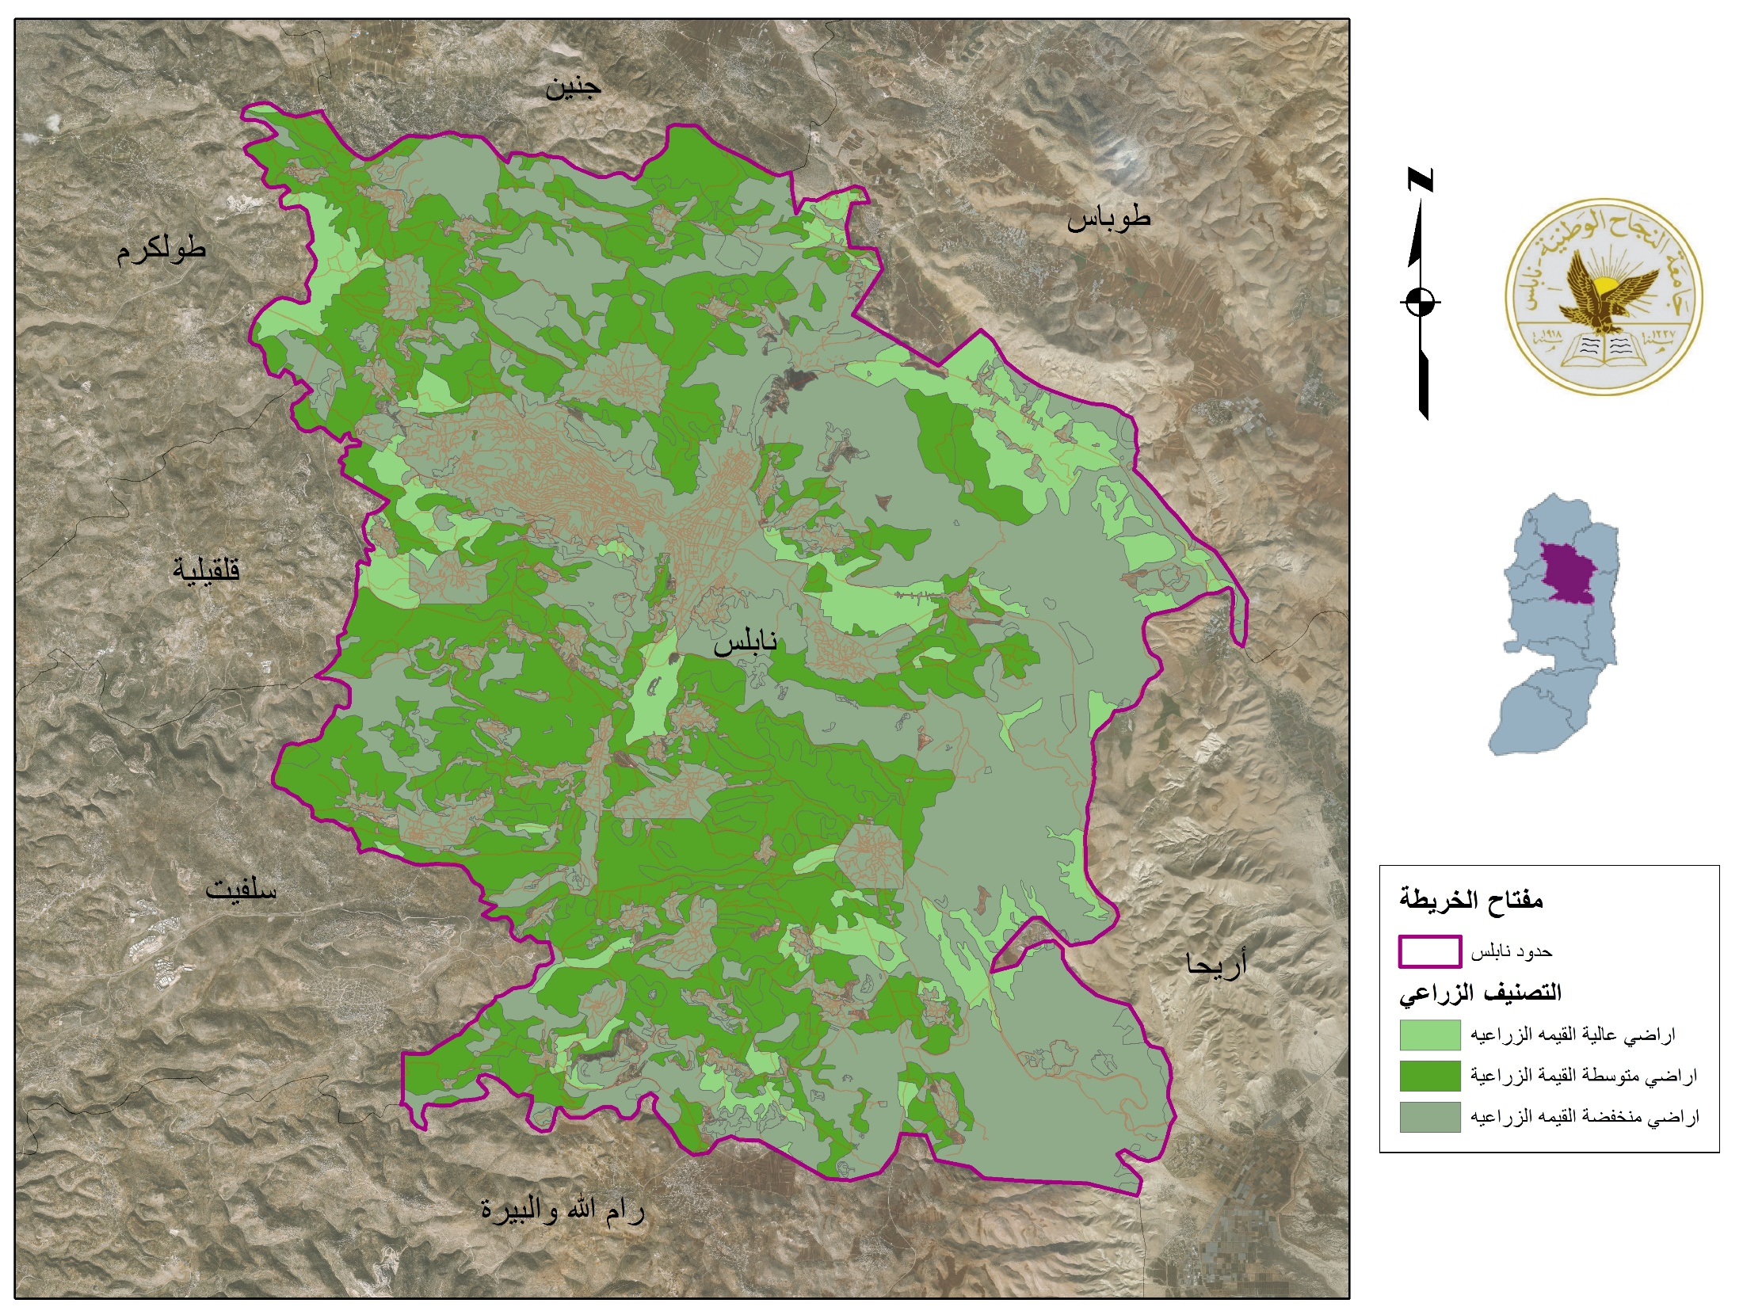

التصنيف الزراعي للأراضي
مقياس 1:170,000

Slide 27
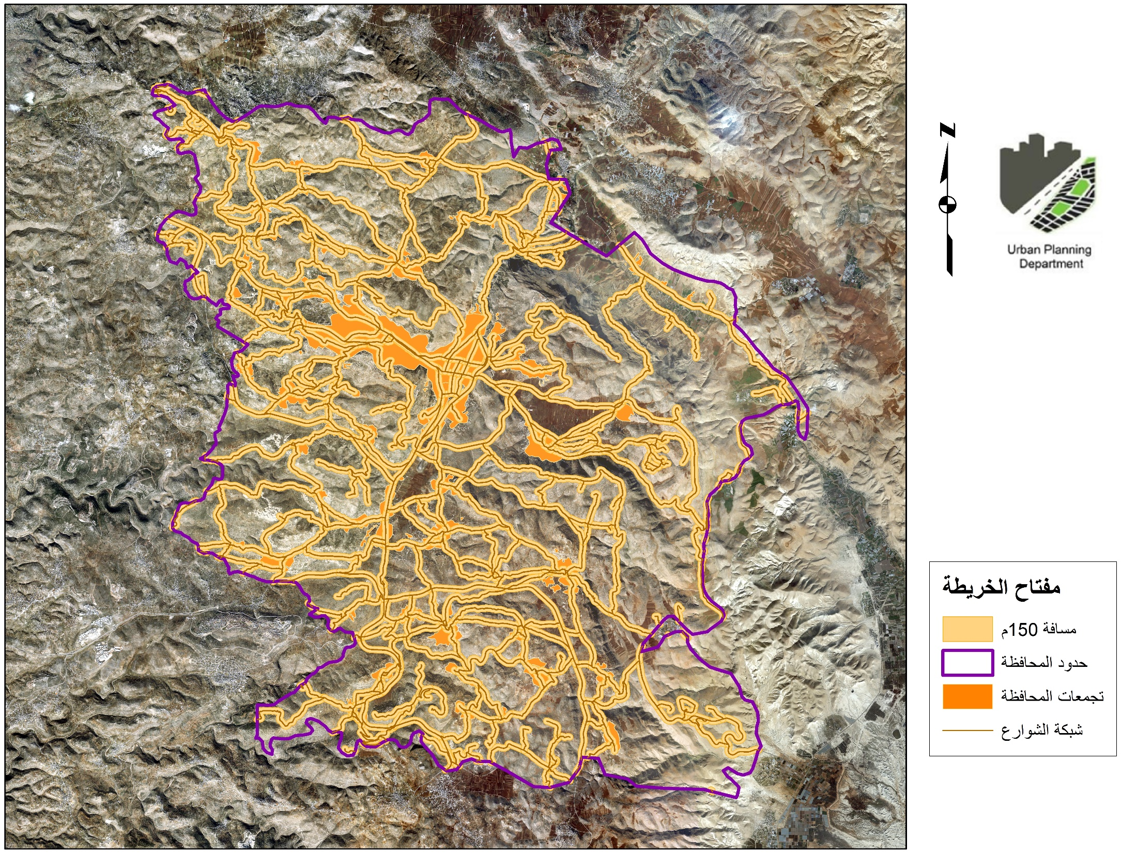
خريطة شبكة الشوارع
مقياس 1:170,000

Slide 28
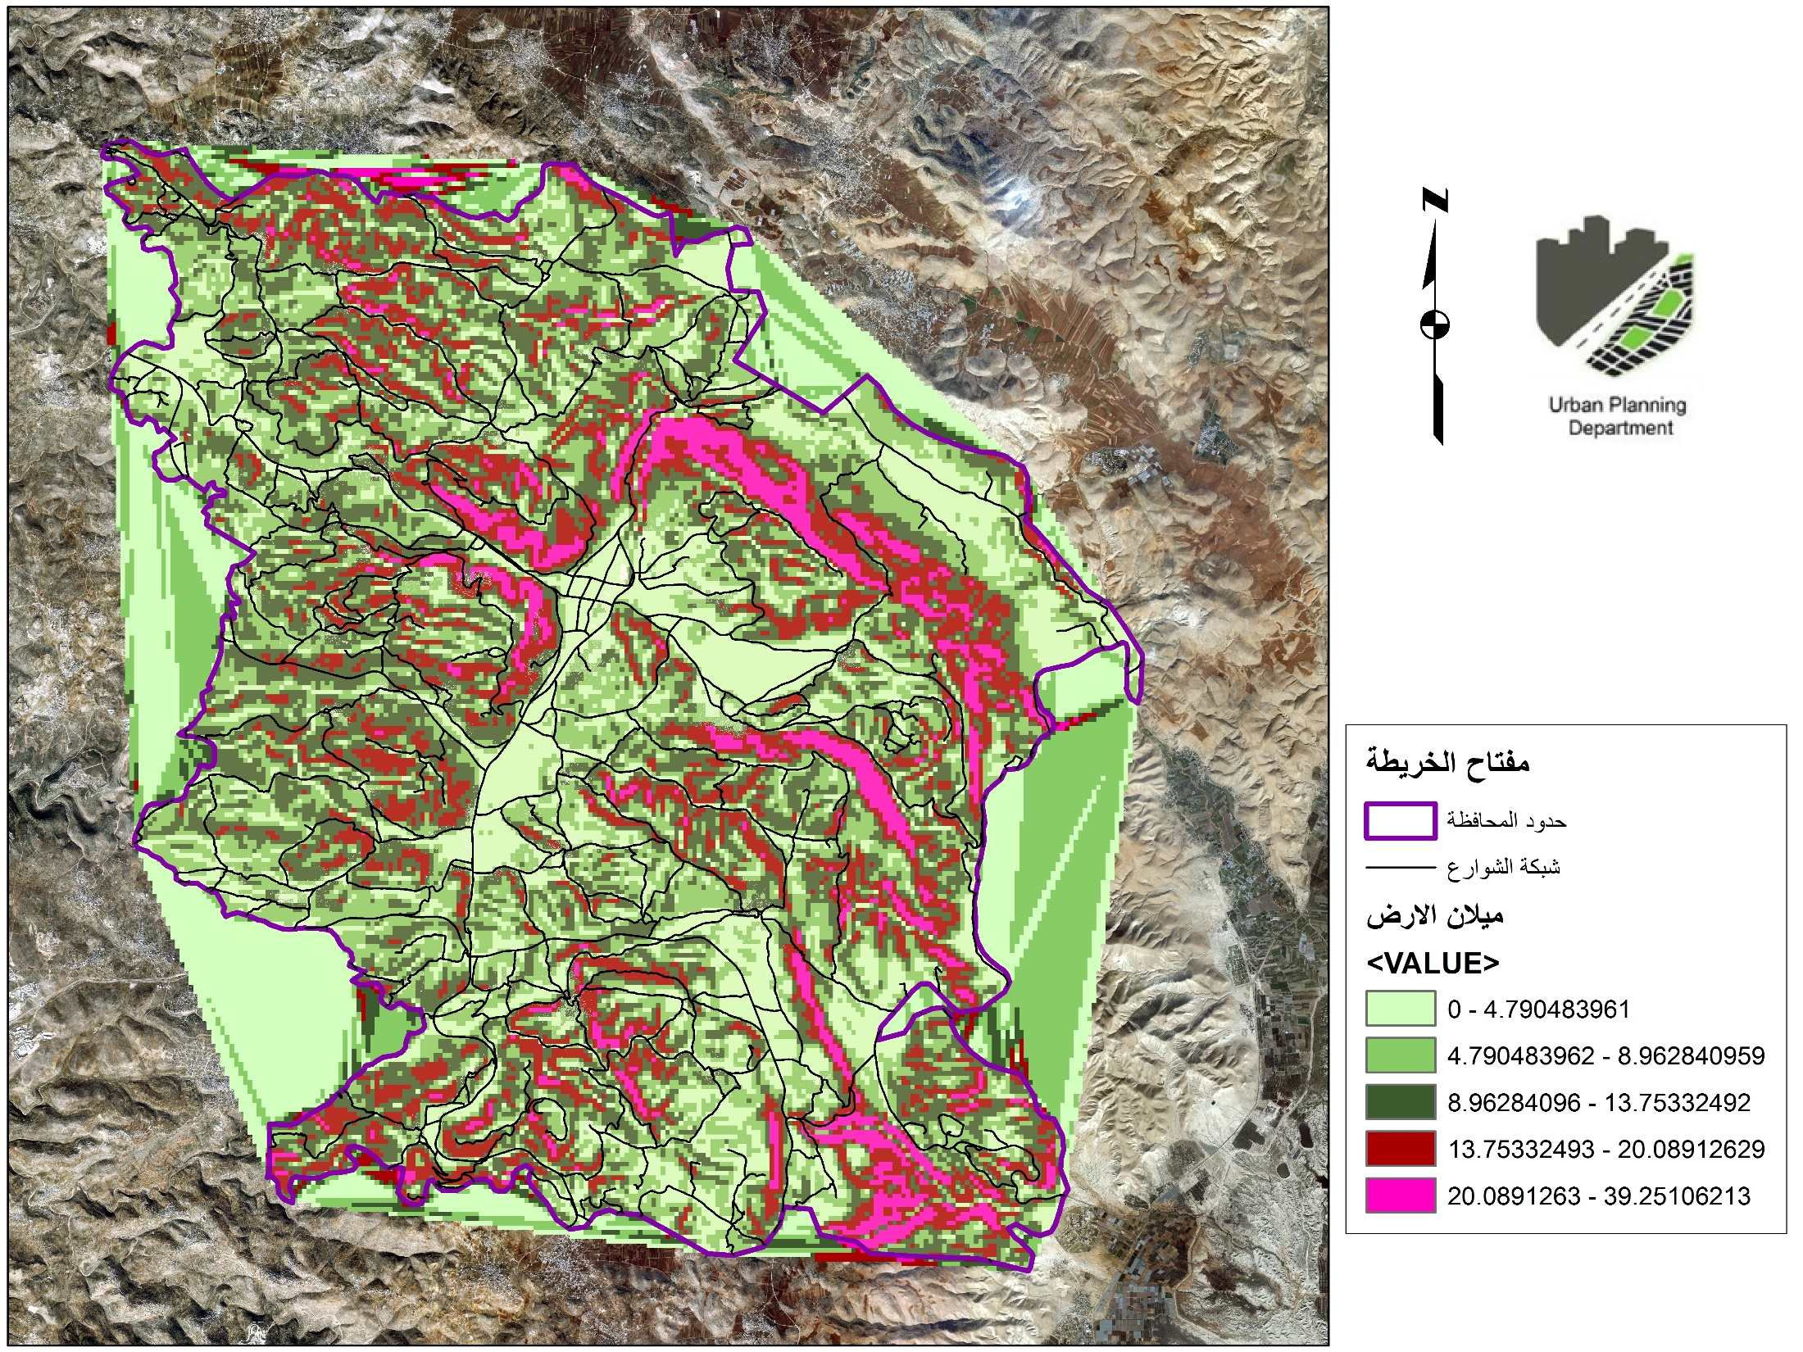

خريطة ميلان الارض
خريطة الميول في المنطقة
Content Here
مقياس 1:170,000
مقياس 1:170,000

Slide 29
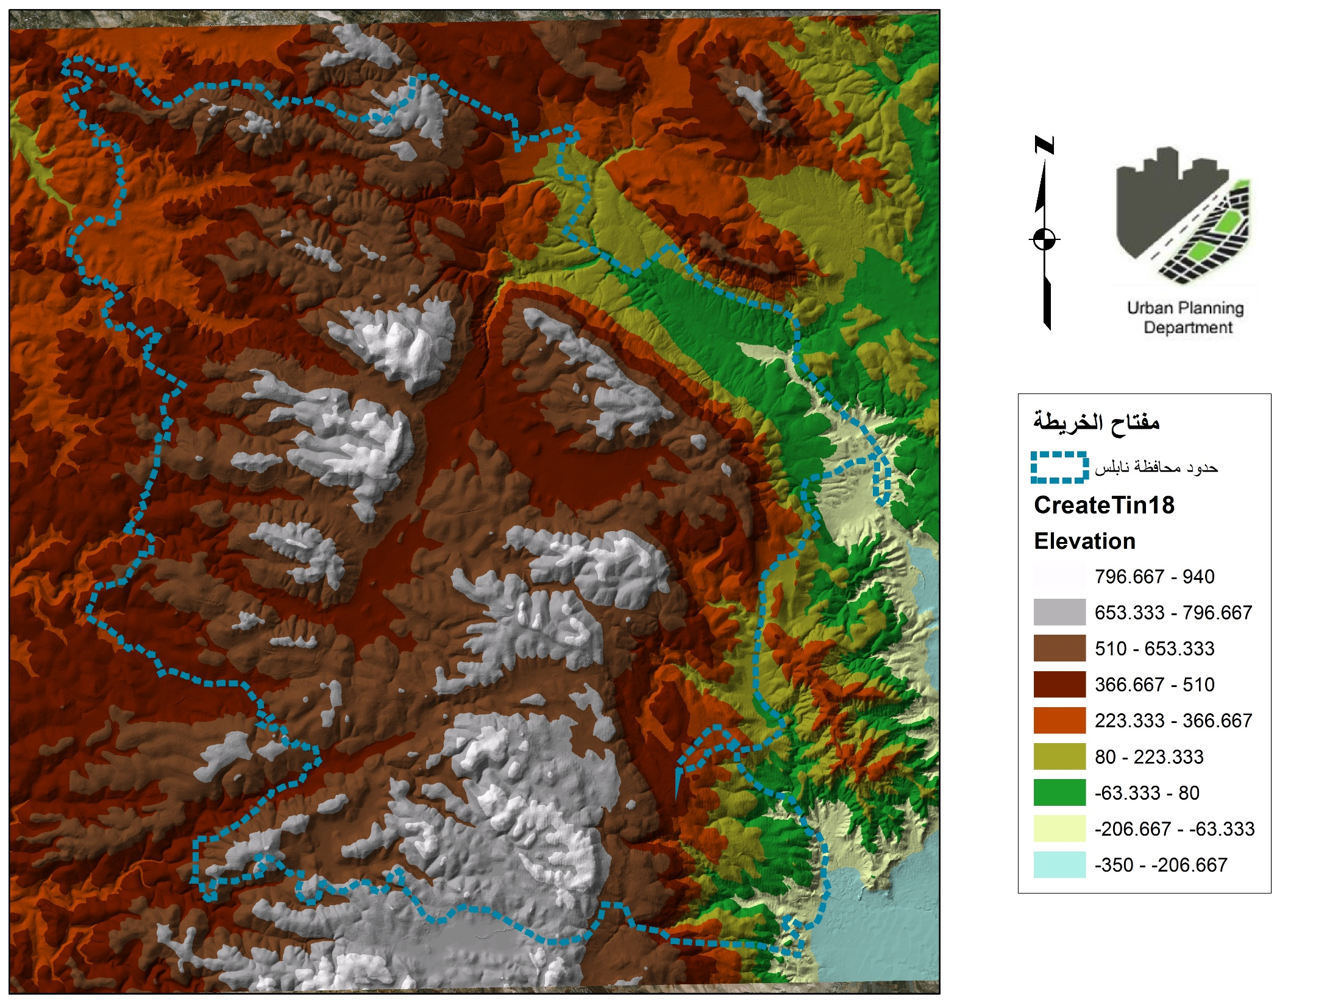
خريطة الطوبوغرافيا في المنطقة
Content Here
مقياس 1:160,000

Slide 30
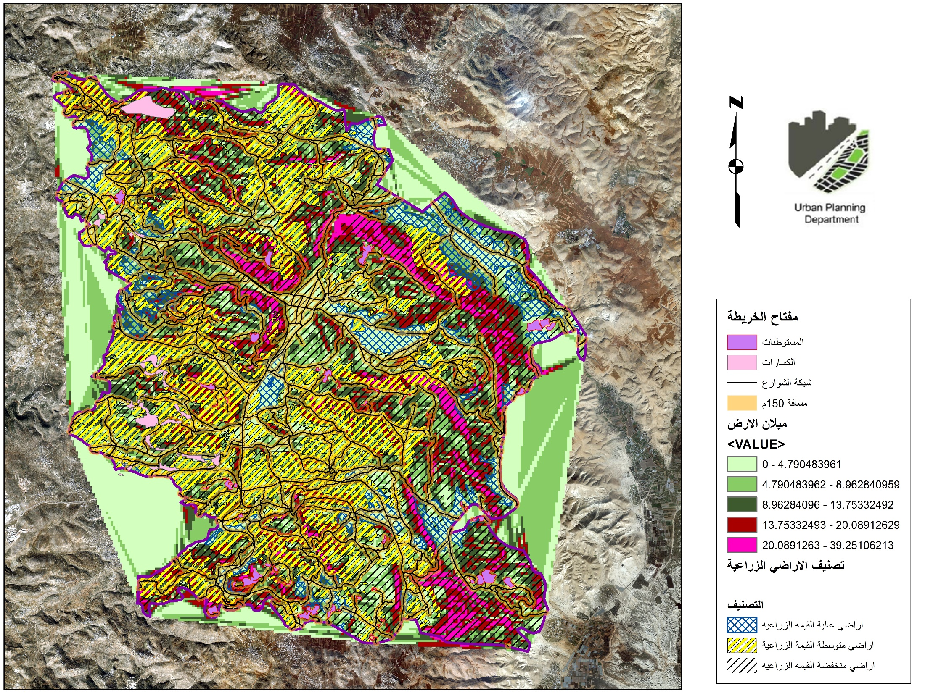
خريطة المعايير واختيار الموقع
مقياس 1:170,000
الكسارات والمناطق الصناعية

Slide 31
خريطة الأراضي المقترحة
عصيرة الشمالية
مقياس 1:170,000
بيتا
عقربا

Slide 32
Selection and weight selection criteria
Criteria | Weight\10 | Site-rank
 |  | 1=Bad | 2=Good | 3=Excellent
The topography | 9 | slope > 10% | Slope = (5-10)% | Slope= (0-5) %
Masterpaln boundary | 6 | Inside boundaries | On boundaries | Out boundaries
Proximity to the street network | 9 | 150m | 100m | 50m
Distance from settelments | 7 | D < 100m | 100m < D < 500m | D > 500m
Land price | 8 | P > 30,000 JD Expensive | 20,000 < p <30,000 JD | 7000 < P <10,000 JD Low
Evaluation table of selected sites and their weights

Slide 33
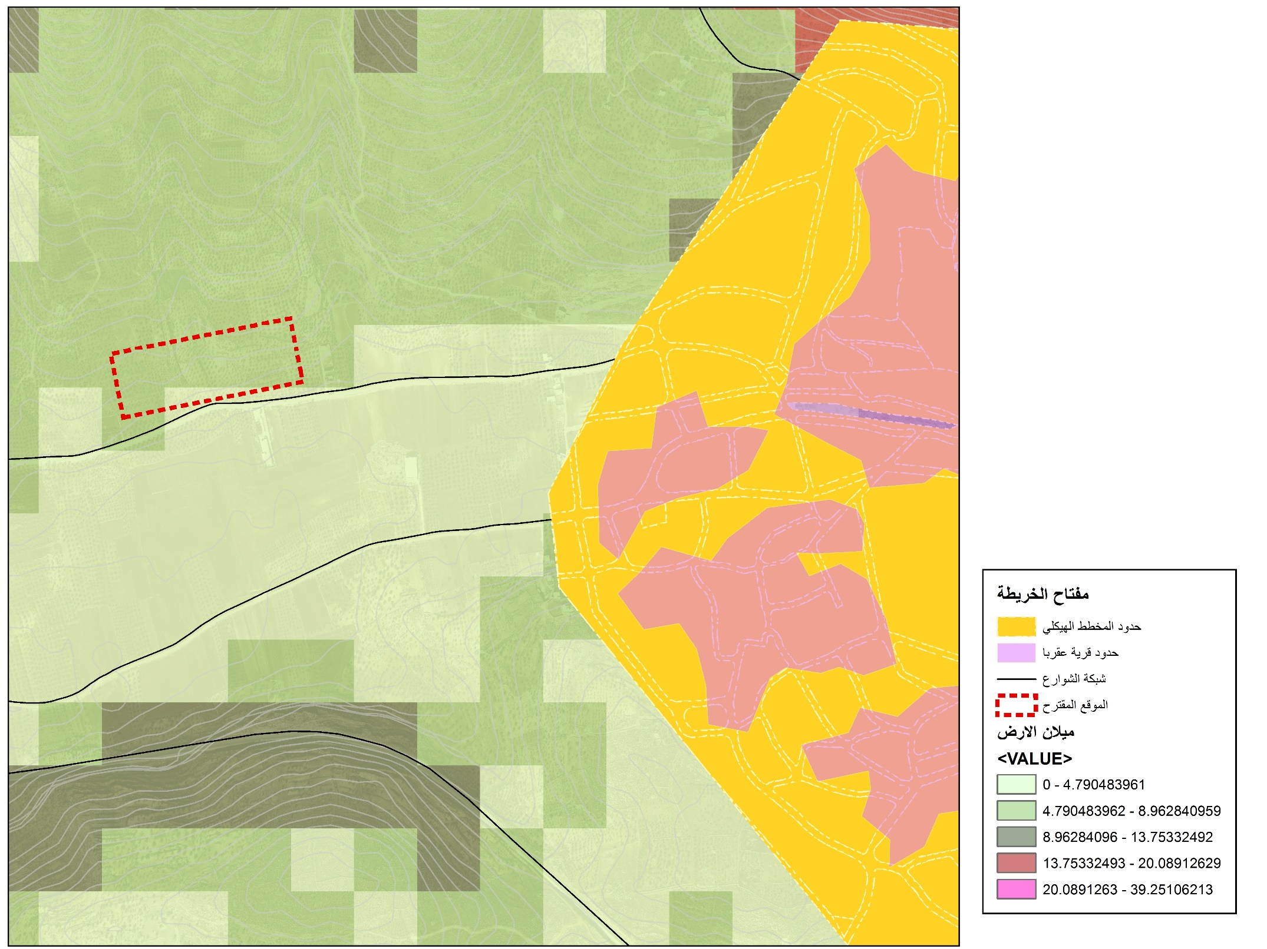

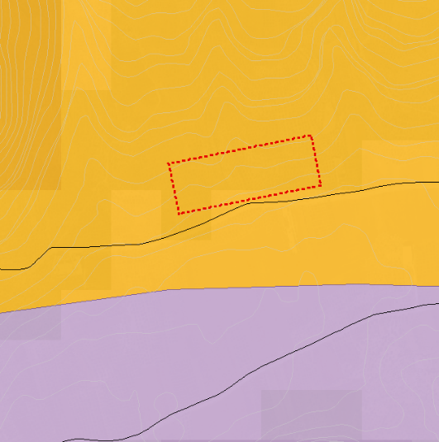
خريطة الموقع الأول
1
First suggested site:
Site : Aqraba
Area :51 donum
Content Here
مقياس 1:10000
Area B
Area C

Slide 34
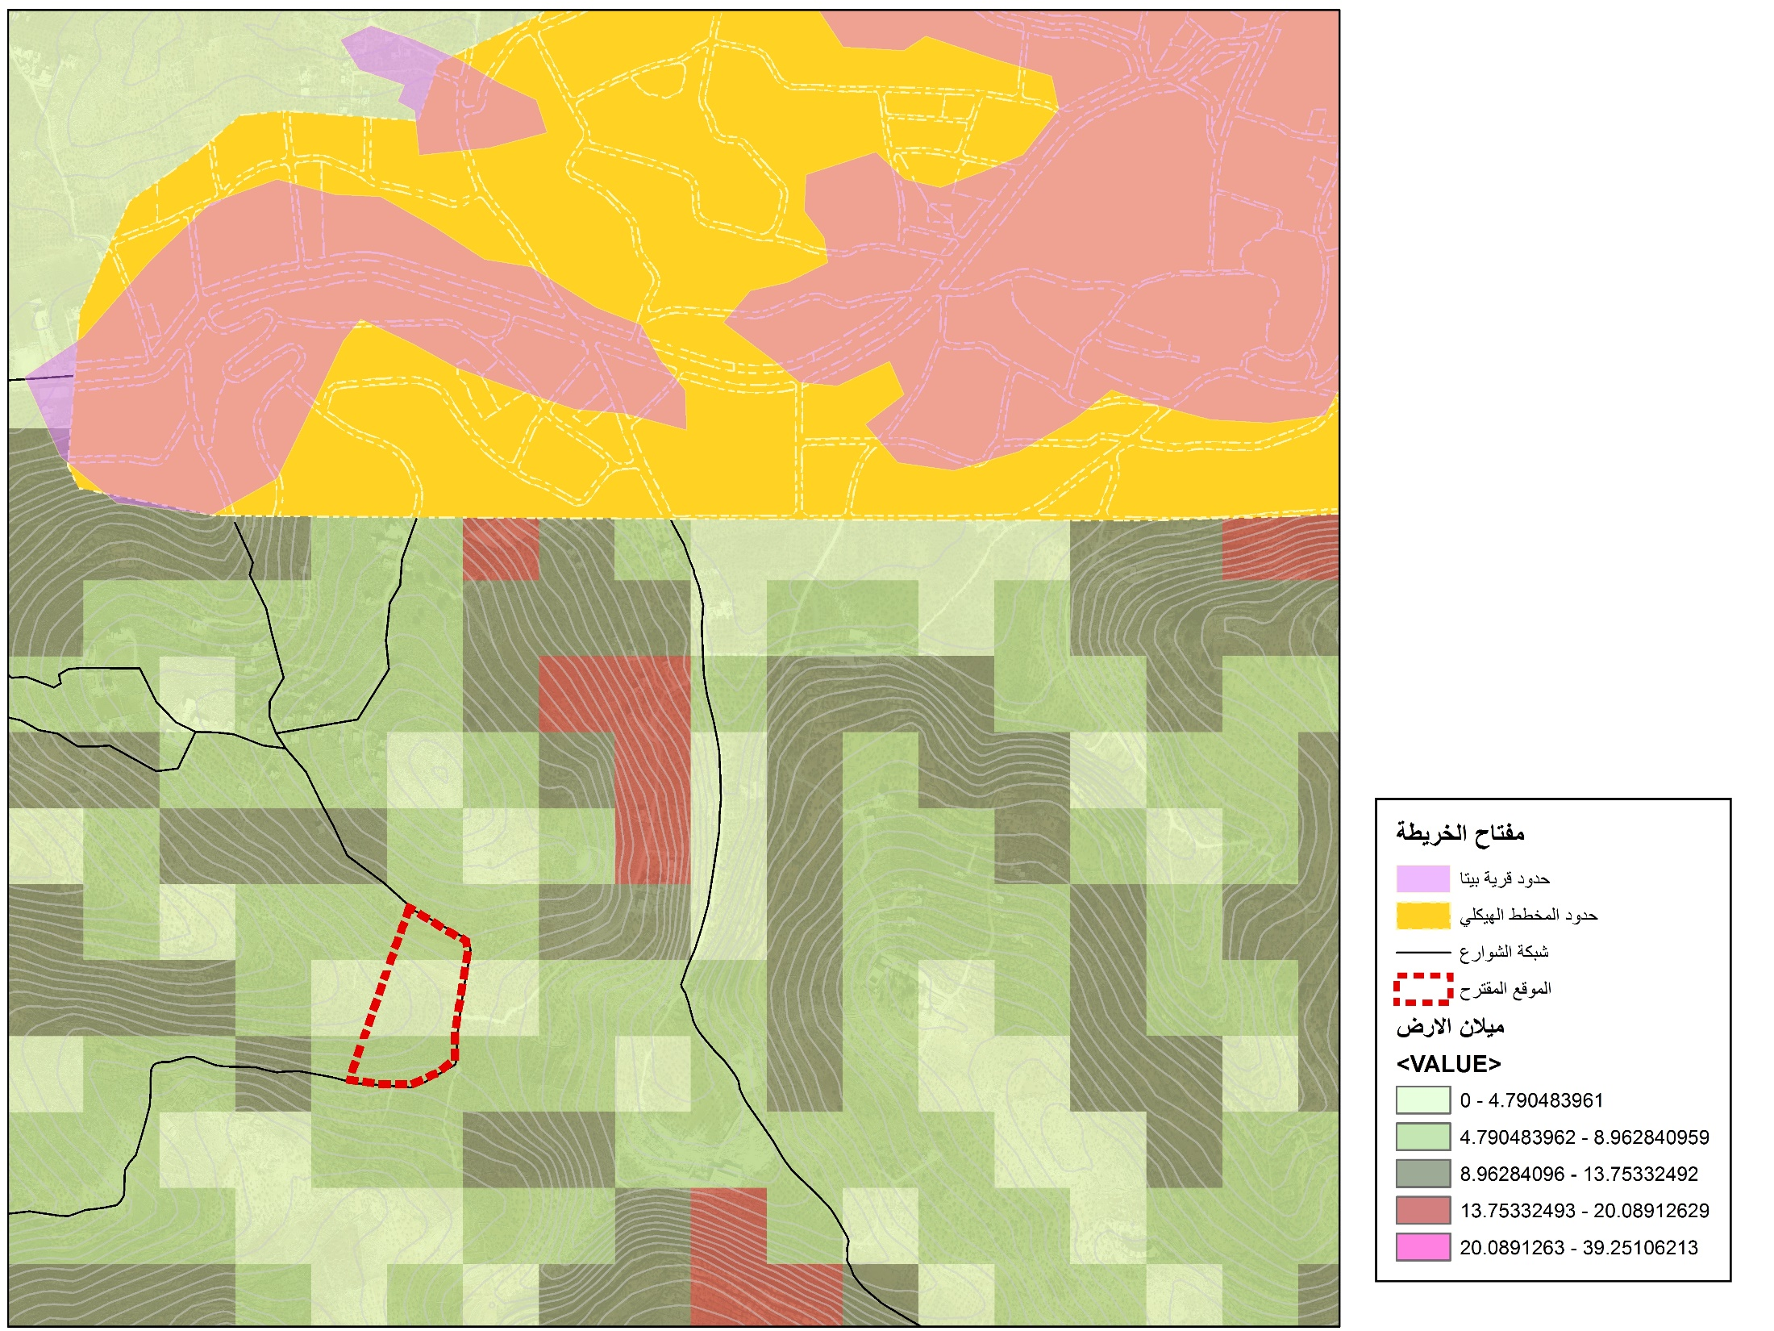
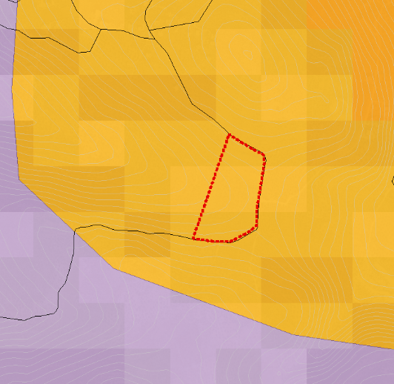
خريطة الموقع الثاني
2
Second suggested site:
Site : Bieta
Area :40 donum
Content Here
مقياس 1:10000
Area B
Area C

Slide 35
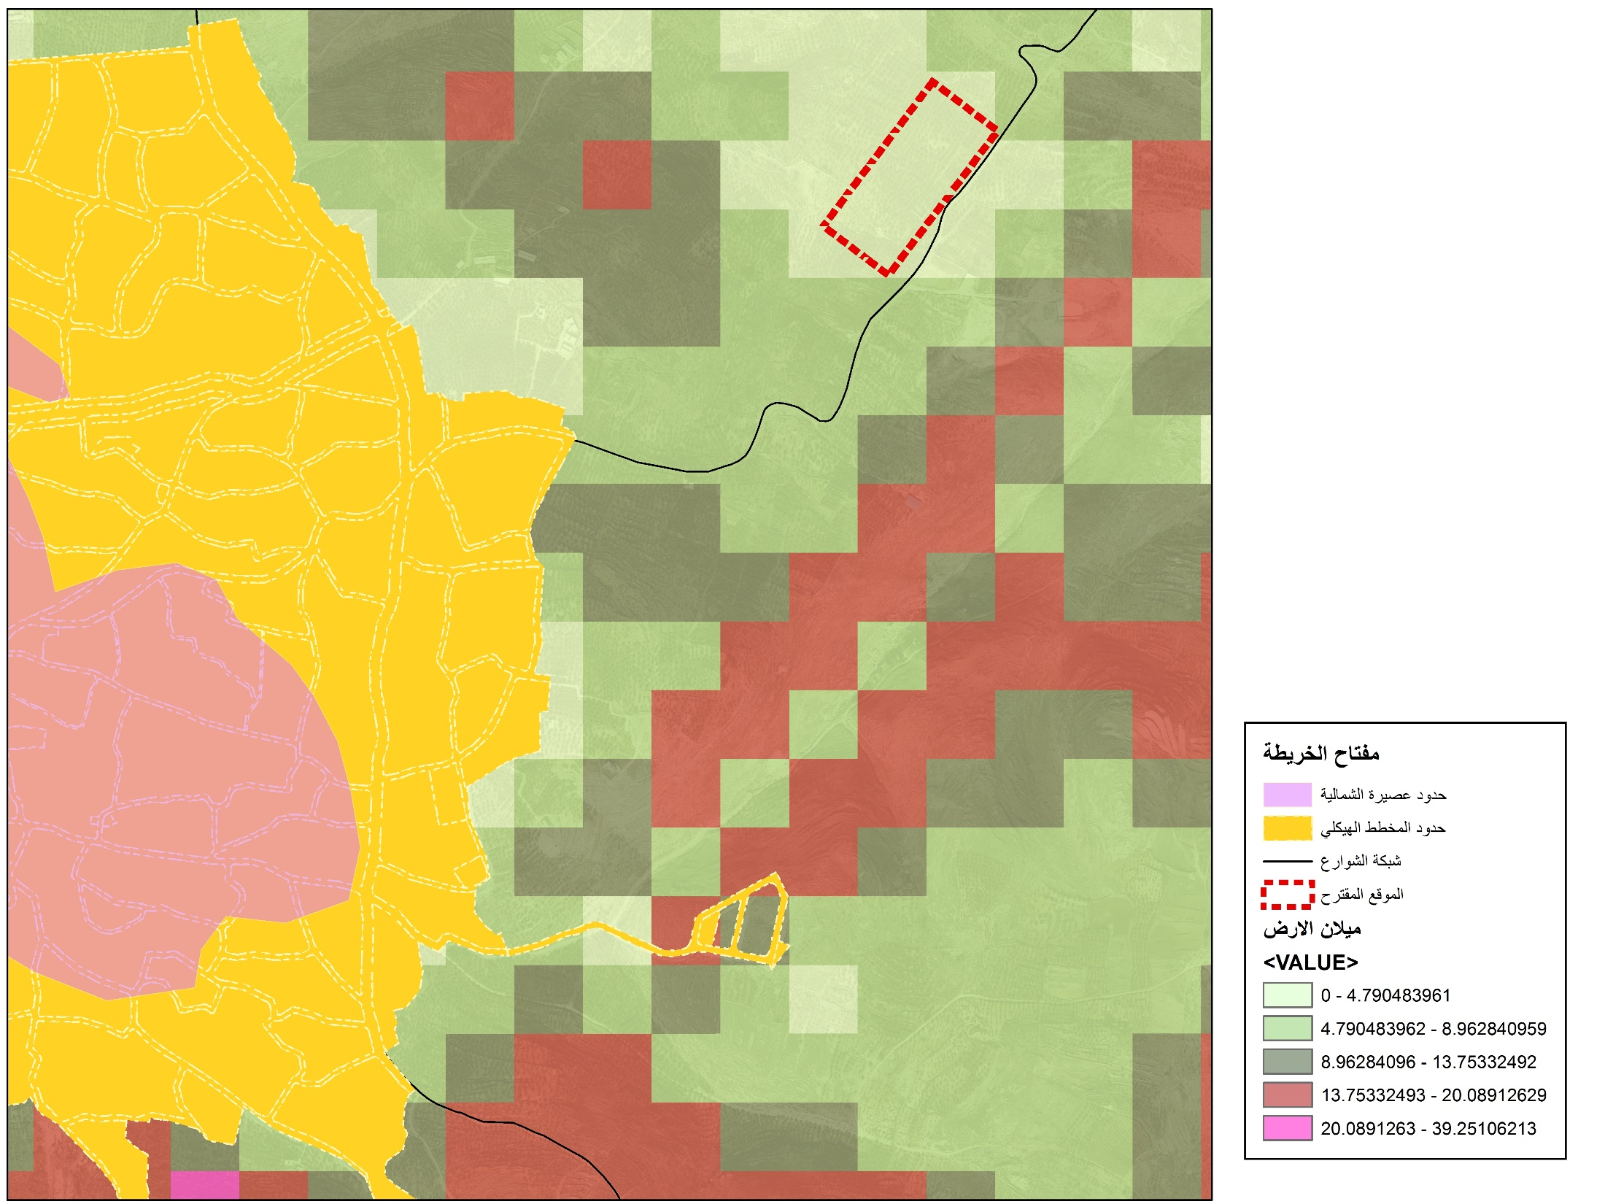
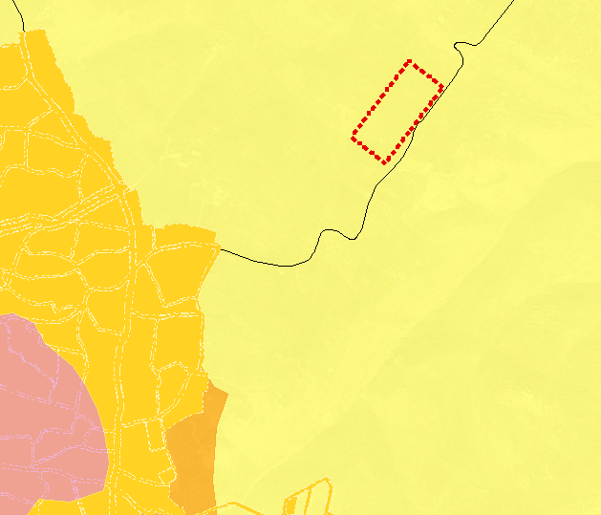
3
Third suggested site:
Site : Asira Alshmailah
Area :53 donum
خريطة الموقع الثالث
Content Here
مقياس 1:10000
Area A

Slide 36
Criteria | Weight\10 | Aqraba |  | Asira -Alshmalia |  | Bieta
 |  | Site-rank (1-3) | Total | Site-rank (1-3) | Total | Site-rank (1-3) | Total
The topography | 9 | 2 | 18 | 3 | 27 | 3 | 27
Masterpaln boundary | 6 | 3 | 18 | 1 | 6 | 2 | 12
Proximity to the street network | 9 | 3 | 27 | 3 | 27 | 3 | 27
Geopolitical classification | 8 | 3 | 21 | 2 | 16 | 1 | 8
Distance from settelments | 7 | 3 | 21 | 3 | 21 | 3 | 21
Land price | 8 | 3 | 24 | 1 | 8 | 2 | 16
Total |  | 145 |  | 108 |  | 111

Slide 37

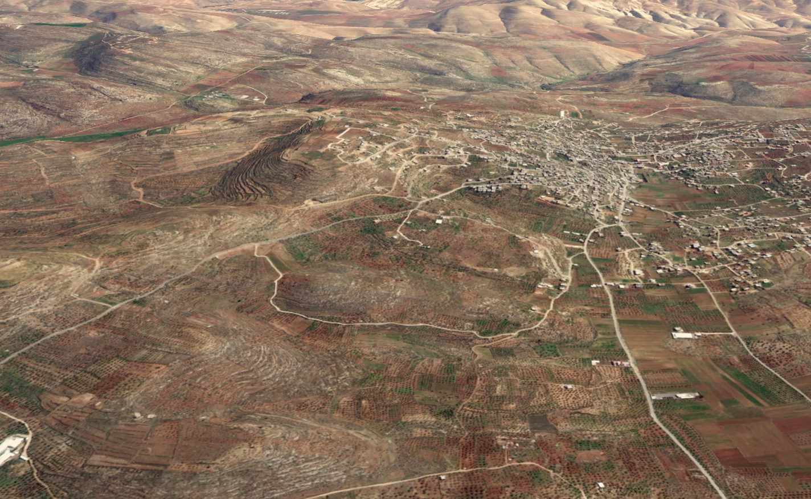

The selected site:
عقربا
بيتا
اوصرين

Slide 38
Site Analysis Stage

Slide 39
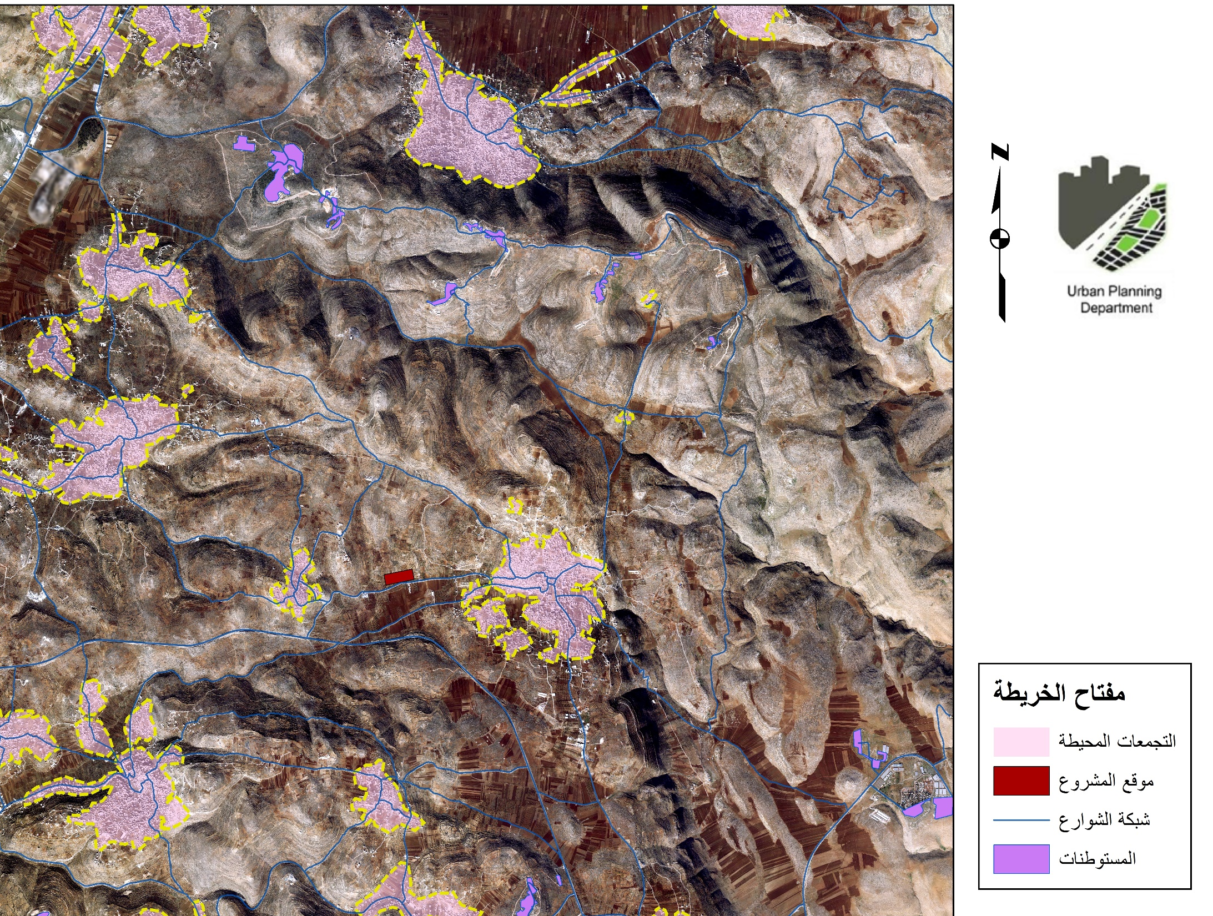
روجيب
خريطة العلاقة بالموقع
المحيط
بيت فوريك
عورتا
بيتا
8km
6km
5km
4km
عقربا
أوصرين
1km
4km
2km
مقياس 1:55,000
3km
قبلان
جوريش

Slide 40
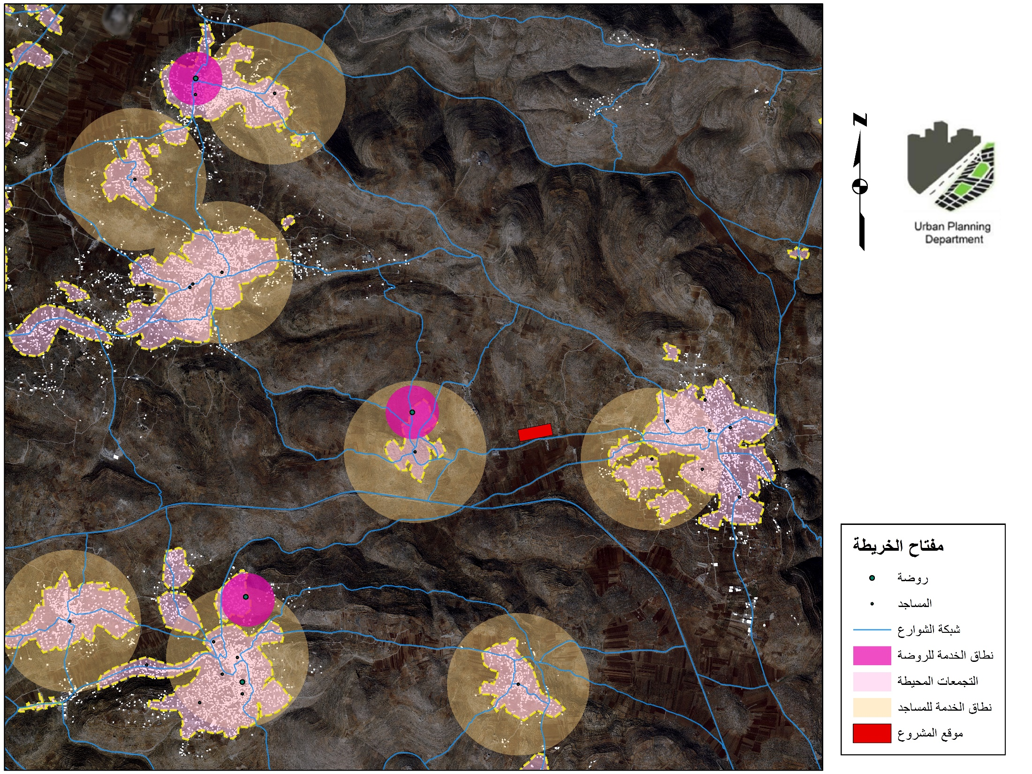







خريطة توزيع الخدمات المحيطة
The scope of service:
عورتا
أودلا
= 500 m
= 800 m
بيتا
= 200 m
مقياس 1:55,000
= 5000 m
مفتاح الخريطة
عقربا
موقع المشروع
أوصرين
مسجد
4km
مستوصف
روضة اطفال
يتما
مركز شرطة محلي
قبلان
جوريش
نطاق خدمة الروضة
نطاق خدمة المسجد

Slide 41
The concept and design Stage

Slide 42
The objectives of the project :
01
Provide houses with an affordable standards and cost for the youths .
02
Support and encourage the youth and the newly couples to live in this housing.
03
Design an affordable housing master plan that suitable residents.
:
Provide the required service that would cover the residents needs.
04

Slide 43
The project program and areas :
The housing accommodates nearly 3000 person.
The total area is 51 dounm .
The service | Area (m2)
Kindergarten | 2100
Mosque | 1900
Health center | 2100
Shopping mall | 750
Park | 5000
Total Area | 11,850

Slide 44
Total area of housing :
Total area of housing and the services distribution :
Service type | Area m2 | Percentage
Shopping mall | 750 | 2%
Mosque | 2300 | 6%
kindergarten | 2100 | 5%
park | 5000 | 12%
Health centre | 2100 | 6%
Resdential buildings | 13,860 | 33%
Streets and open spaces (includes parkings | 15,000 | 36%
Total | 51,650 | 100%

Slide 45
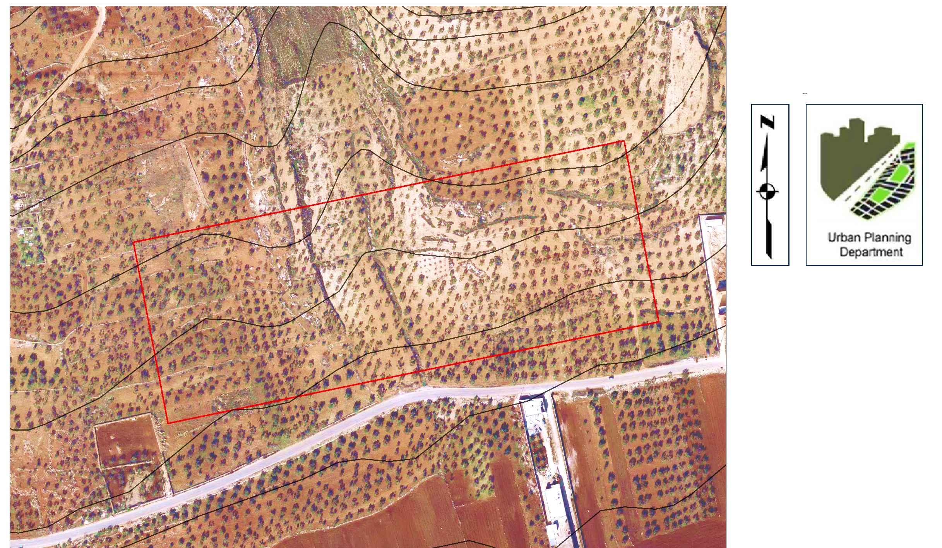
The project concept:
*Grid System
*Slope = 7%
خريطة فكرة المشروع
مقياس 1:600
مفتاح الخريطة
منطقة الخدمات
مناطق سكنية
شبكة الشوارع
المدخل\المخرج

Slide 46
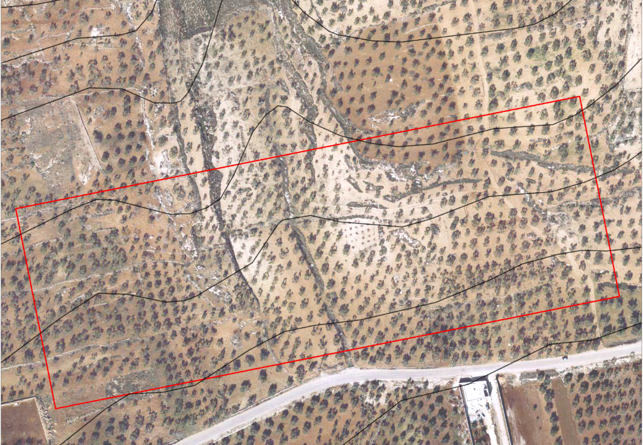
The Land use map concept:
خريطة توزيع استعمالات الاراضي
Residential A (R.A)
(R.B)
Service area
(R.B)
Service +Green area
(R.B)
Residential B (R.B)
Open space
(R.B)
Residential B (R.B)
Open space
مقياس 1:500

Slide 47
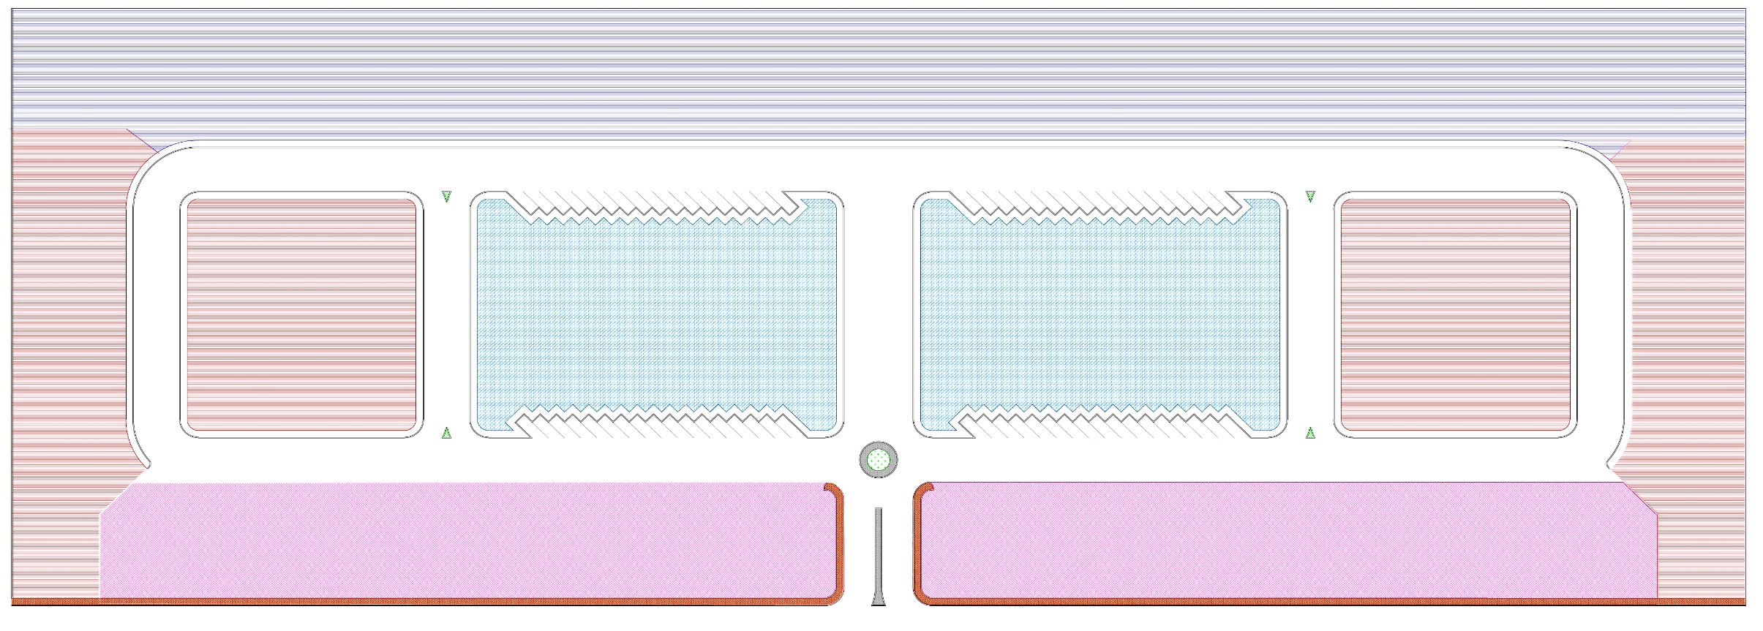

The zoning map:
مفتاح الخريطة
مساحات مفتوحة
سكن أ / شقق 150 م2
سكن ب / شقق 130م2
سكن ج / شقق 100م2
مقياس 1:300
منطقة خدمات

Slide 48
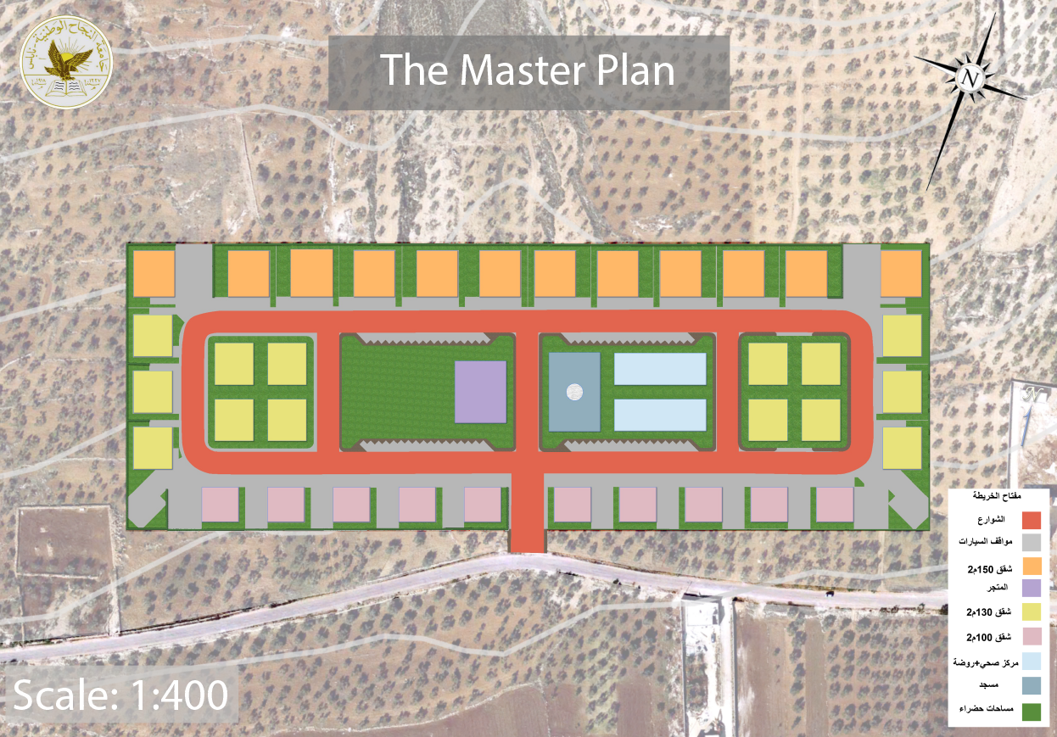

Slide 49
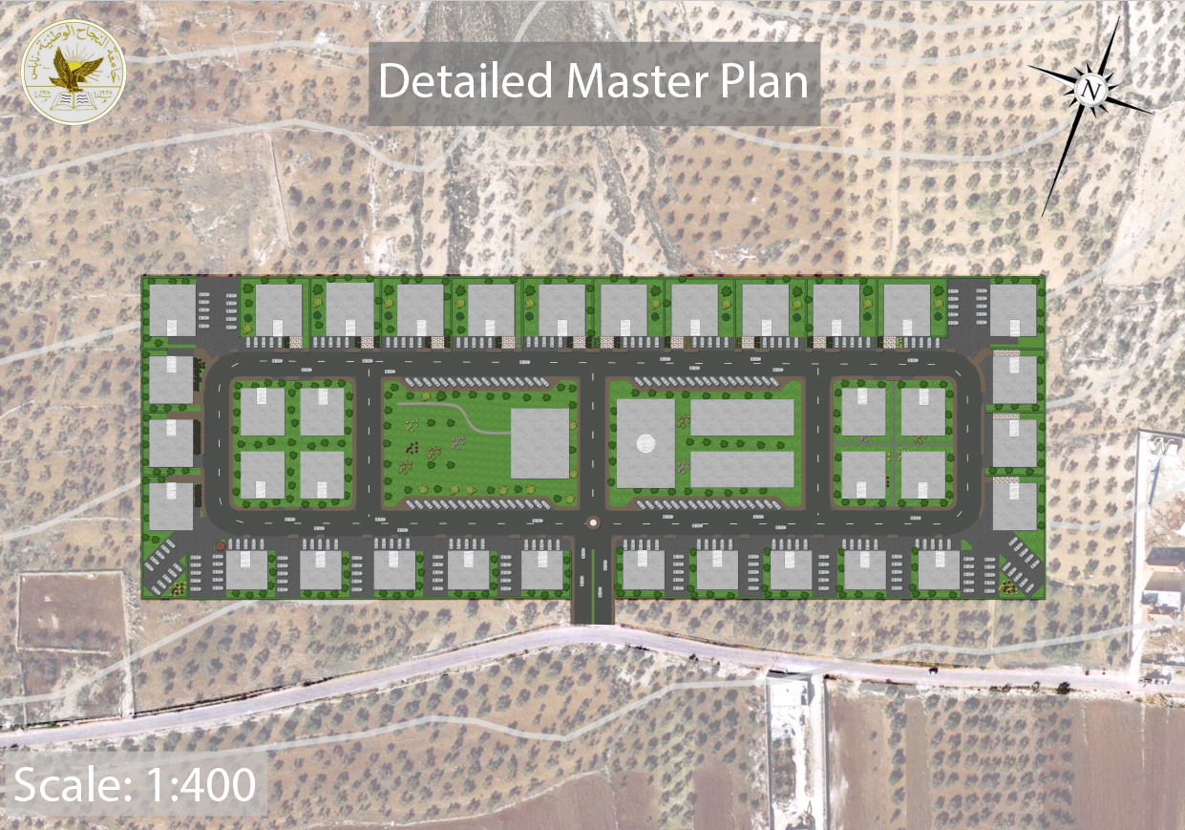

Slide 50
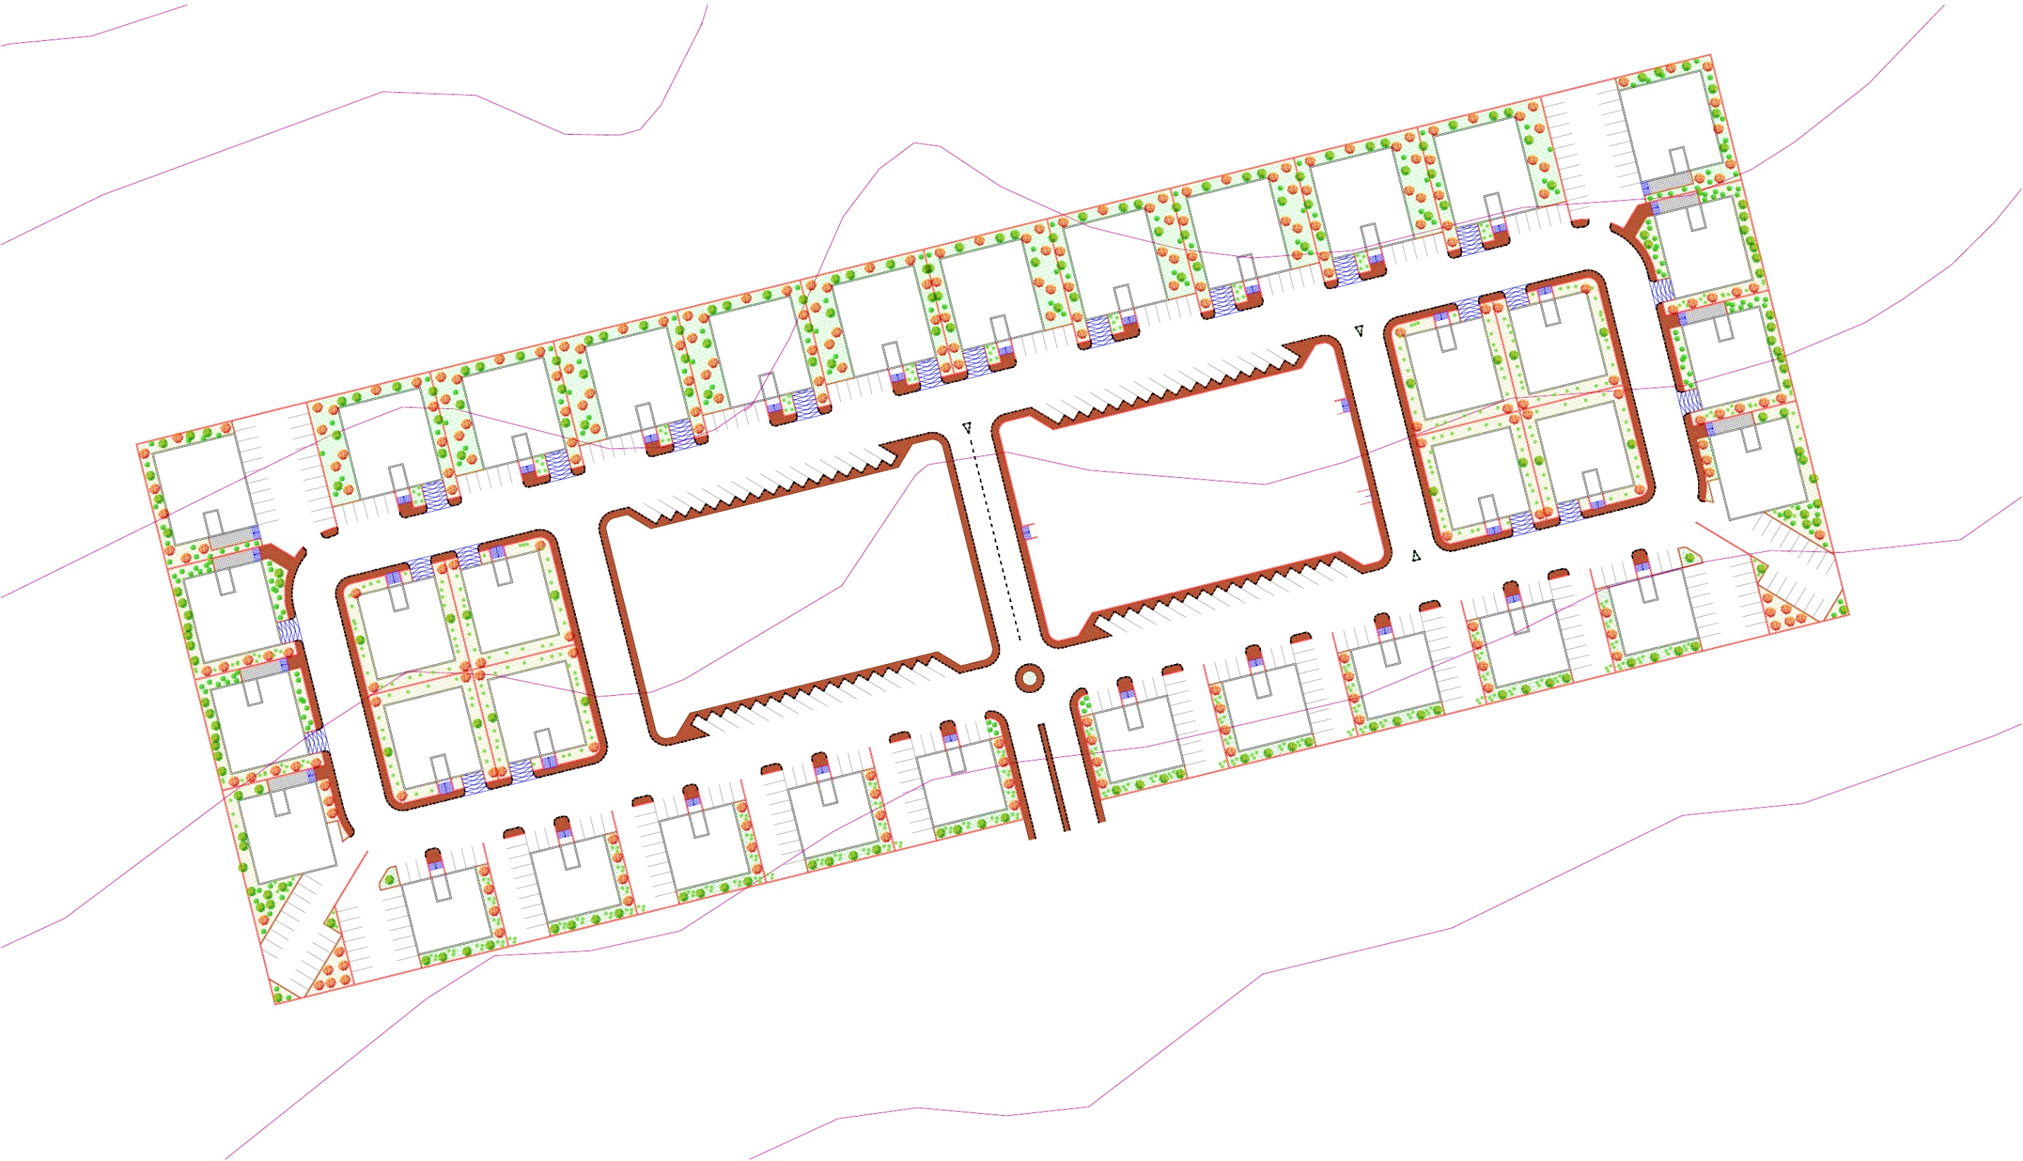
The residential area :
مقياس 1:400
مفتاح الخريطة
شقق 150م2
شقق 130م2
شقق 100م2

Slide 51
Total area of residential units :
Residential buildings | Unit Area m2 | Total No. of units | No.of units in the floor | No. of floors | No. of buildings | Area of building. | Total area of buildings
Unit “A” | 150 | 252 | 3 | 7 + P* | 12 | 450 | 5400
Unit “B” | 130 | 252 | 3 | 6 + P* | 14 | 390 | 5460
Unit “C” | 100 | 150 | 3 | 5 | 10 | 300 | 3000
 |  | 654 |  |  |  |  | 13,860
P* : underground parking.

Slide 52
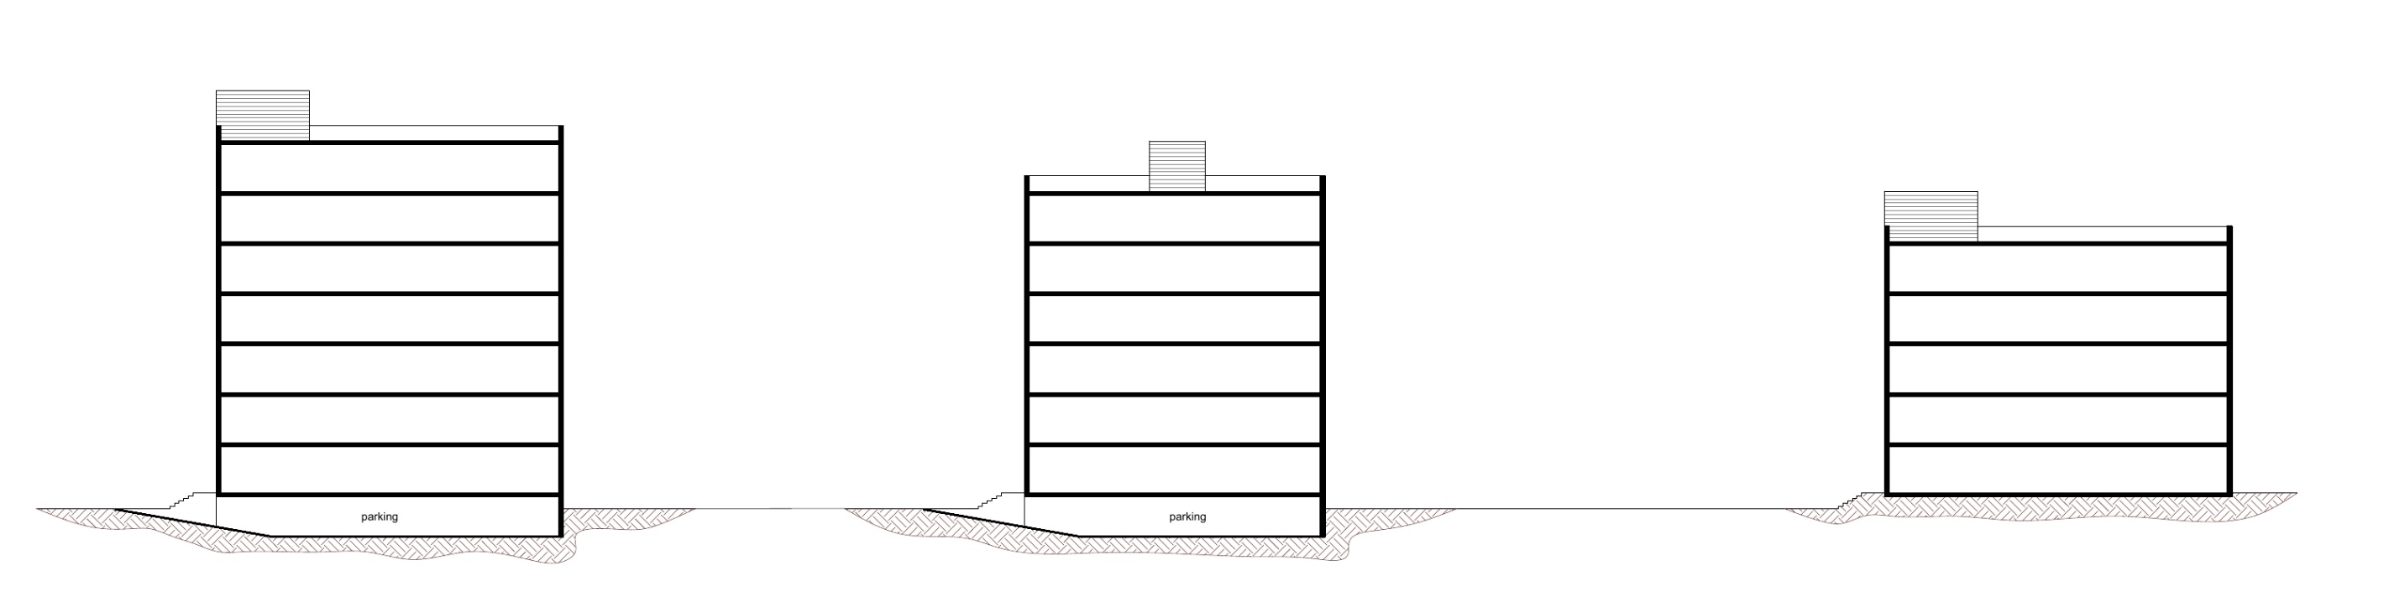
Housing typology and prototypes :
The shape of buildings is symmetrical in order to resist seismic danger .
Housing 150 m² ,7 floors
+ underground parking
Housing 130 m² , 6 floors
Housing 100 m² , 5 floors
01
+ underground parking
02
03

Slide 53
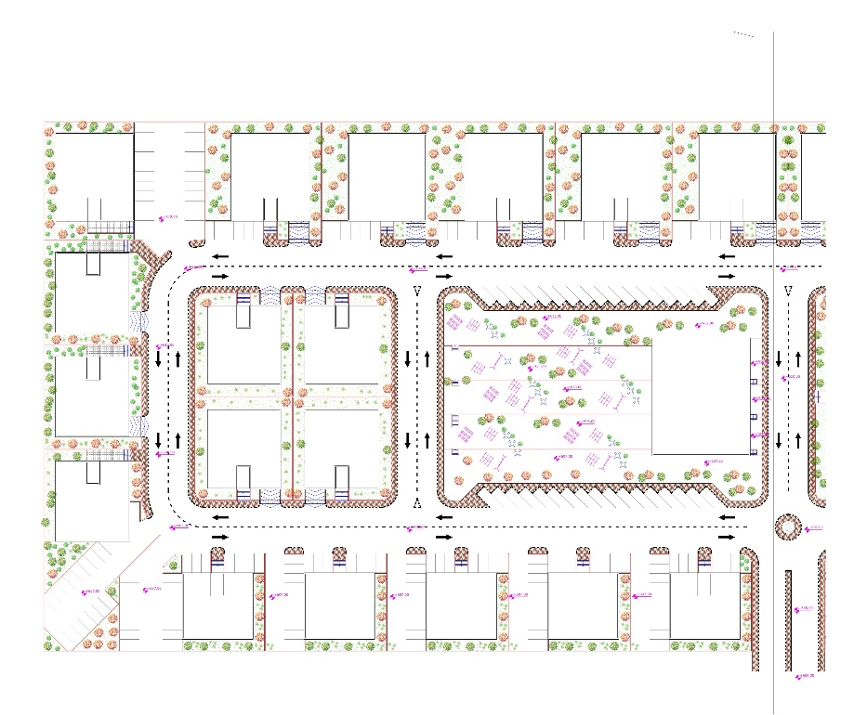
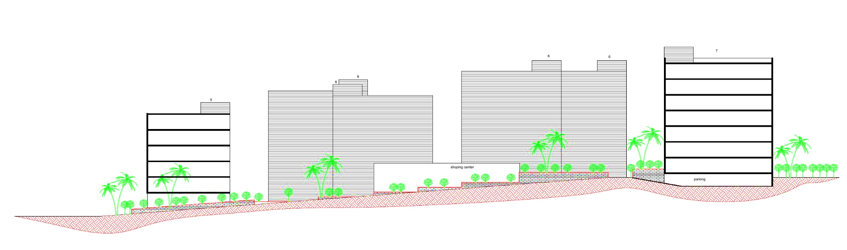
The Main section :
Section A-A
Housing A
Housing B
Housing C
The store

Slide 54
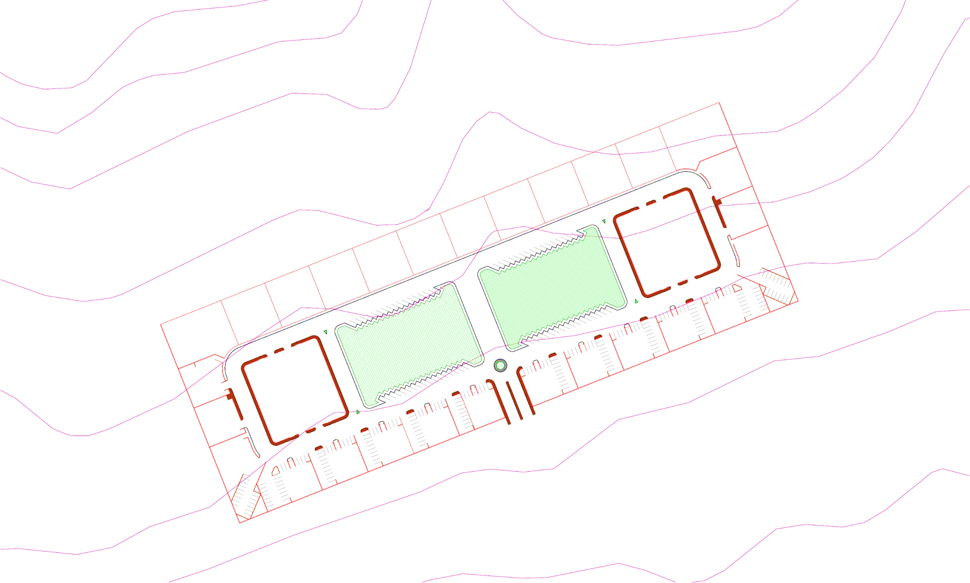
The services area :
مسجد
2
1
مقياس 1:600
1
متجر + حديقة عامة
1
مركز صحي + مسجد + روضة أطفال
2

Slide 55
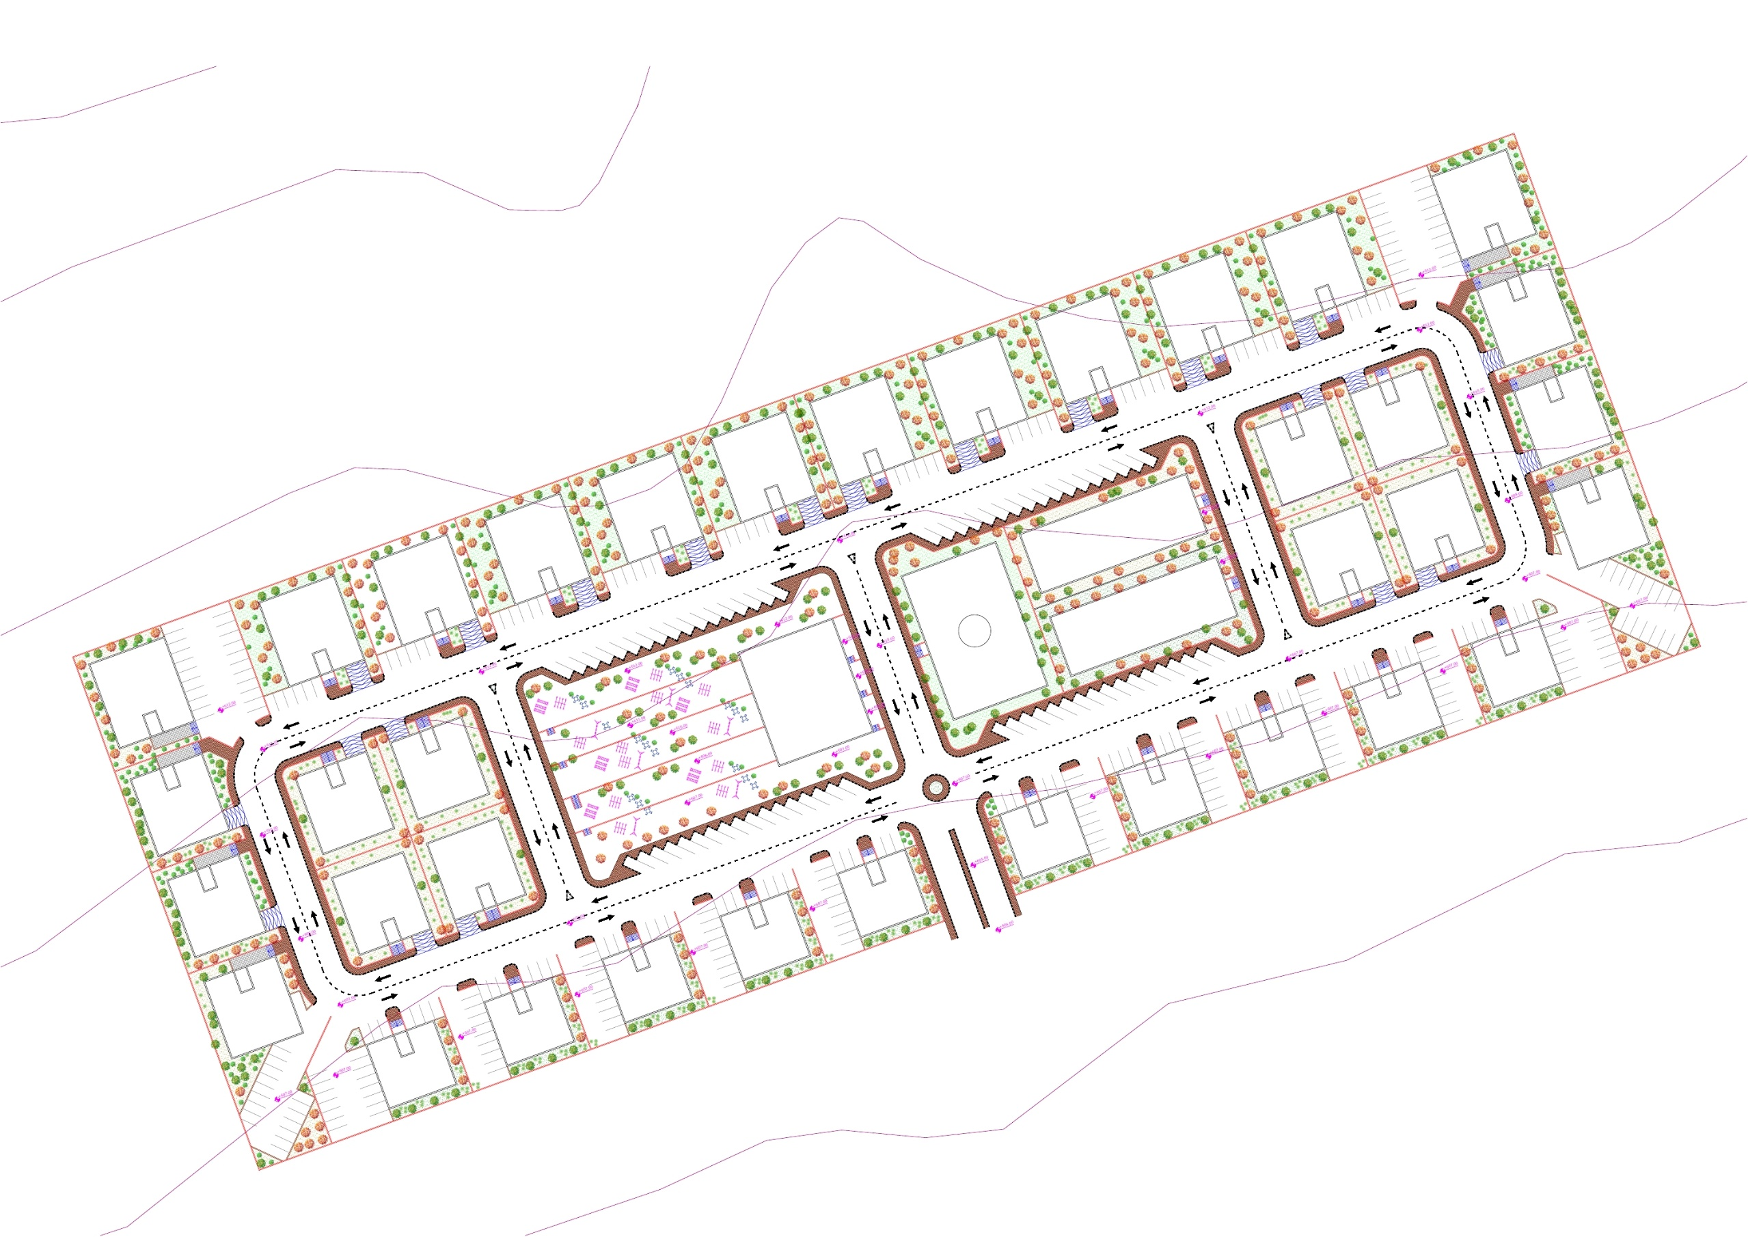
The street directions :
الشوارع الفرعية 10 م
ممرات المشاة 4م
الشارع الرئيسي 15 م

Slide 56
The Roads sections

Slide 57
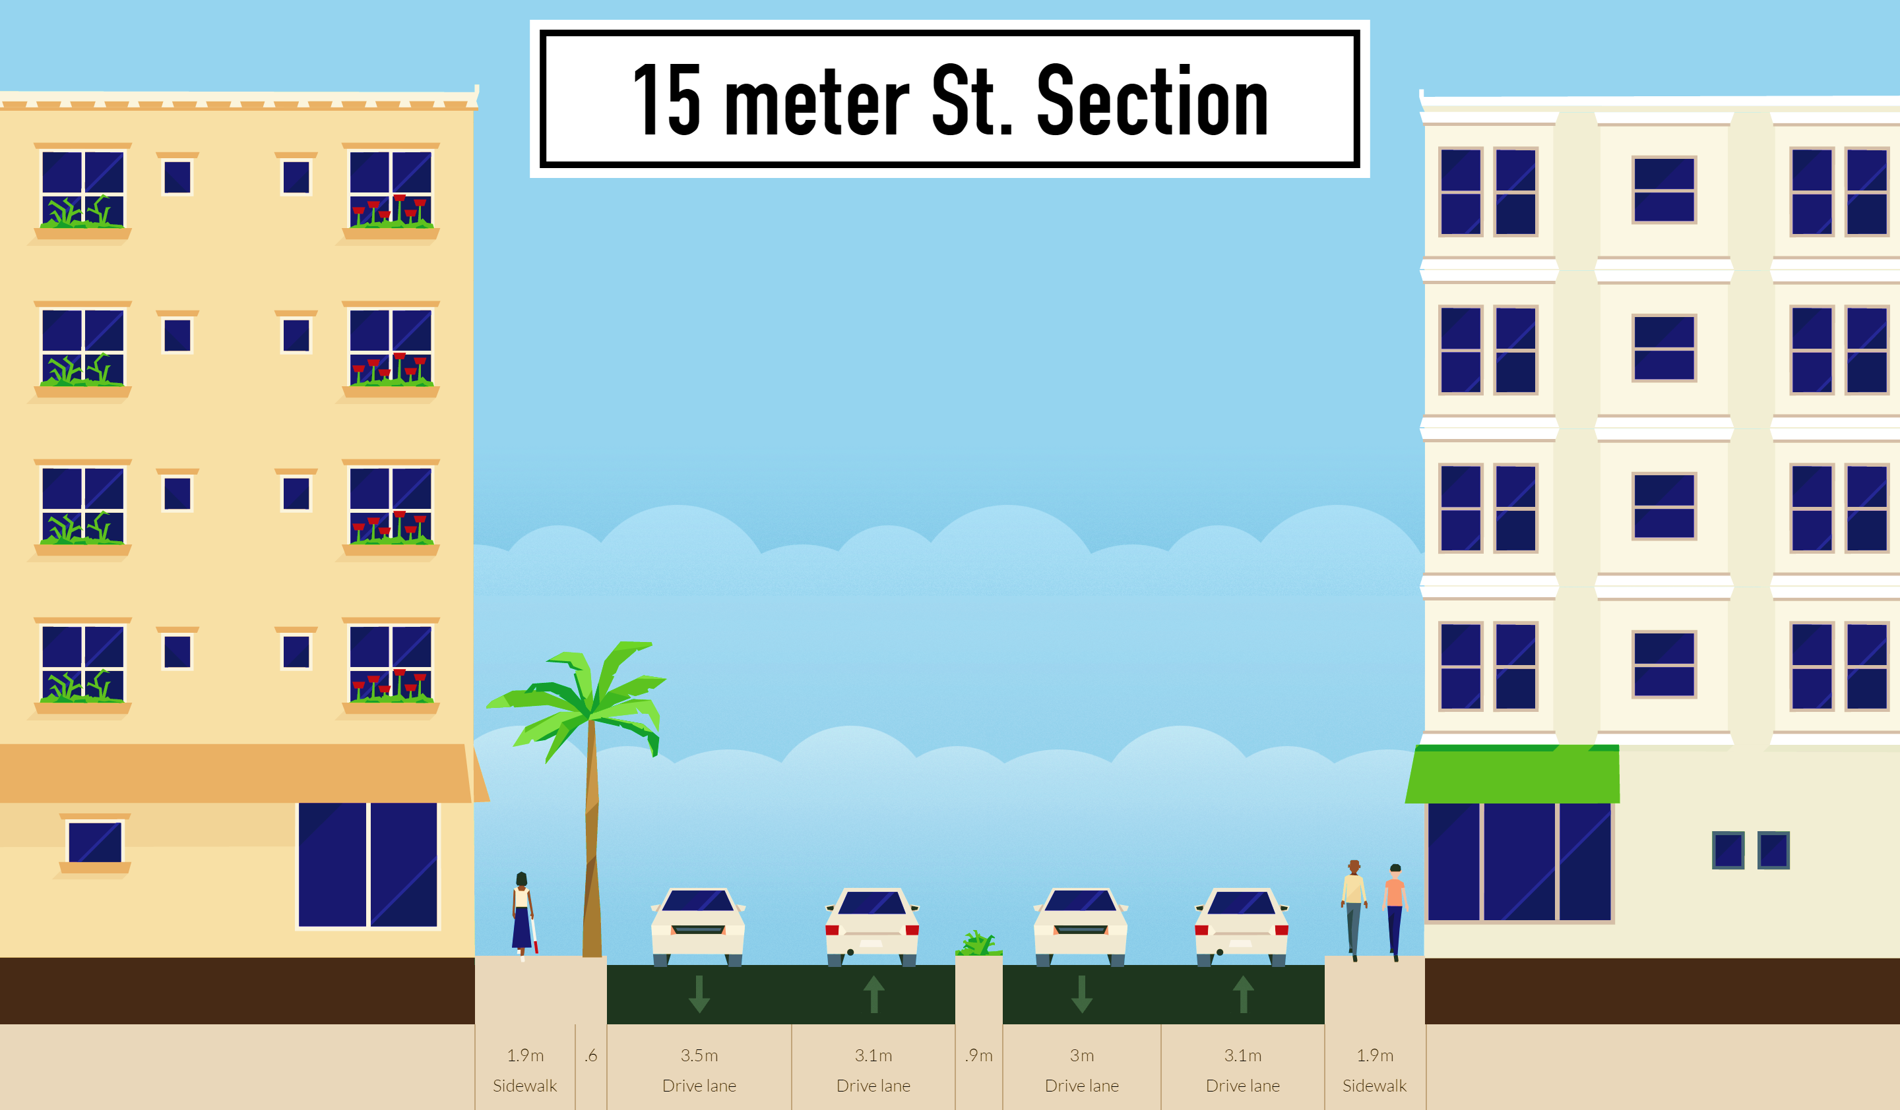

Slide 58
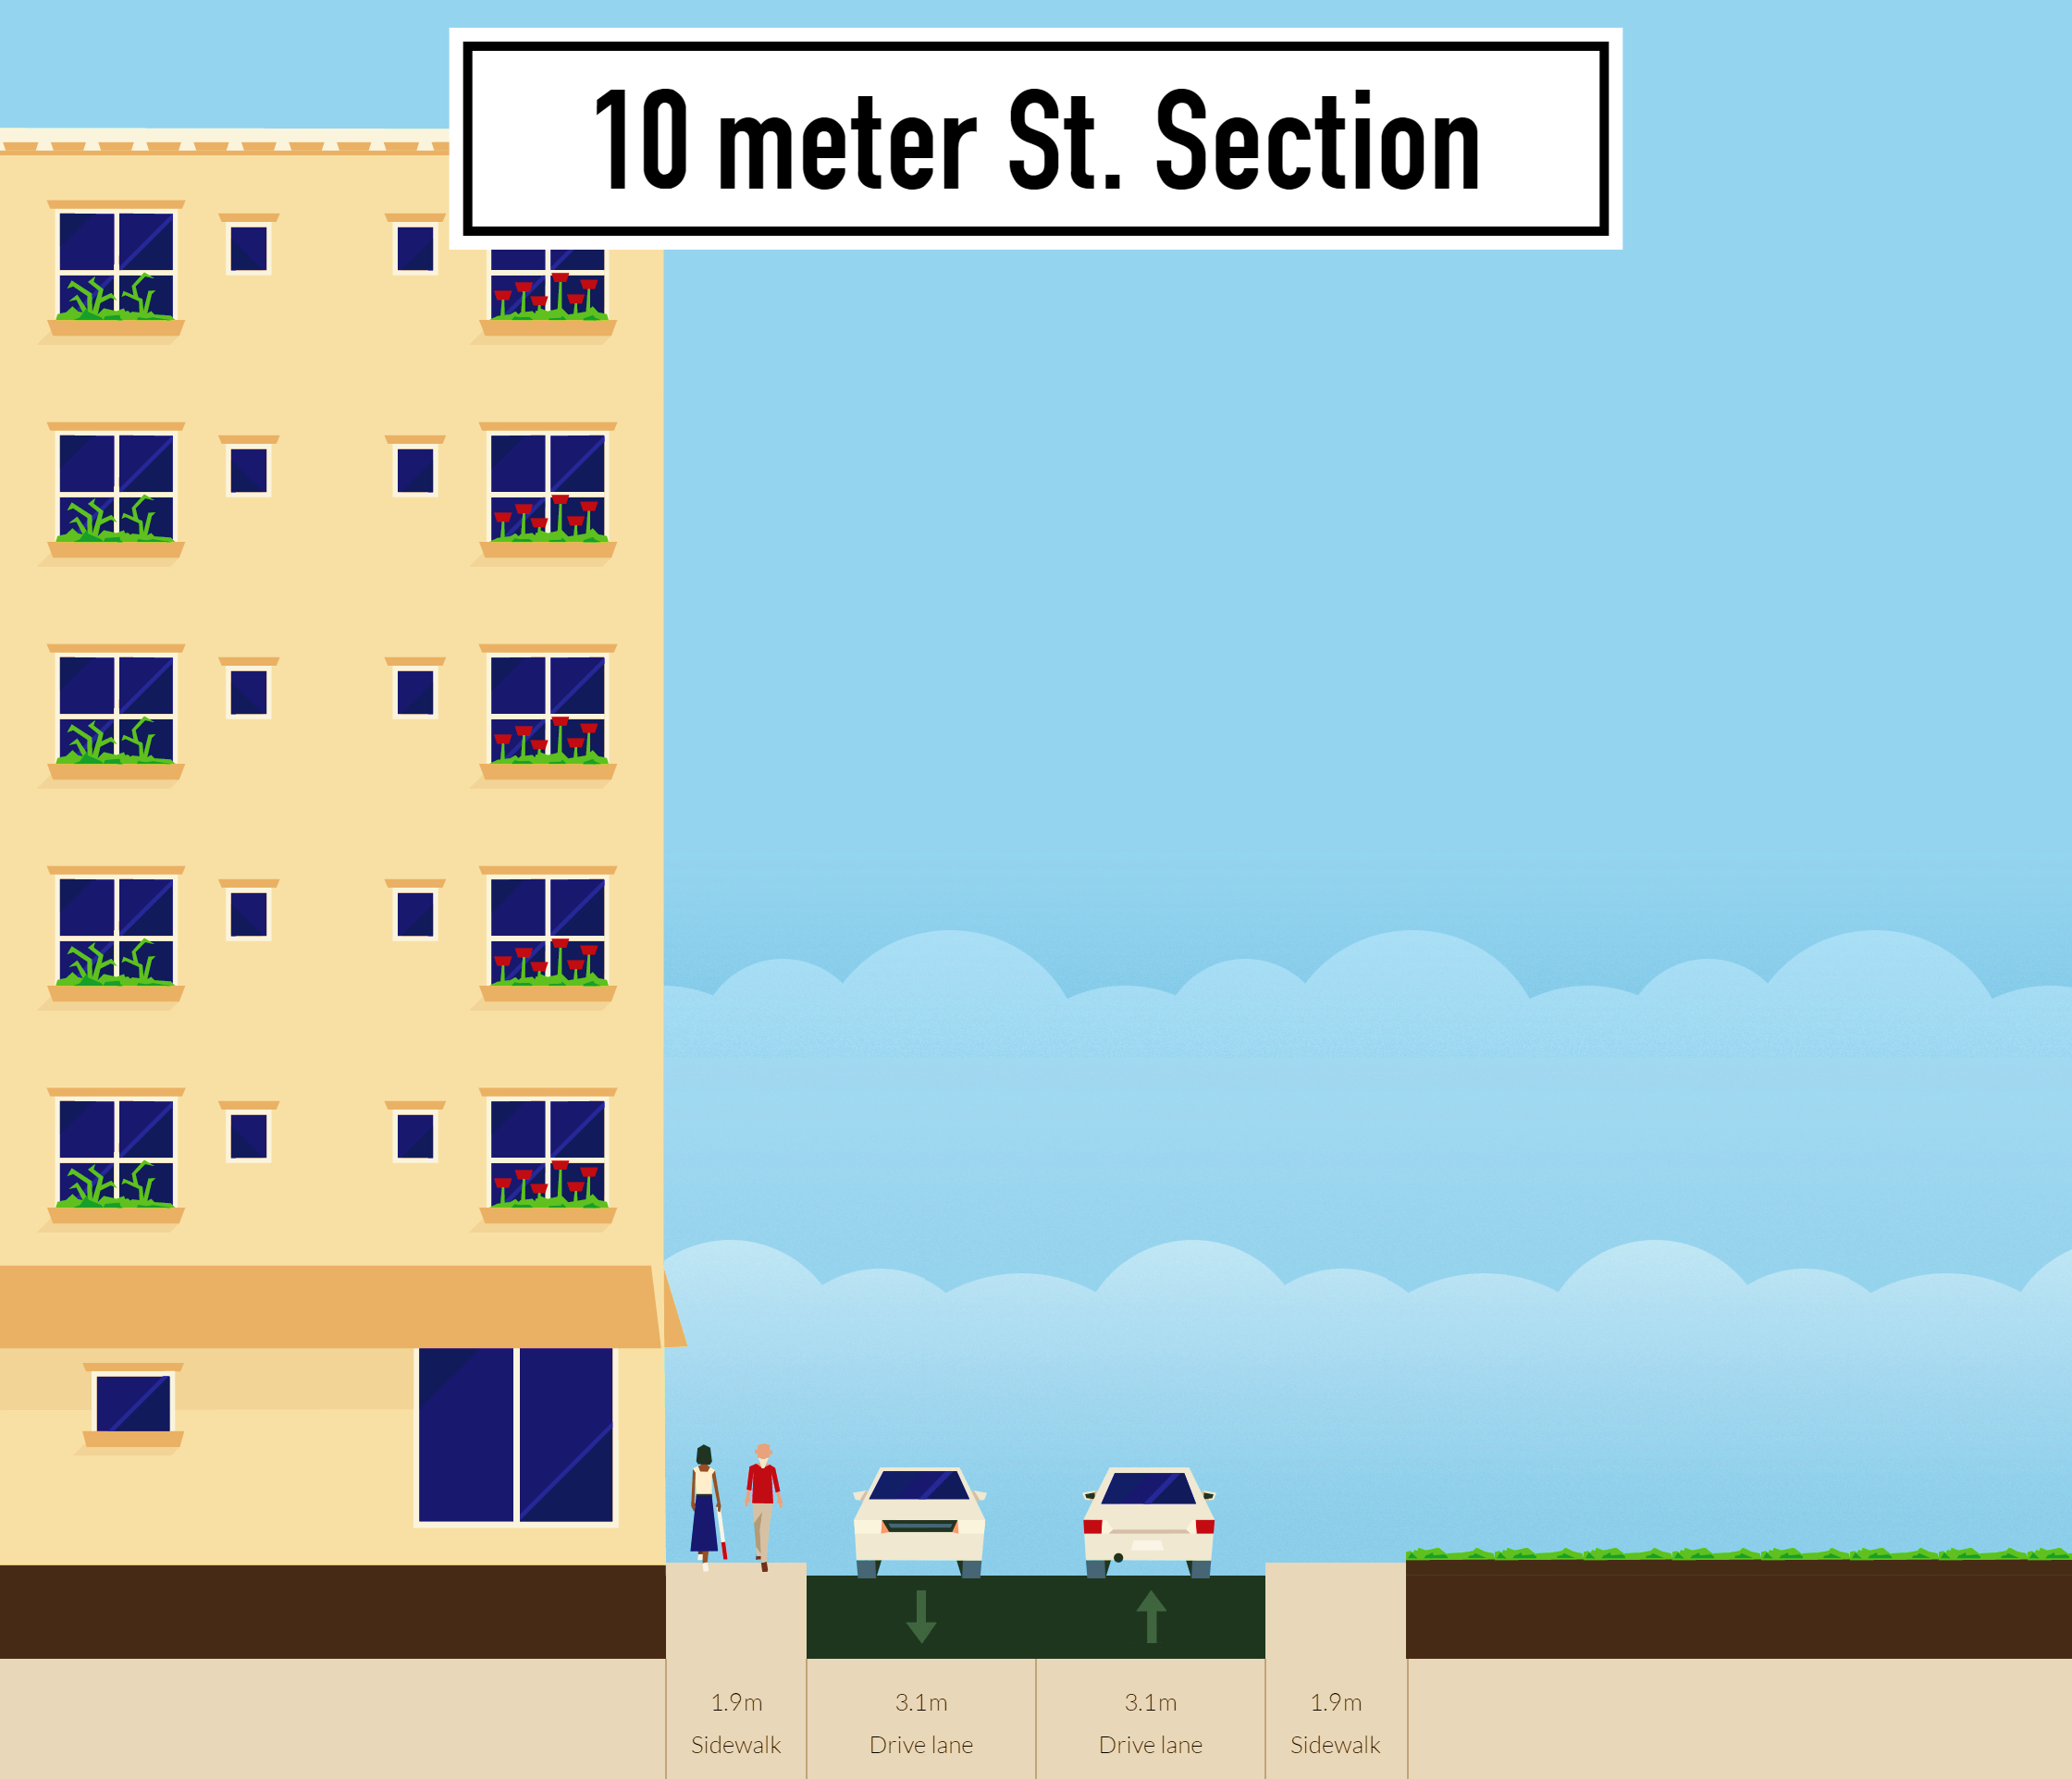

Slide 59
Thank you

