Slide 1

An-Najah National University
Bachelor’s degree in Mechatronics Engineering
Graduation Project 2
3D printing with special materials
Students: | Supervisor:
Saleh Amer Mohammad Odeh Mohammad Sabra | Dr. Bahaa Shaqour

Slide 2
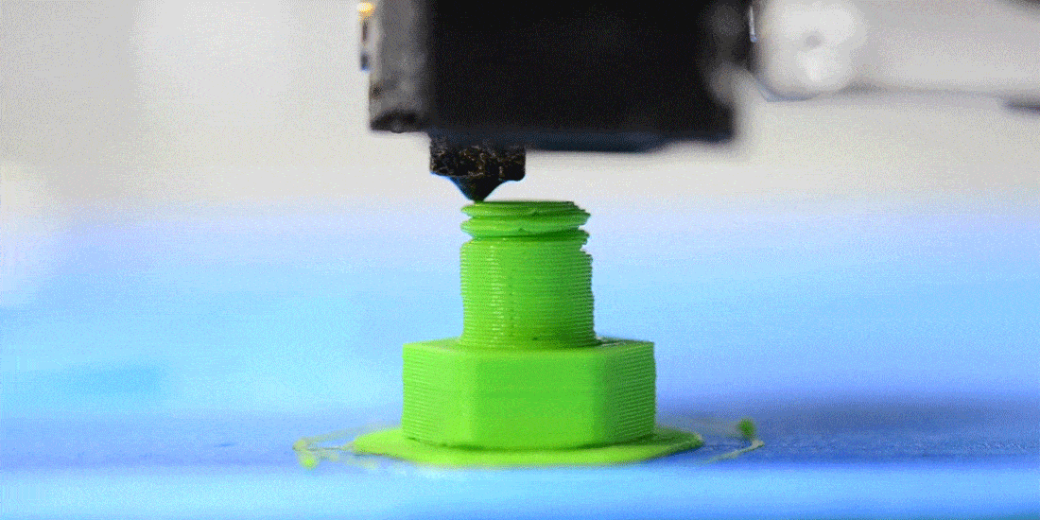
Definition and Overview
3D printing, or additive manufacturing, involves creating objects layer by layer from a digital model. This process contrasts with traditional subtractive manufacturing by allowing for more intricate designs and reduced material waste.

Slide 3
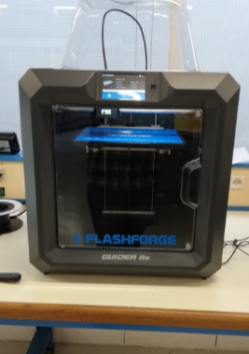
History of 3D Printing Technology
The origins of 3D printing trace back to the 1980s with Charles Hull's invention of stereolithography. Over the years, various techniques and materials have evolved, expanding the technology's applications across numerous industries.

Slide 4
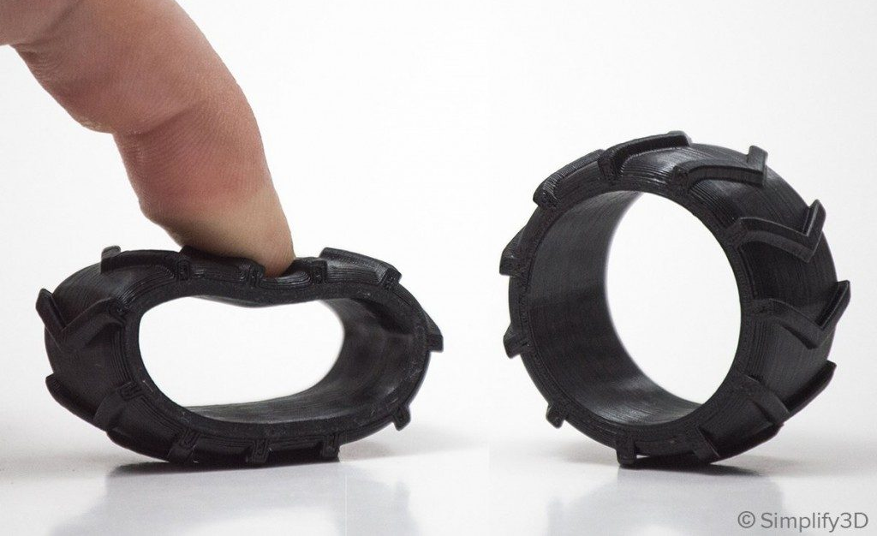
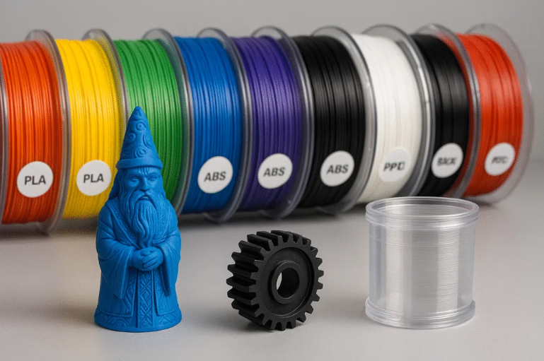
Materials Used in 3D Printing
3D printing uses materials like PLA, ABS, TPU, and metals, each affecting strength and flexibility. The document highlights TPU with foaming agents for lightweight, flexible prints.

Slide 5
Parts of project
Testing of special material(loaded with foaming agent)
Mechanical testing setup
Printer chamber temperature control

Slide 6
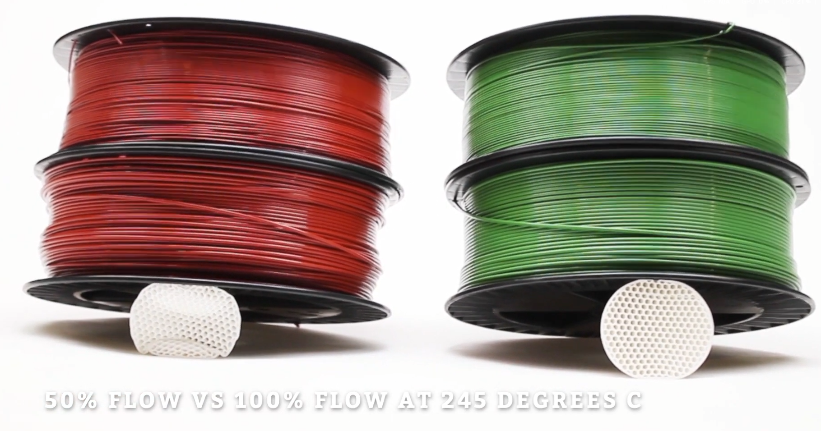
TPU loaded with foaming agent (Colorfabb varioshore)
VarioShore TPU is a lightweight, soft-touch material with variable shore hardness (92A to 55A) achieved by adjusting printing temperature and flow. It foams between 200–250 °C, expanding up to 1.6× to reduce density and increase softness.

Slide 7
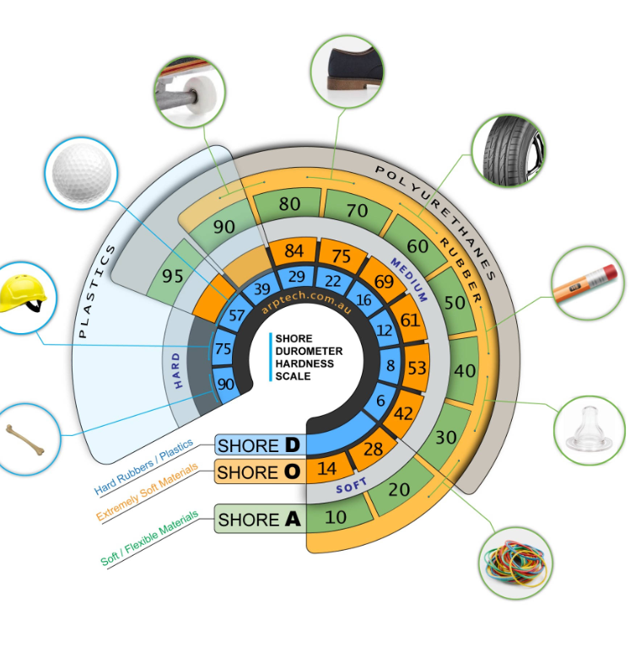
Shore hardness
Shore hardness : a measure of a material's resistance to indentation, commonly used for polymers like rubber and plastics.

Slide 8
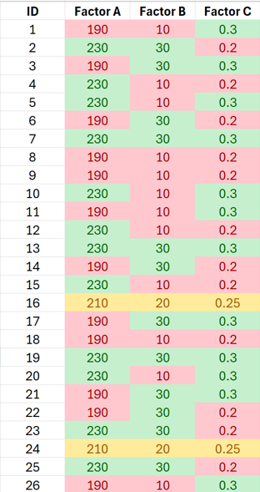
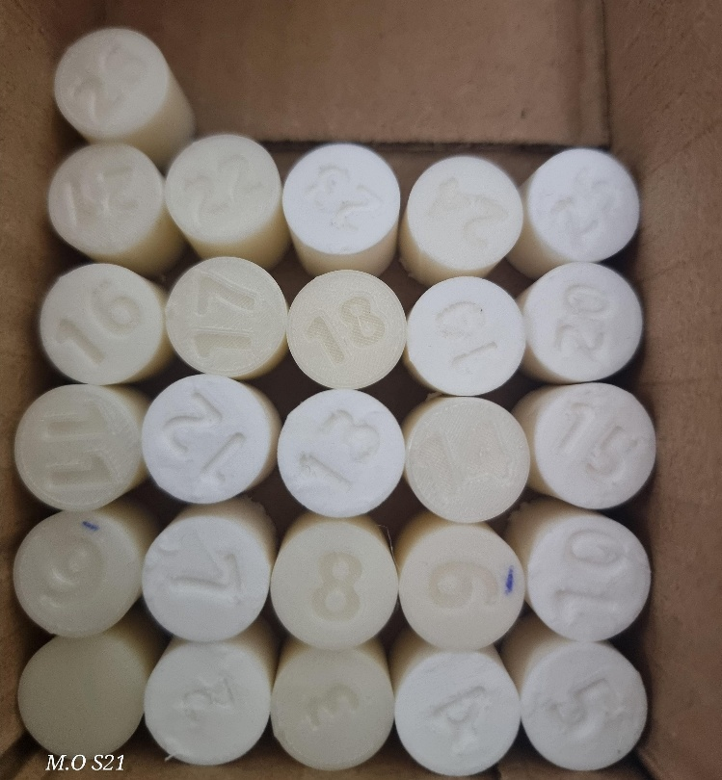
Samples Preparation for µCT imaging and Mechanical testing
To Prepare the samples we used design of experiment method based on several factors as shown in the figure.
Factor A is Temperature, Factor B is speed and Factor C is layer Hight.

Slide 9
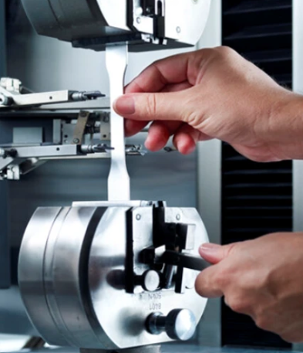
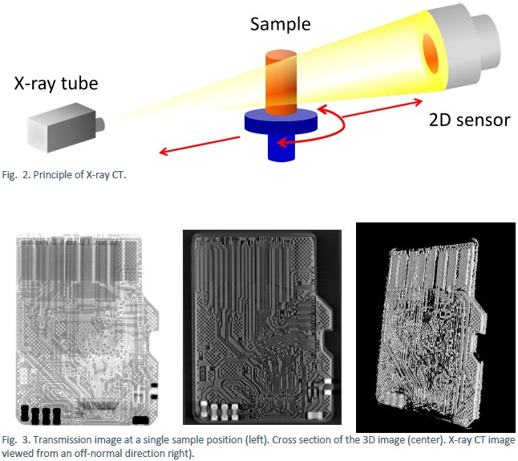
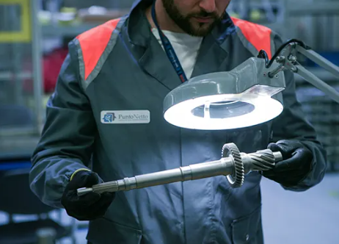
Quality assessment
Mechanical testing
Visual observation
Is to inspect the printed samples for any defects
, we took Xray CT images for the samples at sesame in Jordan by using the Beats beam line which is a hard Xray
Visual observation
X-Ray Tomography

Slide 10
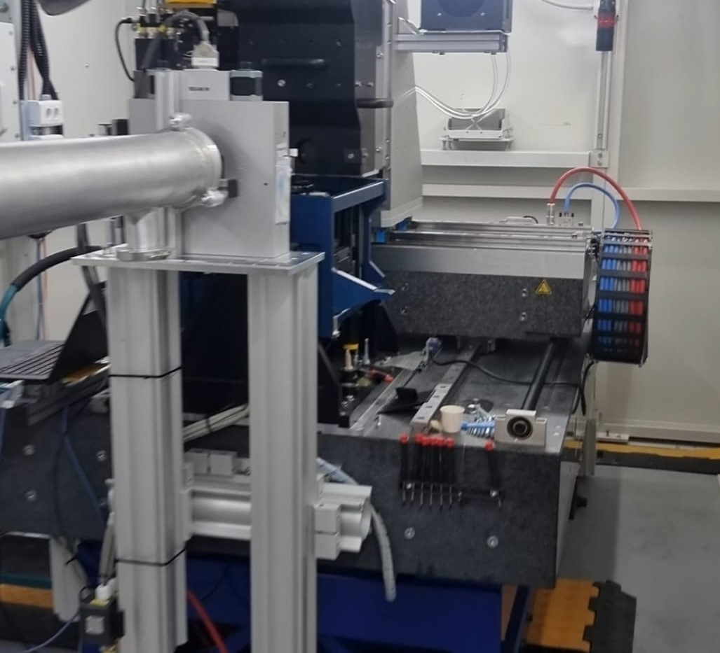
µCT Procedure
At first we calibrate the Lense for the desired resolution, then we calibrate the approximate center of rotation, after that we place the sample in front of the Lense to start taking photos of the samples

Slide 11
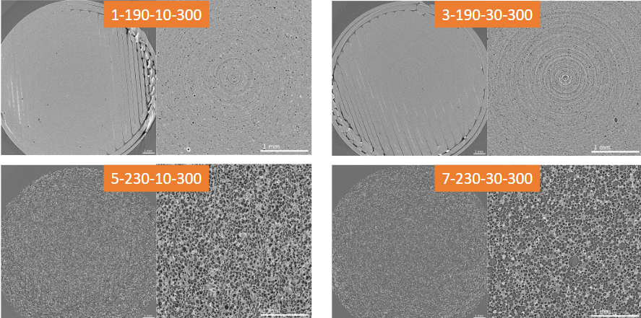
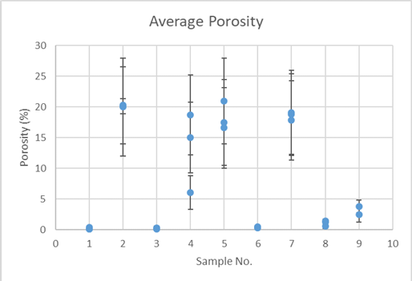
µCT results and analysis
As we see in the figure the bubbles formation varies based on the printing parameters
And as we see in the figure at the bottom which is the average porosity for the µCT images by the MATLAB code

Slide 12
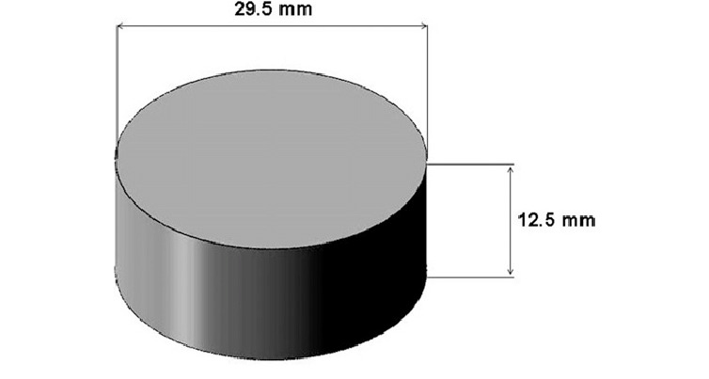
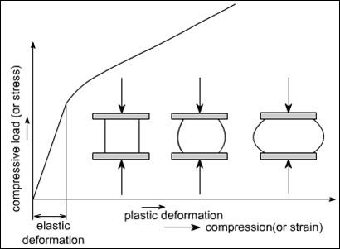
Mechanical testing
In our project, we used the ISO 7743 standard to test how rubber behaves under compression. This standard basically tells you how to run the test and what size the samples should be — usually around 29.5 mm wide and 12.5 mm thick. Sticking to the standard helps us get results that are consistent and easy to compare.
Whin the sample is tested as we see in the following curve we have an elastic region which if the load is removed the samples will return to its original shape, but if we get to the plastic deformation zone the sample won't get back to its original shape after removing the load.

Slide 13
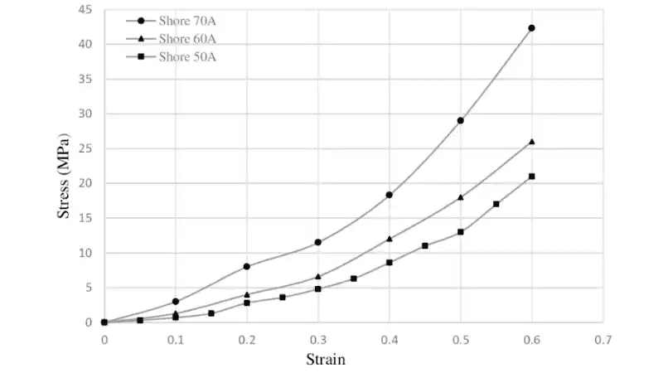
Compression testing curve for differents Shore
This graph shows how different rubber materials behave when we press on them, depending on their Shore hardness — that’s basically how hard or soft they are. The x-axis is strain (how much the material gets squished), and the y-axis is stress (how much force we apply). You can see that the harder the material (like Shore 70A), the more pressure it takes to compress it. It resists better, so its curve goes higher. Softer materials, like Shore 50A, compress more easily — their curve stays lower because they don’t need as much force to deform. So overall, this compression test curve helps us see how each type reacts under pressure.

Slide 14
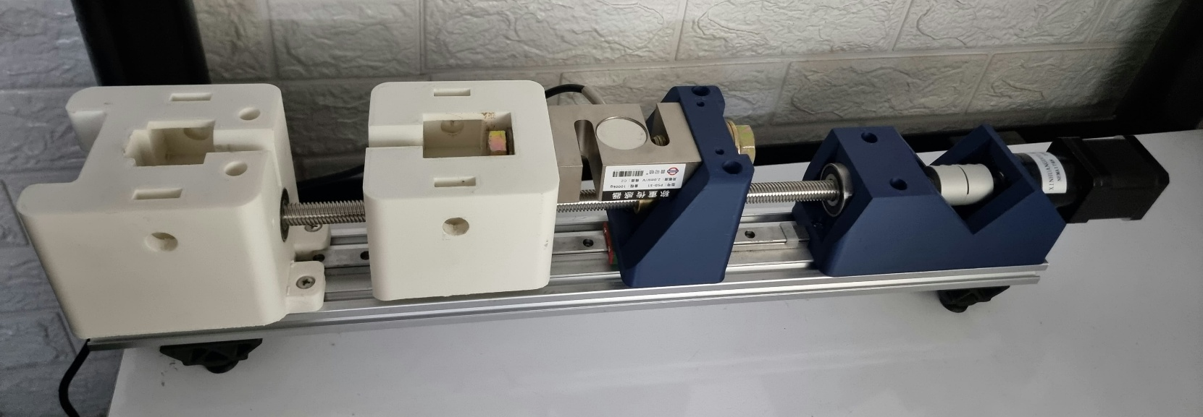
Unversial testing machine
We built a simple machine to see how strong our 3D-printed. It’s made from some 3D-printed parts, a stepper motor, and a load cell that measures force. The plan was to run the test like this: we put the sample between two plates one stays fix while the other moves as the motor turns the power screw. When the moving part moves, it squeezes the sample, and the sensor shows us how much force it takes until the sample starts to deform. But because of the current situation in the country, we couldn’t get the PCB board, so we couldn’t run the test the way it was planned.

Slide 15
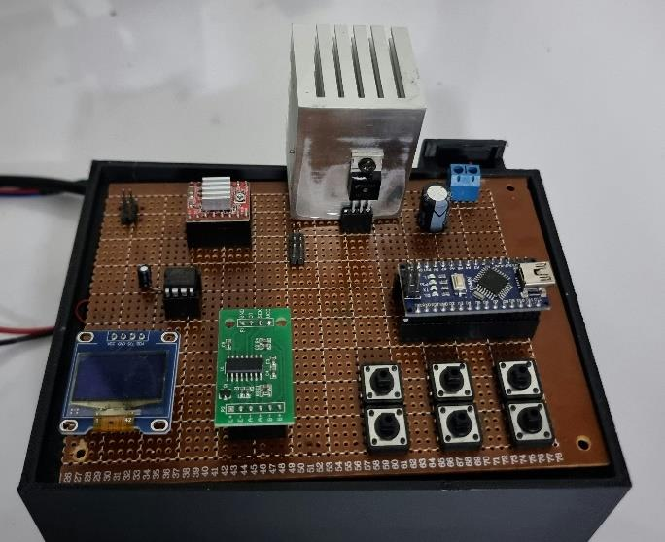
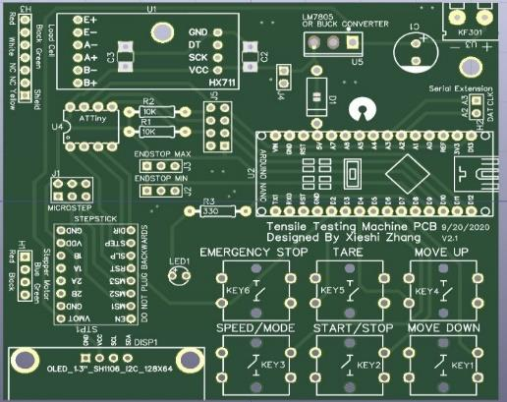
Universal testing setup
We built our testing machine following a DIY guide, printing the parts ourselves and ordering most electronics from AliExpress since local options were limited or pricey. It took about a month to get everything. After assembling the mechanical parts, we started on the electronics but missed the motor’s microcontroller. We ordered it, but it arrived late due to the situation in the country.
When we got it, programming didn’t work right, so we sent the PCB design to the university lab. They found some mistakes, we fixed them, and the PCB was made just before the lockdown. Sadly, we couldn’t pick it up in time.

Slide 16
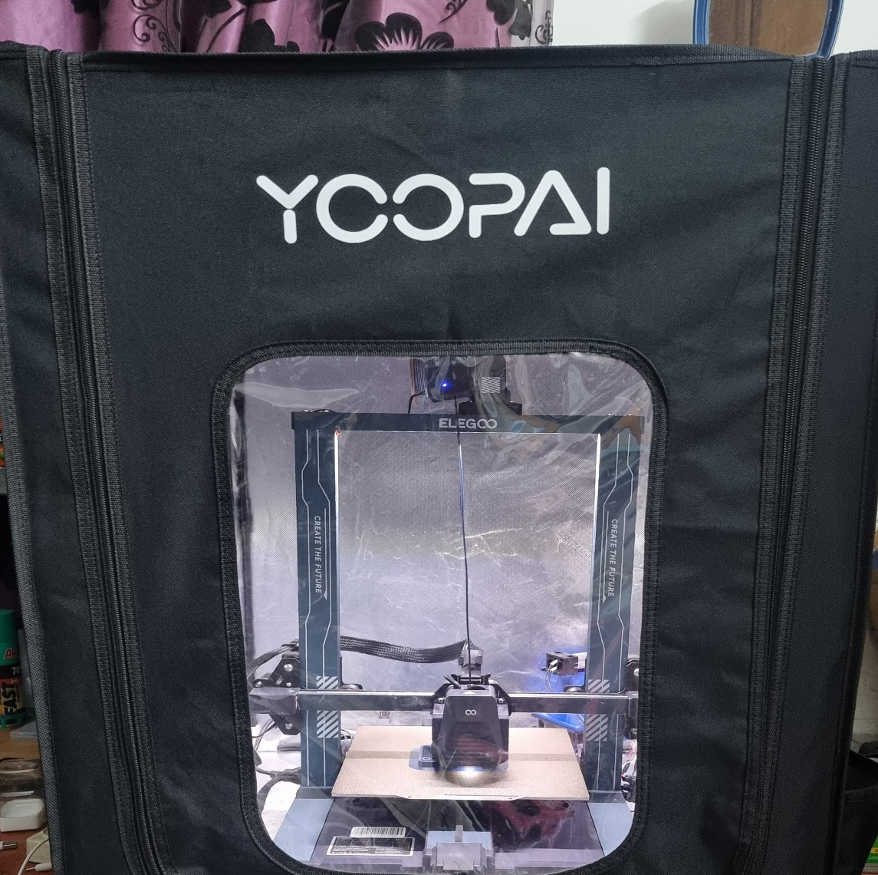
Heating system
Chamber temperature is critical in Fused Filament Fabrication (FFF) 3D printing.
Impacts print quality, mechanical properties, and dimensional accuracy.
Key benefits:
Reduces warping and shrinkage.
Enhances interlayer adhesion.
Improves surface finish and strength.

Slide 17
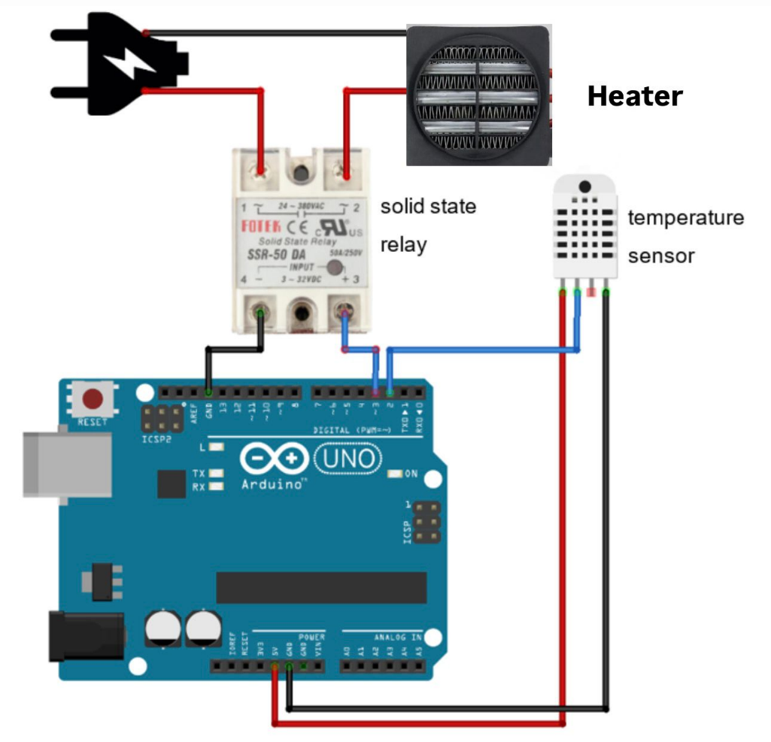
Content:
Enclosure: Fireproof, dustproof cover (75x65x55 cm) to maintain stable temperature.
Heater: 220V 500W integrated heater with fan for uniform heat distribution.
NTC Thermistor: 10kΩ sensor for precise temperature monitoring (±1°C accuracy).
Arduino Uno SMD R3: Controls heater via PID and ON/OFF logic.
Solid-State Relay (SSR): Safely switches heater on/off.

Slide 18

– Implementation Steps
The electrical circuit was connected according to the approved schematic.
The system was installed inside the enclosed printing chamber.
The system was powered up and all components were working properly.
The control code was uploaded to the Arduino Nano board.
The system was tested at different temperatures (30°C and 40°C).
The performance was monitored to ensure efficiency.
30°C was found to be optimal for printing.
When 30°C was reached, the system automatically shuts down to maintain thermal stability.
– Arduino Setup
Set the target temperature to 30°C.
Adjust the hysteresis to adjust the stability.
Connect an NTC 10K temperature sensor to pin A0 to read data.
Connect an SSR to the digital pin D9 to control the heater.
The Arduino Uno was powered via a USB cable connected to the computer.

Slide 19
ON/OFF control
In the ON/OFF control system, the setpoint was set at 30°C. The temperature reached the desired value within 40 seconds, but exceeded 31°C due to residual heat in the heater after it was disconnected. When the setpoint was raised to 40°C, the system took approximately 110 seconds to reach it, showing slower response at higher temperatures.

Slide 20
ON/OFF control
The system is in equilibrium at 40°C. When the chamber door is opened, the temperature drops to about 35°C and stabilizes. When the door is closed, the system returns to equilibrium at 40°C.

Slide 21
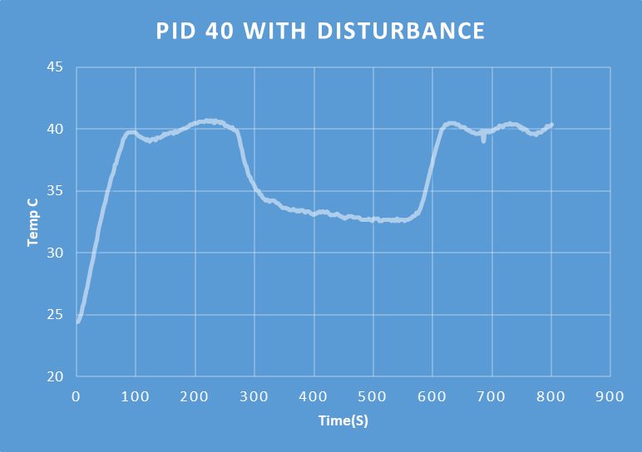
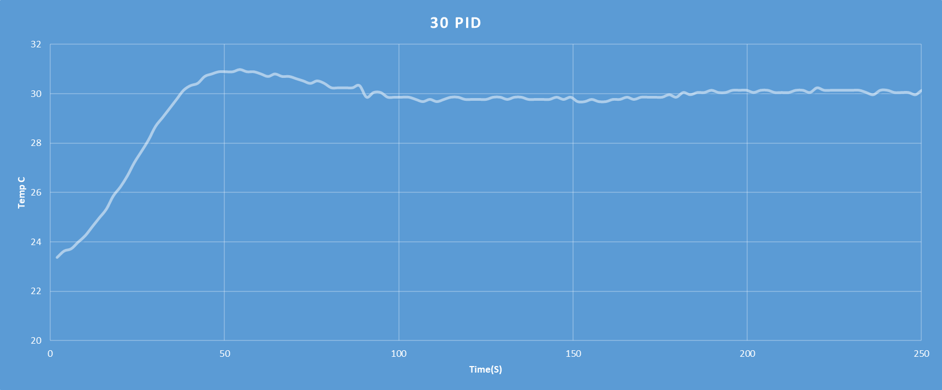
PID control
After experimenting with ON/OFF control, we used a PID system via the Arduino library, but encountered problems. We switched to a hybrid control system that starts with ON/OFF and then transitions to PID via PWM. We adjusted the PID parameters experimentally to achieve a fast response without overshoot. When testing the disturbance by opening the chamber door at 40°C, the temperature dropped to 33°C, then gradually returned to a steady state after the door was closed, as shown in Figures

Slide 22
This table shows the performance of a temperature control system under different conditions, using two control methods.
Condition | Overshoot (%) | Settling Time (s) | Rise Time (s)
ON/OFF 30°C | 3.8 | 110 | 20
ON/OFF 40°C | 0.4 | 185 | 84
ON/OFF 40°C w/ Disturbance | 1.3 | 107 | 75
PID 30°C | 3.7 | 95 | 29
PID 40°C w/ Disturbance | 3.0 | 173 | 55

Slide 23

General Notes:
ON/OFF Performance: More stable at higher temperatures (40°C) with less overshoot, but slower response.
PID Performance: Provides faster response in some situations, but may be less stable under disturbances.
Disturbances: Impact the performance of both systems, but their effect on the PID is more pronounced in the increased settling time.

Slide 24
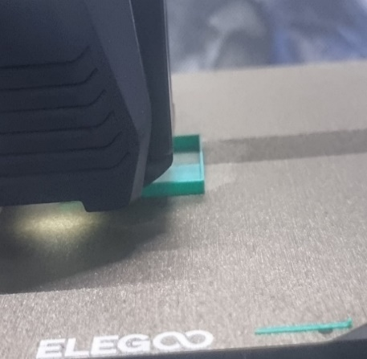
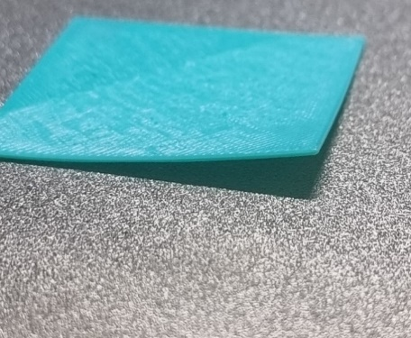
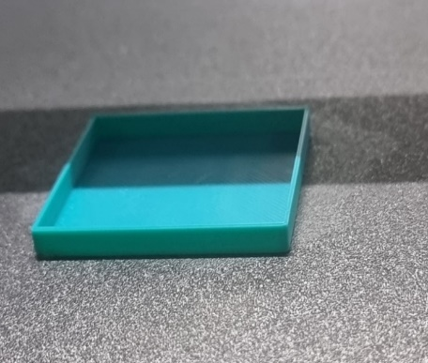
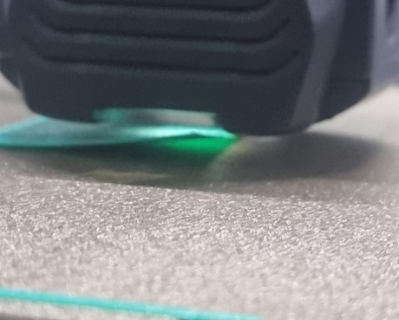
Print sample of ASA material
With heating system
Without heating system

Slide 25

Conclusion
We improved the chamber temperature using PID to keep it stable.
Building the testing machine was challenging but taught us a lot — especially problem-solving and teamwork.
Compression testing will help us understand how our flexible, foam-like TPU material holds up under pressure, which is key for real-world use.
µCT imaging helped us to understand how the bubble formation and distribution accrues in the material

Slide 26
Future work
Improving chamber temperature control accuracy by using multiple sensors and an advanced PID system to reduce temperature variation.
Perform mor testing on the material such as taking CT images while applying compression and tension loads
Completing the testing machine by connecting all the electrical components to the pcb and calibrating the device.
Enhancing the safety by adding a ventilation system with HEPA/activated carbon filters to reduce harmful emissions.

Slide 27
we dedicate this work to our families and our people in Palestine and to all those who love us as well
Thank you for listening.
Your questions ?

