Slide 1
iTour
1
BY: Fadi Jarwan
Mahmoud Shayeb

Slide 2
OUTLINE:
2
Introduction
Challenges
Frameworks and languages
Authentication
Manager actions
User actions
Security and guarantee
Role of admin
Demo

Slide 3
Introduction
3
iTour works as a tourism guide
Museums, hotels, cinemas, remains and many other types of places gathered in one application
For owners, they can present their services and offers as well
It’s a website that facilitates booking and reserving interactions
Reduce time and effort spent on making decision

Slide 4
Challenges
4
Time spent on learning Laravel 5.4 which we didn’t use
Learning ZEND framework

Slide 5
Frameworks and languages
5
We used ZEND framework 3 along with the following:
  Back-end:
    PHP 5.6
  Front-end:
    Html5 and CSS3
    Bootstrap 3 framework
    jQuery
    Ajax

Slide 6
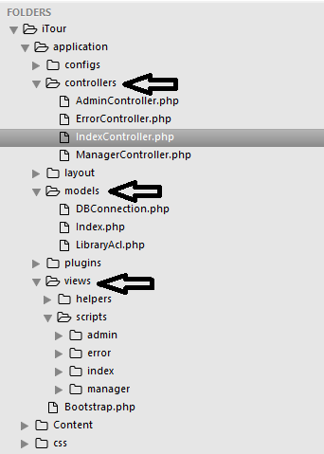
Cont.
6
Zend framework is a MVC architecture:
* Model file deals with the database interactions
* Controller file works as a connection between the
view and the model
* View is the user interface

Slide 7
Authentication
7
iTour provides three authentications
  End-user “member”: is the ordinary tourist that tries to get services
  End-user “Manager”: is the owner of a site can be any user with a level of guarantee.
  Admin: is the manager of the whole website with full access

Slide 8
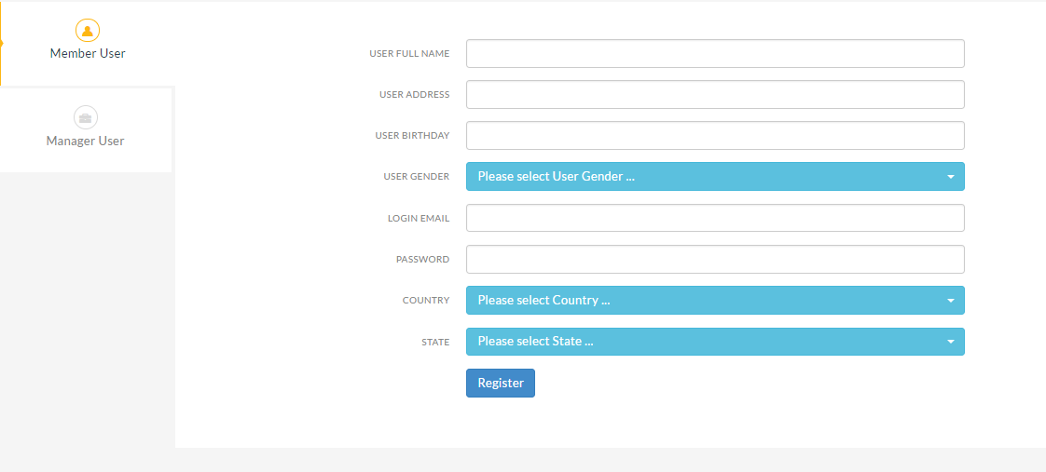
8

Slide 9
Manager role:
9
Can create multiple sites
Services and events each with price
Check subscribed users
Users joining events and services
Search for subscribed users by gender, name, age, country

Slide 10
User Role:
10
Subscribe to sites
Search for any site by searching filters: country, name, type
Join events or book a service
Display schedule of events and services
Provide feedback and rate
Edit his profile

Slide 11
Security:
11
For password hashing : md5
Restriction on user and manager navigations

Slide 12
Admin roles:
12
Admin can create new site types
Change the detail of any site
Change details of any user
Create new users and sites
Can reset password for users
Can create events and services

Slide 13
Demo:
13

Slide 14
Future work:
14
Develop an Android and iOS application
Improve location property

Slide 15
Thank you

