Slide 1

MatjarCom
Multi-Vendor Marketplace
Explore Now

Slide 2
Table Of Contents:
  Introduction
  Features
Explore Now
  Technologies
  Future Work

Slide 3
Introduction
  Overview of MatjarCom:
    A brief description: "MatjarCom is a comprehensive multi-vendor app that allows merchants to create and manage their stores, and customers to explore and purchase from a wide range of stores seamlessly."
  Key Features:
    Multi-vendor platform
    Integrated payment and notification systems
    Customizable store designs

Slide 4


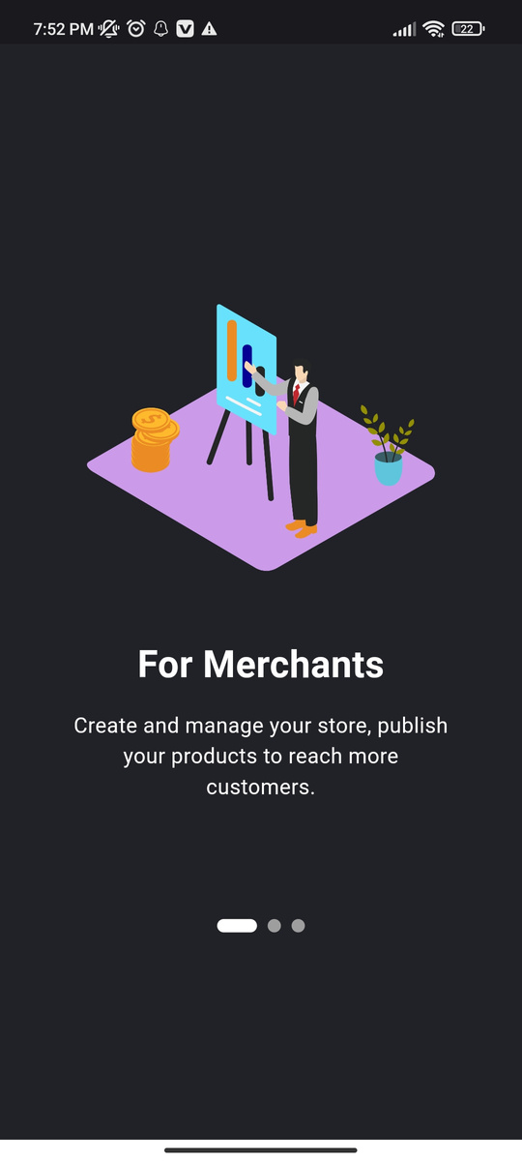
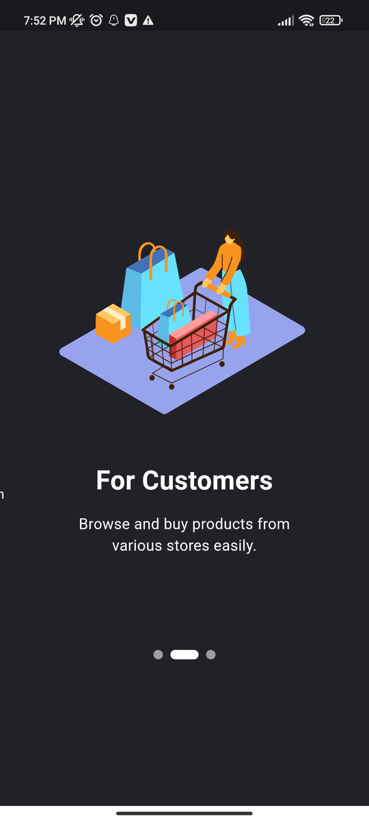
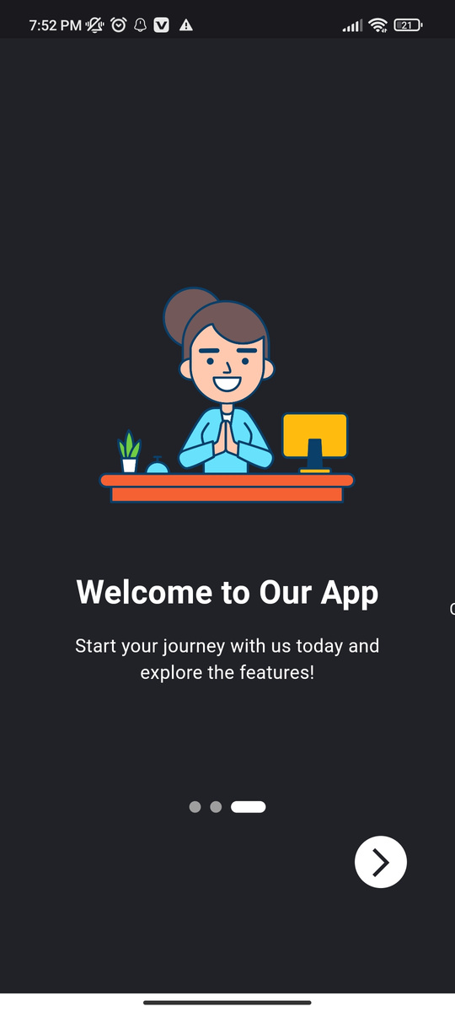
Featrues
  Splash Screen
  Onboarding Page

Slide 5
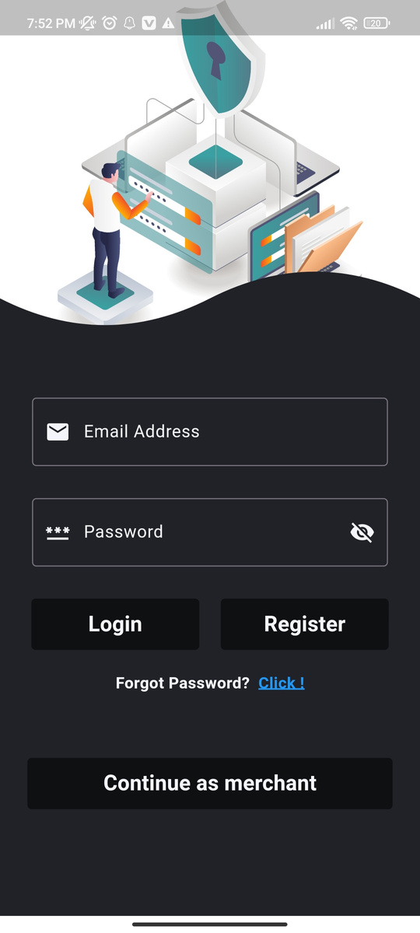
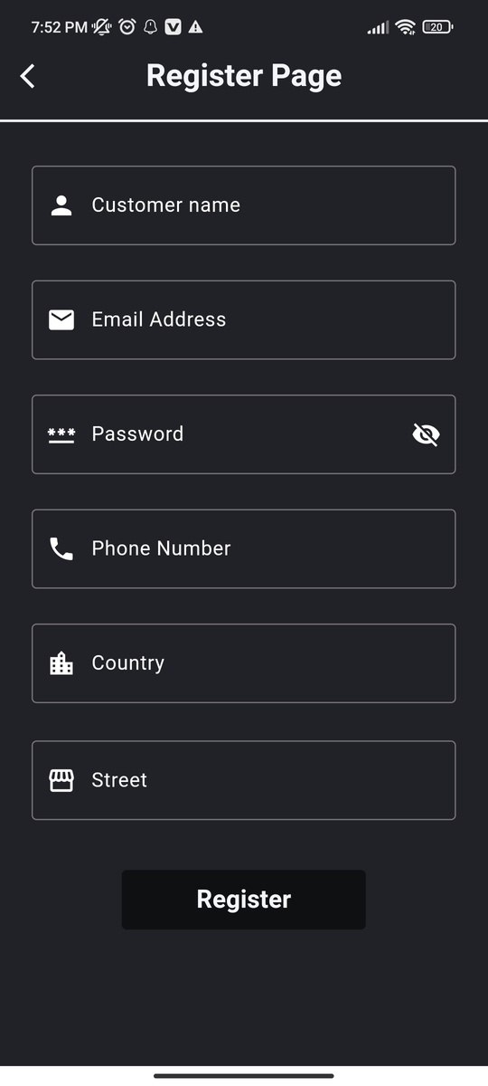
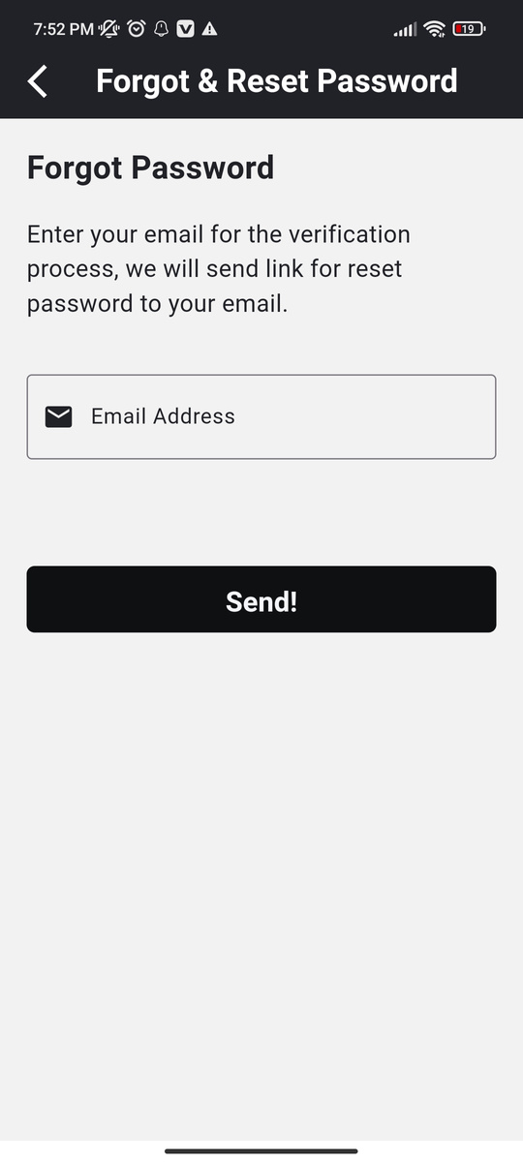
  Customer Login, Register and Forgot & Reset Password Pages

Slide 6
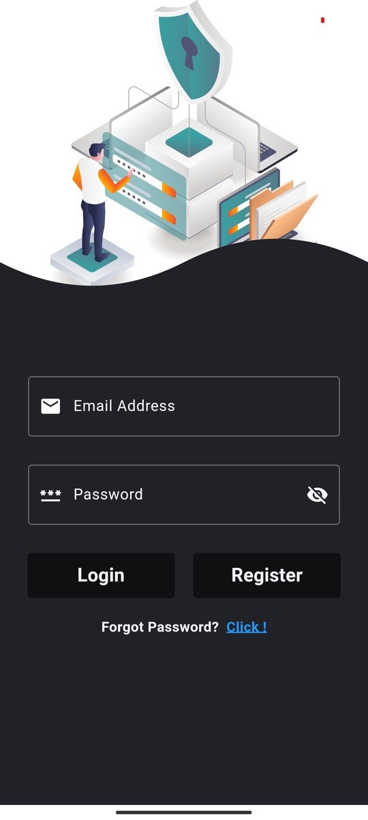
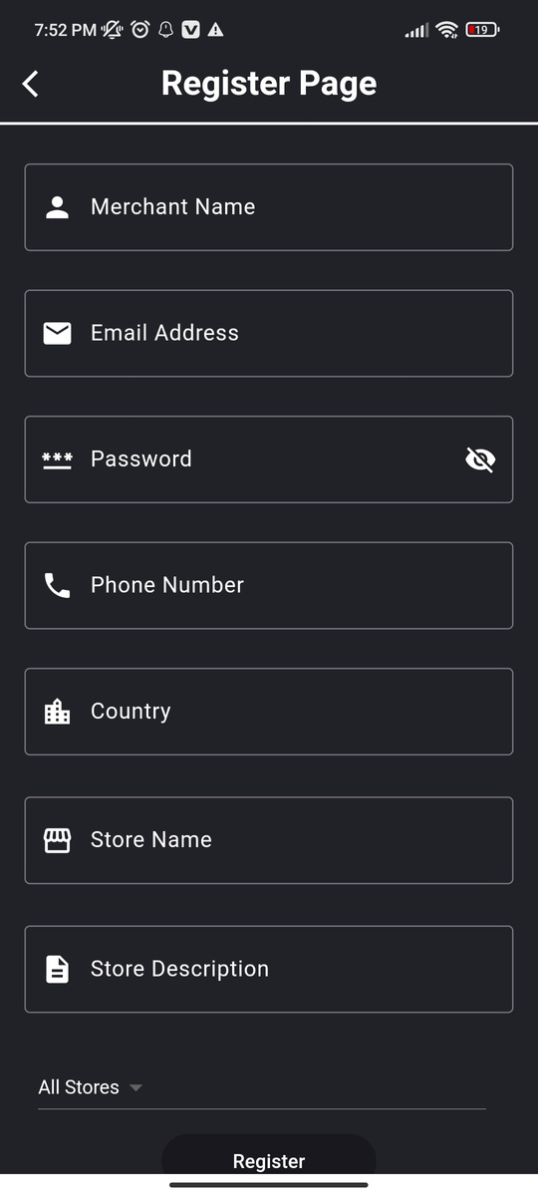

  Merchant Login, Register and Forgot & Reset Password Pages

Slide 7
Merchant Side

Slide 8
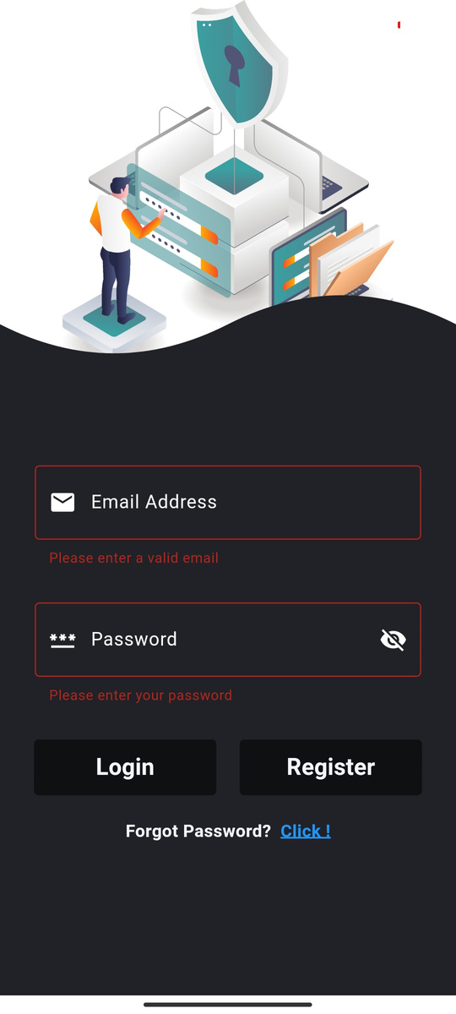
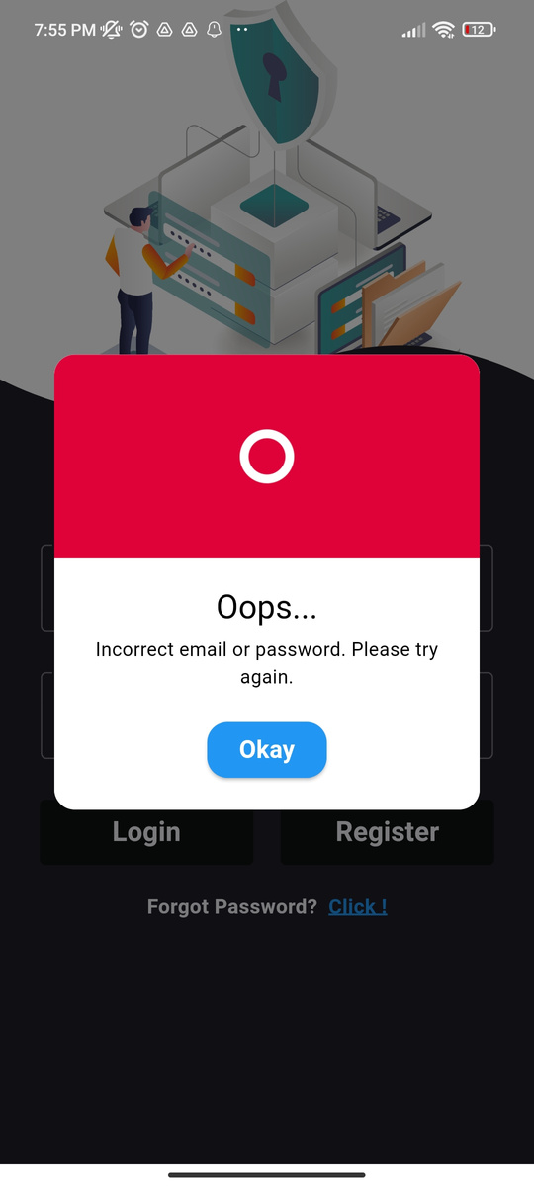
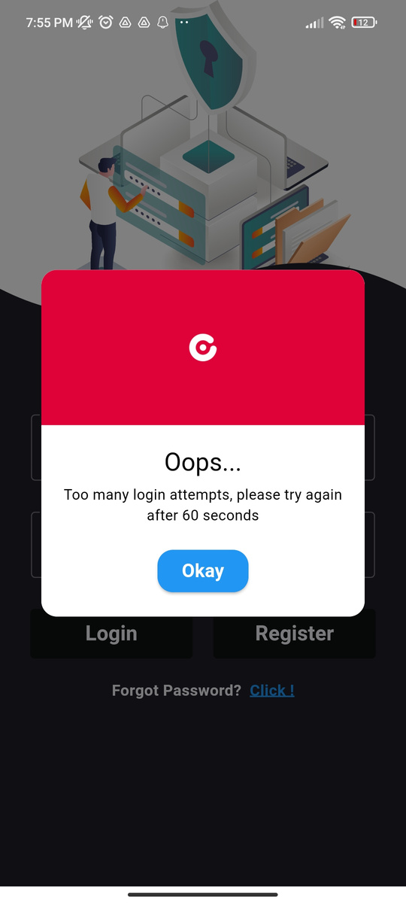
  Robust Login Page

Slide 9
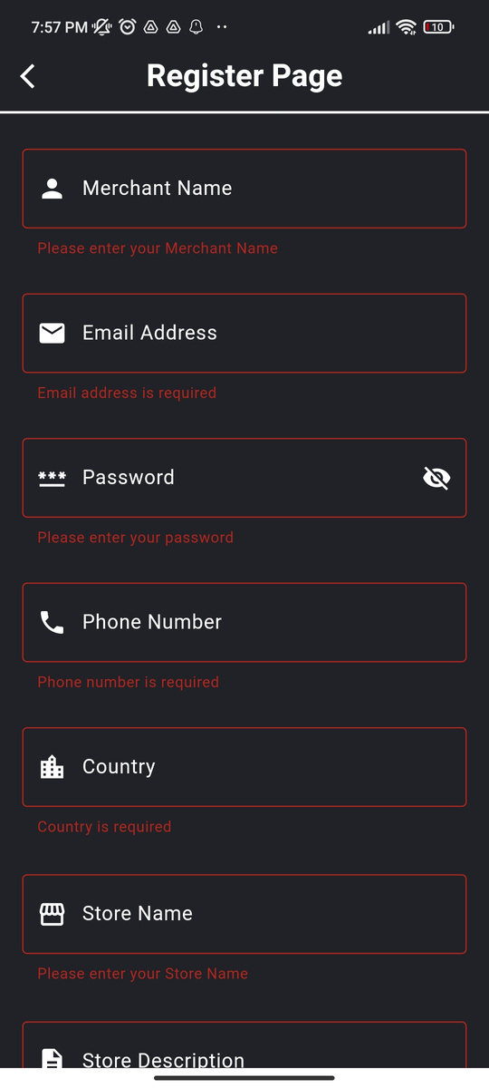
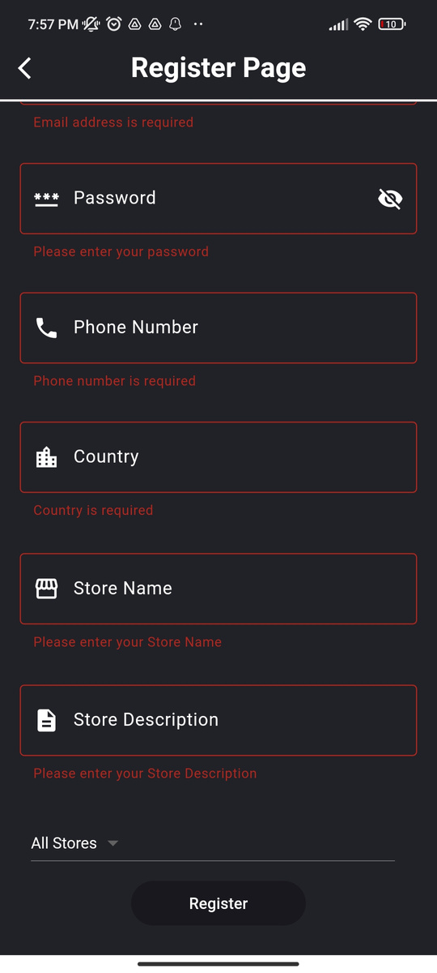
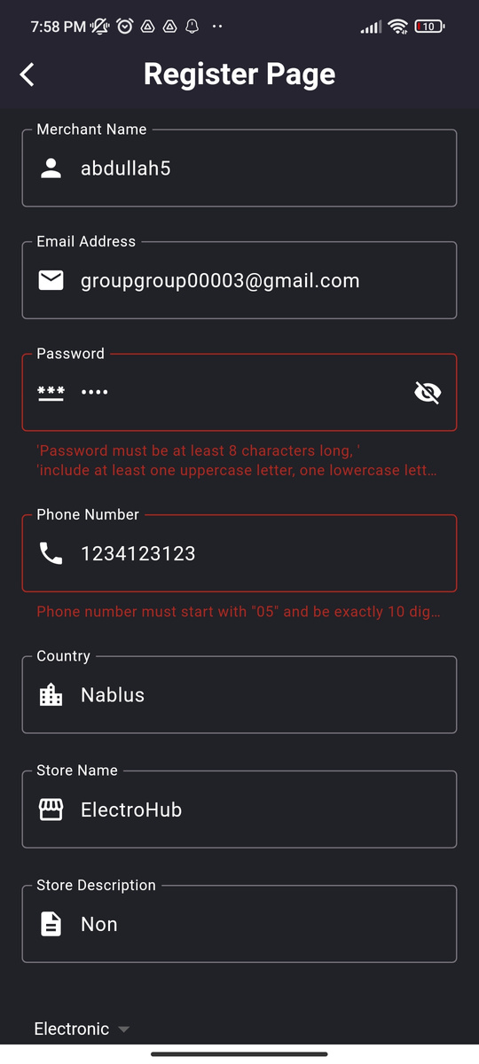
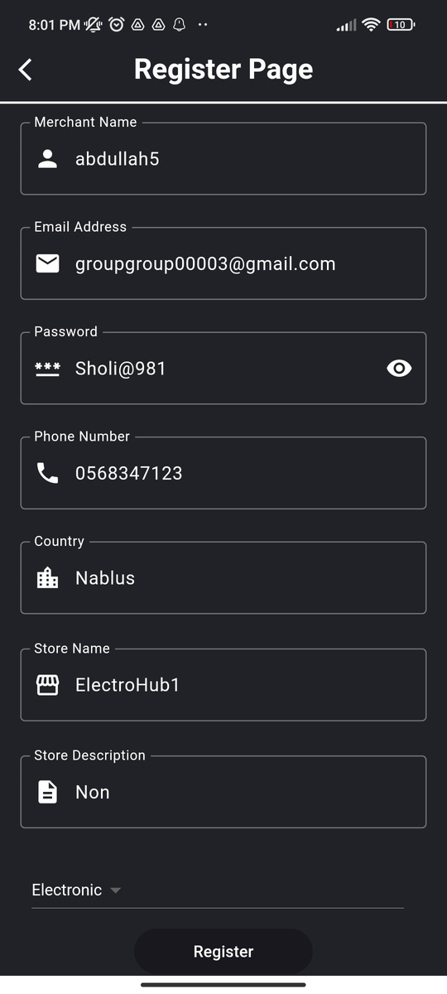
  Registration Page with validators

Slide 10
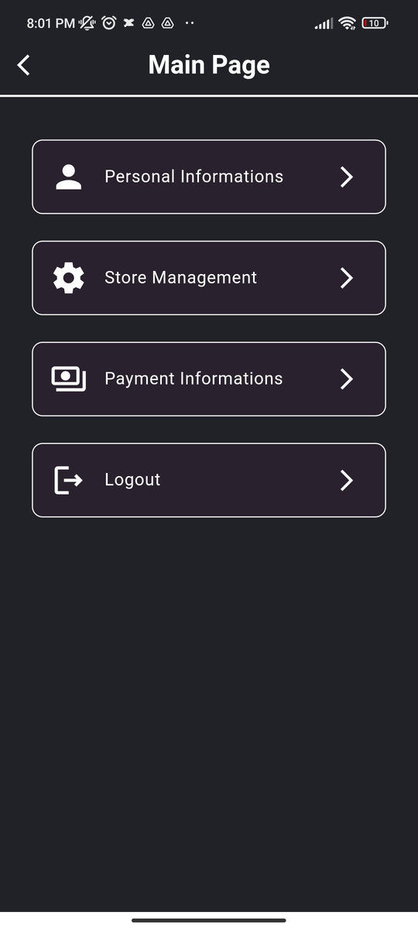
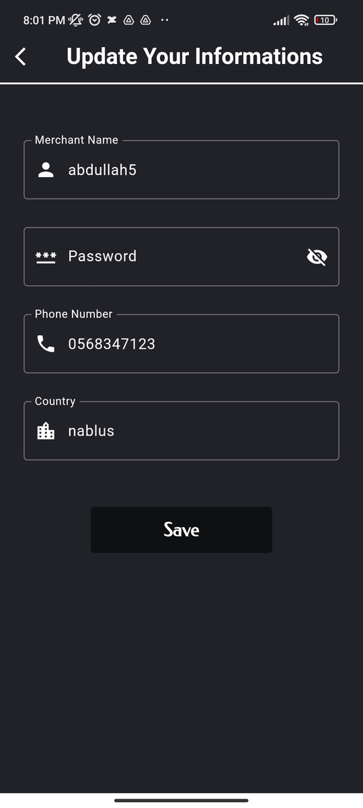
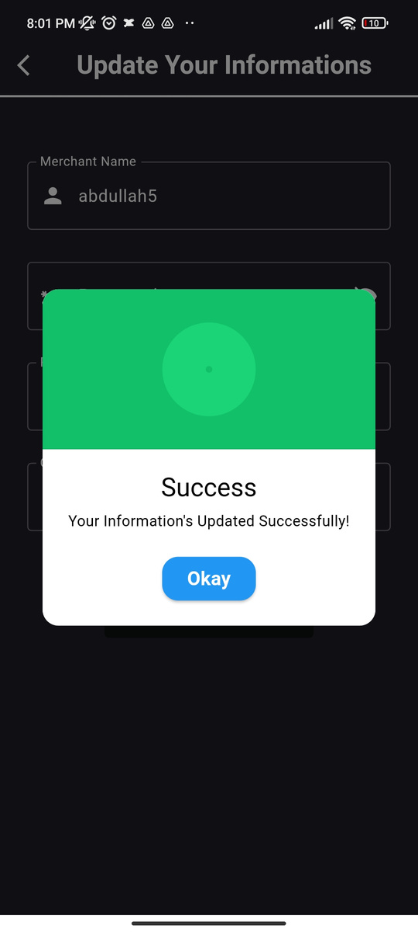
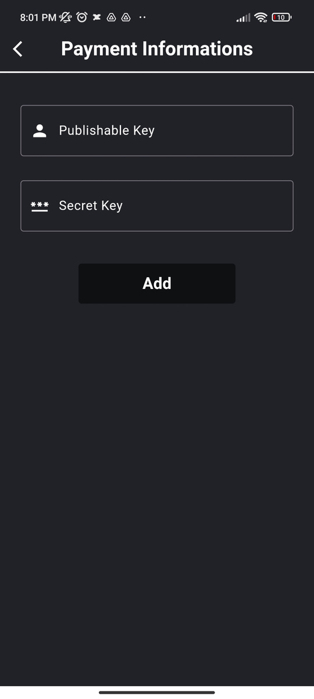
  Main Page, Personal Information & Payment Information

Slide 11
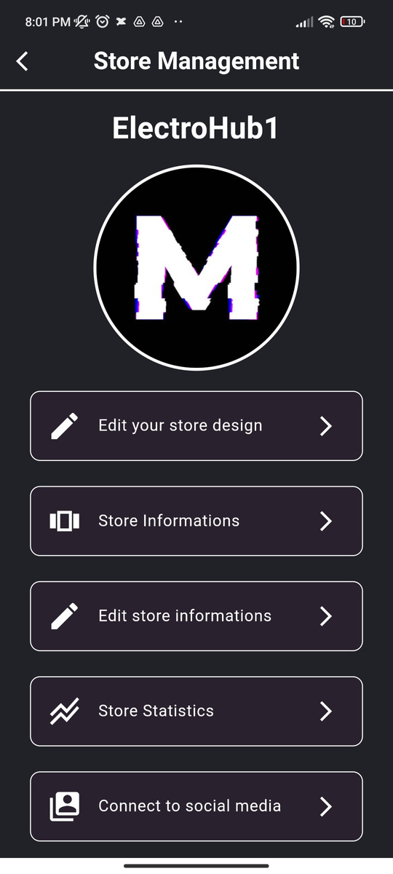
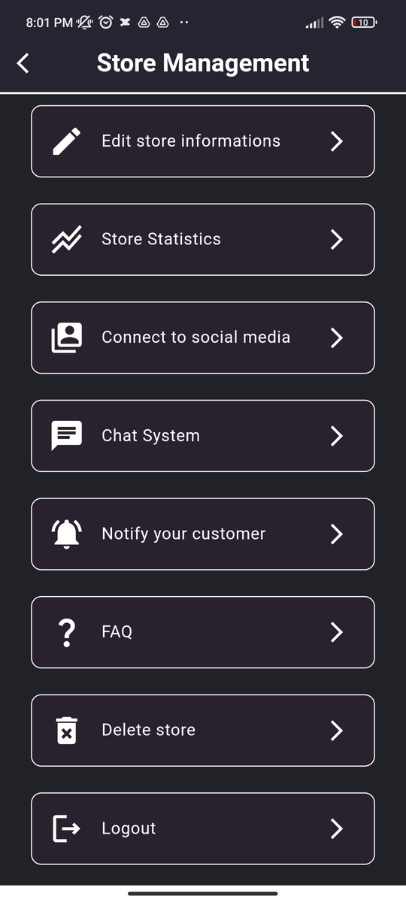
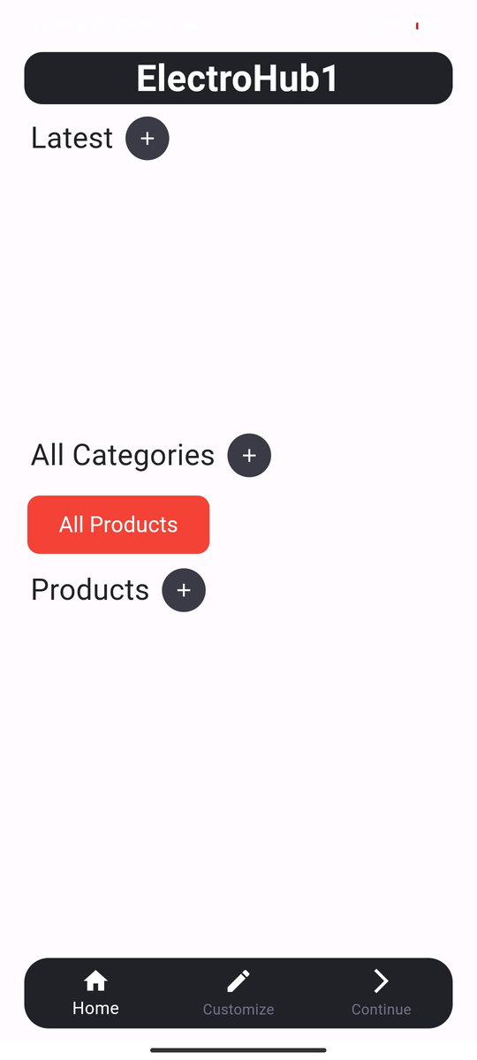
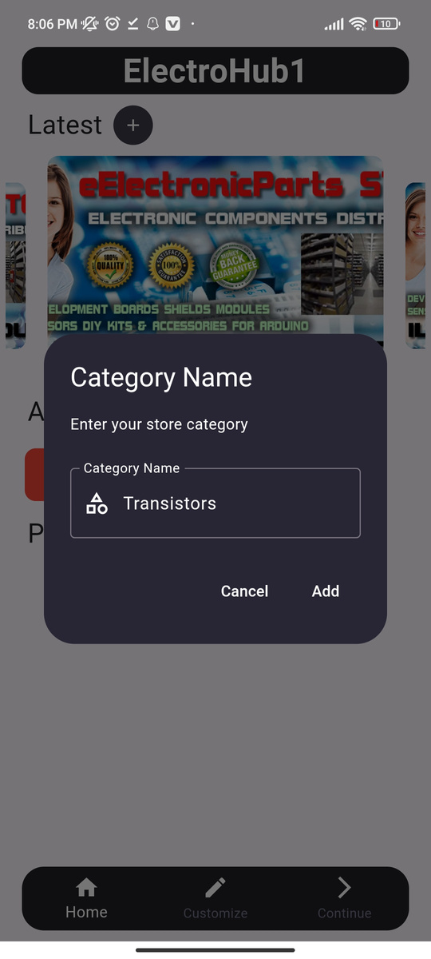
  Store Management ( Edit Store Design )

Slide 12
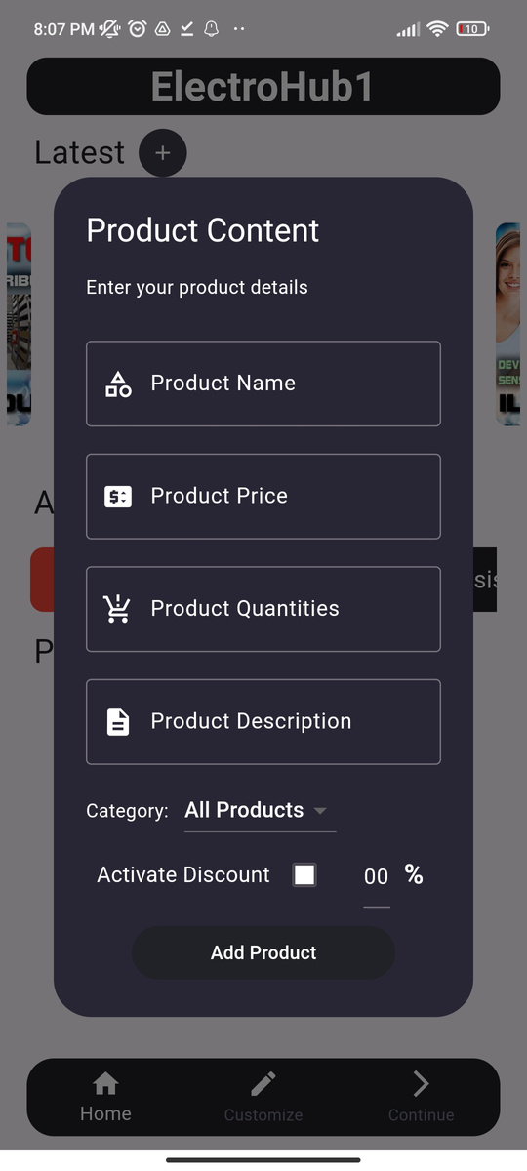
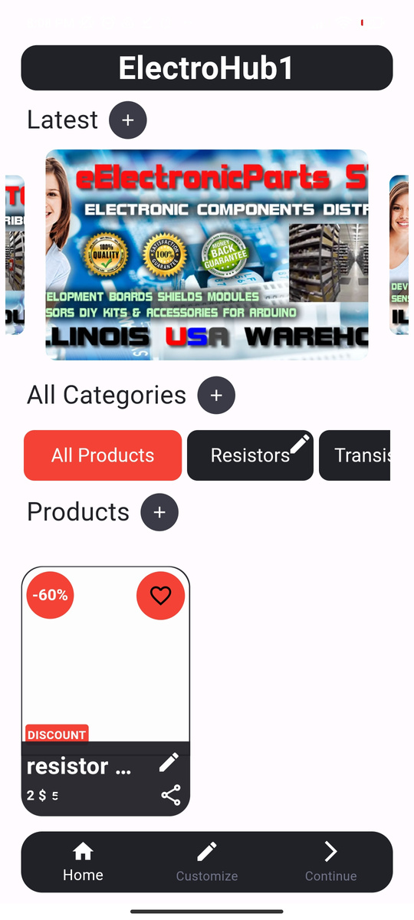
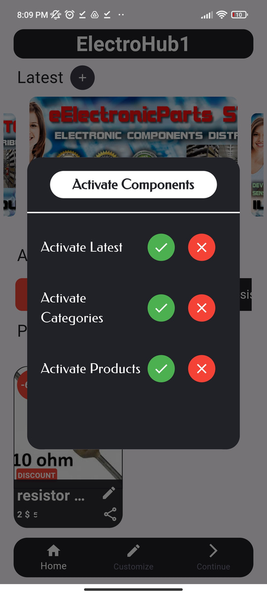
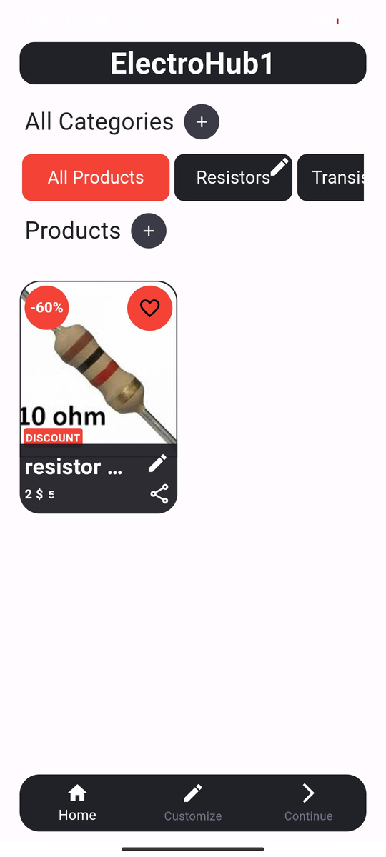

  Add Product & Activate Store Components

Slide 13
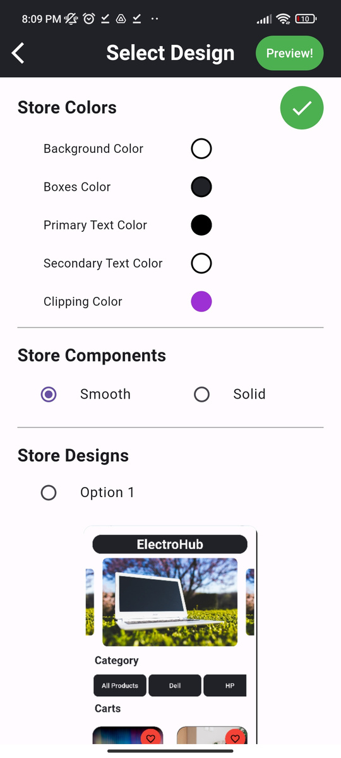
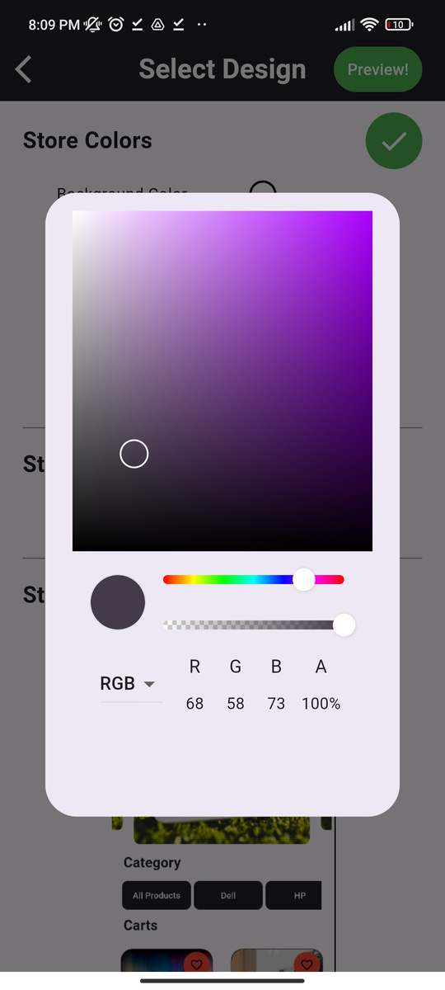
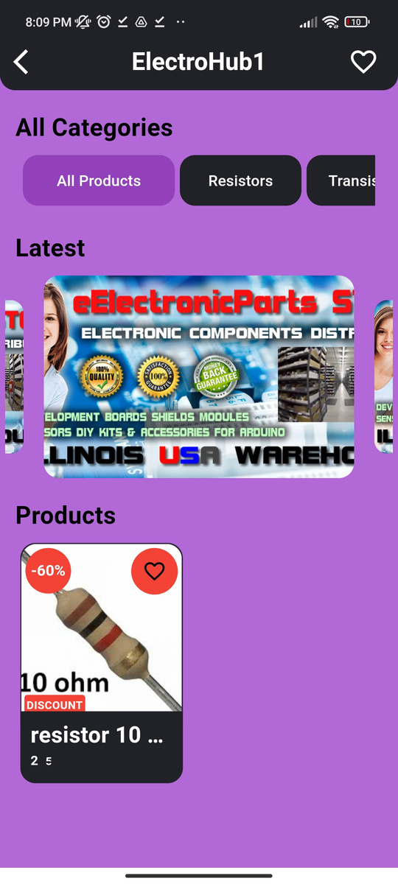

  Select Design & Colors

Slide 14
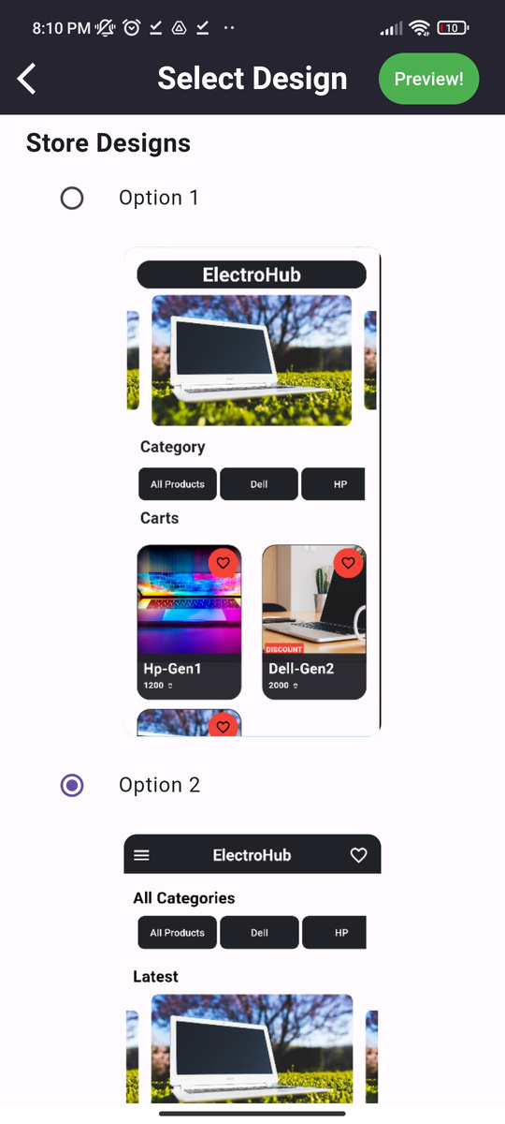
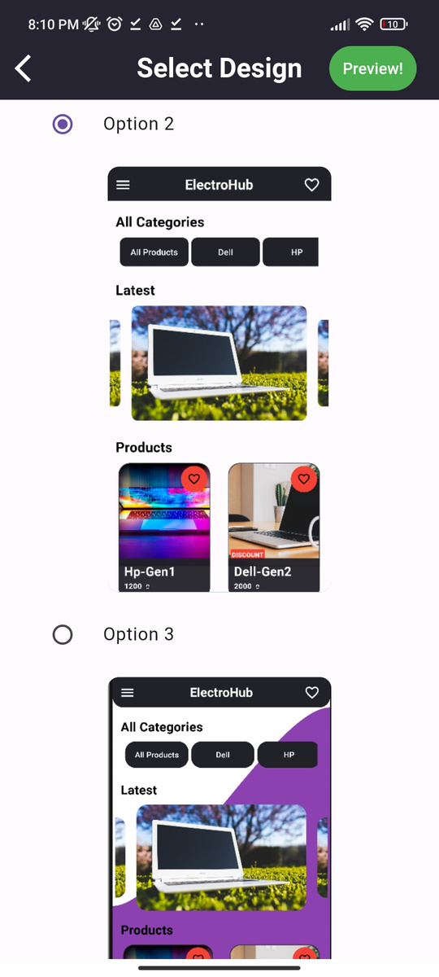
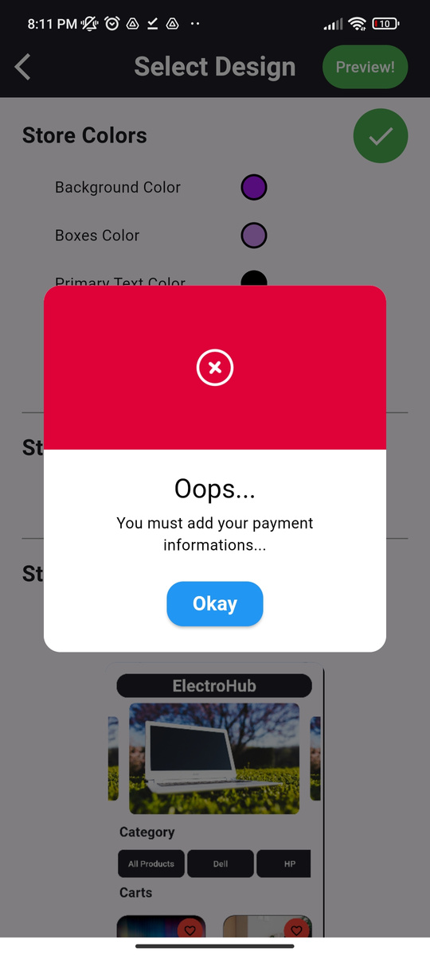
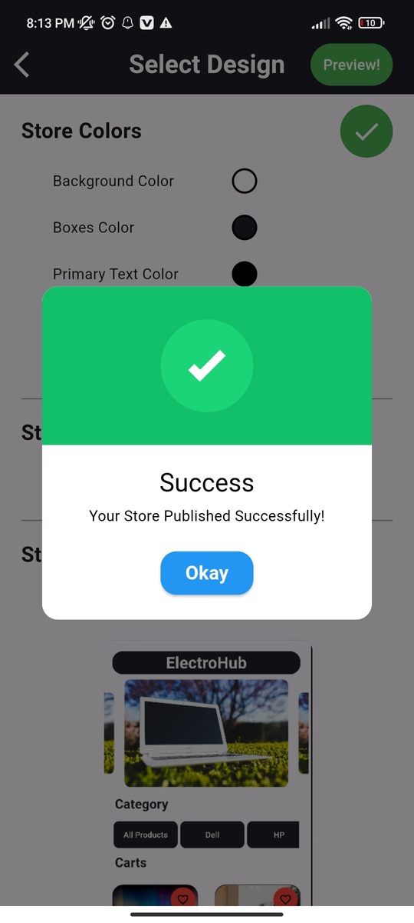
  Store Design Options

Slide 15
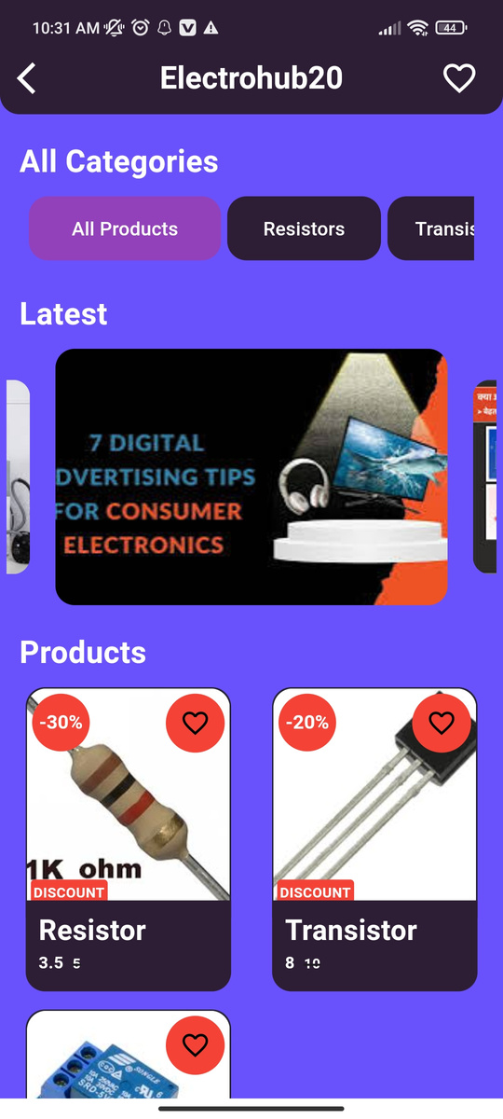
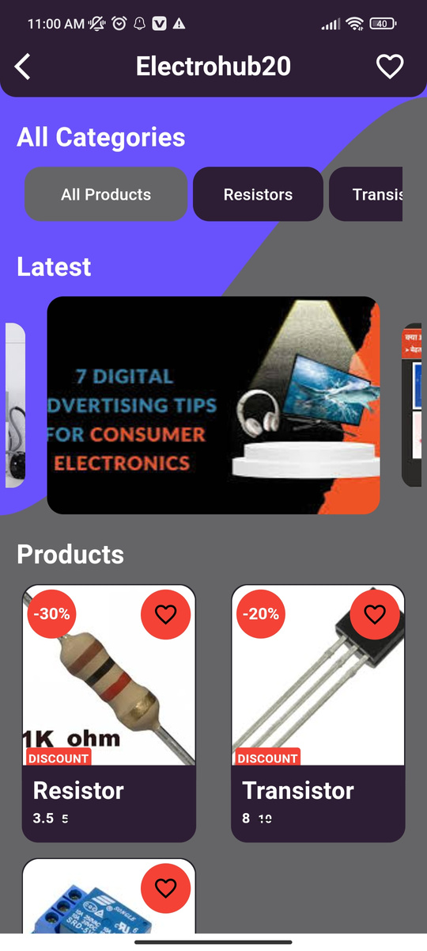
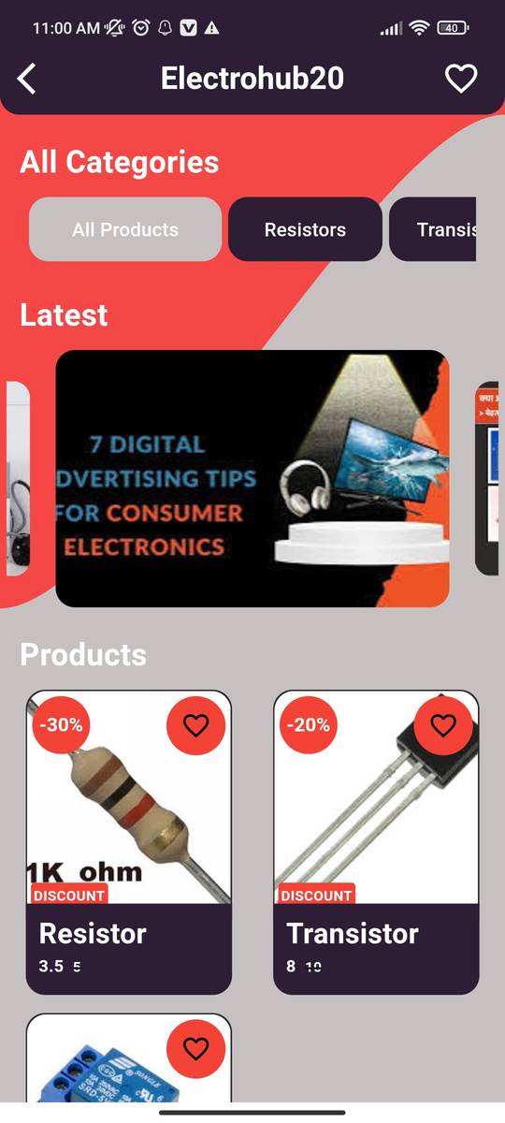
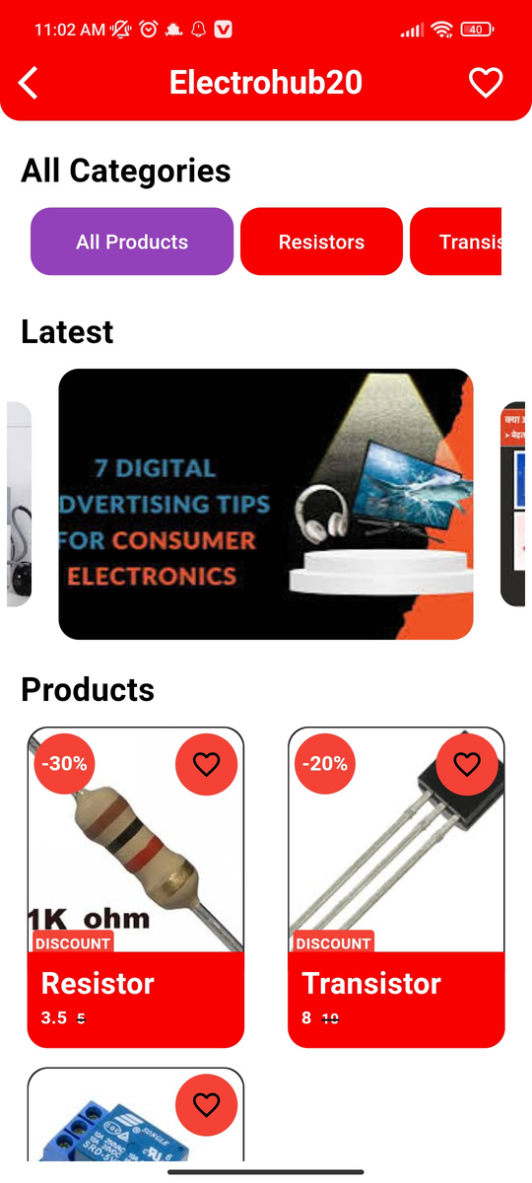
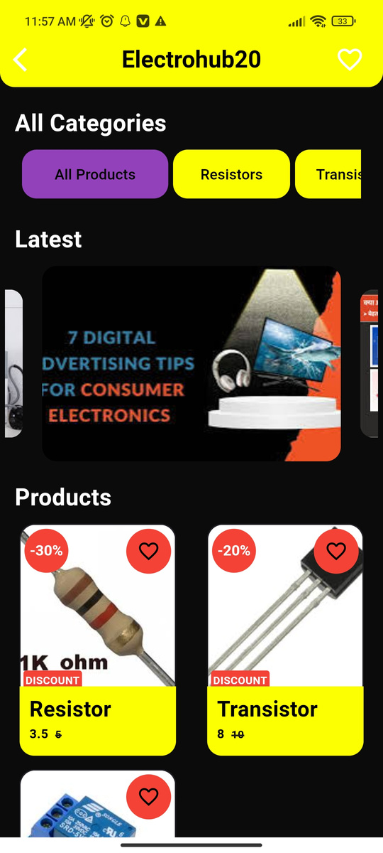
  Huge numbers of options

Slide 16
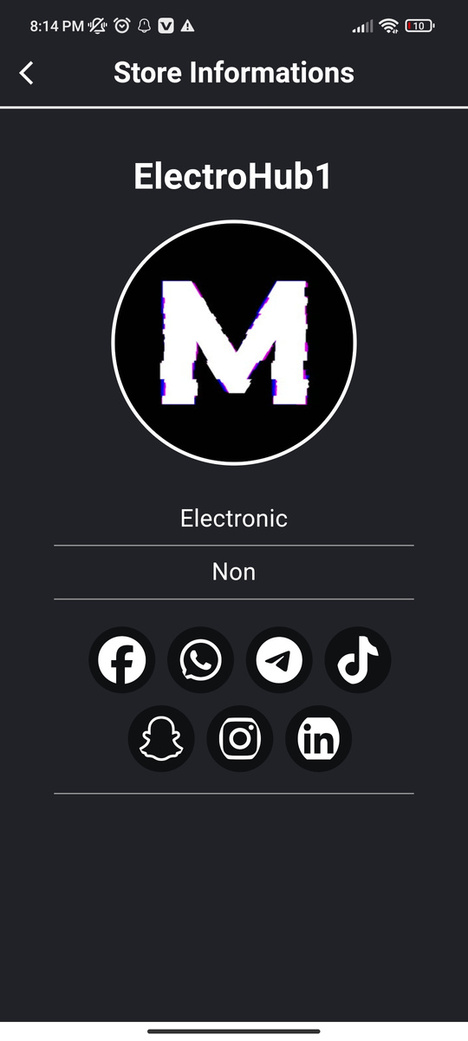
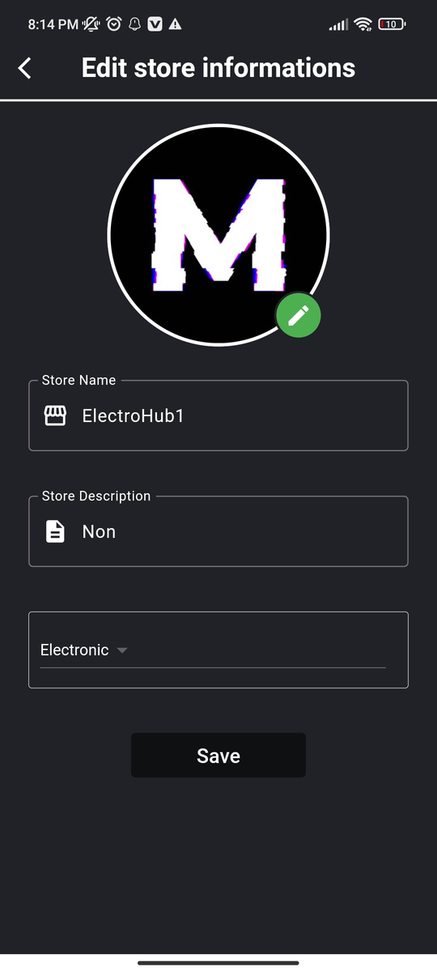
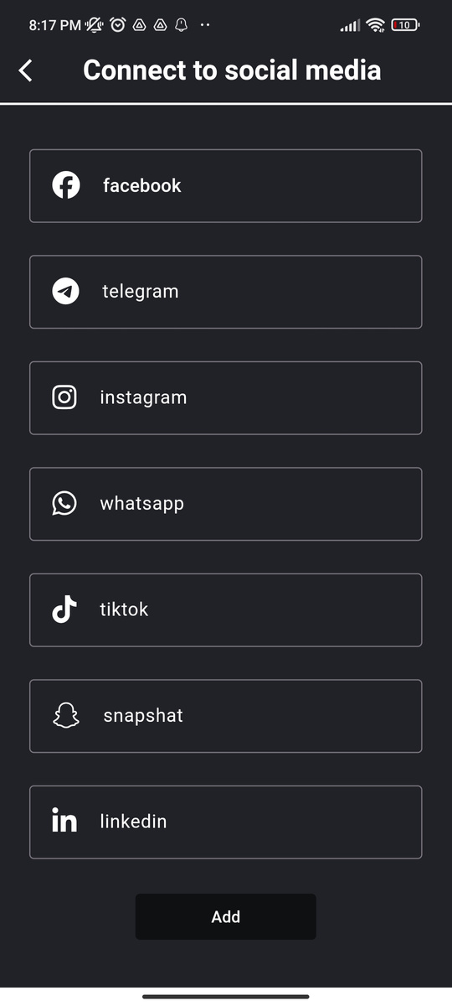

Slide 17
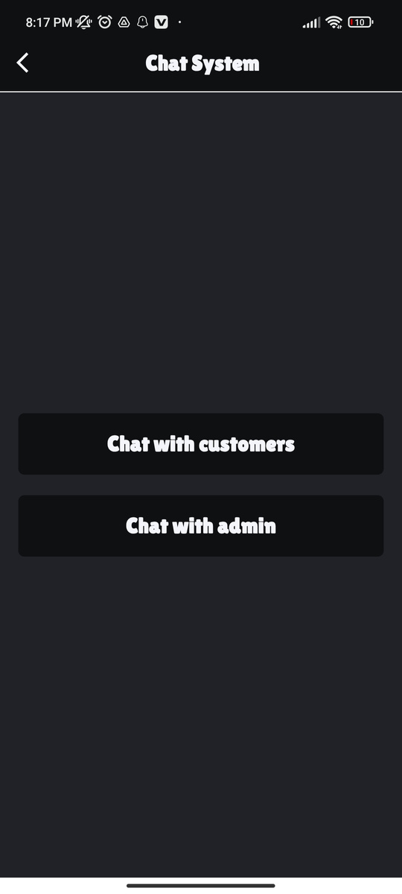

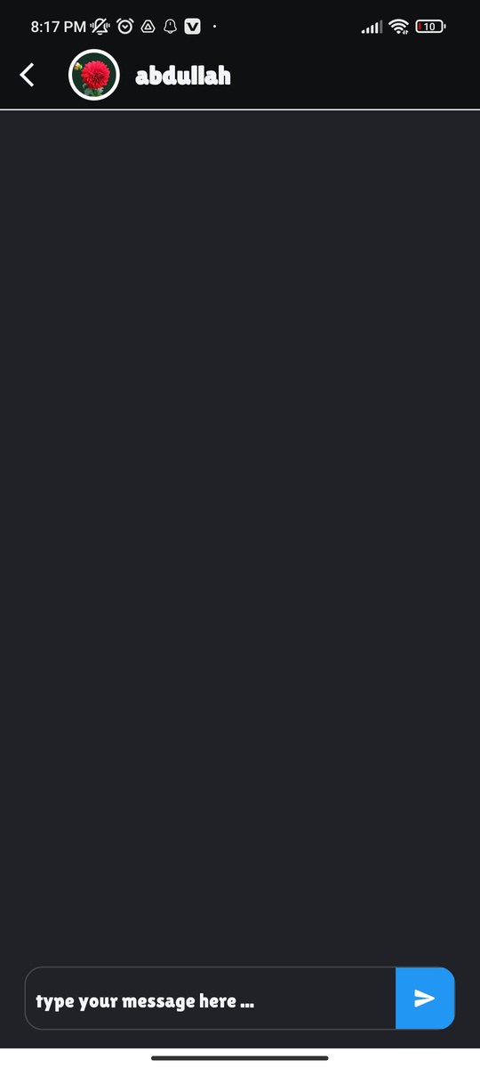
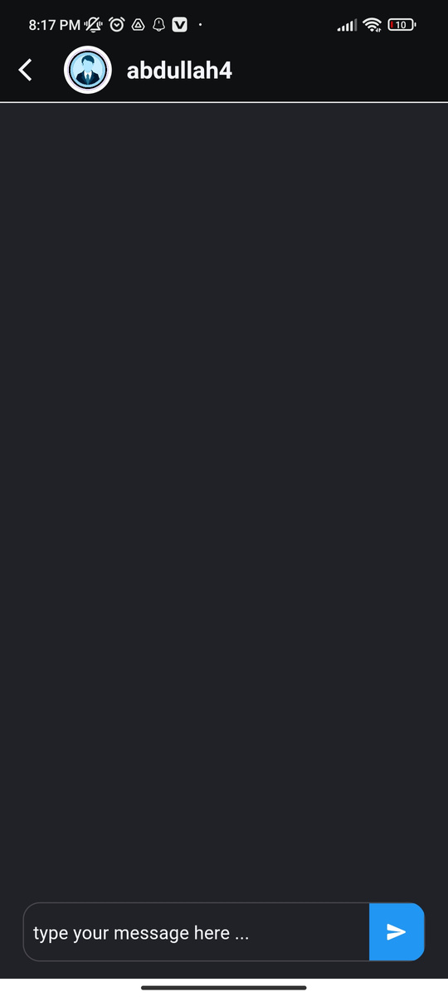
  Chat System

Slide 18
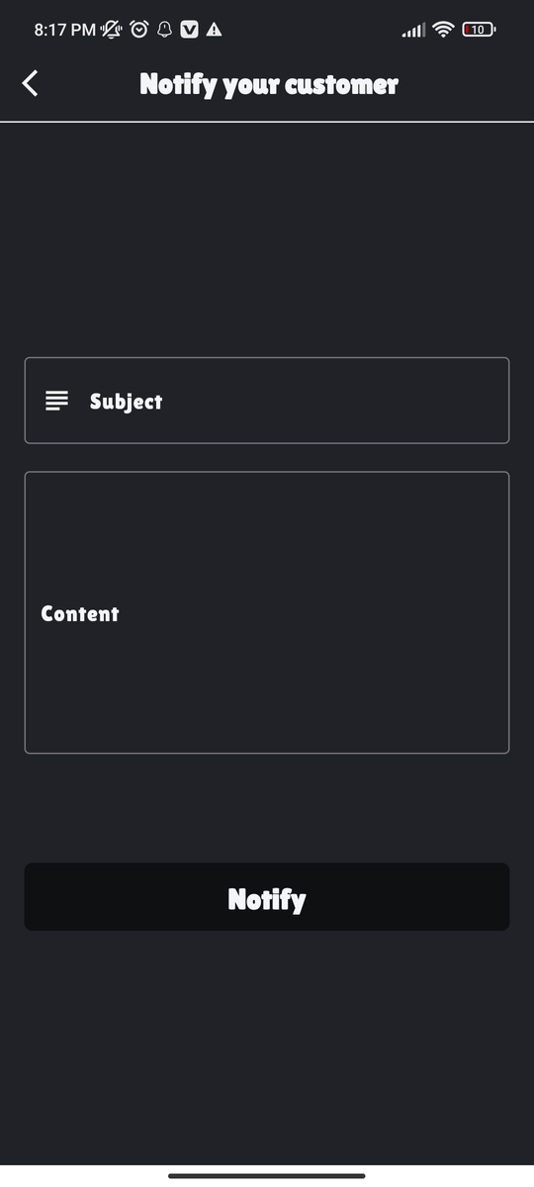
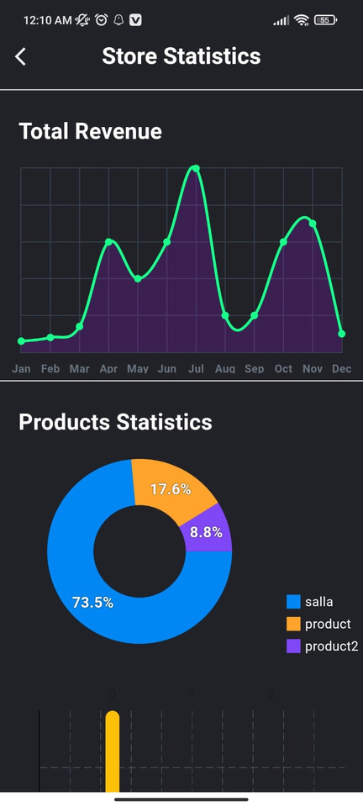
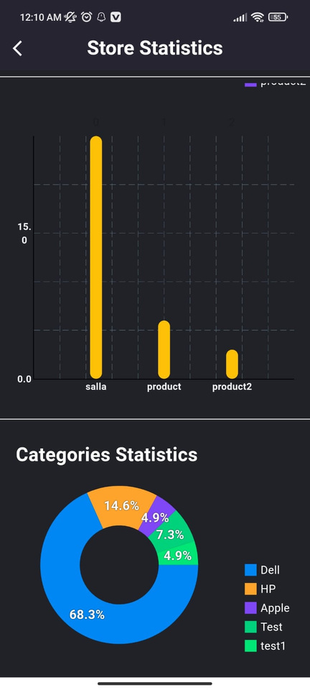
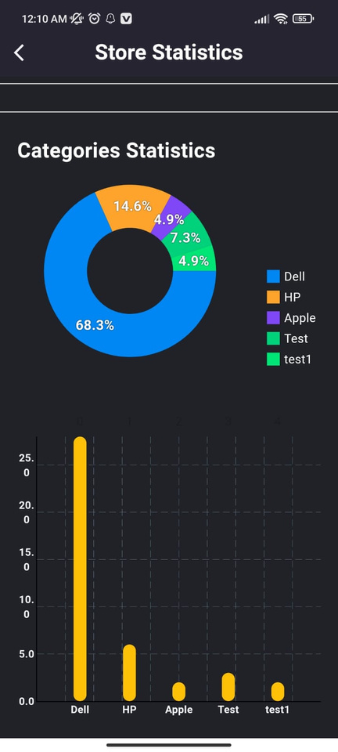
  Store Statistics & Custom Notifications

Slide 19
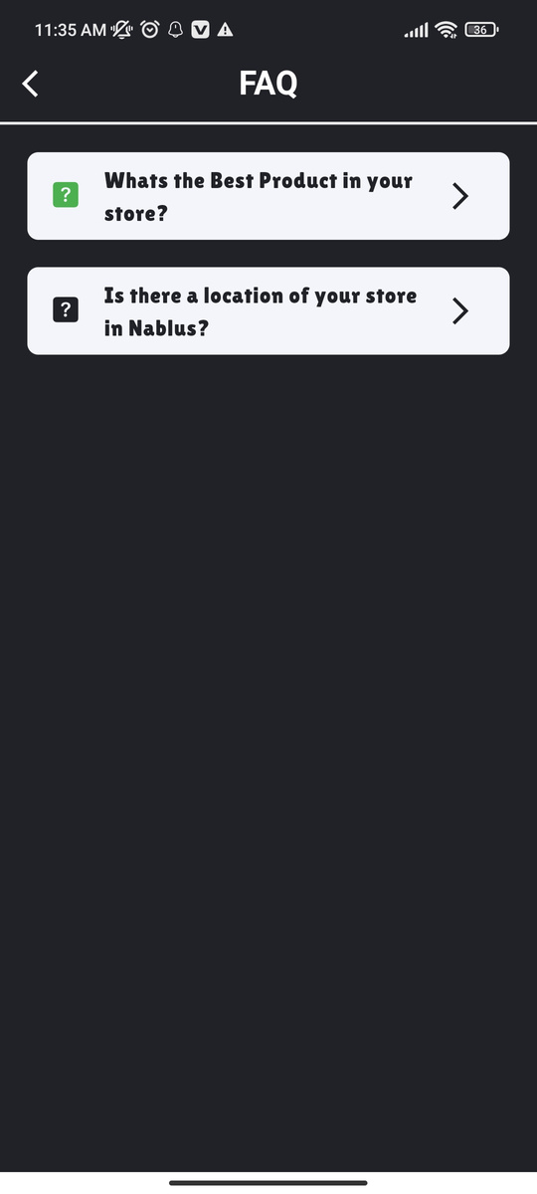


  Delete Store, FAQ & Logout

Slide 20
Customer Side

Slide 21





  Register , Forgot & Reset Password

Slide 22




  Customer Main Page

Slide 23




  Specific Store, favorite products & add product to cart

Slide 24



  Specific Store, favorite products & add product to cart

Slide 25



  Rate & Review

Slide 26





Slide 27
Localization

Slide 28





Slide 29





Slide 30




Slide 31
Admin Dashboard

Slide 32


Slide 33


Slide 34


Slide 35










Technologies
Backend & Database
Email verification & send Email
Frontend
Chat System & Push Notifications
Backend Hosting
Cloud Storage

Slide 36
Future Work
  Cash On Delivery
  Enhance the UI of some pages.
  Enhance chat page.
  Publish app to app store.

Slide 37
Any Questions?
Explore Now

Slide 38
Thank you for
Listening

