Slide 1
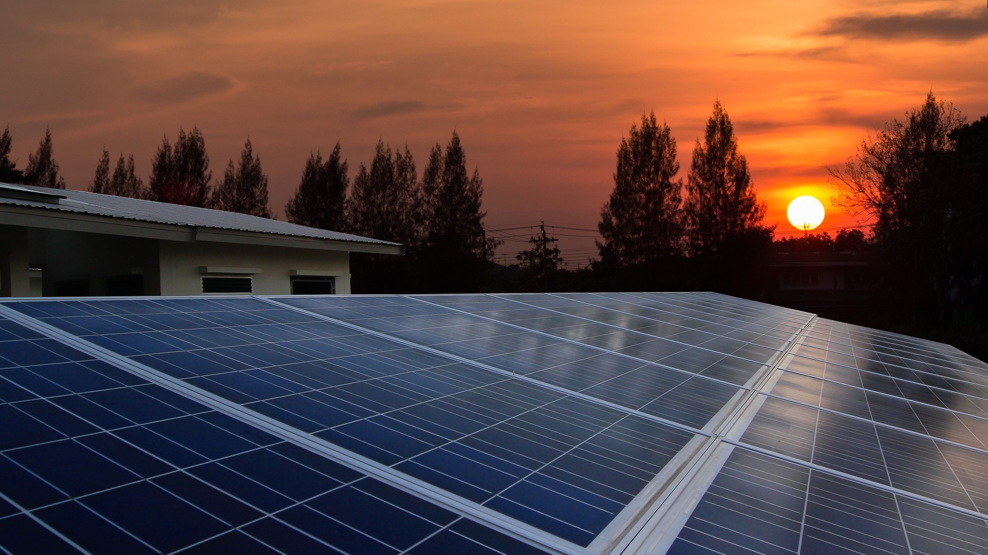

An-Najah National University
Faculty of engineering
Electrical Engineering Department
Graduation Project 1
“Demand-Side Management System for Autonomous DC Microgrid for building”
Authors: 1- Majdi Mazen Dweikat
2- Abdallateef Abu Lebdeh
3- Rasheed Hattab
4- Jalal Hattab
Supervisor: Dr. Moien Omar
Date: 27 May 2020

Slide 2
Abstract
This report proposes a simulation for demand-side management (DSM) scheme for the autonomous DC microgrid for the future building.
The DC distribution system is considered as a prospective system due to the increase of DC loads and DC power sources such as photovoltaic (PV), and battery bank (BB), The BB responds to the changes in a power imbalance between PV generation and demand within an autonomous DC microgrid. The power loss during charging/ discharging of the battery is the great challenge for the autonomous DC microgrid supplied by PV, it decreases the system efficiency.
The control objective of the proposed DSM scheme is to use the PV energy more efficiently. The proposed control algorithm decreases the time period of batteries ON time, in this way it decreases the charging/discharging cycles of the batteries, this is reducing the power losses in the battery and improves system efficiency. The proposed scheme reduces the storage and capital cost of the system.

Slide 3
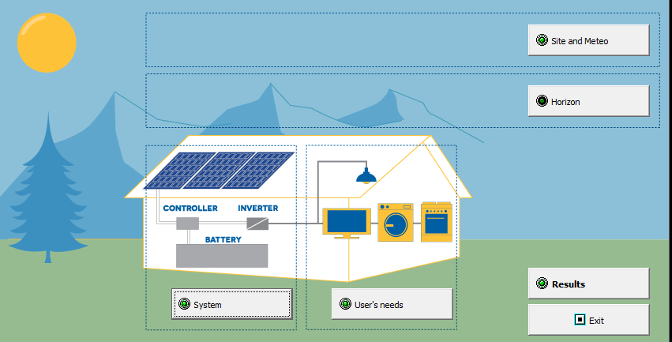
Building and designing dc microgrid on PV SYST
We used PVsyst program to simulate our DC microgrid and specify all the components such as the user needs and the loads in the house and the operating time for each load, size of the PV, the number of batteries and the AH we need, and the controller used.

Slide 4
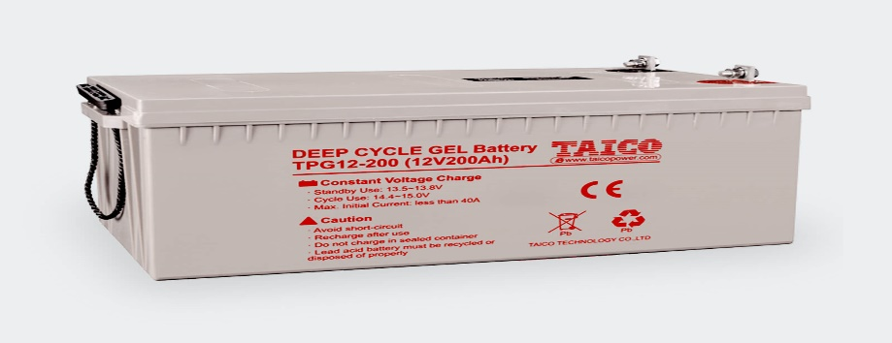
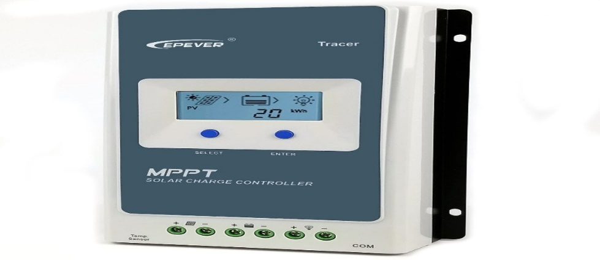
PV Sizing up
The PV watt-hours needed per day is the combination of the total power consumption in the appliances and power losses in the system.
The total load power is 230 w.
We assumed the operating hours per day for every load as below:
Lights-12 Hrs. per day
Fans-Heaters-12 Hrs. per day for summer and winter (variable value but we are taking the worst cases).
Washing machine 1.5 Hrs. per day
Water pump-0.5 Hrs. per day.
So, the total energy in (WH) for the loads is 1210 WH.
*Solar radiation (Peak sun hour) is 5.4 KWH/m2.day
*panels efficiency is 0.95.
1210/ (5.4*0.95) =235 WP
taking into consideration the losses on the system, so we choose the PV size to be 400 WP.
2 modules in series/200W/23V.
Batteries
Total load consumption is 1210 WH.
To find the AH-1210WH/12V=100.83 AH.
Batteries needed=#of AH needed*days of autonomy*Annual correction factor/DOD
Batteries needed = 100.83* 3 * 1,15 / 0,8 = 435 Ah.
*Days of Autonomy means How many days will the solar system run without sunshine?
*Annual correction factory compensates the fact that batteries will not be new forever, but their maximum power will be less over the years.
So, for our project, we chose 3*151 AH Lead-acid batteries,12 volt all in parallel so we can keep the system at 12 V.
Solar Charge Controller
MPPT 1000W\12V\37 A max. charging.

Slide 5
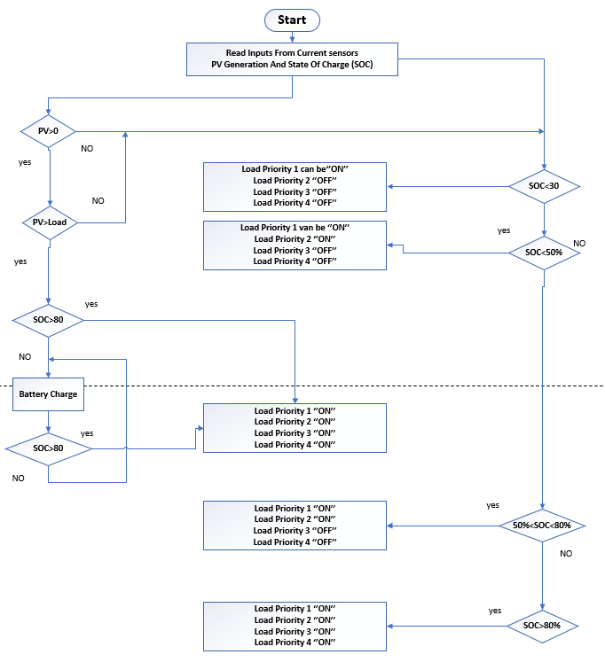
Algorithm
The proposed algorithm considers some a priori rules and correlations to choose the best course of action and estimate the parameter values.

Slide 6
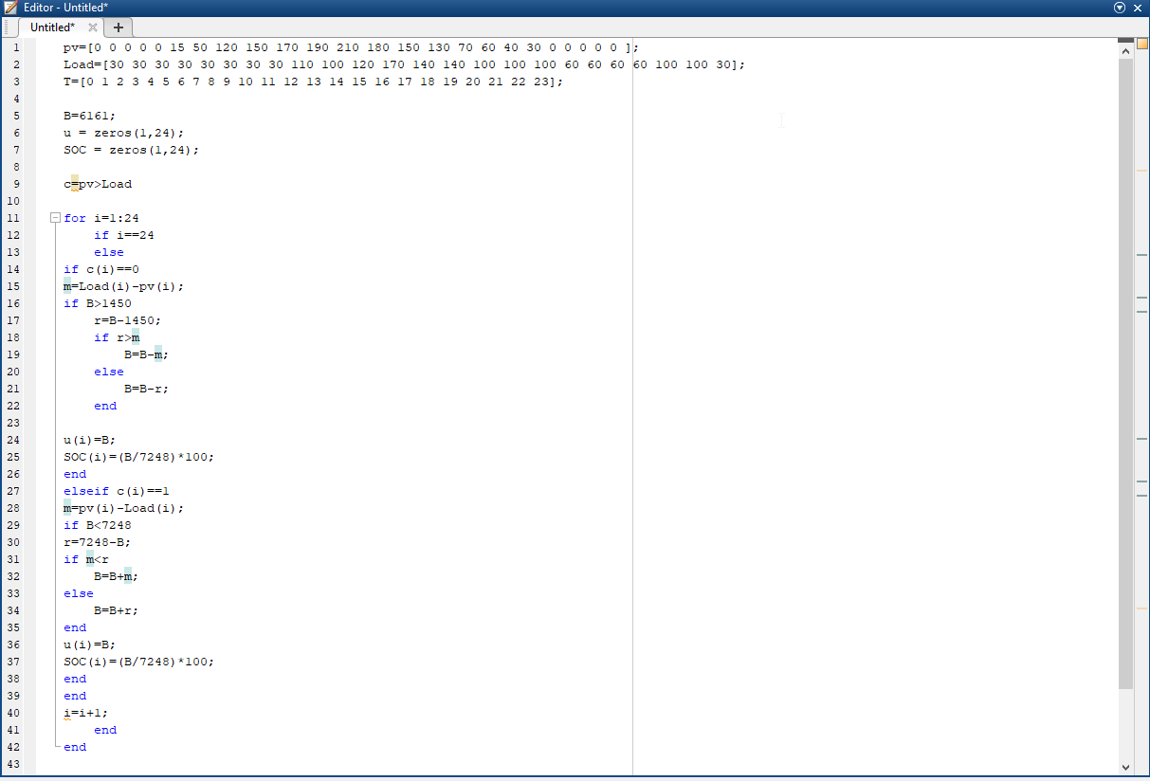
MATLAP code
MATLAB Code for the Conventional scheme

Slide 7
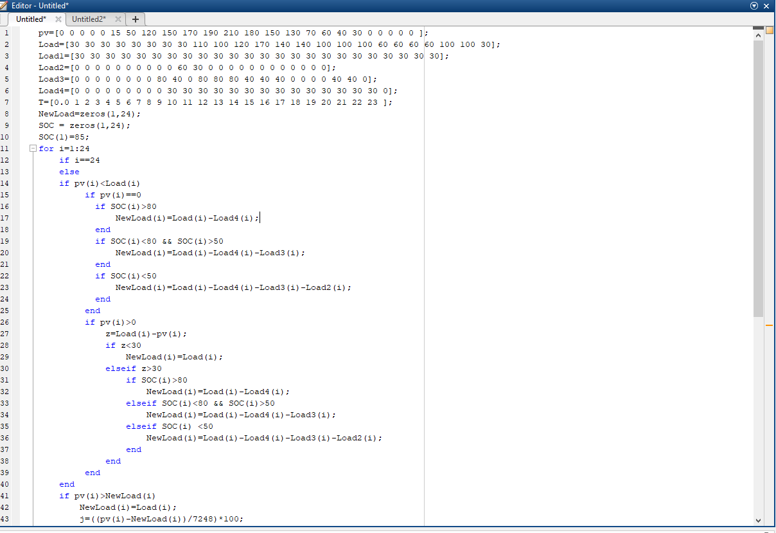
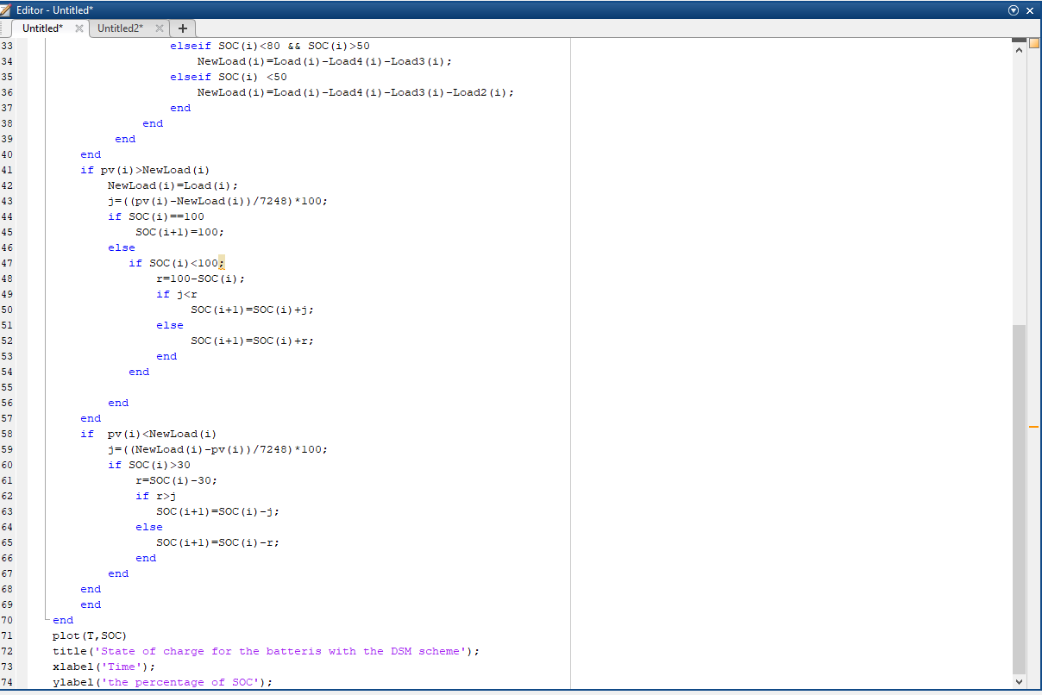
MATLAB Code for the DSM scheme 1
MATLAB Code for the DSM scheme 1

Slide 8
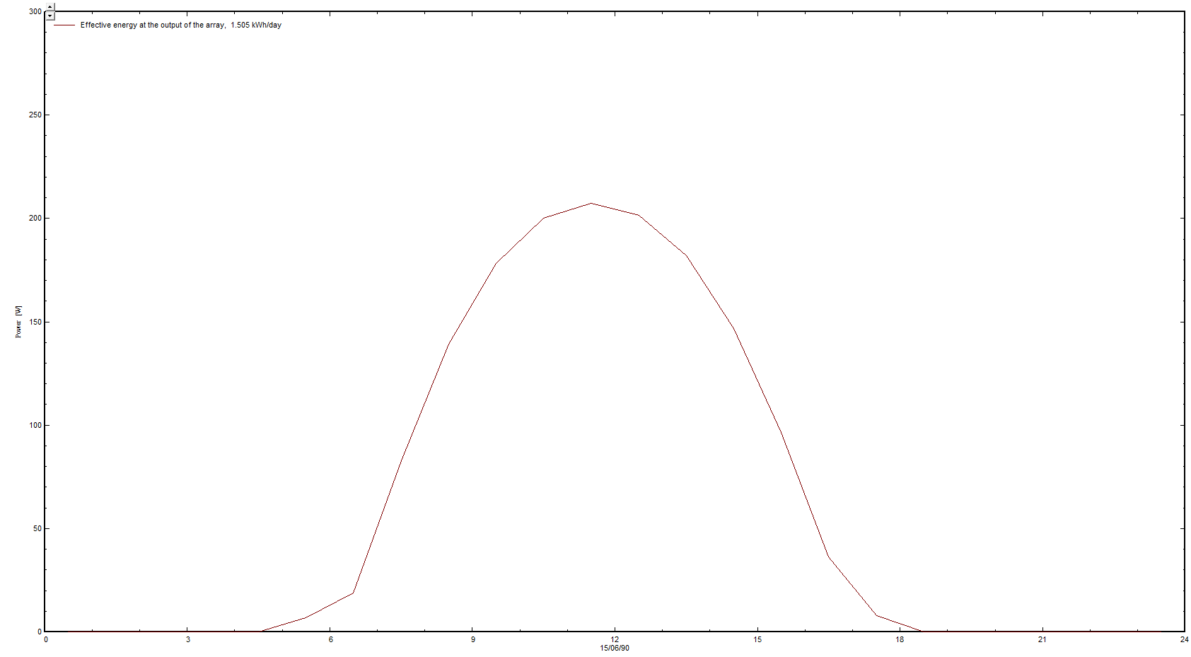
Results
Sunny day

Slide 9
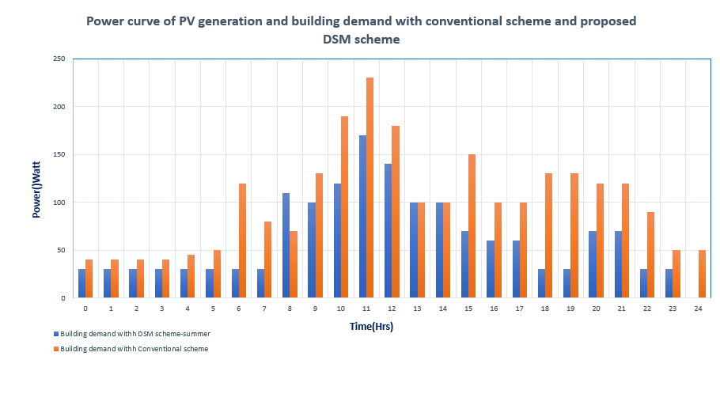

Slide 10
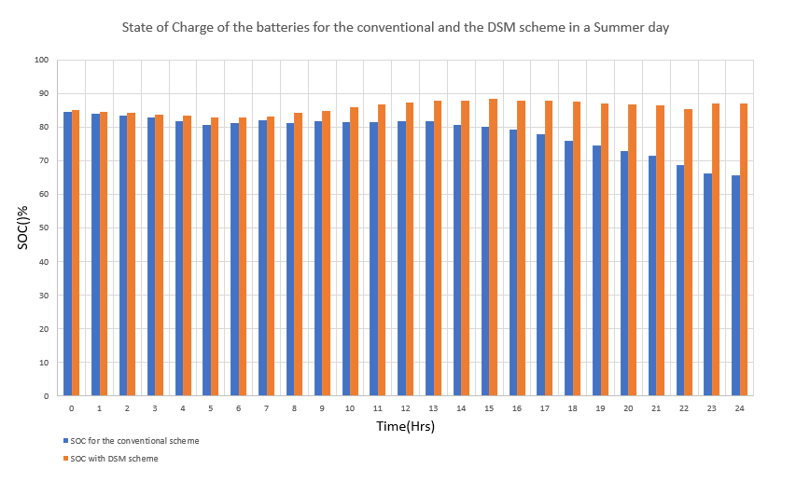

Slide 11
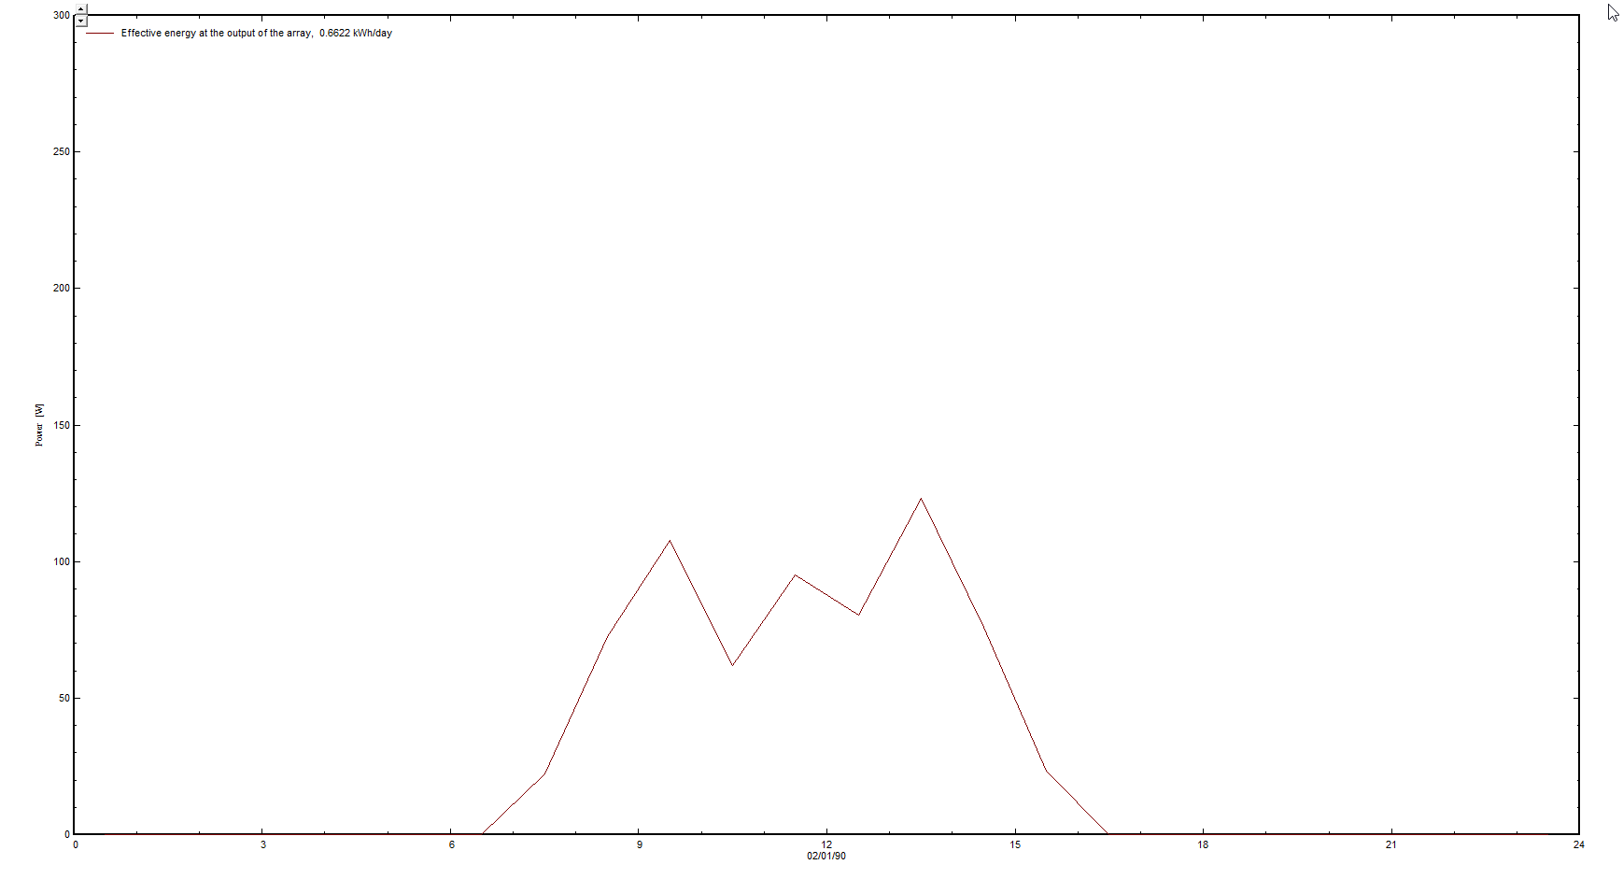
Results
Non-Sunny day

Slide 12
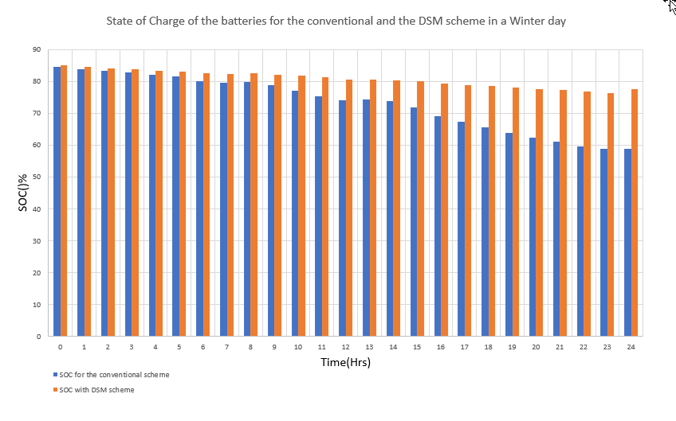

Slide 13
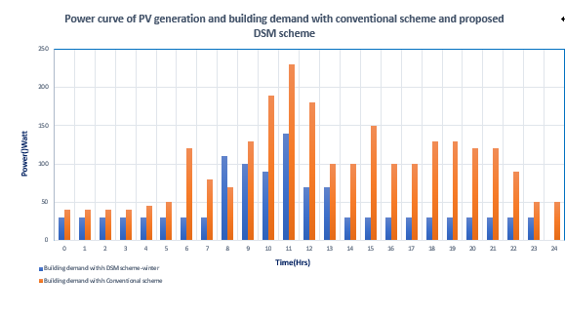

Slide 14
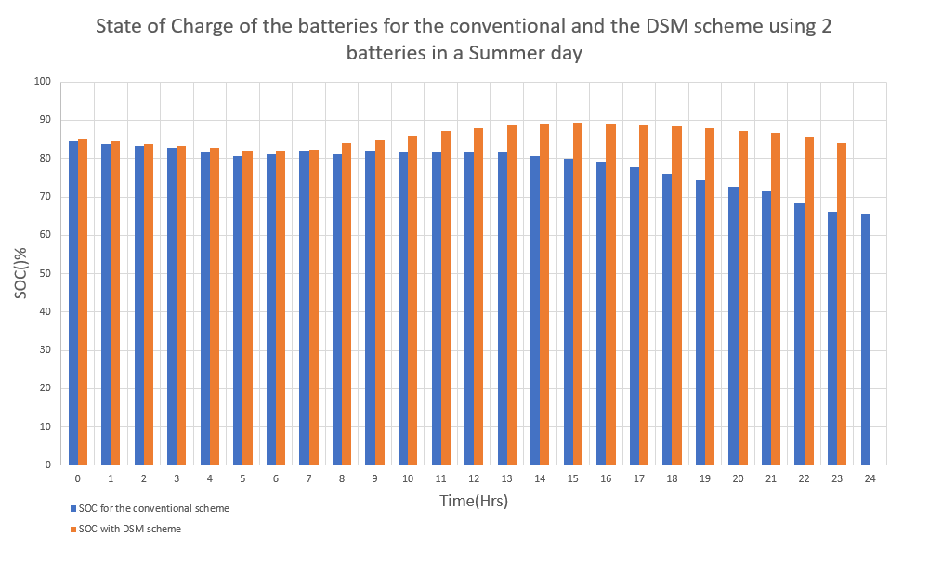
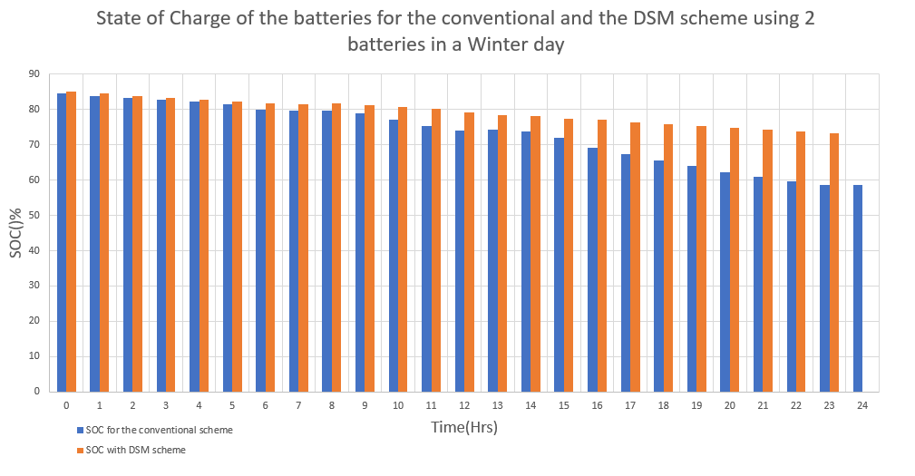
DSM with a smaller number of batteries

Slide 15
Conclusion
This paper presented a demand-side management (DSM) scheme for the autonomous DC micro grid of a residential building. The appliances have been automatically switching ‘ON’/ ‘OFF’ as per the control algorithm. The performance of the DSM scheme has been tested in terms of efficient utilization of the PV energy by scheduling the loads according to its priority
‏Through the results we noticed the difference
‏between the use of DSM and the conventional use of dc microgrids, where we save as much as possible the soc batteries and reduced the use of loads, which led to a significantly increased system efficiency, The proposed scheme can be used for LVDC micro grid such as building with renewable energy sources and data centres.

Slide 16
Thank you

