Slide 1
Structural analysis and design of Husam Quresh building
By:
Qais Ghannam
Aws Radwan
Amr Abed
Supervisor:
Eng. Hind Tbaileh

Slide 2
INTRDUCTION
Project description
Materials
Soil investigation
Codes and standard
  Seismicity of Site and Structure
Loads
Load combination

Slide 3
PROJECT DESCRIPTION
This project is about a Private commercial multi-storey building in Nablus city, rafedia region, and this building is under construction.
The building is over looking on two streets, a major street in the south and a Minor street on the east, and its away 3m from the major street, and 2m from the minor one.

Slide 4
The building is about ten floors, three of them are underground floors, the lowest two floors (B3 and B2) will be Garages, the first underground storey (B1) will be depository, the ground floor will be Stores, the ground floor has an attic 3 meters in height, the first and second floors will be Wedding Hall and museum respectively, and the remaining floors designed to be offices.

Slide 5
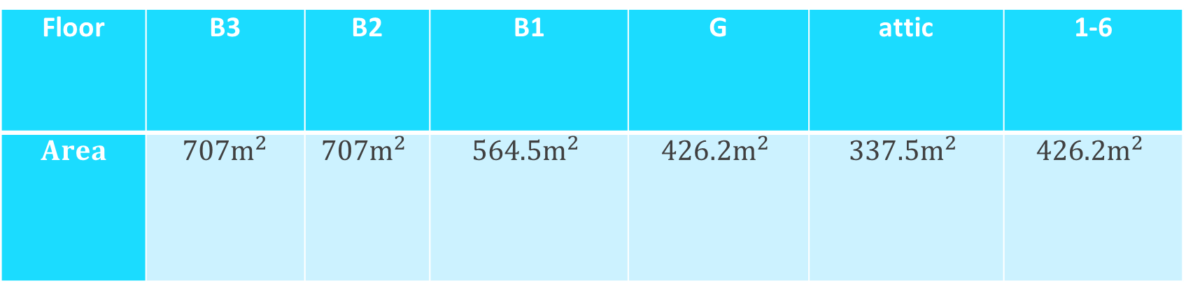

Total area of building = 5300 $m^{2}$
The area of each floor:
Floor | B3 | B2 | B1 | G | attic | 1-6
$$Area$$ | $${707m}^{2}$$ | $${707m}^{2}$$ | $${564.5m}^{2}$$ | $${426.2m}^{2}$$ | $${337.5m}^{2}$$ | $${426.2m}^{2}$$

Slide 6
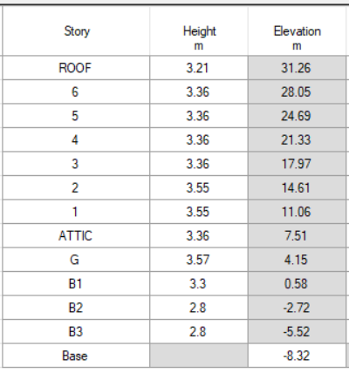
The height and elevation of each floor :

Slide 7
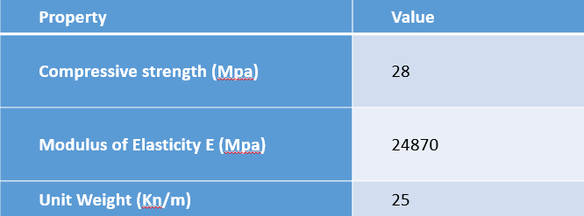
materials
Concrete

Slide 8
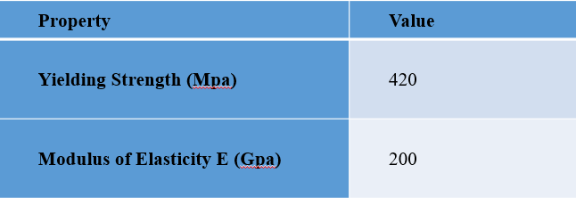
Steel

Slide 9
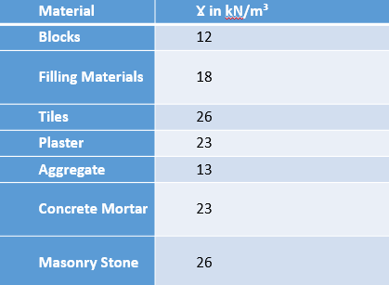
Non-structural materials

Slide 10

Soil investigation
An investigation about the soil was done in the location of the project to get on the bearing capacity of the soil and condition around the site of work, with contact with civil engineer make studies about this region and he out with $q=300 KN/m^{2}$, Then will be using this value in analysis and design of the foundation of the structure.

Slide 11
Codes and standard
ACI 318-14
ASCE7-10
IBC 2012

Slide 12
  Seismicity of Site and Structure

Slide 13
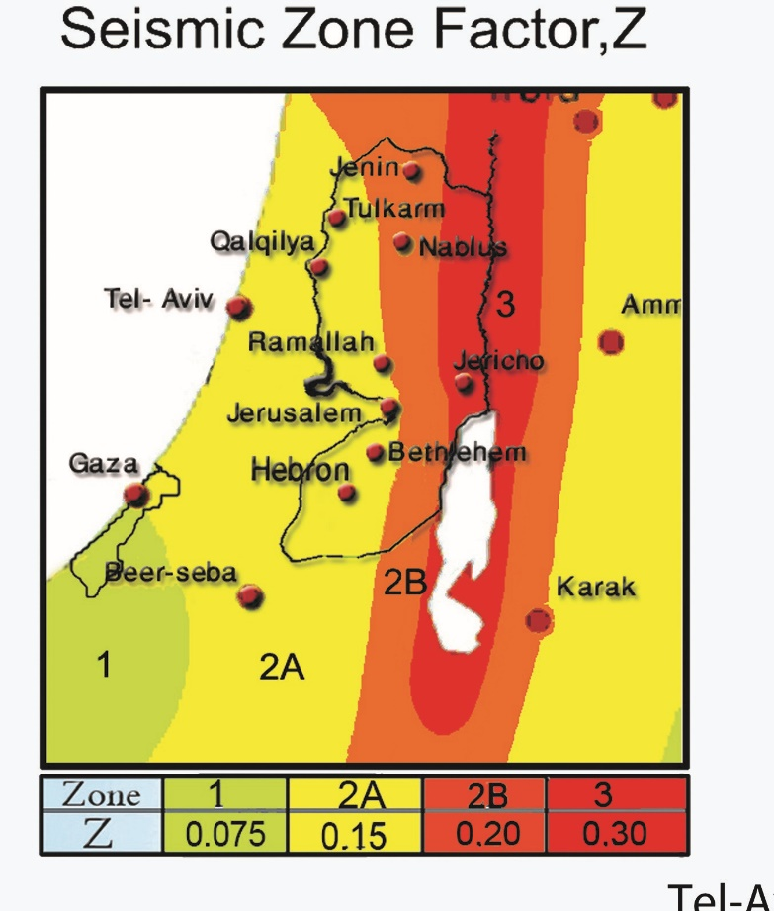
Z for Nablus = 0.2
SS = 2.5 × Z = 2.5 × 0.2 = 0.5
S1 = 1.25 × Z =1.25 × 0.2 = 0.25

Slide 14
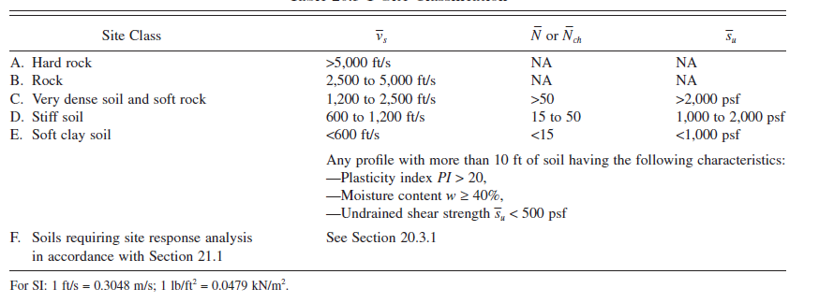
Site class ➔ Stiff Soil (C)

Slide 15
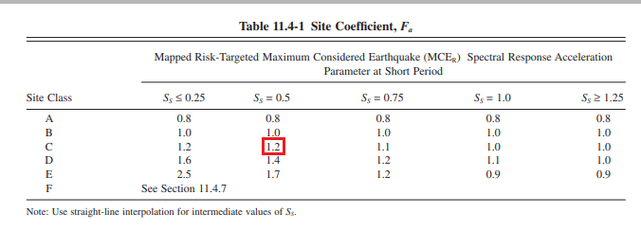
Site Coefficient Fa = 1.2

Slide 16
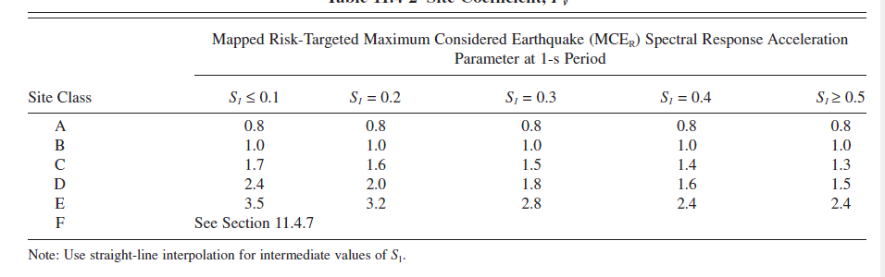
Site Coefficient Fv (by interpolation) = 1.55

Slide 17
SMS = Fa × SS = 0.6
SM1 = Fv × S1 = 0.3875
SDS = SS = 0.6
SD1 = S1 = 0.3875

Slide 18
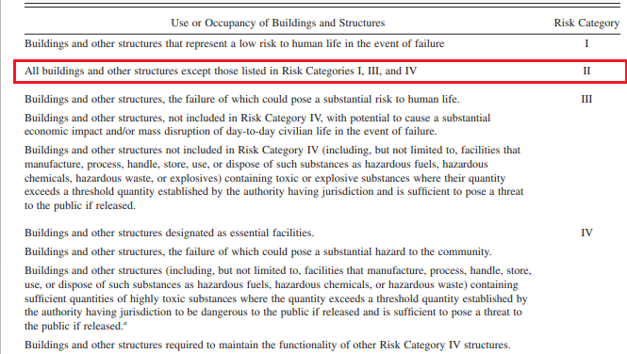
Risk Category = II

Slide 19
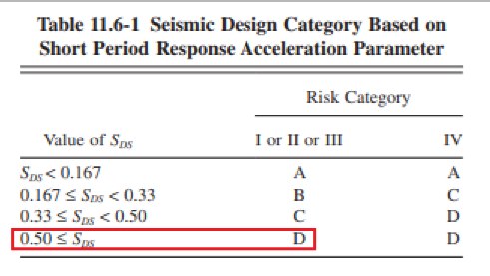
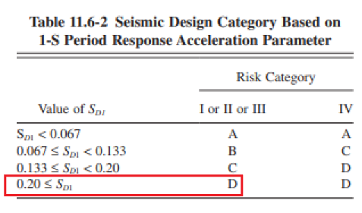
Seismic design category =D

Slide 20
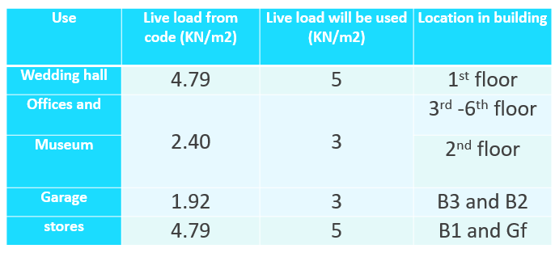

loads
Gravity Loads
  Dead Load: Weight of structural members.
  SD Load: 4.5 KN/$m^{2}$.
  Live load:

Slide 21
Lateral Load
The method used in determination the effect of earthquake load is modal response method.
Verified by ELF

Slide 22

Load combination
Ultimate Load Combinations:
1.4 D
1.2D +1.6L
1.32D +L +1.3EQx +0.39EQy
1.32D +L +1.3EQy +0.39EQx
0.78D +1.3EQx +0.39EQy
0.78D +1.3EQy +0.39EQx
$E=Eh+Ev$
$Eh=ρQE$
$QEy=Ey+0.3Ex$
$QEx=Ex+0.3Ey$
$Ev=0.2× SDs × D$
$$ρ=1.3$$

Slide 23

Service Load Combinations:
D+L
1.084 D+0.91EQx+0.273EQy
1.084 D+0.91EQy+0.273EQx
1.063D +0.75L +0.683EQx +0.205EQy
1.063D +0.75L +0.683EQy +0.205EQx
0.516D+0.91EQx+0.273EQy
0.516D+0.91EQy+0.273EQx
$E=Eh+Ev$
$Eh=ρQE$
$QEy=Ey+0.3Ex$
$QEx=Ex+0.3Ey$
$Ev=0.2× SDs × D$
$$ρ=1.3$$

Slide 24
PRELIMINARY DIMENTIONS
Slabs
Beams
Columns

Slide 25
slab thickness
We have a two way system that used:
1) two way solid slab : it used for B3 slab.
2) two way U-boot slab: it used for all floors except B3 slab.

Slide 26
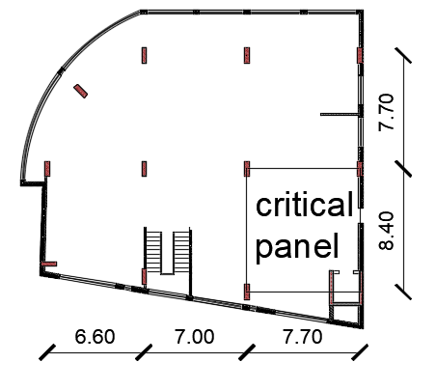

Slide 27
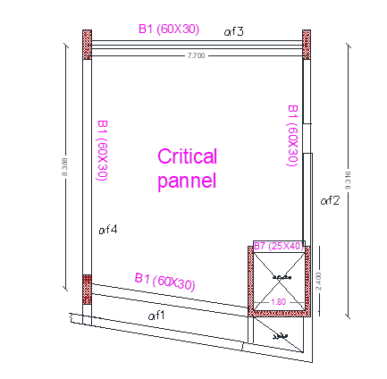

For solid slab :
assuming $α_{fm}>2$:
$$α_{fm}= 2.51>2$$

Slide 28
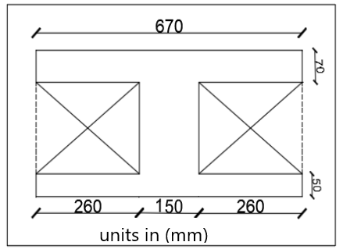
For U-BOOT SLAB :
U-boot dimensions :
Height = 20 cm
Width = length = 52 cm
total depth of slab = 32 cm .

Slide 29

Beams dimensions
for one end continues beam with
L = 8.4 m .
$h=(\frac{L}{18.5})=(\frac{8.4}{18.5})=0.45m$
Try h =0.6 m
b= 0.3m

Slide 30


for one end continues beam with
L = 8.4 m .
$h=(\frac{L}{18.5})=(\frac{8.4}{18.5})=0.45m$
Try h = 0.6 m
b = 0.3m

Slide 31
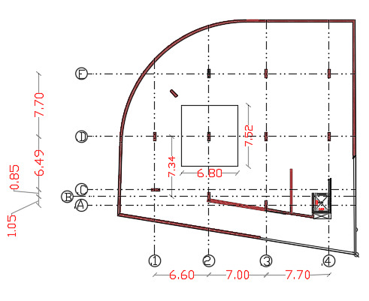
Column dimensions
column dimensions found by
tributary area method
The dimension of column is (1400 × 500)

Slide 32
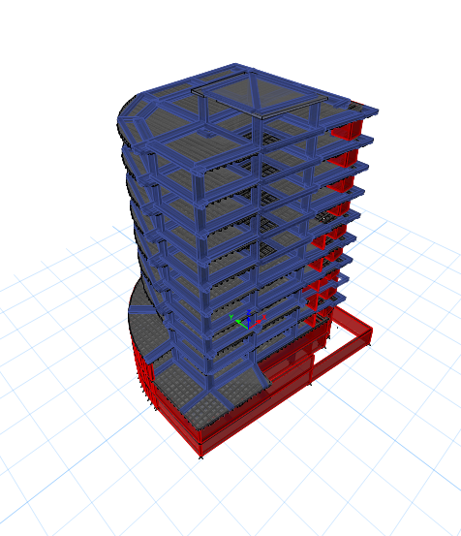
MODELING & CHECkES
ETABs 2016, will be used.
Process of modeling
checks of modeling

Slide 33
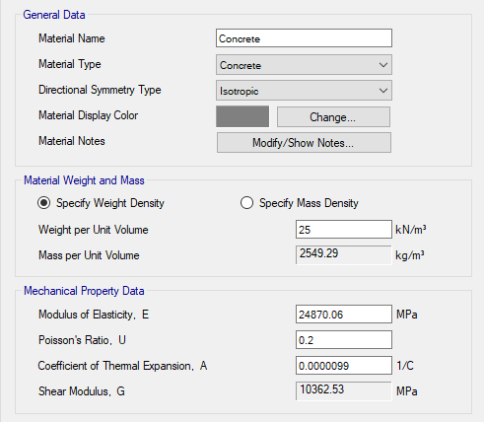
Process of modeling
1) Define of material
- Concrete
concrete was used with
ɣ=25KN/m3 and
F'c =28 MPa
So Ec = 4700×√(f'c) =
4700× √28=
24870 MPA

Slide 34
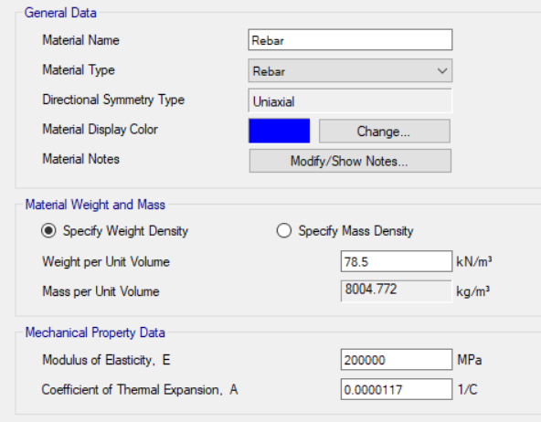
- Steel (rebar)
ɣ=78.5 KN/m3
Fy=420 Mpa
Es= 200 000 MPa

Slide 35
2) Define of sections
Columns & Beams sections
Shear & Retaining walls sections
Slabs sections

Slide 36
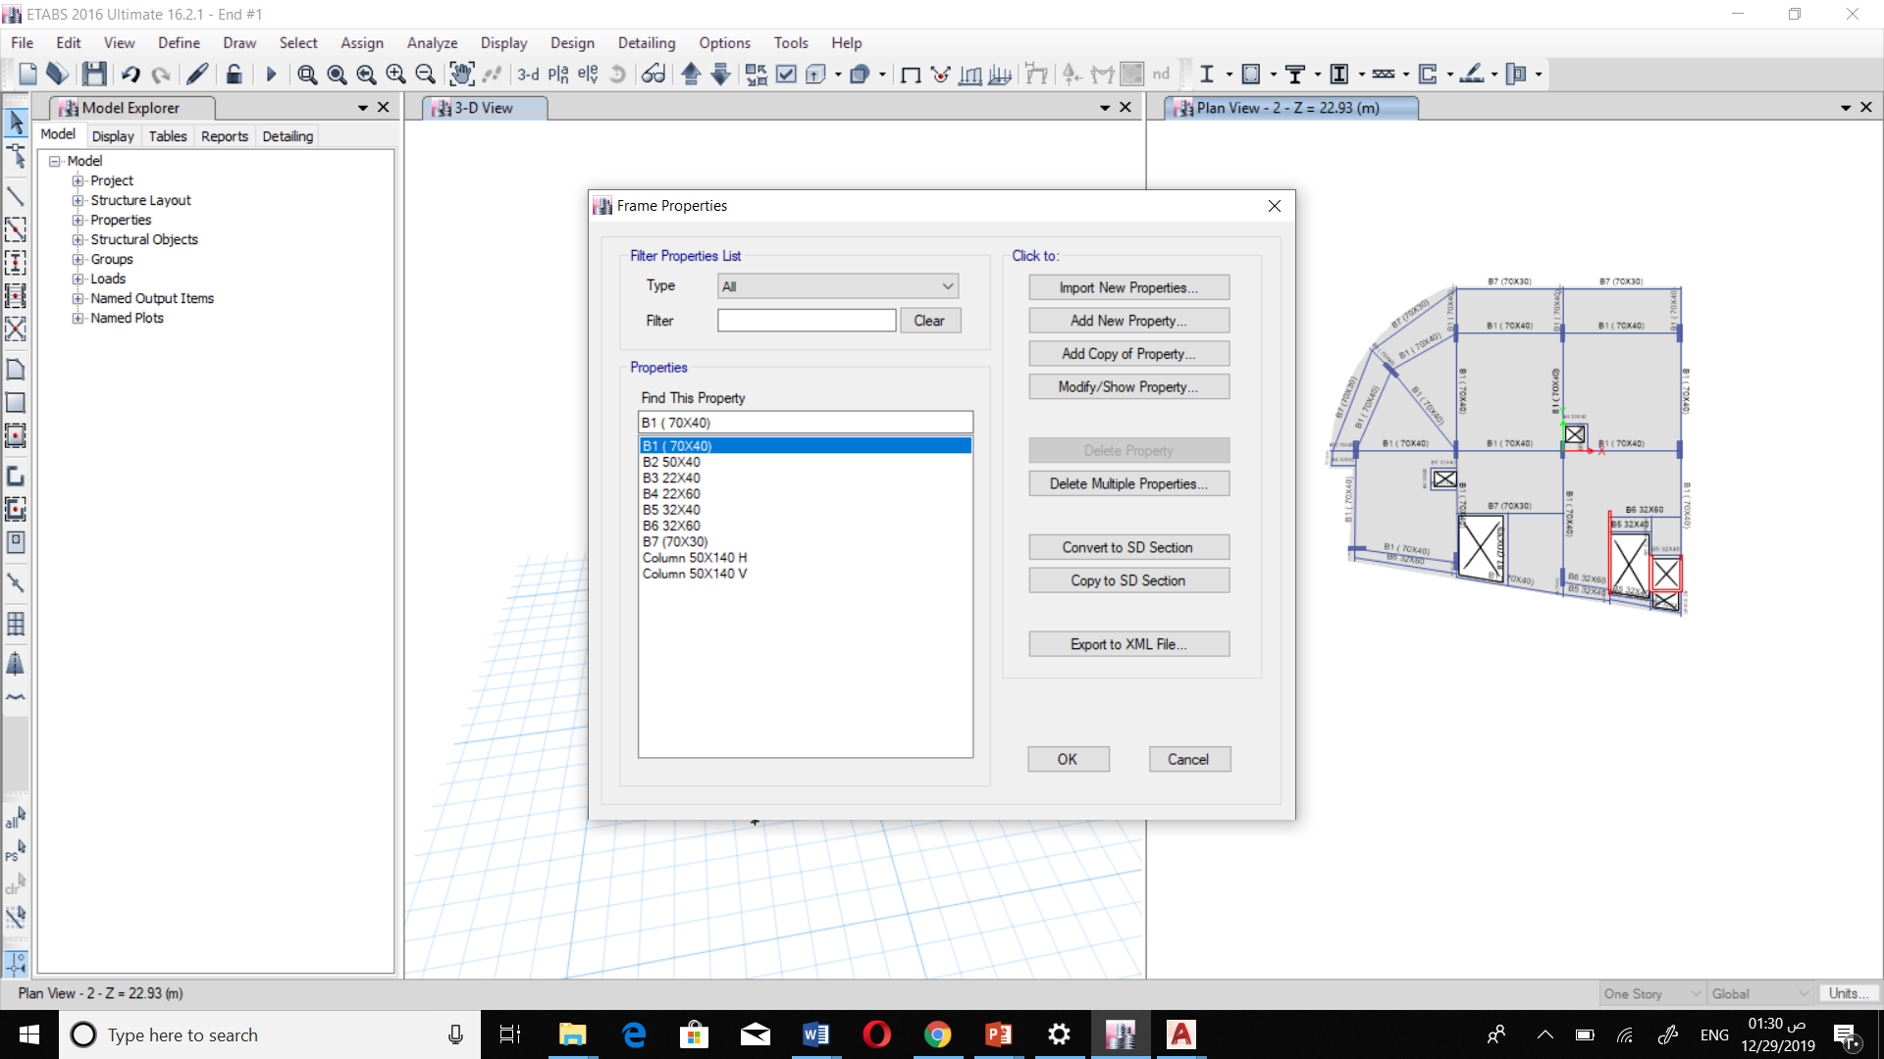
Columns & Beams sections

Slide 37
Beams sections
Main beam
Secondary beams

Slide 38
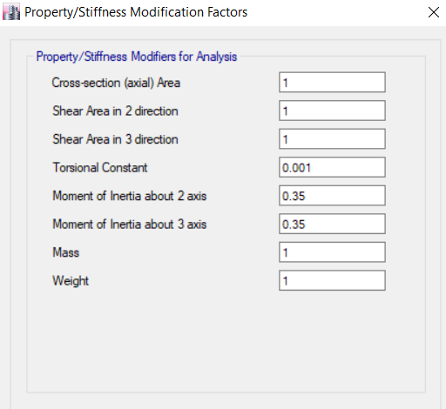
Beams modifiers

Slide 39
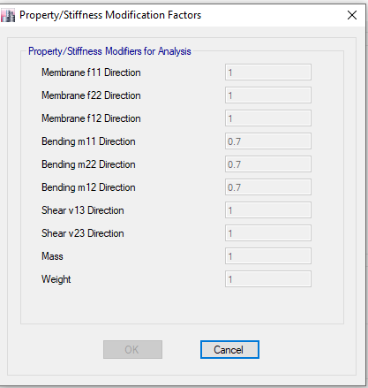
Columns modofires

Slide 40
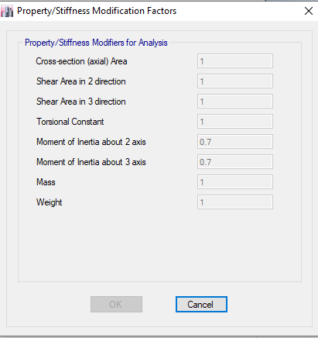
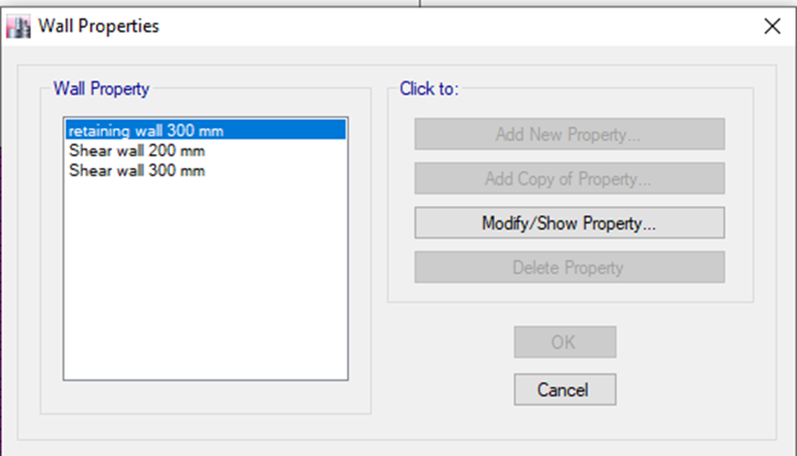
Shear & Retaining walls sections

Slide 41
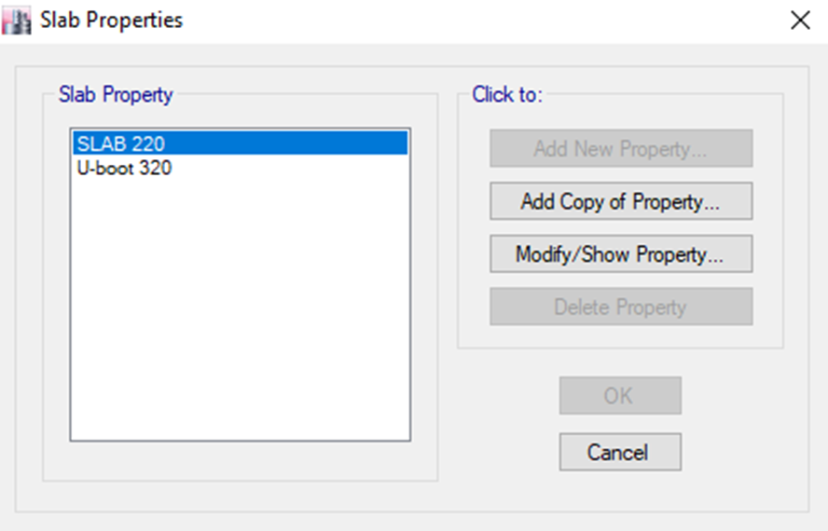
Slabs sections
U- boot section
solid slab

Slide 42
U-boot slab

Slide 43
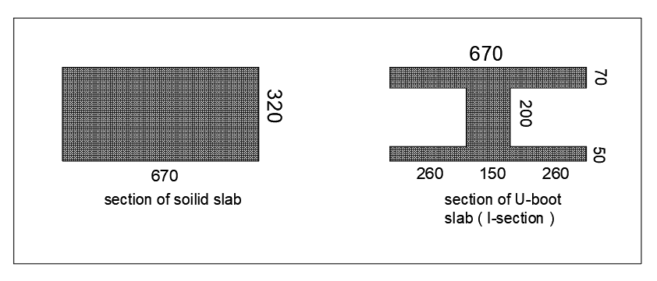

Modifiers for U-boot slab:
F₁₁ = F₂₂ = F₁₂ =$\frac{Area of I section}{Area of rectangular section}$ =$\frac{110400}{214400}$ = 0.5149

Slide 44
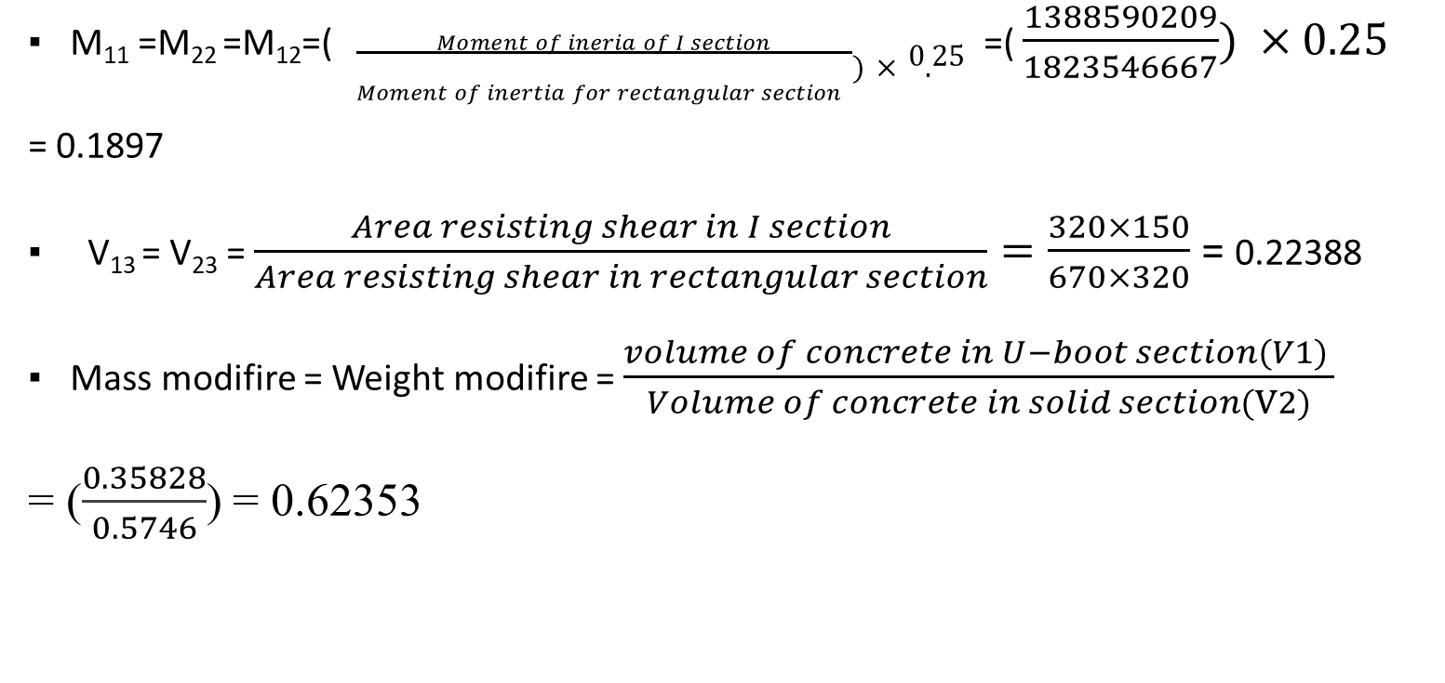
M₁₁ =M₂₂ =M₁₂=( $\frac{Moment of ineria of I section}{Moment of inertia for rectangular section })×0.25$ =( $\frac{1388590209}{1823546667}) ×0.25$
= 0.1897
V₁₃ = V₂₃ = $\frac{Area resisting shear in I section}{Area resisting shear in rectangular section}=\frac{320×150}{670×320}$ = 0.22388
Mass modifire = Weight modifire = $\frac{volume of concrete in U−boot section(V1) }{Volume of concrete in solid section(V2)}$
= ($\frac{0.35828}{0.5746}$) = 0.62353

Slide 45
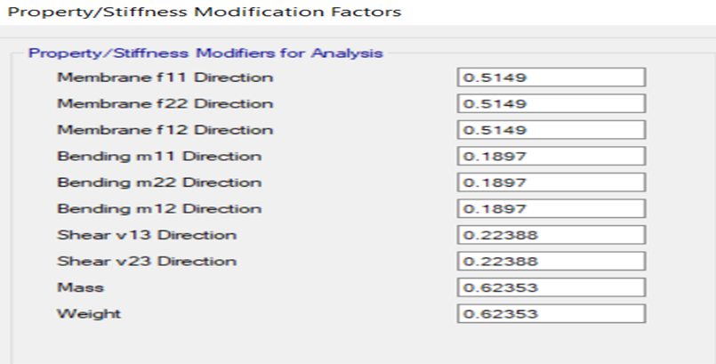

Slide 46
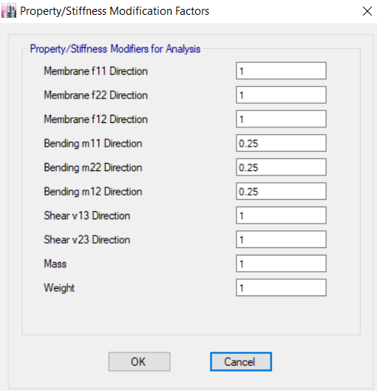
Solid slab
Solid slab section & modifiers

Slide 47
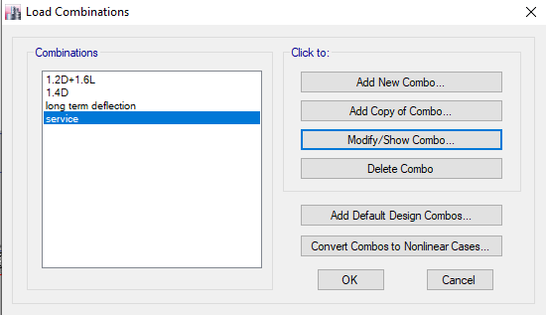
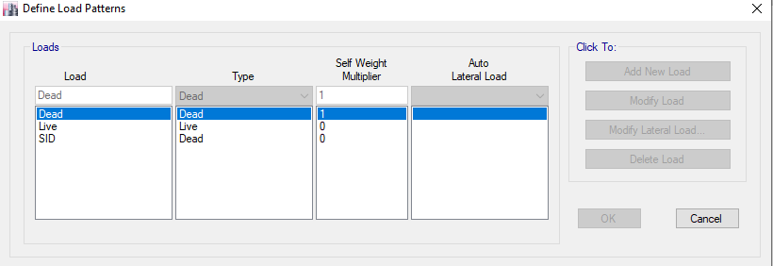
4)Define of load and load combinations

Slide 48
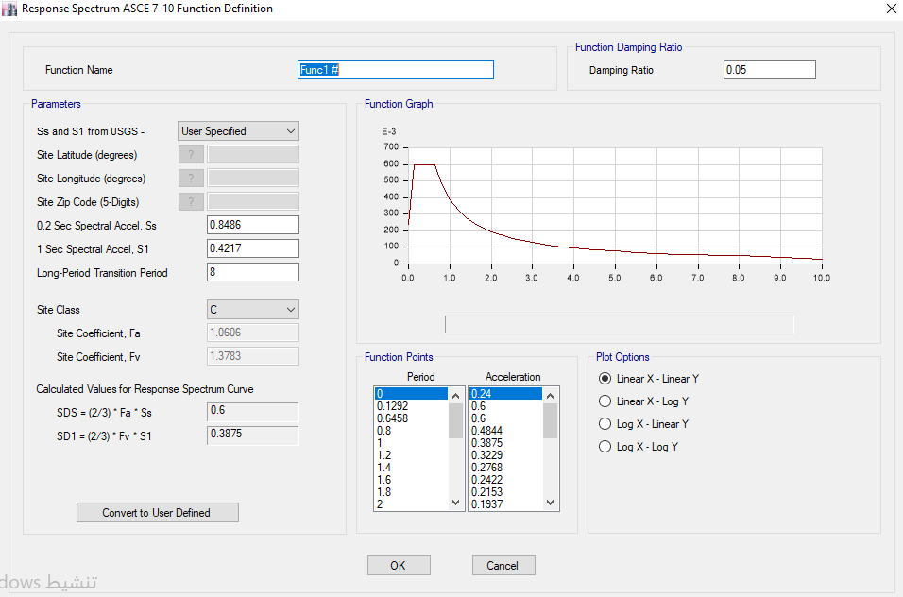
Steps to define lateral load
1)Define function with type of response spectrum with value of SDS 0.60
And SD1 =0.3875

Slide 49
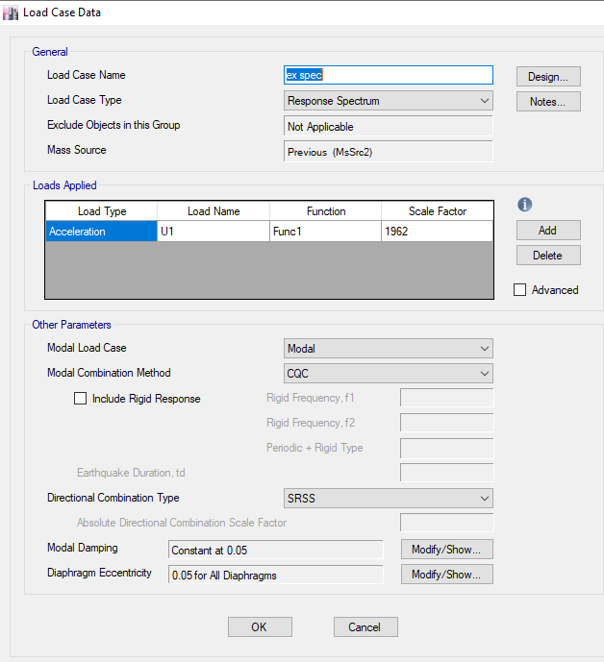
Steps to define lateral load
2) Define load cases in two directions with type of response spectrum using the function that defined in step 1
The scale factor = ( g ×I)/R= (9810 ×1)/5=1962

Slide 50
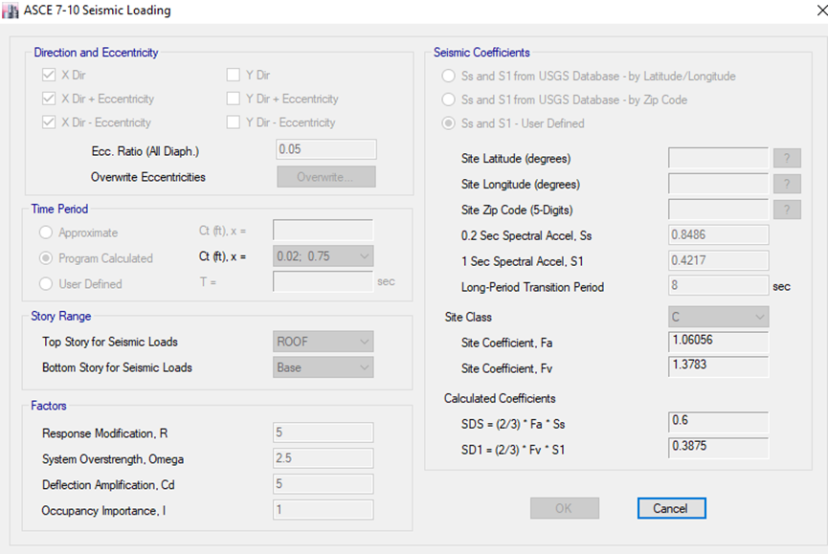
Steps to define lateral load
3) Define equivalent lateral static force in X and Y directions.

Slide 51
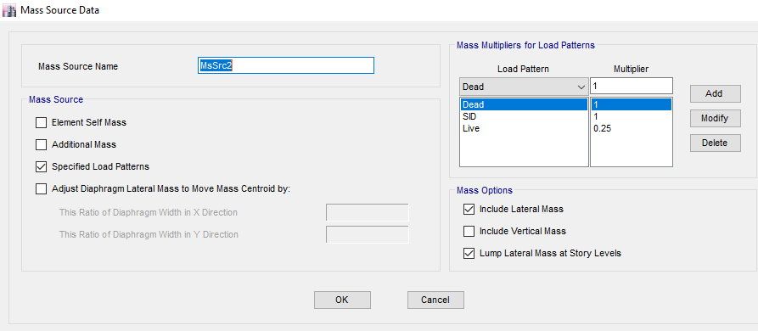
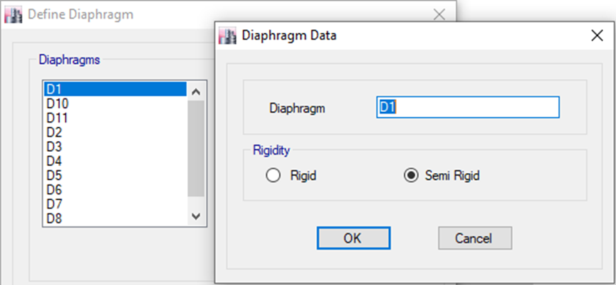
Steps to define lateral load
4) Define mass source for blocks which will be used to find seismic weight of structure.
5) Define diaphragms for each story and it will be semi rigid diaphragm.

Slide 52
Checks of model
Compatibility check.
Equilibrium check.
Stress strain check.
Deflection check.
Modal mass participate ratio check(MPMR)
Base shear check
Drift check
P-delta check

Slide 53
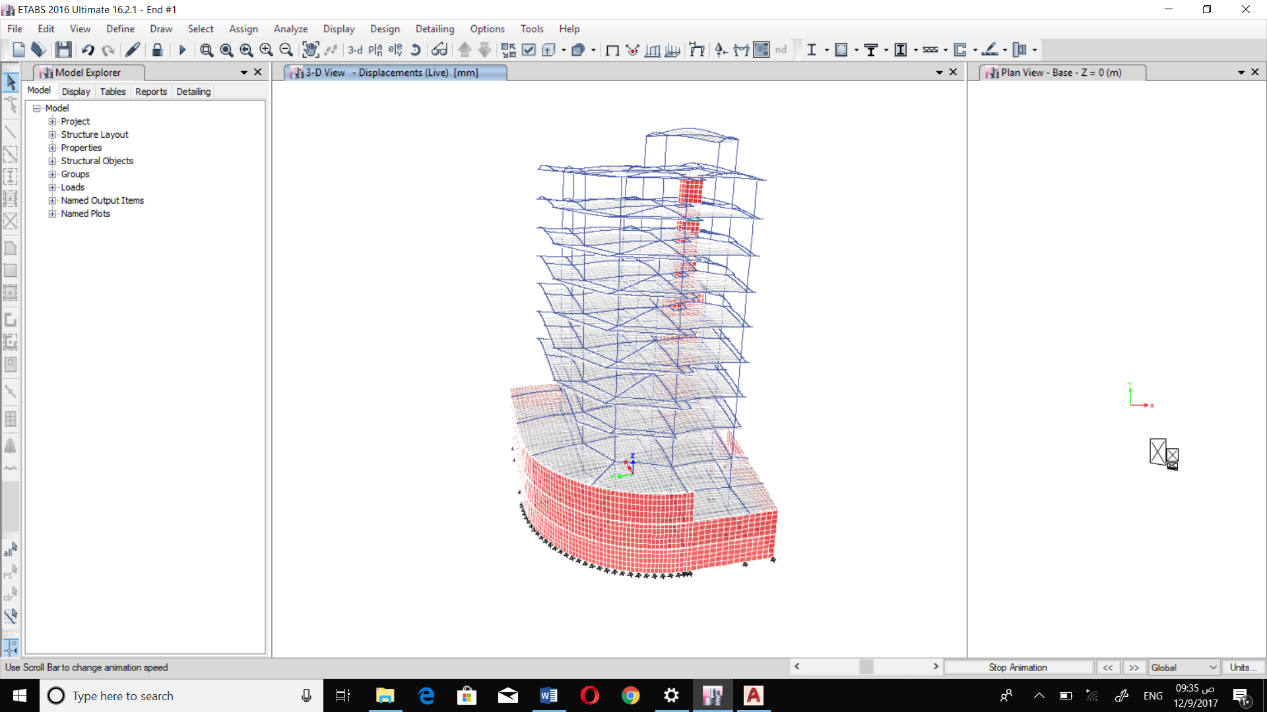
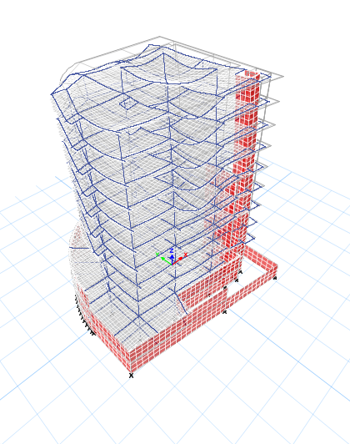
Compatibility check to confirm that the structural elements connect together.

Slide 54
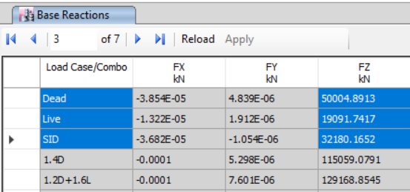
Equilibrium check
This check is to confirm that weight of structure from ETABS are approximately equal to weight of structure by hand calculations.
Max. allowable error in this chick 5%
ETABs result:

Slide 55
Calculations
- Live load
Equilibrium check for total live load
Story | Live load (KN/m^2) | Area (m^2) | Total live load (KN)/story
B2 | 3 | 608.82 | 1826.46
B1 | 5 | 608.82 | 3044.1
G | 5 | 564.46 | 2822.3
Attic | 5 | 337.39 | 1686.95
1 | 5 | 426.3 | 2131.5
2 | 3 | 426.3 | 1278.9
3 | 3 | 426.3 | 1278.9
4 | 3 | 426.3 | 1278.9
5 | 3 | 426.3 | 1278.9
6 | 3 | 426.3 | 1278.9
roof | 3 | 426.3 | 1278.9
Stair slab | 2 | 75.46 | 150.92
Sum. |  |  | 19335.63
ETABs Result |  |  | 19091.74
Error |  |  | 1.26135016
max. allowable error |  |  | 5%
OK

Slide 56
- SID load
Equilibrium check for total SID load
Story | SID load (KN/m^2) | Area (m^2) | Exterior walls on beams | Total SID/story
B2 | 4 | 608.82 | 0 | 2435.28
B1 | 4.3 | 608.82 | 0 | 2617.926
G | 4.3 | 564.46 | 630 | 3057.178
Attic | 4.3 | 337.39 | 1265 | 2715.777
1 | 4.3 | 426.3 | 1220 | 3053.09
2 | 4.3 | 426.3 | 1220 | 3053.09
3 | 4.3 | 426.3 | 1220 | 3053.09
4 | 4.3 | 426.3 | 1220 | 3053.09
5 | 4.3 | 426.3 | 1220 | 3053.09
6 | 4.3 | 426.3 | 1220 | 3053.09
roof | 4.3 | 426.3 | 1220 | 3053.09
Stair slab | 3 | 75.46 | 0 | 226.38
total SID |  |  |  | 32424.171
ETABs Result |  |  |  | 32180.2
Error |  |  |  | 0.752435583
Error < 5% … OK

Slide 57
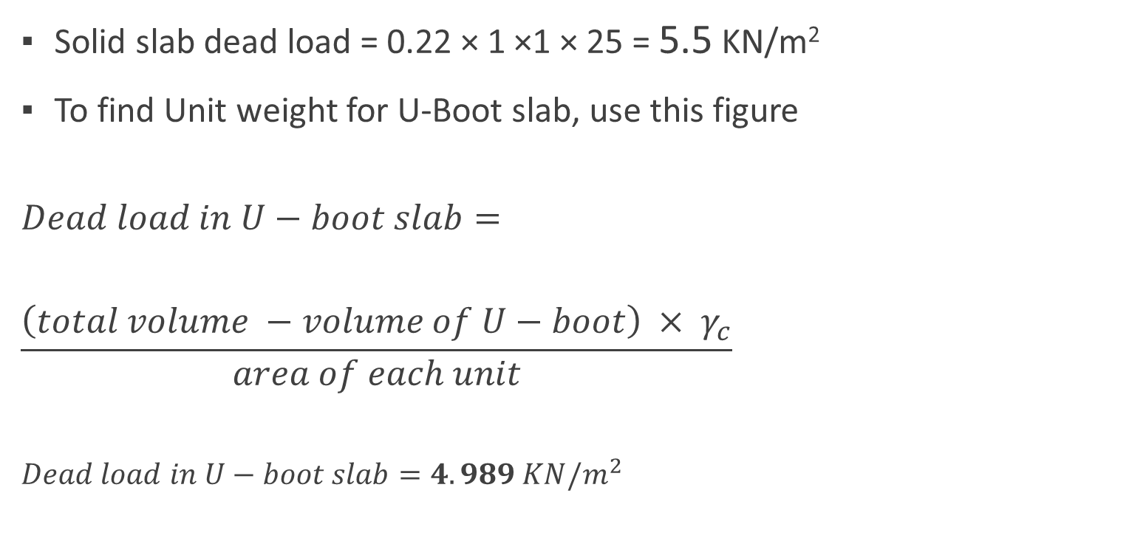
Dead load
Solid slab dead load = 0.22 × 1 ×1 × 25 = 5.5 KN/m²
To find Unit weight for U-Boot slab, use this figure
$$Dead load in U−boot slab=$$
$$\frac{\left(total volume −volume of U−boot\right) × γ_{c}}{area of each unit}$$
$$Dead load in U−boot slab=4.989 KN/m^{2}$$

Slide 58
Dead load from slabs
Equilibrium check for Dead load
SLABs Dead load
Story | Slab weight (KN/m^2) | Area (m^2) | Total Slabs load/story
B2 | 5.5 | 608.82 | 3348.51
B1 | 4.989 | 608.82 | 3037.40298
G | 4.989 | 564.46 | 2816.09094
Attic | 4.989 | 337.39 | 1683.23871
1 | 4.989 | 426.3 | 2126.8107
2 | 4.989 | 426.3 | 2126.8107
3 | 4.989 | 426.3 | 2126.8107
4 | 4.989 | 426.3 | 2126.8107
5 | 4.989 | 426.3 | 2126.8107
6 | 4.989 | 426.3 | 2126.8107
roof | 4.989 | 426.3 | 2126.8107
Stair slab | 5.5 | 75.46 | 415.03
Sum = |  |  | 26187.94753

Slide 59
Dead load from beams
Beams | Section area (m^2) | avg. length (m) | # of beams | weight (KN)
B1 (70X40) | 0.28 | 7.1 | 210 | 10437
B2 50X40 | 0.2 | 2.1 | 30 | 315
B3 22X40 | 0.088 | 1.9 | 4 | 16.72
B4 22X60 | 0.132 | 3.2 | 10 | 105.6
B5 32X40 | 0.128 | 4.8 | 102 | 1566.72
B6 32X60 | 0.192 | 4.4 | 35 | 739.2
B7 (70X30) | 0.21 | 6.8 | 38 | 1356.6
Sum = |  |  |  | 14536.84

Slide 60
Dead load from columns
Columns Dead Load
Story | Section area | Length | No. in each story | Weight
B2 | 0.35 | 2.5 | 11 | 240.625
B1 | 0.35 | 2.5 | 11 | 240.625
G | 0.35 | 3 | 11 | 288.75
Attic | 0.35 | 3.27 | 11 | 314.7375
1 | 0.35 | 3.06 | 11 | 294.525
2 | 0.35 | 3.25 | 11 | 312.8125
3 | 0.35 | 3.25 | 11 | 312.8125
4 | 0.35 | 3.06 | 11 | 294.525
5 | 0.35 | 3.06 | 11 | 294.525
6 | 0.35 | 3.06 | 11 | 294.525
roof | 0.35 | 3.06 | 11 | 294.525
Stair slab | 0.35 | 3.32 | 4 | 116.2
 |  |  | Sum= | 3299.188

Slide 61

Dead load from walls:
Total dead load
= (1640+5163.3+3299.188+14536+26187)
=50827.575 KN
From ETABS= 50005
%error = ($\frac{50827.575−50005}{50827.575})×100\%$
= 1.62% < 5% so it's ok
Retaining Walls | 5163.6
Shear Walls | 1640
Total Dead Load | 50827.57503
ETABs Reading | 50005
Error | 1.618363712
1.62% < 5% ….. >>> OK

Slide 62
Stress strain check
Check moment in frame
Check moment in beam
Check axial on column
Check shear in slab

Slide 63


moment in frame
Live load used to calculate moment in frame in B3-floor
So live load = 3 KN/m²= q
Ln=width of frame = ( $\frac{7.7}{2}+\frac{6.3}{2}$ )
= 7m
L=length of frame = 7.4
M=$\frac{q×Ln×l^{2}}{8}$=$\frac{3×7×7.4×7.4}{8}$
= 143.7 KN.m

Slide 64

moment in frame
Section cut at start of frame
M at start of frame
= 34.6 KN.m

Slide 65

moment in frame
Section cut at mid of frame
M at mid of frame
= 81.4 KN.m

Slide 66

moment in frame
Section cut at end of frame
M at end of frame
= 69.3 KN.m

Slide 67

moment in frame
So M=($\frac{M at start + M at end}{2}$ + M at mid )
M= ( $\frac{34.6+69.3}{2}$+ 81.4 ) = 133.35 KN.m
Hand calculation: M=$\frac{q×Ln×l^{2}}{8}$=$\frac{3×7×7.4×7.4}{8}$= 143.7 KN.m
%error = $\frac{143.7−133.35}{143.35} ×100\%$ = 7.2%
7.2% < 10 % ⇛ so it's an acceptable value

Slide 68

Moment in beam
This check will be done for B1 (70×40) and will be calculated from live load (3 KN/m²), as shown in the figure:
Tributary area
for B1

Slide 69

Moment in beam
L= 7.7 m
A= ( 0.5 × 7.7 × $\frac{7.7}{2}$ ) + (0.5 ×6.3 ×$\frac{6.3}{2})=29.25m$2
Load = 29.25 × 3 = 87.75 KN
W = $\frac{87.75}{7.7}=11.4 KN/m$
So : M= $\frac{w×l^{2}}{8}$= $\frac{11.4×{7.7}^{2}}{8}$ = 84.48 KN.m

Slide 70


Moment in beam
M at second edge = 52.7 KN M at first edge = 25.38 KN.m

Slide 71

Moment in beam
M at mid of beam = 51.7 KN.m

Slide 72

Moment in beam
M at first edge = 25.38 KN.m
M at second edge = 52.7 KN.m
M at mid of beam = 51.7 KN.m
M from ETABS = ( $\frac{52.7+25.38}{2}$+51.7) = 90.74KN.m
Hand calculation: M= $\frac{w×l^{2}}{8}$= $\frac{11.4×{7.7}^{2}}{8}$= 84.48 KN.m
% error = ( $\frac{90.74−84.11}{84.11})=7.8 \% <10\% it^{′}sok$

Slide 73

check axial on column
For column (C8) in 6th floor
Tributary area = 6.9×4.1 = 28.2 m².
P (live) = live load × Area
P = 3 KN/ m² × 28.2 m² = 84.6 KN

Slide 74

check axial on column
From ETABS(P) = 80.3 KN.
Difference percentage = (84.6 – 80.2655)/ 84.6 × 100% = 5.12 %, OK

Slide 75
check shear for slab
Shear Capacity of slab = ФVc
ФVc = Ø × (1/6 ) × √(f'c) ×bw × d
= 0.75 × 1/(6 ) × √(28 ) ×150 × 280 × 1.1 = 30.558 KN/rib
ФVc = 30.558/0.67 = 45.61 KN/ m

Slide 76

check shear for slab
Check of the shear force in x-direction (V13):

Slide 77

check shear for slab
Check of the shear force in y-direction (V23):

Slide 78

Deflection check
Deflection at first panel:
First panel will be checked in first floor
Immediate deflection =
deflection in the middle of the panel –
average deflection of the four beams

Slide 79


Deflection check
from dead load:
Average deflection of beams
=$\frac{9.3+8.4+6+7.7}{4}$ = 7.85 mm.
Deflection at mid of panel = 12 mm
The deflection = 12 – 7.85 = 4.15 mm

Slide 80


Deflection check
From SID:
Average deflection of beams
= $\frac{5+6+6.5+7.2 }{4}$ = 6.175 mm
Deflection at mid of panel = 9.3 mm
The deflection = 9.3 - 6.175= 3.15 mm

Slide 81


Deflection check
From live load:
Average deflection of beams
= $\frac{5.3+4.4+3.2+4.5}{4}$= 4.35mm
Deflection at mid of panel= 8 mm
The deflection = 8 – 4.35 = 3.65 mm

Slide 82


Deflection check
Immediate deflection = ΔDL + ΔSID + ΔLL = 11.25 mm
Long term deflection = 2 ×Δd+2×Δsid +1.5 Δl = 20.7 mm
The following table shows the allowable deflection:
Allowable immediate deflection = $\frac{l}{360}= \frac{7.7}{360}$= 21.3 mm > 11.25 mm It's ok.
Allowable long term deflection = $\frac{l}{240 }= \frac{7.7}{240}=32$ mm > 20.7 mm it's ok .

Slide 83
Mpmr check
to find if response spectrum analysis can be made for seismic design. So The MPMR must be greater than 90% to use response spectrum analysis.

Slide 84
Case | Mode | Period sec | UX | UY | UZ | Sum UX | Sum UY
Modal | 1 | 1.500 | 0.4507 | 0.0322 | 0 | 0.4507 | 0.0322
Modal | 2 | 1.420 | 0.0309 | 0.4896 | 0 | 0.4816 | 0.5217
Modal | 3 | 1.003 | 0.0384 | 1.236E-05 | 0 | 0.52 | 0.5217
Modal | 4 | 0.383 | 0.1078 | 0.002 | 0 | 0.6278 | 0.5237
Modal | 5 | 0.364 | 0.0023 | 0.1151 | 0 | 0.6301 | 0.6389
Modal | 6 | 0.281 | 0.0019 | 0.0154 | 0 | 0.6321 | 0.6543
Modal | 7 | 0.185 | 0.0461 | 0.0012 | 0 | 0.6781 | 0.6555
Modal | 8 | 0.167 | 0.0025 | 0.0577 | 0 | 0.6807 | 0.7132
Modal | 9 | 0.162 | 0.0001 | 0.0016 | 0 | 0.6807 | 0.7147
Modal | 10 | 0.139 | 0.019 | 0 | 0 | 0.6998 | 0.7147
Modal | 11 | 0.135 | 0.0001 | 0.0025 | 0 | 0.6998 | 0.7173
Modal | 12 | 0.124 | 0.0016 | 0.0131 | 0 | 0.7014 | 0.7304
Modal | 13 | 0.116 | 1.91E-05 | 1.281E-05 | 0 | 0.7014 | 0.7304
Modal | 14 | 0.111 | 0.0005 | 0.0434 | 0 | 0.702 | 0.7738
Modal | 15 | 0.105 | 0.0486 | 0.0001 | 0 | 0.7505 | 0.774
Modal | 16 | 0.099 | 0.0022 | 0.0001 | 0 | 0.7528 | 0.774
Modal | 17 | 0.088 | 0.0007 | 0.051 | 0 | 0.7535 | 0.8251
Modal | 18 | 0.082 | 0.0734 | 0.0014 | 0 | 0.8269 | 0.8265
Modal | 19 | 0.076 | 0.0085 | 0.0409 | 0 | 0.8355 | 0.8674
Modal | 20 | 0.069 | 0.0429 | 0.0002 | 0 | 0.8783 | 0.8676
Modal | 21 | 0.066 | 0.0074 | 0.0329 | 0 | 0.8858 | 0.9005
Modal | 22 | 0.061 | 0.0014 | 0 | 0 | 0.8871 | 0.9005
Modal | 23 | 0.059 | 0.0067 | 0.0018 | 0 | 0.8939 | 0.9023
Modal | 24 | 0.059 | 0.0005 | 0.0122 | 0 | 0.8944 | 0.9145
Modal | 25 | 0.058 | 0.0066 | 0.0015 | 0 | 0.901 | 0.9161

Slide 85

Base shear check
Will be make on result of modal response spectrum , response spectrum shall be multiplied by at least 0.85$\frac{v}{vt }$
Base shear manually : V = Cs × W
W = weight of structure = 89927 KN .
Cs = minimum of : $\frac{SDs}{\frac{R}{Ie}}$ , $\frac{SD1}{T(\frac{R}{Ie})}$
SDs = 0.6 , R= 5 , Ie = 1
Ta= Ct ×${hn}^{x}$
T = Ta×Cu

Slide 86

Base shera check
Value of Ct and x taked from code so :
Ct = 0.02 ×${\text{(}\text{0.0488}\text{)}}^{a}$
X = 0.75
hn = 36.37 m
Cu = 1.4
So : T = $1.40 0.0488 {36.37}^{0.75}=1.018 s$
Period For fundamental in ETABS = 1.5
So use T = 1.018 s

Slide 87

Base shear check
$so : Cs=\frac{0.60}{\frac{5}{1}}=0.12$
$$Cs=\frac{0.3875}{1.018\left(\frac{5}{1}\right)}=0.07563$$
Then Cs=0.07598.
V=Cs × w = 0.07598 × 89927 = 6832 KN.

Slide 89


Drift check
This check on drift ( horizontal displacement of storey )
Allowable drift = 0.02 × hnx
From ETABS we take the value of drift multiply by $\frac{cd}{I }$

Slide 90
In x - direction

Slide 91
In y -direction

Slide 92

P-delta check
In this check we show the eddect of P –delta effect by calculation stability coefficient and compare it with allowable limit which equal 0.1
Theta = $\frac{P×Δelastic}{Vx×h}$

Slide 93
Theta in x –direction

Slide 94
Theta in Y -direction

Slide 95

DESIGN AND DETAILING
Flexural design for U-boot slab:
>> use 4$∅$14 /m in two direction
$V_{u}= 166 kN$
$∅V_{c}$ $=189 kN$
$∅V_{c}>V_{u}$

Slide 96

Beams Design:

Slide 97


Shear reinforcing design for beams:
${(\frac{A_{v}}{S})}_{min}=max\left\{\begin{aligned}\frac{0.35}{f_{y}} \\ \frac{0.063×\sqrt{f_{c}^{′}}}{420}\end{aligned}\right.×b_{w}$

Slide 98


Example of beams design:

Slide 99

Column design:
From ETABS we find that rebar Percentage $\left(ρ\right)=1\%$ >> OK.
$A_{s}=0.01×1400×500=7000 {mm}^{2}$
use 36 $∅$14
For shear design >> Use 5∅10/20 cm

Slide 100

Shear wall design:
Vu from ETABS = 53.3 KN
ΦVc = 91.9KN/m >> Vu so thickness is ok.
vertical steel: Mu=64 KN.m/m .. As = 6.08×10⁻³×1000×250 =
1520mm2 > As min .. use 1$∅$14/10 cm
Horizontal steel .. Mu=33. 6 KN.m/m .. As = 4.1×10^{-3 ×}1000×150 =
615 mm² .. So Use 1Φ12 /15 cm on each side

Slide 102

Footing design
Using safe program
K= factor × qall
K=120×300 = 36000
Check for punching shear :
There is no punch on the footing
as we see on picture.

Slide 103

Check bearing capacity:
As we see on the picture there is no regions on footing
that above bearing capacity

Slide 104
For footing we use:
Q = 300 KN/m^2 .. H = 600 mm .. D = 520 mm ..
Ex :
More and more detailing
in AutoCAD drawing
and word report

Slide 105


