Slide 1
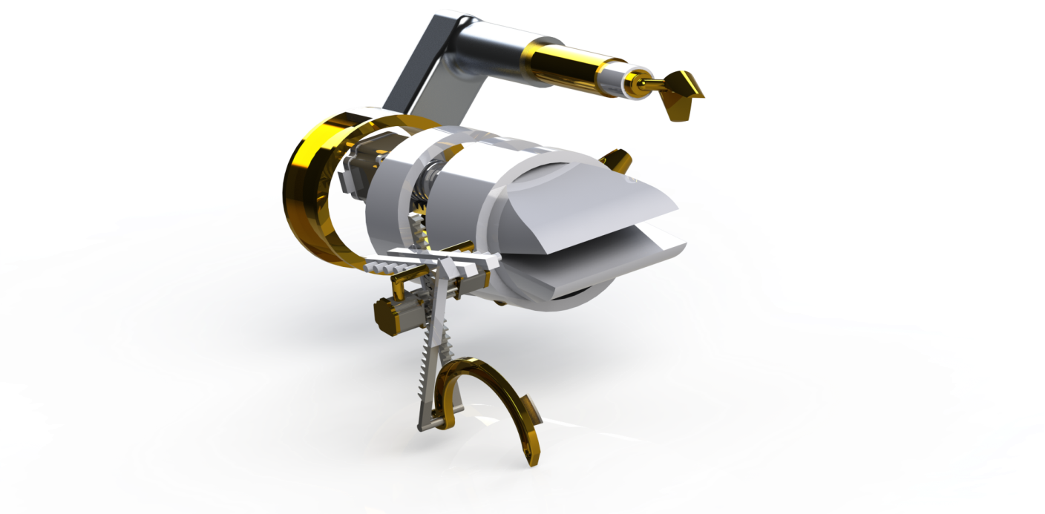
Surgical Suturing Machine
By: Rafat Odeh
Wseem Halawah
Motaz Madeni
Omar Hamadneh

Slide 2
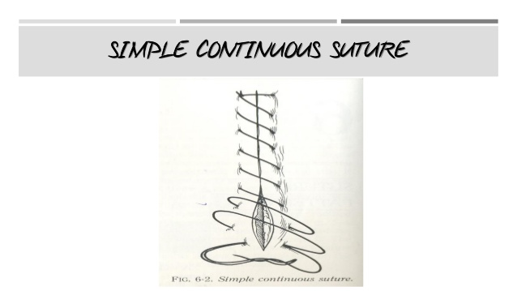
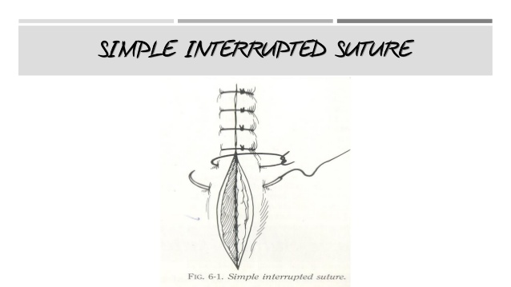
Main types of suturing

Slide 3
This suturing machine type
1-Skin stitches type (not intradermal).
2-Non-absorbable thread type.
3-Interrupted suture.
4-It creates knot.
5-Automated movements (doesn’t receive it’s movements from the doctor).

Slide 4
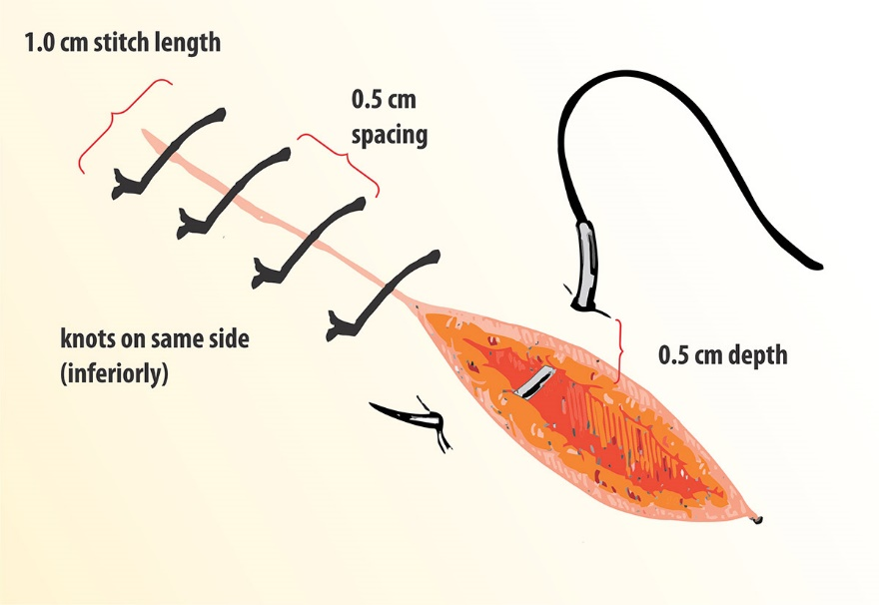
Interrupted suture properties

Slide 5
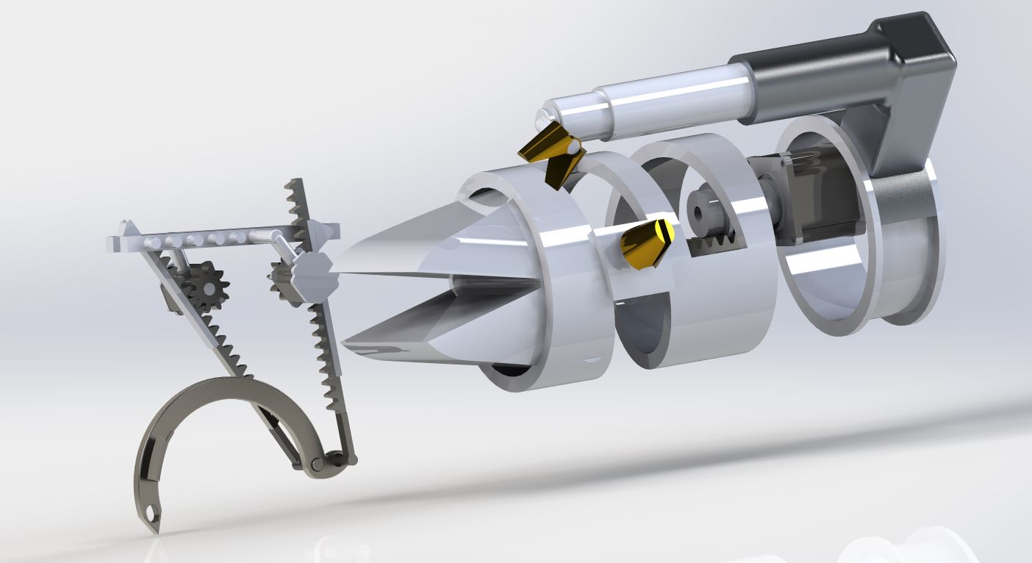
Final design
Notes:
Our main goal of this project is creating a mechanism that could do the interrupted suture ,no previous design

Slide 6
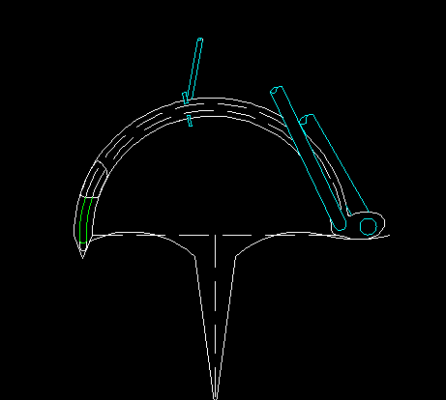
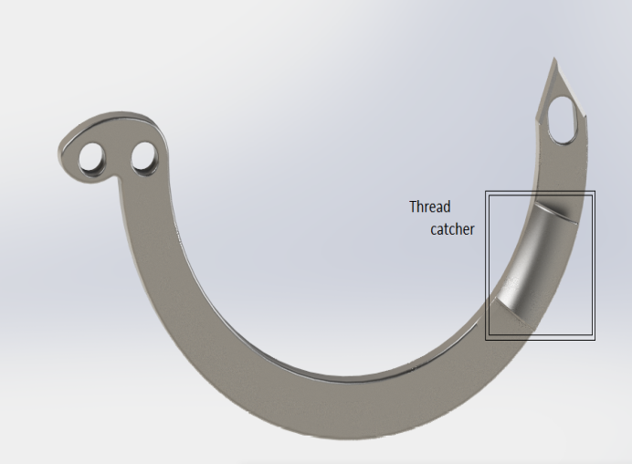
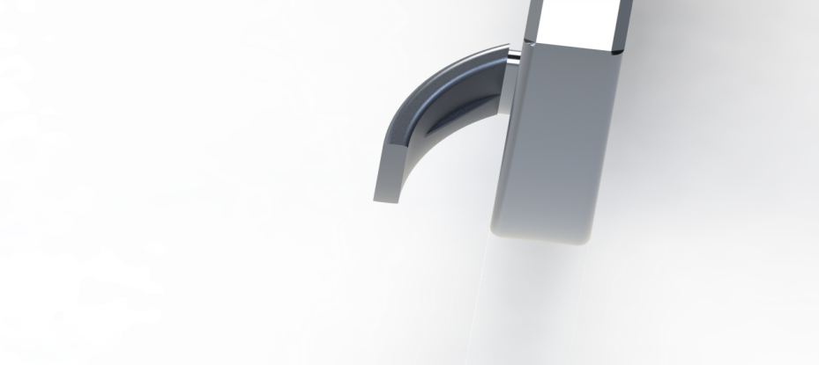
Multi function needle modification
1- penetration.
2- thread catching.
3-thread cutting.

Slide 7
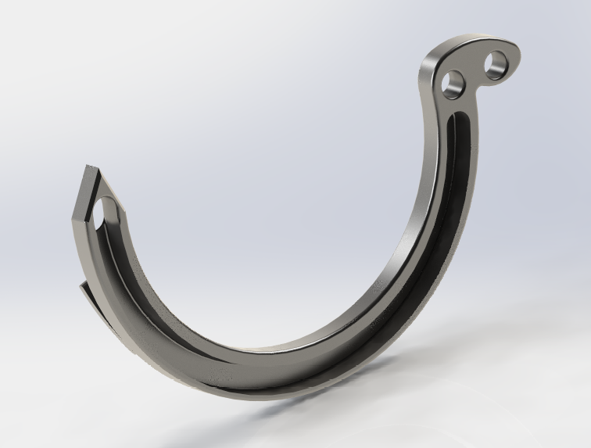
Multi function needle modification
4- thread carrying groove

Slide 8
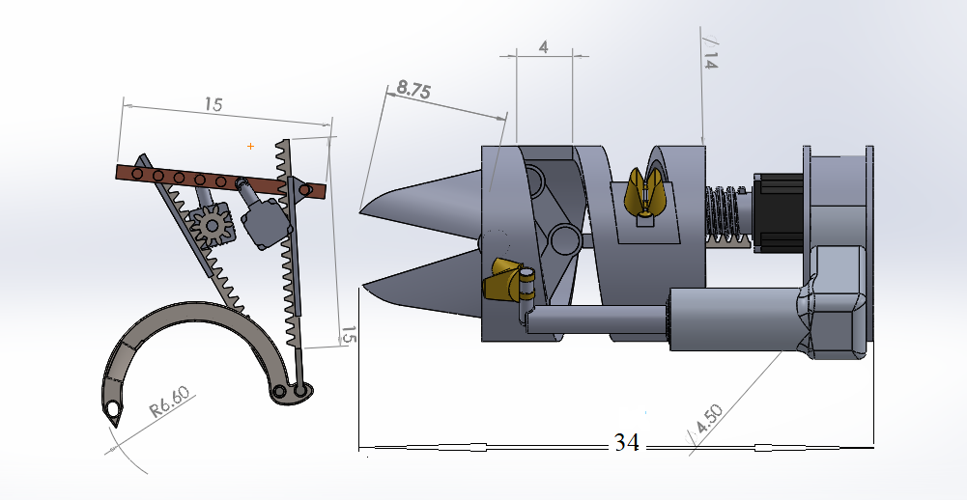
Final design

Slide 9
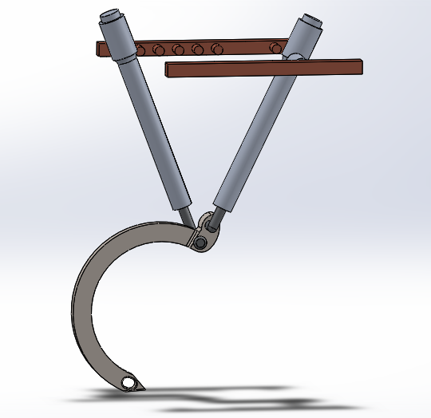
Previous design
The previous design (project 1) was depending on an external compressed air, because of the big number of tubes it’s complicated to synchronize the parts movements.
No need for external machine.
So we started a new design depends on stepper motors.

Slide 10
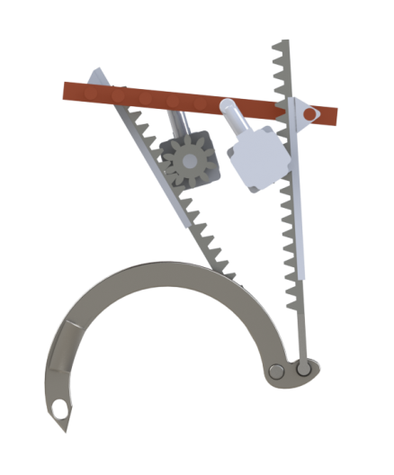
Current design
The new design requires gears instead of tubes, pistons and valves.

Slide 11
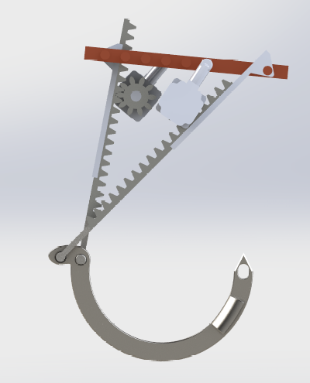
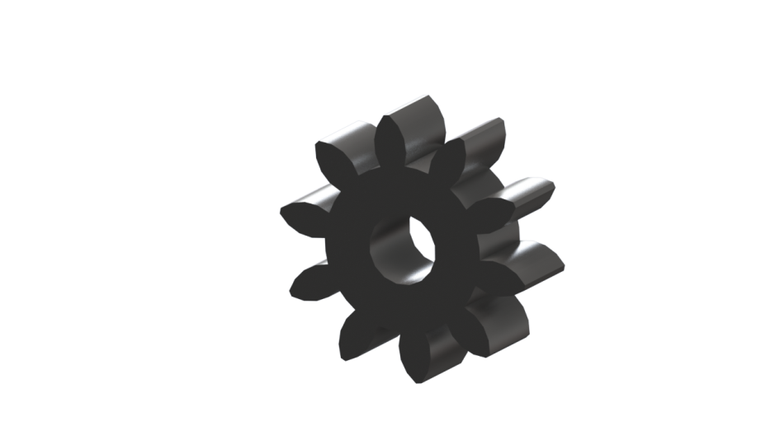
Analysis of the current design
Spur gear

Slide 12
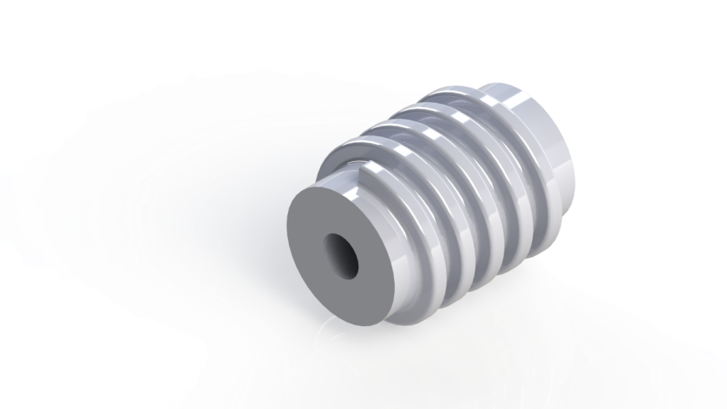
Worm gear
The worm gear its used to transmit
power from worm to the rack .

Slide 13
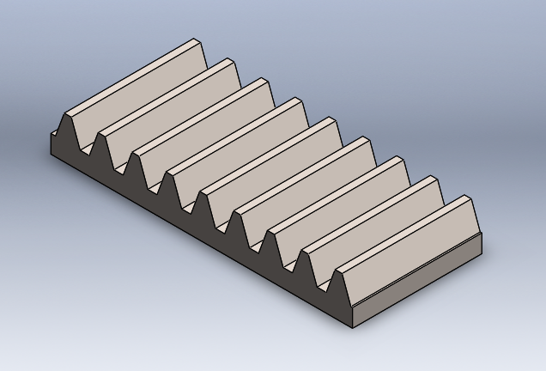
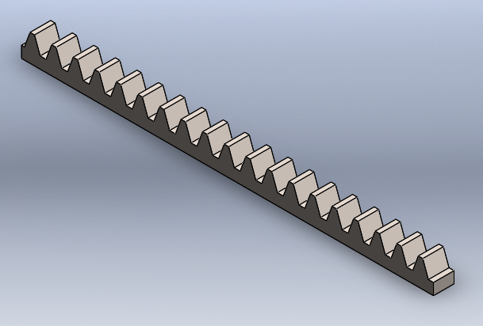
Racks
Notes:
Gear rack are utilized to convert rotating movement into linear motion and operates with a pinion which is a small gear meshing with the gear rack

Slide 14
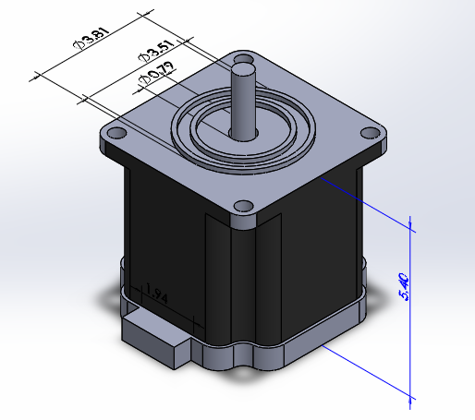
FDK corporation
Stepper motor
Dimensions (mm) | 3.80 (diameter)*5.40 (length)
Shaft diameter (mm) | 0.79
Weight (g) | 0.27
Tourqe | 0.045 mN.m

Slide 15
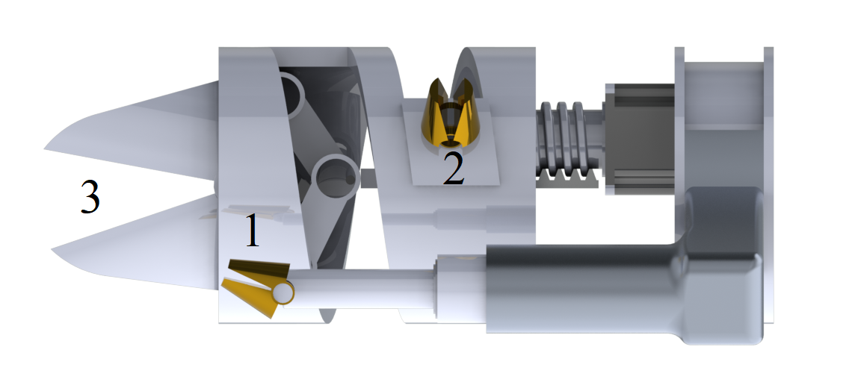
External parts
Clamps

Slide 16
Calculations:
Penetration force | 7-10 N
Spur rotation speed | 30 rpm
Worm rotation speed | 30 rpm
Spur diameter | 3 mm
Transmitted force | 12.7 N
torque | 19 mN.m

Slide 17
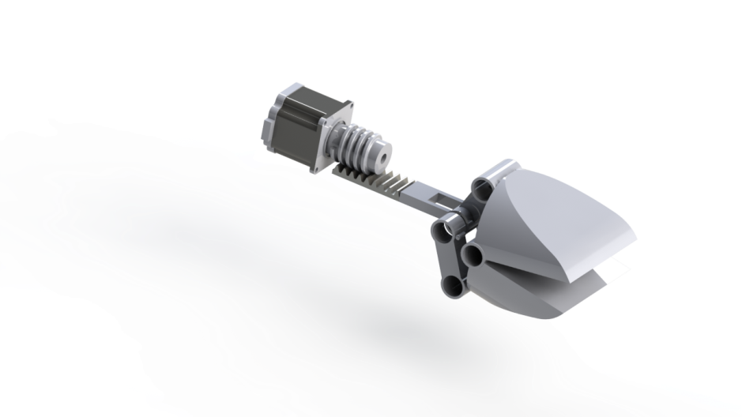

Slide 18
1

Slide 19
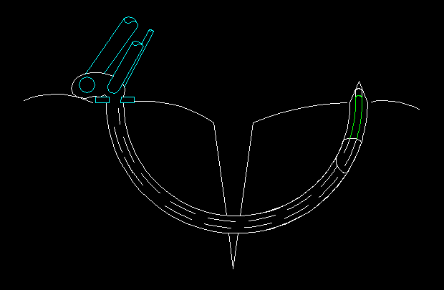
1

Slide 20
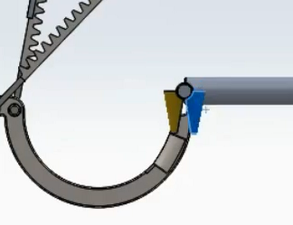
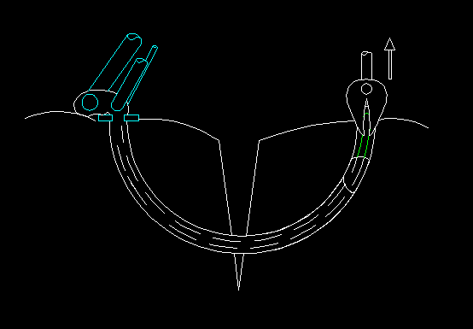
2

Slide 21
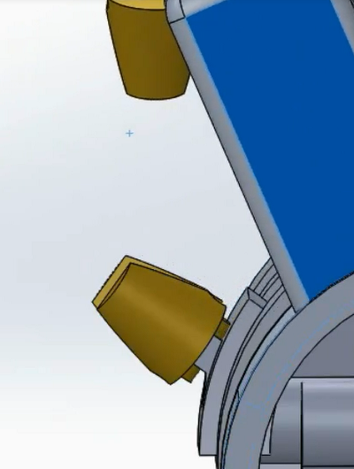
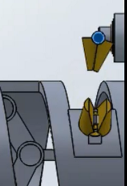
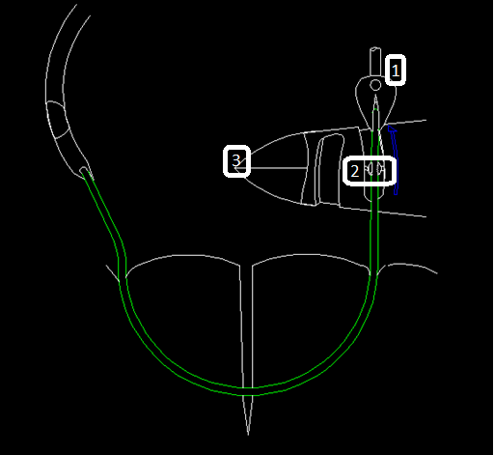
3

Slide 22
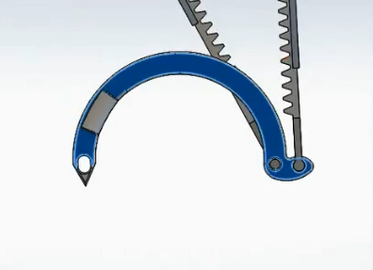
3

Slide 23
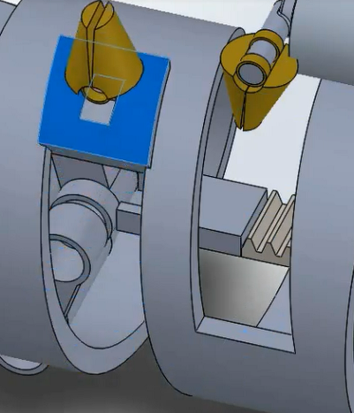
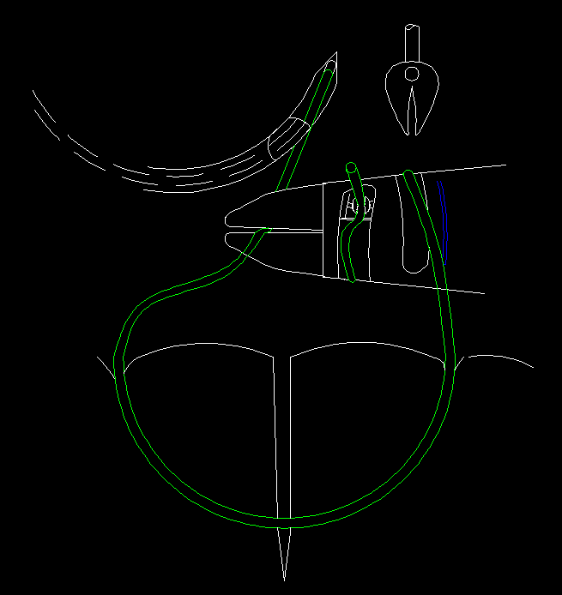
4

Slide 24
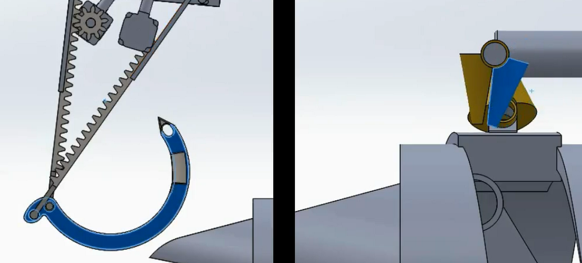
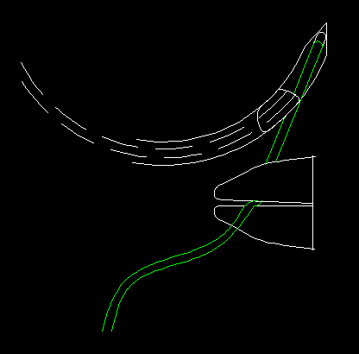
5

Slide 25
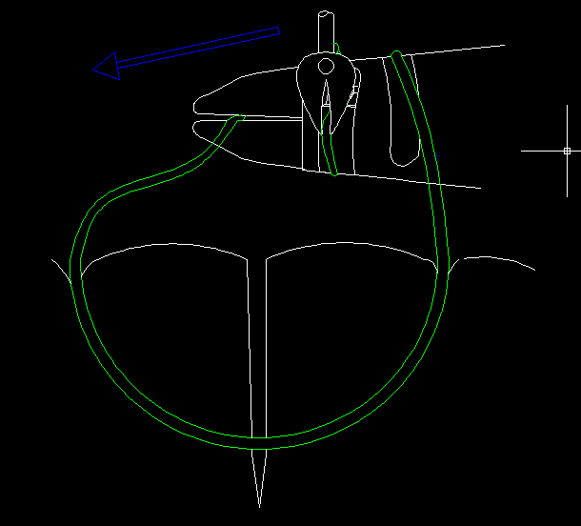
5

Slide 26
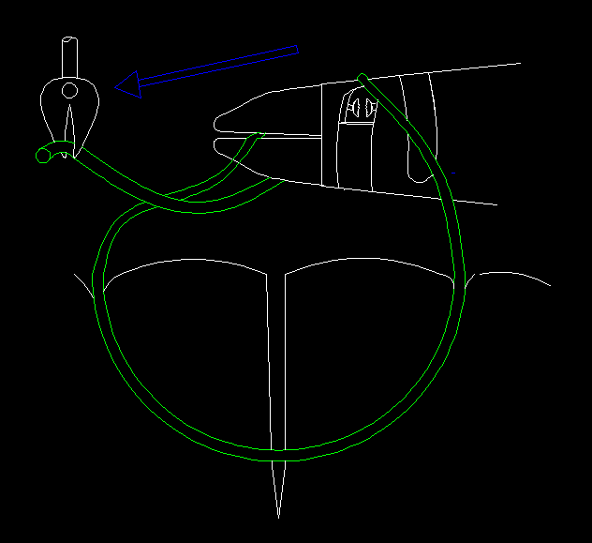
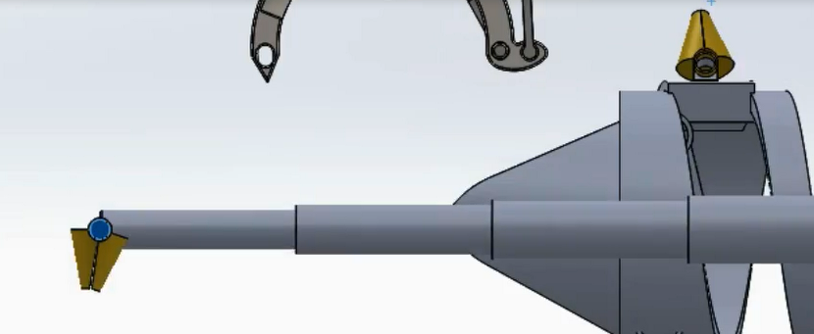
5

Slide 27
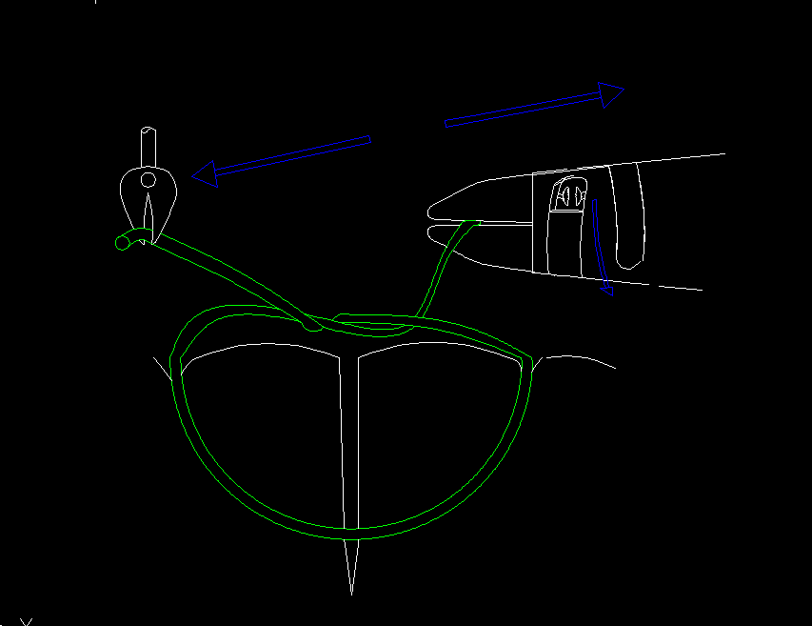
5

Slide 28
Short video

Slide 29
Conclusion
Notes:
As a new idea, no previous design

