Slide 1
An-Najah National University
Faculty of Engineering
Graduation Project Report II
SEISMIC DESIGN OF ALBEZREH BUILDING IN NABLUS
Prepared by:
Ahmad Ismail
Mohammad Issa
Hazem qaisi
Supervisor: Dr. Riyad Awad

Slide 2
Outline:
Introduction.
3D model.
SEISMIC Design.
Design of shear wall.
Design of Stairs.
Design of Mat foundation .

Slide 3
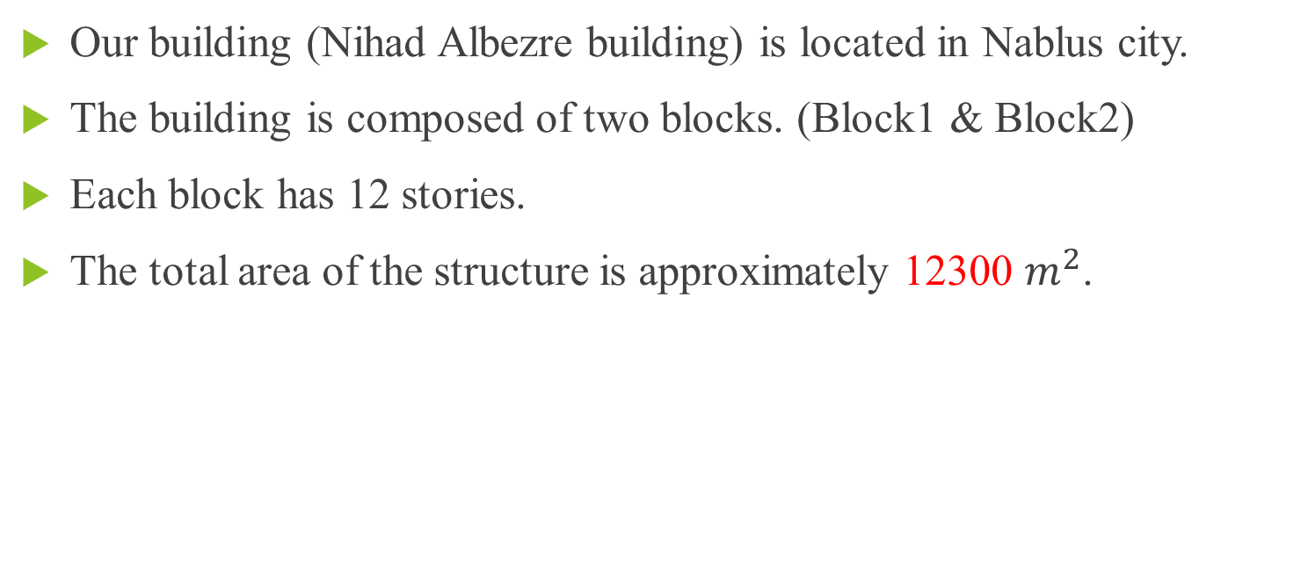
Introduction
Our building (Nihad Albezre building) is located in Nablus city.
The building is composed of two blocks. (Block1 & Block2)
Each block has 12 stories.
The total area of the structure is approximately 12300 $m^{2}$.

Slide 4
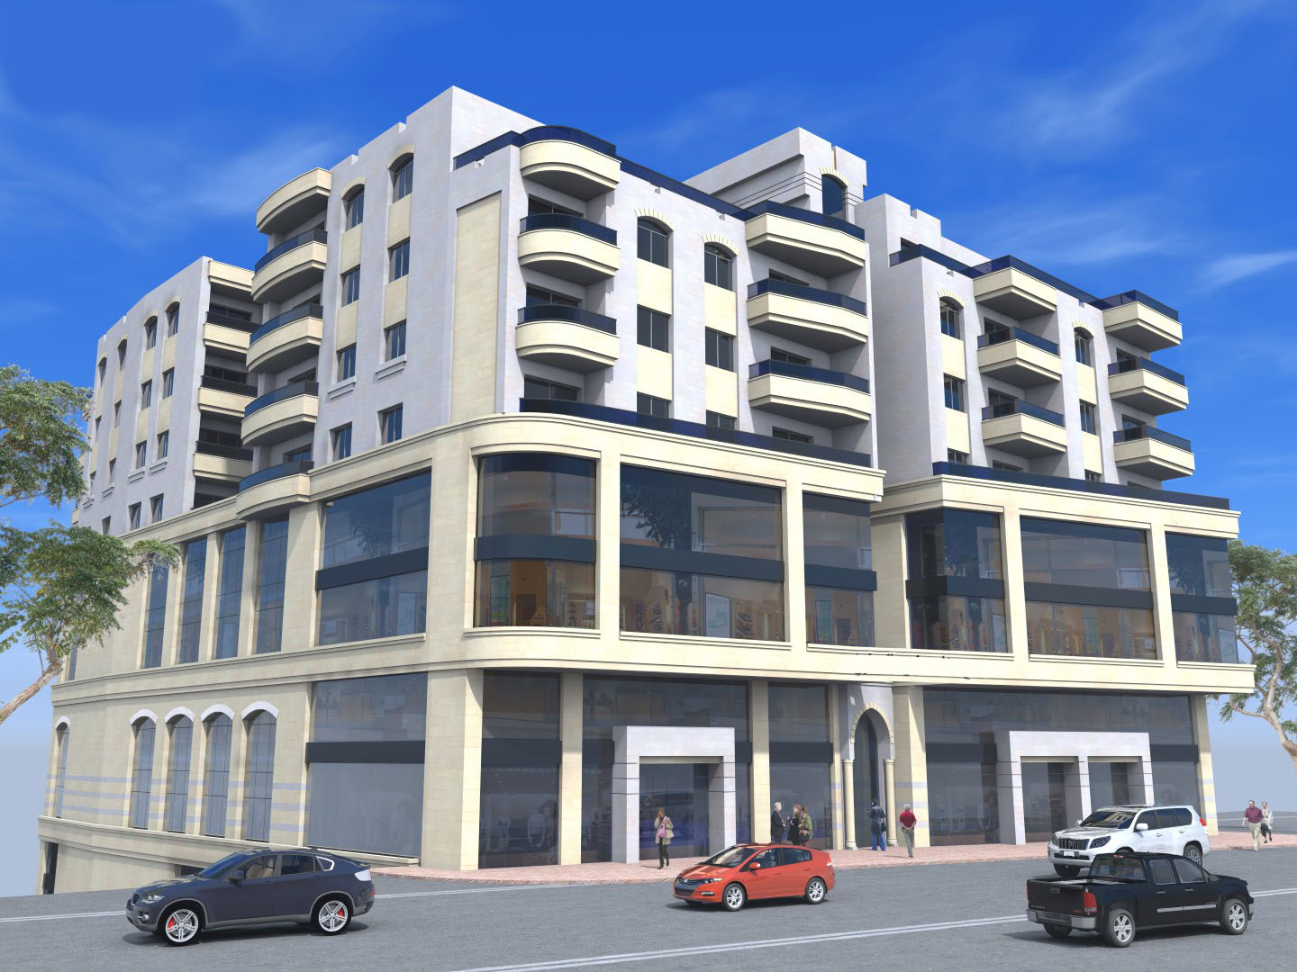

Slide 5
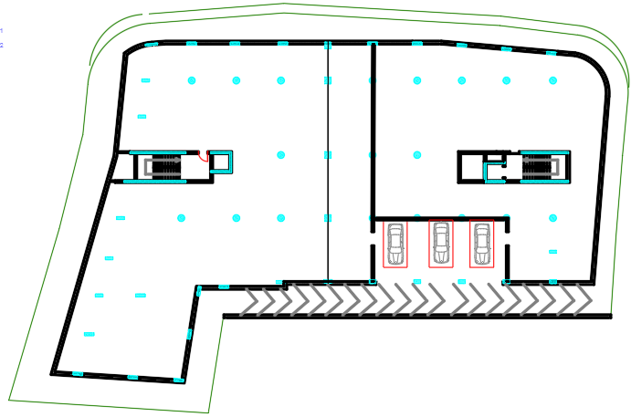
Project description. (Storage story)

Slide 6
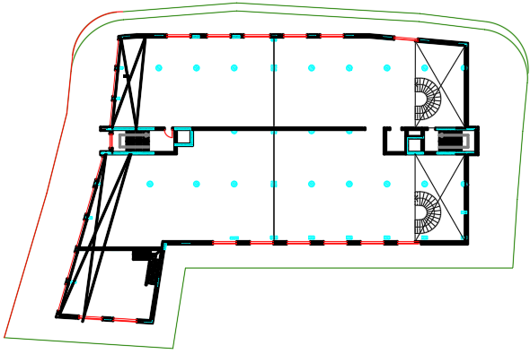
Project description. (Exhibition story)

Slide 7
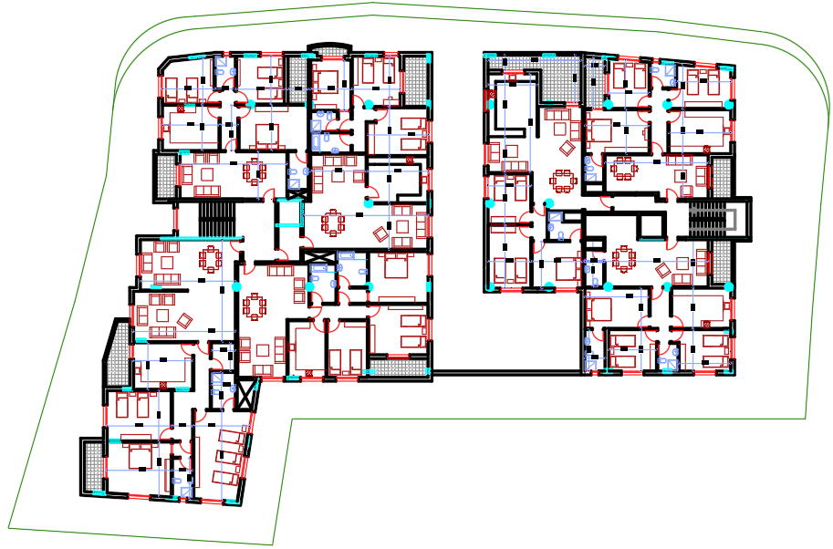
Project description. (Apartments story)

Slide 8
Description of stories
Story | Elevation (m) | Area (𝑚²)
4th Basement | -13.8 | 1414.25
3rd Basement | -10 | 1414.25
2nd Basement | -3.00 | 1271.10
1st Basement | 0.00 | 1271.10
Ground Floor | +3.5 | 1013.09
String Floor | +6.5 | 1195.28
1st Floor | +9.75 | 1013.09
2nd Floor | +13.00 | 1013.09
3rd Floor | +16.25 | 1050.17
4th Floor | +19.50 | 1050.17
5th Floor | +22.75 | 1050.17
6th Floor | +26.50 | 851.38
Stairs floor | +29.50 | 109.73
Summation |  | 12302.62

Slide 9
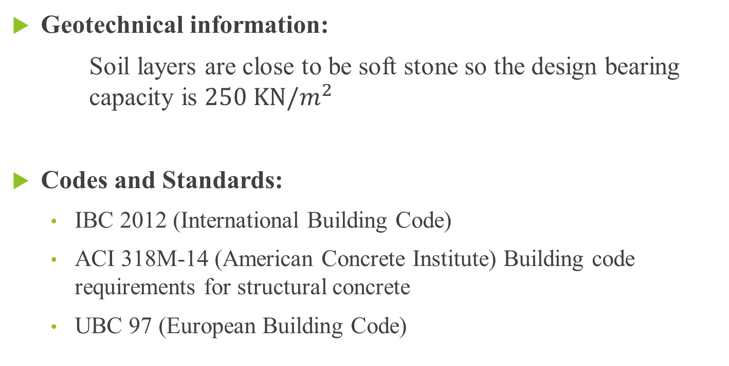
Introduction:
Geotechnical information:
Soil layers are close to be soft stone so the design bearing capacity is $250 KN/m^{2}$
Codes and Standards:
  IBC 2012 (International Building Code)
  ACI 318M-14 (American Concrete Institute) Building code requirements for structural concrete
  UBC 97 (European Building Code)

Slide 10
Introduction:
Materials:
Rebar Steel: Yielding strength of used steel (fy) = 420MPa.
Concrete: strength: 30 MPa

Slide 11
Introduction:
Programs:
1- ETABS 2016
2- Safe
3- AutoCAD
4- Excel

Slide 12
DRAW 3D MODEL,
AND CHECKS

Slide 13
Thickness of slab:
Thickness for Solid slab = 27 cm
Thickness for Ribbed slab = 30 cm

Slide 14
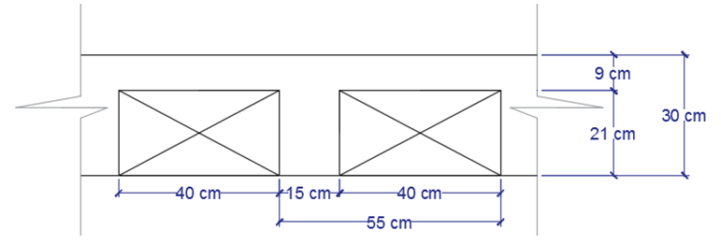
Section of ribbed slab:

Slide 15
properties and details of the 1st block slabs:
Story | Height | Elevation | Area | Type of slab | Thickness of Slab | Function
 | m | m | m² |  | mm
Story 13 | 3.5 | 43.2 | 34.68 | Solid | 150.00 | Stairwell
Story 12 | 3.25 | 39.7 | 457.55 | Ribbed | 300.00 | Apartments
Story 11 | 3.25 | 36.45 | 457.55 | Ribbed | 300.00 | Apartments
Story 10 | 3.25 | 33.2 | 457.55 | Ribbed | 300.00 | Apartments
Story 9 | 3.25 | 29.95 | 457.55 | Ribbed | 300.00 | Apartments
Story 8 | 3.25 | 26.7 | 457.55 | Ribbed | 300.00 | Apartments
Story 7 | 3.25 | 23.45 | 456.96 | Solid | 270.00 | Exhibition
Story 6 | 3 | 20.2 | 456.96 | Solid | 270.00 | Stowage
Story 5 | 3.5 | 17.2 | 456.96 | Solid | 270.00 | Stowage
Story 4 | 3 | 13.7 | 604.43 | Solid | 270.00 | Garage
Story 3 | 3.2 | 10.7 | 604.43 | Solid | 270.00 | Garage
Story 2 | 3.8 | 7.5 | 709.71 | Solid | 270.00 | Garage
Story 1 | 3.7 | 3.7 | 709.71 | Solid | 270.00 | Garage

Slide 16
properties and details of the 2nd block slabs:
Story | Height | Elevation | Area | Type of slab | Thickness of Slab | Function
 | m | m | m² |  | mm
Story 13 | 3.5 | 43.2 | 32.34 | Solid | 150.00 | Stairwell
Story 12 | 3.25 | 39.7 | 697.72 | Ribbed | 300.00 | Apartments
Story 11 | 3.25 | 36.45 | 691.19 | Ribbed | 300.00 | Apartments
Story 10 | 3.25 | 33.2 | 691.19 | Ribbed | 300.00 | Apartments
Story 9 | 3.25 | 29.95 | 691.19 | Ribbed | 300.00 | Apartments
Story 8 | 3.25 | 26.7 | 691.19 | Ribbed | 300.00 | Apartments
Story 7 | 3.25 | 23.45 | 634.81 | Solid | 270.00 | Exhibition
Story 6 | 3 | 20.2 | 546.80 | Solid | 270.00 | Stowage
Story 5 | 3.5 | 17.2 | 634.55 | Solid | 270.00 | Stowage
Story 4 | 3 | 13.7 | 769.06 | Solid | 270.00 | Garage
Story 3 | 3.2 | 10.7 | 719.99 | Solid | 270.00 | Garage
Story 2 | 3.8 | 7.5 | 719.99 | Solid | 270.00 | Garage
Story 1 | 3.7 | 3.7 | 308.49 | Solid | 270.00 | Garage

Slide 17
Frame
Sections:
Name | Material | Shape | t3 | t2 | Area
 |  |  | mm | mm | cm²
Beam 15*30 | 30MPa | Concrete Rectangular | 150 | 300 | 450
Beam 15*70 | 30MPa | Concrete Rectangular | 150 | 700 | 1050
Beam 27*25 | 30MPa | Concrete Rectangular | 270 | 250 | 675
Beam 27*40 | 30MPa | Concrete Rectangular | 270 | 400 | 1080
Beam 27*50 | 30MPa | Concrete Rectangular | 270 | 500 | 1350
Beam 27*60 | 30MPa | Concrete Rectangular | 270 | 600 | 1620
Beam 27*70 | 30MPa | Concrete Rectangular | 270 | 700 | 1890
Beam 27*90 | 30MPa | Concrete Rectangular | 270 | 900 | 2430
Beam 30*25 | 30MPa | Concrete Rectangular | 300 | 250 | 750
Beam 30*60 | 30MPa | Concrete Rectangular | 300 | 600 | 1800
Beam 60*40 | 30MPa | Concrete Rectangular | 600 | 400 | 2400
Beam 60*50 | 30MPa | Concrete Rectangular | 600 | 500 | 3000
Beam 60*60 | 30MPa | Concrete Rectangular | 600 | 600 | 3600
Beam 60*70 | 30MPa | Concrete Rectangular | 600 | 700 | 4200
Beam 60*80 | 30MPa | Concrete Rectangular | 600 | 800 | 4800
Beam 60*90 | 30MPa | Concrete Rectangular | 600 | 900 | 5400
Beam 70*50 | 30MPa | Concrete Rectangular | 700 | 500 | 3500
Beam 70*60 | 30MPa | Concrete Rectangular | 700 | 600 | 4200
Beam 70*70 | 30MPa | Concrete Rectangular | 700 | 700 | 4900
Beam 70*80 | 30MPa | Concrete Rectangular | 700 | 800 | 5600
Beam 80*100 | 30MPa | Concrete Rectangular | 800 | 1000 | 8000
Beam 80*60 | 30MPa | Concrete Rectangular | 800 | 600 | 4800
Column100 | 30MPa | Concrete Circle | 1000 |  | 7854
Column 100*30 | 30MPa | Concrete Rectangular | 1000 | 300 | 3000
Column 70*40 | 30MPa | Concrete Rectangular | 700 | 400 | 2800
Column 70*60 | 30MPa | Concrete Rectangular | 700 | 600 | 4200

Slide 18
Modifiers for Slabs, Beams and Columns:
Name | A Modifier | AS2 Modifier | AS3 Modifier | J Modifier | I22 Modifier | I33 Modifier | Mass Modifier | Weight Modifier
Solid Slab | 1 | 1 | 1 | 0.25 | 0.0025 | 0.0025 | 1 | 1
Ribbed Slab | 1 | 1 | 1 | 0.25 | 0.25 | 0.0025 | 1 | 1
Beam | 1 | 1 | 1 | 0.35 | 0.35 | 0.35 | 1 | 1
Column | 1 | 1 | 1 | 0.7 | 0.7 | 0.7 | 1 | 1

Slide 19
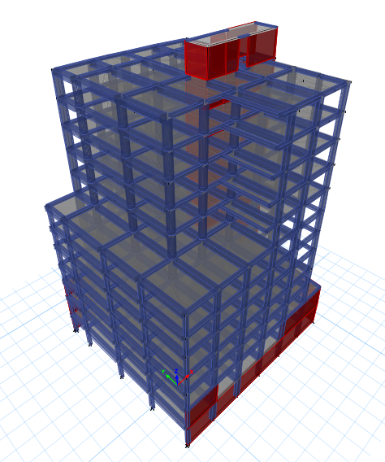
3D model:
Block1

Slide 20
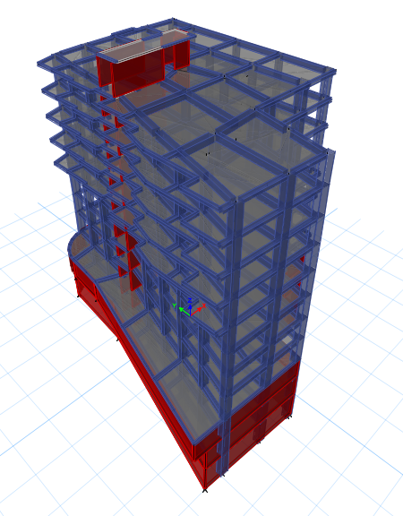
3D model:
Block2

Slide 21
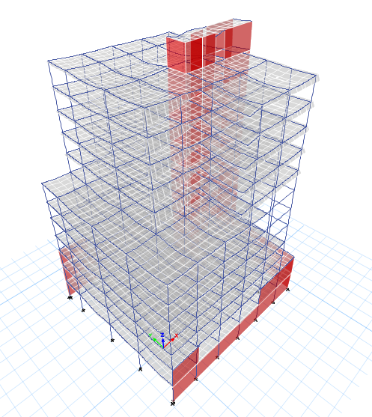
3D model:
Checks
1- Compatibility check:

Slide 22
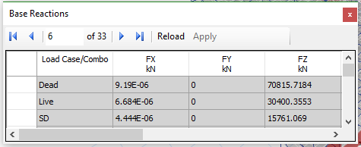
3D model:
Checks for block1.
2- equilibrium check: ETABS Z-direction forces reactions.

Slide 23

3D model:
Checks
2- Hand calculations of forces reactions, and errors.
Live load: 30622.5 KN
$$Error=0.730\% <5\% ≫Accept$$
SD: 16065 KN
$$Error=1.92\% <5\% ≫Accept$$
Dead load: 76393.2 KN
$$Error=0.064\% <5\% ≫Accept$$

Slide 24

3D model:
Checks
3- stress strain check:
$$Difference=\frac{16.57−15.69}{16.57}∗100\%=5.3\%<10\%$$

Slide 25
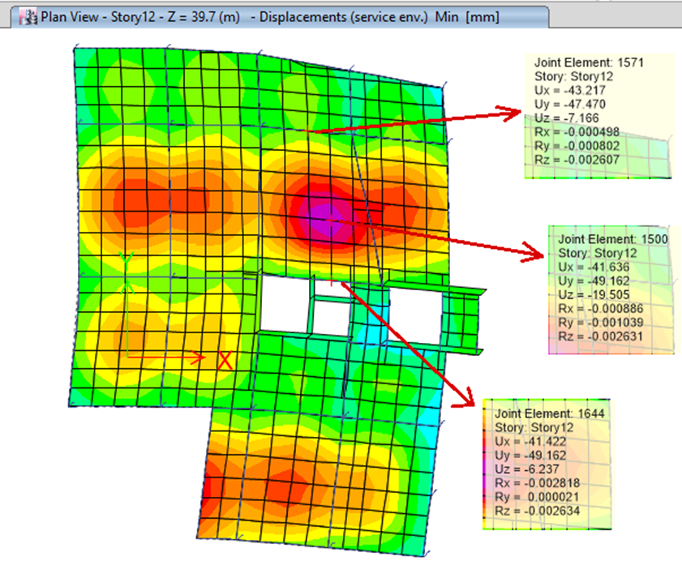
3D model:
Checks
4- Deflection check:
The long-term deflection = 25.6 mm.
The allowable deflection = 32.7 mm.
32.7 mm > 25.6 mm. OK

Slide 26
DEFINE SEISMIC PARAMETERS IN “ETABS” PROGRAM, AND CHECKS

Slide 27

Determination of seismic parameters:
Seismic Zone factor (Z) :
Nablus city which is in Zone 2B, and has Z = 0.2 g

Slide 28
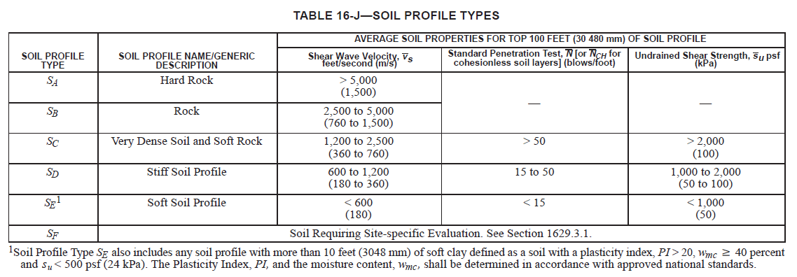
Determination of seismic parameters:
Site classifications :
bearing capacity as 250 KN/m2 >> soil is classified as Sc

Slide 29
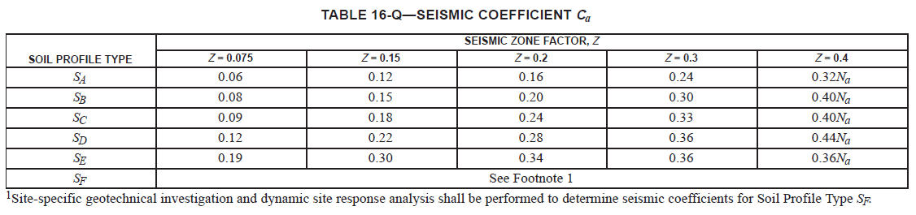
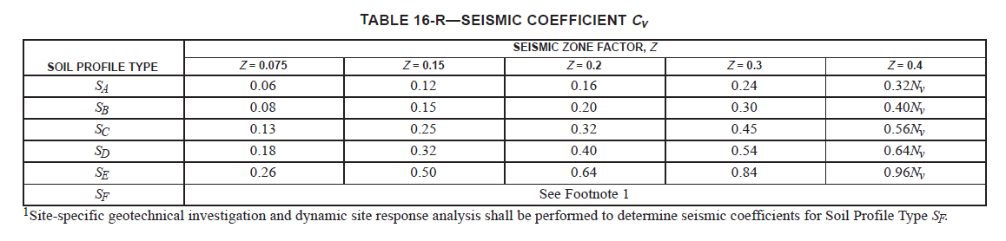
Determination of seismic parameters:
Determine seismic coefficients Ca and Cv:
Ca = 0.24 Cv = 0.32

Slide 30
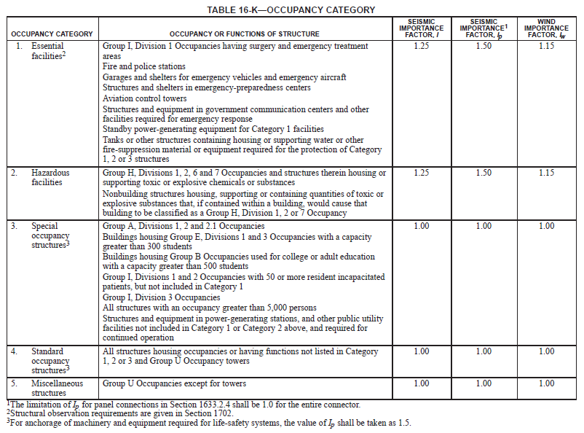
Determination of seismic parameters:
Determine seismic importance factor, I:
Use I = 1.00

Slide 31
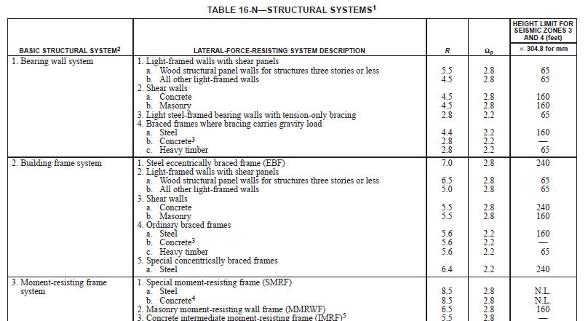
Determination of seismic parameters:
Determination of Response Modification Coefficient, R:
Use R= 5.5

Slide 32
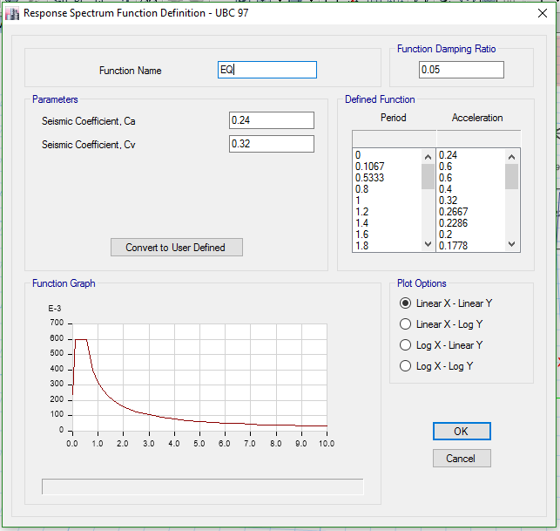
Define Response
Spectrum
Function at Etabs:

Slide 33
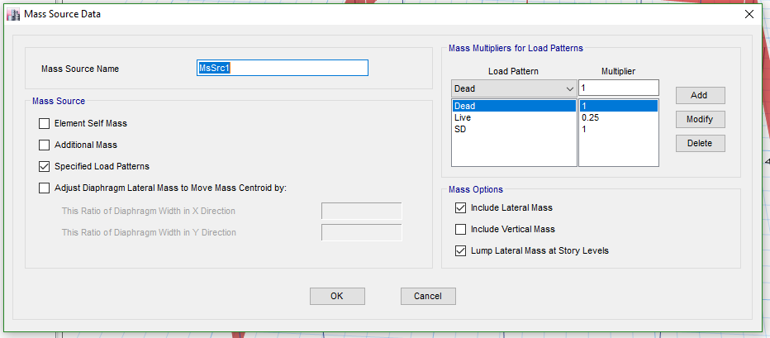
Define mass source:

Slide 34
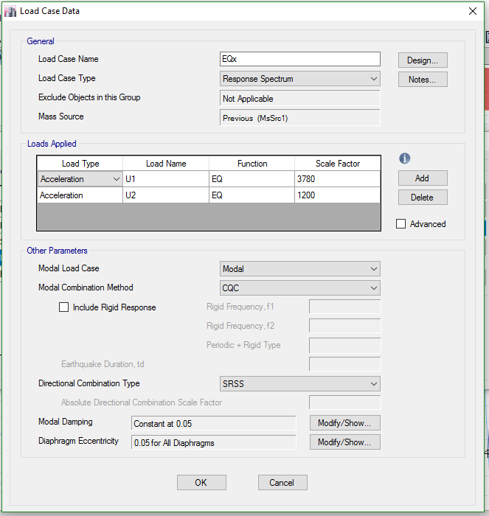
Define load case’s (Earthquake) for Block1:
Scale Factor
= gI/R = 9810 * 1 /5.5
= 1783.63

Slide 35
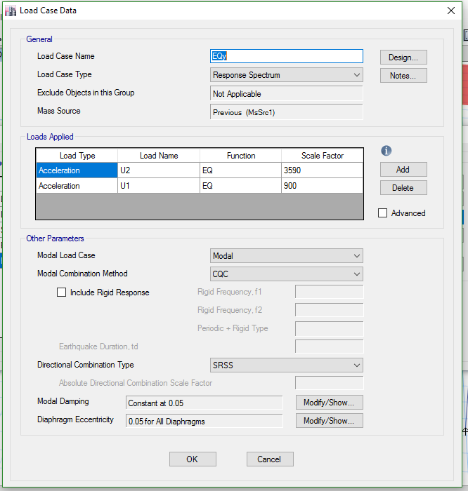
Define load case’s (Earthquake) for Block1:

Slide 36
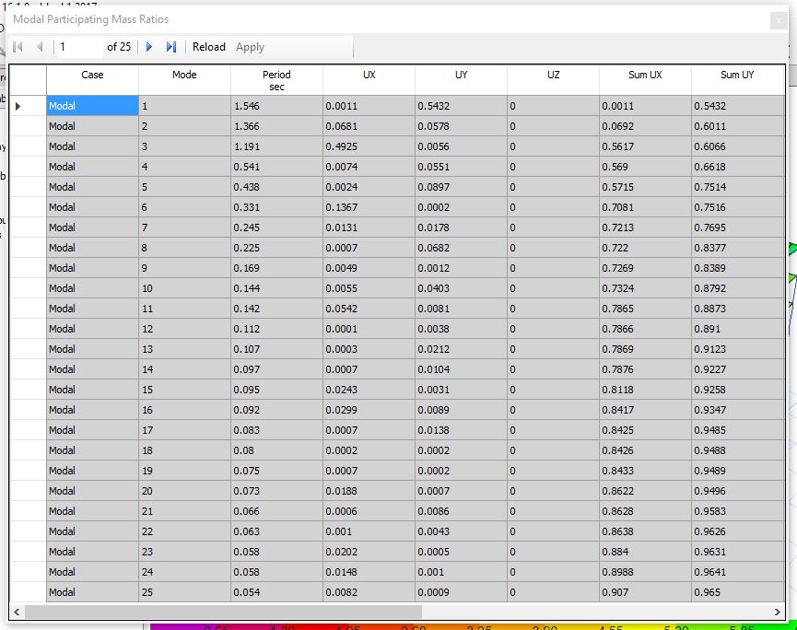
Check Modal
Participation Mass Ratio

Slide 37
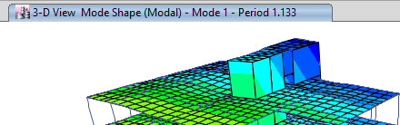

Period check
Method A:
$T_{A}=0.822 sec$
$$1.4T_{A}=1.4∗0.822=1.1512 sec$$
Method B (Etabs result):
1.133 sec < 1.1512 sec that’s OK

Slide 38
Base Shear check:
 | T | V | Etabs Result | OK or NOT
x-direction | 0.882 | 5866.21 | 6126.92 | OK
y-direction | 1.133 | 4566.63 | 5169.77 | OK

Slide 39
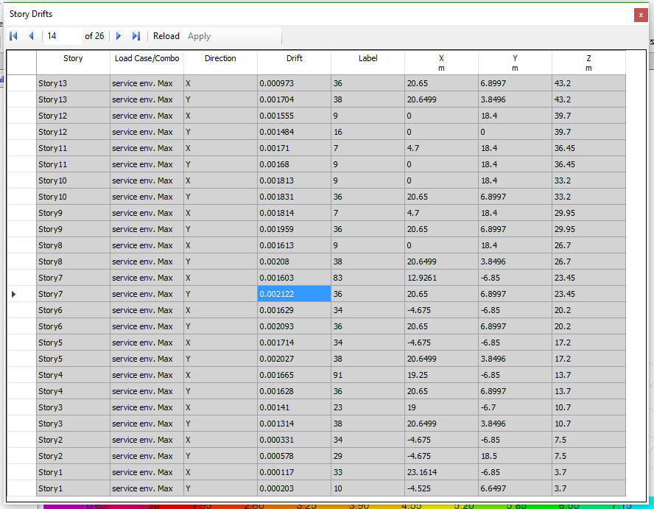
Check drift:
Allowable drift
= story hight / 500
Min. high = 3.25 m
Allowable drift = 3.25/500
= 0.0065
As shown, Max. drift
= 0.0021 < 0.0065 >>> OK

Slide 40
Design Frames for the two Blocks

Slide 41
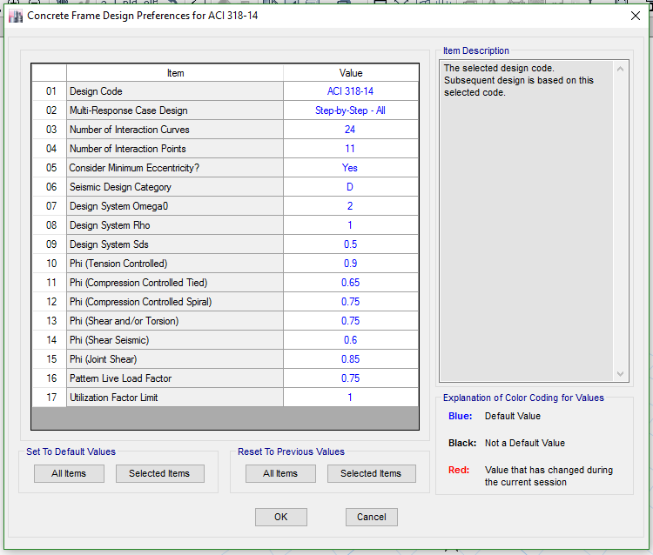
Design Code

Slide 42
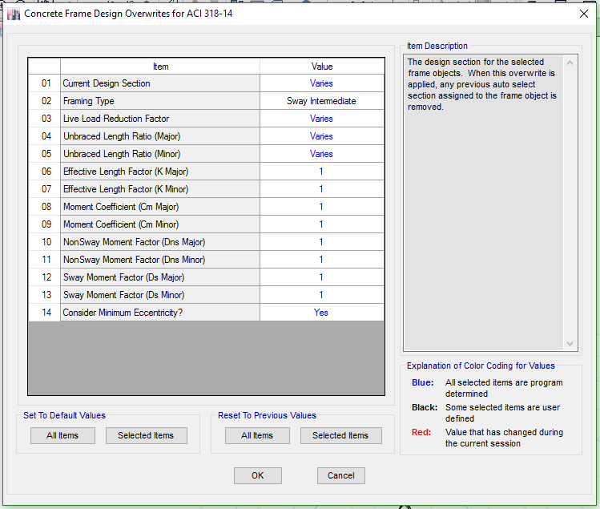
Frame type

Slide 43
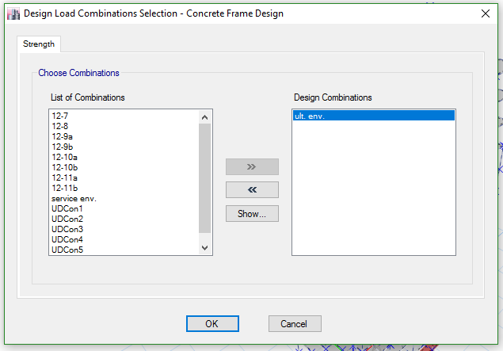
Combination used

Slide 44
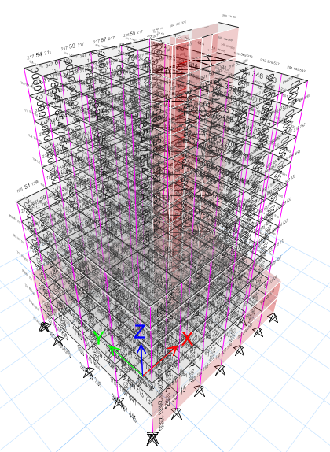
Design result for
Block1

Slide 45
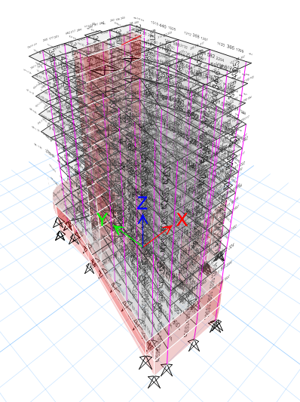
Design result for
Block2

Slide 46
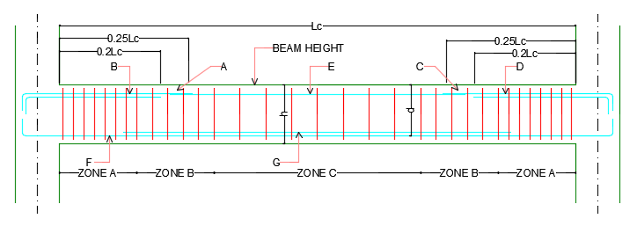
Typical Concrete Beam

Slide 47
Typical Concrete Column

Slide 48
Design Slabs for Block1

Slide 49
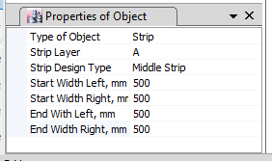
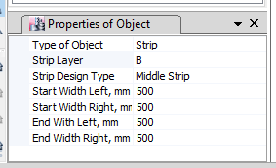
Design of slabs:
Strips properties for solid slab.
at x-direction
at y-direction

Slide 50
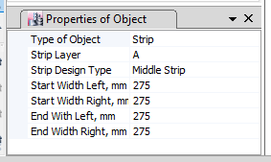
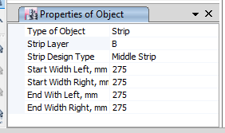
Design of slabs:
Strips properties for ribbed slab.
at x-direction
at y-direction

Slide 51
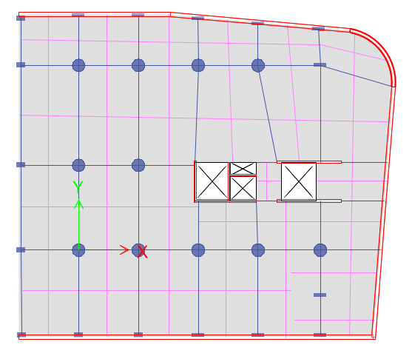
Strips A and B for story1 (solid slab)

Slide 52
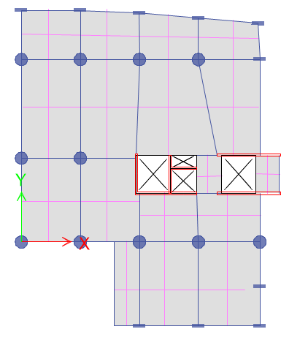
Strips A and B for story8 (ribbed slab)

Slide 53
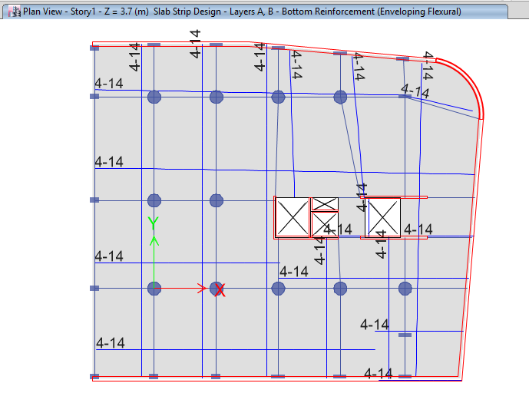
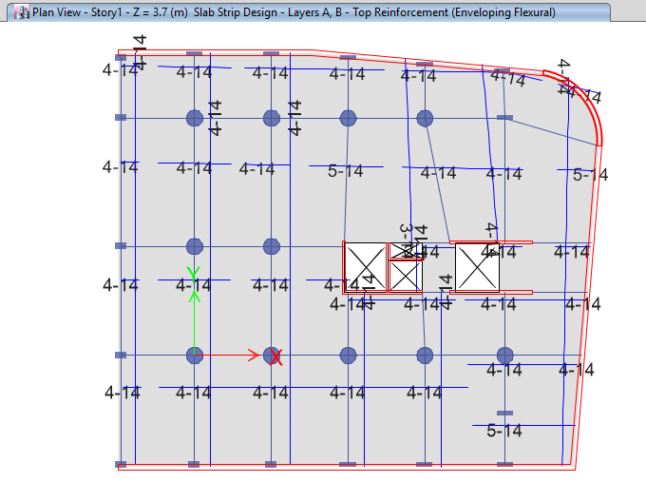
Flexure design for story1 slab (solid slab)

Slide 54
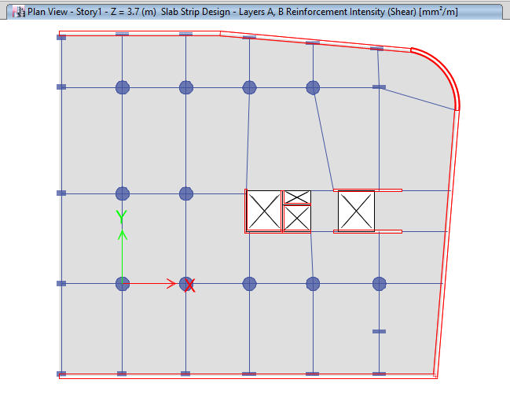
Shear design for story1 slab (solid slab)

Slide 55
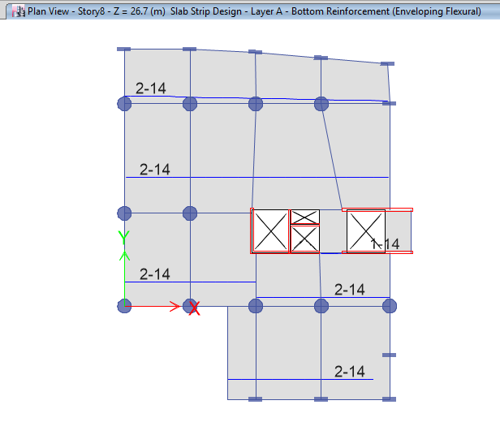
Flexure design for story8 slab (ribbed slab)

Slide 56
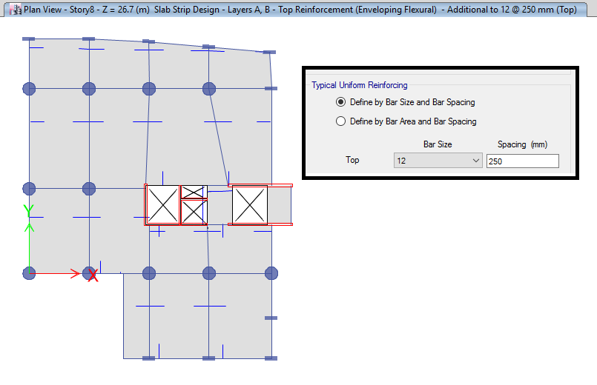
Flexure design for story8 slab (ribbed slab)

Slide 57
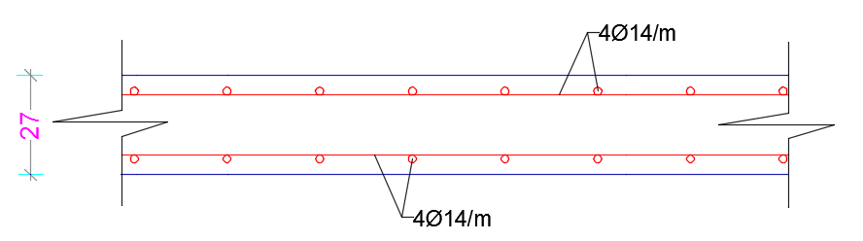
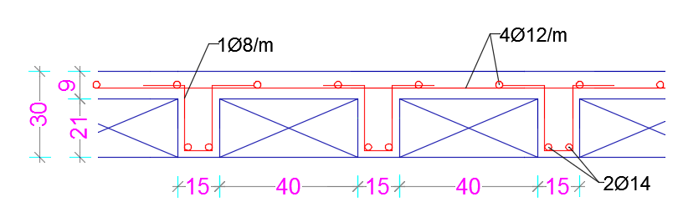
Cross sections for solid and ribbed slabs

Slide 58
Design of shear wall

Slide 59
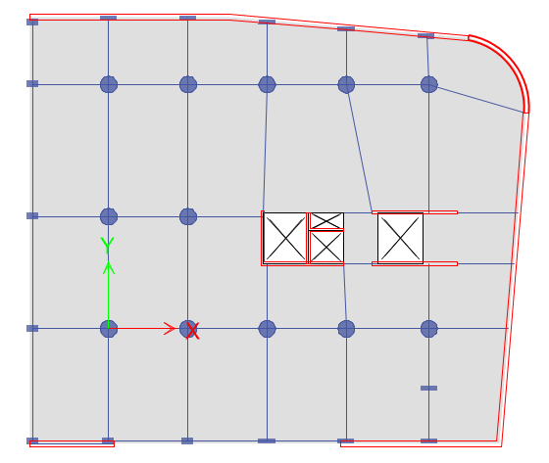
Location of the shear wall to be designed. (SW1)

Slide 60
Shear wall dimensions.
Length = 5200mm.
Thickness = 200mm
Ultimate Internal Forces from ETABS
Mmajor = 1170KN.m, Pu = 1476 KN
Mminor = 55 KN.m, Vu_{major} = 327 KN, Vu_{minor} =42 KN

Slide 61
Total Area of rebar = 5025mm2 (2512.5mm2 in each layer).
Longitudinal bars of diameter Ø12mm are used.
Spacing = Use 1Ø12/200mm in each layer

Slide 62
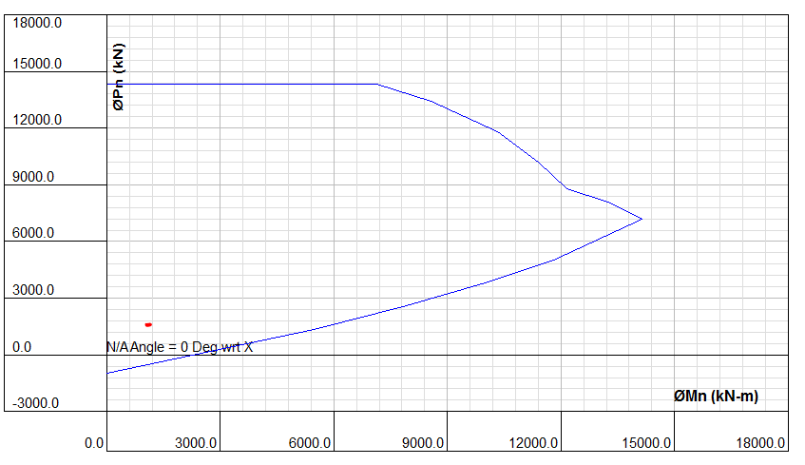
As shown in , the ultimate major bending moment (Mu=1170KN) and ultimate axial force (Pu=1476KN) lies inside the interaction curve, which means the design is safe and no additional reinforcement is required in longitudinal direction.

Slide 63
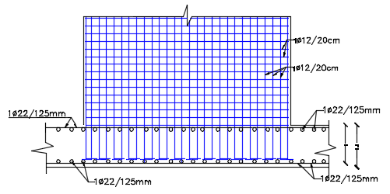
Cross section of shear wall

Slide 64
Design of Stairs

Slide 65
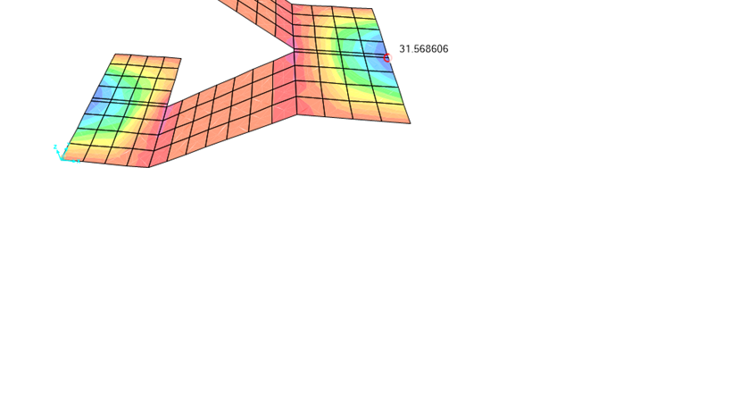
Design of landing
1 Ø12 /20 cm bottom steel
1 Ѳ12 /25 cm top steel

Slide 66
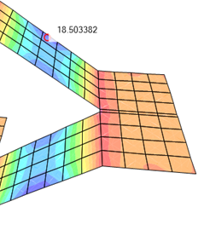
Design of soffit
1 Ø10 /20 cm bottom steel
1 Ѳ 8 /15 cm top steel

Slide 67

Cross section of stairs

Slide 68
Design of Mat foundation by Safe

Slide 69

Plan view

Slide 70


Check for deflection
$$The maximum$$
$$differential settlement$$
$$is:6.4 mm<10 mm OK$$

Slide 71


Check for soil pressure
$$\text{Maximum} \text{stress} \text{on} \text{the} \text{footing} \text{is}$$
$$\text{160}\text{.}\text{35 }\text{KN}\text{/}\text{m}\text{2 }\text{< }\text{250 }\text{KN}\text{/}\text{m}\text{2 }$$
$$\text{➔} \text{Safe}$$

Slide 72

Check footing thickness based on punching shear

Slide 73

Design for shear
$${∅V}_{c}=2725 KN$$
$$Vu=2572 KN<2725 KN→ OK$$
No need for shear reinforcement

Slide 74

Design for flexure

Slide 75
Thanks

