Slide 1
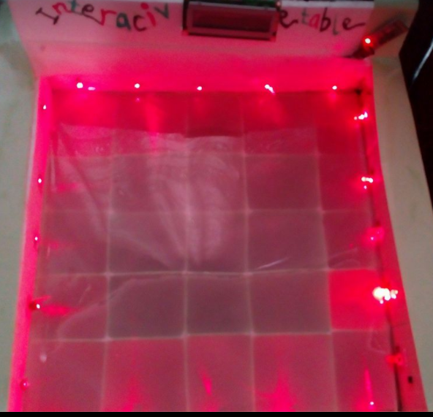
Interactive Table
Team work: Ameena Deeb
Ikram Abu_Mazen
Supervisor: Dr.Sofyan Samara

Slide 2
Outline:
1.Objective of project.
2.components.
3.Methodology.
4.constraints.
5.Future work.

Slide 3
Objective:
To make interaction between user and table

Slide 4
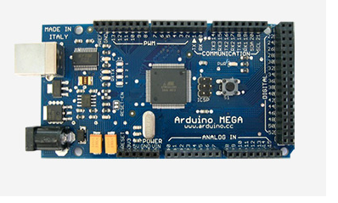
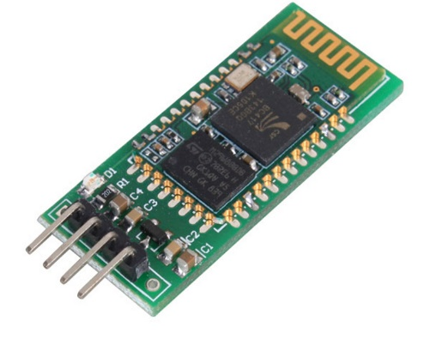
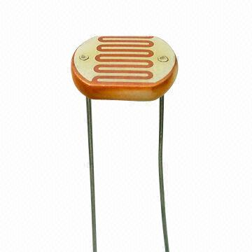
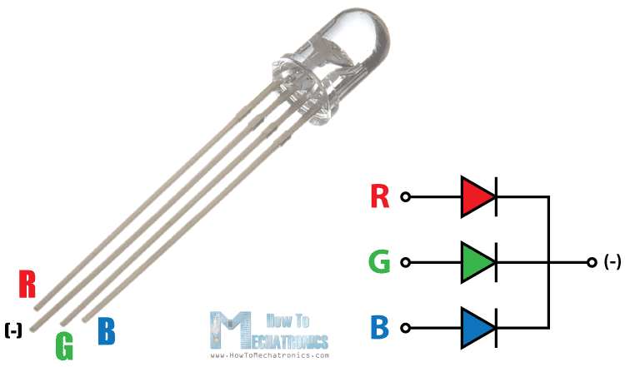
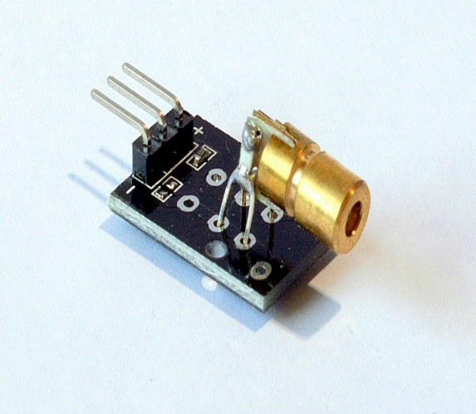
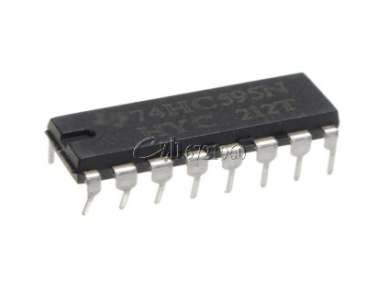
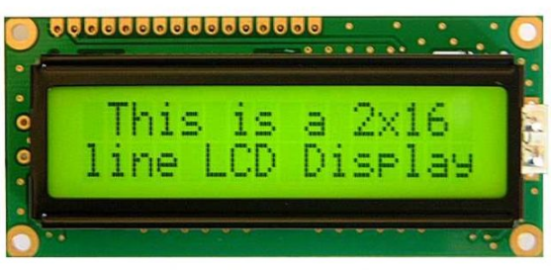
Components:
Bluetooth module HC-05
LDR
Arduino maga 2560
Shift Register 74HC595
RGB LED
LCD
LASER transmitter

Slide 5
Methodology:
Part 1:RGB led matrix
Part 2:Touch Screen Design
Part 3:Applications on Touch Screen

Slide 6
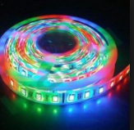
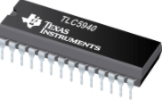
Idea:
To make 5*5 RGB led matrix
Possible choices:
1.Using TLC5940 LED driver.
2.Using Shift Register 74HC585

Slide 7
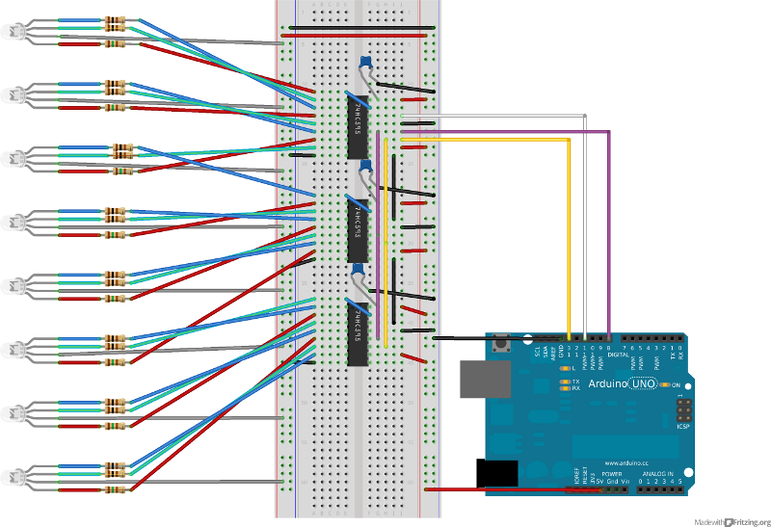

Slide 8
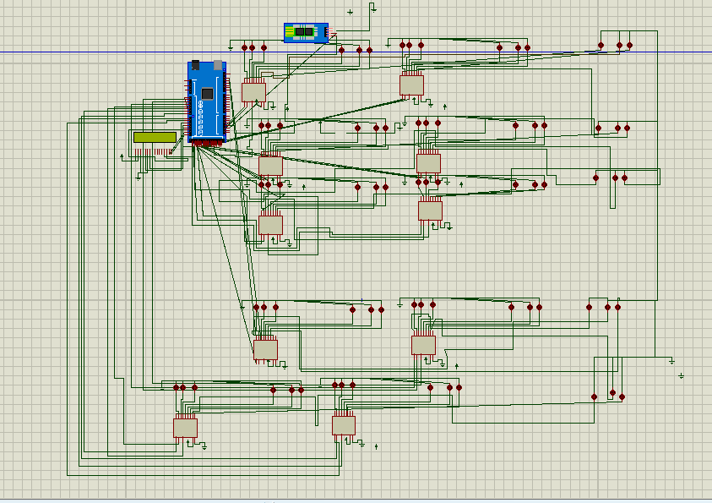

Slide 9
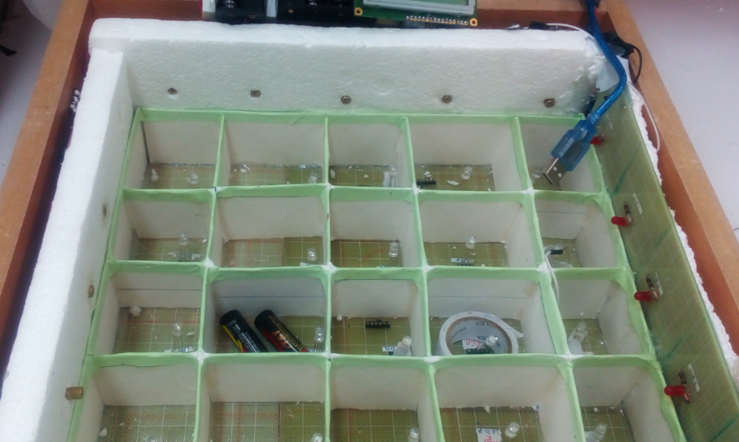

Slide 10
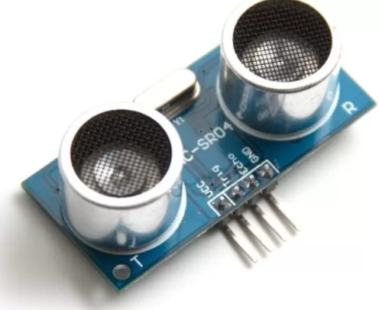
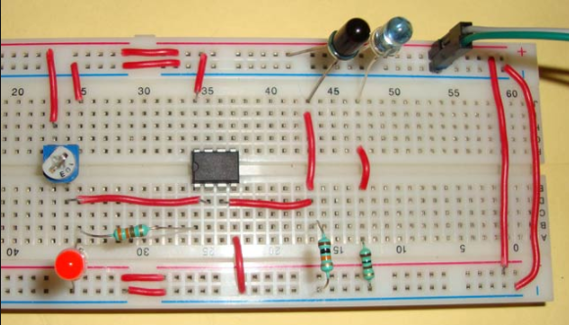
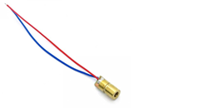
Part 2:TouchScreen design
Possible choices:

Slide 11
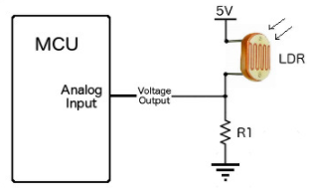
LDR & LASER CCT:

Slide 12
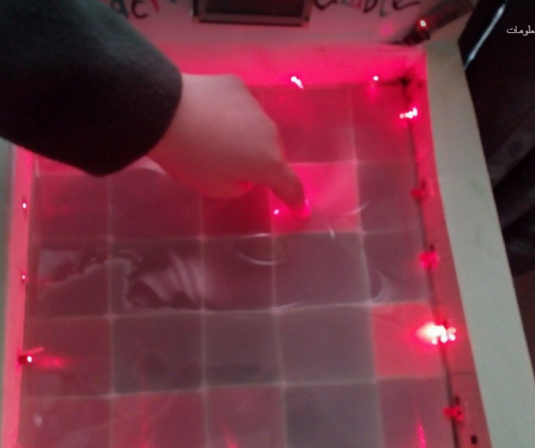

Slide 13
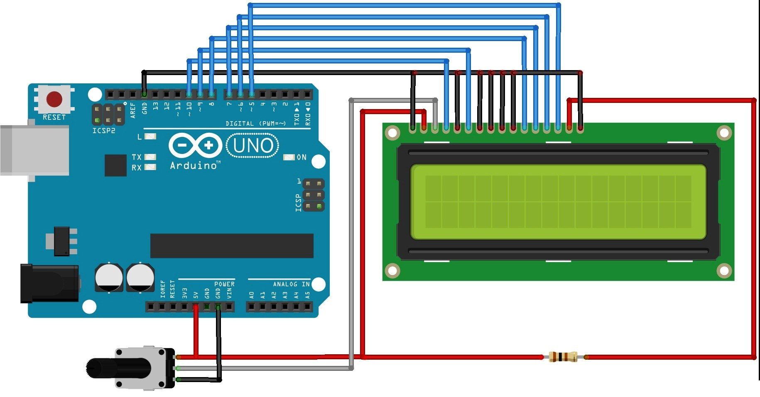
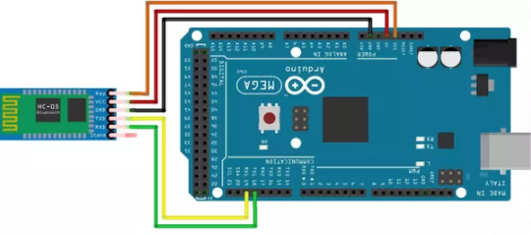
Part 3:applictions on touch
Screen to make interactive table

Slide 14
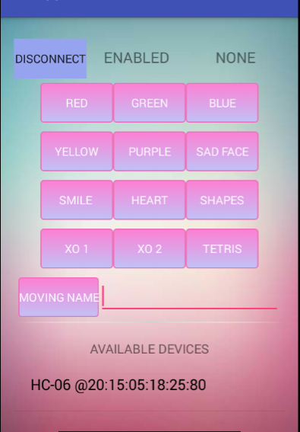
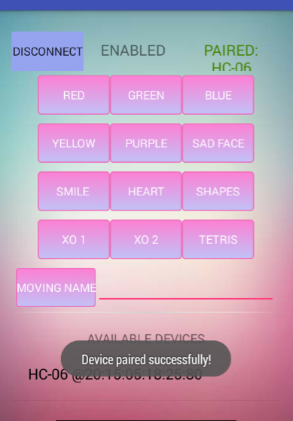
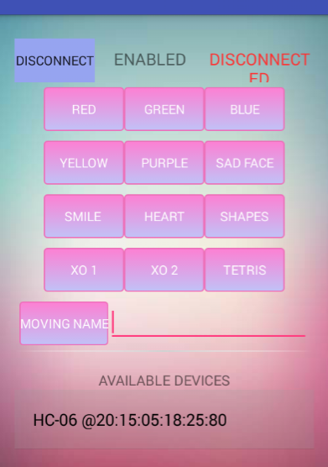

Slide 15
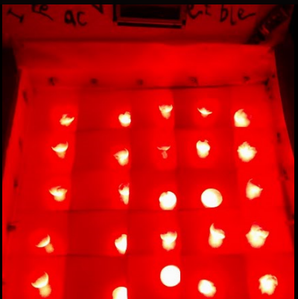
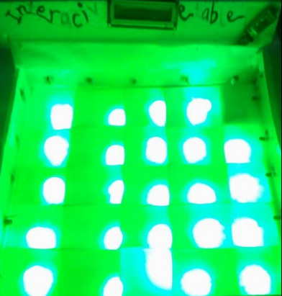
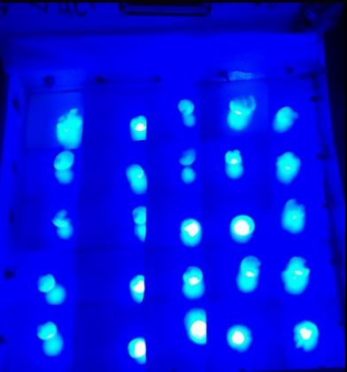
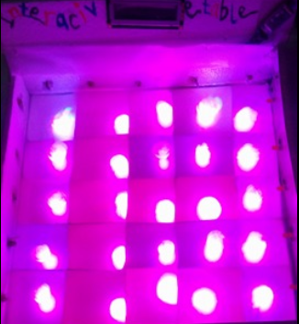
1.Coloring :

Slide 16
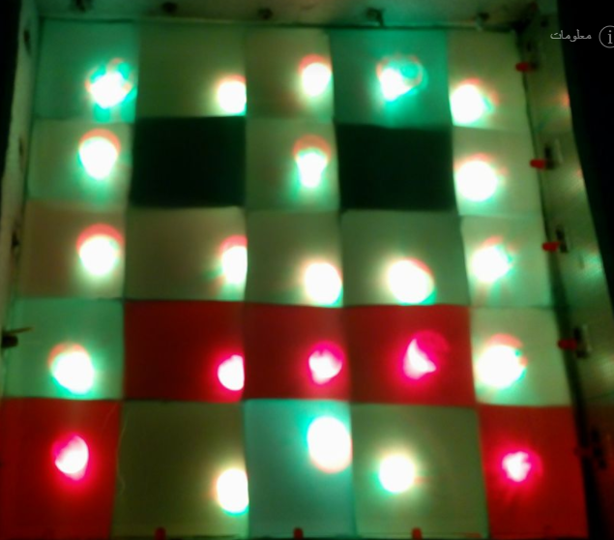
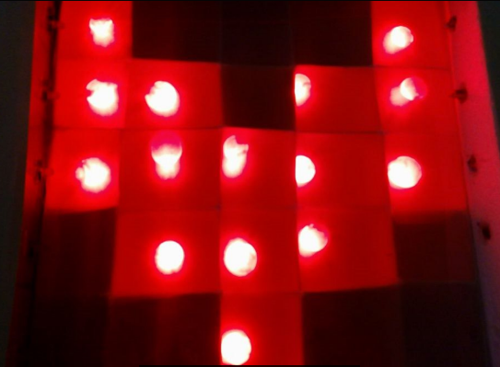
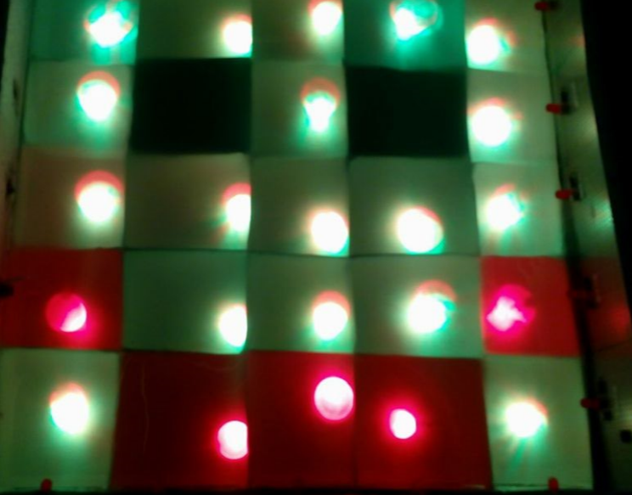
2.Shapes

Slide 17
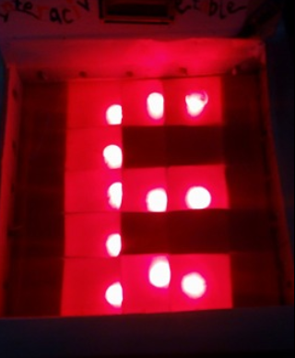
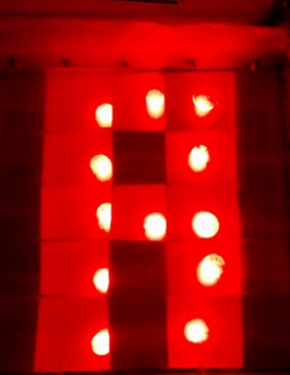
3.Moving message

Slide 18
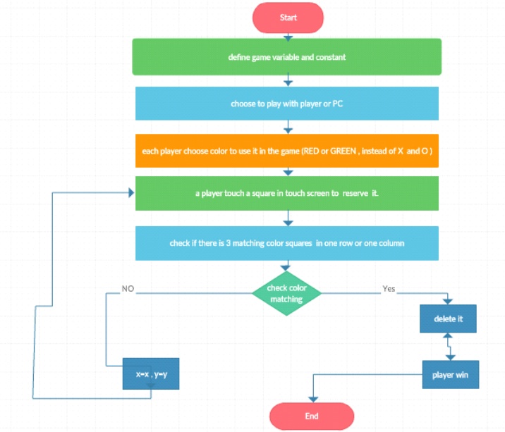
3. XO Game

Slide 19
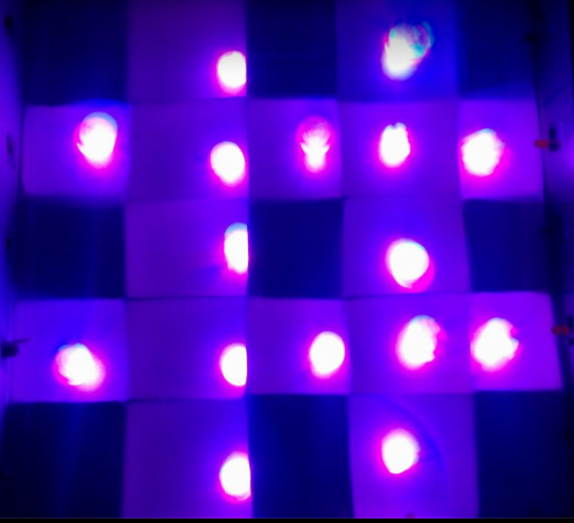

Slide 20
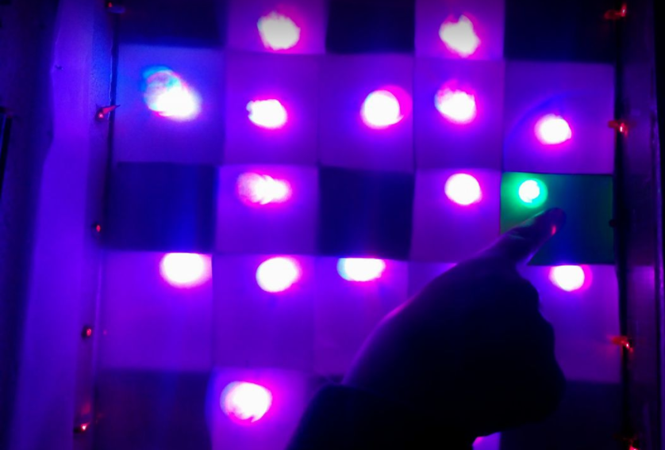

Slide 21
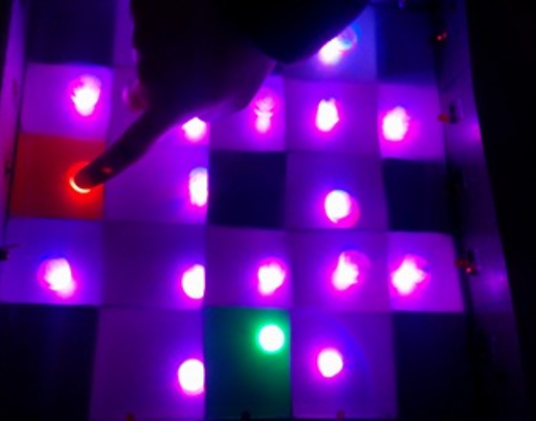

Slide 22
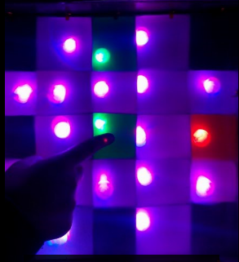

Slide 23
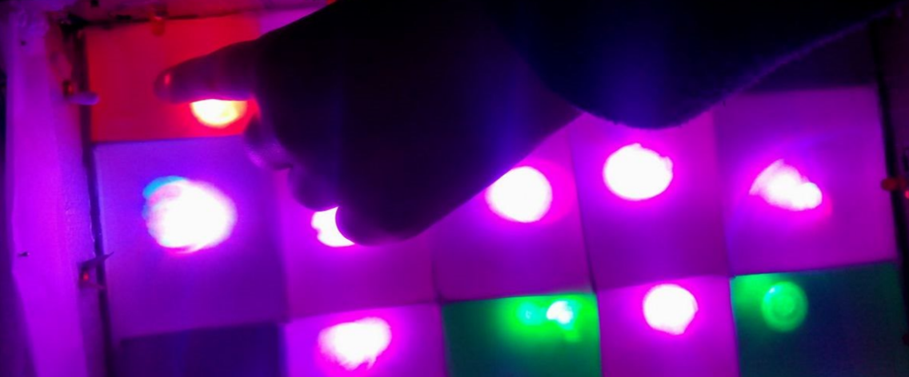

Slide 24
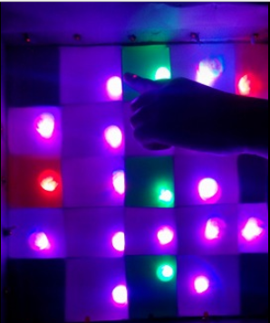

Slide 25

4.Tetris game

Slide 26
4.Tetris game
Each pattern represents by 3*3 matrix .​
​
​
Each pattern has 4 arrays for four directions :​
6* 4 = 24 pattern (array values)

Slide 27
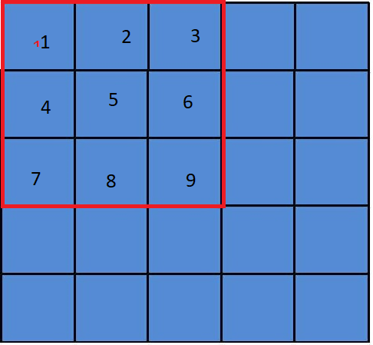

Slide 28
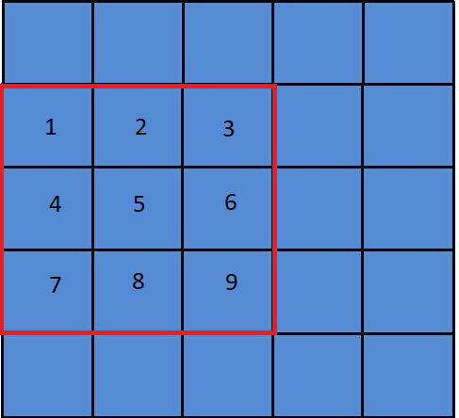

Slide 29
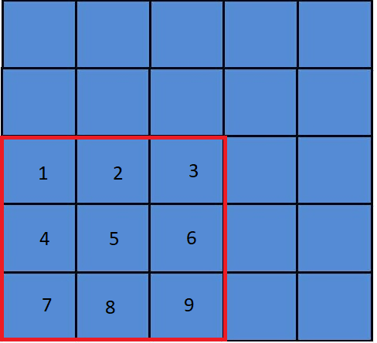

Slide 30
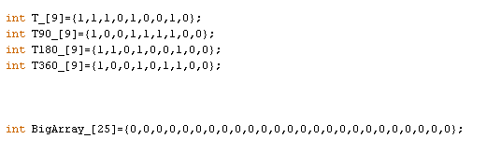
4.Tetris game

Slide 31
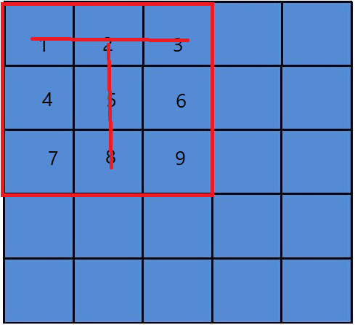

Slide 32
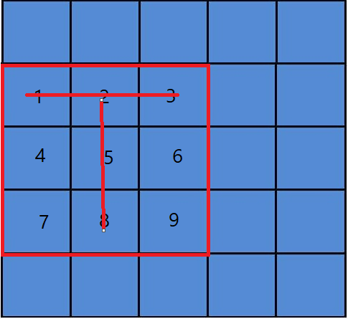

Slide 33
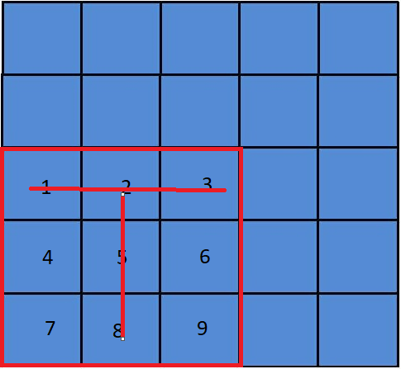

Slide 34
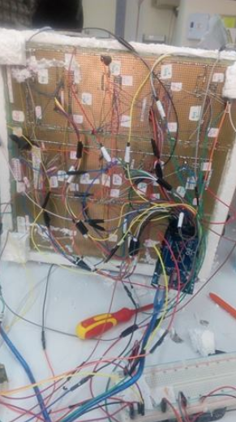
Constraints:
1.Choose the simplest circuit with available components to do the work
2.Using efficient and possible way to get the position
Problems:
1.LDR value keeps varying.
2.Wire connections.
3.LDR and LASER positioning

Slide 35
Future work:
Dining table in restaurants that can show any form and request of food, it can be linked simply by Bluetooth to receive food requests.
2. Attract children's attention and teach them colors and shapes
3. Make any game you want, that needs a touchscreen.
4. Design a studying table based on a touch screen such that the student will not need to write on the papers and throwing them away after the usage ,he will only need to write on the touch table then clear it when he finishes the table could be improved if it supported with other things that the student may need like a virtual calculator for computation.

Slide 36
Thank you

