Slide 1
Design of foundation for multistory building considering seismic loads
Prepared by :
Baha’a Adel Irshaid
Jad-alhaq Muhammed Zamzam
Muhammed Husni Weld Ali
Muhammed Maher khilfeh
Mahmoud Abd-alnaser al-kharraz
Under supervision of :
Dr. Issam Jardaneh

Slide 2
Outline
Preview
Effect of increasing number of floors on:-
*Foundation type
*Foundation dimension
*Foundation cost
considering seismic loads

Slide 3
Preview
Soil type of the site is brownish silty-clay
Soil’s bearing capacity = 120 kN/m²
The soil was being improved using three layers of compacted base coarse, after this improvement soil’s bearing capacity = 180 kN/m²

Slide 4
Soil layers of the site

Slide 5
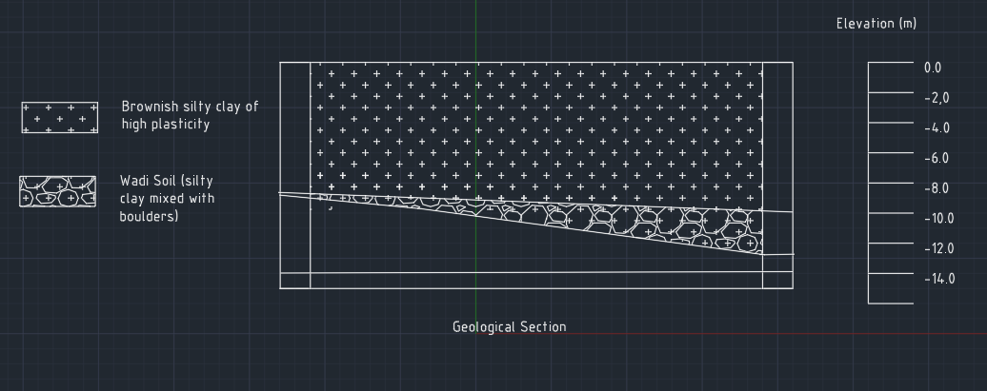
Geological section of site

Slide 6
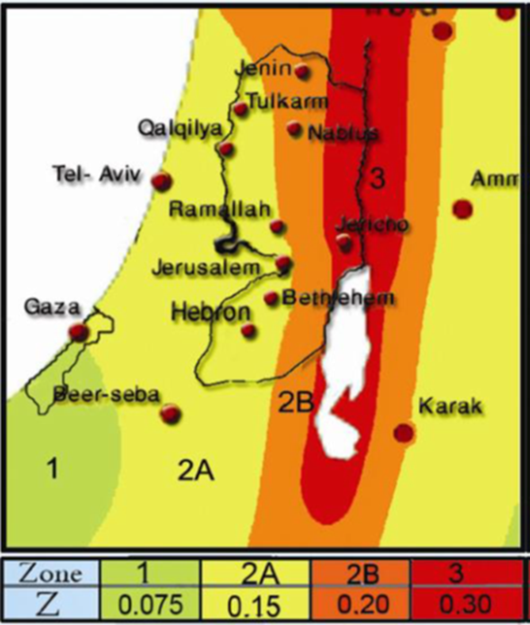
Seismic Zone Factor (Z)
This is an estimation of the site peak ground acceleration expressed as a function of the gravity acceleration g
Z factor in Nablus = 0.2g

Slide 7
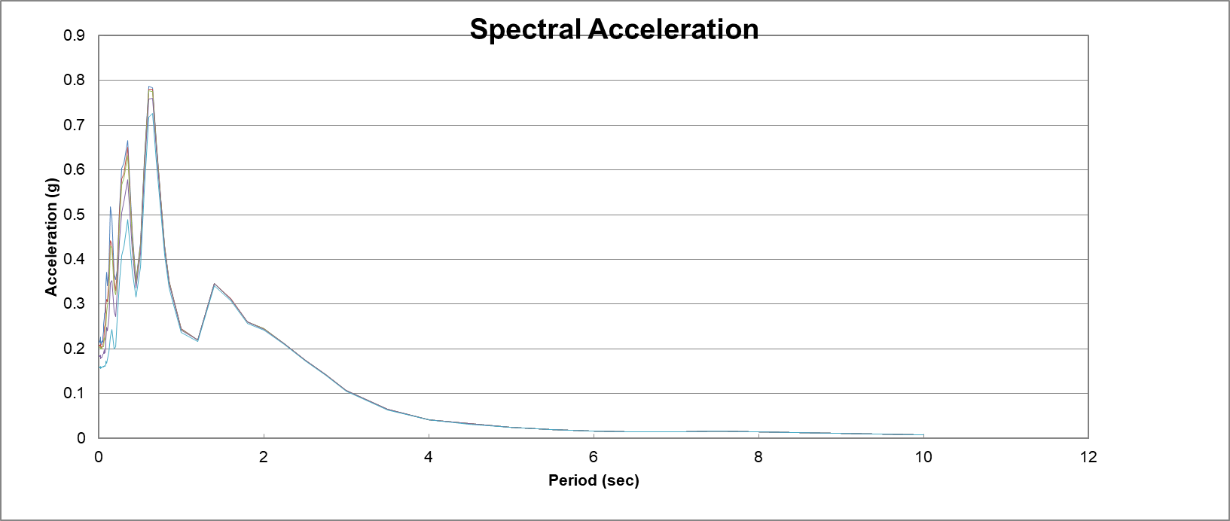
Soil response spectra
From the figure below we noticed maximum spectral acceleration is 0.78 g

Slide 8
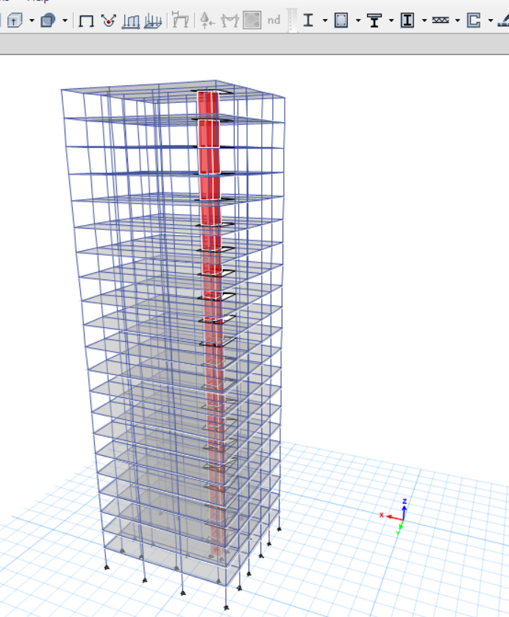
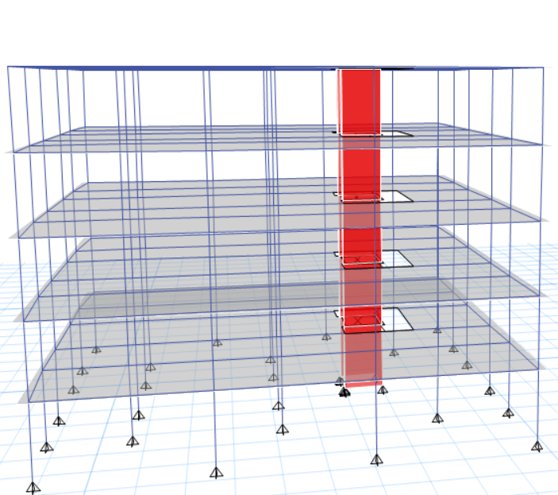
Modeling

Slide 9
Analysis
Formulation the model into 3D using analysis software (ETAPS 2016), which can provide static and dynamic with seismic analysis, and then the results from ETAPS are discussed for several factors.

Slide 10
Material
The compressive strength at 28days, 𝒇'_{c}= 350kg/cm² ( 28 MPa.)
The yield strength of steel bars, ℱ_{y}=420 mPa (high strength steel).

Slide 11
Loads
Dead load (DL) due to the own weight of the building component.
-Super Imposed Dead load (SID) = 4.5 kN/m2
-Live load (LL) due to moving loads expected through the function of the building=3 kN/m2.
Response spectrum

Slide 12
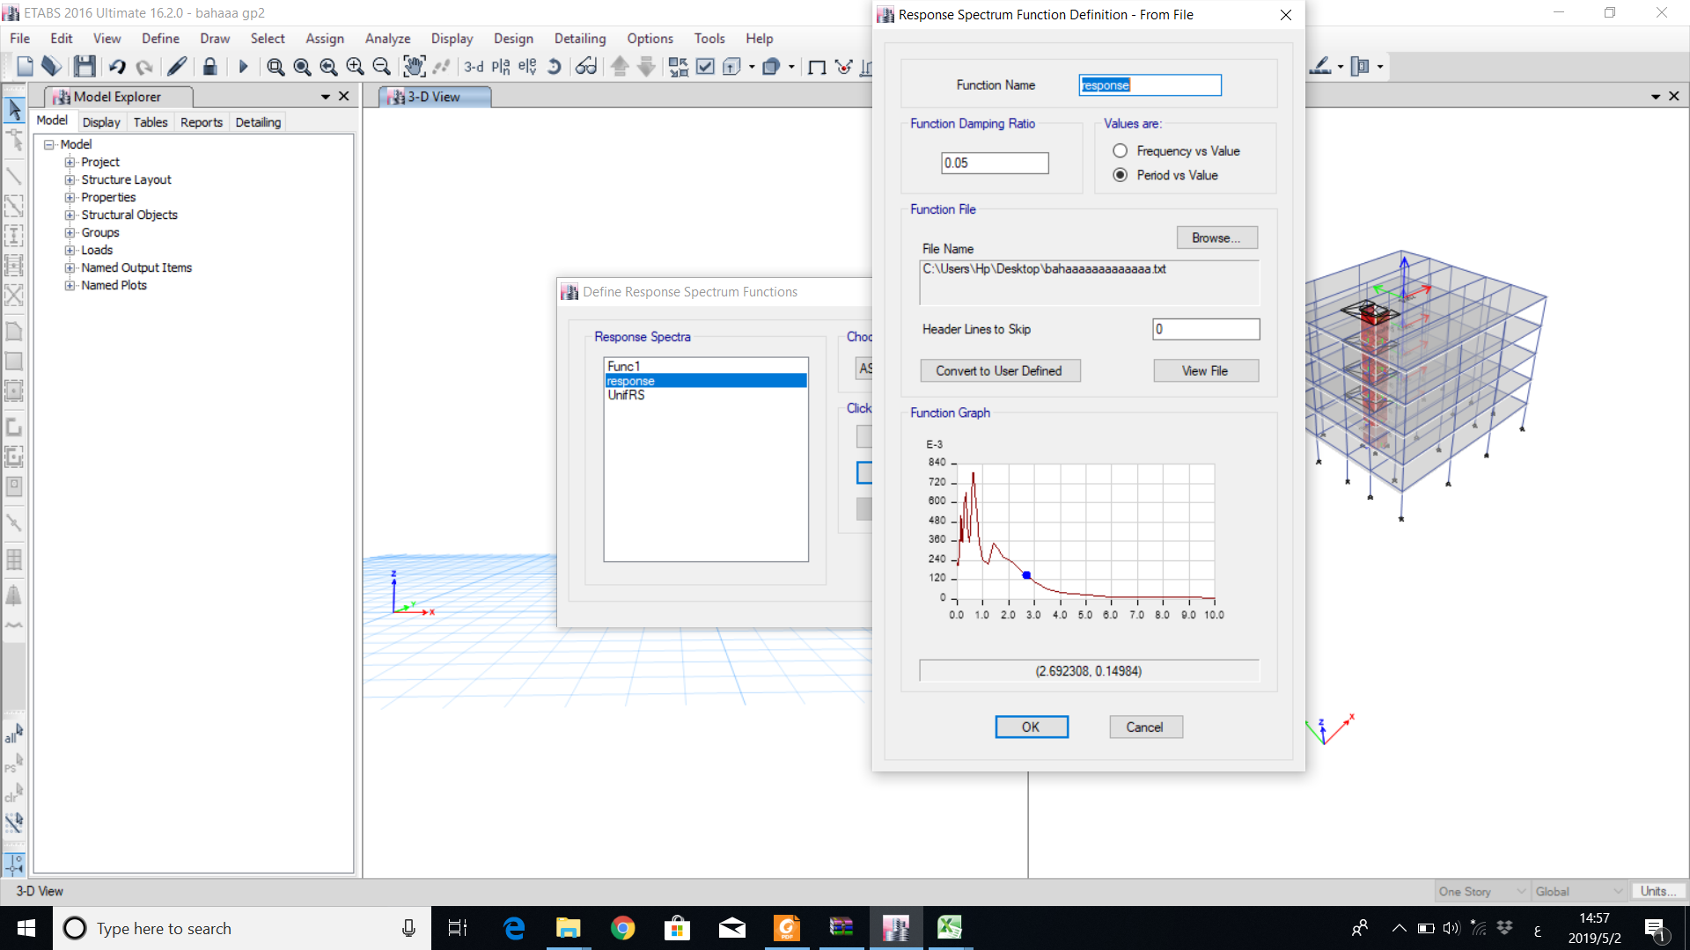
-Response spectrum as function

Slide 13
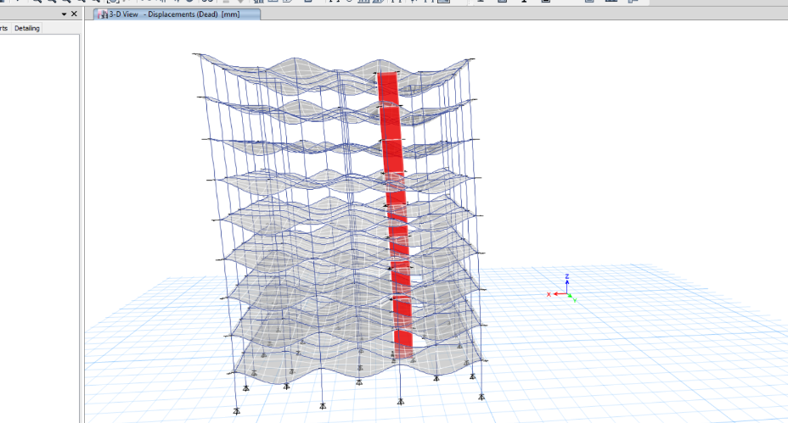
Checks
Compatibility

Slide 14
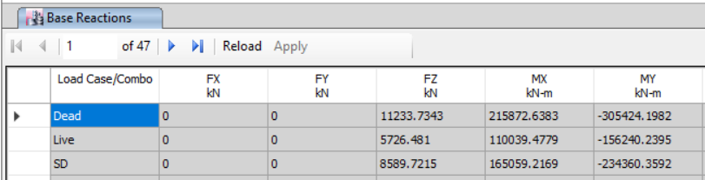

Equilibrium
% of difference dead $=\frac{11233.7343−11000}{11000}=0.021$
% of difference live $=\frac{5726.481−5650}{5650}=0.02$
% of difference SD $=\frac{8589.7215−8480}{8480}=0.013$

Slide 15
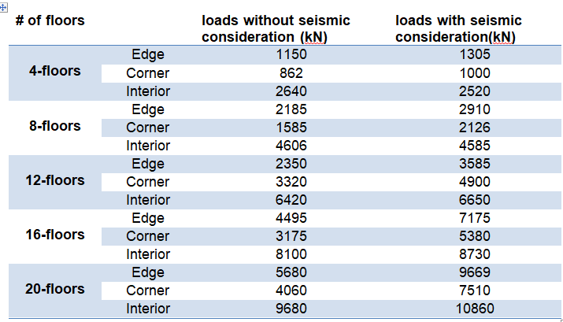
Result of Etabs Analysis

Slide 16
Comparison between total columns loads and number of floors

Slide 17
Design
CODES
For Design will Use ACI 318-11 code
For Seismic Design UBC 97 Code
LOAD COMBINATIONS
Wu=1.4 D
Wu=1.2 D +1.6 L
Wu=1.2D.L +1.0L.L ±1.0E
Wu=0.9 D ±1.0 E

Slide 18
Foundation Design Options
Single footing
Combined footing
Mat foundation
Piles foundation
Mat over Piles foundation

Slide 19
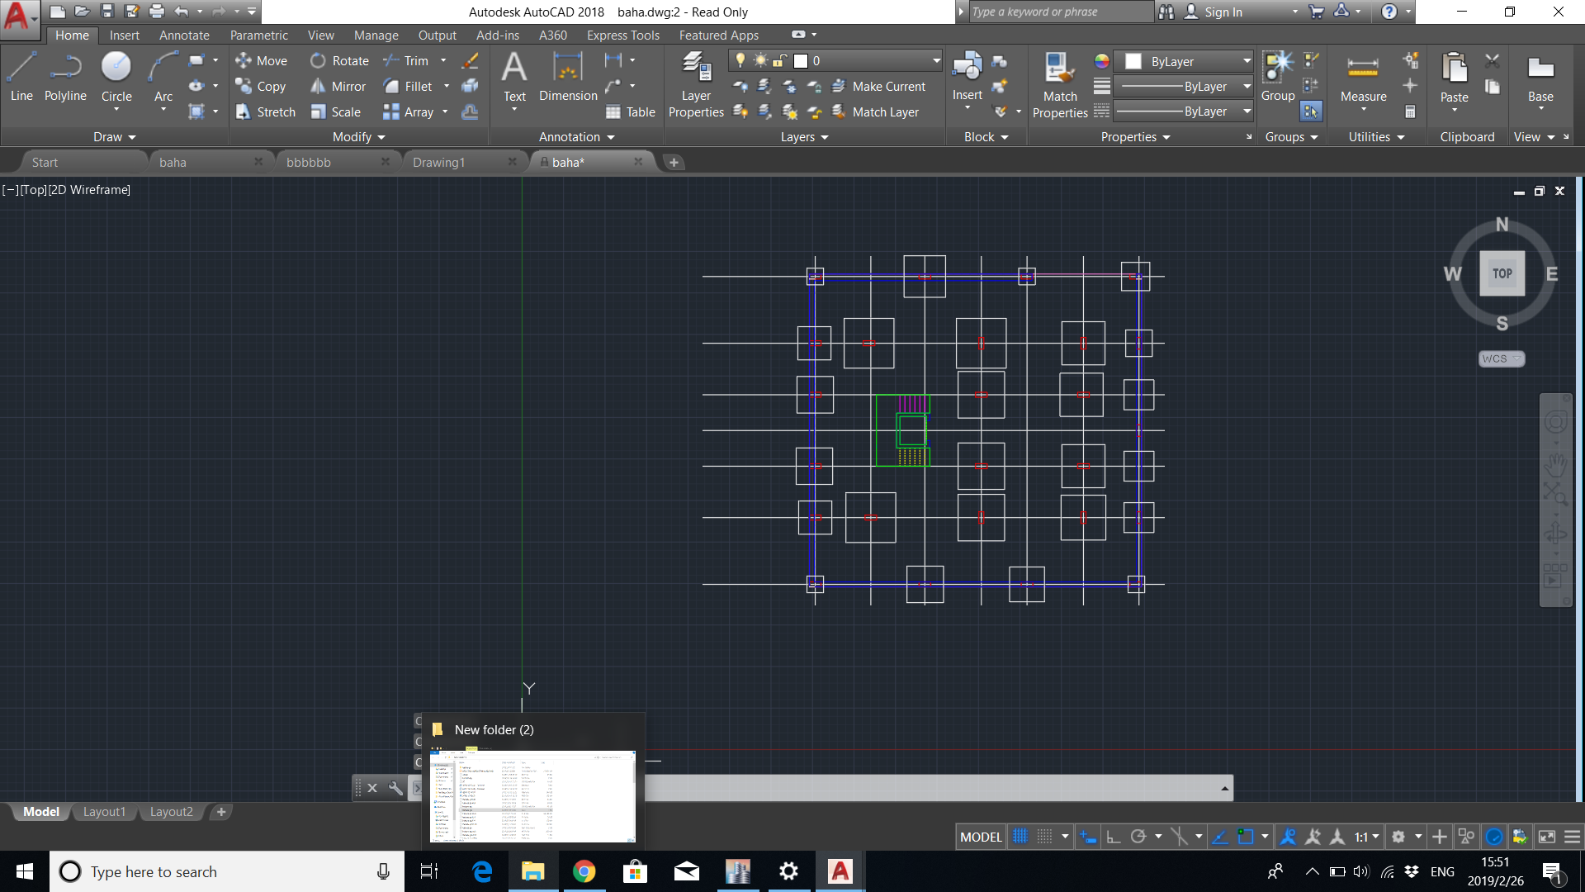
Isolated and combined footing option
Isolated and combined footing option fails due to huge overlap between footings since the net area of footings is greater than two thirds of building’s area. as shown in the figure below

Slide 20
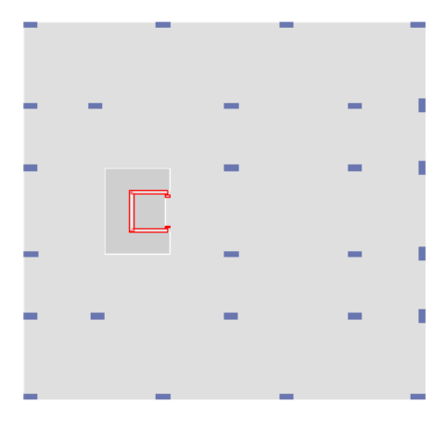
Mat foundation Option
Mat foundation meets the building and soil requirements, so Mat foundation was being adopted in this project .

Slide 21
Design of Mat Foundation
Soil defined with bearing capacity as simple springs under the Mat Foundation

Slide 22
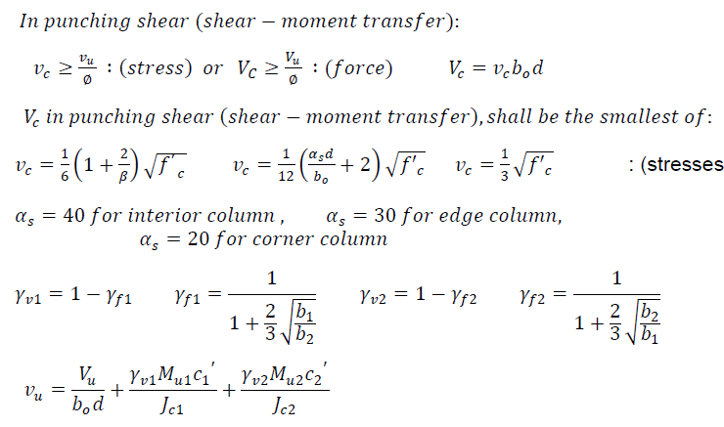
Applied Loads

Slide 23
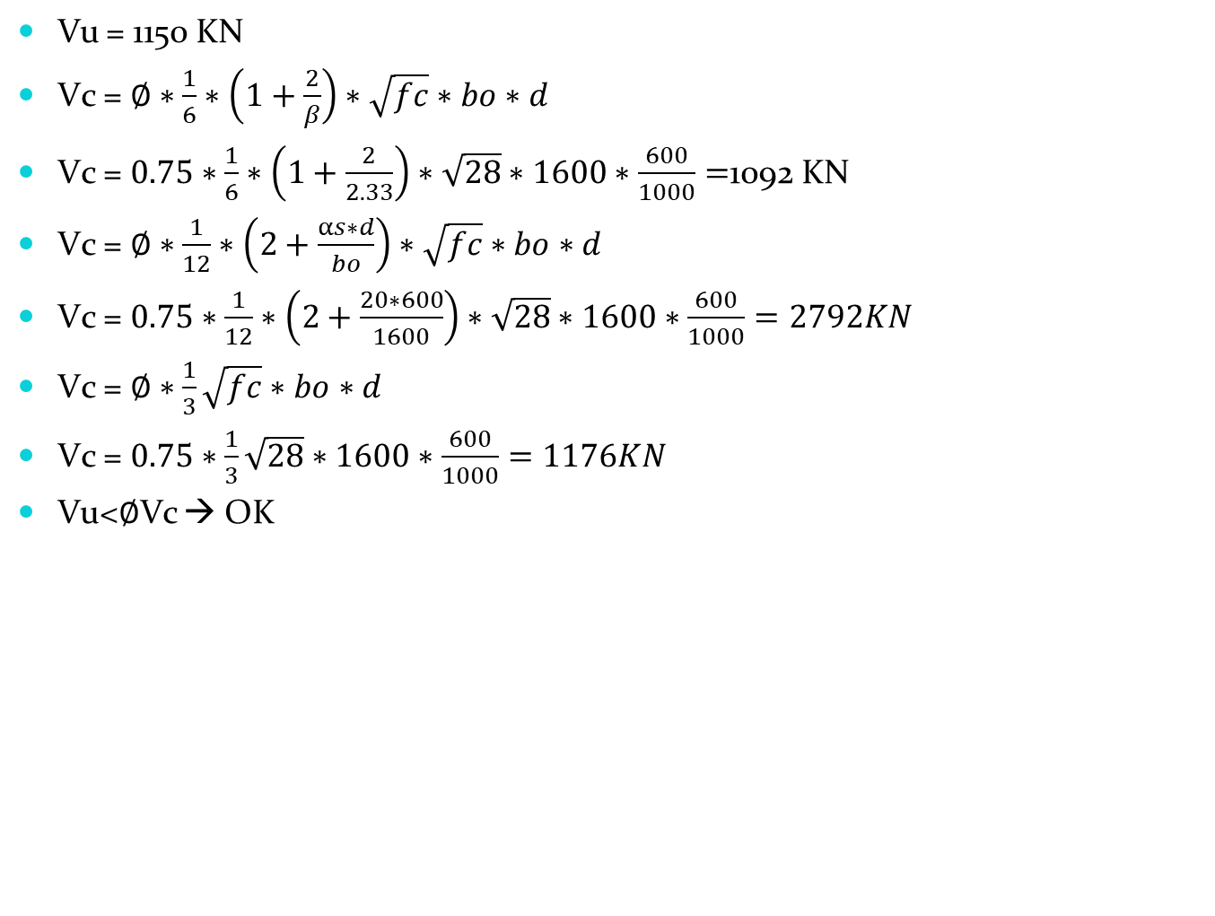
Selecting of mat thickness
Vu = 1150 KN
Vc = $∅∗\frac{1}{6}∗\left(1+\frac{2}{β}\right)∗\sqrt{fc}∗bo∗d$
Vc = $0.75∗\frac{1}{6}∗\left(1+\frac{2}{2.33}\right)∗\sqrt{28}∗1600∗\frac{600}{1000}=$1092 KN
Vc = $∅∗\frac{1}{12}∗\left(2+\frac{αs∗d}{bo}\right)∗\sqrt{fc}∗bo∗d$
Vc = $0.75∗\frac{1}{12}∗\left(2+\frac{20∗600}{1600}\right)∗\sqrt{28}∗1600∗\frac{600}{1000}=2792KN$
Vc = $∅∗\frac{1}{3}\sqrt{fc}∗bo∗d$
Vc = $0.75∗\frac{1}{3}\sqrt{28}∗1600∗\frac{600}{1000}=1176KN$
Vu<∅Vc → OK

Slide 24
Etabs Results
MAT THICKNESS (mm) | Seismic load consideration | FLOOR No.
700 | Yes | 4
700 | No
1100 | Yes | 8
1000 | No
1500 | Yes | 12
1200 | No
1900 | Yes | 16
1500 | No
2200 | Yes | 20
1600 | No

Slide 25
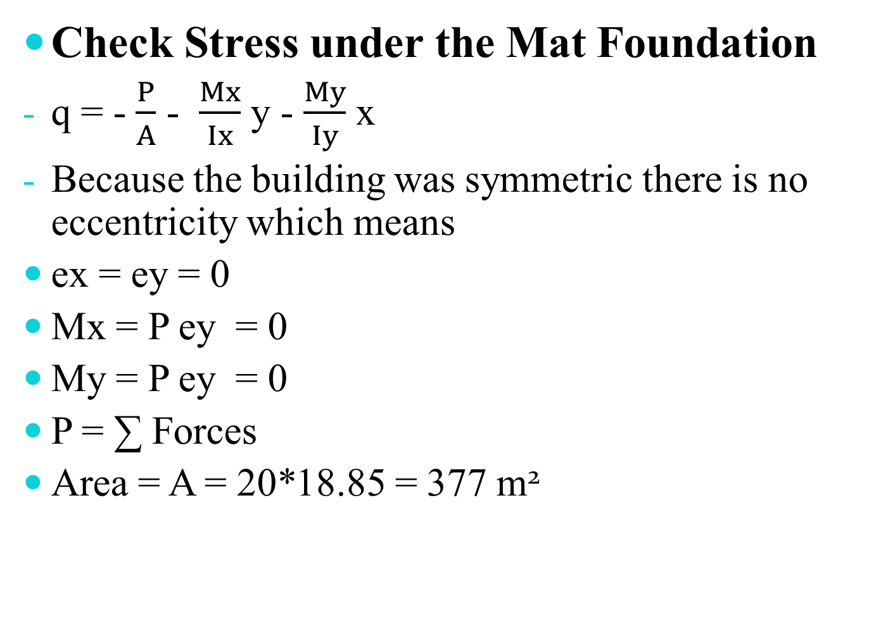
Check Stress under the Mat Foundation
q = - $\frac{P}{A}$ - $\frac{Mx}{Ix}$ y - $\frac{My}{Iy}$ x
Because the building was symmetric there is no eccentricity which means
ex = ey = 0
Mx = P ey = 0
My = P ey = 0
P = ∑ Forces
Area = A = 20*18.85 = 377 m²

Slide 26
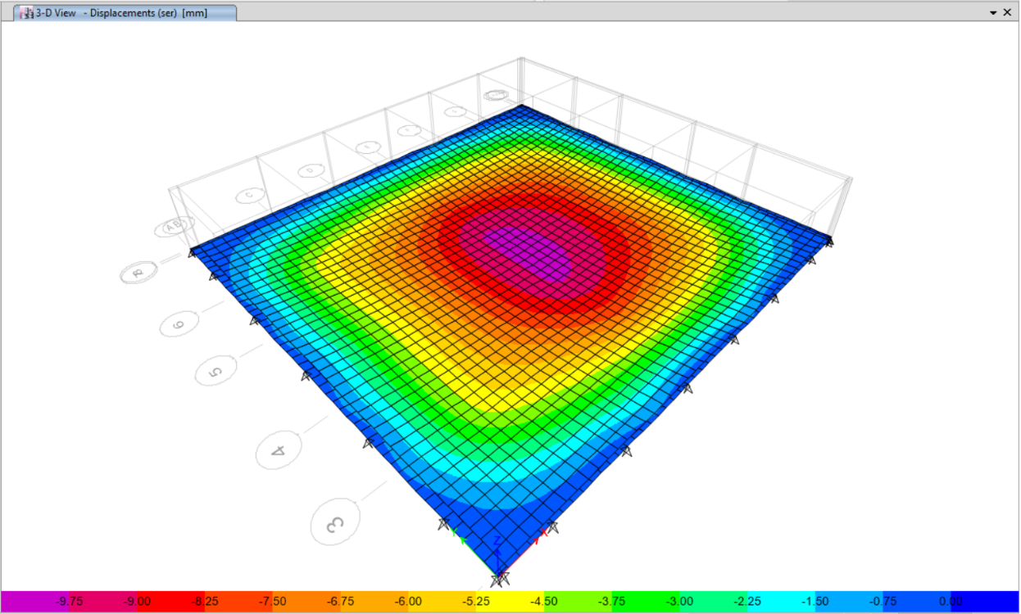
Mat displacement

Slide 27
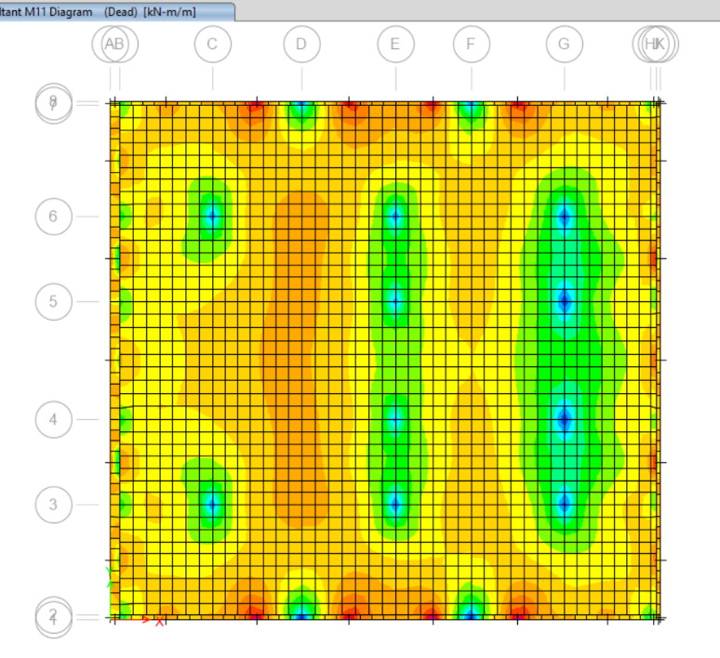
Mat Reinforcement
Calculating the moment in X-direction

Slide 28

Calculating area of steel for M11
For M11
X= 3.7 Y = 14.67 b =3.6m
Xstart = Xend = 2.9
Y start =12.87 Y end = 16.47
M = 3200 KN.m
ρ= $\frac{0.85∗fc^{′}}{fy}\left(1−\sqrt{\frac{2.61∗Mu}{bd^{2}fc^{′}}}\right)$
ρ= 0.00198< ρmin
Use ρmin
As =ρbd
As = 0.00333*1000*1100= 3663
# of bars =$\frac{3663}{491}$= 8 bars
1φ25mm/12cm

Slide 29
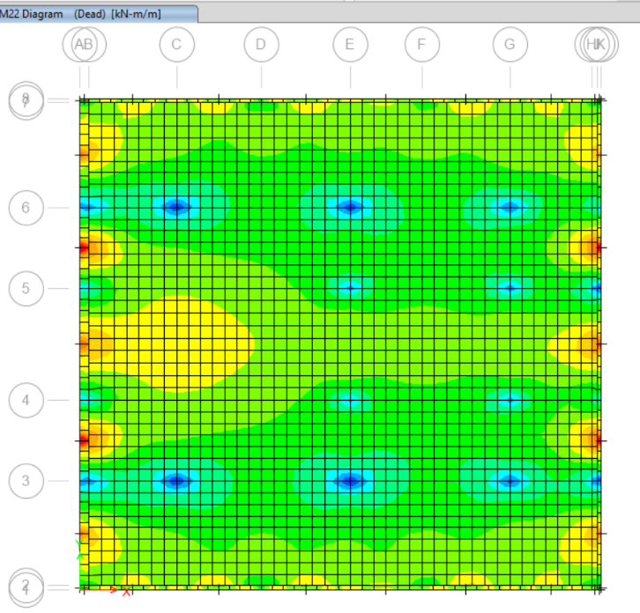
Mat Reinforcement
Calculating the moment in Y-direction to find Area of steel required

Slide 30

Calculating area of steel for M22
For M22
X= 3.7 Y = 14.67 b =3.08m
Xstart = 2.05 Xend = 5.35
Y start = Y end =14.02
M = 3770 KN.m
ρ= $\frac{0.85∗fc^{′}}{fy}\left(1−\sqrt{1−\frac{2.61∗Mu}{bd^{2}fc^{′}}}\right)$
ρ= 0.027< ρmin
Use ρmin
As =ρbd
As = 0.00333*1000*1100= 3663
# of bars =$\frac{3663}{491}$= 8 bars
1φ25mm/12cm

Slide 31
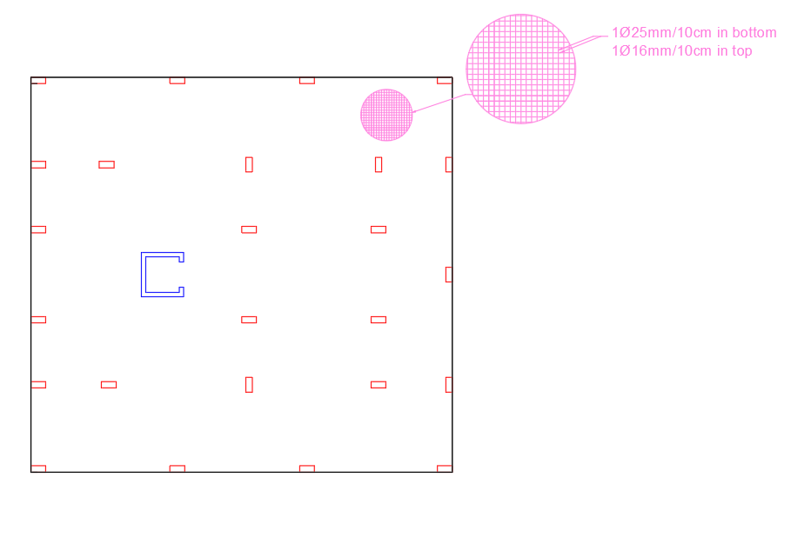
Mat Reinforcement in case of Seismic consideration

Slide 32
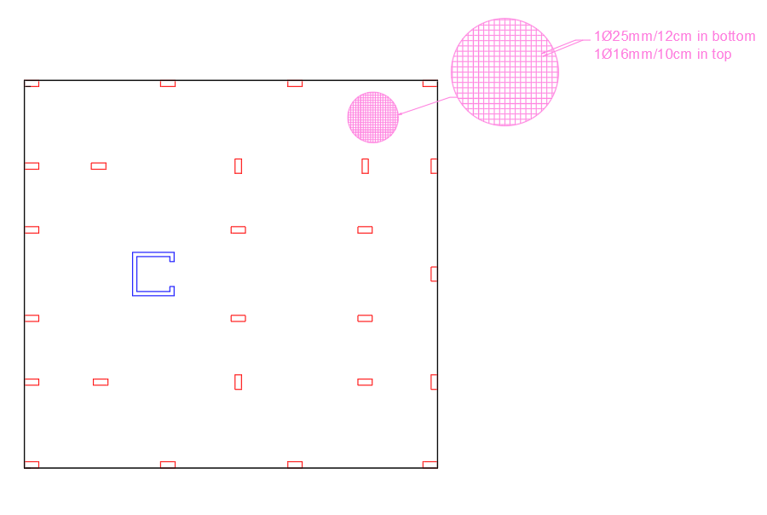
Mat Reinforcement in case of without Seismic consideration

Slide 33
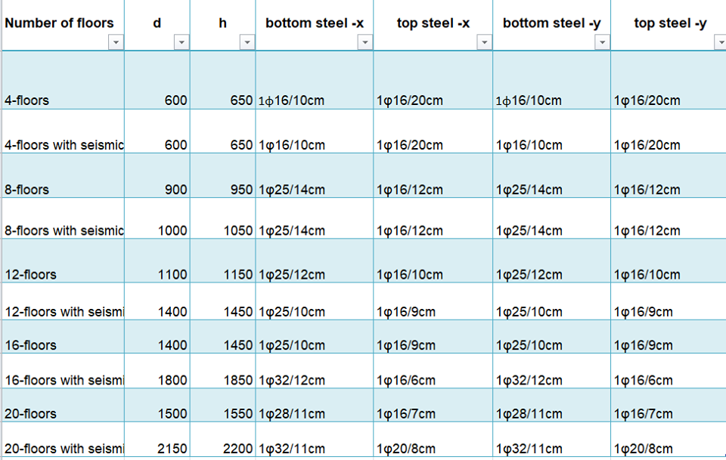

Slide 34
Cost calculations
This is for 8-floor without seismic consideration
Total weight of steel = 17983 kg
Steel price = 50352.98 Nis
Volume of concrete = 245m³
Concrete price = 36750 Nis
Total price = 87103 Nis

Slide 35
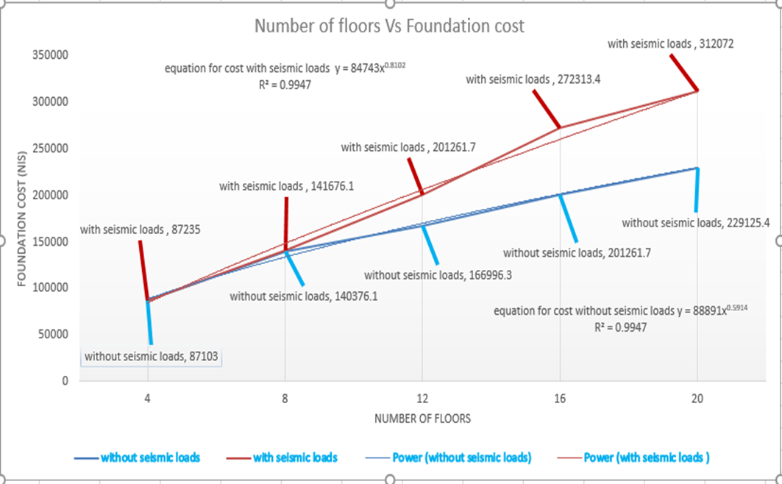
Cost calculations

Slide 36
Recommendations
Soil Improvement
The characteristic of the soil can be improved in many ways, the most common way is compaction by adding base course with good characteristics and compact it.
2. Mat Foundation
The effect of the earthquake can be reduced at the edges of the mat foundation by adding 20 cm reinforced concrete around the mat.

Slide 37
3. Number of floors
Depend in the study of the soil in eastern region of Nablus at Al-Hisbeh Street , it is recommended that the height of the building around eight floor because the effect of the earthquake is minimum which is almost constant till eight floor, after that steep increase in the effect of the earthquake.

