Slide 1

An-Najah National University
Faculty of Engineering
Hydrologic and Drainage Problem of Marj Sanour
Prepared by : Ahmad Atta Abd Alghany
Abdulaziz H. hussain
Under the direction of:
Dr. Hafez Q. Shaheen

Slide 2
Agenda
Methodology
Problem definition
Objective
Data collected
Proposed solution
Selection
Data analysis
Design selective solution
Relative works
Summary

Slide 3
Methodology
Problem definition
Propose solutions
Objective
Ponds
wells
Pump
Selection
Data Analysis
Design
Relative works

Slide 4
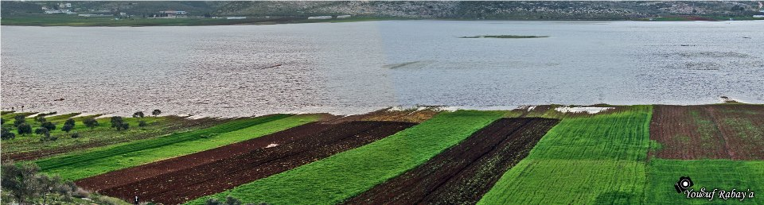
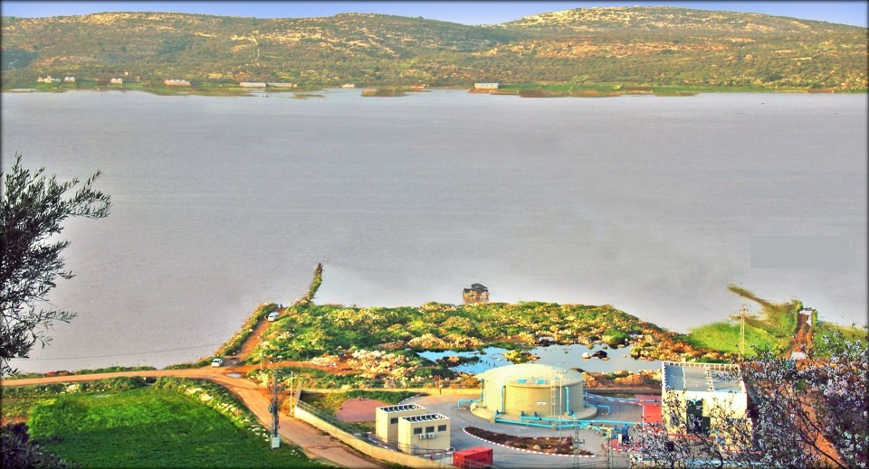
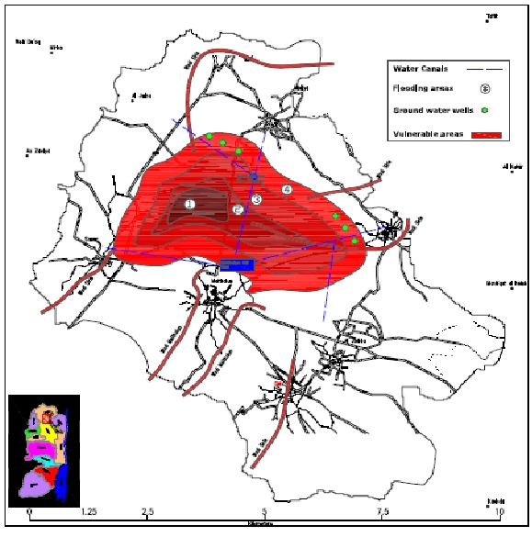
Problem Definition

Slide 5
Problem Definition
Farmers’ opinions about the flood of Marj Sanour
معارض بشدة% | معارض% | محايد% | موافق % | موافق بشدة% | الفقرة
- | 2.0 | - | 39.4 | 58.6 | غرق المرج يشكل مشكلة اقتصادية للمزارعين
- | 1.0 | 0.3 | 41.4 | 57.3 | غرق المرج يشكل مشكلة بيئية للمزارعين
- | 0.7 | 0.3 | 42.3 | 56.7 | غرق المرج يحدث في وقت يؤدي إلى خسارة العمل المستثمر
- | 1.6 | 0.3 | 42.7 | 55.4 | غرق المرج أدى إلى أضرار صحية
- | 1.6 | 0.7 | 39.7 | 58.0 | غرق المرج أدى إلى خسارة البذار والتقاوي
- | 2.0 | 0.1 | 52.1 | 45.8 | غرق المرج مرتبط عادة بانجراف التربة في الجبال
- | 3.3 | 0.9 | 41.4 | 54.4 | غرق المرج يؤدي إلى خسارة الأسمدة الكيماوية والعضوية المضافة
1.4 | 10.7 | 2.3 | 14.3 | 71.3 | ترى بأن الزراعة حالياً في المرج لا تحقق عائداً اقتصادياً مجدياً
- | 3.9 | 6.6 | 41.0 | 48.5 | تعتقد بأن حل مشكلة غرق المرج من الأولويات لديك
98% of the farmers think flooding problem causing economical issues.

Slide 6
Objectives
Studying a deferent solutions to the flood problem.
Select the best solution which serve public sector.
Find the best investment for the flooded water.
Enhance the agricultural sector of Marj Sanour.

Slide 7
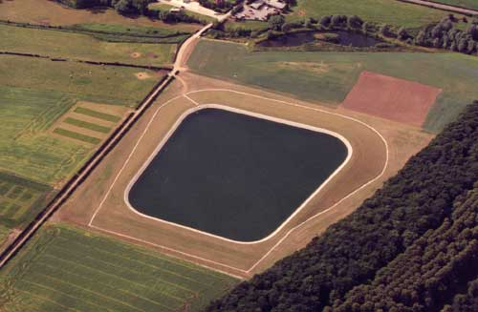
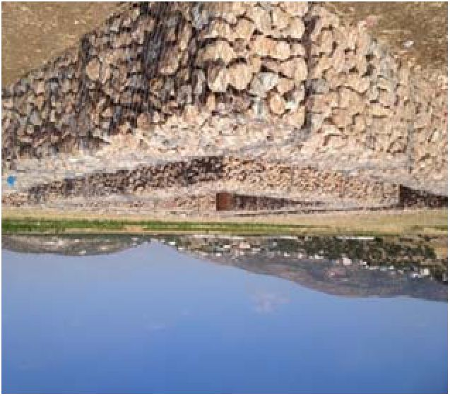
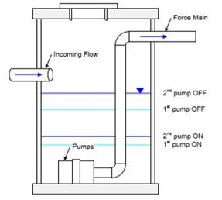
Proposed Solutions

Slide 8
Water collection ponds
Literature review
Meteorological information
Vesting site

Slide 9

Literature review
Water budget:
Storage = Income – Outcome
Design flood :
Plotting position based on weibull method
P = $\frac{m}{n+1}$ , T=1/P
Where:
p is probability of exceedance , m : rank , n : number of annual rain fall data.
T is retain period

Slide 10
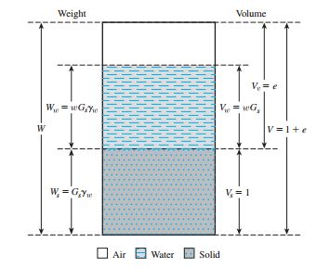
Literature review
Soil Weight volume relationships:

Slide 11
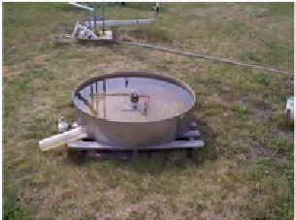
Literature review
Evaporation pan test

Slide 12
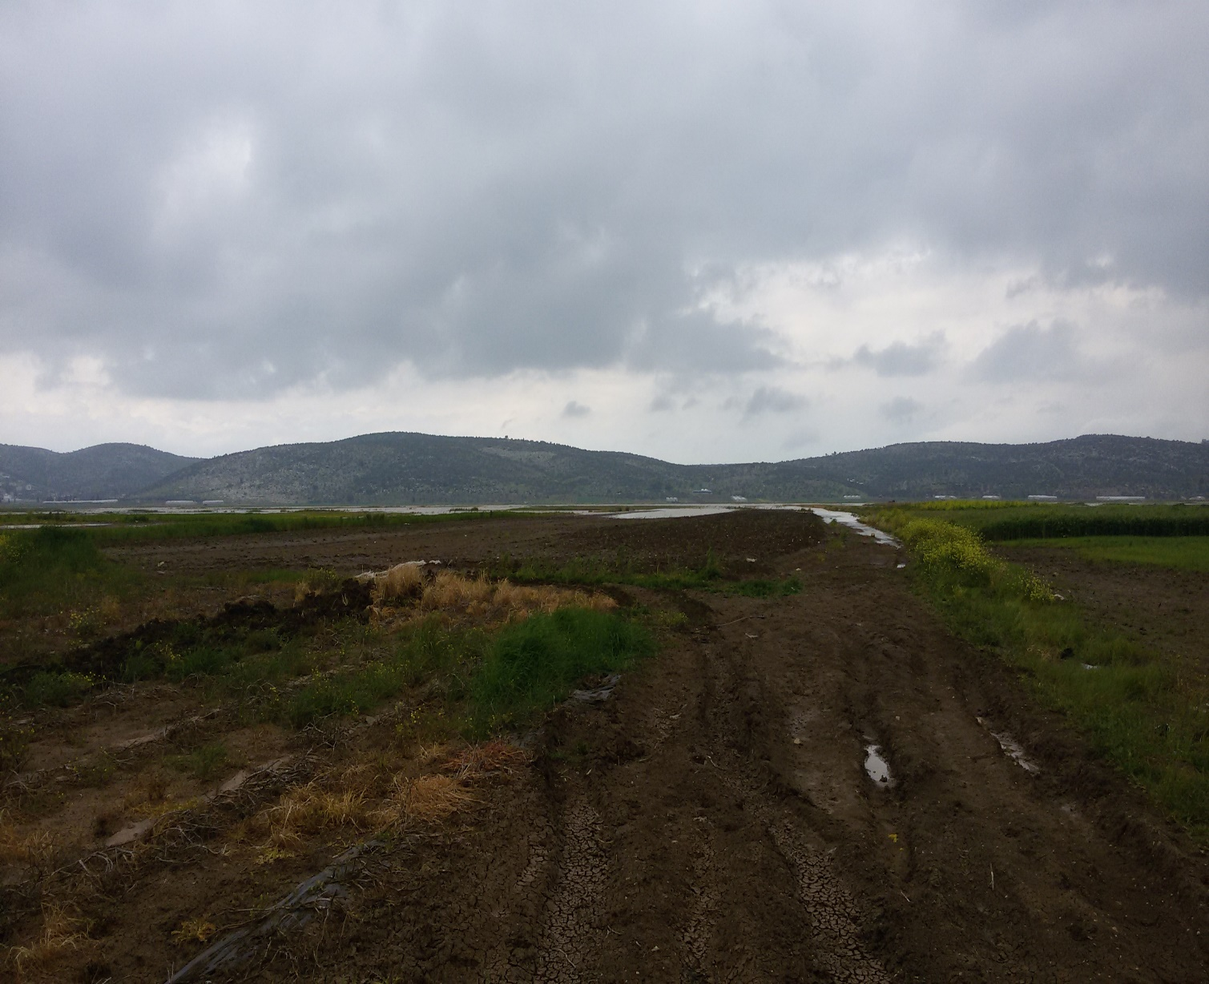
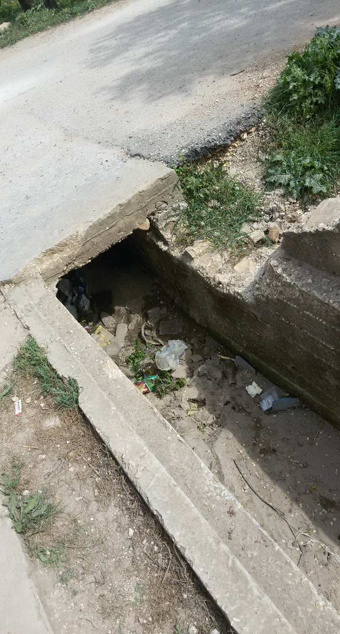
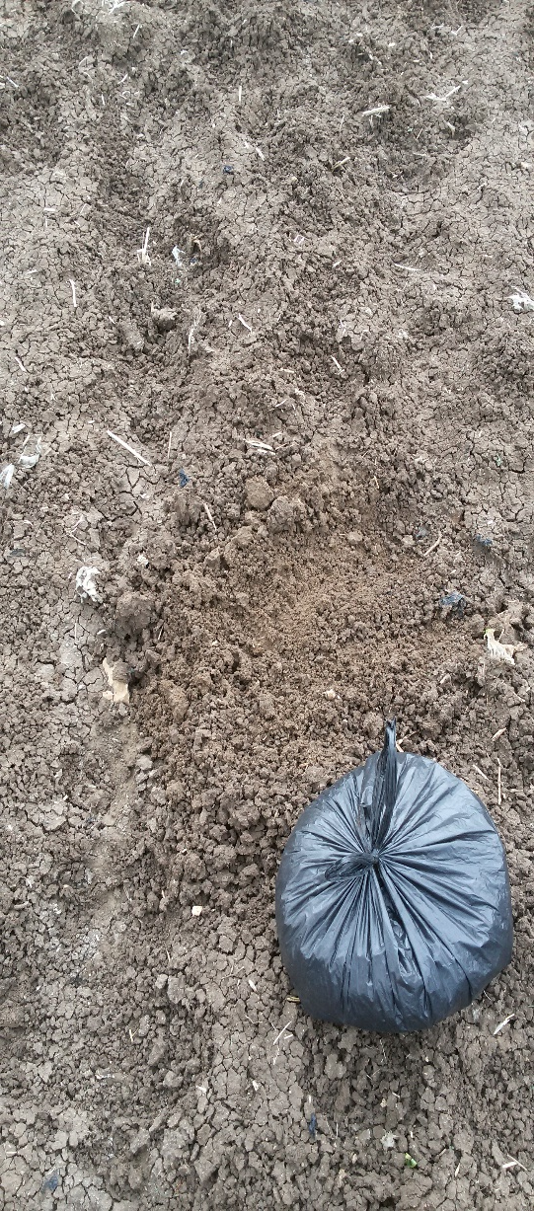
Viseting site

Slide 13
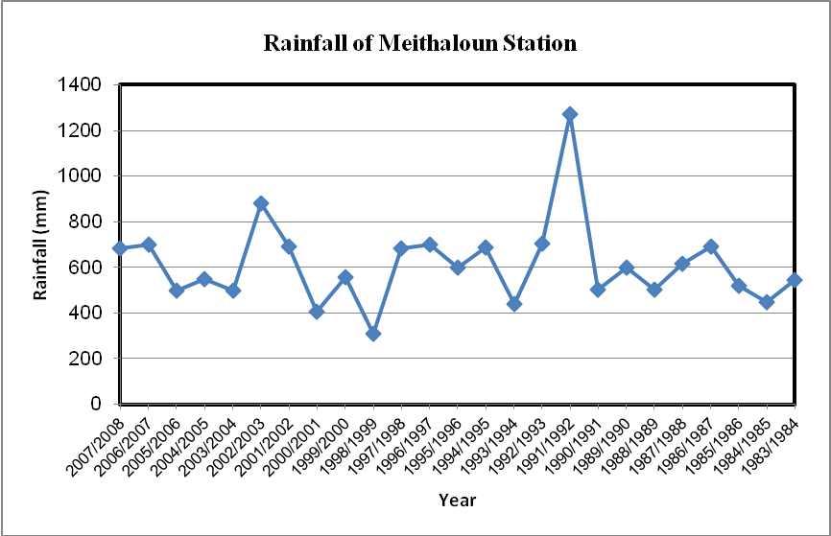
Meteorological Data

Slide 14
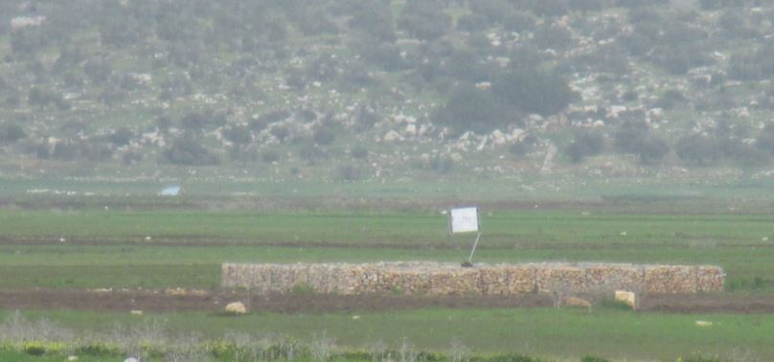
Artificial Recharge
Two injection wells were constructed by P.H.G
Recharge test capacity was conducted
8033 m³/d
1104 m3/d

Slide 15
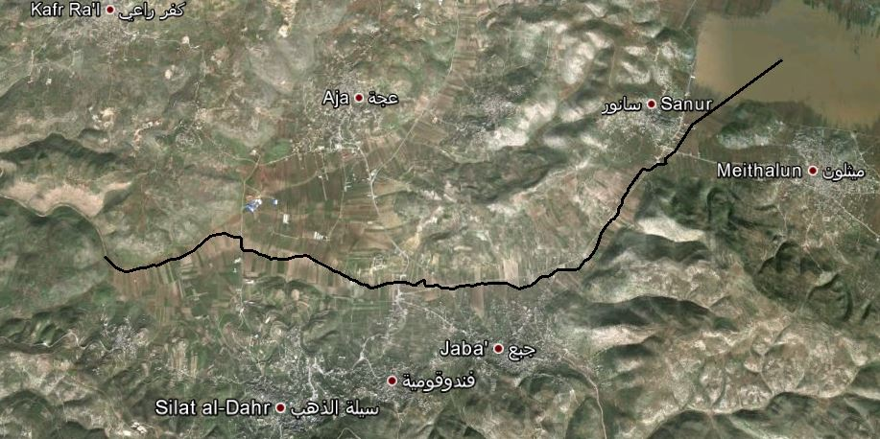
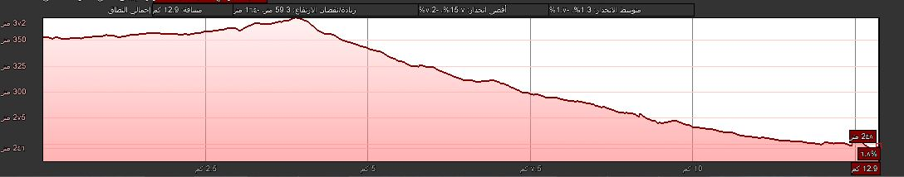
Pumping Water to nearbay Wadi
Wadi Massen
II
I
III

Slide 16
Selection
Multiple Criteria Decision Method
Criteria | Score | Weight (%) | A |  | B |  | C
Economic | 10 | 5 | 1 | 5 | 5 | 25 | 8 | 40
Social | 60 | 30 | 8 | 240 | 6 | 180 | 2 | 60
Environmental | 40 | 20 | 6 | 120 | 8 | 160 | 1 | 20
Political | 10 | 5 | 8 | 40 | 5 | 25 | 1 | 5
Agricultural | 80 | 40 | 9 | 360 | 6 | 240 | 1 | 40
Total | 200 | 100 | 765 |  | 630 |  | 165
A: water collection pond, B: Artificial Recharge, C: Pumping Water to Wadi.
Grades: (1-10) : 1 is bad and 10 is good .

Slide 17
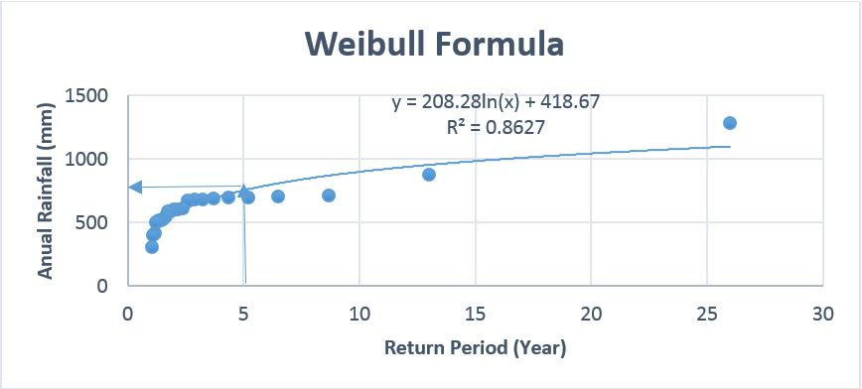
Data Analysis
Storage = Input - Output
700
20% probability of exceedance 5 years return period

Slide 18
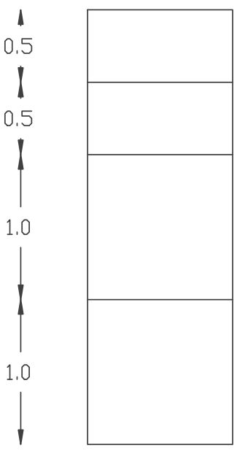


Data Analysis
Storage = Input - Output
w% = 10
n= 0.49
$w_{av}$%= 30 and
$n_{av}$= 0.42
w% = 30
n= 0.45
Available free water = (0.42- 0.3)*3= 0.36
w% = 35
n= 0.40
We take it 350 mm
So
R = P – 350 = 700 – 350 = 350 mm
where R: runoff, P: rainfall
w% = 35
n= 0.40

Slide 19
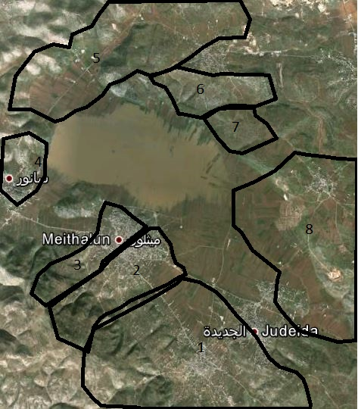
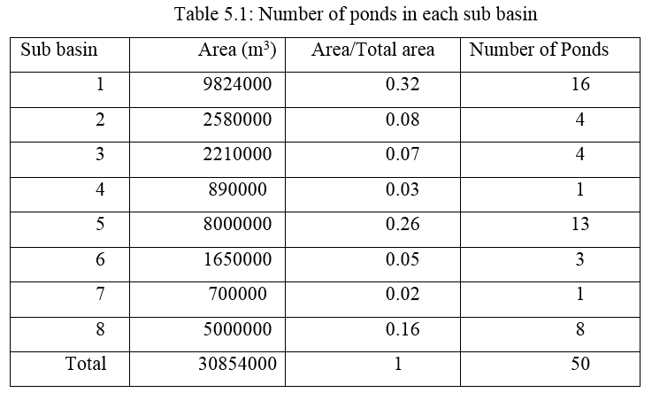
Data Analysis
Storage = Input - Output
5
6
7
4
8
3
2
1

Slide 20
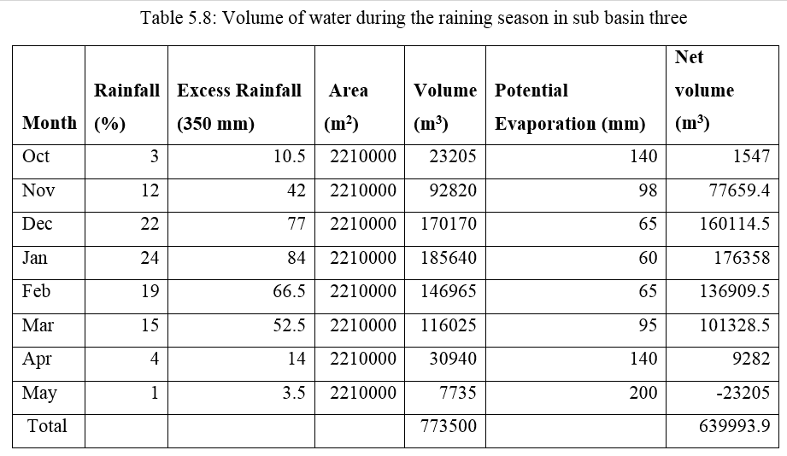
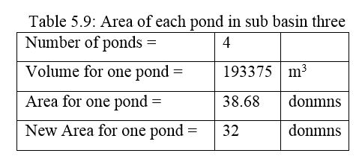
Data Analysis
Storage = Input - Output

Slide 21
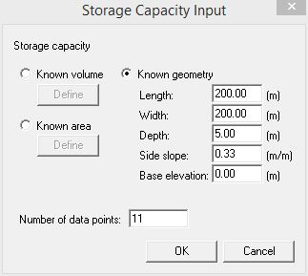
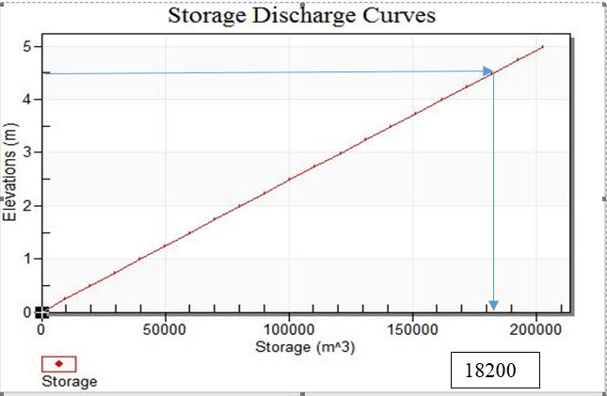
Design of a typical pond

Slide 22
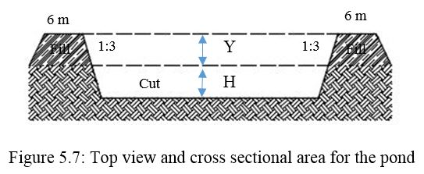
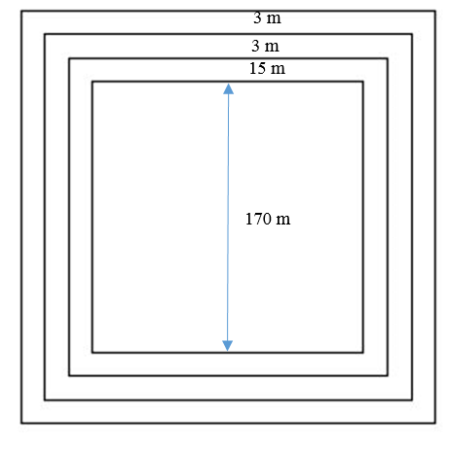
Design of a typical pond

Slide 23
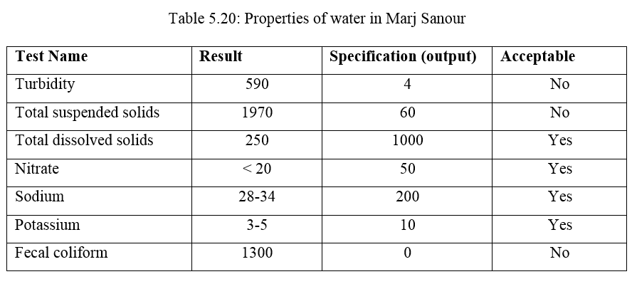
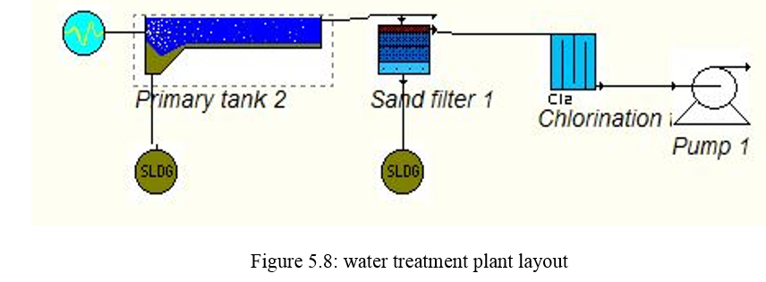
Relative works

Slide 24
Summary and conclusion
Data have been collected about the study area that is Marj Sanour. These data have been analyzed in order to identify the problems related to the drainage problem. It was reported by Ministry of Agricultural that the ponds solution will be done in the next 2 years. An artificial recharge option was designed by PHG to solve the Marj problem by constructing a two test boreholes in 2013. The design involved geometric and filter system. A third alternative has been suggested at the end of this report which involves pumping the flood water out of the Marj.
The cost analysis in this project was obtained from an engineer who have sufficient experience in the calculation and processing of quantities and prices.
The two main software programs used in this project is CIVIL3D and Google Earth Pro.

Slide 25
The End
Thank you
Questions???

