Slide 1

Jamati
Supervisor:Dr.Ashraf Armoush
Malik Ali & Shaheen Abbas

Slide 2
Overview:
Introduction.
Tools and technologies.
Features.
Future Work.
Question & Answer.

Slide 3

Introduction:
What is jamati.
Statement of problem.
Objectives of work.

Slide 4
What is jamati:
Mobile Application.
Website

Slide 5

Statement of Problem:
Many students struggle to find diverse and creative project ideas.
Challenges in locating suitable courses related to their majors

Slide 6

Objectives:
Enable universities students to: :
Share projects with peers.
Communication and real-time chatting.
Enroll in courses that align with their academic goals

Slide 7








Tools and Technologies:
Backend:
Frontend:

Slide 8
Features

Slide 9
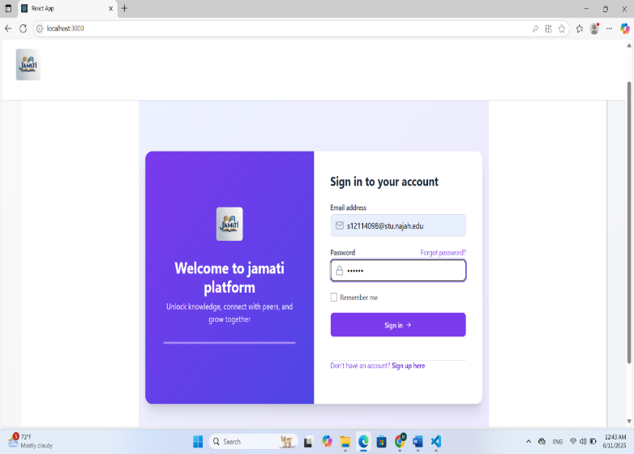
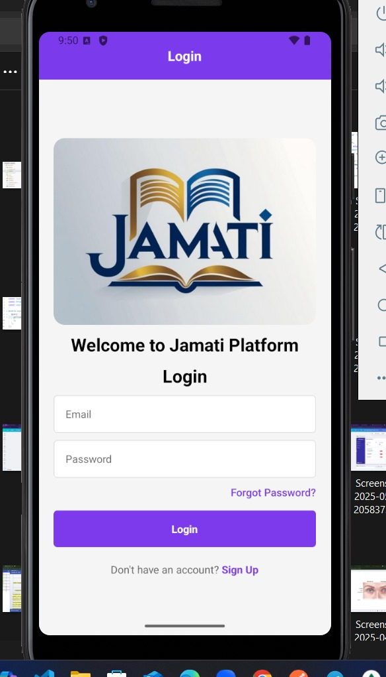
Log in & Welcome Screen

Slide 10
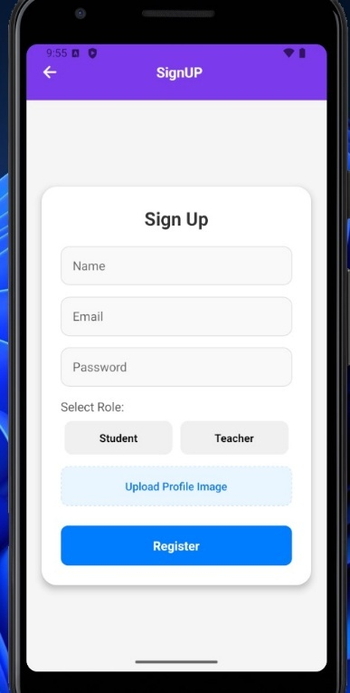
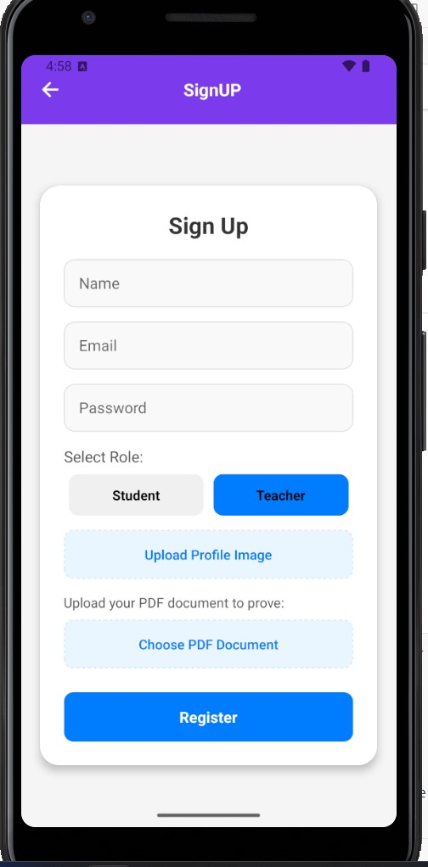
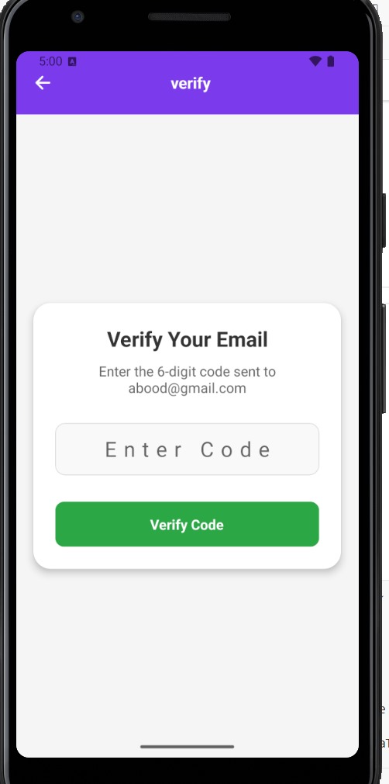
Registration

Slide 11
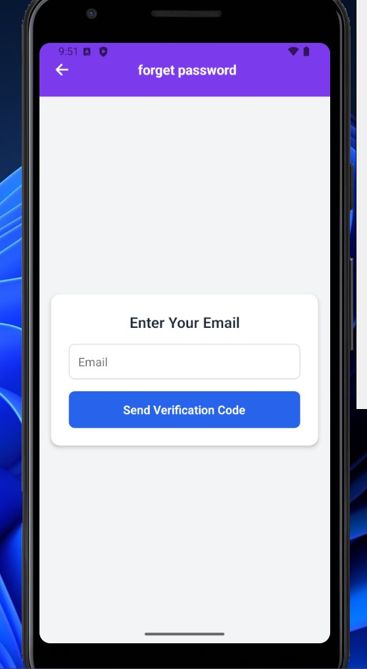
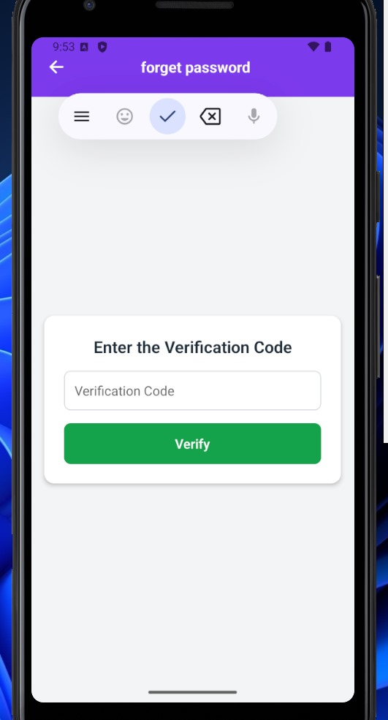
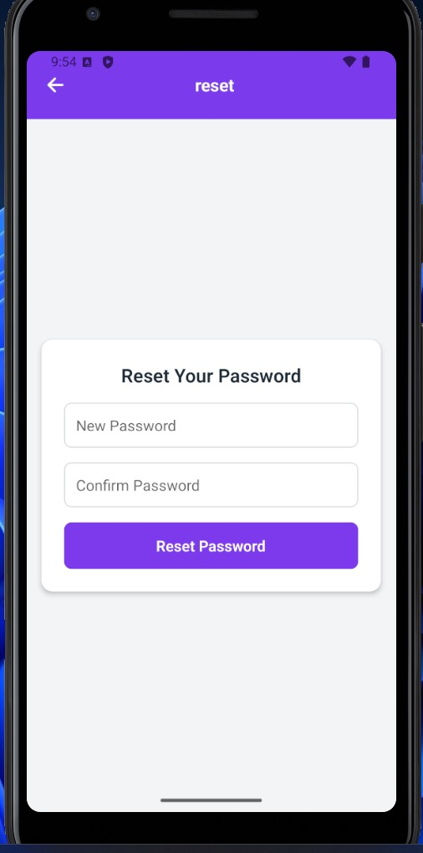
Forgot Password

Slide 12
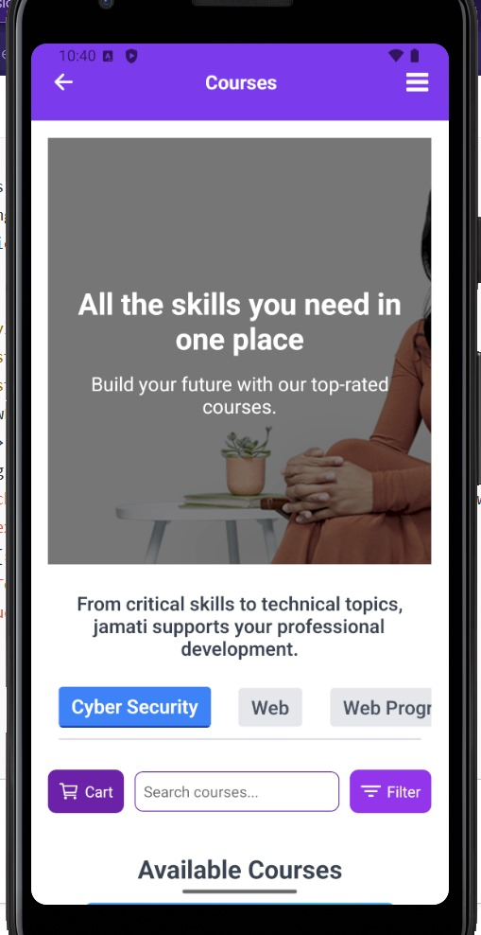
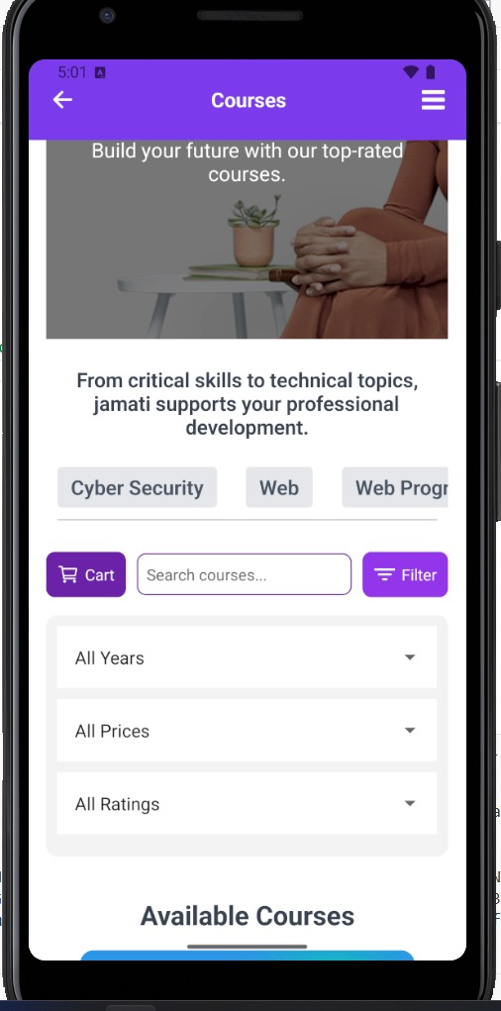
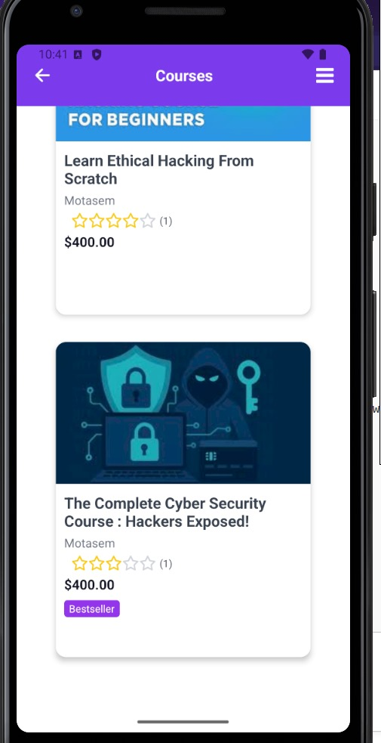
Courses
Main Screen

Slide 13
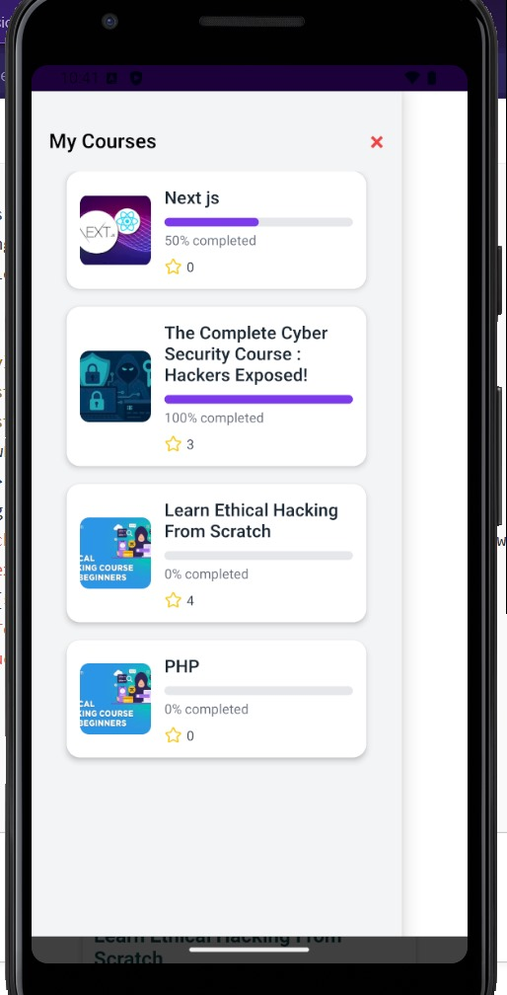
Cart
Courses

Slide 14
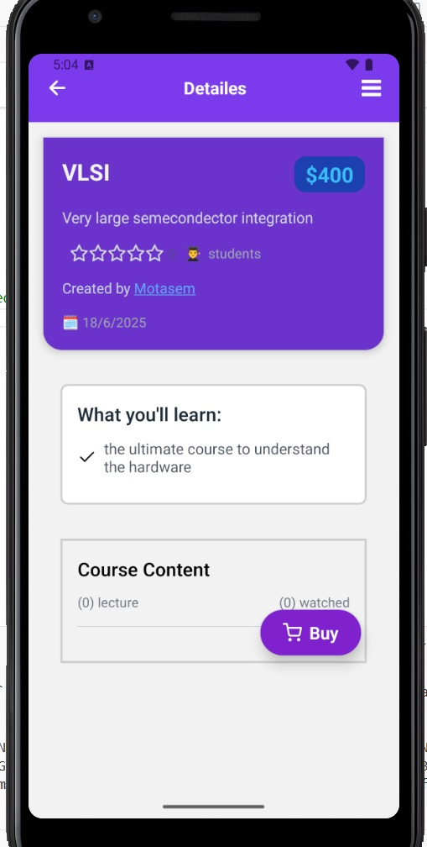
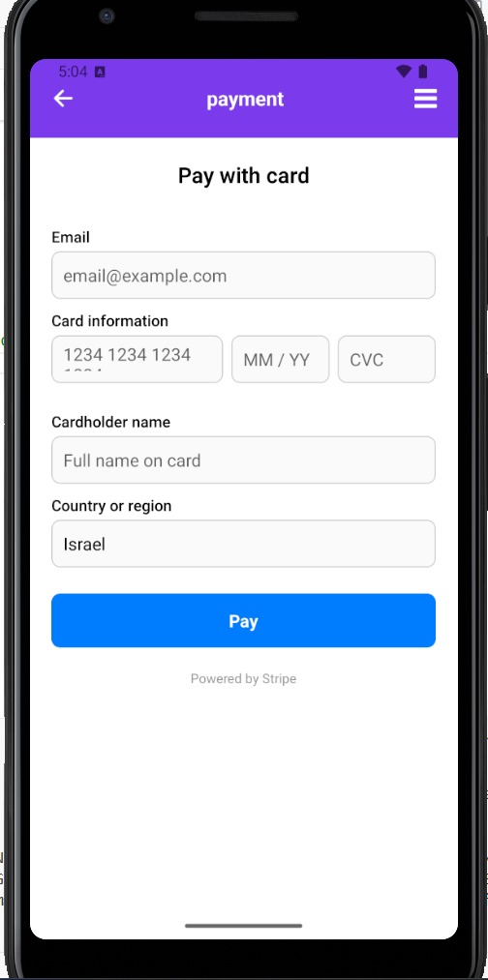

Payment Screen
Courses

Slide 15
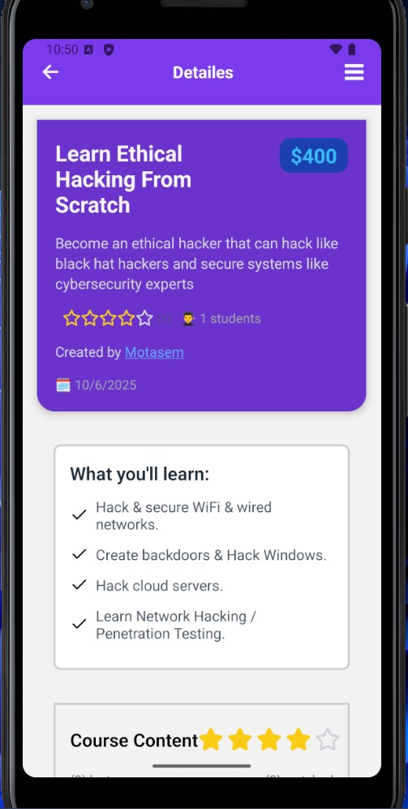
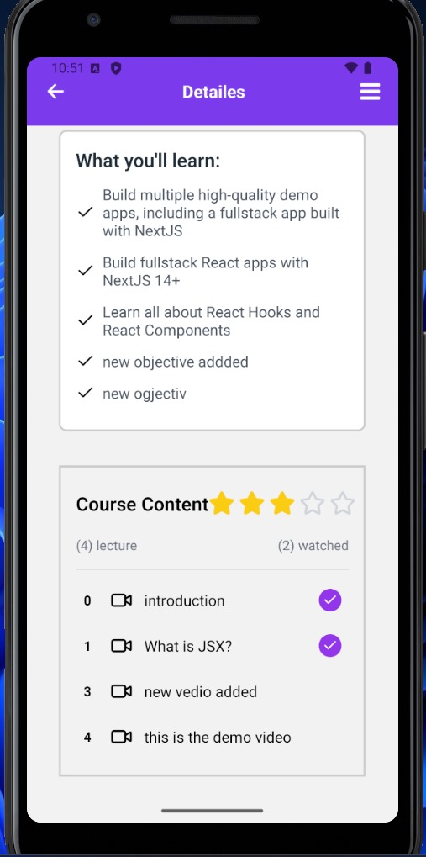
Course Details Screen
Courses

Slide 16
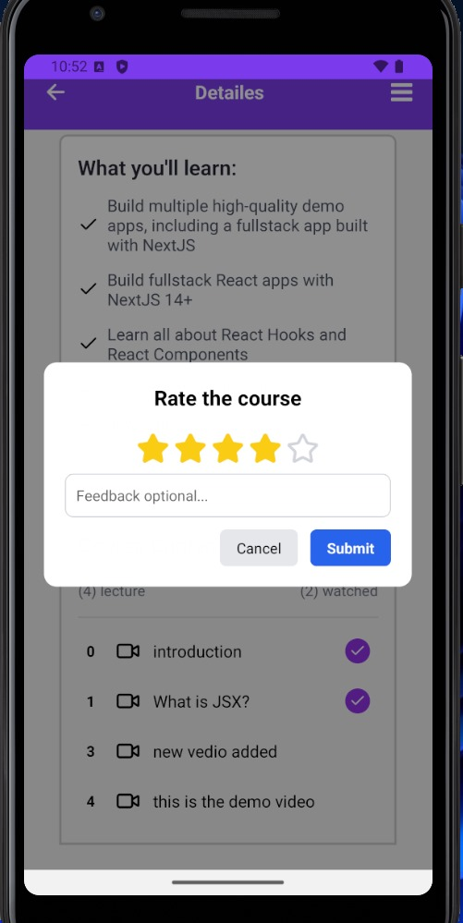
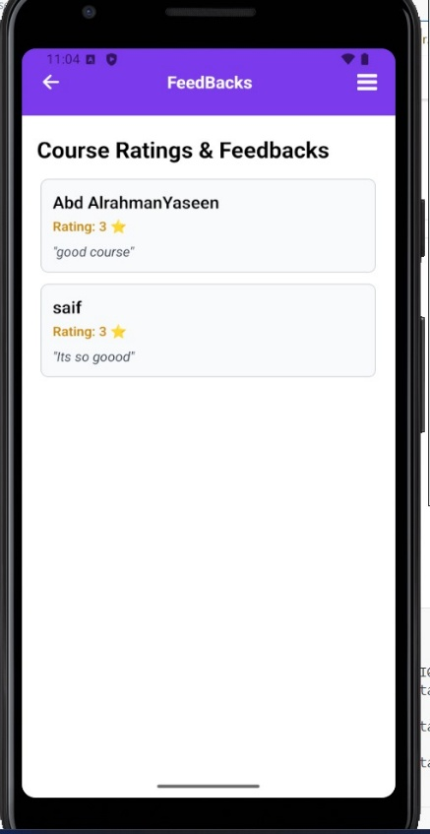
Course Rating& Feedbacks Screen
Courses

Slide 17
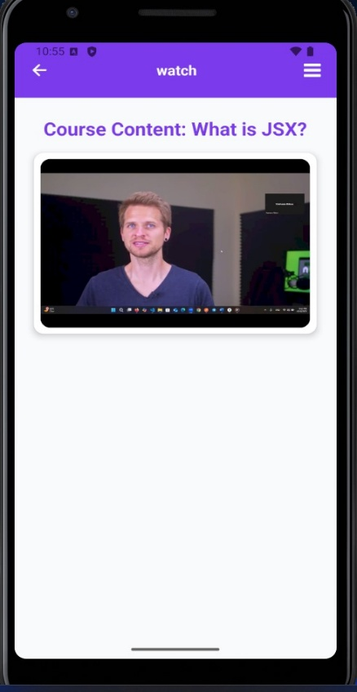
Courses
Watch Screen

Slide 18
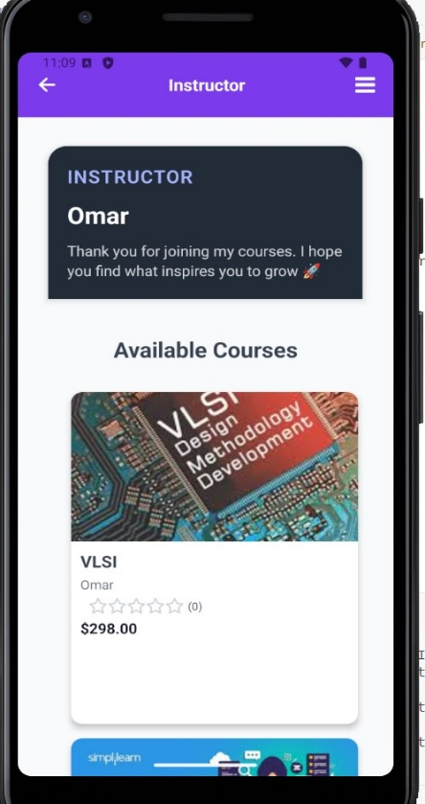
Courses
Instructor Courses Screen

Slide 19
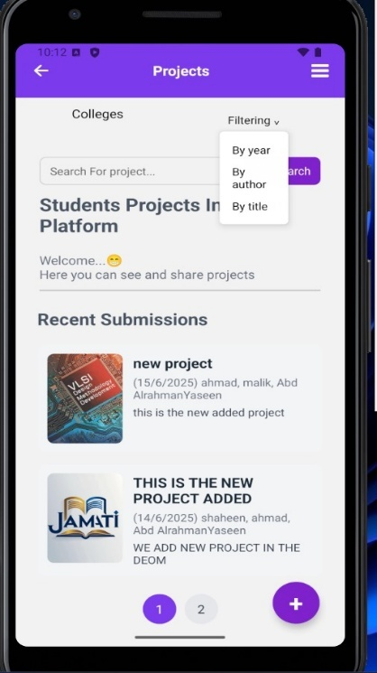
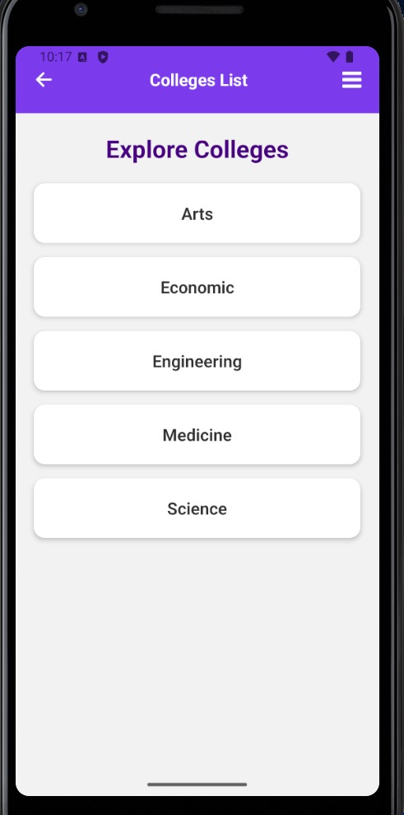
Projects
Main Screen

Slide 20
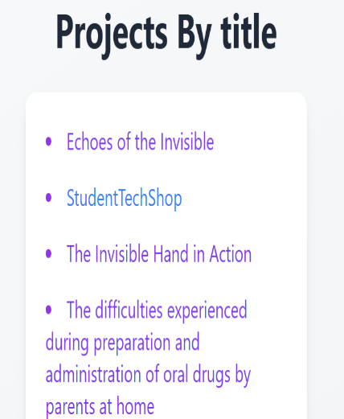
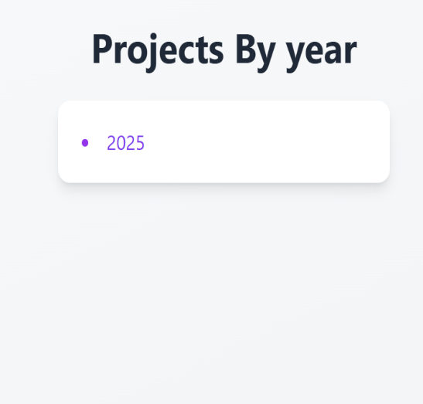
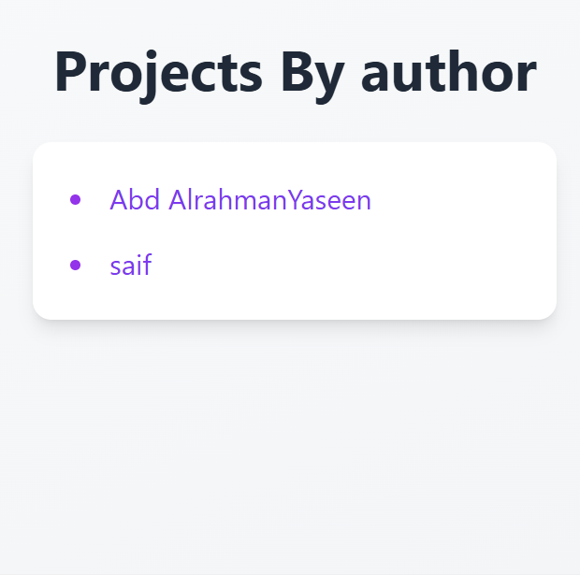
Projects
Filters Lists Screen

Slide 21
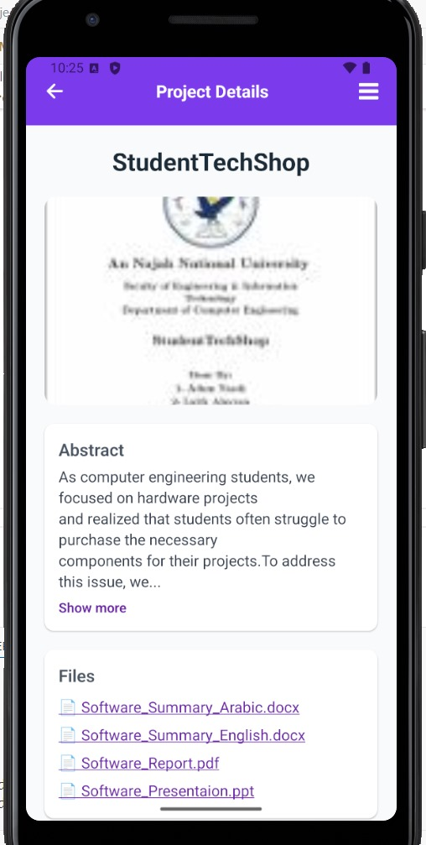
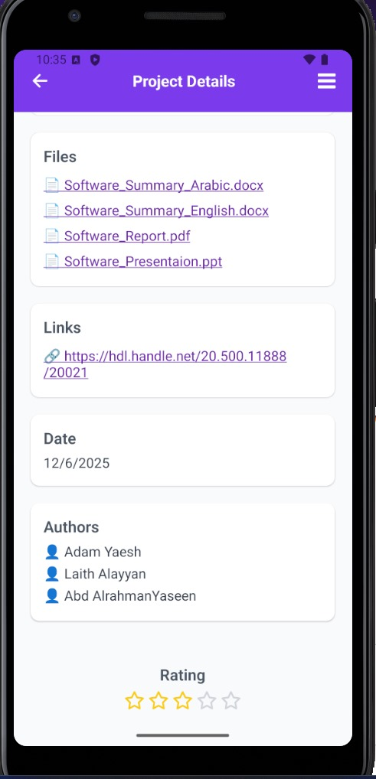
Projects
Project Details Screen

Slide 22
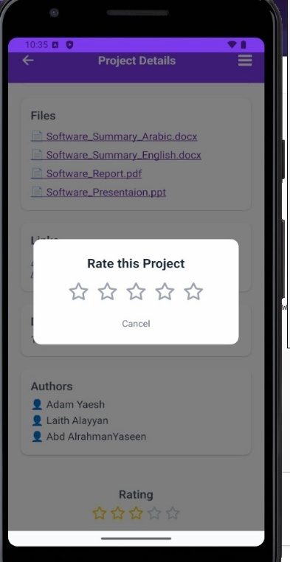
Projects
Rate Project

Slide 23
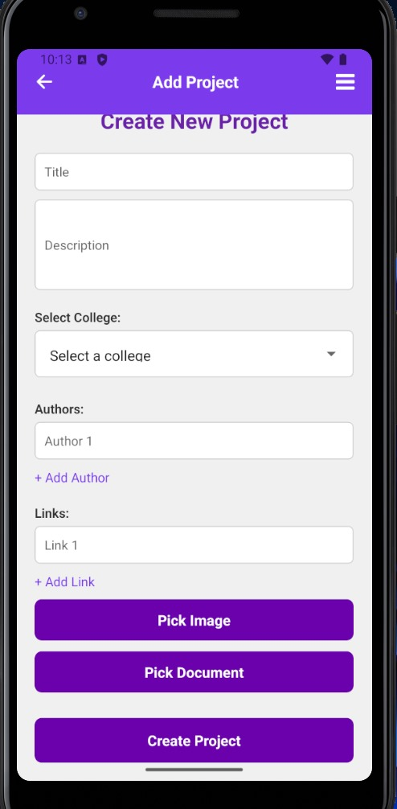
Create Project Screen
Projects

Slide 24
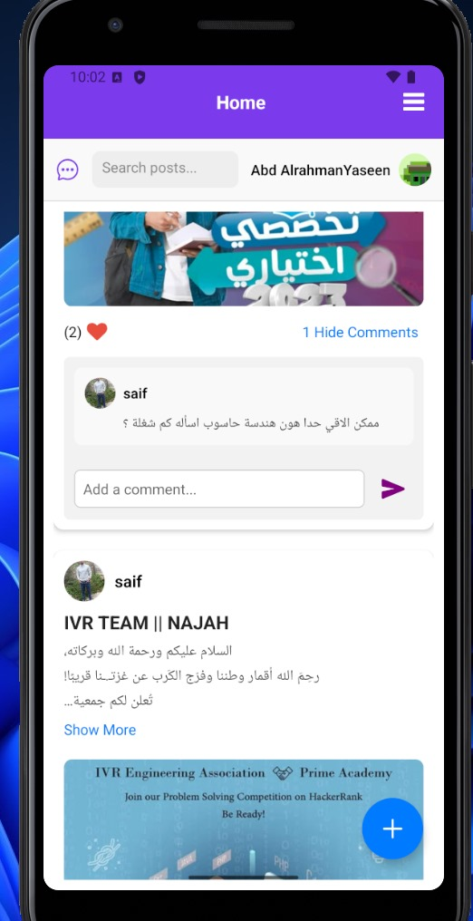
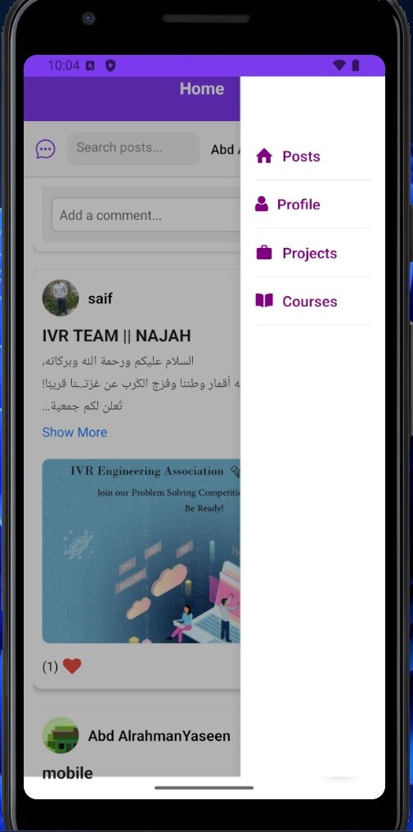
Posts & community
Home Screen

Slide 25
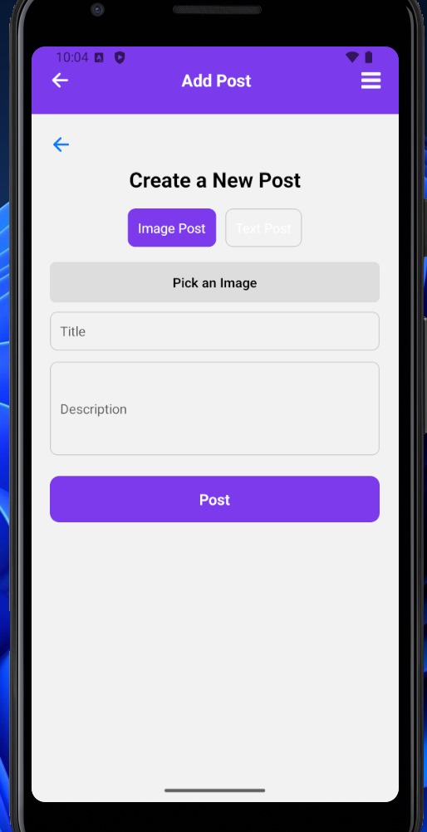
Add Post Screen
Posts & community

Slide 26
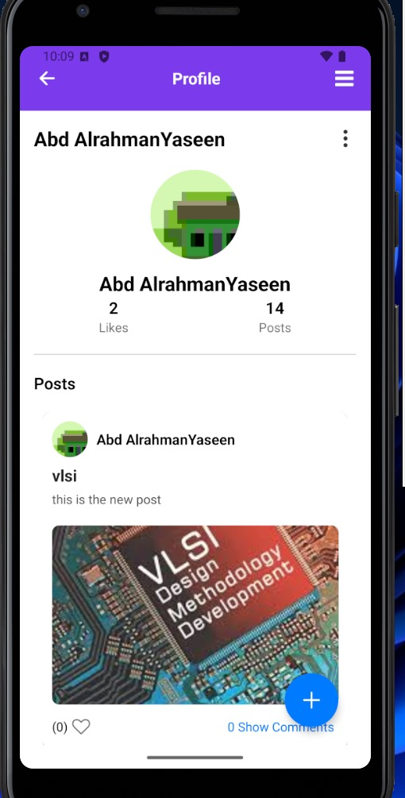
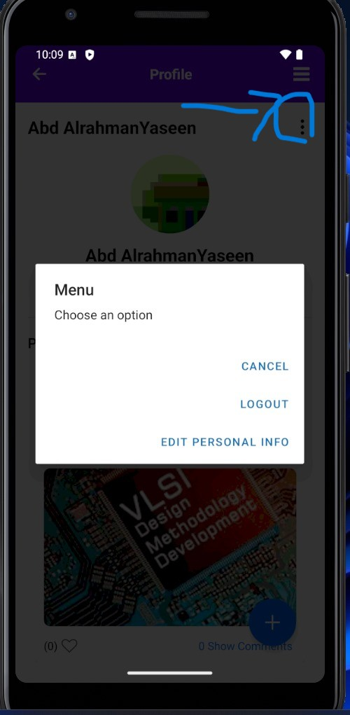
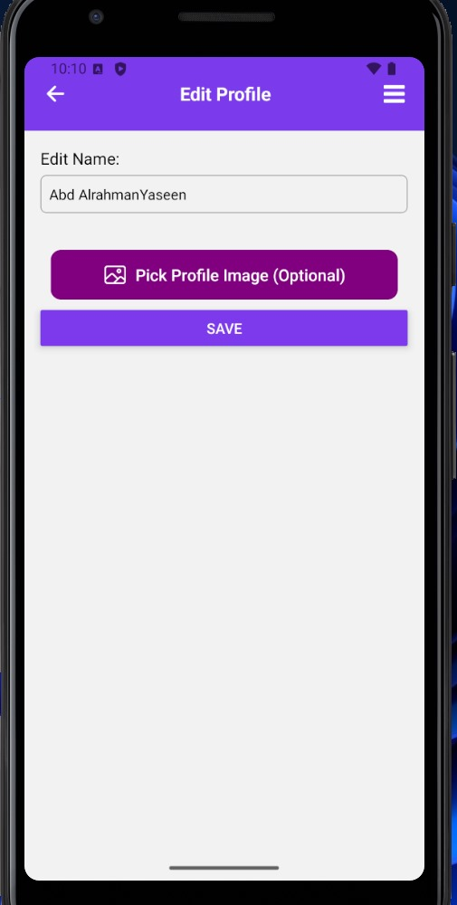
Profile Screen
Posts & community

Slide 27
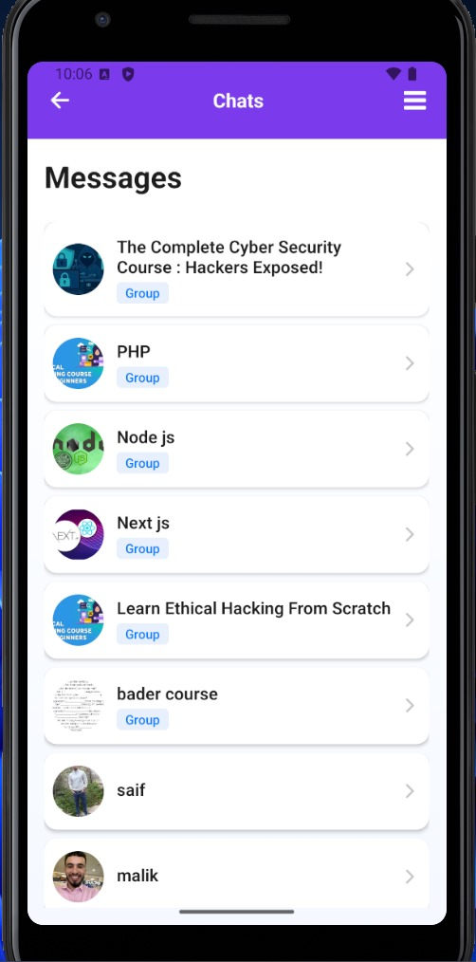
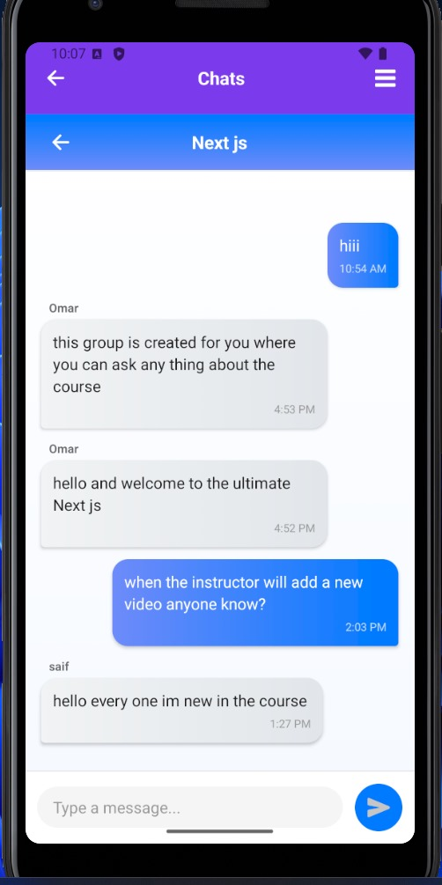
Chatting Screen
Chatting & community

Slide 28

Admin

Slide 29
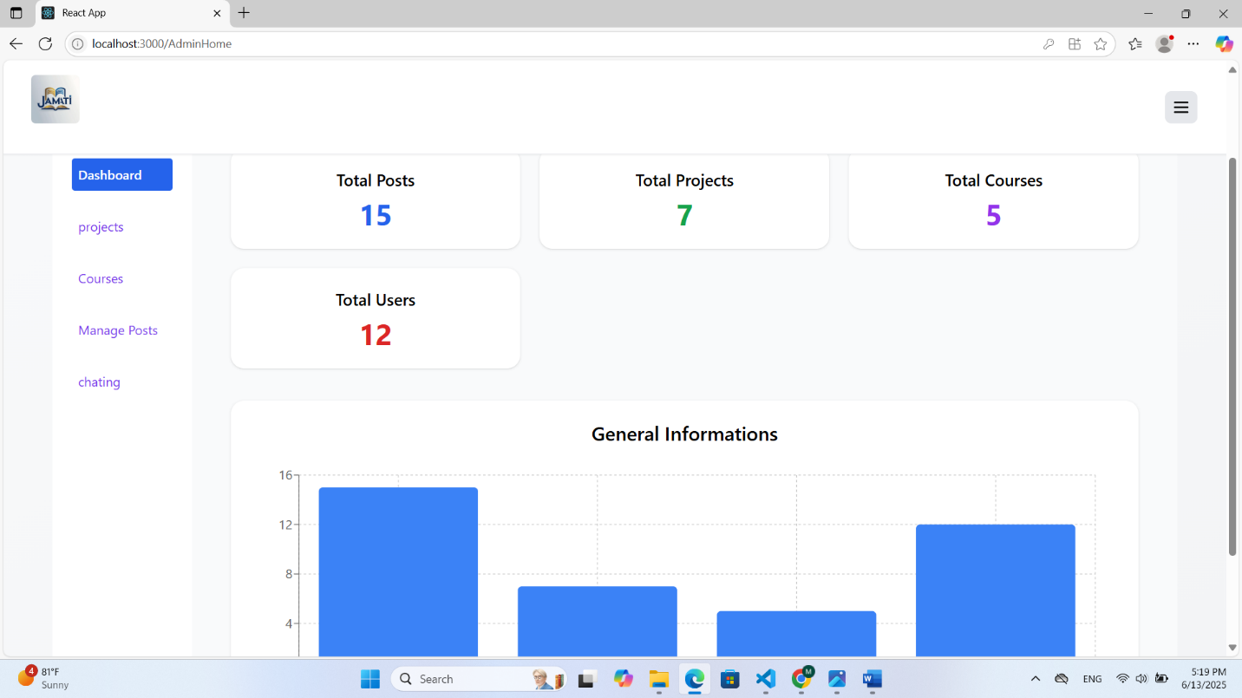
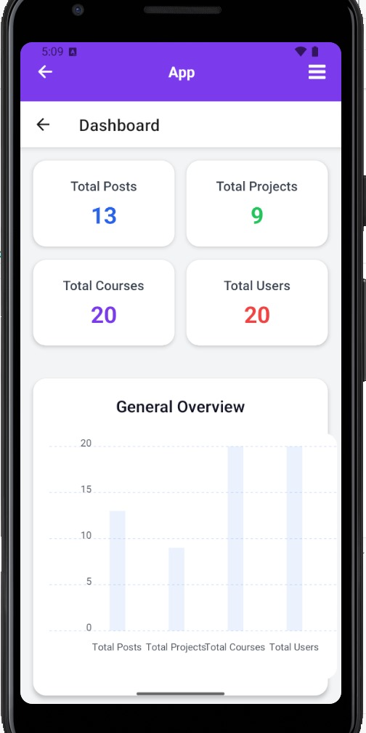
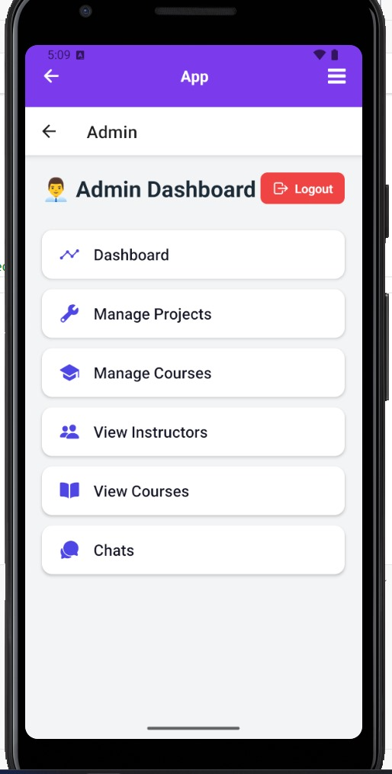
Dashboard Screen
Admin

Slide 30
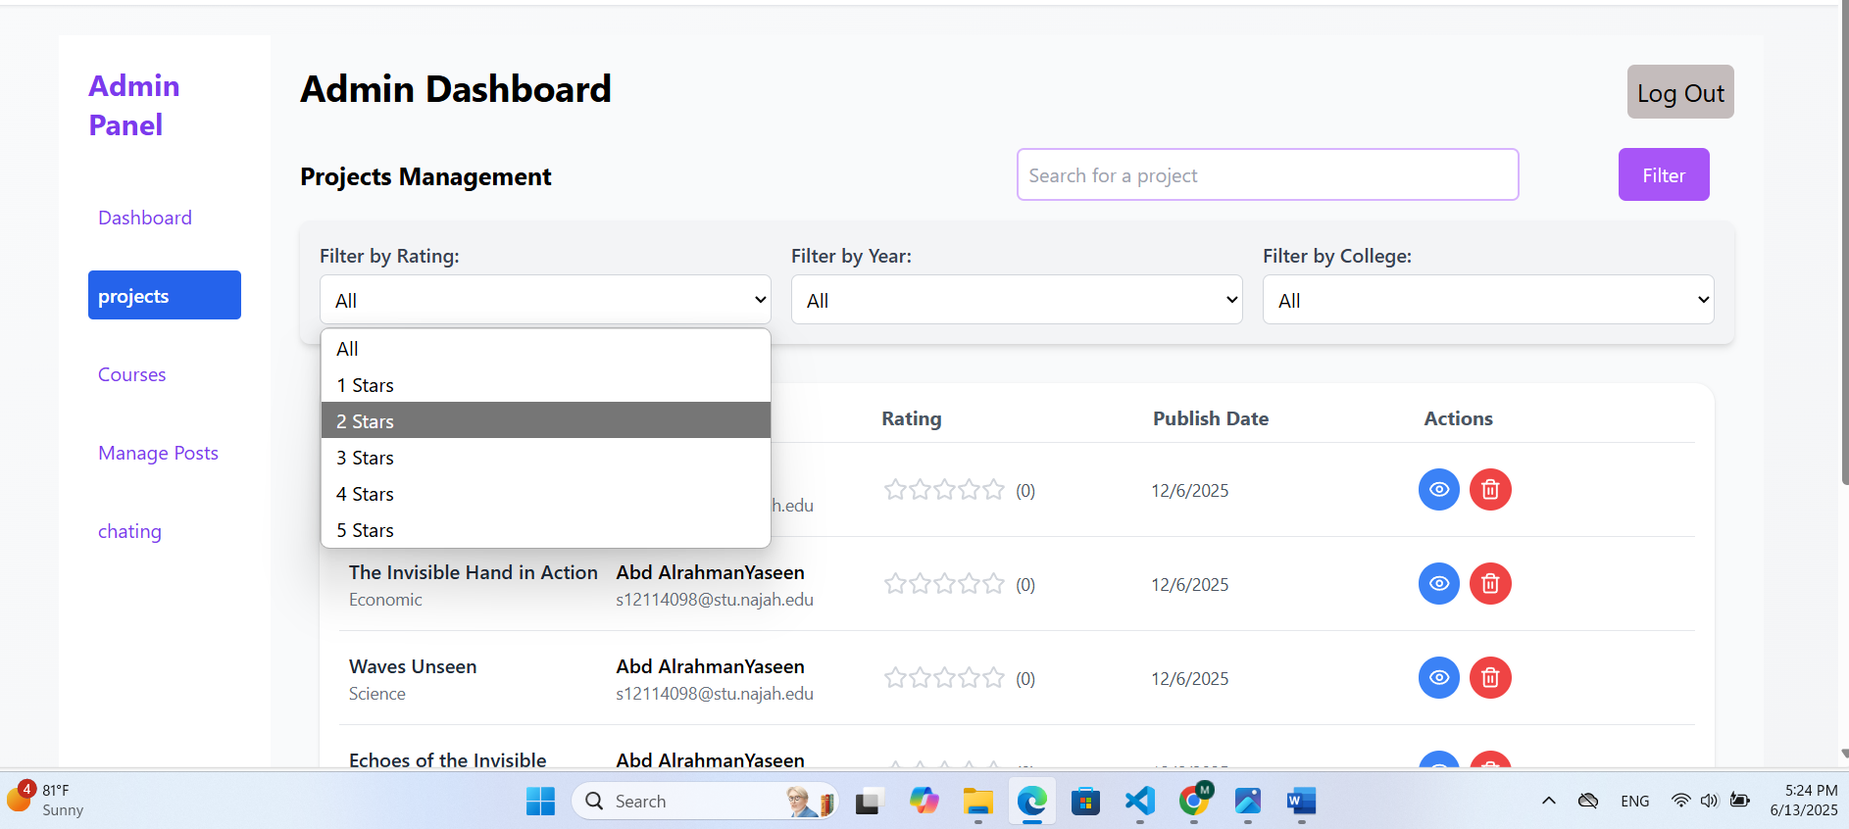
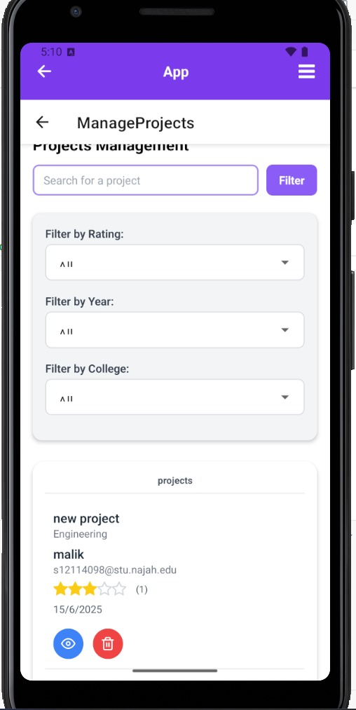
Manage Projects Screen
Admin

Slide 31
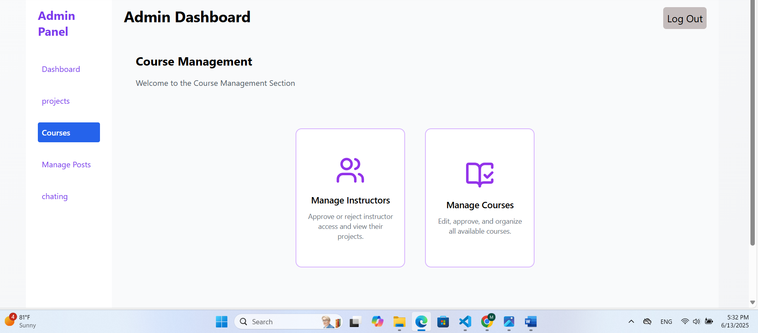
Courses Screen
Admin

Slide 32
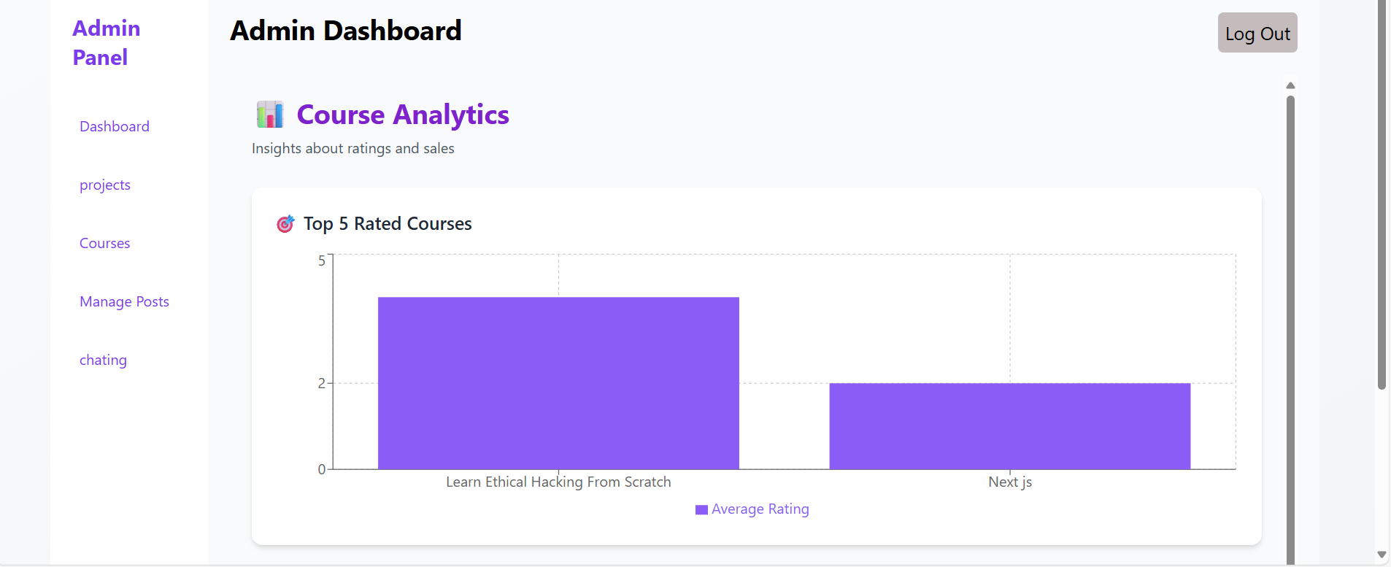
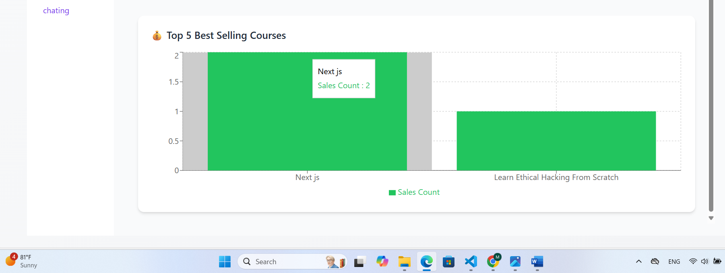
Courses Screen
Admin

Slide 33
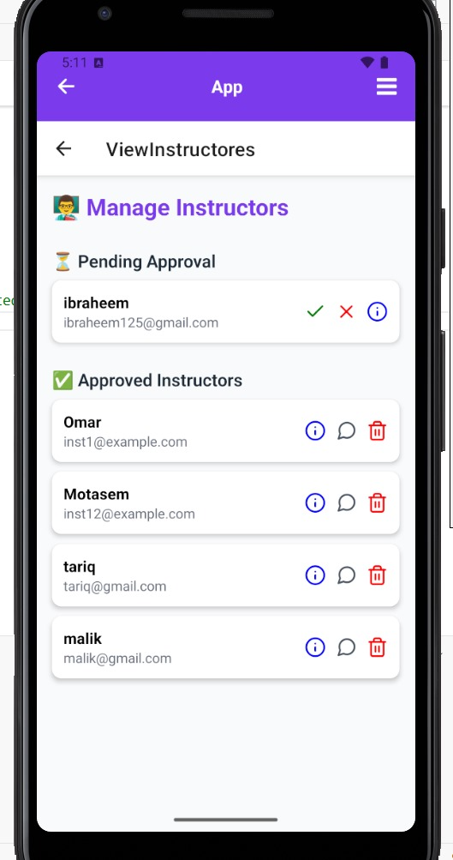
Manage Instructors Screen
Admin

Slide 34
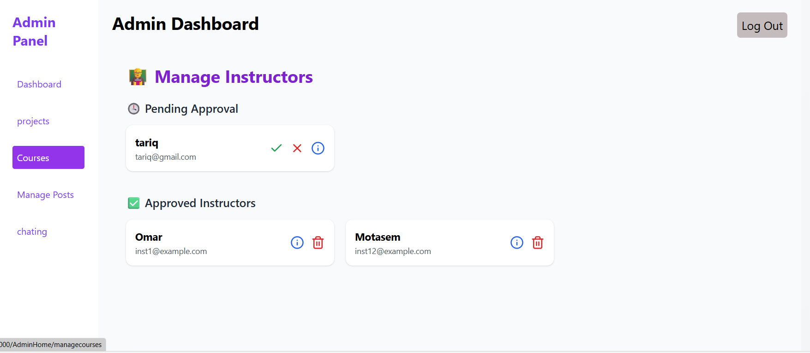
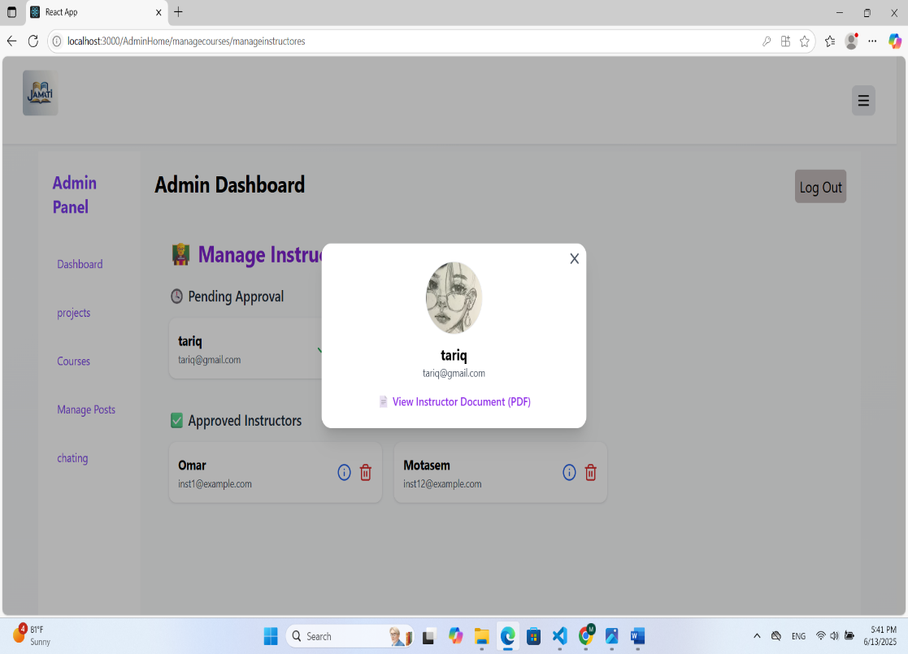
Manage Instructors Screen
Admin

Slide 35
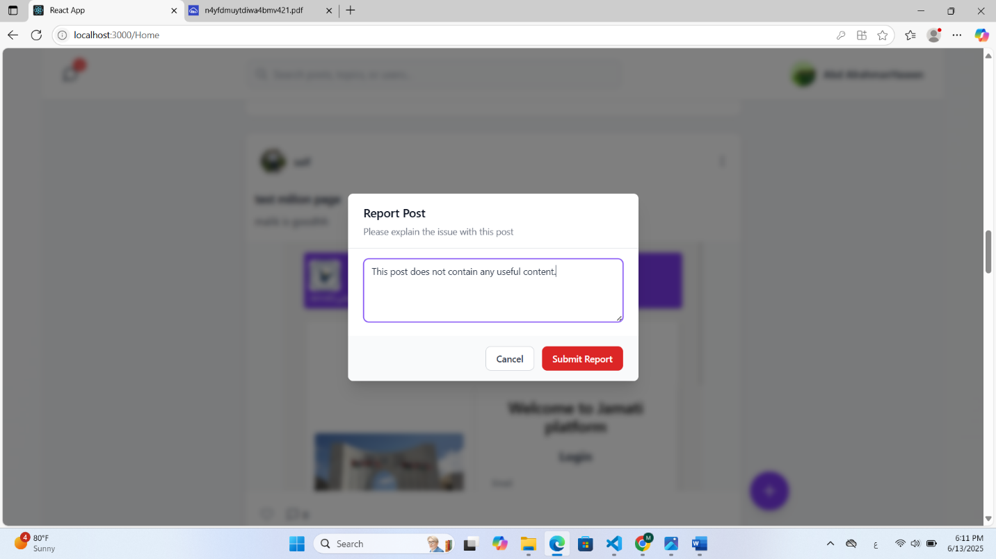
Reported Posts Screen
Admin

Slide 36
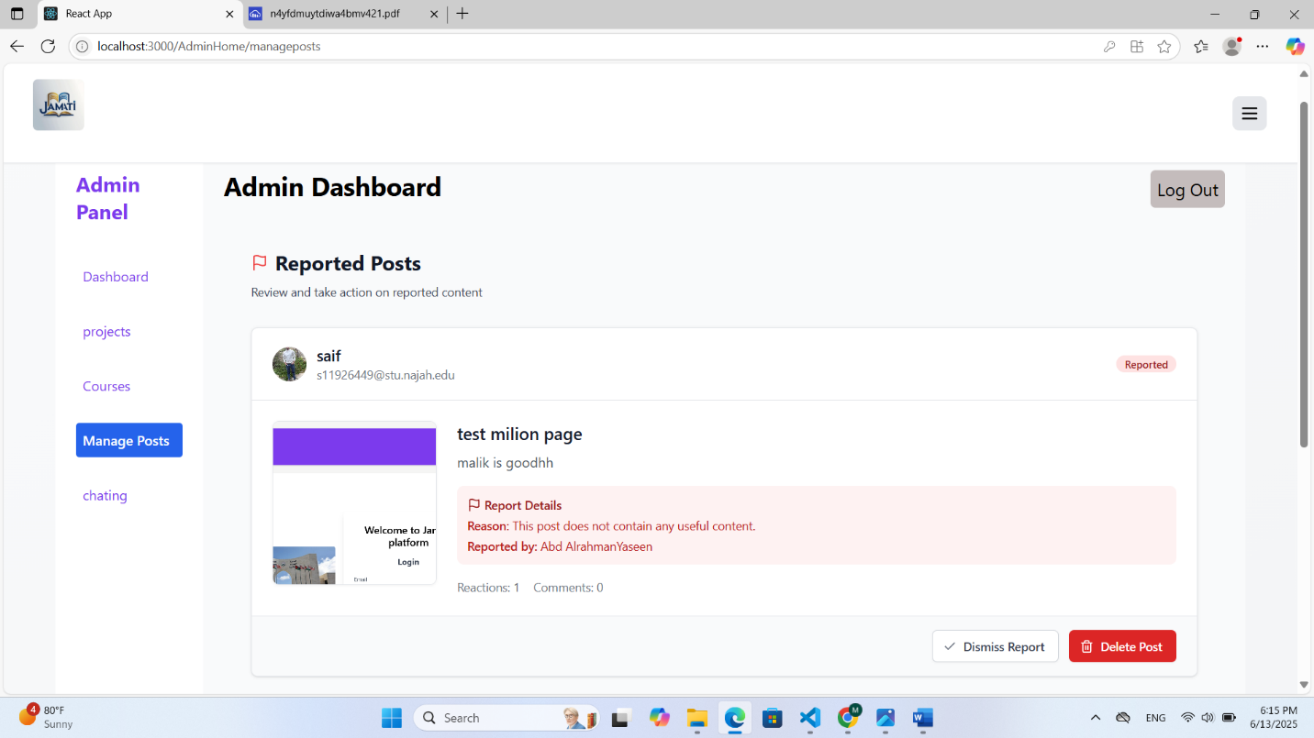
Reported Posts Screen
Admin

Slide 37

Instructor Views
(Web version)

Slide 38

Main Instructor Screen
Instructor

Slide 39

Main Instructor Screen
Instructor

Slide 40


Course Details Screen
Instructor

Slide 41

Course Discount
Instructor

Slide 42

Add New Video
Instructor

Slide 43

Manage Ratings and Feedbacks
Instructor

Slide 44


Add Course Screen
Instructor

Slide 45

Instructor
Edit Course Information's Screen

Slide 46
Students
(Web version)

Slide 47


Courses

Slide 48

Courses

Slide 49


Courses

Slide 50

Courses

Slide 51

Courses

Slide 52


Courses

Slide 53


Courses

Slide 54

Projects

Slide 55

Projects

Slide 56

Projects

Slide 57


Projects

Slide 58


Projects

Slide 59


Posts

Slide 60

Posts

Slide 61

Posts

Slide 62

Chatting

Slide 63

Chatting

Slide 64
Future Work:
AI Based Course Recommendation.
Advanced Project Filtering.
Course Subcategories.

Slide 65
Thank you

