Slide 1

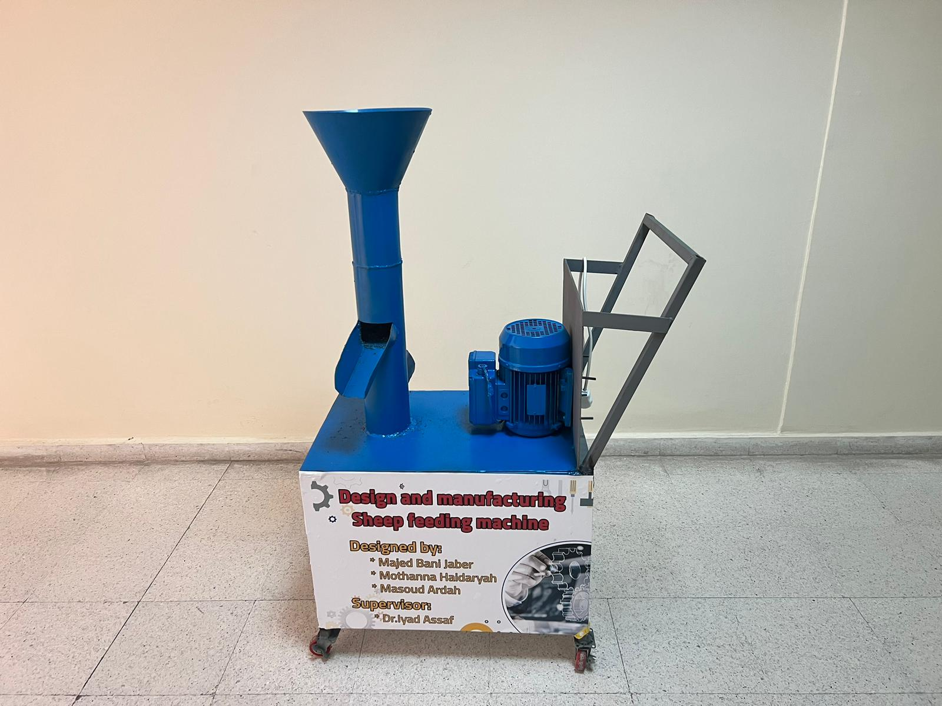
Design and manufacturing Sheep feeding machine
Student :
Majed Bani Jaber
Mothanna Haidariah
Masoud Ardah
Supervisor: Dr.Iyad Assaf
1

Slide 2

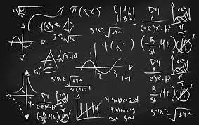

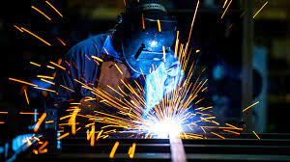
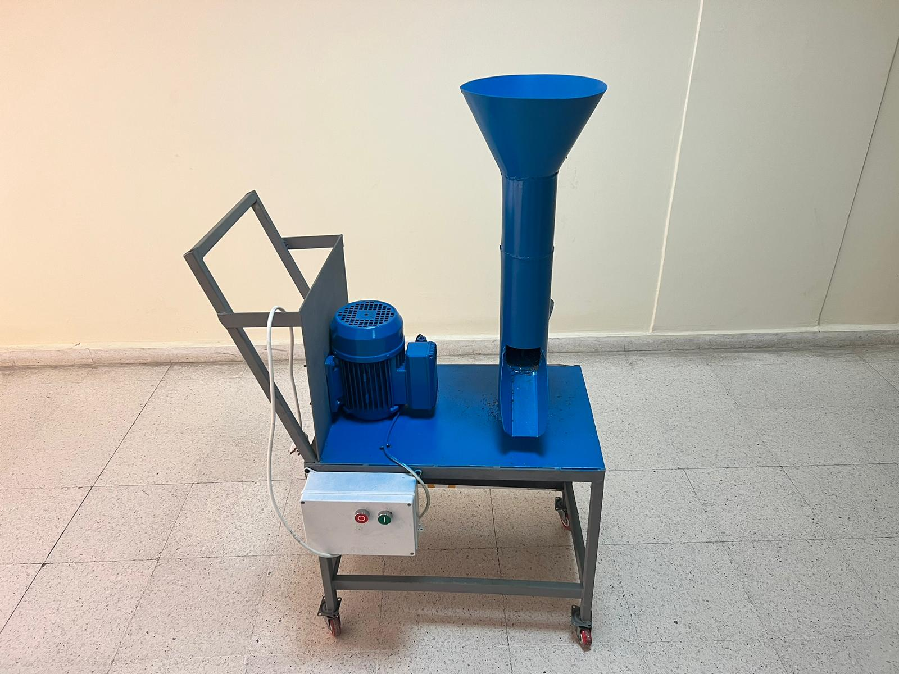

Introduction and review project 1
machine components
Design of machine parts
The main topics in this presentation.
Machine Fabricating
Machine testing
Conclusion
2

Slide 3
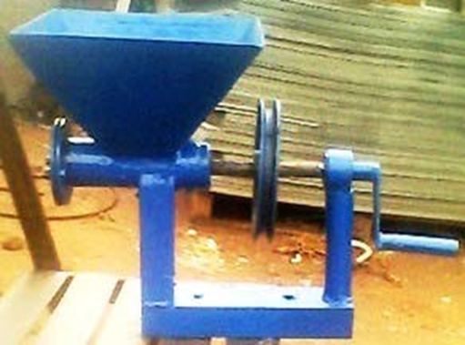
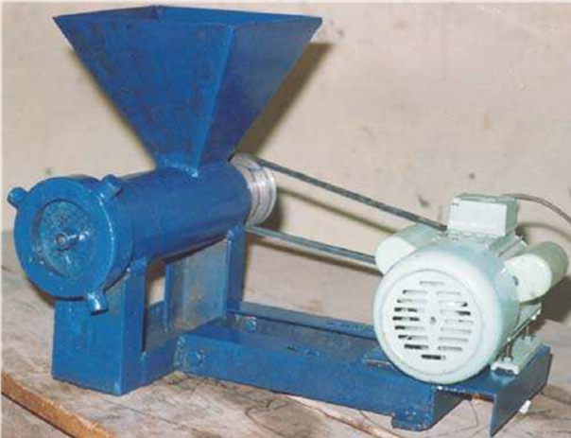
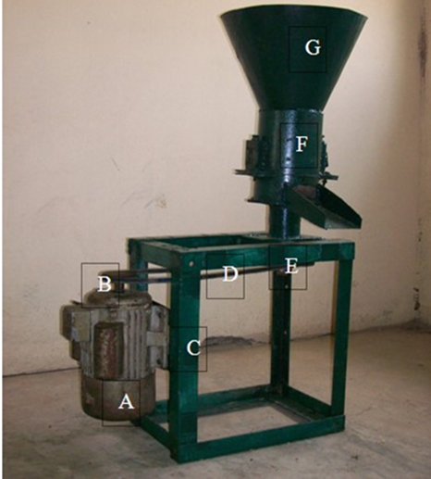
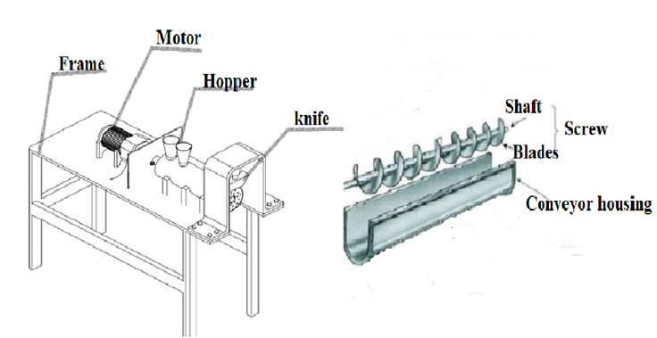
The main objective of this project is to design and manufacture a machine for feeding sheep that can use in small animal farms.
Machine development
Introduction and review project 1
1
2
3
4
3

Slide 4
Machine types
Machine types
1
Hydraulic system
Extrusion press system using a screw conveyor
2
3
Roller-Plate die
4

Slide 5
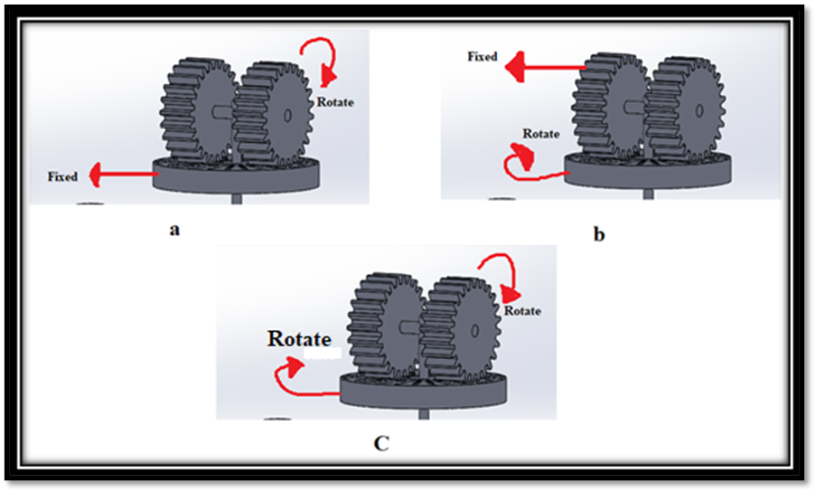
concepts of the machines.
5

Slide 6
Machine components
Components | Material used | Material properties
Roller, Die, knife and transmission shaft | Stainless steel 304 | High performance, corrosion resistance, durability and high strength
Hopper, chamber and frame | Galvanized sheet tin | High strength, extended durability and formability
Electric motor
V-belt | A26
Pulleys
bearing | Deep groove ball bearing
Bolt | Medium carbon steel - M12
6

Slide 7

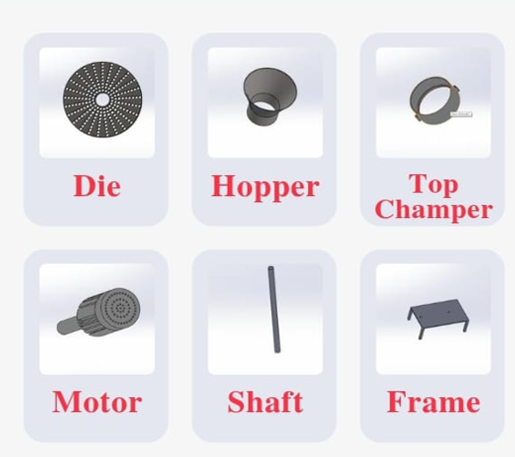
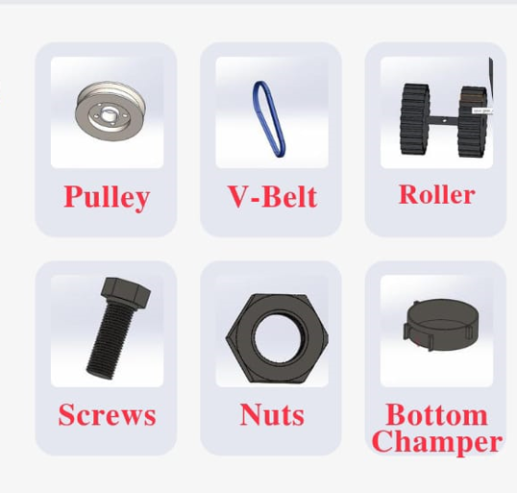
7

Slide 8
Design of machine parts
Hopper volume
Roller velocity
Die thickness
Shaft diameter
Motor selected
Pulleys selected
8

Slide 9
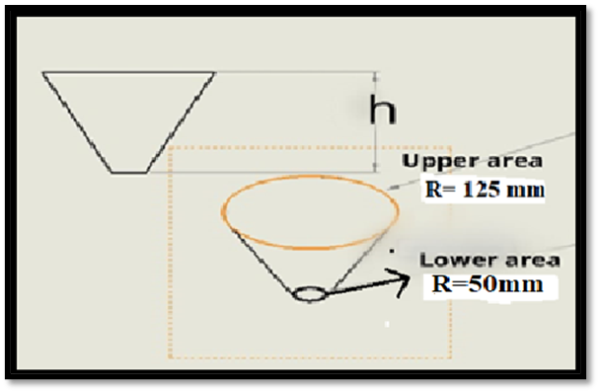
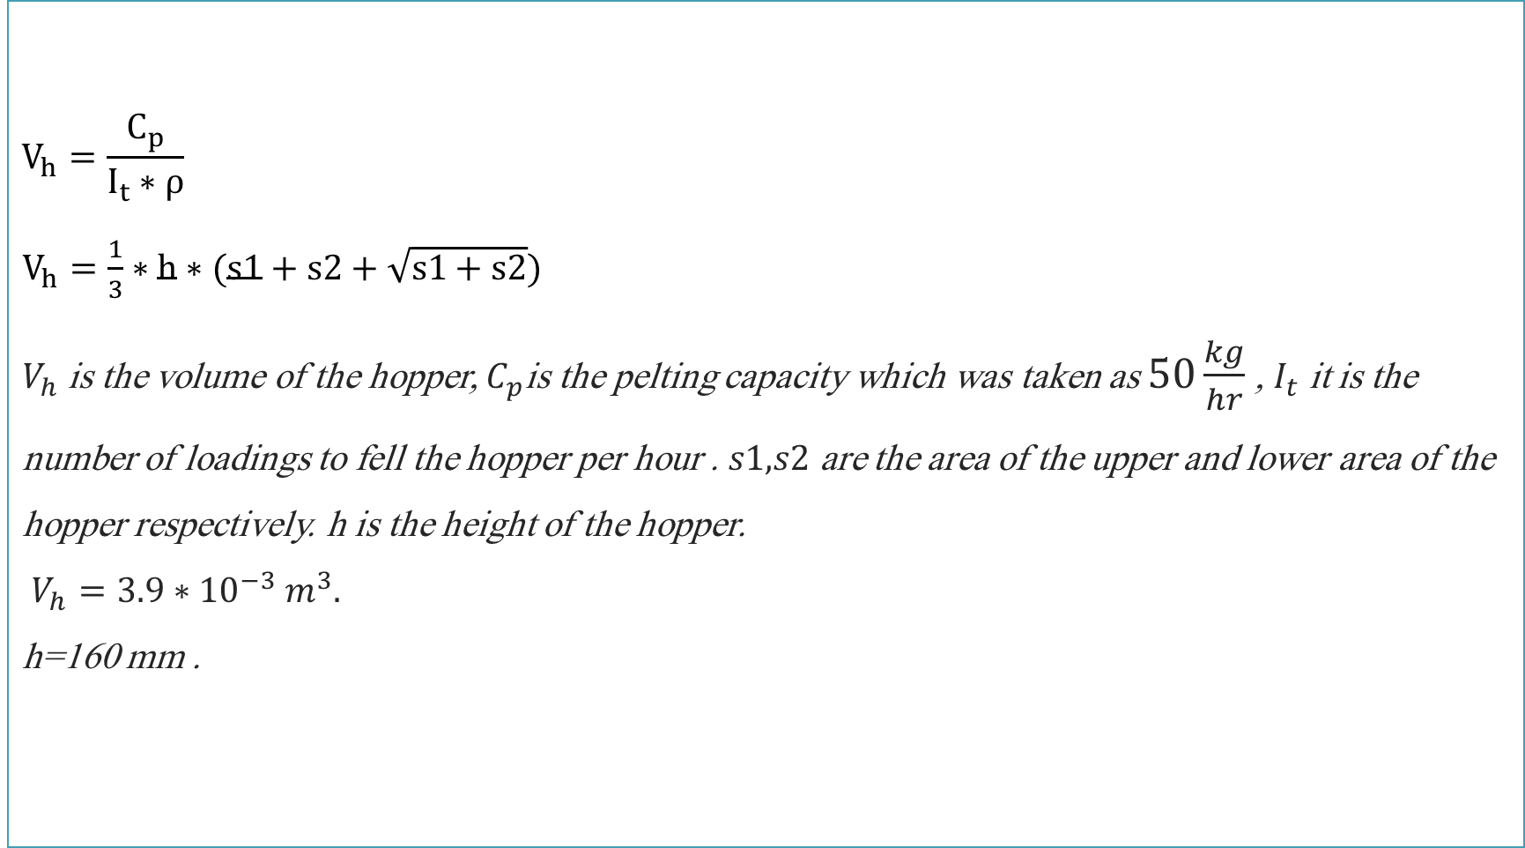
$$V_{h}=\frac{C_{p}}{I_{t}∗ρ}$$ $V_{h}=\frac{1}{3}∗h∗(s1+s2+\sqrt{s1+s2})$ $V_{h}$is the volume of the hopper, $C_{p}$is the pelting capacity which was taken as $50\frac{kg}{hr}$ , $I_{t}$ it is the number of loadings to fell the hopper per hour . $s1,s2$ are the area of the upper and lower area of the hopper respectively. h is the height of the hopper. $V_{h}=3.9∗{10}^{−3}{ m}^{3}.$ h=160 mm .
Hopper volume
9

Slide 10
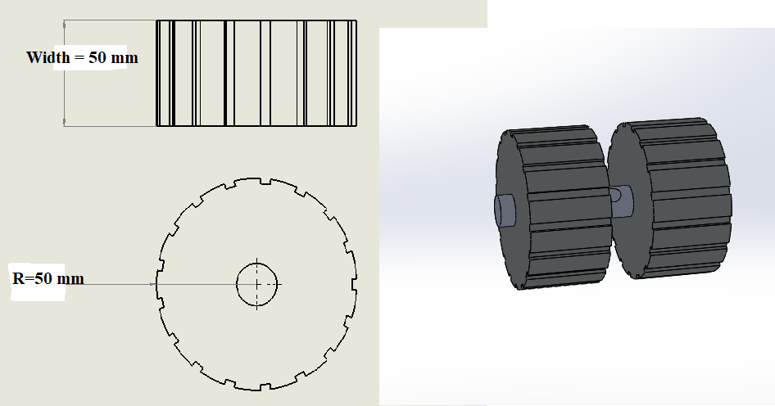
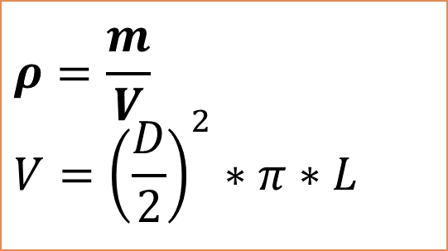
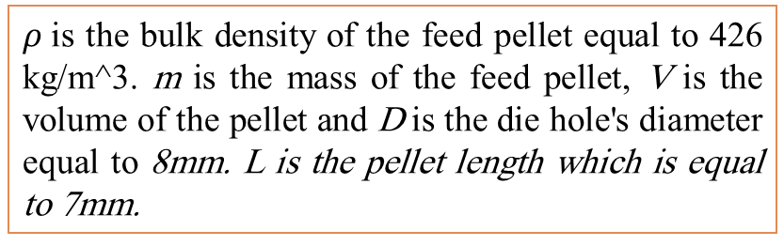
$$ρ=\frac{m}{V} \\ V={\left(\frac{D}{2}\right)}^{2}∗π∗L$$
$ρ$is the bulk density of the feed pellet equal to 426 kg/m^3. m is the mass of the feed pellet, V is the volume of the pellet and D is the die hole's diameter equal to 8mm. L is the pellet length which is equal to 7mm.
Roller velocity
pellet mass will be 0.15 grams. using 20 holes
1(turn) 6 (g)
X(turn) 50000 g/hr
x=1turn*50000ghr/6g , x=8333.3turn/hr=138.8 rpm
10

Slide 11
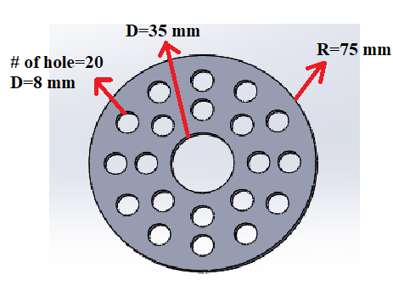
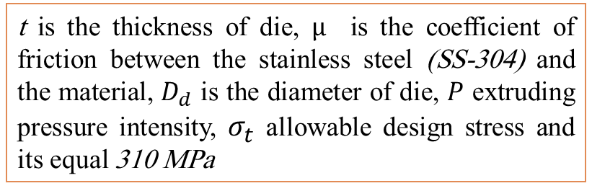
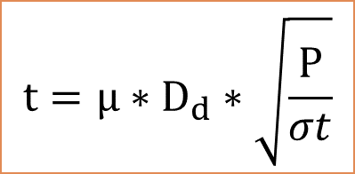
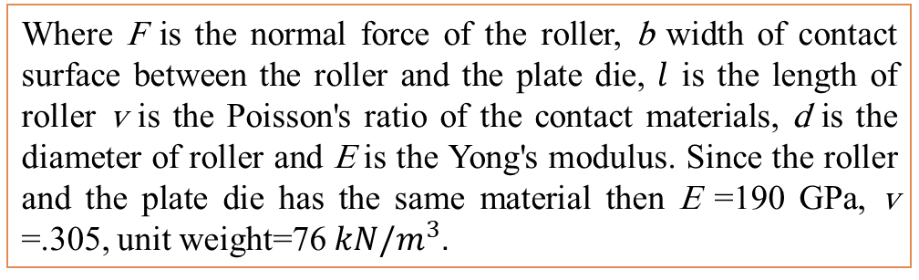
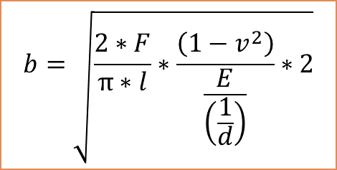

Where F is the normal force of the roller, b width of contact surface between the roller and the plate die, $l$ is the length of roller v is the Poisson's ratio of the contact materials, d is the diameter of roller and E is the Yong's modulus. Since the roller and the plate die has the same material then E =190 GPa, v =.305, unit weight=76$kN/m^{3}$.
Die thickness
$$t=µ∗D_{d}∗\sqrt{\frac{P}{σt}}$$
Then the die thickness= 14 mm
t is the thickness of die, $µ$ is the coefficient of friction between the stainless steel (SS-304) and the material, $D_{d}$ is the diameter of die, $P$ extruding pressure intensity, $σ_{t}$ allowable design stress and its equal 310 MPa
$$P=\frac{2∗F}{π∗b∗L}$$
$$b=\sqrt{\frac{2∗F}{π∗l}∗\frac{\left(1−v^{2}\right)}{\frac{E}{\left(\frac{1}{d}\right)}}∗2}$$
11

Slide 12

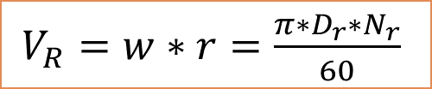
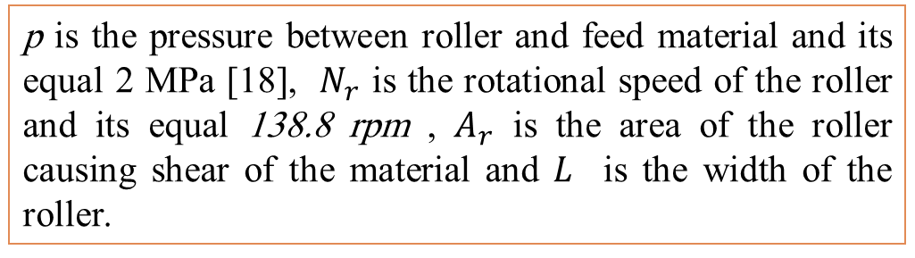

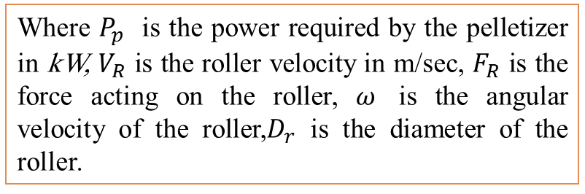


Motor selected
$$P_{p}=\frac{V_{R}∗F_{R}}{1000}$$
p is the pressure between roller and feed material and its equal 2 MPa [18], $N_{r}$ is the rotational speed of the roller and its equal 138.8 rpm , $A_{r}$ is the area of the roller causing shear of the material and $L$ is the width of the roller.
$V_{R}=w∗r=\frac{π∗D_{r}∗N_{r}}{60}$
$$F_{R}=µ∗P∗A_{r}$$
Then, $P_{p}=880∗\frac{.726}{1000}=.634 KW$
$$A_{r}=.1∗d_{die}^{2}∗\frac{π}{4}$$
Where $P_{p}$ is the power required by the pelletizer in kW, $V_{R}$ is the roller velocity in m/sec, $F_{R}$ is the force acting on the roller, $ω$ is the angular velocity of the roller,$D_{r}$ is the diameter of the roller.
An electric motor of 1 hp and 750 rpm is selected
12

Slide 13


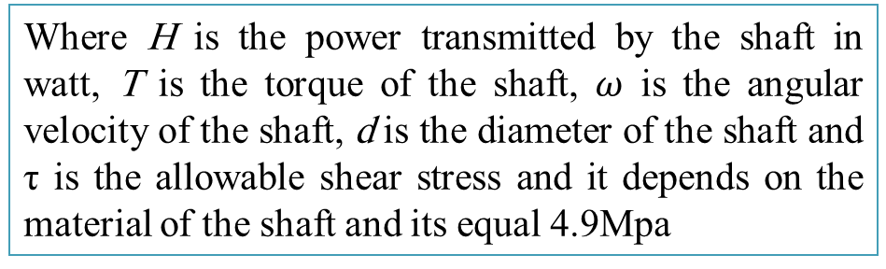

Shaft diameter
Where H is the power transmitted by the shaft in watt, T is the torque of the shaft, $ω$ is the angular velocity of the shaft, d is the diameter of the shaft and τ is the allowable shear stress and it depends on the material of the shaft and its equal 4.9Mpa
$$H=T∗w$$
$ω=\frac{2∗π∗N_{shaft}}{60}$
$T=\left(\frac{π}{16}∗d^{3}\right)∗τ$
Then d=.035 m=35mm.
13

Slide 14
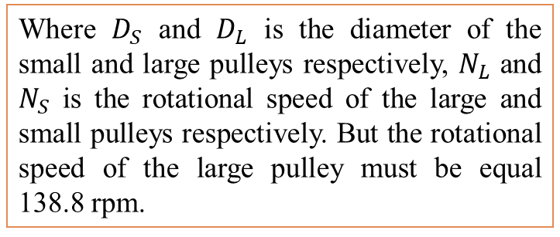

Pulleys selected
A small pulley diameter equal to 2 in. This pulley will rotate at the same rotational speed as the motor, which will be installed on the motor shaft. The rotational speed of the motor has been previously selected and is equal to 750 rpm
$$\frac{D_{S}}{D_{L}}=\frac{N_{L}}{N_{S}}$$
Where $D_{S}$ and $D_{L}$ is the diameter of the small and large pulleys respectively, $N_{L}$ and $N_{S}$ is the rotational speed of the large and small pulleys respectively. But the rotational speed of the large pulley must be equal 138.8 rpm.
Then the diameter of the large pulley equal to 11in.
14

Slide 15
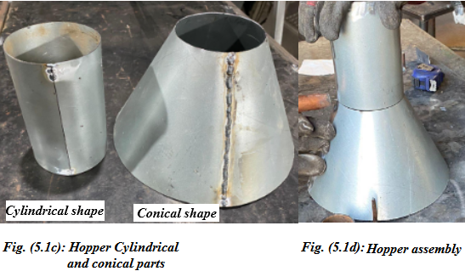
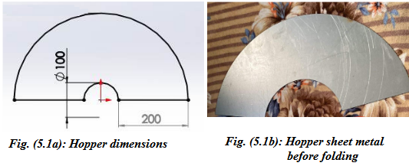
Machine Fabricating
Hopper
15

Slide 16
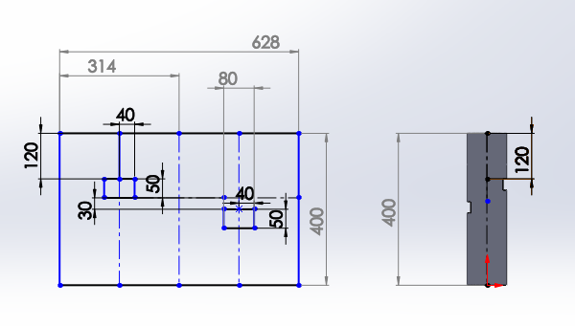
Machine Fabricating
Chamber
16

Slide 17
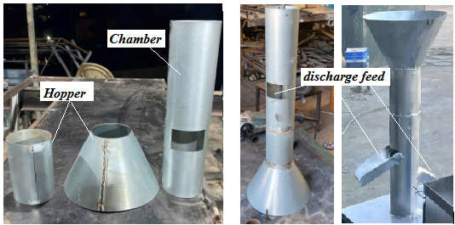
Machine Fabricating
Assembly of the chamber with the hopper
17

Slide 18
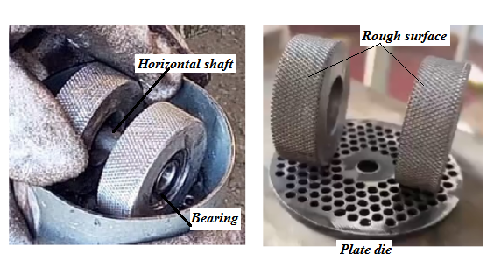
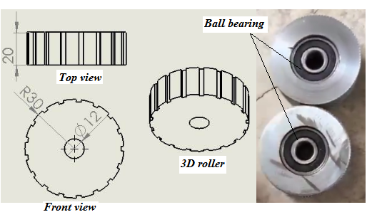
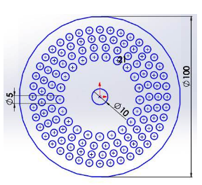
Machine Fabricating
Plate die and roller
18

Slide 19
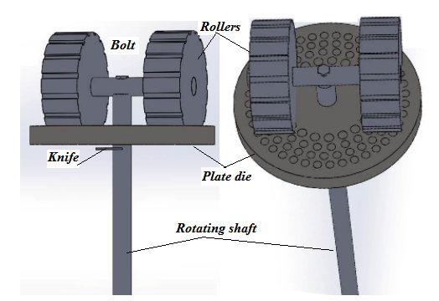
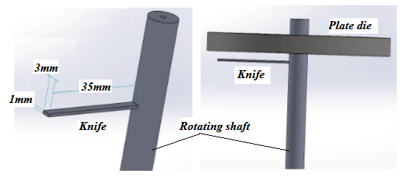
Machine Fabricating
Knife and vertical shaft
19

Slide 20
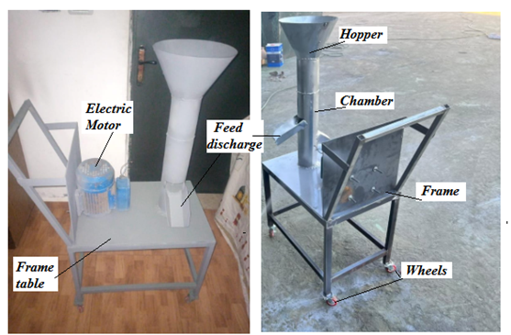
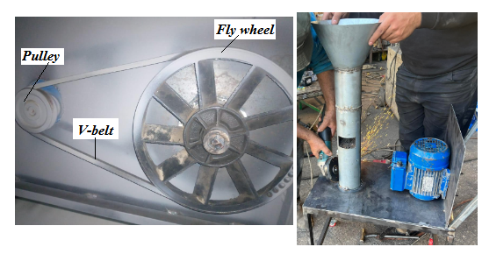
Machine Fabricating
Machine Frame
20

Slide 21
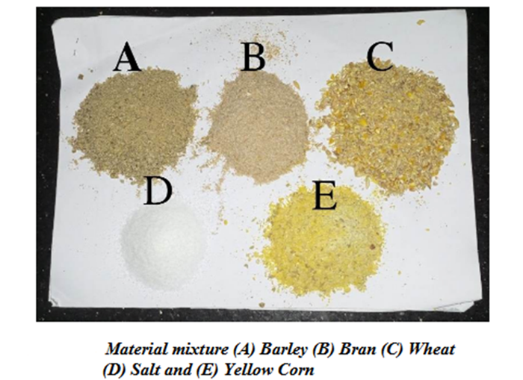
Material mixture
Machine testing
21

Slide 22
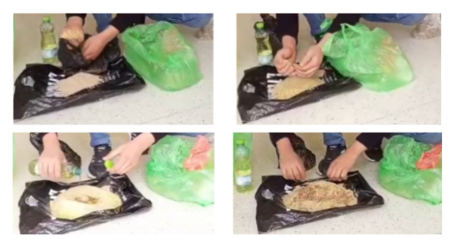
Machine testing
Preparing the material mixture
22

Slide 23
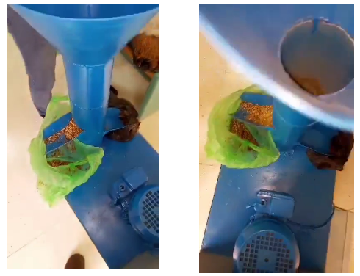
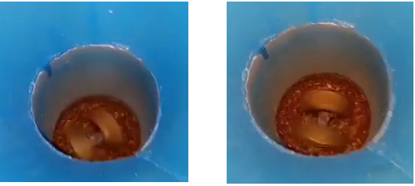
Machine testing
and explain the principle of work.
23

Slide 24
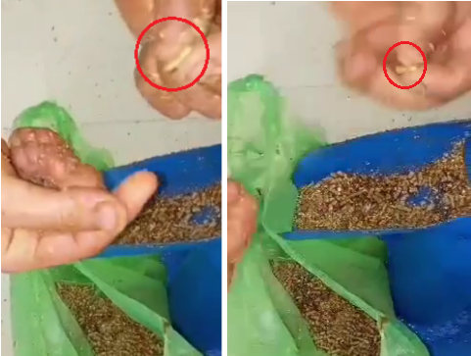
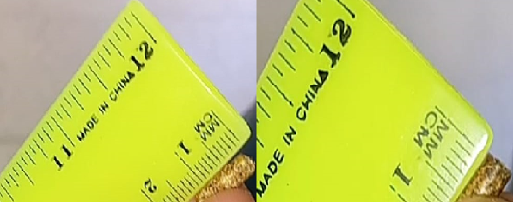
Machine testing
24

Slide 25
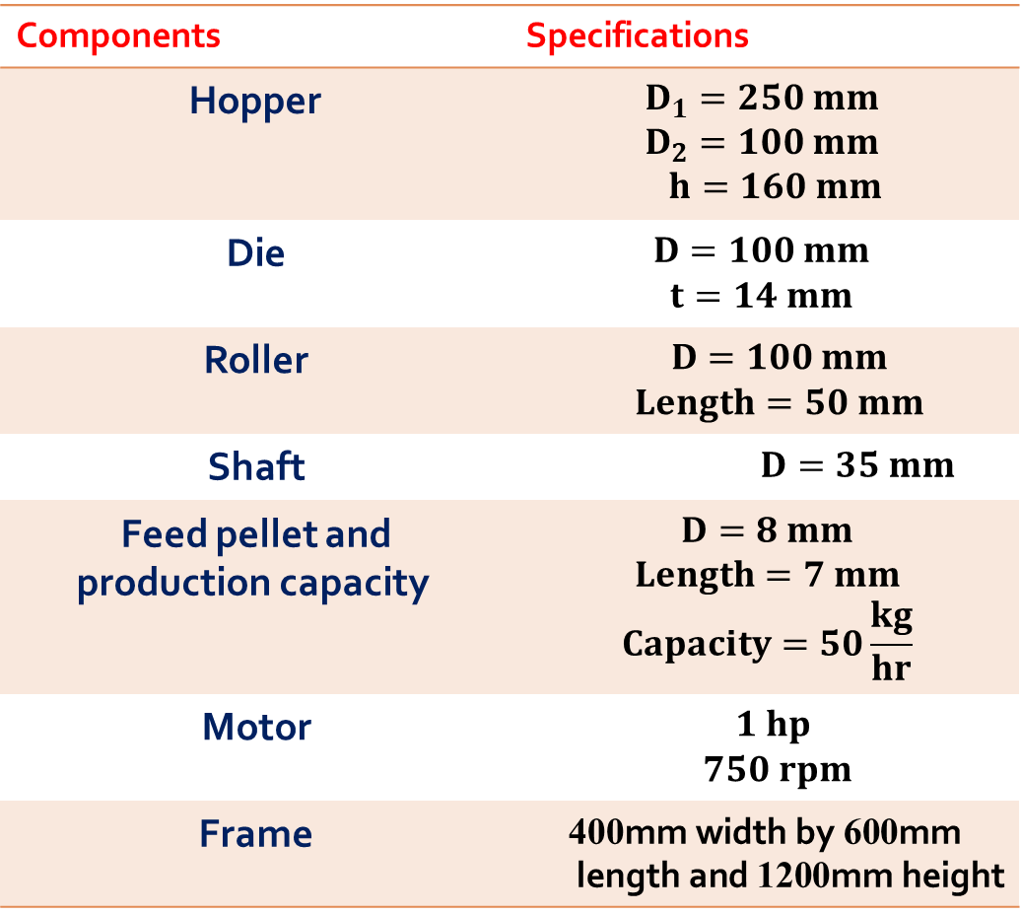
Conclusion
Specifications of the machine that was designed.
Specifications | Components
$$D_{1}=250 mm$$ $$D_{2}=100 mm$$ $h=160 mm$ | Hopper
$$D=100 mm$$ $$t=14 mm$$ | Die
$$D=100 mm$$ $$Length=50 mm$$ | Roller
$$D=35 mm$$ | Shaft
$$D=8 mm$$ $$Length=7 mm$$ $$Capacity=50\frac{kg}{hr}$$ | Feed pellet and production capacity
$$1 hp$$ $$750 rpm$$ | Motor
$$\text{400}\text{mm} \text{width} \text{by} \text{600}\text{mm} \text{length} \text{and} \text{1200}\text{mm} \text{height}$$ | Frame
Small or medium size feed pellet machine has been designed to meet the required specifications.
1
2
The machine can be used in households.
Efficient and friendly user machine that can produce a significant amount of pellets per day
3
4
easy to operate and maintenance
25

Slide 26
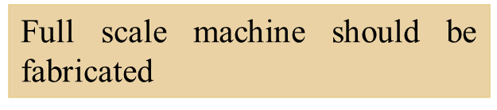

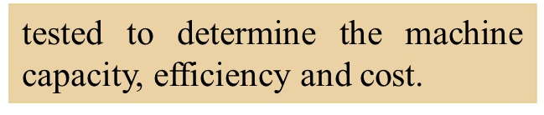


Recommendations
Design and fabricate different types of plate-die that can produce different sizes of pellets to meet the ideal size of pellets for different animals such as fish, poultry, and cattle.
26

