Slide 1


Smart Egg Incubator
By: Rola Salahat & Afeef Moghaiar
Project supervisor: Dr.Hanal Abu Zant
Smart Egg
Incubator

Slide 2
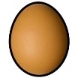
Hatching Cycle
Temperature
The range of temperature should be 37.7-38 C
Humidity
Turning System
In the Last three days the humidity values must change to 80-85.5%
In the 4th day the turning system will start
End
Start
4
19
1
21
Incubation period for chicken is 21 days
Humidity
Turning System
The range of humidity should be 70-75%
In the Last three days the turning system will start
In The first day the user put the eggs in the incubator and press start

Slide 3
Why We Choose To Work On This Project?
During the hatching period using traditional incubators, farmers face several problems:
Providing the necessary conditions for the egg hatching cycle was a burden on farmers, as the values of humidity and temperature are not fixed in all regions and sometimes need to be adjusted through an external influence especially in winter.
Eggs need to be flipped periodically during the hatching period with great caution. Most incubators need the farmer to stir manually.
Farmers need to periodically and continuously check the incubator to ensure the appropriate conditions and to calculate the remaining days for hatching.
What is the most popular problems that face the farmers during hatching cycle?

Slide 4
Objectives
Intelligent temperature and humidity control system
User-friendly control system
1
4
Intelligent egg turner
Quick and remote access to necessary information
2
Our project provides an automatic and intelligent flipping system for eggs at a certain angle and according to the days required in the hatching cycle.
5
User-friendly and secure authentication system
3

Slide 5
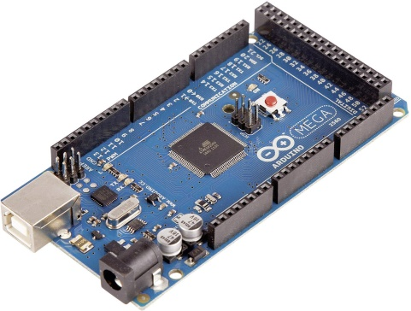

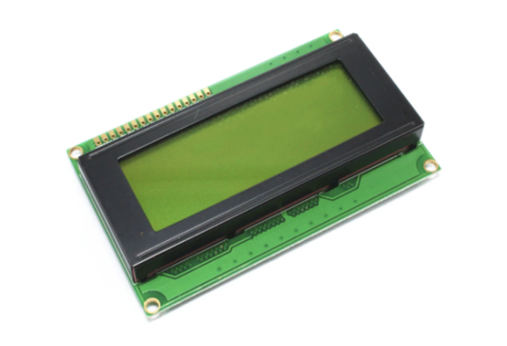
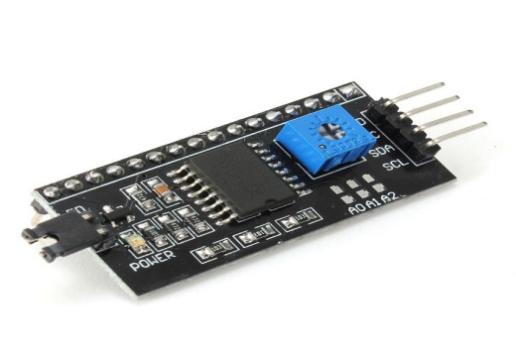
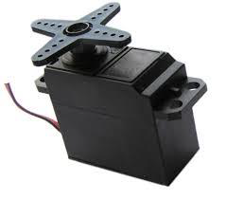
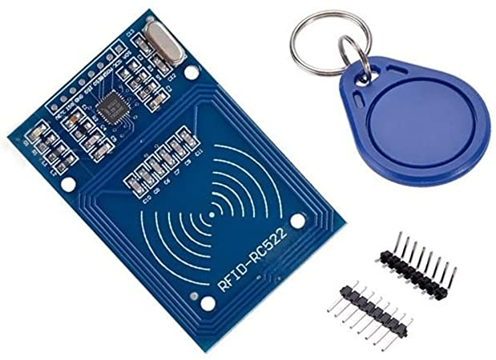
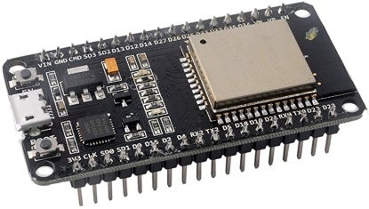
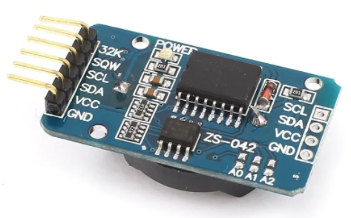
Hardware Components
Arduino Mega
Keypad
LCD 20x4
I2C
Servo Motor
RFID
ESP32
RTC

Slide 6
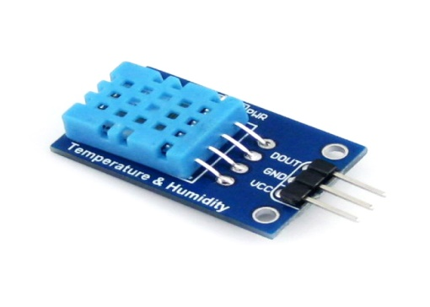
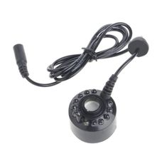
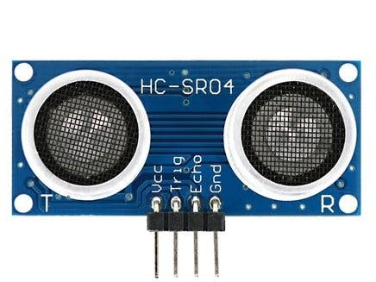
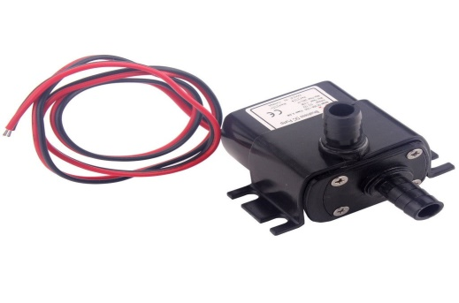
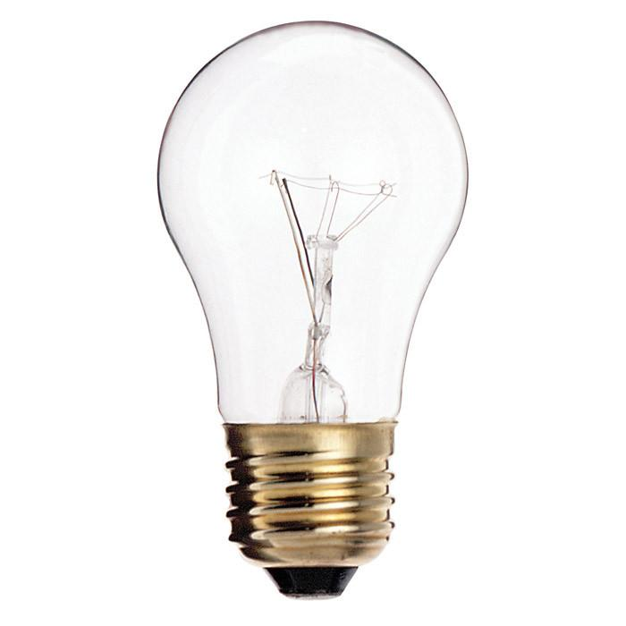
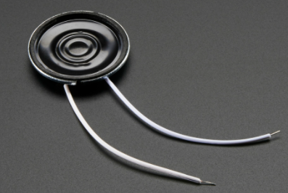
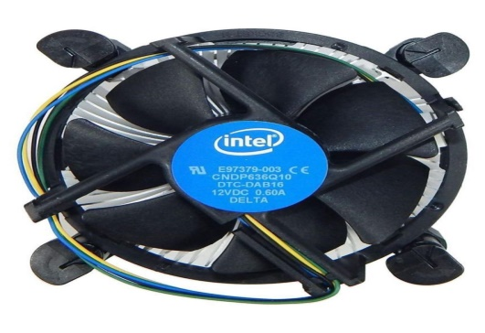
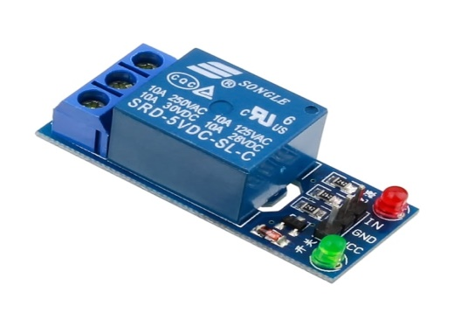
Hardware Components
DHT11
Fogger
Ultrasonic
Water Pump
Lamp
Speaker
Fan
1 Relay Module

Slide 7
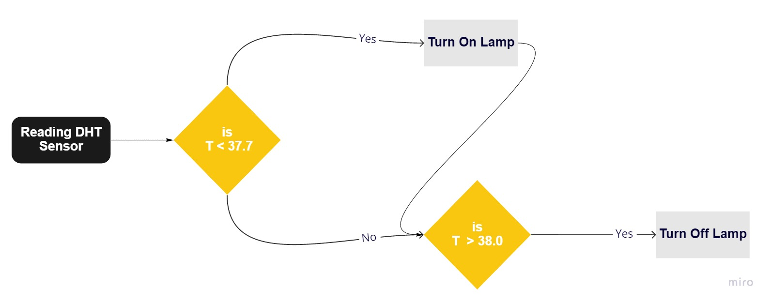
Heating Control Algorithm
Humidity Control Algorithm

Slide 8
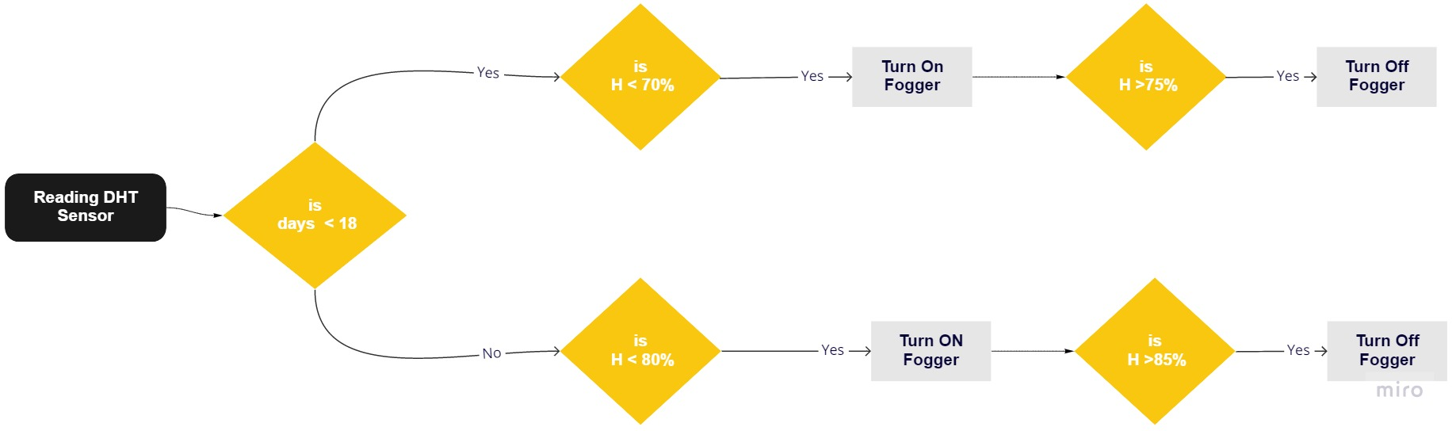
Humidity Control Algorithm

Slide 9
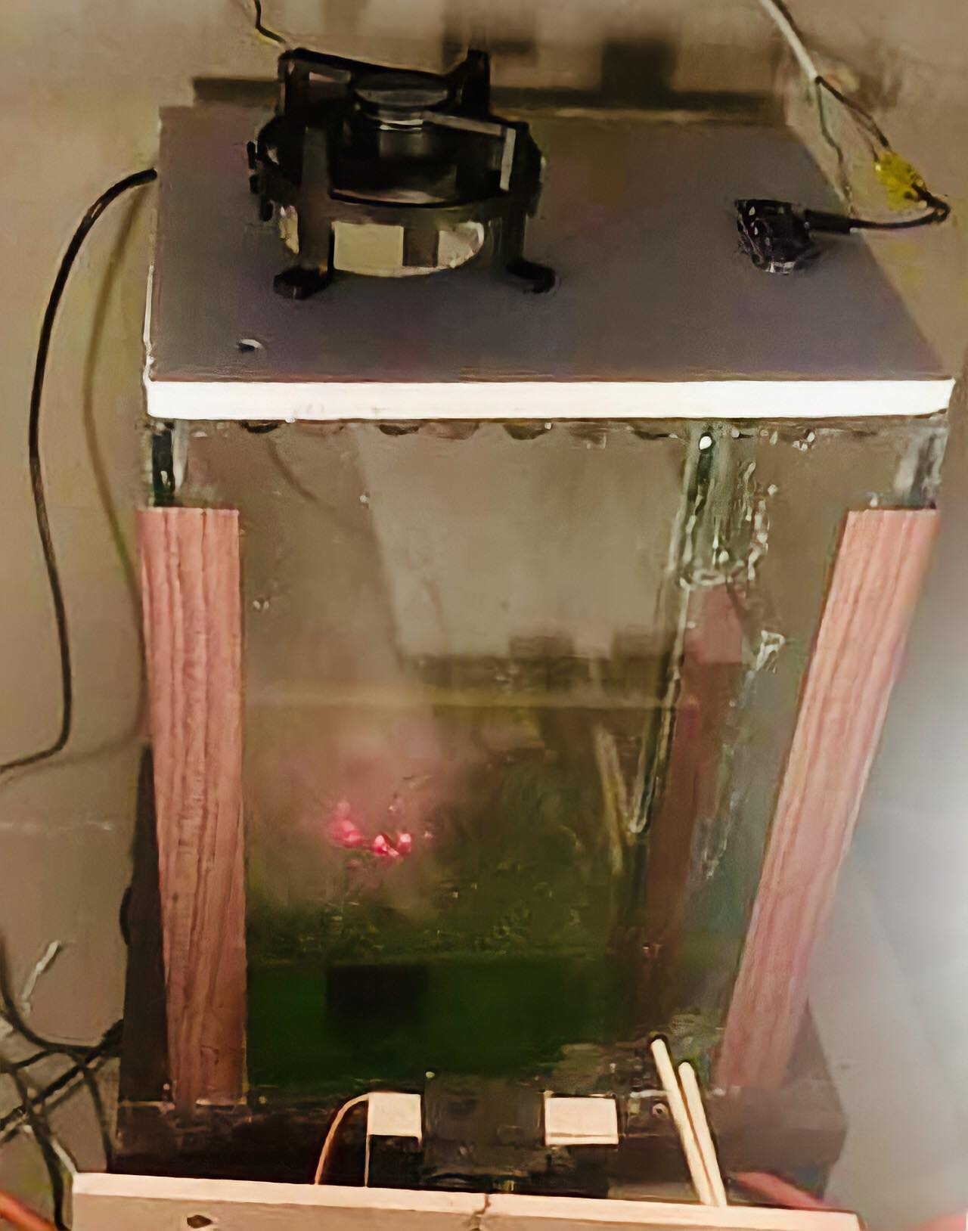
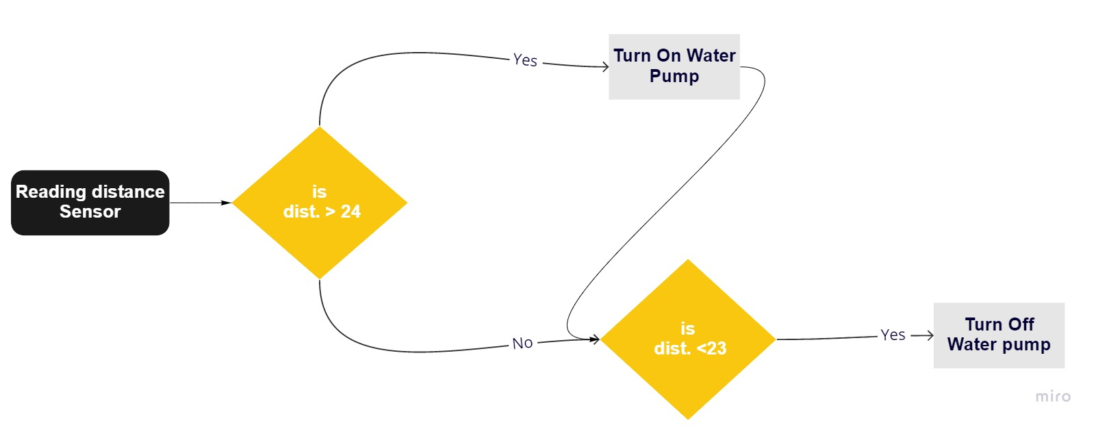
Water Filling Algorithm

Slide 10
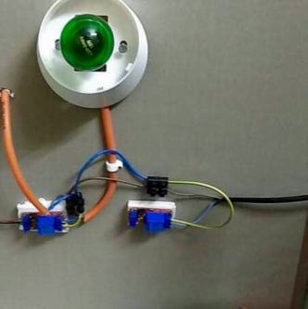
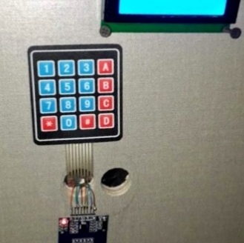
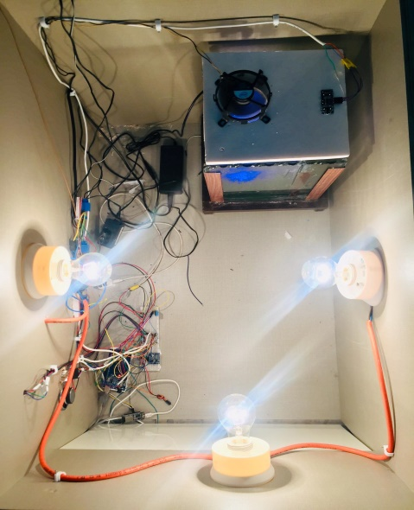
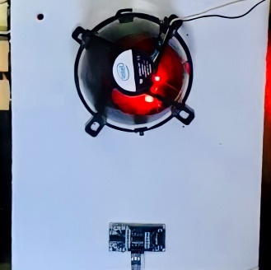
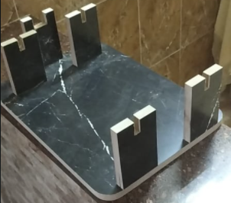
Our System
Heating Control System
Authentication System
If the temperature is lower than the required level, this leads to a delay in the hatching period.
Hatching is so sensitive period which need a strong secure system
Humidity Control System
Turning Egg System
If the humidity is low, this leads to dehydration of the embryo inside the egg and thus death.
Eggs must be physically turned to prevent the developing chick from sticking to the shell.

Slide 11
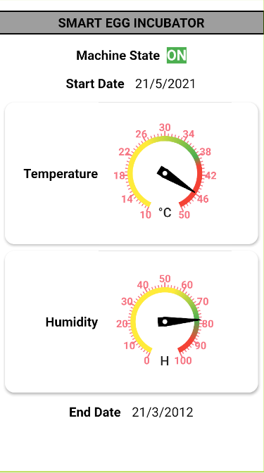
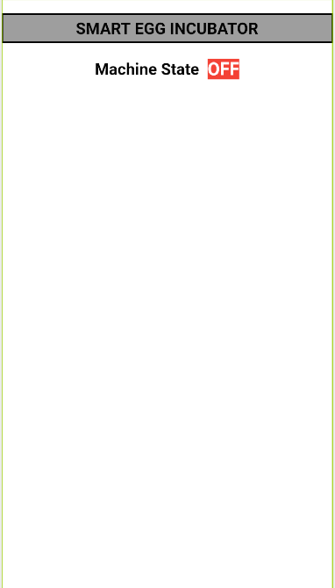
Mobile Application

Slide 12
Future Work
01
Developing our project so that other types of eggs are hatched in addition to chicken eggs.
02
Adding a software system to distinguish and remove rotten eggs.

Slide 13
Conclusion
The exploitation of technical knowledge to meet the needs of farmers and non-farmers of people who are passionate about poultry farming was our main goal. So that we tried as much as possible that the dependence of the machine on the user is almost nonexistent. Through the system of controlling the appropriate conditions such as humidity and temperature, then the automatic stirring system, the percentage of their dependence on the user is close to 0%.
In addition to providing a user-friendly system to control the machine and a protection system from any unwanted tampering. Through this project, we gained great experience about the Arduino language and how to use it in building hardware projects, in addition to knowledge of several electronic components that we did not know before, so that we learned how to use them and their importance in building projects.

Slide 14
THANK YOU
Smart Egg Incubator

