Slide 1
HomeManagementService(HMS)
Supervisor: Dr. Manar Qamhiya
Participants:
Mahde Souqi & Haroon Dweikat

Slide 2
Table of Contents
Problem and Objective
Implementation and Tools
Constraint and Future Work

Slide 3
Problem and Objective
Motivation
What made us create this project

Slide 4
Motivation
Convenience especially for disable people
Energy Efficiency controlled in a smart way
Time Saving use your time wisely
Luxury it is a Fancy to have a smart house

Slide 5
Implementation
Subsystem , Component and mobile app

Slide 6
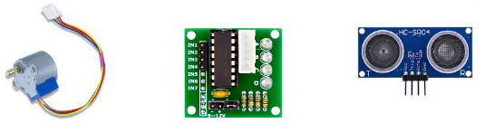
House Gate System
This system responsible of open and close the house gate in manual way(from the mobile app).
How Does It Work ?
The user can control on the house gate from the mobile app he can open and close it , the ultrasonic used for object detection.
Tools :
Stepper motor
Stepper motor driver
Ultrasonic

Slide 7
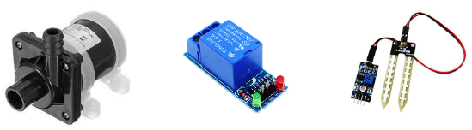
Irrigation System
Full automatic irrigation system to irrigate the crops
How Does It Work ?
When the soil humidity is lower than a specific value the system will automatically run and start irrigate .
Tools :
12v pump
relay
soil moisture sensor

Slide 8
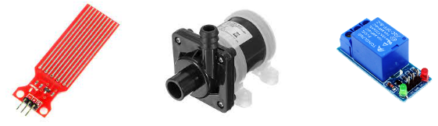
Water Tank Filling System
The system responsibility is to fill the water tank in a automatic or manual way.
How Does It Work ?
When the water level get lower than a certain level the system will start the water pumping into the tank .
Also the user can turn on the pump manually from the mobile app.
Tools :
Water Level Sensor
12v pump
relay

Slide 9
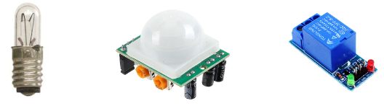
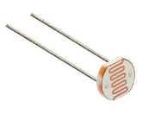
Outdoor Light System
This system can be managed in an automatic or manual way .
How Does It Work?
When a motion detected and the luminous intensity is lower than a certain level the lamp will be on .
Also the lamp can be controlled from the mobile app .
Tools :
12v Lamp
Motion Sensor
Relay
LDR

Slide 10
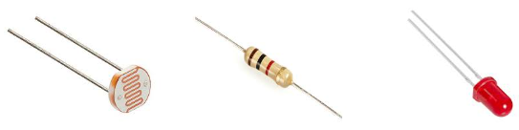
Indoor Lighting System
This system can be managed in an automatic or manual way .
How It is Work ?
It depend on the luminous intensity level to turn on the LEDs.
Also the user can turn it on/off from the mobile app.
Tools :
LDR
Resistor
LEDs

Slide 11
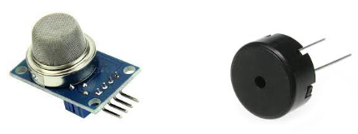
Fire Detection System
This system basically depend on the smoke detection .
How It Is Work ?
When the smoke sensor detect a smoke the system turn on the buzzer .
Also the user can turn on/off the buzzer but, still can see the detection state.
Tools :
Smoke Sensor
Piezo Buzzer

Slide 12
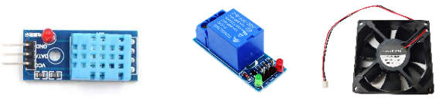
Air Condition System
This is the system responsible for maintaining a certain temperature level.
How It Is Work ?
When the read temperature is greater than a certain threshold the fan will turn on , and when it’s lower it turn off .
The user can control on the threshold value from the mobile app .
Tools :
Temperature Sensor
Relay
12v Fan

Slide 13
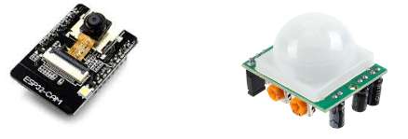
Security & Monitoring System
This system notify the user if a movement detected .
How It Is Work ?
When the user turn on the security option from the mobile app the system will notify the user if a movement detected .
Tools :
ESP32Cam
Motion Sensor

Slide 14
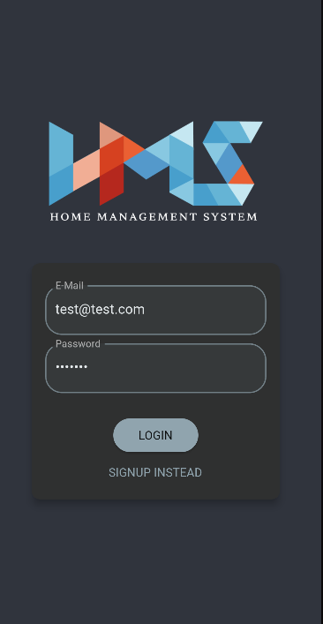
Mobile App.
This is the software which
give the user to control
and monitor the house
remotely.

Slide 15
Constrains
Challenges we faced in this project

Slide 16
Constraints
Time limitation .
The lack or high price of the component .
Come up with suitable model .

Slide 17
Future Work
Add door and windows control feature .
Add gas sensors to know if any leck occur .
Make the system more controllable .
Make the monitoring system rotatable .

Slide 18
Thanks :)

