Slide 1
Biodegradable polymeric microcapsule for drug delivery system
Prepared by:
Afif Hithnawi Lubna Ashayer
Nuha Abu Zahra Sundus Aghbar
Superviser:
Dr.Hassan Sawalha
Co-Superviser:
Dr. Mohyedine Assali

Slide 2
Drug problems
Side effects, immune system reactions.
Patient compliance and convenience problems to the repeated doses .
low extended period of time at desired release rate of drug.
weak achieving for drug targeting in cancer treatment.
Biodegradability and biocompatibility.

Slide 3
Outlines:
Objectives.
Introduction.
Experimental work.
Results.
Conclusion.

Slide 4
Objective :
The main objective of the current study was investigate the effect of the type of polymers on the drug release behavior from biodegradable microcapsules for drug delivery applications.

Slide 5
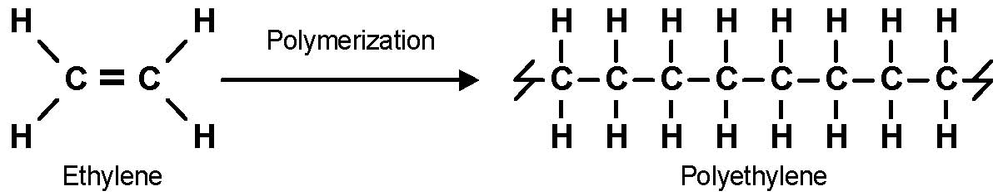
Introduction
Polymers: many small molecules that can be linked together by covalent bonds to form long chains.

Slide 6
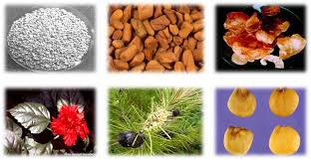
Introduction
Polymers can be classified into several categories:
Basis of their occurrence:
natural polymers:
e.g: proteins , carbohydrates , and quartz.

Slide 7
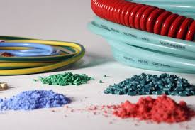
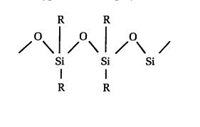
Introduction
synethetic polymers:
e.g: Nylon, polystyrene, rubber.
Semisynthytic:
silicones, polyacrylamide

Slide 8
Introduction
Behavior toward temperature:
Thermoplastic.
Thermoset.
Other basis:
Based on line structure.
Based on tacticity.
Based on morphology.
Based of polymerization of reactions.

Slide 9
Introduction
Biodegradable polymers:
are polymers that do not have resistance to degradation that take place through action of enzymes and chemical deterioration associated with living organism.
e.g. poly caprolactone (PCL), and Poly(esters) like poly D and L lactide(PLLA)(PDLLA).

Slide 10
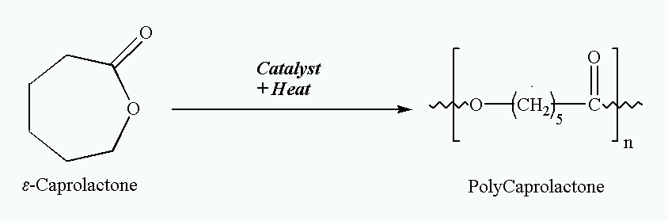
Introduction
Poly-Caprolactone:
PCL is a synthetic, biodegradable and semi-crystalline polymer is prepared using ring-opening polymerization of ε- Caprolactone.

Slide 11
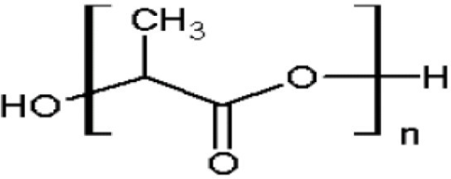
Introduction
Polylactic Acid:
PLA is a biodegradable poly ester and semi-crystalline thermoplastic polymer. it's hydrophobic polymer and unstable in wet conditions.

Slide 12

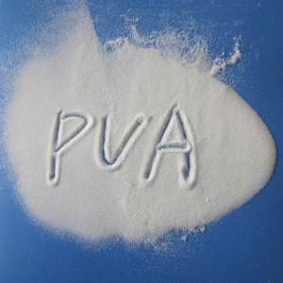
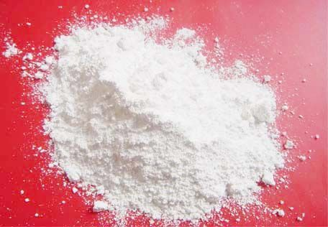

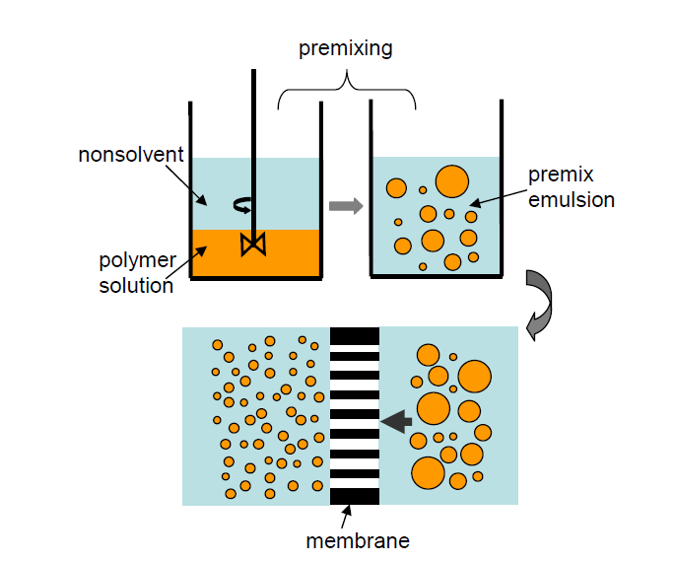
Experimental work
+
+
+
+
8g water
1g DCM
3g PVA
10mg Carvedilol
+
0.5g polymer solution

Slide 13
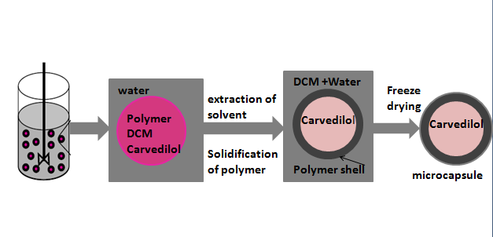
Experimental work

Slide 14
MICROCAPSULE
(1μ)
CRV
CRV
CRV
TARGETING
CRV
CRV
CONTROLLED RELEASE

Slide 15
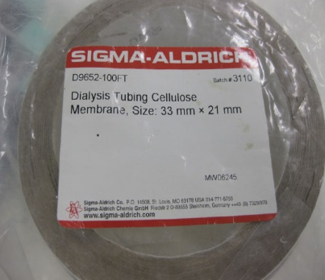
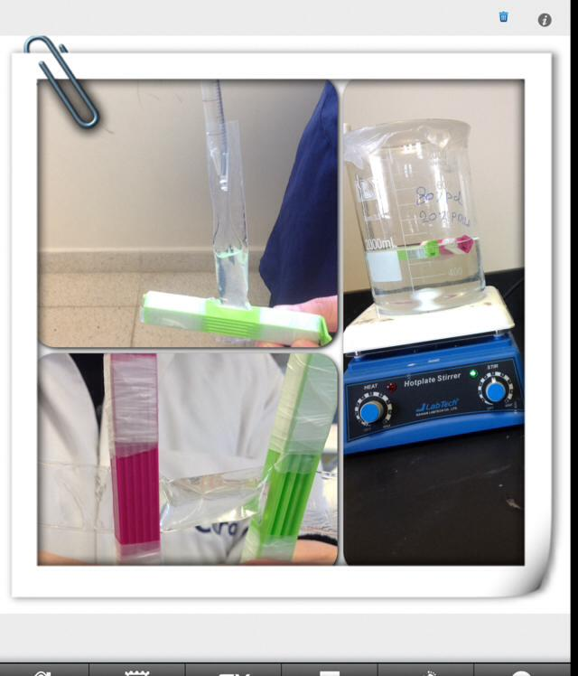
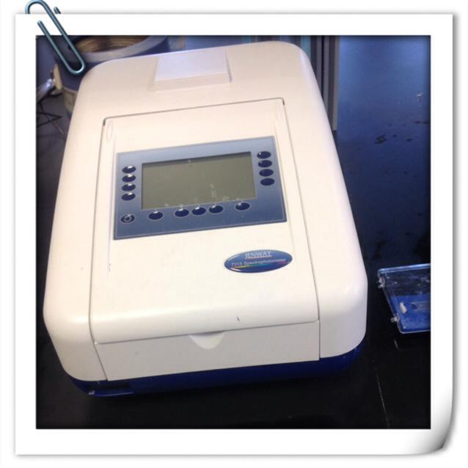
Release process description:
Washing the membrane
Saline buffer, pH=7.4
Then
Microcapsule
dissolved in
5ml buffer
Dialysis membrane
Inserting the sample in the washed membrane.
The membrane was clamped by tongs and dip in buffer .

Slide 17
* After a certain periods of time, (5ml) from the buffer which contained the released drug was withdrawn.
* The absorbance of withdrawn sample was measured by using U.V. Spectrophotometer.

Slide 18
Result And Discussion
Drug Loading :
Freeze drying Conditions | %loading | Drug added (in preparation) | Biodegradable polymer
-87°C/5mTorr | 482.00% | 10 mg | PDLLA
-87°C/5mTorr | 389.00% | 10 mg | PCL
-87°C/5mTorr | 105.92% | 5 mg | PLLA

Slide 19
Drug Loading :
Conditions(Temp./Pressure) | %loading | Drug added(in preparation) | Biodegradable polymer
-79 °C/6mTorr | 44.11% | 5mg | 50% PLLA- 50%PCL
-79 °C/6mTorr | 38.14% | 5mg | 50%PDLLA-50%PCL

Slide 20
Drug release studying
The drug release system of neat polymers :

Slide 21
Drug release studying
The drug release system of PCL-PDLLA Blend:
PCL

Slide 22
Drug release studying
The drug release system of PCL-PLLA Blend:
PCL

Slide 23
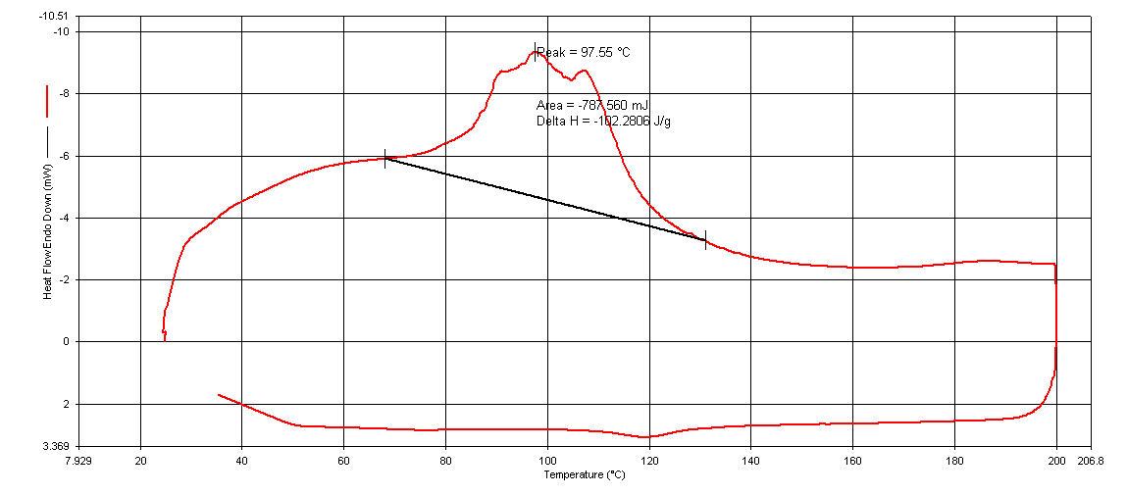
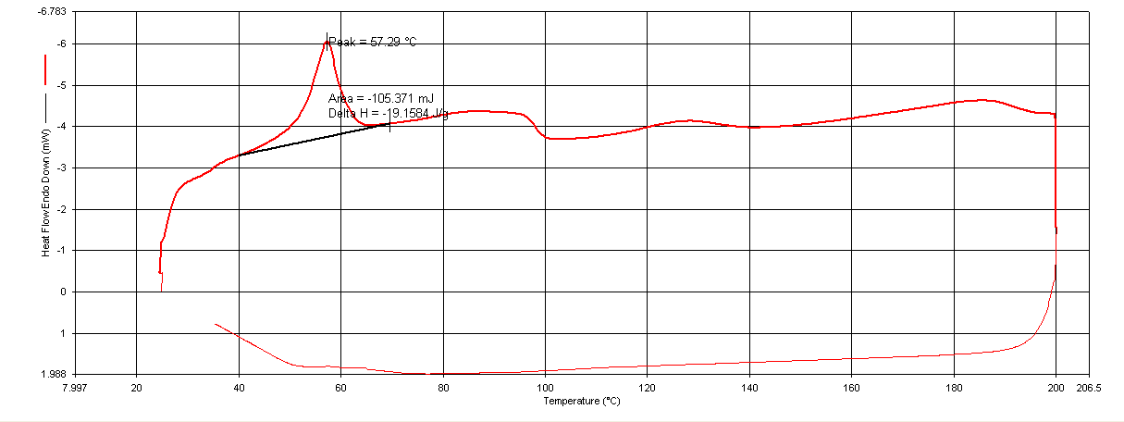
DSC test
DSC curve for PDLLA and PCL sample:

Slide 24
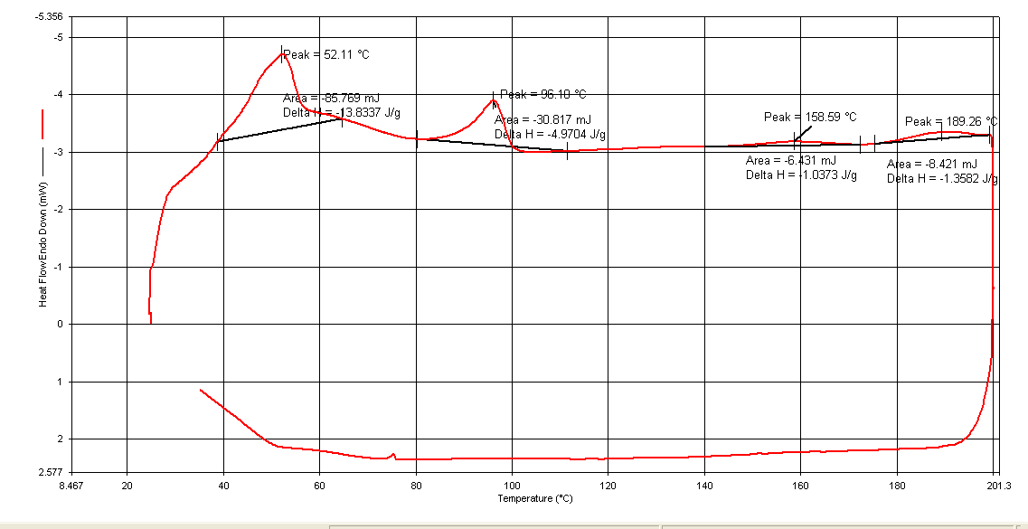
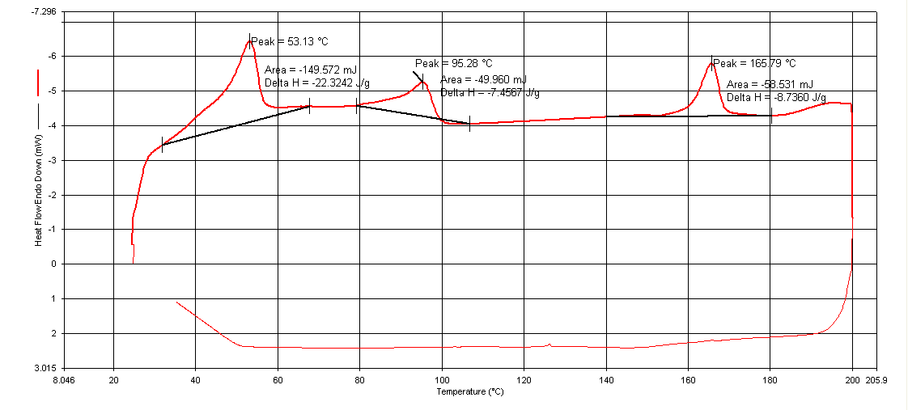
DSC test
DSC curve for50% PCL/50%PDLLA and 50% PCL/50%PLLA samples:

Slide 25
AFM test
The atomic force microscope for the sample of PDLLA, PLLA and PCL microcapsules.
PDLLA
PLLA
Average size=0.75
Average size=0.46
PCL
Average size=0.0.50

Slide 26
AFM test
The atomic force microscope for the sample of PCL-PDLLA blend and PCL-PLLA blend microcapsules.
PCL-PDLLA Blend
PCL-PLLA Blend
Average size=0.41
Average size=0.74

Slide 27
Conclusion
In this study CRV (active drug) was encapsulated inside biodegradable polymeric microcapsules(PCL, PLLA, and PDLLA).
The prepared microcapsules were fairly uniform with an average size of 0.5 -0.8µm.
Higher loaded amount of CRV was found with PDLLA microcapsules.
Higher accumulative release percentage of drug was obtained with PLLA microcapsules.
(50%PDLLA-50%PCl) blend system which most favorable system since it has the highest percentage of release with the most long period of time.

Slide 28


Slide 29

The
Time
Of
Questions

Slide 30

Congratulation us.
Currently , We Are .........Engineers

