Slide 1
B
L
O
C
K
C
H
A
I
N

Slide 2





Blockchain Helping
the World:
Problems Blockchain
Technologies Have
Overcome
Aya Subuh, Farah Saleem, Malak Hassoun, Thanaa Sholi
Supervised by:
Mohammed Abdel-Khaleq Dwikat

Slide 3
Table of Content
1
Scientific Research
Why we chose Scientific Research, Types of Scientific Research
2
Introduction
Research Approach, Style format, Research Purpose
3
Historical Background of Blockchain
What is Blockchain Technology?/ How it works?
4
How Blocks are Connected to Each Other, Adding New Block to the Blockchain, Blockchain characteristics and properties.
5
Top Real World Problems That Blockchain Solves
6
Future of Blockchain

Slide 4

Scientific Research
The creation of new knowledge or the use of existing knowledge in a new and creative way so as to generate new concepts, methodologies and understandings by analysis of previous research and other resources.

Slide 5
Types of Scientific Research
Qualitative Research
Quantitative Research
Mixed methods Research

Slide 6
Style Format Types
(APA) style:
associated with the social sciences
Turabian:
a variation of Chicago style intended for student writers
(CSE) style:
associated with the natural science
(MLA) style:
associated with the humanities
Chicago:
associated primarily with history
Modern Languages Association
American
Psychological Association
Chicago
Turabian
Council of Science Editors

Slide 7

Why we chose Scientific Research
We took a Scientific Research course which we find interesting and useful.
Tend to make a new idea as we are the first group to make a Scientific Research as a graduation project in the MIS department.
Hoping to inspire other students to this point and the importance of it.
The importance of it and the benefit it could give.

Slide 8
Research paper writing process
01
02
03
04
Specify the topic by focusing on the Problems blockchain has overcome.
Selecting the topic which is Blockchain.
Collecting the resources.
Drawing the literature map.
06
07
Reading more & more to improve, correct mistakes if there are and doing the format.
05
Reading and start Writing the paper.
Evaluate

Slide 9
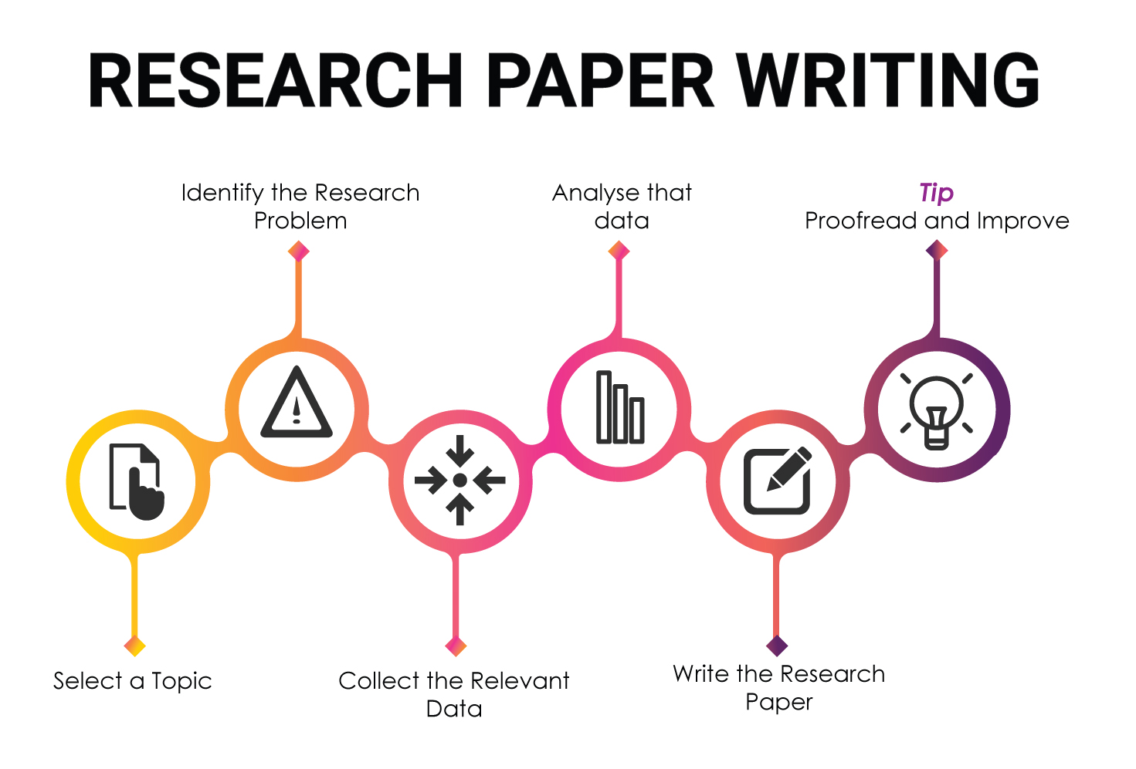
Research paper writing process
Our research involves a review of publications in academic journals, research papers, conference proceedings, and internet resources, along with books and other related materials in order to make a good understanding and a well made research paper.

Slide 10




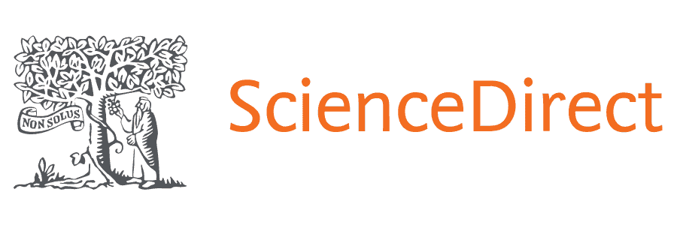

SOURCES
SOURCES

Slide 11
Acquired Knowledge
As we done the previous process we are now able to do any type of research according to our experience in doing one in the course we took and this one for Graduation project. Understanding the basics, knowing the mechanism and how the evaluating process done these also are information we gained and empowered our knowledge.

Slide 12
Introduction
Blockchain topic was chosen for its importance that emerged significantly in the new Era and the huge tendencies to invest in this new technology especially by the big player companies in the world because of its multiple applications. Blockchain proved itself by solving a lot of problems that were forming an obstacle for the business world. That is what will be discussed in the research paper named Blockchain Helping the World: Problems Blockchain Technologies Have Overcome.
A
B
C
D

Slide 13
Research Approach
Qualitative Approach
Style Format
APA

Slide 14
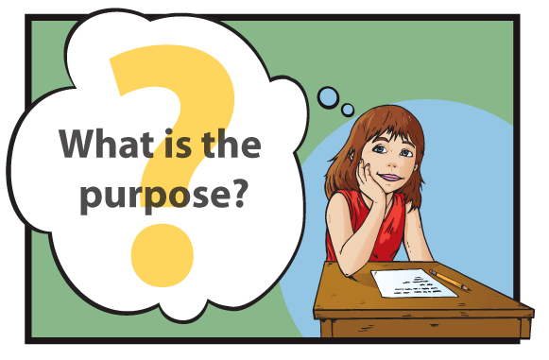
Research Purpose
Review the blockchain, given the rapid technological changes of blockchain. This paper focuses on an overview and framework of how the blockchain works, including its implementations in solving many problems in order to increase the awareness of the blockchain role nowadays by removing obstacles communities face.

Slide 15
Historical Background of Blockchain
1998
2000
2008
2009
2014
2018-
1991-2008
Phase 1
Phase 1
Phase 2
Phase 2
Phase 2
Phase 2
Phase 3
A cryptographically secured chain of blocks is described for the first time by Stuart Haber and W.Scott Stornetta.
Stefan Konst published his theory of cryptographic secured chains, plus ideas for
implementation
Developer(s) working under the pseudonym Satoshi
Nakamoto released a white paper establishing the model for a blockchain
Nakamoto implemented the first blockchain as the public
ledger for transactions made using bitcoin.
Blockchain technology is separated from the currency and its potential for other financial,
inter-organizational transactions are explored. Blockchain 2.0 is born
multi-applications of blockchain
Computer scientist Nick Szabo works on ‘bit gold’, a decentralized digital currency.

Slide 16
What is Blockchain Technology?
How it Works?

Slide 17
Blockchain technology
How Does Blockchain Work ?
The blocks in the chain are connected to each other in a peer-to-peer (P2P) connection where the first block of the chain is called the Genesis block.
Each block consists of the following:
Data.
Hash Code.
Consensus Algorithm.
How Blocks are Connected to Each Other ?
Each new block in the chain is linked to the previous block.
Each block has a copy of the other blocks' transactions that exist on the same network.
The blocks are connected like a chain by the hashes.
Genesis block
“
is a distributed digital ledger of transactions or a network of blocks;
containing documented transactions (data and information) replicated and distributed through the network of computer systems that make up the blockchain.
”

Slide 18
How Blocks are Connected to Each Other
Blocks
Previous Hash
Transactions
Proof of Work
Previous Hash
Transactions
Proof of Work
Previous Hash
Transactions
Proof of Work
SHA 256
000000000000000000000000000000001011101110101001101011011010
SHA 256
000000000000000000000000000000001011101110101001101011011010
SHA 256
000000000000000000000000000000001011101110101001101011011010

Slide 19
Adding New Block to the Blockchain
The requested transaction is broadcast to a P2P network of computers ( nodes )
Block's validity
Transaction request
Block's validity checked by participants of the blockchain
The transaction is complete
New block is added to the chain permanently
New block of data is created

Slide 20
Blockchain characteristics and properties
Distributed / decentralized
Anonymous transparency with pseudonymity
third party is no longer needed in blockchain.
The identity of participants is unknown
Consensus and Peer-to-Peer Transmission
Programmable / Computational logic
A blockchain is programmable (‘Smart Contracts ’)
all the nodes must agree on the validity of the records and communicating with other nodes directly
Secure
All the records are encrypted
Time-stamped
Transaction timestamp is recorded in a block
Immutable
Any validated records are irreversible and cannot be changed

Slide 21
Top Real World Problems That Blockchain Solves
The main idea of our paper focuses on problems that people in the world are facing and how blockchain helps in solving them..
9
Patient Data in HealthCare Organizations
5
Supply Chain Management
7
2
3
Traditional Contracts and Agreements
Cross-Border Payments
Data Security
10
1
Government Systems and Public Sectors
6
8
Crowdfunding
Identity Theft
4
Sports and eSports
Real estate

Slide 22

Managing and Protecting Patient Data in HealthCare Organizations

Slide 23

Managing and Protecting Patient Data in HealthCare Organizations
Patient data include information relating to their past and current health or illness, their treatment history, lifestyle choices and genetic data.

Slide 24
Patient Data in HealthCare Organizations before blockchain
Key problem
The lack of secure links that can connect all independent health systems together to establish reachable network by all Healthcare institutions.
Between 2009 and 2017
176 million health records were compromised.
    Credit card numbers
  Genetic research
  documents

Slide 25
Patient Data in HealthCare Organizations after blockchain
Using blockchain technology can create decentralized patient data log with a large distributed databases managing transactions, in a secure and permanent manner, providing:
Accessibility and transparency to all Healthcare institutions.
Security and reliability of patient data.
Also secrecy.

Slide 26
EXAMPLE(Blockchain companies for healthcare data management)
 |  | Name | Country | Website
Electronic Medical Record(EMR) data management |  | PokitDoc | USA | http://pokitdoc.com
 |  | Gem | USA | http://enterprise.gem.co/health
 |  | YouBase | USA | http://www.youbase.io
Electronic Health Record(EHR) data management |  | Medicalchain | USA | http://www.medicalchain.com
 |  | HealthWizz | USA | http://www.healthwizz.com
 |  | Curisium | USA | http://www.curisium.com
 |  | Hearthy | Spain | http://hearthy.co
 |  | Iryo | Slovenia | http://iryo.io
 |  | Robomed | Russia | http://www.robomed.io
Personal Health Record(PHR) data management |  | Medcredits | USA | https://medcredits.io
 |  | MyClinic | UK | https://myclinic.com

Slide 27
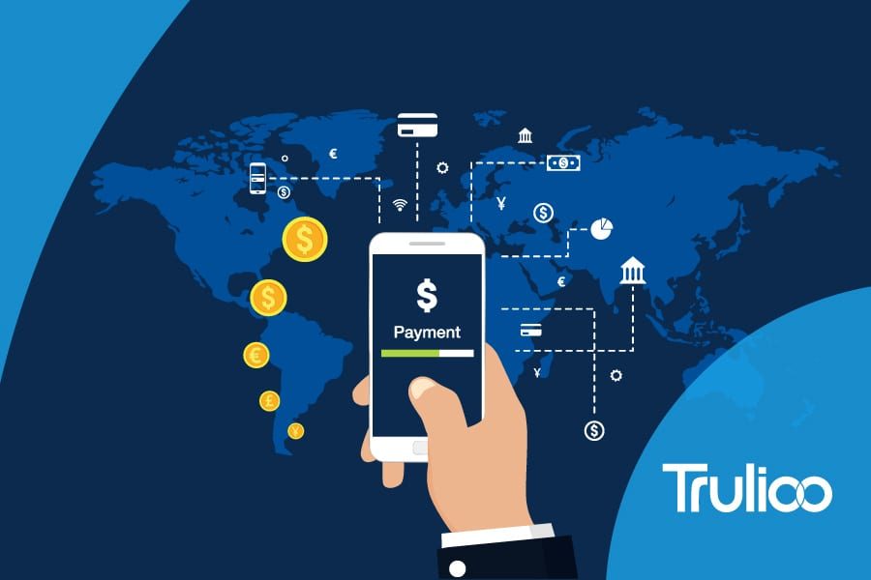
Cross-border payments

Slide 28
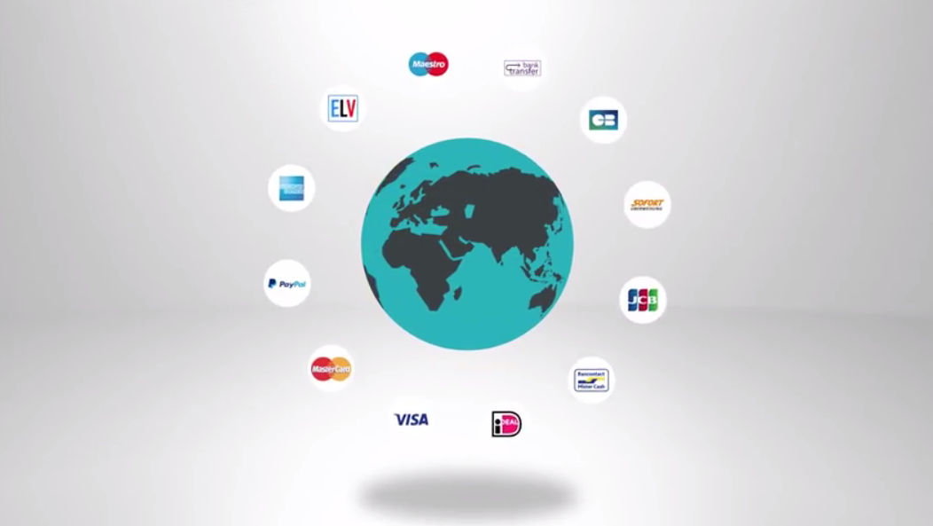
2. Cross-Border Payments
Cross-border payments: are transactions where the payee and the transaction recipient are both located in different countries.

Slide 29
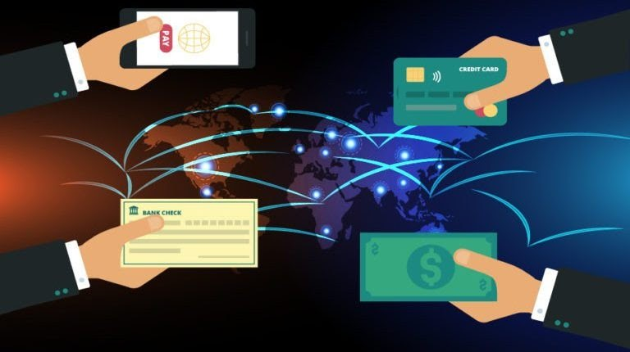
Traditional Cross Border Payments:
Many steps to do.
Needs a lot of time and effort.
High cost.
Requires third party.

Slide 30
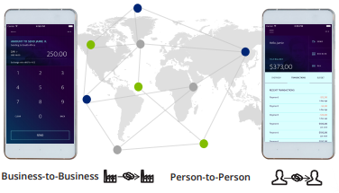
Cross-border Payments after Blockchain
Enabling Business-to-Business and Person-to-Person payments across borders on vendor blockchain-based payment rails.

Slide 31
Cross-border Payments after Blockchain
Low-Cost: 40–80% reduction in transaction costs.
Faster operation: takes around 4-6 seconds & eliminates any third party.
Promotes trust: Verifiable record of every transaction
Secure: Transactions can’t be altered or reversed, it guarantees more accountability & security.

Slide 32
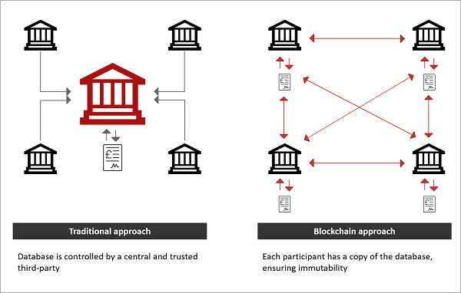
Traditional VS Blockchain Cross-border payments
SWIFT
Ripple

Slide 33
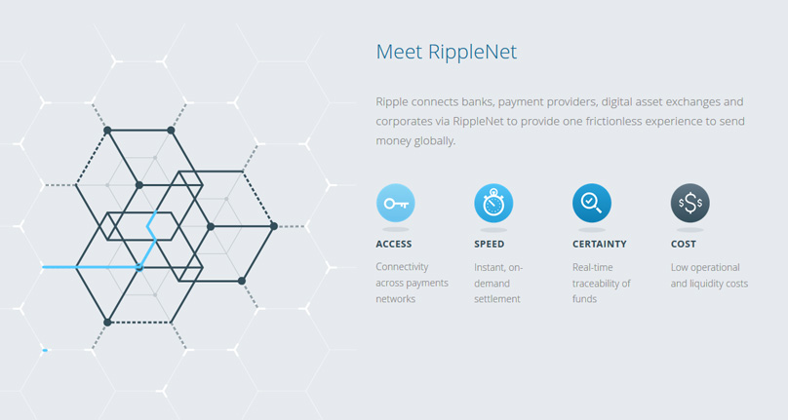
EXAMPLE

Slide 34


Slide 35

3. Data security
Data security is the science and study of methods of data protection for preventing unauthorized access of data in computer and communication systems

Slide 36

Data Security before blockchain
Centralized storage
Vulnerable to security breaches
Construct multiple barriers by requiring several factors of authentication to accessing data.
Several factors may cause centralized databases to fail.
Need of a third party

Slide 37
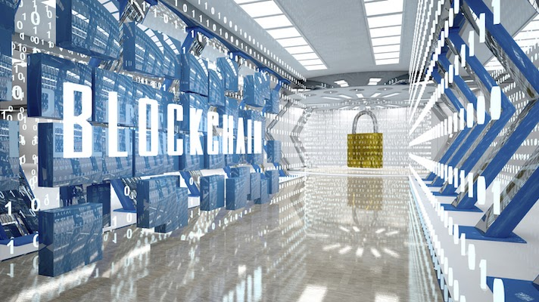
Data Security after blockchain
Increase security
Increase speed of cloud storage.
The data cannot be tampered with or stolen.
There is no need for a central entity or place to store data.
There is no need for a third party.

Slide 38
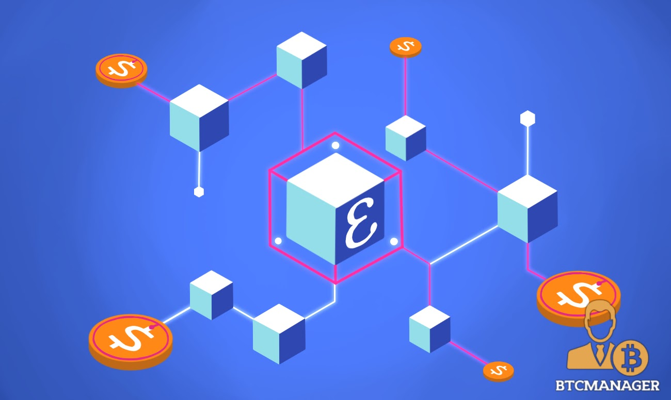
EXAMPLE
Enigma, for example, is a decentralized computation platform with guaranteed privacy, and an evolution upon the blockchain technology. Enigma’s goal is to enable developers to build a ‘privacy by design’, end-to-end decentralized application without a trusted third party.

Slide 39

Real Estate

Slide 40
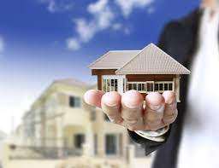
4. Real Estate
Real Estate are the assets owned by a company, group of people or an ordinary person, such as buildings, and lands which are physical, tangible, real and can be owned.
Issues with real estate dealings :
Needs face to face engagement.
Needs prove the legal property.
Papers need to be signed by the government organizations.
Real estate fraud.
Real estate sector is vulnerable.

Slide 41
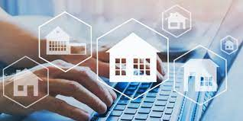
Real Estate Sector Development after Blockchain
Blockchain technology played a big role in solving the issues related to real estate where it enables the owners to digitize their assets and store them inside the blockchain cryptography.
offers the speed and security.
there is no third party control and validates the transaction.
offers the transparency.
Automation of the entire home-buying/selling process.

Slide 42
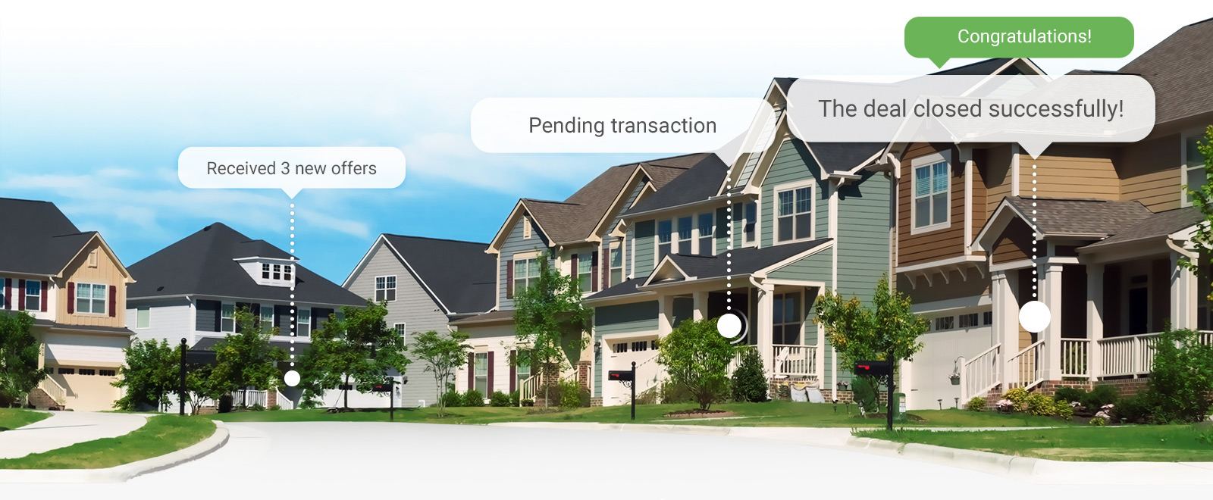
EXAMPLE
Propy Company
one of the first businesses to use smart contracts in the purchase and sale of real estate. A $60,000 apartment in Ukraine was the first transaction made using their system.

Slide 43
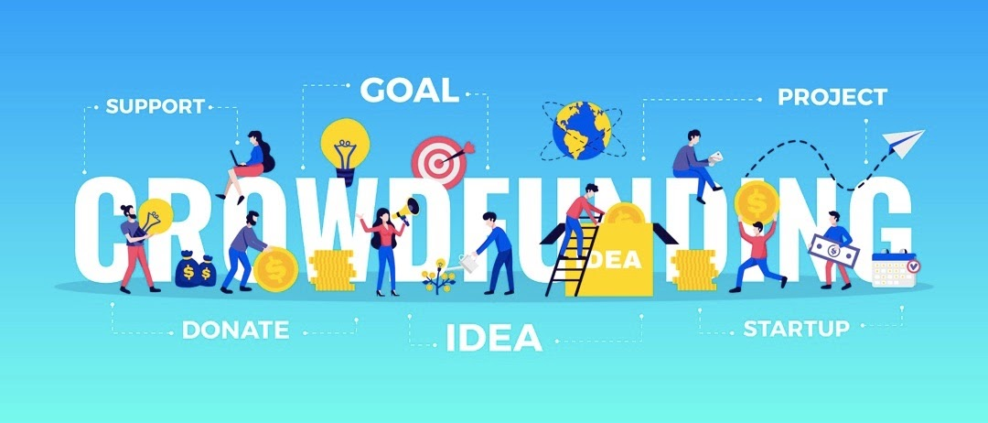

Slide 44
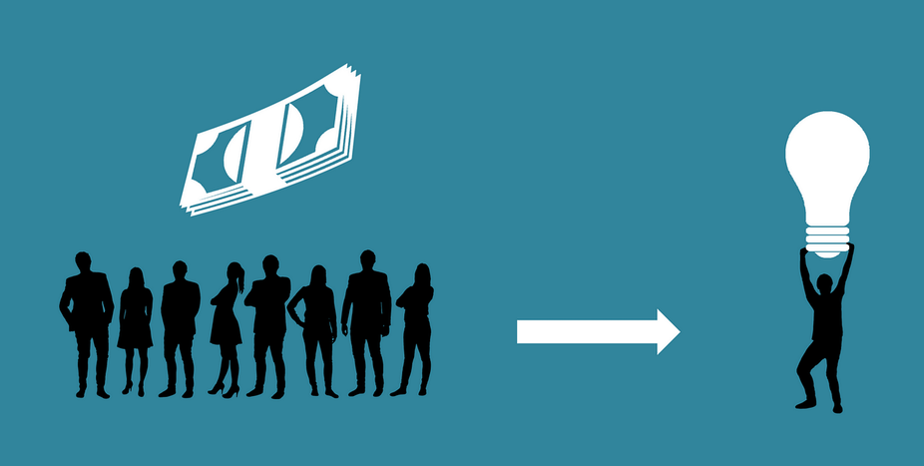
1. Crowdfunding
Collecting small amounts of donations from a large group of people to support a new business idea.

Slide 45
Traditional Crowdfunding:
Security risks
Illegal Transactions
Fraud and abuse

Slide 46
An example of a crowdfunding scam:
Asenergy Case (2015)
By leveraging crowdfunding platforms such as Fundable and EquityNet.
Raised 5 million dollars from about 90 investors.
The money was supposed to be spent on oil and gas operations.
The founder used most of the funds for overseas trips, dining, dietary supplements and personal care products.
Before the SEC took action, 1.2 million dollars had been siphoned off.

Slide 47
Crowdfunding after blockchain
Business issues tokens that serve as the company's stock.
The tokens can be purchased with fiat currencies such as USD.
These Tokens can be tracked across the network.
Reliable
Transparent
Trusted
Cost-efficient
With blockchain transactions are
Example: Petro company.

Slide 48
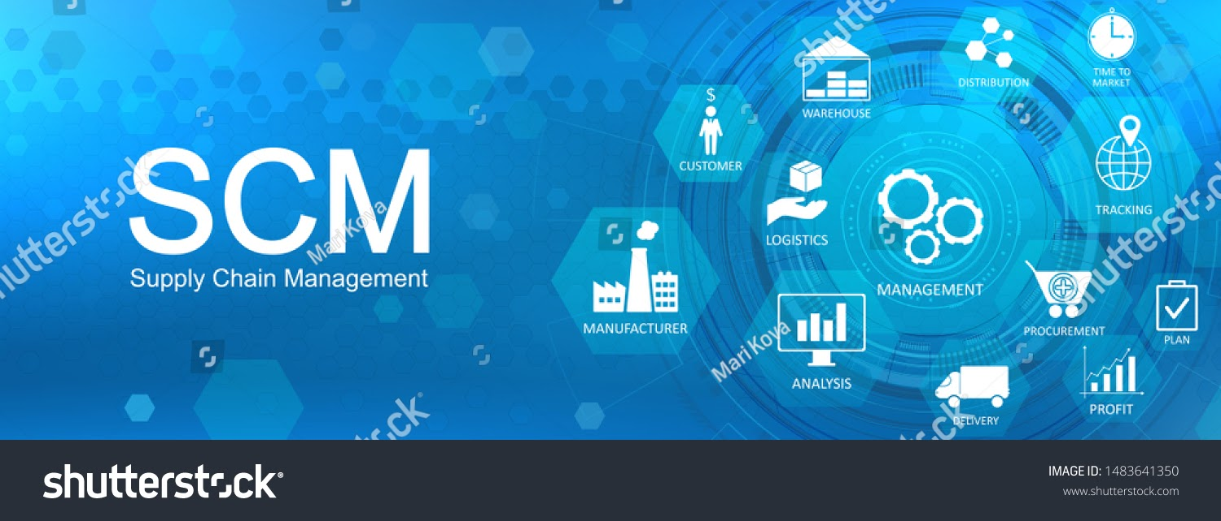

Slide 49
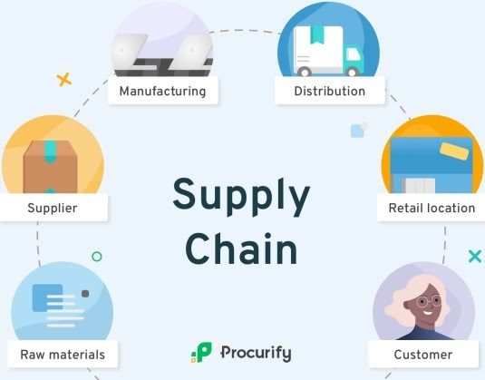
5. Supply Chain Management
Materials, information, and payments flow through the supply chain in both directions.

Slide 50
SCM before blockchain
Lack of transparency
Information disclosure.
Faces the risks of:
Data tampering.
Single node attack.
Security threats.

Slide 51
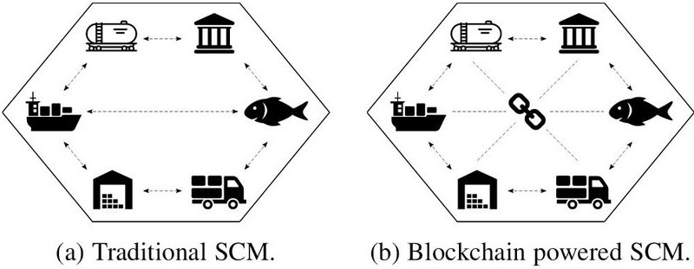
SCM after blockchain
Using Blockchain-based systems will provide:
Secure traceability and control.
Data immutability.
Interoperability.
Transparency.

Slide 52
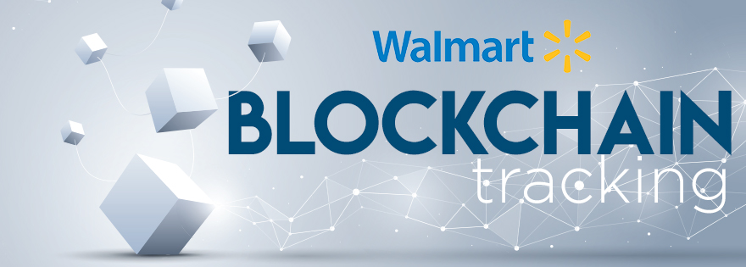
EXAMPLE
Walmart has identified the following benefits after integrating with IBM for food safety in the supply chain:
Reduction in fraud.
Improved supply chain efficiency.
Increased trust of the consumer.
Lower inventory and courier costs.

Slide 53


Slide 54
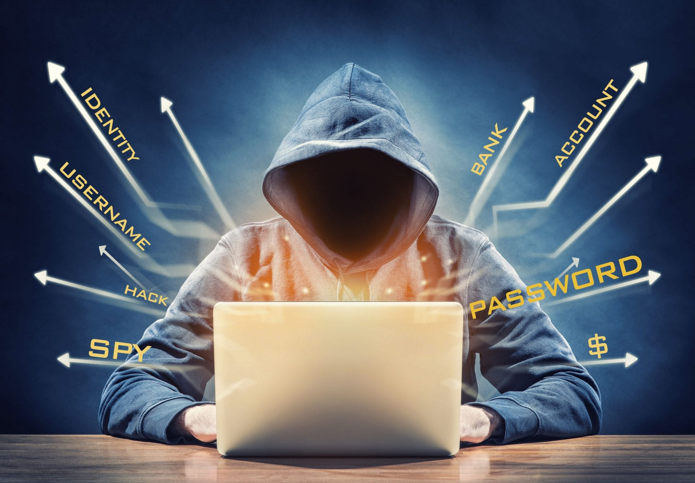
6. Identity Theft
It’s all types of crime in which someone steals another person's personal or financial data in order to use them in fraud or deception.
What is Identity in first place?
It’s bunch of data entered telling who
you are as a person such as:
Address
ID number
Passport number
Driver's license number …etc.

Slide 55
How Identity theft can happen to a person?
SPAM
Internet
In public places (shoulder surfing)
Receive applications for credit cards
Hackers

Slide 56
What a criminal could do with it?
He will be able to commit various crimes such as:
False applications for loans and credit cards.
Fraudulent withdrawals from bank accounts.
Obtaining other goods or privileges.
!

Slide 57
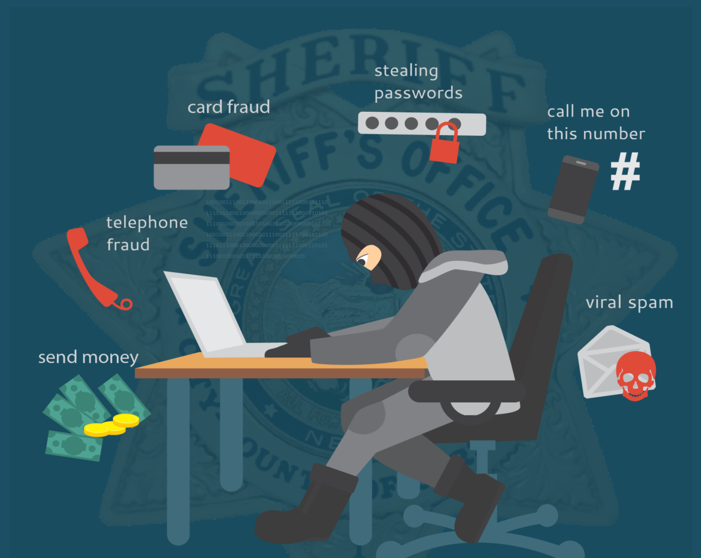
Issues with identity theft
Simple information can lead to identity theft.
Victims don’t recognize they are victims until they see the negative consequences.
An online survey by The Harries Showed that nearly 60 million people have been affected by identity theft in 2018, which is only in the USA.

Slide 58

Identity Theft after Blockchain
Extremely difficult on hackers to manipulate data.
Hackers needs to get access each device on the network.
Records can only be deleted after consensus.
Any modification will be reflected in the systems, which in its role will warn all participants.

Slide 59
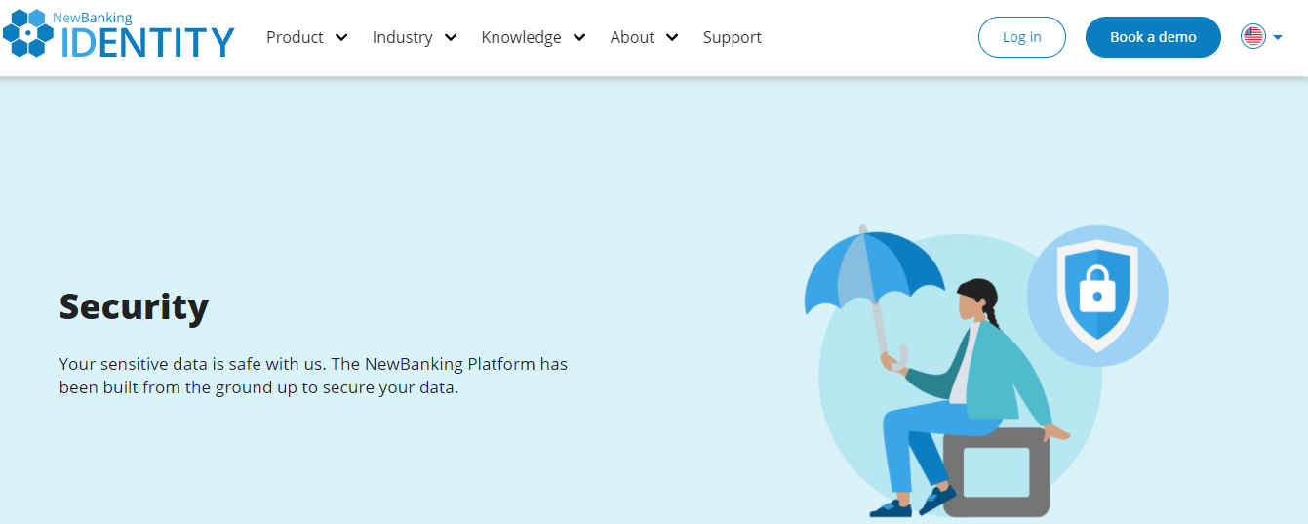
EXAMPLE

Slide 60


Slide 61
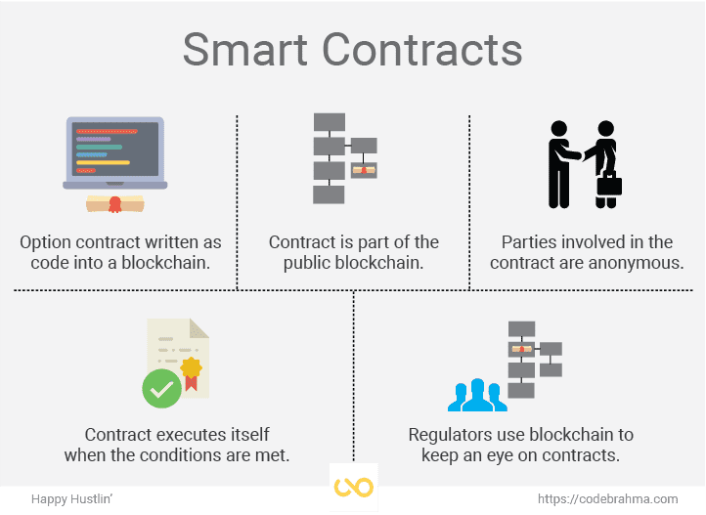
7. Smart Contract
A smart contract is executable code that runs on the blockchain to facilitate, execute and enforce the terms of an agreement.

Slide 62
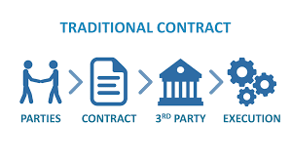
Traditional Contracts and Agreements:
Multi-step process.
waste of time.
waste of money.
Third-party involvement is needed.

Slide 63
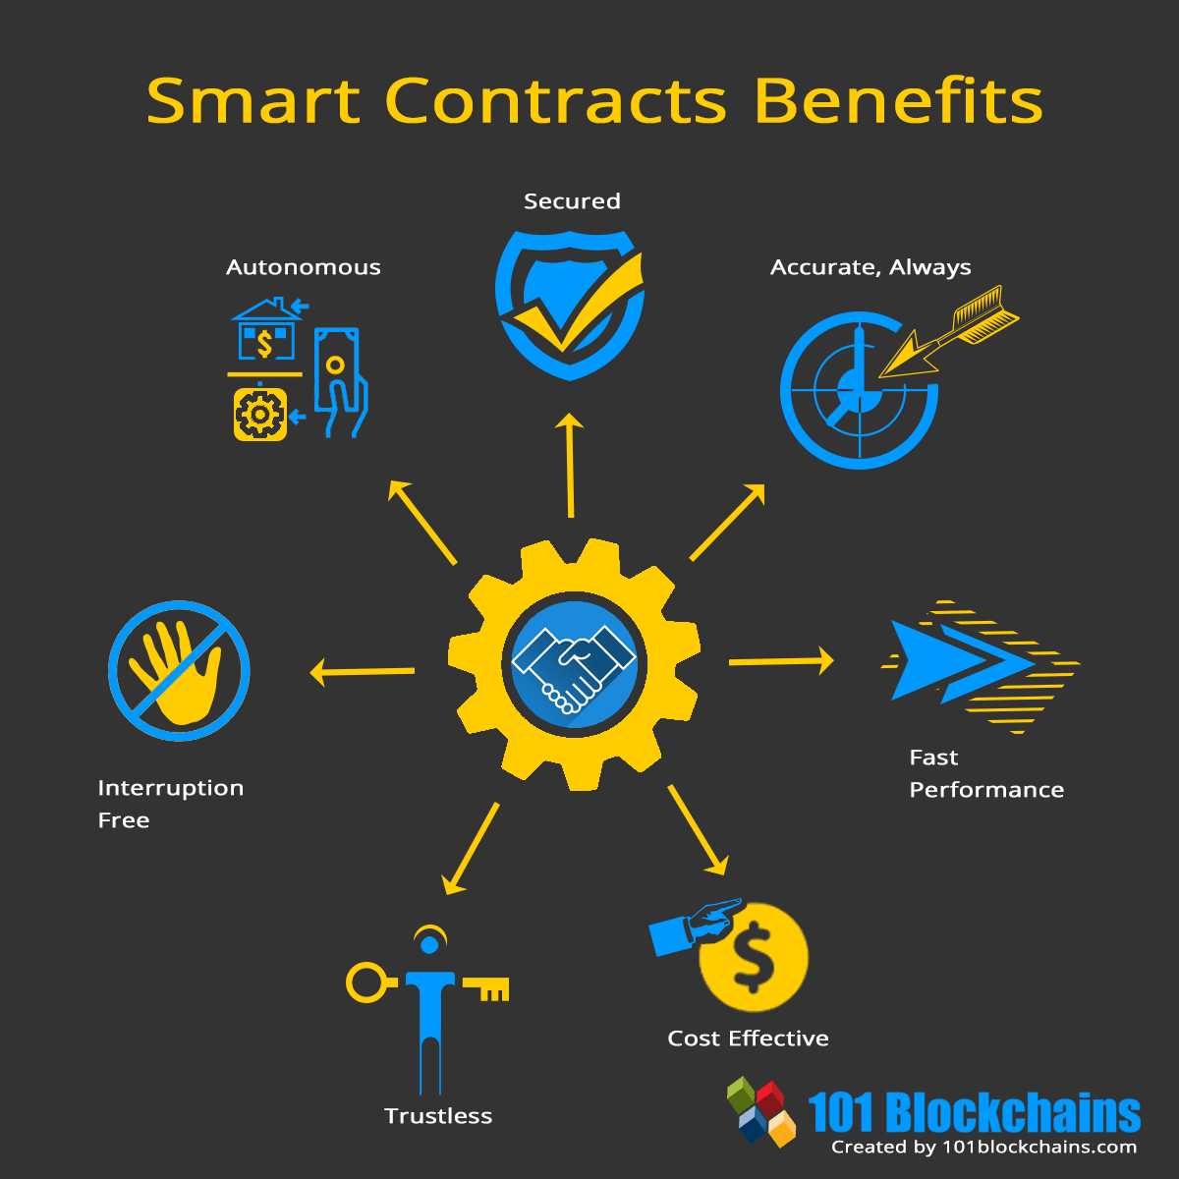
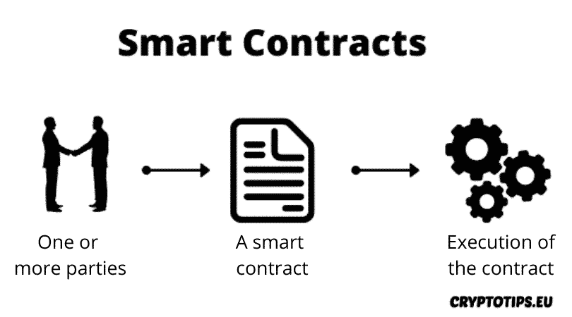
Contracts after Blockchain
When using blockchain technology, the problem of traditional contracts can be avoided.
Example: Smart contracts are used to encode rules to govern an organization

Slide 64

Sports and eSports

Slide 65
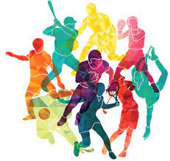
8. Sports and eSports
Sports and Esports : are part of the entertainment sector where each has its fans who are interested in catching up their news.
What is the deference between Sports and Esports ?
Sports means the traditional championships established in the real world such as football, basketball and so on.

Slide 66

Sports and eSports cont.
The eSport (Electronic Sports) means real time competition, video games facilitated by electronic devices (computers, smart phones, PS4, and Xbox... etc.) used by cyberathletes to play various numbers of games.

Slide 67
Issues with Traditional Sports and Esports
eSports
Sports
The absence of transparency.
Sponsorship management.
New investments obstacles.
Tickets Scalping.
The anonymity of the players identity.
Limitation of revenue stream models.
The existence of third-party(distributors).

Slide 68
Sports and Esports Development after Blockchain
A p2p connection.
Decrease the time.
Powering smart ticket systems.
Using smart contracts and tokenization in crowdfunding.
Detailed logs and cryptocurrency-based payment.

Slide 69
Sports and Esports Development after Blockchain cont.
Preventing the manipulation and delaying the payments.
Developing new stream revenue models.
Reducing the costs.
There is no need for a third-party who controls the network.
High transparency.

Slide 70
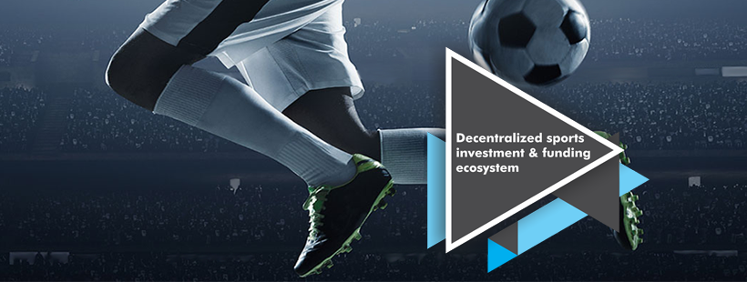
EXAMPLE
Sporty.Co
Sporty.co is one of the firms who deployed blockchain technology in the sport industry. It published white paper in order to explain the big transformation towards using blockchain crowdfunding platform that
helps athletes, teams, and other sports organizations raise the money they need to succeed.

Slide 71
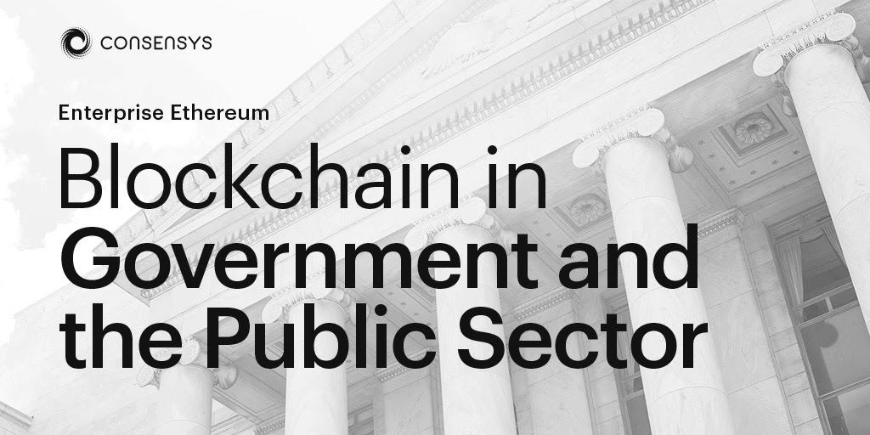

Slide 72

10. Government Systems and Public Sectors
Public Sectors: The grouping of units owned or controlled by public units is referred to as the public sector, Managed and funded mainly by the government, and all public companies.
All publicly controlled or publicly funded agencies/enterprises.
Other entities that deliver public programs, goods, or services.

Slide 73

Government Systems and Public Sectors cont.
Government Systems: Systems used by the governments in order to accomplish its duties such as payments, land registration, voting for elections, healthcare, taxation, corporate registration, identity management, and legal entities management.

Slide 74
Governments and Public sectors before blockchain
Most of the governments and public sectors depend on old-fashioned methods and systems.
High Cost
Less Security
Slow
Opening the way to fraud and corruption.
Puts sensitive data at risk and leads to serious problems.

Slide 75
Governments Systems after blockchain
Structure is immutable (no fraud or data theft).
Safe exchange of resources and data.
Blockchain-based digital government
Transparent government process (increase people's confidence in the system).
Saving time and money (automating a lot of activities).

Slide 76
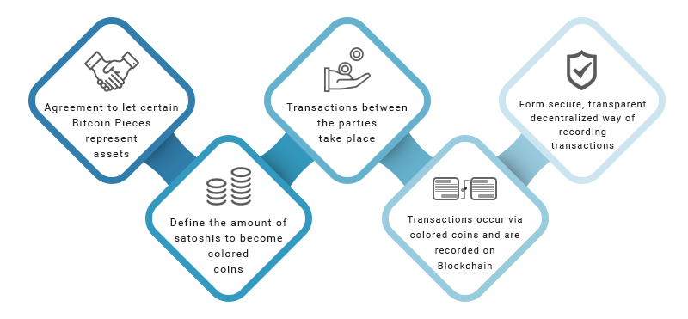
Public Sectors after blockchain
Time, Cost, Storage and Fraud.
Security and Trust.

Slide 77
EXAMPLE
Government-led blockchain projects:
China → Blockchain-based asset custody(more than 100 transactions).
Dubai → Government documents management system.
Electronic voting systems based on blockchain:
Estonia → called i-Voting(National voting system).

Slide 78
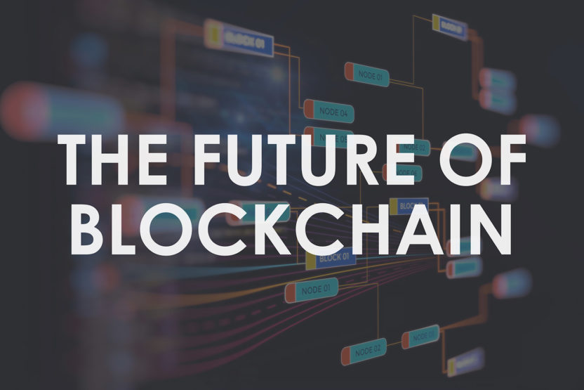

Slide 79
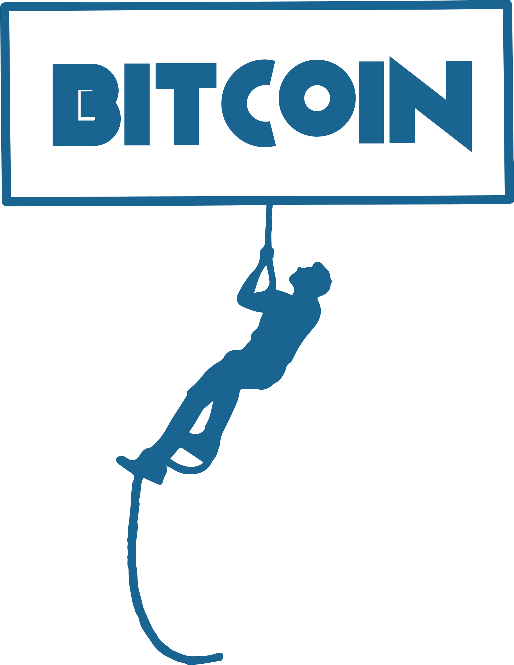
Future of Blockchain
“The Future Will Be Decentralized. Who will control the next big thing online? Everyone and no one.”
- Tyler Cowen
FUTURE
“Blockchain technology has the potential to revolutionize industry, finance, and government—a must read for anyone interested in the future of money and humanity.”
- Perianne Boring
“We believe that blockchain technology will be transformative in the tech and IT sector in the coming years, similar to what the internet did for the world back in the 90s and early 2000s,”
- John Zanni

Slide 80
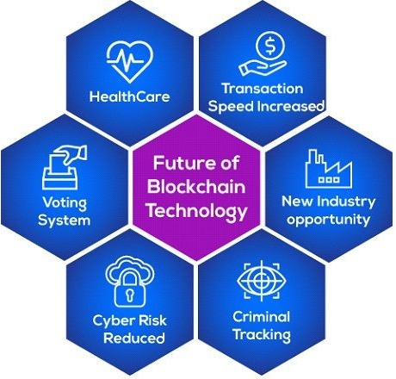
Future of Blockchain
Empower people in developing countries.
The use in voting systems.
Virtual cryptocurrency for China.
That DeFi Will Continue to Increase(Decentralized finance).

Slide 81
Future of Blockchain
The number of transactions beyond conventional mechanisms and mediums would increase substantially.
Help in improving the safety of big Data.
Democratize ownership and sharing of big data.

Slide 82
  Unintentional deletion.
  Alteration of data .
  Time, Cost and Effort(for each transaction).
Blockchain has overcome the centralized system issues.
Blockchain is the future for the world and it could be the next generation of the Internet.
Blockchain technology has the ability to solve a lot of problems by its characteristics.
Conclusion

Slide 83
Recommendations
Keep on searching Blockchain development and applications in various fields.
Invest more in blockchain (research, apply it in order to develop).
Starting new majors/courses related to blockchain technology in universities.
Conducting more time and work to the application and incorporation of the Blockchain into the key industrial directions.

Slide 84


