Slide 1
Introduction
Streaming Video from Raspberry pi to mobile.
Controlling the Robot using by wireless(ESP).

Slide 2
Objective
using technology to make our life easier and more safe.
Have a live stream video about what the Robot saw inside the home .

Slide 4
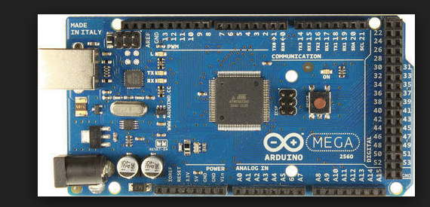
Tools:
Arduino Mega

Slide 5
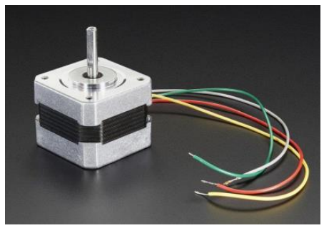
Stepper motor

Slide 6
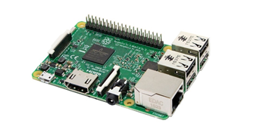
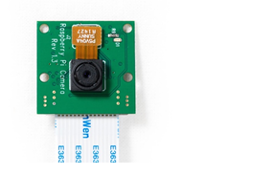
Raspberry Pi 3 Raspberry Pi Camera v1

Slide 7
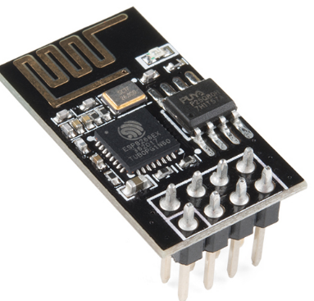
ESP8266

Slide 8
Video streaming:
We use two servers works well with as :
we use“UV4L which is a video streaming service and serves the video to any local client.
Node.js server (same as UV4L server)
Steps:
Download the server on your raspberry
- Apply some commands on the “ CMD” to set port number for raspberry and height & width for the video
- In our mobile browser we call the raspberry pi “ IP “ after connecting the raspberry pi and your device on the same network.

Slide 9
Demo camera

Slide 10
Demo robot

Slide 11
Limitation:
using a raspberry pi and the difficulty of dealing with it.
using the camera forced us to use the raspberry
Dealing with the camera
Defect in some hardware components
Delay in getting the hardware components

Slide 12
Future work:
Add virtual reality for video.
Image processing to analyze video.

