Slide 1
Periscope
Prepared by:haya shubi & samar suwadeh
Submitted to:manar qamhieh

Slide 2
introduction?
In our daily life book is very necessary substance without it we can’t express knowledge. So, books are the main source of knowledge. For that the existence of libraries is very essential. Our project is a distributed library management system. As the project name is totally concerned with the management of books and other libraries contents. The main feature of our project is that it is Distributed i.e. the database lies on a server and all client’s machines can access that system and benefit from it. It is a multiple user system there is two types of users: library manager and regular user, and each of one has its appropriate rights.

Slide 4
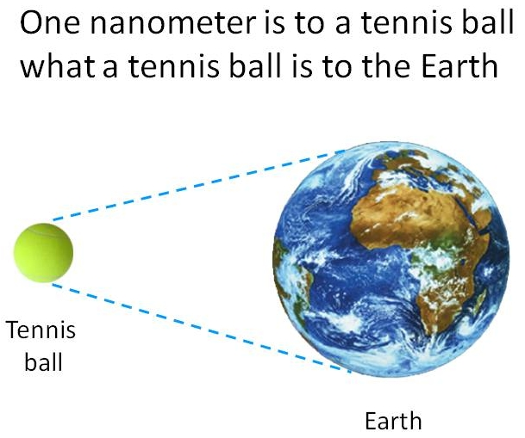

Slide 5

Periscope: is mainly consists of the processing , separation, consolidation, and deformation of materials by one atom or by one molecule.

Slide 6
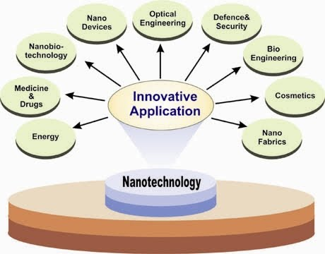
Periscope Applications :

Slide 7
Advantages of Periscope:
1. the material product become more stronger,
lighter cheaper and durable.
2. computers can become a billion times faster and smaller .
3. Automatic pollution cleanup .
4. end of illnesses like censer and heart disease .

Slide 8
Disadvantages of periscope:
The most dangerous Nano-application use for military purpose is the Nano-bomb .

Slide 9
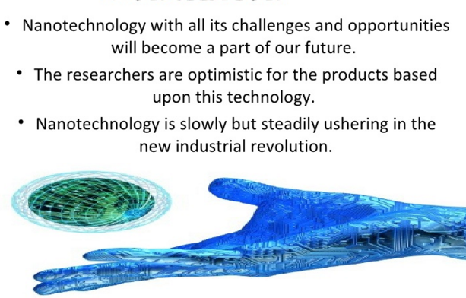
conclusion

