Slide 1

Graduation Project II
Bus & taxi Station
An-Najah National University
Faculty of Engineering and information Technology
Building Engineering Department
Supervisor: Dr. Moayad Salhab
Prepared By:
Abeer Hawash Afnan Foqha Haya Awad

Slide 2
Outlines
Introduction
Architectural Design
Structural Design
Environmental Design
Electrical Design
Mechanical Design
Safety Design
Quantity Surveying and Cost Estimation

Slide 3
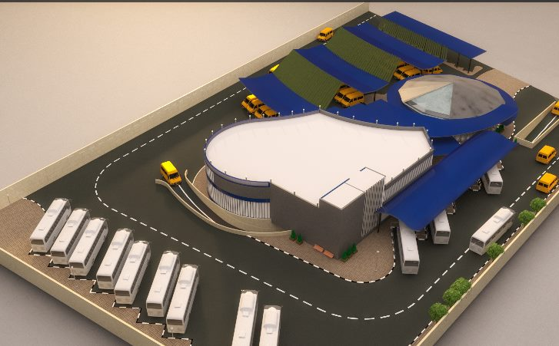
INTRODUCTION

Slide 4
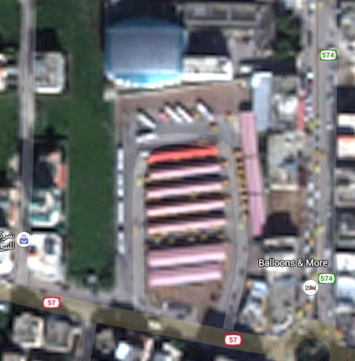
SITE LOCATION
Location: Tulkarm.

Slide 5
Site Advantage
Land located near the city center which gives a great advantage; it will be easier for the passengers to reach their destinations.
The site have an easy access for vehicles.
The slope of the land is moderate, and area of site is suitable and not small.
The surrounding buildings are relatively far and that allows using daylight and good ventilation.

Slide 6
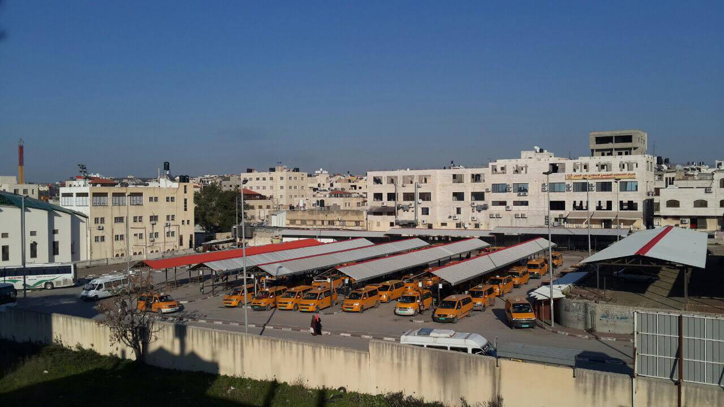
Current Taxi Parking

Slide 7
Exist project Disadvantage
The exist parking has many problems that we are going to solve, for example:
No specific path for walkers who want to reach buses or cars, and no paths for disabled people.
No place for waiting, so this will make waiting un comfortable and annoying.
There is no W/C`s, or any services.
No treatments for environmental pollutions, like noise or air pollution or thermal comfort for passengers.

Slide 8
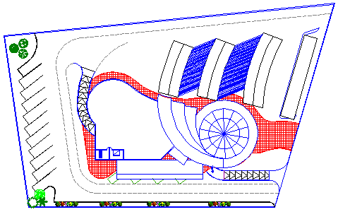
Architectural Design
Site Plan : total land area around 10,000 m2

Slide 9
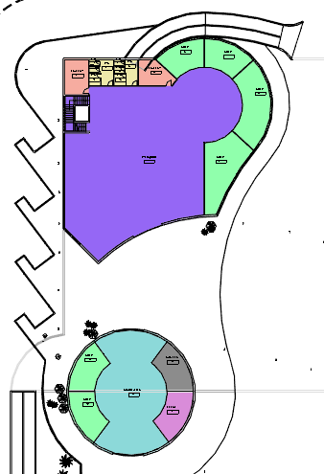
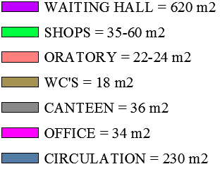
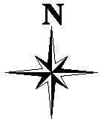
Architectural Design

Slide 10
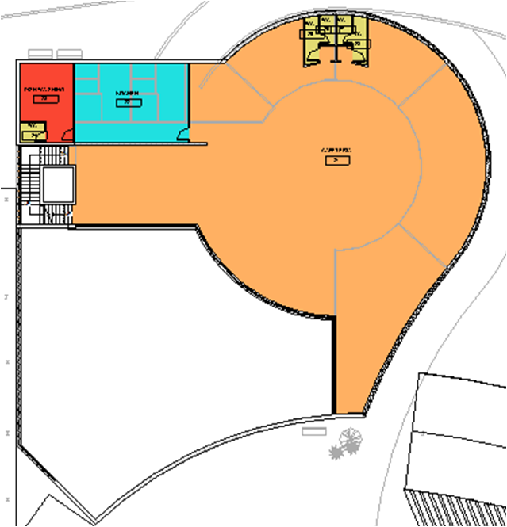

Architectural Design

Slide 11
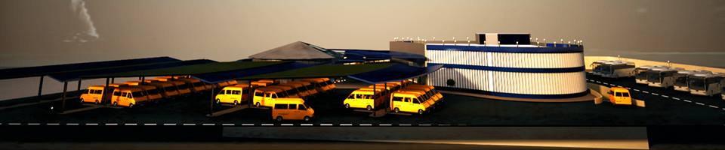
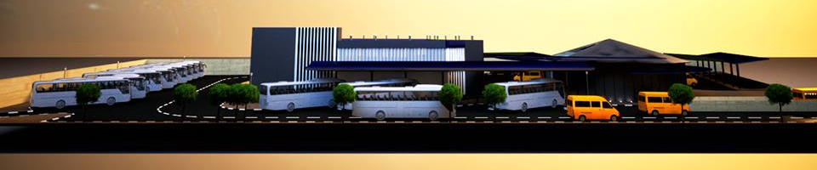
Architectural Design
Elevations :
East Elevation
West Elevation

Slide 12
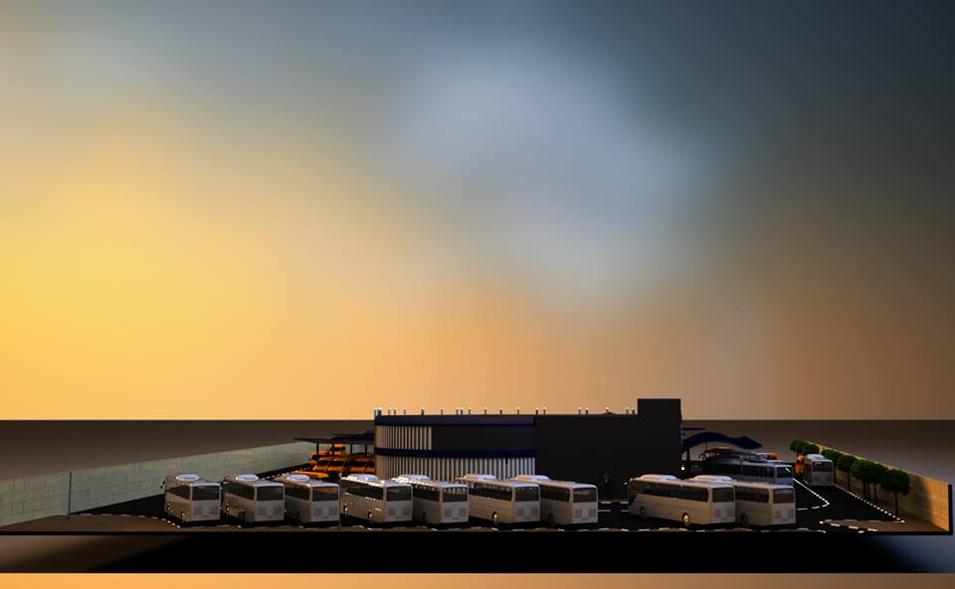
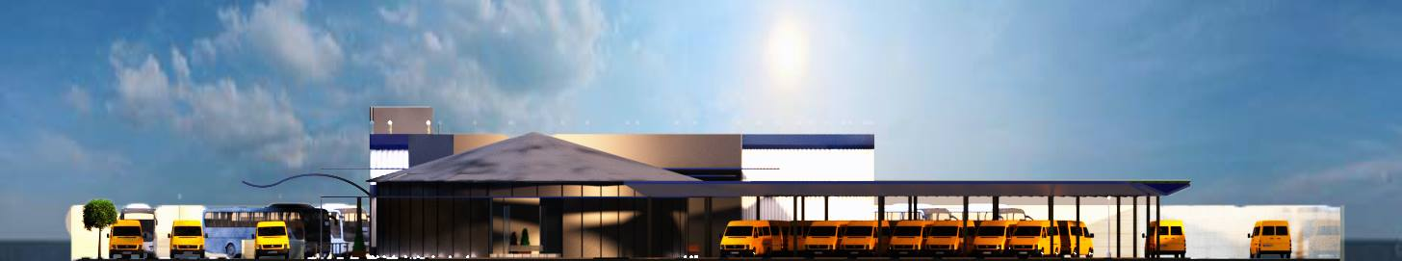
Architectural Design
North Elevation
South Elevation

Slide 13
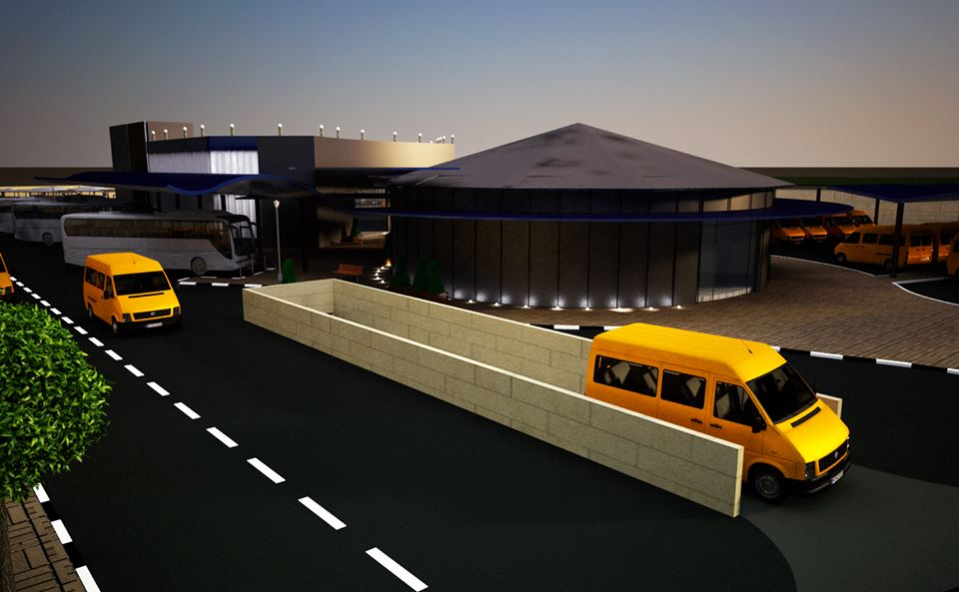
Architectural Design
3D view’s

Slide 14
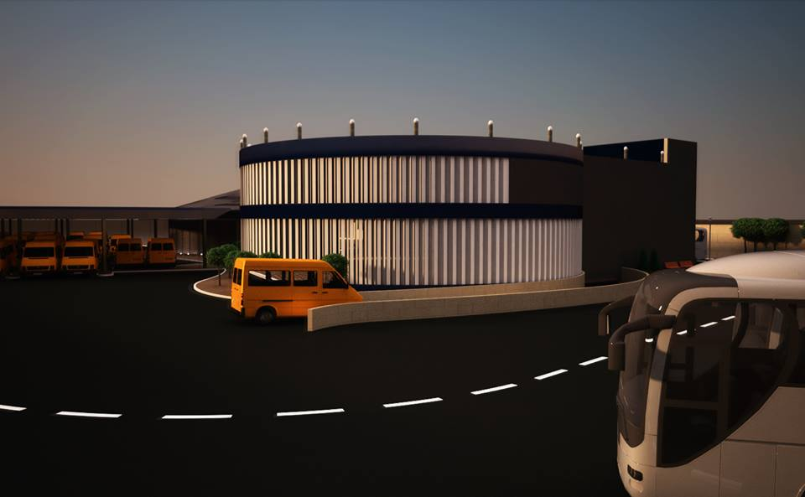
Architectural Design
3D view’s

Slide 15
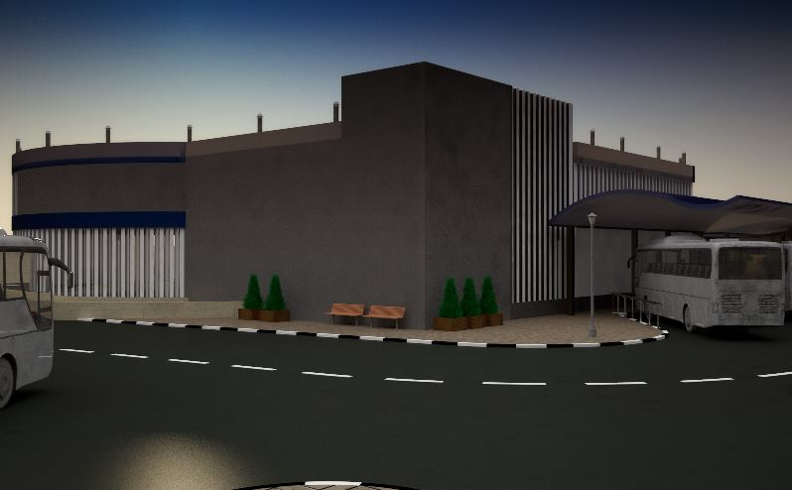
Architectural Design
3D view’s

Slide 16
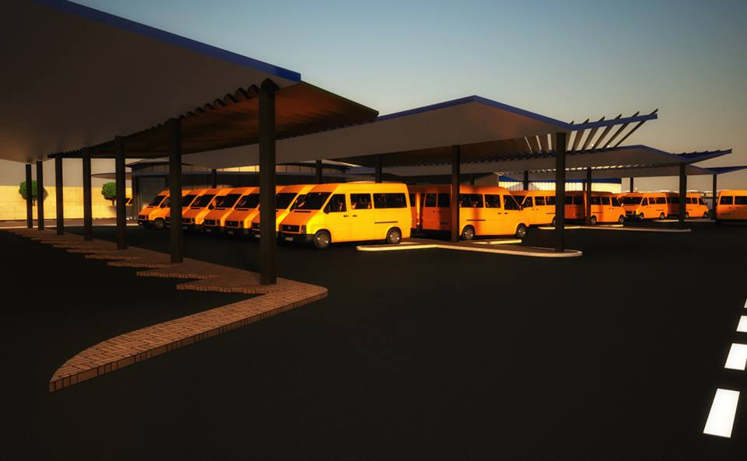
Architectural Design
3D view’s

Slide 17
Architectural Design
3D view’s

Slide 18
Environmental Design:
Environmental Design
and Analysis

Slide 19
Environmental Design:
Daylight Calculation
Thermal Calculation
Acoustical Design

Slide 20
Environmental Design:
Avg. Daylight Values:
Ecotect model was used to compute the daylight factor for the design.
The daylight factor must be within the range of (3-5).

Slide 21
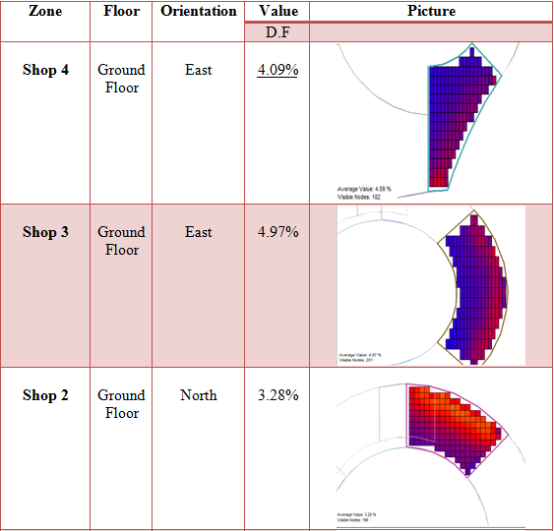
Environmental Design:

Slide 22
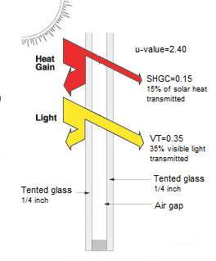
Environmental Design:
Double Tented Glass:
U-Value = 2.4
Solar Heat transmitted = 15%
Visible Light Transmitted =35%

Slide 23
Environmental Design:
solar analysis :
Shadow in critical day (21- December )- ( in winter) :
8:00 am.
12:00 pm

Slide 24
Environmental Design:
Shadow in critical day (21- June )- ( in summer) :
8:00 am
12:00 pm

Slide 25
Environmental Design:
Thermal Design:
1)Material properties
2)Heating and Cooling Load
3)Heat Gain Breakdown
4)Temperature Distribution.

Slide 26
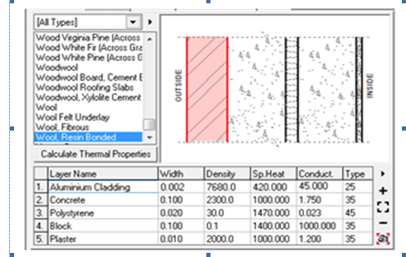
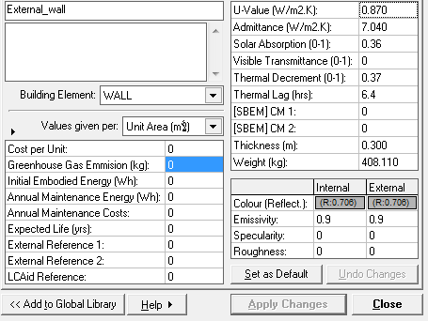
Environmental Design:
Material properties:
External Wall Details
U-value = 0.5 W/m2.K
Thermal Lag= 6.4 hrs.

Slide 27
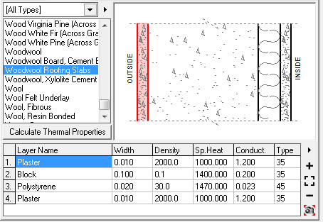
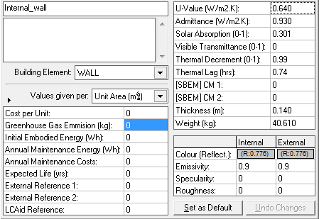
Environmental Design:
Material properties:
Internal Wall
U-value = 0.64 W/m2.K
Thermal Lag= 0.74 hrs.

Slide 28
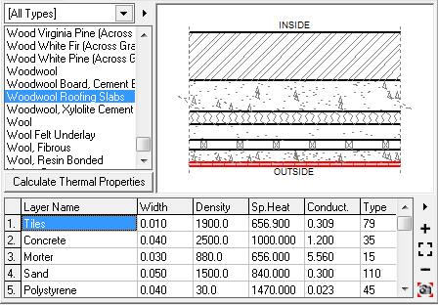
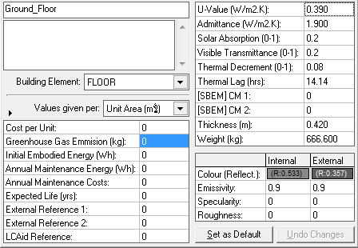
Environmental Design:
Material properties:
Ground Floor
U-value = 0.46 W/m2.K
Thermal Lag= 14.14 hrs.

Slide 29
Environmental Design:
Material properties:
Ceiling
Thermal Lag= 4 hrs.

Slide 30
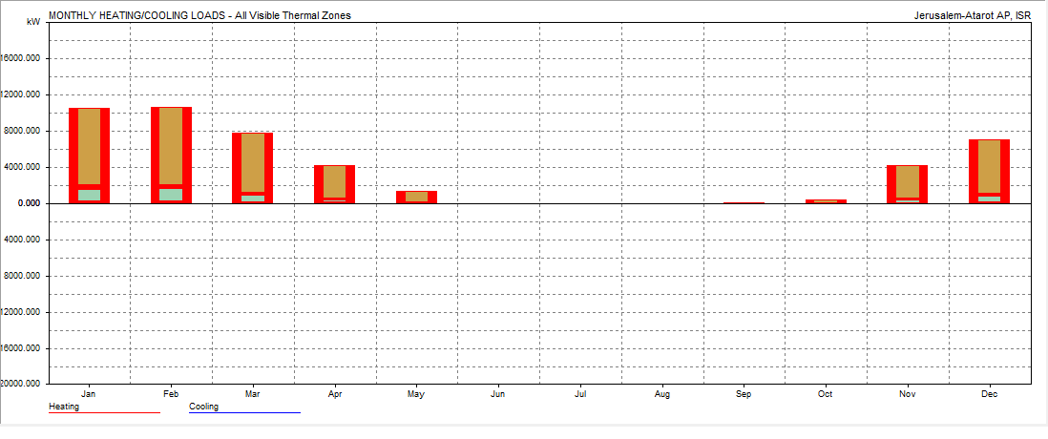
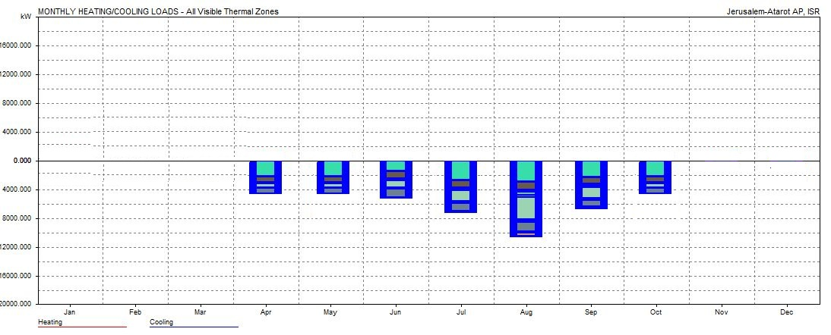
Environmental Design:
Heating and Cooling Load
@ Winter:
Max heating load (Only) = 20.43 kwhr/m2
@ summer:
Max cooling load (Only)=56.28 kwhr/m2

Slide 31
Environmental Design:
Heat Gain Breakdown:
To see where heating and cooling loads come from.
Heat Gain (solution):
Increase Cooling
load or decrease
Heating load .
41.8 %
43.2 %
Heat Loss
(solution):
Increase Heating
load or decrease
Cooling load
39.8 %
60.1 %
Internal
Sol – AIR
(solar radiation)
Conduction
Ventilation

Slide 32
Environmental Design:
Temperature Distribution:
Cold
Comfort
Hot
The building is in the Comfort Temperature which is between(18 - 28)c.

Slide 33
Environmental Design:
Acoustical Design :
1) RT 60
2) STC
3) IIC

Slide 34
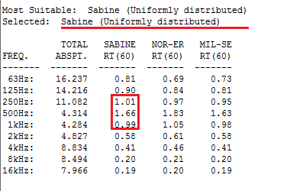
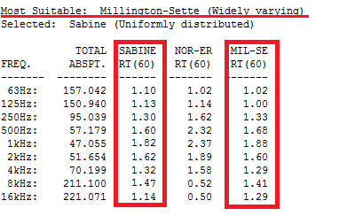
Environmental Design:
Acoustical Design for Oratory:
RT60 Range for mosque must be in between (1.2 – 1.6)
Values for Original wall
Values for Modified wall

Slide 35
Environmental Design:
STC Value:
We use this layer of wall :
-Dense hollow block (thick 15cm) STC = 43 db
-Plaster to both side STC = 4 db
-Absorption material STC = 3 db
-Gypsum board STC = 4 db
-Staggered studs STC = 9 db
Total STC of wall = 63 db > 52 ok

Slide 36
Environmental Design:
IIC Value:
IIC for false ceiling:
-8 in dense hollow block IIC = 26 db
-100 mm solid concrete IIC =16 db
-Air cavity IIC = 18 db
Total IIC = 60 db > 52 db ok

Slide 37
Structural Design:
Two structural systems were used in the project:
1) concrete structure.
2) steel structure in covering.

Slide 38
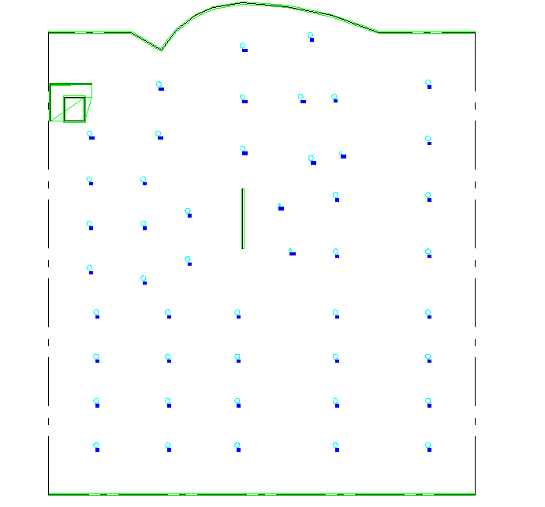
Structural Design
Columns Distribution:

Slide 39
Structural Design
Design Data:
Concrete F’c For all elements is 28 Mpa.
Bearing Capacity For Soil 150 Mpa.

Slide 40
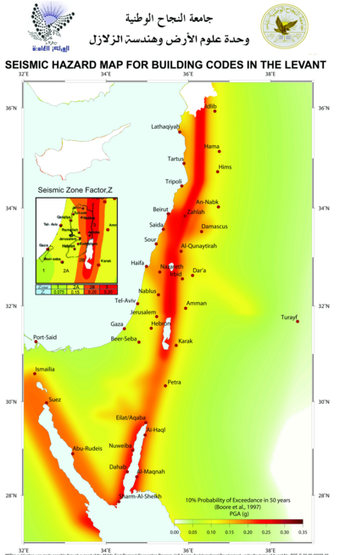
Seismic Design:
Importance factor (I) = 1
Soil profile: Silt Clay
Seismic Coefficient (Cv)= 0.32
Seismic Coefficient (Ca)= 0.22
Structural system
Coefficient (R) = 5.5
The Structural System in Tulkarm.
Sway Intermediate

Slide 41
Structural Design
Loads Used for Concrete blocks:
Value used | Load type
5KN./m^2 | Live Load
3KN/m^2 | SID

Slide 42
Structural Design
Preliminary Design:
Beams:
Main beams 60*80 cm^2.
Secondary beams starts with 60*40 cm^2.
Columns:
60cm diameter .
slabs:
First slab (above parking is a solid slab with 27 cm thickness.
Second and third are ribbed slabs with 33cm thick.

Slide 43
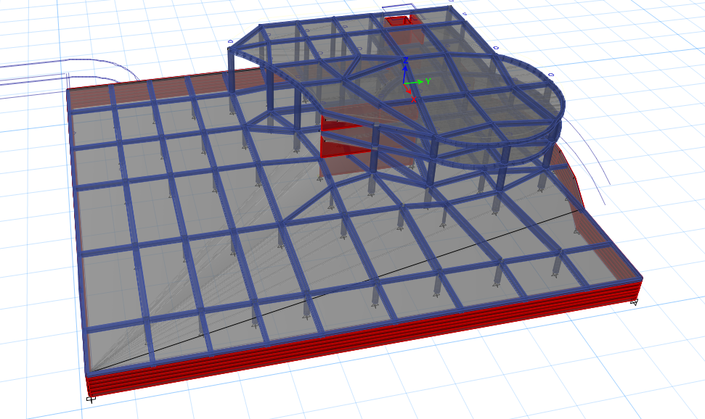
Structural Design
3D Model:

Slide 44
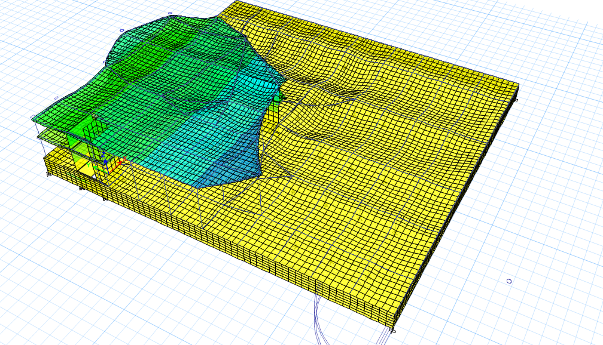
Structural Design
3D-model, compatibility check.

Slide 45
Structural Design
Equilibrium Check:
%of error | Manual Results | Etabs Results | Loads
0.05% | 23295 | 23308 | Live
2.1% | 46950 | 47954 | Dead
0.7 % | 16608 | 16476.6 | SID
Error = ( ( Manual – ETABS Load ) / Manual Load ) X 100% < 5%

Slide 46
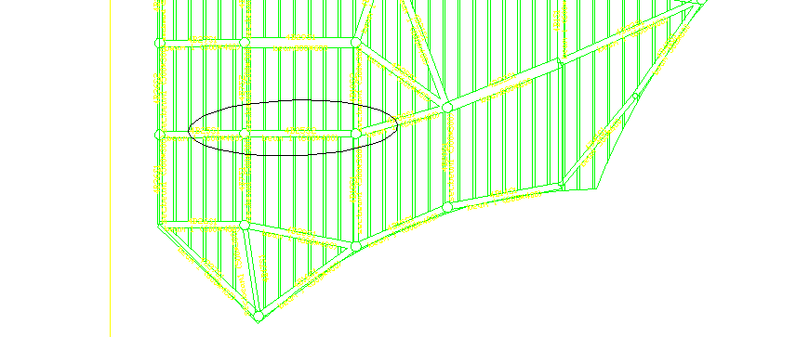
Structural Design
Beam Internal moment Check:

Slide 47
Structural Design
% error | (KN.m)ETAB Moment | Manual Moment (KN.m)
0.29 <10% | 504 | 652

Slide 48
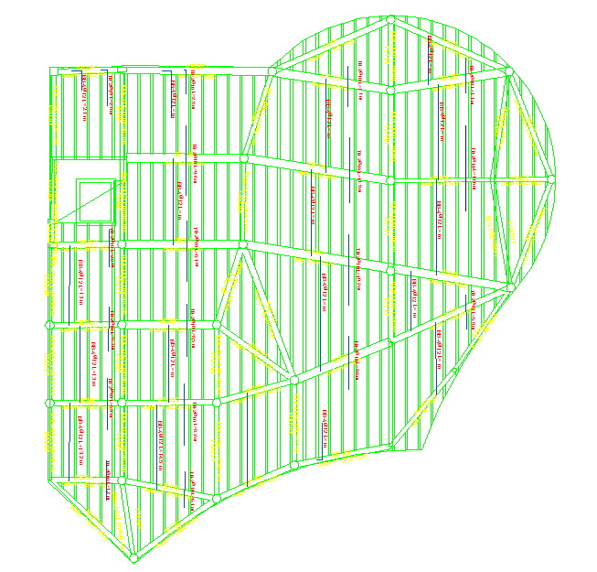
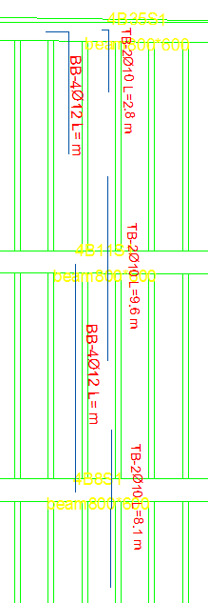
Structural Design
Design Stage:
Typical Ribbed Slab
Reinforcements in
Y – Direction :

Slide 49
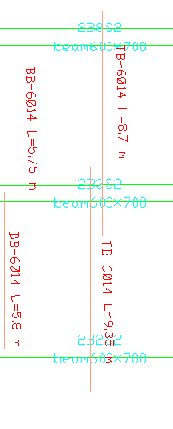
Structural Design
Typical Solid Slab
Reinforcements :

Slide 50
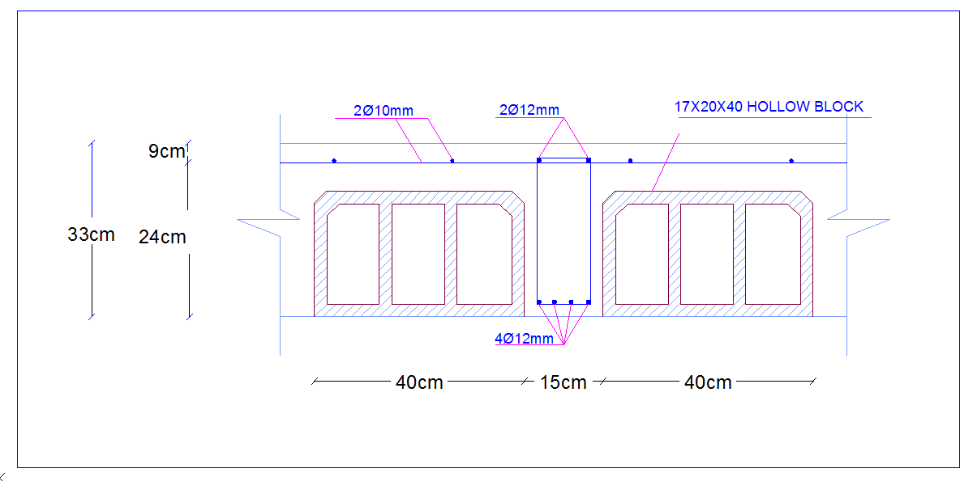
Structural Design
One – Way Ribbed Slab Reinforcements in
Y – Direction :

Slide 51
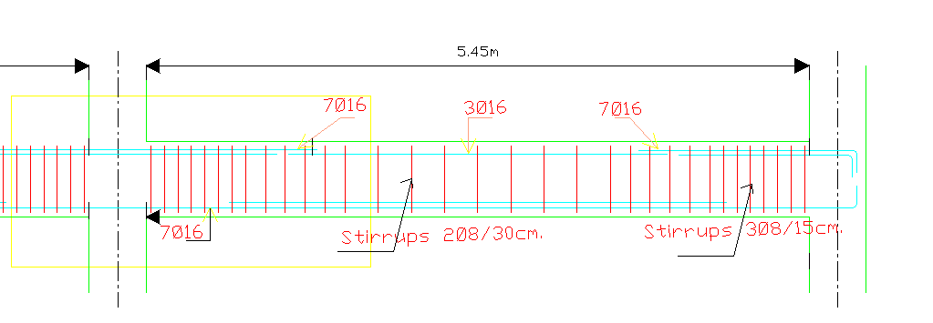
Structural Design
Beams Reinforcements:

Slide 52
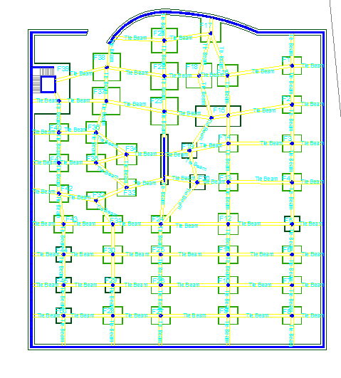
Structural Design
Footing Lay out:

Slide 53
Structural Design
Steel truss system used to cover circular building by using aluocbond sheet as covering material
Covering Material properties:
Comp. strength =420MPa
Weight of cover = 5.5 kg/m²
4mm thickness
ρ= 12 KN/m³
E70xx welding material, with strength F =480 Mpa.

Slide 54
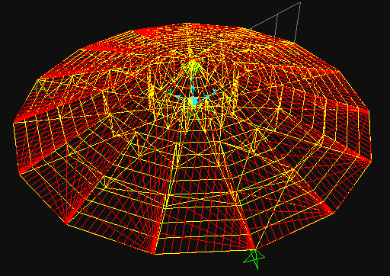
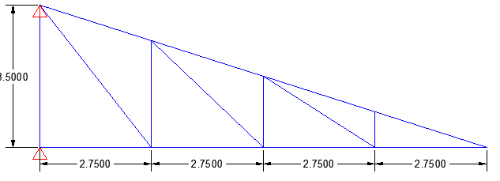
Structural Design
SID = 0.054KN/m²
Live Load= 1 KN/m²
Snow load= 1.50 KN/m²
Wind load = 0.27 KN/m²
3D truss SAP model
2D truss SAP model

Slide 55
Structural Design
SAP Checks:
Compatibility: Start animation OK
period (Modal) T=0.08 < 1 ok
Equilibrium:
Max Deflection = 0.56mm ➔ deflection check is ok
load | SAP (KN) | Manual (KN) | Error(%)
S.I.Dead | 20.96 | 21.54 KN | 2.7 ok
Live | 368.77 | 362.27 | 1.8 ok
Snow | 555 | 543.6 | 2.1 ok
Wind | 99.66 | 107.7 | 7.47 ok

Slide 56
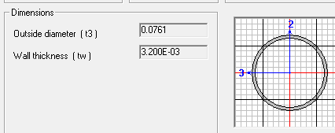
Structural Design
All Truss member section is tube-D = 76.1 mm * 3.2

Slide 57
Electrical Design
Artificial Lighting
The simulation analysis and design by “DIALux Evo”

Slide 58
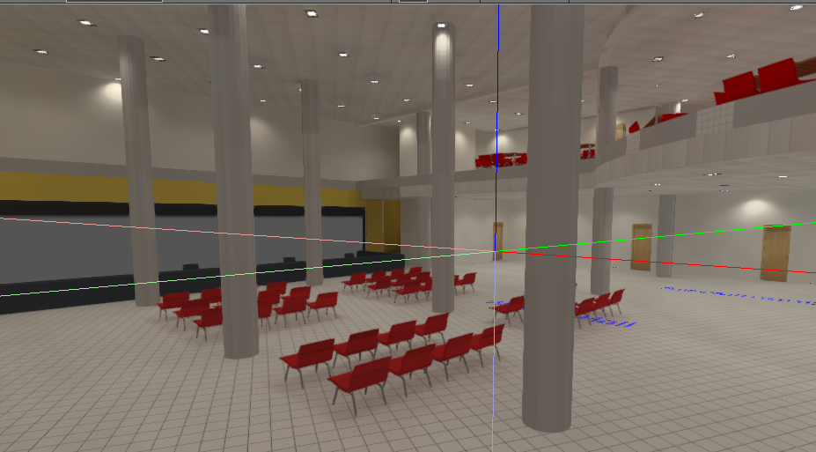
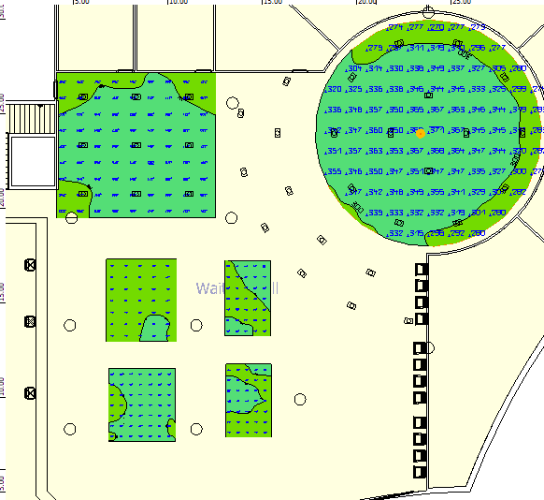
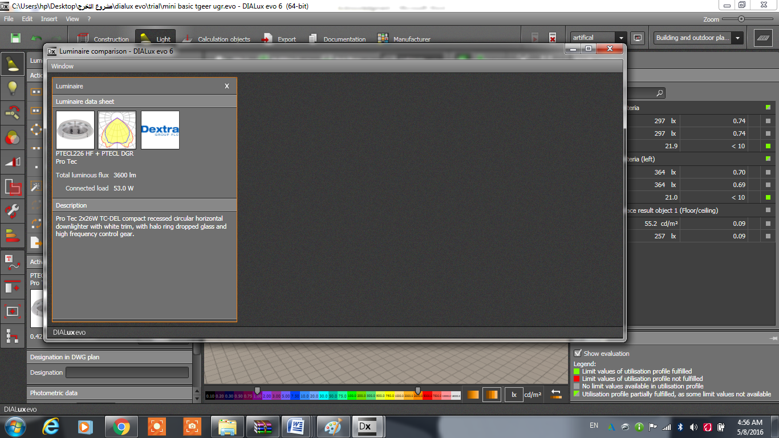
Electrical Design
Waiting Hall
U | Targeted Lux. (avg.) | Recommended Lux. | No. of Luminaries
95% | 291 | 200 | 46

Slide 59
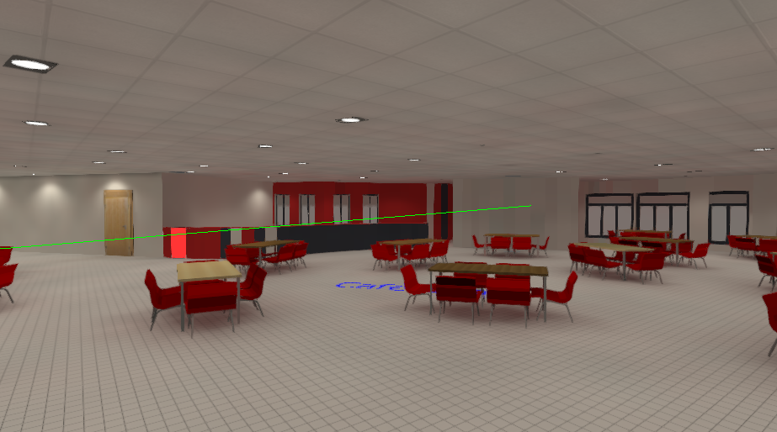
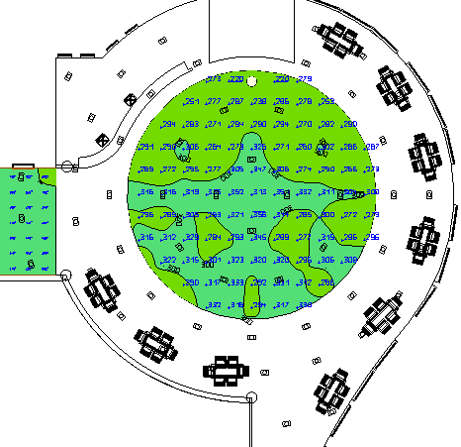
Electrical Design
Cafeteria
U | Targeted Lux (avg.) | Recommended Lux | No. of Luminaires
74% | 297 | 200 | 62

Slide 60
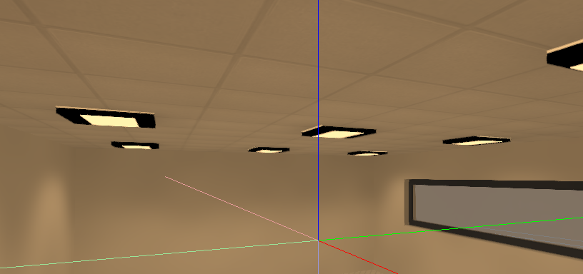
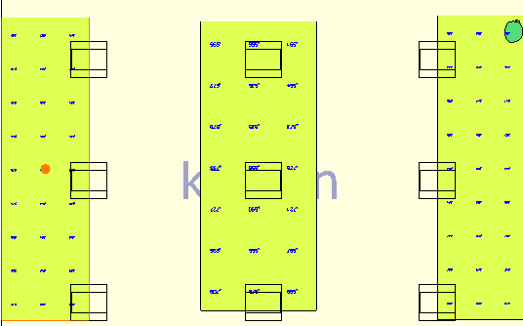
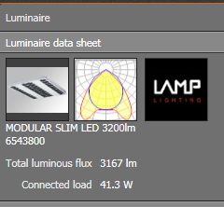
Electrical Design
Kitchen
U | Targeted Lux. (avg.) | Recommended Lux. | No. of Luminaries
84% | 637 | 500 | 9

Slide 61


Electrical Design
Oratory
U | Targeted Lux. (avg.) | Recommended Lux. | No. of Luminaries
77% | 147 | 100 | 2

Slide 62


Electrical Design
Shop
U | Targeted Lux. (avg.) | Recommended Lux. | No. of Luminaries
80% | 528 | 500 | 11

Slide 63


Safety Design:
Fire fighting systems :
Fire hose cabinet
Fire Sprinkler

Slide 64

Safety Design:
Fire Sprinkler system :

Slide 65
Mechanical Design:
HVAC System:
Water Supply System
Drainage system

Slide 66
Mechanical Design:
HVAC System:
- Cooling Load:
Zone Name | Area | Cooling Load | Zone Name | Area | Cooling Load
مصلى 1 | 24 | 1.98 | Internal Space | 570 | 48.301
مصلى 2 | 21.5 | 1.59 | Shop 5 | 35 | 3.181
Shop 1 | 32 | 3.13 | Shop 6 | 35.8 | 3.314
Shop 2 | 32.6 | 3.065 | Shop 7 | 36 | 3.317
Shop 3 | 58.8 | 5.61 | Cantina | 35.3 | 3.14
Shop 4 | 64.2 | 6.72 | Parking | 3095 | 325.78

Slide 67
Mechanical Design:
- Heating Load
Zone Name | Area | Heating Load | Zone Name | Area | Heating Load
مصلى 1 | 24 | 0.791 | Internal Space | 570 | 21.49
مصلى 2 | 21.5 | 0.87 | Shop 5 | 35 | 1.08
Shop 1 | 32 | 1.87 | Shop 6 | 35.8 | 0.866
Shop 2 | 32.6 | 1.64 | Shop 7 | 36 | 0.985
Shop 3 | 58.8 | 2.25 | Cantina | 35.3 | 0.875
Shop 4 | 64.2 | 3.16 | Parking | 3095 | 68.206

Slide 68

Mechanical Design:
HVAC System :
For shope5,6,7 and cantina :

Slide 69
Mechanical Design:
Water Supply System
we used two roof tank each one provide 2 cubic meter
Individual demand in bus station from cold water is 40 liter/person.
The size of the tank will be computed for two days.

Slide 70


Mechanical Design:
First floor water pipe distribution
Ground floor water pipe distribution

Slide 71

Mechanical Design:
Drainage system
First floor drainage pipe distribution

Slide 72

Mechanical Design:
Ground floor drainage pipe distribution

Slide 73

Quantity Survey and Cost Estimation :
Total Cost for only one building = 2159844 NIS
Total Cost for only one building = 2159844 NIS

