Slide 1
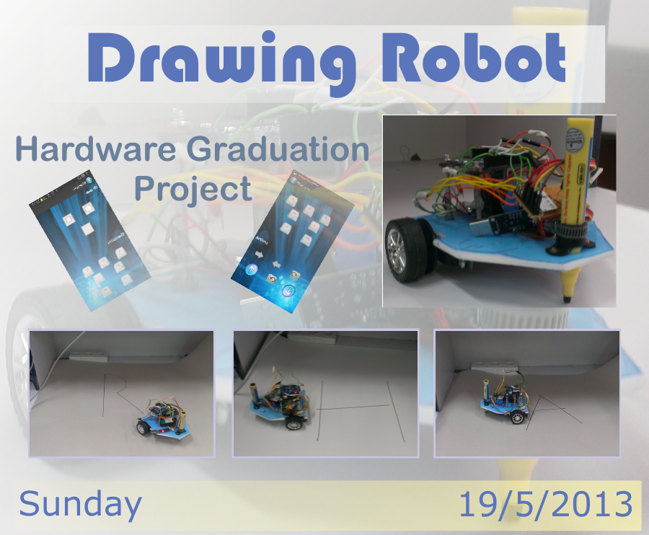

Slide 2
Prepared By:
Isra’ Abdulhaq
Hedaya Omar
Prepared for :
Dr. Raed Alqadi
Dr. Luai Malhis
Dr. Haya Samaneh

Slide 3
Drawing Robot (Description)
Our project is a drawing robot that draws shapes like a circle,
Rectangle and letters etc. We remotely send the object that we want
to draw, and then the robot will draw it on the
paper.

Slide 4
Topics to be discussed!???
Motivation.
Project Feature.
Project implementation.
Difficulties and challenges.
Results and future work.

Slide 5
Motivations:
To facilitate the work of writing and drawing on large posters.
Reduce the time needed to draw, and reduce the effort needed.
May be used for edutainment purposes and teaching kids by drawing the element in front of them.

Slide 6
Project Features:
Applicable project.
User friendly just control the car using android application without any difficulties
Reasonable cost device
Used for multi purposes

Slide 7
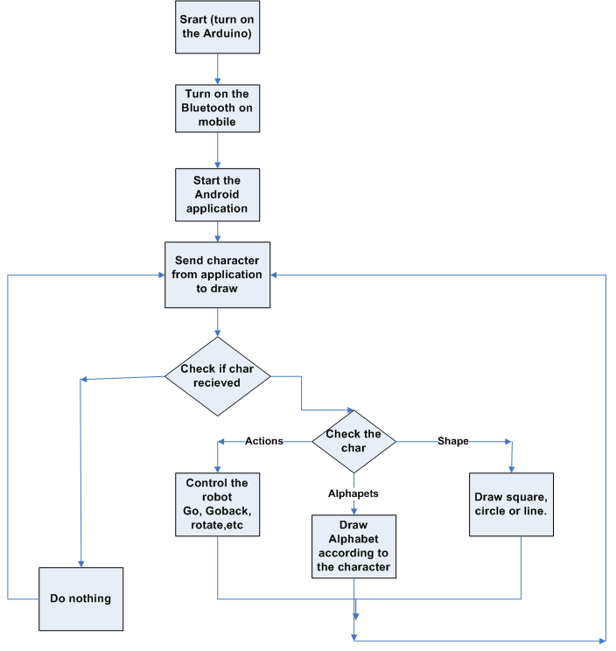
Analysis System Design

Slide 8
Implementation:
Robot Design:
We analyzed our project, searching through the internet of
hardware component available, consulted our Dr. Raed AL Qadi
then we find that our robot consists of five main parts

Slide 9
Robot Parts ……
Microcontroller
actuators
Feed back mechanism
Powers sources
Wireless communication

Slide 10
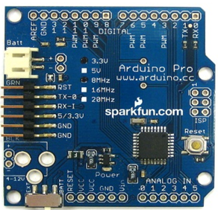
Microcontroller :
Arduino pro mini :
Microcontroller | ATmega328
Operating Voltage | 5V
Digital I/O Pins | 14 (of which 6 provide PWM output)

Slide 11
Actuators:
we need rotational actuators that transform electrical energy
into a rotating motion, First we think of Standard servo motors
with built in gearing and feedback control loop circuitry
but this type can rotate about 180 degrees. So it is
unable to continually rotate, meaning they can't be used for
driving wheels we can just use it to up and down pen.

Slide 12

So What should we do !!!!!!
We need both benefits of gearing and feedback control loop
circuitry and also full rotation to driving wheels.
we use full rotation servo motor with built in gearing and
we add an external feed back mechanism which is photo
interrupter (opt coupler)

Slide 13
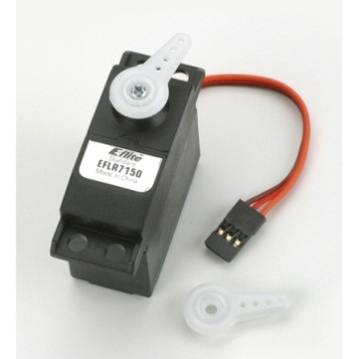
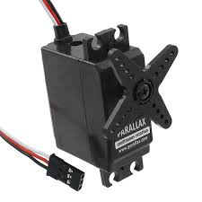
Servos ….
Standard servo motor to up and down the pen.
Full rotation servo motors to driving wheels.

Slide 14
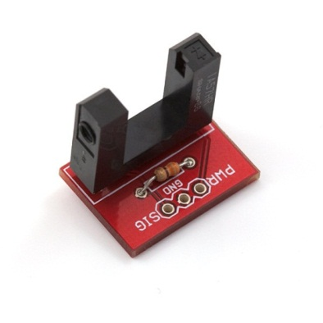
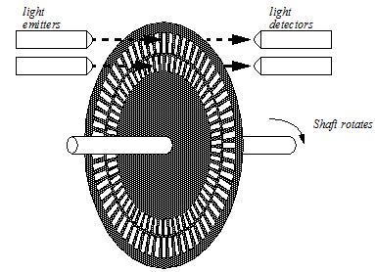
Feed back mechanism:
  Photo interrupter :
  Light from emitters passes through the servo’s horn to detectors.
  light beams are broken and pulses is creating
  we attach this photo interrupters with interrupts
  on the arduino and trigger it on change so we can calculate how
  many pulses we have and this help us to calculate the travelling
  distance

Slide 15
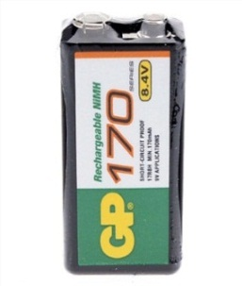
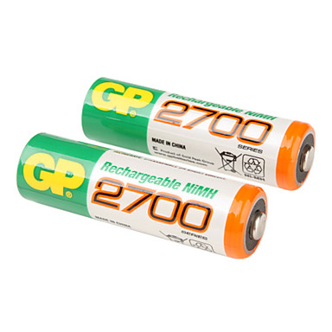
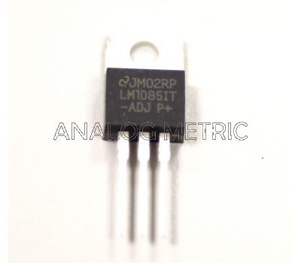
Power Sources….
A 9V chargeable battery :
to feed the microcontroller with a built in voltage regulator .
(1.2*4) V chargeable batteries :
to feed the servo motors .
1085 regulator :
regulates Arduino voltage(5 V)to 3.3 V output that use as input for Bluetooth

Slide 16
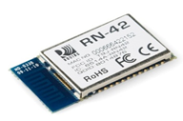
Wireless communication…
  Bluetooth Module RN42
  to transfer the data between mobile and Arduino
  that controlled the movement of the wheels

Slide 17
Our calculations :
Calculations for traveling a specific distance:
Wheel circumference = wheel diameter * pi.
Distance-per-pulse = wheel circumference / pulses needed for a 360-degree wheel rotation.
Number of Steps = distance / distance-per-pulse.

Slide 18
Coding :
movement functions:
Go
Go Back.
Rotate.
These are the main functions that we use to create the paths of
each shape or characters

Slide 19
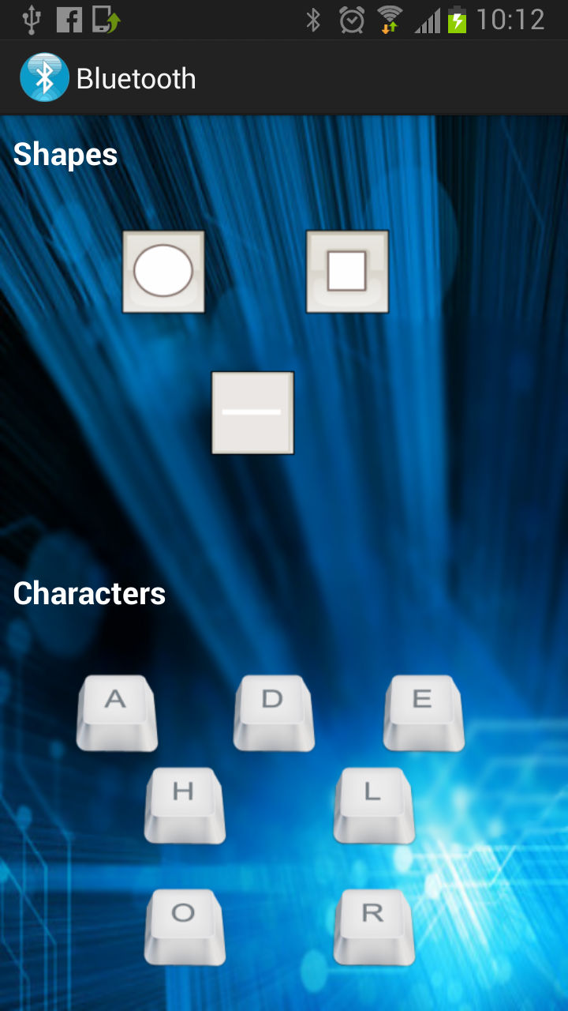
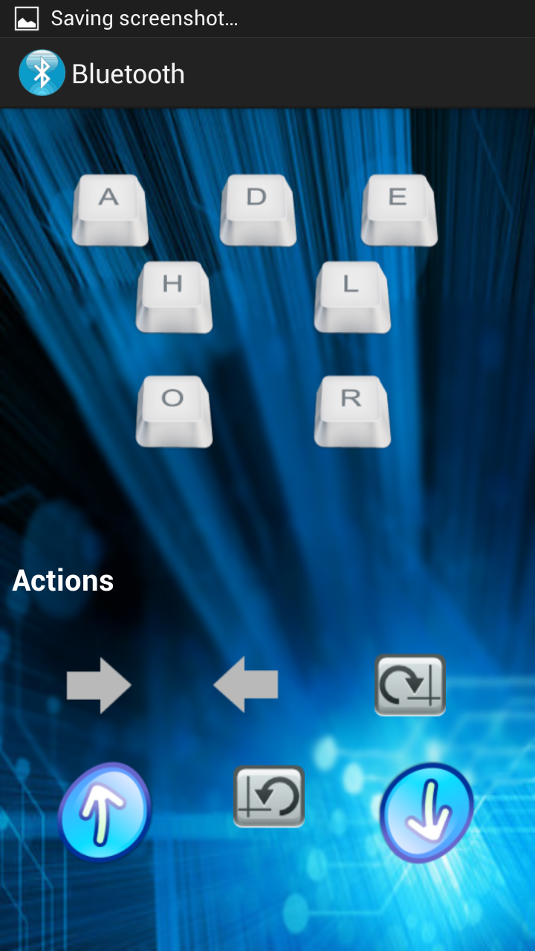
Coding (cont’d):
We develop an Android application that communicate with the
RN 42 Bluetooth module and send data to the arduino to make
robot draw

Slide 20
Software programs :
Arduino 1.0.4 software in c++ language.
Android Eclipse juno and indigo in java language.

Slide 21


Problem we faced…
The component of the project is not available all the time:
One month to get the basic component and some of them need
more than one month like Bluetooth.
to burn some of component like motors mean that a catastrophic
disaster has been occurred because you need to wait until
the component become available.

Slide 22

Problem we faced…(cont’d)
We rotate the standard servo in wrong manner at the first
time and each time this servo hit the board of the robot and
this damaged the servo so we forced to buy another one.
and fortunately we find the last one so
we don’t need to wait one month
again

Slide 23
Problem we faced…(cont’d)
The servos that we used with low quality and so one of the
servo is slower then the other and this affect the process of
drawing straight lines, so we try to make the speed consistent
by changing the speed.

Slide 24
Problem we faced…(cont’d)
The batteries must be full charged.
Using RN42 Bluetooth module, require a lot of accuracy for
soldering a wire to the pins.
we used the small papers that we connected to each other
using stuck that affect the route of the robot. We solve this
problem by using a large piece of paper .

Slide 25
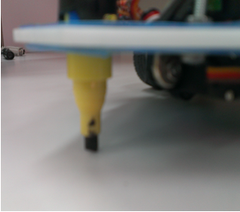
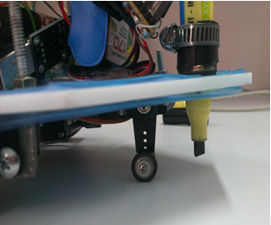
Problem we faced …(Cont.…)
The design of the robot, must be small with a light weight.
The mechanism that is required to control the pen up and down without affect the balance.

Slide 26
Future work:
Using this robot for educational proposes.
Changing the color of pen easily.
Draw any shapes by this robot by transferring the pixels to the
microcontroller instead of fixed shapes.

Slide 27
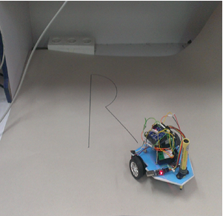
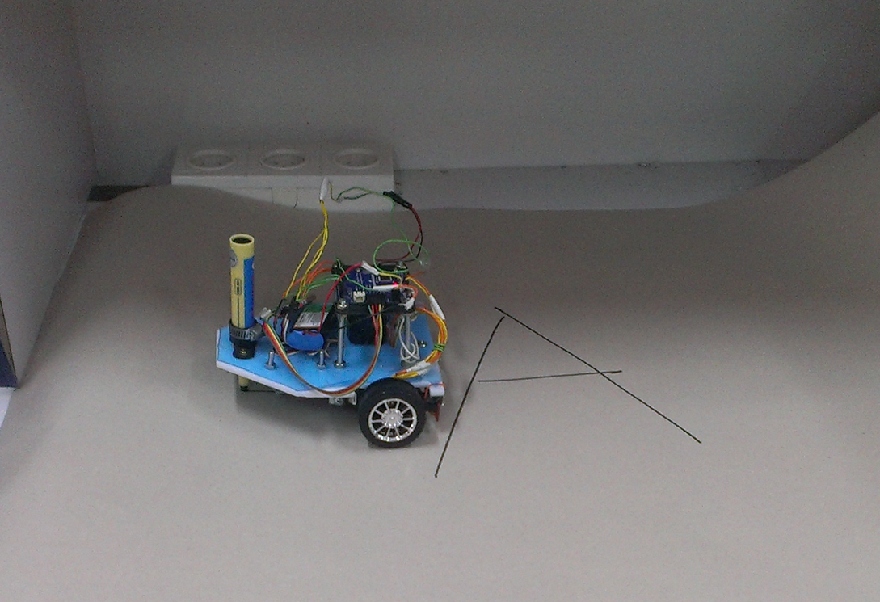
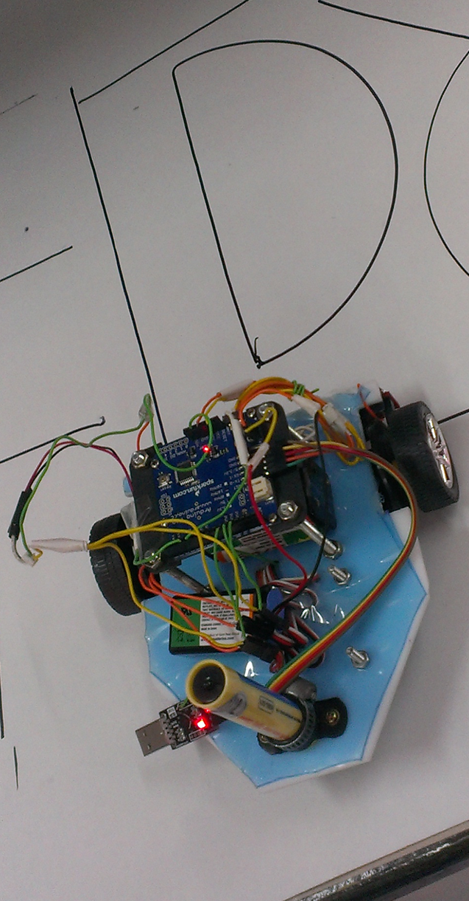
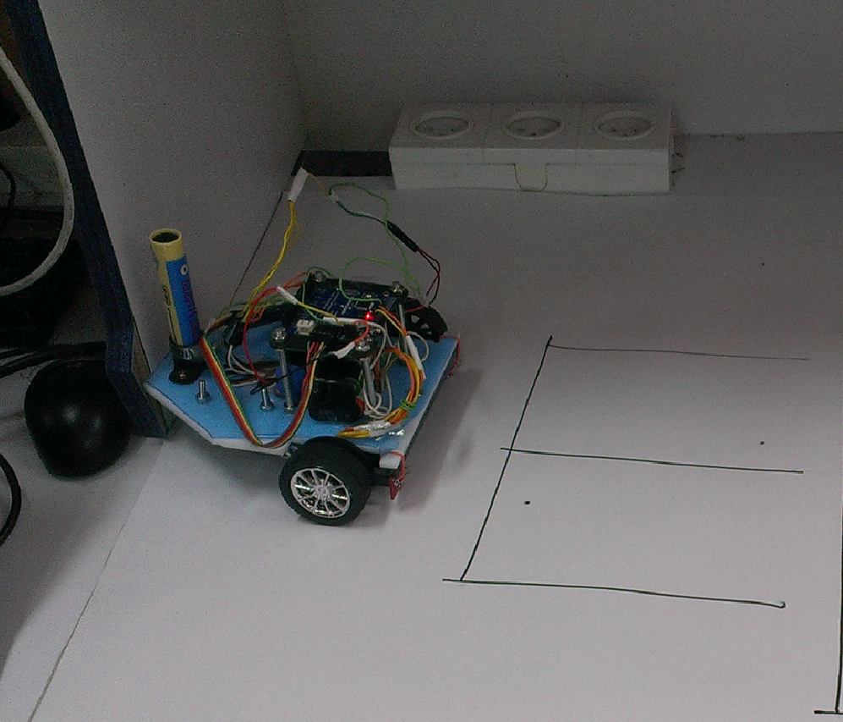
Snapshots:

Slide 28
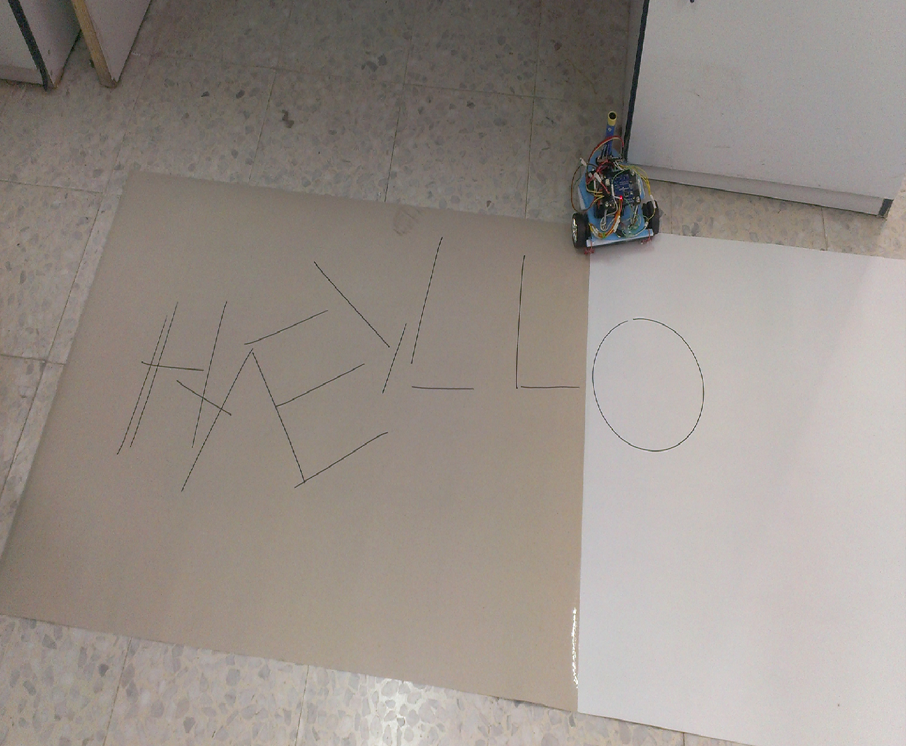
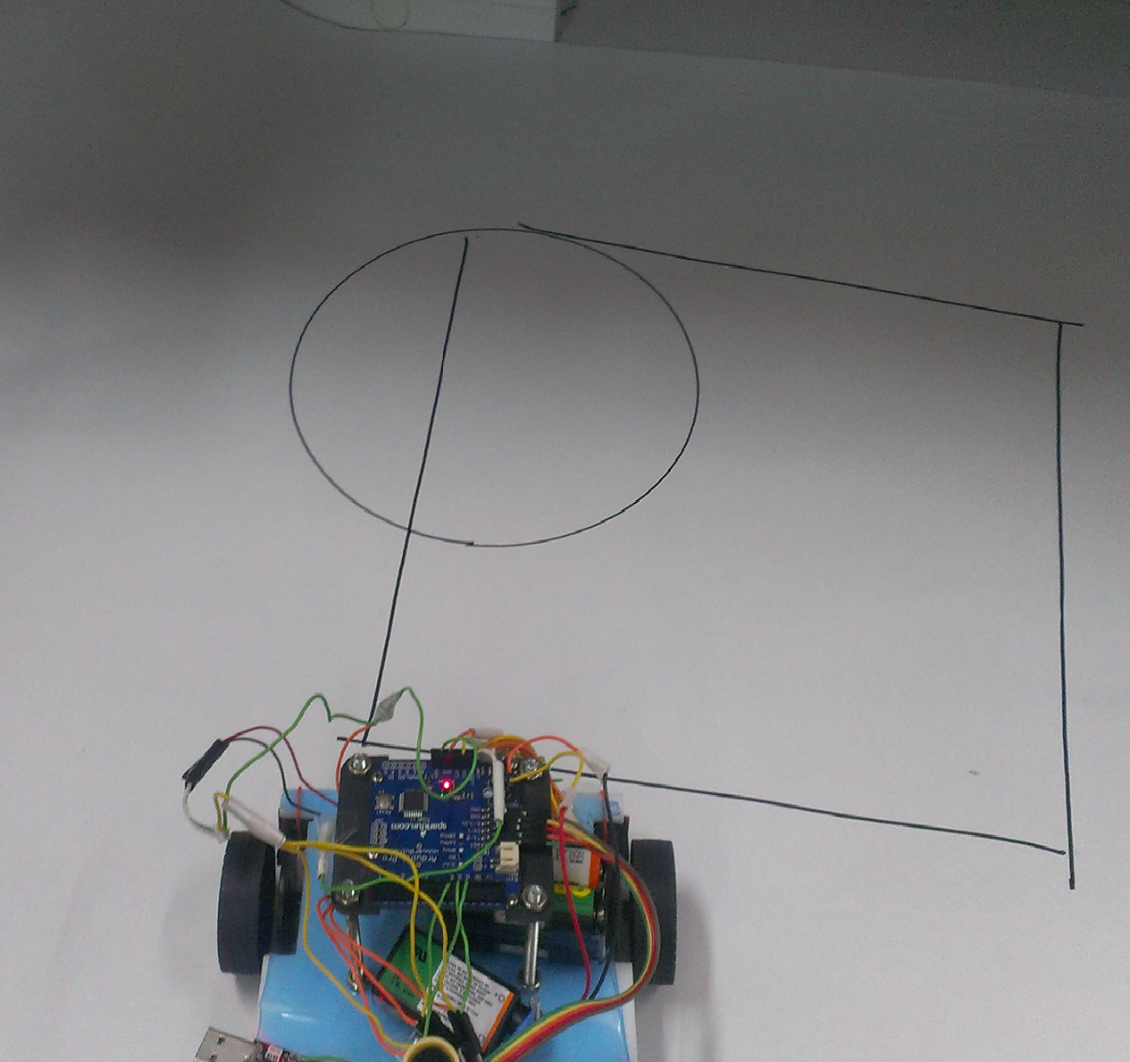
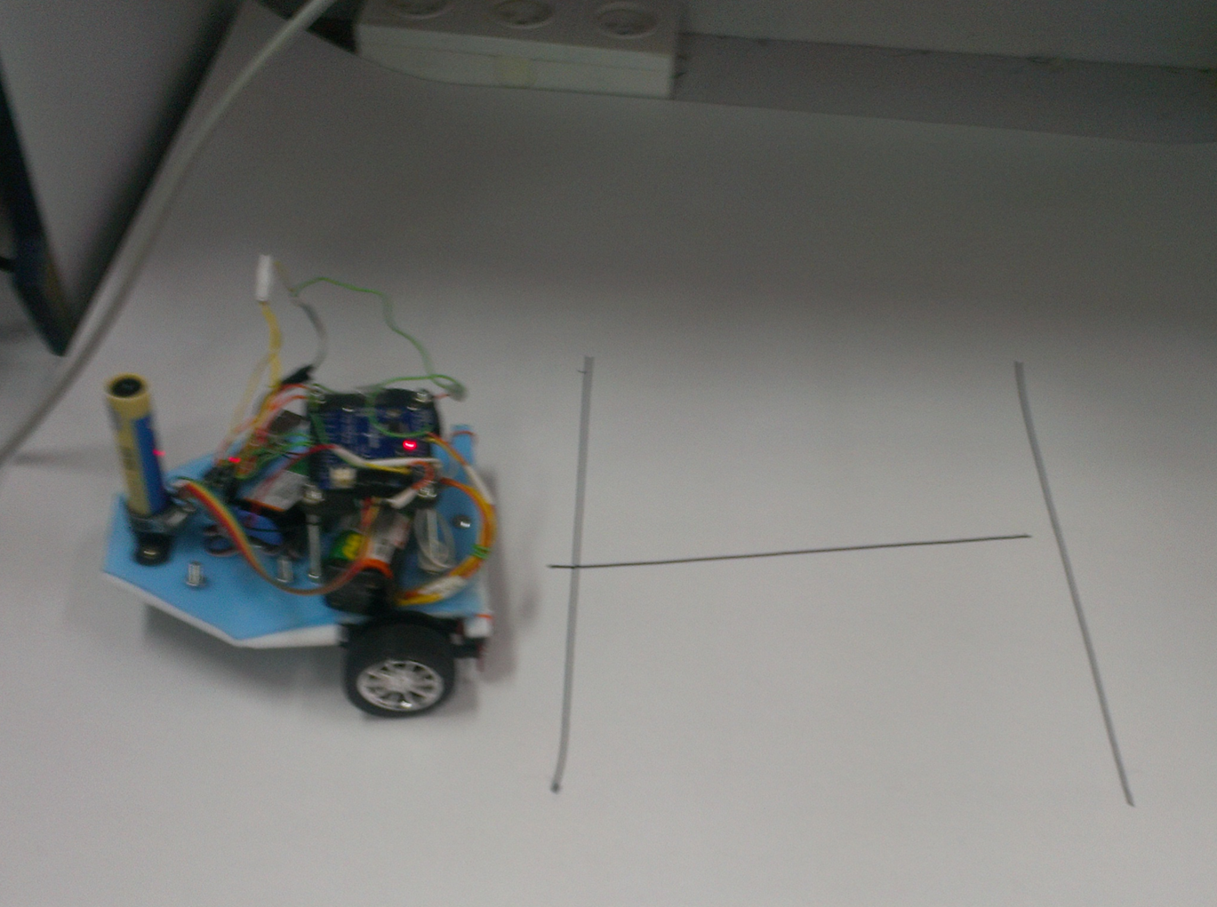
Snapshots…(cont’d)

Slide 29
Demo Time ….
Play

Slide 30
Thank you for your kindly attention

