Slide 1
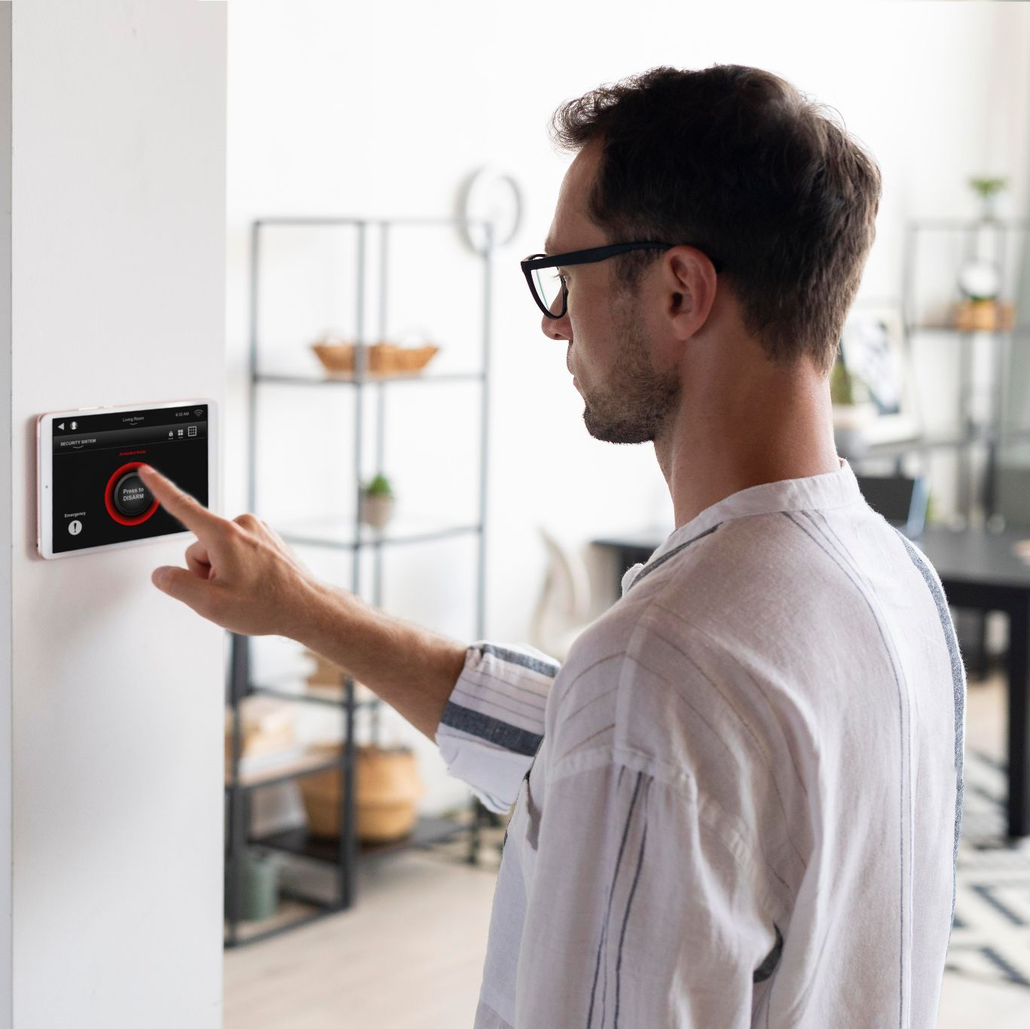
PERFICIENT
SMART COMPANY

Slide 2

Presenters
Dana Ramadan
Sana’ Zetawi
Supervisors
Dr. Emad Natsheh
Dr. Suleiman Abu Kharmeh

Slide 3
TABLE OF CONTENTS
01
The Idea problems
02
MAJOR FEATURES solutions
03
RESULTS

Slide 4
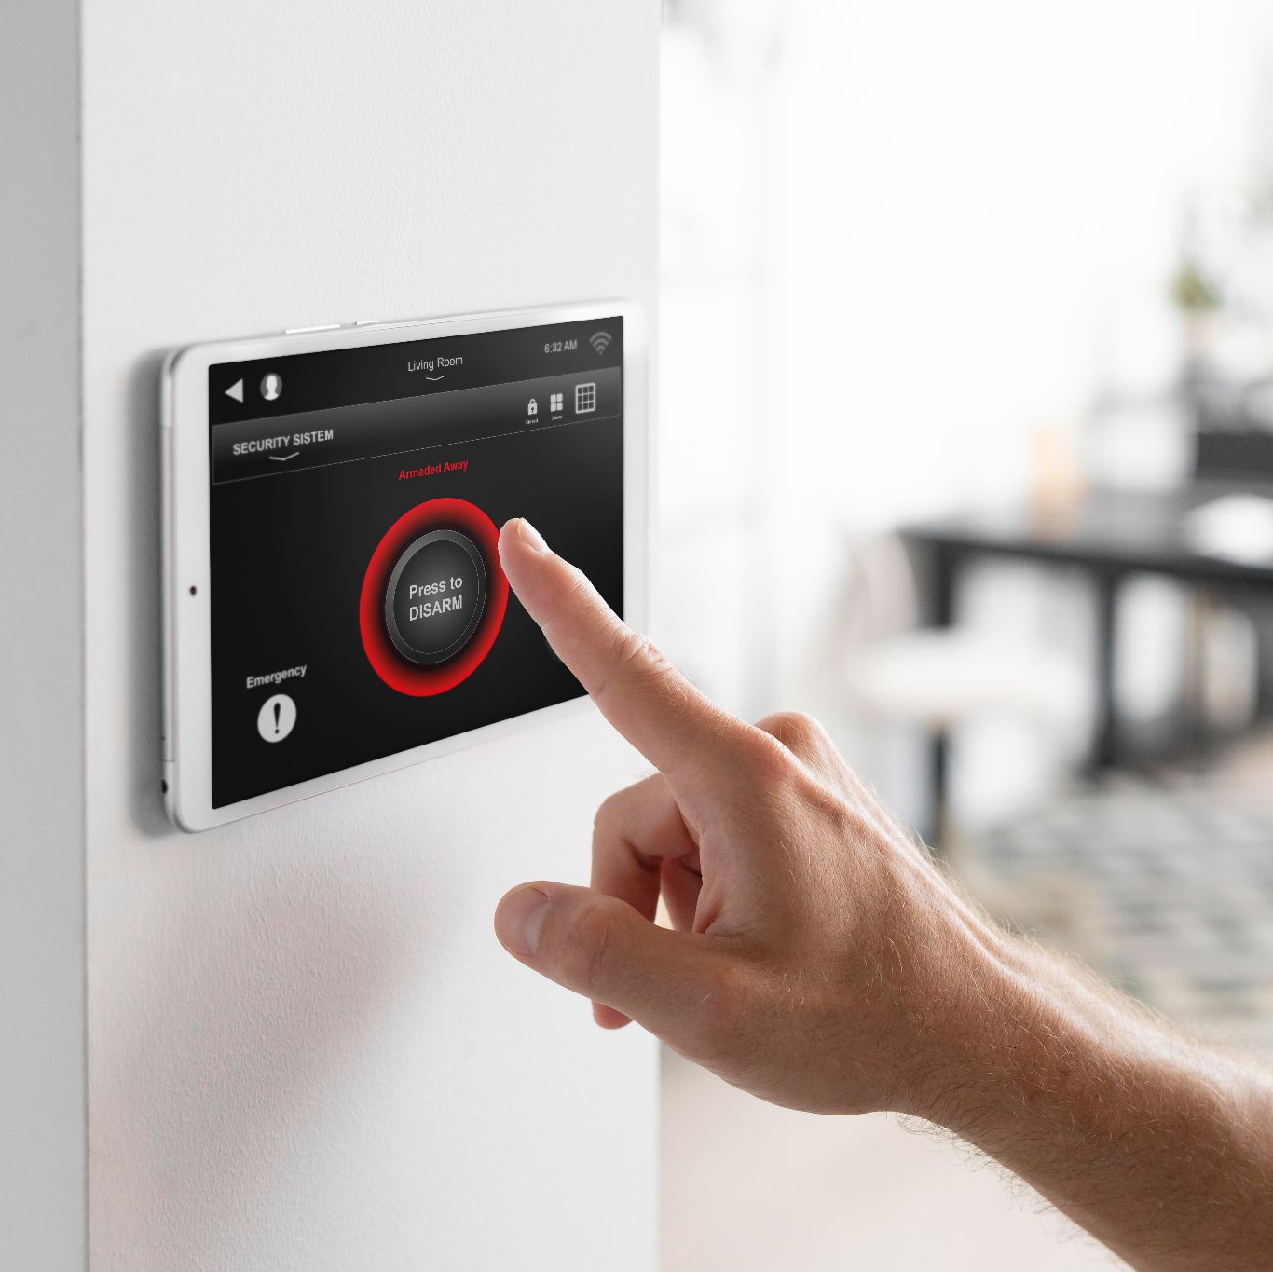
01.
PERFICIENT COMPANY

Slide 5
Why this idea?
The Era of Speed
Increase Security
People seek to make their lives more comfortable and save time and effort
Increase security in companies is very important

Slide 6
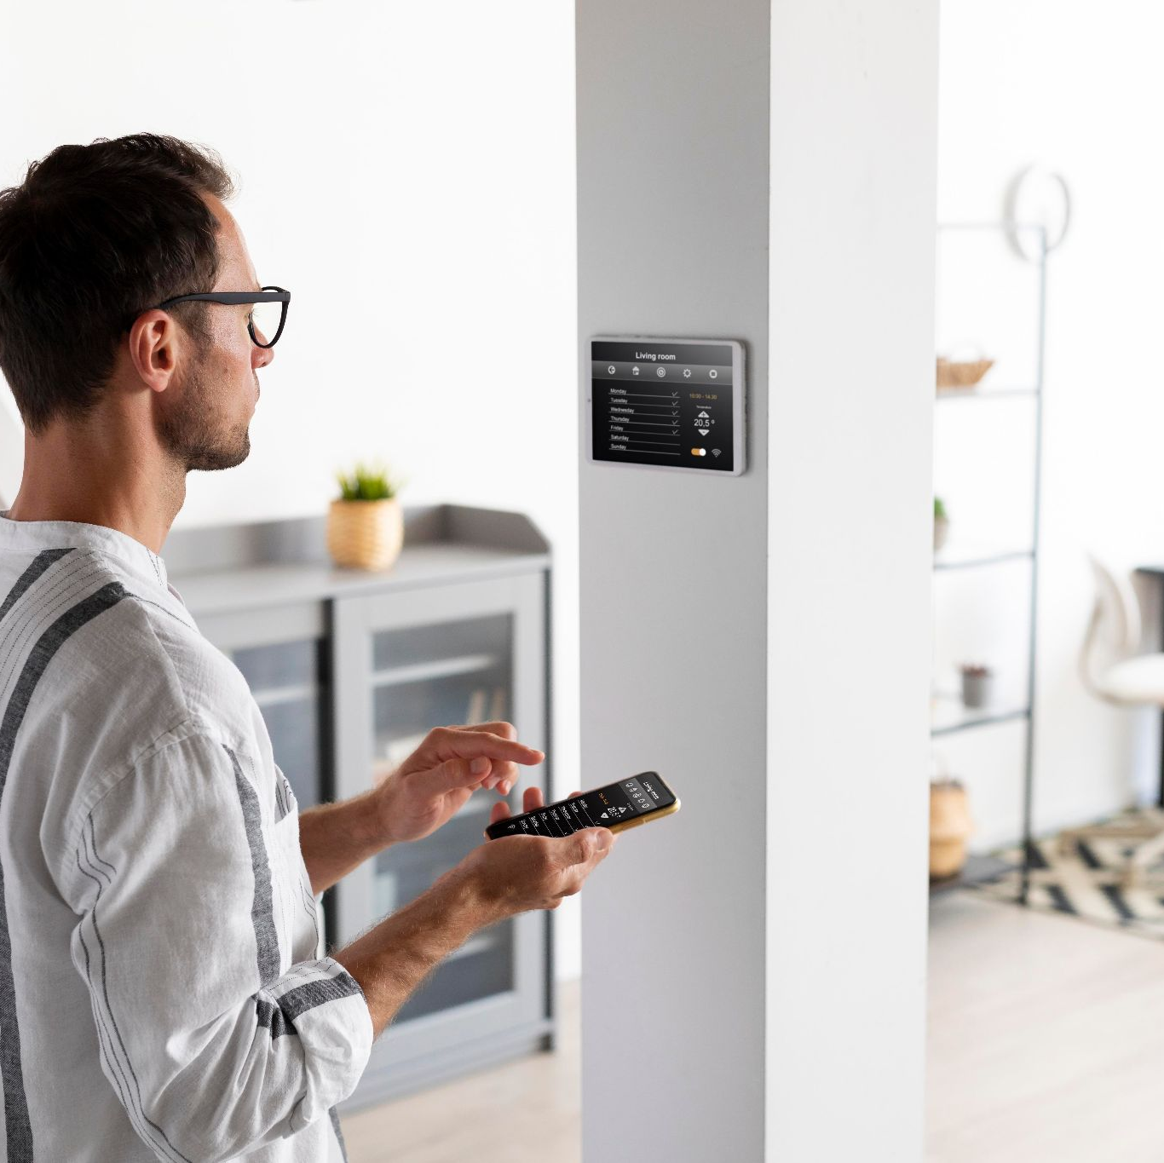
2. FEATURES

Slide 7
MAJOR FEATURES
Main Door security
Gas System
Light System
Parking
Temperature System

Slide 8
HOW IS IT DISTRIBUTED
Main Door
Light System
Control the whole lights and the office lights
Gas System
Parking system

Slide 9
Hardware Components

Slide 10
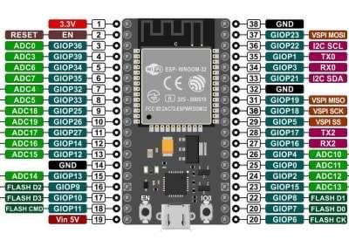
ESP32
Built-in Wi-Fi and bluetooth!

Slide 11
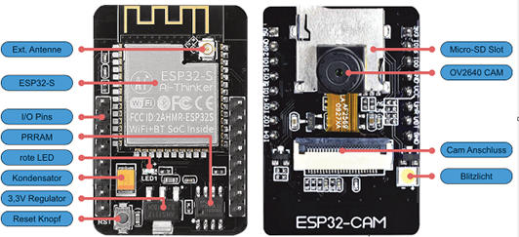
ESP32 CAM
Small low price camera

Slide 12
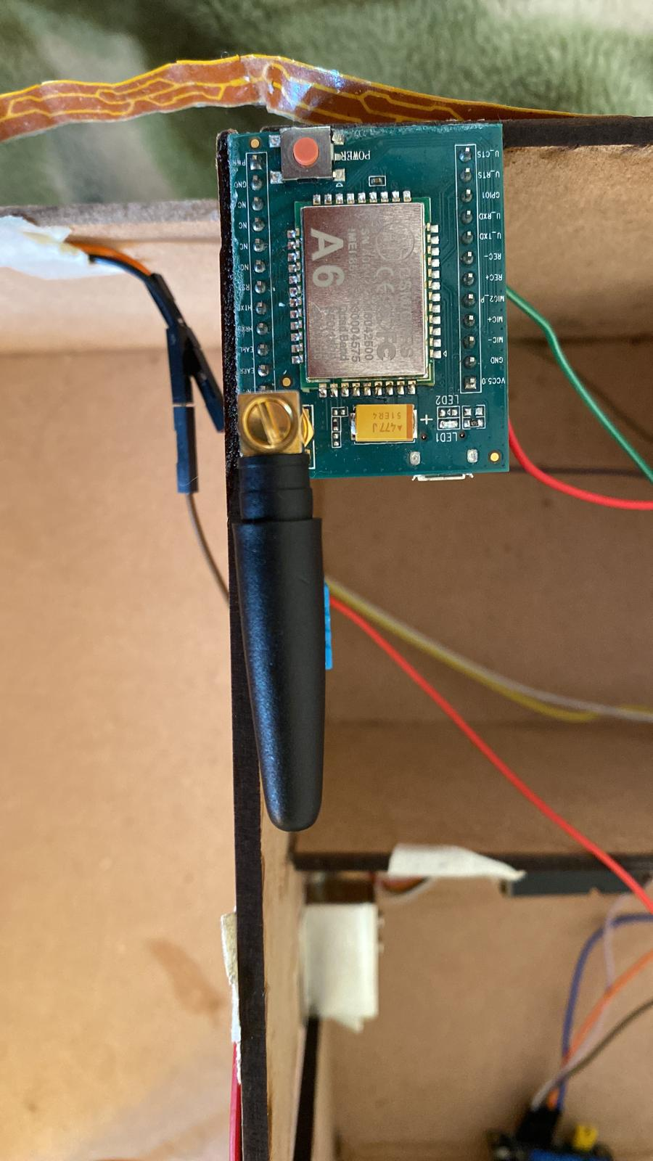
GSM
Make real SMS’s and calls

Slide 13
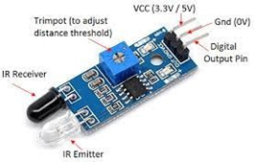
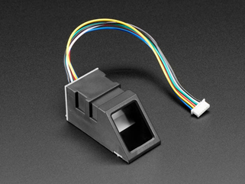
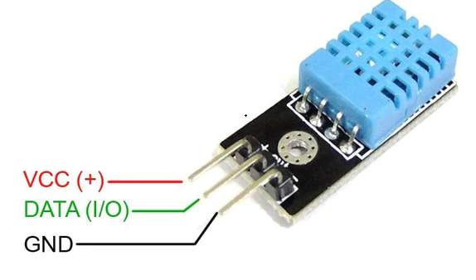
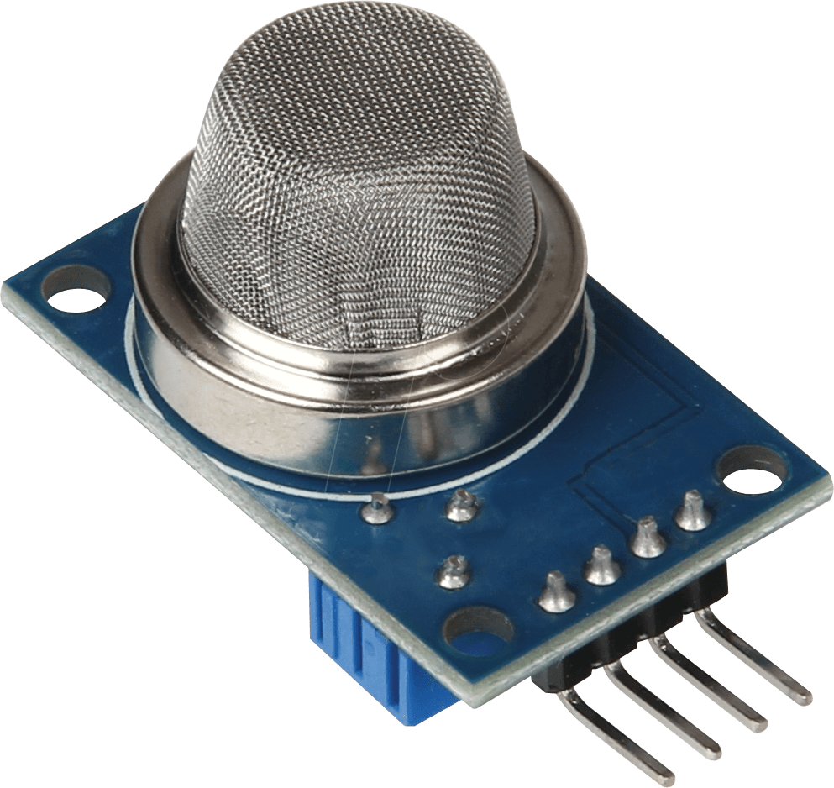
IR sensor
Fingerprint sensor
Sensors
MQ-5 sensor
Dht11
For the visitors
For the back door lock
Gas and smoke sensor
Tempreture sensor

Slide 14
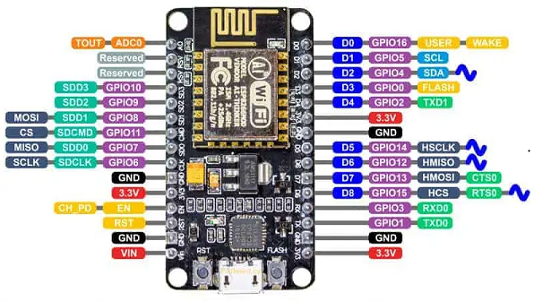
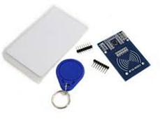
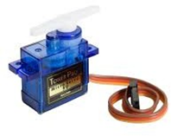
Parking System
Servo motor
NodeMCU
RFID
Main Controller with Wi-Fi connection

Slide 15
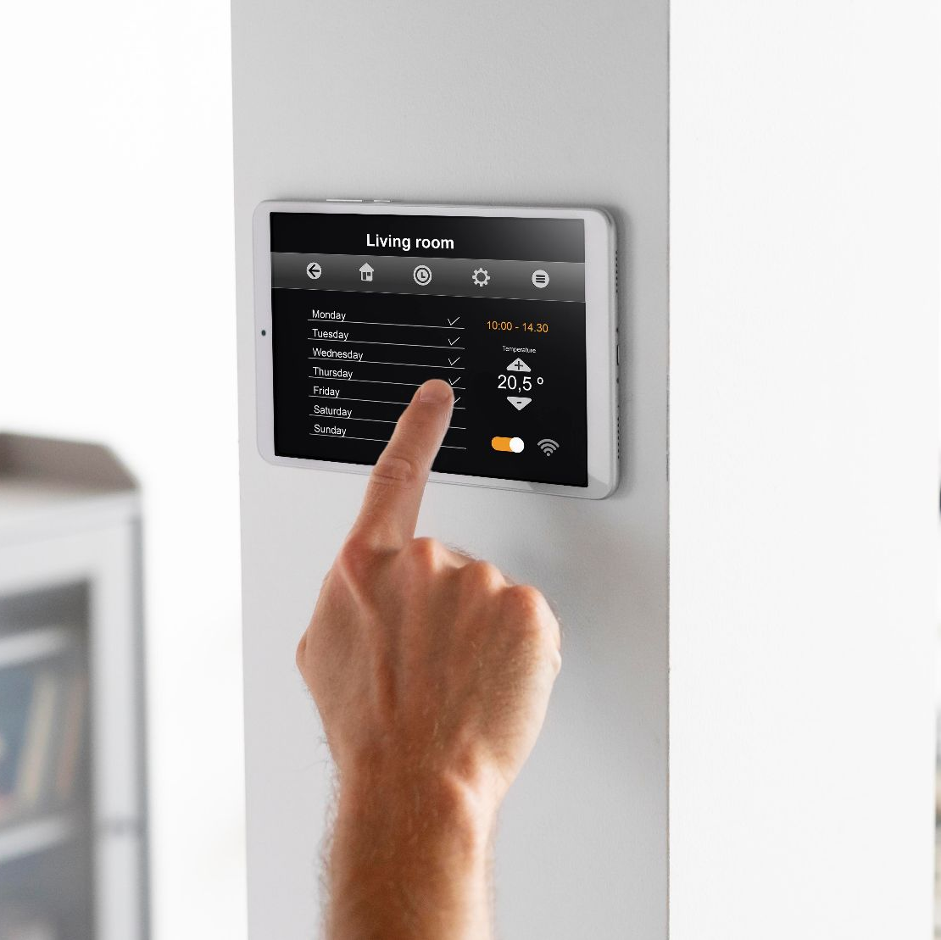
RESULTS

Slide 16
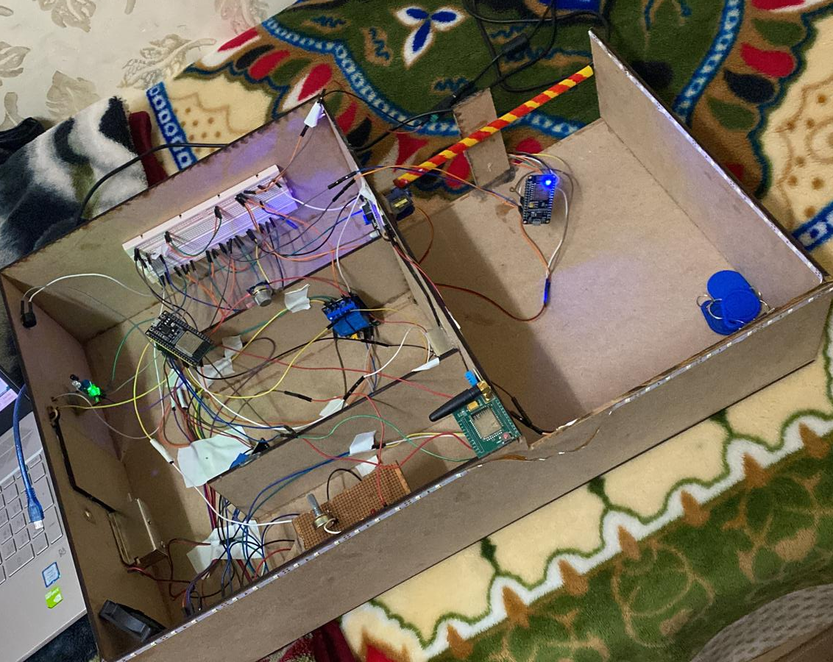

Slide 17


LIVE DEMO

Slide 18
THANKS
youremail@freepik.com
+91 620 421 838
yourcompany.com
First thanks to GOD to reach this point,
We would like to thank our Supervisors, Dr. Emad Natsheh and Dr. Suleiman Abu Kharmeh, for standing with us in the whole process
We are grateful to the entire Computer Engineering Department, Our families, and friends.
PLEASE KEEP THIS SLIDE FOR ATTRIBUTION

Slide 19
RESOURCES
[1] Prathapagiri, Dilip, and Eethamakula Kosalendra. "Wi-Fi Door Lock System Using ESP32 CAM Based on IoT." The International journal of analytical and experimental modal analysis. XIII. 20002003 (2021).
[2] Kamelia, Lia, et al. "Door-automation system using bluetooth-based android for mobile phone." ARPN Journal of Engineering and Applied Sciences 9.10 (2014): 1759-1762.
[3] Kaustubh Dhondge Kaushik Ayinala Baek-Young Choi Sejun Song, “Infrared Optical Wireless Communication for Smart Door Locks Using Smart phones”, 12th International Conference on Mobile Ad-Hoc and Sensor Networks, 2016.
[4] Shrivastava, Ashish, et al. "GSM based gas leakage detection system." International Journal of Technical Research and Applications 1.2 (2013): 42-45.
[5] http://esp32.net/
[6] https://randomnerdtutorials.com/esp32-cam-video-streaming-face-recognition-arduino-ide/
[7] https://github.com/espressif/esp32-camera
[8] https://randomnerdtutorials.com/esp32-client-server-wi-fi/
[9] https://how2electronics.com/esp32-fingerprint-sensor-security-system/

