Slide 1
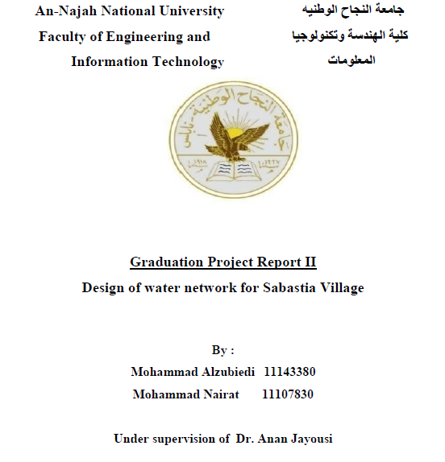

Slide 2
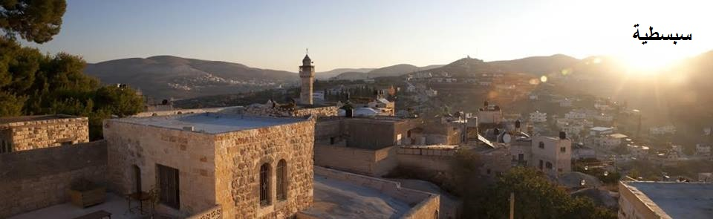

Slide 3
Outline
Project objectives.
Study area and Basic information about Sabastya village.
Questionnaire analysis and figure.
Simulate Model (Water CAD).
Demand calculation.
Thiessen polygon method.
Result and discussion.
Estimated cost.
Conclusions and recommendations.

Slide 4
Project objectives

Slide 5
Study area

Slide 6
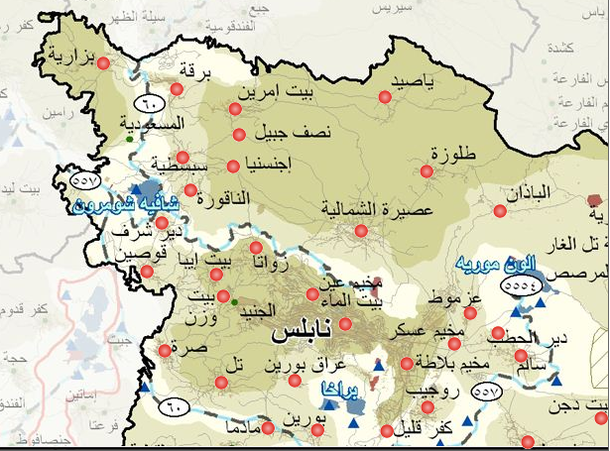
-Location

Slide 7
- Climate.
-source of the water.
- Area of the village.

Slide 8
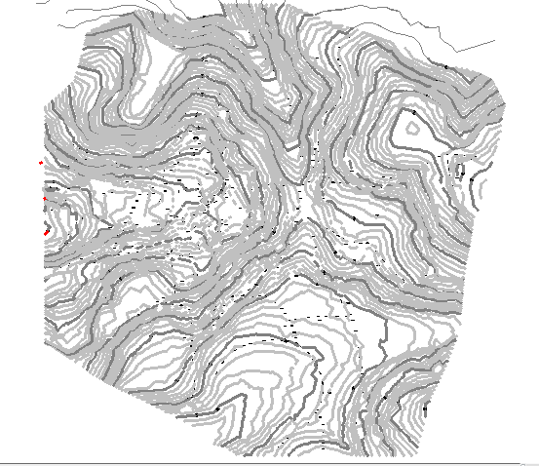
Contour map for sabastia.
- elevation .

Slide 9
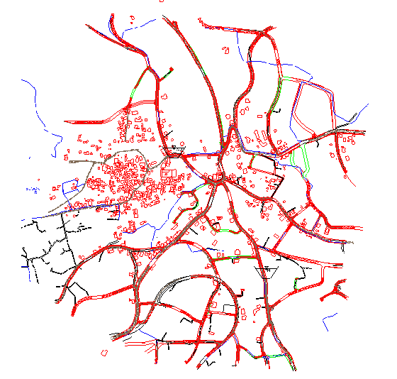
-Road and house distribution in sabastia

Slide 10
Questionnaire analysis
-Consumption = 145 L/C/day

Slide 11
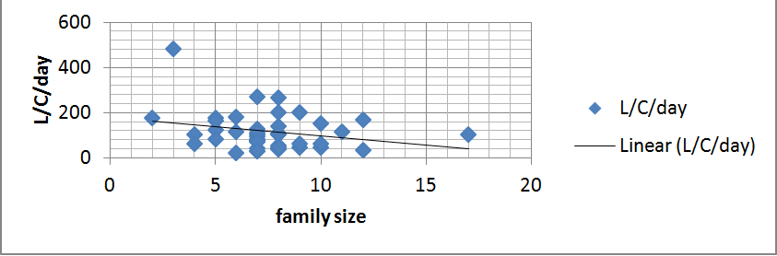

Slide 12
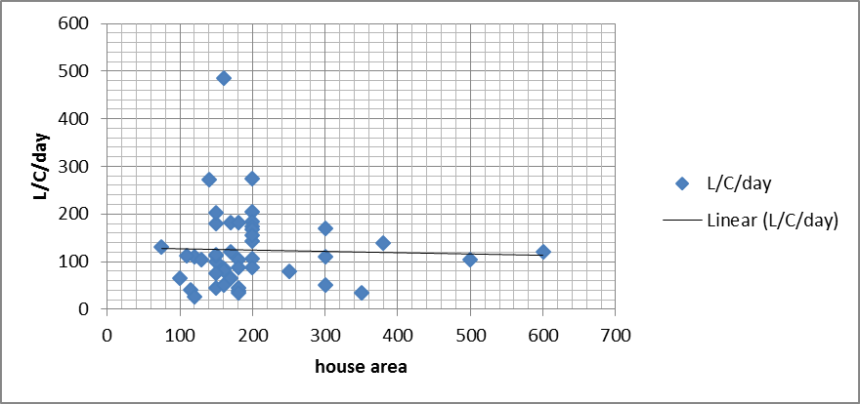

Slide 13
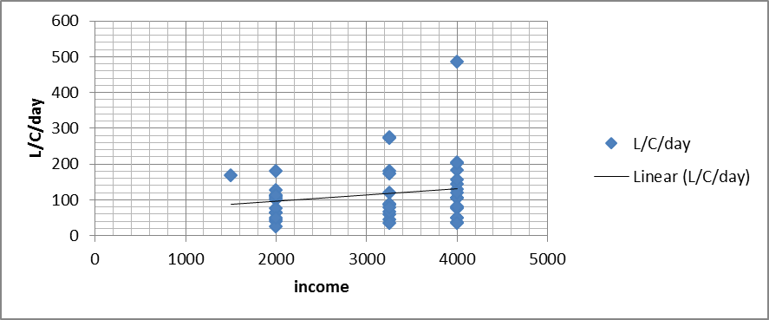

Slide 14
Simulate Model (Water CAD)
We use water cad to built the distribution network
with initial estimate for diameter.

Slide 15
Demand
Assume geometric growth for population
Design period 30 year .
Demand = 7300 m³/d.

Slide 16
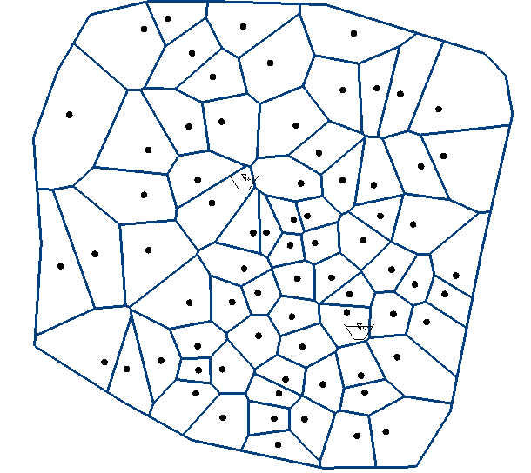
Thiessen polygon

Slide 17
Result and discussion

Slide 18
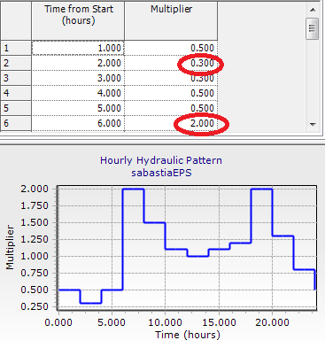
The following Unsteady state case for sabastia is shown in the following picture

Slide 19
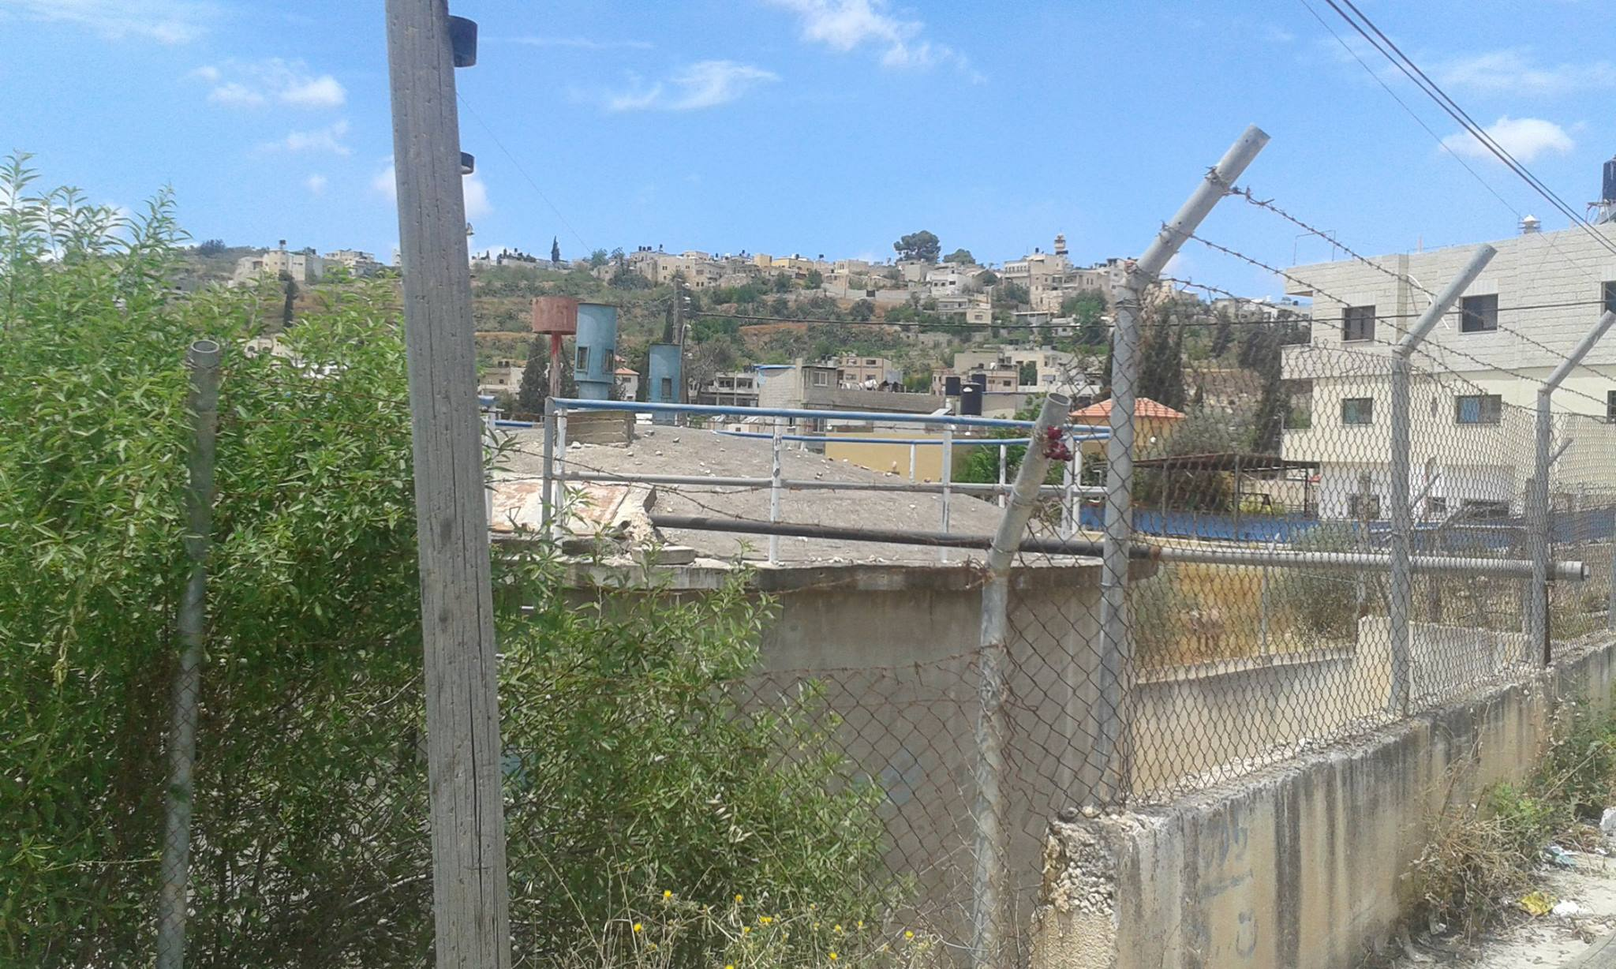
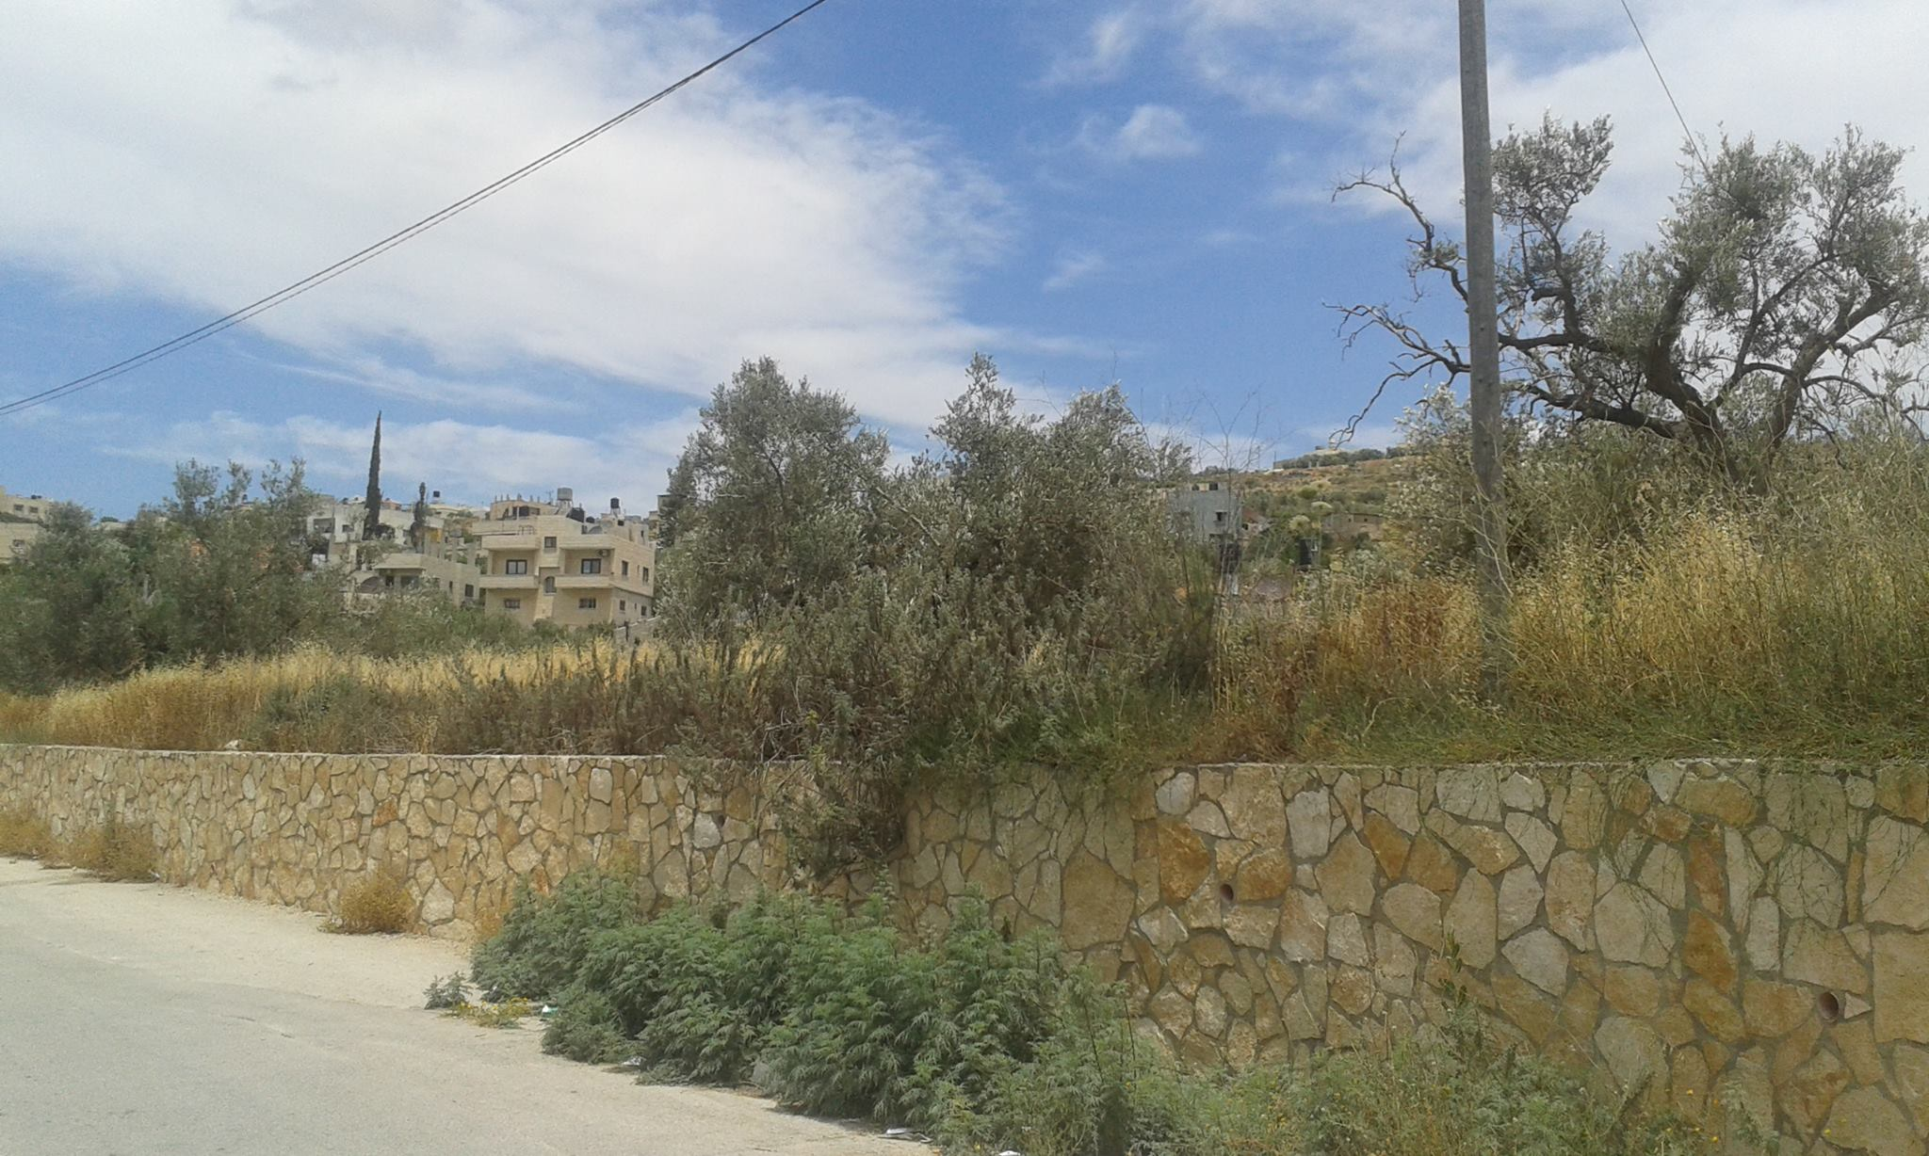
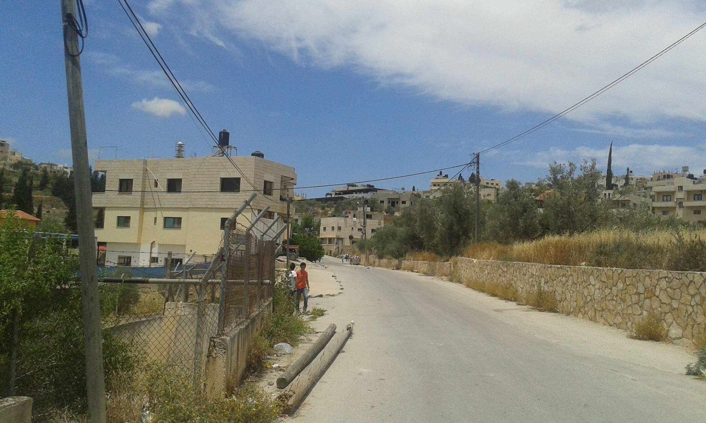

Slide 20
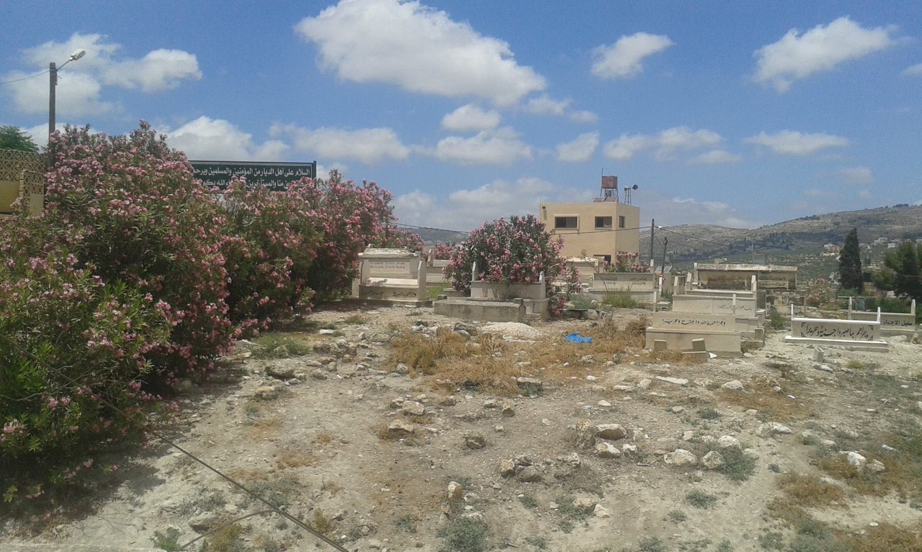
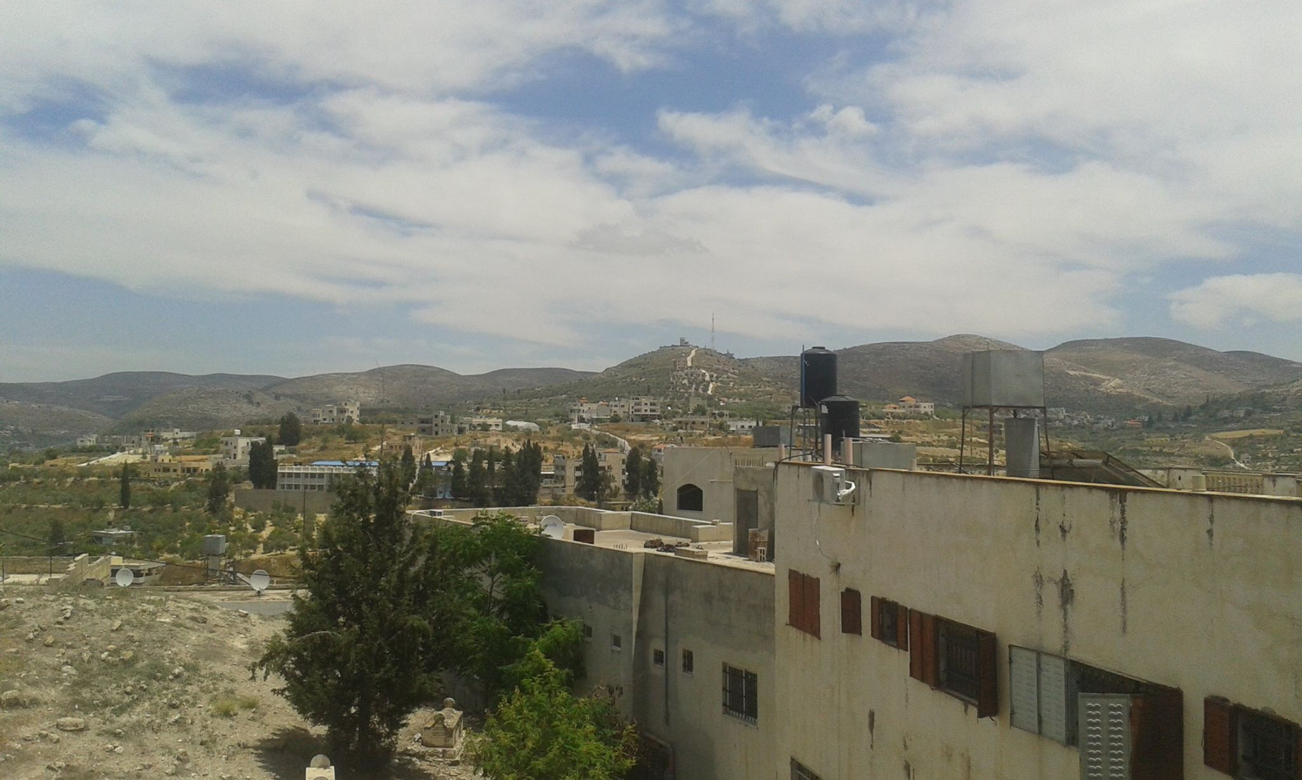

Slide 21
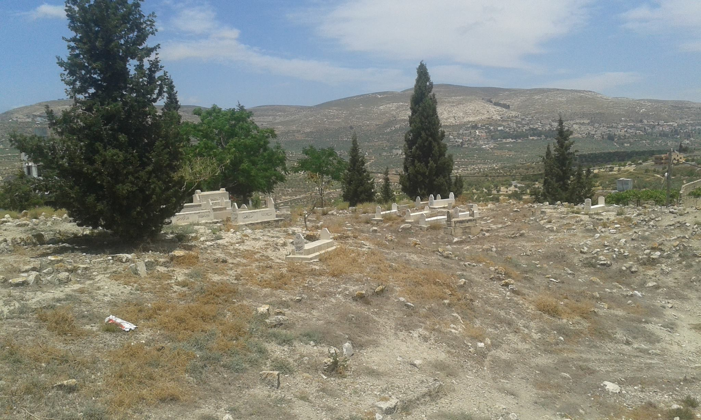

Slide 22
Pressure

Slide 23
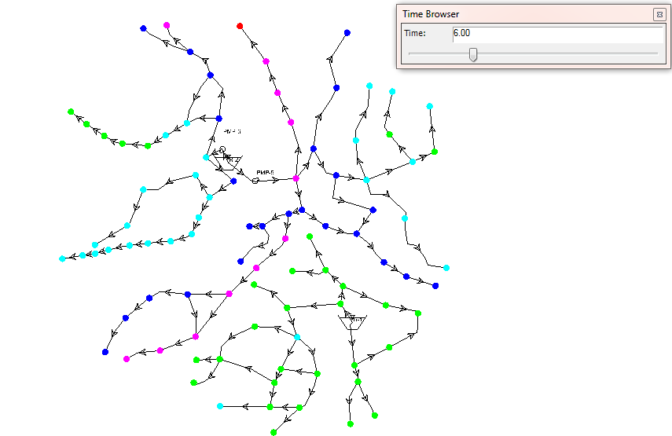
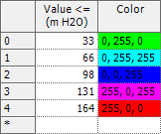

Slide 24
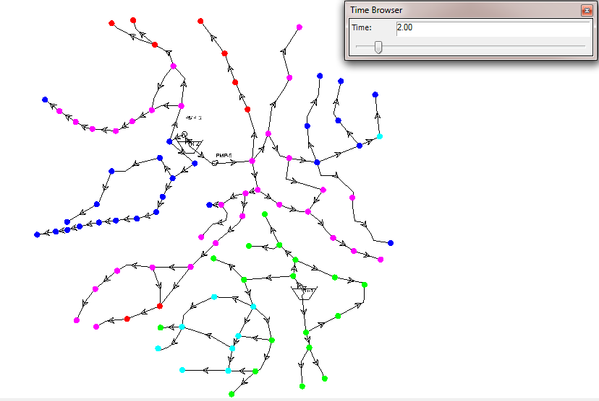

Slide 25
Velocity

Slide 26
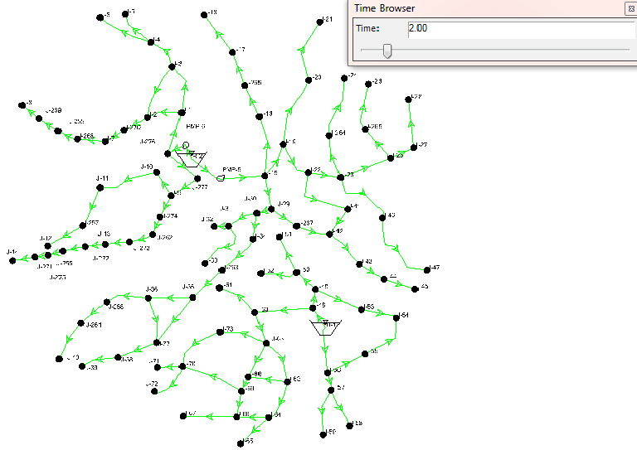
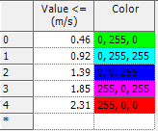

Slide 27
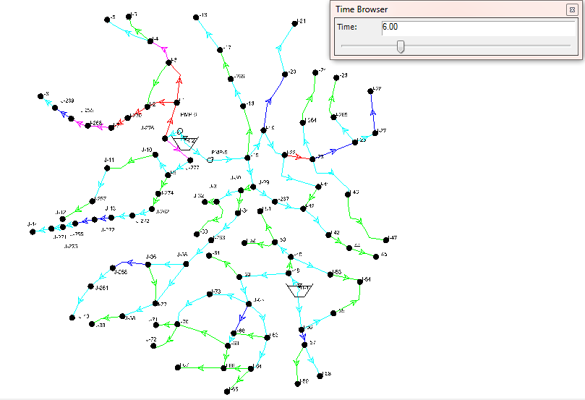

Slide 28
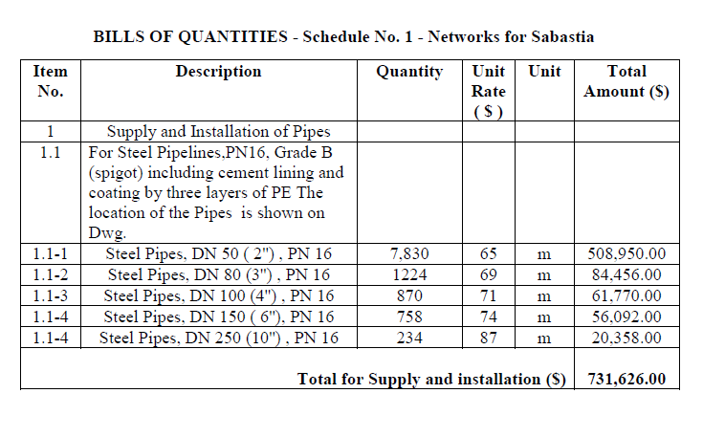
Estimated cost

Slide 29
Conclusions and recommendations

Slide 30
Our design is applicable and serviceable for
the selected design period which is 30 years

Slide 31
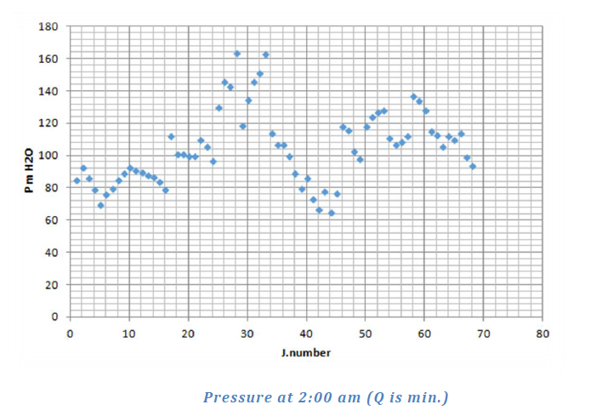
The value of velocity and pressure within the allowable ranges and in the design
criteria is as follow Pressure (20-100) m H2O & Velocity (0.2-3.0) m/s.

Slide 32
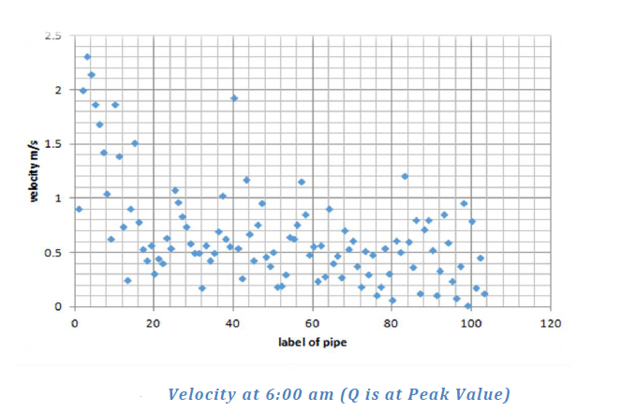

Slide 33
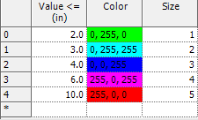
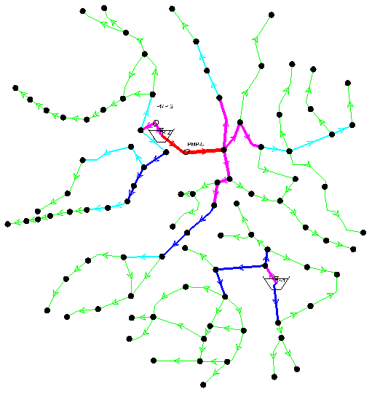
For construct the main network steel pipe
with different diameters 2,3,4,6 & 10 inch

Slide 34
Pressure reducing valve where used for
reducing the pressure

Slide 35
Two reservoirs were used to provide the network with water
for the water travels along some pipes under the influence
of gravity & two pumps used for otherwise

Slide 36
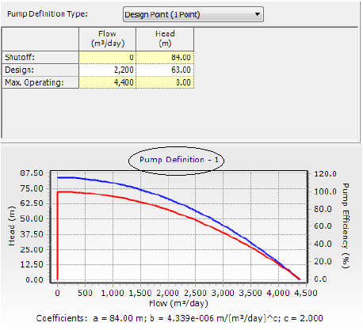
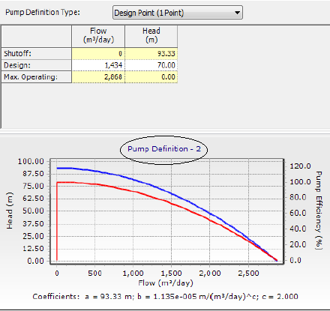

Slide 37
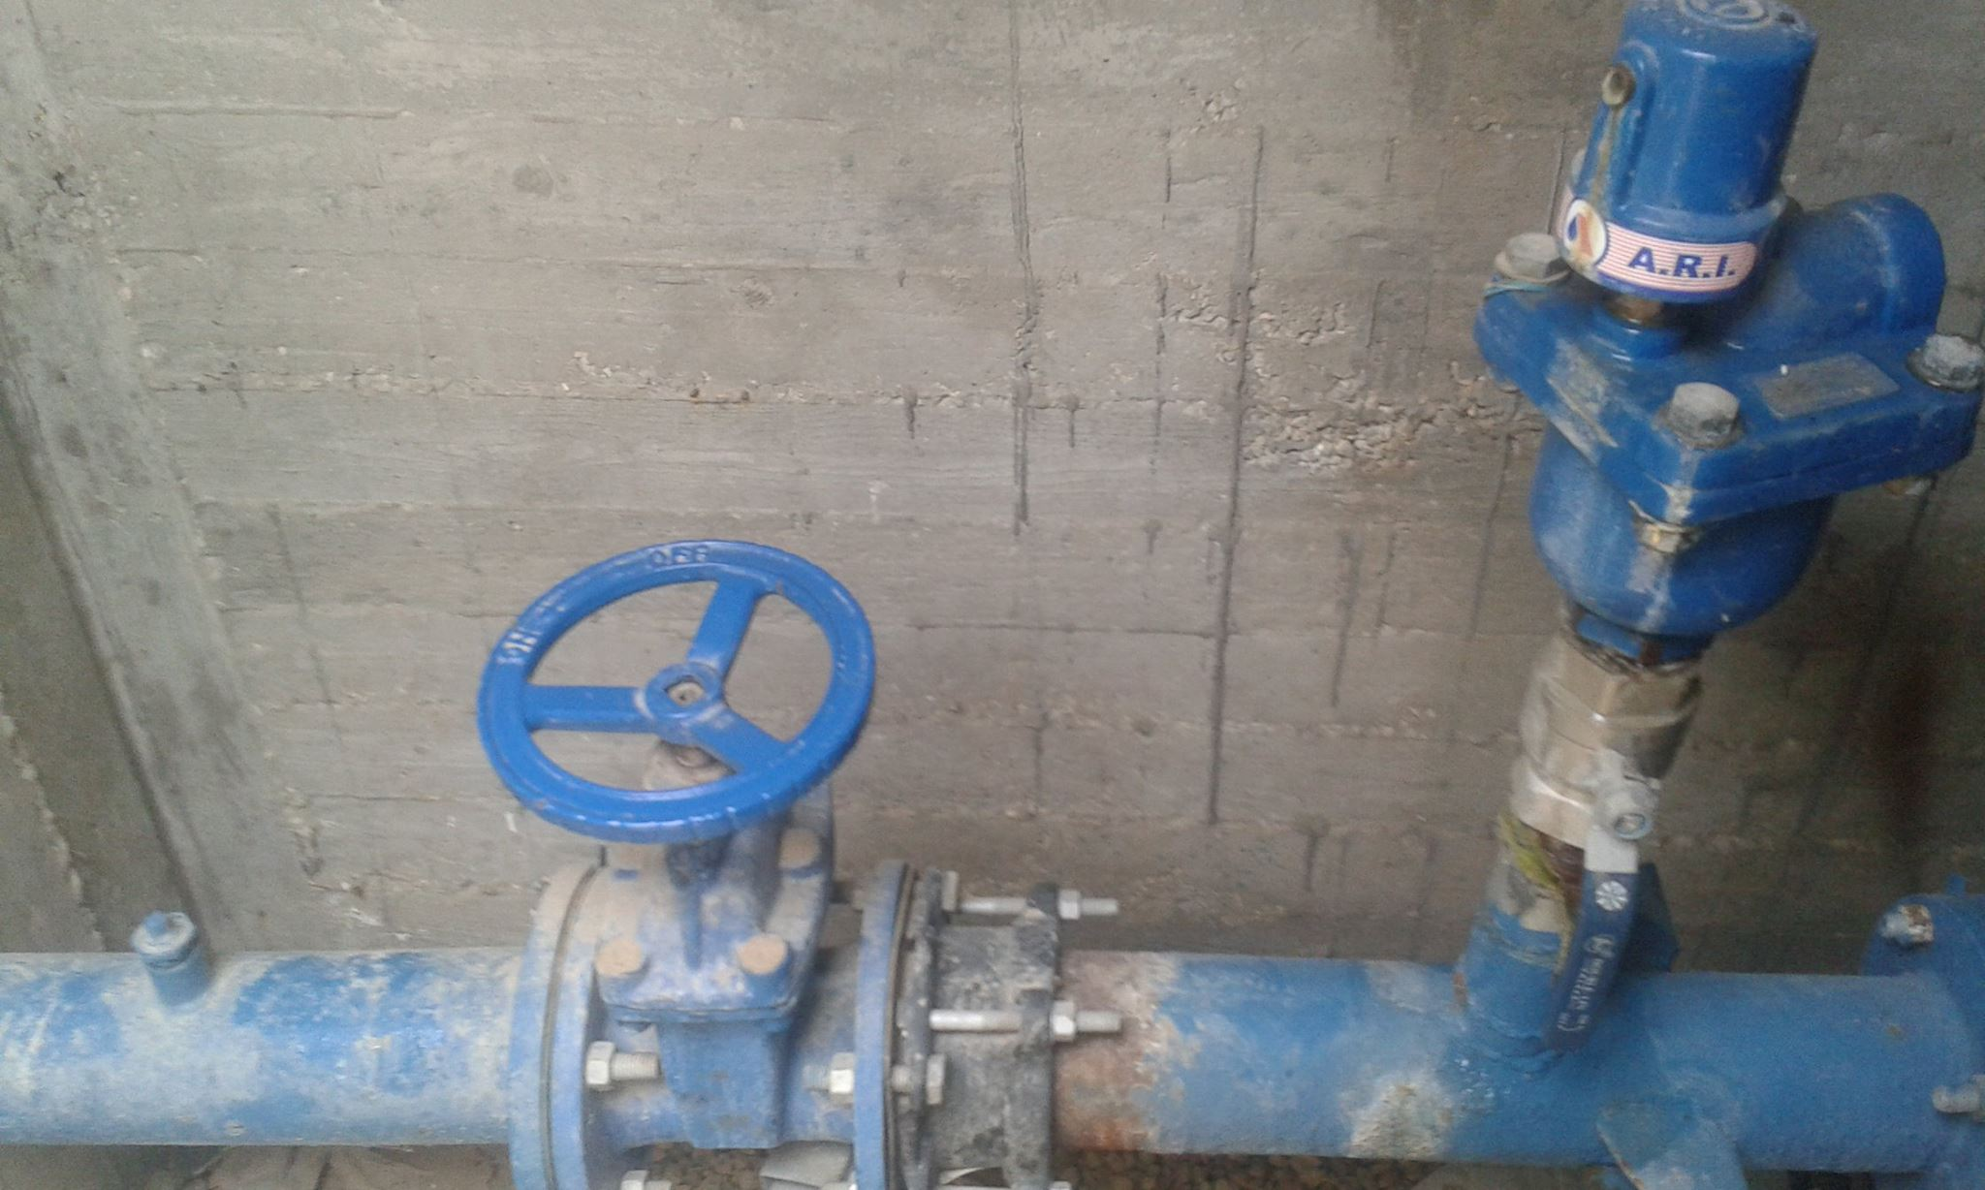

Slide 38
thank you very much

Slide 39
you can ask your questions

