Slide 1

An-Najah National University Faculty of Engineering Civil Engineering Dept. Graduation Project Design of Foundation for Residential Building By : 1.A’laa Sabobeh 2.Mohammad Sawallha 3.Mohammad Ali Saleh Supervisor: Dr.Isam Jardaneh

Slide 2
Agenda
Introduction
Types of Foundation
Design Single Footing
Design Tie Beams
Design Pile Foundation
Conclusion

Slide 3
Introduction
The foundation of structure is defined as that part of the structure in direct contact with the ground, which transmits safely the load of the structure to the ground.

Slide 4
Introduction
This means that the foundation is a primary part in any structure. So that the foundation must be designed in a perfect way.
The foundations in this project are classified into two alternatives:
Shallow Foundation (Single Footing).
Deep Foundation (Pile Foundation).

Slide 5
Single Footing
We decided to use this type of foundation due to two main reasons:
Bearing capacity is relatively high (400KN/m2).
Total area of footing < 60% area of building.

Slide 6
Pile Foundation
Pile foundation used because an adequate bearing capacity can't be found at shallow enough depths to support the structural loads.

Slide 7
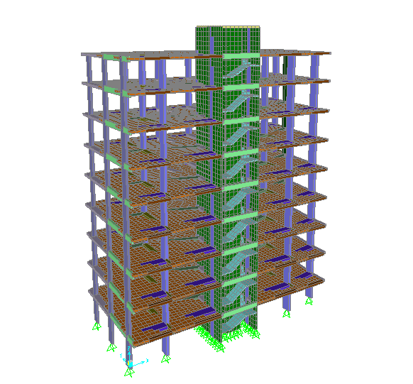

Slide 8
Design for Single Footing
In the Beginning we divide the columns for tow groups depends on the loading.

Slide 9
Grouping
Joint # | OutputCase | CaseType | StepType | F3(fixed) | F3(pin) | Area Req.
Group 1
3 | Envelope | Combination | Max | 3587.428 | 3588.331
3 | Actual | Combination |  | 2826.724 | 2827.331 | 7.07
5 | Envelope | Combination | Max | 3638.078 | 3638.178
5 | Actual | Combination |  | 2853.873 | 2853.897 | 7.13
7 | Envelope | Combination | Max | 3564.07 | 3564.304
7 | Actual | Combination |  | 2798.563 | 2798.72 | 7.00
9 | Envelope | Combination | Max | 3728.522 | 3728.652
9 | Actual | Combination |  | 2924.388 | 2924.488 | 7.31
11 | Envelope | Combination | Max | 3390.735 | 3391.447
11 | Actual | Combination |  | 2667.404 | 2668.041 | 6.67
21 | Envelope | Combination | Max | 3928.357 | 3928.668
21 | Actual | Combination |  | 3094.509 | 3094.906 | 7.74
23 | Envelope | Combination | Max | 3841.991 | 3844.738
23 | Actual | Combination |  | 3026.197 | 3028.216 | 7.57
27 | Envelope | Combination | Max | 2966.91 | 2965.158
27 | Actual | Combination |  | 2374.574 | 2373.369 | 5.93
35 | Envelope | Combination | Max | 3507.313 | 3507.715
35 | Actual | Combination |  | 2700.347 | 2700.631 | 6.75
37 | Envelope | Combination | Max | 3381.925 | 3383.2
37 | Actual | Combination |  | 2605.922 | 2606.911 | 6.52
Group2
1 | Envelope | Combination | Max | 2254.257 | 2253.817
1 | Actual | Combination |  | 1809.105 | 1808.586 | 4.52
13 | Envelope | Combination | Max | 2271.943 | 2270.33
13 | Actual | Combination |  | 1821.008 | 1819.752 | 4.55
25 | Envelope | Combination | Max | 2242.433 | 2242.684
25 | Actual | Combination |  | 1799.311 | 1799.256 | 4.50
39 | Envelope | Combination | Max | 2197.429 | 2195.279
39 | Actual | Combination |  | 1747.604 | 1746.004 | 4.37
41 | Envelope | Combination | Max | 2562.685 | 2561.85
41 | Actual | Combination |  | 2037.858 | 2037.448 | 5.09

Slide 10
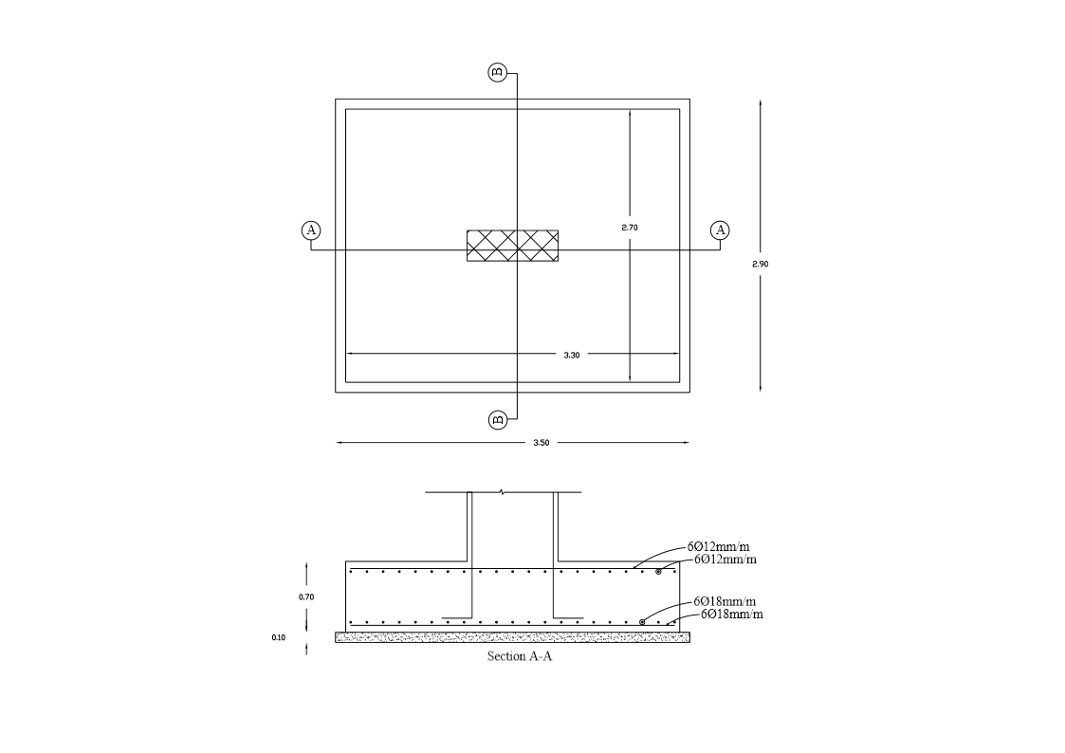
Group one,

Slide 11
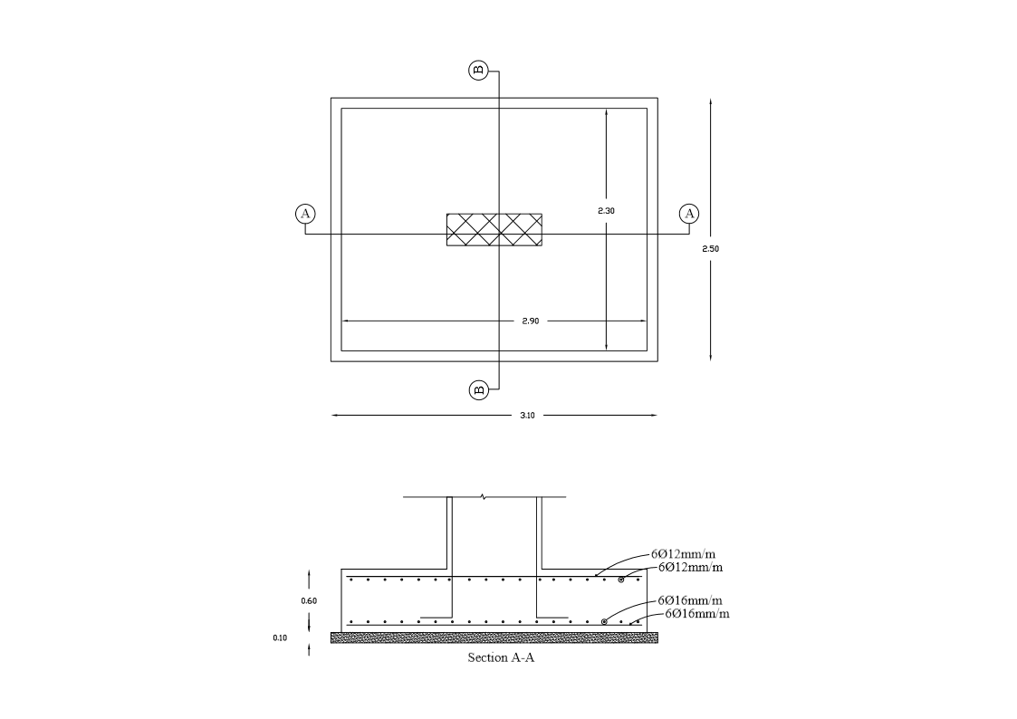
Group two,

Slide 12
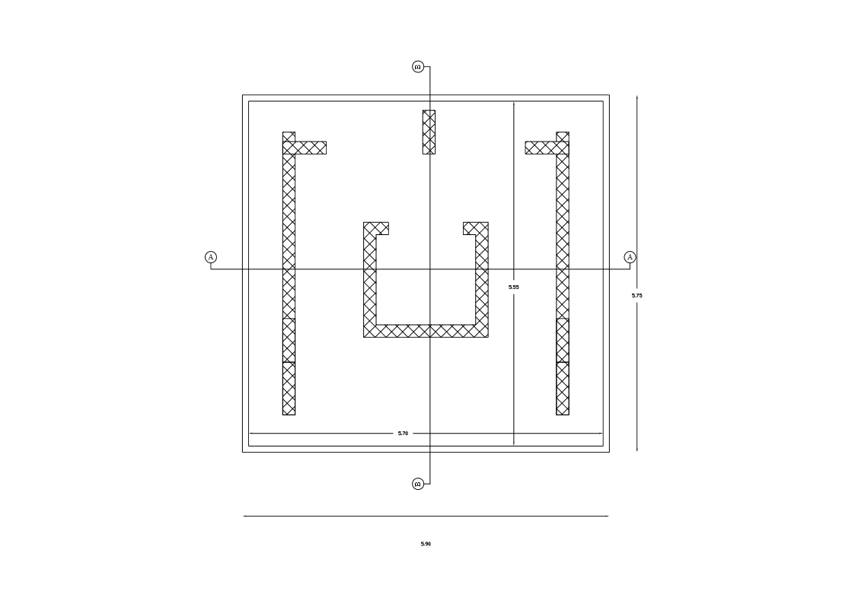
Stairways,

Slide 13
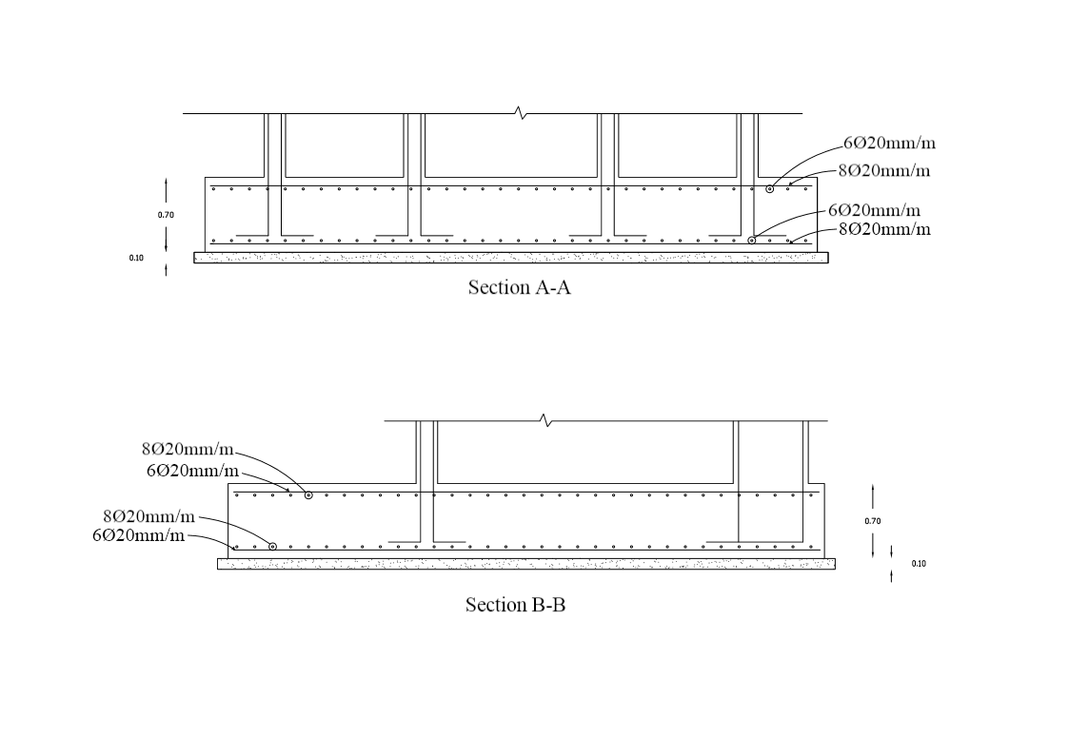
Stairways,

Slide 14
Tie Beams
Beams used to connect between columns necks, its function to provide resistance moments applied on the columns, tie beams useful to resist earthquakes load, and it’s also important if settlement occurs.

Slide 15
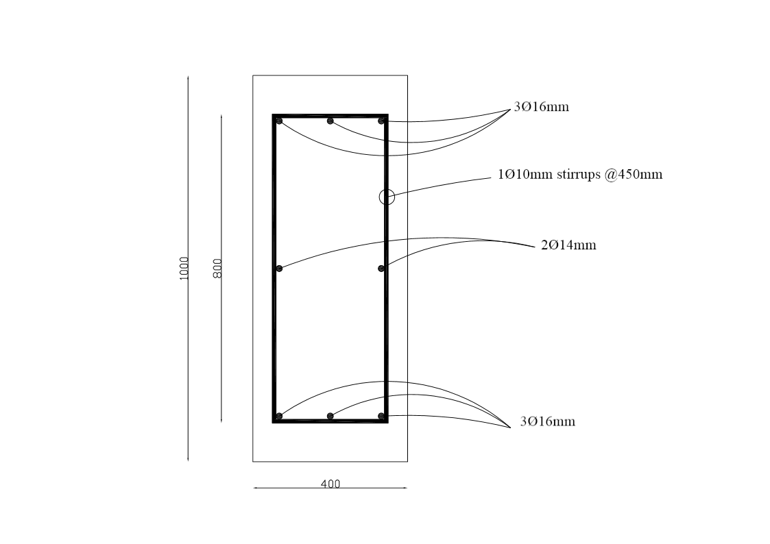
Tie Beams,

Slide 16
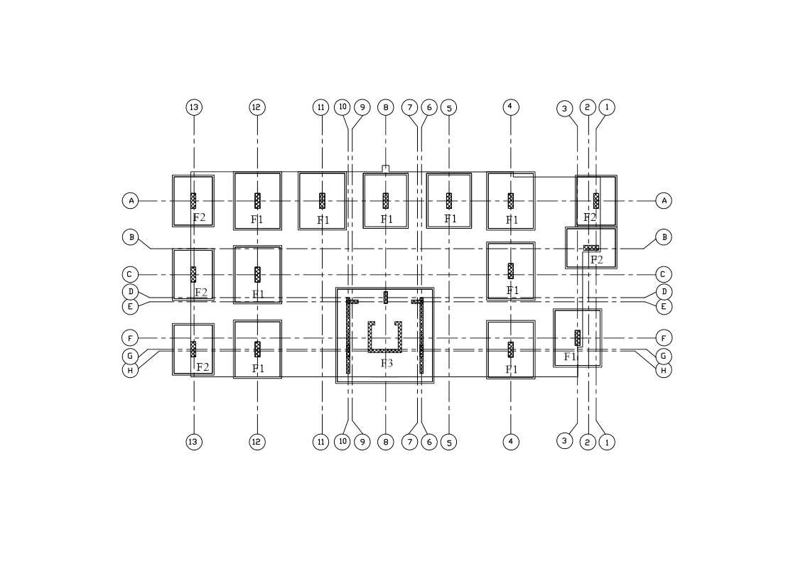
Footing Plan

Slide 17
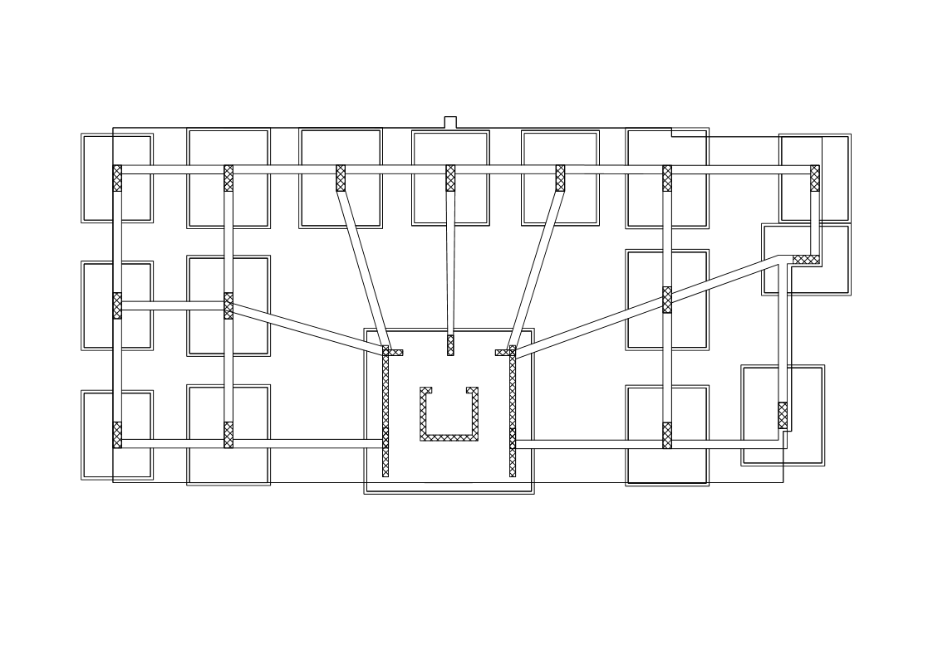
Tie Beams Plan

Slide 18
Pile Foundation
Piles are structural member that are made of steel, concrete, or timber. They are used to build pile foundations, which are deep.
When we Use Pile Foundations:
Inadequate Bearing Capacity of Shallow
Foundations.
To Prevent Uplift Forces.
To Reduce Excessive Settlement which cost more than shallow foundations.

Slide 20
Conclusion

Slide 21
THANK YOU

