Slide 1

Graduation Project II
Structural Analysis and Design of building in Nablus city -Palestine.
An-Najah National University
Faculty of Engineering
Civil Engineering Department
جامعة النجاح الوطنية
كلية الهندسة ونكنولوجيا المعلومات
By
Adham Adnan Ashour
Under supervision of: Dr.Mahmoud Dwaikat.

Slide 2
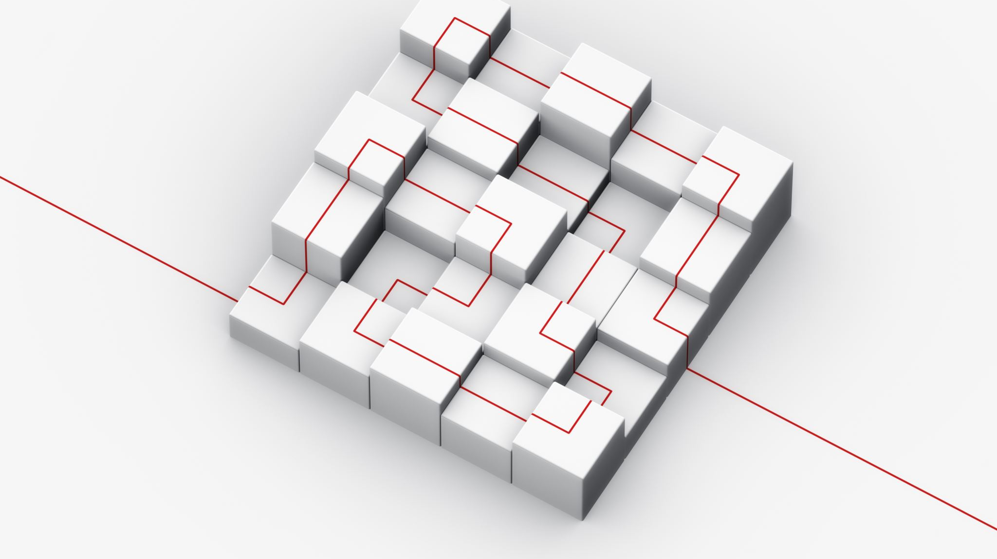
Outline :
1. General Description
2. Preliminary Design
3.Three-Dimensional Modeling and Analysis
4.Design
5.Footing

Slide 3
General Description

Slide 4
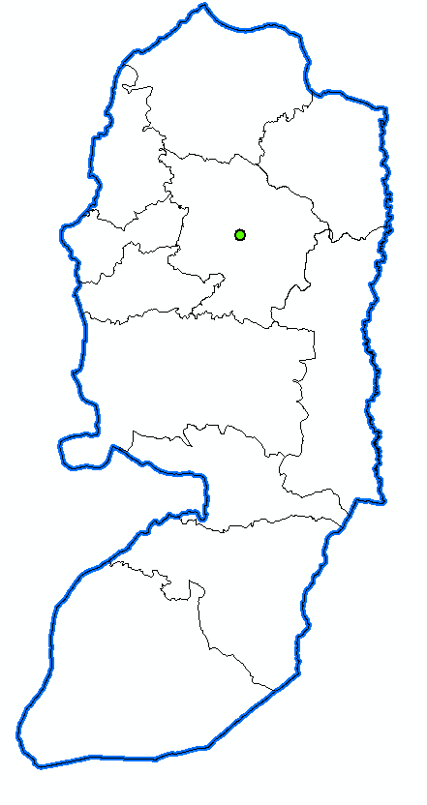

General Description
Location
It is located in Nablus – Palestine, and the coordinates of the project according to the palestinian coordinate system are 181080″N, 175535″E. Location elevation (site level) is +662m AMSL (above mean sea level).

Slide 5
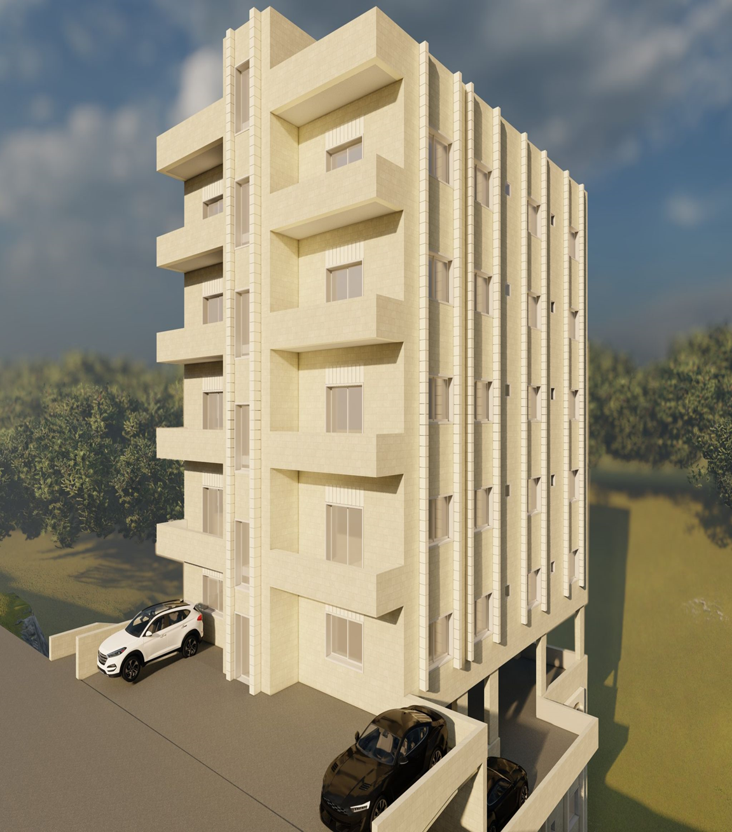

Slide 6
General Description
Assumptions
All supports are Pin supporter in the 3D.
As for the external walls, part of them are made of glass walls and the other part are stone walls, and they are added as dead loads on the external beams.
The slab system is two-way solid slab.
In preliminary design chapter, a quick preliminary was performed, so the thicknesses of retaining and shear walls were taken from architectural plans.
Seven checks were made include compatibility check, equilibrium check, stress-strain check, time period, base shear ,story drift , and P-delta.

Slide 7
General Description
Height and Area For Each Floor

Slide 8
General Description
Codes and Standard.
ASCI 318-14 (American Concrete Institute)
ACI 318-19 (American Concrete Institute)

Slide 9
General Description
Load Combinations
Ultimate load combinations:
1.4D
1.2D + 1.6L
1.2D + 1.6L + 0.5(Lr or S or R)
1.2D + 1.6(Lr or S or R) + (1.0L or 0.5W)
1.2D + 1.0W + 1.0L + 0.5(Lr or S or R)
1.2D + 1.0E + 1.0L + 0.2S
0.9D + 1.0W
0.9D + 1.0E
Service load combinations:
D + L
D + 0.75L
D + 0.7E
D + 0.75L + 0.75(0.7E)
0.6D + 0.7E

Slide 10
General Description
Load Combinations
Ultimate load combinations: (lateral load)
1.4D
1.2D + 1.6L
1.29D + L + Ex
1.29D + L - Ex
1.29D + L + Ey
1.29D + L - Ey
0.9D + 1.0Ex
0.9D - 1.0Ex
0.9D + 1.0Ey
0.9D - 1.0Ey

Slide 11
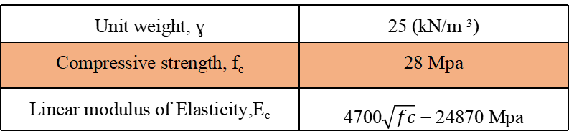
General Description
Construction Materials
Structural Elements
Unit weight, ɣ | 25 (kN/m ³)
Compressive strength, f_{c} | 28 Mpa
Linear modulus of Elasticity,E_{c} | 4700$\sqrt{fc}$ = 24870 Mpa

Slide 12
General Description
Construction Materials.
Non- Structural Elements :
Material | Unit weight ɣ(KN/m³)
Masonry stone | 26
Cement mortar &Plaster | 23
Partition blocks | 12
Filing material aggregate | 14
Glass | 25
Tiles | 26
Ytong Block | 5
Reinforce concrete | 25

Slide 13
General Description
Loads
Gravity loads :
Dead load
Super imposed dead load
Live load
Lateral loads :
Soil load
Seismic load

Slide 14
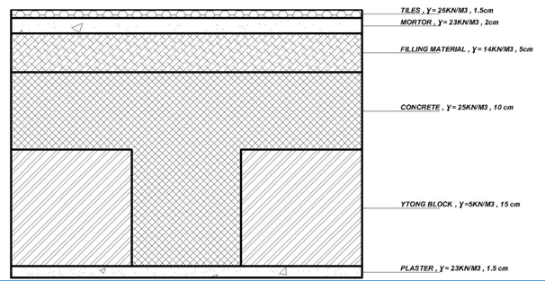
General Description
The floor layers:
Finishing materials weight = Σ (thickness of layer × unit weight for each layer)
Superimposed Dead load calculation
Element | Thickness (cm) | Unit weight (KN/m^3)
Filling | 5 | 14
Mortar | 2 | 23
Tiles | 1.5 | 26
Ytong Block | 17 | 5
Plaster | 1.5 | 23
SD= Tile weight + Mortor weight + Filling weight + Block weight + Plaster weight + SD of Partitions
SD = 5 KN/m2

Slide 15
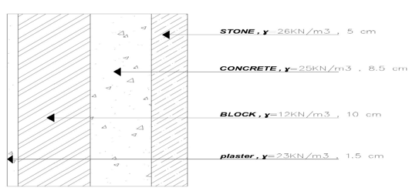
General Description
Exterior wall load
-Stone wall :
SD masonry wall = unit weight × thickness
=18KN/M

Slide 16
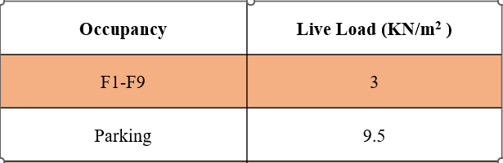
Live Load

Slide 17
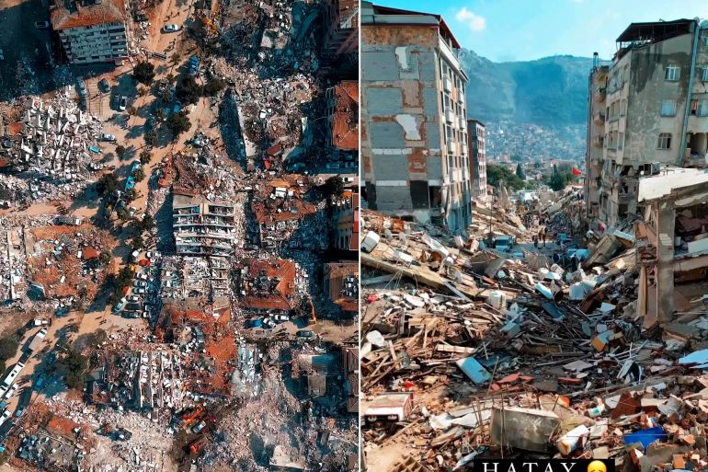
Lateral Load
Seismic loads:

Slide 18
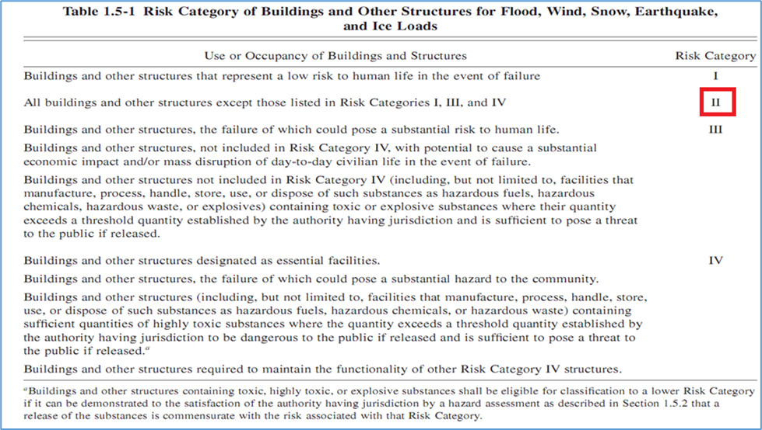
Lateral Load
Seismic loads:
According to ASCE 7-10 code to seismic analysis for this structure:
- Risk category: risk category of the building is III

Slide 19
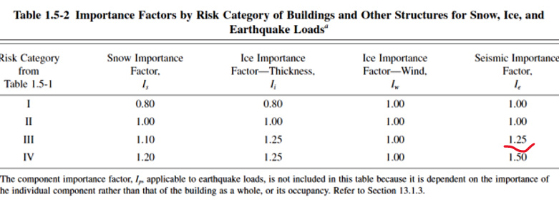


Lateral Load
Importance factor : (Ie) = 1.25
Zone factor (Z) for Nablus = 0.2
- Mapped acceleration parameters Ss & S1 :
From Palestine seismic map:
Ss= 0.6
S1 = 0.14
Site Class
Site classification is C

Slide 20
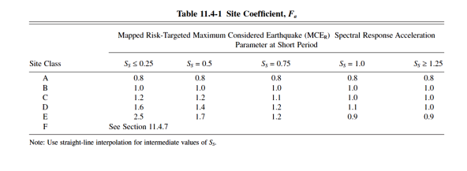
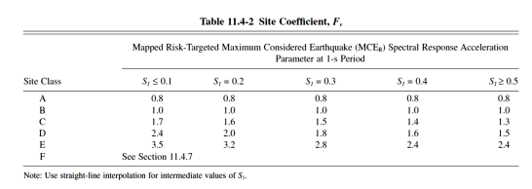
Site Coefficients
- The values of Fa and Fv According to the site class in this project are 0.90 ,0.80 respectively.

Slide 21
Seismic Design Category
-The maximum considered earthquake Spectral Response Acceleration
Parameters SMS and SM1:
Fa = 1.1652 Fv = 1.7
Sms = 1.1652* 0.6 = 0.7
Sm1 = 1.7 * 0.14 = 0.238
Sds = 2/3 * 0.7= 0.47
Sd1 = 2/3 * 0.238 = 0.16

Slide 22
Lateral Force Resisting System
Type of the lateral forces resisting system :
Ordinary reinforced concrete shear walls
Response Modification Factor (R) = 5
Over-strength Factor (Ω_{o}) = 2.5
Deflection Amplification Factor (C_{d}) = 4.5

Slide 23
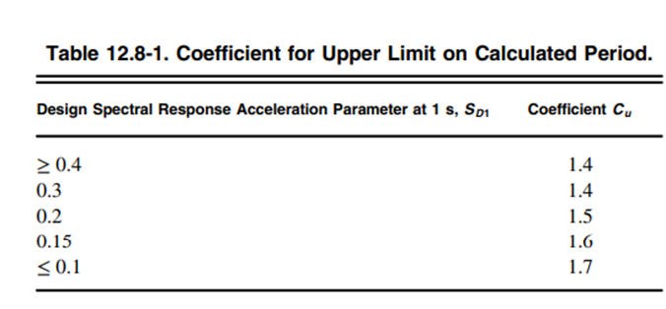
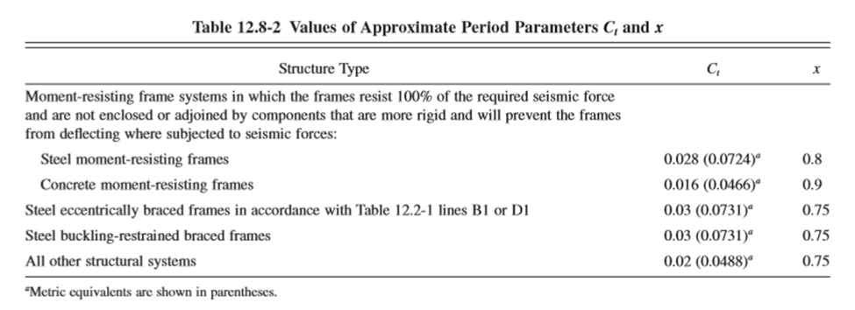
Structural Period
T_{a} = C_{t} h_{n} ^{x} =Ta = 0.0488 * (3.2m * 9n)^0.75 = 0.6 sec
T from ETABS ≤ T_{a} C_{u}
The period is limited to T_{u} = T_{a} C_{u}= T max at X and Y = 1.37 * 0.6= 0.82sec

Slide 24


General Description
Computer Programs

Slide 25
Structural Preliminary Design

Slide 26
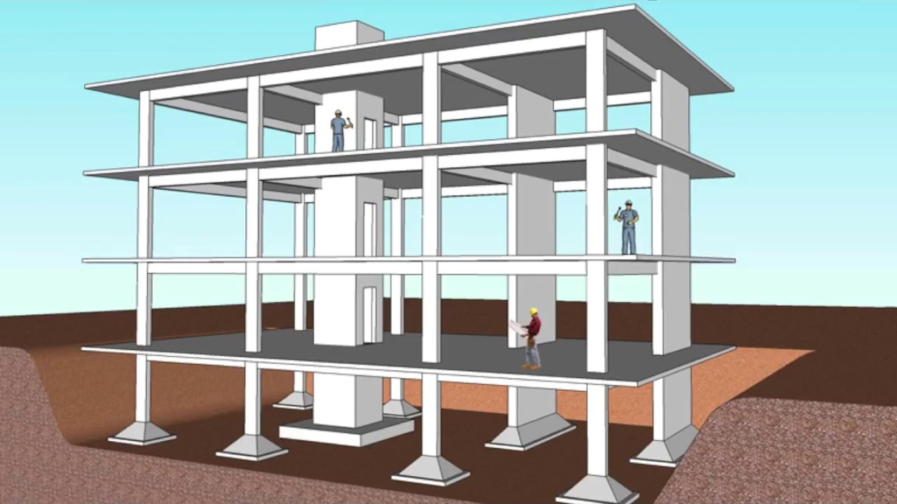
1. Slab System
2.Beam System
3. Column System
4. Wall System
Preliminary Design
Structural Systems for analysis and design

Slide 27

Slab Preliminary dimensions

Slide 28
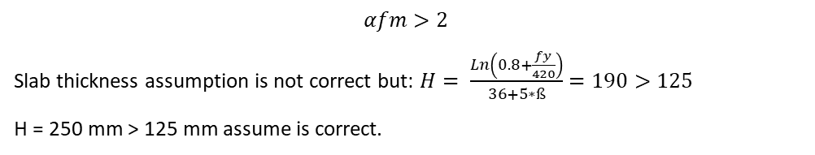
Using two-way solid slab,
Preliminary Design
Slab System
By referring to Table 8.3.1.1 in ACI-318-19:
$$αfm>2$$
Slab thickness assumption is not correct but: $H= \frac{Ln\left(0.8+\frac{fy}{420}\right)}{36+5∗ß}=190>125$
H = 250 mm > 125 mm assume is correct.
h = 250mm

Slide 29
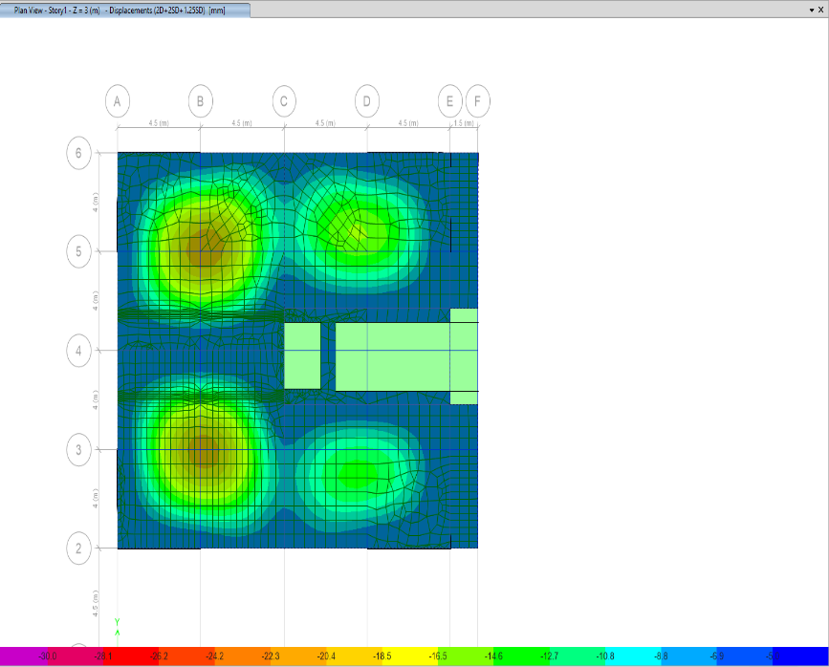
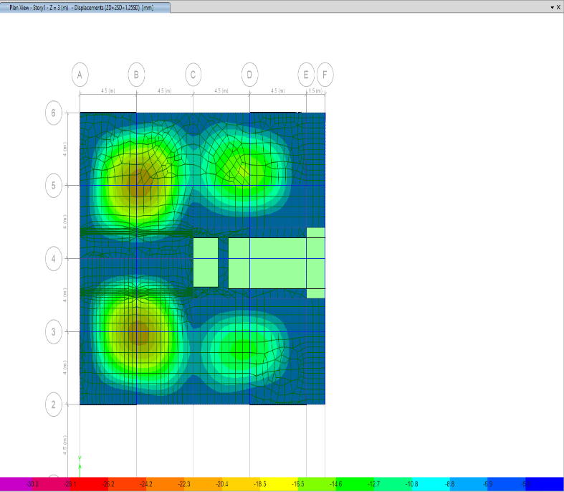
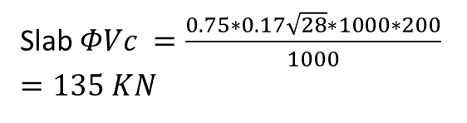
Preliminary Design
Slab System
Check Slab for shear
Slab $ΦVc =\frac{0.75∗0.17\sqrt{28}∗1000∗200}{1000}=135 KN$
Maximum Shear force in X-Direction from Etabs = 60kN
Maximum Shear force in Y-direction from Etabs = 100 kN

Slide 30
Beams Layout

Slide 31
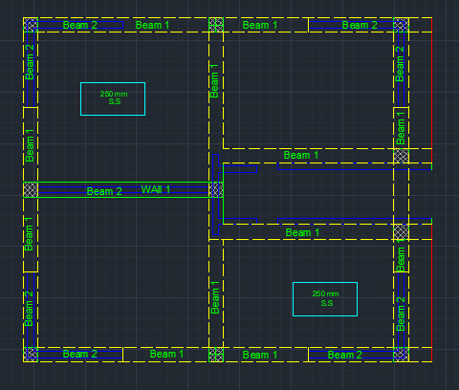
Preliminary Design
Beam Layout

Slide 32
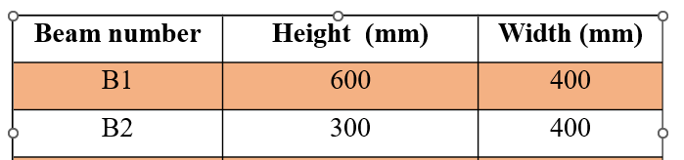
Preliminary Design
Beam System

Slide 33
Column Layout

Slide 34
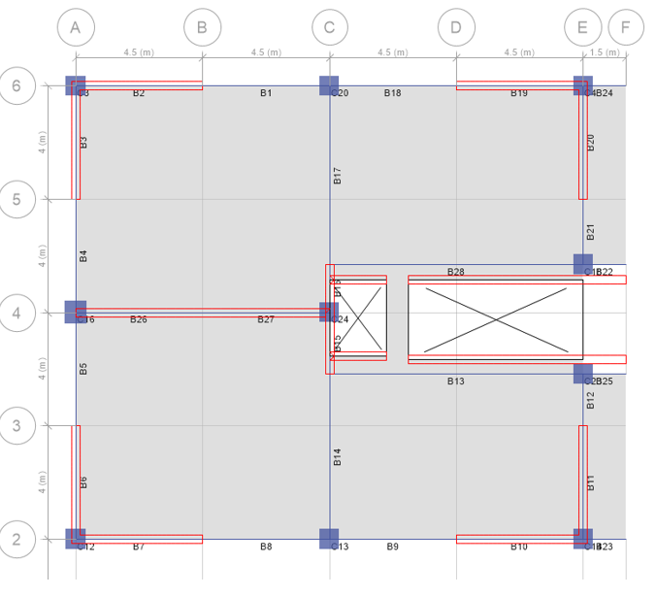

Slide 35
Preliminary Design
Column System
Column | Type | Dimension
C1 | R | 700*700
R: Rectangular column

Slide 36
Wall Layout

Slide 37
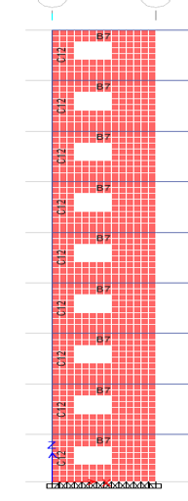
Preliminary Design
Wall System
Types of walls in this structure will be used:
1. Shear walls
From architectural plans, elevators and staircase walls have an walls have an thickness equal to 300 mm
Wall name | Wall thickness (mm)
Wall 1 | 300

Slide 38
3D-Modeling and Analysis

Slide 39
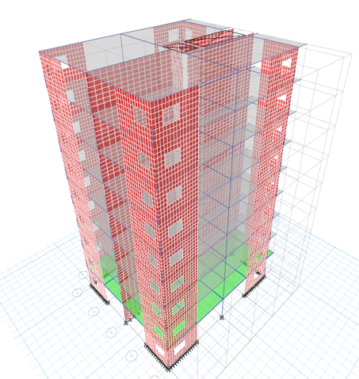
3D-Modeling and Analysis

Slide 40

Verification of Structural Analysis

Slide 41
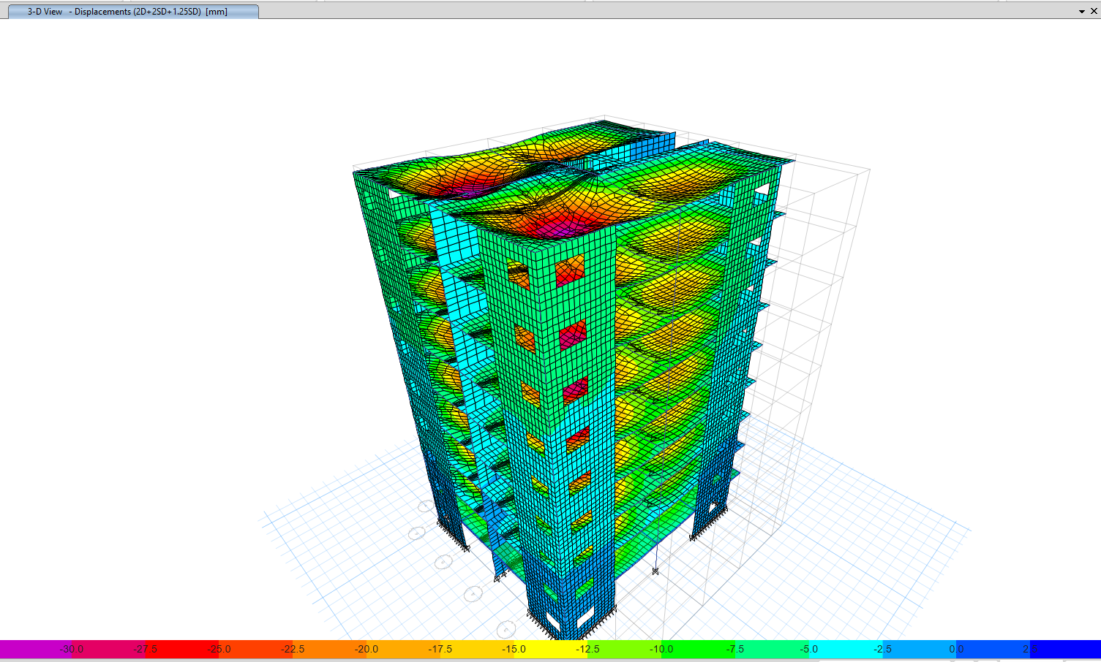
3D-Modeling and Analysis
Compatibility Check

Slide 42
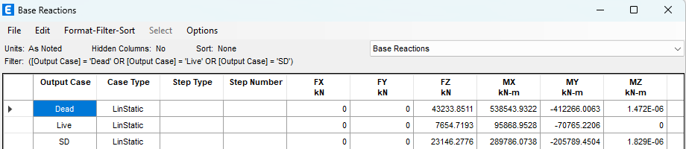

3D-Modeling and Analysis
Equilibrium Check
Live load
Live load = 3 kn/m²
Total Slab area = 306 – 18 = 288 m²
Total live load = 288*3*9 = 7776 kN
Total live load from Etabs = 7654.7 kN
$$Error= \frac{7776−7654.7}{7654.7}∗100= 0.01\%<5\% ok$$

Slide 43
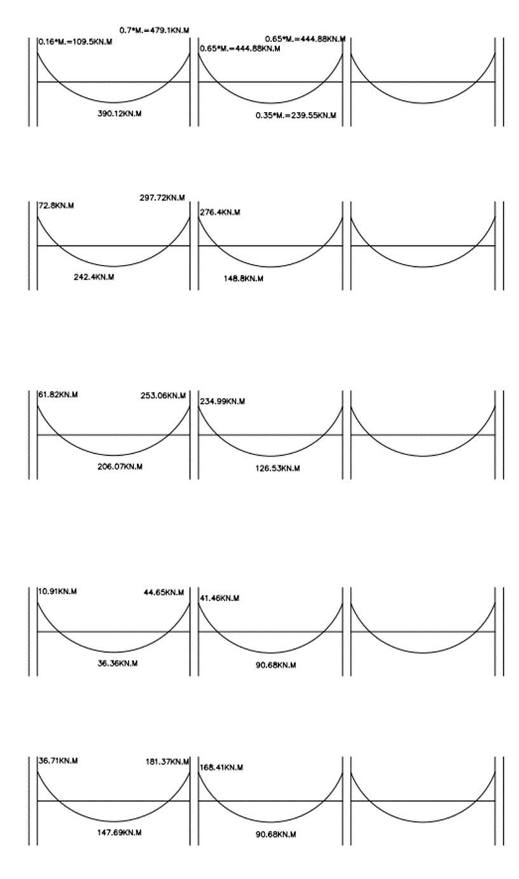
3D-Modeling and Analysis
Stress Strain Load

Slide 44

3D-Modeling and Analysis
Deflection Check

Slide 45
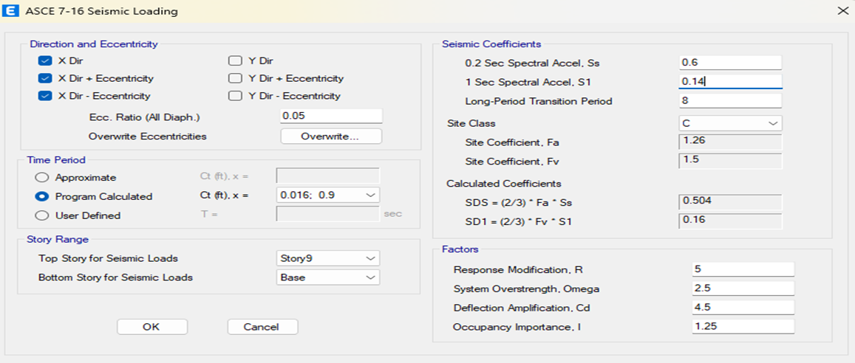
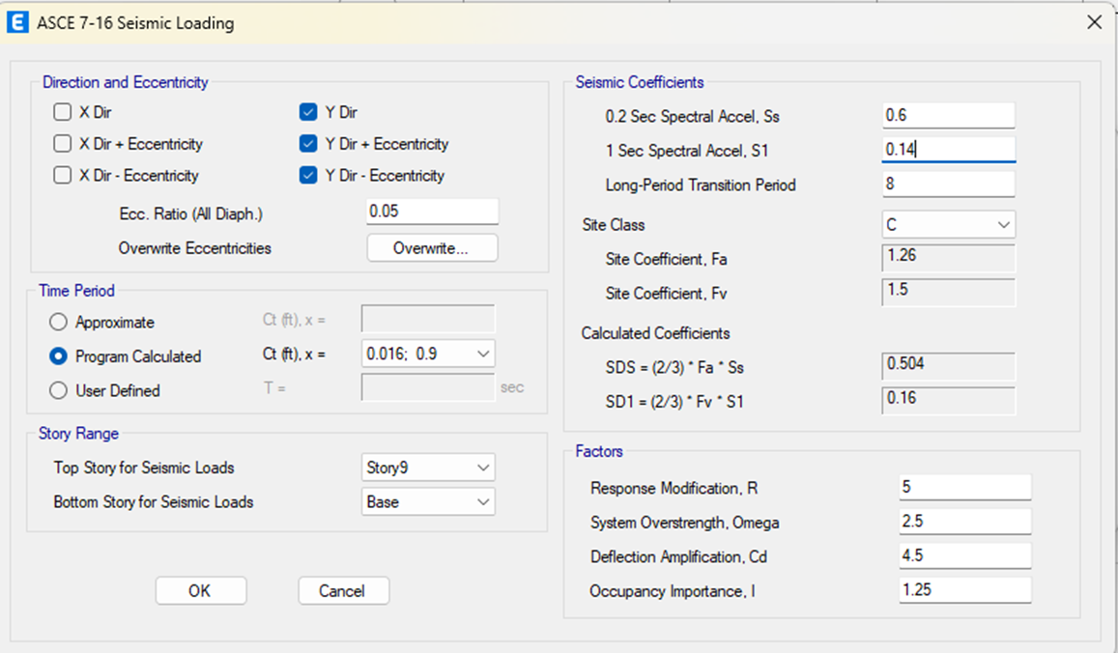
3D-Modeling and Analysis
Seismic Analysis Methods
1.Equivalent lateral force method (ELF).
Seismic loading in X-direction
Seismic loading in Y-direction

Slide 46
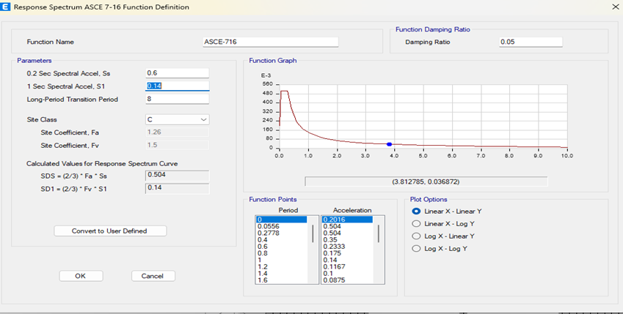
3D-Modeling and Analysis
Seismic Analysis Methods
  2.Modal response spectrum method (MRS).
Definition of MRS in ETABS

Slide 47
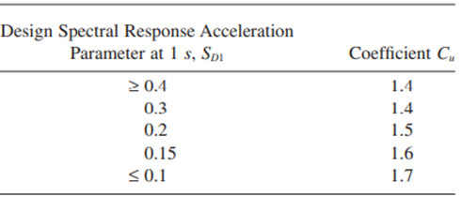
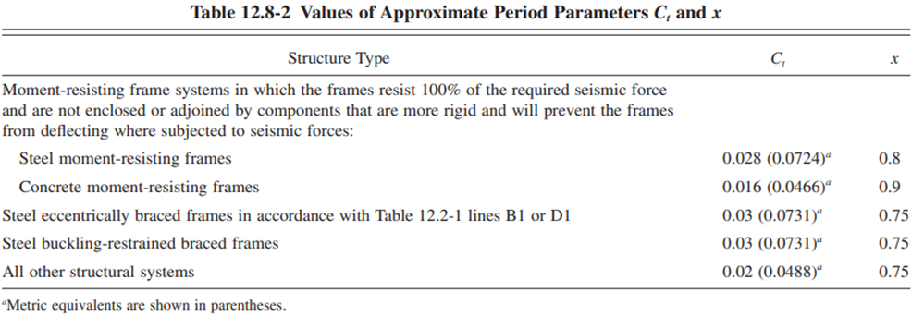
3D-Modeling and Analysis
Period

Slide 48
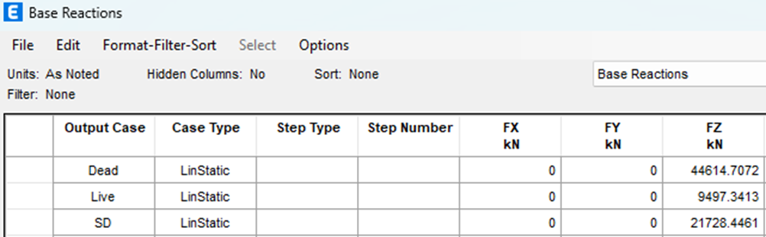
3D-Modeling and Analysis
Base Shear Check
→ V manually = Cs * Building weight
-Where:
V: seismic base shear.
Cs: seismic response coefficient.
W: effective weight.

Slide 49
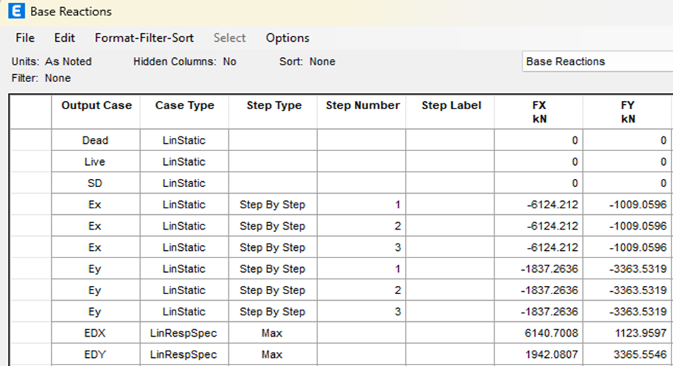
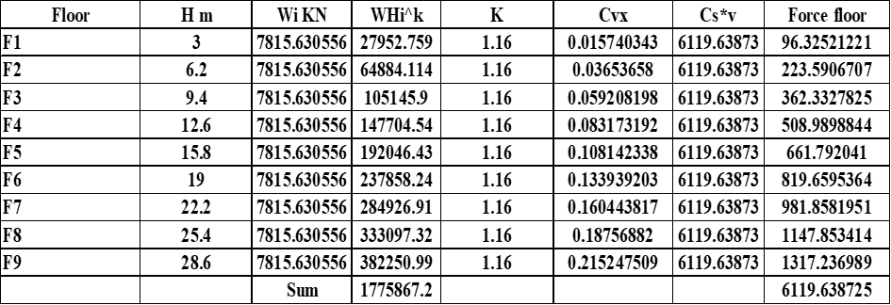
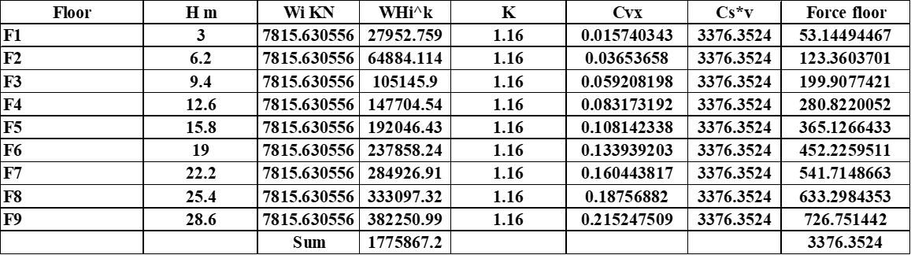
3D-Modeling and Analysis
Base Shear Check

Slide 50
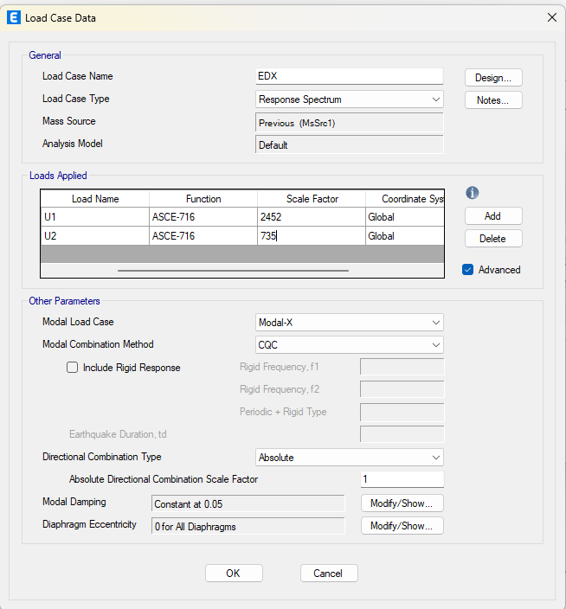
3D-Modeling and Analysis
Response spectrum
The values of dynamic earthquake forces must be approximately equal to the value of earthquake forces in the static method. However, the values were not equal, which led to a change in the scale factor for each of the dynamic earthquake forces in X and Y.
→ Define load case in both directions (Ex and Ey initial)
Factor=9810*I/R = 9810*I/5 =2452.5 See figure

Slide 51
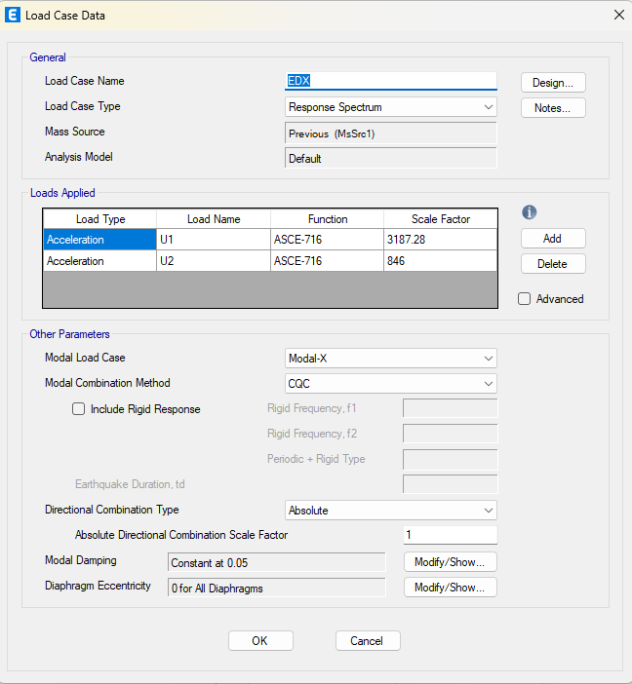
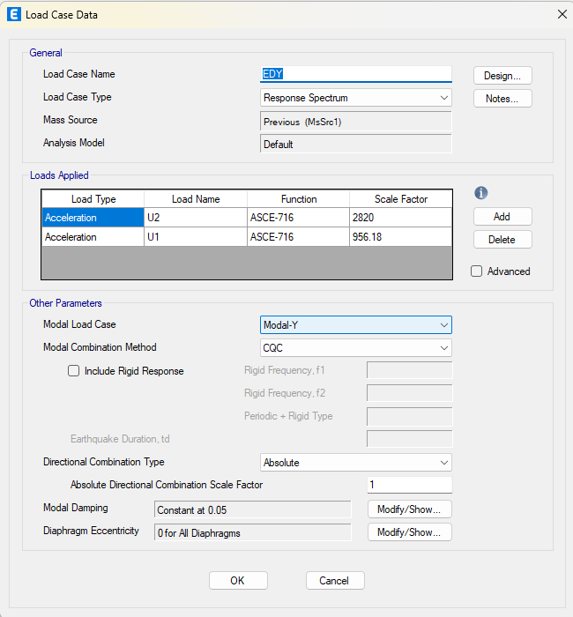
3D-Modeling and Analysis

Slide 52
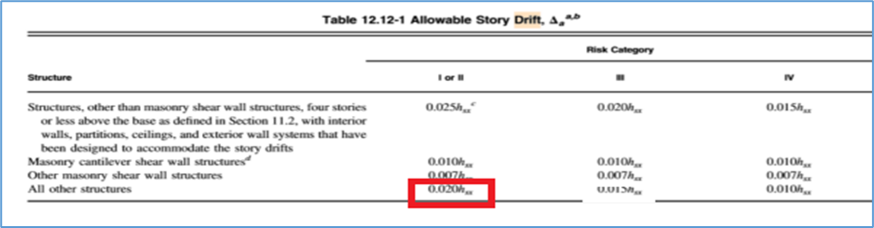
3D-Modeling and Analysis
Story Drift
𝜕𝑥 =𝐶𝑑 ∗ 𝜕𝑥𝑒/𝐼𝑒
The allowable drift = 0.02 hx

Slide 53
3D-Modeling and Analysis
Story Drift
Drift in X-Direction
Story | Delta(elastic) | H | Drift | allowable
9 | 0.00205 | 4.5 | 0.01128 | 0.06 | OK
8 | 0.00206 | 4.5 | 0.01133 | 0.06 | OK
7 | 0.00203 | 4.5 | 0.01118 | 0.06 | OK
6 | 0.00193 | 4.5 | 0.01064 | 0.06 | OK
5 | 0.00177 | 4.5 | 0.00974 | 0.06 | OK
4 | 0.00125 | 4.5 | 0.00687 | 0.09 | OK
3 | 0.00027 | 4.5 | 0.0015 | 0.055 | OK
2 | 8.70E-05 | 4.5 | 0.00048 | 0.08 | OK
1 | 2.10E-05 | 4.5 | 0.00012 | 0.09 | OK

Slide 54
3D-Modeling and Analysis
Story Drift
Drift in Y-Direction
Story | Delta(elastic) | H | Drift | allowable
9 | 0.00205 | 4.5 | 0.01128 | 0.06 | OK
8 | 0.00206 | 4.5 | 0.01133 | 0.06 | OK
7 | 0.00203 | 4.5 | 0.01118 | 0.06 | OK
6 | 0.00193 | 4.5 | 0.01064 | 0.06 | OK
5 | 0.00177 | 4.5 | 0.00974 | 0.06 | OK
4 | 0.00125 | 4.5 | 0.00687 | 0.09 | OK
3 | 0.00027 | 4.5 | 0.0015 | 0.055 | OK
2 | 8.70E-05 | 4.5 | 0.00048 | 0.08 | OK
1 | 2.10E-05 | 4.5 | 0.00012 | 0.09 | OK

Slide 55
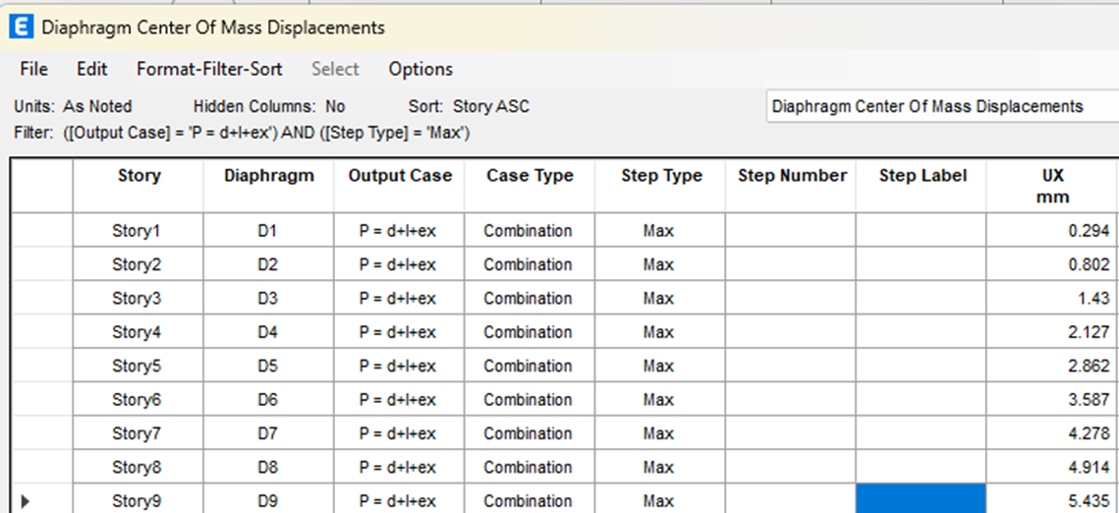
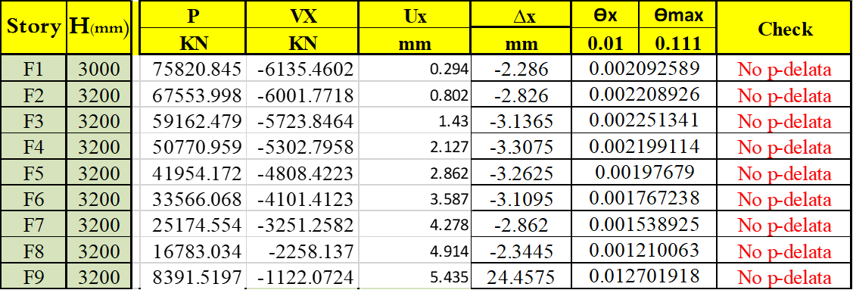
3D-Modeling and Analysis
Effect of P-delta
𝜃 =𝑃𝑥∗ ∆ / 𝑉𝑥∗ℎ𝑥
The values of θ in X direction less than 0.1neglect effect of P-delta.

Slide 56
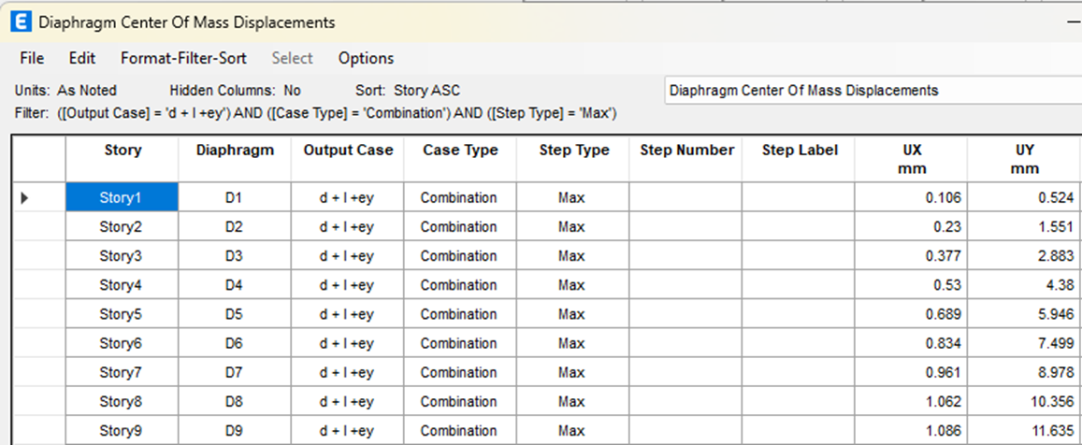
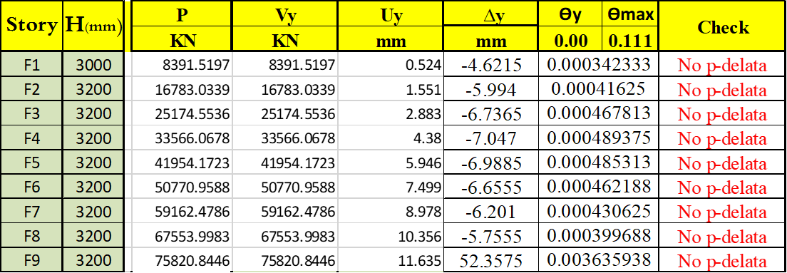
3D-Modeling and Analysis
Effect of P-delta
𝜃 =𝑃y∗ ∆ / 𝑉y∗ℎy
The values of θ in Y direction less than 0.1neglect effect of P-delta.

Slide 57
Design

Slide 58
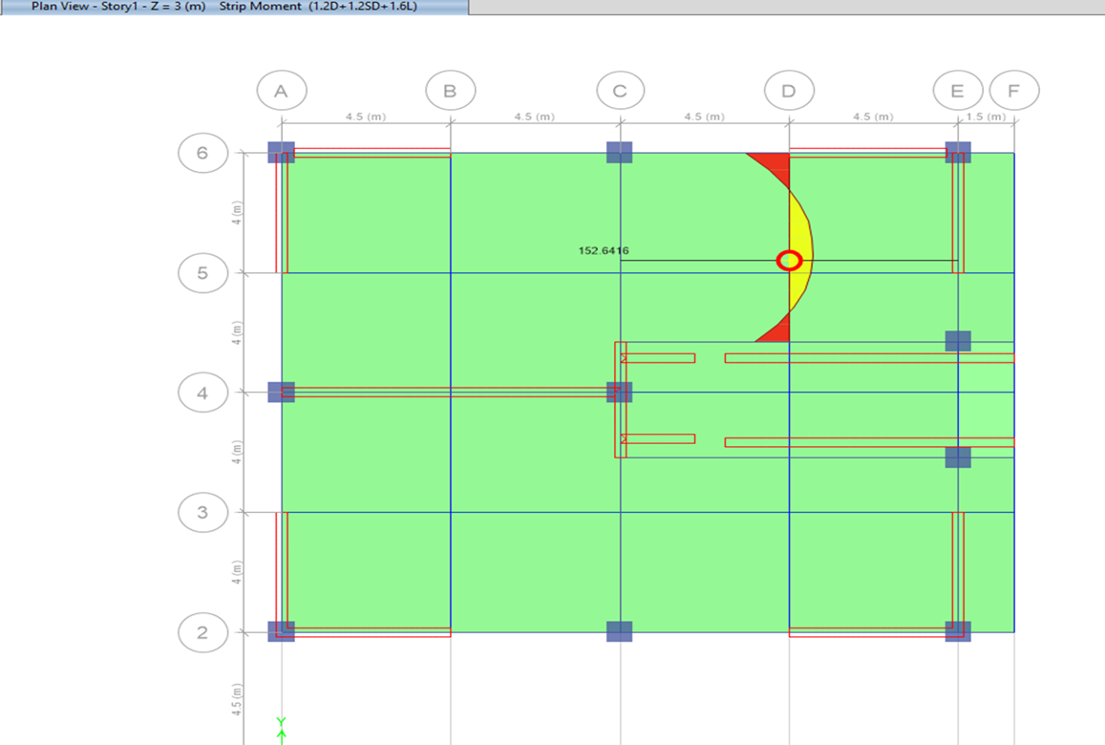
Design
Design of Slab

Slide 59
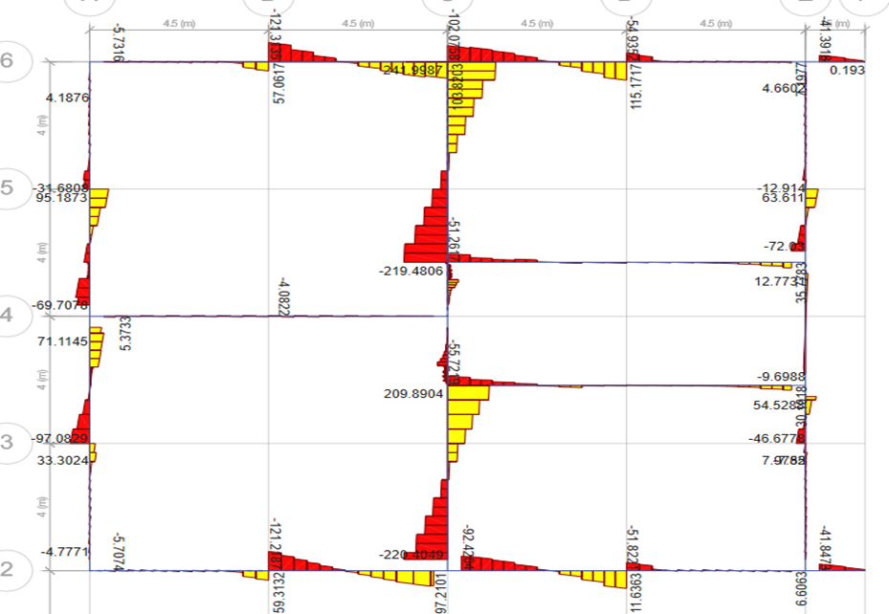
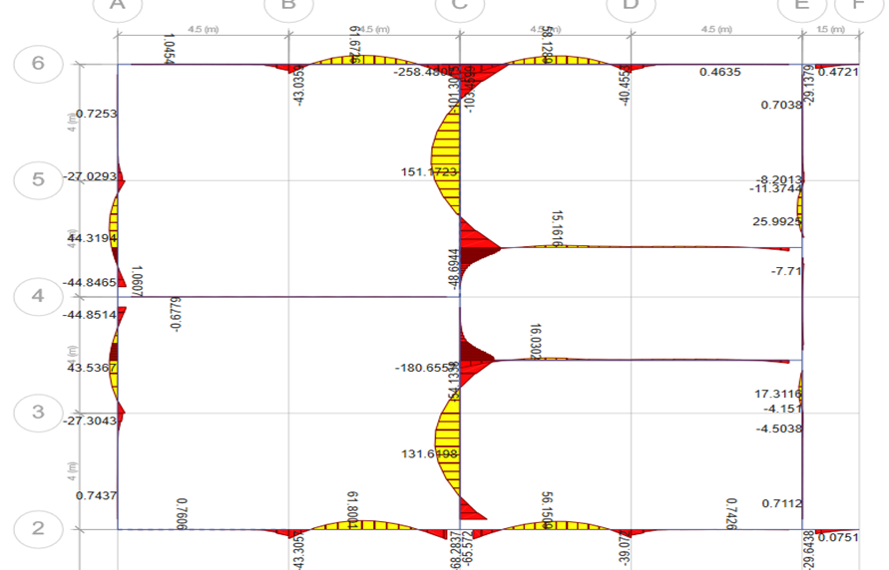
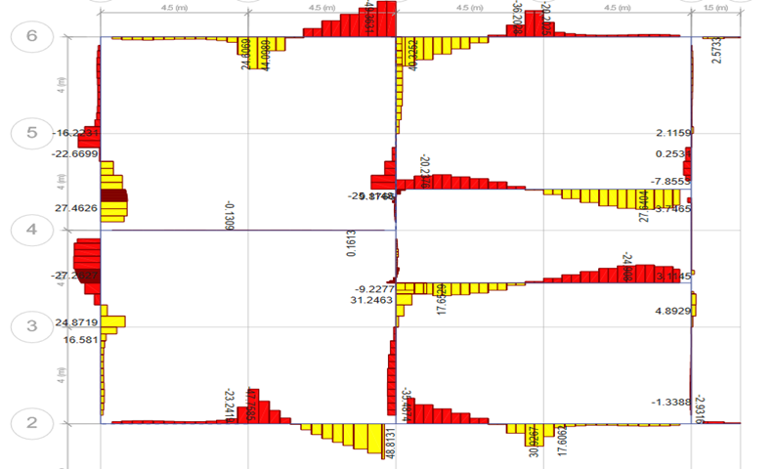
Design
Design of beam

Slide 60
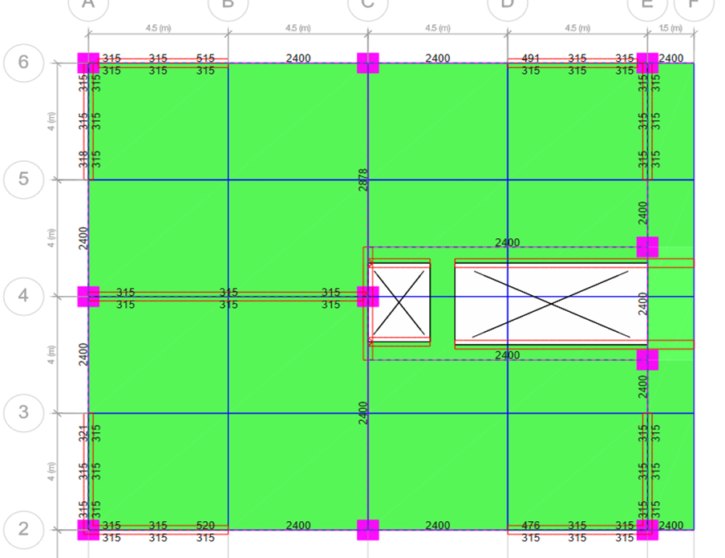
Design
Design of beam
 |  |  |  |  | Area steel
 | b | d | d^2 | Mu+ | Mu- | ƿ+ | ƿ- | Fy | Fc | As+ | As-
Beam 1 | 400 | 520 | 270400 | 151 | 151 | 0.00382 | 0.00382 | 420 | 28 | 793.646 | 793.646
Beam 2 | 400 | 240 | 57600 | 30 | 30 | 0.00355 | 0.00355 | 420 | 28 | 340.81 | 340.81
As min = 0.00333*400*520 = 788.5 m2

Slide 61

Design
Design of columns
Column at grid (5G) has been selected. See figure:
Axial load from ETABS = 4122.63 KN See figure:

Slide 62

Design
Design of columns
0.7*0.7

Slide 63

Footing

Slide 64
Footing
This project is a design for some types of footing, which the Mat foundation and Wall Footing
Ultimate load combinations:
1.4D
1.54D
1.2D + 1.6L
1.32D+1.76L
1.1D+1.1L (Service load)

Slide 65

Footing
Mat foundation Layout (AutoCAD drawing): See Figures:
→Allowable bearing capacity of soil = 250 Kn/m²
→

Slide 66

Footing
Mat Foundation and Wall footing checks :
Check soil pressure :
The pressure must be less than q allowable =250kn/m². → Ok. See figure:

Slide 67

Footing
Check Punching shear :
Check punching shear for mat foundation (less than (1) to get a high factor of safety ). OK. See figure:

Slide 68


Footing

Slide 69

Footing

Slide 70

Plans

Slide 71


Slide 72


