Slide 1


DR GLOWY
BY HALA ATOUT & MASA YASEEN
SUBERVISOR : SULEIMAN NAEEM

Slide 2
TABLE OF CONTENTS
01
INTRODUCTION
02
TOOLS & USED
03
OBJECTIVES
04
FEATURES
05
FUTURE WORK

Slide 3

INTRODUCTION
Dr Glowy is a multi-purpose platform for doctors, product owners, and users seeking skincare services.
It analyzes facial images using image processing to offer personalized skincare and makeup recommendations.
The platform includes a discussion space for expert advice, product advertising, skincare tips, and a chat function for quick support.

Slide 4

OBJECTIVES
Personalized Skincare
Recommendations
Product Promotion
Community Engagement

Slide 5
OBJECTIVES
Expert Guidance
Quick Support & Notifications
User-Friendly Experience

Slide 6

TOOLS & TECHNOLOGIES
USED
Flutter
Node.js
Firebase
python
MongoDB
RASA

Slide 7
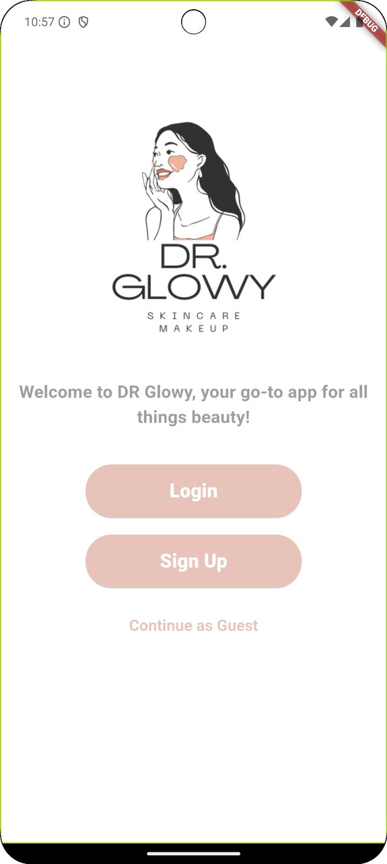

FEATURES
Dr GLOWY
Welcome Screen

Slide 8
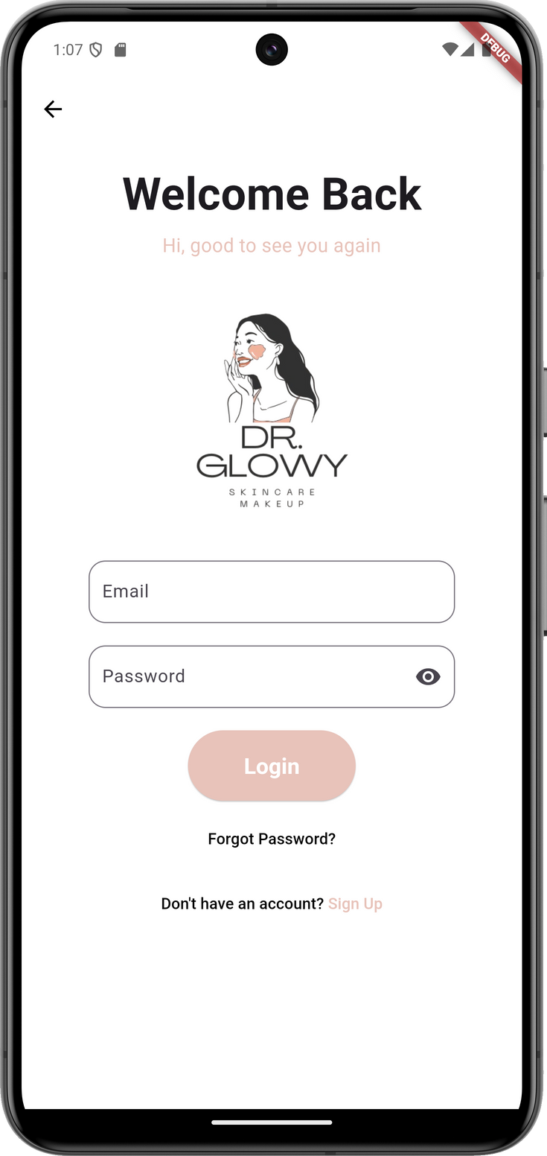
FEATURES
Login process Screen for :
  Regular Users (Customer)
  Doctors
  Product Company Owners

Slide 9
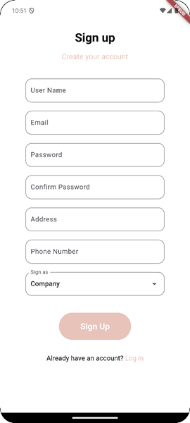
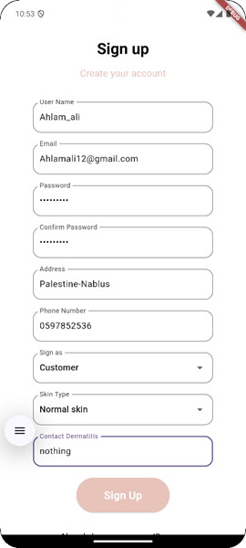
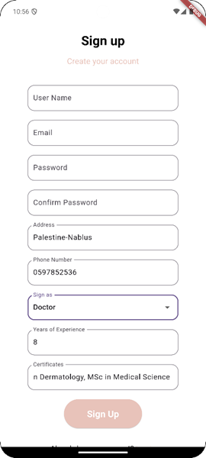
FEATURES
Register process Screen for :
  Regular Users (Customer)
  Doctors
  Product Company Owners

Slide 10
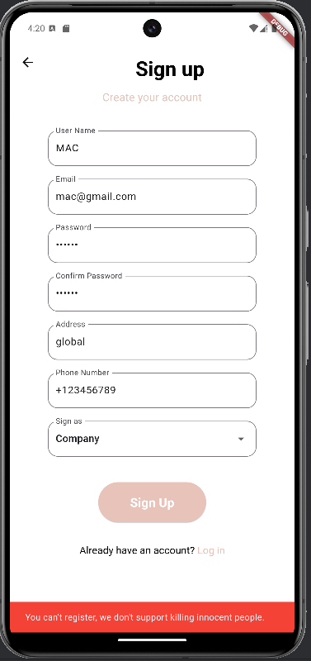
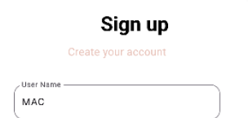

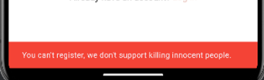
FEATURES
Preventing the registration of boycotted companies
(companies that supported the Israeli occupation)

Slide 11
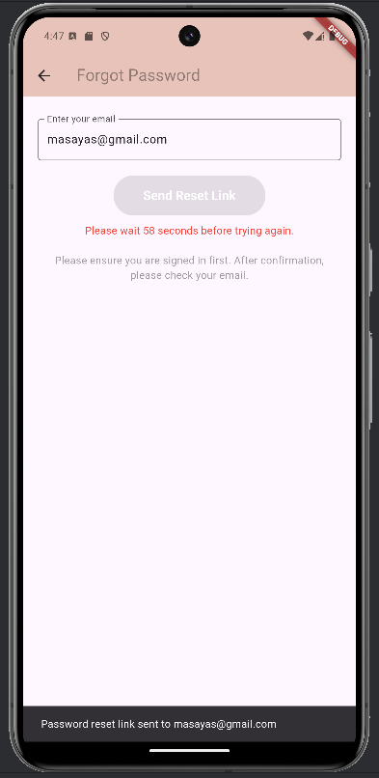
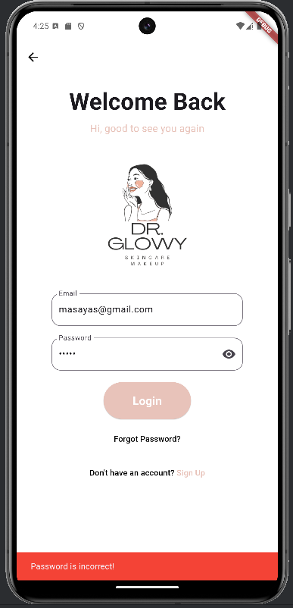

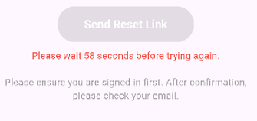
FEATURES
One of the inputs is wrong
(password)
Password reset screen

Slide 12
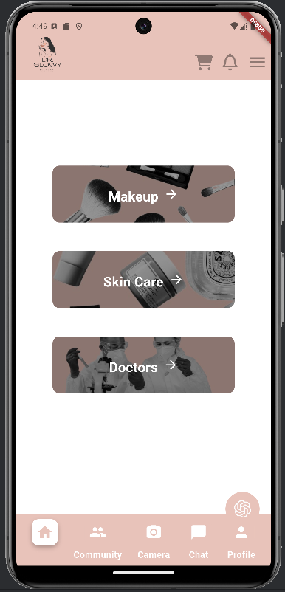
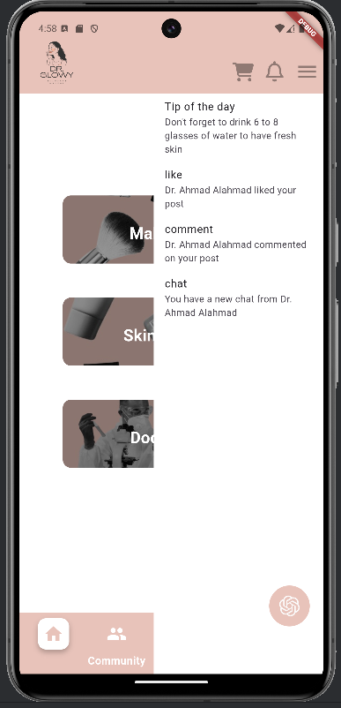
FEATURES
Notifications for customer
Following is Home Page
for Customer

Slide 13
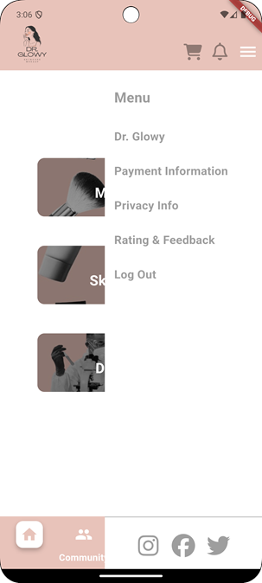
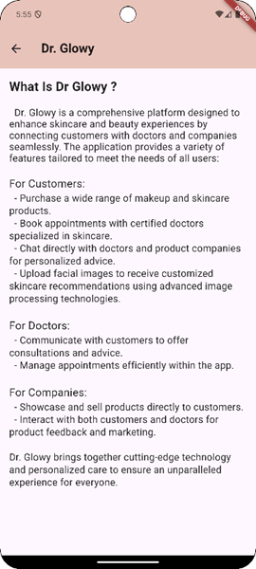
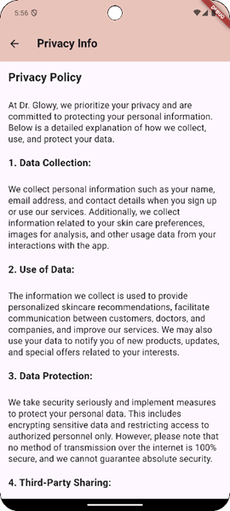
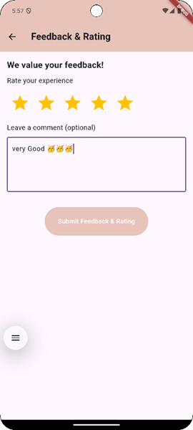
FEATURES
Customer
menu

Slide 14
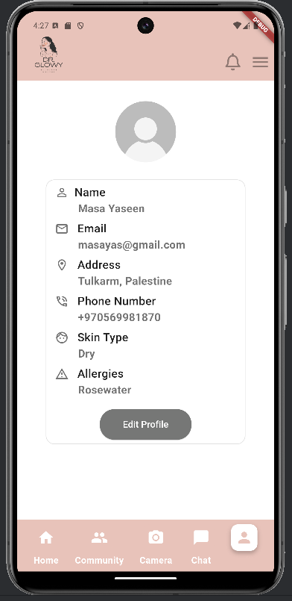
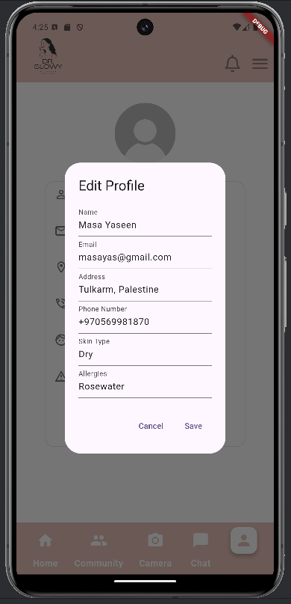
FEATURES
Customer profile
With the possibility of modifying its data

Slide 15
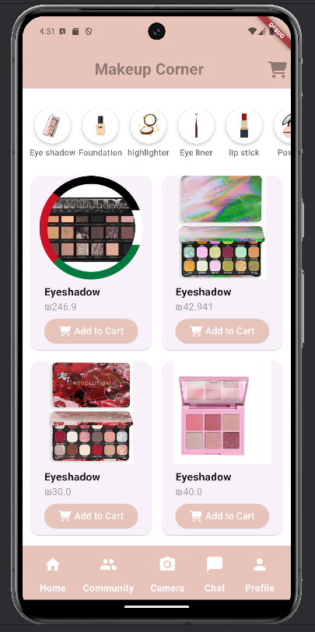
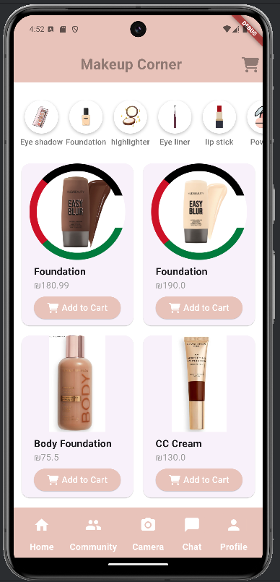
FEATURES
From the makeup corner screen
Eyeshadow page and foundation page
With priority in appearing for products belonging to companies that support Palestine

Slide 16
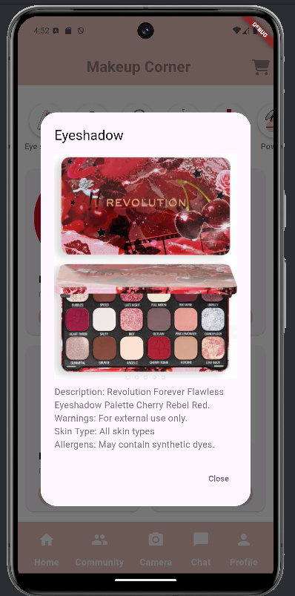
FEATURES
In addition to displaying details about the product

Slide 17
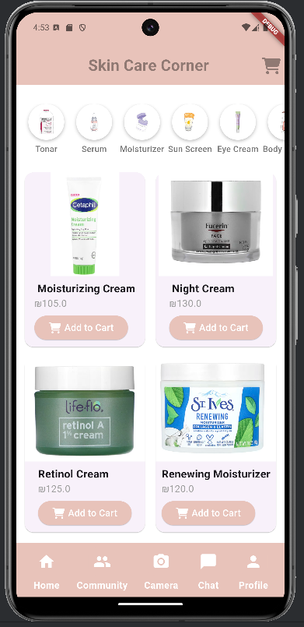
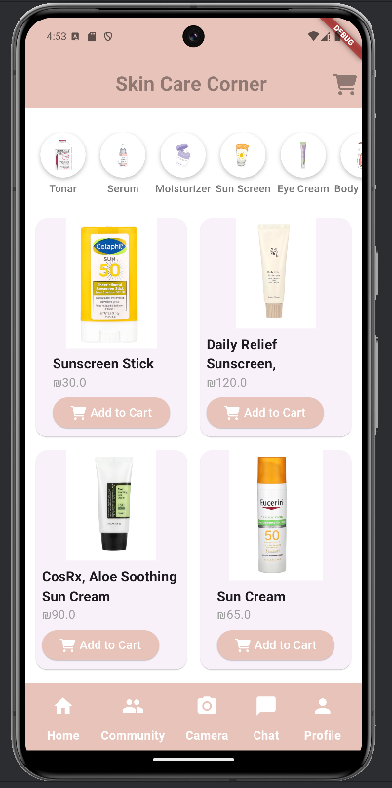
FEATURES
From the Skin Care
corner screen
Moisturizers page and
sunscreen page

Slide 18
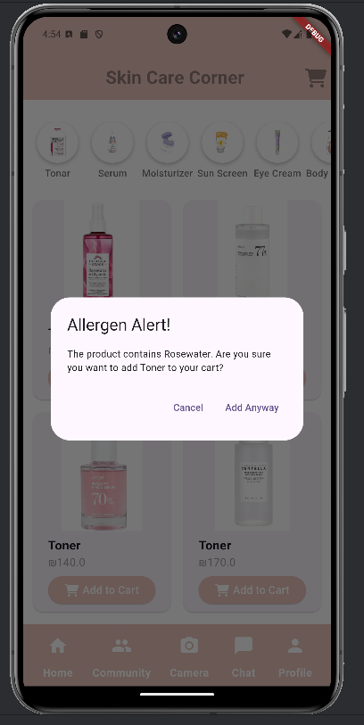
FEATURES
Alert feature for allergy to any component of the product

Slide 19
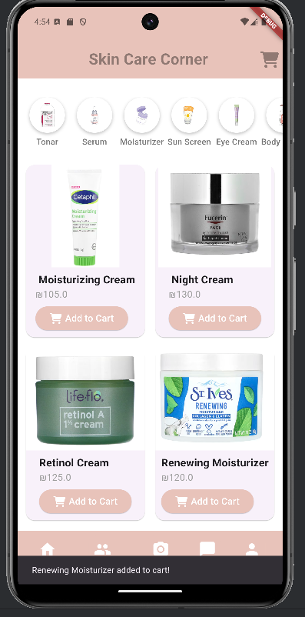
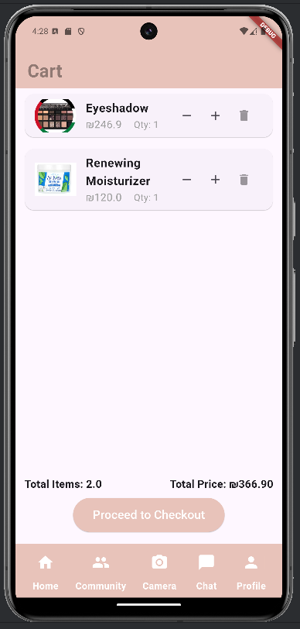

the cart
FEATURES
Add the product
to the cart

Slide 20
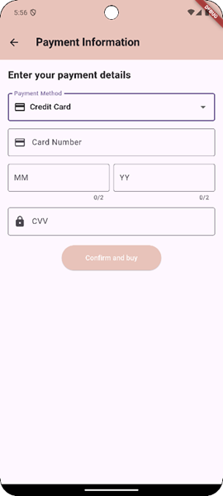
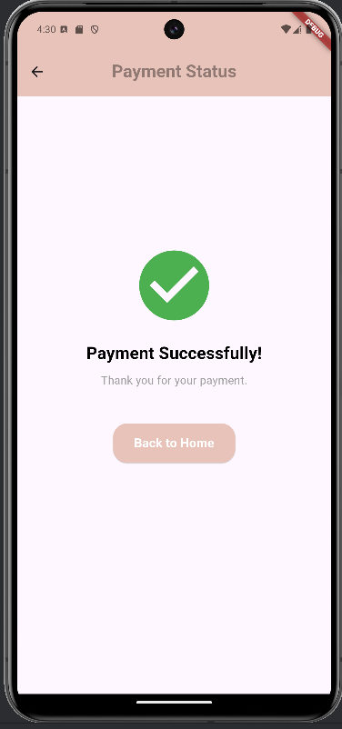
Payment has been completed
FEATURES
Payment options

Slide 21
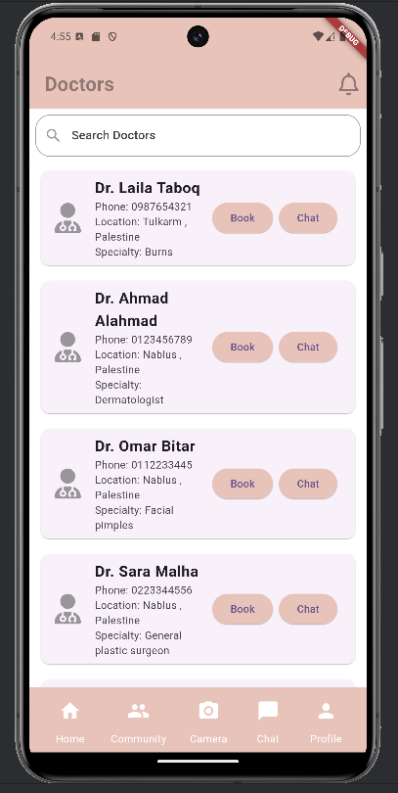
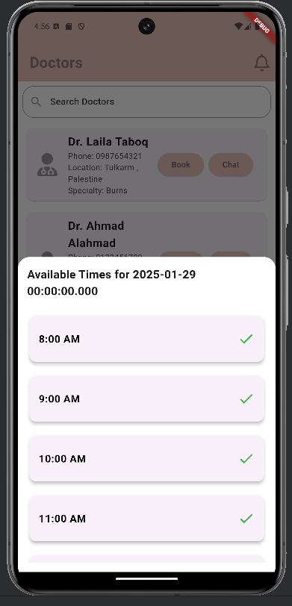
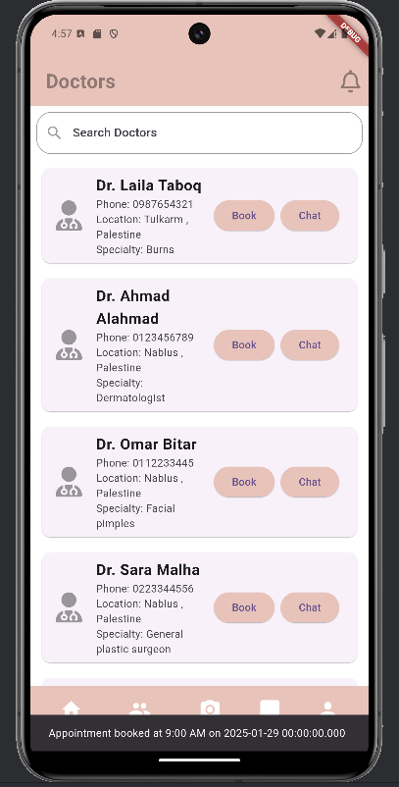
FEATURES
Stages of booking
an appointment

Slide 22
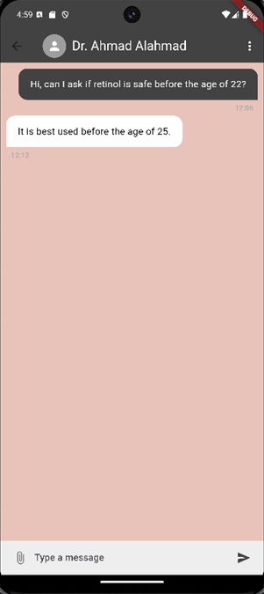
FEATURES
Chat screen

Slide 23
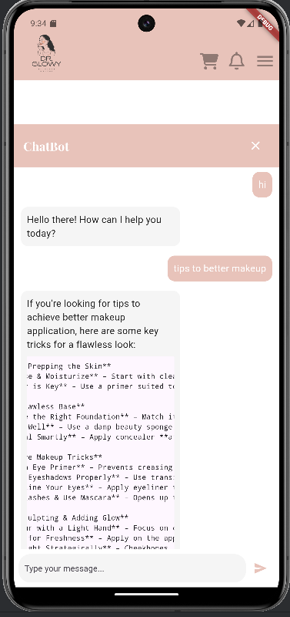
FEATURES
Chatbot using external API

Slide 24
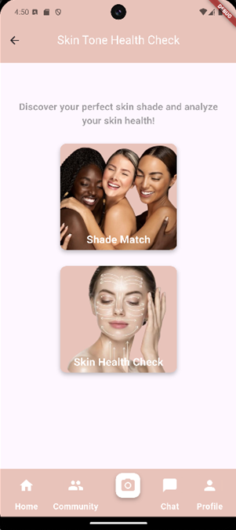
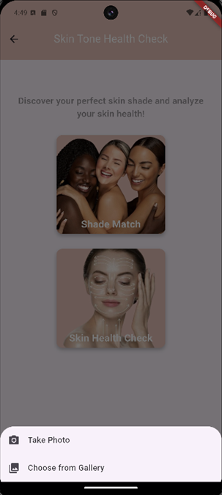
FEATURES
Image options
Camera screen

Slide 25
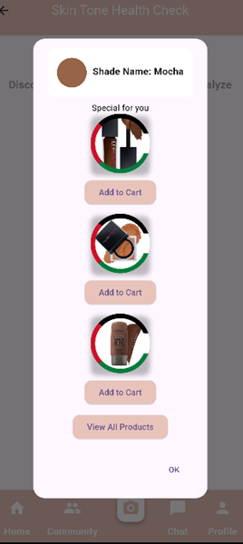
FEATURES
Determine skin tone
Show products that have the same shade

Slide 26
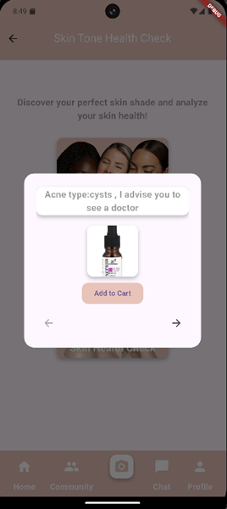
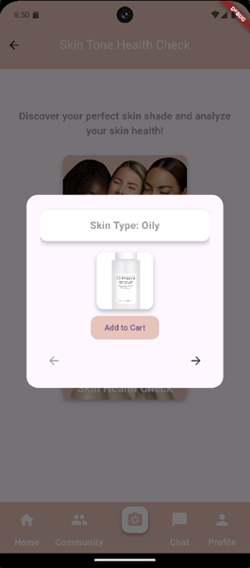
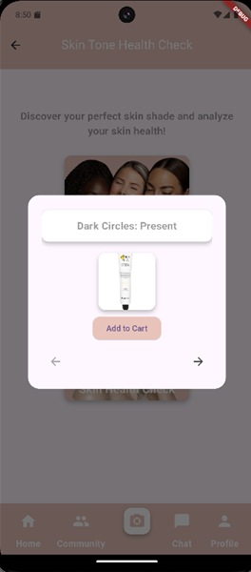
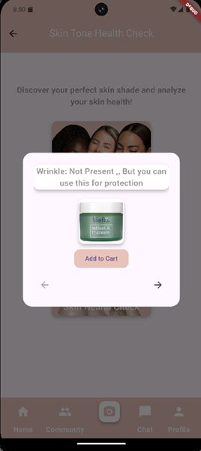
FEATURES
Check skin health and type

Slide 27
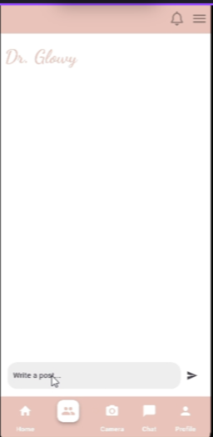
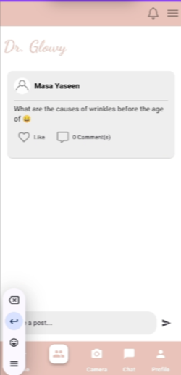
FEATURES
Community
screen

Slide 28
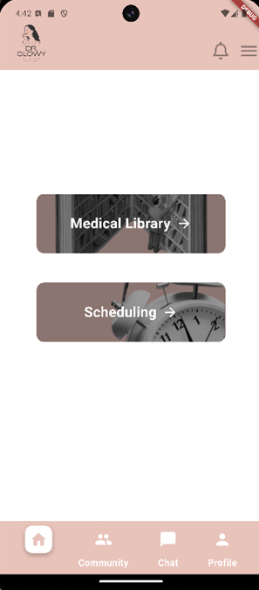
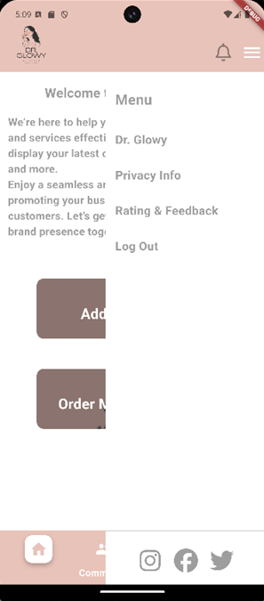
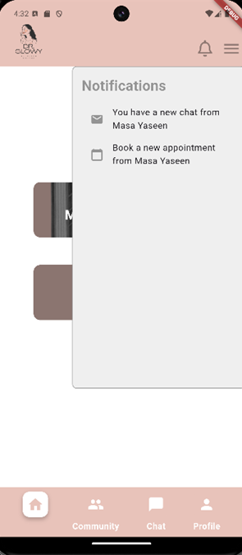
FEATURES
Doctor Pages
Doctor home page
Doctor menu
Doctor Notifications

Slide 29
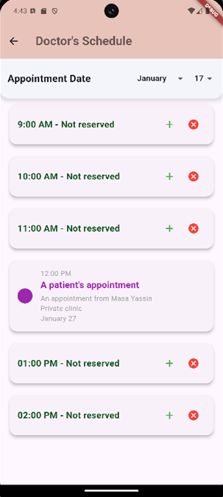
FEATURES
Scheduling

Slide 30
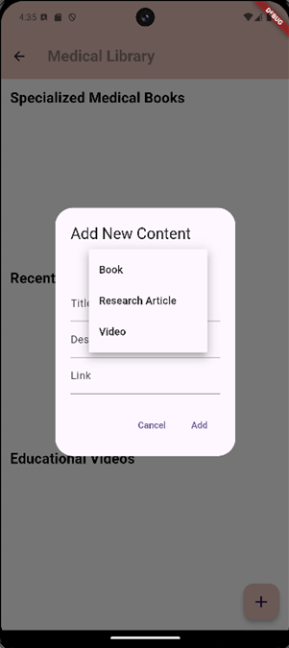
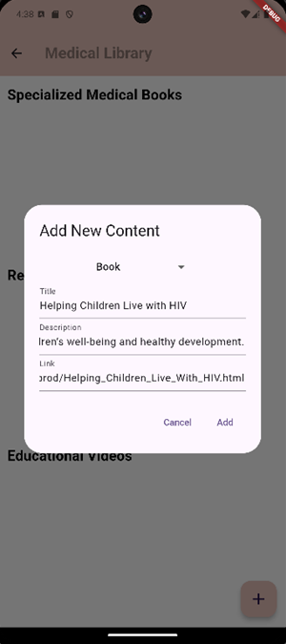
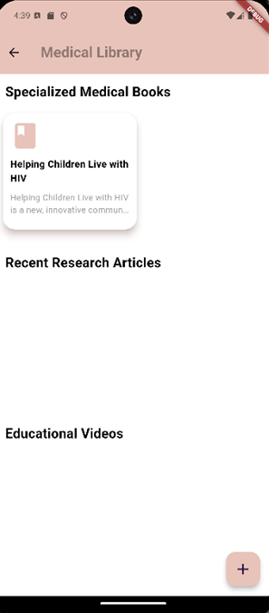
FEATURES
Medical
library

Slide 31


FEATURES
Interaction with
the community

Slide 32


FEATURES
Chat screens

Slide 33

FEATURES
Doctor Profile

Slide 34



FEATURES
Company
Pages
Company home page
Company menu
Company Notifications

Slide 35


FEATURES
Add a product

Slide 36


FEATURES
Order Management
Screens

Slide 37

FEATURES
Interaction with
the community

Slide 38

FEATURES
Company chat

Slide 39

FEATURES
Company
profile

Slide 40



FEATURES
Admin Pages

Slide 41
FUTURE WORK
  Virtual Consultations.
  AI Enhancement .
  Doctor-Prescribed Content.
  Comprehensive Medical Consultations.
  Loyalty & Rewards Program.
  In-App Delivery Service.

Slide 42

THANK YOU ALL
ANY QUESTION?

