Slide 1
Graduation Project II Analysis and Design of Residential Building in Nablus City
Name:
Musab Rasheed Saleh
Naef Sameer Zaid
Ameer ahmad Salem
Submitted to: Dr. Munther Diyab

Slide 2
Contents
General Description for Building
Gravity Analysis
Seismic Analysis
Design Results and Detailing

Slide 3
General Description:
The total area of building = 6006.5 m² (742 m² )
Typical floor height = 3.10 m
Reinforced Steel : GR60 (fy = 420MPa)
Concrete Compressive Strength = 24MPa (B300)
Concrete Columns Compressive Strength = 28MPa (B350)

Slide 4
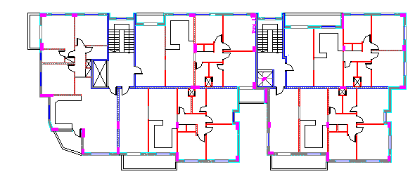

Slide 5
Codes
UBC 97
ASCE 7-10
ACI 318-14

Slide 6
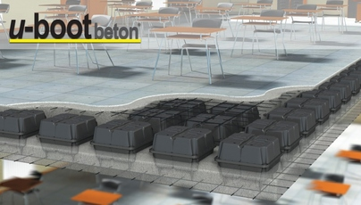
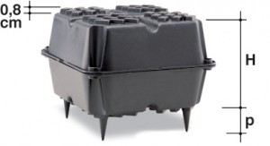
U-Boot is used in the Slabs:
The shape of U-Boot Segment
Section of the Slab for U-Boot system

Slide 7
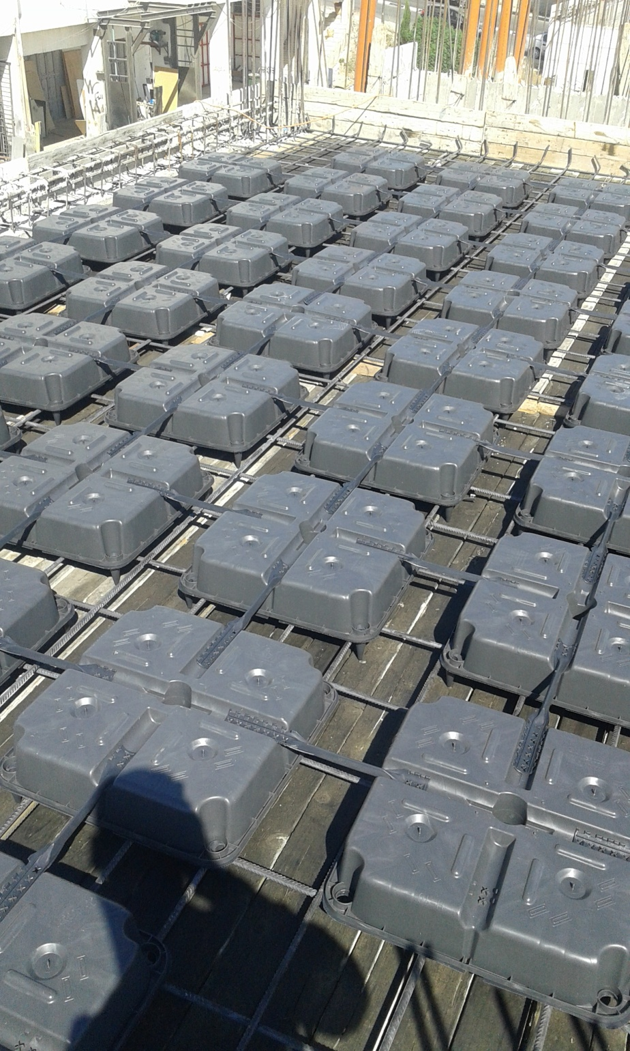
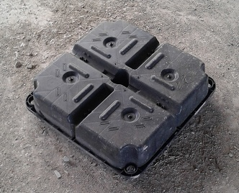
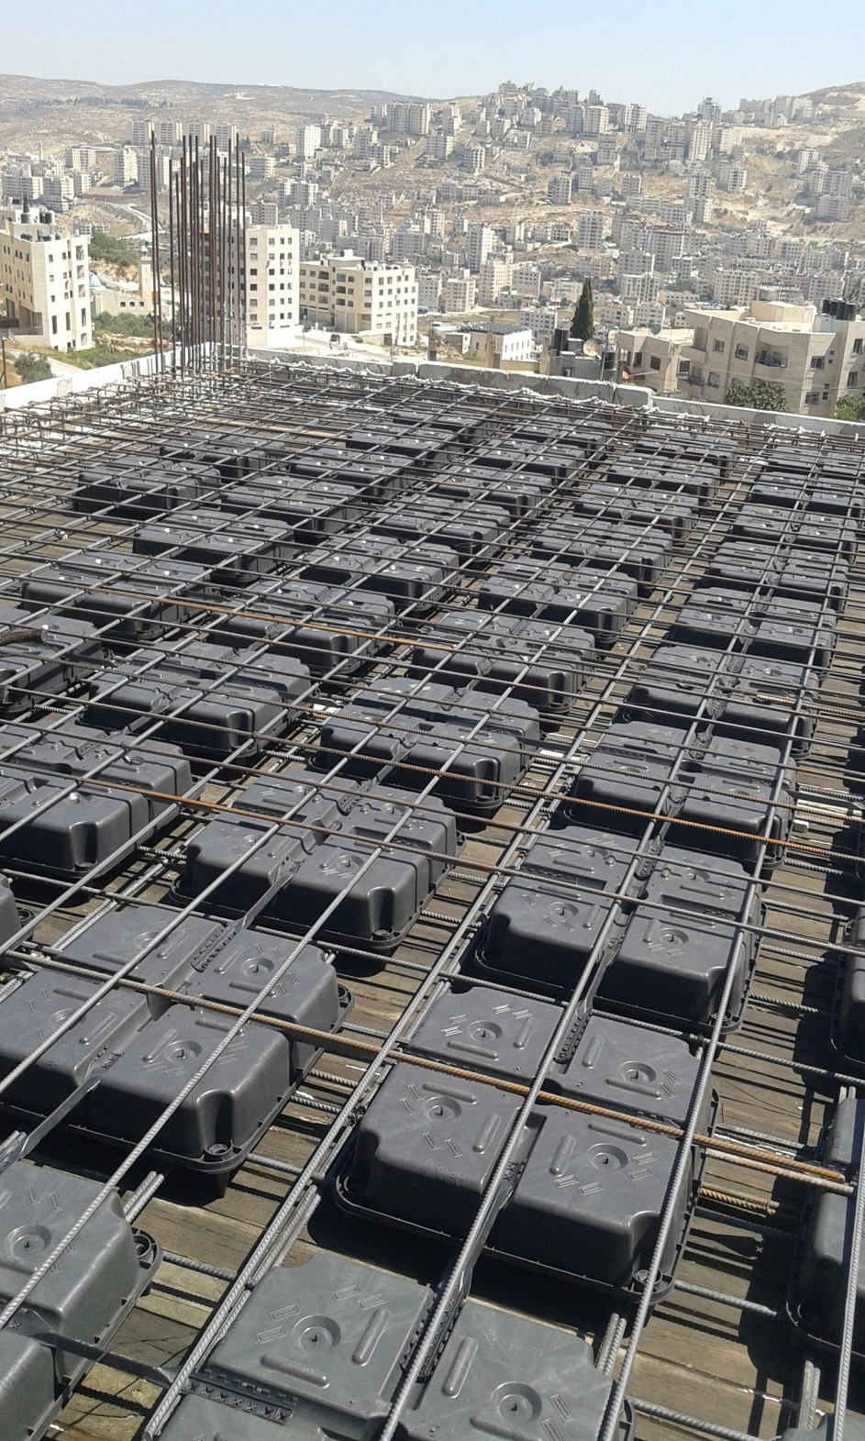

WHY ?!

Slide 8
Characteristics of the Structure with U-Boot:
Light and with high inertia
Reduced weight on the foundations
Saving in concrete and steel strengthening
Reduced building time
Variable thickness , minimum 25 cm
High fire-resistance

Slide 9
Advantage of using U-Boot
Large span and great architectural freedom
Reduced slab thickness
Less deep foundation excavation
Reduction in the overall load of the structure weighing on columns and foundations
Reduced number of foundations

Slide 10
Gravity Analysis
Gravity Checks
Compatibility Check.
Equilibrium Check.
Internal Forces Check.

Slide 11
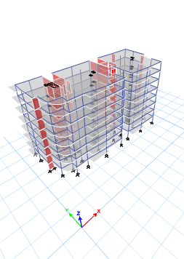
Gravity Analysis
RESULTS FROM ETABS
Period=0.719 second.
Dead error = 0.45%
Live error = 0.05% (3kN)
Superimposed error = 0.05% (4.5kN)
Exterior Wall error = 0.02%(17kN)
(Wu = 17.4 ) - (17-22kN)
TOTAL ERROR = 0.57 % < 5 % ,
Acceptable

Slide 12
Preliminary Design
Preliminary design is one of the most important stages in designing the project, since a first indication of the sizes and dimensions of different structural elements is formed in this stage.
It's important to notice that in this project only gravity loads are taken into consideration for determining the dimensions then the structure will be checked for seismic loads using ETABS for the final design.

Slide 13

To dettermine the equivelent the solid slab thickness :
I eq solid = I U-boot
$\frac{67∗h^{3}}{12}= \frac{67∗{25}^{3}}{12}−\frac{52∗{13}^{3}}{12}$ $Then h eq=24.06 cm$

Slide 14
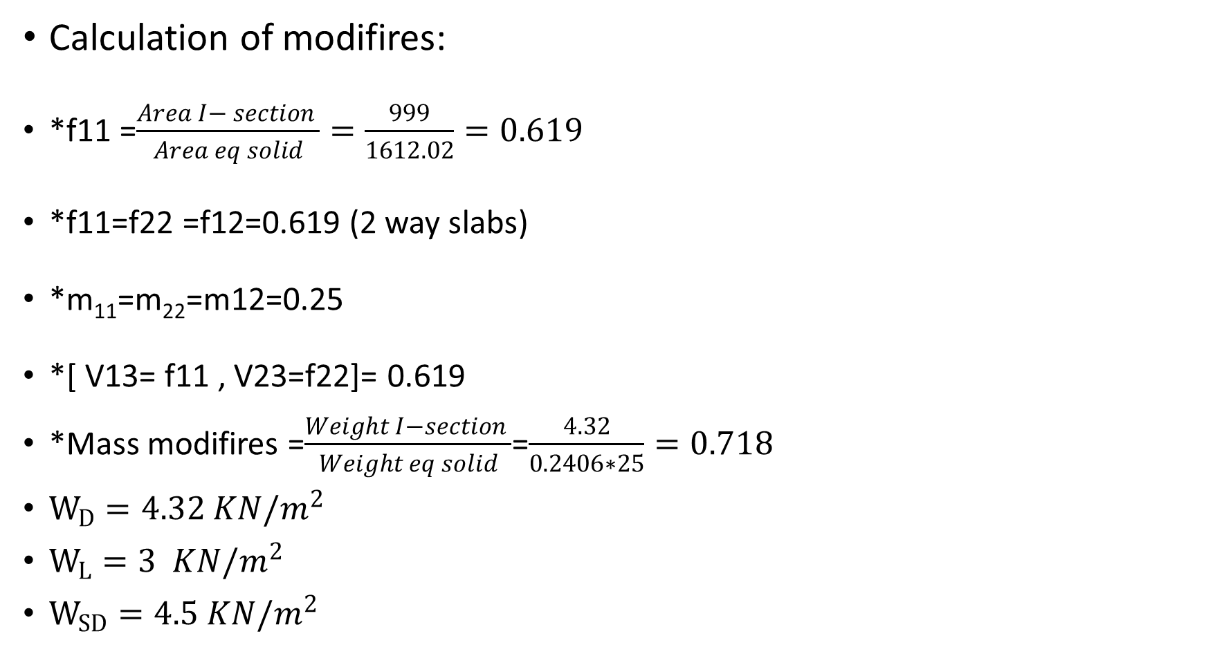
Calculation of modifires:
*f11 =$\frac{Area I− section }{Area eq solid}=\frac{999}{1612.02}=0.619$
*f11=f22 =f12=0.619 (2 way slabs)
*m₁₁=m₂₂=m12=0.25
*[ V13= f11 , V23=f22]= 0.619
*Mass modifires =$\frac{Weight I−section }{Weight eq solid}$=$\frac{4.32}{0.2406∗25}=0.718$
$W_{D}=4.32 KN/m^{2}$
$W_{L}=3 KN/m^{2}$
$W_{SD}=4.5 KN/m^{2}$

Slide 15
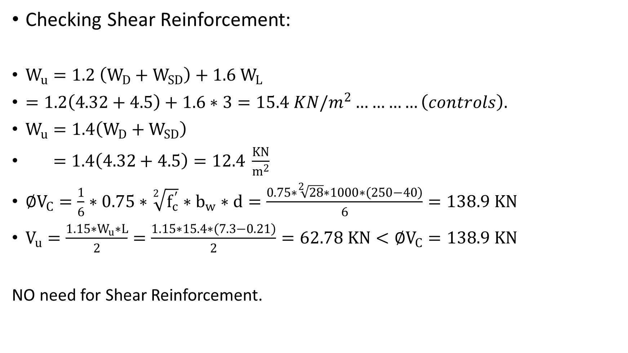
Checking Shear Reinforcement:
$W_{u}=1.2 \left(W_{D}+W_{SD}\right)+1.6 W_{L}$
$=1.2\left(4.32+4.5\right)+1.6∗3=15.4 KN/m^{2}…………\left(controls\right).$
$W_{u}=1.4\left(W_{D}+W_{SD}\right)$
$=1.4\left(4.32+4.5\right)=12.4 \frac{KN}{m^{2}}$
$∅V_{C}=\frac{1}{6}∗0.75∗\sqrt[2]{f_{c}^{′}}∗b_{w}∗d=\frac{0.75∗\sqrt[2]{28}∗1000∗\left(250−40\right)}{6}=138.9 KN$
$V_{u}=\frac{1.15∗W_{u}∗L}{2}=\frac{1.15∗15.4∗\left(7.3−0.21\right)}{2}=62.78 KN<∅V_{C}=138.9 KN$
NO need for Shear Reinforcement.

Slide 16
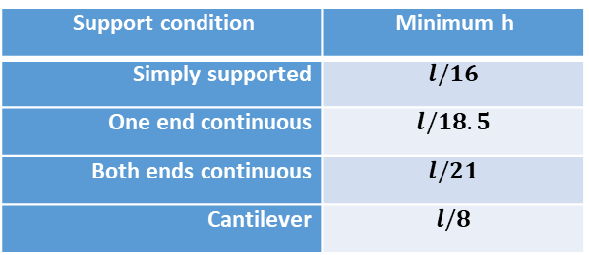
Beam:
Cover for slab = 60mm
In ETABS, all beams were represented as rectangular sections with dimensions of 0.20m x 0.5m
Support condition | Minimum h
Simply supported | $$l/16$$
One end continuous | $$l/18.5$$
Both ends continuous | $$l/21$$
Cantilever | $$l/8$$
Minimum thickness of non-prestressed beams

Slide 17
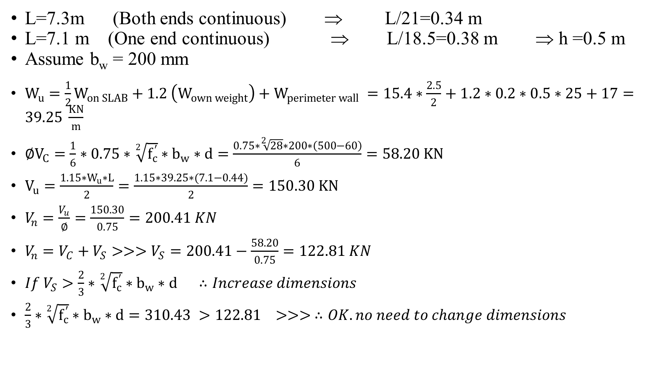
L=7.3m (Both ends continuous) ⇒ L/21=0.34 m
L=7.1 m (One end continuous) ⇒ L/18.5=0.38 m ⇒ h =0.5 m
Assume b_{w} = 200 mm
$W_{u}=\frac{1}{2}W_{on SLAB}+1.2 \left(W_{own weight}\right)+W_{perimeter wall} =15.4∗\frac{2.5}{2}+1.2∗0.2∗0.5∗25+17=39.25 \frac{KN}{m}$
$∅V_{C}=\frac{1}{6}∗0.75∗\sqrt[2]{f_{c}^{′}}∗b_{w}∗d=\frac{0.75∗\sqrt[2]{28}∗200∗\left(500−60\right)}{6}=58.20 KN$
$V_{u}=\frac{1.15∗W_{u}∗L}{2}=\frac{1.15∗39.25∗(7.1−0.44)}{2}=150.30 KN$
$V_{n}=\frac{V_{u}}{∅}=\frac{150.30}{0.75}=200.41 KN$
$V_{n}=V_{C}+V_{S}>>>V_{S}=200.41−\frac{58.20}{0.75}=122.81 KN$
$If V_{S}>\frac{2}{3}∗\sqrt[2]{f_{c}^{′}}∗b_{w}∗d ∴Increase dimensions$
$\frac{2}{3}∗\sqrt[2]{f_{c}^{′}}∗b_{w}∗d=310.43 >122.81 >>> ∴OK.no need to change dimensions$

Slide 18
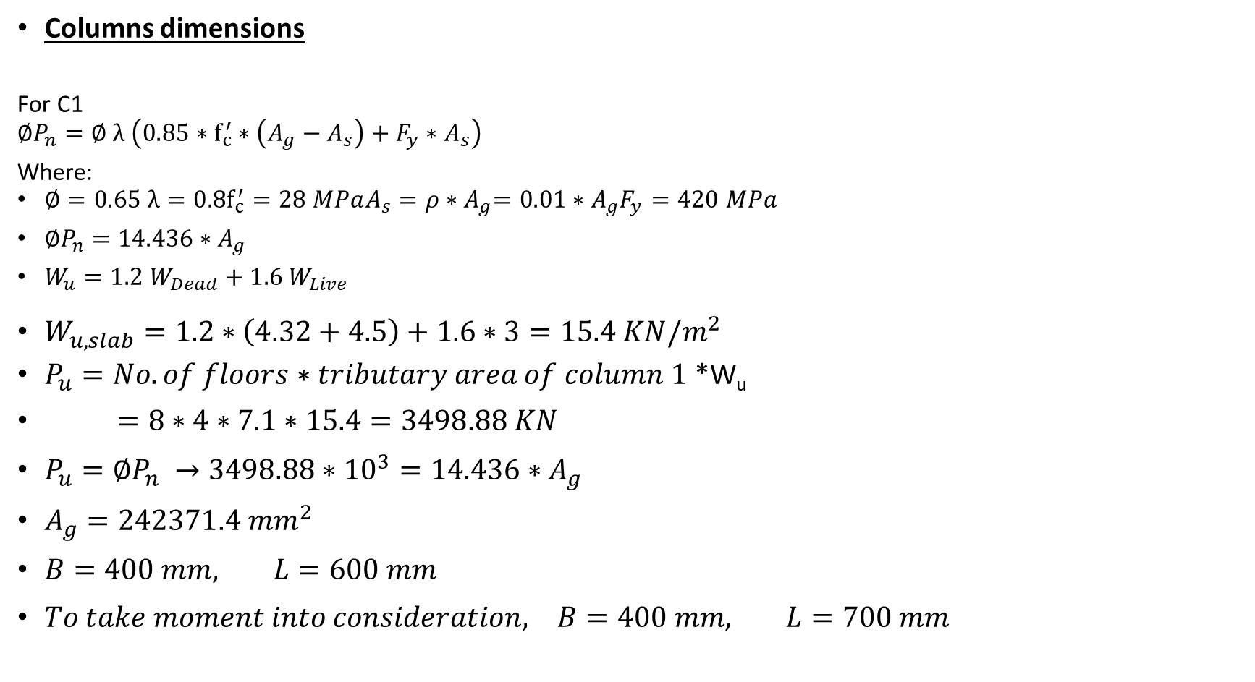
Columns dimensions
For C1
$$∅P_{n}=∅ λ \left(0.85∗f_{c}^{′}∗\left(A_{g}−A_{s}\right)+F_{y}∗A_{s}\right)$$
Where:
$∅=0.65 λ=0.8f_{c}^{′}=28 MPaA_{s}=ρ{∗A}_{g}=0.01∗A_{g}F_{y}=420 MPa$
$∅P_{n}=14.436∗A_{g}$
$W_{u}=1.2 W_{Dead}+1.6 W_{Live}$
$W_{u, slab}=1.2∗\left(4.32+4.5\right)+1.6∗3=15.4 KN/m^{2}$
$P_{u}=No.of floors∗tributary area of column 1$ *W_{u}
$=8∗4∗7.1∗15.4=3498.88 KN$
$P_{u}=∅P_{n} →3498.88∗{10}^{3}=14.436∗A_{g}$
$A_{g}=242371.4 {mm}^{2}$
$B=400 mm, L=600 mm$
$To take moment into consideration, B=400 mm, L=700 mm$

Slide 19
After taking the moment into consideration the sections of columns that will be used are summarized in Table:
Column group | Dimensions (mm)
C1 (0.4*0.7) | 400*700
C2 (0.4*1.0) | 400*1000
C3 (0.4*0.8) | 400*800
C4 (0.3*1.0) | 300*1000
C5 (0.3*1.05) | 300*1050
C6 (0.3*0.9) | 300*900
C7 (0.35*1.0) | 300*1000

Slide 20
Seismic Design ( UBC 97)
Seismic Design Parameters
Seismic Analysis Methods
Seismic Modeling Using Response Spectrum Method
Seismic Checks

Slide 21
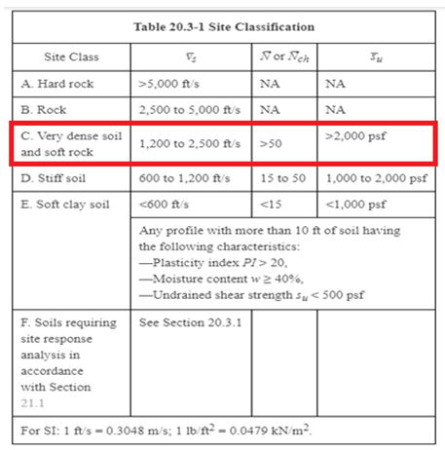
Seismic Design Parameters
Soil Characteristics
Soil Type ⇒
Sc

Slide 22
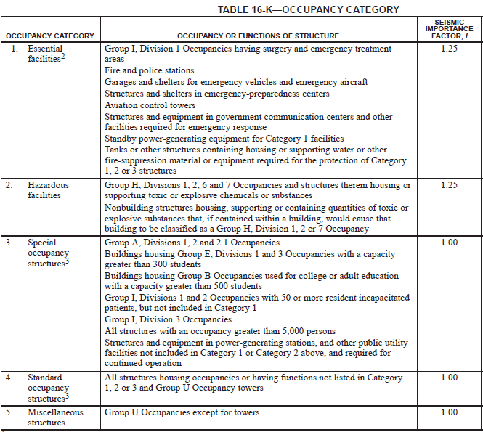
Seismic Design Parameters
Occupancy Category
Importance factor (I)
I = 1

Slide 23
Seismic Design Parameters
Site Seismic Characteristics
Seismic Zone Factor (Z)
Seismic Zone for Nablus is 2B
Z = 0.2
Ca = 0.24
Cv =0.32
⇒

Slide 24
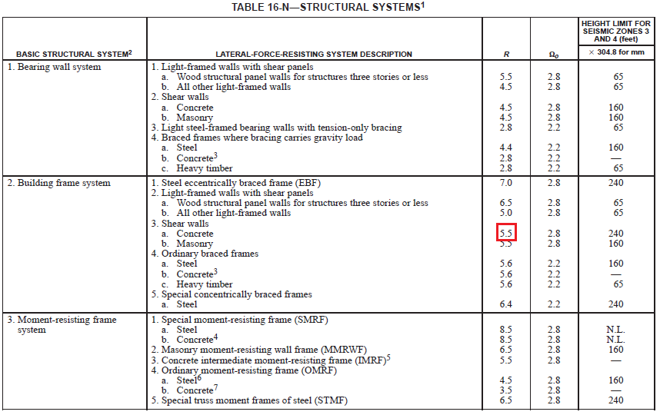
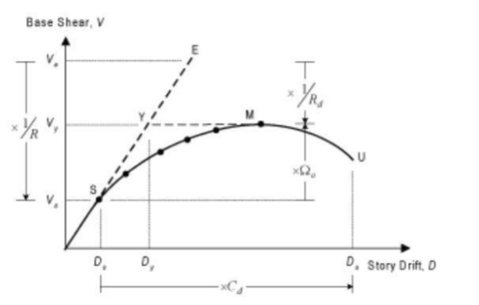
Seismic Design Parameters
Structural Systems
Response Modification Factor(R)
⇒ R = 5.5

Slide 25
Seismic Analysis Methods
Equivalent Lateral Force Method (ELF).
Response Spectrum Analysis(MCER).
History analysis

Slide 26
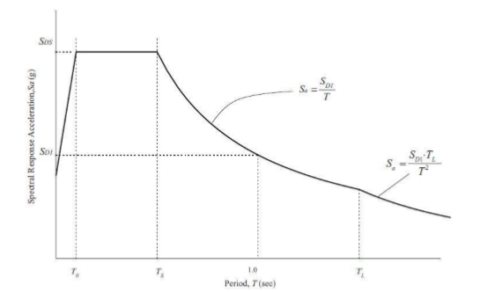
Response spectrum Analysis

Slide 27
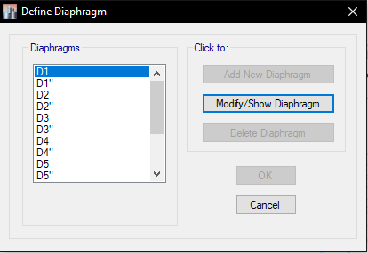
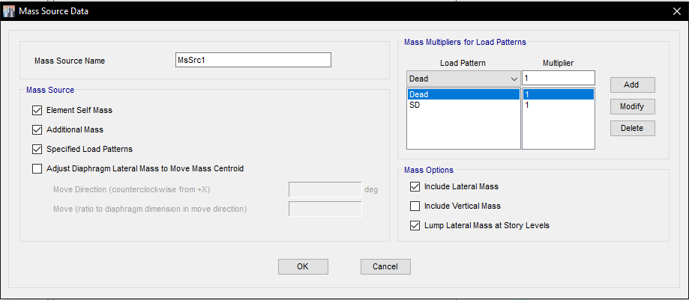
Seismic Modeling using Response Spectrum Method
Diaphragms
Mass Source

Slide 28
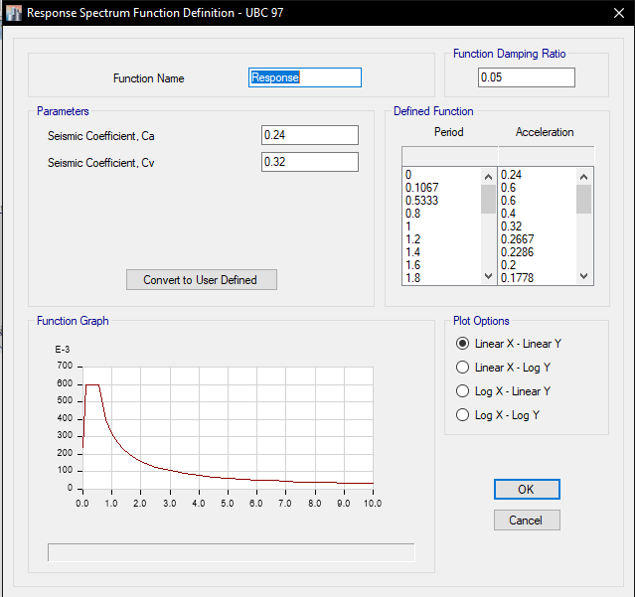
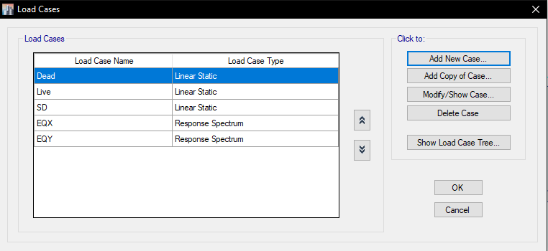
Seismic Modeling using Response Spectrum Method
Response Spectrum function
Load Case

Slide 29
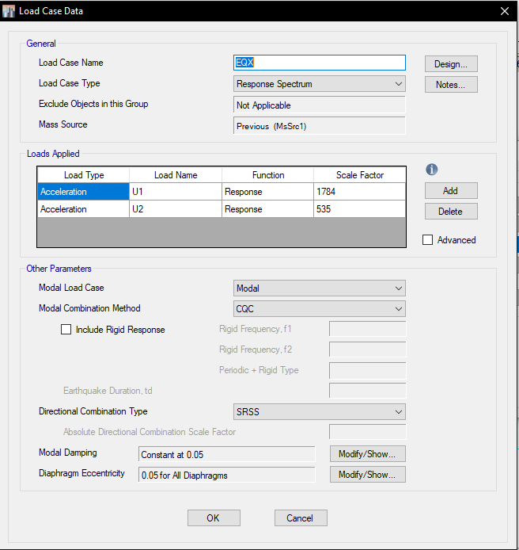
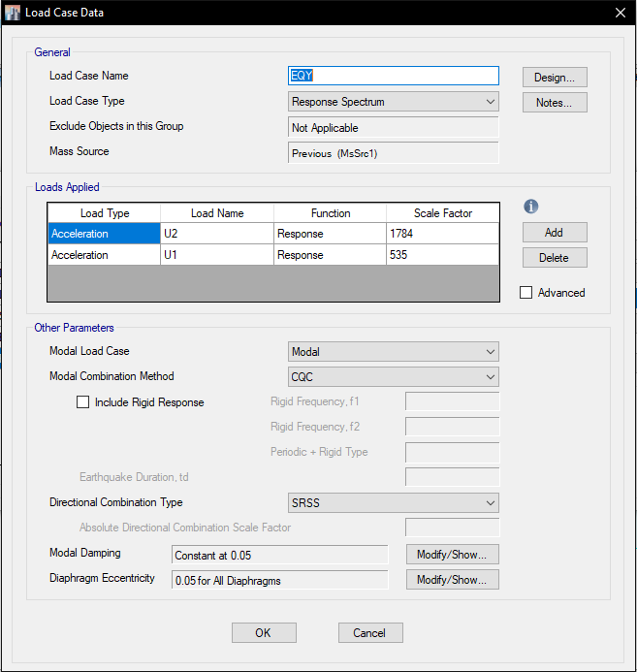
Seismic Modeling using Response Spectrum Method
EQX
EQY

Slide 30
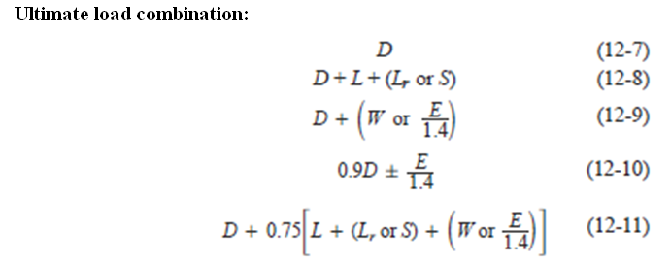
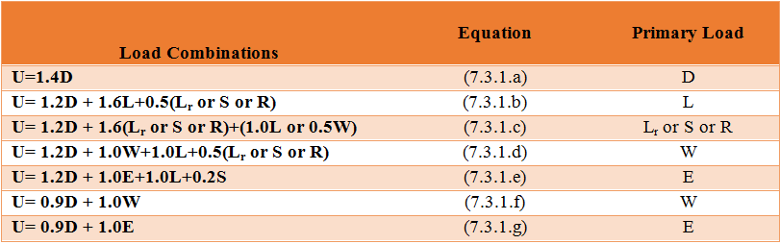
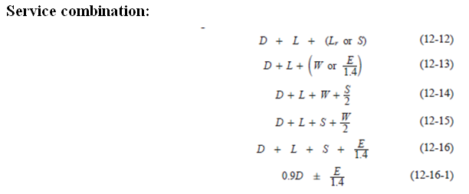
Seismic Modeling using Response Spectrum Method
Load Combination

Slide 31
Seismic Checks
Period
Modal Mass Participation Ratio
Base Shear
Deflection
Drift
Checks

Slide 32
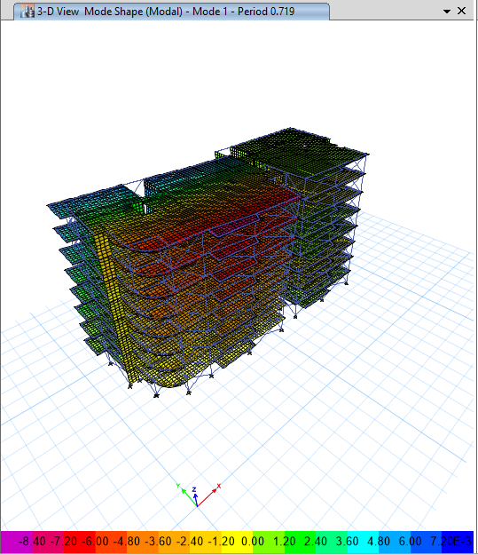
1- Period Checks:
Period from Etabs = 0.719 Sec

Slide 33
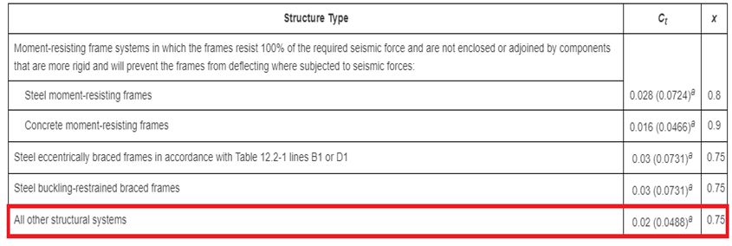

Values of approximate period parameters Ct and X
Ct = 0.0488
X= 0.75
Ta = 0.538 second

Slide 34
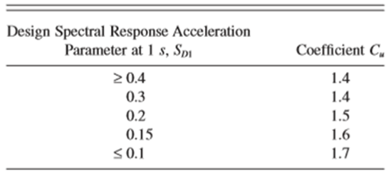
Period from Etabs < 1.4Ta
The period from Etabs= 0.719 second < 1.4× 0.538 =0.753 second ⇒ ok
Where Cu is a coefficient for upper limit on calculated period = 1.4

Slide 35
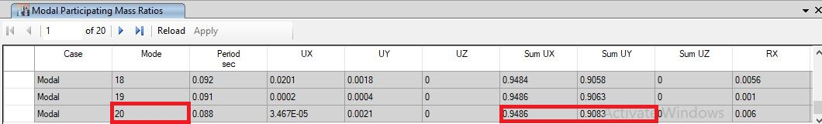
2- Model Mass Participation Ratio Checks:
Sum Ux and Sum Uy ≥ 90%
The summation of modes in X and Y is greater than 90% ⇒ ok

Slide 36
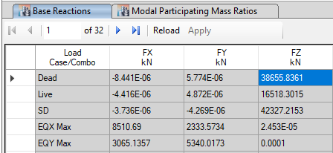
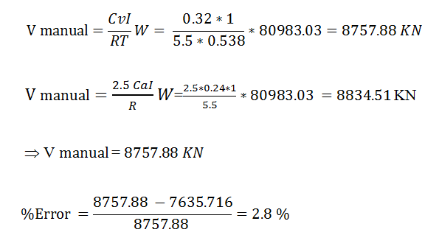
3- Base shear Checks:
V Etabs = 8510.69 KN

Slide 37
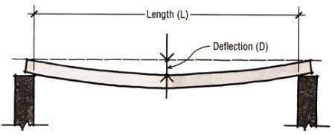
4- Deflection Checks:
Slab
∆ D = 9.7 mm
∆ L = 3.35 mm
∆ LTD = 2 ∆ D + 2 ∆ L = 26.1 mm
∆ Allowable = L/240
= 6300/240
= 26.25 mm ⇒ ok

Slide 38
Deflection Checks:
Beam
∆ D = 8 mm
∆ L = 2.6 mm
∆ LTD = 2 ∆ D + 2 ∆ L = 21.2 mm
∆ Allowable = L/240
= 6900/240
= 28.7 mm ⇒ ok

Slide 39
DESIGN OF STRUCTURAL MEMBER & DETALING
SLABS
BEAMS
COLUMNS
FOOTING

Slide 40
DESIGN OF SLABS

Slide 41
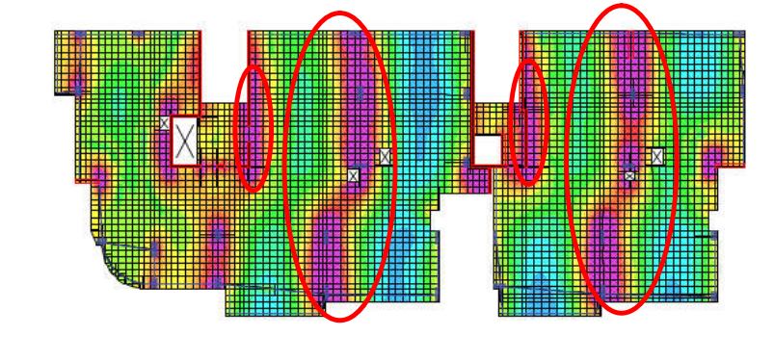
TWO-SLAB SYSTEM (Flat plate – with exterior beams)
h = 240 mm , d = 200mm , b =1000mm
As min . ,Mu min.

Slide 42
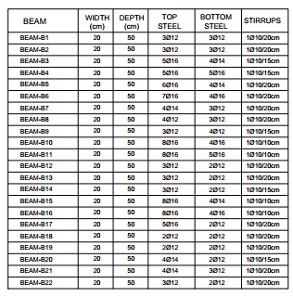
DESIGN OF BEAMS
FIXED DIMENSIONS
20*50

Slide 43
DESIGN OF COLUMNS

Slide 44
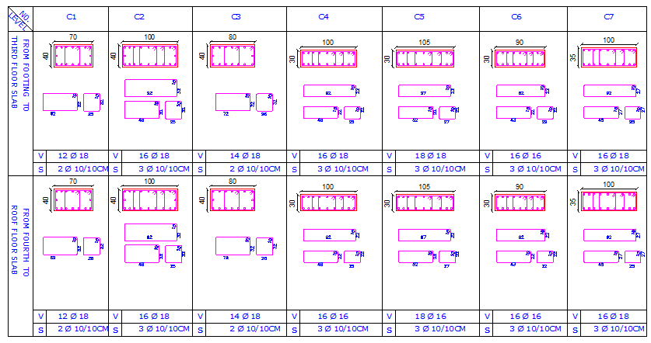

Slide 45
DESIGN OF MAT FOUNDATION

Slide 46
Properties of soil : Load bearing capacity = Depth of mat foundation =

Slide 47
Thank you

