Slide 1


An-Najah National University Faculty of Engineering and Information Technology
جامعة النجاح الوطنية
كلية الهندسة وتكنولوجيا المعلومات
Graduation Project II
{Investigating the effect of adding combination of polyester and crushed glass on the hot mix asphalt mixture}
By
Abdalrhman Salman – 11820886
Dyaa Odeh– 11820774
Leena AL-Qadi– 11840135
Nawal Badran – 11820101
Yosef Domidi–11820873
Supervisor: Dr. Amjad Issa

Slide 2
ABSTRACT
- Due to the continuous increase in road traffic and expensive maintenance cost of streets and traffic components, combined with lack of funds and professional supervision, the invention, creation, and discovery of new and novel technologies and components are becoming an urgent necessity.
- Dry mixing (Marshal method)
- ¾ inch hot mix asphalt

Slide 3
The results indicated that fiber and crushed glass additives improved the properties of asphalt mixture. As expected, after adding a certain percentage of glass and fiber, the properties of the asphalt mixture were improved, in term of the stability, strength and durability. It is expected also it decrease rutting, cracking, and shoving and improve fatigue resistance, permanent deformation and stiffness. According to the results, the specifications are achieved at 15% from combination of polyester and crushed glass.

Slide 4
The main materials in hot mix asphalt:
Crushed Glass
Aggregates
Bitumen
polyester

Slide 5
Objectives
- The main objective of this project is to investigate how the combination of polyester and Crushed glass affects the properties of asphalt mixtures when various percentages of optimum bitumen content are used. The use of fiber and glass is expected to increase the tensile strength and improve the fracture resistance of asphalt mixtures.
Percentage of materials to add : (5%,10%,15%,20%)

Slide 6
Significant of research
Engineering
Economic
Environmental

Slide 7
  Project Constraints
The project team faced several challenges and constraints during the project period such as:
Finding the required raw material (fibers and proper bitumen).
Safety aspects in term of the dangerous conditions of using hot bitumen.
The lack of necessary equipment and tools to perform the tests.
The political condition in terms of Nablus closure.

Slide 8
  Literature Review
In 2016 studied the effect of glass in asphalt mixture
that the stability has increased in significant way. On the other hand, the bulk specific gravity (Gmb) decreases with the increase of glass percentage in the mix. Finally, the Air voids in the samples decreases with the increase of bitumen percentage.
In 2019 explored the effect of polymers on the asphalt mix.
They found that the density of mixture increased with 2% phenol resin. However, when the content was increased up to 4% or 6%, then the density decreased. An increase in polyester resin in the mixtures decreased the density. Finally, with epoxy mixtures, in general the physical properties have enhanced by using the polymers.

Slide 9
METHODOLOGY

Slide 10
Data collection
Literature Review
Conducting meeting with relevant specialist
Field visits to Asphalt Factory
Importing raw materials

Slide 11
Preparing the required samples
conducting marshal test
selecting the proper ratios of both materials
Data analysis and results
Conclusion and recommendations

Slide 12
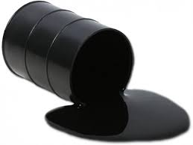
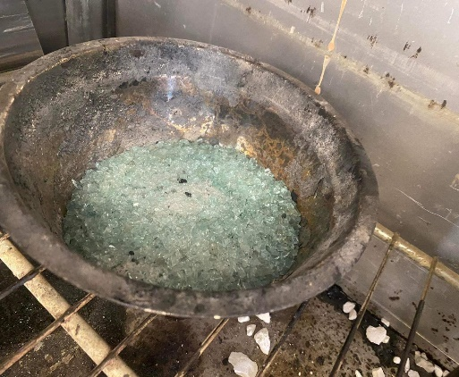
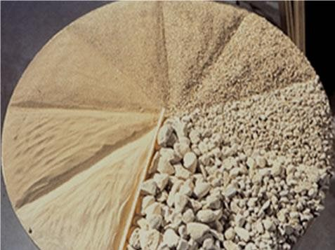
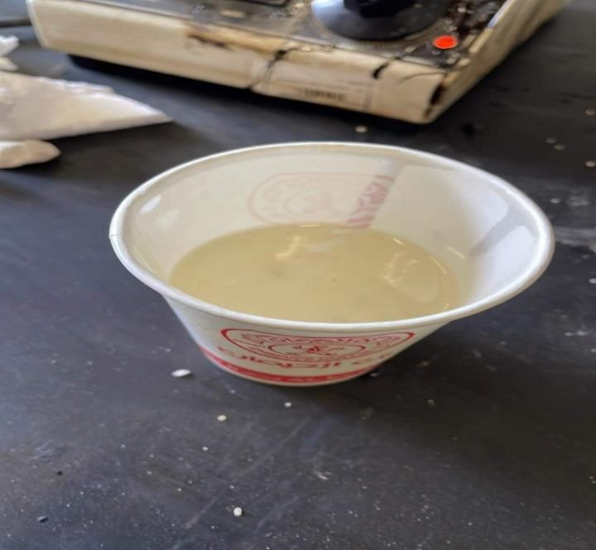
EXPERIMENTAL WORK
Sample preparation:
Raw material used:

Slide 13
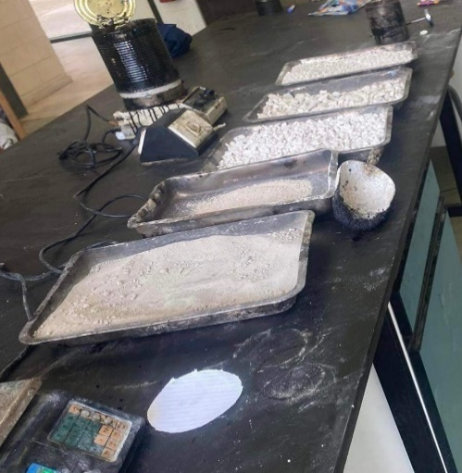
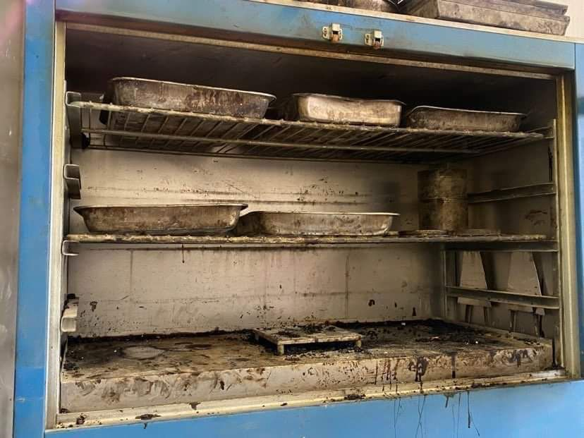
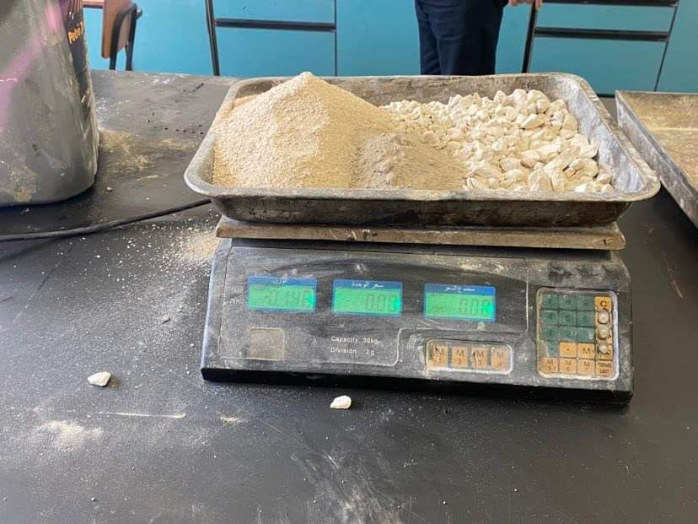
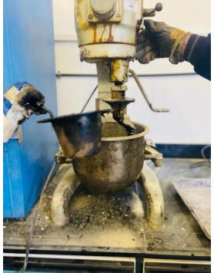
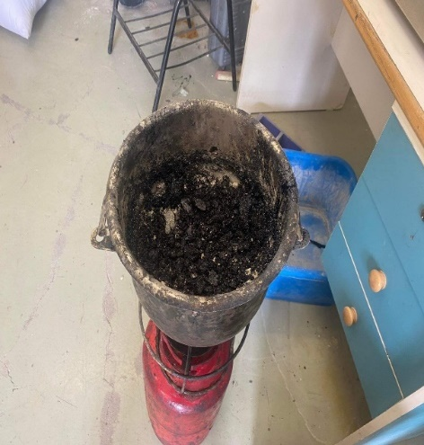
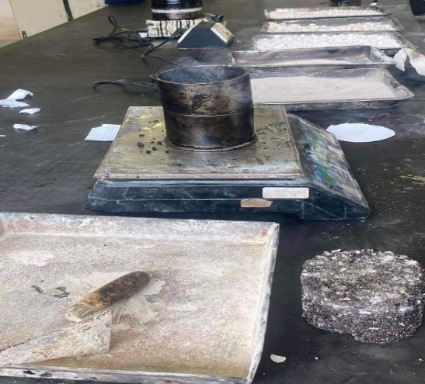
Detailed Laboratory Procedure for samples preparation:

Slide 14
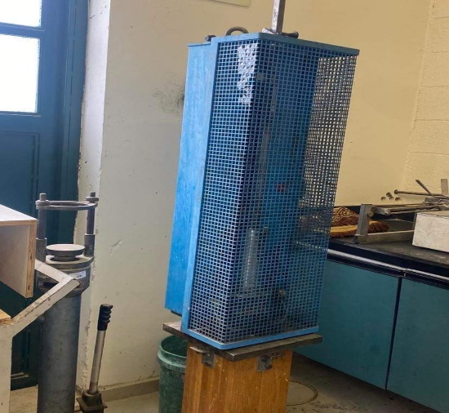
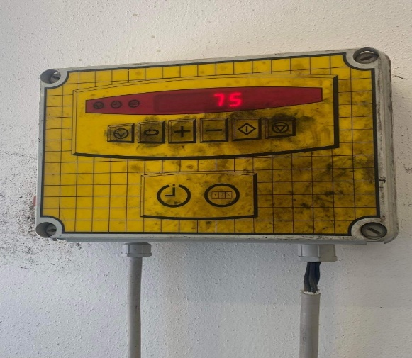
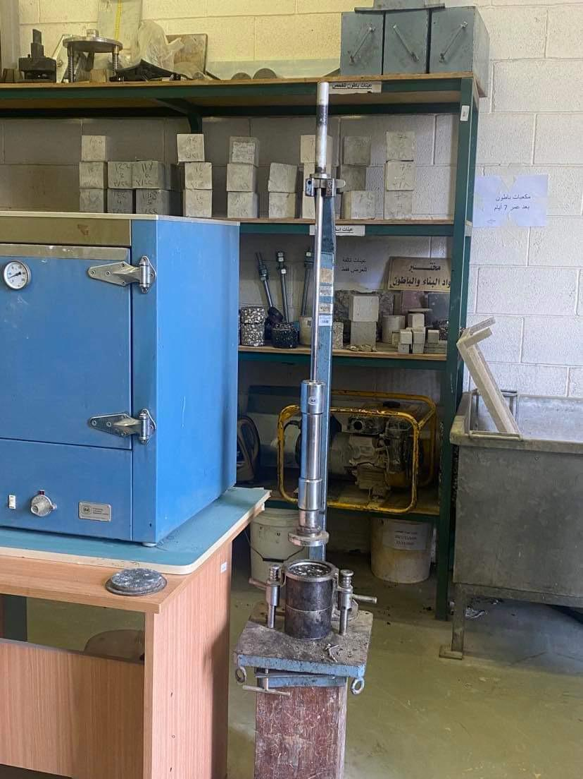
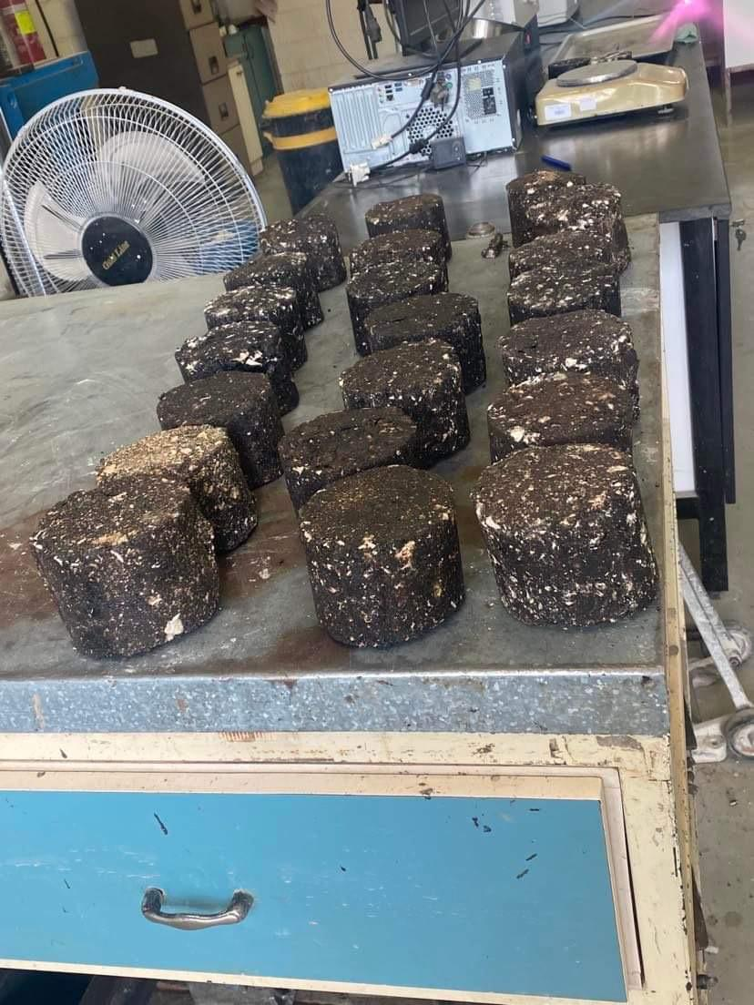
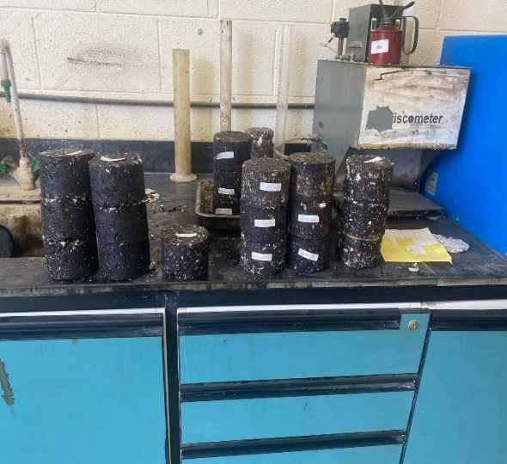

Slide 15
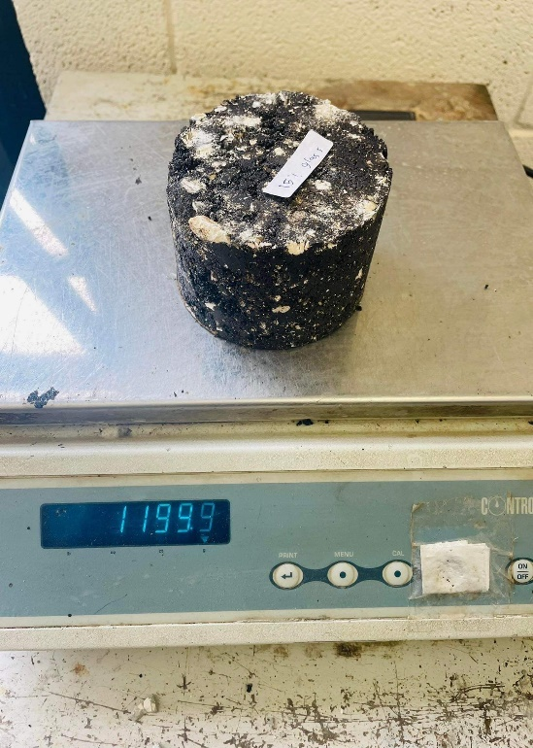
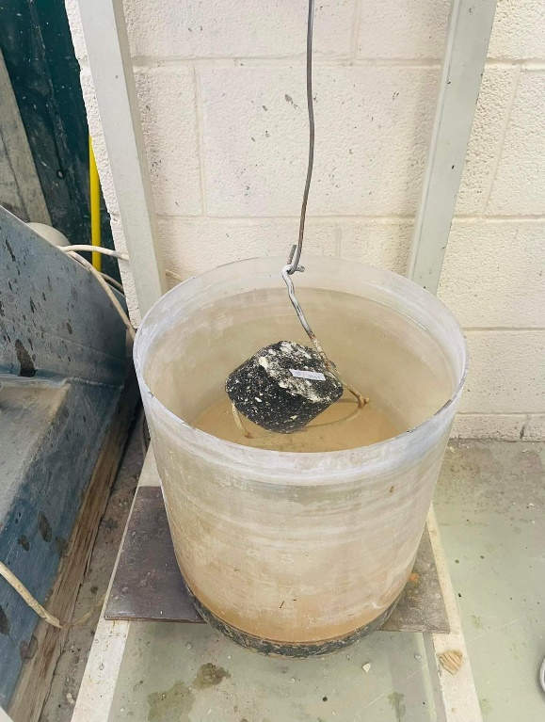
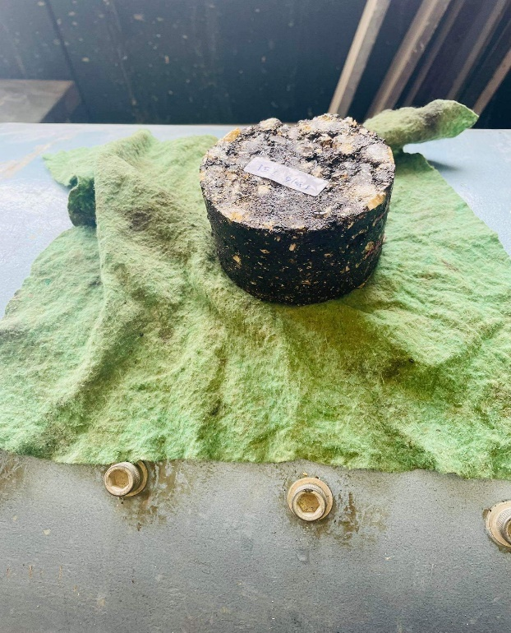
Testing stage:
1- Measuring the height of samples
Each sample height was measured to check that it was within the specified range (62.2 -64.8 mm).
2- Specific weight test

Slide 16
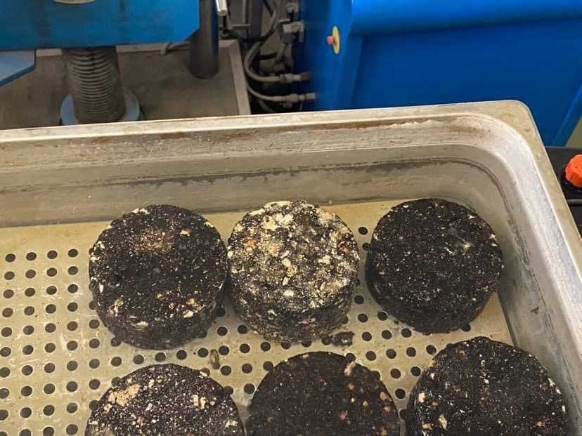
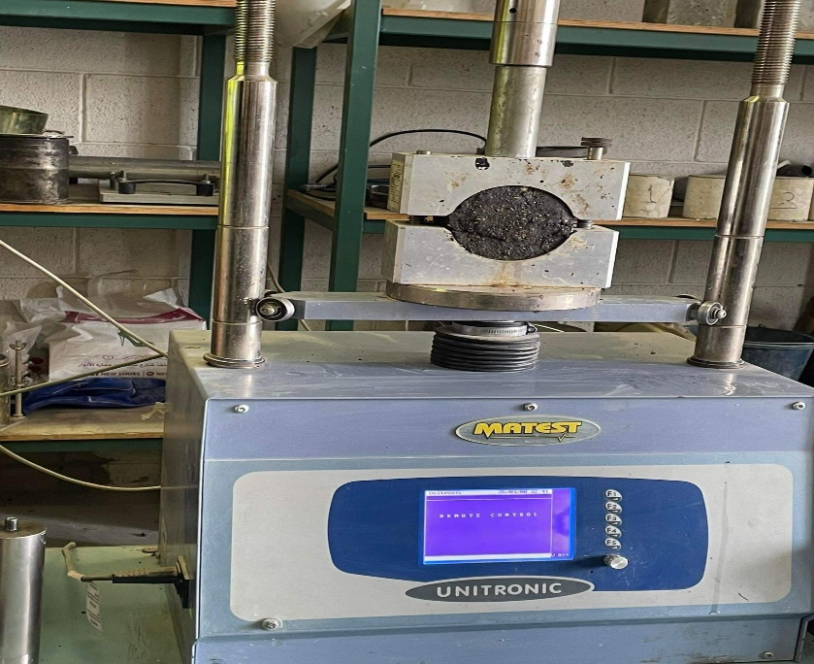
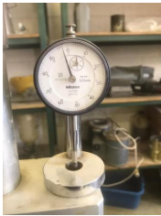
Stability and Flow test

Slide 17
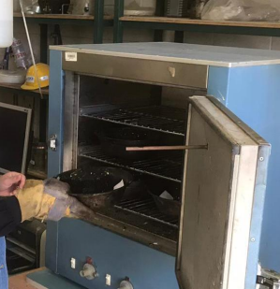
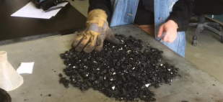
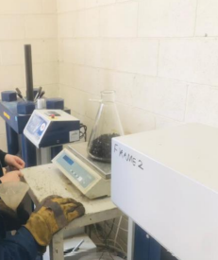
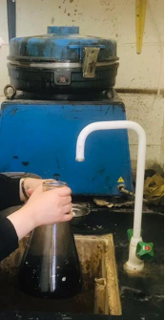
Maximum theoretical bulk specific gravity test (evaluate Gmm)

Slide 18
ANALYSIS AND RESULTS

Slide 19
1- Bulk specific gravity and unit weight
Bulk specific gravity and unit weight values for Polyester
Percentage by Weight of Bitumen With Polyester | Gb |  |  |  | Unit weight (ϒ) Kg/m3
 | A | B | C
0% | 2.35 | 2.34 | 2.34 | 2.34 | 2343.80
5% | 2.35 | 2.36 | 2.33 | 2.34 | 2346.50
10% | 2.30 | 2.29 | 2.16 | 2.25 | 2250.10
15% | 2.37 | 2.38 | 2.31 | 2.35 | 2354.640
Avg.

Slide 20
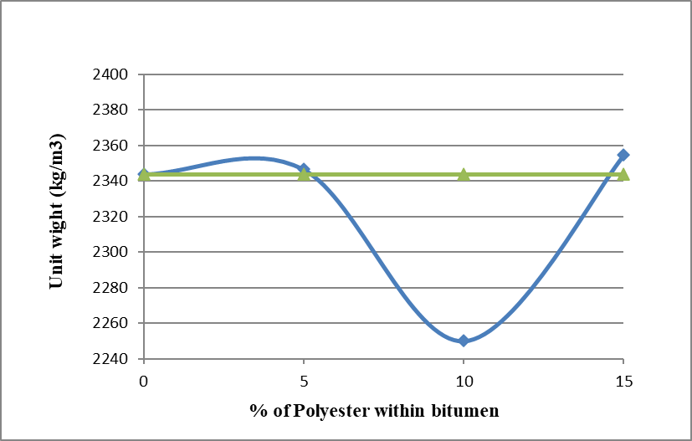
Unit wight vs. % of Polyester
In this case, at 5% and 15%, the density is increased, but in a simple way, but in the case of 10%, it is decreased but within 20% of density, which is acceptable for density.

Slide 21
Bulk specific gravity and unit weight values for crushed glass

Slide 22
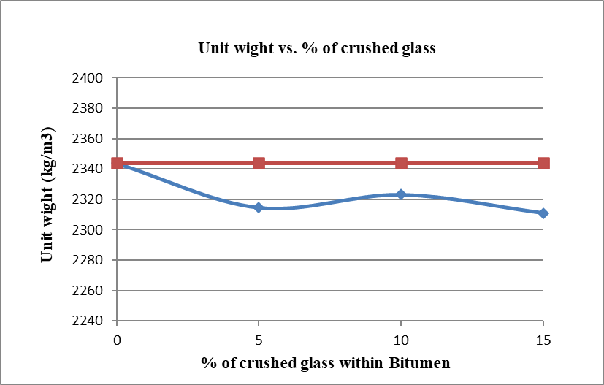
All percentages within the range and it is acceptable.

Slide 23
Bulk specific gravity and unit weight values for combination crushed glass and polyester
Percentage by Weight of Bitumen With polyester and crushed glass | Gb |  |  |  | Unit weight (ϒ) Kg/m3
 | A | B | C | Avg.
0% | 2.35 | 2.34 | 2.34 | 2.34 | 2343.80
5% | 2.37 | 2.39 | 2.36 | 2.37 | 2376.32
10% | 2.27 | 2.34 | 2.32 | 2.31 | 2313.95
15% | 2.39 | 2.36 | 2.41 | 2.38 | 2387.89
20% | 2.31 | 2.35 | 2.31 | 2.33 | 2331.83

Slide 24
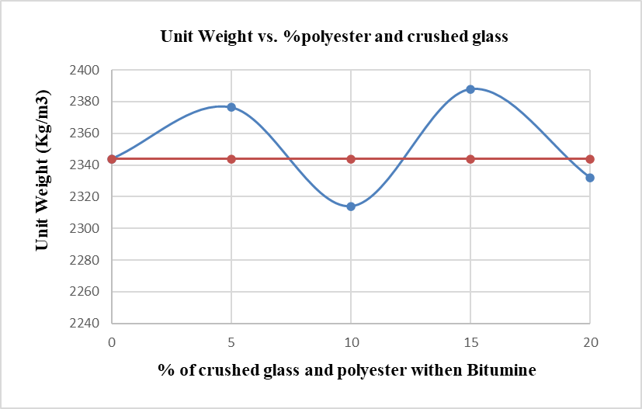
The values of density within range and acceptable, but the behavior of the curve is illogical in 15% of combination polyester and crushed glass.

Slide 25
2.Stability
Stability values for Polyester
Percentage by Weight of Bitumen with Polyester | Stability (Kg)
 | A | B | Avg.
0% | 1693.60 | 1288.00 | 1475.75
5% | 1797.90 | 1121.60 | 1459.70
10% | 1012.60 | 898.60 | 955.60
15% | 1106.90 | 1334.70 | 1220.00

Slide 26
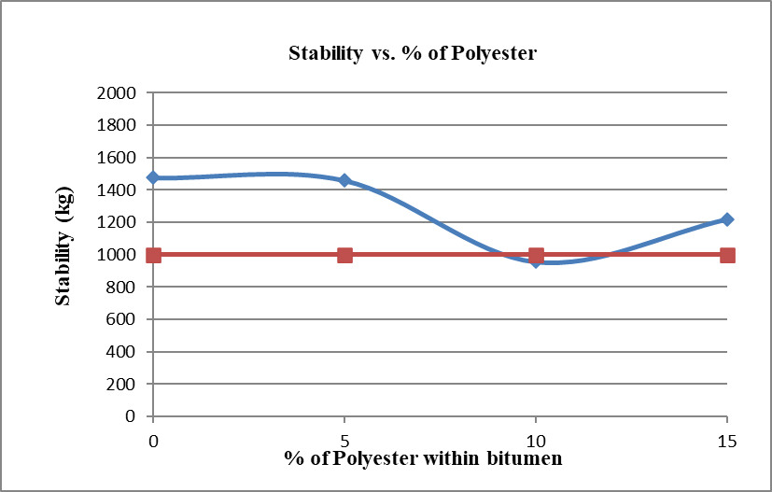
As shown in the curve the addition of polyester up to 10% gives negative effect, On the other hand the use of 15% has positive effect.

Slide 27
Stability values for crushed glass
Percentage by Weight of Bitumen with Crushed glass | Stability (Kg)
 | A | B | Avg
0% | 1693.60 | 841.90 | 1267.70
5% | 898.50 | 796.63 | 847.70
10% | 1795.22 | 1775.10 | 1785.16
15% | 1706.60 | 1680.60 | 1693.60

Slide 28
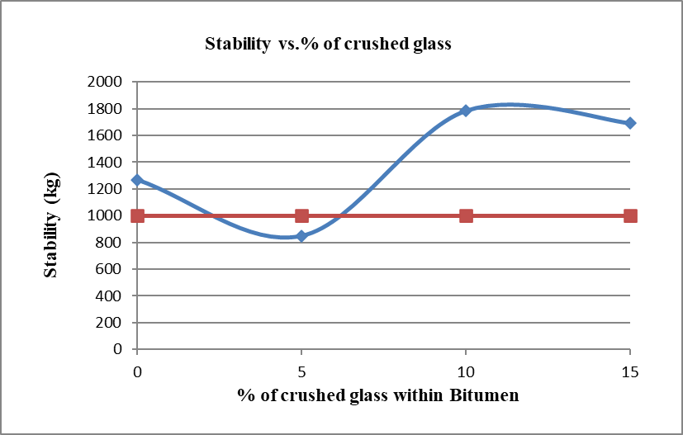
As shown in the curve, the addition of polyester up to 10% and 15% gives positive effect. on the other hand, the use of 5% has negative impact.

Slide 29
Stability values for combination of polyester and crushed glass
Percentage by Weight of Bitumen with combination of crushed glass and polyester | Stability (KN) | Stability (Kg)
0% | 12.43 | 1267.70
5% | 9.71 | 988.88
10% | 7.72 | 787.35
15% | 11.89 | 1212.02
20% | 8.21 | 836.90

Slide 30
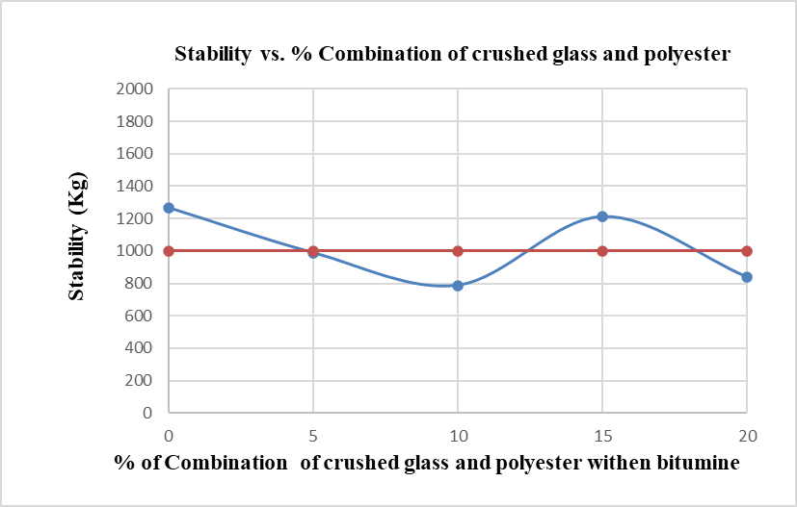
As shown in the curve, the addition of polyester up to 5%, 10% and 20% is negative impact, On the other hand in 15% it’s had positive impact.

Slide 31
3.Flow
Flow values for polyester
Percentage by Weight of Bitumen with polyester | Flow (mm)
 | A | B | Avg.
0% | 3.21 | 3.40 | 3.31
5% | 3.59 | 3.43 | 3.51
10% | 3.58 | 4.75 | 4.16
15% | 3.10 | 4.31 | 3.87

Slide 32
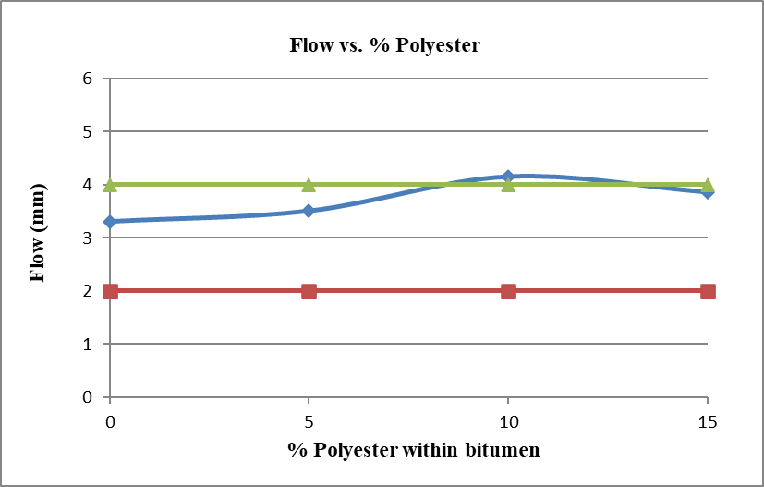
The acceptable range of flow based on AASHTO specification is (2-4) mm. From curve, at 10% the flow value is not within at specification limits.

Slide 33
Flow values for crushed glass
Percentage by Weight of Bitumen with crushed glass | Flow (mm)
 | A | B | Avg.
0% | 3.21 | 3.40 | 3.30
5% | 3.33 | 3.23 | 3.28
10% | 2.97 | 4.40 | 3.68
15% | 5.77 | 5.57 | 5.67

Slide 34
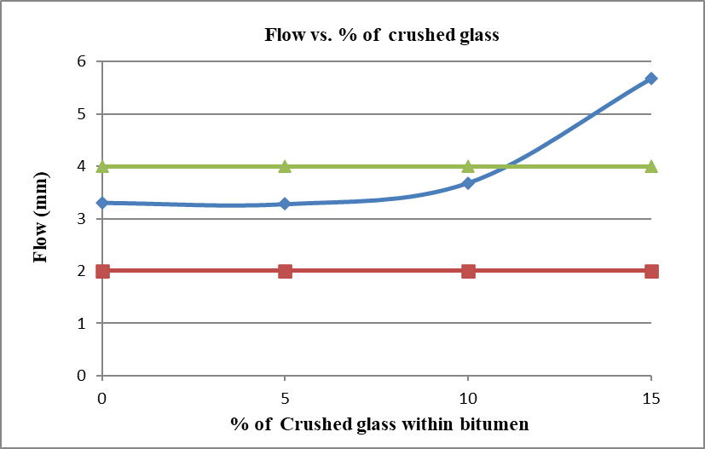
The acceptable range of flow based on AASHTO specification is (2-4) mm. From curve, at 15% the flow value is not within at specification limits.

Slide 35
Flow values for combination of polyester and crushed glass
Percentage by Weight of Bitumen with crushed glass and polyester | Flow (mm)
0% | 3.05
5% | 6.77
10% | 8.65
15% | 3.55
20% | 4.17

Slide 36
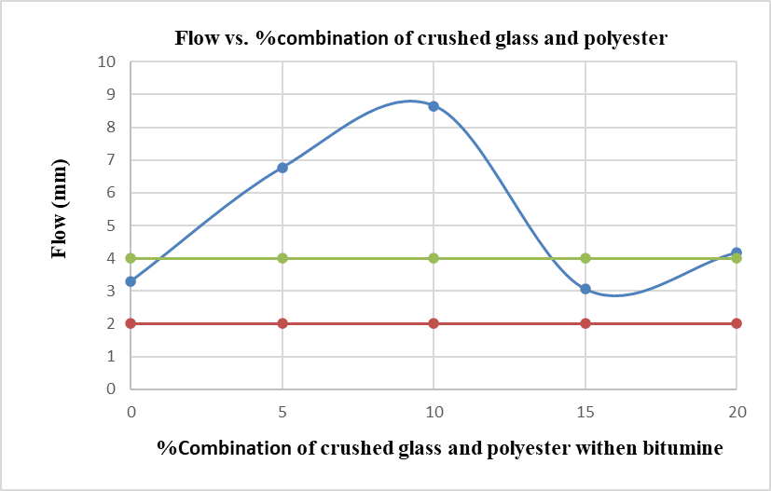
The acceptable range of flow based on AASHTO specification is (2-4) mm. From curve, at 15% the flow value is within at specification limits.

Slide 37
4. Air voids
Gmm test weights
% Percentage by Weight of Bitumen with crushed glass and polyester | W(sample in air) | W (sample + water + flask) | W (water + Flask)
0% | 1173.50 | 4077.07 | 3390.00
5% | 1177.66 | 4083.66 | 3390.00
10% | 1172.66 | 4068.00 | 3390.00
15% | 1167.66 | 4085.33 | 3390.00
20% | 1183.56 | 4079.00 | 3390.00

Slide 38
Air voids value
% Percentage by Weight of Bitumen with crushed glass and polyester | Gmm | Gmm modifer | Gb | Air voids %
0% | 2.42 | 2.41 | 2.34 | 3.10
5% | 2.43 | 2.42 | 2.37 | 2.09
10% | 2.37 | 2.36 | 2.31 | 2.14
15% | 2.47 | 2.46 | 2.38 | 3.16
20% | 2.39 | 2.38 | 2.33 | 2.31

Slide 39
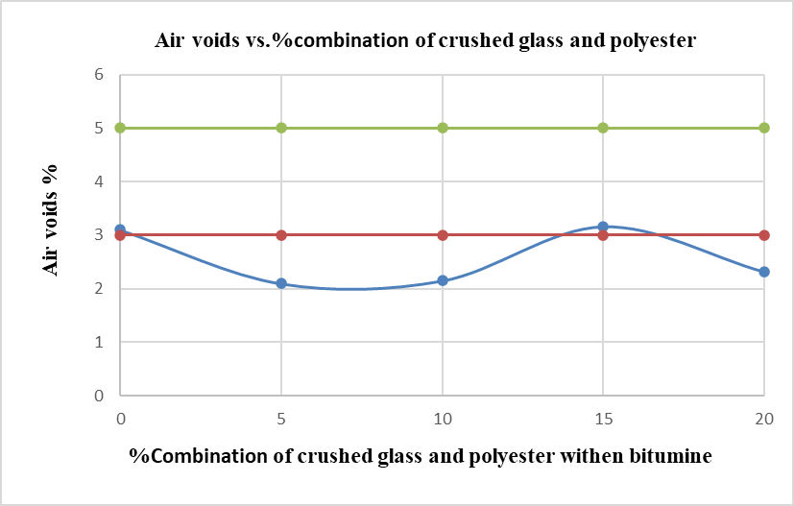
The acceptable range of air voids based on AASHTO specification is (3-5) %. From curve, it is clear the 15% of mix, the specifications are satisfied.

Slide 40
DISCUSSION

Slide 41
Percentage of Polyester and corresponding specific gravity, stability and flow
values and corresponding Specifications for polyester
%Polyester | Gb | Stability (>1000) Kg | Flow (2-4) mm | Specifications (Yes/No)
5% | 2.35 | 1459.79 | 3.51 | Yes
10% | 2.25 | 955.66 | 4.16 | No
15% | 2.35 | 1220.85 | 3.86 | Yes

Slide 42
Percentage of Crushed glass and corresponding specific gravity, stability and flow v a l u e s and corresponding Specifications for crushed glass
% Crushed glass | Gb | Stability (>1000) Kg | Flow (2-4) m m | Specifications (Yes/No)
5% | 2.31 | 847.55 | 3.28 | No
10% | 2.32 | 1785.11 | 3.68 | Yes
15% | 2.31 | 1693.68 | 5.67 | No

Slide 43
Percentage of Polyester and glass corresponding specific gravity, stability, flow and air voids values and corresponding Specifications for combination polyester and crushed glass
%Polyester and crushed glass | Air void (3-5) | Stability (>1000 Kg) | Flow (2-4) mm | Specifications (Yes/No)
5% | 2.09 | 988.88 | 6.77 | No
10% | 2.14 | 787.35 | 8.65 | No
15% | 3.16 | 1212.02 | 3.55 | Yes
20% | 2.31 | 836.9 | 4.17 | No

Slide 44
CONCLUSIONS

Slide 45
Change amount of adding 10% ratio of crushed glass on Marshall Properties
Marshall properties | 10% of crushed glass | 0% of crushed glass | Change amount
Stability (kg) | 1785.12 | 1267.83 | 40.8% increasing
Flow (mm) | 3.68 | 3.30 | 10% increasing

Slide 46
Change amount of adding different ratios of polyester on Marshall Properties
Marshall properties | 5% polyester | 0% polyester | Change amount
Stability (kg) | 1459.80 | 1267.83 | 15.1% increasing
Flow (mm) | 3.51 | 3.30 | 6.36% increasing
Marshall properties | 15% polyester | 0% polyester | Change amount
Stability (kg) | 1220.84 | 1267.83 | -3.7% decreasing
Flow (mm) | 3.86 | 3.30 | 16.97% increasing

Slide 47
Change amount of adding 15% ratio of combination of crushed glass and polyester on Marshall Properties
Marshall properties | 15% of combination of polyester and crushed glass | 0% of crushed glass and polyester | Change amount
Stability (kg) | 1212.02 | 1267.7 | -4.39% increasing
Flow (mm) | 3.55 | 3.05 | 16.39% increasing
Air void (%) | 3.16 | 3.10 | 1.8 % increasing

Slide 48
Recommendations and future Perspectives

Slide 49
The following are the main points recommended by the project team:
1- In Palestine, the use of crushed glass and polyester in 3/4inch HMA and medium traffic is encouraged due to their role in improving the asphalt mixture's physical attributes, as presented in the previous tables and figures.
2- To investigate the effects of adding crushed glass and polyester to bitumen characteristics and ensure that they satisfy the required criteria.
3- To re-examine using larger glass and polyester percentages (more than 20%) in future work.

Slide 50
3- To re-examine using larger glass and polyester percentages (more than 20%) in future work.
4- To build a road segment (for example, 100 meters) using the results in the mix design to investigate the results on the ground.
5- To investigate the percentage of glass and polyester in the aggregate component in the future work.
6- To investigate the feasibility of adding such materials by conducting benefit cost ratio analysis (B/C).

Slide 51

Thank you!

