Slide 1
Jackaroo Game
Prepared by: Lutfi Azhari
Tariq Asedeh
Supervisors: Dr.Muhanned Al-Jabi
Dr.Manar Qamhia

Slide 2
Outline
What’s Jackaroo?
Overview
Components
Methodology
Constraints
Future Work
Demo

Slide 3
What's Jackaroo?
Game that is played using playing cards, board, and marbles.
Played by many players on the board.
Each Player has number of cards.
The goal is to make marbles rotate around the board and come back to the player.
Each card makes the player do different move from the other.

Slide 4
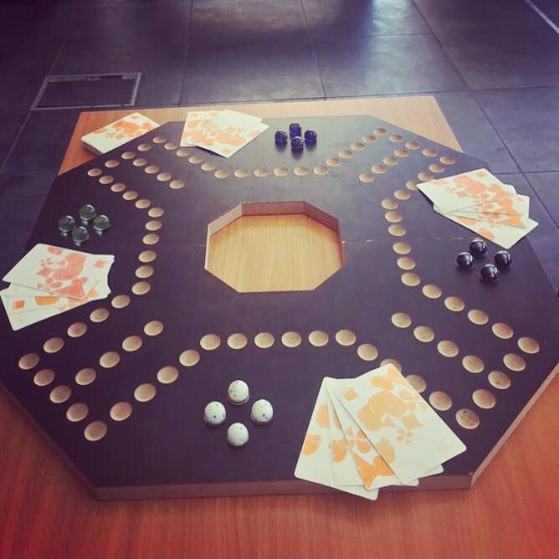

Slide 5
Overview
Project aims to make an electronic version of the game.
Playing cards are swapped with our own cards that are scanned.
Marbles are swapped with LEDs.

Slide 6
Components
RFID reader (ID-20LA)
RFID cards.
RGB LEDs.
Arduino Uno.
Shift Registers.

Slide 7
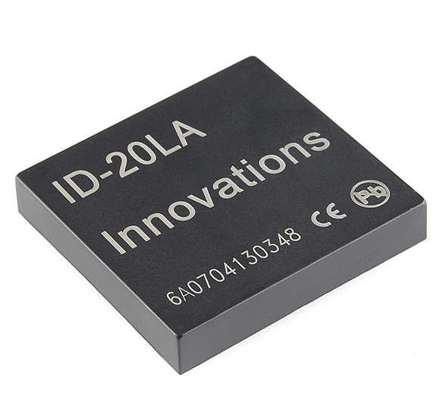
RFID reader (ID-20LA)

Slide 8
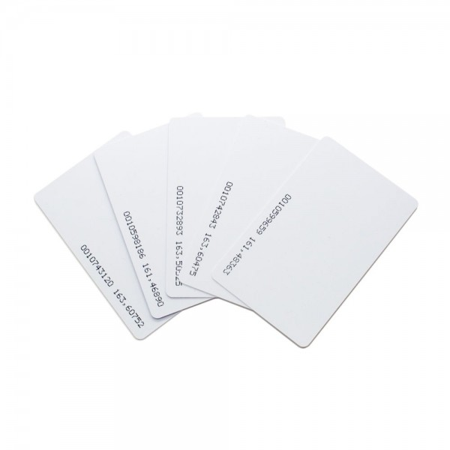
RFID Cards

Slide 9
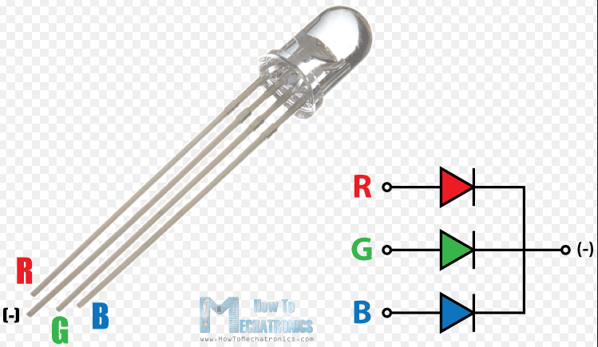
RGB LEDs

Slide 10
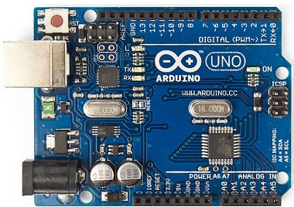
Arduino Uno

Slide 11
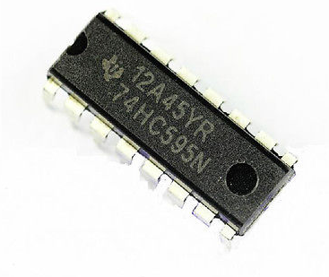
Shift Registers

Slide 12
Methodolgy
RFID cards are scanned using RFID reader.
Values are inserted in the Arduino.
Each card that is scanned has its corresponding rule.
Output is sent to shift registers with the color of the player.

Slide 13
Methodogly
Each shift register give the LEDs the value and the color.
Operation is shown on the LCD.
Color is altered after each player’s turn is over.
Game is over when one color rotates around the whole board.

Slide 14
Methodolgy
Moves that each player can make are made according to specific rules.
4: Goes back 4 steps
10: Make the player after you skip a turn
Ace: Start the game or move one step forward

Slide 15
Constrains
Number of pins on the Arduino Uno is low (needed to use shift registers).
RFID reader can read from 10cm at most.

Slide 16
Future work
Increase the number of the LEDs on the board to be equal to that of the full game.
Increase the number of playing cards to be that of 52.

Slide 17
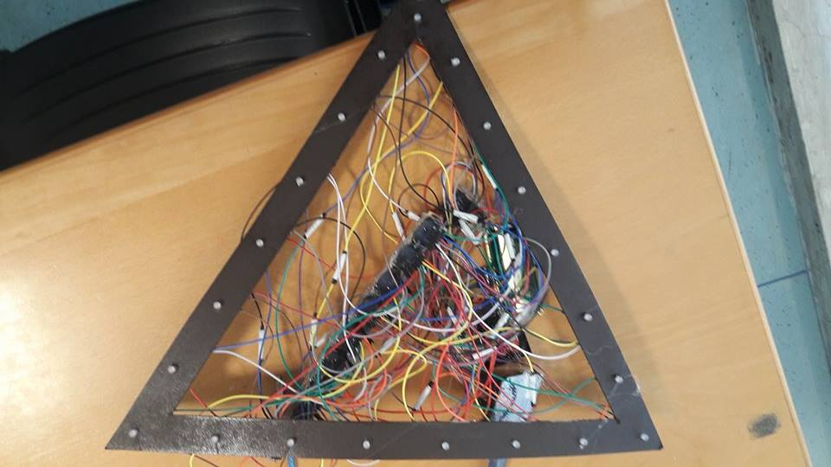
Result

Slide 18
Demo
Demo

Slide 19


