Slide 1
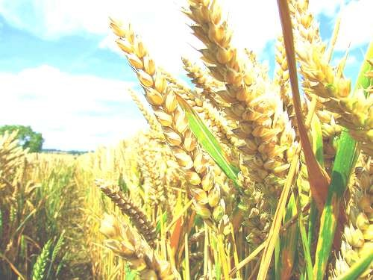




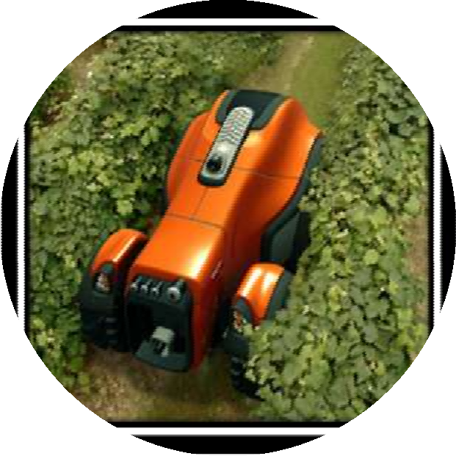

Agricultural Robot
Presented by
Abdulqader Abduljalil
Omar Azamtta
Mahmoud Qaisiya

Slide 2
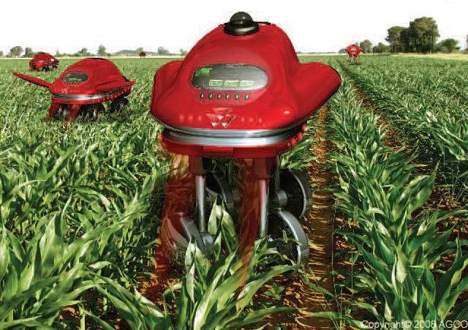
Contents
1.Introduction to agriculture robot
2.methodology
3hardware design
4.software design
5.problems and suggested solution
6.conclusion

Slide 3

Agricultural robotics
Agricultural robotics is the use of automation in industrial systems such as agriculture, forestry. It is replacing the conventional techniques to perform the same tasks, with efficiency.
Applying automation to agriculture has helped create several advancements to the industry while helping farmers save money and time.

Slide 4
What will this project provide
fully remotely-automated system that is capable of planting seedling.
High speed and a good accuracy and precision
Easy to handle by the client and to adjust the parameters of it.
Powerful tools to provide a good performance

Slide 5

2.Methodology
methodology
Two separated systems were taken.
1.the first is the wireless control system which gives the robot the information like the length of the land and the distance between each seedling and the other.
2.the second is the agriculture robot system which will receive the information and will plant the seedling each in it’s place.

Slide 6
2.1 wireless control system
It will be formed of:
1.Keypad:the interface input for the client, and by using he will enter the wanted values like the distance between seedlings and land length.
2.Arduino Uno: the controller will receive the information from the keypad and give it to the LCD and transceiver
3.LCD: the interface output for the client to show what are the numbers he entered
4.Transceiver: will send the information needed to the other transceiver on the robot

Slide 7
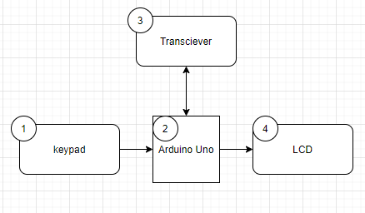
s
Flowchart of wireless control system

Slide 8
2.2 Agriculture robot system
It will be formed of 4 parts:
1.moving part: which will move the robot to the destination of the seedling.
2.robotic arm part: which will grab the seedling and put it into the digger
3.digger part: which will work to dig the ground and put the seedling in it
4.receiver part: will receive the information from the transmitter
5.Arduino Mega: the controller to link all these systems together

Slide 9
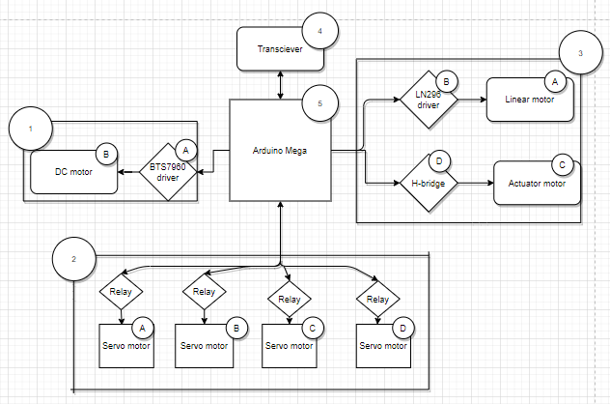
Flowchart of Agriculture robot system

Slide 10
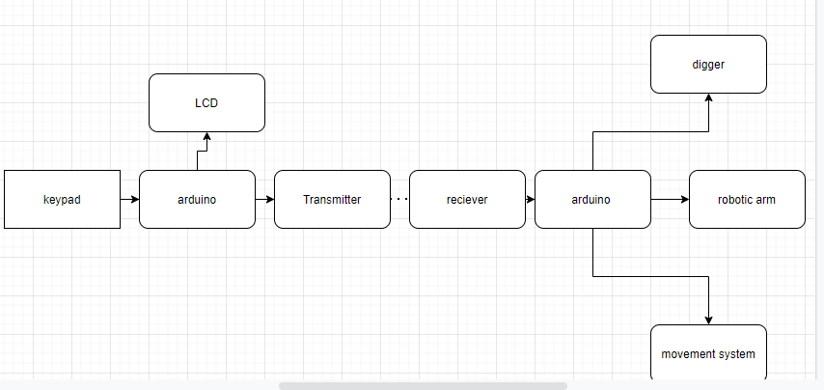
Flow chart of the whole operation
So the operation will go as follows:
1.Enter the length of the land and the distance between each seedling and the other to the Arduino
2.The Arduino Uno will show the length and the distance on the LCD and will give the information to the transceiver to be transmitted
3.The transceiver will receive the signal and give it to the Arduino Mega which will move the robot syste.

Slide 11

3.Hardware design
The hardware design included the whole system included the wireless control system and the robot system.
Those two system contained of the mechanical design and the electrical design(circuitry)

Slide 12
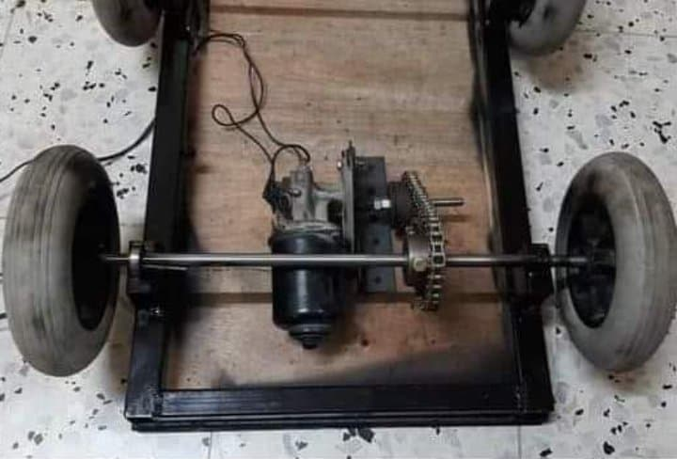
Mechanical design-Moving system
Showing the motor connected with the wheels by a chain

Slide 13
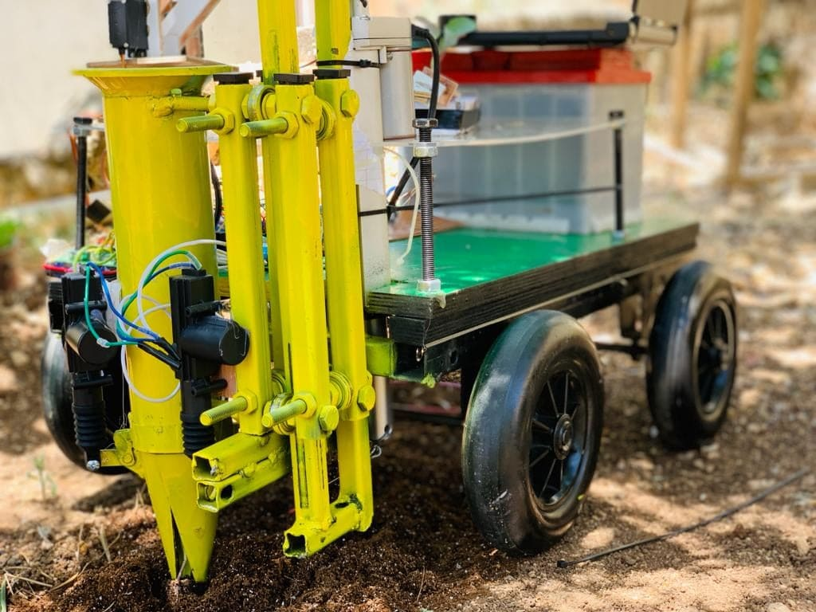
Mechanical design-Digging system
Showing the linear motor connected to the digging system as shown

Slide 14
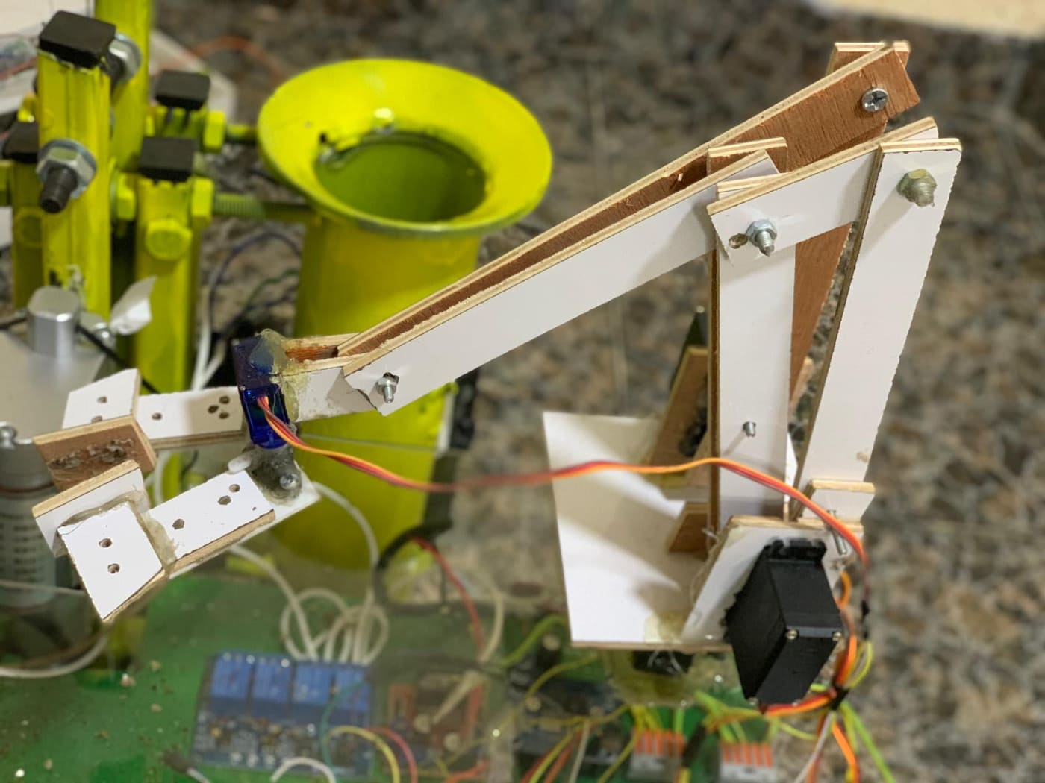
Mechanical design-Robotic system
Showing the robotic arm with it’s Servo motors

Slide 15
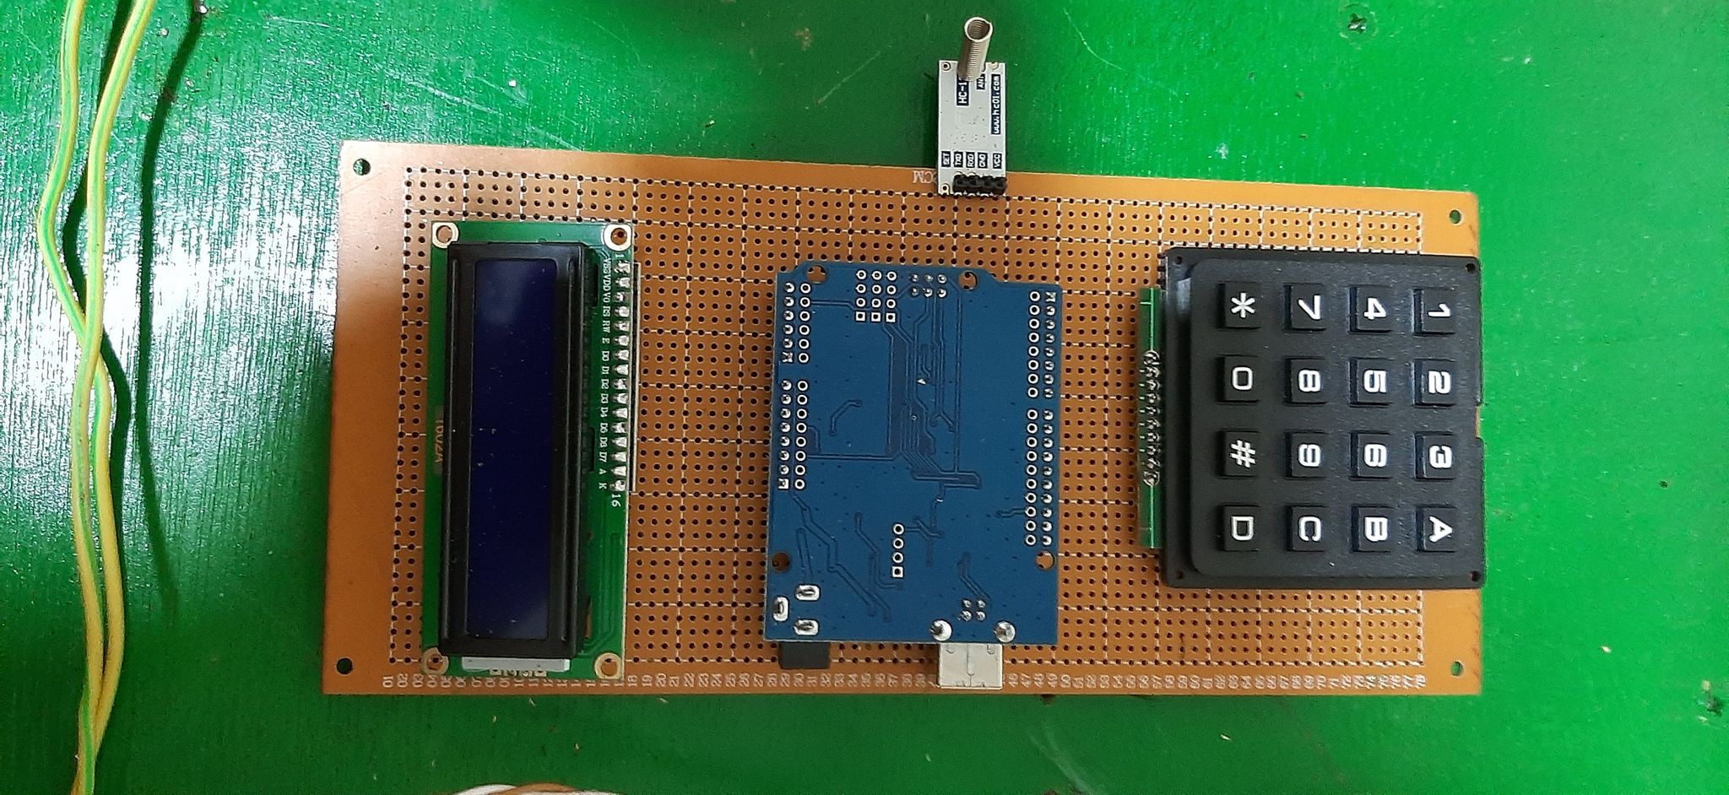
Electrical design-wireless control system

Slide 16
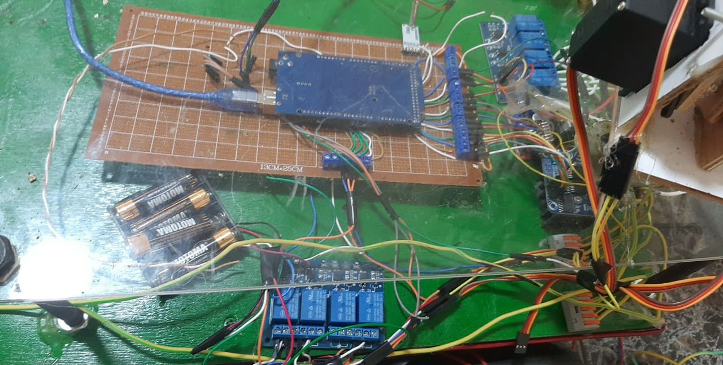
Electrical design-Robot system

Slide 17
4.software design
The software design included the simulation part using Solidworks and the coding part to run the whole operation

Slide 18
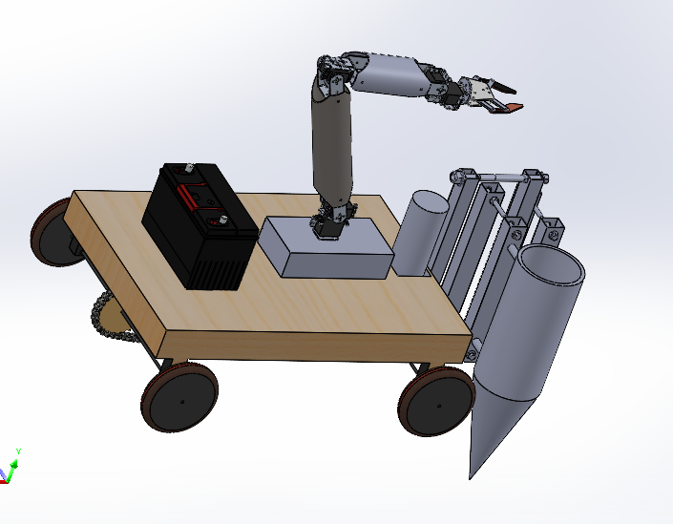
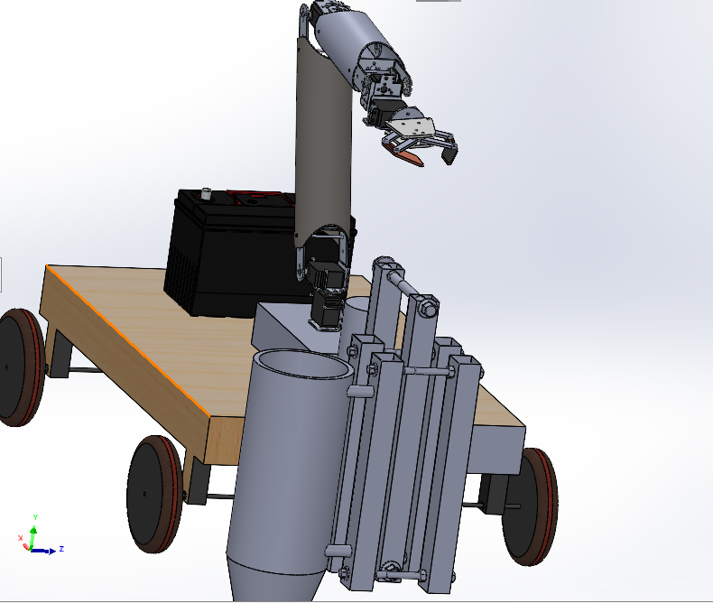
software design-SOLIDWORKS simulation
left side picture front picture

Slide 19
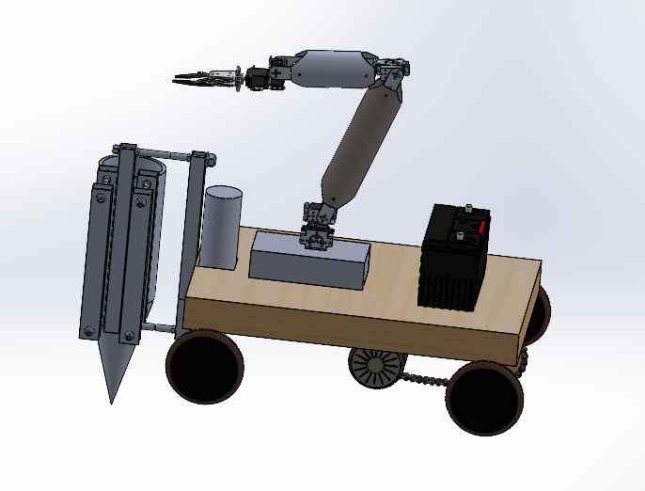
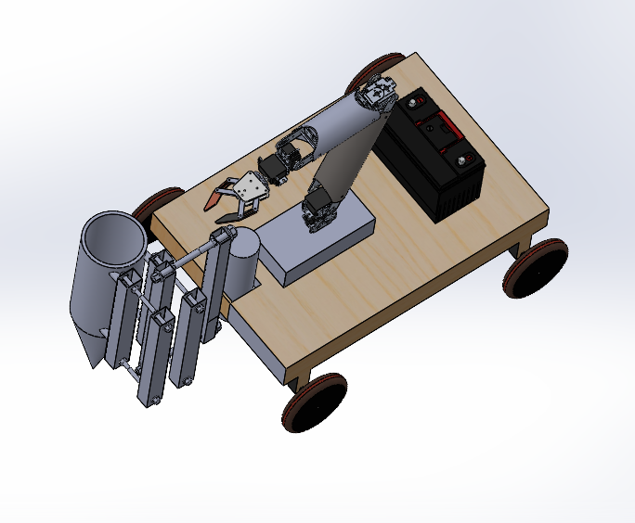
software design-SOLIDWORKS simulation
right side picture upward picture

Slide 20
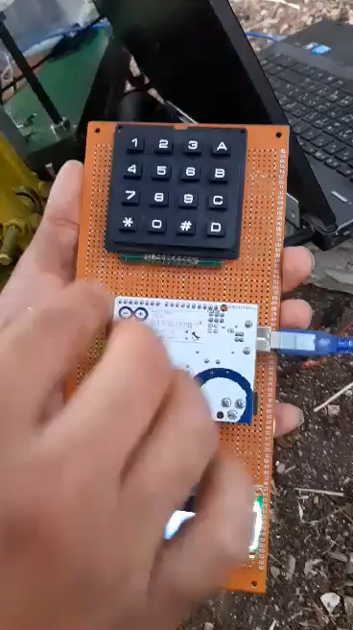

Slide 21
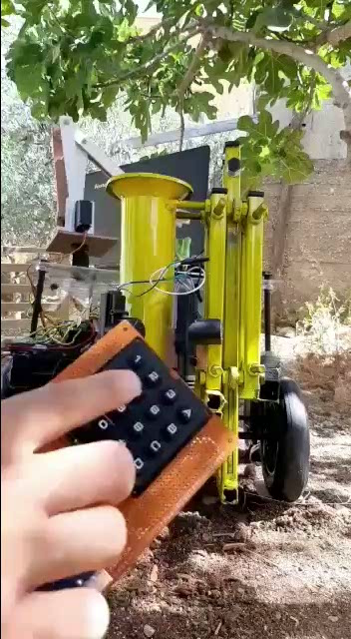

Slide 22
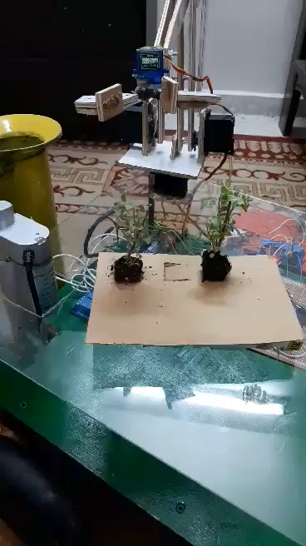

Slide 23
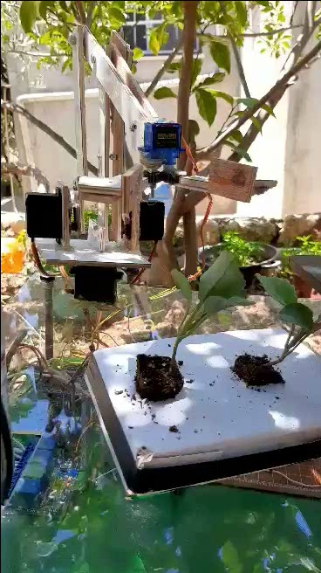

Slide 24
5.Problems and suggested solution
1.power: the system has 4 power supply
A.9 volts :for the control system controller
B.9 volts :for the robot system controller
C.6 volts :for the robotic arm
D.12 volts :for the linear motor and actuator (digger) and the DC motor(moving).
This over-battery system on the robot can be replace by 12volts battery only by using it with a buck-converter.
So based on our calculation we can se that

Slide 25
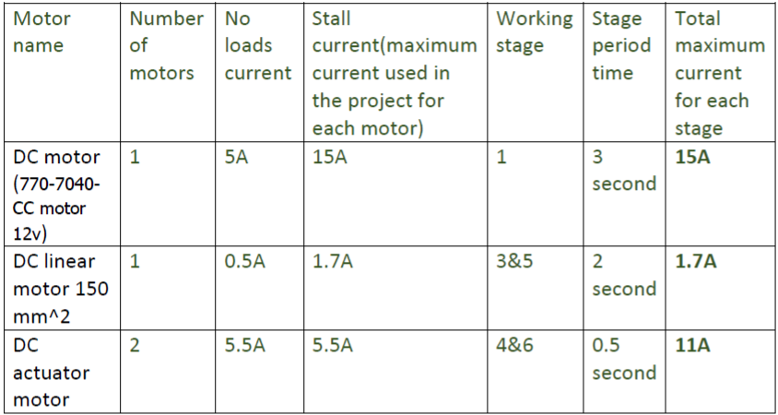
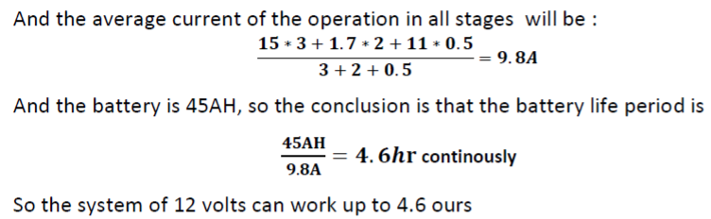
12 volt load calculation

Slide 26
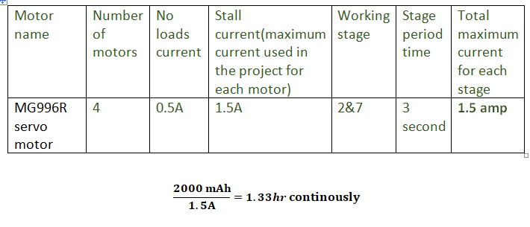
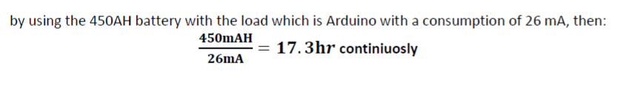
6 volt load calculation
9 volt load calculation

Slide 27
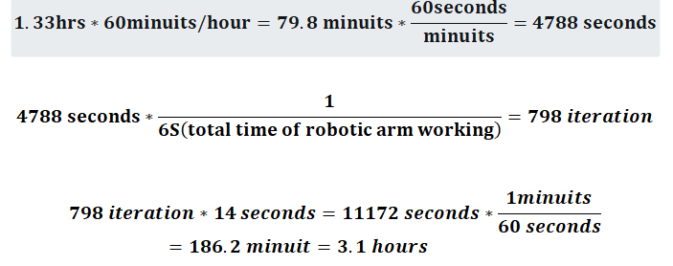
Total time for the operation and how many seedling are planted?
so from the calculation we can see that we can plant up to 198 seedling with total time of 46.2 minutes, we can increase the time and seedling planted also by using a buck converter as we have suggested before and a solar system with 200 watts so we can take advantage of the robot being in sun.

Slide 28
2.Accuracy and precision: the robot shows a good precision and accuracy, but we can increase the accuracy by using a GPS system for the navigation of the robot to increase it’s reliability instead of the coordinate system we’re using now.
3.soil type and land shape: this robot is designed plains with soft red soil, it can’t handle to be in a rocky land, although we can increase the power of the digger so it can handle another land types by using another mechanisms with powerful motors.

Slide 29
4.enviromental effect: the robot is not designed with obstacle or heat adjuster, also it doesn't have any waterproof, we can use Ultrasonic sensor to make the obstacle detector and a temperature sensor and a fan to make the heat adjustor, and we can put plastic cover for the waterproof.
5.Remotely distance of the transceiver : as we’re using HC-12 as a transceiver and a spring-Antenna with transmission power of 20 dBm we mange to reach a distance of 150 meters, but we can increase this distance by using different type of Antenna which can theoretically reach up to 2 KM, or to use another way like Wi-Fi or Wi-max or RF transceiver.

Slide 30
6.Bandwidth : as we’re using HC-12 as a transceiver, we have used the resonance frequency of 433.6 MHZ with a bandwidth of 400 KHZ, which is an industrial bandwidth with a lot of every-day equipment using it so there might be some noise, so we can buy a local bandwidth and use it alone or as we said we can use different type.

Slide 31
6.conclusion
approximately every operation in agriculture starting with ploughing, planting, fertilizing, spraying, monitoring…etc needs a separated system includes of robots and a one control system that connects them in an integrated way, this project is only to cover ploughing and planting process , it’s good to mention that when combining robots with this process it doesn't eliminate the human power, it just help human so the operation can be easier for them.

Slide 32

Thank you for listening

