Slide 1
FitBit – Fitness Application
Ghadir Shraim Hayat Salawdeh
Supervisor: Dr. Samer Arandi

Slide 2
Outline:
Introduction.
Motivation of the idea.
Features.
How app works.
Used technologies.
Methods and techniques.
Constraints.
Future work.

Slide 3
FitBit
A fitness Application.
A cross-platform mobile application that helps you to get fit.
How does it do that?
Tracks your food & your activity.

Slide 4
Motivation
Being fit, makes you happier, reduces your stress, depression and anxiety and makes you live longer.
So, being fit and in a good health concerns a lot of people.

Slide 5
Features:
Group of exercises.
Food tracker and related calories calculator.
Tracker – how far do you go and how much calories you have burned with google map.
Music player.
Achievements page, recodes your progress.
Water tracker.
Notification system.
Settings page.

Slide 6
Used Technologies
React-native
NodeJS
MongoDB
Nutritionix Database for Food
Firebase Camera Barcode Detector & open food facts .
Google Map.

Slide 7
How Does it work?

Slide 8
Fitbit features
  Simplicity
  Cross platform
  Flexibility
  Security
  User friendly
  Accessibility (search option)
  Offline features
  Reliability
  Smoothly

Slide 9
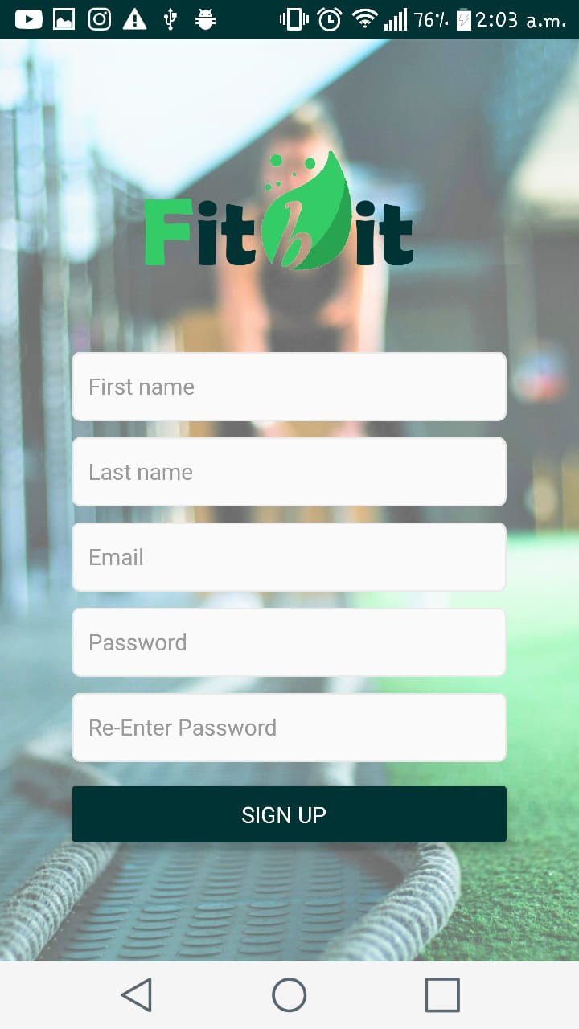
Login & Sign up
At this page , the user will register into our application by entered his info (full user name, email, password)
This information is required and we use validation for it if it’s empty
We validate email pattern to be accurate and valid

Slide 10
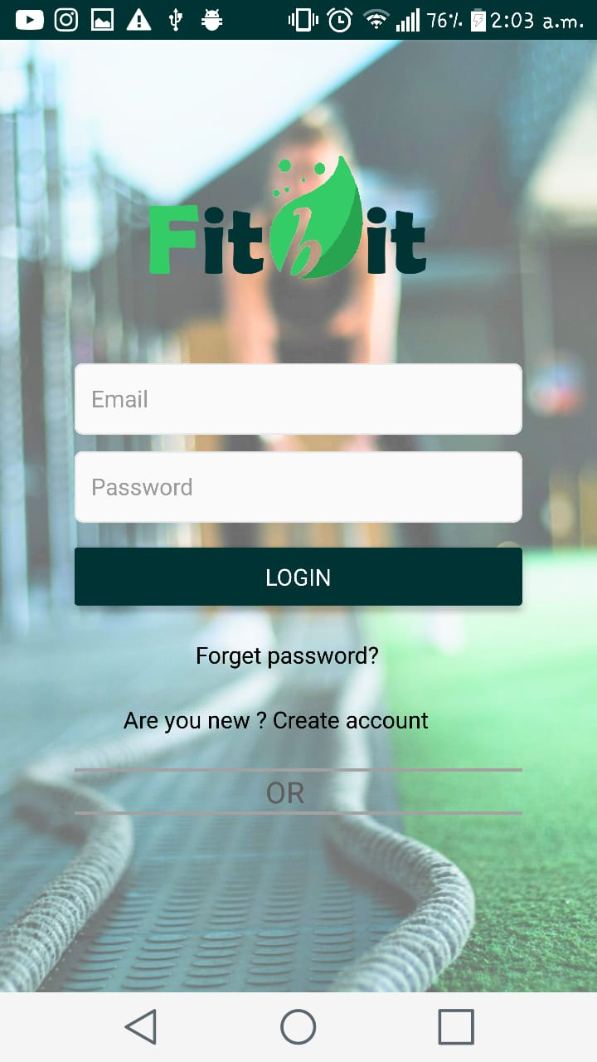
Login & Sign Up
The user will enter our app by his email and password.
After that we saved this info to make the accessiblety open while the user is logging into the app.
If the user forgot his password , he can recover it and changed it with the new one.

Slide 11
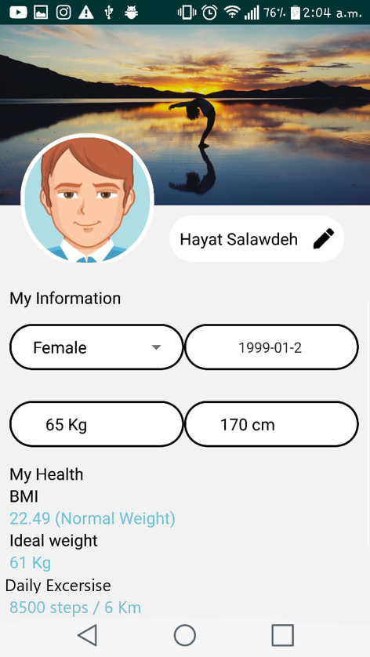
User Profile
Edit personal info
Change profile and cover picture
Auto calculate BMI value
Auto calculate ideal weight
Auto calculate daily exercises goal

Slide 12
Food Tracker

Slide 13
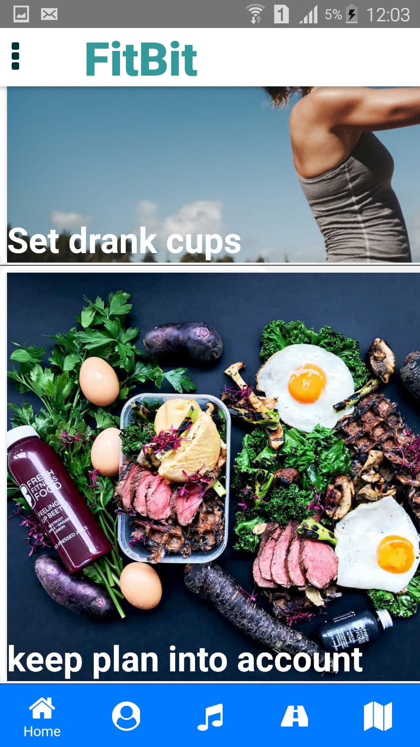
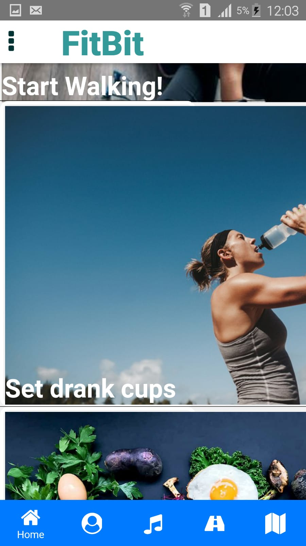

Slide 14
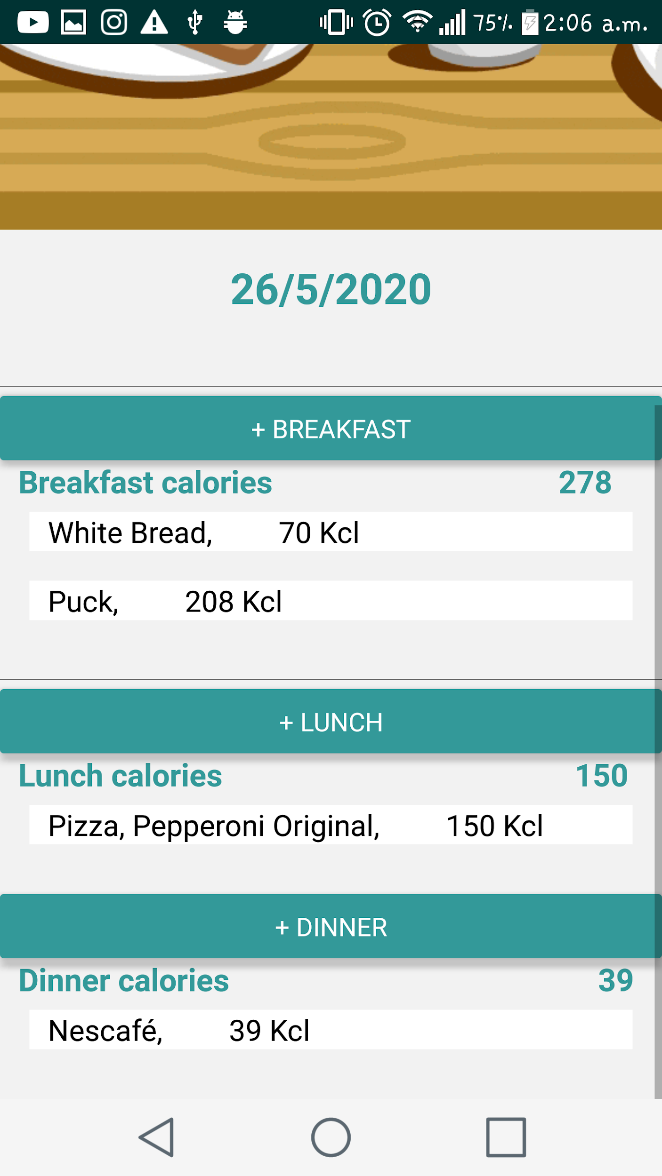
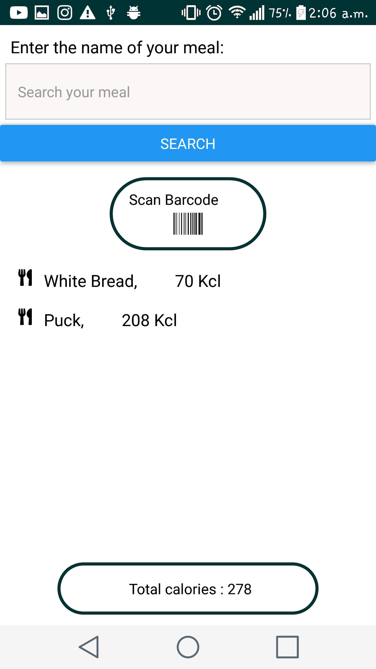
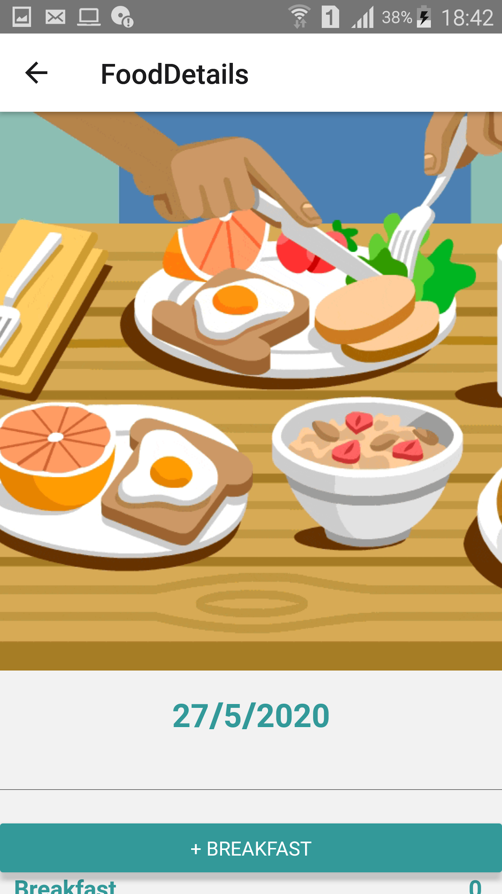
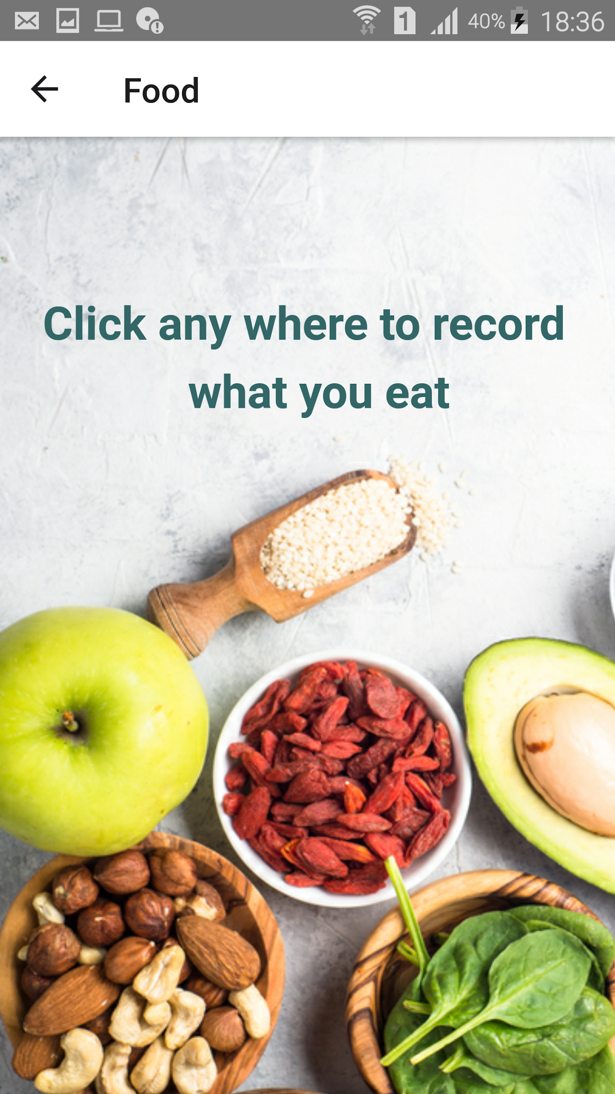
Food tracker

Slide 15
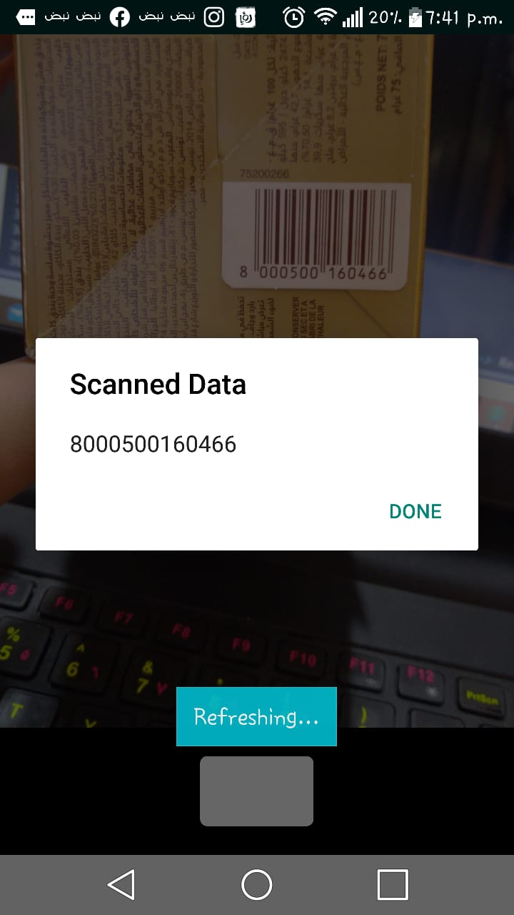
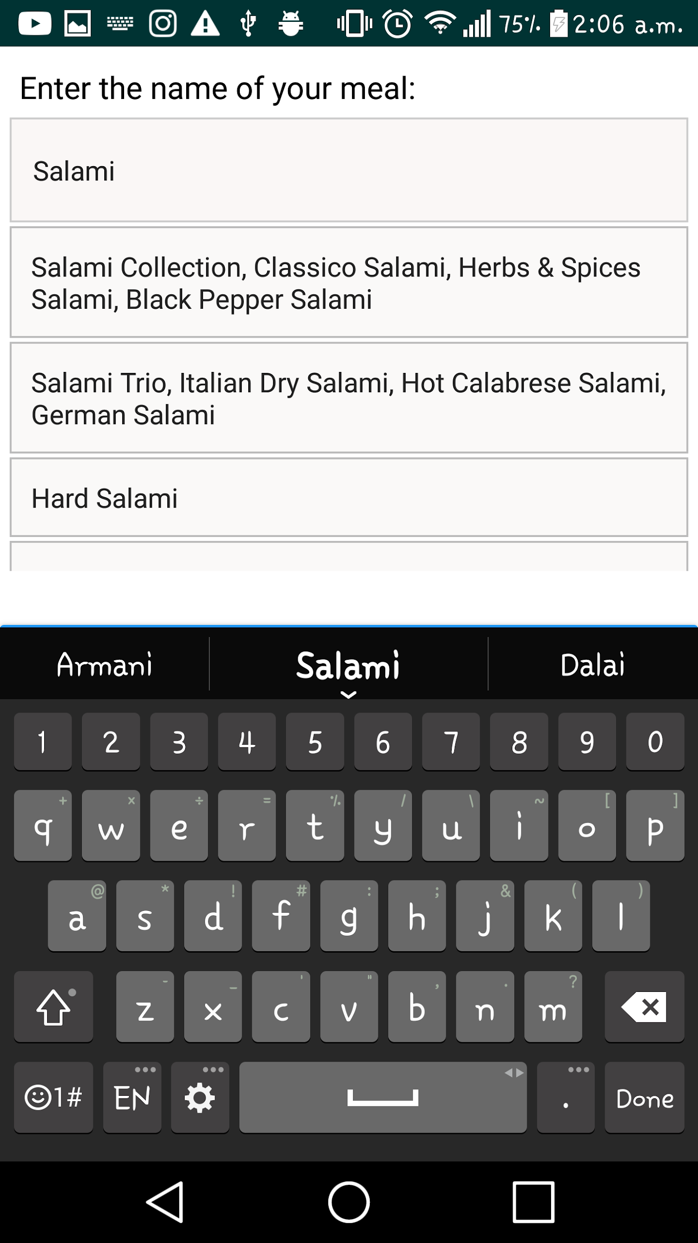

Slide 16
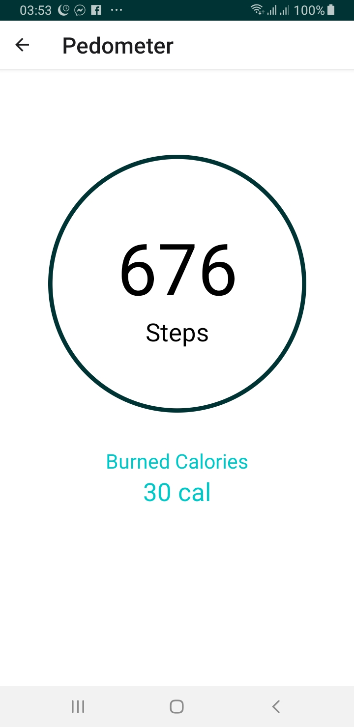
Pedometer
Counting steps using Google fit ( Fitness Api)
Calculate burned calories depend on number of steps
Calculate calories that consumed while running

Slide 17
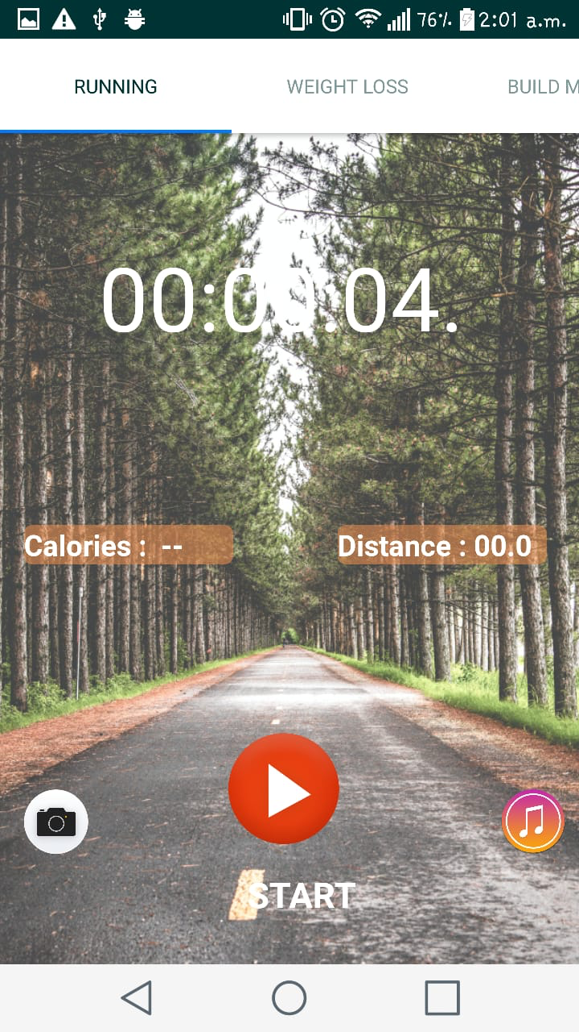
Exercises
Running (indoor running)
Calculate distance while start running
Calculate time and period from start running to finish it
Calculate calories that consumed while running
Listen to music during indoor running
Capture a photo to save it

Slide 18
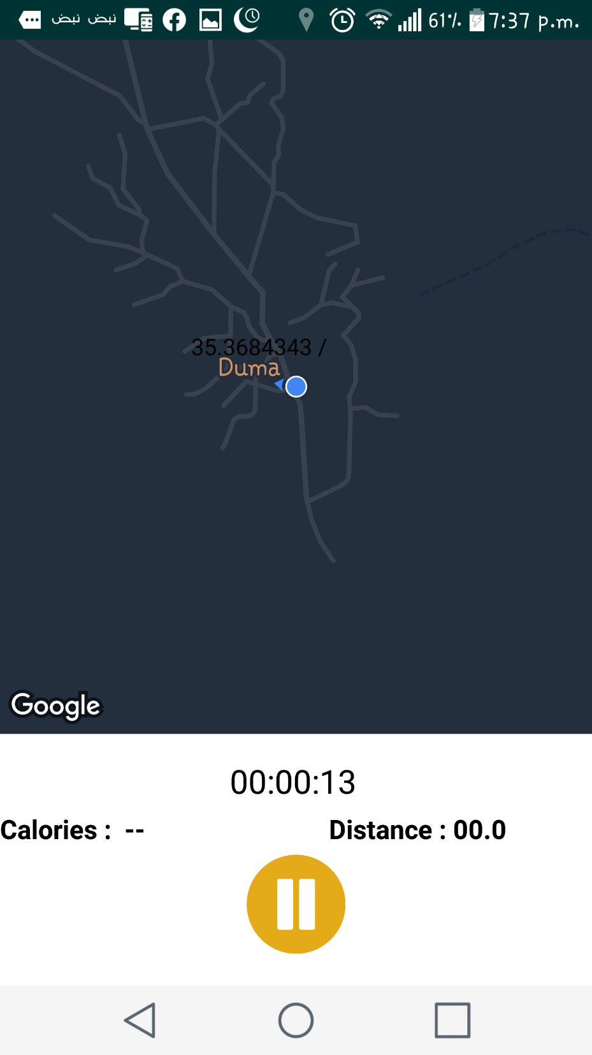
Exercises cont’
Track (outdoor walking)
Calculate distance and calories burned depend on the map
Using google map

Slide 19
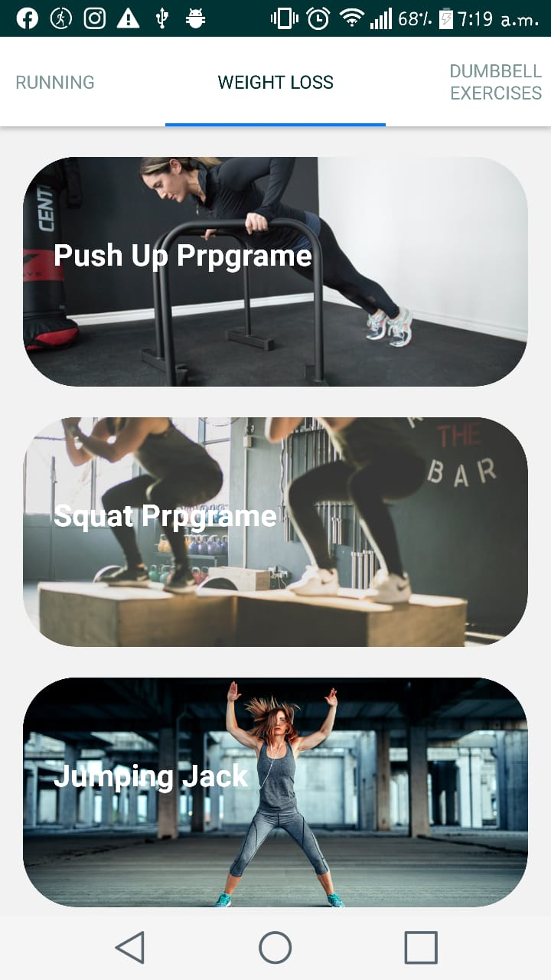
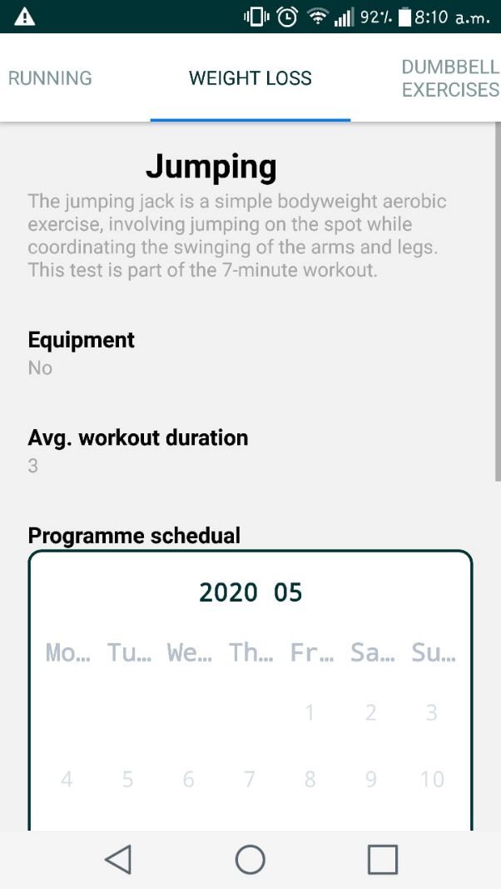
Exercise cont’
Preview exercises tutorials
Play the video using youtube video player
Join the program of exercise
Show the period of exercise program
See the days remaining from the program you joint using calendar
See the equipment need

Slide 20
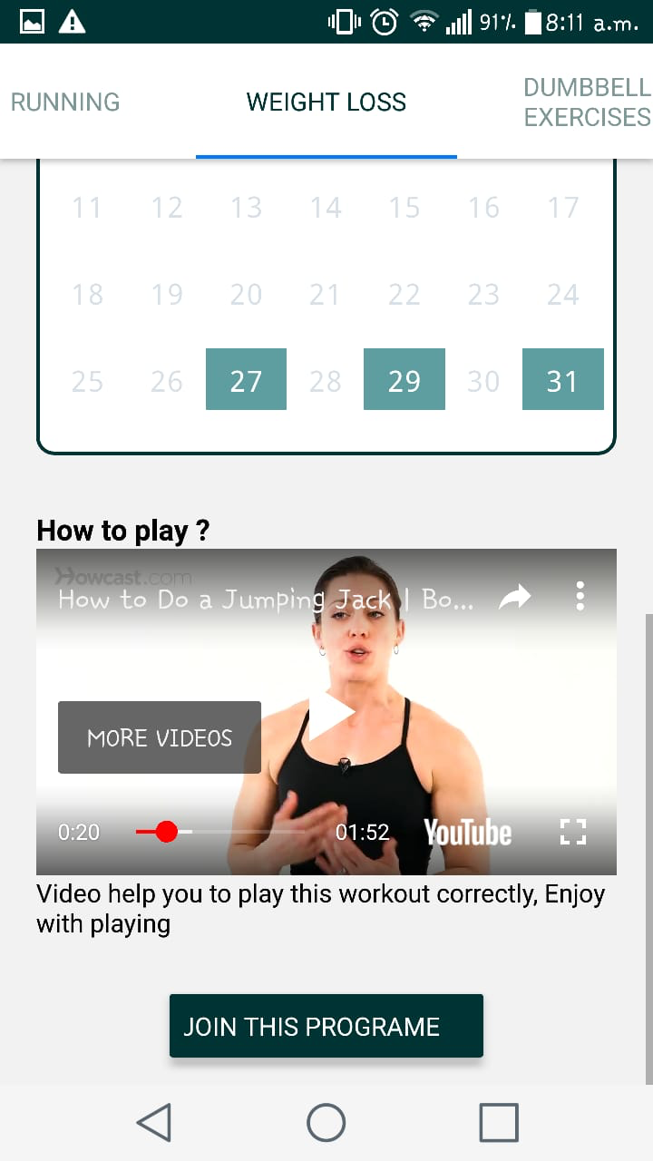
Exercise program
More details about program that the user joint
Show the period and dates of a program using calendar and the user will see when it will finish and how many days remaining

Slide 21
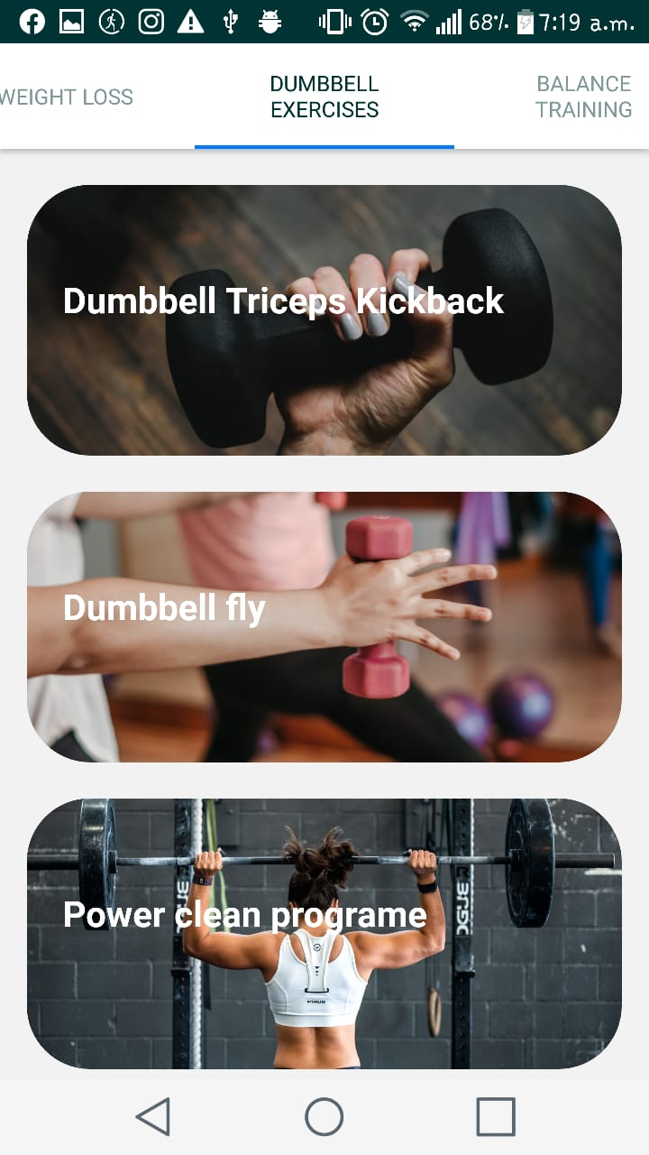
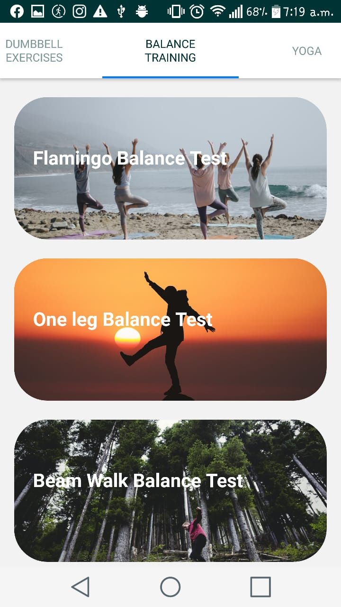
Exercises cont’
Dumbbell exercise
Balance training

Slide 22
Music Player

Slide 23
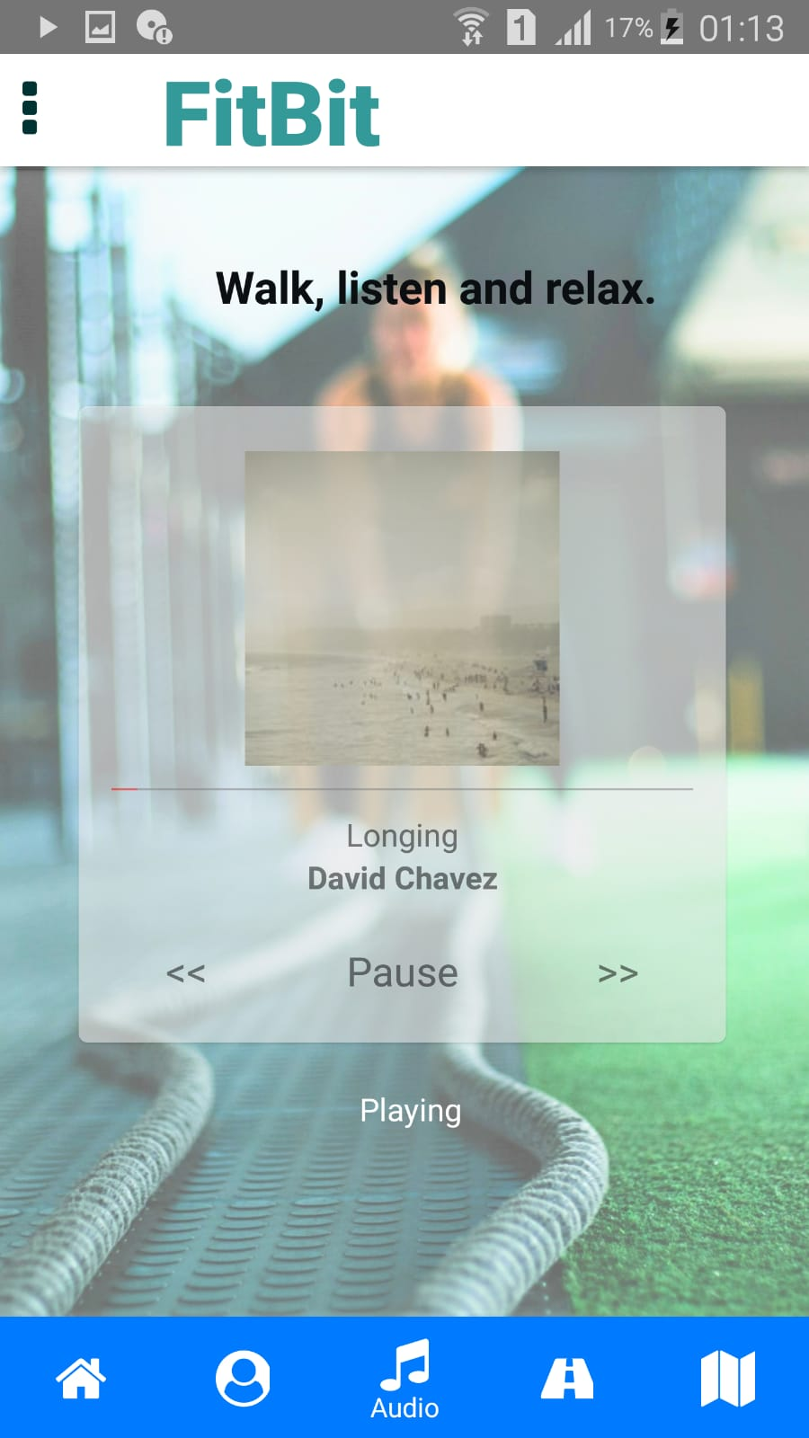
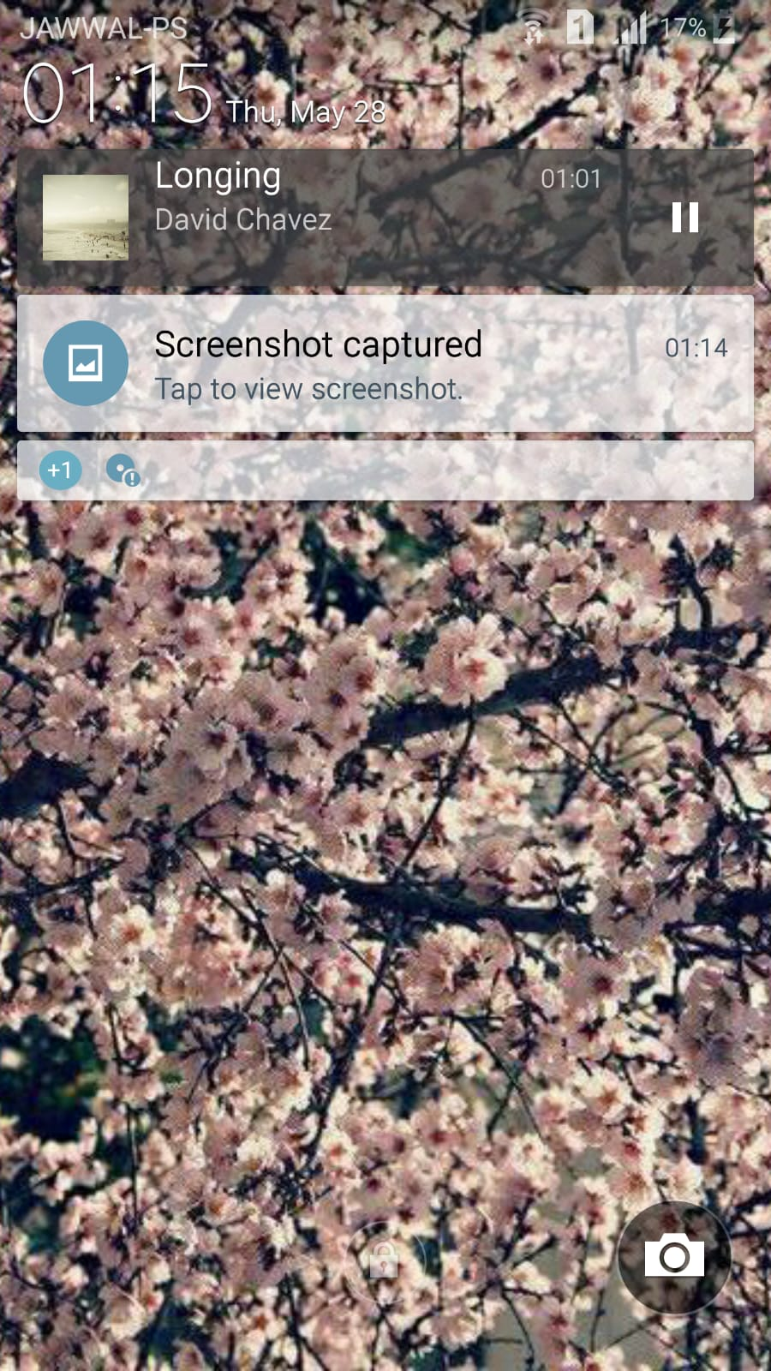

Slide 24
Water

Slide 25
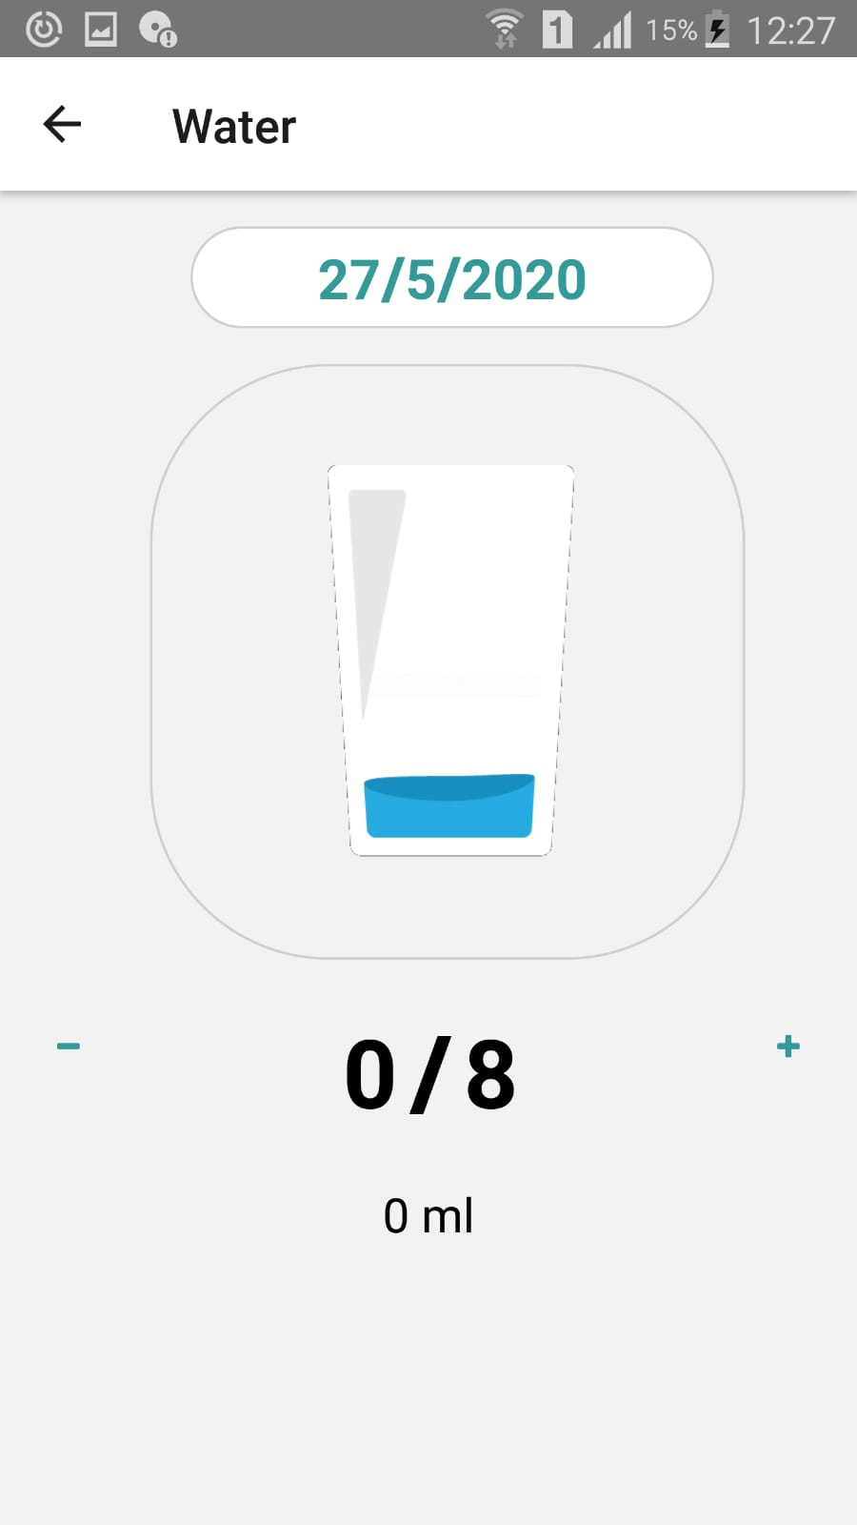
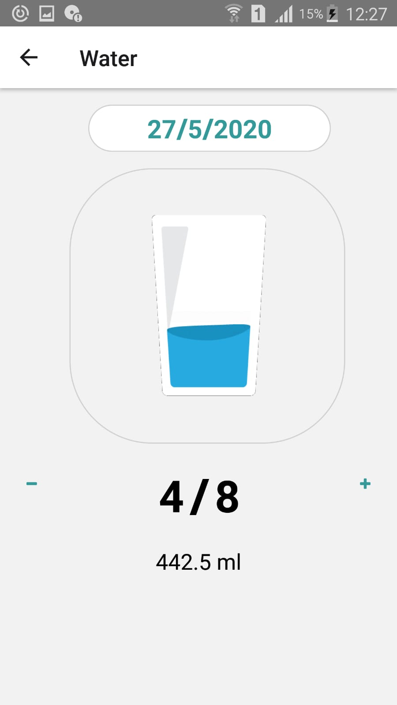

Slide 26
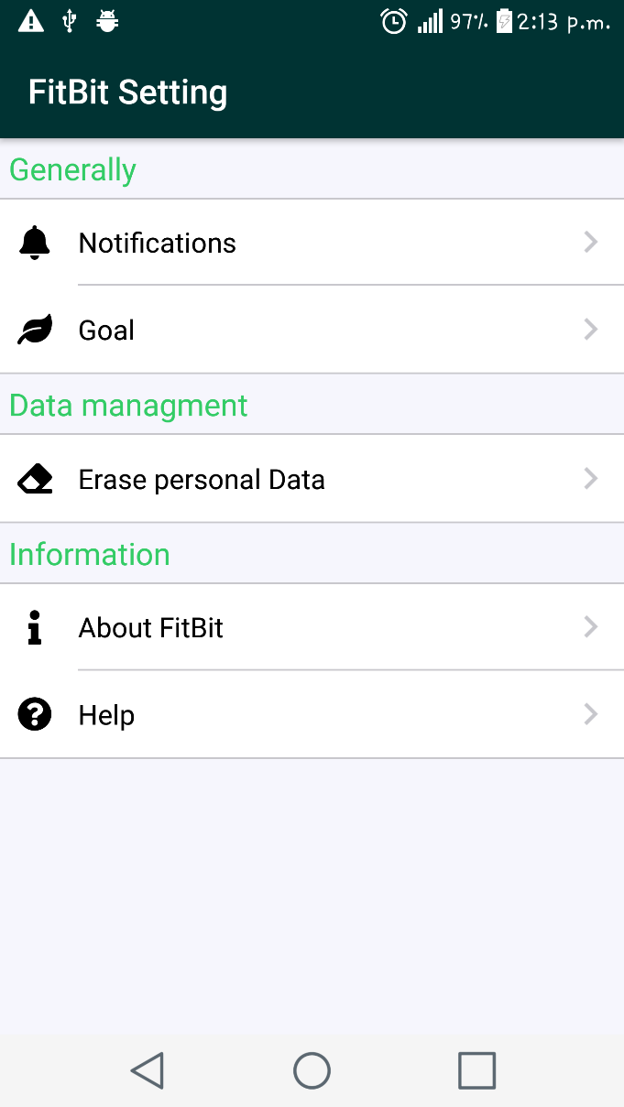
Settings
View notifications that received
Change the goal value of daily steps
Clear user’s cache for the logged data
About our application
Help page to help user how to use the app

Slide 27
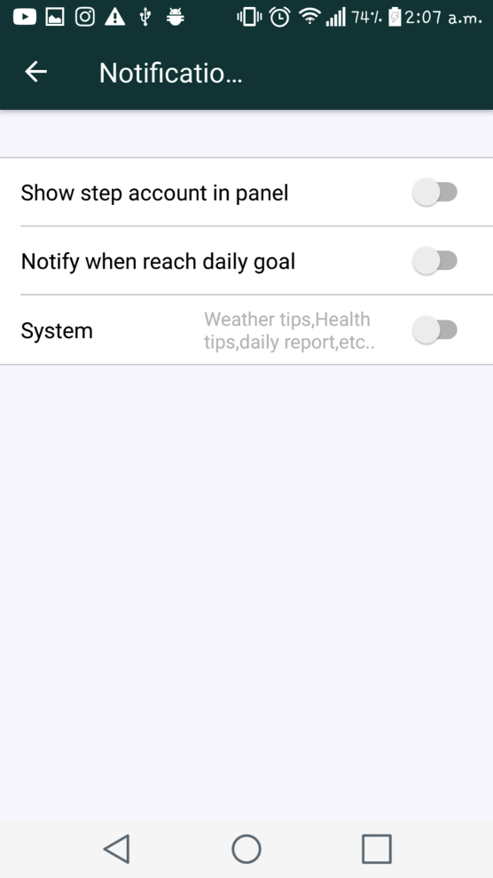
Notification page
We design this page to add more setting for notifications .

Slide 28
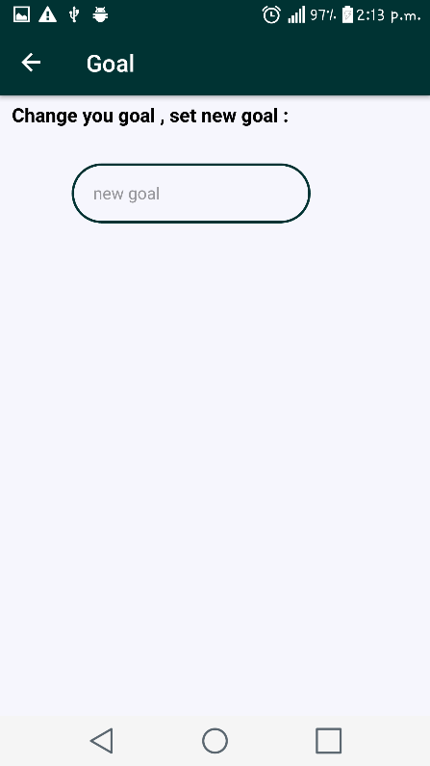
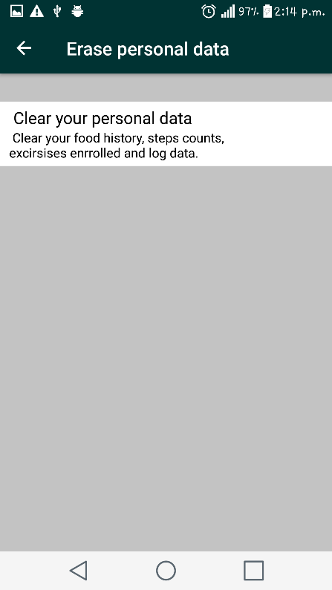
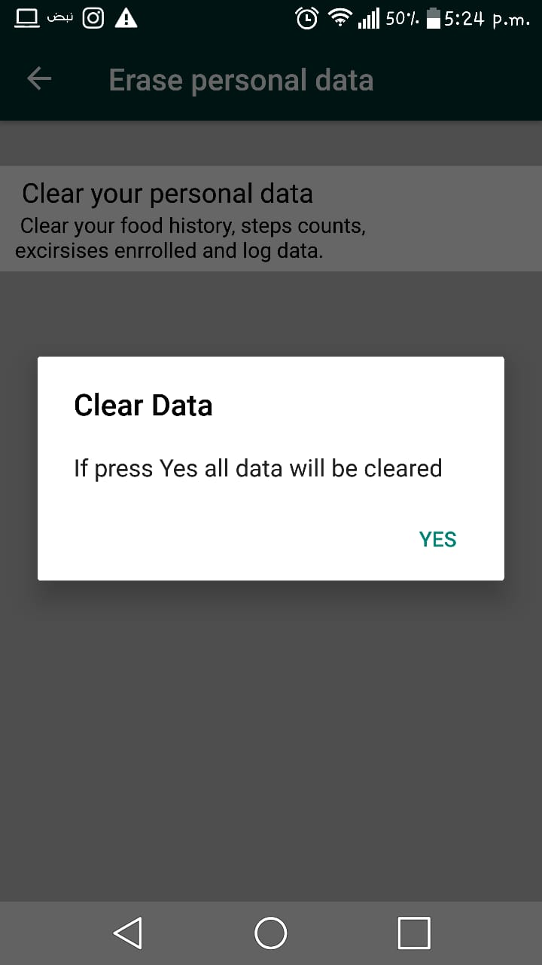
Goal page
Clear personal data

Slide 29
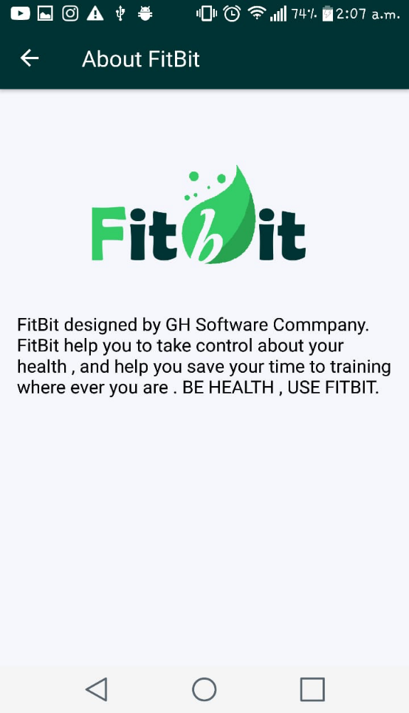
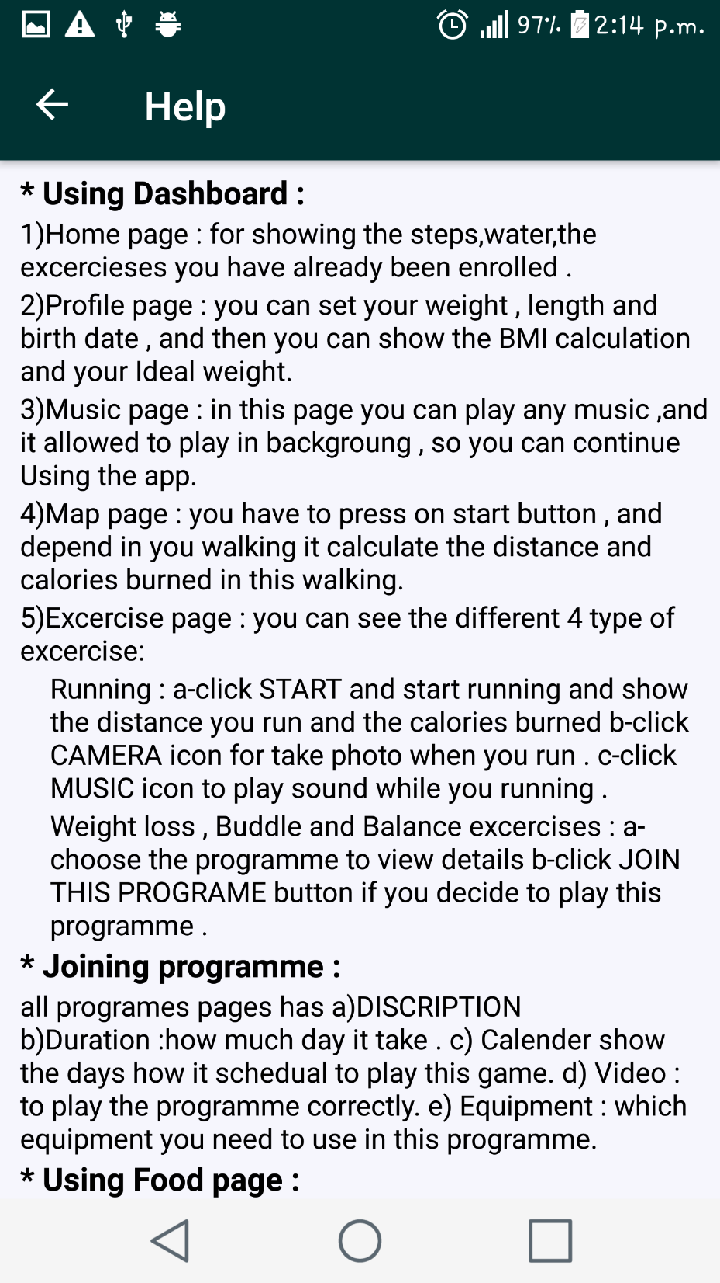
Help page
About app page

Slide 30
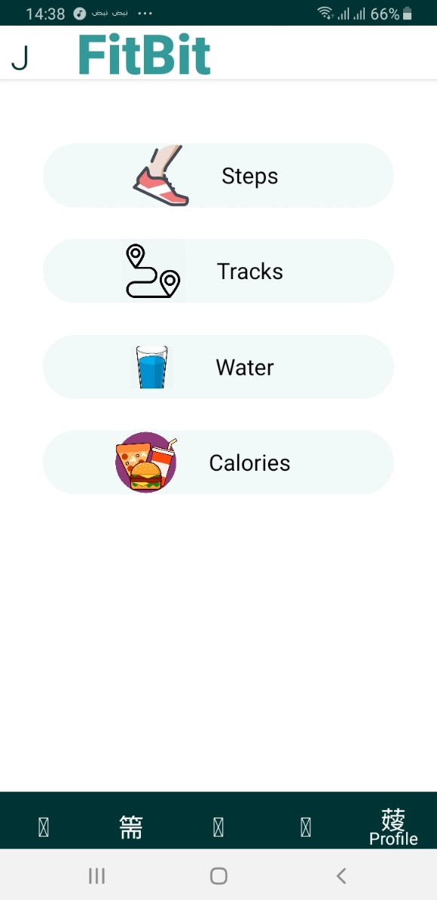
Achievements
View the history of your achievement in different activities.

Slide 31
Website

Slide 32
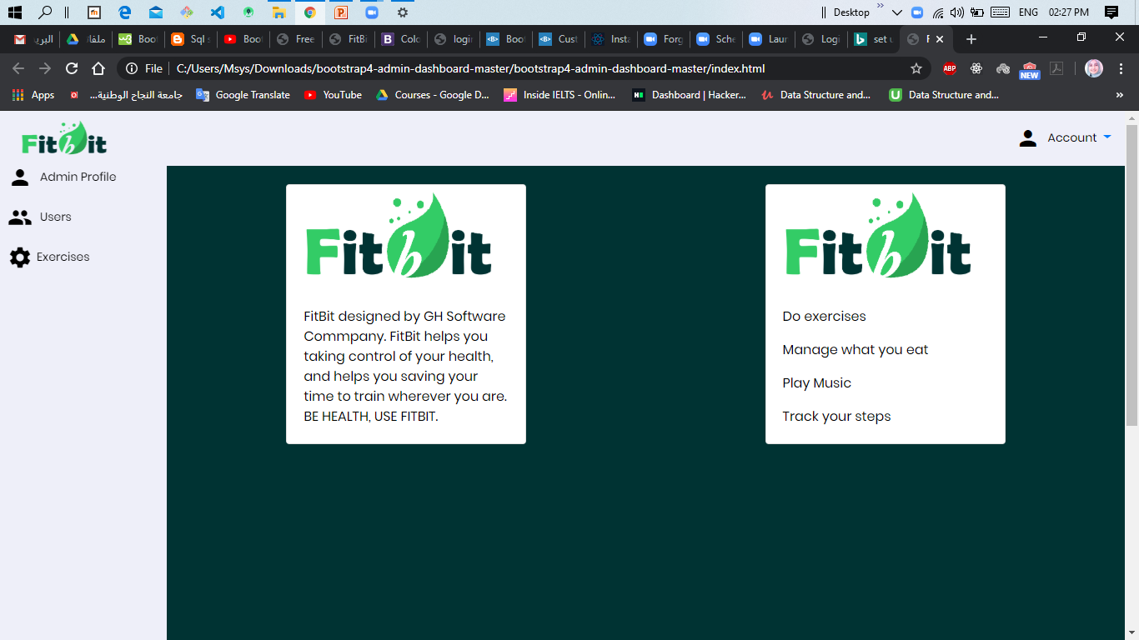

Slide 33
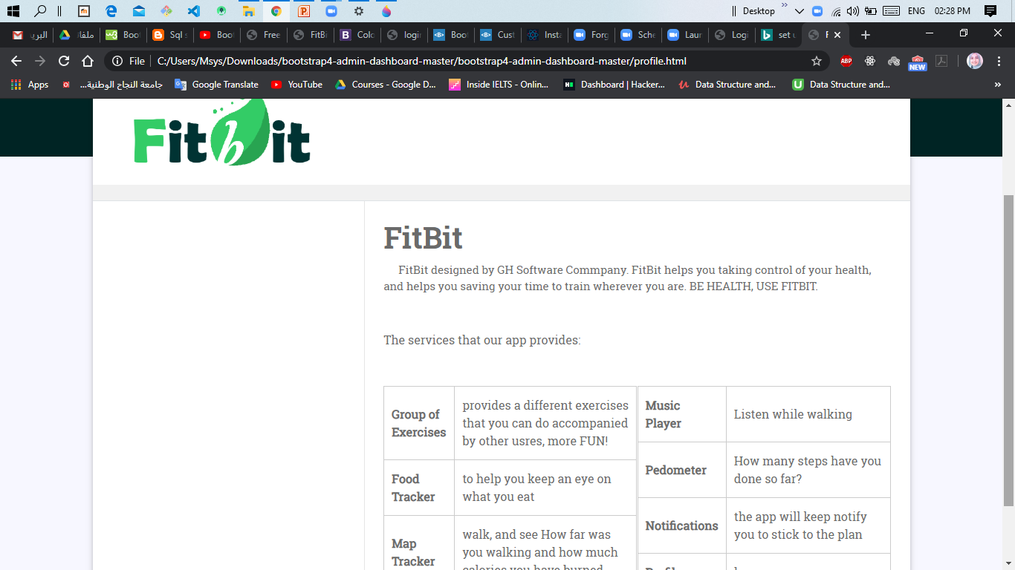

Slide 34
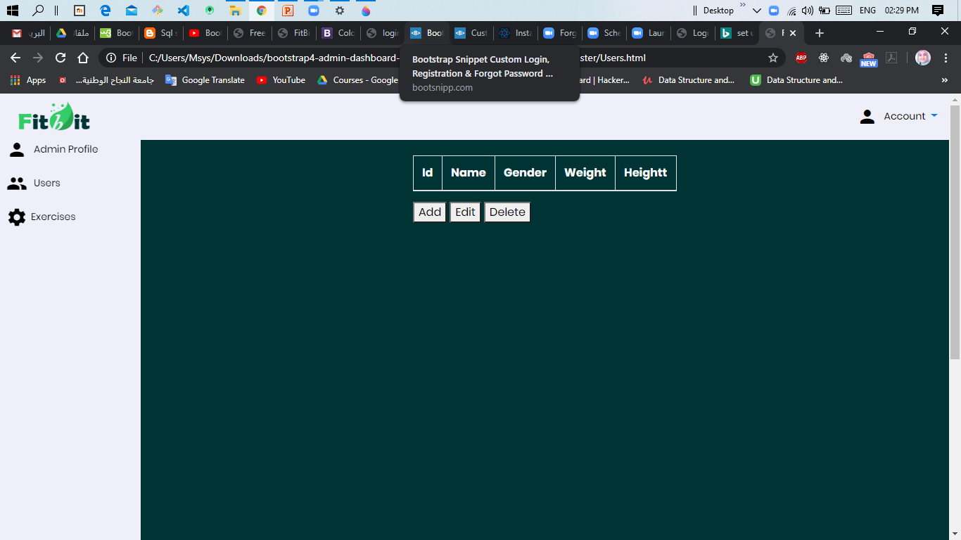

Slide 35
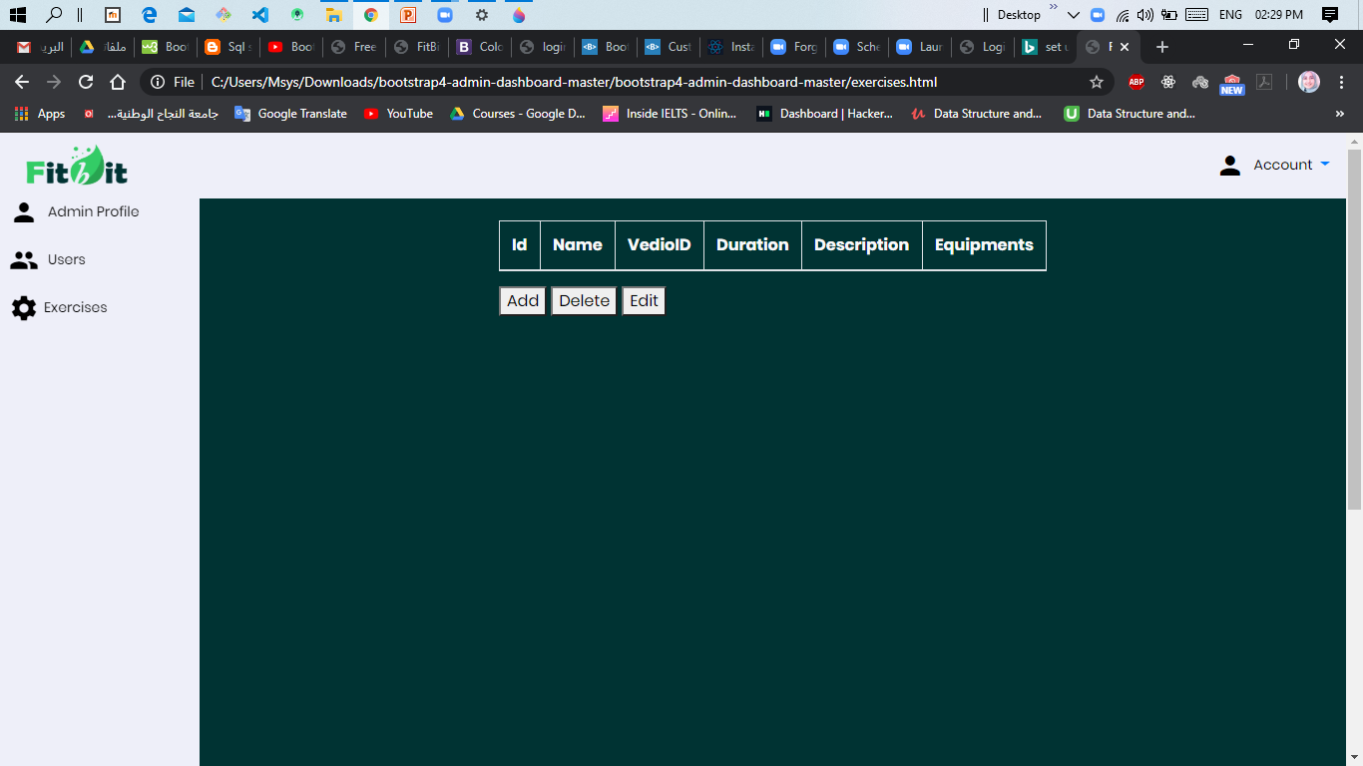

Slide 36

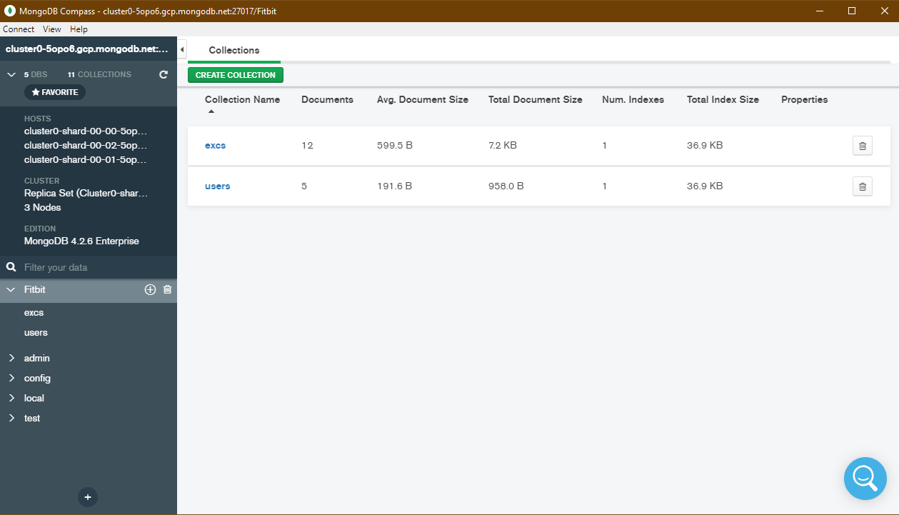
Our Database

Slide 37
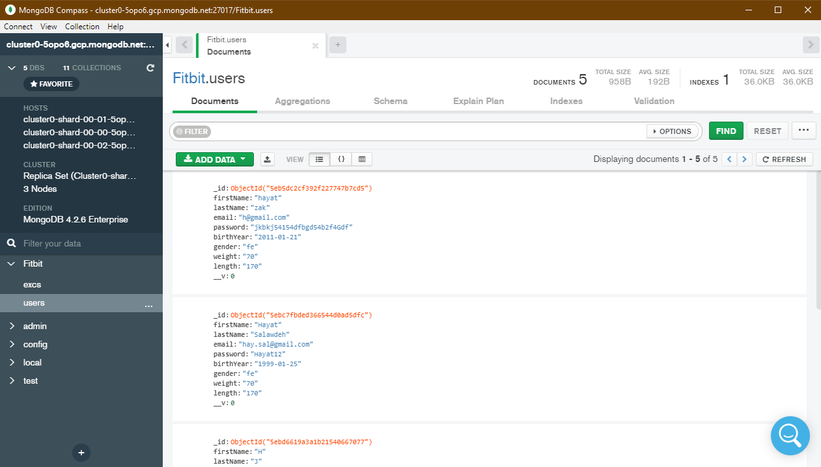

Slide 38
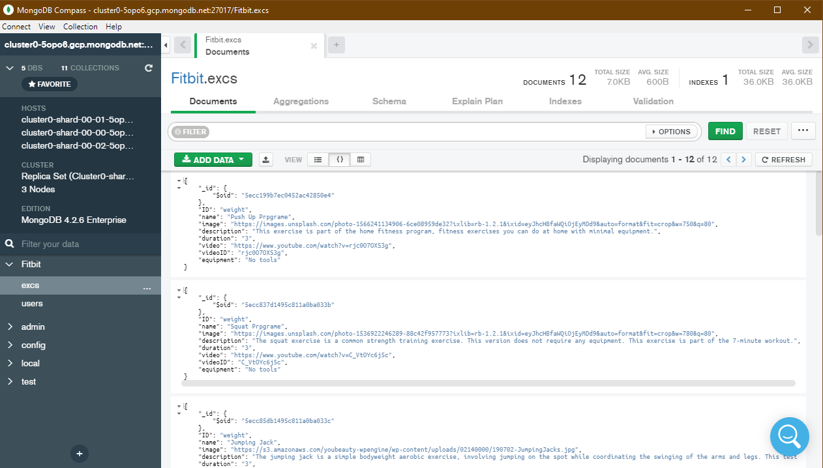

Slide 39
Constraints
Unimplemented features.
Uncompleted features.
Difficulties with some features.

Slide 40
Future Work
Add more features depend on each mobile collection of sensor.
Make the application fits smart watches.
Add a sleep Tracker feature.
Add a page for online store for selling sport products.

Slide 41
Thank You

