Slide 1


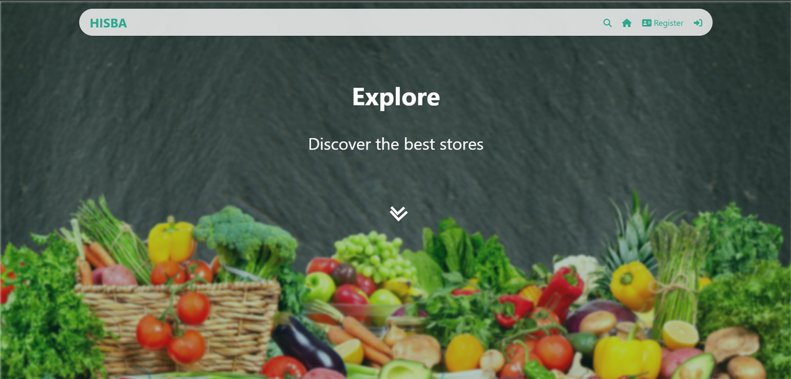
YEAR
2024
Any One Can Be A Farmer

Slide 2



Project Team
Mohammed Najeh Ghanim
Haneen Bashar Hashaika
Hala Zahi Najim
is a computer science student at An-Najah National University in Nablus. He has a strong interest in software development and enjoys working on innovative projects.
is also studying computer science at An-Najah National University in Nablus. She is passionate about coding and technology, and she excels in problem-solving and teamwork.
is a student majoring in networks and information security at An-Najah National University in Nablus. She is dedicated to learning about cybersecurity and network management, aiming to enhance digital security.
NEXT

Slide 3


Slide 4



Slide 5

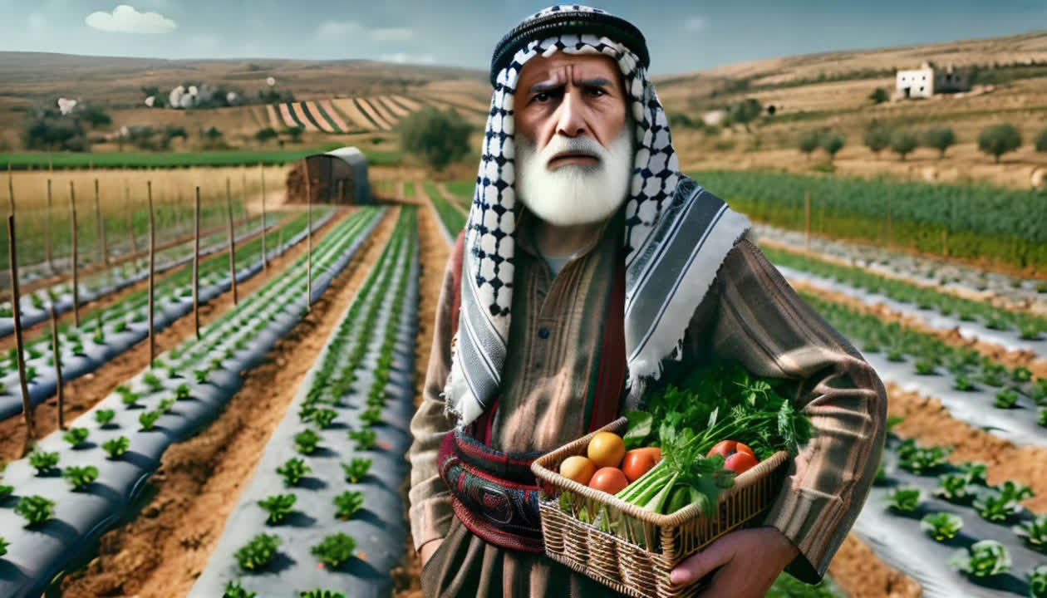
؛PROBLEM STATEMENT
Inefficient Market Linkages and Limited Agro-Processing Access
Challenges in accessing suitable markets and limited processing capabilities reduce product value and farmer profits.
1
NEXT

Slide 6
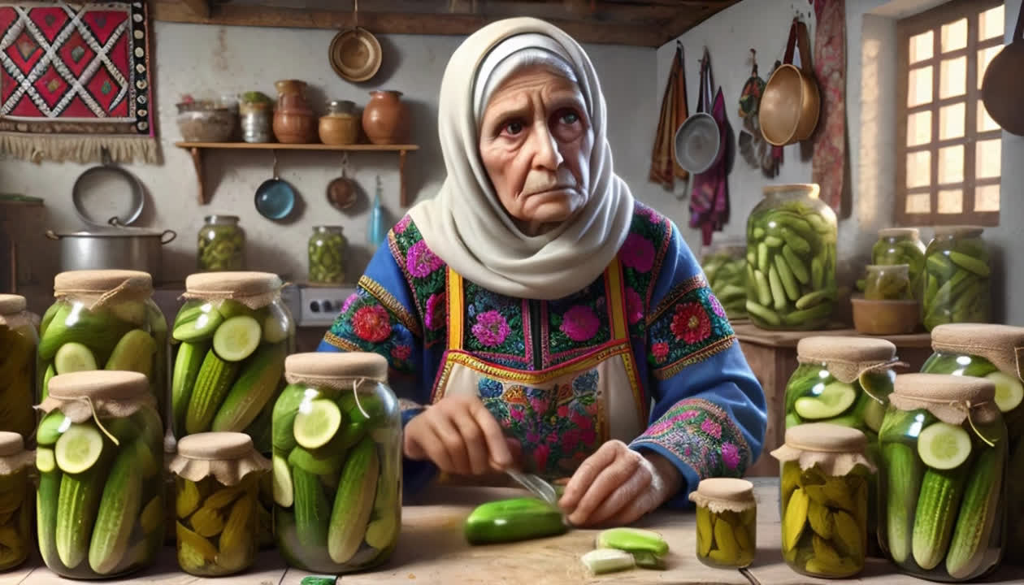
؛PROBLEM STATEMENT
Underutilization of Female Workforce and Lack of Tech Engagement
The agriculture sector misses out on productivity gains from female workers and is slow in adopting beneficial technologies.
2
NEXT

Slide 7
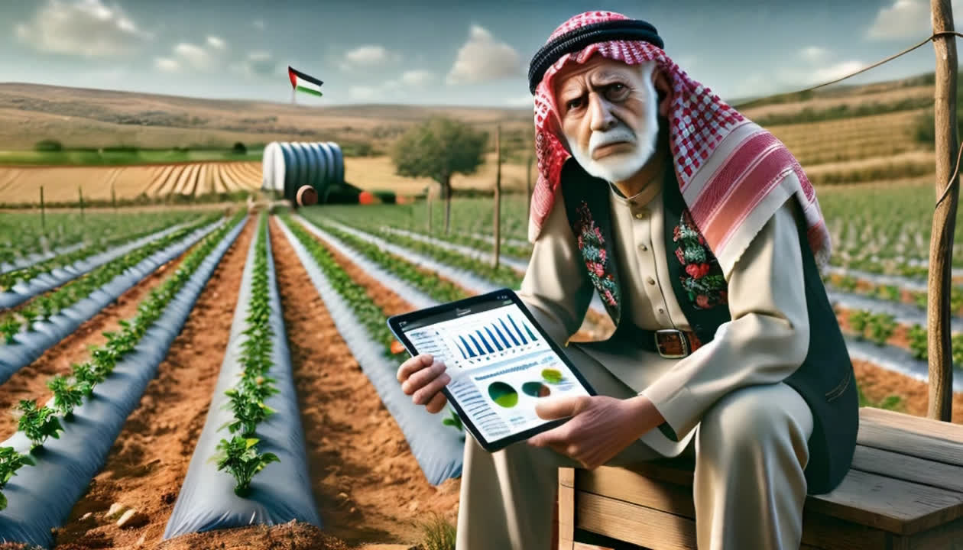
؛PROBLEM STATEMENT
technological improvement
Underutilization of Technological Advancements in the Agricultural Sector
3
NEXT

Slide 8


Slide 9
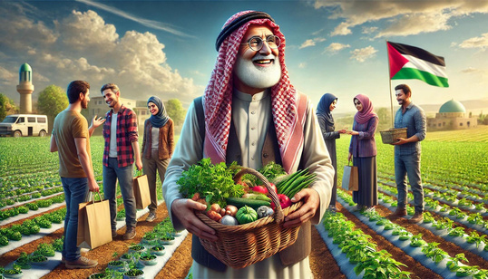
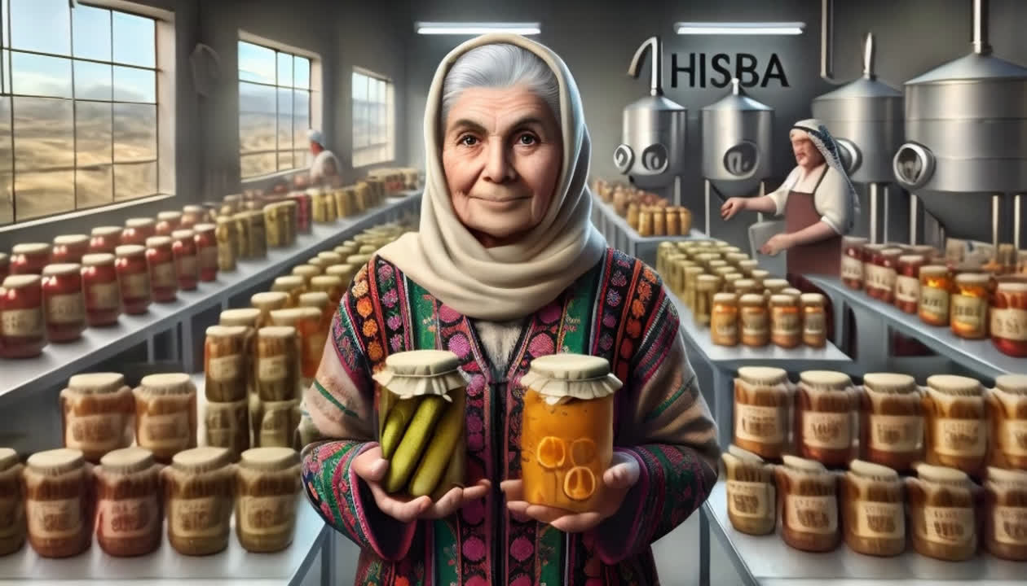
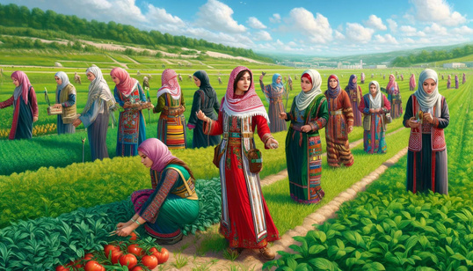
01
Enhance Direct Farm-to-Consumer Connectivity
Improve the direct sales channels between farmers and consumers to ensure fresh and high-quality products reach consumers efficiently.
INTRODUCTION
Goals and Objectives
02
Promote Value-Added Agricultural Production
Encourage the development and marketing of agricultural products that have been processed or refined to increase their market value and profitability.
03
Empower Women in Agriculture
Provide resources, training, and opportunities for women to actively participate and lead in the agricultural sector, enhancing overall productivity and sustainability.
NEXT

Slide 10
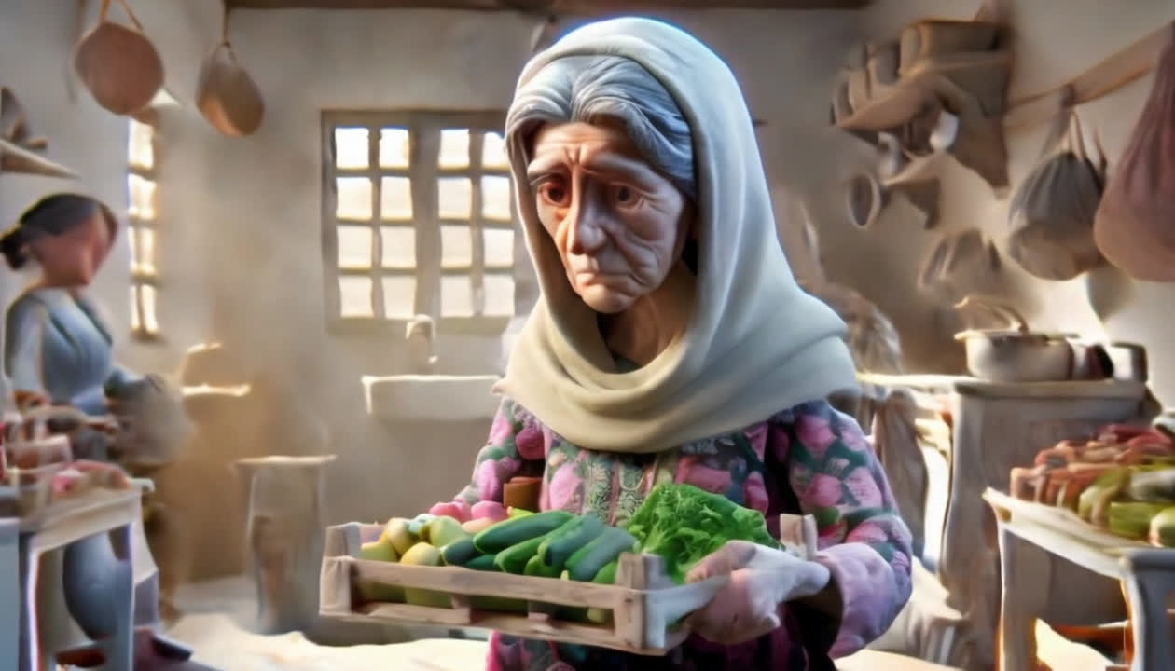
Fatima, an elderly Palestinian woman, sits in her modest kitchen, worried about her financial struggles.

Slide 11

Despite her struggles, Fatima makes homemade pickles with limited resources, determined to make a change.

Slide 12

One day, Fatima discovers the Hisba platform on her tablet and sees a glimmer of hope.

Slide 13
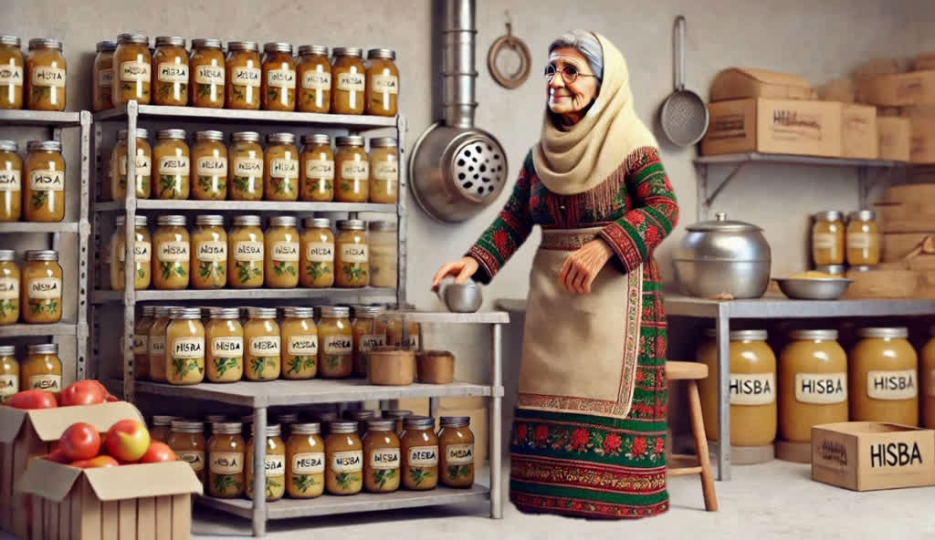
With Hisba's support, Fatima transforms her kitchen into a small processing facility, proudly displaying her products.

Slide 14
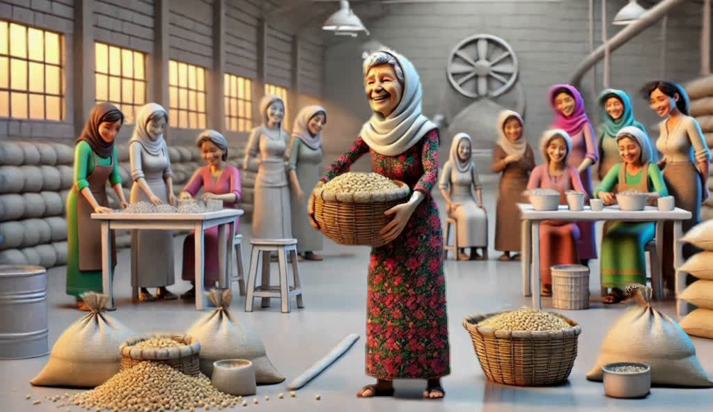
Fatima now stands proudly in her thriving processing facility, surrounded by her products and other women inspired by her success.

Slide 15
Fatima now owns a successful factory, producing value-added agricultural products and employing many women from her community.

Slide 16
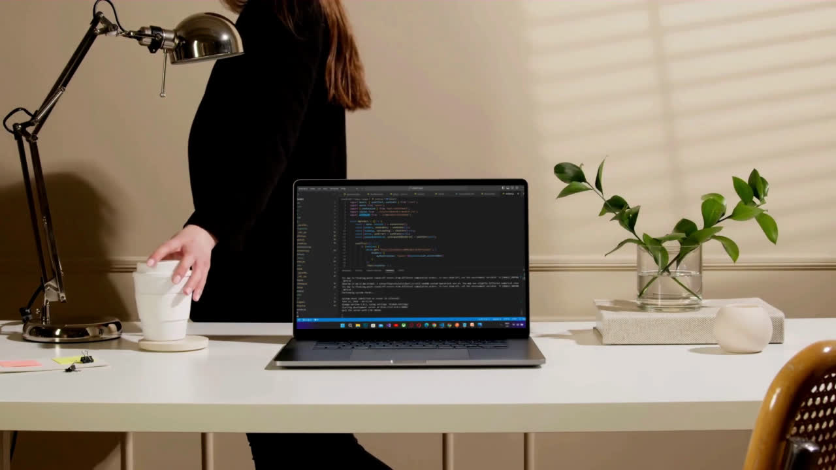
Technology Used

Slide 17

Backend:

Slide 18

Frontend:

Slide 19
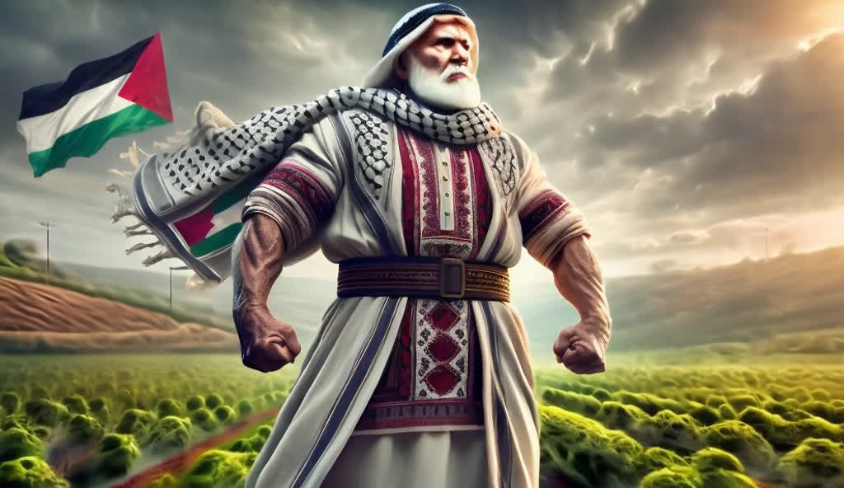
HISBA
SPECIAL POINTS

Slide 20

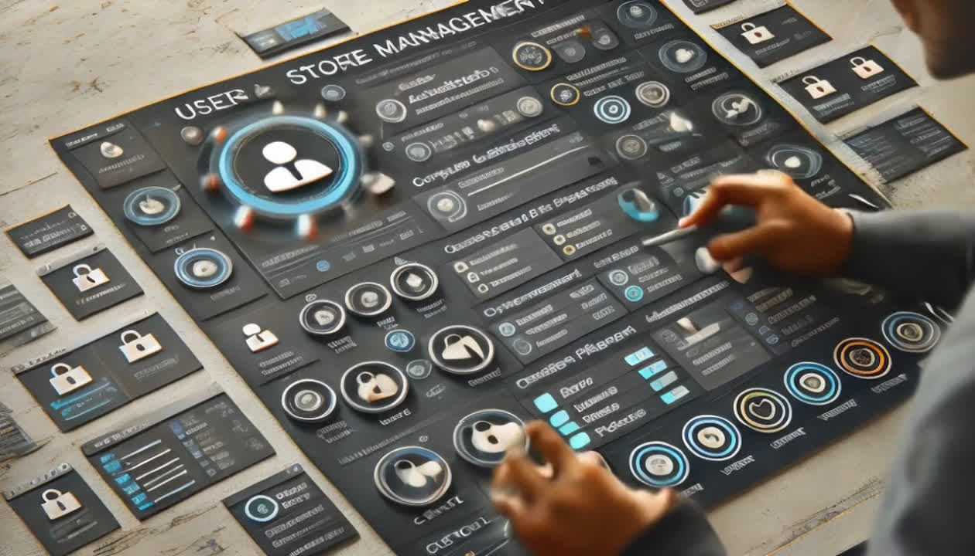
SPECIAL POINTS
Comprehensive User and Store Management:
Strong authentication and permission system with full functionality to create, update, and manage user profiles.
Complete support for managing stores and products, including creating, viewing, updating, and deleting stores and products, with custom filtering options.
1
NEXT

Slide 21
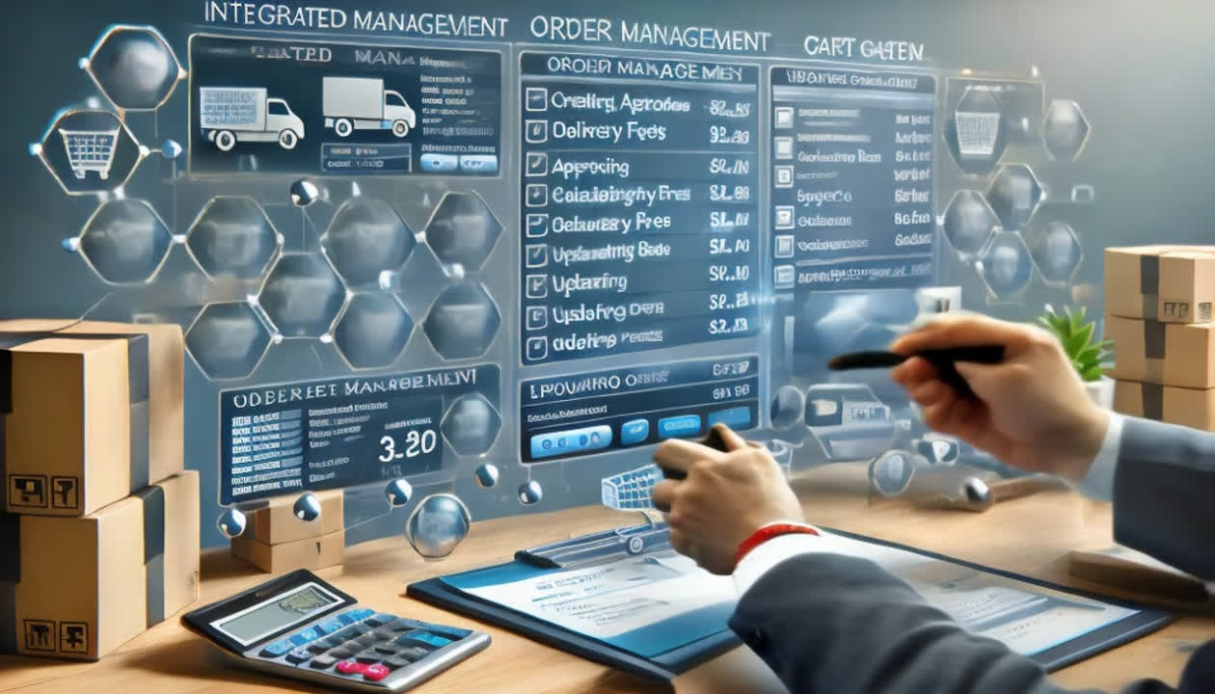
SPECIAL POINTS
Integrated Order and Cart System:
Full order management including creating, approving, viewing, and updating orders, with support for calculating delivery fees and updating order status.
Comprehensive cart management functions including adding, updating, and removing products from the cart.
2
NEXT

Slide 22
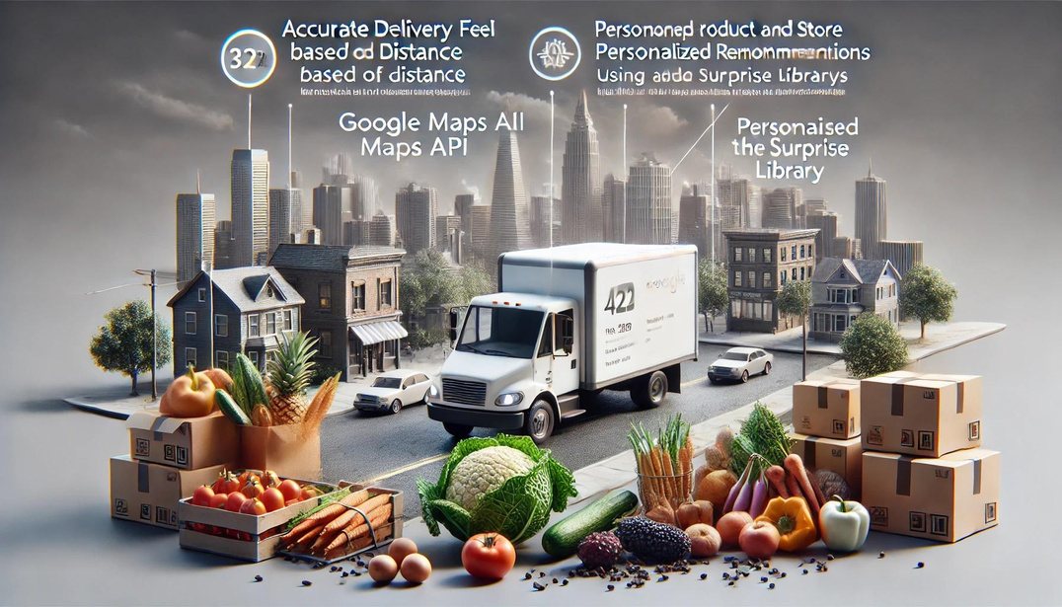
SPECIAL POINTS
Accurate Delivery Fee Calculation and Personalized Recommendations:
Functions to calculate delivery fees based on distance using the Google Maps API, ensuring accurate delivery charges.
Personalized product and store recommendations using the surprise library, enhancing user experience and increasing purchase opportunities.
3
NEXT

Slide 23
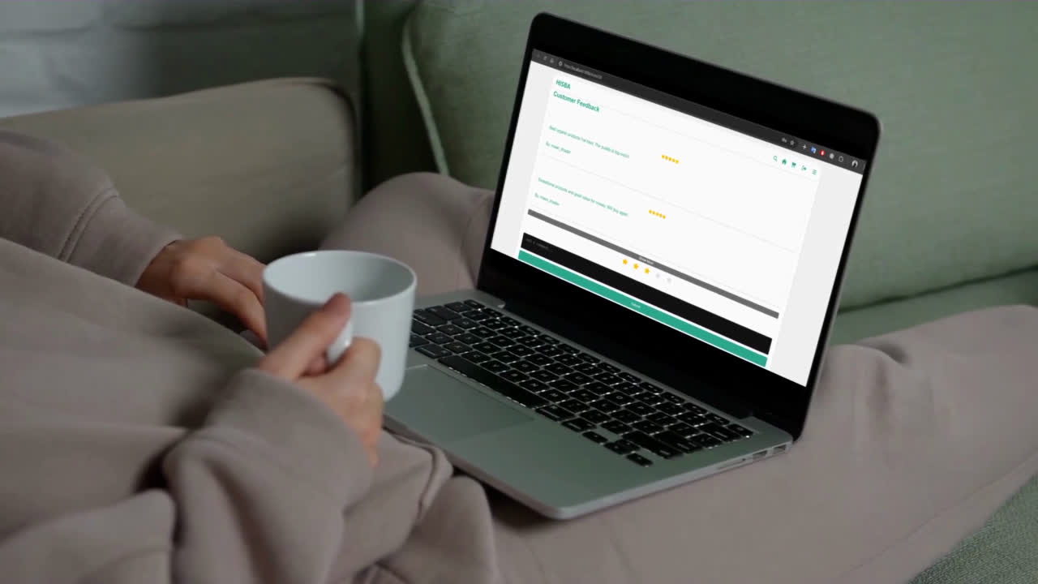
Rating Algorithm

Slide 24
Calculate Weighted Average:
Weighted Average=∑(Ri×Wi​)​ / ∑Wi
where :
Ri​: is the rating value given by the ith user.
Wi​: is the weight assigned to the ith
user’s rating based on their credibility

Slide 25
Apply Correction Factor:
C=0.9 if ratings <10
C=1.0 if ratings ≥10

Slide 26
Final Rating:
Final Rating=Weighted Average×C

Slide 27
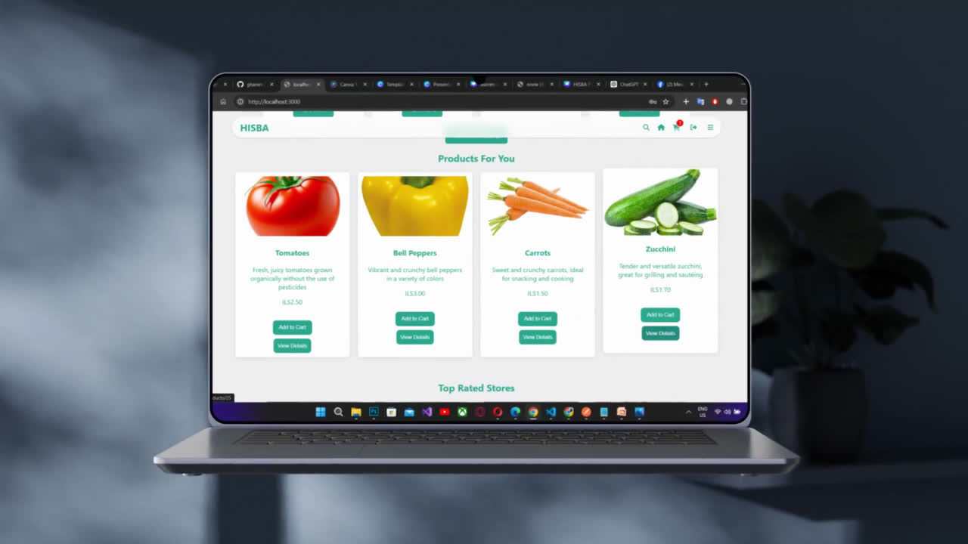
Product Recommendation System

Slide 28
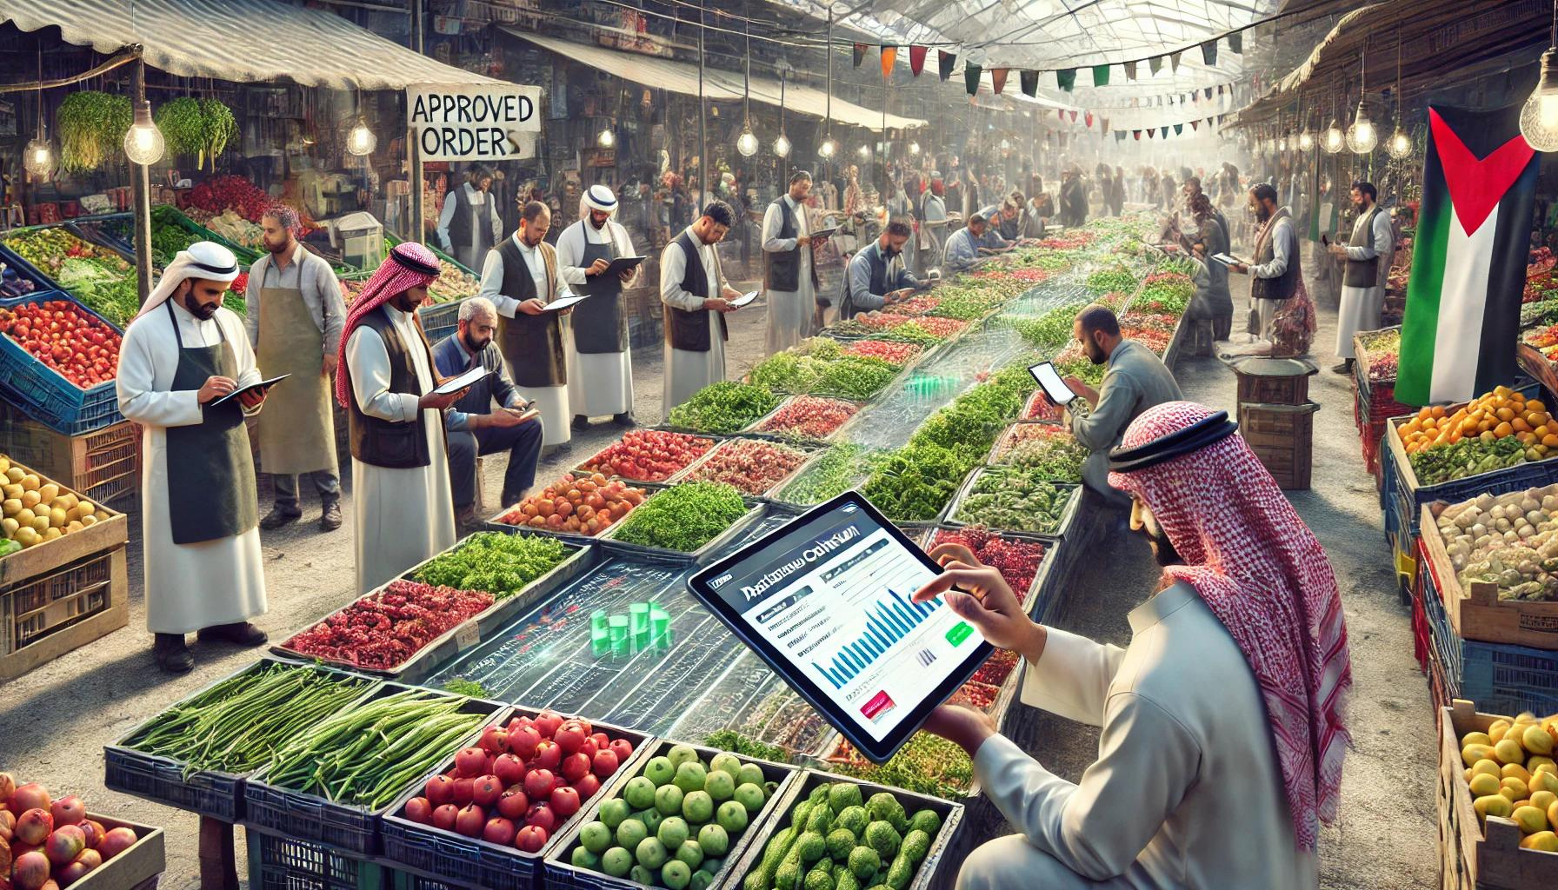
DATA COLLECTION AND PREPARATION
Gather data from all orders approved by both the store and admin.
This includes user and product information.

Slide 29
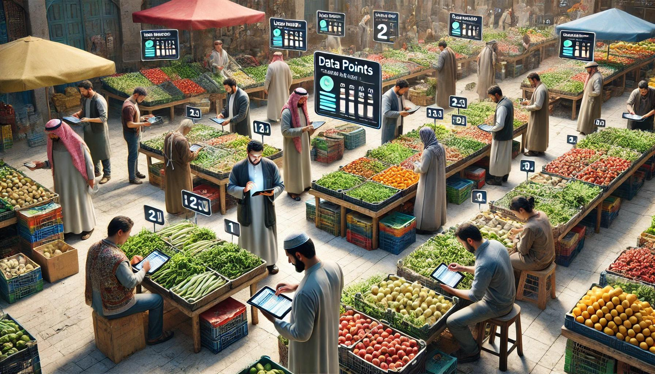
DATA PREPARATION
Organize the collected data into a tabular format suitable for processing

Slide 30
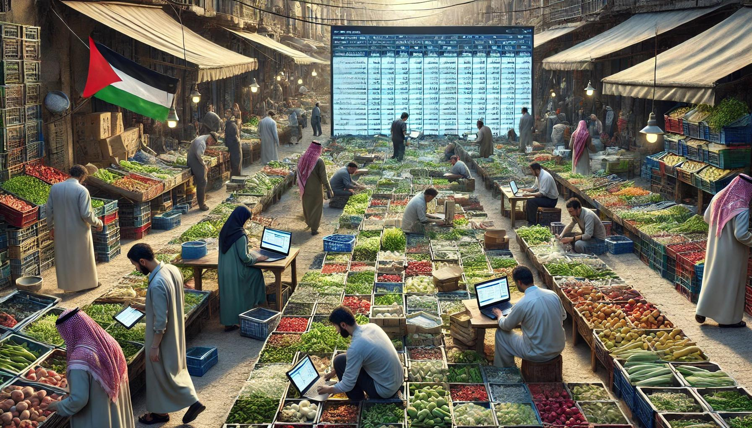
MODEL TRAINING
Split the data into training and testing sets.
Train the K-Nearest Neighbors (KNN) model using the training set.

Slide 31
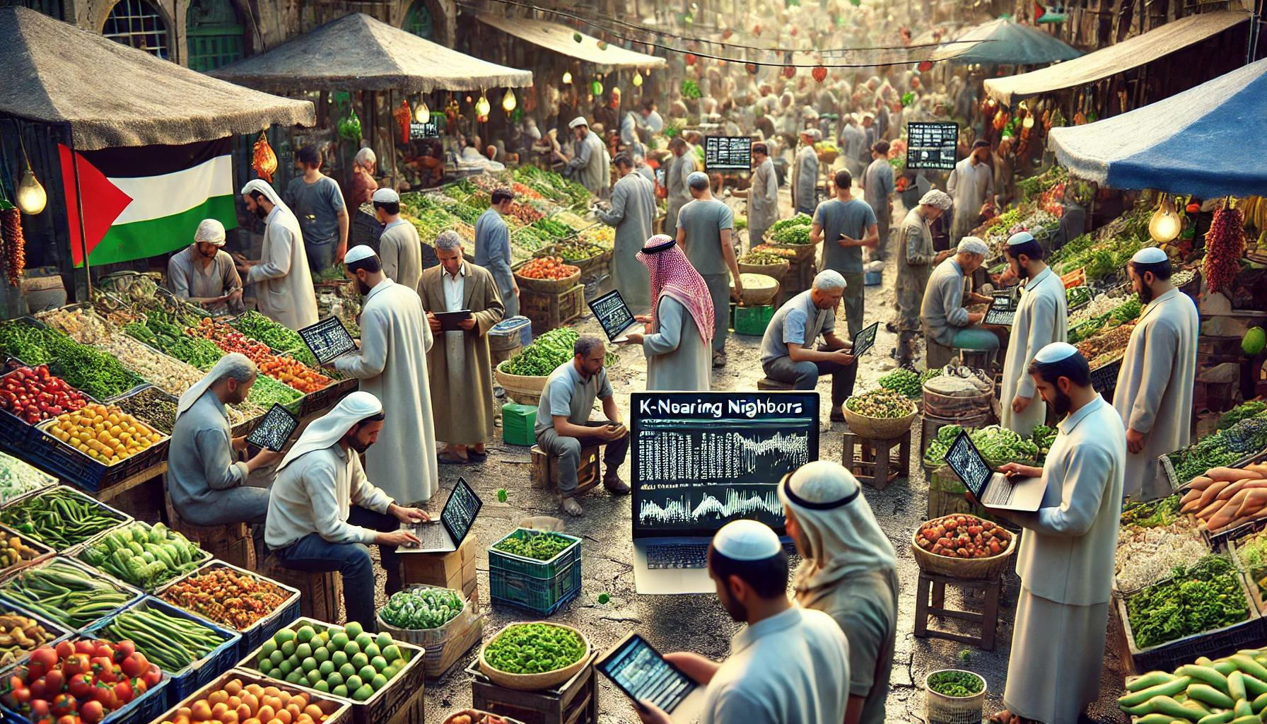
USER INTERACTION CHECK
Check if the user has previous interactions.
If not, recommend popular products.

Slide 32
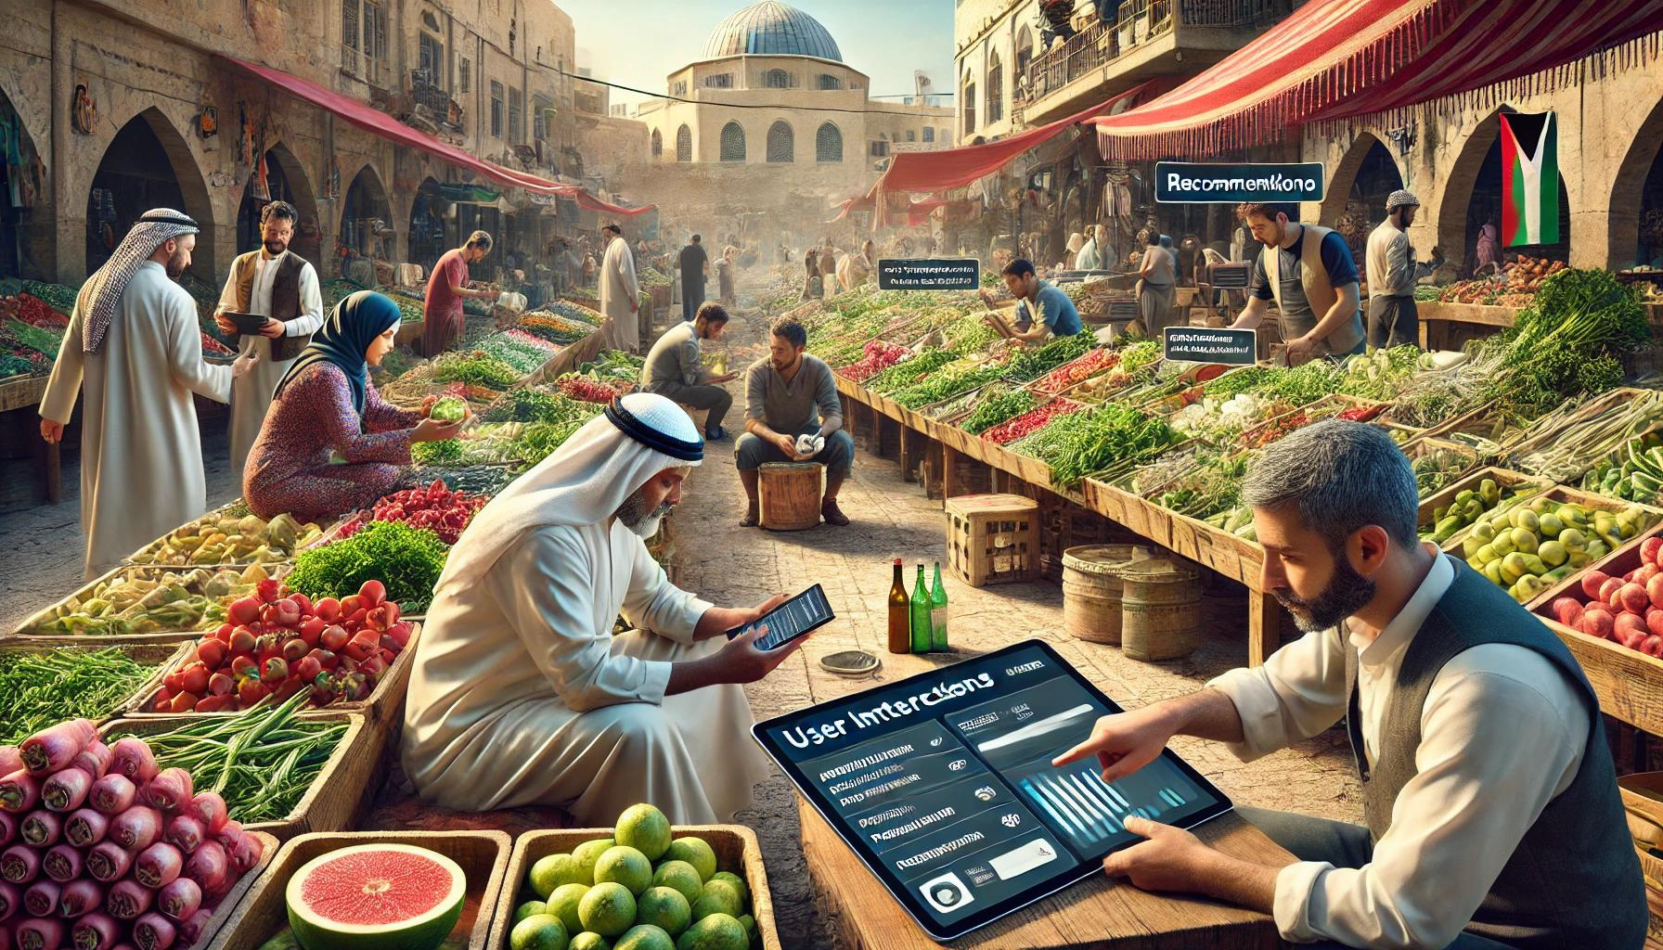
GENERATING RECOMMENDATIONS
If the user has interacted with products before, use the trained model to find similar products.

Slide 33
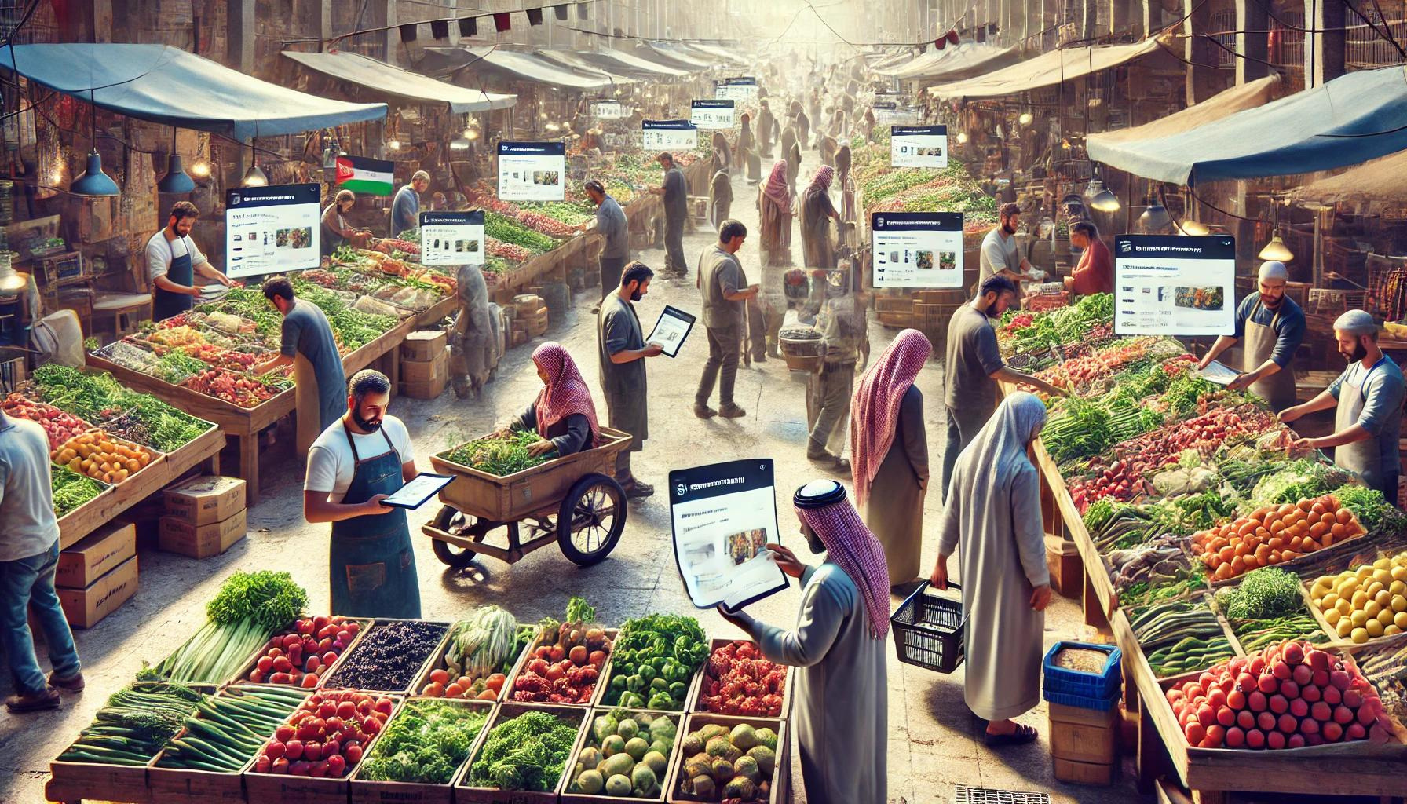
RETURNING RECOMMENDATIONS
Organize recommended products into a list that can be sent back to the user

Slide 34
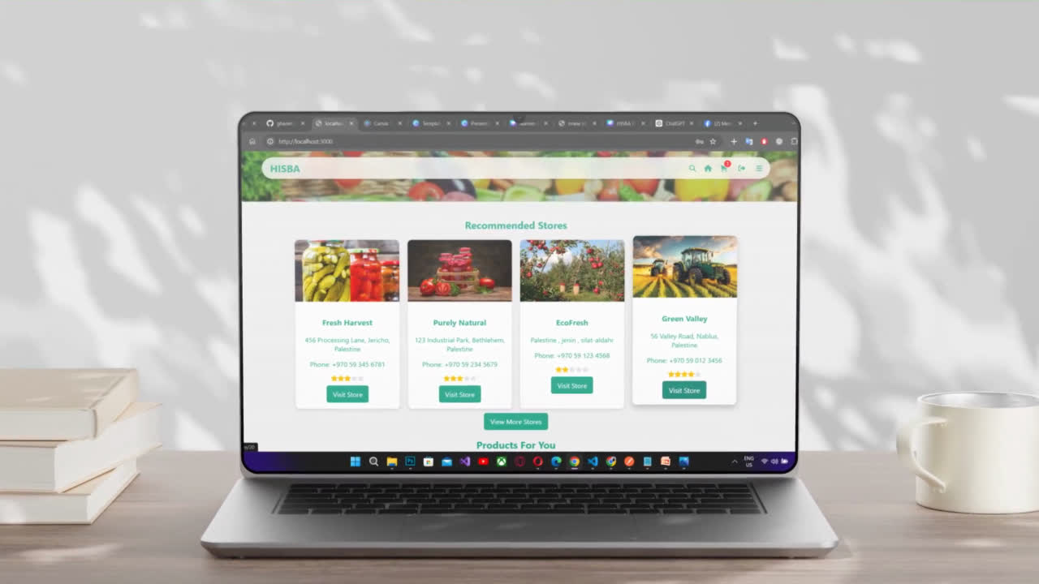
Store Recommendation System

Slide 35
01
02
03
Store Recommendation Algorithm
Data Collection and Preparation
Model Training
Generating and Returning Recommendations
The data is split into training and testing sets. The K-Nearest Neighbors (KNN) algorithm trains on the training set to learn user-store interaction patterns.
The algorithm gathers user-store interactions and store ratings from approved orders. It collects user IDs, store IDs, and average ratings, then organizes this data into a table.
The algorithm checks for previous user interactions with stores. If none, it recommends popular stores. If interactions exist, it finds similar stores using the trained model. Recommended stores are organized into a list and sent to the user.
NEXT

Slide 36
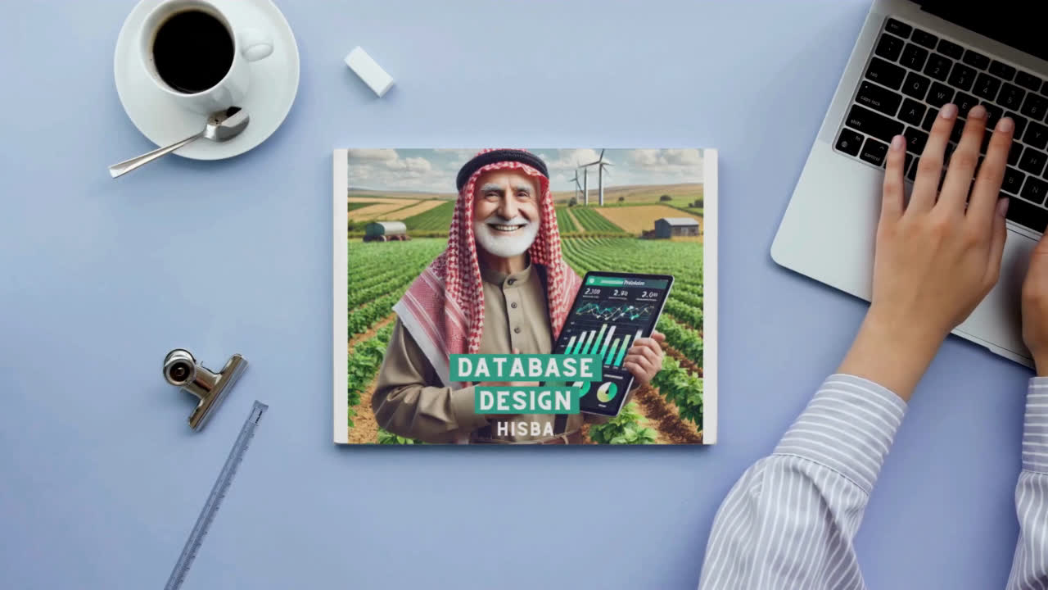

Slide 37
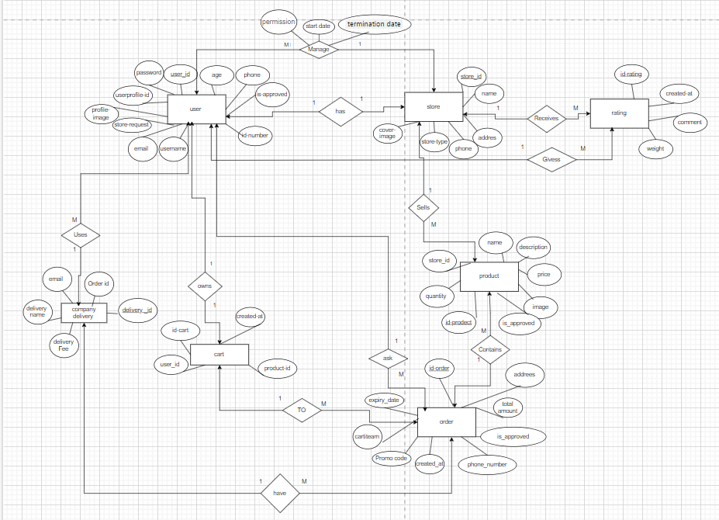

Slide 38
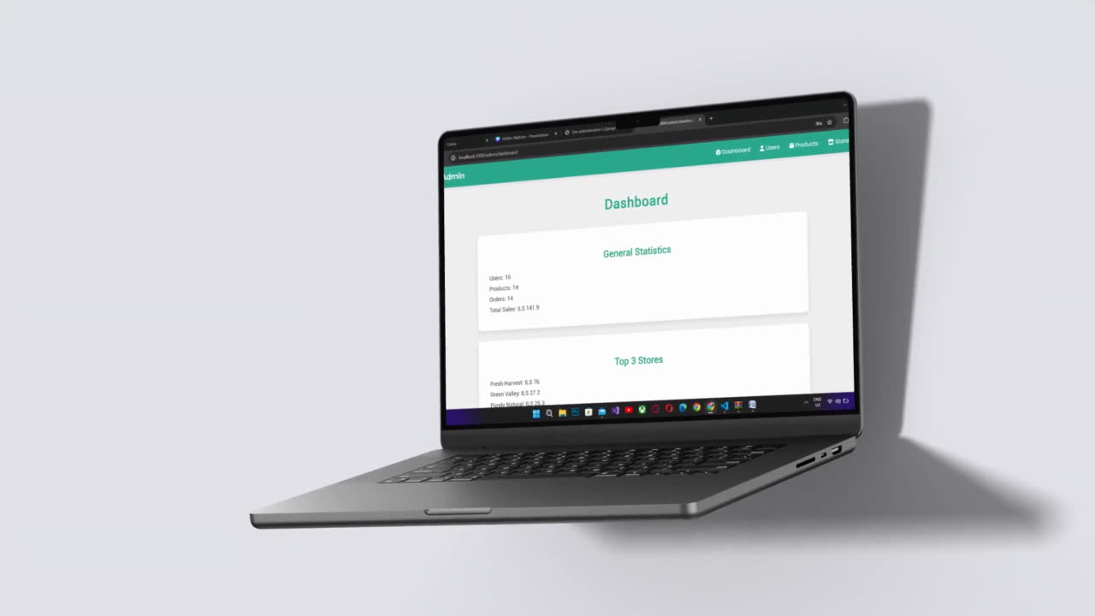
Admin
Dashboard

Slide 39

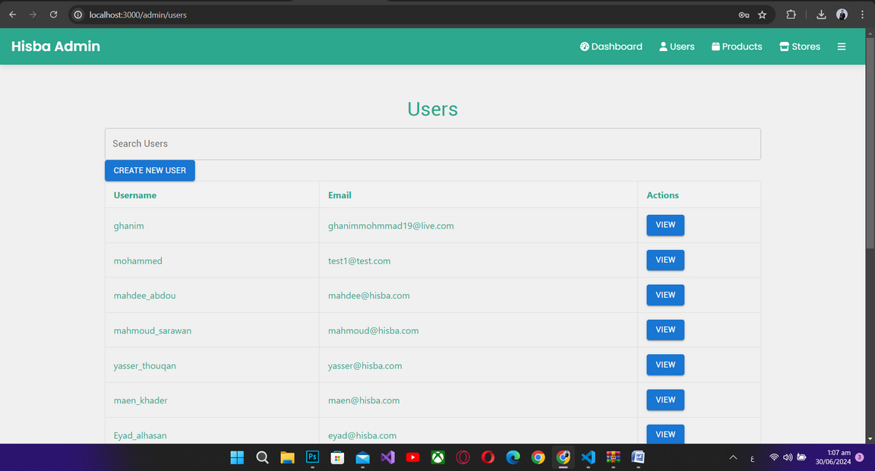
Users Page Overview
Search Users
Create New User :
allows the admin to quickly find specific users by username or email.
for adding new users to the system.
VIEW
allowing the admin to view more details or edit user information.

Slide 40
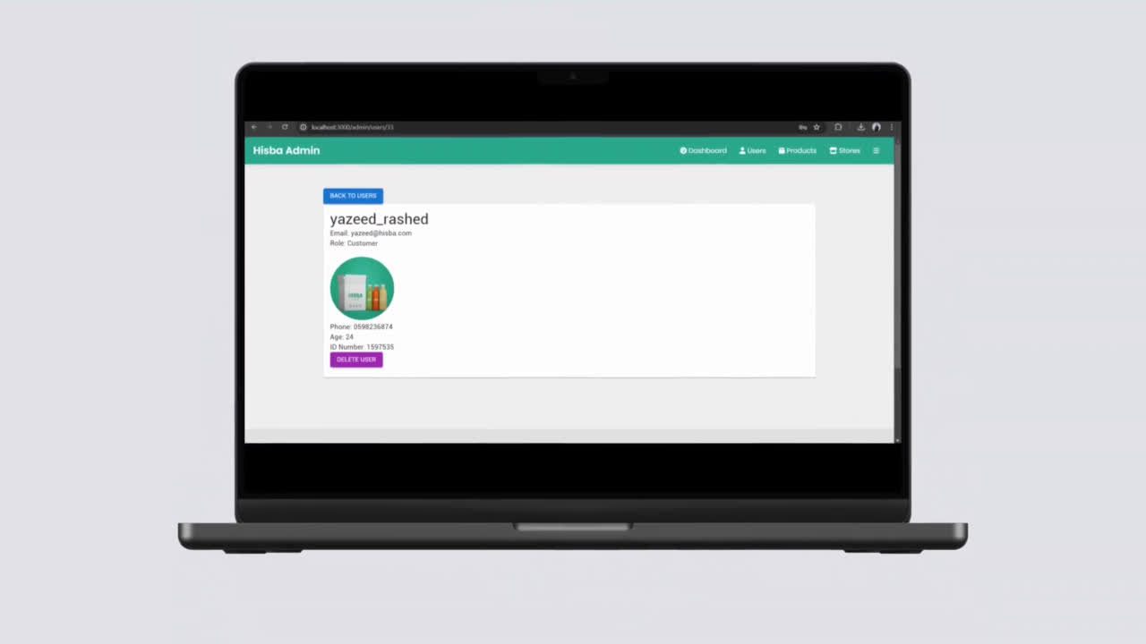

Slide 41
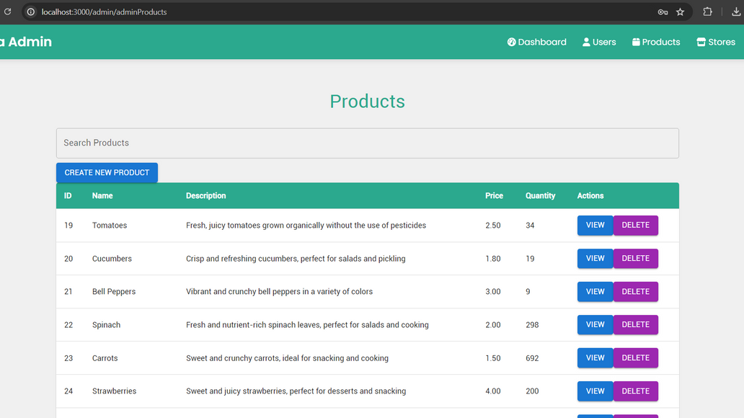
Products Page Overview
Search Products
allows the admin to quickly find specific products by name or description.
Create New Product
for adding new products to the system.
DELETE
VIEW
delete the product
allowing the admin to view more details

Slide 42
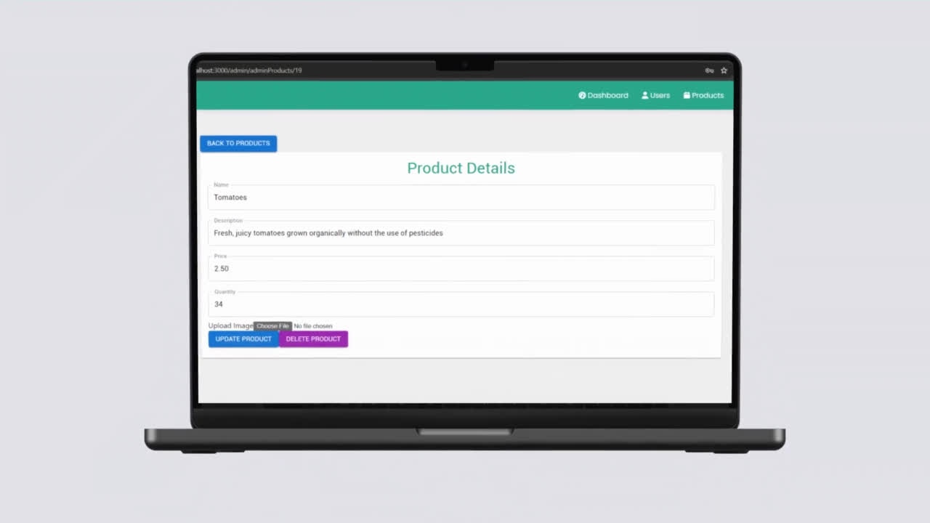

Slide 43
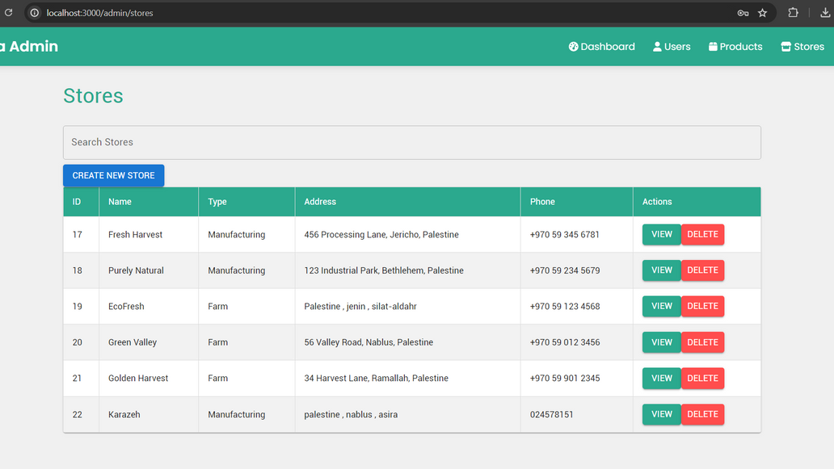
Stores Page Overview
Search Stores
allows the admin to quickly find specific stores by name or address.
Create New Store
for adding new stores to the system.
DELETE
VIEW
delete the Store
allowing the admin to view more details

Slide 44
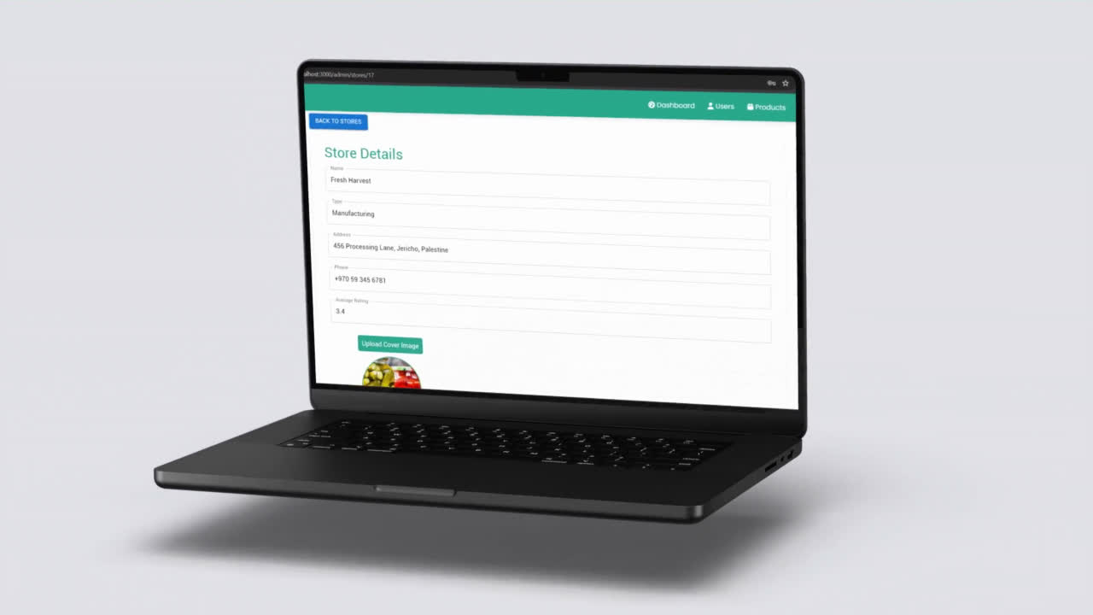

Slide 45
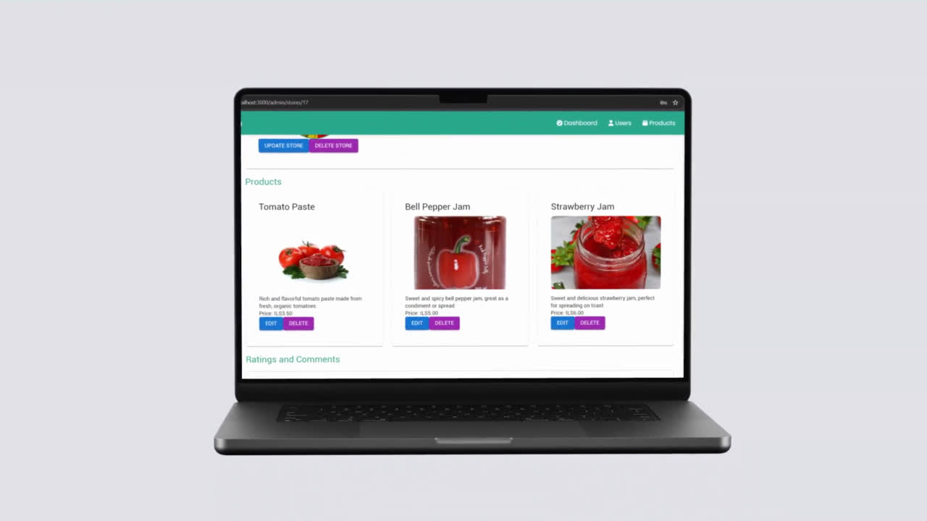

Slide 46
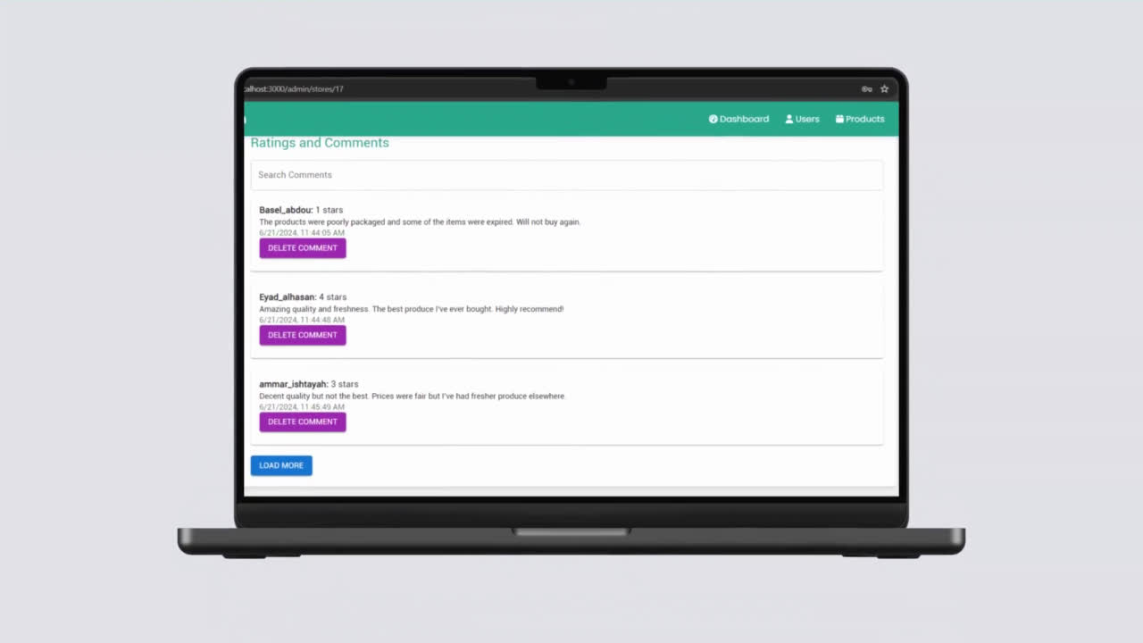

Slide 47
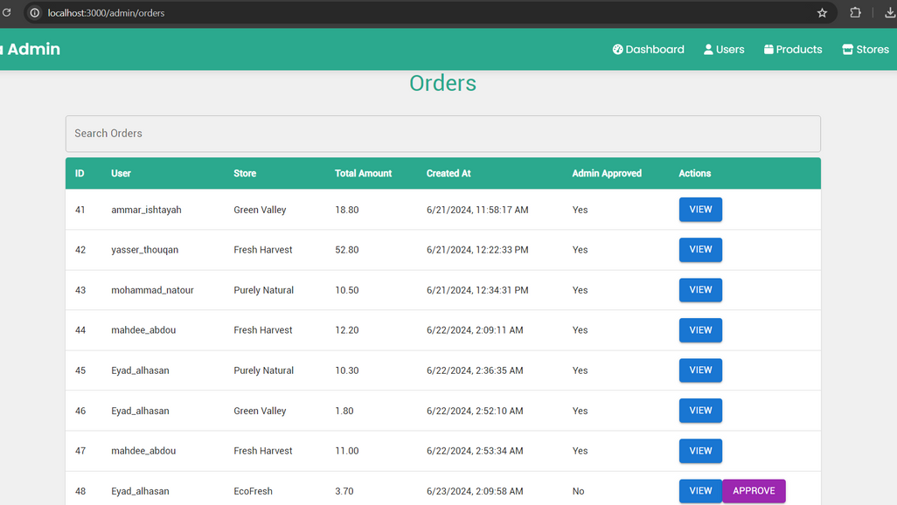
Orders Page Overview
Search Orders
allows the admin to quickly find specific orders by user, store, or order details.
VIEW
allowing the admin to view more details
APPROVE
approve the order

Slide 48
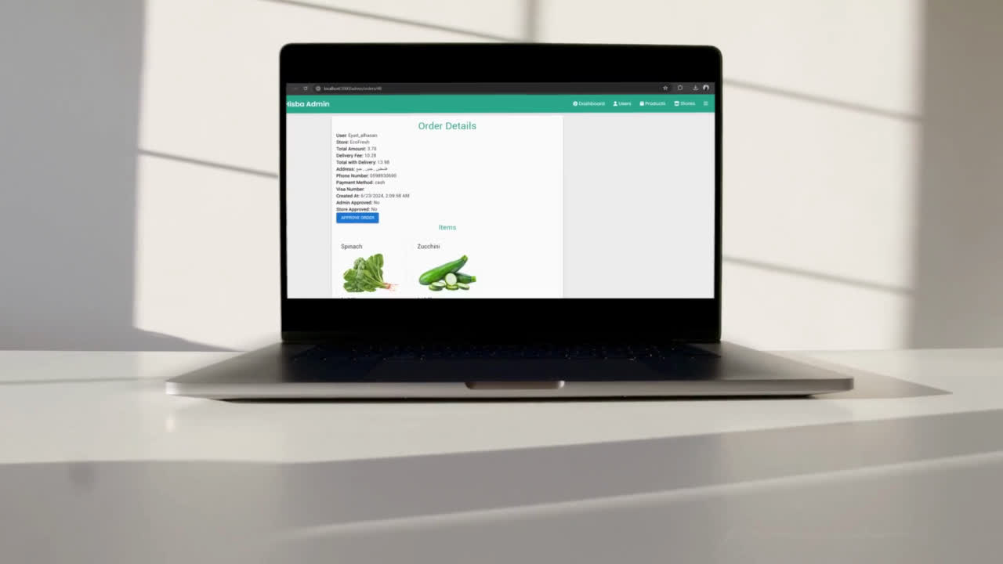

Slide 49
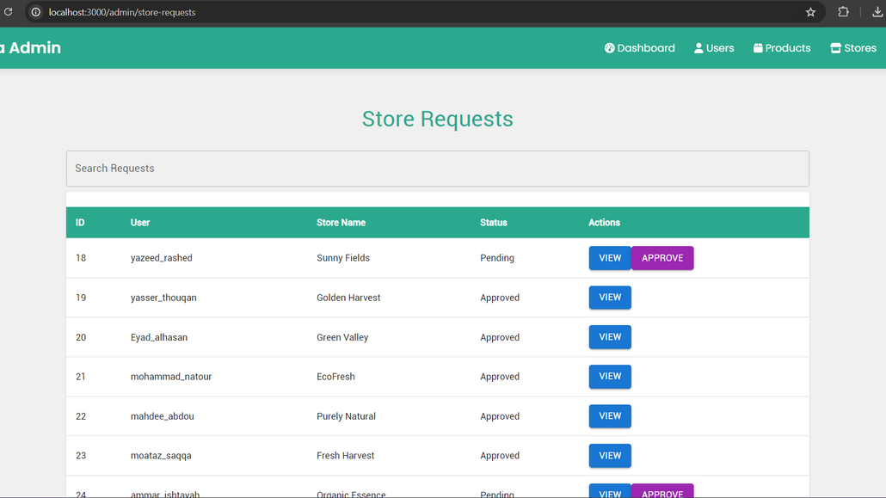
Store - Requests Page Overview
Search Requests
allows the admin to quickly find specific store requests by user or store name.
VIEW
allowing the admin to view more details
APPROVE
approve the request

Slide 50
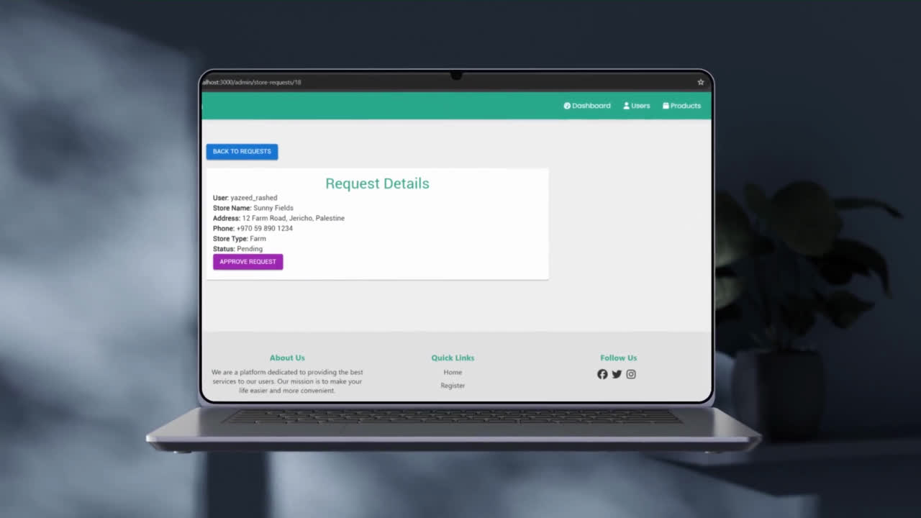

Slide 51
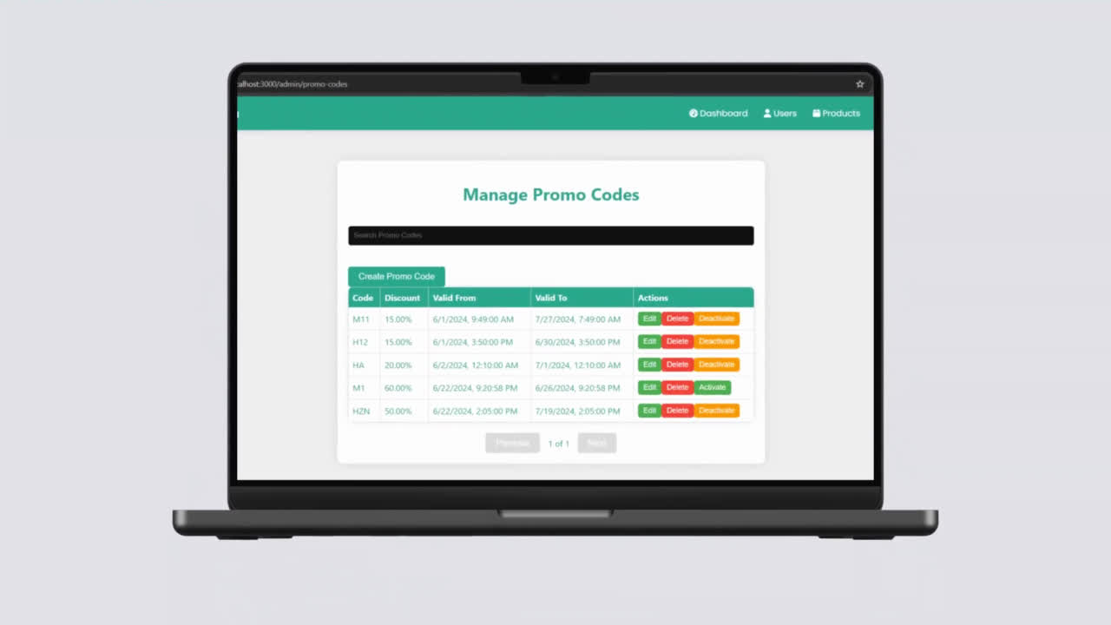

Slide 52
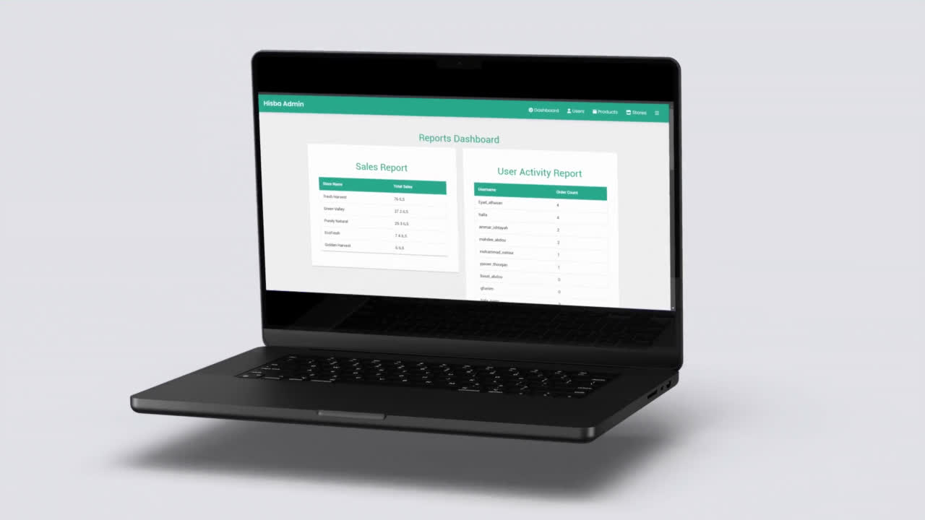

Slide 53
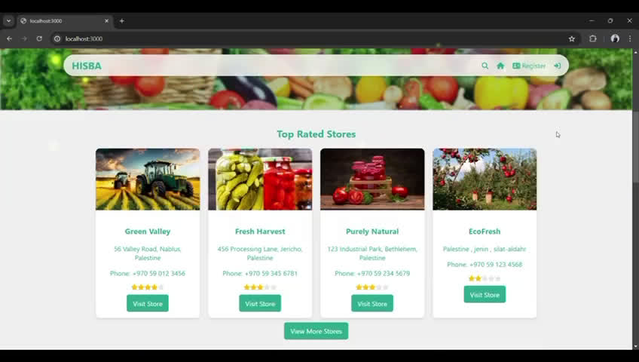

Slide 54
Future works
Mobile Application Development
International Expansion
Enhanced User Experience
3
NEXT

Slide 55

CONCLUSION
The Hisba platform project successfully created a user-friendly and efficient e-commerce solution tailored for the agricultural sector. Through meticulous planning and execution, we developed a robust platform that meets high standards of design, functionality, and user experience. With its successful launch, Hisba is well-positioned to empower farmers and connect them directly with consumers, fostering economic growth and sustainability in the agricultural community.

Slide 56
Thank You

