Slide 1

Graduation Project II
Structural Design of Al- Jama’a Tower in Jenin–Palestine
An-Najah National University
Faculty of Engineering
Civil Engineering Department
جامعة النجاح الوطنية
كلية الهندسة ونكنولوجيا المعلومات
By
Abdalla Dashoun
Amal Zakaria Ammar
Mays Hamdan
Under supervision of: Ibrahim Arman.

Slide 2


Slide 3
Outline
1
General Description
2
Preliminary Design
3
Three-dimensional analysis and design.

Slide 4
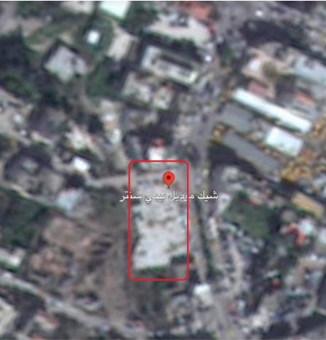
General Description
● Location.
Location on google map.

Slide 5
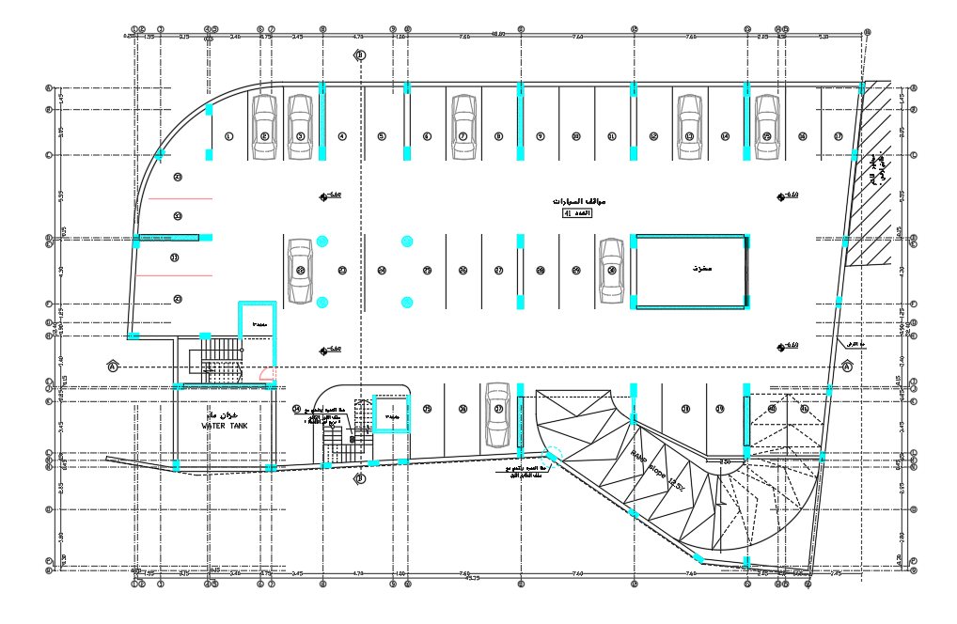
General Description
● Architectural Plans.
Basement 2

Slide 6
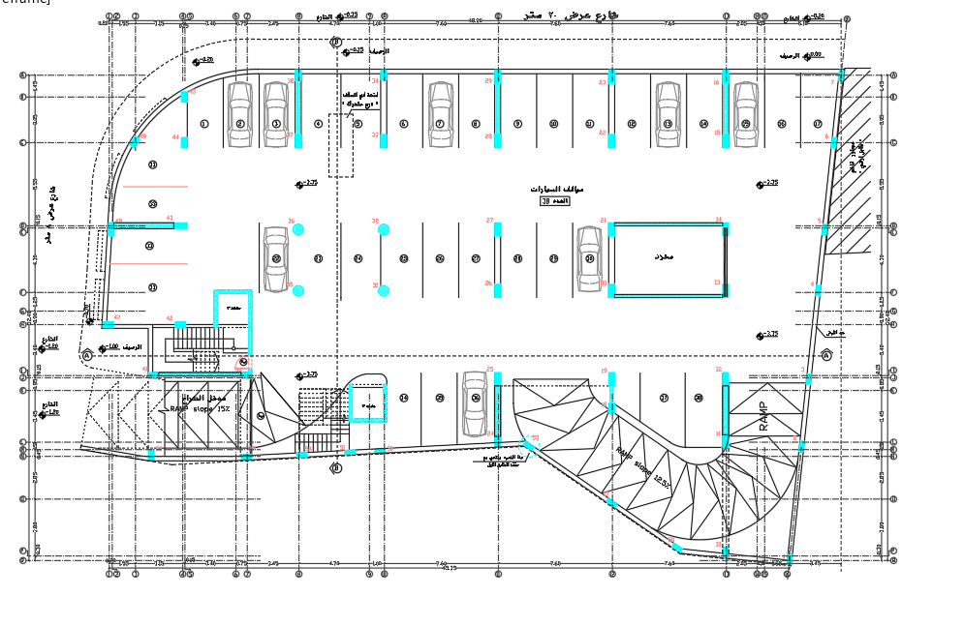
General Description
● Architectural Plans.
Basement 1

Slide 7
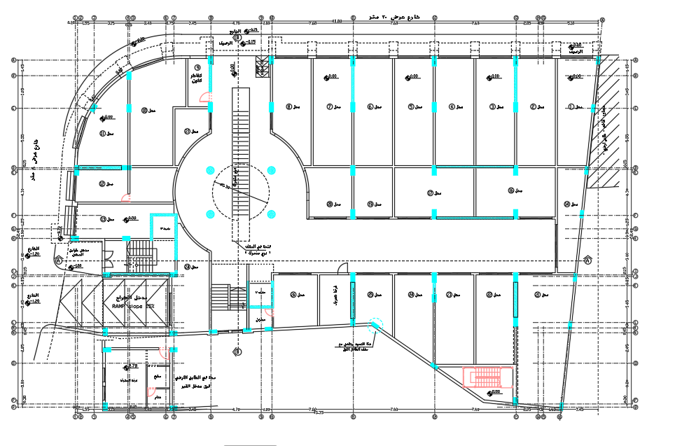
General Description
● Architectural Plans.
Ground floor

Slide 8
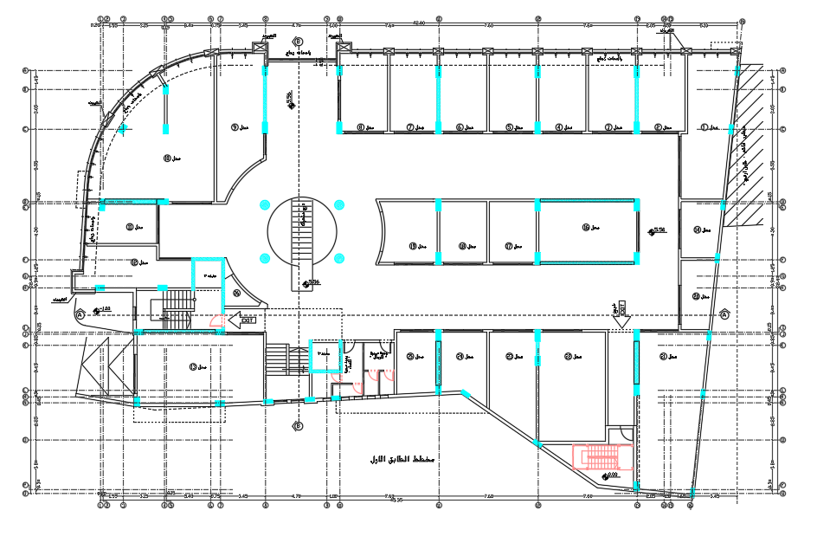
General Description
● Architectural Plans.
First floor

Slide 9
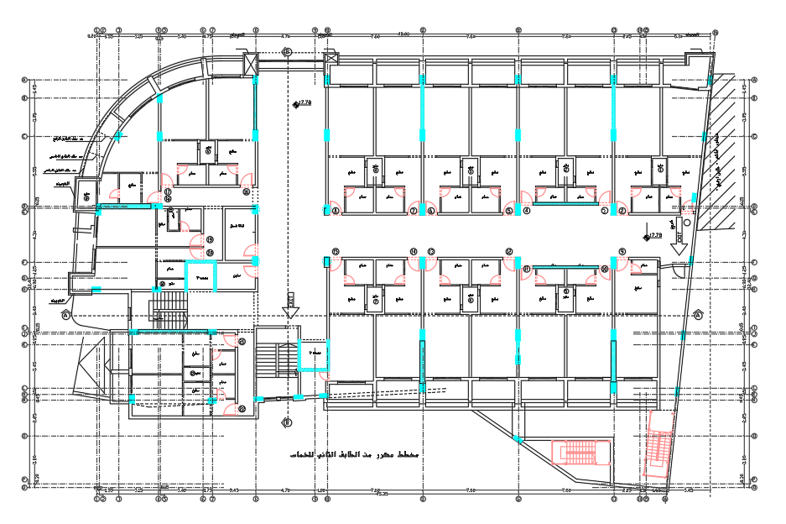
General Description
● Architectural Plans.
Second floor

Slide 10
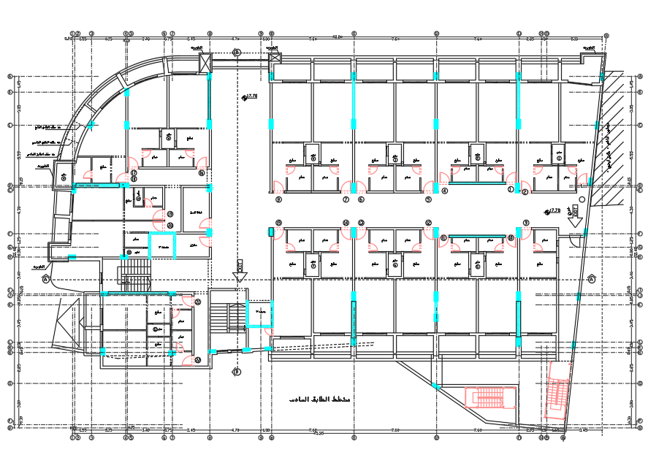
General Description
● Architectural Plans.
Third , Forth , Fifth and Sixth floor

Slide 11
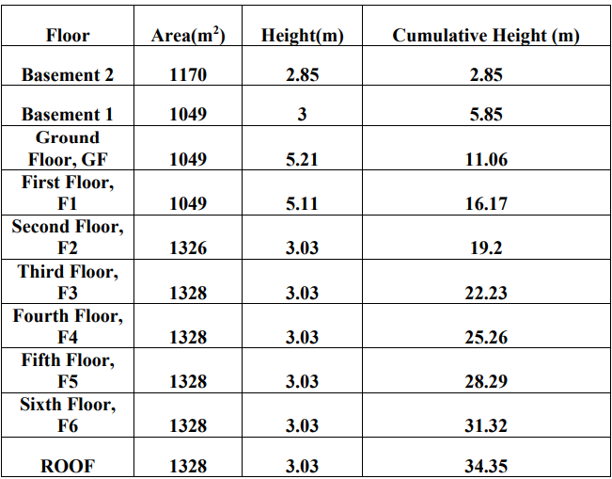
General Description
● Height and Area for each floor

Slide 12
General Description
● Codes and Standards.
1) American Concrete Institute (Building code).(ACI 318-14).
2) American Society for Testing and Materials(ASTM 2018)
3) American Society of Civil Engineering (Minimum Design Loads) (ASCE 7-10).
4) Jordan National Building Codes.

Slide 13
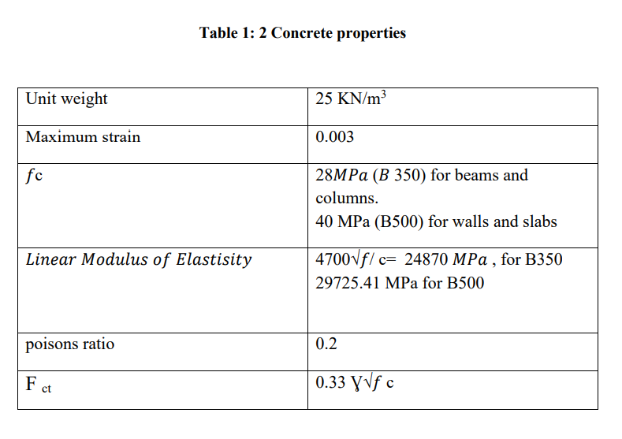
General Description
● Construction Materials.
1- Structural Elements.

Slide 14
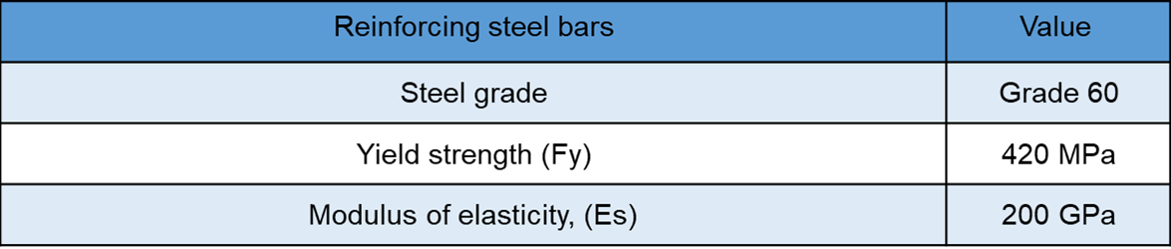
General Description
● Construction Materials.
1- Structural Elements.

Slide 15
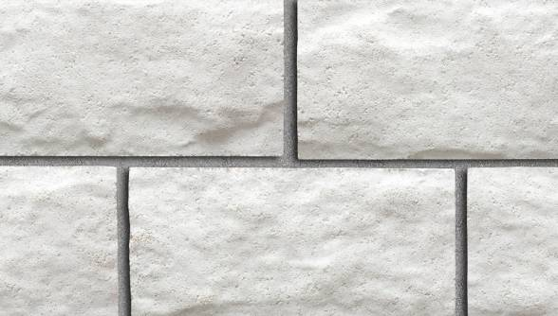
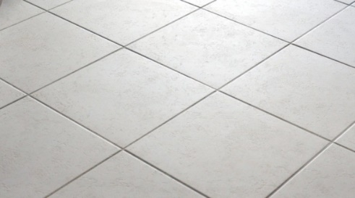
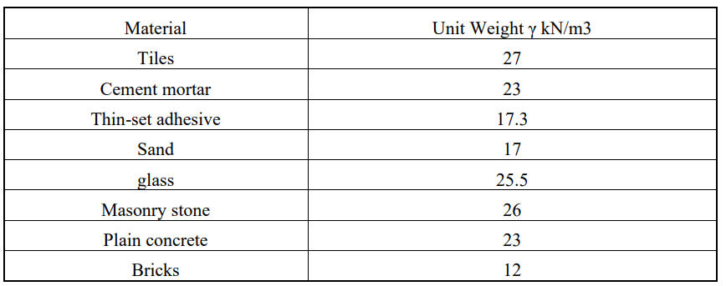

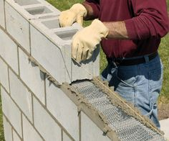
General Description
2- Non-Structural Elements.

Slide 16
General Description
Loads :
1-Gravity loads
a- Dead load
b- Super dead load
c- Live load
d- Snow load
2 – Lateral loads:
a- Soil load
b- Seismic load

Slide 17
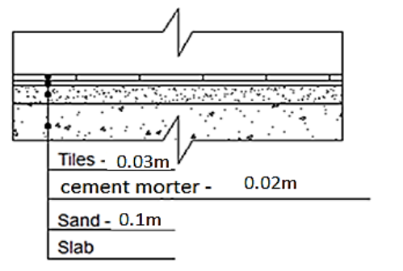
General Description
● Gravity Loads.
1- Superimposed dead load:
The floor layers:
Finishing materials weight = Σ (thickness of layer * unit weight for each layer)
Element | Thickness ( cm ) | Unit weight ( KN/m³)
Filling | 10 | 17
Mortar | 2 | 23
Tiles | 3 | 27
Plaster | 1 | 23
SD= W Tile + W Mortar+ W aggregate + W plaster + W false ceiling SD= 27*0.03 + 0.02*23+ 17*0.1 + 23*.01 +0.2 = 3.4 kN/m2

Slide 18
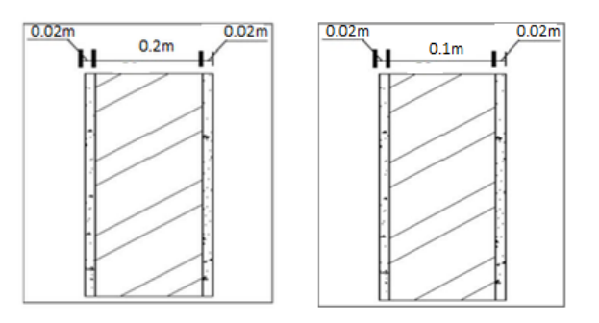
General Description
The internal partitions
Total weight of Blocks = ((Length of partitions (specific area) x thickness x floor height x y block) + Length of plaster (specific area) x thickness x floor height x + Length of partitions (specific area) x thickness x floor height x y tiles)) / specific area
GF =((75.2 x 0.2 x 5.21 x 12) +(75.2*2*.02*23*5.21))/360 = 3.6 KN/m2
F1 = ((68 x 0. 2 x 5.11 x 12) +(68*2*.02*5.11*23))/391.8 = 3 KN/m2
Other story = ((71.1 x 0.2 x 3.03 x 12) +(36 x 0.1 x 3.03 x 12) +(107.1*2*.03*3.03*23) +(36 x 0.01 x 3.03 x 27))/248.6 = 3.95 KN/m2

Slide 19
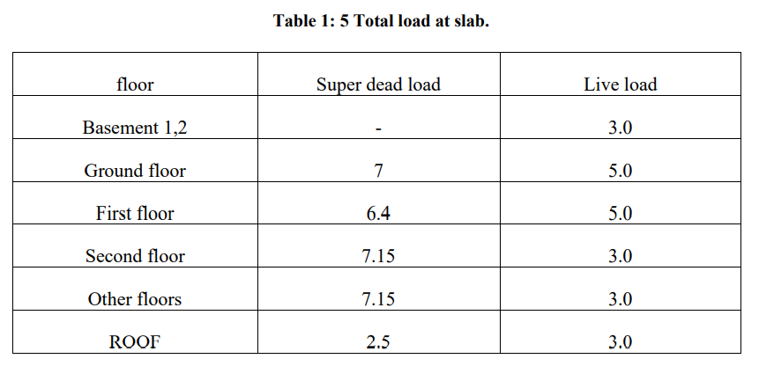
General Description
Total super dead load

Slide 20
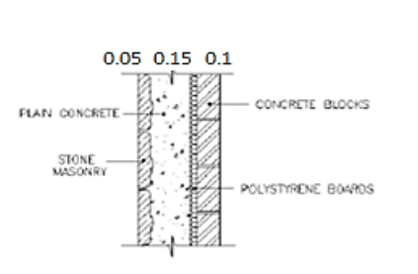
General Description
Exterior wall load
Stone wall:
Load (kN/m) for stone wall = unit weight * total thickness * height of floor
GF = (26*0.05+23*0.15+12*0.1) *5.21= 14.76 →25.5kN/m
F1= (26*0.05+23*0.15+12*0.1) *5.11= 14.76 →25kN/m
Others = (26*0.05+23*0.15+12*0.1) *3.03= 14.76 →14.8 kN/m

Slide 21
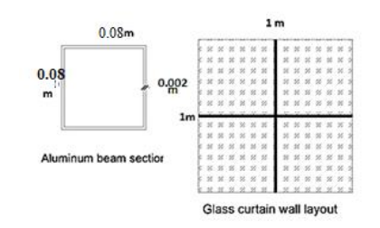
General Description
Exterior wall load
Glass wall:
Load (kN /m2 ) for glass wall GF = ((1*1*0.01*25.5)+2*(0.08*0.08-0.076*0.076)*27))*5.21 =1.56 kN/m . → use 1.6 kN/m
Load (kN /m2 ) for glass wall F1 = ((1*1*0.01*25.5)+2*(0.08*0.08-0.076*0.076)*27))*5.11 =1.53 kN/m . → use 1.6 kN/m
Load (kN /m2 ) for glass wall = ((1*1*0.01*25.5)+2*(0.08*0.08-0.076*0.076)*27 )*3.03
=0.91 kN/m .

Slide 22
General Description
● Gravity Loads.
2- Live load:
Occupancy (Intended Function) | Live Load (KN/m²)
Basement 1,2 | 3
Offices | 3
Residential floors | 3
Ground floor and F1( stores) | 5
Stairs and exit ways | 5
3- Snow load:
1.1 kN/m²

Slide 23
General Description
Lateral load:
1- Soil load
Soil pressure = y *K0*h
= 20*0.5 *5.85 =58.5 KN /m2
additional earth pressure caused by seismic force =0.40 k yt hrw
= 0.40 *0.296*20 *5.85 = 13.8 KN /m2
The surcharge load = 6KN/m2
Total soil pressure (bottom) = 58.5+13.8 +6 = 78.3 KN/m2
Total soil pressure (top) = 13.8+6 = 19.8 KN/m2

Slide 24
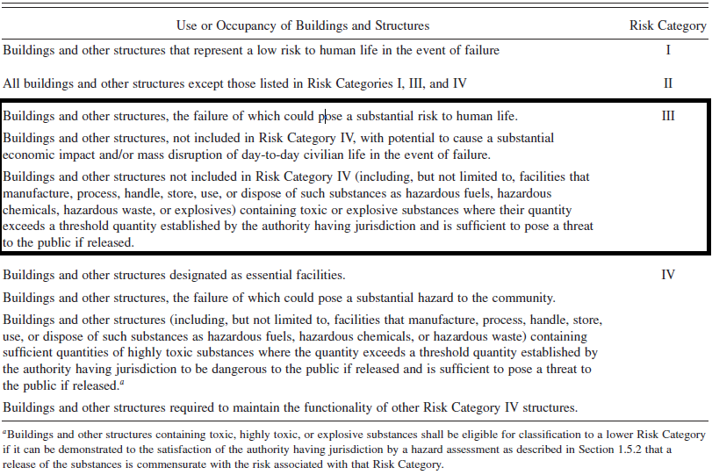
General Description
● Lateral Loads.
According to ASCE 7-10 code to seismic analysis for this structure:
1- Risk category:
risk category of the building is III

Slide 25
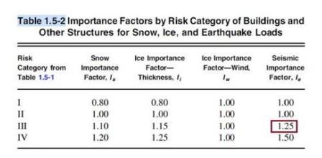
General Description
● Lateral Loads.
2- Importance factor :
Ie = 1.25

Slide 26
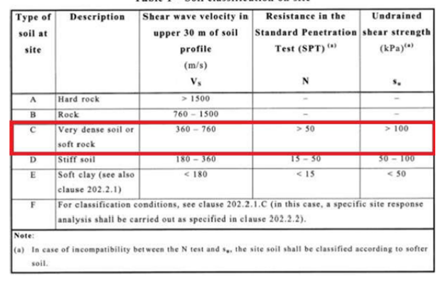
General Description
3-Mapped acceleration parameters Ss&S:
From Palestine seismic map:
Ss= 0.74g
S1 = 0.15g
4- Site class:
Site classification is C

Slide 27
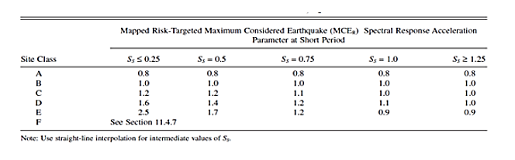
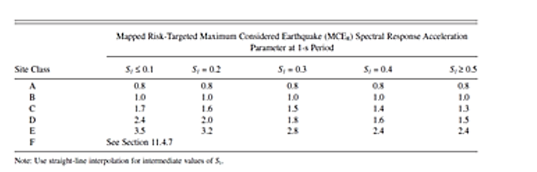
General Description
5- Site coefficients:
The values of Fa and Fv are 1.104 ,1.65 respectively.

Slide 28
General Description
6- The maximum considered earthquake Spectral Response Acceleration
Parameters SMS and S 1:
SMS=Fa * Ss= 1.104 * 0.74 = 0.817
SM1= Fv * S1 = 1.65 * 0.15 = 0.2475
7- Design spectral acceleration
SDS & SD1:
SDS = SMS = 0.817
SD1 = SM1 = 0.2475

Slide 29
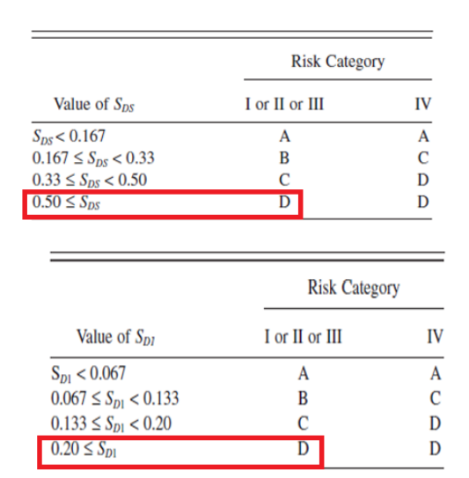
General Description
8- Seismic Design Category ( SDC):
Seismic design category (SDC): D

Slide 30
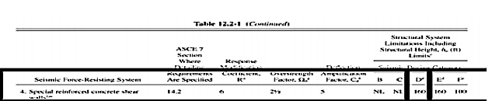
General Description
9- Type of the lateral forces resisting system:
building frame system: special shear walls
Response modification factor= 6
Overstrength factor Ω = 2.5
Deflection Amplification Factor = 5

Slide 31
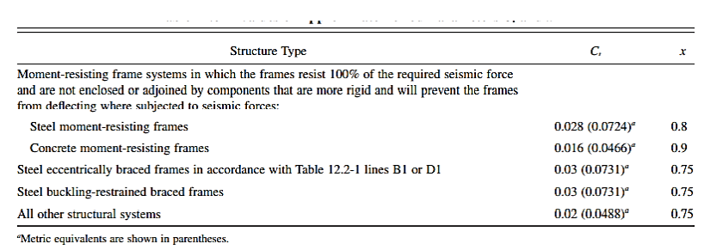
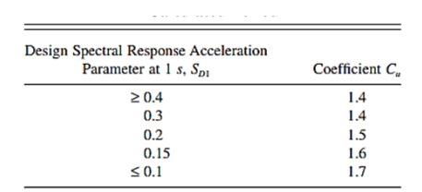
General Description
10- Structural period
Ta = Ct h^x
Ta = 0.0488 *34.35^ 0.75 = 0.69 sec
T ETABS ≤ Ta Cu
The period is limited to Ta = 0.69*1.4525= 1 sec

Slide 32
General Description
10- Seismic Base Shear
V = Cs W
Cs= 0.17
Cs min = 0.045
Cs max = 0.075→ V = 0.075 W

Slide 33



Computer Program

Slide 34
Preliminary Design

Slide 35
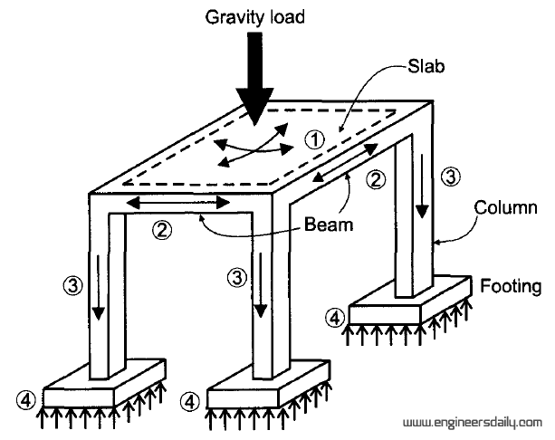
Preliminary Design
Structural system to analysis and design:
1. Slab system.
2. Beam system.
3. Column system.

Slide 36
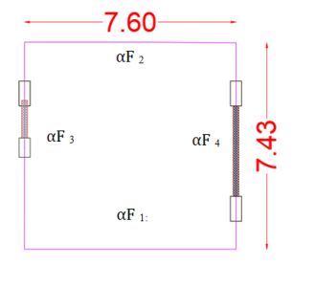

Preliminary Design
Slab system:
Using Two-way solid slab system
L/B < 2.By referring to table (8.3.1.2) page 95 from ACI318-14 code.
$$h_{min}= \frac{l_{n }\left(0.8+ \frac{f_{y}}{1400}\right)}{36+9β}$$
h min. = 20cm.
Vu =75.15 kN/m
ØVc = 105.83 kN/m > Vu

Slide 37
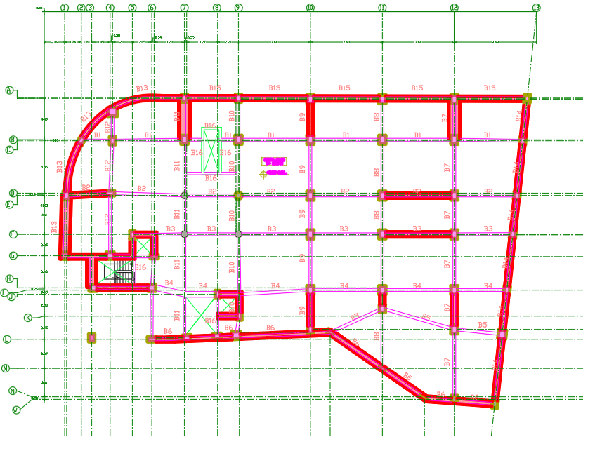
Preliminary Design
Beams layout :

Slide 38
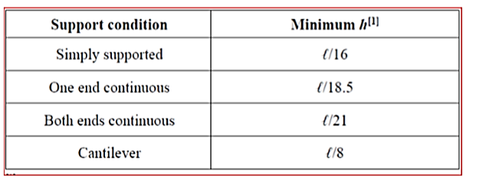
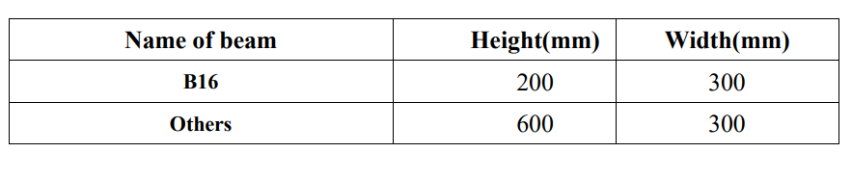
Preliminary Design
Beams system:
Depth
Width = L/20

Slide 39
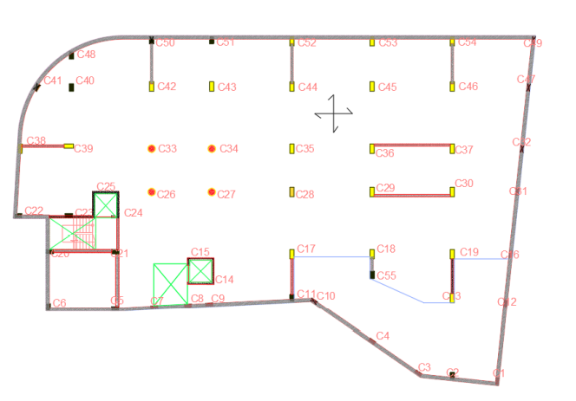
Preliminary Design
Columns layout:

Slide 40
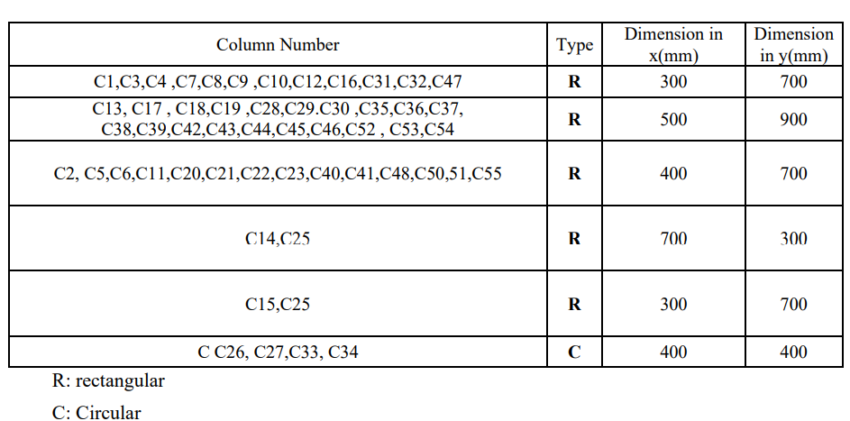
Preliminary Design
Columns layout:

Slide 41
Preliminary Design
Walls layout:
Two types of walls in this structure:
1. Basement retaining walls.
2. Elevators and staircase walls. (Shear Walls)
From architectural plans, these walls have an initial thickness equal to 30 cm

Slide 42
3D-Modeling and Analysis

Slide 43
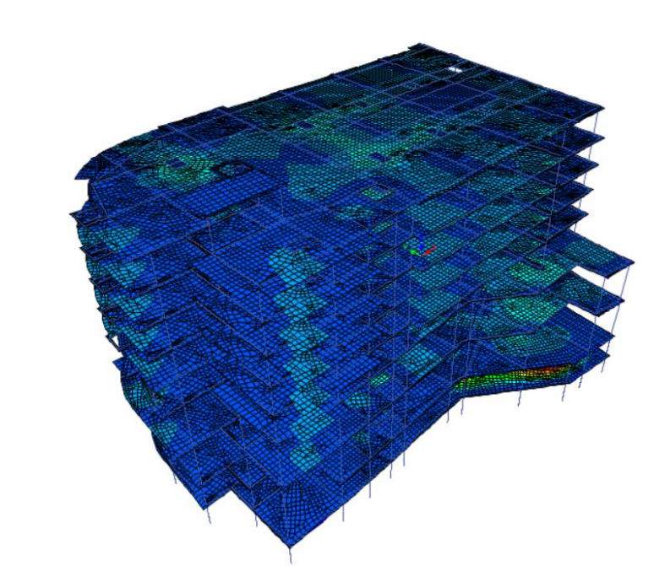
3D-Modeling and Analysis

Slide 44
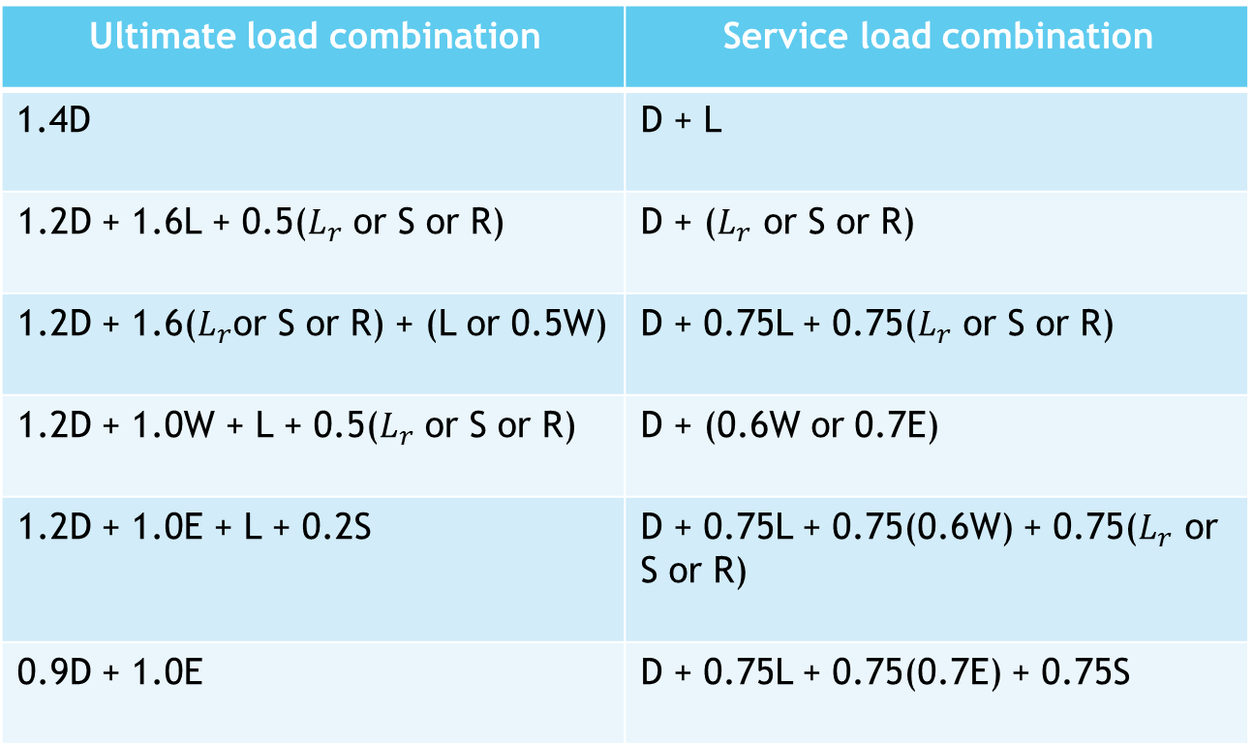
3D-Modeling and Analysis
Load combinations:
Service load combination | Ultimate load combination
D + L | 1.4D
D + ($L_{r}$ or S or R) | 1.2D + 1.6L + 0.5($L_{r}$ or S or R)
D + 0.75L + 0.75($L_{r}$ or S or R) | 1.2D + 1.6($L_{r}$or S or R) + (L or 0.5W)
D + (0.6W or 0.7E) | 1.2D + 1.0W + L + 0.5($L_{r}$ or S or R)
D + 0.75L + 0.75(0.6W) + 0.75($L_{r}$ or S or R) | 1.2D + 1.0E + L + 0.2S
D + 0.75L + 0.75(0.7E) + 0.75S | 0.9D + 1.0E

Slide 45
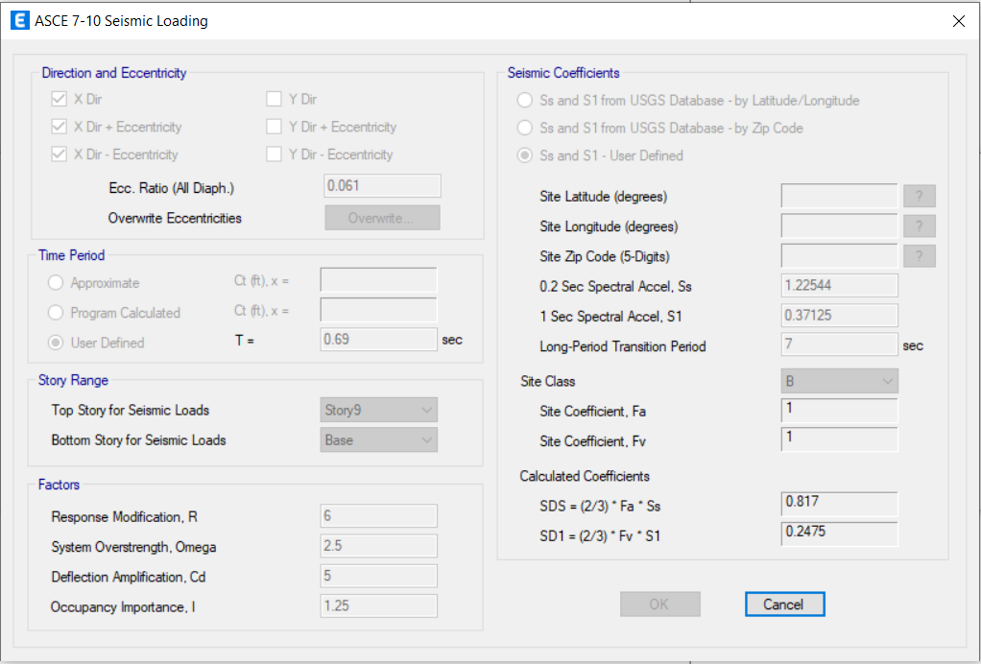
3D-Modeling and Analysis
→ Seismic Analysis Methods:
  1- Equivalent lateral force method (ELF).
Definition of ELF in ETABS :
Seismic loading in X-direction

Slide 46
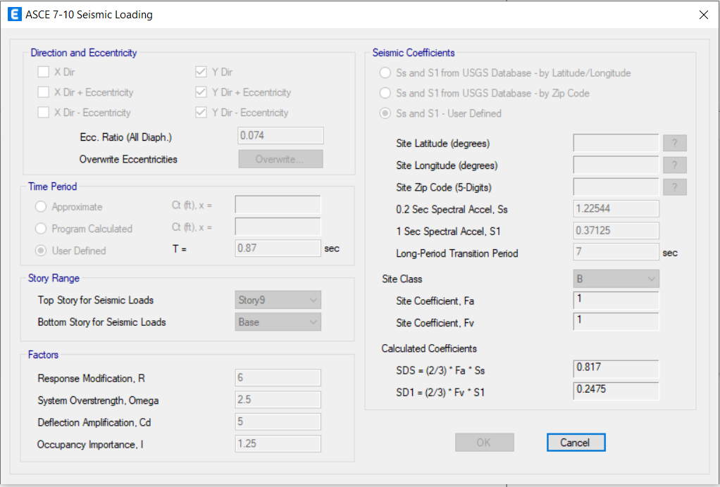
3D-Modeling and Analysis
Seismic loading in Y-direction

Slide 47
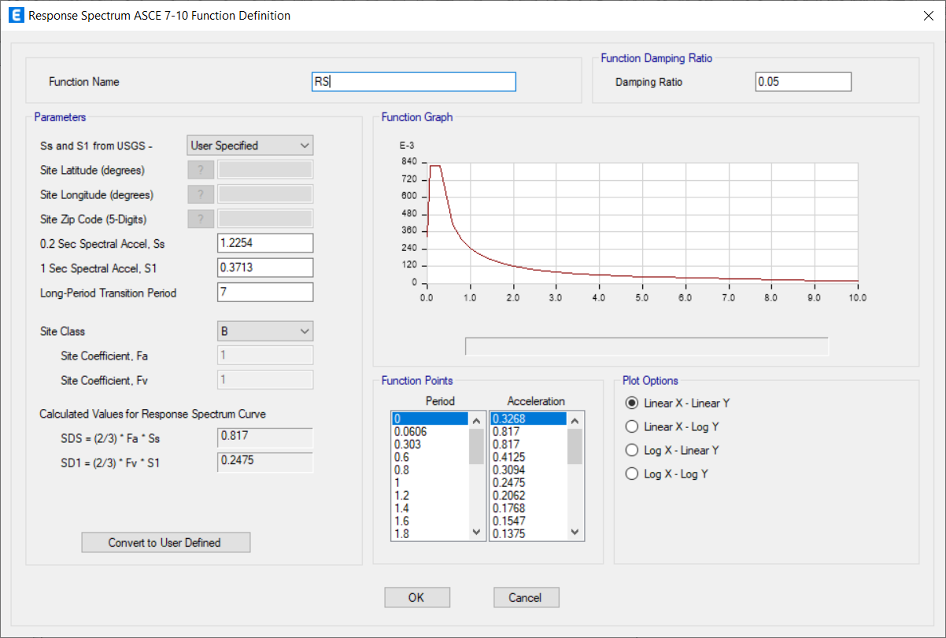
3D-Modeling and Analysis
  2- Modal response spectrum method (MRS).
→ Definition of RS function in ETABS:

Slide 48
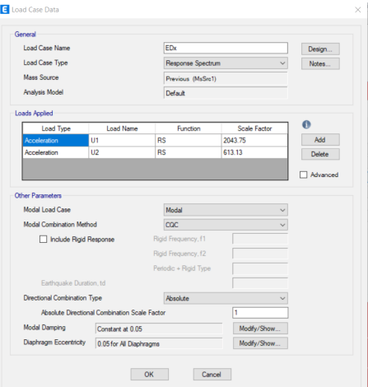


3D-Modeling and Analysis
In X-direction → Scale factor = $\frac{9810∗1.25}{6}=\text{2043.75}$
In Y-direction → Scale factor = $\frac{9810∗1.25}{6}=$2043.75

Slide 49
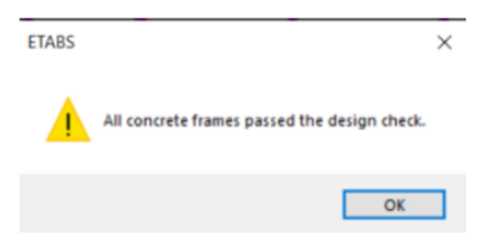
3D-Modeling and Analysis
Evaluation of the preliminary design:

Slide 50
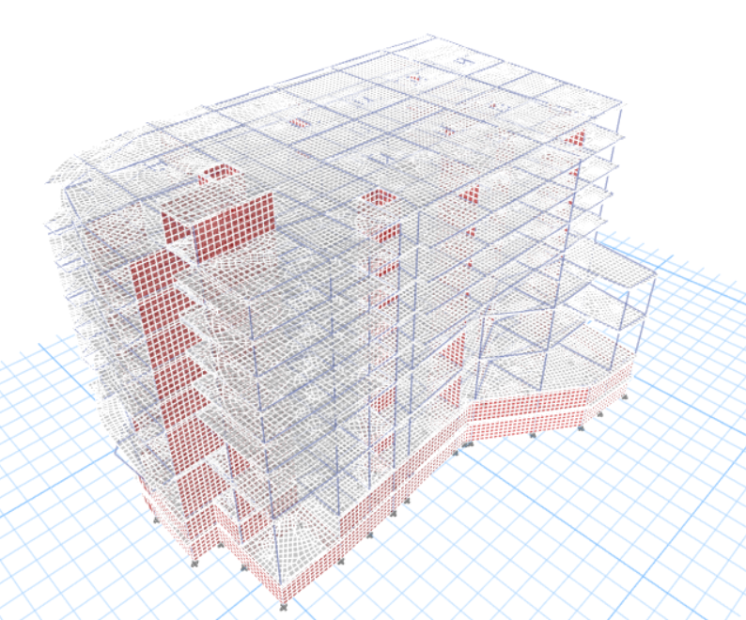
3D-Modeling and Analysis
Analysis Checks:
- Compatibility check:

Slide 51
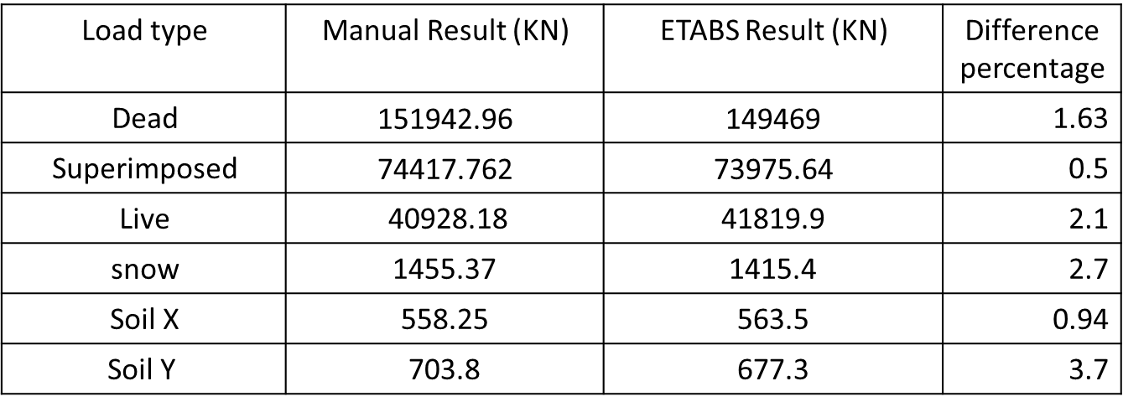
3D-Modeling and Analysis
- Equilibrium Check :
Difference percentage | ETABS Result (KN) | Manual Result (KN) | Load type
1.63 | $$\text{149469}$$ | $$\text{151942.96}$$ | Dead
0.5 | $$\text{73975.64}$$ | $$\text{74417.762}$$ | Superimposed
2.1 | 41819.9 | 40928.18 | Live
2.7 | 1415.4 | 1455.37 | snow
0.94 | 563.5 | 558.25 | Soil X
3.7 | 677.3 | 703.8 | Soil Y
Difference percentage less than 5 % → it is ok

Slide 52
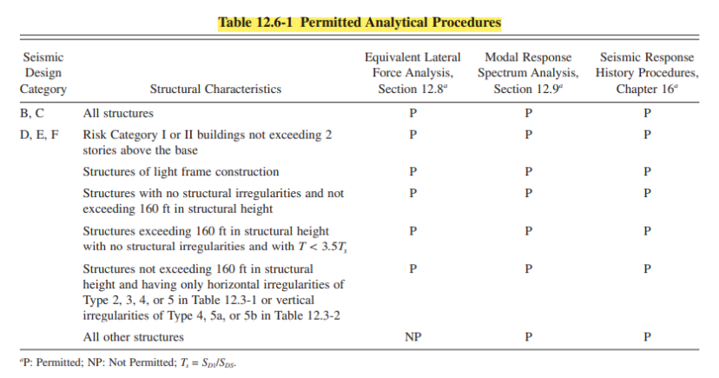
3D-Modeling and Analysis
- Seismic forces:
✓ Analysis method
The analysis method used in this project is response spectrum analysis, and use equivalent lateral force method to base shear check.

Slide 53
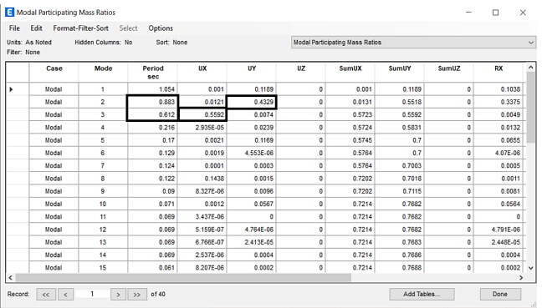
3D-Modeling and Analysis
- Seismic forces:
✓ Period check
Ta = 1 sec
From ETABS Tx =0.612 seconds , Ty = 0.883 seconds.
Tx< Ta , period check ok.
Ty<Ta , period check ok.

Slide 54
3D-Modeling and Analysis
- Seismic forces:
✓ Check equilibrium: base shear
the values of dynamic earthquakes must be equal to the value of
earthquakes in the static method, but the values were not equal on ETAPS, which led to change the scale factor for each of the dynamic earthquake forces in X and Y.
Modification factor in X direction = 1.23
Modification factor in Y direction = 1.4

Slide 55
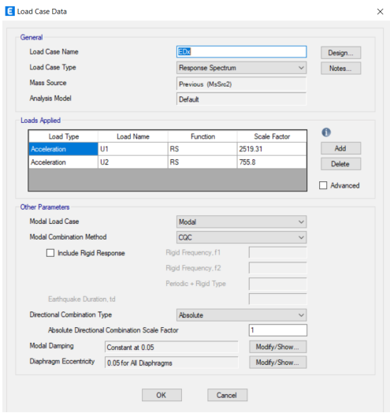

3D-Modeling and Analysis
- Seismic forces:
✓ Check equilibrium: base shear
In X → scale factor = 2519.31
In Y→ scale factor = 2898.72

Slide 56
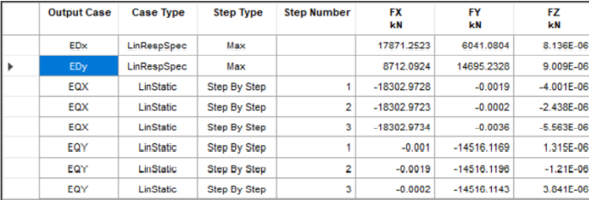
3D-Modeling and Analysis
- Seismic forces:
✓ Check equilibrium: base shear
V = 0.075 W
Where W = D+ SD+ 0.25 L
From ETABS W = 233908 KN
V x = 0.075 *233908 = 17543 KN
V y = 0.06 *233908 = 14034 KN

Slide 57
3D-Modeling and Analysis
- Seismic forces:
✓ Check equilibrium: base shear
Difference percentage | Manual Result (KN) | ETABS Result (KN) | Difference percentage
EQX | 17543 | 18303 | 4.3
EQY | 14034 | 14516 | 3.43
EDX | 17543 | 17871 | 1.9
EDY | 14034 | 14695 | 4.7
Difference percentage less than 5 % → it is ok

Slide 58

3D-Modeling and Analysis
- Seismic forces:
✓ Type of lateral force structural system

Slide 59


3D-Modeling and Analysis
- Seismic forces:
✓ Type of lateral force structural system
In X direction :
Total Reactions = 17139 KN
Wall Reactions = 16860 KN
Percentage of load resisting by walls = (16860/17138) × 100% = 98.4%, so the system is Shear Wall Resisting System in the X direction

Slide 60
3D-Modeling and Analysis
- Seismic forces:
✓ Type of lateral force structural system
In Y direction :
Total Reactions = 13708KN
Wall Reactions = 13303 KN
Percentage of load resisting by walls = (13303/13709) × 100% = 97%, so the system is
Shear Wall Resisting System in the Y direction.

Slide 61

3D-Modeling and Analysis
- Seismic forces:
✓ Mass participation ratio for modal analysis
1- The structure needed 33 modes in X-direction to collect mass
participation ratio more than 90%.
2. The structure needed 29 modes in Y-direction to collect mass
participation ratio more than 90%.
3. The structure needed 39 modes in RZ-direction to collect mass
participation ratio more than 90%.

Slide 62



3D-Modeling and Analysis
- Seismic forces:
✓ Story forces:
Hand calculation in X :
From ETABS :

Slide 63


3D-Modeling and Analysis
- Seismic forces:
✓ Story forces:
Hand calculation in Y :
From ETABS :

Slide 64

3D-Modeling and Analysis
- Seismic forces:
✓ Check horizontal irregularity
In X direction:
The ratio between δ max and δ avg = 1.325 → Ax = 1.22→ torsion irregularity exist
Then the eccentricity in X direction = 0.05 *1.22 = 0.061
In Y direction:
The ratio between δ max and δ avg = 1.46 → Ax= 1.48→ extreme torsion irregularity exist Then the eccentricity in Y direction = 0.05 *1.48= 0.074

Slide 65


3D-Modeling and Analysis
- Seismic forces:
✓ Effect of p-delta
Px represented this load combination : Ev + D+SD+ L+EQ
In X:
The values of θ in X direction less than 0.1 → neglect effect of P-delta

Slide 66

3D-Modeling and Analysis
- Seismic forces:
✓ Effect of p-delta
In Y :
The values of θ in Y direction less than 0.1 → neglect effect of P-delta

Slide 67
3D-Modeling and Analysis
- Internal forces check:
  To ensure that the load will be distributed in an expected way to structural elements such as slabs, beams and columns.
  1- Slab check.
  2- Beam check.
  3- Column check.
Note :All check from live load

Slide 68


3D-Modeling and Analysis
1- Slab check:
in X-direction:
Manual result:

Slide 69

3D-Modeling and Analysis
ETABS result:

Slide 70


3D-Modeling and Analysis
1- Slab check:
in Y-direction
Manual result:

Slide 71

3D-Modeling and Analysis
ETABS result:

Slide 72


3D-Modeling and Analysis
3- Column check:

Slide 73

3D-Modeling and Analysis
- Deflection check:
From ACI 318 Table 9.5(b) maximum permissible deflections.

Slide 74



3D-Modeling and Analysis
Deflection check:

Slide 75

3D-Modeling and Analysis
Story drift:

Slide 76

3D-Modeling and Analysis
Story drift:
In X direction :

Slide 77

3D-Modeling and Analysis
Story drift:
In Y direction :

Slide 78
3D-Modeling and Analysis
Design of slab
Check for shear: ∅Vc = ∅ 6 * √𝑓`𝑐 * bw * d ∅Vc = 0.75 6 * √40 * 1000 * 210 = 166 KN
Floor | Ultimate shear(KN )
Basement 2 | 120
Basement 1 | 45
Ground floor | 57.5
First floor | 45
Second floor | 102.3
Sixth floor | 71.3
∴ No Need for shear reinforcement.

Slide 79

3D-Modeling and Analysis
Design of slab
Using ETABS software, the positive and negative moment value was taken
For example :
Maximum positive Moment (M11) in basement 2 = 33 KN/m
$ρ=\text{2}×{10}^{−3}$
$A_{s}=2 ×{10}^{−3}×1000×210=420{mm}^{2}$
$A_{min}=1.8×{10}^{−3}×1000×250=450{mm}^{2}$
$A_{s}<A_{min}→use 450{mm}^{2}$

Slide 80

3D-Modeling and Analysis
Design of slab
Reinforcement for the slabs is shown in Table below.

Slide 81

3D-Modeling and Analysis
Design of slab
General reinforcement for the slab

Slide 82
3D-Modeling and Analysis
Design of beams
General :
According to ACI 318-14 There is a set of specifications and conditions that must apply to beams in order to be designated as special beams They will all be mentioned in this section .
Dimensions limits :
1. Clear span ℓn shall be at least 4d
2. Width bw shall be at least the lesser of 0.3h and 250 mm.
3. Projection of the beam width beyond the width of the supporting column on each side shall not exceed the lesser of c2 and 0.75c1.

Slide 83

3D-Modeling and Analysis
Design of beams
General :
Shear strength

Slide 84
3D-Modeling and Analysis
Design of beams
General :
Longitudinal reinforcement :
Beams shall have at least two continuous bars at both top and bottom faces. At any section, for top as well as for bottom reinforcement and the reinforcement ratio ρ shall not exceed 0.025.
Splicing :
Lap splices shall not be used in these locations :
1- Within the joints.
2- Within a distance of twice the beam depth from the face of the joint.
3- Within a distance of twice the beam depth from critical sections where flexural yielding is likely to occur as a result of lateral displacements beyond the elastic range of behavior.

Slide 85
3D-Modeling and Analysis
Design of beams
General :
Transverse reinforcement:
The first hoop shall be located not more than 5 cm from the face of a supporting column.
Hoops shall be provided in the following regions of a beam:
1- Over a length equal to twice the beam depth measured from the face of the supporting column toward midspan, at both ends of the beam.
2- Over lengths equal to twice the beam depth on both sides of a section where flexural yielding is likely to occur as a result of lateral displacements beyond the elastic range of behavior.
Spacing of the hoops shall not exceed the least of:
1- d/4 .
2- Six times the diameter of the smallest primary flexural reinforcing bars .
3- 150 mm.

Slide 86
3D-Modeling and Analysis
Design of beams
General :
Transverse reinforcement:
Where hoops are not required, stirrups with seismic hooks at both ends shall be spaced at a distance not more than d/2 throughout the length of the beam.
✓ Maximum spacing between bars not restrained by legs of hoops =150 mm.
✓ Maximum spacing between bars restrained by legs of hoops = 350 mm .
✓ Extension of hoops = 6db >150 mm.

Slide 87

3D-Modeling and Analysis
Design of beams
General :
The development length

Slide 88

3D-Modeling and Analysis
Design of beams
Beam design verification:
Design check was done on beam B8 which is located in the second floor:
This beam has a length of 4.3m and the dimensions for the cross section are 400 mm in width and 700 mm in depth (d=640 mm).
Flexure Design Verification:
The negative ultimate moment for the design = 216.5kN.m

Slide 89

3D-Modeling and Analysis
Design of beams
Beam design verification:

Slide 90


3D-Modeling and Analysis
Design of beams
Beam design verification:
Shear verification :

Slide 91

3D-Modeling and Analysis
Design of beams
Sample of calculation in B1
Longitudinal Reinforcement:
Bottom Steel:
As = 892mm2 → use 4Ø18.
Top1 Steel:
As = 1643 mm → use 4Ø25.
Top2 Steel:
As = 1448 mm2 → use 3Ø25.
❖ Development Lengths:

Slide 92
3D-Modeling and Analysis
Design of beams
Sample of calculation
Transverse reinforcement :
Assume one stirrup Ø12
Av = 2*113 = 226 mm2
S = 226/1.162 = 195 mm
spacing between hoops
≤ 160mm
≤ 108 mm
≤ 150 mm.
Select (s) = 100 mm over a length equal twice depth of beam form joint = 1.4 m
Need 1Ø12 / 100 mm
In other places select (S) = 300 mm = d/2

Slide 93

3D-Modeling and Analysis
Design of beams
Longitudinal section in beam 1.

Slide 94

3D-Modeling and Analysis
Design of beams
Crosse section in beam 1.

Slide 95

3D-Modeling and Analysis
Design of Columns
General :
The requirements for the special moment resisting frames According to ACI 318-14:
Dimensional limits:
The least dimension ≥ 300 mm.
shortest dimension / the perpendicular ≥ 0.4.
Minimum flexural strength of columns:
The flexural strengths of the columns shall satisfy:
$$∑Mnc ≥ (6/5)∑Mnb$$

Slide 96
3D-Modeling and Analysis
Design of Columns
General :
Longitudinal reinforcement:
Min As = 0.01Ag
Max As=0.06Ag
In columns with circular hoops, at least six bars.
Transverse reinforcement:
1.) every hoop corner that supports a longitude bar has to make angle ≤ 135 degrees.
2.) spacing between any unsupported bar and supported one ≤ 150mm.

Slide 97


3D-Modeling and Analysis
Design of Columns
General :
3.) clear distance between any leg of the hoops and the another (hx) ≤ 350 mm.
4.) if Pu > 0.3Agfc′ or fc′ > 69 mpa , every bar on perimeter of the core of the cross section must be supported with corner of hoop & hx ≤ 200mm.
5.) Lap splice at mid hight and transverse reinforcement spacing (S) is Min of:
6×$∅$d
150mm
6.) The factors kf and kn :
$Kf=\frac{fc′}{25000}+0.6≥1 , {fc}^{′}in psi$
$$Kn=nl/(nl−2)$$

Slide 98

3D-Modeling and Analysis
Design of Columns
General :
Transverse reinforcement shall extend over ℓo from each joint face
ℓo = max of:
(a) d
(b) 1/6 clear span of the column
(c) 450mm.
Transverse reinforcement spacing;
Min of:
(a) 1/4 of the Min dimension
(b) 6×$∅$d
(c) So in (inch):
$$So=4+\left(\frac{14−hx}{3}\right)$$
Note: 100mm ≤ So ≤ 125mm

Slide 99

3D-Modeling and Analysis
Design of Columns
General :
Amount of transverse reinforcement:

Slide 100

3D-Modeling and Analysis
Design of Columns
General :
Illustration of transverse reinforcement in columns.

Slide 101




3D-Modeling and Analysis
Design of Columns
Design check :
Design check was performed on column C23 with dimensions of 7$00×$700mm.
$$P_{0}=λ\left[0.85×{F`}_{c}×\left(A_{g}−A_{s}\right)+f_{y}×A_{s}\right]$$
$${\text{Ø}P}_{0}\text{ = }\text{9465}\text{.}\text{5 }\text{kN}$$

Slide 102

3D-Modeling and Analysis
Design of Columns
Design check :
Moment axial interaction diagram for column C23 at zero degrees:-

Slide 103

3D-Modeling and Analysis
Design of Columns
Design check :
Moment axial interaction diagram for column C23 at nineteen degrees:-

Slide 104


3D-Modeling and Analysis
Design of Columns
Design check :
Using the moment axial interaction diagrams, and at the design moment values of both zero and nineteen degree curves$(M_{u2},M_{u3})$, the nominal axial load strength along the zero degrees curve ($P_{nx}$) equals 9397$KN$, also along the nineteen degrees curve ($P_{ny}$) equals 9397$KN$.
The reciprocal load method was used.
$\frac{1}{ ∅Pn }$ = $\frac{1}{ ∅Pn, 3 }$ +$\frac{1}{ ∅Pn, 2 }$ - $\frac{1}{ ∅Pn, o }$
$\frac{1}{{∅P}_{n}}=\frac{1}{\text{9397}}+\frac{1}{\text{9397}}−\frac{1}{\text{9465.5}}$
${∅P}_{n}=\text{9329.5}KN$
$P_{u}=$5128 KN
${∅P}_{n}$> Pu , OK.

Slide 105

3D-Modeling and Analysis
Design of Columns
Minimum flexural strength of columns checks:
Take column c28-story 3 & story 4:
Mn beam= As*fy*(d- 𝑎/2 )
∑𝑀𝑛𝑏 =max of
✓ Mn1+Mn2=658 KN.m
✓ Mn1*+Mn2*=613.2 KN.m
Pu on story 3=6280KN
PU on story 4= 5263KN

Slide 106

3D-Modeling and Analysis
Design of Columns
Minimum flexural strength of columns checks:
Mn2-story 3=1380 KN.m
Mn2-story 4=1410KN.m
∑𝑀𝑛𝑐 =1380+1410=2790 KN.m > 6/5(∑𝑀𝑛𝑏 )=6/5*658=789.6 KN.m , O.K.

Slide 107

3D-Modeling and Analysis
Design of Columns
Design :
The design sample was performed on column C21-story 3, , with dimensions of 700x700mm, and cover equal to 40mm
$$Pu limit=0.3Agfc′ =4116KN , Pu=5354.13KN >4116 KN$$
Assume using 16 bar around the perimeter

Slide 108


3D-Modeling and Analysis
Design of Columns
Design
Flexure reinforcement:
AS from Etabs =12057mm2 ,
use 16$∅$32
Shear reinforcing:
𝑃𝑢 > 𝑃𝑢 𝑙𝑖𝑚𝑖𝑡
so, every longitude bar around column parameter should have lateral support with hoop corner
$hx =(700−2∗40−2∗12−32)/4=141mm$<200 mm

Slide 109

3D-Modeling and Analysis
Design of Columns
𝑆 𝑚𝑎𝑥 = 𝑚𝑖𝑛 𝑜𝑓:
a) 0.25 × 𝑎 =0.25*700=175mm
b) 6 × ∅ = 6 ∗ 32 = 192𝑚𝑚
c) So =4 + ( 14−ℎ𝑥 /3 ) = 4 + ( 14−5.55 /3 ) = 6.82𝑖𝑛𝑐ℎ = 173.2𝑚m
Note: 100mm < So < 125mm , so take so take S0 = Smax =125mm

Slide 110

3D-Modeling and Analysis
Design of Columns

Slide 111

3D-Modeling and Analysis
Design of Columns
Design
Column C21 details:

Slide 112
Design of Stairs
General
Design of stairs was accomplished manully for each of flight slab and landing slab assuming simply supported structural model .
- Height of the riser is 150mm.
- Width of the tread (or going) is 300mm.
- The thickness of landing is 200mm.
- Concrete cover is 40mm.
- Live load equal to 5 KN/m2.
- f’c = 28 MPa
- fy = 420 MPa
- d=160 mm

Slide 113

Design of Stairs
General
Plan of stairs.

Slide 114
Design of Stairs
flight (as 200mm slab):
mortar thickness : 2cm
filling material thickness : 5cm
tiles (marble) thickness :3cm,
load calculation
Weight of staircase = 0.02 ∗ 23 + 0.05 ∗ 17 + 0.03 ∗ 27 = 2.12𝐾𝑁/𝑚2 .
Wight of concrete triangle of the stair = 0.5∗0.15∗0.3 /.335^2 = 0.2 𝐾𝑁/𝑚2 .
S.D load = 2.12 + 0.2 = 2.32 𝐾𝑁/𝑚2 .
Dead load = 25 ∗ 0.2 = 5 𝐾𝑁/𝑚2
Wu =1.2𝐷 + 1.6𝐿 = 16.78 𝐾𝑁/𝑚𝑚2 .

Slide 115

Design of Stairs
flight (as 200mm slab):
Design

Slide 116

Design of Stairs
flight (as 200mm slab):

Slide 117

Design of Stairs
flight (as 200mm slab):

Slide 118

Design of Stairs
landing (as a200mm slab):
S.D load = 0.02 ∗ 23 + 0.05 ∗ 17 + 0.03 ∗ 27 = 2.12𝐾𝑁/𝑚2 .
Dead load = 0.25 ∗ 0.2 = 5 𝐾𝑁/𝑚2..
Wu= 1.2𝐷 + 1.6𝐿 + 𝑅𝑒𝑎𝑐𝑡𝑖𝑜𝑛 𝑓𝑟𝑜𝑚 𝑓𝑙𝑖𝑔ℎ𝑡 𝑠𝑙𝑎𝑏
= 1.2 ∗ (5 + 2.12) + 1.6 ∗ 5 + 26 = 42.54 𝑘𝑁/𝑚2

Slide 119

Design of Stairs
landing (as a200mm slab):

Slide 120

Design of Stairs
As shrinkage = .0018 ∗ 𝑏𝑤 ∗ ℎ = .0018 ∗ 1000 ∗ 200 = 360𝑚𝑚2 ./𝑚 < 𝐴𝑠,𝑂k
So, use ∅14/100 mm.
For top and transverse steel use As min , use ∅12/250 mm

Slide 121
3D-Modeling and Analysis
Design of Walls
General :
According to ACI 318-14 There is a set of specifications and conditions that must apply to walls in order to be designated as special wall They will all be mentioned in this section .
Dimensions limits :
Use any section required in the design

Slide 122
3D-Modeling and Analysis
Design of Walls
Longitudinal reinforcement:
The distributed web reinforcement ratios, ρ_{l} and ρ_{t}, for structural walls shall be at least 0.0025.
Spacing between bars must b_{e} ≤ 18"
No cut off bars
Splicing:
Longitudinal reinforcement shall extend beyond the point at which it is no longer required to resist flexure by least 0.8ℓw, except at the top of a wall.
At locations where yielding of longitudinal reinforcement is likely to occur as a result of lateral displacements, development lengths of longitudinal reinforcement shall be 1.25 times the values calculated for f_{y} in tension.
L_{Splice}= 1.25*1.3*L_{Developed}

Slide 123
3D-Modeling and Analysis
Design of Walls
Boundary elements of special structural walls:
σ_{c} ≥ 0.2fc′, need Boundary elements
σ_{c} ≤ 0.15fc′, no need Boundary elements
Dimensions limits for Boundary elements:
The boundary element shall extend horizontally distance at least the greater of c – 0.1ℓw and c/2.
Width of the flexural compression zone b, shall be at least hu/16.

Slide 124
3D-Modeling and Analysis
Design of Walls
The boundary element transverse reinforcement:
Every hoop corner that supports a longitude bar has to make angle not exceeding 135 degrees.
The spacing between any unsupported bar and supported one must be ≤ 150mm.
The clear distance between any leg of the hoops and the another (h_{x}) must be:
h_{x} ≤ 350 mm
h_{x} ≤ 2/3 × thickness of wall
The boundary element transverse reinforcement shall extend at least ℓ_{d}.

Slide 125

3D-Modeling and Analysis
Design of Walls
The boundary element transverse spacing limit:
Spacing of transverse reinforcement shall not exceed the smallest of:
(a) 1/3 of the wall dimension
(b) 6×$∅$ of smallest bar diameter
(c) S_{O} in (in), as calculated by:
$$So=4+\left(\frac{14−hx}{3}\right)$$
Note: 100mm ≤ S_{o} ≤ 125mm

Slide 126
3D-Modeling and Analysis
Design of Walls
Amount of transverse reinforcement:

Slide 127

3D-Modeling and Analysis
Design of Walls
Design check :
Design check was performed on wall has a length of 5.21m and the dimensions for the cross section are 7600 mm and 500mm thickness.
Pu = 9756 kN
Mu,2 = 101 kN.m
Mu,3 = -334kN.m

Slide 128

3D-Modeling and Analysis
Design of Walls
Design check :
interaction diagram between ØPn and ØMn,2

Slide 129

3D-Modeling and Analysis
Design of Walls
Design check :
interaction diagram between ØPn and ØMn,3

Slide 130



3D-Modeling and Analysis
Design of Walls
Design check :
$$P_{0}=λ\left[0.85×{F`}_{c}×\left(A_{g}−A_{s}\right)+f_{y}×A_{s}\right]$$
$${\text{Ø}P}_{0}\text{ =}\text{64941}\text{kN}$$
ØPn,3 = 67559 kN ØPn,2 = 67559 kN
The reciprocal load method was used.
$\frac{1}{ ∅Pn }$ = $\frac{1}{ ∅Pn, 3 }$ +$\frac{1}{ ∅Pn, 2 }$ - $\frac{1}{ ∅Pn, o }$
$\frac{1}{{∅P}_{n}}=\frac{1}{\text{67559}}+\frac{1}{\text{67559}}−\frac{1}{\text{64941}}$
${∅P}_{n}=\text{64941}KN$
${ P}_{u}=$ 9756 KN
${ ∅P}_{n}$> Pu , OK.

Slide 131

3D-Modeling and Analysis
Design of Walls
Longitudinal Reinforcement:
Sample of calculation was taken on wall (w14) –Basement 2:

Slide 132

3D-Modeling and Analysis
Design of Walls
Longitudinal Reinforcement:
A_{s} from ETABS for Flexural design = 9500mm², Use $∅$14/200 mm
A_{s} from ETABS for shear design = 1250mm², Use $∅$12/250 mm
Reinforcement for boundary element:
Top-Left = 772.9 mm
Top-Right = 772.9 mm
Bottom-Left = 818.8 mm
Bottom - Right = 818.8 mm
Use boundary element= 850 mm

Slide 133


3D-Modeling and Analysis
Design of Walls
Development Lengths:
L dt = $\frac{0.48∗420}{\sqrt{28}}$ *14 = 446.5 mm, use 500 mm
L dt = $\frac{0.48∗420}{\sqrt{28}}$ *12 = 382.78 mm, use 400 mm
Transverse reinforcement:
$S max = min of$:
$0.333×a=$0.25*500=125mm
$6×∅ smallest for lomgitudal bars=6∗14=84mm$
So =$4+\left(\frac{14−hx}{3}\right)=4+\left(\frac{14−3.5}{3}\right)=10.5inch=266.7mm$
Note: 100mm < So < 125mm, so take SO =125mm.

Slide 134


3D-Modeling and Analysis
Design of Walls
Transverse reinforcement:
$Ash/sbc= max of$
$0.3∗\left(\frac{Ag}{Ach}−1\right)∗\frac{{fc}^{′}}{fy}=0.3∗\left(\frac{5.2∗{10}^{6}}{3∗{10}^{6}}−1\right)∗\frac{28}{420}=0.0146$
$\frac{0.09∗{fc}^{′}}{fy}=\frac{0.09∗28}{420}=6∗{10}^{−3}$
$S$=$\frac{565.48}{6∗{10}^{−3}∗364}=258.91mm$ > s max, so take s= 80 mm
wall 14 details:

Slide 135
Design of Footings
General :
Concrete B500 (40MPa) was used for this mat foundation. It was defined in SAFE software with bending modifiers equal to 0.5.
Mat foundation was used in this structure, and SAFE software was used to design this foundation.
The design code selected in SAFE software is ACI 318-14 code.

Slide 136

Design of Footings
General :
The bearing capacity of the soil equal to 225 $KN/m^{2}$, this value was increased due to the existing soil around the structure, as shown:-
${Bearing capacity}_{new}={Bearing capacity}_{old}+(γ×h)$ ${Bearing capacity}_{new}$
$$=198+\left(18×7.05\right)=325 KN/m^{2}$$
Maximum stress under footing (Mat foundation) = 292.119 KN/m²
So, since all stresses are less than bearing capacity (325 KN/m²) and larger than 0, then the structure is safe and areas of footings are suitable.

Slide 137

Design of Footings
General :
The thickness of the mat foundation was assumed to be 1.2 m, and punching shear check was performed on this thickness:-
One-way shear:
Maximum shear (at distance d from face of wall) = 393.269 KN
∅ V_{C} = 869.62 KN
∅ Vc > Vu

Slide 138

Design of Footings
Two-way shear (punching shear):
Where:
vu, p: ultimate punching shear (kN)
∅ vc, p: punching shear capacity for footing (kN)
∅ vc, p = 7438.4 KN
vu, p = 3036 KN
∅ vc, p > vu, p

Slide 139

Design of Footings
Two-way shear (punching shear):
Maximum punching shear form SAFE = 0.605 MPa

Slide 140


Design of Footings
Footing design verification:
Moment in direction 1 = -336.663 kN.m
= (0.85 ∗28)/420 (1 – (1 − 2.61∗336.663∗10⁶/ 40∗1000∗1100² )^{0.5}) = 0.00073806
As = ρ b h = 0.001026 × 1000 × 1100 = 1128.6 mm² / m
As min= ρ min × b × h = 0.0018 × 1000 × 1200 = 2160 mm².
As max= ρ min × b × h = 0.018 × 1000 × 1200 = 21600 mm².
As < As min, use As min = 2160 mm²

Slide 141

Design of Footings
Footing design verification:
Area of steel (As) in direction 1 and in bottom face = 2173.04 kN.m at the same point
% error = As from ETABS−As from manual/ As from manual
* 100% = 0.6 % <10%, then OK.

Slide 142
Design of Footings
Flexural design:
As an example of using finite element method
Minimum area of steel = 0.0018 * 1000 * 1200 = 2160 mm² = ∅ 25 / 200 mm
X-direction:
Top reinforcement = ∅ 25 / 200mm
Bottom reinforcement = ∅ 25 / 200mm
Y-direction:
Top reinforcement = ∅ 25 / 200mm Bottom reinforcement = ∅ 25 / 200mm

Slide 143

Design of Footings
Flexural design:
Additional reinforcement required for both directions X and Y

Slide 144

Design of Footings
  Development lengths:
Tension development lengths will be increased by 30 %; because all footings’ depths are larger than 300 mm.
≥ 8 db = 144 mm
≥ 150 mm
L dt (∅25) = 1.3 × $\frac{0.59∗420}{\sqrt{40}}$ *25 = 1274 mm, use 1300 mm
As shown in Figure :
R = 6 db = 6 * 18 = 108 mm, arch length = 170 mm L1 = 12 * db = 216 mm, use 220 mm
L dt (∅25) = $\frac{0.24∗420}{\sqrt{40}}$ *25 = 398.73 mm, use 400 mm

Slide 145

Design of Footings
Samples of detailing:

Slide 146


