Slide 1
Image-Processing Controlled Robot
A graduation project carried out at An-Najah National University
This project showcases a smart robotic car with vision and precision. Guided wirelessly by a camera, it detects, picks, and sorts objects by placing balls in their bin and trash in its own bringing us closer to the future of autonomous robots.
Presented by: Arqam Mousa & Jad Kawa
Supervised by: Dr. Raed Qadi

Slide 2
Content
Main
Idea
Hardware Components
Features
Constraint
Next
Steps
Q&A

Slide 3
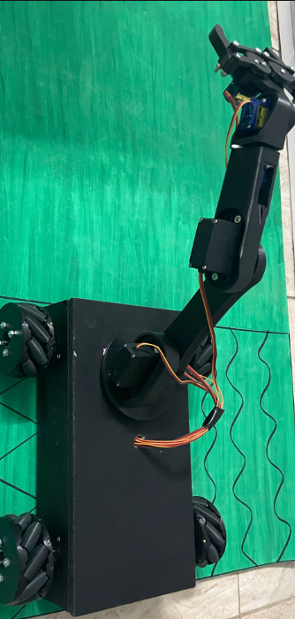
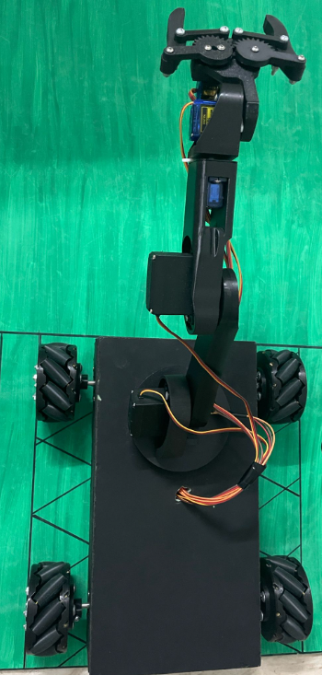
Our Project

Slide 4
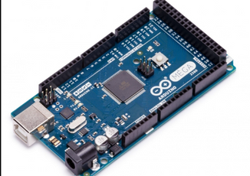
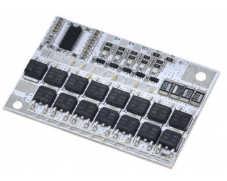
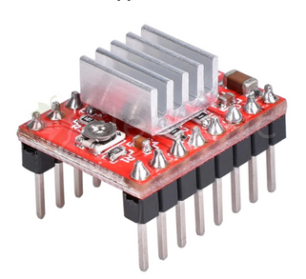
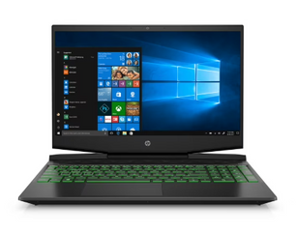
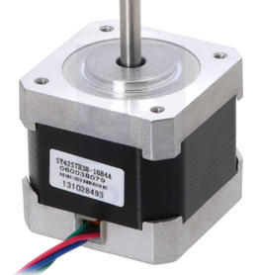
Hardware Components
ARDUINO MEGA
A4988 DRIVER
BMS 3S
LAPTOP FOR IMAGE PROCESSING
NEMA17

Slide 5
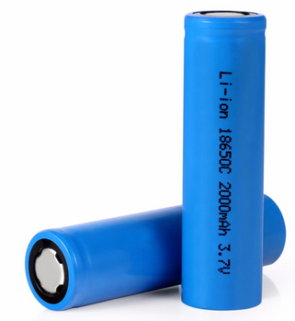
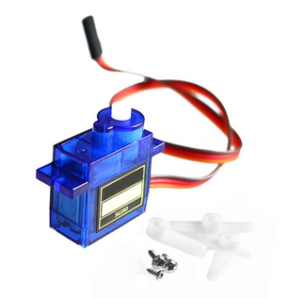
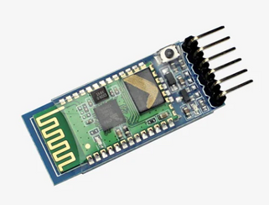
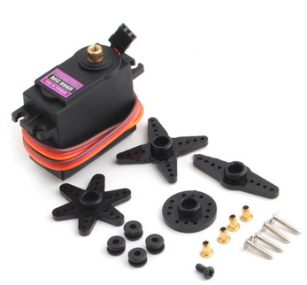
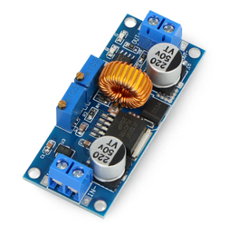
18650 Li-ion
Battery
SG90
MG
996R
HC-05
XL4015

Slide 6
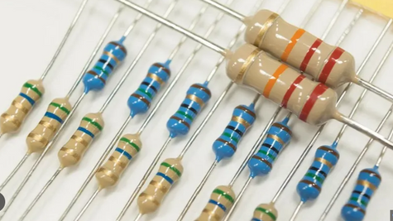
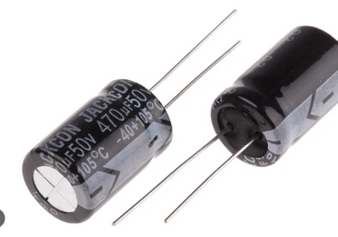
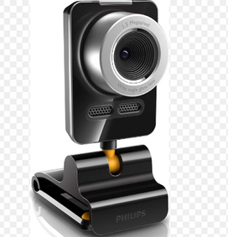
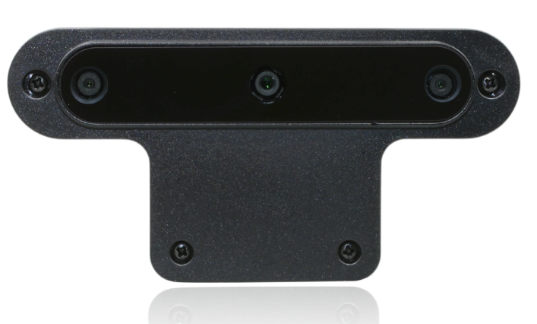
RESISTORS
CAPACITORS
WEB CAM
(for the majority of the semester)
OAK-D CAM
(For the last two days)

Slide 7
7
6
5
Bluetooth
Communication
FEATURES
Robotic Arm
Manipulation
Hybrid Operation
Mobile App
Control
Autonomous Sorting
04
07
Modular Design
06
02
03
05
01
Wireless Vision
System
4
Camera sends movement commands directly to the robot.
Camera and robot are separate but seamlessly connected.
Picks and places objects with precision.
Manual override and remote operation via smartphone.
Camera sends movement commands directly to the robot.
Robot decides whether to place objects in the ball bin or trash bin.
External camera detects and classifies objects in real time.
3
2
1

Slide 8
7
6
5
Bluetooth
Communication
Robotic Arm
Manipulation
Hybrid Operation
Mobile App
Control
Autonomous Sorting
04
07
Modular Design
06
02
03
05
01
FEATURES
Wireless Vision
System
4
Camera sends movement commands directly to the robot.
Camera and robot are separate but seamlessly connected.
Picks and places objects with precision.
Manual override and remote operation via smartphone.
Camera sends movement commands directly to the robot.
Robot decides whether to place objects in the ball bin or trash bin.
External camera detects and classifies objects in real time.
3
2
1

Slide 9
7
6
5
Bluetooth
Communication
Robotic Arm
Manipulation
Hybrid Operation
Mobile App
Control
Autonomous Sorting
04
07
Modular Design
06
03
05
02
01
FEATURES
Wireless Vision
System
4
Camera sends movement commands directly to the robot.
Camera and robot are separate but seamlessly connected.
Picks and places objects with precision.
Manual override and remote operation via smartphone.
Robot decides whether to place objects in the ball bin or trash bin.
Camera sends movement commands directly to the robot.
External camera detects and classifies objects in real time.
3
2
1

Slide 10
7
6
5
Bluetooth
Communication
Robotic Arm
Manipulation
Hybrid Operation
Mobile App
Control
Autonomous Sorting
04
07
Modular Design
06
05
02
01
03
FEATURES
Wireless Vision
System
4
Camera sends movement commands directly to the robot.
Camera and robot are separate but seamlessly connected.
Picks and places objects with precision.
Manual override and remote operation via smartphone.
Camera sends movement commands directly to the robot.
External camera detects and classifies objects in real time.
Robot decides whether to place objects in the ball bin or trash bin.
3
2
1

Slide 11
7
6
5
Bluetooth
Communication
Hybrid Operation
Robotic Arm
Manipulation
Mobile App
Control
Autonomous Sorting
07
04
Modular Design
06
05
02
01
03
FEATURES
Wireless Vision
System
4
Camera sends movement commands directly to the robot.
Camera and robot are separate but seamlessly connected.
Picks and places objects with precision.
Manual override and remote operation via smartphone.
Camera sends movement commands directly to the robot.
External camera detects and classifies objects in real time.
Robot decides whether to place objects in the ball bin or trash bin.
3
2
1

Slide 12
7
6
5
Bluetooth
Communication
Hybrid Operation
Robotic Arm
Manipulation
Mobile App
Control
Autonomous Sorting
07
04
06
Modular Design
05
02
01
03
FEATURES
Wireless Vision
System
4
Camera sends movement commands directly to the robot.
Camera and robot are separate but seamlessly connected.
Manual override and remote operation via smartphone.
Picks and places objects with precision.
Camera sends movement commands directly to the robot.
External camera detects and classifies objects in real time.
Robot decides whether to place objects in the ball bin or trash bin.
3
2
1

Slide 13
7
6
5
Bluetooth
Communication
Hybrid Operation
Robotic Arm
Manipulation
Mobile App
Control
Autonomous Sorting
07
04
Modular Design
06
05
02
01
03
FEATURES
Wireless Vision
System
4
Camera sends movement commands directly to the robot.
Camera and robot are separate but seamlessly connected.
Picks and places objects with precision.
Manual override and remote operation via smartphone.
Camera sends movement commands directly to the robot.
External camera detects and classifies objects in real time.
Robot decides whether to place objects in the ball bin or trash bin.
3
2
1

Slide 14
7
6
5
Bluetooth
Communication
Robotic Arm
Manipulation
Hybrid Operation
Mobile App
Control
Autonomous Sorting
04
07
Modular Design
06
05
02
01
03
FEATURES
Wireless Vision
System
4
Camera sends movement commands directly to the robot.
Camera and robot are separate but seamlessly connected.
Picks and places objects with precision.
Manual override and remote operation via smartphone.
Camera sends movement commands directly to the robot.
External camera detects and classifies objects in real time.
Robot decides whether to place objects in the ball bin or trash bin.
3
2
1

Slide 15
Constrains
Low-Quality Components
Camera Limitations
Bluetooth Restrictions
Power Constraints
Limited performance.
Low resolution and accuracy.
Short communication range.
limited
operating time.

Slide 16

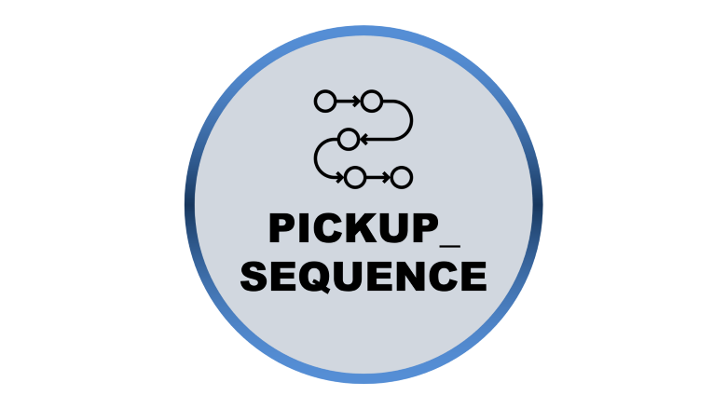
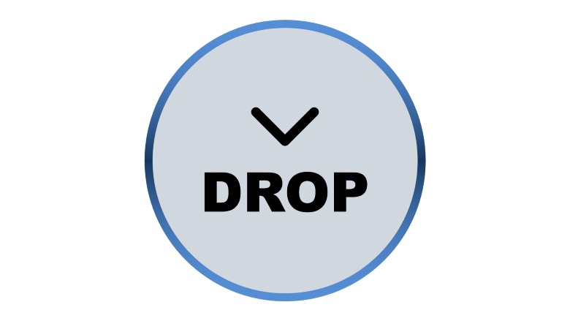
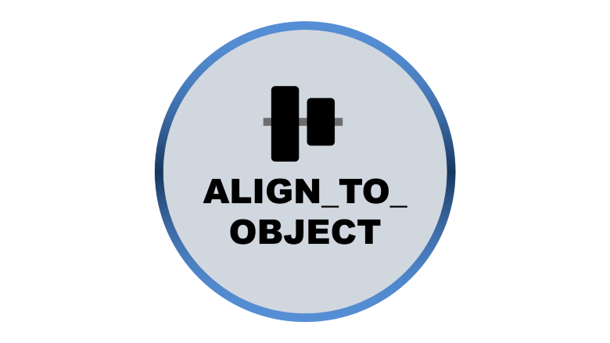
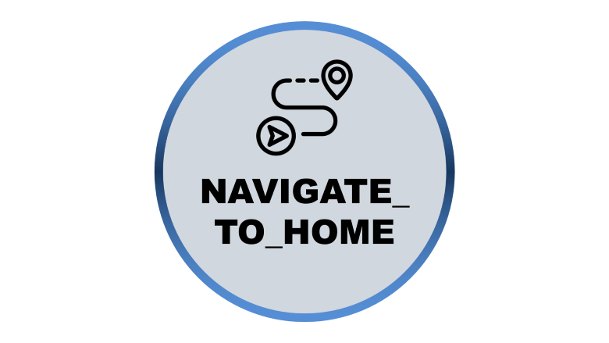
State Machine Overview
The robot control system uses the following main states:

Slide 17

SEARCH

Slide 18

SEARCH
1
Initial state
2
Robot stops and looks for valid targets
3
Transitions to ALIGN_TO_OBJECT
when a target is found.

Slide 19

ALIGN_TO_OBJECT

Slide 20

ALIGN_TO_OBJECT
- Contains multiple sub-phases:
- determine_case
- align_x
- move_forward
- create_margin
- move_backward
- Handles different approach scenarios based on relative positions
Transitions to PICKUP_SEQUENCE when aligned.
Smarter app with live camera feed, object tracking, and advanced controls.

Slide 21
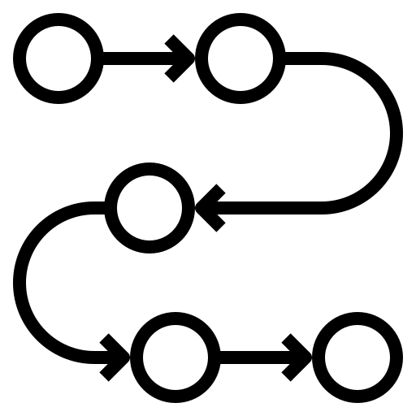
PICKUP_
SEQUENCE

Slide 22
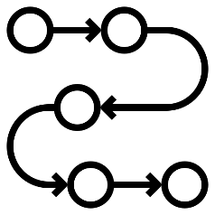
PICKUP_SEQUENCE
1
2
3
Sub-phases:
Carefully positions the robot and executes pickup.
Transitions to NAVIGATE_TO_HOME after pickup.
fine_align_x
fine_align_y
execute_pickup

Slide 23

NAVIGATE_TO_HOME

Slide 24

NAVIGATE_TO_HOME
Transitions to DROP when aligned.
Aligns robot with home position.
Uses persistent home detection.

Slide 25

DROP

Slide 26
DROP
Executes appropriate drop command based on target type.
Transitions back to SEARCH.

Slide 27
Robot Alignment and Pickup State Machine
Notes
Assumptions
Decision Conditions & Actions

Slide 28
Assumptions
Robot and robotic arm are always facing forward.
The coordinate system has origin (0,0) at the top-left.
Assumptions
x increases to the right.
y increases downward.
Decision Conditions & Actions
Safety margin and alignment thresholds are predefined.
Robot maintains Bluetooth connectivity.

Slide 29
Decision Conditions & Actions:
A
B
C

Slide 30
Robot Below Object
(object_upper_y < robot_lower_y - safety_margin)
Align x: Move left or right until horizontal centers of robot and object are within acceptable pixels.
1.
Move forward until robot_upper_y <= object_lower_y - safety_margin.
2.
Execute Pickup Sequence.
3.
B
C

Slide 31
Robot Next To Object
(|robot_center_y - object_center_y| <= margin)
Move left until distance between robot and object is acceptable
Move backward until robot_upper_y < object_lower_y - safety_margin.
Dynamically align horizontal centers.
Move forward until robot_upper_y < object_lower_y - safety_margin.
Execute Pickup Sequence.
C

Slide 32
Robot Next To Object
(|robot_center_y - object_center_y| <= margin)
If object is to the left within margin:
If object is to the right within 100 pixels:
Move right until distance between robot and object is acceptable.
Move backward until robot_upper_y < object_lower_y - safety_margin.
Dynamically align horizontal centers.
Move forward until robot_upper_y < object_lower_y - safety_margin.
Execute Pickup Sequence.
Move left until distance between robot and object is acceptable
Move backward until robot_upper_y < object_lower_y - safety_margin.
Dynamically align horizontal centers.
Move forward until robot_upper_y < object_lower_y - safety_margin.
Execute Pickup Sequence.
C

Slide 33
Robot Next To Object
(|robot_center_y - object_center_y| <= margin)
If object is to the left within margin:
Move right until distance between robot and object is acceptable.
Move backward until robot_upper_y < object_lower_y - safety_margin.
Dynamically align horizontal centers.
Move forward until robot_upper_y < object_lower_y - safety_margin.
Execute Pickup Sequence.
C

Slide 34
Robot On Top of Object (robot_lower_y > object_upper_y)
Robot On Top of Object (robot_lower_y > object_upper_y)
1.
2.
3.
4.
5.
Horizontal Positioning:
If object is left of robot: move right until object_right_x - robot_left_x = good margin.
If object is right of robot: move left until
object_left_x - robot_right_x = good margin.
Move forward until robot_upper_y <= object_lower_y + safety_margin.
Move backward until robot_upper_y < object_lower_y + safety_margin.
Dynamically align horizontal centers.
Execute Pickup Sequence.

Slide 35
Robot On Top of Object (robot_lower_y > object_upper_y)
Robot On Top of Object (robot_lower_y > object_upper_y)
1.
2.
3.
4.
5.
Horizontal Positioning:
If object is left of robot: move right until object_right_x - robot_left_x = good margin.
If object is right of robot: move left until
object_left_x - robot_right_x = good margin.
Move forward until robot_upper_y <= object_lower_y + safety_margin.
Move backward until robot_upper_y < object_lower_y - safety_margin.
Dynamically align horizontal centers.
Execute Pickup Sequence.

Slide 36
Robot On Top of Object (robot_lower_y > object_upper_y)
Robot On Top of Object (robot_lower_y > object_upper_y)
1.
2.
3.
4.
5.
Horizontal Positioning:
If object is left of robot: move right until object_right_x - robot_left_x = good margin.
If object is right of robot: move left until
object_left_x - robot_right_x = good margin.
Move forward until robot_upper_y <= object_lower_y + safety_margin.
Move backward until robot_upper_y < object_lower_y - safety_margin.
Dynamically align horizontal centers.
Execute Pickup Sequence.

Slide 37
Robot On Top of Object (robot_lower_y > object_upper_y)
Robot On Top of Object (robot_lower_y > object_upper_y)
1.
2.
3.
4.
5.
Horizontal Positioning:
If object is left of robot: move right until object_right_x - robot_left_x = good margin.
If object is right of robot: move left until
object_left_x - robot_right_x = good margin.
Move forward until robot_upper_y <= object_lower_y - safety_margin.
Move backward until robot_upper_y < object_lower_y - safety_margin.
Dynamically align horizontal centers.
Execute Pickup Sequence.

Slide 38
Robot On Top of Object (robot_lower_y > object_upper_y)
Robot On Top of Object (robot_lower_y > object_upper_y)
1.
2.
3.
4.
5.
Horizontal Positioning:
If object is left of robot: move right until object_right_x - robot_left_x = good margin.
If object is right of robot: move left until
object_left_x - robot_right_x = good margin.
Move forward until robot_upper_y <= object_lower_y - safety_margin.
Move backward until robot_upper_y < object_lower_y - safety_margin.
Align horizontal centers.
Execute Pickup Sequence.

Slide 39
Notes
Alignment is dynamic and continuously adjusted based on real-time vision feedback.
This state machine ensures that the robot approaches the object efficiently, aligns properly, and performs the pickup with minimal adjustments.
All movement distances consider safety margins to prevent collisions.
All movement distances consider safety margins to prevent collisions.

Slide 40
7.
6.
8.
ROBOT CONTROL SYSTEM OPTIMIZATIONS
5.
1.
4.
2.
3.

Slide 41
7.
6.
8.
PERFORMANCE OPTIMIZATIONS
a.
Frame Processing
Fixed-size frame buffer using deque(maxlen=120)
Rolling average FPS calculation
framebuf = deque(maxlen=120)
framebuf.append(fps)
avg = float(np.mean(framebuf))
ROBOT CONTROL SYSTEM OPTIMIZATIONS
5.
1.
b.
Detection Processing
Efficient YOLOv12s model inference
4.
2.
3.

Slide 42
7.
6.
8.
MEMORY MANAGEMENT
a.
Resource Cleanup
Proper camera release
Video writer cleanup
Window destruction
ROBOT CONTROL SYSTEM OPTIMIZATIONS
5.
1.
b.
Object Reuse
Bounding box object reuse
Center point caching
last_seen_target = (bbox, center, area) persistent_home = home_det
4.
2.
3.

Slide 43
7.
6.
8.
STATE MACHINE OPTIMIZATIONS
a.
State Transitions
Clear state boundaries
Timeout mechanisms
Fast fallback to search
if now - last_state_time>MAX_ALIGN_TIME:
robot.stop()
state = "SEARCH"
ROBOT CONTROL SYSTEM OPTIMIZATIONS
5.
1.
b.
State Persistence
Home location persistence
Target tracking memory
if home_det:
persistent_home = home_det
elif persistent_home:
_, _, _, hbox, _, _ = persistent_home
4.
2.
3.

Slide 44
7.
6.
8.
MOVEMENT OPTIMIZATIONS
a.
Command Debouncing
Duplicate command filtering
Minimum command interval
filter if last_command == current_command and last_sent_command > 1 second
ROBOT CONTROL SYSTEM OPTIMIZATIONS
5.
1.
b.
Gradual speed adjustments
Target tracking memory
Tolerance-based movements
if abs(dx) > X_ALIGN_TOL:
if dx > 0:
robot.move_left()
else:
robot.move_right()
4.
2.
3.

Slide 45
7.
6.
8.
DETECTION OPTIMIZATIONS
a.
Object Tracking
Center-based tracking
  Returns best matching object to avoid multiple detections of the same object
ROBOT CONTROL SYSTEM OPTIMIZATIONS
5.
1.
b.
Occlusion Handling
Target memory
Timeout-based recovery
4.
2.
3.

Slide 46
7.
6.
8.
ERROR HANDLING
a.
Recovery Mechanisms
Overlap recovery
Retry limits
if overlap:
recover from overlap
ROBOT CONTROL SYSTEM OPTIMIZATIONS
5.
1.
Exception Management
Comprehensive try-except
Graceful degradation
try:
# Processing logic
except Exception as e
logger.error(f"Error during operation: {e}")
robot.stop()
b.
4.
2.
3.

Slide 47
7.
6.
8.
COMMUNICATIONS
a.
ROBOT CONTROL SYSTEM OPTIMIZATIONS
Serial Interface
Command buffering
Error handling
Command filtering (duplicate command skip)
5.
1.
4.
2.
3.

Slide 48
7.
6.
8.
LOGGING OPTIMIZATIONS
a.
ROBOT CONTROL SYSTEM OPTIMIZATIONS
Multi-level Logging
File and console output
Performance monitoring
Multiple levels info and debug
5.
1.
4.
2.
3.

Slide 49
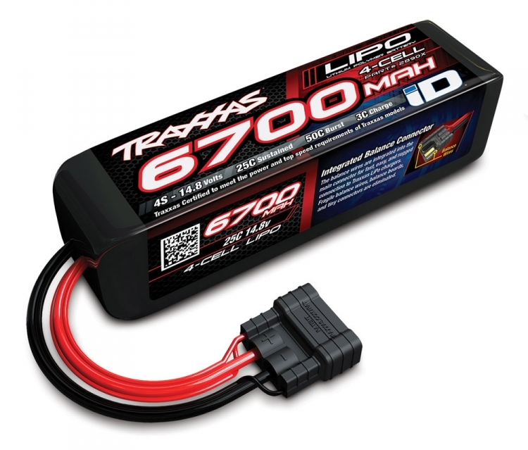
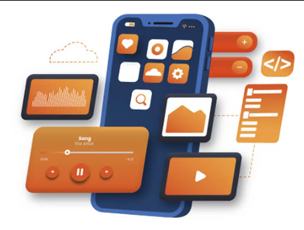
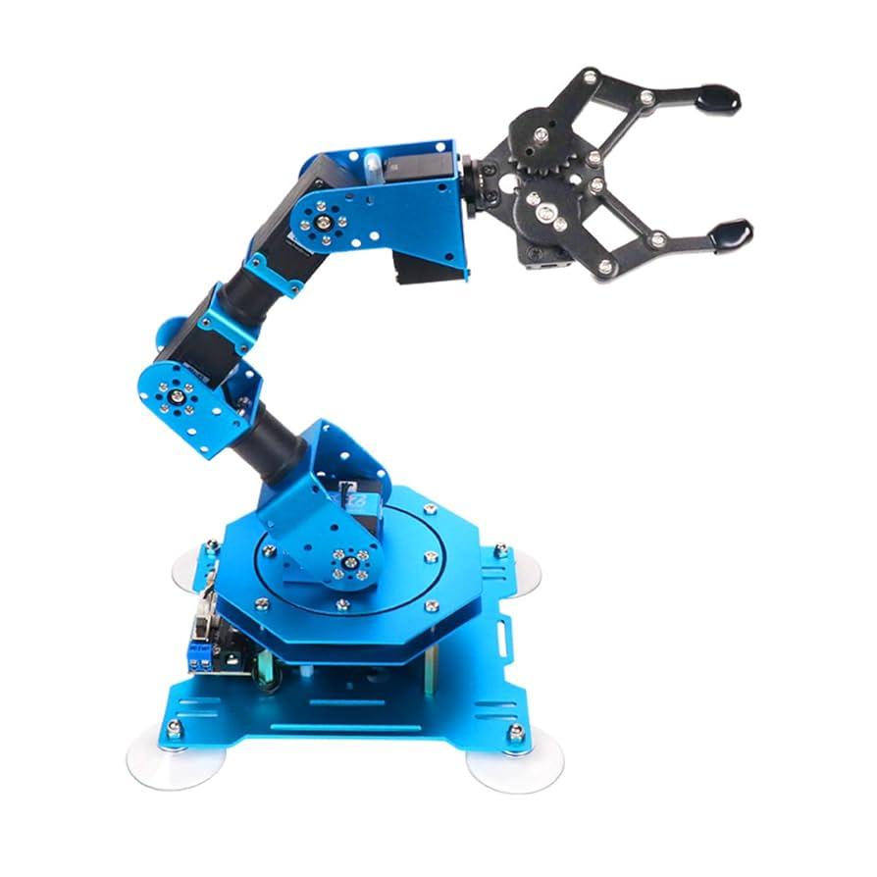
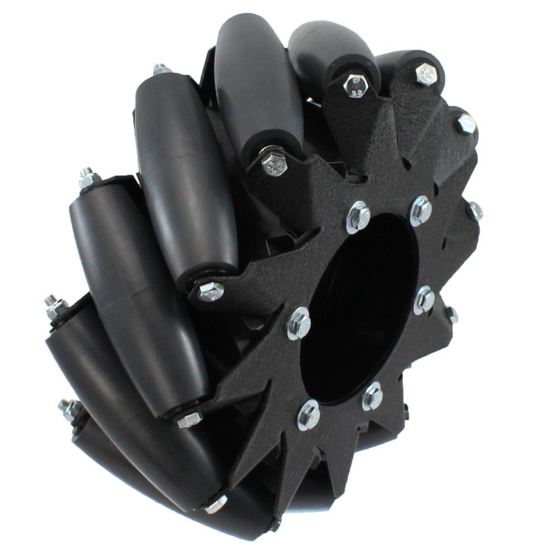



Next
Steps

Slide 50
Next Steps

Slide 51
Next Steps
Utilize full robot capabilities
Use all 8 directions for more efficient movements and dynamically control the arm.

Slide 52
Next Steps
Improve Communication
Replace Bluetooth with Wi-Fi for faster and longer-range wireless control.

Slide 53
Next Steps
Onboard Processing
Shift image processing to the robot itself for more autonomy.

Slide 54
Next Steps
Enhanced Object Detection
Implement AI/ML for detecting more object types with higher accuracy.

Slide 55
Next Steps
Robotic Arm Upgrade
Stronger, more precise arm capable of handling varied objects.

Slide 56
Next Steps
Battery Optimization
Integrate higher-capacity or swappable rechargeable batteries, and add an efficient power management system to extend operating time.

Slide 57
Next Steps
Mobile App Enhancements
Smarter app with live camera feed, object tracking, and advanced controls.

Slide 58
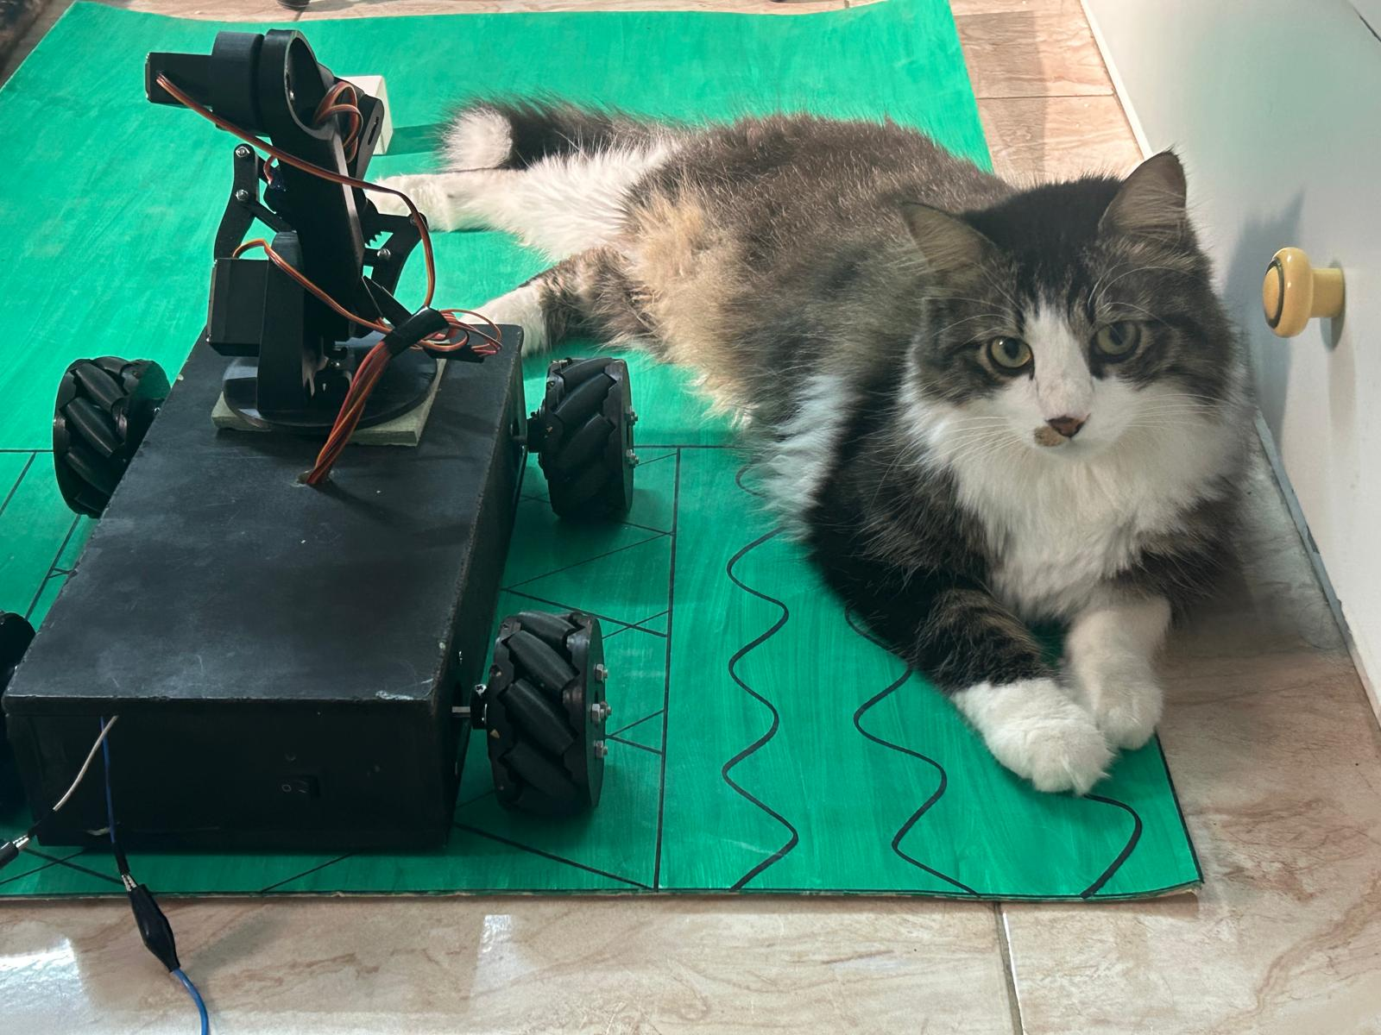
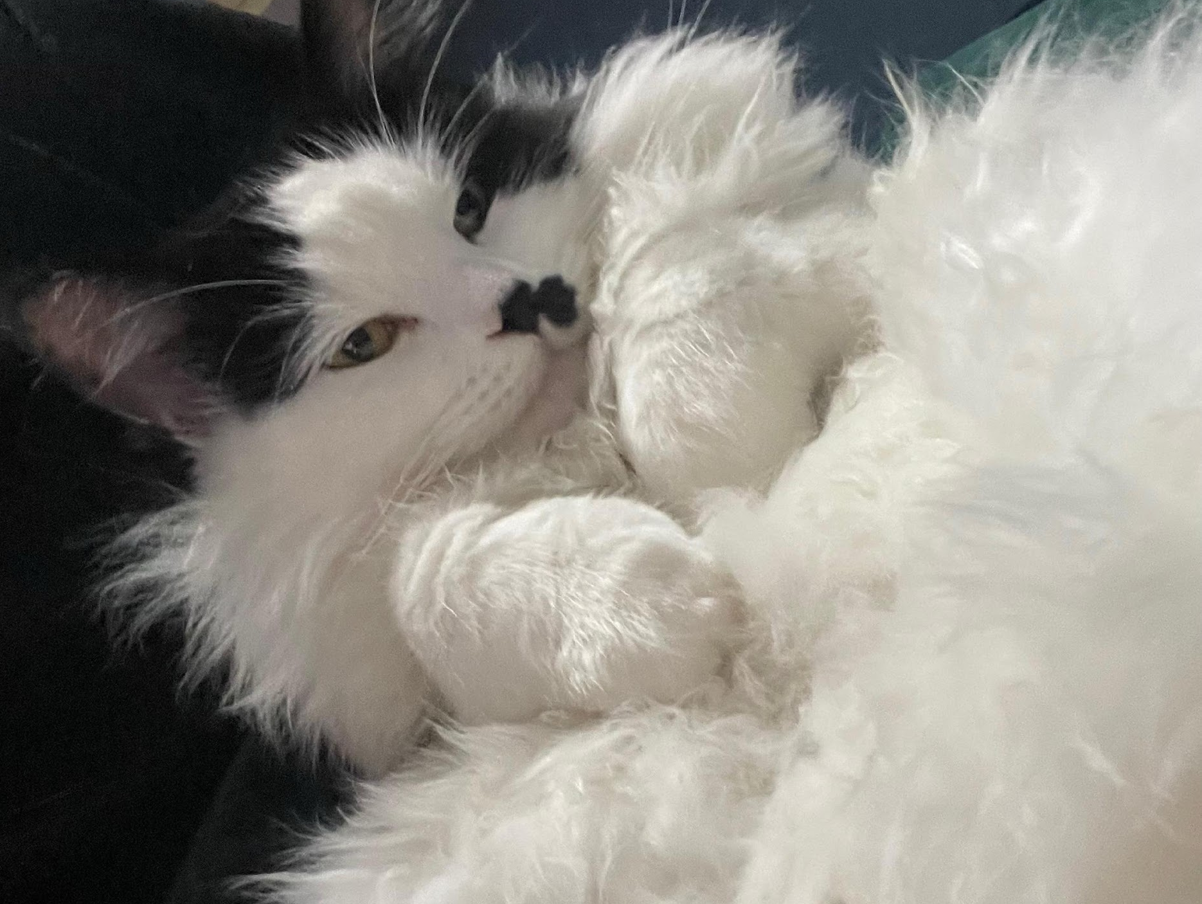
Q&A
Thank you for you time!
Any questions?

