Slide 1

Reconfigurable Antenna by
Ahmed Alawneh, Mohammed Mansour and Alaa Rawajbeh
The supervisor: Dr. Allam Mousa
2014
An-Najah National University
Fuculty of Engineering
Telecommunication Engineering Department

Slide 2
Overview
the reconfigurable antenna is a new technology for next generation of wireless network
it has the ability to modify its geometry and behavior
adapt the changes in environmental conditions or system requirements
such as:
enhanced bandwidth, change in operating frequency, polarization, radiation pattern etc.

Slide 3
Objectives
Type of the Reconfigurable antennas
Implement reconfigurable antenna
Frequency reconfigurable antenna
Channel hopping in Wi-Fi
Pattern reconfigurable antenna
BER Improvement

Slide 4
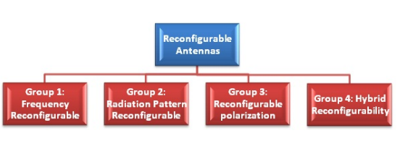
Types of Reconfigurable antenna

Slide 5
Types of Reconfigurable antenna
Types | Process | Applications
Frequency Reconfigurable Antennas | Change the surface current distribution | WLAN, GSM, UMTS, PCS, Bluetooth, Cognitive Radio
Pattern Reconfigurable Antennas | Change the radiating edges, slots or the feeding network | MIMO, Software Defined Radio,
Polarization Reconfigurable Antennas | Change the antenna surface structure or the feeding network | Satellite Communication, MIMO, Cognitive Radio

Slide 6
In this project we work on two reconfigurable types:
1- Frequency reconfigurable antenna
2- Pattern reconfigurable antenna

Slide 7
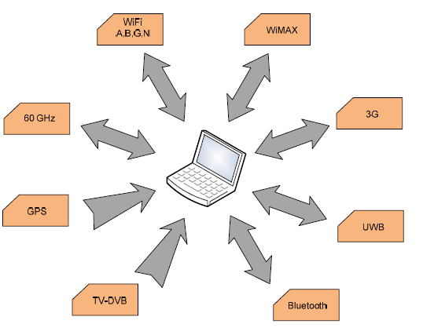
Frequency Reconfigurable antenna
The Problem:
A single wireless device such as laptop and mobile need to support a number of communication standards ( e.g. WIMAX,3G ,Bluetooth ,GPS ,Wi-Fi, UWB)

Slide 8
The Solutions:
Individual antenna for each standard ( lack of space and the strong coupling between radios)
multiband antennas (more filters , large space)
Frequency reconfigurable antenna (less space and filters)

Slide 9
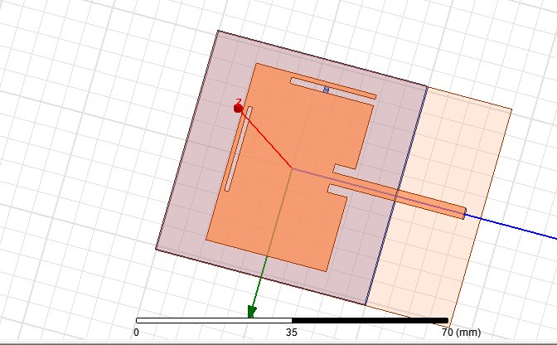
Our Design of frequency RA
We used HFSS program to design a Microstrip reconfigurable antenna to operate in two scenarios:
Single-band 2.4 GHz.
Dual-band 2.4 &3.5 GHz.

Slide 10
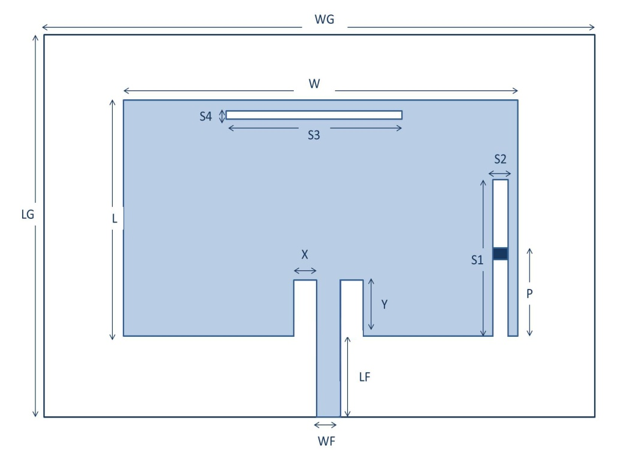
Re-configurability Implementation
Parameter | Value/mm
Width of Patch (W) | 42
Length of Patch (L) | 28.73
Width of Ground (WG) | 52
Length of Ground (LG) | 50
Width of Feed Line (WF) | 2.7
Length of Feed Line (LF) | 31.735
Patch & Ground Thickness (M) | 0.05
Substrate Thickness (H) | 1.6
Insert Width (X) | 2
Insert Length (Y) | 4.8
Vertical Slot Width(S1) | 20
Vertical Slot Length(S2) | 1.5
Horizontal Slot Width(S3) | 20
Horizontal Slot Length (S4) | 1
PIN Diode Switch (P) | 12
horizontal and vertical slots with ON/OFF PIN diode switch are used to allow the reconfigurable antenna to operate in two scenarios

Slide 11
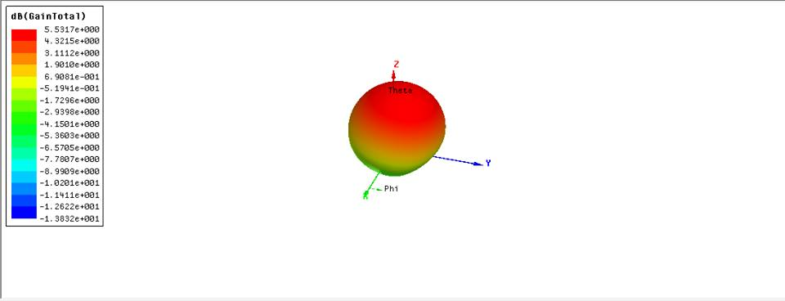
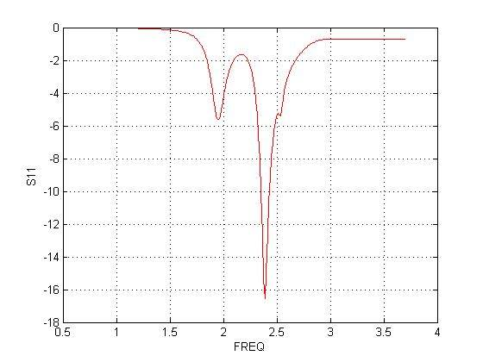
When PIN diode is in ON mode the resonant frequency measured at 2.4 GHz with return loss -16.5 and gain of 5.5 dB as illustrated in Figures below .

Slide 12
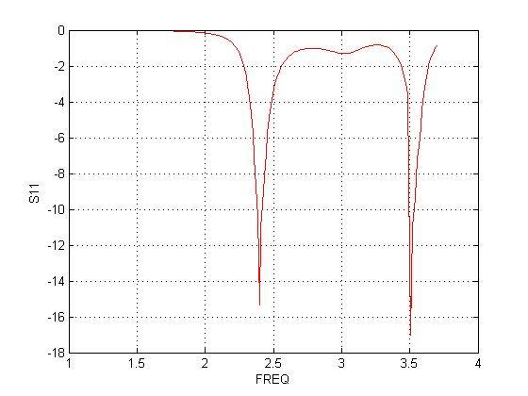
When PIN diode is in OFF mode the resonant frequencies measured at 2.4 and 3.5 GHz with return loss -14.6 & -16.5dB respectively as shown in the figure below.

Slide 13
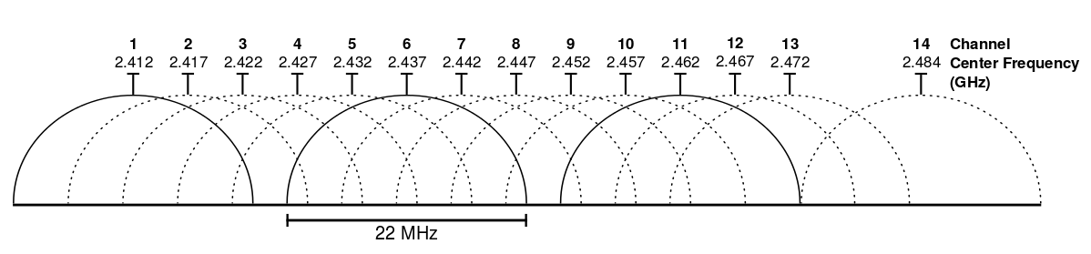
Frequency channel hopping on Wi-Fi

Slide 14
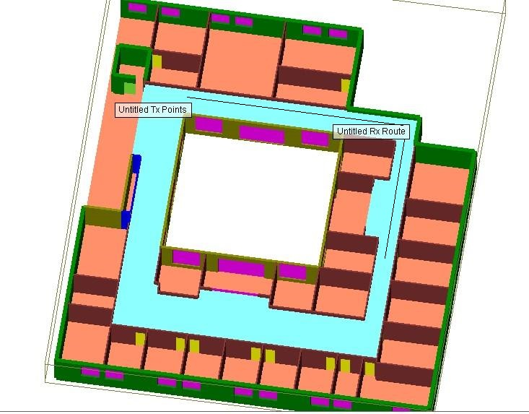
Wireless InSite Simulation Design for Faculty of Engineering

Slide 15
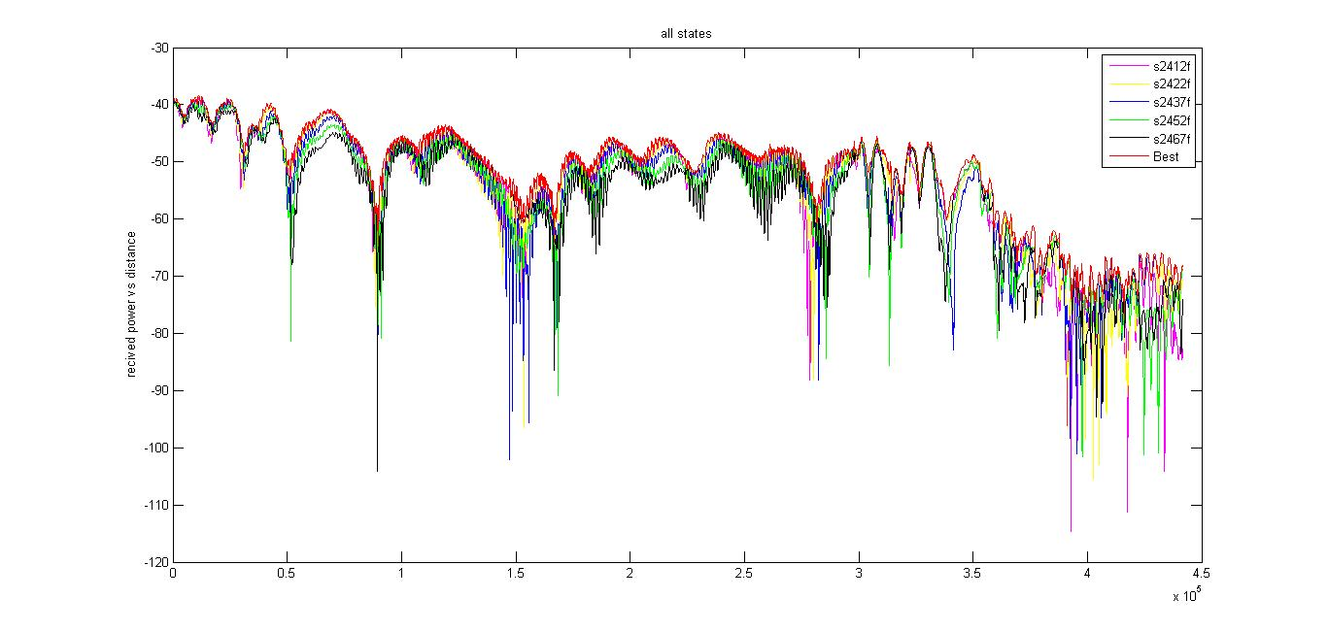
Power(dB) of various Wi-Fi channel

Slide 16
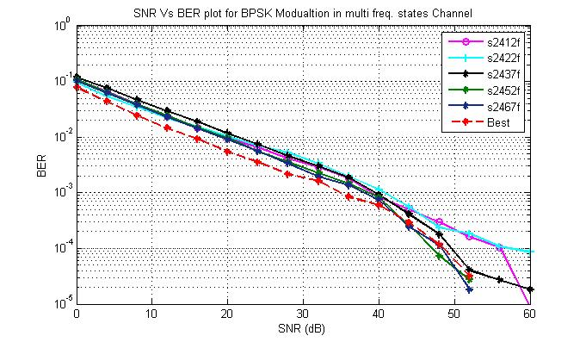

Slide 17
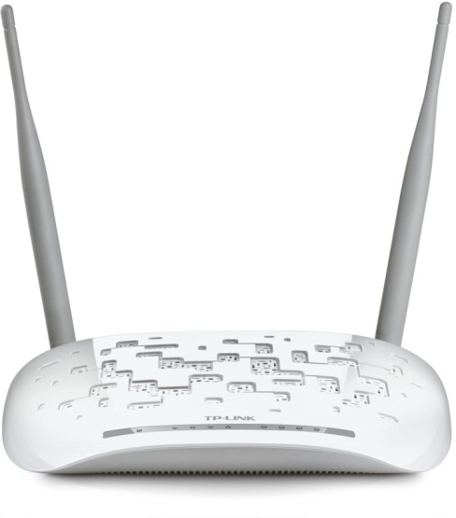
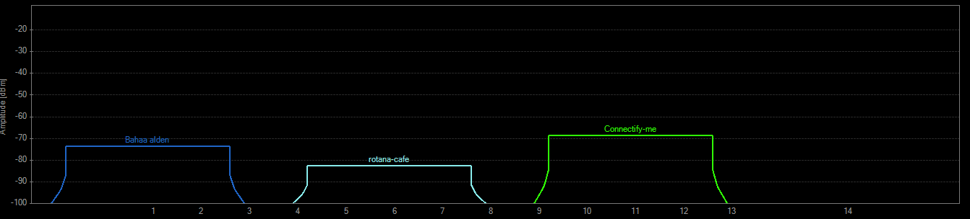
Frequency channel hopping on Wi-Fi

Slide 18
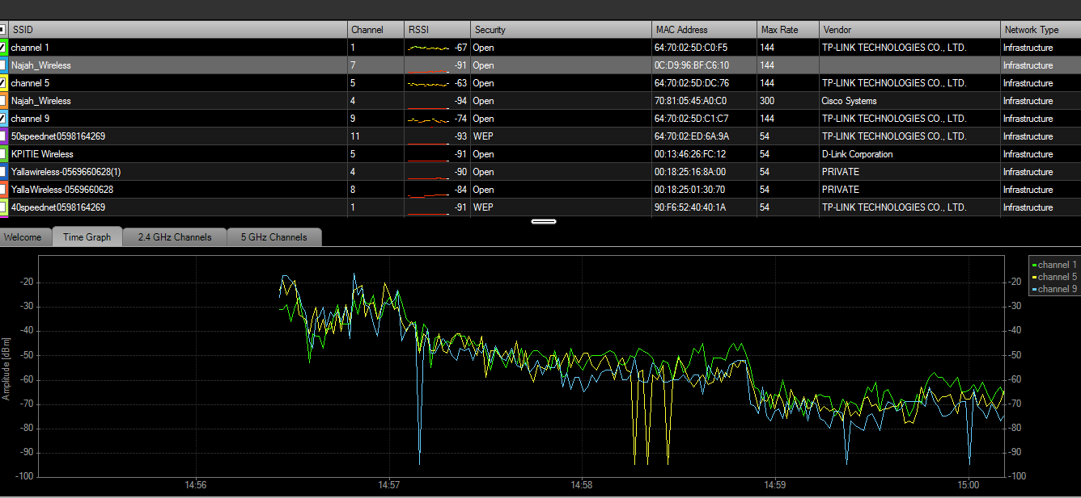

Slide 19
Pattern Reconfigurable antenna
The Problem:
multipath fading in indoor propagation model for
Wi-Fi technology.
The solution:
Pattern Reconfigurable antenna

Slide 20
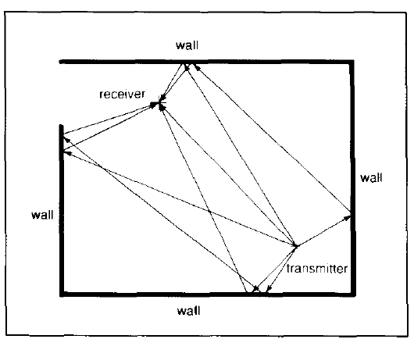
Fading and Multipath
Fading refers to the distortion that comes form the Multipath

Slide 21
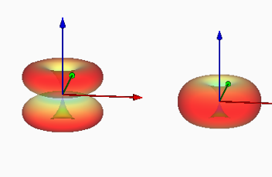
Beam for Dipole Antenna L/2, L

Slide 22
Wireless InSite Simulation Design for Faculty of Engineering

Slide 23
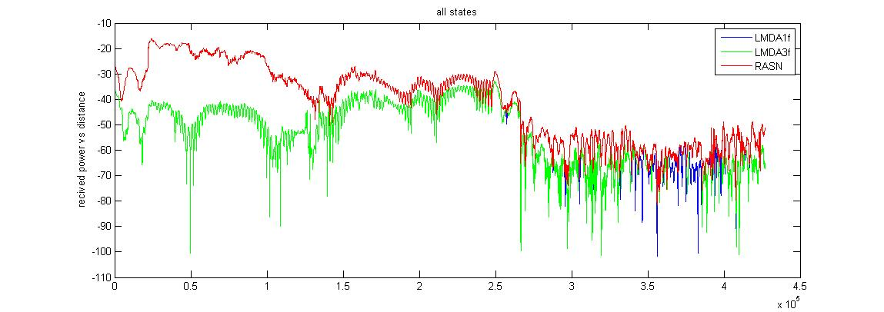
Received signal power in (dBm) for different antenna radiation patterns Vs. Distance points

Slide 24
The Communication System
Generate bits
Convolutional Coding
BPSK modulation
Channel
Demodulation
Decoding
BER Calculations

Slide 25
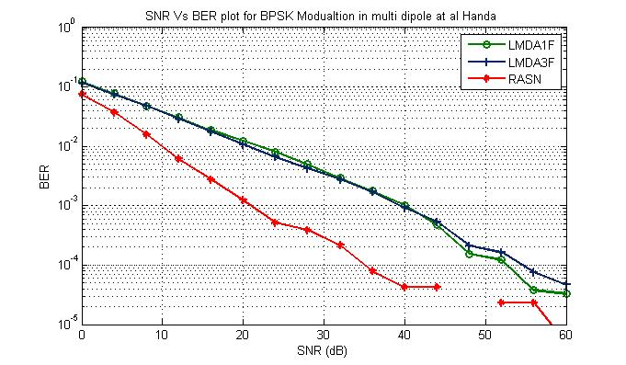
BER improvement

Slide 26
Results
frequency reconfigurable antenna its possible to make a multiband with one antenna
Reconfigurable with Wi-Fi channel improve the BER
Patten reconfigurable antenna reduce the the transmit power needed by nearly 10 db

Slide 27
Future Vision
Reconfigurable antenna will see the light up with new generations of Wireless technology.

Slide 28
Thank you

