Slide 1

An-Najah National University
Faculty of Engineering
Civil Engineering Department
REDESIGN OF SANUR – QABATYA ROAD
Prepared by:
Ahmad Mansour
Mahmoud ALTaha
Nser Daood
Ziyad Omar
Supervisor: Amjad Issa

Slide 2

Project Outline
INTRODUCTION
METHODOLOGY
DATA COLLECTION AND ANALYSIS
TRAFFIC ANALYSIS
GEOMETRIC DESIGN
PAVEMENT DESIGN
TRAFFIC CONTROL DEVICES
INTERSECTIONS DESIGN
BILL OF QUANTITY AND COST
CONCLUSIONS AND RECOMMENDATIONS

Slide 3
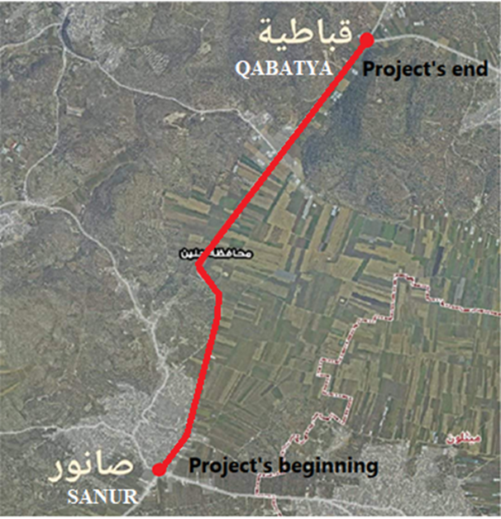
INTRODUCTION
Study Area
Sanur – Qabatya
street

Slide 4
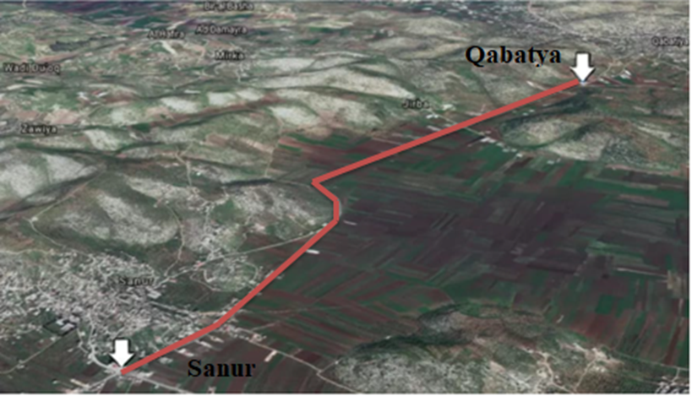
3D Map of Sanur – Qabatya Street

Slide 5
Objective
Geometric design
LOS and capacity
pavement design
Bill of quantity
considering the existing conditions

Slide 6
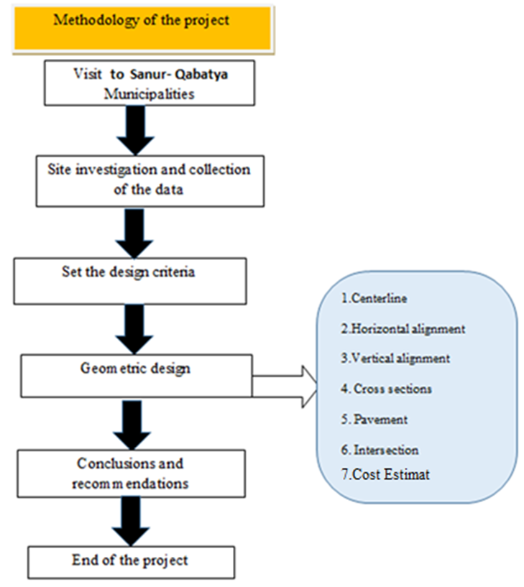
METHODOLOGY

Slide 7
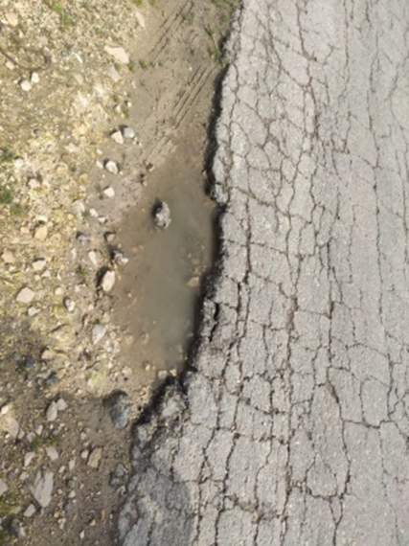
DATA COLLECTION AND ANALYSIS
Edge and alligator Crack

Slide 8
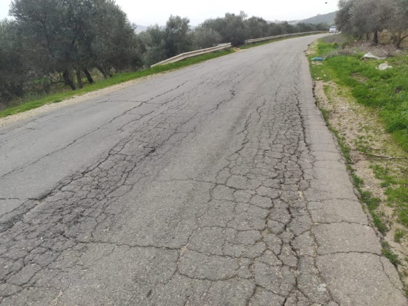
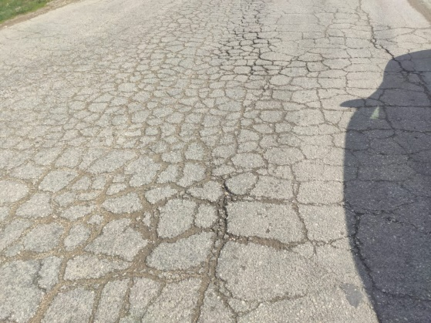
Longitudinal, block and alligator Crack

Slide 9
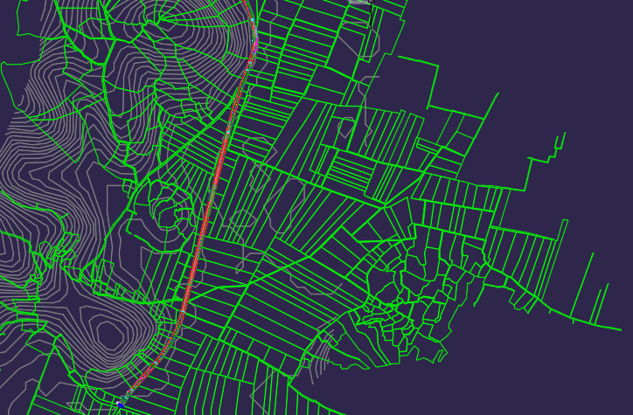
Master Plan and Contour Lines of 5 m Intervals

Slide 10

The Peak Hour Traffic Count Results
DHV = $\frac{PHV}{PHF}$

Slide 11
The Peak Hour Traffic Count Results
Vehicles Classification

Slide 12
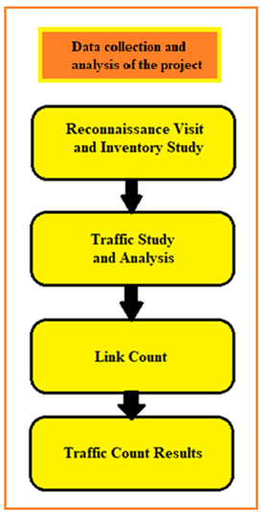
Data collection and analysis flowchart

Slide 13
TRAFFIC ANALYSIS
Sanur – Qabatya Street is Classified as a two-lane high of Class II as referred to by the (HCM).
Two conditions will be considered:
Existing conditions for the street.
Future conditions for the street.

Slide 14
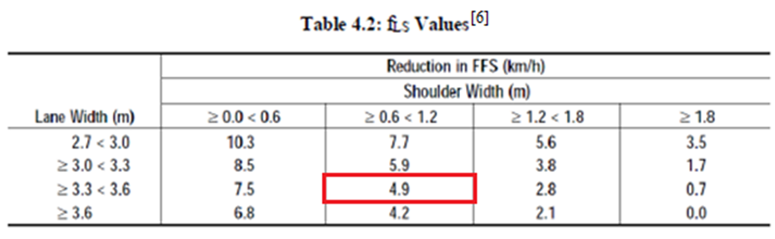
Analysis of the Existing Conditions
FFS = BFFS – fLS – fA
Assume BFFS = 85 km/h.
fLS = 4.9 Km/h according to the following table.

Slide 15
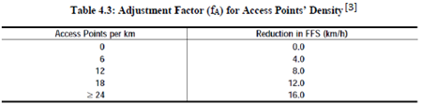
Analysis of the Existing Conditions
fA = 0.0
So, FFS = 85 – 4.9 – 0 = 80.1 km/h

Slide 16
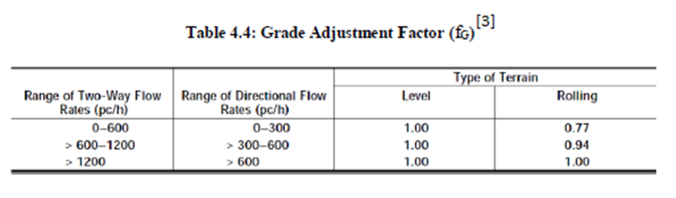

Analysis of the Existing Conditions
$Vd=\frac{v}{PHF∗fG∗fHV}$
PHF = 0.75
$fG$ is equal 1 according to the following Table.

Slide 17
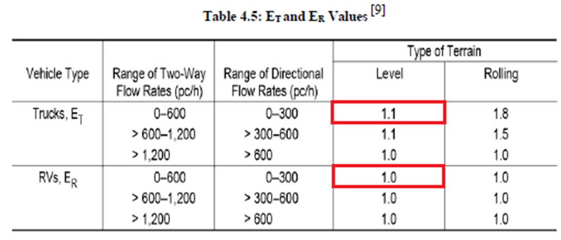

Analysis of the Existing Conditions
$fHV$=$\frac{1}{1+PT\left(ET−1\right)+PR\left(ER−1\right)}$
ET = 1.1, ER =1.0 from the following Table.

Slide 18
Analysis of the Existing Conditions
From the traffic survey done and illustrated in Chapter3, PT = 4.37%, PR = 0%.
So, fHV = 0.695
All the previous data are entered on the software as shown in Appendix B.

Slide 19
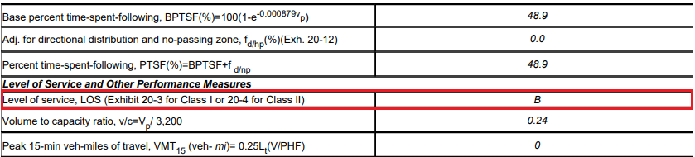
Analysis of the Existing Conditions
Result of LOS (Existing Conditions)

Slide 20
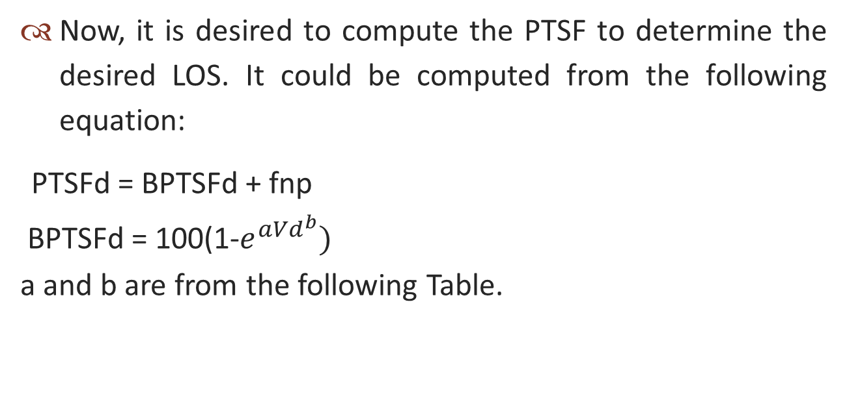
Analysis for the Future Condition
Now, it is desired to compute the PTSF to determine the desired LOS. It could be computed from the following equation:
PTSFd = BPTSFd + fnp
BPTSFd = 100(1-$e^{aVd^{b}})$
a and b are from the following Table.

Slide 21
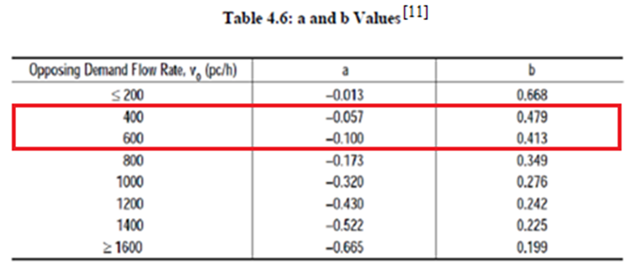
Analysis for the Future Condition
Since VO is 514 pc/h, by interpolation a = -0.084 and b = 0.441.

Slide 22
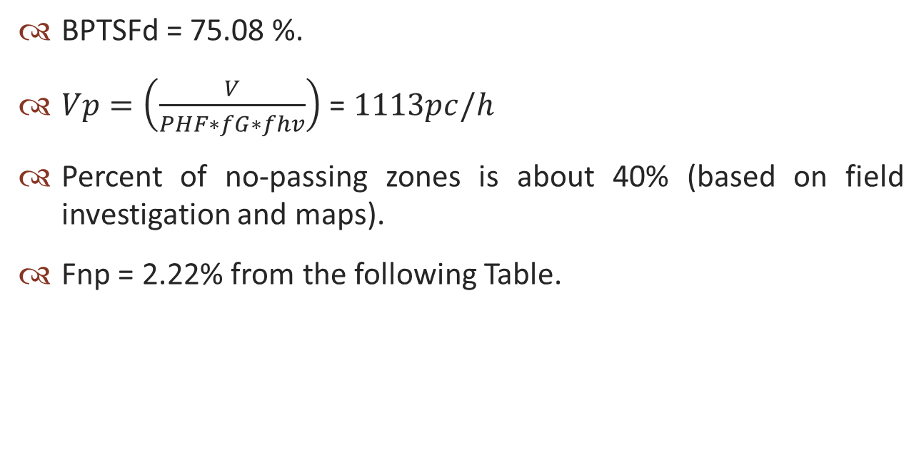
Analysis for the Future Condition
BPTSFd = 75.08 %.
$Vp=\left(\frac{V}{PHF∗fG∗fhv}\right)$ = $1113pc/h$
Percent of no-passing zones is about 40% (based on field investigation and maps).
Fnp = 2.22% from the following Table.

Slide 23
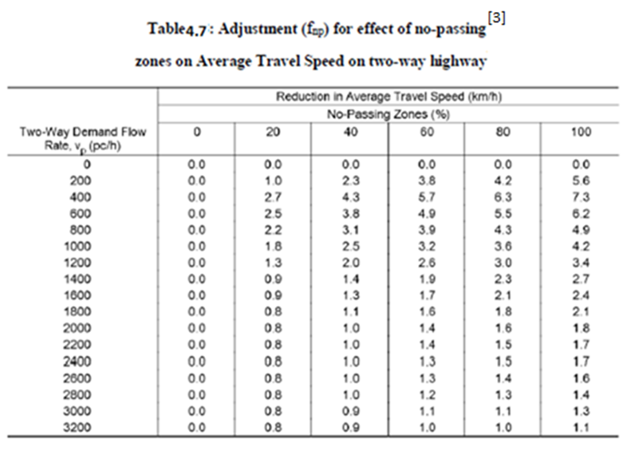
Analysis for the Future Condition

Slide 24
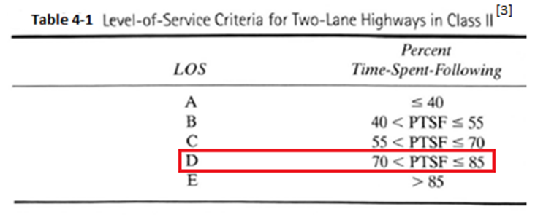
Analysis for the Future Condition
PTSFd = 75.08+2.22 = 77.30%
So the desired LOS is D from the following Table.

Slide 25
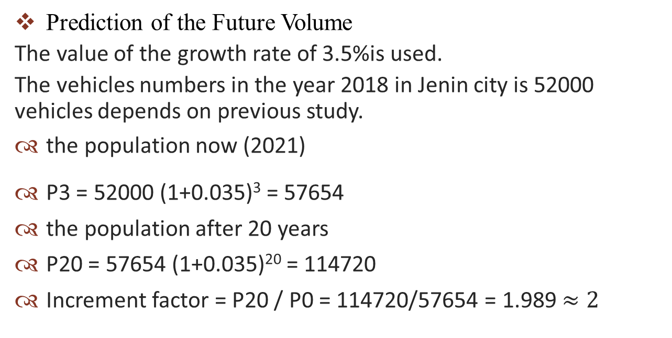
Analysis for the Future Condition
Prediction of the Future Volume
The value of the growth rate of 3.5%is used.
The vehicles numbers in the year 2018 in Jenin city is 52000 vehicles depends on previous study.
the population now (2021)
P3 = 52000 (1+0.035)³ = 57654
the population after 20 years
P20 = 57654 (1+0.035)²⁰ = 114720
Increment factor = P20 / P0 = 114720/57654 = 1.989$≈2$

Slide 26
Analysis for the Future Condition
So, DHV= 760*(2) = 1520 veh/h.
The value of K equal to 0.18 for rural areas.
Now we must calculate AADT:
DHV = K*AADT
AADT = DHV/K = 1520/0.18 = 8445 veh/day.
The level of service analysis for future conditions is presented in Appendix C.

Slide 27
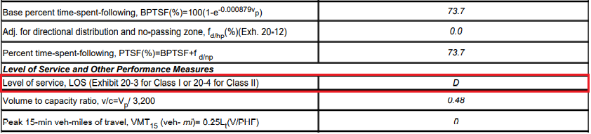
Analysis for the Future Condition
LOS for the street in 20 Years
According to HCS results, the LOS (D) after 20 years equal to the minimum desire LOS(D) so no need for another lane the road will be the same (two way – two lane).

Slide 28
GEOMETRIC DESIGN
Horizontal Alignment Design Criteria
Design Speed
recommended design speed ranges from 70 km/h to 80 km/h based on AASHTO (2018).
Design Vehicle
The design vehicle for this street is a (WB-20) based on the traffic count survey.

Slide 29
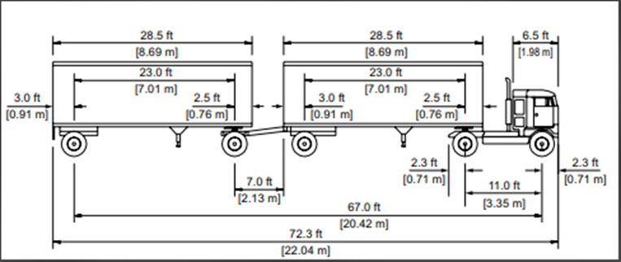
The Design Vehicle Dimensions - WB-20
The characteristics of this vehicle as described in AASHTO (2018) are:
Width = 2.59m. Length = 22.04m. Height = 4.11m.

Slide 30
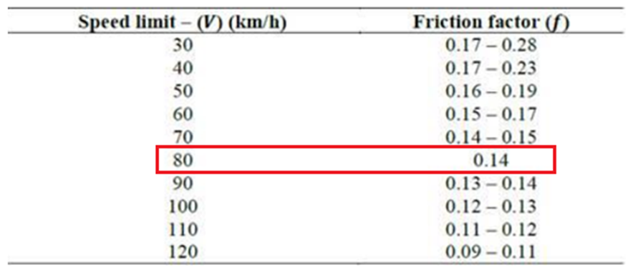
GEOMETRIC DESIGN
Super elevation
A value of 8% super elevation rate was considered as a maximum value to determine the minimum radius.
Side Friction Factor
fs is 0.14 based on AASHTO (2018), see the following Table

Slide 31
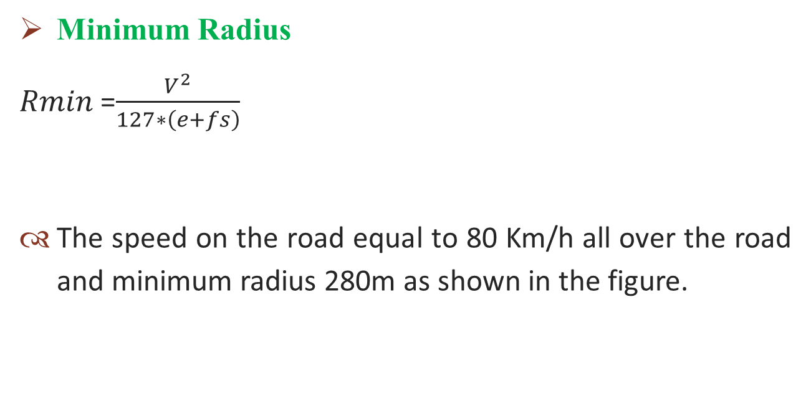
GEOMETRIC DESIGN
Minimum Radius
𝑅𝑚𝑖𝑛 =$\frac{V^{2}}{127∗\left(e+fs\right)}$
The speed on the road equal to 80 Km/h all over the road and minimum radius 280m as shown in the figure.

Slide 32
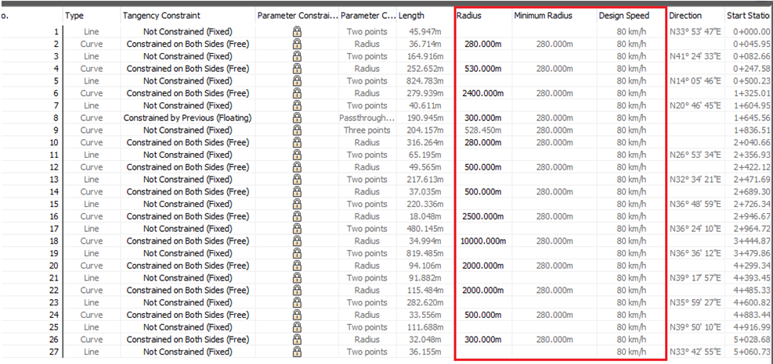
GEOMETRIC DESIGN
Design criteria from (civil 3D 2018)

Slide 33
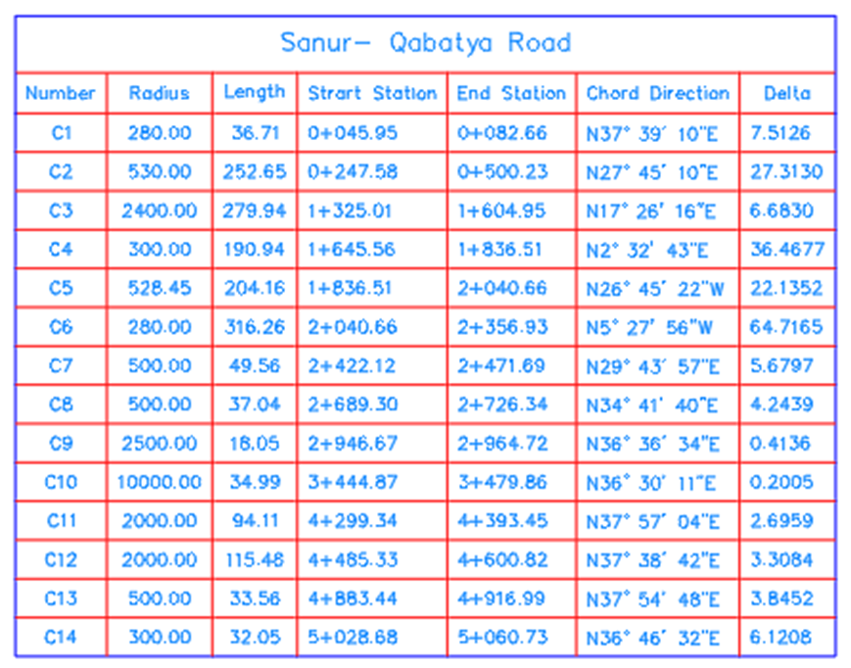
GEOMETRIC DESIGN
Horizontal Curves Radius values

Slide 34
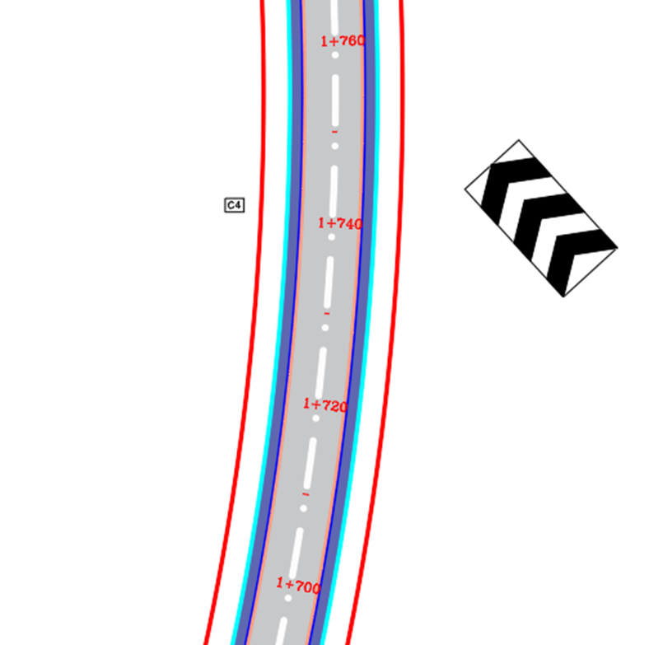
GEOMETRIC DESIGN
Example on Horizontal Curve

Slide 35
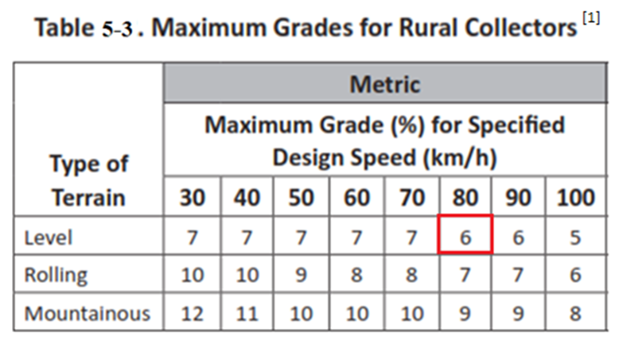
GEOMETRIC DESIGN
Vertical Alignment
According to the following Table the maximum grade for this street is 6%.

Slide 36
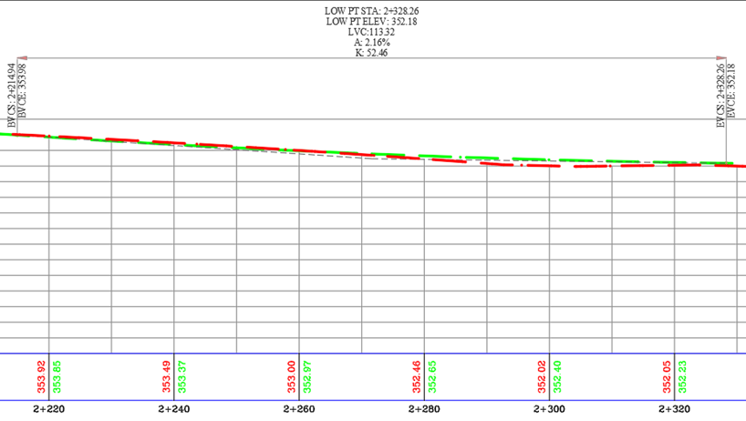
GEOMETRIC DESIGN
The following figure shows the proposed profile (vertical curve) of the street.

Slide 37
GEOMETRIC DESIGN
Cross Section
Travel Lanes
lane width was chosen to be 3.6 m.
Shoulders
Shoulders 1.5m wide was used.
It was preferred to use concrete shoulders.

Slide 38
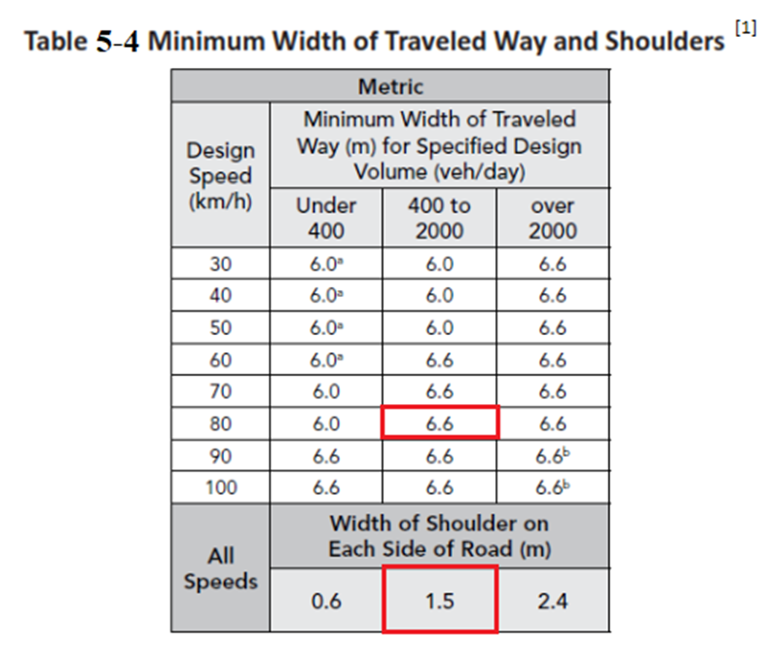
GEOMETRIC DESIGN

Slide 39
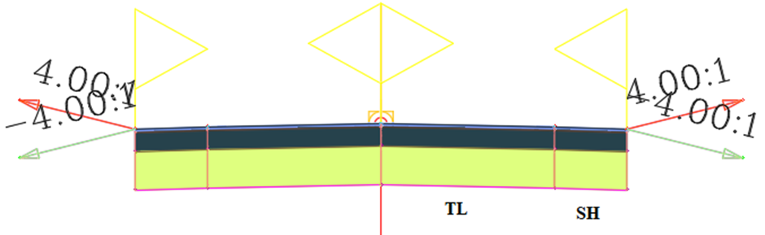
GEOMETRIC DESIGN
Example on Cross Section with Lanes and Shoulders

Slide 40
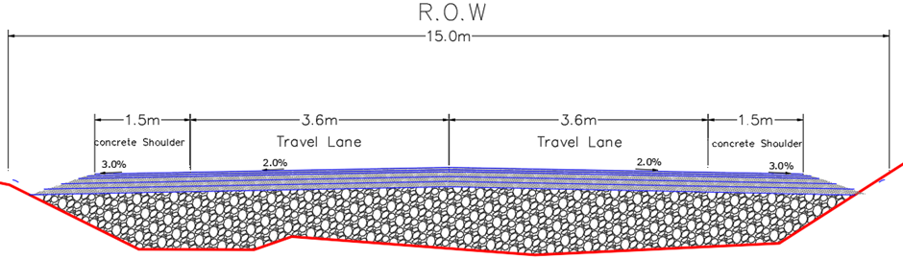
GEOMETRIC DESIGN
Typical designed cross-section.

Slide 41
PAVEMENT DESIGN
Introduction
Pavement design is the major component in the road construction. Highway pavements are divided into two main categories flexible and rigid. The type of pavement to be constructed depends on several factors such as Initial cost, Environmental conditions, Traffic intensity, Availability of good materials and Cost of maintenance.

Slide 42
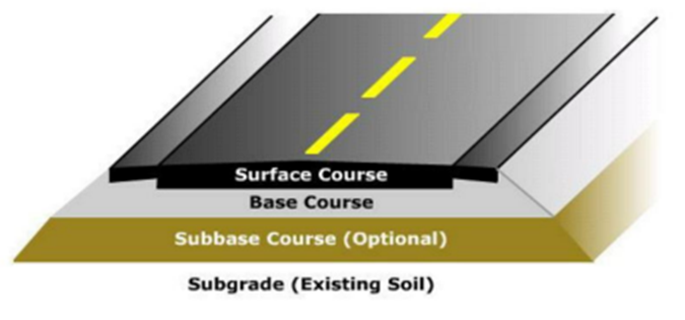
PAVEMENT DESIGN
Structural Components
The structural component of the flexible pavement.

Slide 43
PAVEMENT DESIGN
Geotechnical Report Analyses
Geotechnical results show the moisture content, %finer sieve # 200, plasticity index, maximum dry density, optimum moisture content, California Bearing Ratio, and AASHTO soil classification.

Slide 44
PAVEMENT DESIGN
Tests Results
Sample No. | %finer sieve # 200 | Liquid Limit % | Plasticity Index | Soil Classification | CBR Value
1 | 66 | 34 | 10 | A-6 | 3
2 | 64 | 40 | 17 | A-6 | 4
3 | 63 | 37 | 15 | A-6 | 3
4 | 52 | 35 | 21 | A-6 | 3

Slide 45
PAVEMENT DESIGN
Soil Treatment
The road soil is weak as all samples have low CBR. To improve the strength of the pavement, rock fill and geotextile materials were used.

Slide 46
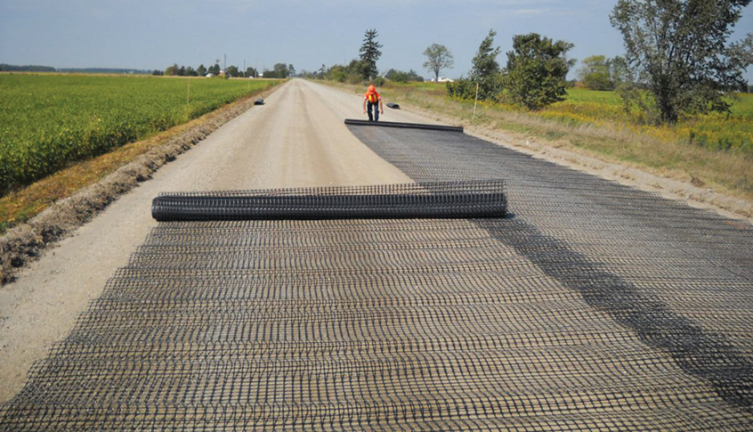
PAVEMENT DESIGN
Geotextile

Slide 47
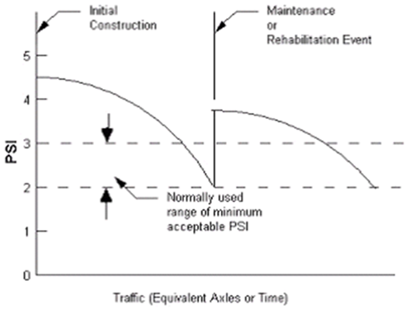
PAVEMENT DESIGN
Structural Design
Pavement Performance
Serviceability Index
Pi = 4.5 Pt for collector roads = 2.0 PSI = 4.5 – 2 = 2.5

Slide 48
PAVEMENT DESIGN
Traffic Load
ESAL can be calculated from the following equation:
𝐸𝑆A𝐿𝑖 = 𝑓𝑑 × 𝐺𝑟𝑛 × 𝐴𝐴𝐷𝑇𝑖 × 365 × 𝑁𝑖 × 𝐹𝑒𝑖
The reference axle load is an 18,000-lb. single axle with dual tires.

Slide 49
PAVEMENT DESIGN
The total ESAL is computed as illustrated in the Table.
Vehicle Class | %Vehicle | Vehicle No. | ESAL Factor | Vehicle No.*ESAL Factor
Passenger cars (class A) | 75.70 | 3196 | 0.0004 | 1.2788
Taxi van (class B) | 17.80 | 752 | 0.02 | 15.0400
SU 2 axle 4 tiers (class C) | 1.60 | 68 | 0.02 | 1.3600
SU 2 axle 6 tiers (class C) | 0.53 | 22 | 0.21 | 4.6200
Bus (class C) | 1.13 | 48 | 0.21 | 10.0800
Truck / Trailer (class D) | 3.24 | 137 | 0.98 | 134.2600
Total | 100.00 |  |  | 165.6388

Slide 50
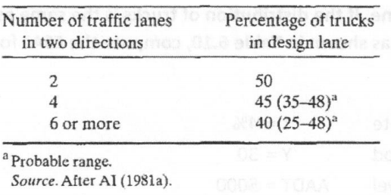
PAVEMENT DESIGN
𝑓𝑑
The value of 𝑓𝑑 = 50% as shown in the Table.

Slide 51
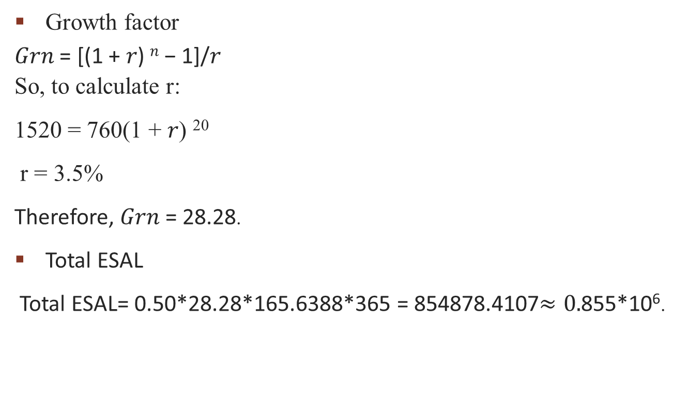
PAVEMENT DESIGN
Growth factor
𝐺𝑟𝑛 = [(1 + 𝑟) ^{𝑛} − 1]/𝑟
So, to calculate r:
1520 = 760(1 + 𝑟) ²⁰
r = 3.5%
Therefore, 𝐺𝑟𝑛 = 28.28.
Total ESAL
Total ESAL= 0.50*28.28*165.6388*365 = 854878.4107$≈0.$855*10⁶.

Slide 52
PAVEMENT DESIGN
Materials of Construction
𝑀𝑟 for asphalt layer = 450,000 𝐼𝑏 /𝑖𝑛²
𝑀𝑟 for base coarse layer = 28,000 𝐼𝑏 /𝑖𝑛²
𝑀𝑟 for sub base layer = 17,500 𝐼𝑏 /𝑖𝑛²

Slide 53
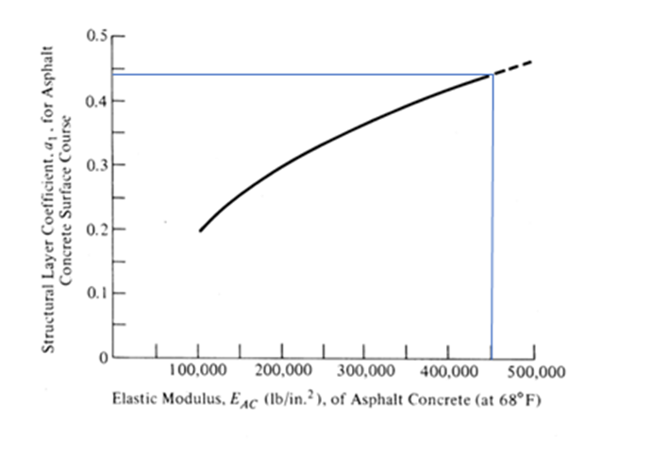
PAVEMENT DESIGN
For asphalt layer a1= 0.44

Slide 54
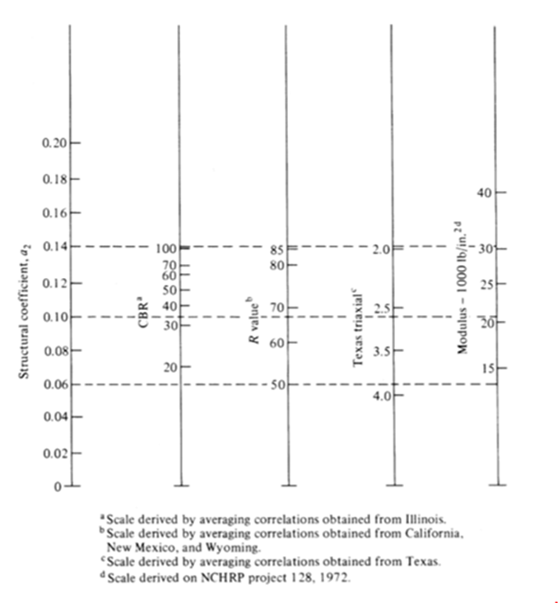
PAVEMENT DESIGN
For base coarse layer a2= 0.14

Slide 55
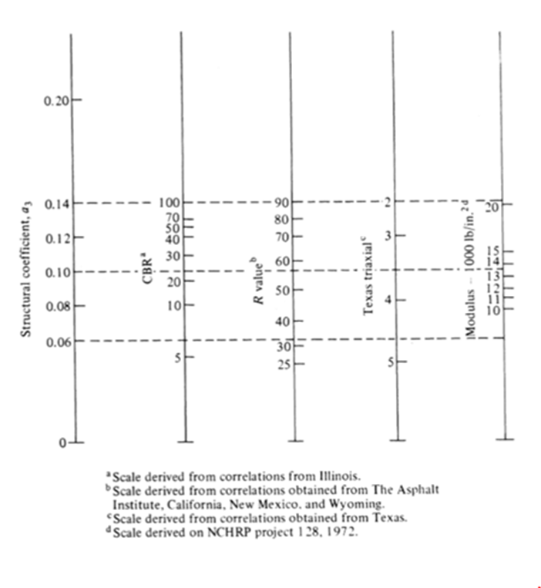
PAVEMENT DESIGN
For sub base layer a3= 0.12

Slide 56
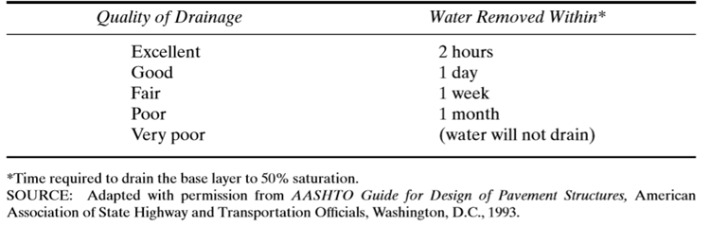
PAVEMENT DESIGN
Drainage
The quality of drainage is fair, then water is removed within one week. The percent saturation condition = (5-25) % So mi = 0.9 from table.

Slide 57
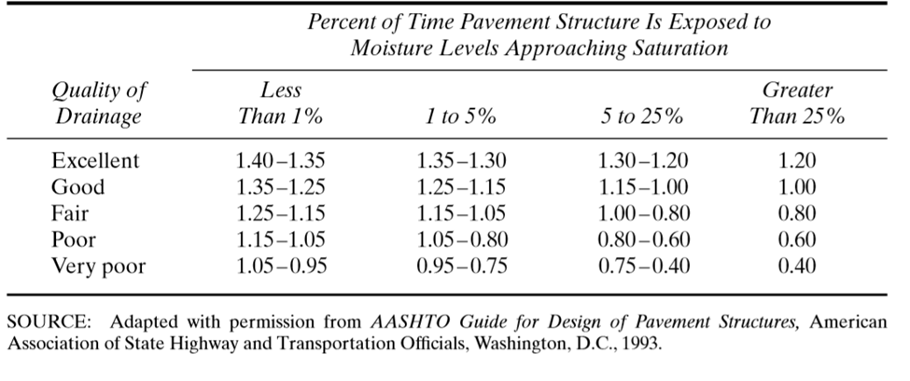
PAVEMENT DESIGN

Slide 58
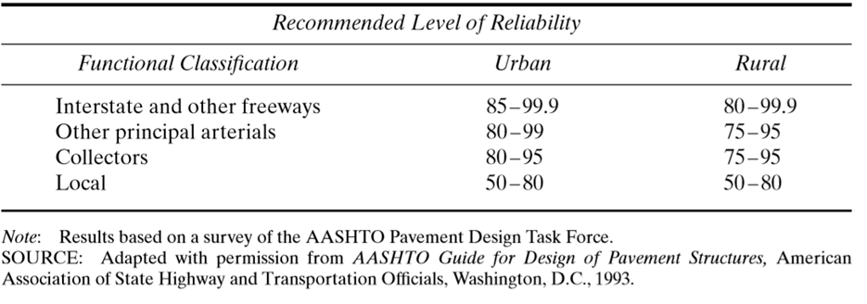
PAVEMENT DESIGN
Reliability
Assumed R=85% from table and standard deviation (S_{o}) = 0.45.

Slide 59
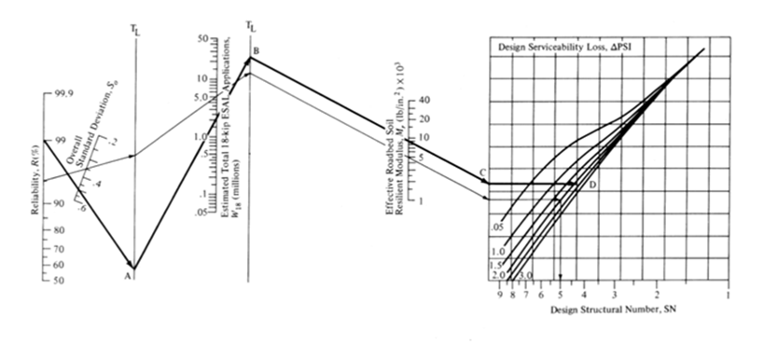
PAVEMENT DESIGN
Structural Design
𝑆𝑁 = 𝑎1𝐷1 + 𝑎2𝐷2𝑚2 + 𝑎3𝐷3𝑚3
The SN could be found from the following graph.

Slide 60
PAVEMENT DESIGN
Two cases of design
1- without Rock fill layer
SN for Base coarse SN1 = 2.0
SN for sub base SN2 = 2.5
SN for subgrade SN3 = 4.0
SN1 = a1 D1 => D1= 4.55 in (11.5cm).
Take D1* = 3 in.
SN1*= a1 D* = 0.44*3.0 = 1.32

Slide 61

PAVEMENT DESIGN
D2* = (SN2−SN1*) /a2m2 = (2.5−1.32)/ (0.13∗0.9) = 10 in.
Take D2* = 8 in SN2*= SN1* +a₂D2*m₂ = 1.32 + (0.13*8*0.9) = 2.26 D3*= (SN3−SN2*)/ a₃m₃ = $\frac{4−2.26}{0.12∗0.9}=16.29in$ Take D3* = 16in (40cm).

Slide 62
PAVEMENT DESIGN
2- with Rock fill layer
If subgrade improved by Rock fill layer, then
Mr = 15000
SN for base coarse SN1 = 2.0
SN for sub base SN2 = 2.5
SN for subgrade SN3 = 2.8
SN1 = a1 D1 => D1= 4.55 in (11.5cm).
Take D1* = 3 in.
SN1*= a1 D* = 0.44*3.0 = 1.32

Slide 63
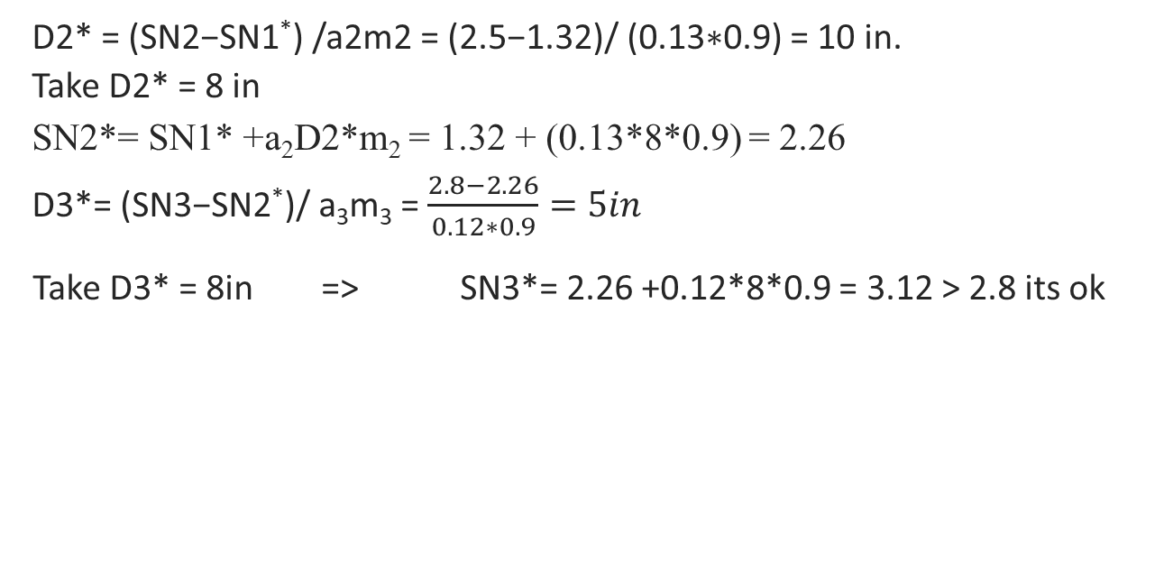
PAVEMENT DESIGN
D2* = (SN2−SN1*) /a2m2 = (2.5−1.32)/ (0.13∗0.9) = 10 in.
Take D2* = 8 in SN2*= SN1* +a₂D2*m₂ = 1.32 + (0.13*8*0.9) = 2.26 D3*= (SN3−SN2*)/ a₃m₃ = $\frac{2.8−2.26}{0.12∗0.9}=5in$
Take D3* = 8in => SN3*= 2.26 +0.12*8*0.9 = 3.12 > 2.8 its ok

Slide 64
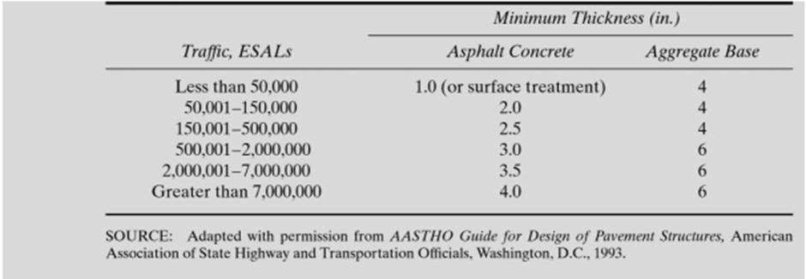
PAVEMENT DESIGN
Recommended Minimum Thicknesses of Highway Layers

Slide 65
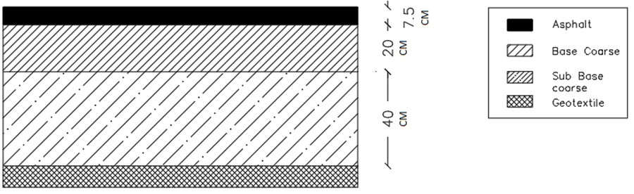
PAVEMENT DESIGN
Summary
1- without Rock fill layer

Slide 66

PAVEMENT DESIGN
2- with Rock fill layer

Slide 67
TRAFFIC CONTROL DEVICES
Introduction
Road traffic control devices are marking, signs, and signal devices used to inform, guide and control traffic, including pedestrians, motor vehicle drivers, and bicyclists.
Traffic Signs
Traffic signs fall into three categories:
• Regulatory signs.
• Warning signs.
• Guidance signs.

Slide 68
TRAFFIC CONTROL DEVICES
Road Surface Markings
They fall into three board categories:
• Longitudinal markings
• Transverse markings
• Word and symbol markings

Slide 69






TRAFFIC CONTROL DEVICES
An example of some of the signs used

Slide 70
INTERSECTION DESGIN
Introduction
An intersections is an area, shared by two or more roads, whose main functions is to provide for change of route directions. An intersections is one of the main sources of traffic conflicts. Intersection is also critical segments of highway in that they can affect the operational characteristic and safety of the highway.
Types of Intersections
Intersections at grade
Grade separations without ramps
interchanges

Slide 71
INTERSECTION DESGIN
At-grade intersections are three types:
Three - leg intersections.
Four- leg intersections.
Multi- leg intersections.
Geometric Design
The design vehicle is the WB-20 it has been taken into consideration so the intersection is designed according to this design vehicle with minimum turning radius of 13.7 m.

Slide 72

INTERSECTION DESGIN

Slide 73
BILL OF QUANTITY AND COST
The estimated total cost of Sanur - Qabatya road is 2605027 $

Slide 74
Recommendation
The project team recommended to give priority to the targeted road by the Ministry of Public Works and Housing and rehabilitation as the road is important, vital and links between the two governments Nablus and Jenin.

Slide 75



THANK YOU

