Slide 1

POWERING AGRICULTURAL PUMPS BY SOLAR ENERGY IN TULKAREM DISTRICT
Graduation Project II
Made by (Students):
Eng. Mohammed Ramadan
Eng. Qusai Al-Khalil
Eng. Muhannad Tobeh
Supervisor:
Dr. Ihab Al-Surakji

Slide 2

Presentation Content
Introduction
Selection and sample study
Technical Study
Site View
Components Selection Criteria
PVSYST Software
Manual Calculations
Feasibility Study
Capital Cost
Payback Period
Regulations and Laws
Conclusion

Slide 3

Introduction:
What did we do?
GP I: Selection and analyzing
Design Process of a full PV Solar On-Grid System
Economic Feasibility of implementing the project

Slide 4
Overview
Collect Data
Wells’ Data
Prioritize and select
Design the system
Solar PV cells calculations
Feasibility Study
Regulations and laws
Site View

Slide 5

Technical Study
PVSYST Software
Manual Design and calculations

Slide 6
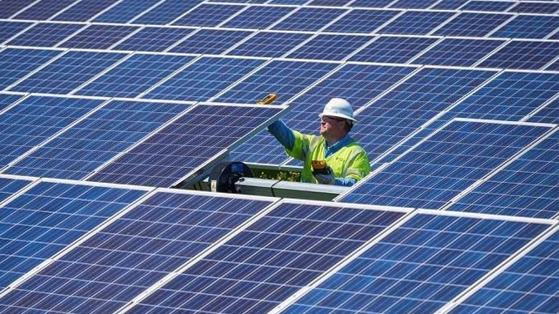
Technical Study:
PV Cells Selection Criteria
Presenting the existing types of Solar PV cells in the Palestinian Market is to select the best choice depending on specific criterions.
The criteria depends on several factors: Efficiency, Output Power, Cost, Temperature Coefficient.

Slide 7
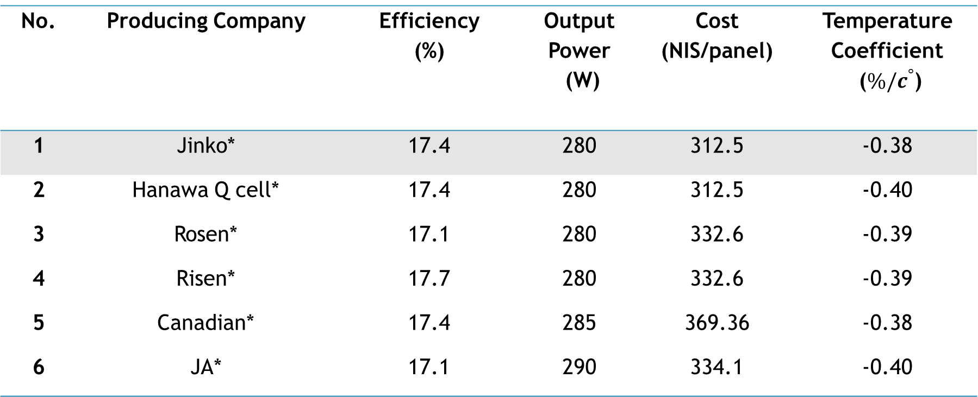
Technical Study: PV Cells Selection Criteria
Table 1: Description of commercial Solar PV cells available in Palestinian local market.
No. | Producing Company | Efficiency (%) | Output Power (W) | Cost (NIS/panel) | Temperature Coefficient ($\%/c^{°}$)
1 | Jinko* | 17.4 | 280 | 312.5 | -0.38
2 | Hanawa Q cell* | 17.4 | 280 | 312.5 | -0.40
3 | Rosen* | 17.1 | 280 | 332.6 | -0.39
4 | Risen* | 17.7 | 280 | 332.6 | -0.39
5 | Canadian* | 17.4 | 285 | 369.36 | -0.38
6 | JA* | 17.1 | 290 | 334.1 | -0.40

Slide 8
Technical Study: PV Cells module selection
Table 2: Description of JINKO Solar PV cells available in Palestinian local market.
Specifications
Module Type | JKM275P | JKM280P | JKM285P | JKM290P | JKM295P
Maximum Power at STC (P_{max}) | 275 Wp | 280 Wp | 285 Wp | 290 Wp | 295 Wp
Maximum Power Current (I_{mp}) | 7.77 A | 7.89 A | 7.92 A | 7.97 A | 8.02 A
Module Efficiency (%) | 14.17 % | 14.43 % | 14.69 % | 14.95 % | 15.20 %
Temperature coefficient of P_{max} | -0.45 %/C ̊

Slide 9
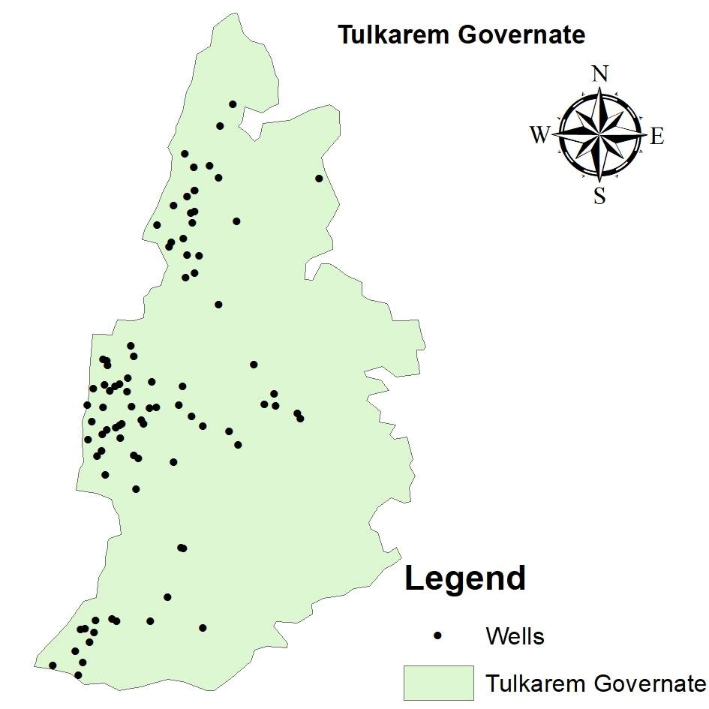
Why Tulkarem In Specific?
The importance of Agricultural Sector in Tulkarem
There is 54 Agricultural Water Wells in Tulkarem District
Agriculture is an essential income source for the people of Tulkarem
Tulkarem suffers from a serious power shortage problem
Figure 1: Wells locations in Tulkarem governorate

Slide 10
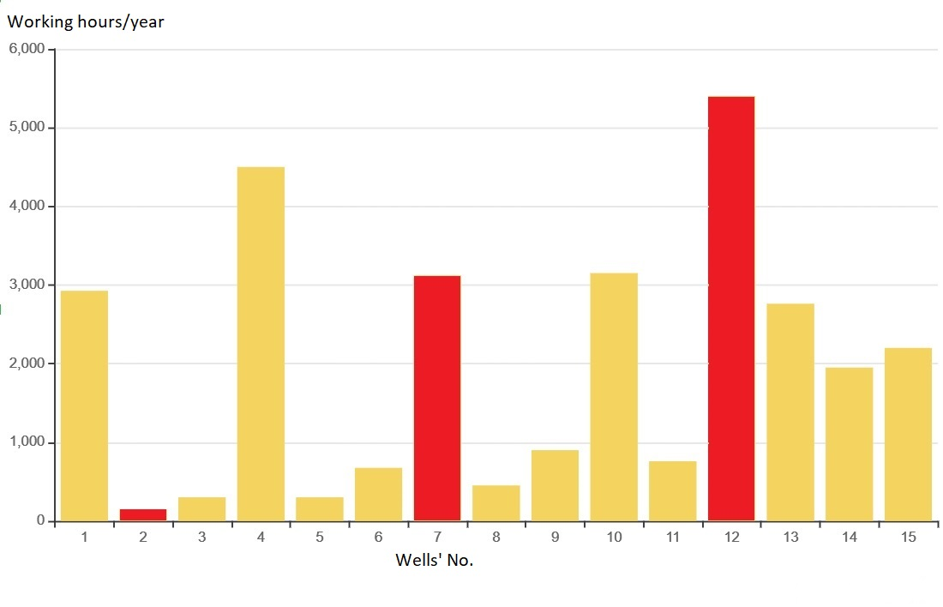
Case Study: Results
Figure 2: Average working hours of wells in Tulkarem per year

Slide 11
Technical Study: Site View
The well has two pumps, recently renewed and installed with 150 hp and 250 hp powers.
The wells’ owner has a piece of land with an estimated space of 1 acre (1000 m far from the well) and is willing to install a PV system to cover the pumps energy needs.
The well distributes water widely, with an average working hours of 5400 hrs/year.

Slide 12
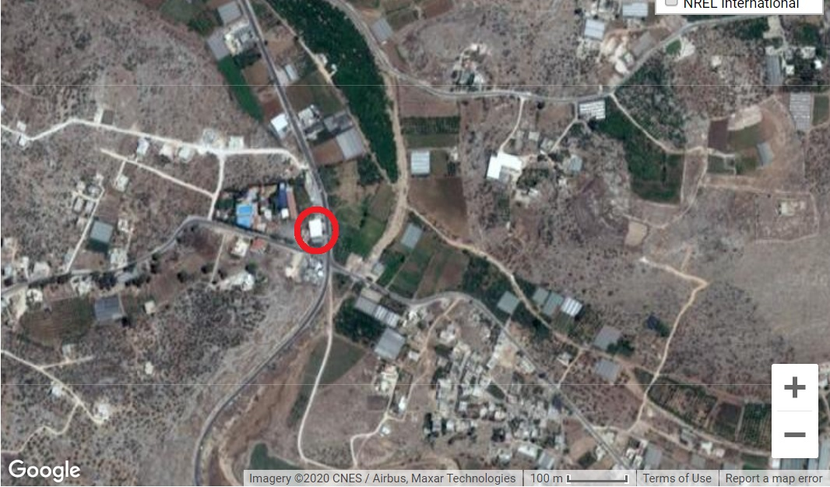
Technical Study: Site View
Figure 3: Suggested Location for the PV project

Slide 13
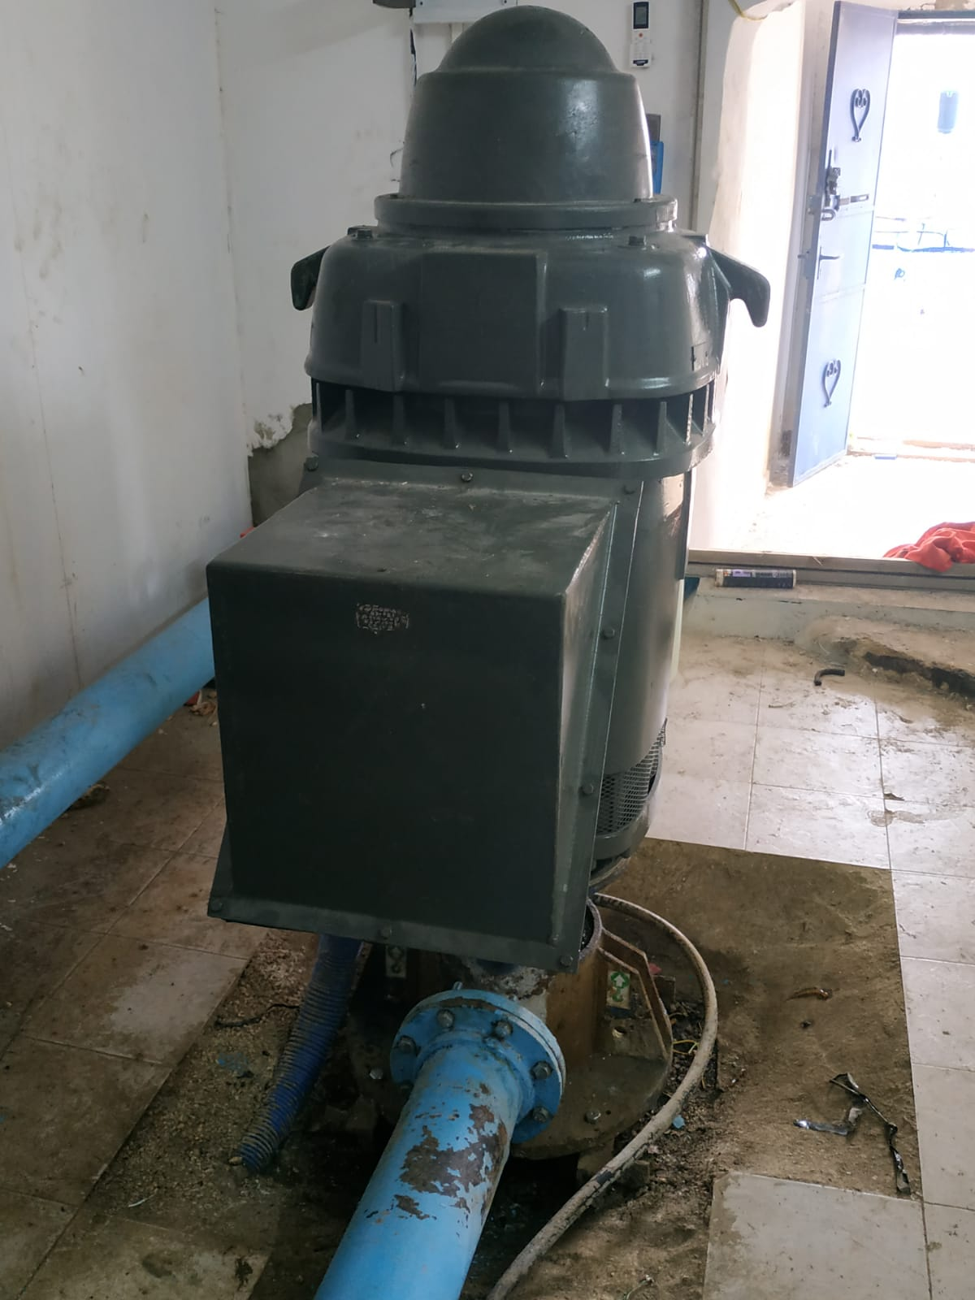
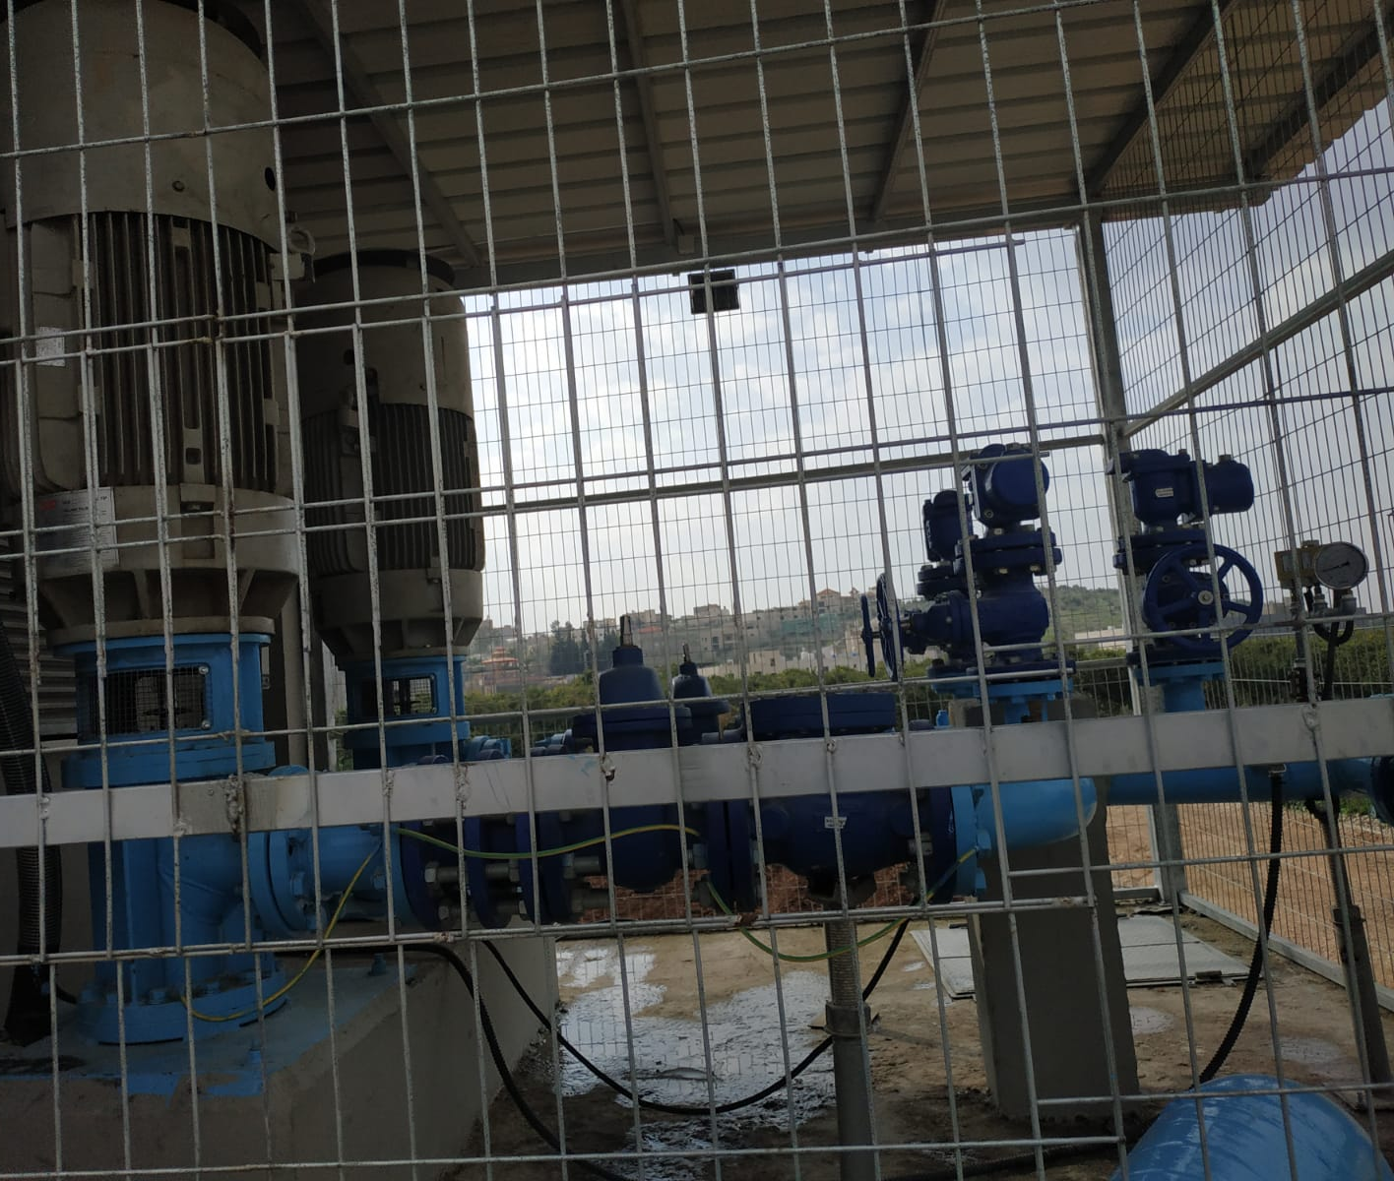
Figure 4: The wells’ pump

Slide 14
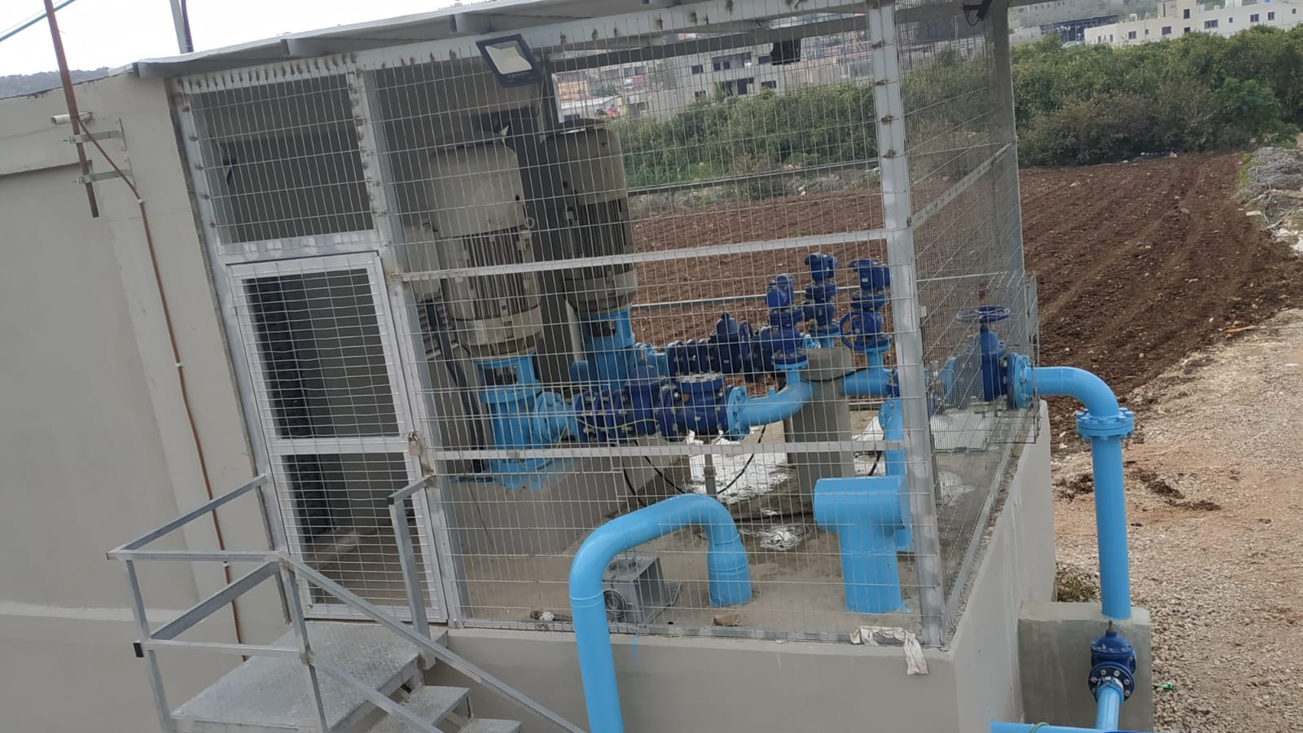

Slide 15
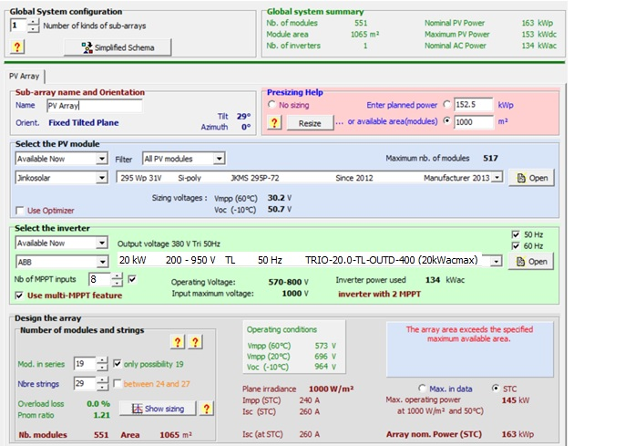
Technical Study: PVSYST Software
Figure 5: PVSYST Design

Slide 16
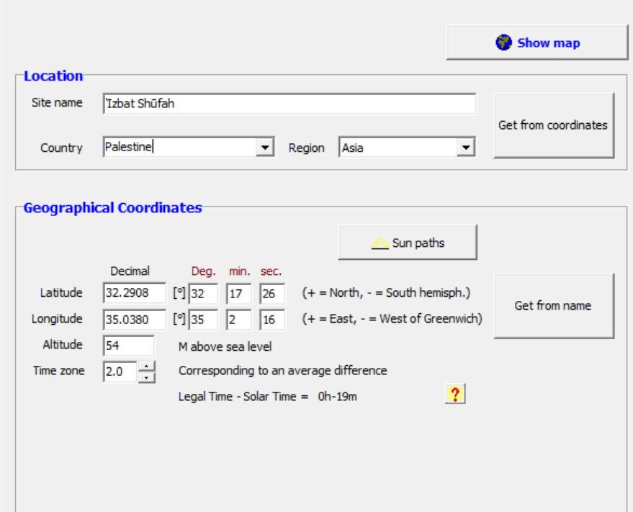
Technical Study: PVSYST Software
Figure 5: PVSYST Projects’ Location

Slide 17
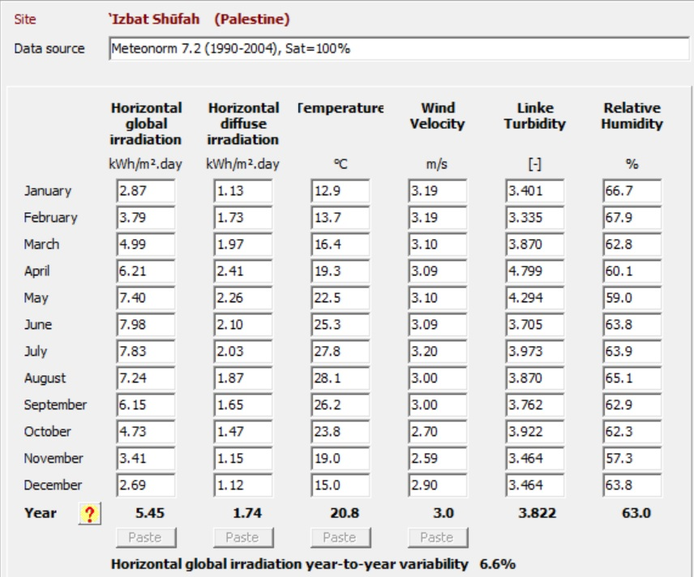
Technical Study: PVSYST Software
Figure 6: Areas’ Solar Characteristics

Slide 18
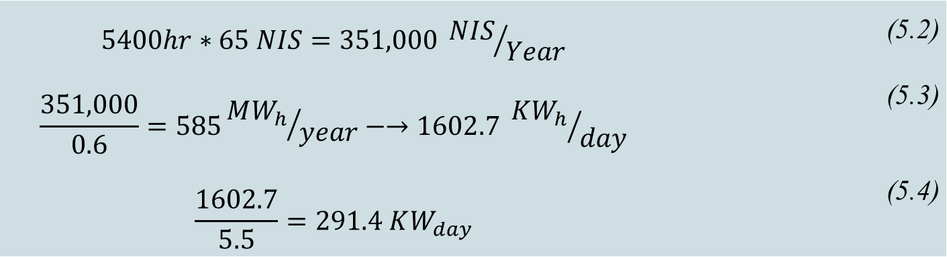
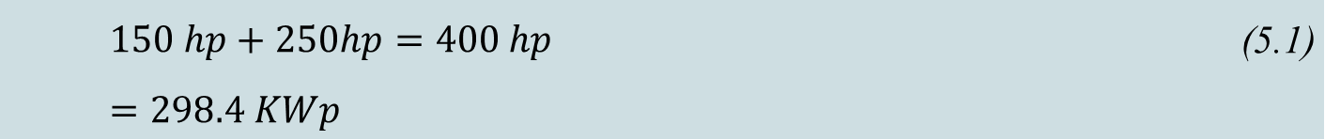
Technical Study: Manual Design Results
The two pumps are 150 hp and 250 hp, they consume 65 NIS/hr and work approximately 5400 hr/year.
Taking into consideration these numbers, with the price of 1 kW = 0.6 NIS in Tulkarem City and the power factor for Palestine = 5.5 :
$$150 hp+250hp=400 hp=298.4 KWp$$ | (5.1)
$$5400hr∗65 NIS=351,000 {NIS}/{Year}$$ | (5.2)
$$\frac{351,000}{0.6}=585{MW_{h}}/{year}−→1602.7 {KW_{h}}/{day}$$ | (5.3)
$$\frac{1602.7}{5.5}=291.4 KW_{day}$$ | (5.4)

Slide 19
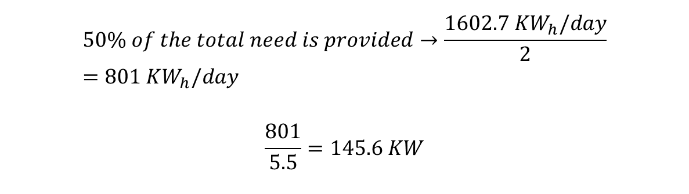
Technical Study: Manual Design Results
Since the chosen PV cells have 295 W_{p} of power, the needed number of panels to cover the whole needs is:
$$\frac{291.4KW}{0.295KW_{p}}=987.7 panel$$
With the available space to implement the system given as 1000 m², the number of panels that can fit is 517 panel, which covers around 50% of the wells’ need of power.
For the number of inverters needed for this project:
$$50\% of the total need is provided→\frac{1602.7 KW_{h}/day}{2}=801 KW_{h}/day$$
$$\frac{801}{5.5}=145.6 KW$$
Which is using 7 inverters
of 20 KW and 1 inverter of 10 KW.

Slide 20
Feasibility Study and Payback Period
Table 3 Capital Cost of the project
Type | # Of Units | Unit Cost | Total Cost
PV | 517 | 1225 | 633,325 | NIS
Inverter 20KW | 7 | 12208 | 85,456 | NIS
Inverter 10KW | 1 | 4200 | 4200 | NIS
Internet connected monitoring system | 1 | 1700 | 1700 | NIS
Structure | 1000 | 50 | 50,000 | NIS
Total Cost for Cables | - | - | 95,000 | NIS
Total Cost for Protection instruments | - | - | 20,000 | NIS
Total Asset = 889,665 NIS

Slide 21
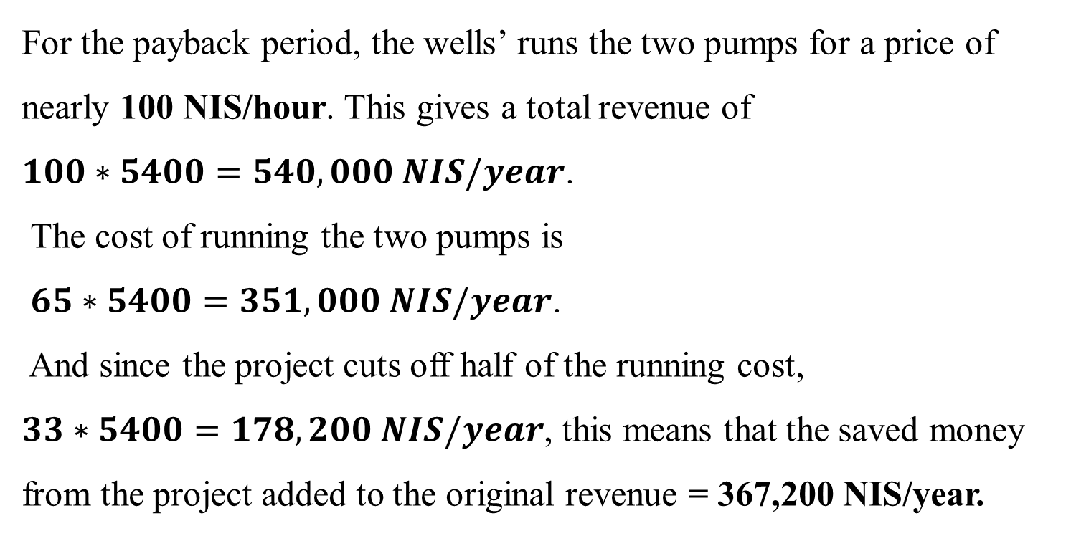
Feasibility Study and Payback Period
For the payback period, the wells’ runs the two pumps for a price of nearly 100 NIS/hour. This gives a total revenue of
$100∗5400=540,000 NIS/year$.
The cost of running the two pumps is
$65∗5400=351,000 NIS/year$.
And since the project cuts off half of the running cost,
$33∗5400=178,200 NIS/year$, this means that the saved money from the project added to the original revenue = 367,200 NIS/year.

Slide 22
Feasibility Study and Payback Period
Table 4 Payback Period
# of year | NCF (NIS) | CCC (NIS)
0 | -889,665 | -889,665
1 | +367,200 | -522,465
2 | +367,200 | -155,265
3 | +367,200 | +211,935
2.42 Years = 2 years and 155 days.

Slide 23
Regulations And Laws For Renewable Energy Projects in Palestine
Palestinian Electricity Regulatory Council (PERC)
Technical Parameters
Calculation and Tariff
General Issues

Slide 24
Conclusion
The project is implementing 517 Jinko 295wp Solar PV cell on a space of 1 acre.
The solar panels are implemented at 29̊ tilt angle to maximize the solar gain.
All regarding laws and regulations are presented.
Implementing 517 solar panel would cover nearly 50% of the wells’ need of energy.
The chosen well for the study has the highest average working hours among the sample of wells.

Slide 25

THE END
YOUR OPINION MATTERS.

