Slide 1


Slide 2
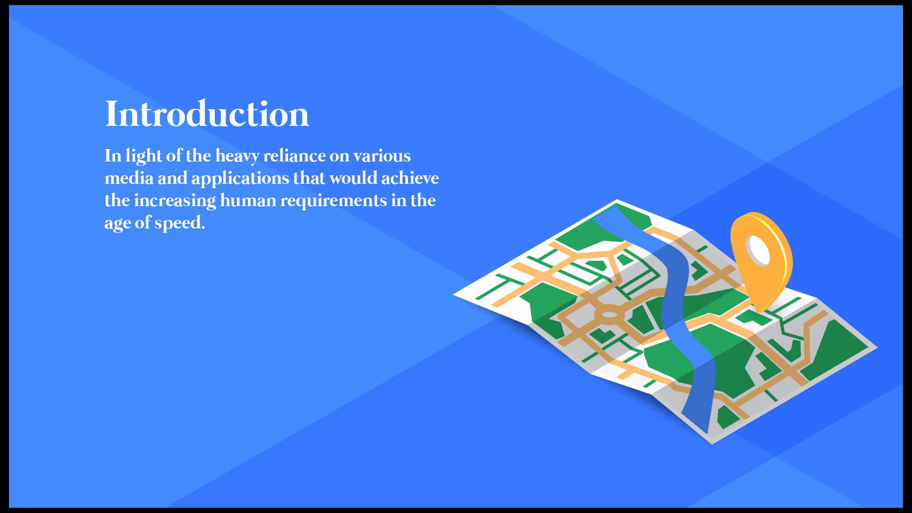

Slide 3


Slide 4
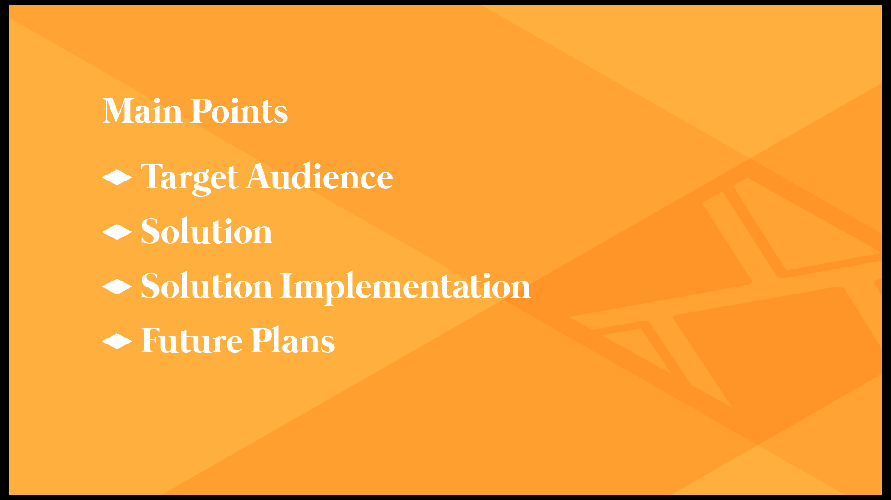

Slide 5
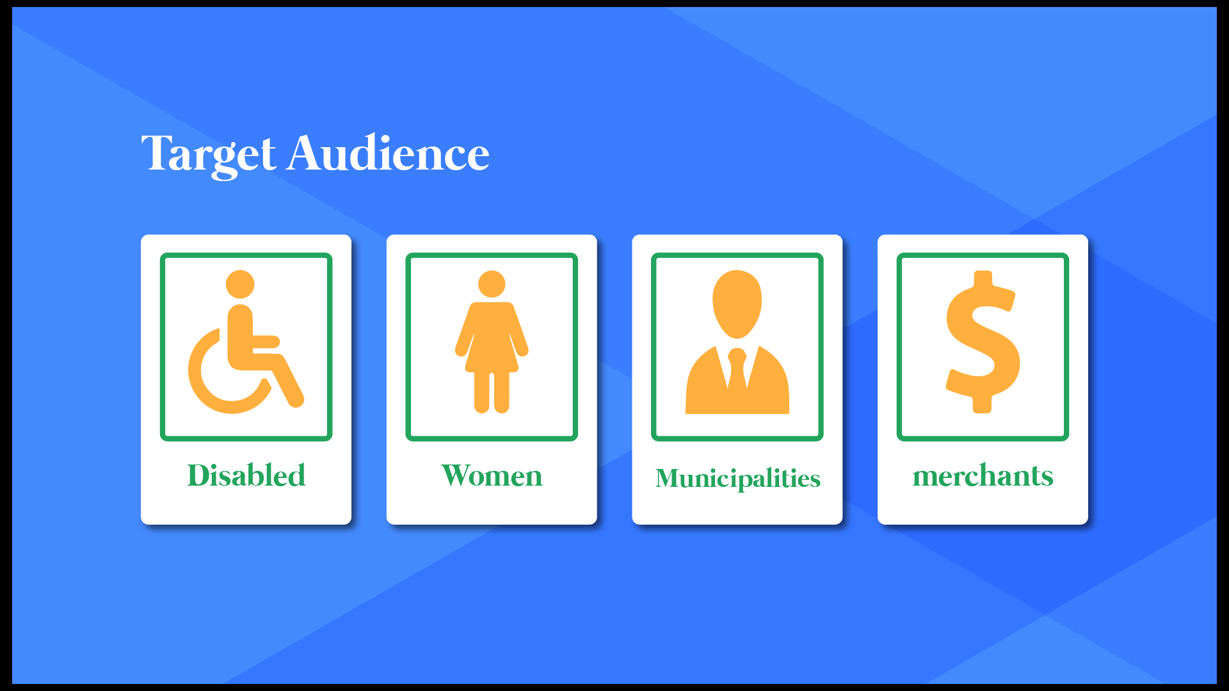

Slide 6


Slide 7

Implementation
Synthesize
Client Side
Server Side
Design
Mobile App

Slide 8


Design
Adobe Illustrator for Designing the Project and the logo
Set the theme and layout of the application
Logo elements that represent the idea

Slide 9
Client Side
Request information from API
Show and organize responses
No heavy lifting

Slide 10


Client Side
Mobile Application
Flutter as a framework
Dart as a programming language
Efficient cross-platform
Easy to learn and Easy to Use
Rich Community Support

Slide 11



Client Side
Website
ReactJS with Bootstrap
Java Script as a programming language
Great documentation
Easy to learn and Easy to Use
Rich Community Support

Slide 12




Server Side
Docker Compose
JavaScript as a programming language
Diversification Strategy
PostGIS as a DB Plugin
NodeJS Express Framework
Postgres DB for the database

Slide 13

Server Side
Docker Compose
The Manager of The Server Side
Platform Independent
Responsible for communication between
server components

Slide 14
Server Side
API Server
The core of the system
Responsible for communication between
server and application
Responsible For The Business Logic

Slide 15

Server Side
Database
Spacial Plugin Support
Better scalability and performance
Great Object Relation Mapping (ORM)

Slide 16
Final Outcome
Potential solution to presented
problem
Website
Cross-platform mobile application

Slide 17

Challenges
Mobile Devices Support And Availability
Acquiring Domain Knowledge
Immature AR Technology

Slide 18

Future Work
Making The AR Section of The App
Including other
Making The App Multilingual

Slide 19


YOU!
Waleed Saleh
Mohammad Al-Bzoor

