Slide 1

Graduation Project 2
Structural Analysis and Design of and commercial
Building by software sap (2000) in Nablus
An-Najah National University
Nablus - Palestine
Faculty of Engineering
Civil Engineering Department
Prepared by:
Aseel Ahmad Ali
Mais hijab
Nirmeen Issam Natour
Supervised by:
Dr. Riyad Awad
2021

Slide 2
Outline
Project Description
Building structural system
Codes and Standards
Materials
Software
Load Types
Load Combinations
Preliminary Dimensions
Modeling
Irregularities
Checks
Design of structural elements

Slide 3
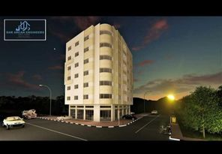

Slide 4
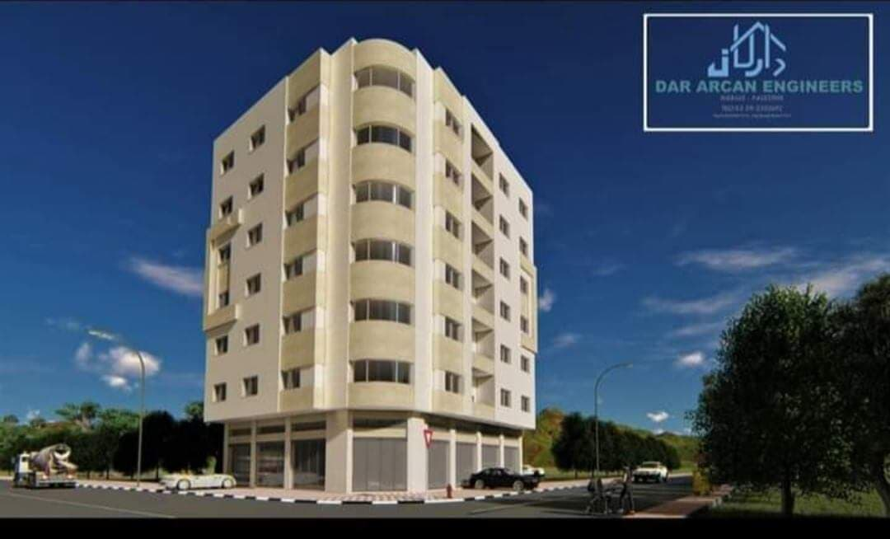

Slide 5
Project Description

Slide 6
This is a graduation project to redesign the structural elements of the building for gravitational and lateral loads.
This structure is the building of Abdalhameed al Sosa in Nablus. The building will be analyzed and deigned using the primary principles of structural design. Also one of the most modern software programs to analyze reinforced concrete structures was used.
The project will give a summary of the design principles of different structural elements in the structure, and finally it will introduce practical design drawings for implementation.

Slide 7
Building Structural System

Slide 8
Building Structural System
The structural system of the building is formed of two types: two-way solid slabs without beams (flat plate slabs) and two way ribbed slabs, one-way ribbed slab x-direction and one-way ribbed slab y-direction with hidden interior beams
The beams are supported by columns, which are the main vertical structural elements.
We will discuss design of structural element like slab and beam and other elements: such as columns, shear walls, retaining wall and footings.

Slide 9
Floor | Area (m²) | Height (m) | Use of floor
Basement 2 | 525.96 | 2.60 | Car Parking
Basement 1 | 525.96 | 2.60 | Car Parking
Ground floor | 317.75 | 4.5 | Stores
Typical Floors (6 floors) | 317.75 | 2.95 | Offices

Slide 10
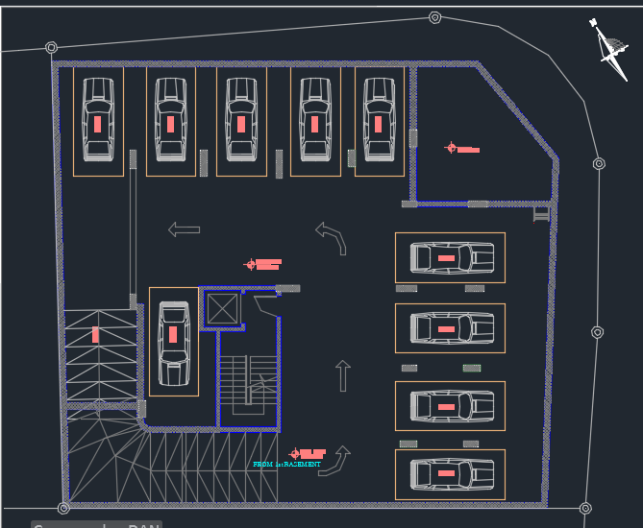
Plan for First Basement

Slide 11
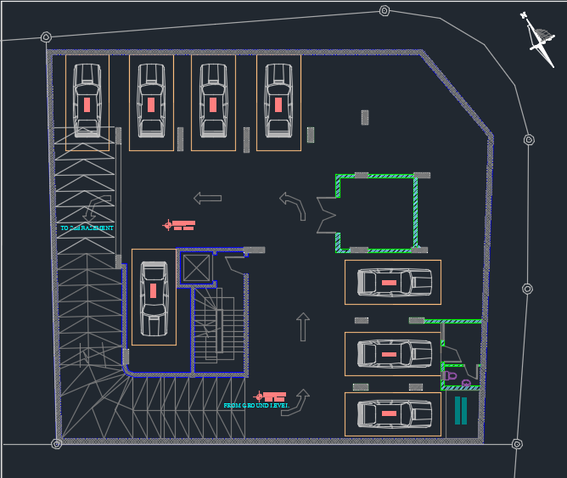
Plan for second Basement

Slide 12
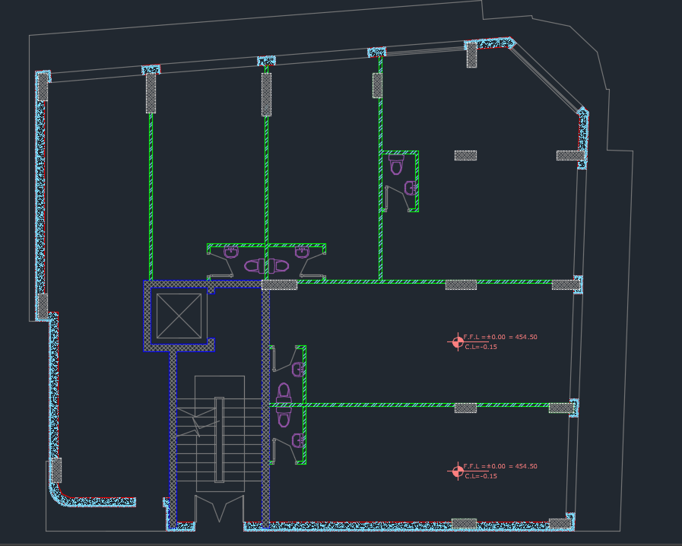
Plan for
Ground Floor

Slide 13
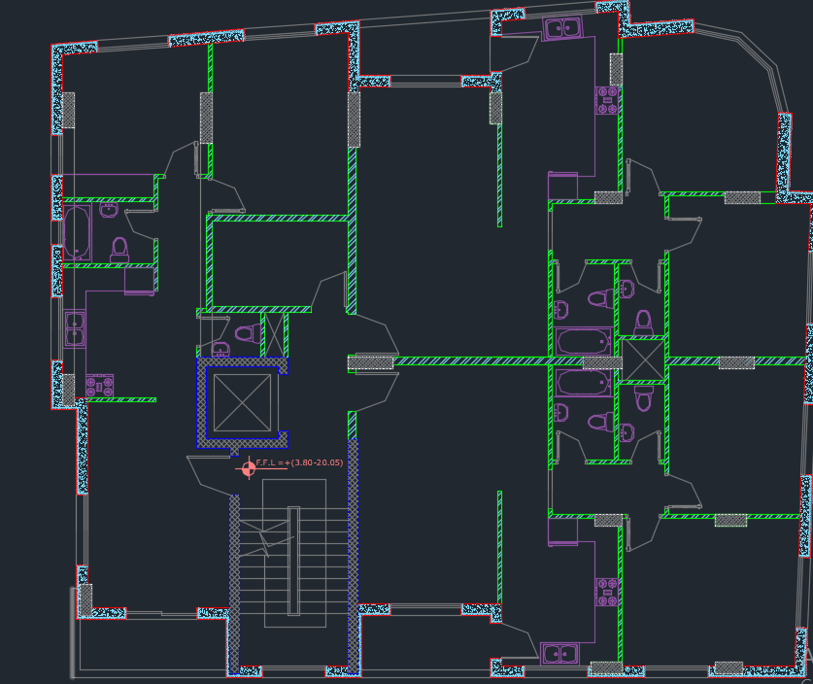
Plan for
Typical Floor

Slide 14
Materials
Materials for structural elements:
Concrete (f’c = 28 MPa)
E = 24870. MPa, γ = 25 kN/m³
Reinforcing Steel (ASTM A615, Grade 50)
Fy = 420 MPa, Fu = 450 MPa Es = 200 GPa

Slide 15
Materials
Materials for non- structural elements:
Material | 𝛾 𝑖𝑛 kN/𝑚³
Block | 12
Tiles | 25
Plastering | 23
Filling Material | 18
Concrete mortar | 23

Slide 16
Codes
ACI 318-11: For sections design and detailing.
IBC–2017: Were used for gravity live load .
UBC-1997: We used it for Earthquake load

Slide 17
Software
SAP2000 19.
AUTOCAD 2017.

Slide 18
  Loads
  Load patterns can be classified in this structure into two categories
  1-Gravity loads, including dead, live, and super imposed dead loads.
  2-Lateral loads, which include seismic loads.

Slide 19
Gravity load Types
Dead Loads
It is mainly the own weight of the structural elements, which can be defined as the loads that does not change with time progressing.
Superimposed Dead Loads
These loads are mainly created by the non-structural elements of the building as tiles, stones, partitions, filling materials and plastering and so on

Slide 20
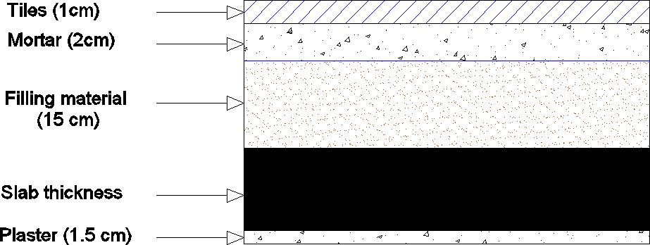
Section in a slab

Slide 21
Superimposed dead load = weight of tiles + weight of mortar + weight of filling material
+ weight of plaster + weight of partitions
𝑊𝑆𝐷 = 0.01*25 + 0.02*23 + 0.15*18 + 0.015*23 + 1 = 4.75KN/m² = 5 KN/m²
*For garage parking area:
𝑊𝑆𝐷 = 0
Super imposed dead load summarized in Table .
Story No. or Use | S. D (kN/m²)
Parking Floors | 0
Stores | 5
Offices | 5

Slide 22
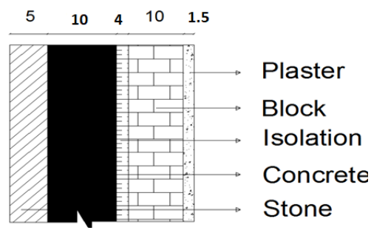
Section in the external wall
Material thickness
Layer | Thickness(cm)
Stone | 5
Concrete | 10
Isolation | 4
Block | 10
Plaster | 1.5

Slide 23
Wall weight
Usually the used isolation is polystyrene rolls with unit weight of 0.3 KN/ m³, the first story height is 4.5m and the second story high is 2.95 m
So, the wall weight per unit length were calculated as follows for 4.5 m
Wall weight in ground floor = (0.05*27 + 0.10*23 + 0.04*0.3 + 0.1*12 + 0.015*23) * 4.5 = 23.43 kN/m
Wall weight in typical floor = 5.207 * 2.95 = 15.36 kN/m
Wall weight in roof floor = 5.207 * 1.2 = 6.25 kN/m

Slide 24
Load Types
Live Loads
Live loads are temporary loads, of short duration, or the load to which a structure is subjected in addition to its own weight, such as, people, furniture, cars…etc.
In our structure, there are many live loads depending on use of every floor according to ASCE 7- 10.
Distribution of live load on the slabs are summarized in Table 1.5.
Story No. or Use | Live (kN/m²)
Parking Floors | 5
Stores | 5
Offices | 2.5

Slide 25
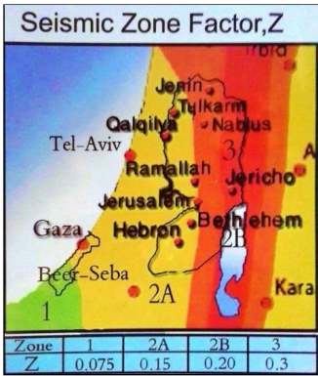
Seismic load
to determine the seismic load value the requirements of UBC97 code will be
Applied Mapped spectral response acceleration parameters: .
These parameters can be obtained in the maps of risk-target maximum considered earthquake accelerations at 10% of critical damping. Seismic hazard map of spectral response accelerations
Zone factor value is Z = 0.20

Slide 26
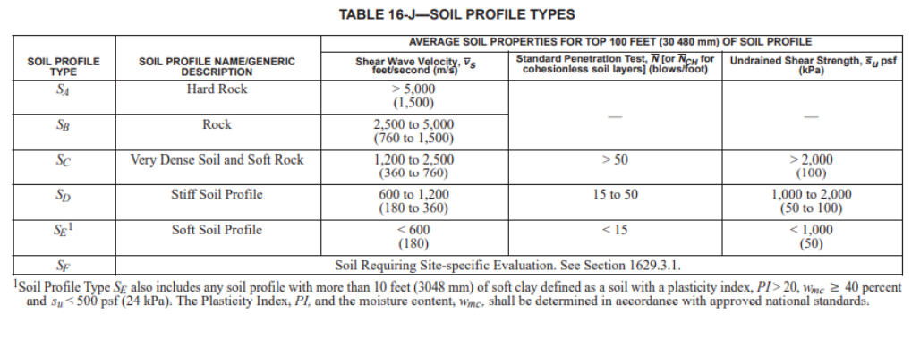
Soil profile type:
Bearing capacity for soil (qall) equal 210 kN/m2 To check the site class, average undrained shear strength is applied.
Su = qall /2 = 210 2 = 105 kpa.
The soil profile is ‘Sc’ .

Slide 27
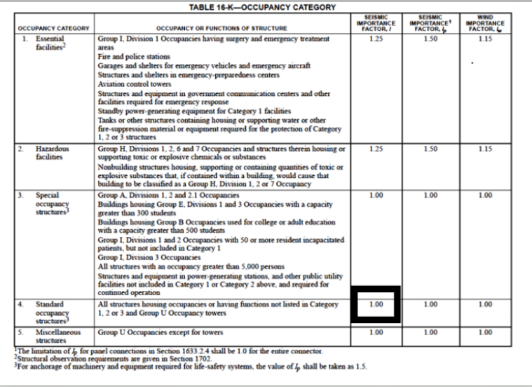
Importance factor and risk category
The risk category was decided to be (4), so the importance factor is equal to 1.00 according to UBC97, see Figure.

Slide 28
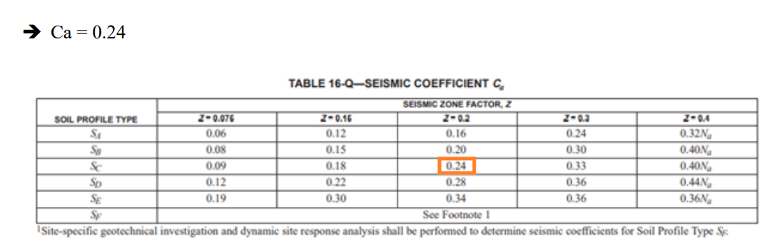
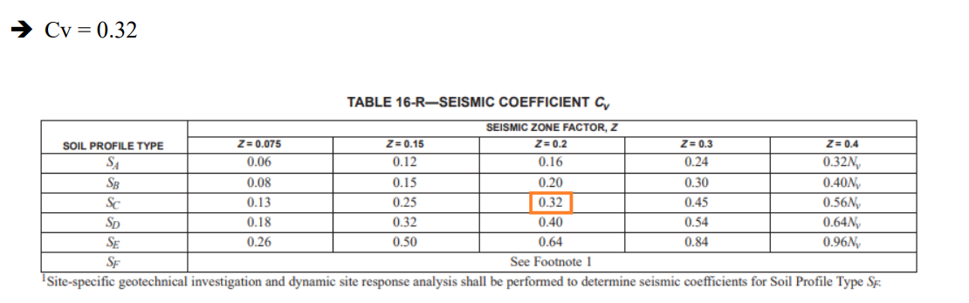
Seismic Coefficients for Response Spectrum Design

Slide 29
Load Combinations
According to the “ACI 318-11” code section 9.2.1, the following loading combinations may be considered:
U=1.4D
U= 1.2D + 1.6L
U = 1.2D + 1.0E + 1.0L
U=1.2D + 1.0E - 1.0L
U= 0.9D + 1.0E
U = 0.9D - 1.0E
Where:
U: ultimate load D: dead load
L: live load
E: earthquake Load

Slide 30
Preliminary Dimensions

Slide 31
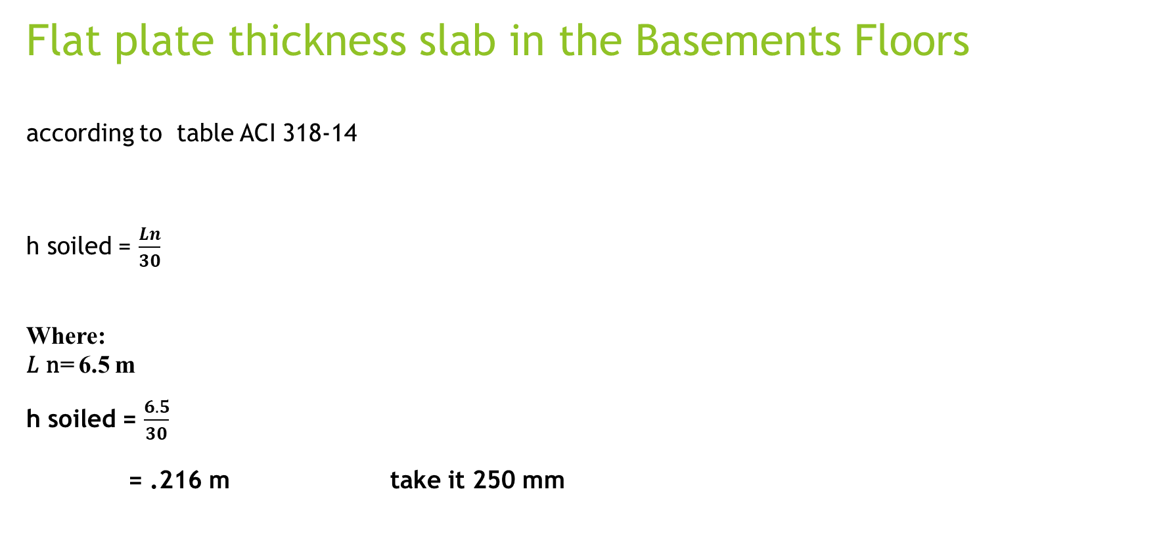
Flat plate thickness slab in the Basements Floors according to table ACI 318-14 h soiled = $\frac{Ln}{30}$
Where:
𝐿 n= 6.5 m h soiled = $\frac{6.5}{30}$
= .216 m take it 250 mm

Slide 32
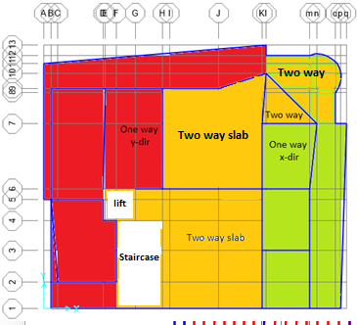
Ribbed slab thickness in typical floors and ground floor

Slide 33
Thickness of two way ribbed slab
𝑳
ℎ Ribbed two way =
𝟑𝟑

Slide 34
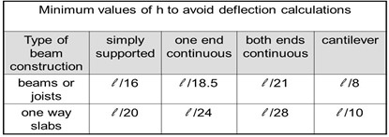
Thickness of one way ribbed slab:

Slide 35
ℎ ribbed one way = ^{𝑳} or
𝑳
𝟖
𝟏𝟖.𝟓
Where:
𝐿 = 2.40 m (cantilever)
𝐿 = 3.55 m (one end continuous)
h ribbed = ^{𝟐.𝟒𝟎}
or ^{𝟑.𝟓𝟓} = 0.30 or 0.19
take it 300 mm.
𝟖
𝟏𝟖.𝟓

Slide 36
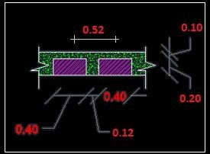

Slide 37
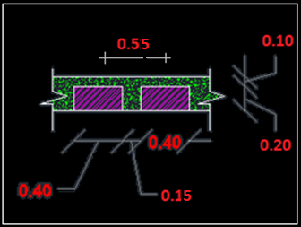
After Graduation project I, the last ribbed slab section

Slide 38
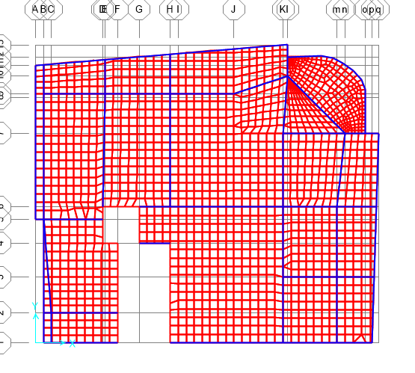
Beams dimensions

Slide 39
The selected beam has a length equals 6.52 m

Slide 40
H beam = ^{𝟔.𝟓𝟐} = 0.31
take it 300 mm
𝟐𝟏
The width of the beam will be taken approximately as the following relation:
Width (B) = ^{𝑳𝒆𝒏𝒈𝒕𝒉}
𝟐𝟎
B beam = ^{𝟔.𝟓𝟐} = 0.326 m
take it 400 mm
𝟐𝟎
Beam groups | Dimension (mm)
Main Beams | 400*300
Secondary Beams | 400*300
.

Slide 41
Columns, shear walls and retaining walls dimensions
Vertical Structural Members | Dimensions (mm)
Columns | 300*800
Retaining walls | 300
Shear walls 1 | 300
Shear walls 2 | 250
After assuming vertical members, their dimensions shall be checked proper or not by SAP2000.

Slide 42
Modeling

Slide 43
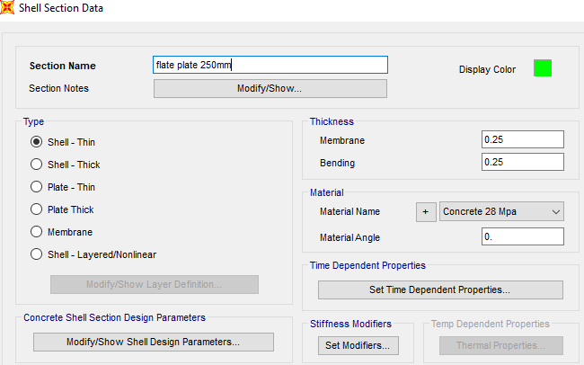
Flat plate slab definition

Slide 44
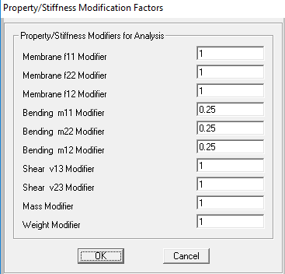
Flat plate slab modifiers

Slide 45
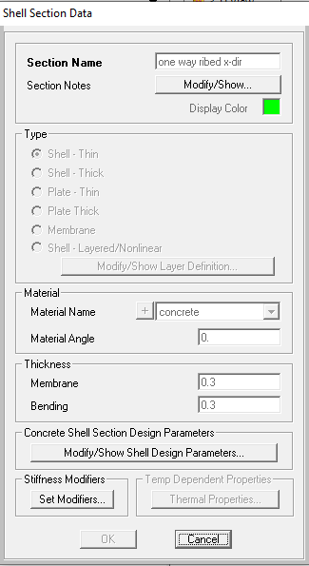
One way ribbed slab X-Direction Slab defntion

Slide 46
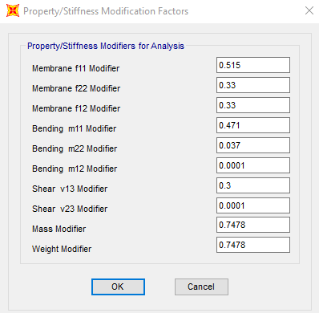
One way ribbed slab X-Direction Slab modifires

Slide 47
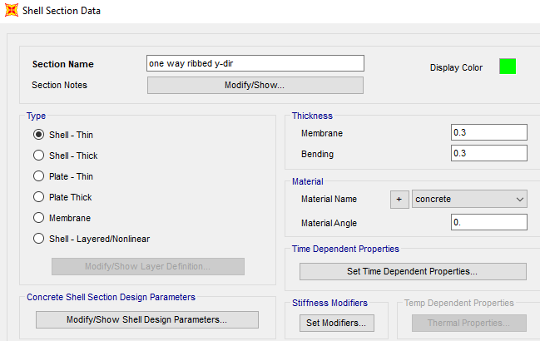
One way Y-Direction Slab deffintion

Slide 48
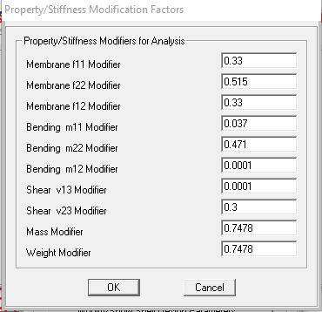
One way Y-Direction Slab modifiers

Slide 49
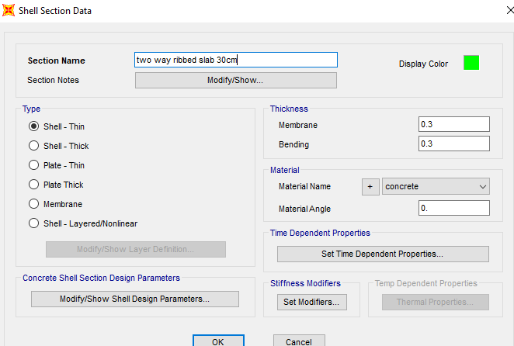
Two way ribbed slab definition

Slide 50
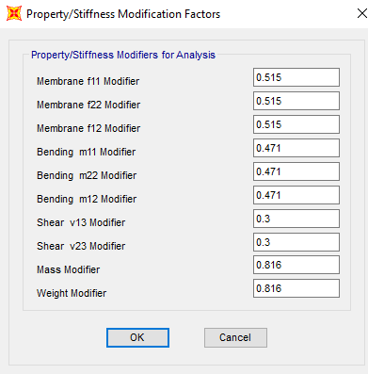
Two way ribbed slab modifiers

Slide 51
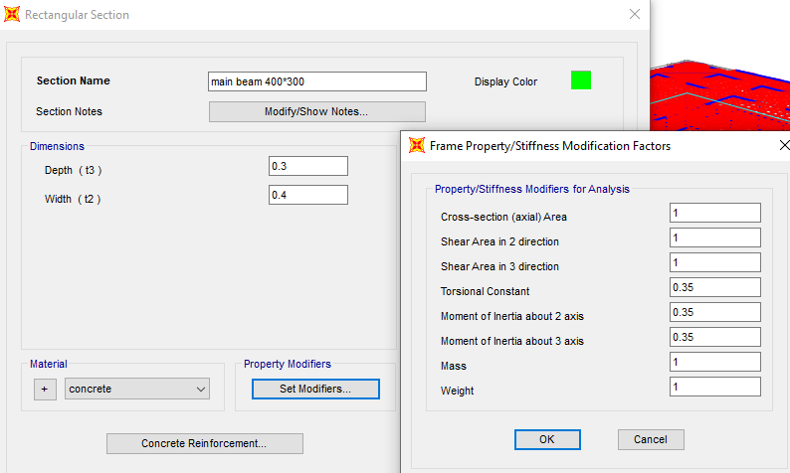
Beams definition and modifiers

Slide 52
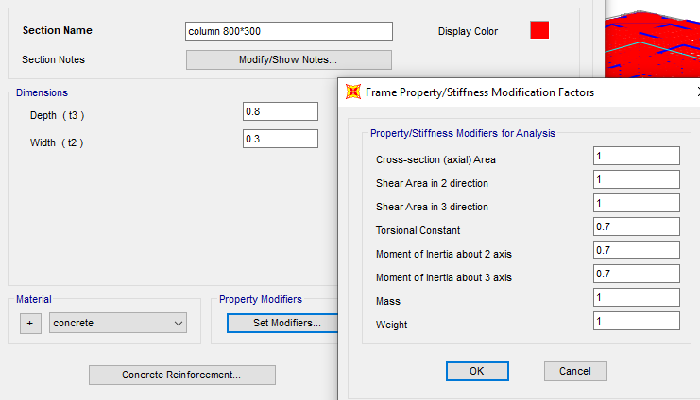
Column definition and modifiers

Slide 53
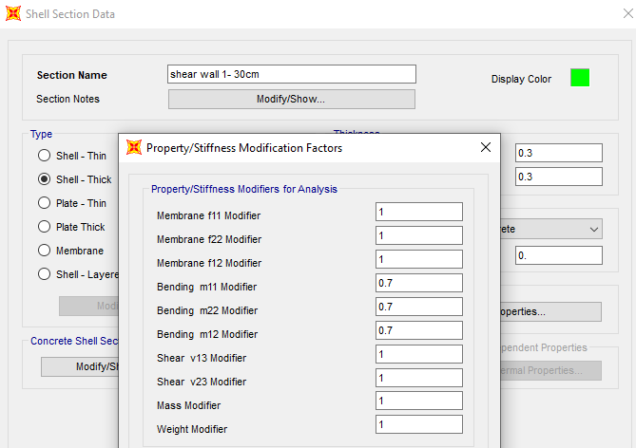
Shear wall 30 cm definition and modifiers

Slide 54
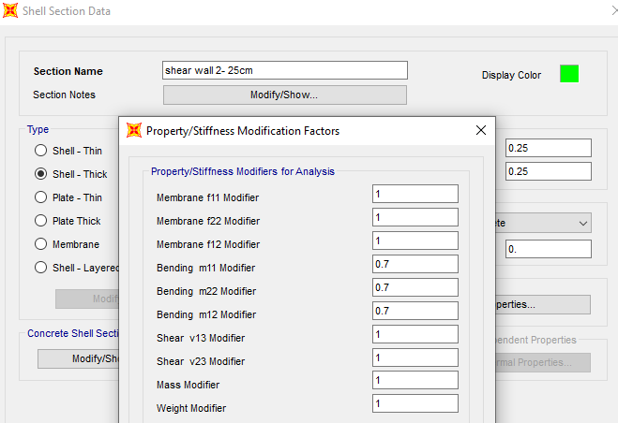
Shear wall 25 cm definition and modifiers

Slide 55
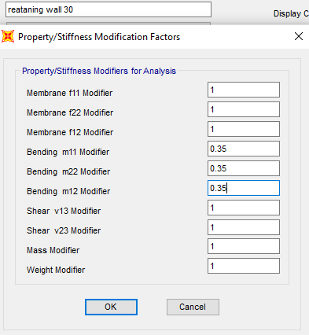
Retaining Wall definition and modifiers

Slide 56
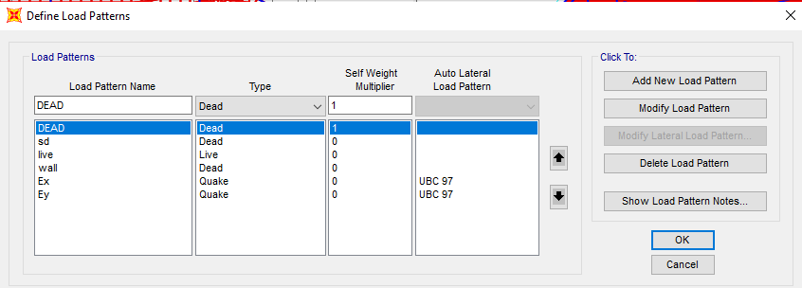
Loud pattern

Slide 57
Model checks

Slide 58
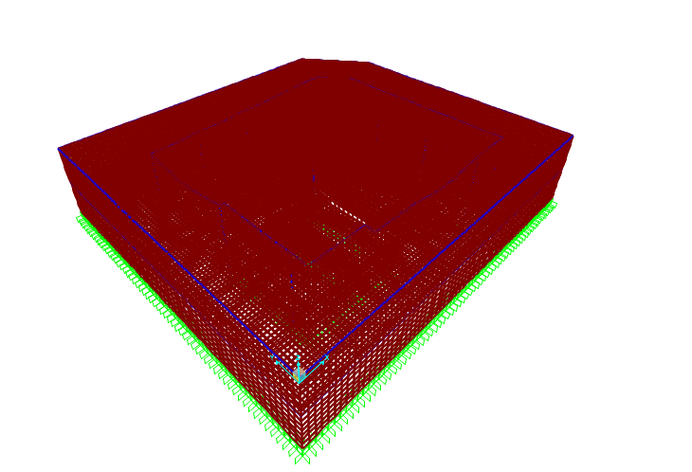
Compatibility check model one

Slide 59


Slide 60
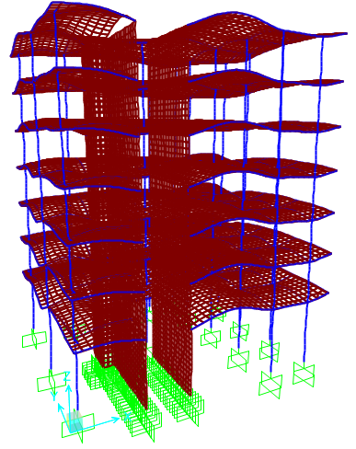
Model two

Slide 62
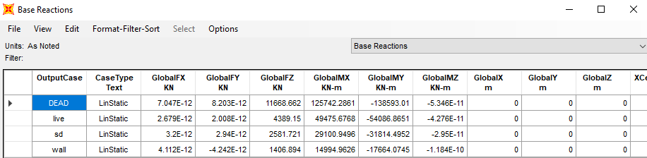
Equilibrium check model one

Slide 63
All error < 5% ok
Load type | Manual results (kN) | SAP2000 results (kN) | Error %
Live | 4470.66 | 4389.15 | 1.8
Dead | 11718.99 | 11668.66 | 0.43
SD | 2629.80 | 2581.72 | 1.8
Wall | 1407.13 | 1406.89 | 0.02

Slide 64
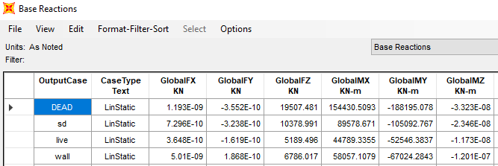
Model two
Load type | Manual results (kN) | SAP results (kN) | Error %
Live | 5190.15 | 5189.49 | 0.01
Dead | 20019.48 | 19507.48 | 2.55
SD | 10380.30 | 10378.99 | 0.02
Wall | 6737.15 | 6789.01 | 0.77
All error < 5% ok

Slide 65
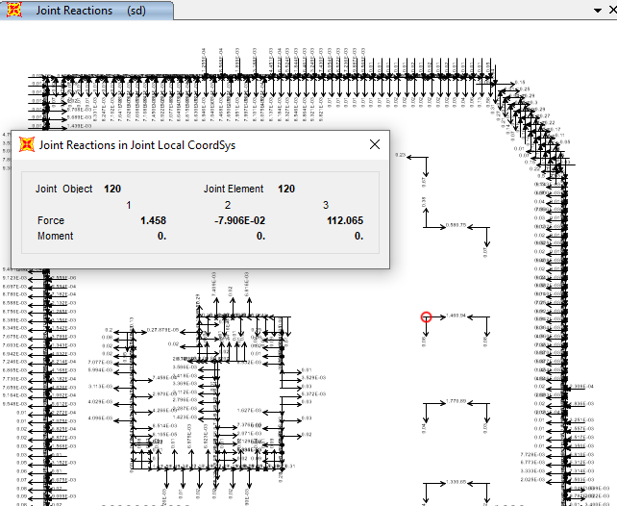
Stress strain check model one
P (SD) = 112.06 kN
P (SD) theo = 97.53 KN
%Error = 14.89 % >10% (this is because there are shear walls in addition to columns)

Slide 66
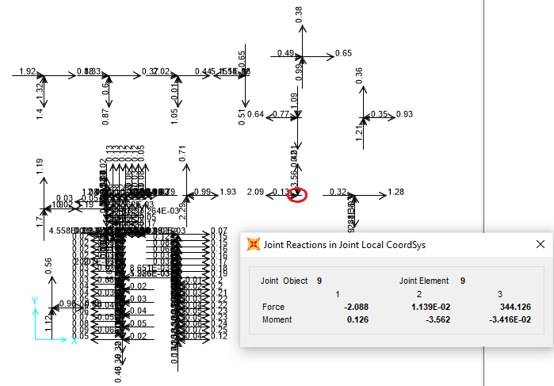
model two
P (live) = 344.12 kN
P (live) theo = 341.33 kN
%Error = 0.82 % <10% → OK

Slide 67
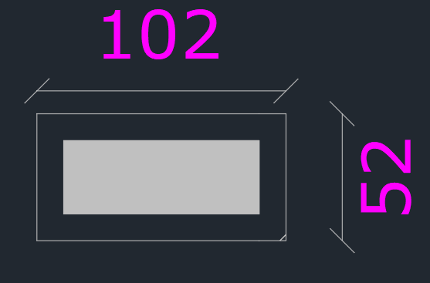
Punching shear check flat plate
Vc,p < 2.46 Mpa
< 1.004 Mpa
< 1.76 Mpa
From saap = .95 < 1.004 ok

Slide 68
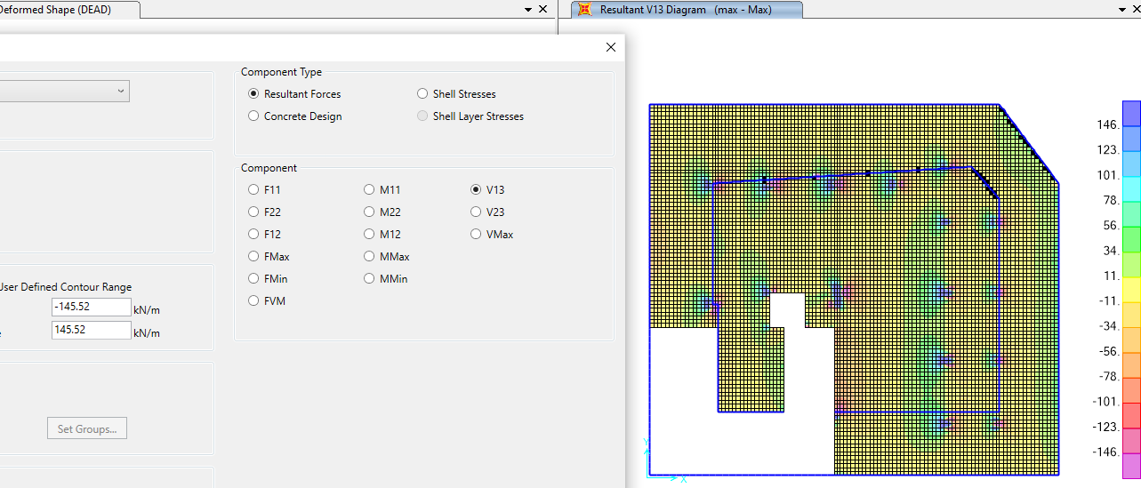
      shear check
      Model one
      Shear capacity of flat plate slab =
      Distribution of shear in x-direction
145.52 kN/m

Slide 69
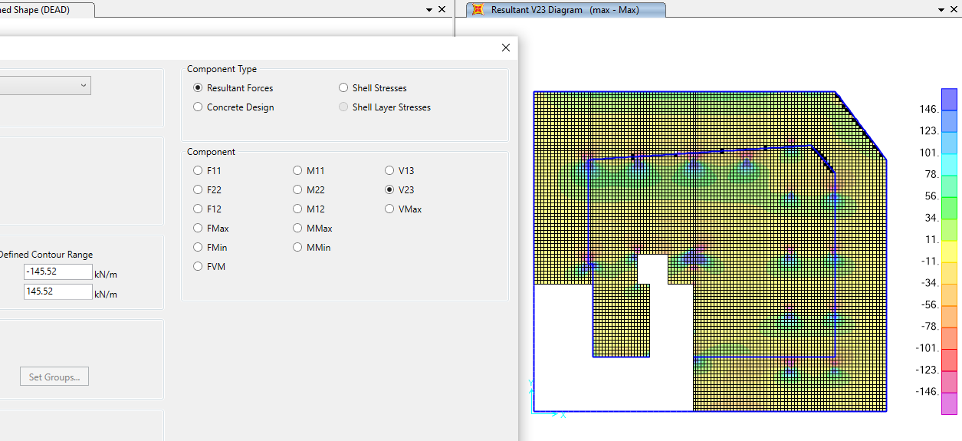
Distribution of shear in y-direction

Slide 70
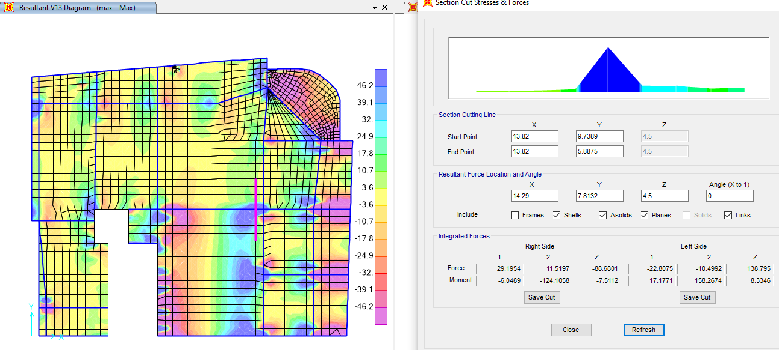
Shear capacity new section slab = 46.16 KN/m shear in x-direction from saap = 35.58 KN/m
35.58 < 46.16 ok
Model two

Slide 71
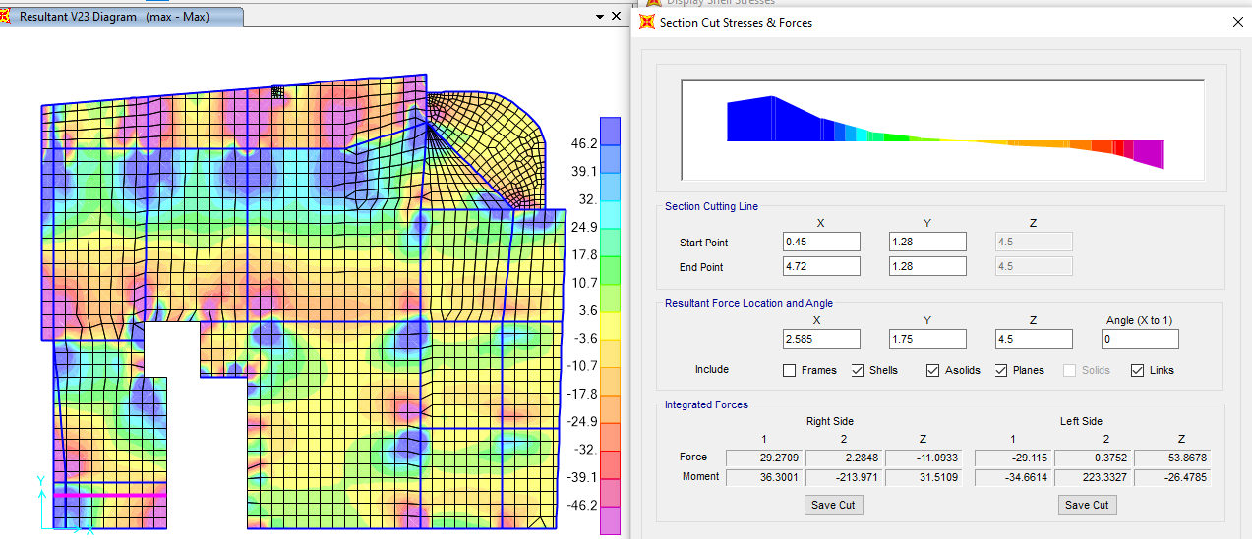
Shear in y-direction
shear in y-direction from saap 12.61 KN/m < 46.16 KN /m ok
The result from saap show that the slab is adequate for shear instead of balacons that need shear reinforcement

Slide 72
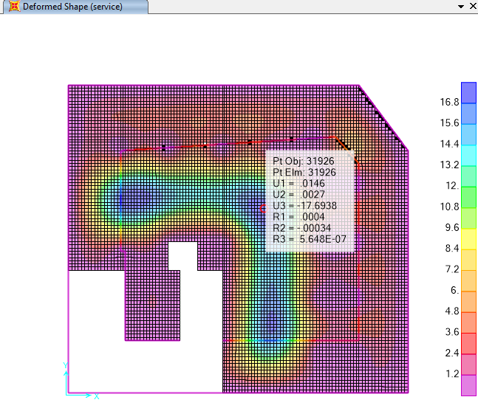
Deflection Check model one

Slide 73
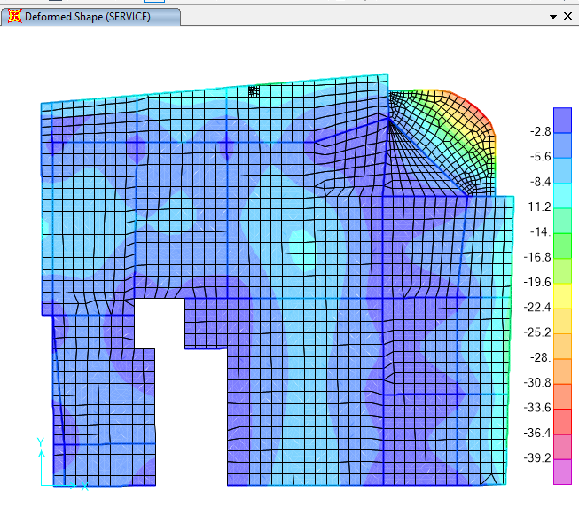

Model two
Δ allowable = $\frac{L}{240}$ = $\frac{3370}{240}$ = 14.04 mm
= 13.72 mm > 14.04 mm OK

Slide 74
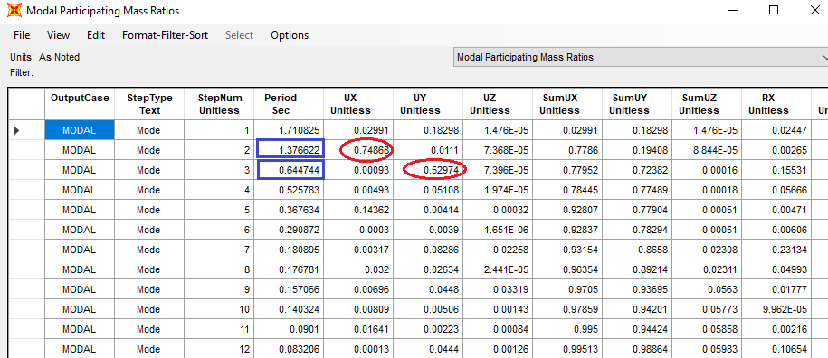
Period check
T ≤ 1.4 Ta
Ta = .49 second
Building is too soft in x-direction

Slide 75
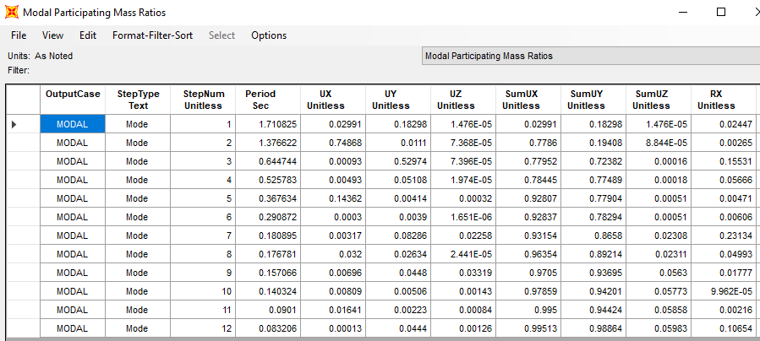
Mass participation ratio for model analysis

Slide 76
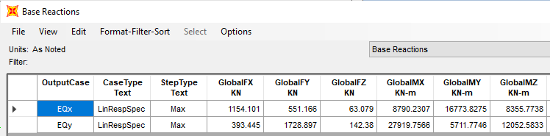
Base shear check
base shear by hand = 38434.46 kN

Slide 77
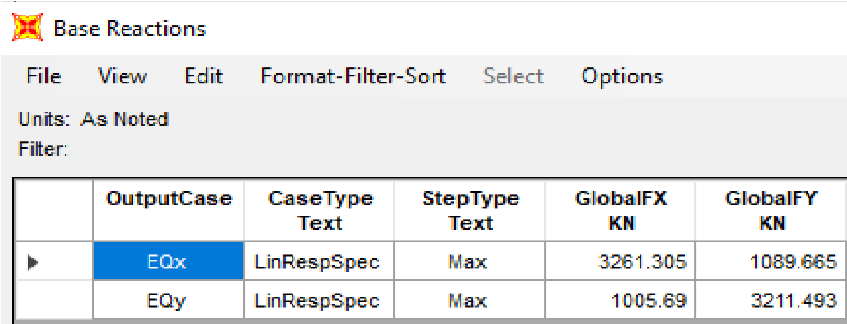
After edit the scale factor
All values are more than 85% of base shear from equivalent static

Slide 78

Torsion Irregularity check
The maximum story drift from earthquake in X- direction.

Slide 79

Ratio = max/avg = 13.05/12.42 = 1.05 < 1.20 →OK

Slide 80

The maximum story drift from earthquake in y- direction

Slide 81

➔ All ratios in two directions less than 1.2 then no Torsional Irregularity.

Slide 82
Drift check
Story drift calculations due to earthquake load in X-direction
Story Number | Displacement (Δs’) | Relative Displacement (Δs) | Drift (Δ_{M}) | h_{s} | Δ _{allowable}
1 | 5.95 | 5.95 | 27.0725 | 4500 | 112.5
2 | 13.05 | 7.10 | 32.305 | 2950 | 73.75
3 | 21.13 | 8.08 | 36.764 | 2950 | 73.75
4 | 29.28 | 8.15 | 37.0825 | 2950 | 73.75
5 | 37.03 | 7.75 | 35.2625 | 2950 | 73.75
6 | 44.19 | 7.16 | 32.578 | 2950 | 73.75
7 | 50.61 | 6.42 | 29.211 | 2950 | 73.75

Slide 83
Story drift calculations due to earthquake load in Y-direction
Story Number | Displacement (Δs’) | Relative Displacement (Δs) | Drift (Δ_{M}) | h_{s} | Δ _{allowable}
1 | 3.33 | 3.33 | 15.15 | 4500 | 112.5
2 | 5.54 | 2.21 | 10.06 | 2950 | 73.75
3 | 8.48 | 2.94 | 13.38 | 2950 | 73.75
4 | 11.6 | 3.12 | 14.20 | 2950 | 73.75
5 | 14.75 | 3.15 | 14.33 | 2950 | 73.75
6 | 17.75 | 3 | 13.65 | 2950 | 73.75
7 | 20.39 | 2.64 | 12.01 | 2950 | 73.75
➔ All values of drift are Ok

Slide 84
Design of Structural Elements
Notes:
Design results of program was verified on all structural elements, so final design results were taken directly from the program.

Slide 85


Design of flat plate slab
The ultimate minimum moment in both direction X and Y:
• depth of slap (H) = 250 mm
• Width of slap section (B) = 1000 mm.
• Effective depth of the slap (d) = 220 mm.
• 𝜌min = 0.0018 and 𝜌 max = 0.018
• As min = 0.0018 x 1000 x 250 = 450 mm2
a $= \frac{450 ∗420}{.85∗28∗1000}$ =7.94mm
$\text{∅}\text{M} =\text{As}\text{ × }\text{fy}\text{ × (}\text{d}\text{ −}\frac{a}{2})=$40.83 kN. m

Slide 86

Check for the ultimate moment in x- direction (M11):

Slide 87

Check for the ultimate moment in x- direction (M11):
As shown in Figure there are two type of zone where the moment is more than the minimum moment.
Distribution of moment in X- direction (M11) for ground floor.

Slide 88


Slide 89
Note: Steel of flat plate slab in x- direction:
• Use bottom steel equal ∅12/200mm in zone A.
• Use top steel equal ∅12/140 mm in zone B.
• Use bottom and top steel equal ∅10/200mm for the other zones.

Slide 90

Check for the ultimate moment in y- direction (M22):
Distribution of moment in y- direction (M22) for ground floor.

Slide 91
Note: Steel of flat plate slab in y- direction:
• Use bottom steel equal ∅12/200mm in zone A.
• Use top steel equal ∅12/140 mm in zone B.
• Use bottom and top steel equal ∅10/200mm for the other zones.

Slide 92
Design of flat plate
floor | Bottom steel in direction X Zone A | Top steel in direction X Zone B | Bottom steel in direction Y Zone A | Top steel in direction Y Zone B | Other Zone Minimum steel
Slab of first basement | ∅12/200mm | ∅12/140 mm | ∅12/200mm | ∅12/140 mm | ∅10/200mm
Slab of second basement | ∅12/200mm | ∅12/140 mm | ∅12/200mm | ∅12/140 mm | ∅10/200mm

Slide 93
Design of ribbed slab

Slide 94

Design of ribbed slab

Slide 95

Check for the ultimate moment in x- direction (M11):
As shown in Figure there are two type of zone where the moment is more than the minimum moment.

Slide 96

The ultimate moment in zone B (x-direction).

Slide 97
• Note: Steel of ribbed slab in x- direction:
• Use bottom steel equal 2∅12/rib in zone A.
• Use top steel equal 2∅20/rib in zone B.
• Use bottom and top steel equal 2∅10/rib for the other zones.

Slide 98

Check for the ultimate moment in y- direction (M22):
As shown in Figure there are two type of zone where the moment is more than the minimum moment.

Slide 99




The ultimate moment in zone B (y-direction).

Slide 100

Note: Steel of ribbed slab in y- direction:
    Use bottom steel equal 2∅12/rib in zone A.
    Use top steel equal 2∅25/rib in zone B area No.1.
    Use top steel equal 2∅18/rib in zone B area No.2.
    Use top steel equal 2∅12/rib in zone B area No.3.
    Use top steel equal 2∅12/rib in zone B area No.4.
    Use bottom and top steel equal 2∅10/rib for the other zones.

Slide 101


Shear Design of ribbed Slab :
As per discussed later when we do check, some areas need shear reinforcement to increase efficiency of slab to resist shear loads.
Figure shows the highest three values of slab shear.
Vu1 = 49.51 kN/m
Vu2 = 71.67 kN/m
Vu3 = 59.59 kN/m
We will design shear for maximum value and choose Vu2 = 71.67 kN/m.

Slide 102

Design of Beams
Figure show Beams distribution in typical floors

Slide 103

Flexure Design for Beams
Beams only in the typical floors distributed as figure Then, sap results for beams are shown in the Figure.

Slide 104

There are red beams suffering from shear and torsion problems, then we should increase the section as per message from SAP .

Slide 105

We will try to increase size section as per Figure 4.20 that shown final dimensions of beams.
*Three type of beams mentioned (B400*300, B700*300 and B900*300)

Slide 106

Longitudinal reinforcing area for beams is shown in the Figure 4.

Slide 107

Shear Design for Beams
Shear reinforcing ratio for beams is shown in the Figure 4

Slide 108

Torsion Design for Beams
Torsion reinforcing for beams is shown in the Figure .

Slide 109

Design of Beams
General beam longitudinal section.

Slide 110
Design of Beams
Let’s take the same beam named in the AutoCAD drawings B8 in Figure .

Slide 111


Slide 112

Design for Columns:
Flexure Design for columns
Longitudinal steel reinforcement check:
The rebar percentages for columns from SAP2000 are shown Figure

Slide 113


Any column with rebar percentage less than 3%,
column pass Any column more than 3% (selected in the Figure 4.29), column size to be enlarge.

Slide 114

New rebar percentages for columns from ETABS after changing size are shown Figure

Slide 115


Slide 116
summery of reinforcement of columns.
Longitudinal steel for columns
Column Name | Width (mm) | Length(mm) | % of rebar | Longitudinal Bars
C1 | 300 | 800 | 3.5% | 18Ø25
C2 | 300 | 1000 | 3.45% | 22 Ø25
C3 | 300 | 1200 | 3.5% | 256 Ø
C4 | 400 | 1200 | 3.84% | 24 Ø32
Spacing requirements for shear reinforcement for columns.
Column-Name | L_{s}(mm) | L_{o}(mm) | S_{o}(mm) | S₁(mm)
C1 | 650 | 800 | 150 | 250
C2 | 650 | 1000 | 150 | 250
C3 | 650 | 1200 | 150 | 250
C4 | 800 | 1200 | 150 | 250

Slide 117

Design of Shear walls
Sample Design and Detailing for Shear Walls

Slide 118

Internal forces in shear wall: Vu = 25 kN/m
Mu = 20 kN.m/m
Pn = 1700 kN
Design for shear.
For horizontal shear reinforcement: Use 2Ф10/250mm
For vertical shear reinforcement: Use 2Ф10/250mm
special boundary elements check.
Special boundary elements are needed if the stress σ > 0.2 f'c
σ = 0.2 x 24 = 4.8 MPa Vu = 25 kN/m Mu = 20 kN.m/m Pn = 1700 kN

Slide 119


Slide 120

Design for Retaining walls:

Slide 121


Slide 122

Design of Mat Footing

Slide 123

Deflection:
Deflection is the main criterion for the design of footing. Figure shows maximum deflection on mat footing from envelope combination

Slide 124

Stress under the base:

Slide 125

Thickness of footing
Punching shear

Slide 126


Thickness of footing
One-way shear

Slide 127


Design of mat footing
Design footing in x-direction.
Description | Moment value (kN.m/m) | $$ρ$$ | Area of steel (mm²/m) | Min. area of steel (mm²/m)
Bottom steel | 888 | 0.0041 | 3075 | 1440
Top steel | 314 | 0.0016 | 1292 | 1440
Design footing in y-direction.
Description | Moment value (kN.m/m) | $$ρ$$ | Area of steel (mm²/m) | Min. area of steel (mm²/m)
Bottom steel | 888 | 0.0041 | 3075 | 1440
Top steel | 314 | 0.0016 | 1292 | 1440

Slide 128
Thank you

