Slide 1


Air Hockey Robot
An-Najah National University
Facility Of Engineering
Students:
Abdullah Ahmad & Moath Omar
Supervisor:
Dr. Samer Arandi
Computer Engineering Department

Slide 2
شكر وتقدير

Slide 3
مي_وملح#

Slide 4
Outline
Introduction: Air Hockey Game.
The Project idea.
Components and apparatus.
System modules.
Background.
Design and implementation
  Table.
  Axis and conveyers.
  motors.
  Trajectory module.
  Air flow implementation.
Future work
References.
Demo.

Slide 5
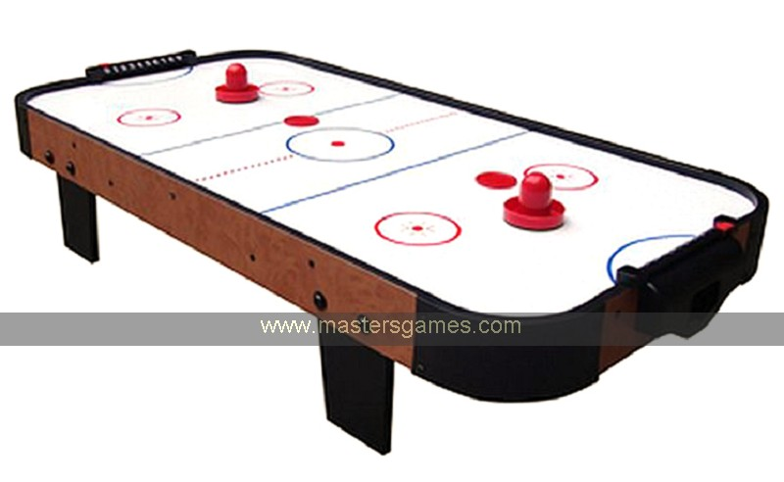
Air hockey game
Played by two players, each try to maximize his score.
Score gained by entering the puck in the opponent goal.
Play ground: a low friction table.

Slide 6
Project Idea
To design a robot that plays the game.
Challenge & knowledge domain:
  To apply hardware and software design knowledge:
    Motor interfacing.
    Puck tracking “image processing”.
    Problem solving.
  To play the game with single player.

Slide 7
Components & apparatus
Wood boards for Air Hockey Table.
Arduino Uno.
Pic 16F877A.
stepper motors , dc motors and servo motors.
motor cables and connections.

Slide 8
Components & apparatus
Aluminum rods.
Belt for the axis.
8*5 LED matrix.
Resistors, capacitors, transistor and many other IC’s.

Slide 9
Components & apparatus
Power supply.
PC or Laptop.
Webcam .
Small Fans.
Drill .

Slide 10
System components
Table and Air flow System
Robot and Motors
Camera and Tracking System
Scoring System

Slide 11
Background

Slide 12
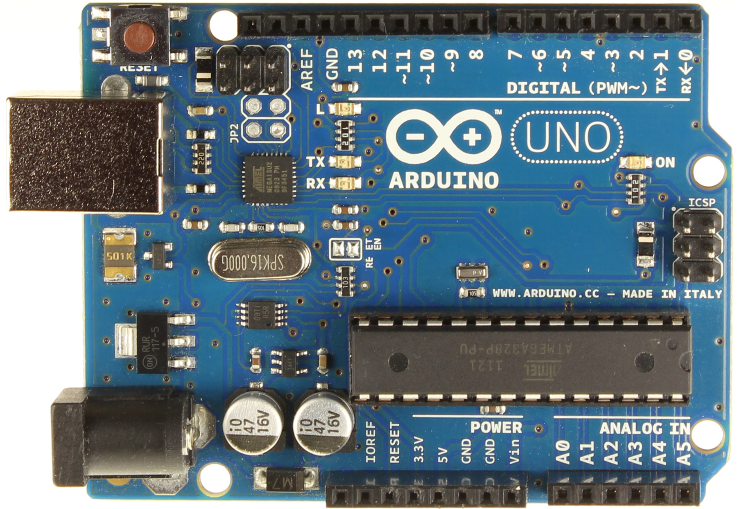
Arduino
The Arduino Uno is a microcontroller board based on the ATmega328 .It contains everything needed to support the microcontroller; simply connect it to a computer with a USB cable or power it with an AC-to-DC adapter or battery to get started

Slide 13

OpenCV
OpenCV (Open Source Computer Vision Library) is an open source computer vision and machine learning software library.

Slide 14
Motors
Stepper Motor
DC Motor
Servo Motor

Slide 15
Stepper motor
Advantages :
Precise step, usually 1.8 degree => position control.
Good torque.
Through micro stepping, it can be pushed to high speed.

Slide 16
Stepper motor
Disadvantages :
Need a driving circuit.
Need a high/ mid power usually more than 10 watts.
No feedback.
Can lose some steps!
Can be categorized as heavy “heavier than servo!’.

Slide 17
Servo motor
Advantages
It gives you feedback.
High torque. Very light. Internal driving circuit.
Mid speed up to 150 RPM.
Doesn’t consume pins from the controller.

Slide 18
Servo motor
Disadvantages:
Limited speed, hard to turn around.
A limited range of freedom “180 degree angle.
Hard to find in local stores.

Slide 19
DC motor
Low cost, found everywhere.
Very high speeds “given high power”, in term of thousand of RPMs.

Slide 20
DC motor
Disadvantages:
Low torque.
Nonlinear control. Has a very sharp start and stop transient !
Need a feedback circuit.
Brush based, broken soon.
May Need a braking system.

Slide 21
Design and implementation

Slide 22
Robot

Slide 23
X and Y axes or carriages
We need X and Y axes or carriages that provide easy and fast movement of our robot with minimum friction

Slide 24
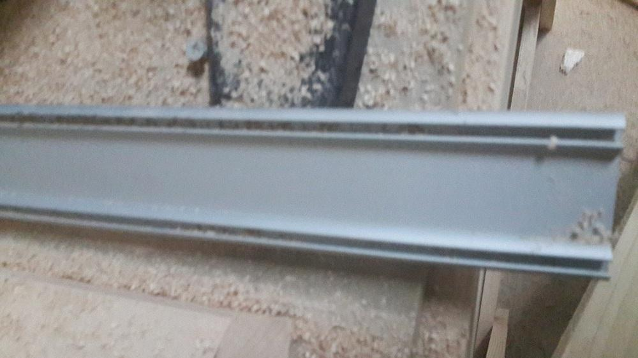
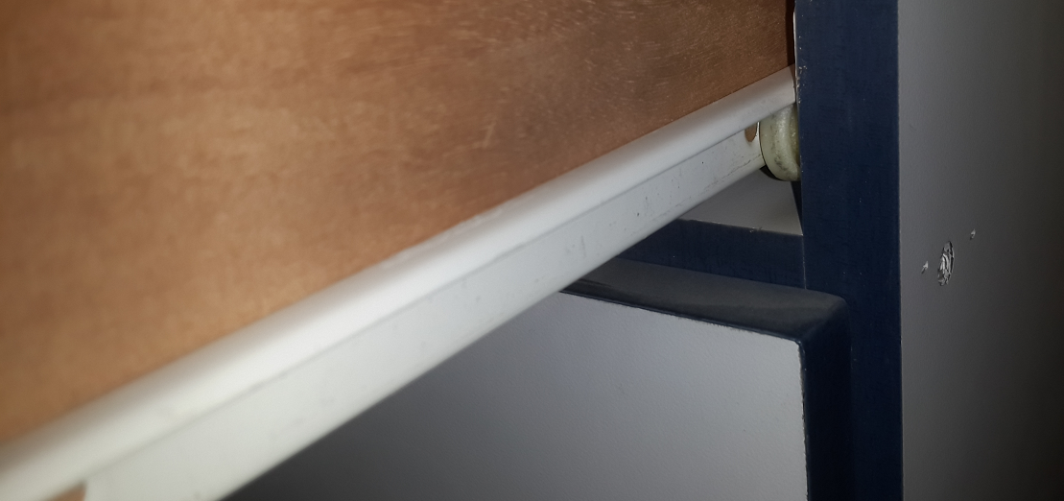
X and Y axes or carriages

Slide 25
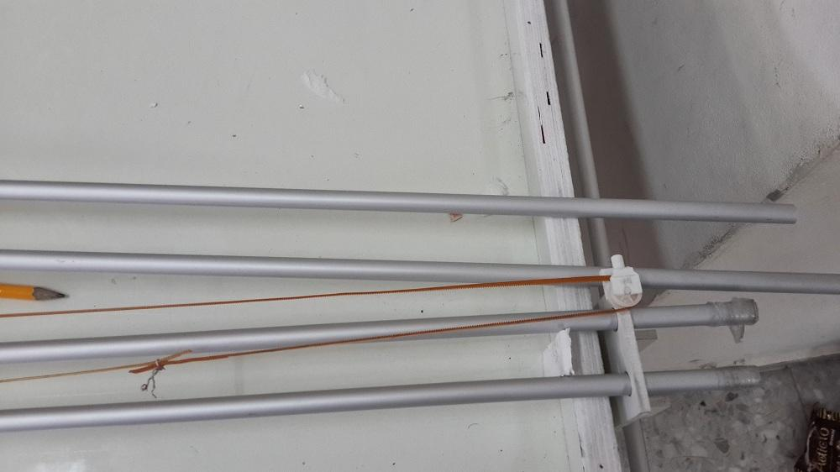
X and Y axes or carriages

Slide 26
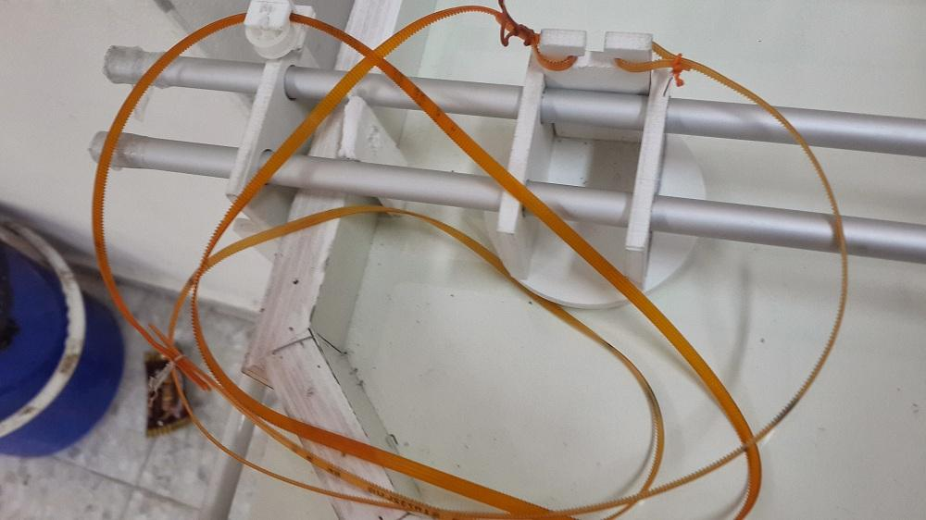
Motors belt
We need belts that have small section and lightweight.

Slide 27
Motors

Slide 28
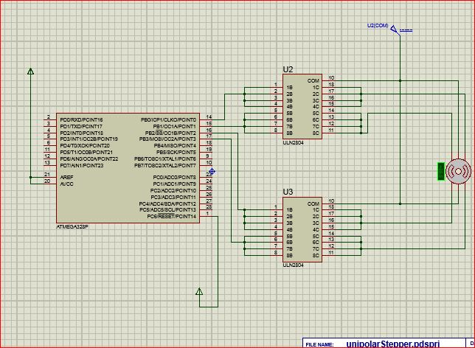
Stepper motor
Uni-polar motor

Slide 29
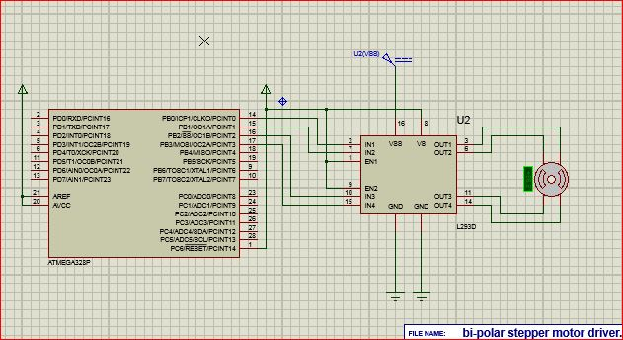
Stepper motor
bi-polar stepper

Slide 30
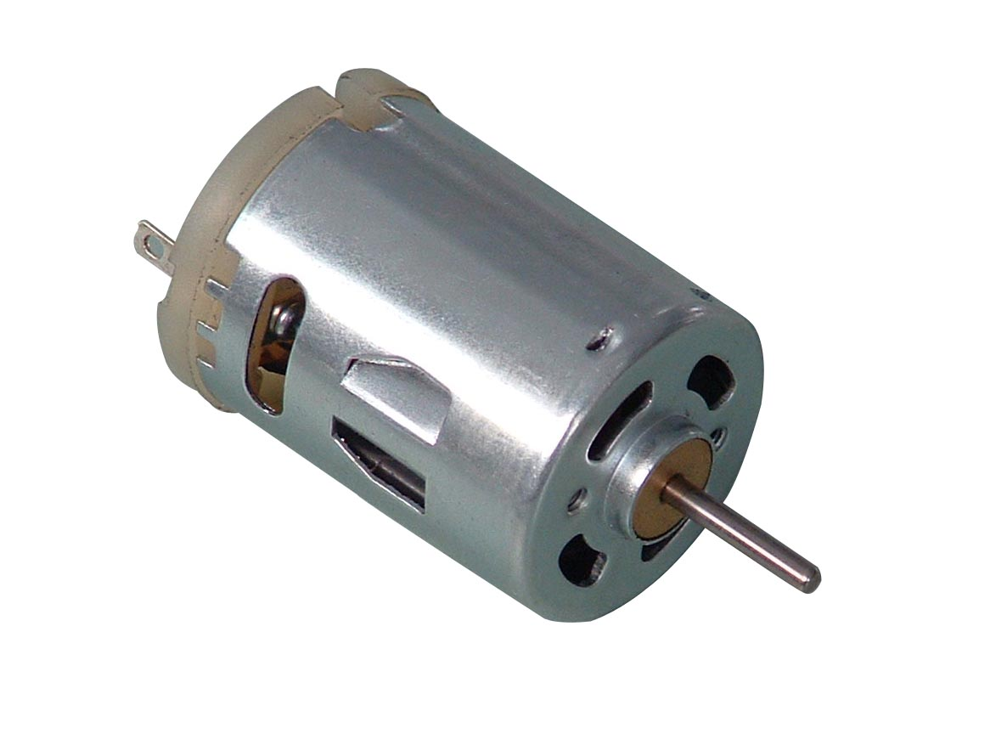
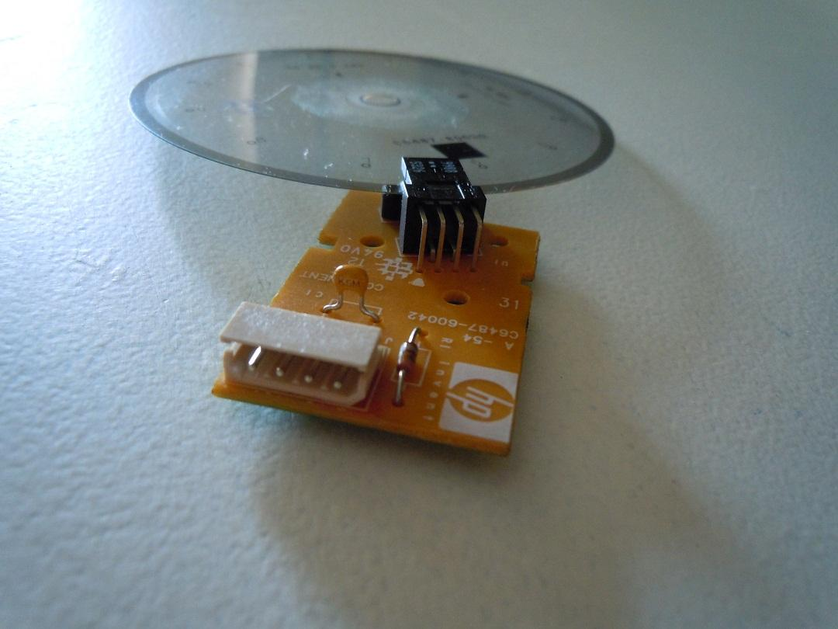
DC Motor
As we mentioned earlier, the DC motor tend to be very fast usually, but it is not linear, voltage dependent , and in our case it must be used within a closed loop system which mean a feedback circuit.

Slide 31
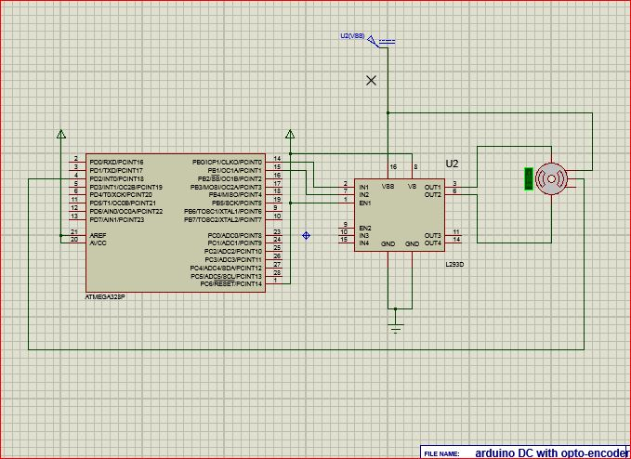
DC Motor

Slide 32
Servo motor:
Although they are always great for robotics, due to their size, low power, high torque, high stability, and given feedback. The bad news was there limited speed, which was up to 150 rpm “the high speed versions!!!”, moreover, the available motors were limited in the degree of movement, to 180 degree only.

Slide 33
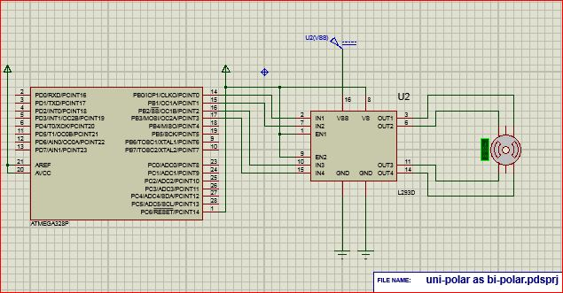
Stepper Motor again
Uni-polar as bi-polar Stepper Motor:

Slide 34
Tracking system

Slide 35
Tracking system
Our tracking system consist of Camera, c++ application combined with openCV libraries. That use the camera to detect the puck, then track it and do the suitable calculation
The camera we used is –Logitech c570-.
we initially setup the camera to take 640*480px frames, to obtain 30fps.

Slide 36
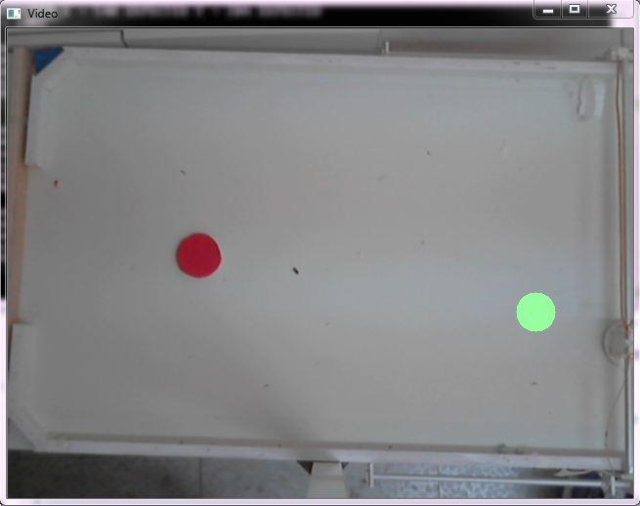
Tracking system
Full frame size captured by camera

Slide 37
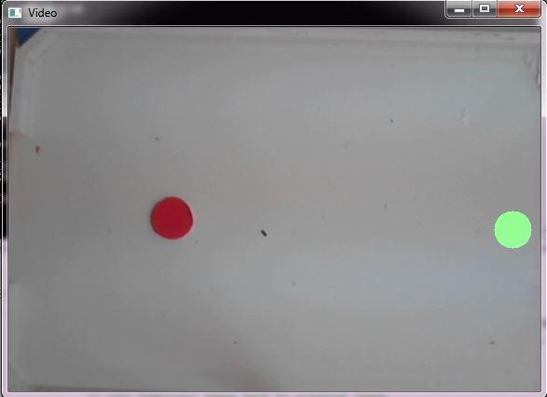
Tracking system
Cropping frame since we interested only with the area inside the table

Slide 38
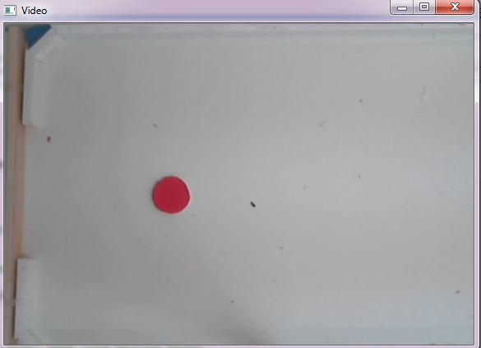
Tracking system
smooth the frame using Gaussian algorithm

Slide 39
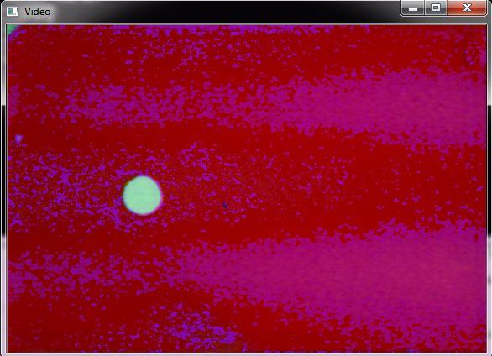
Tracking system
convert the image from RGB to HSV

Slide 40
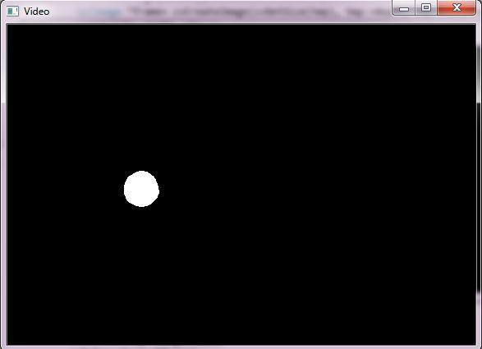
Tracking system
apply threshold filter to detect RED color (puck color)

Slide 41
Tracking system
Each time we take two consecutive frames, calculate the position of the puck and its speed.
using mathematical and Trigonometry equations we developed algorithm to predicate the puck direction and the path
Trajectory prediction

Slide 42
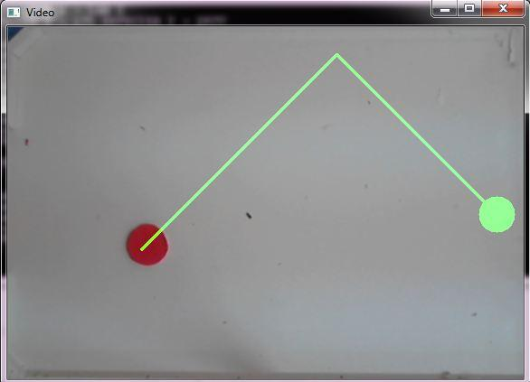
Tracking system
Trajectory prediction with angle

Slide 43
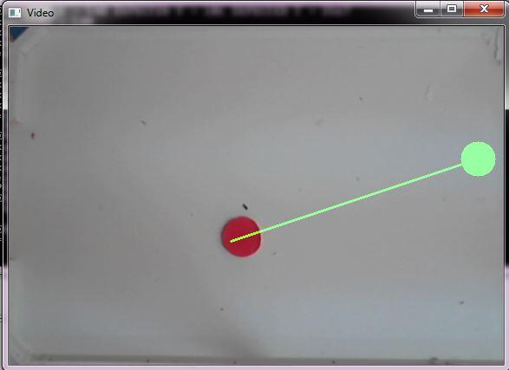
Tracking system
Trajectory prediction without angle

Slide 44
Tracking system
Problems
Memory management
Object size problem

Slide 45
Scoring system

Slide 46
Scoring system
Responsible for detecting and counting goals scored by each side.
Displaying the result on a 5*8 led matrix.
We used an Infrared transmitter and receiver, line of sight, that fire a signal when crossed by the Puck.

Slide 47
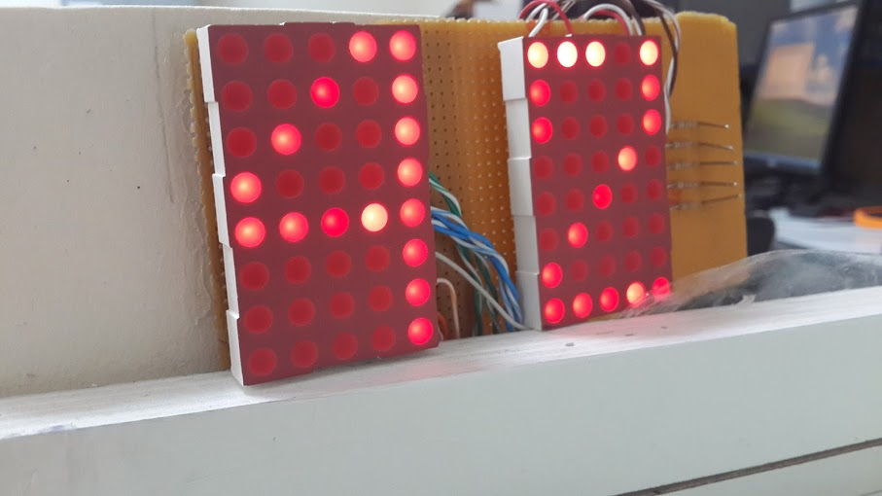
Scoring system

Slide 48
Table

Slide 49
Table
Air Hockey table is the base of our project, after searching for a suitable size of our table we get the dimensions from a previous project. The dimension of our Table is 110cm * 60cm

Slide 50
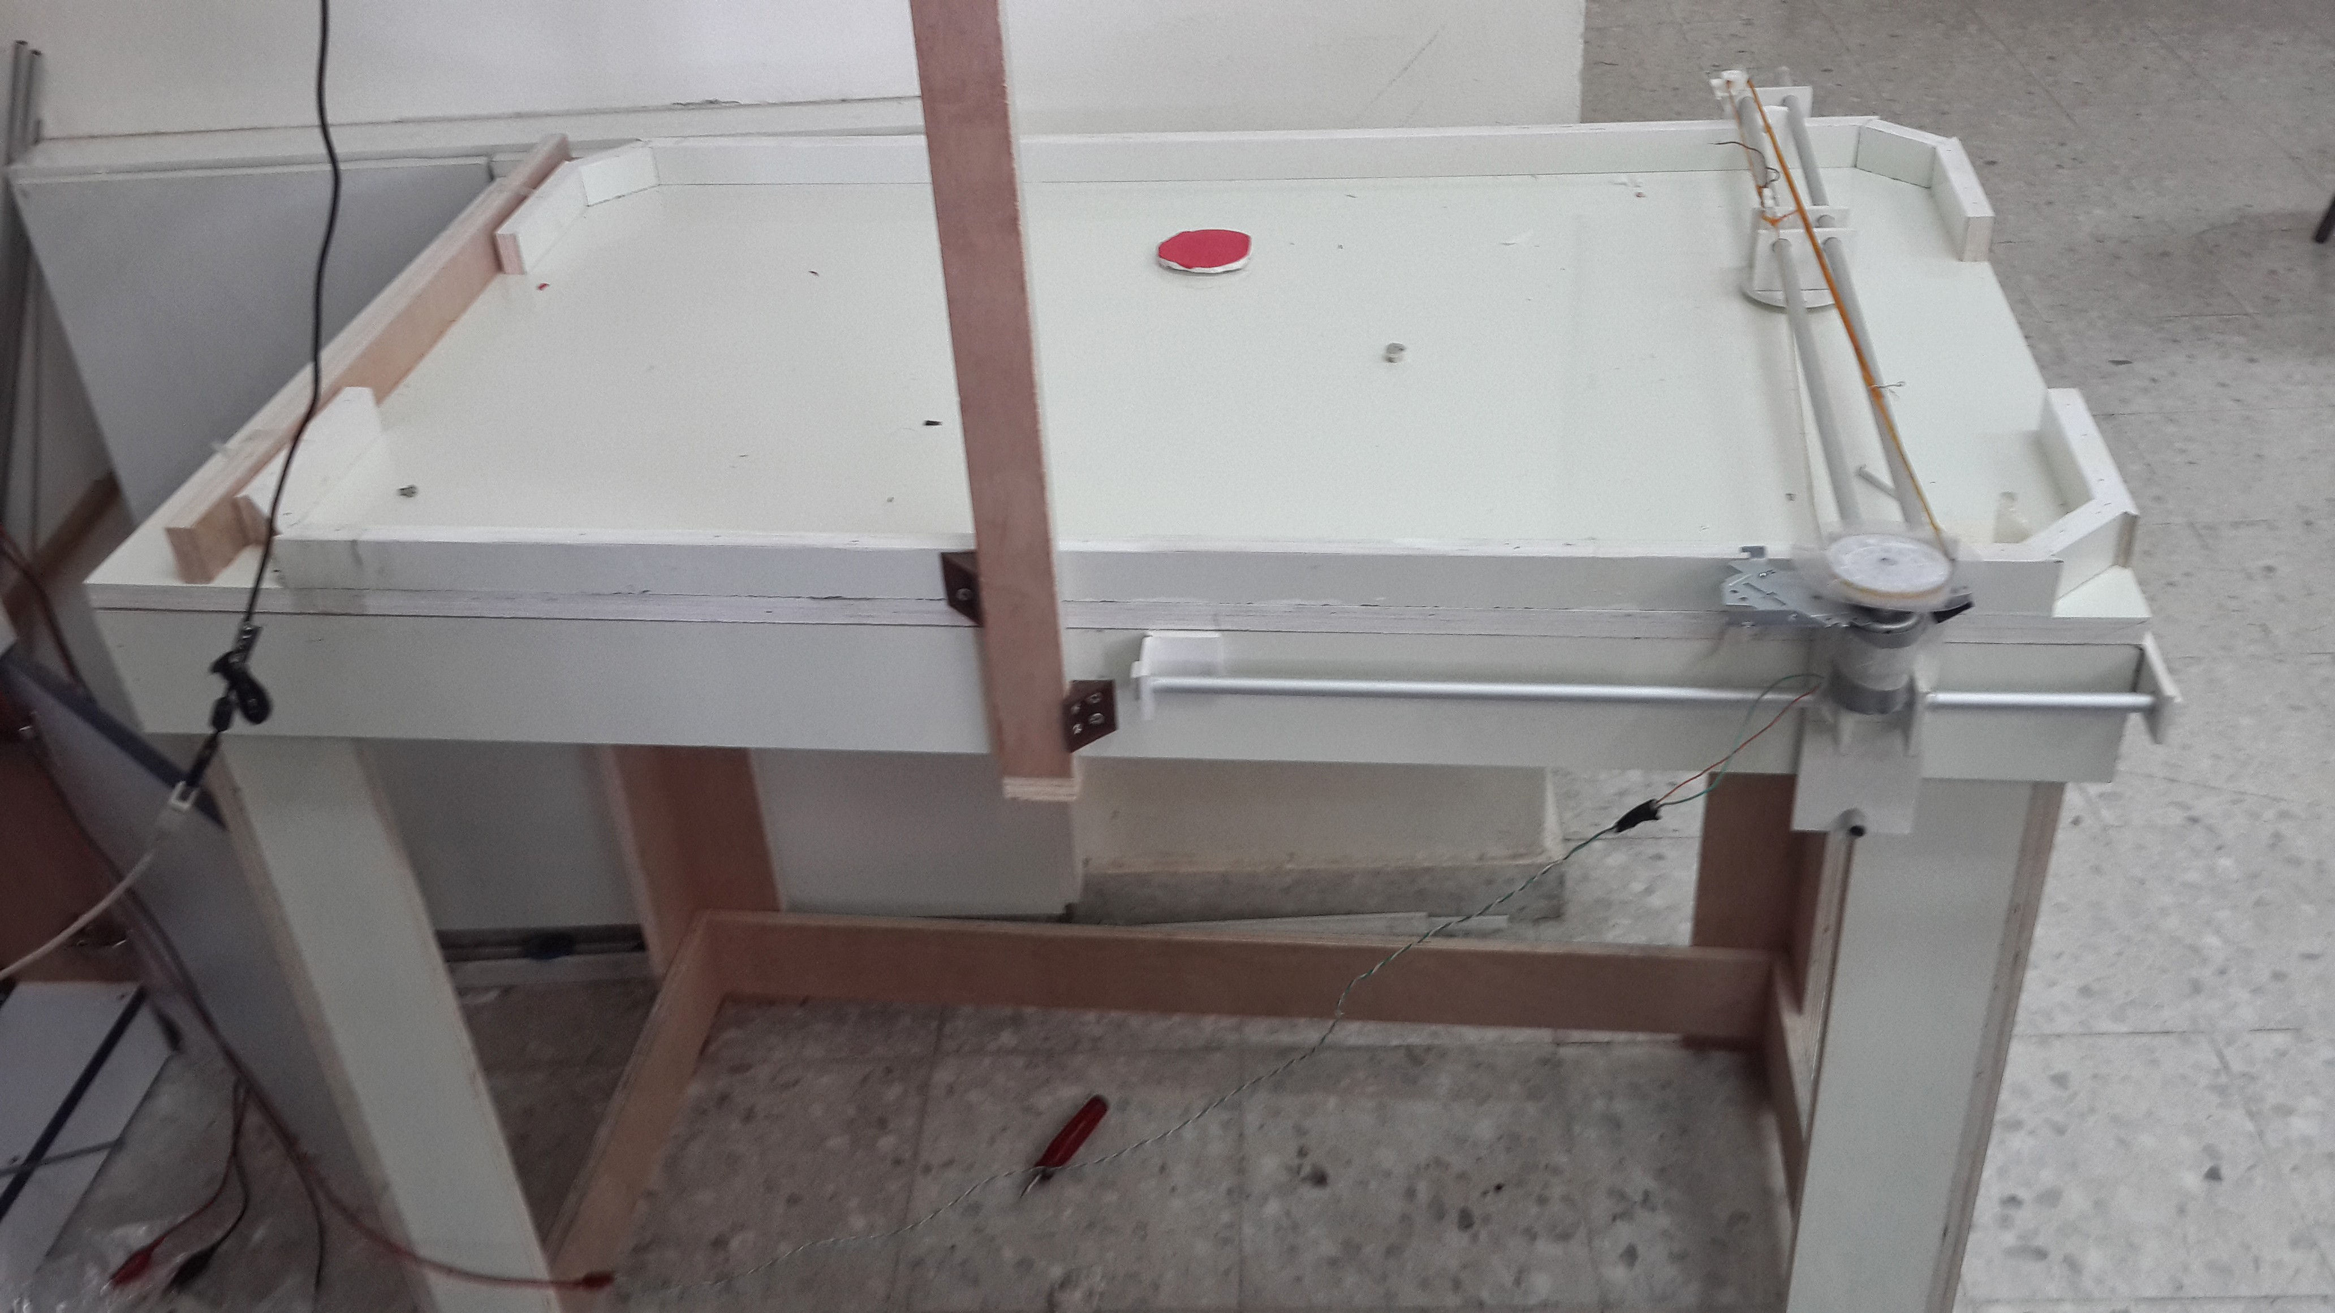
Table
Table First design

Slide 51
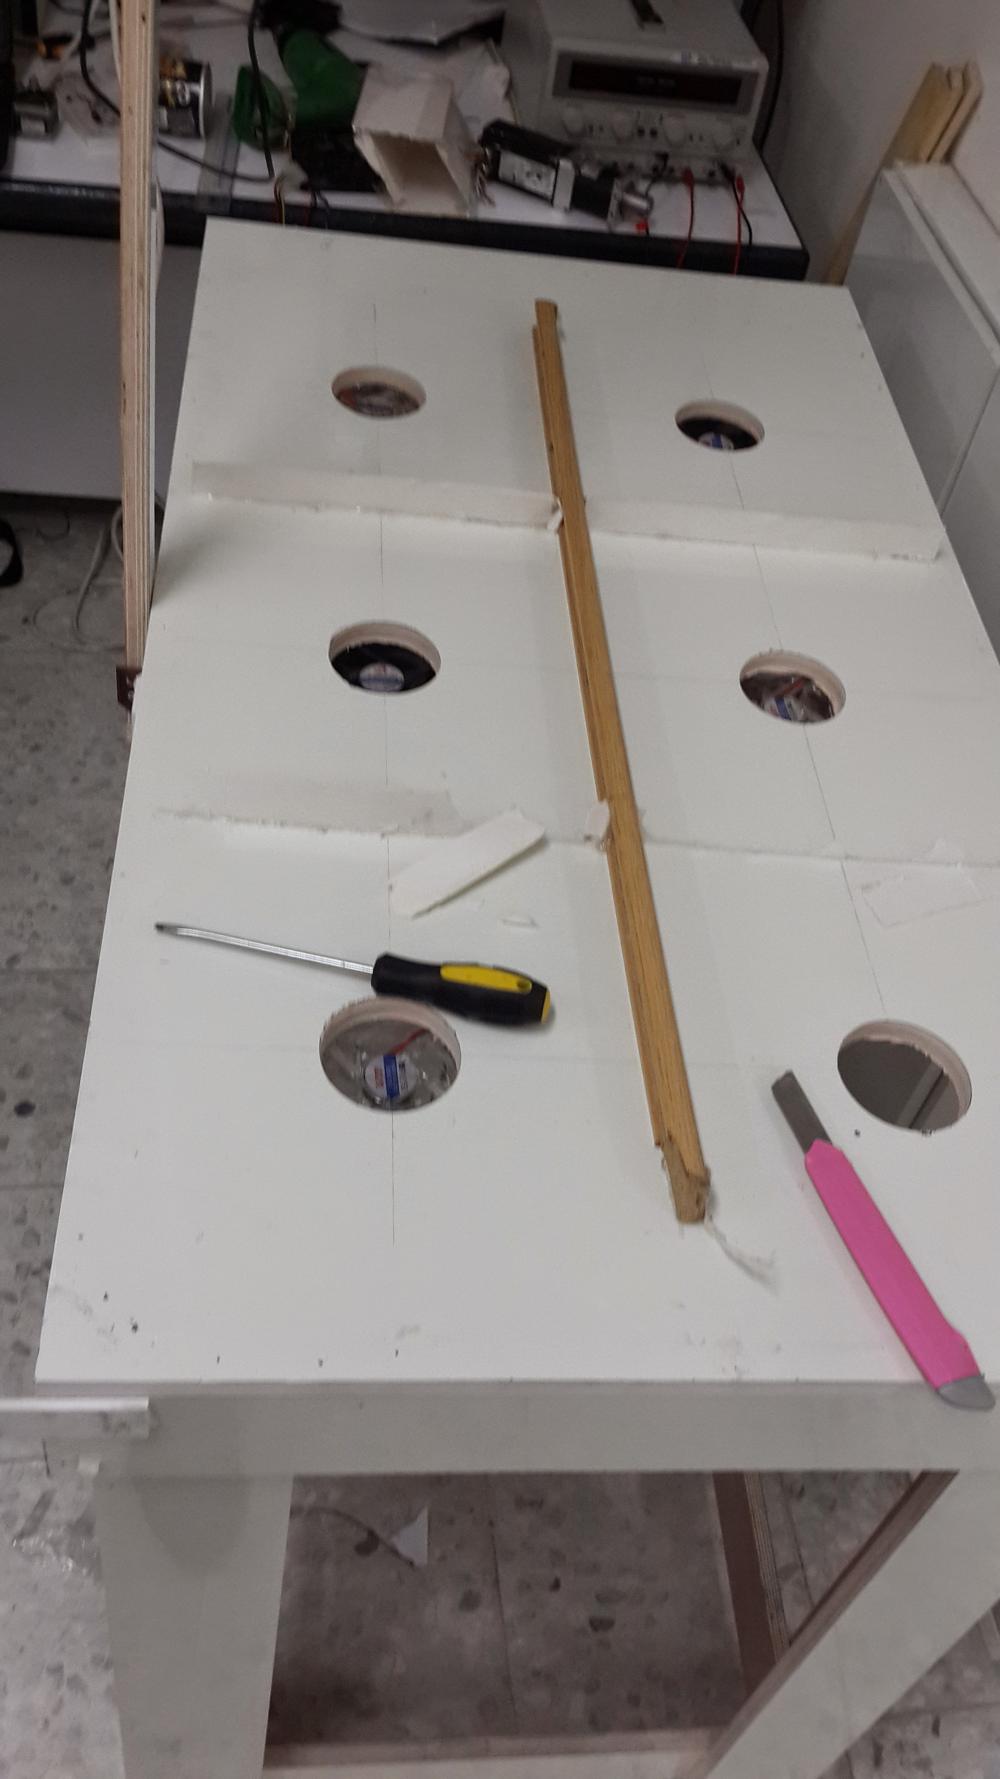
Table
Air System

Slide 52
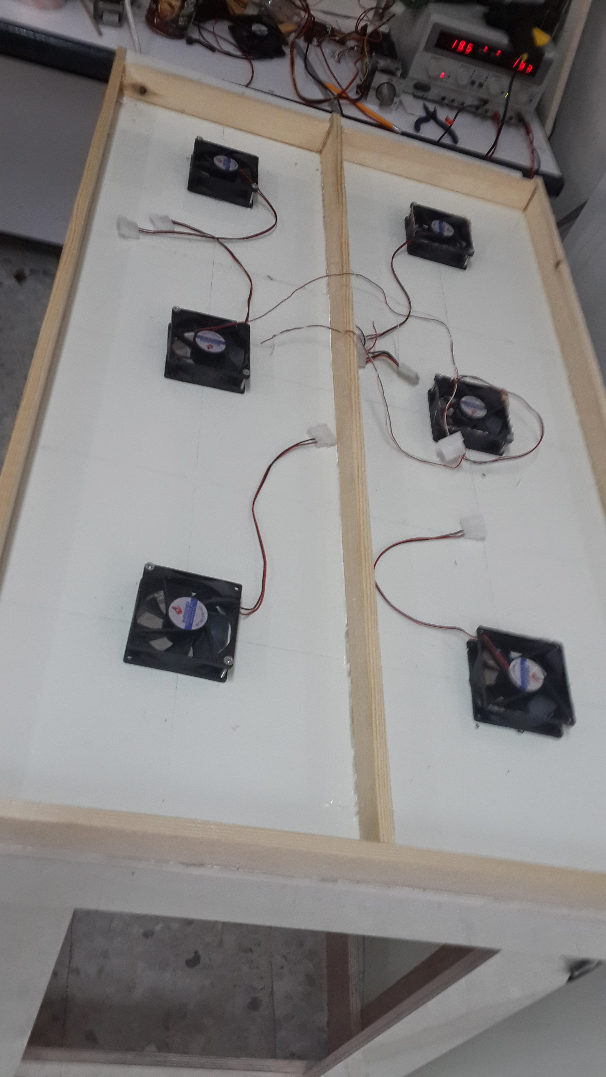
Table
Air System

Slide 53
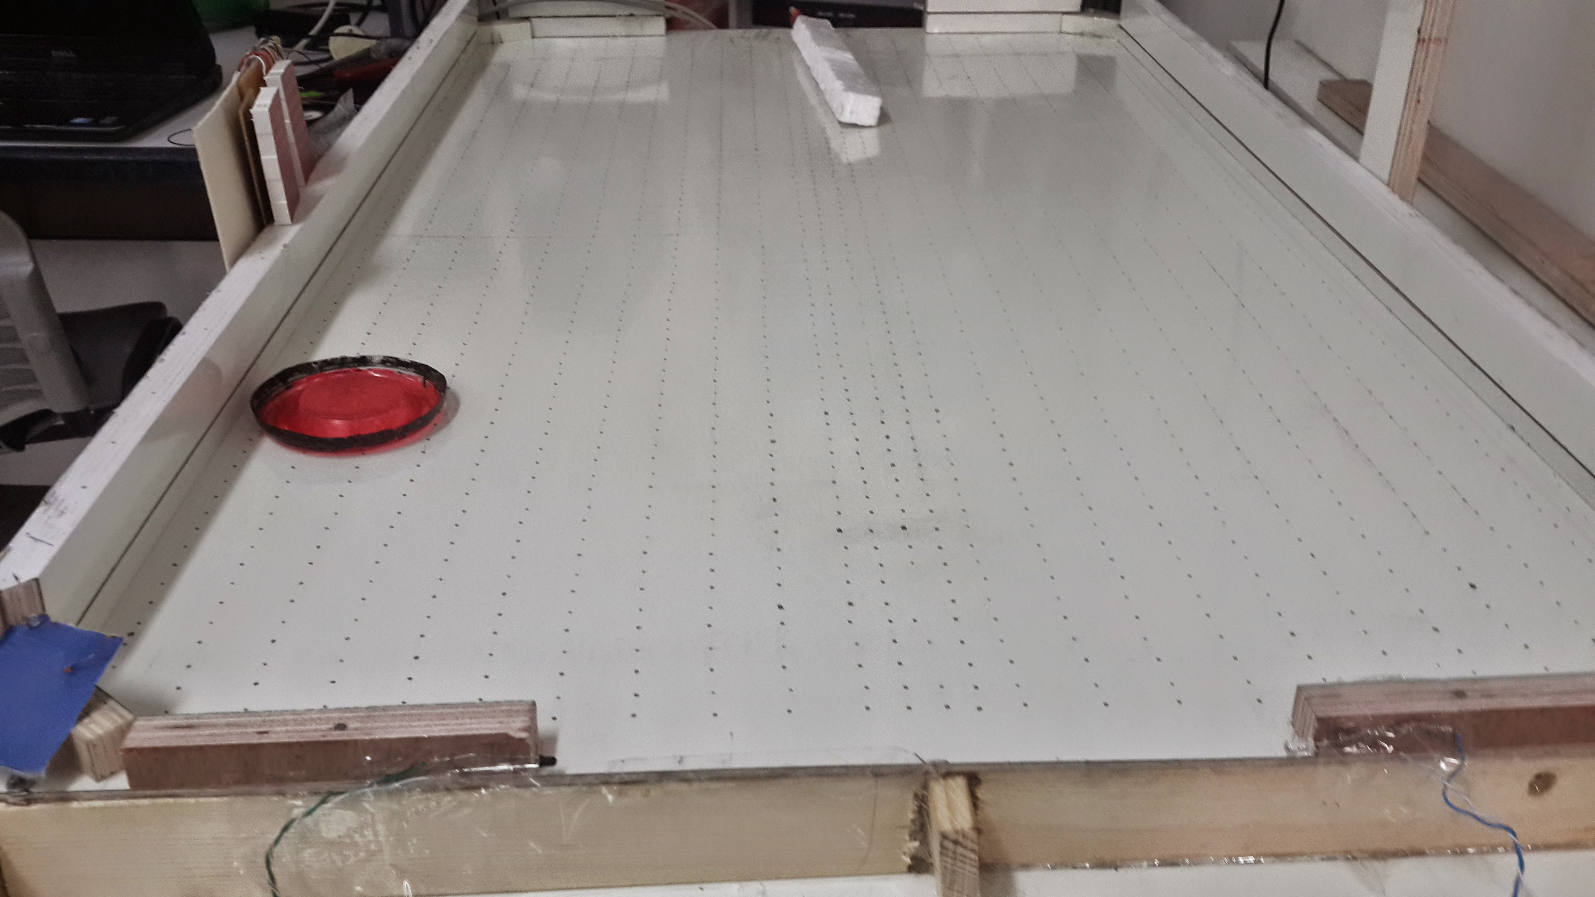
Table
Air System

Slide 54
Future Work
Use faster Motors.
Enhance tracking system.
Intelligence playing mode.

Slide 55
References
[1] Air hockey image, www.Mastergames.com.
[2]OpenCV library, Opencv.org.
[3]ArduinoArduino.cc.

Slide 56
Demo

Slide 57

Any Questions ???...!

Slide 58
Thanks For Listening ☺

