Slide 1

An-Najah National University College of Engineering and Information Technology Management Information Systems.

Slide 2

Human Resource Planning for Sard Company with Odoo.
Supervised by: Dr. Maher Abu Baker.
Prepared By: Baha'a Jaber, Ghazal Abu Zahra, Nervana Shelbayeh.

Slide 3
Table of Contents:
Introduction
Tools used in analysis
Current State
Reasons for using odoo
Solution
Modules
Reports

Slide 4


Introduction
Founded in Nablus in 2022.
consists of 5 branches.
This store is managed by Mohammad abu Shihab.
It employs approximately 55 employees.
Our project aims to implement Human Resource Planning For Sard Company.

Slide 5
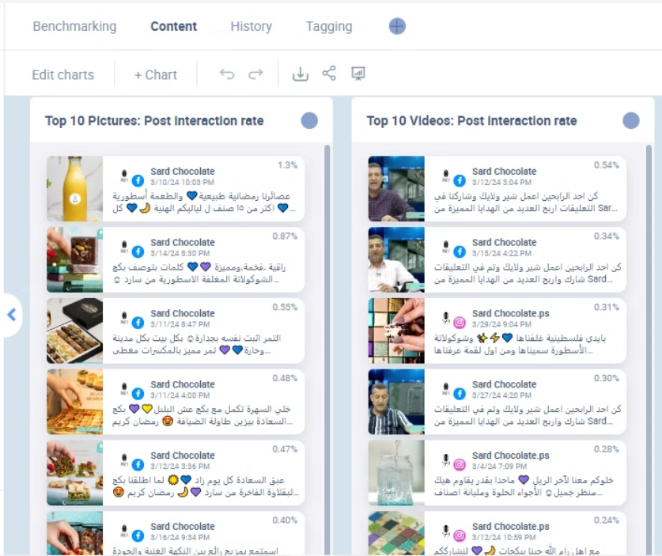
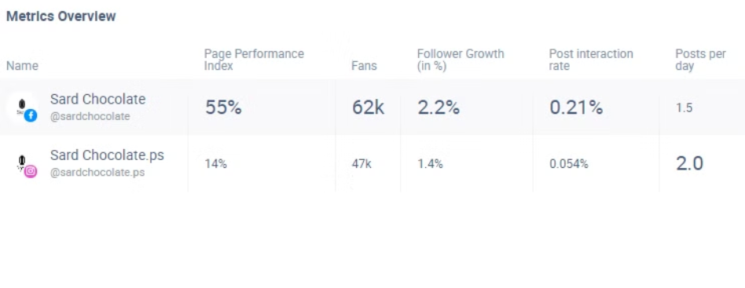
Tools 🔽
Fanpage karma:
Workday:

Slide 6


Current State
1
Communication Limitations.
2
Limited information of employee.
3
No reporting.

Slide 7

The Odoo Solution
Employees' files.
Attendance management.
Performance management and evaluation.
Salary and benefits management.

Slide 8
Why Odoo ?
Customization
High
Function scope
All Modules
Cloud offer Available
yes
Security
High
Integration
High

Slide 9
Key Modules
1
Employees
2
Contracts
3
Payroll
4
Planning
5
Attendance
6
Time off
7
Appraisal
8
Recruitment
9
Website
10
Approvals
11
Dashboard

Slide 10

Modules In Odoo:
Let’s start with Employees module:

Slide 11
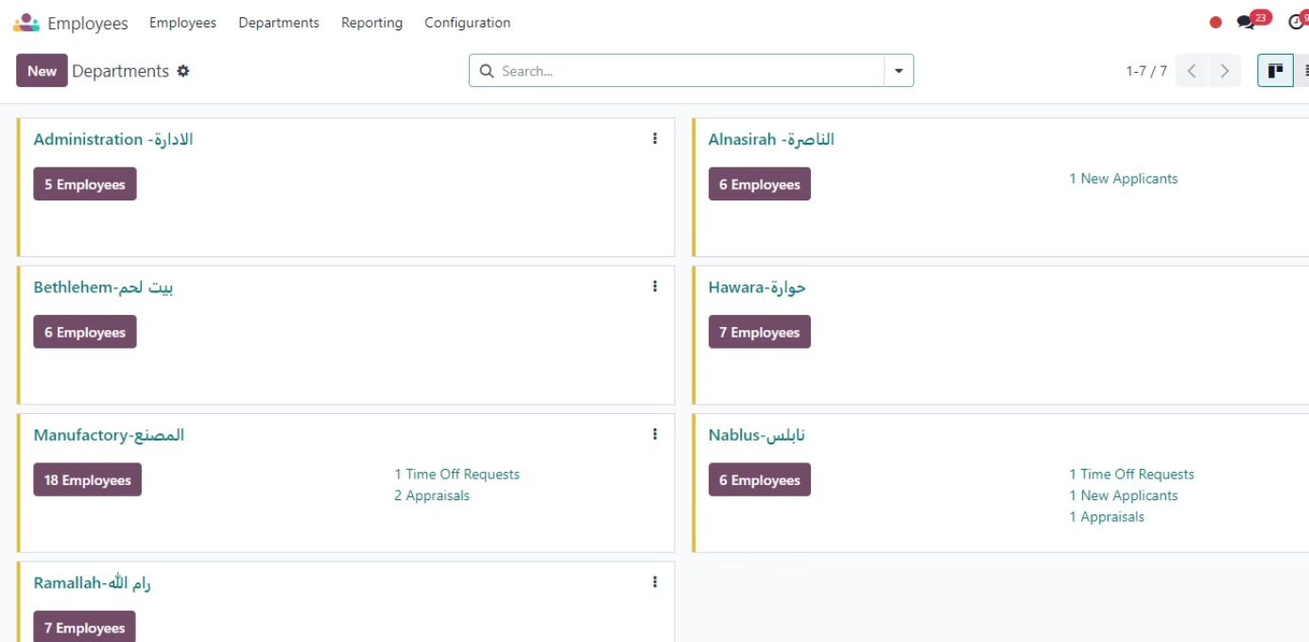

Slide 12
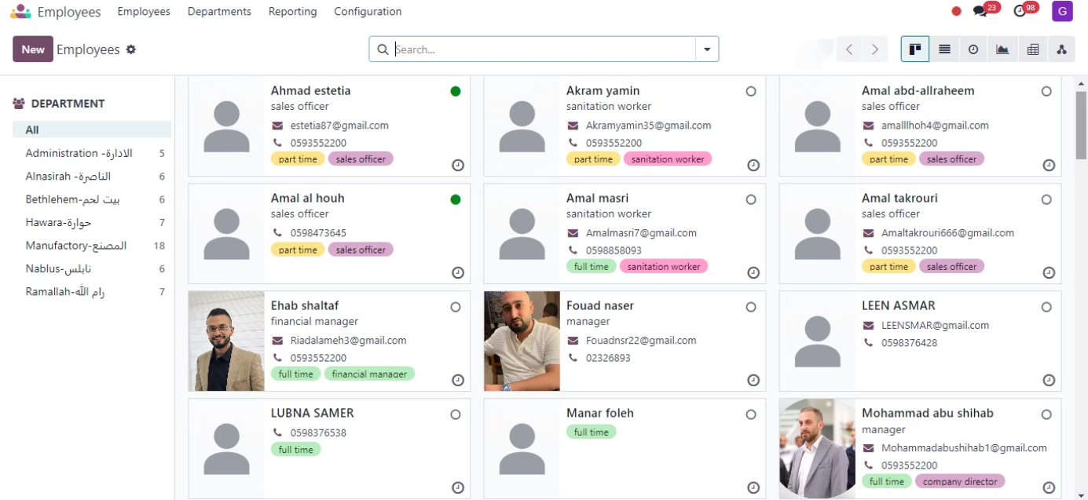
Employees

Slide 13
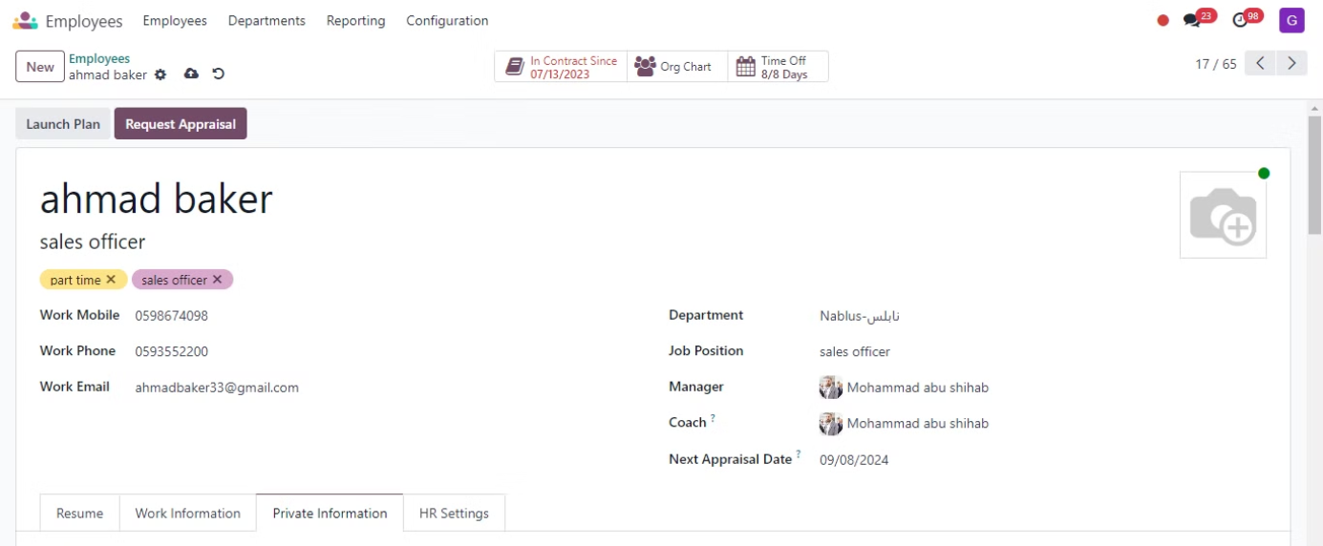

Slide 14
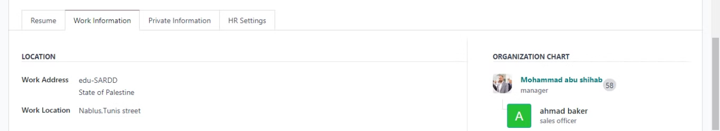
work information

Slide 15
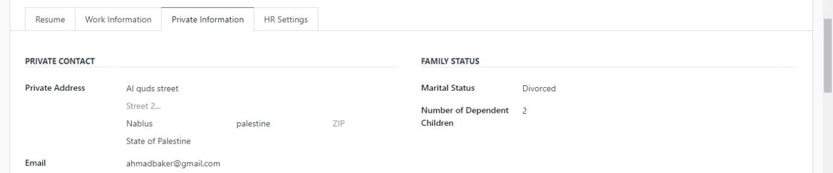
Private Information

Slide 16
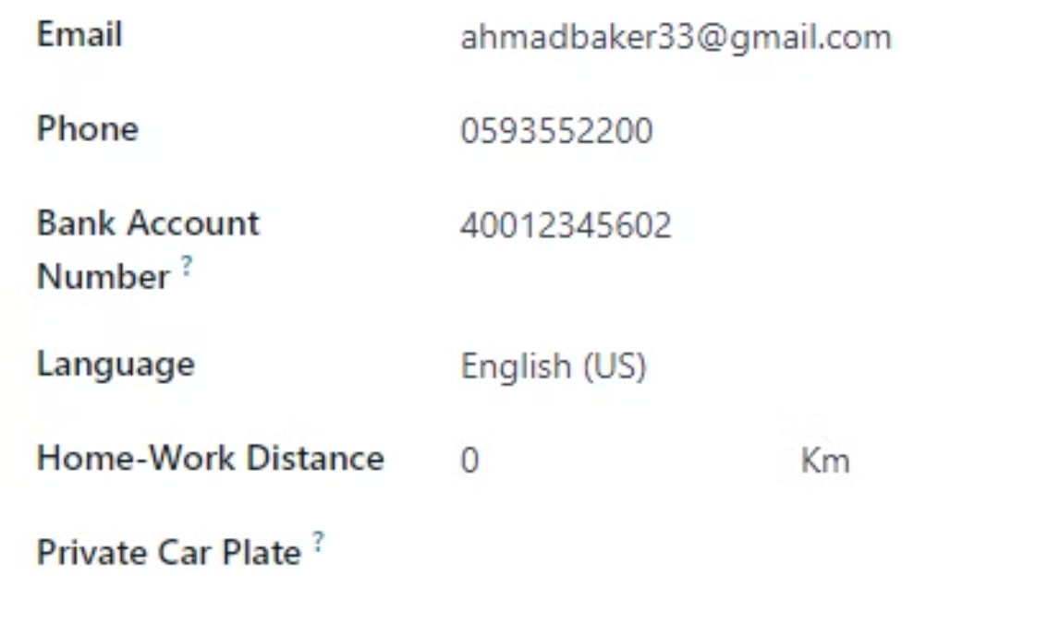
private information

Slide 17

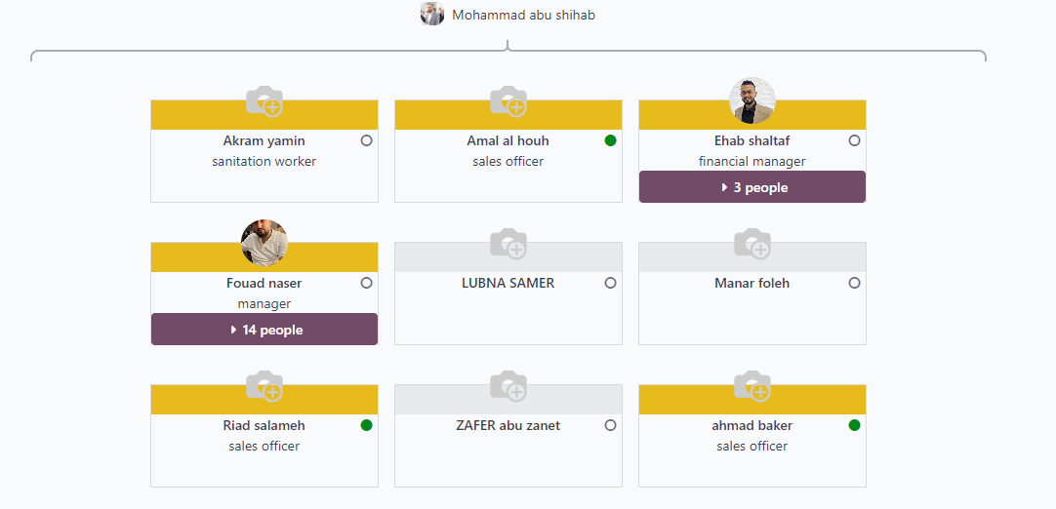
Org Chart

Slide 18
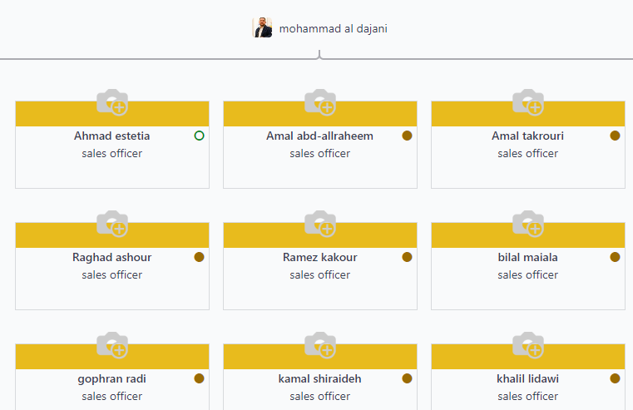
Org Chart

Slide 19

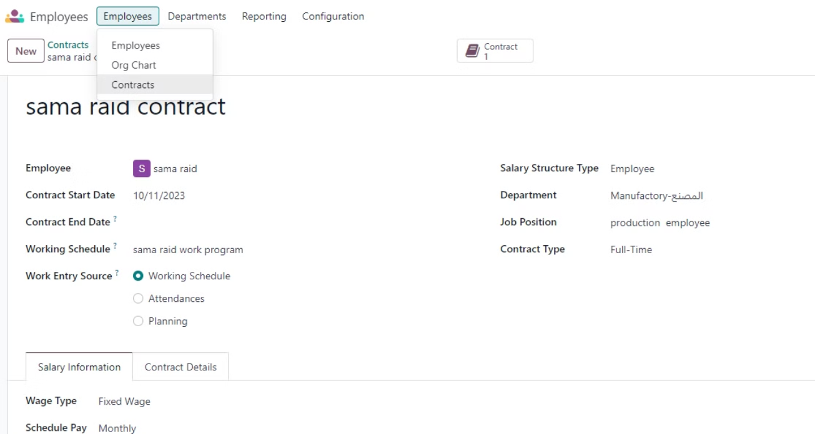

Slide 20

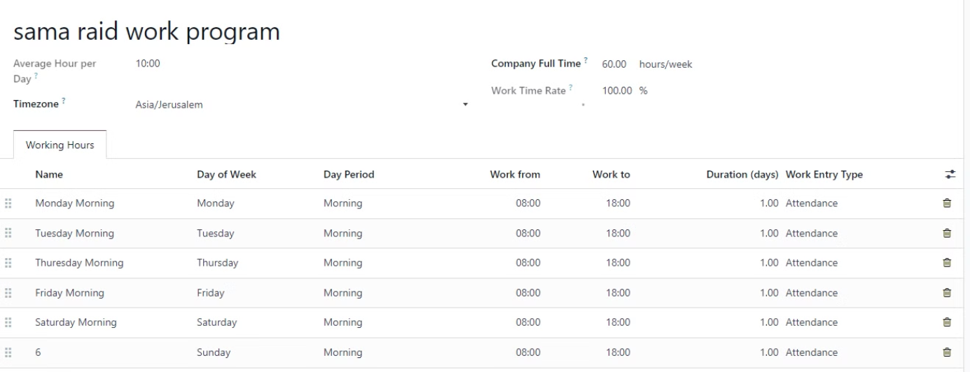

Slide 21

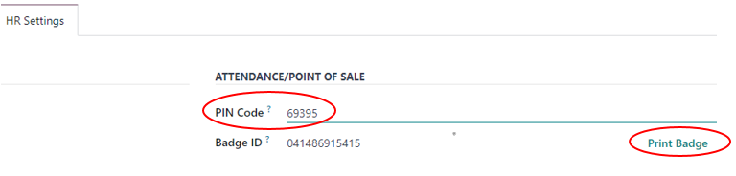
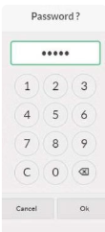
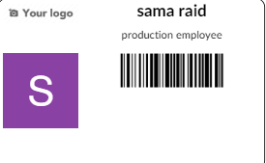

Slide 22


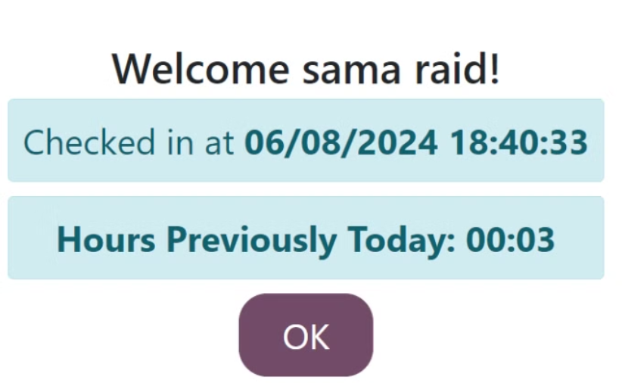

Slide 23


customization (Fingerprint) .
It cost $1500-$3000

Slide 24

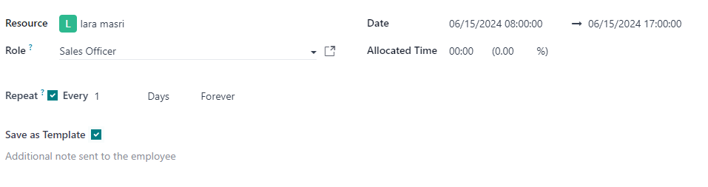
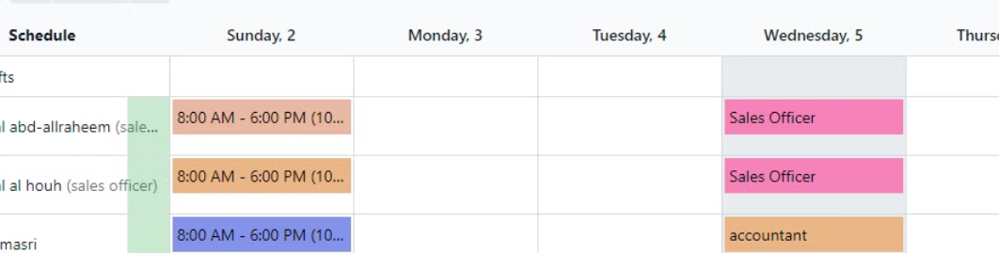

Slide 25

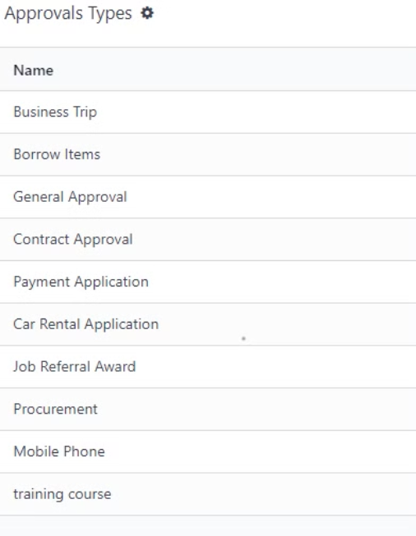

Slide 26
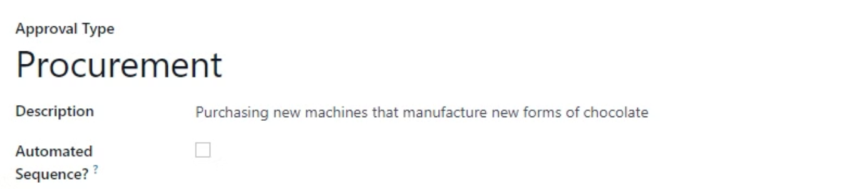
Identify a new approval

Slide 27

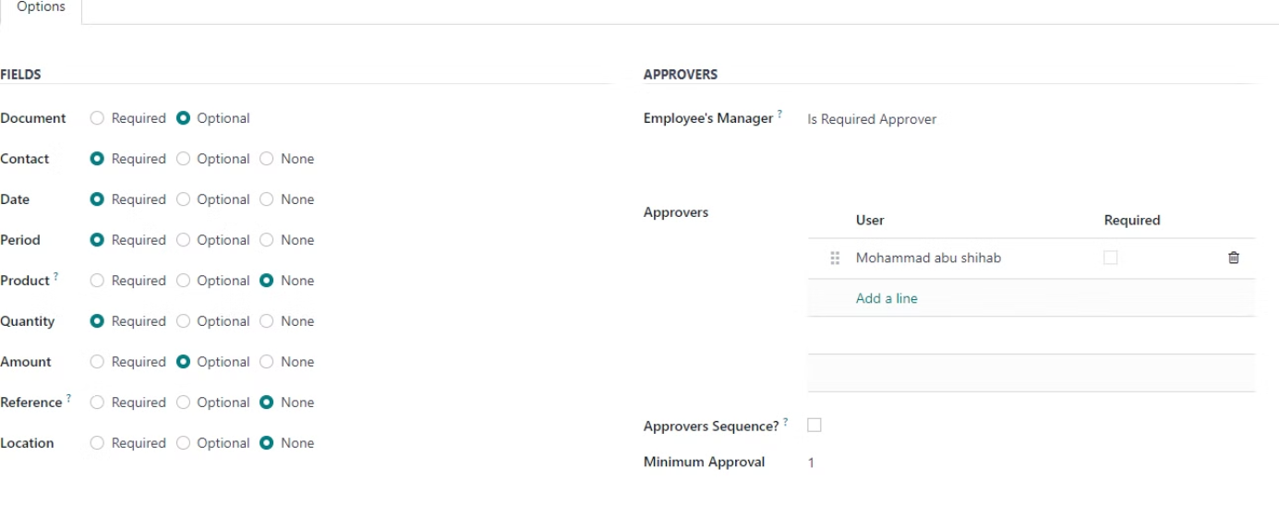

Slide 28
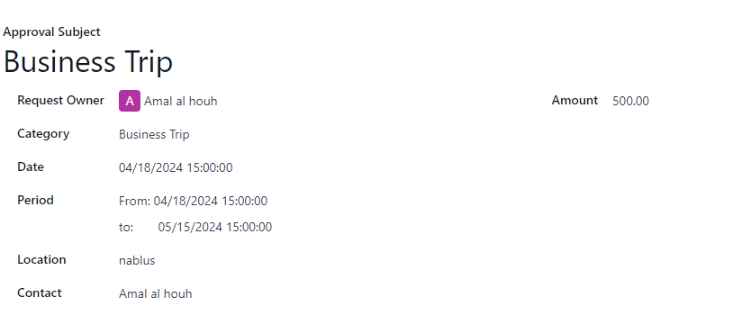
Ask for approval

Slide 29
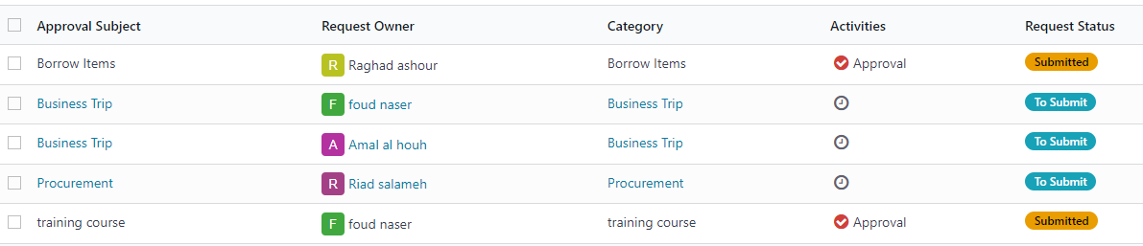
All approvals

Slide 30

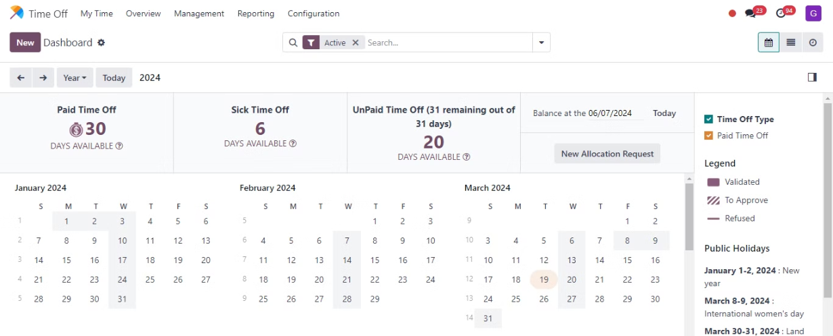
For Example 🔽

Slide 31

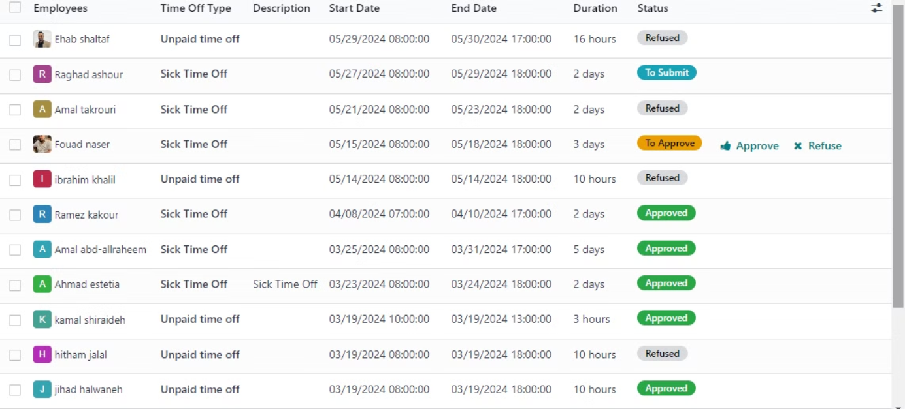

Slide 32

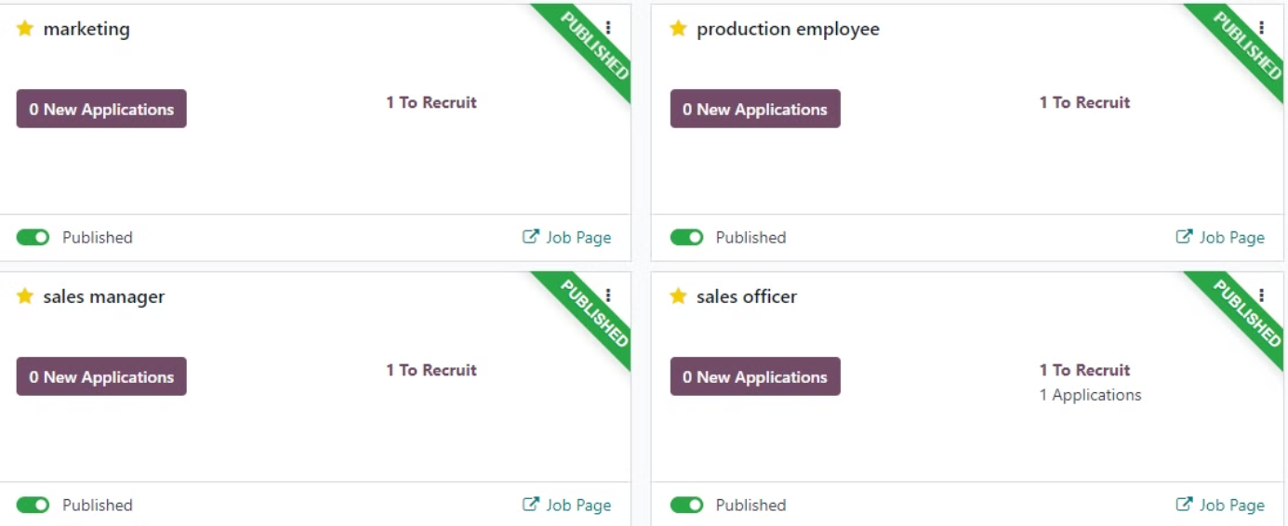

Slide 33



Slide 34



Slide 35

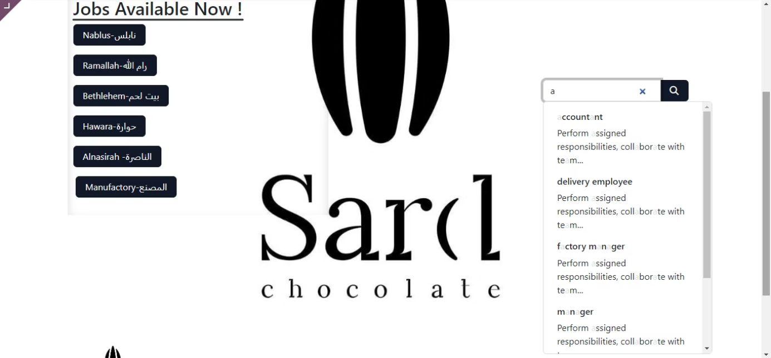

Slide 36



Slide 37



Slide 38

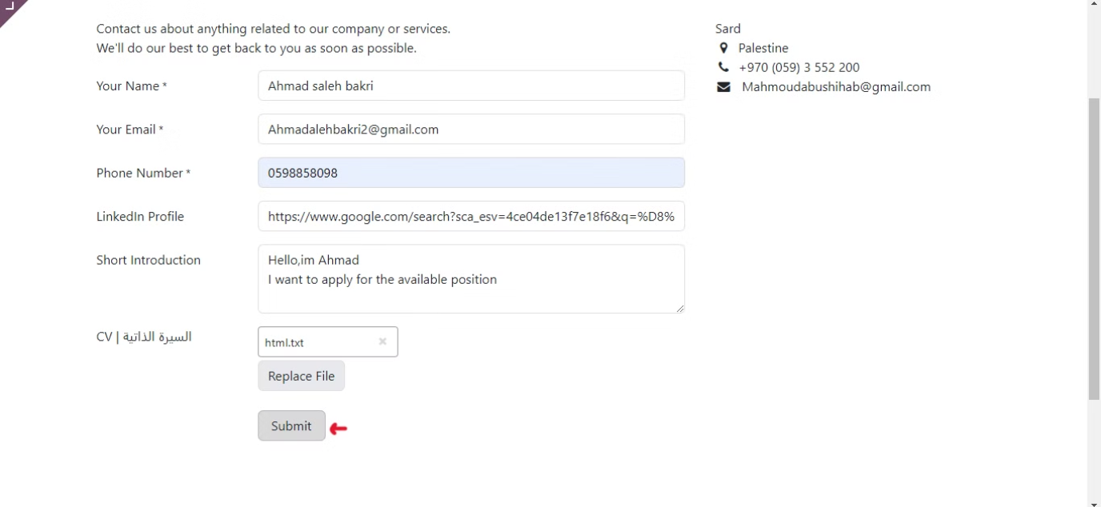

Slide 39

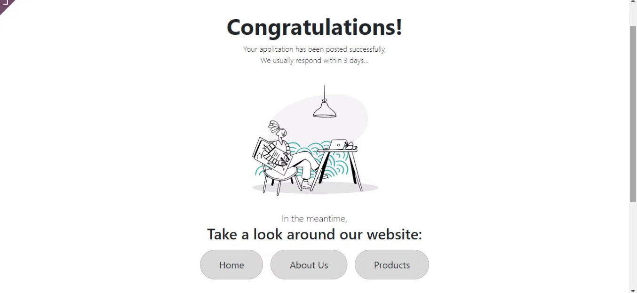

Slide 40

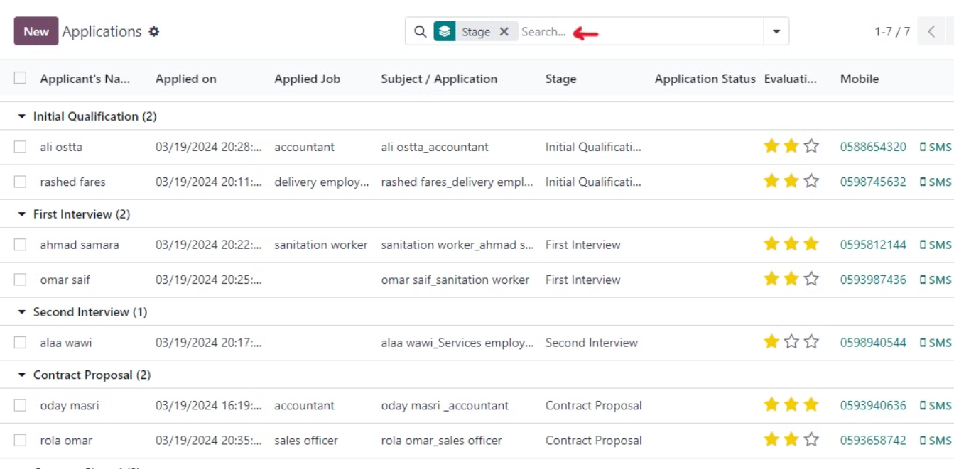

Slide 41



Slide 42

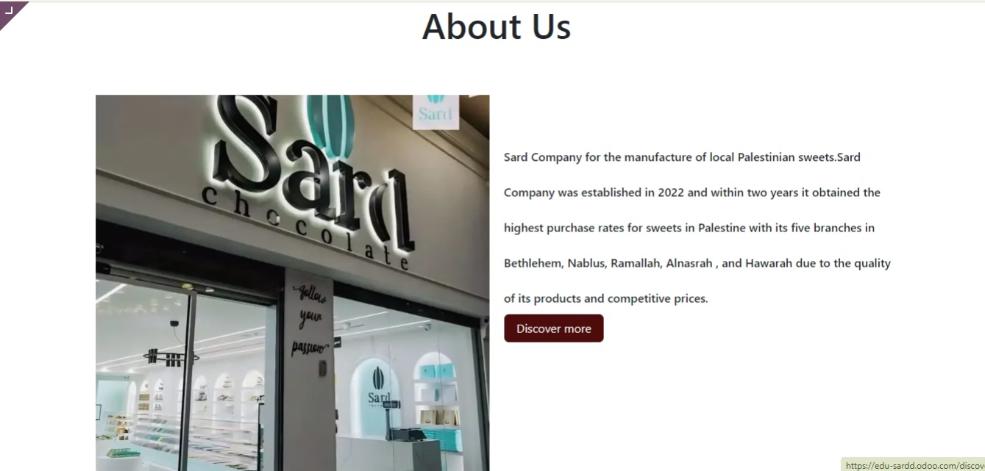

Slide 43

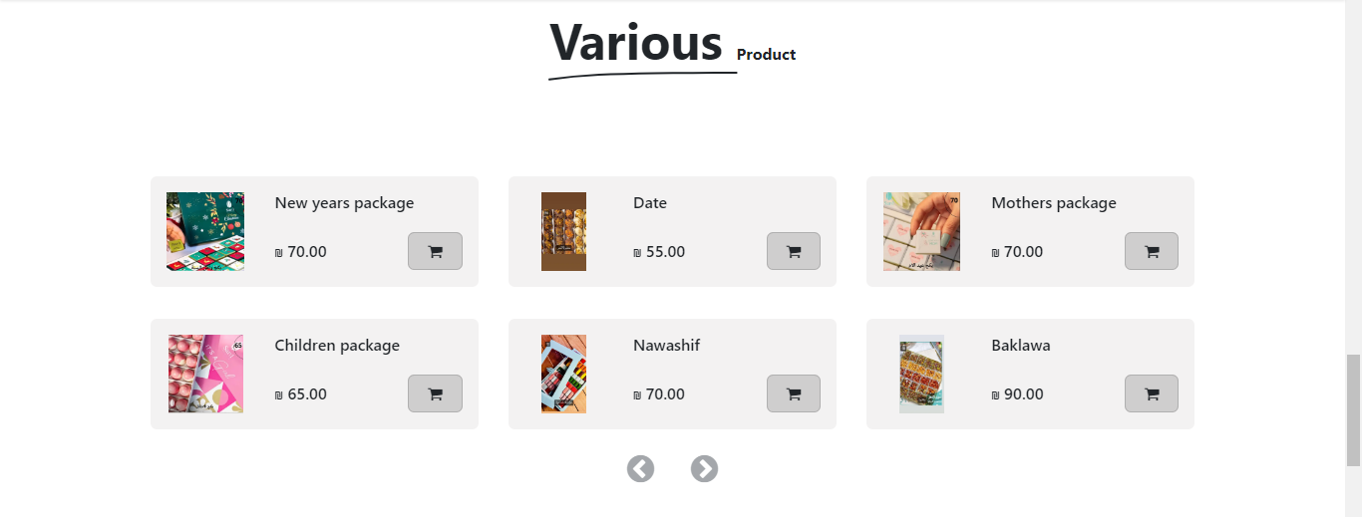

Slide 44

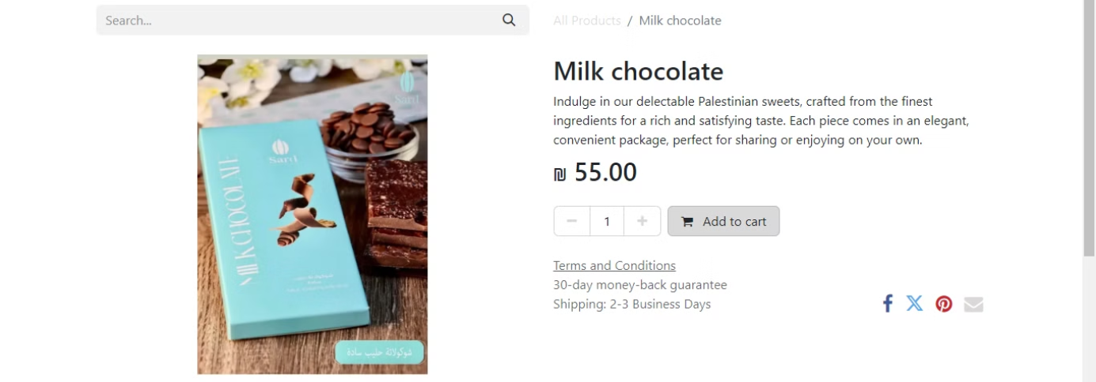

Slide 45

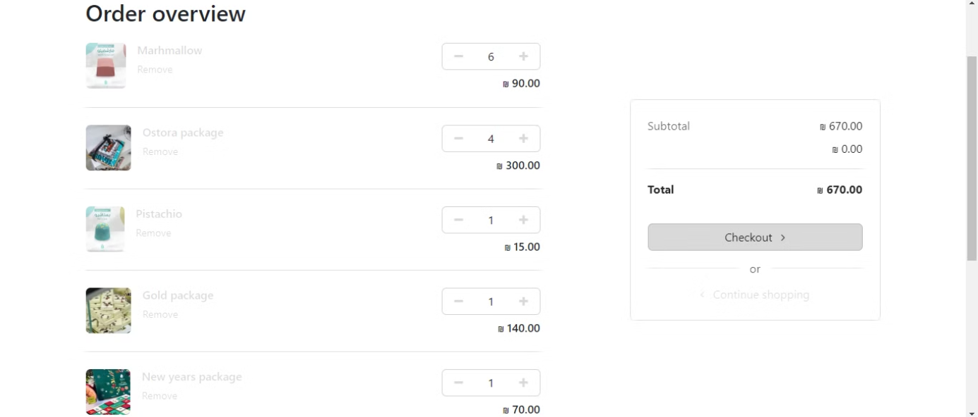

Slide 46

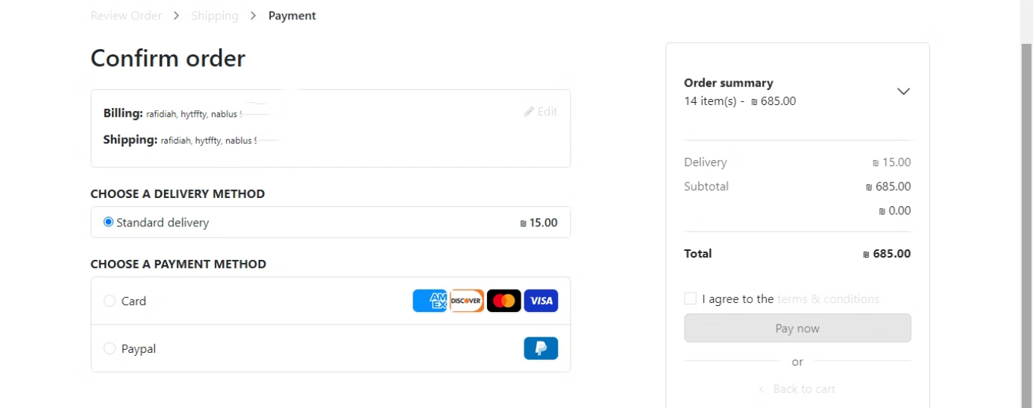

Slide 47

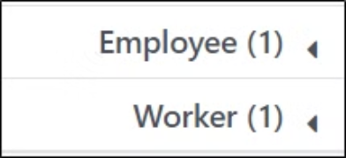
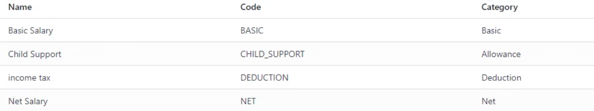

Slide 48

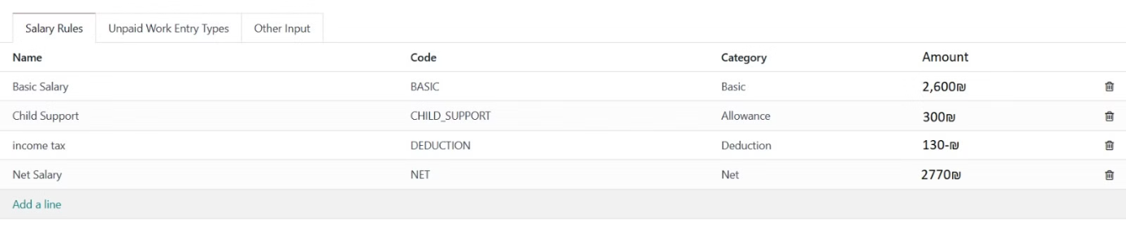

Slide 49

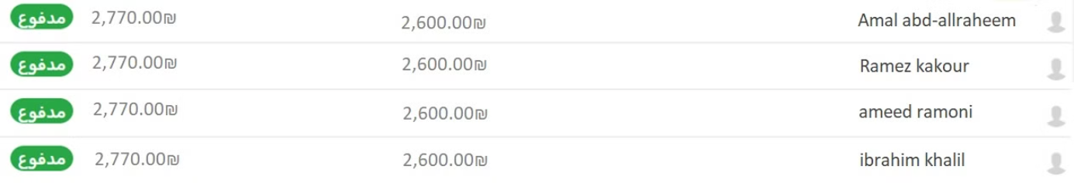

Slide 50

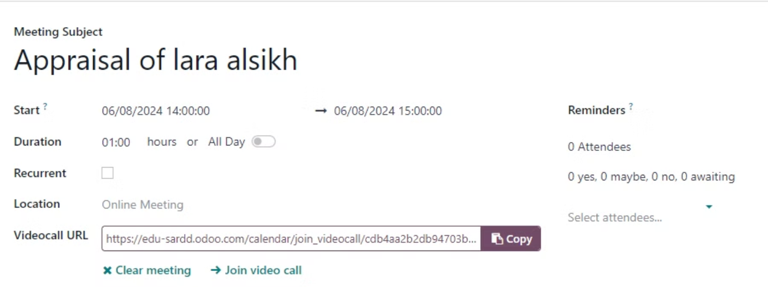
appraisal meeting

Slide 51
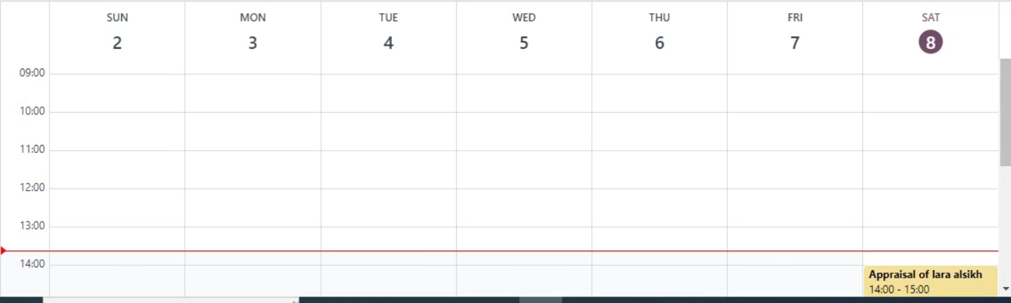
Appraisals Calendar

Slide 52
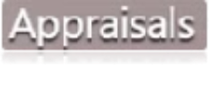
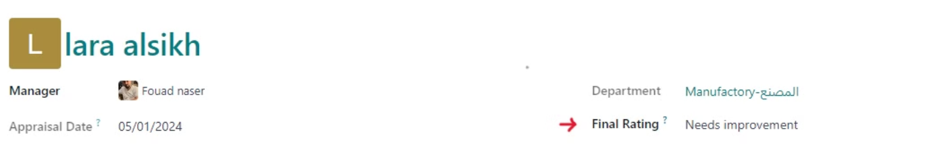

Slide 53
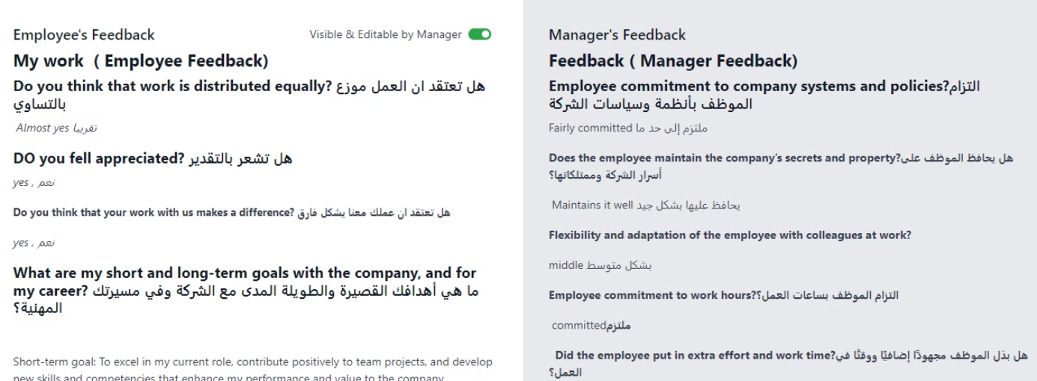

Slide 54

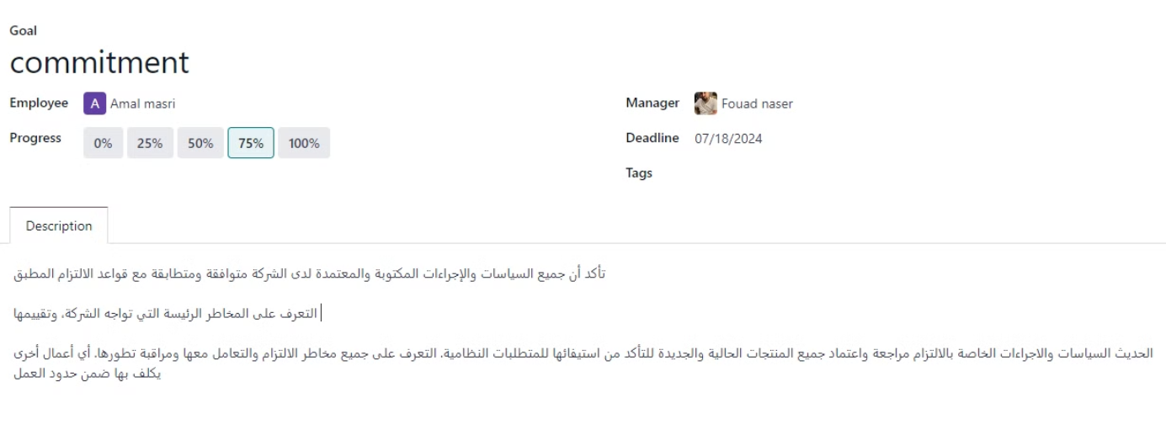

Slide 55




Slide 56

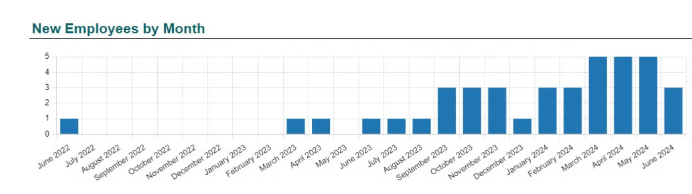
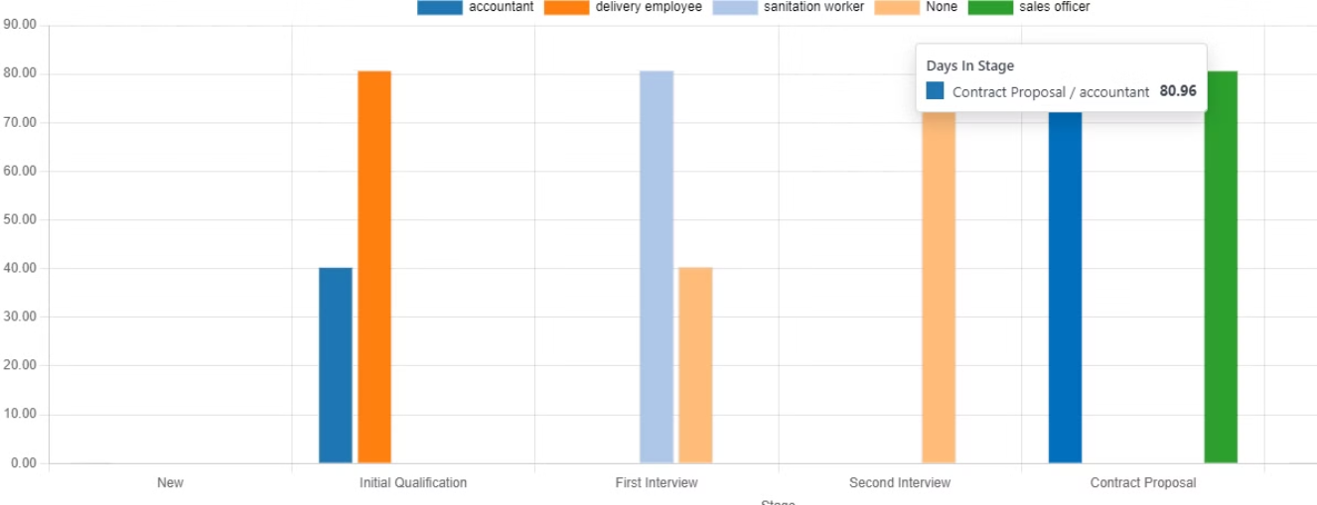
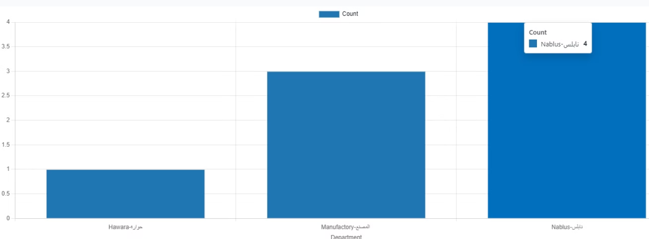
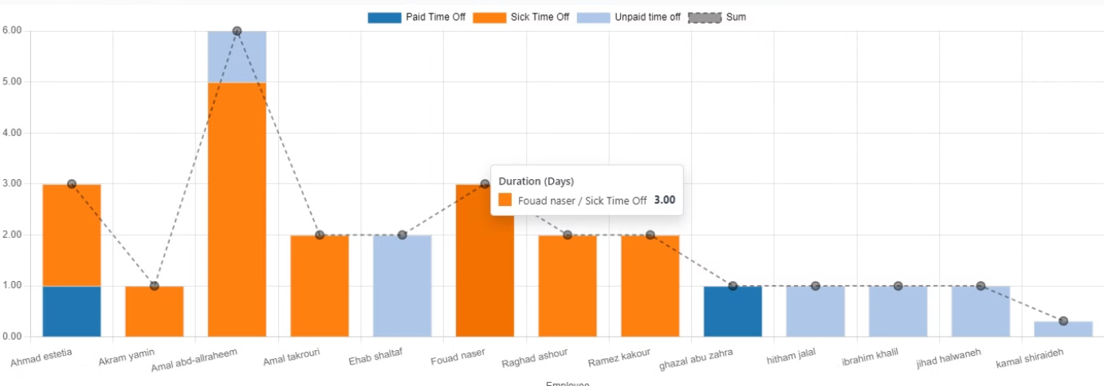


Slide 57

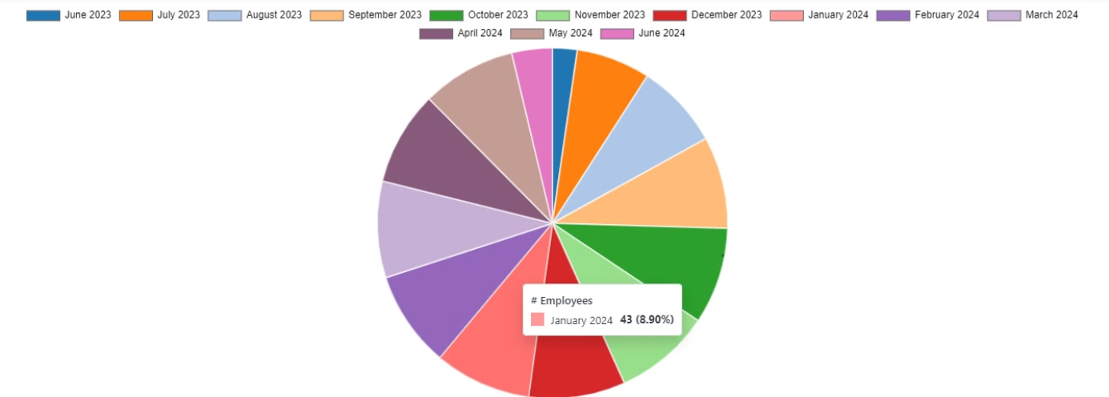


Slide 58


