Slide 1

An-Najah National University
Engineering Faculty
Civil Engineering Department
Design of Mechanically Stabilized Earth Retaining Walls
Graduation Project - Part One
Prepared by:
Omar Hindia (11924081) Yazan Ghanim (11925105)
Qassim dababseh (11927489) Mohamad jabareen (11925003)
Submitted to: Dr. Isam Jardaneh

Slide 2
Introduction :
There are different methods to retain soil cuts or support vertical sides of soil embankments. Traditional methods are simply different types of typical retaining walls, such as, gravity retaining walls, semi-gravity retaining walls, cantilever retaining walls, counterfort retaining walls, etc. However, new modern trends are now available for these projects and the most common one is soil reinforcement. It is simply based on reinforcing the soil by horizontal strong intrusion made by steel or geosynthetic materials. This system is first suggested by Vidal in the 60’s of the last century. The system specialized for supporting soil vertical cuts is called Mechanically Stabilized Earth Retaining Wall and mainly composed of facing elements, reinforcing bars and backfill soils.

Slide 3
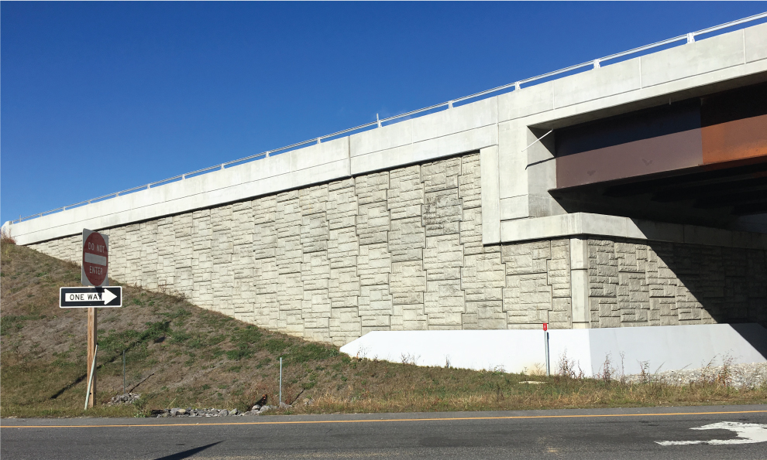
Objectives :
The aim of this project is to design mechanically stabilized earth retaining walls for different heights and compare this design with traditional retaining walls, such as, cantilever retaining walls which the most common types in our region. Finally, comparisons will be made between the two types of retaining walls from economical and time of construction point of views.

Slide 4
Chapter Two
Types of Traditional Retaining Walls

Slide 5
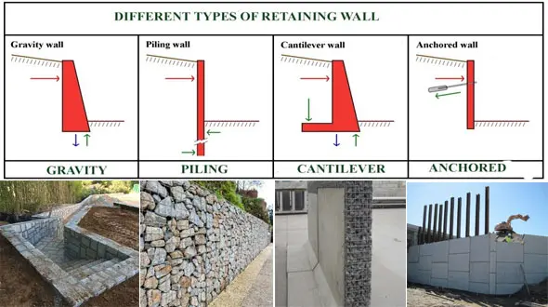
Introduction
There are various types of traditional retaining wall structures which are used for numerous goals, It is generally required in building hills, dams, and stents , etc.

Slide 6
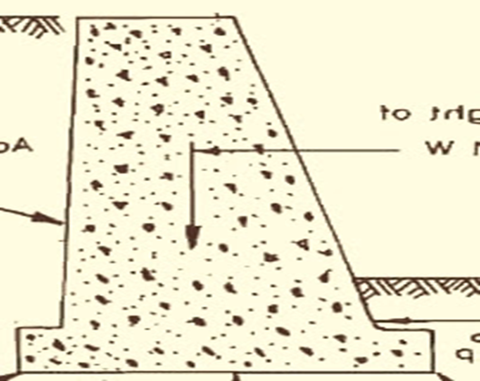
Types of traditional retaining walls
Gravity Retaining walls : the gravitational wall depends on its weight only to resist the side pressure of the Earth, so this wall must be very huge to face this action.
It can be built from different materials such as concrete, stone and brick units, and it is an economy for a height of up to 3 meters.

Slide 7
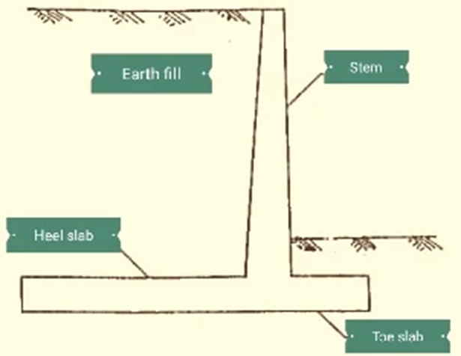
Cantilever Retaining Walls:
A wall of a cable consisting of stem tiles and base, It is made of reinforced concrete, preceding casting, or pre -strain.
The wall of the bond or the cable is economical to a height of 10 meters.

Slide 8
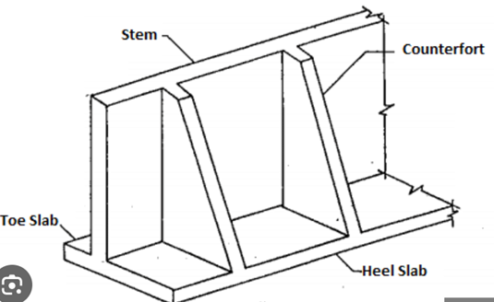
Counterfort Retaining walls :
A counterfort retaining wall is a cantilever wall with counterforts, or buttresses, attached to the inside face of the wall to further resist lateral thrust.
The height of the counterfort wall ranges from 8 to 12 meters.

Slide 9
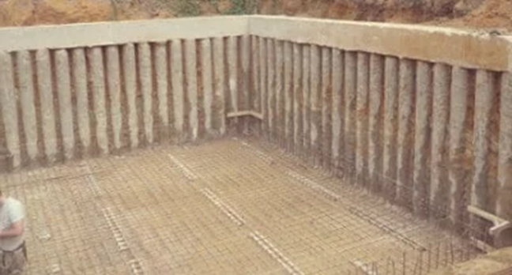
Piled Retaining Walls:
Piles are circular structural elements executed in the ground for the purpose of transferring vertical and horizontal loads into deeper and better layers of the foundation soil.
The walls of the piles provide a highly solid that maintains the ability to withstand side pressure in the depths of large pits.

Slide 10
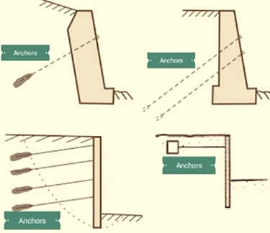
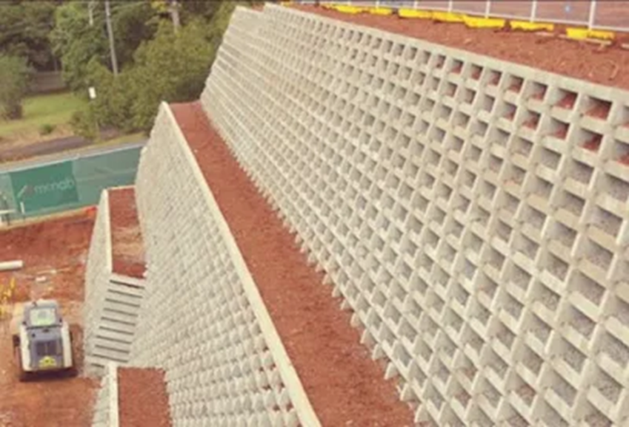
Anchored Retaining Walls:
Crib Retaining Walls:
This type of remedial walls is used when the area is limited or the thin wall is required.
Crib walls are a form of gravity wall, It is made of interlocking boxes made of wood or pre -casting concrete.

Slide 11
Chapter Three
Review of Soil Reinforcement

Slide 12
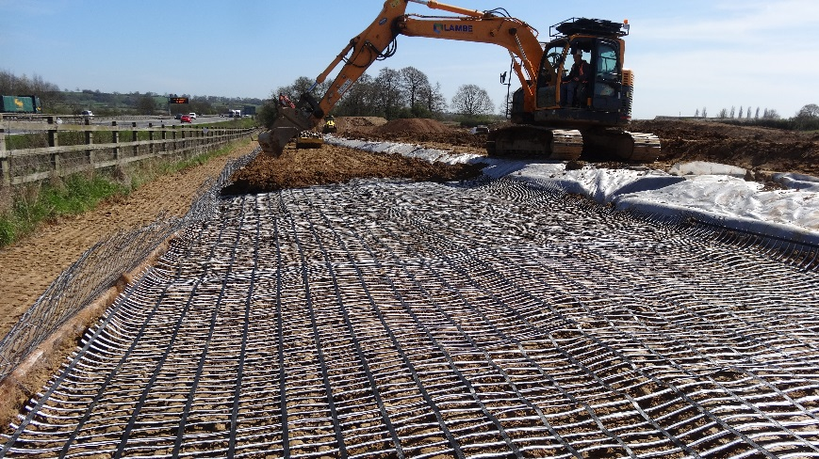
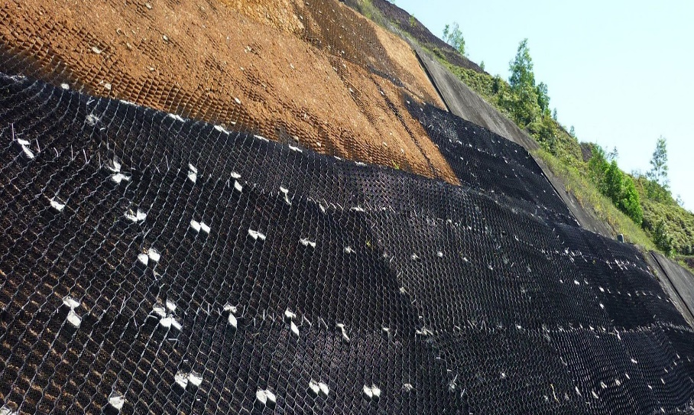
Introduction
This chapter talks about soil reinforcement, which is a method used to strengthen the soil and increase its bearing capacity.

Slide 13
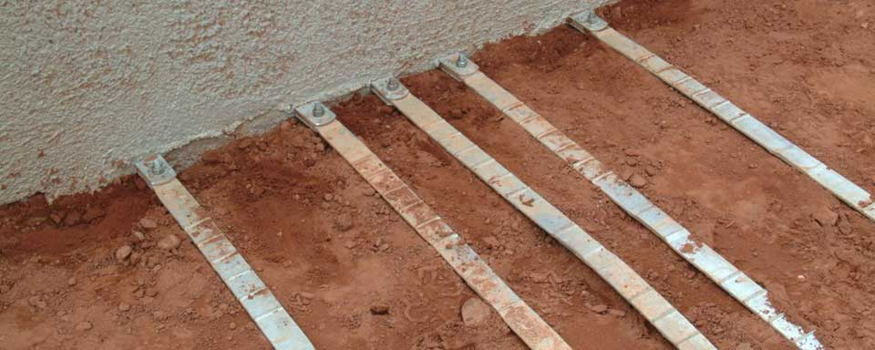
Types of Soil Reinforcement
Strip Reinforcement:
Strips are the flexible linear elements. Their breadth is greater than their thickness.

Slide 14
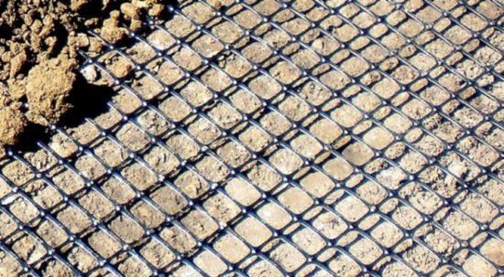
Grids Reinforcement:
It is used to resist tensile strength and to increase the area of usable land on the site. It allows the construction of steep slopes or walls, the construction of roads on poor ground conditions.

Slide 15
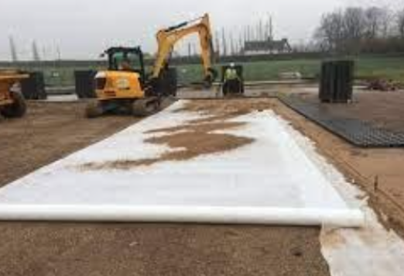
Sheet Reinforcement:
Sheet reinforcement can be made from galvanized steel, fabric or expanded metal which cannot be in the criteria of the grid. Use of geosynthetic sheet instead of steel strips has cost-efficient.

Slide 16
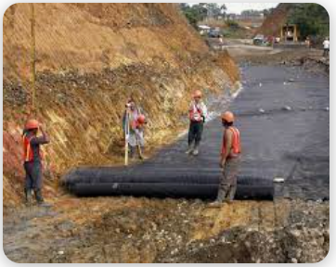
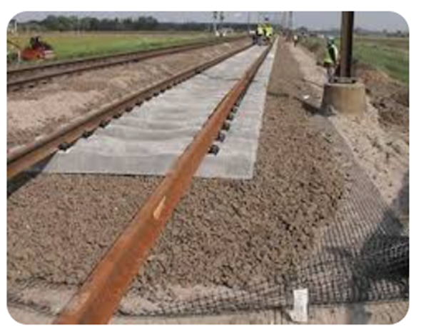
Applications of Soil Reinforcements
In the foundation layers of roads built on weak soil
It is used to support and strengthen the foundation layers that are created above the soft soil layers on roads.
In Railways
Soil reinforcement used to construct railways.

Slide 17
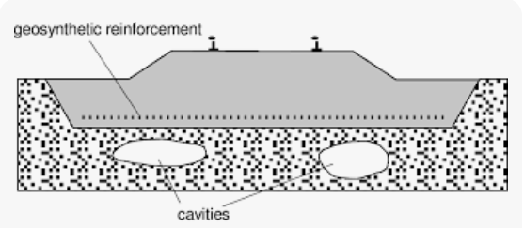
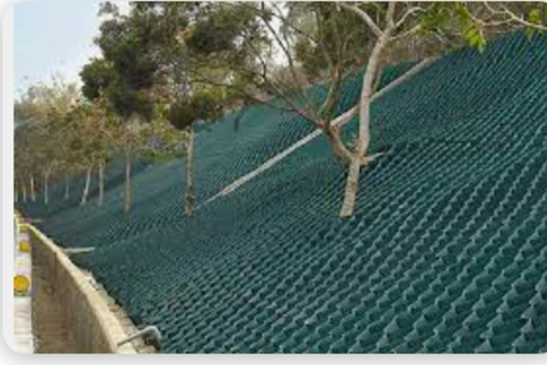
In repairing holes (bridging)
It is used in the process of filling potholes that may arise on the road in areas that contain gaps.
Support Slopes
Use in high and steep places
because its high tensile resistance.

Slide 18
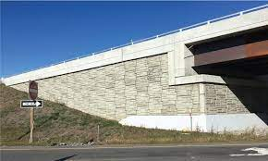
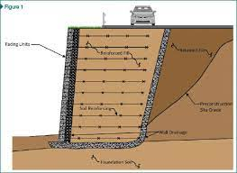
Construction of Mechanically Stabilized Retaining Walls
It is used in walls where the face of the walls is attached to elements that extend into the soil and are backfilled.

Slide 19
Principle of Soil Reinforcement
The working principle of reinforced soil depends mainly on the interaction between the soil and the reinforcing elements in order to help improve the properties of the soil.

Slide 20
The Advantages of Soil Reinforcement
It is used to improve the strength and durability of soil and increase its ability to withstand pressures and vibrations.
Increasing the life span of soil layers.
It saves time and cost, providing less use of labors.
The Disadvantages of Soil Reinforcement
Use is not recommended in locations with elevated groundwater levels.
This technique's material is prone to rust It is hard to change when a problem arises in it.

Slide 21
Chapter Four
Mechanically Stabilized Earth Retaining Walls (MSERW)

Slide 22
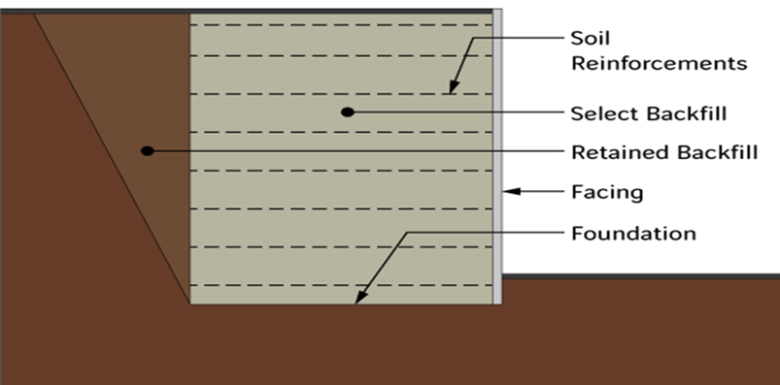
Introduction
MSERW are innovative construction techniques that involve the use of reinforcement between compacted soil layers. These methods are employed to create various earth structures such as retaining walls, bridge abutments, embankments, and steep, yet stable slopes.

Slide 23
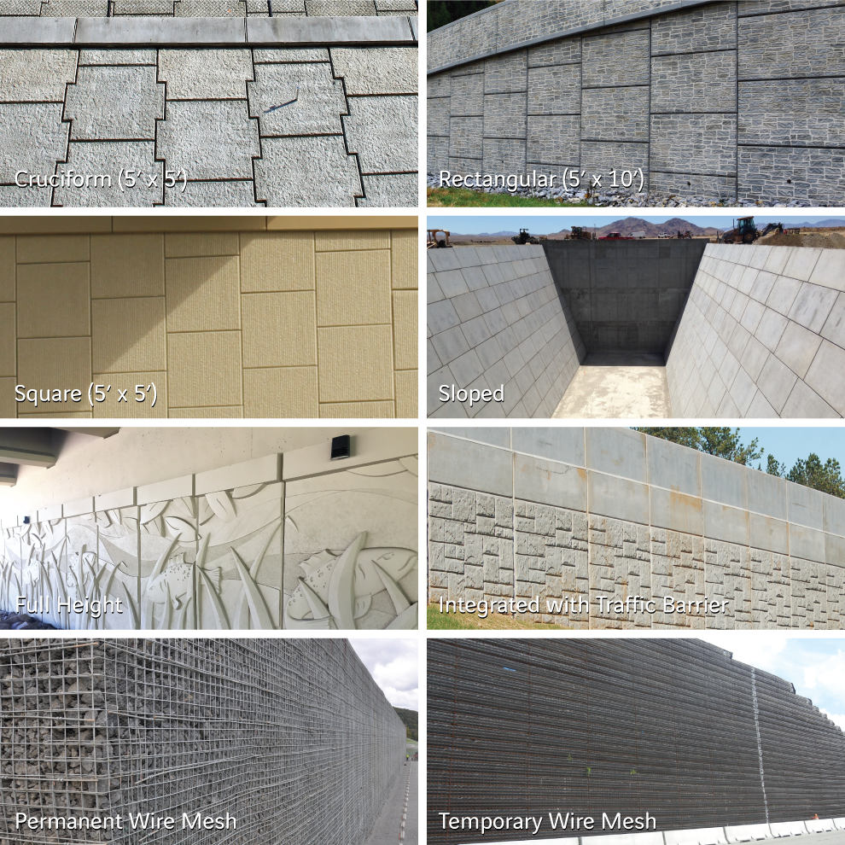
Component of (MSERW)
Facing elements :
are modular precast concrete panels or wire mesh.
Choosing the right facing type depends on the application, aesthetics, differential settlement, service life, and other factors.

Slide 24
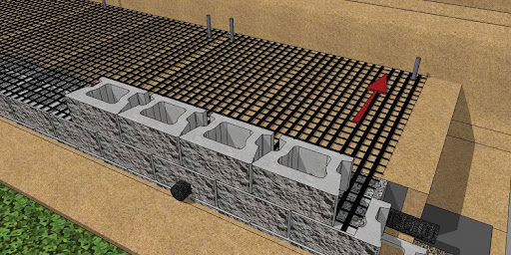
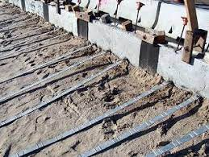
Soil reinforcements :
are typically steel or geosynthetic, in the form of strips or ladders.

Slide 25
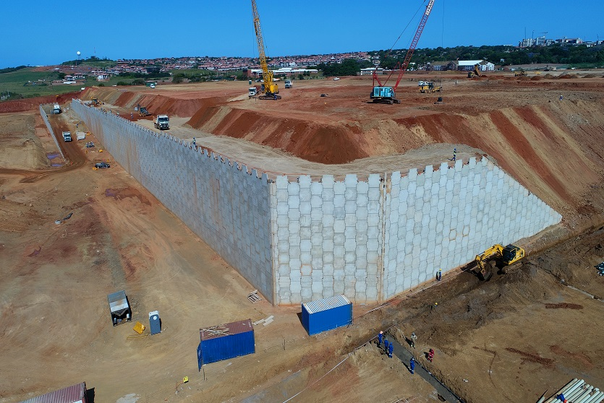
Select backfill :
allows for reliable construction and performance of the wall, in which the gradation, plasticity, electrochemical properties, and overall durability should be closely analyzed. It can be obtained on site, or from a distributor.

Slide 26
Using of (MSERW)
They have been effectively utilized as
retaining walls
embankments
coastal defenses
stabilizing elements for bridges (abutments)
towers
buildings
industrial storage enclosures
roads
railways
and various other construction undertakings

Slide 27
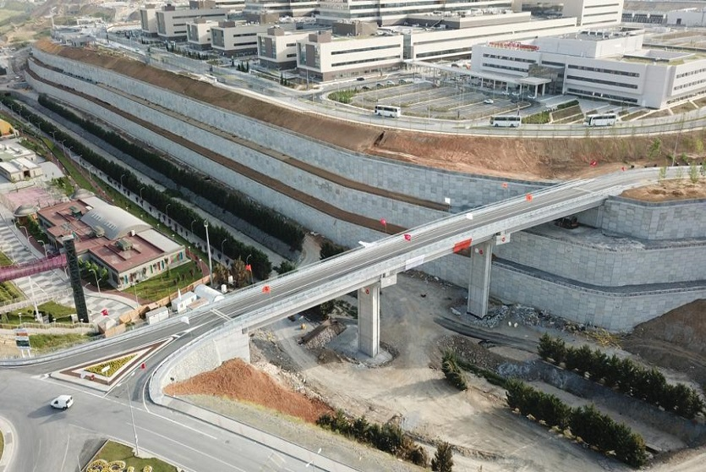
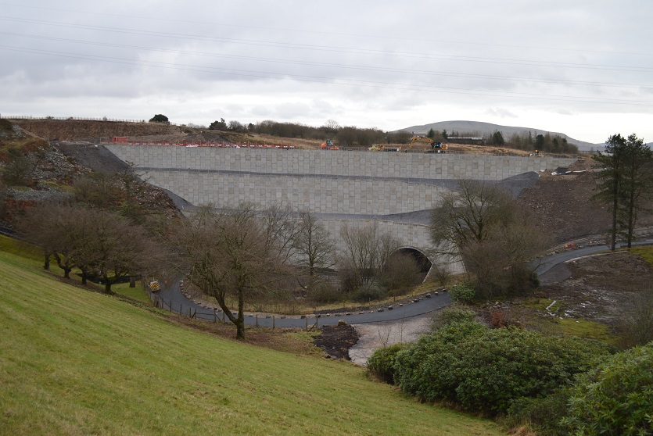
Advantages of (MSERW)
These walls present numerous advantages including
ease of construction
limited reliance on heavy equipment
swifter assembly in comparison to traditional concrete walls
the potential to utilize more land area for construction purposes.
Can be used to create high, curved, or shaped walls

Slide 28
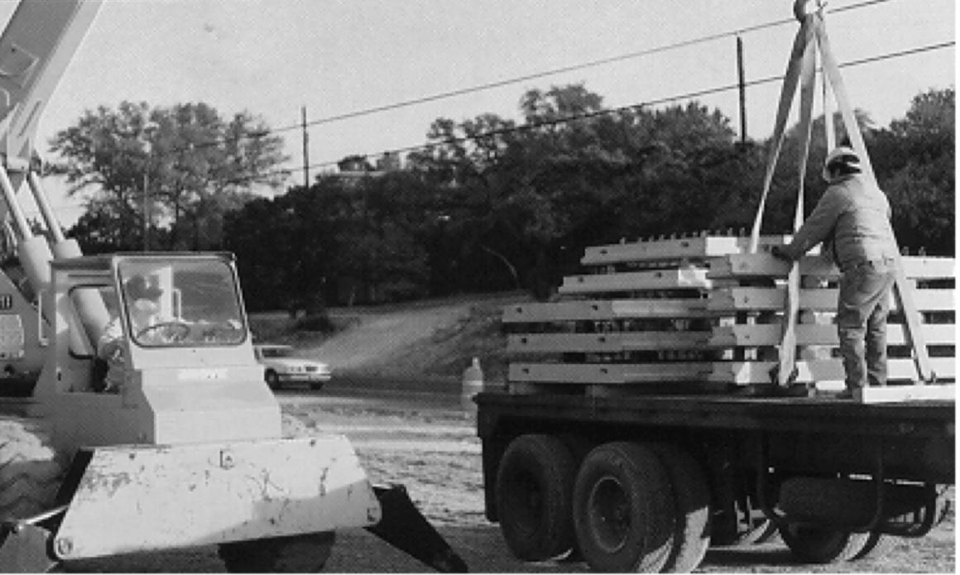
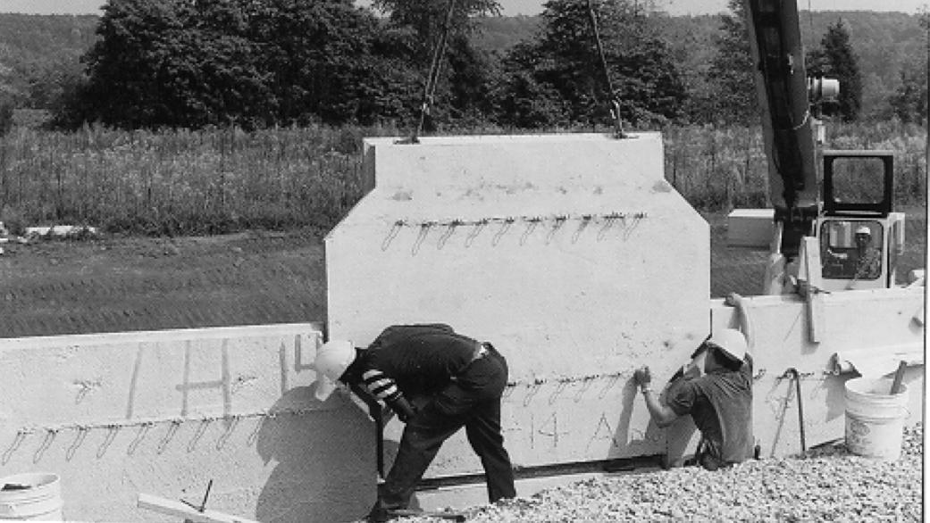
Construction Sequence in picture
Preparation of subgrade. This step involves removal of unsuitable materials from the area to be occupied by the retaining structure.
Erection of the first row of facing panels on the prepared levelling pad.

Slide 29
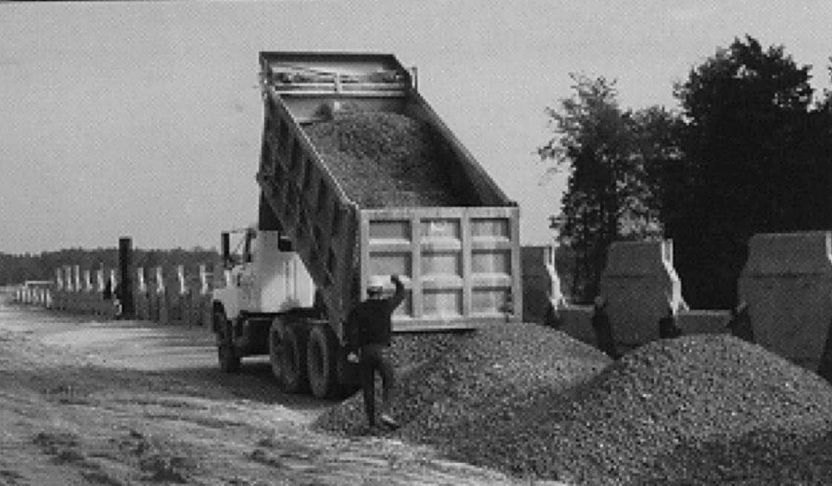
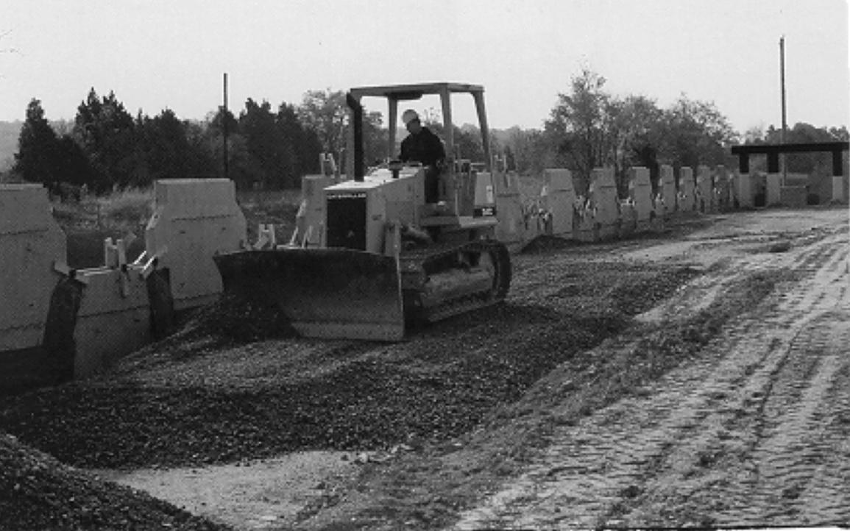
Placement and compaction of backfill on the subgrade to the level of the first layer of reinforcement and its compaction.

Slide 30
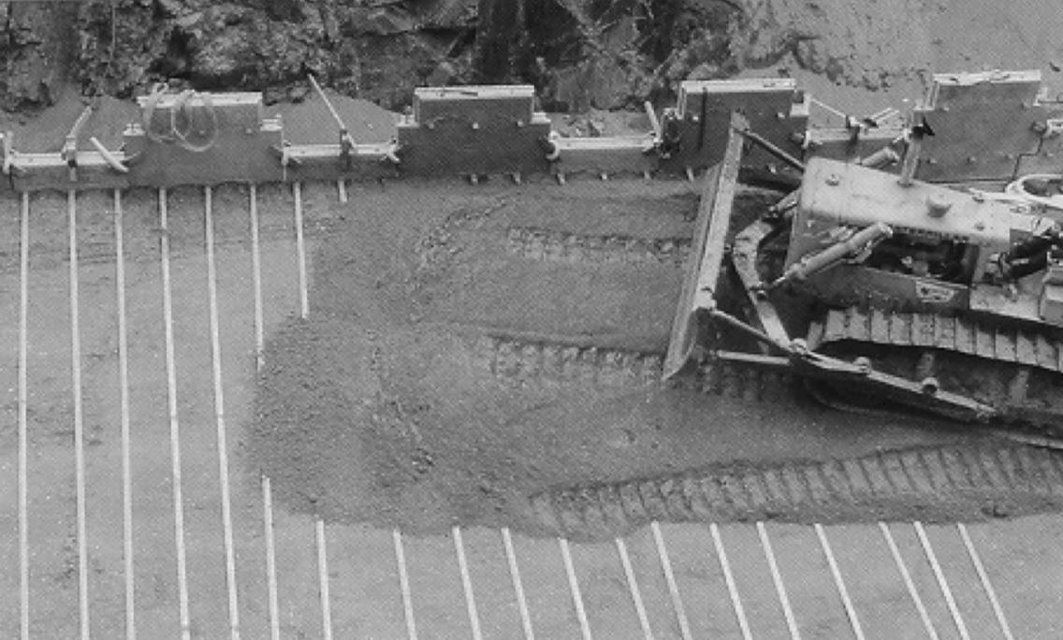
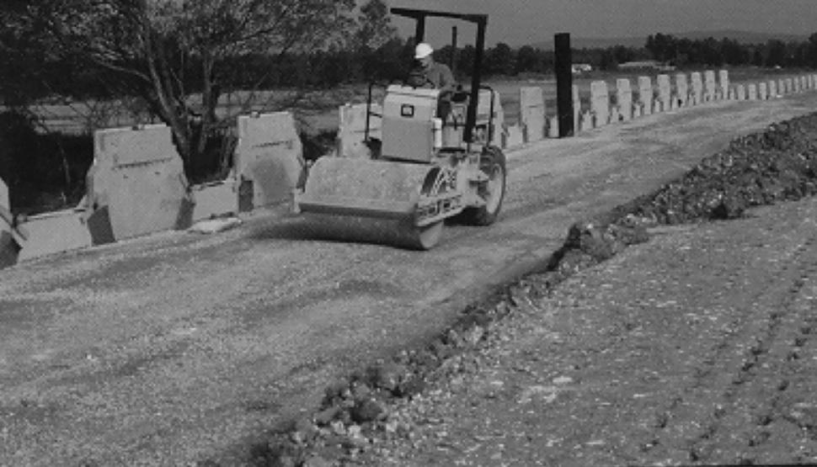
Placement of the first layer of reinforcing elements on the backfill. The reinforcements are placed and connected to the facing panels.
Placement of the backfill over the reinforcing elements to the level of the next reinforcement layer and compaction of the backfill. The previously outlined steps are repeated for each successive layer.

