Slide 1

Prepared By: Heba Khushashi, Lina Nabulsi.

Slide 2

A new offline mobile device for extracting I-V characteristic curve for photovoltaic modules

Slide 3
Problem definition
The main objectives of this project are:
  Predicting I-V curve for different types of PV modules using machine learning.
  Use the program on Raspberry Pi with touch screen to propose an easy and general device.

Slide 4
Software part

Slide 5
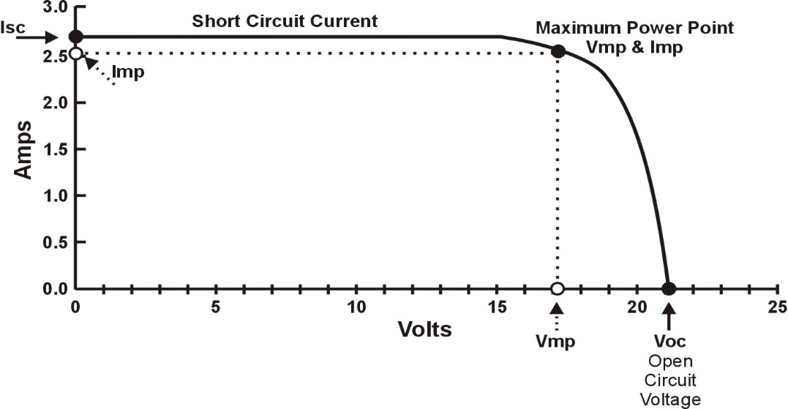
I-V Curve
I-V curve (current-voltage characteristic curve), is a graphical representation of the relationship between voltage and current of PV at the existing conditions of solar radiation and temperature

Slide 6
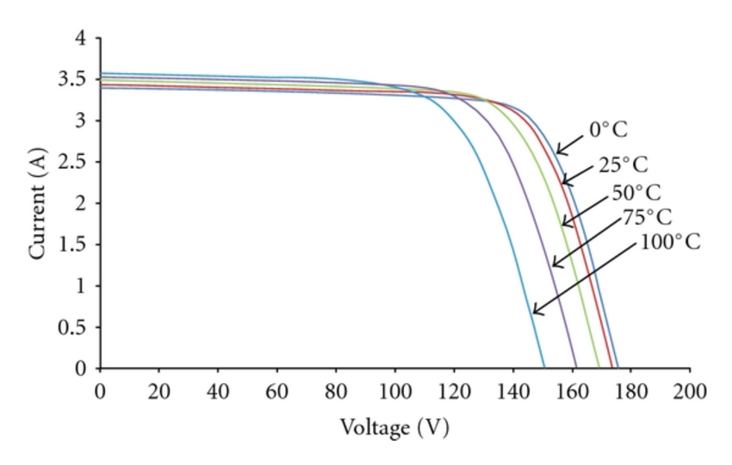
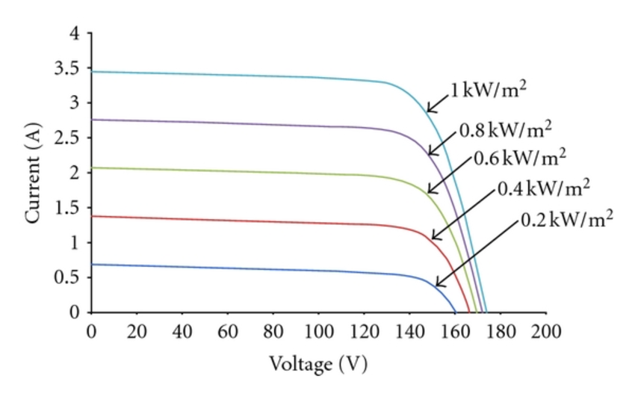
Temperature and Solar Radiation Effects on
I-V Curve

Slide 7
Artificial Neural Network (ANN)
Artificial Neural Networks (ANN) are the pieces of a computing system designed to simulate the way the human brain analyzes and processes information.
They are the foundations of Artificial Intelligence (AI)
Can solve problems that would prove impossible or difficult by human or statistical standards.
ANN have self-learning capabilities that enable them to produce better results as more data become available.

Slide 8
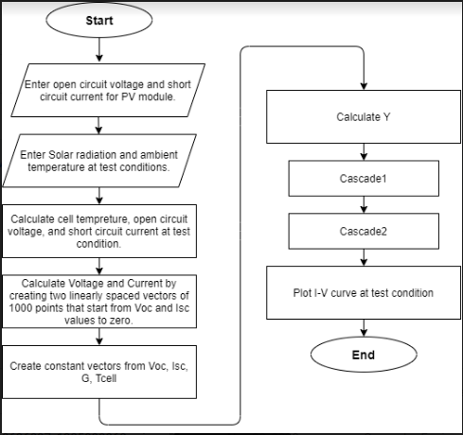
Proposed algorithm of predicating the I-V curve

Slide 9
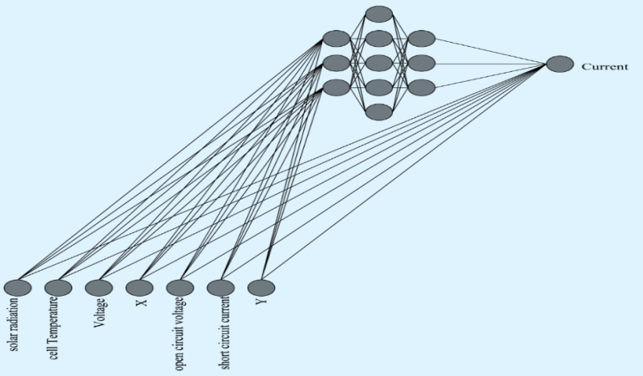
Data
X
Voltage | Current | G | Tcell | Isc | Voc | Y | X
40.64879 | 0 | 647 | 335 | 5.961 | 40.648 | 242 | 13360
39.36289 | 1.749725 | 647 | 335 | 5.961 | 40.648 | 242 | 22.49662
39.29145 | 1.865359 | 647 | 335 | 5.961 | 40.648 | 242 | 21.06375
38.86282 | 2.318766 | 647 | 335 | 5.961 | 40.648 | 242 | 16.76013
37.21972 | 3.77332 | 647 | 335 | 5.961 | 40.648 | 242 | 9.863918
37.0054 | 3.882868 | 647 | 335 | 5.961 | 40.648 | 242 | 9.53043
15.5737 | 5.885162 | 647 | 335 | 5.961 | 40.648 | 242 | 2.646265
15.21651 | 5.885162 | 647 | 335 | 5.961 | 40.648 | 242 | 2.585572
14.78787 | 5.885162 | 647 | 335 | 5.961 | 40.648 | 242 | 2.512738
5.71512 | 5.93385 | 647 | 335 | 5.961 | 40.648 | 242 | 0.963139
0 | 5.961237 | 647 | 335 | 5.961 | 40.648 | 242 | 0.071904
current

Slide 10
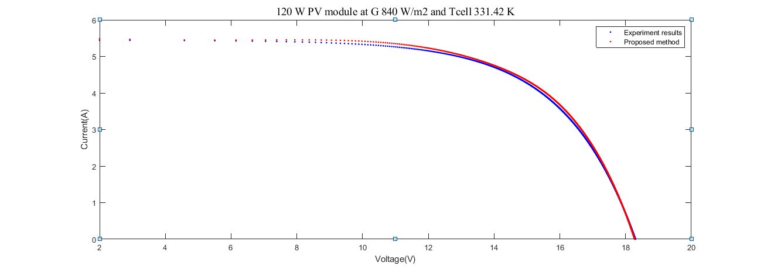
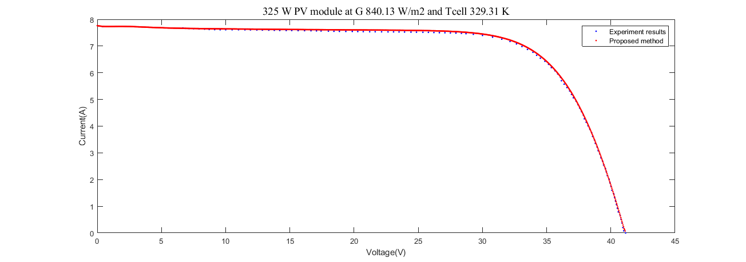
Results

Slide 11
Values of errors for testing data
Solar radiation (W/m²) | Temperature (K) | MAPE | MBE (A) | RMSE (A)
660.1987 | 331.0524 | 0.60% | 0.0158 | 0.0481
706.836 | 330.4716 | 0.69% | 0.0096 | 0.0277
840.1326 | 329.3101 | 1.05% | 0.0425 | 0.0511
980.3752 | 326.9868 | 0.75% | 0.0097 | 0.054
571.8855 | 335.1181 | 1.00% | 0.0348 | 0.0405
491.17 | 323.5 | 0.01% | 0.0022 | 0.0461

Slide 12
Proposed method VS previous methods
Method | Accuracy | Method type
Variable resistance | 78% | Online
Capacitive load | 80% | Online
MOSFETs | 91.6% | Online
Boost converter | (61% – 67%) | Online
Artificial neural network | (85.3% – 99.5%) | Offline
Numerical methods | (90.5% –99%) | Offline
Evolutionary algorithms | (78%–98.6%) | Offline
Proposed method | (97.9%-99.5%) | Offline

Slide 13
Hardware part

Slide 14
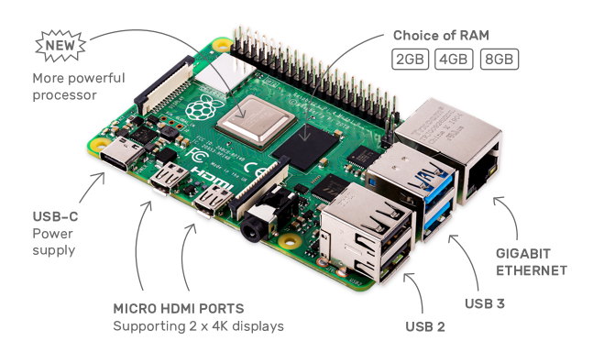
Tools
Raspberry Pi 4 Computer – Model B 2GB RAM

Slide 15
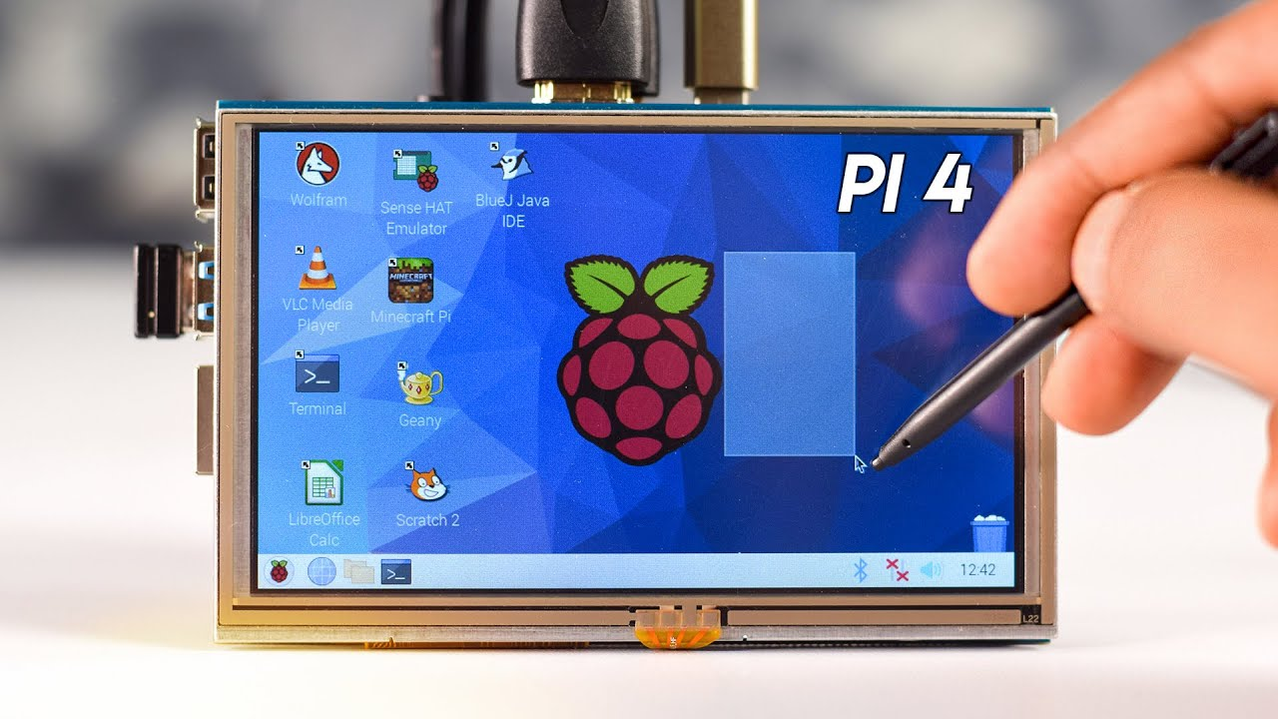
Tools
5inch HDMI Display

Slide 16

Micro SD Card

Slide 17
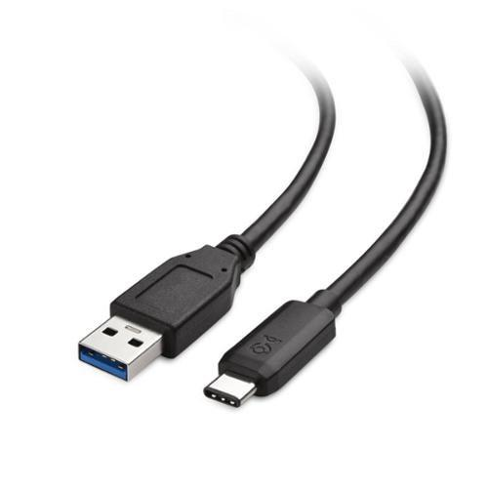
USB Type-C cable

Slide 18
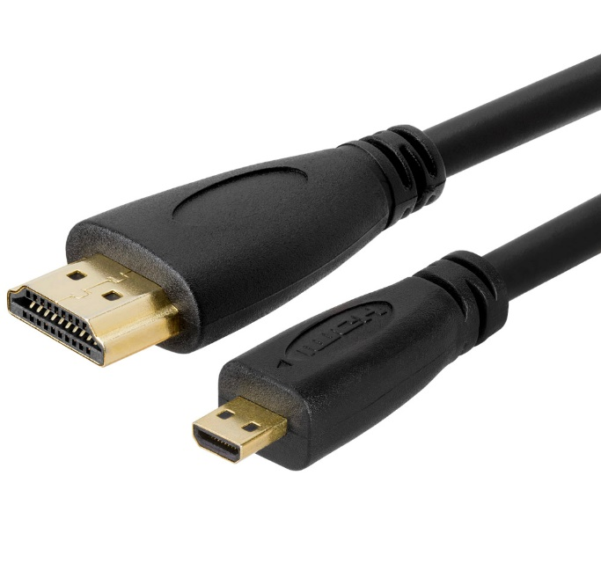
HDMI to Micro HDMI cable

Slide 19
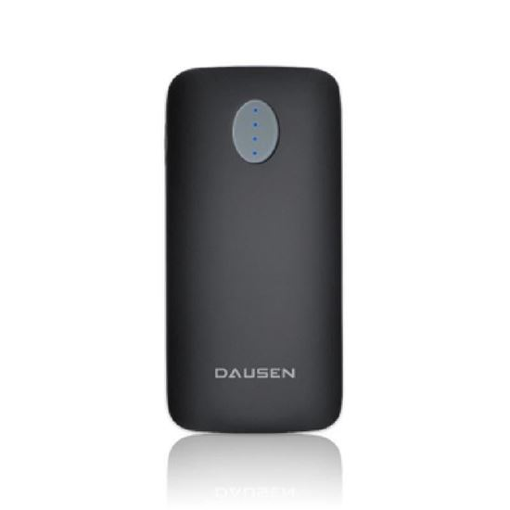
Powerbank

Slide 20

Switch

Slide 21
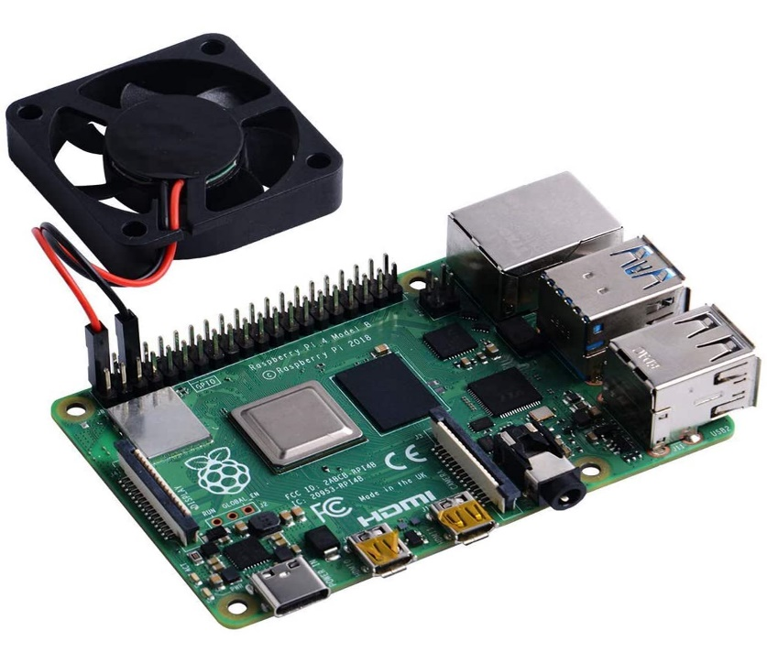
Fan

Slide 22
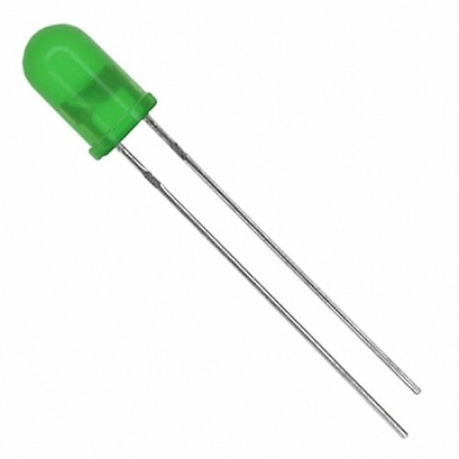
LED

Slide 23
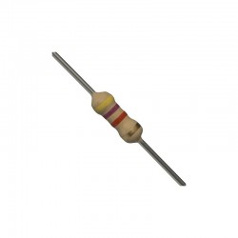
Resistor

Slide 24
Hardware part - Connections

Slide 25
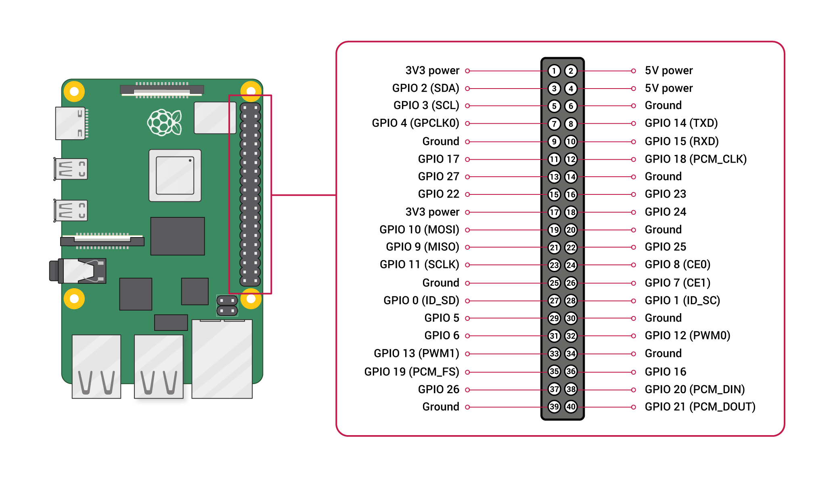

Slide 26
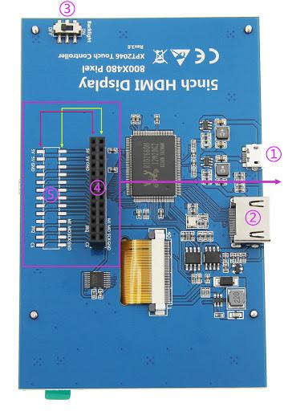

Slide 27
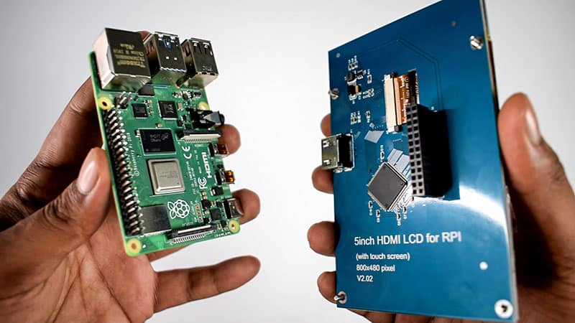

Slide 28
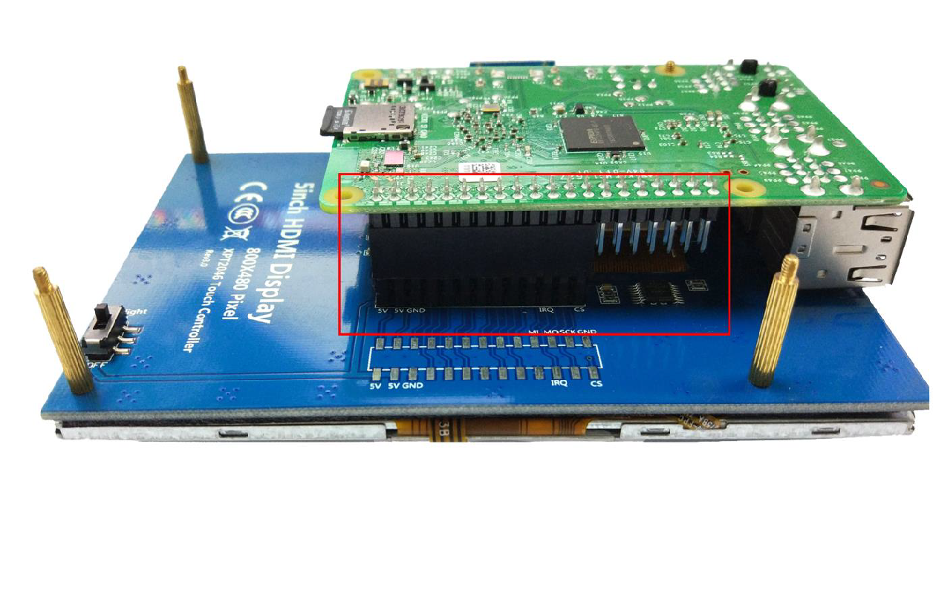

Slide 29
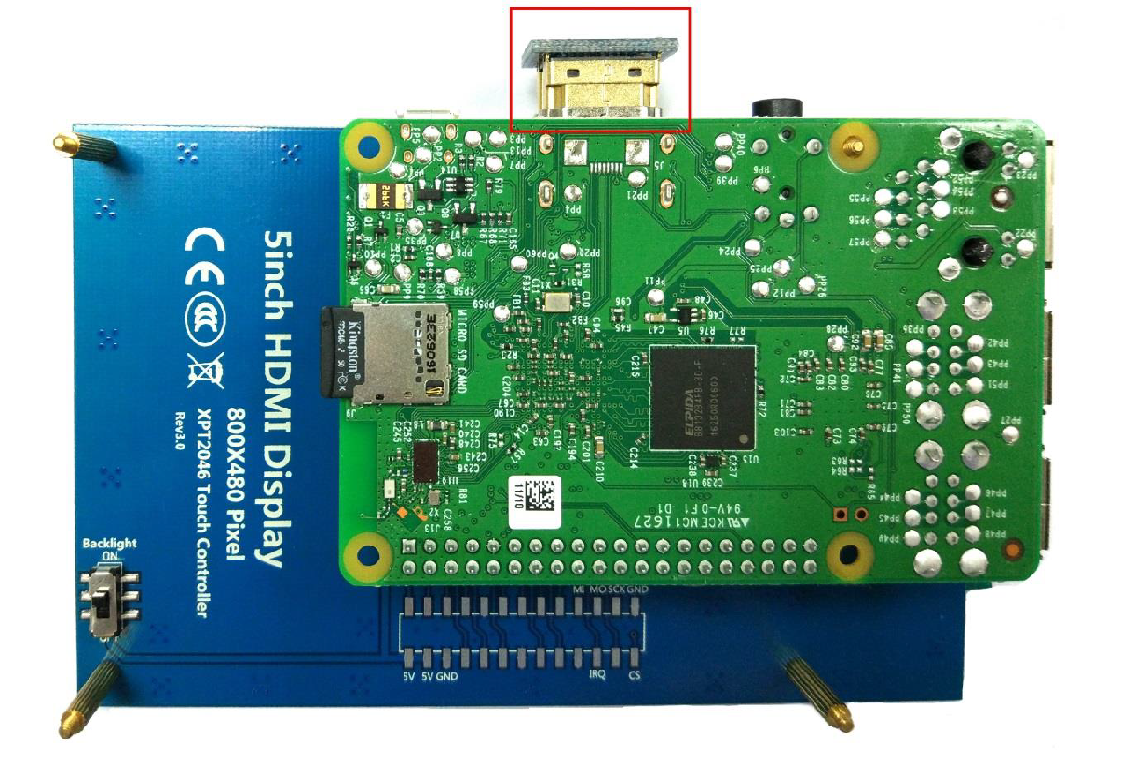

Slide 30
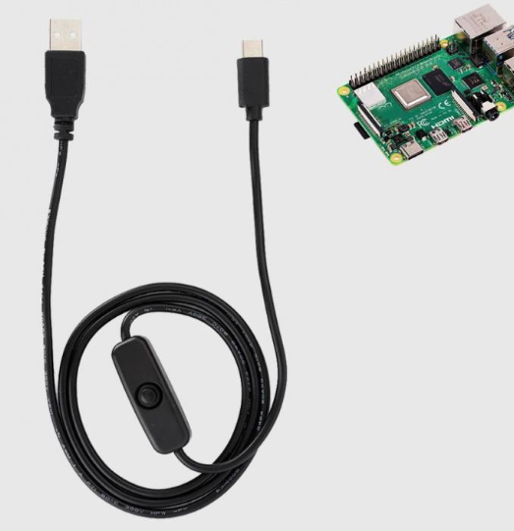

Slide 31
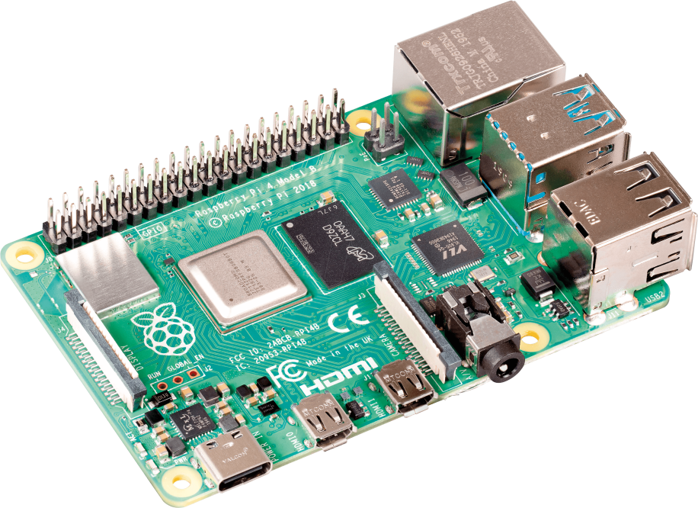

Slide 32
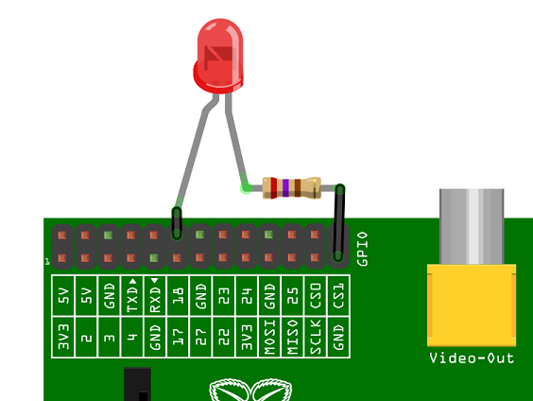

Slide 33
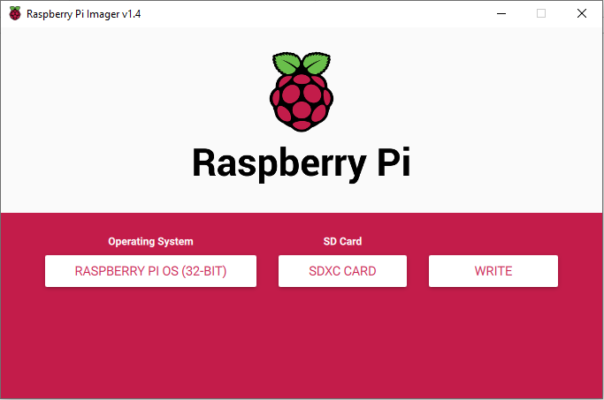


Slide 34
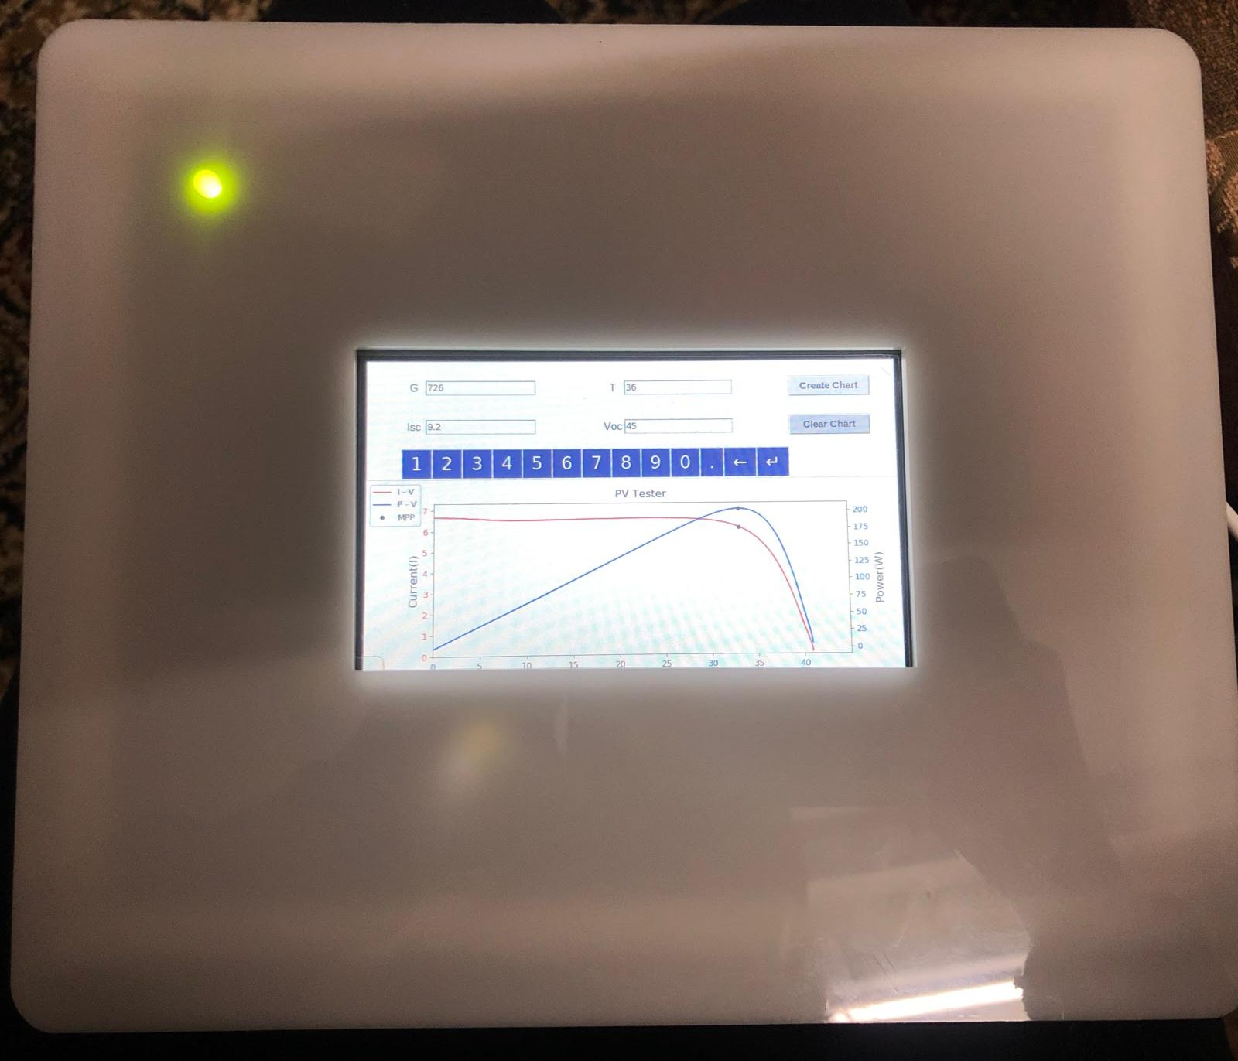

Slide 35
Conclusion
A new offline mobile device was proposed for extracting I-V characteristic curve for photovoltaic modules. This device is faster and lighter than the currently used devices. Also, it is offline, general and can be used for different solar cells.

Slide 36
THANK YOU

