Slide 1
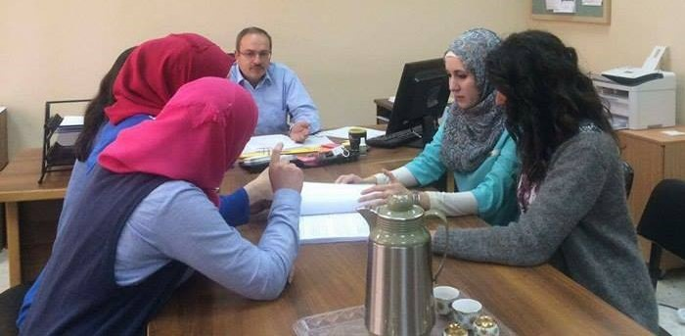
Preparing the Faculty of Graduate Studies at ANNU For ISO Accreditation based on IWA2 guidelines
Prepared by:
Hadeel Ghannam
Mais Ismail
Nagham Jadallah
Raana Donbuk
Rand Wazani
Supervised by:
Dr. Ahmad Al-Ramahi

Slide 2









Outline
Problem statement
Objectives
Scope of the work
Importance of the project
Standards
Literature review
Methodology
Results & analysis
Conclusions & Recommendations

Slide 3



Problem Statement
The Faculty has around 2000 students distributed among fifty six programs for different disciplines for masters and PhD degrees
Processes Implemented within the faculty requires coordination with all the university’s departments & faculties
The need for QMS to control and improve the faculty administrative & educational aspects

Slide 4
Objectives
Build a QMS for the Faculty of Graduate Studies at ANNU by preparing it for ISO 9001:2015 accreditation based on IWA2 guidelines to organize, control and improve all the works carried out within the faculty.

Slide 5
Scope of the work
All the administrative and educational services provided by the faculty and all the activities and processes implemented within it.

Slide 6


Standards
ISO 9001:2015 IWA2

Slide 7


Importance of the project
1- Improve ANNU world ranking, creditability & image.
2- Improve quality and drive efficiencies towards fewer errors.

Slide 8


3- Better communication between employees
4- Organize the faculty relations with the interested parties

Slide 9


5- Eliminate Wastes.
6- Enhance students & employees satisfaction.

Slide 10
Quality management
Other related publications
Standard
Best practices in academic organization
Literature review
ISO
Risk Management
Gap Analysis
Job discerption
Strategic planning
Standard Operating Procedures (SOPs)

Slide 11


Methodology
1. Approval
2. Recommending suitable accreditation and determining the scope of work

Slide 12


3. Studying ISO 9001:2015 standard and IWA2 guidelines.
4. Kick-off meeting

Slide 13


5. Analyzing the gap between the faculty current situation and ISO requirements
6. Defining the faculty profile
Vision
Mission
Values
Quality Objectives
Quality Policy

Slide 14

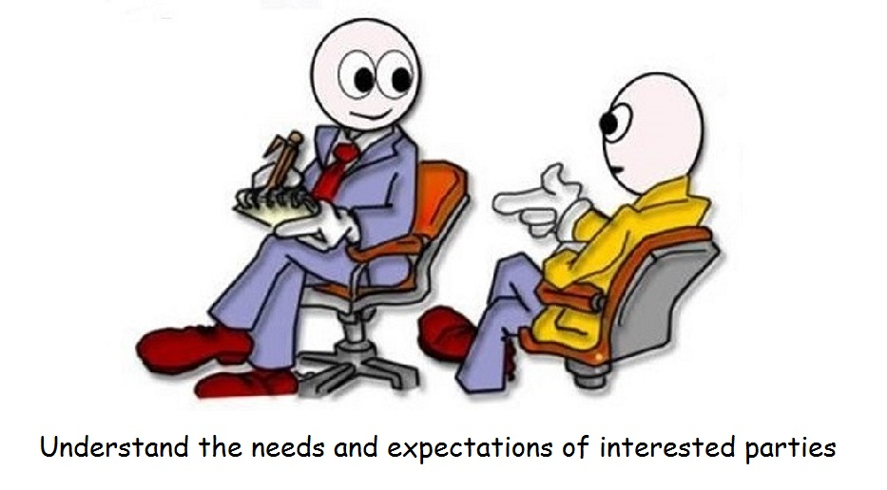
7. Developing SWOT analysis
8. Determining interested parties, internal and external issues

Slide 15
job title
9. Developing Job Description
responsibilities
place of work
authorities
administrator
Job Description
experience
subordinates
skills
salary
job requirements

Slide 16
10. Developing SOP’s
Interviewing employees
Developing flow charts
Developing SOP’s
Developing forms
Coding
Coding
The procedures were coded in the following form GS-P-NN
The form were coded in the following form GS-F-NN-nn
GS: Graduate Studies
P: procedure
F: form
NN: SOP number
nn: form number

Slide 17
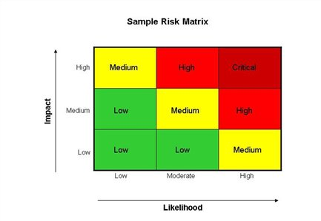
11. Assigning Risks

Slide 18

Results, Analysis & Discussion

Slide 19
Faculty deanship staff
Name of employees | Scientific certificate
Dr. Ahmad Ramahi | Mechanical engineering
Dr. Khalil Issa | Bones, joints and spine surgery
Dr. Sameh Atout | Accounting
Dr. Awni Abu Hijleh | Biology & biochemistry
Zulfa Nase-Eddin | Information technology
Ghadir Ghazal | Computer Engineering
Mai Abu Nab'a | Management Information system
Jihan Assi | Secretary
Mohammad abu keshek | Information Technology
Wajeeh Faour | _
Position
Dean of high graduate studies college
Chairperson of Medical and Health Sciences department
Chairperson of Humanities department
Chairperson of Natural Sciences department
Technical Supervision of M.A. + Ph.D. Thesis
Website administrator
Electronic archiving employee
Dean Secretary & Graduate Students Affairs
Secretary of chairmen departments
Reporter

Slide 20
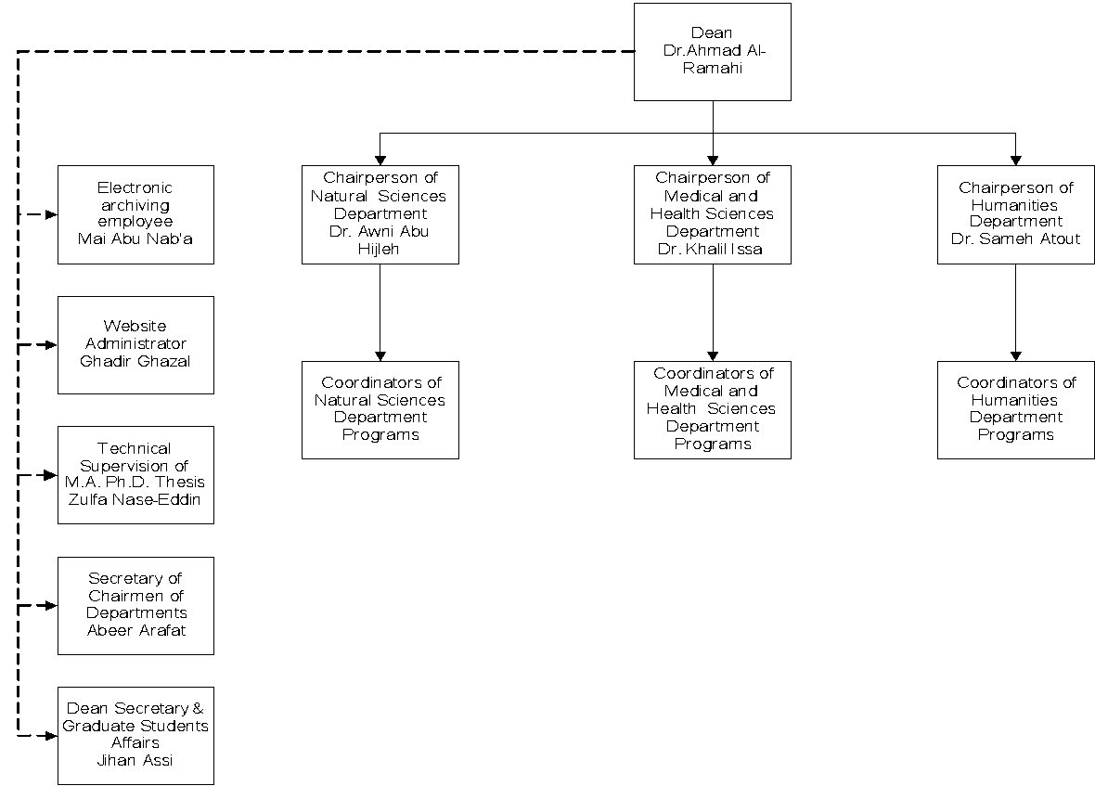
Faculty structure
5.3 Organizational roles, responsibilities and authorities

Slide 21
Faculty Profile
5. Leadership
Vision
Mission
Values
Quality objectives
5.2 policy
Quality policy

Slide 22
SWOT Analysis
Strengths | Weaknesses
Highly qualified staff with long experience The Faculty has Good Reputation locally Programs are affordable (suitable prices) Good quality of students Availability of academic systems and regulations to control the educational processes Top Management’s desire for improvement Programs are in line with international standards Variety in available programs that covers market needs Location (covers the north and central region needs) Low turnover for employees (high satisfaction and loyalty) Good quality of students | Few published research Lack of professors and associate professors in some programs Space is tight (offices & halls for presentations) & the furniture isn’t comfortable There is no strategic plan for the faculty Some of the researches conducted by students are not in the required quality Some of the academic Instructions are relatively outdated and needs development & unification Limited Financial resources Some programs don’t have advisory plan Limited Research applied jointly with industry Permissive acceptance criteria Paper transactions and paper-based administrative procedures Low turnout on some programs Structure of the comprehensive test is somewhat outdated Few instructors adopt unclear criteria in evaluating students’ work (reports, case studies)

Slide 23
Opportunities | Threats
Construction of new building for scientific centers in the new campus that can be exploited Conduct funded joint research with local industry The return of postgraduate students who are abroad on scholarship. Benefit from the available research incentives in the university. The possibility to open branches for some master programs in Ramallah The possibility to develop modern criteria to evaluate students in addition to exams Availability of active portal that can accommodate computerizing the faculty administrative procedures and the traditional paper work Possibility of attracting students from the occupied Palestinian territories | Competition Lack of demand that may results in closing some programs Israeli occupation that may limit the freedom in some researches High rates of employees with high ranks are leaving work as they are exceeding the limiting age for working at the university
4.1 Understanding the organization and its context
6.1 Actions to address risks and opportunities

Slide 24
Developed SOP’s
الرقم | اسم الاجراء | رمز الاجراء | اسم النموذج | رمز النموذج
19 | توزيع البريد | GS-P-19 | نموذج توزيع البريد | GS-F-19-01
20 | طلب تغيير و اضافة مشرف | GS-P-20 | نموذج طلب تغيير مشرف نموذج طلب اضافة مشرف | GS-F-20-01 GS-F-20-02
21 | تحديد موعد مناقشة رسالة ماجستير | GS-P-21 | نموذج تحديد موعد مناقشة الماجستير نموذج تقرير الممتحن الداخلي والخارجي | GS-F-21-01 GS-F-21-02
22 | تحديد القاعات والمدرسين وطرح البرامج | GS-P-22 | نموذج تحديد القاعات نموذج طرح المساقات | GS-F-22-01 GS-F-22-02
23 | اخذ قرار تمديد من مجلس العمداء | GS-P-23 | نموذج تمديد عمداء | GS-F-23-01
24 | تمديد الدراسة | GS-P-24 | نموذج تمديد الدراسة | GS-F-24-01
25 | تغيير او تعديل علامة يومية | GS-P-25 | نموذج تعديل او تغيير علامة يومية | GS-F-25-01
26 | تأجيل قسري | GS-P-26 | نموذج تأجيل قسري | GS-F-26-01
27 | ضبط جودة مواصفات برامج الكلية | GS-P-27 | نموذج خطة مساق نموذج التقييم الذاتي السنوي للبرامج الاكاديمية | GS-F-27-01 GS-F-27-02
28 | ضبط جودة العملية التعليمية بالكلية | GS-P-28 | نموذج التقرير السنوي للكليات | GS-F-28-01
29 | ضبط حالات عدم المطابقة | GS-P-29 | نموذج التعامل مع حالة عدم مطابقة | GS-F-29-01
30 | الإجراءات التصحيحية والوقائية | GS-P-30 | نموذج التعامل مع حالة عدم مطابقة | GS-F-30-01
31 | قياس رضا العملاء | GS-P-31 | نموذج اتصال عميل | GS-F-31-01
8.1 Operational planning and control
4.4 Quality management system and its processes
5.1.2 Customer focus

Slide 25
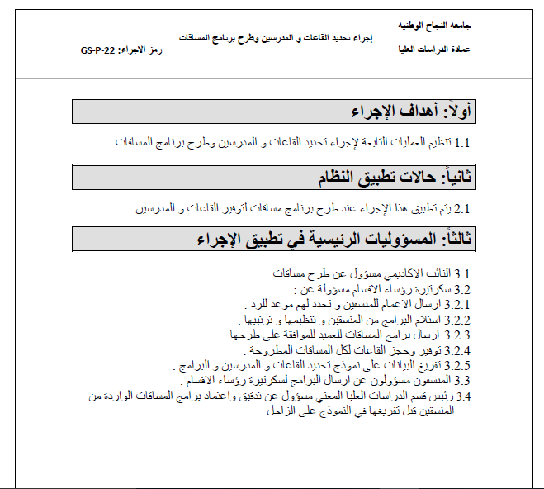
4.3 Determining the scope of the QMS
.
5.3 Organizational roles Responsibilities and authorities

Slide 26
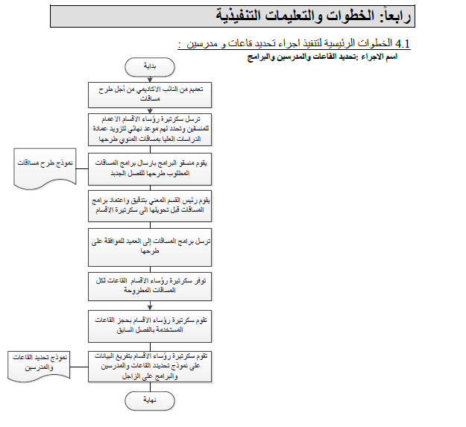

Slide 27
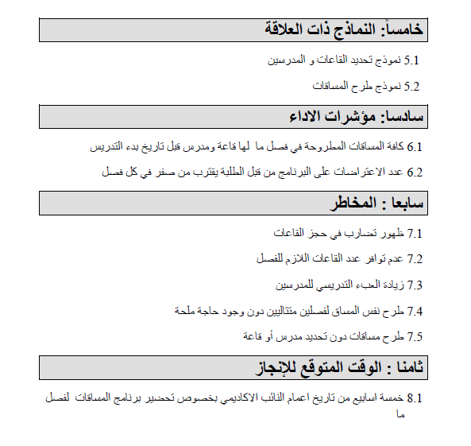
8.1 Operational Planning & Control
6.1 Actions to address risks & opportunities
8.1 Operational Planning & Control

Slide 28
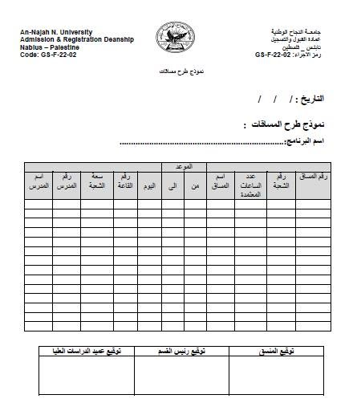

Slide 29
Risks
6.1 Actions to Address Risks &Opportunities
رمز الاجراء | رقم المخطر | المخاطر | الاحتمالية | الحدة | الدرجة
GS-P-01 | 1 | قبول طلبات بالرغم من عدم استيفاء جميع الأوراق الثبوتية لاستكمال قبول الطلبات | Low | high | medium
GS-P-01 | 2 | حدوث اخطاء في ارقام تسجيل الطلبة المقبولين و المعلن عنهم في الموقع الالكتروني و الصحف | Low | high | medium
GS-P-01 | 3 | قبول طلبة في برنامج ما دون التنسيق مع لجنة (منسق ) البرنامج المعني | medium | medium | medium
GS-P-02 | 4 | تقديم وثائق غير صحيحة | Low | high | medium
GS-P-02 | 5 | أن يكون الطالب منتقل ولم يصرح بذلك عند تعبئة طلب الالتحاق | medium | medium | medium
GS-P-03 | 6 | عدم التحضير المسبق الكافي من قبل اعضاء لجنة المناقشة | medium | medium | medium
GS-P-03 | 7 | أن يكون الطالب فصل ثامن ويتأخر في تسليم الاطروحة وتحديد موعد المناقشة | Low | high | medium
GS-P-04 | 8 | ان يكون البحث مكررا و لا يضيف قيمة جديدة في مجال التخصص | High | medium | High
GS-P-04 | 9 | ان يكون المشرف غير ملائم لطبيعة البحث من حيث التخصص او من حيث الخبرات البحثية (عدد المنشورات ) | medium | medium | medium
GS-P-04 | 10 | ان يتجاوز الطالب المدة الزمنية (عدد الفصول ) المسموح خلالها تقديم طلب تحديد عنوان الاطروحة و المشرف | medium | medium | medium
GS-P-05 | 11 | ترشيح لجان مناقشة غير محايدة | Low | high | medium
GS-P-05 | 12 | ترشيح أعضاء لجان مناقشة لا تنطبق عليهم شروط الممتحنين | medium | medium | medium
GS-P-05 | 13 | وجود خلل فني في إجراء فحص الأصالة | Low | medium | Low

Slide 30
رقم المخطر | الإجراء التصحيحي
8 | اقتراح المواضيع التي تحتاجها الجامعة لعمل ابحاث عليها
18 | التنبؤ بحاجات السوق وابتعاث طلاب للدراسة في الخارج
26 | استقطاب مشرفين مؤهلين من خارج الجامعة
29 | تخزين بيانات الطلبة في اكثر من مكان
37 | حوسبة البريد وجود تدقيق قبل ارسال البريد
39 | حوسبة البريد متابعة السكرتاريا للتأكد من ارسال البريد في الوقت المناسب
40 | اقتراح اكثر من مشرف لحل ازمة عبء المشرفين
50 | ان يتم تنبيه الطالب بعد تجاوزه عدد الفصول الدراسية المسموح بها
63 | عمل نظام للتدقيق لنظام الجودة بشكل دوري

Slide 31
4.1 Understanding the Organization and it’s Context
External Issues
Government regulations and changes in law
Economic shifts in the organization's market
The organization's competition
Events that may affect corporate image
Changes in technology
Internal Issues
Regulatory requirements
Strategies to achieve its policies and objectives
Resources and knowledge
Assets
Services
Standards guidelines and models adopted by the organization
Information Systems

Slide 32
4.2 Understanding the Needs &Expectations of Interested Parties
Interested Parties
Customers
People in the organization/employees
Suppliers and partners
Society
Government and Non-Government Organizations

Slide 33
Rate | Probability | Severity | Risks | Number of risk | Interested Parties
high | high | high | poor quality of service delivery | 1 | Customers
medium | medium | medium | poor Loyalty of customers | 2 | Customers
high | medium | high | Inability to keep up with market needs | 3 | Customers
Low | low | medium | discrimination between students | 4 | Customers
Low | low | medium | incorrect actions based on faulty feedback | 5 | Customers
medium | low | high | lack of commitment to faculty instructions | 6 | Employees
medium | low | high | Lack of harmony between employees | 7 | Employees
medium | medium | medium | poor loyalty of employees | 8 | Employees
Low | low | medium | High turnover of employees | 9 | Employees
high | high | high | resistance to change | 10 | Employees
medium | medium | medium | Unexperienced staff | 11 | Employees

Slide 34
Corrective action | Number of Risk
take regular feedback from customers | 1
strategic plan for the faculty | 3
make meeting with employees to explain the benefits of changes | 10
provide external funding | 22
provide external funding | 23

Slide 35
بطاقة وصف وظيفي
5.3 Organizational Rules Responsibilities & Authorities
عميد الكلية | المسمى الوظيفي
**** | الرتبة الوظيفية
كلية الدراسات العليا – جامعة النجاح الوطنية | مكان العمل
رئيس الجامعة | المسؤول المباشر
جميع موظفين الكلية | المرؤوسين
**** | راتب البدأ
متطلبات العمل (مؤهلات دراسية+مهارات+خبرة)
حاصل على درجة الدكتوراه يمتلك مهارات البحث العلمي ومهارات ادارية ومهارات شخصية لديه خبره لا تقل عن ثماني سنوات عمل في الجامعة المعرفة التامة بانظمة العمل في الجامعة
الصلاحيات
توجيه وادارة كافة أعمال الكلية وموظفيها وفق الأنظمة والتعليمات اتخاذ كافة القرارات المتعلقة بأعمال الكلية الداخلية بالتنسيق مع مجلسها تمثيل الكلية داخل وخارج الجامعة التوقيع على كافة المعاملات الاكاديمية والادارية والمالية الخاصه بالكلية
المهام والمسؤوليات
المسؤول الاول والمشرف على كل عمليات واجراءات ونشاطات الكلية بالتشاور مع روؤساء الاقسام والمنسقيين ابتداء من قبول الطلبه الجدد, ومسؤول عن حسن سير العملية التدريسية من التزام المدرسين وانتظام المحاضرات والامتحانات ومراجعة معاملات الطلبة وتدقيقها وفق تعليمات الكلية ومتابعة تحديث وتطوير البرامج وكافة اعمال الكلية

Slide 36
Conclusion
At the end of this project we can conclude that we were able to increase the level of readiness of the Faculty of Graduate Studies at ANNU for ISO 9001:2015 accreditation from 24% to 61%.

Slide 37
Project deliverables:
Profile of the faculty including vision, mission, quality objectives, quality policy and valuables.
SOP’s prepared for all the procedures conducted within the faculty
Coded forms and SOP’s to connect them together
Job description for all the employees in the faculty
Documented faculty administrative structure

Slide 38
Documented SWOT analysis for the faculty.
Documented external and internal issues in detail
Determined interested parties with their relation with the faculty besides their needs and expectations
Summarized risks which are related to the procedures conducted within the faculty besides the ones related to the relation between the faculty and the interested parties that may affect the faculty

Slide 39


Recommendations
Adopt the data we documented as reliable reference in the faculty.
Develop an integrated information system to connect the faculty with the other related departments to organize mailing instead of the present used traditional way.

Slide 40


Encourage employees to implement the new standard
Raise awareness of employees and students commitment to the faculty instructions

Slide 41


Give some of the qualified employees training in ISO & internal auditing
Forming an advisory board for the faculty

Slide 42

Develop electronic archiving to reduce papers, files, area and effort needed. And computerize the needed procedures
Study the ability to provide enough classrooms allocated for the faculty of graduate studies to avoid conflicts with other faculties’ lectures.

Slide 43


Take actions to support scientific research in the faculty to conduct funded joint research with local industry
Develop new improved criteria to evaluate students in addition to traditional exams

Slide 44


To begin implementing the procedure related to control the educational operation by the beginning of the next year
Work on the rest of the terms in ISO 9001:2015 standard that are remained uncompleted yet

Slide 45

Thank You

